Slide 1



Simulation of the effects of charge on the kinetics of a triblock copolymer hopping across a membrane
Sylvia Luyben, Rob Wickham
University of Guelph
CAP Congress
May 27, 2024

Slide 2
















Protein Reconstitution → Polymer Hopping
Hydrophilic
Hydrophobic
Hydrophilic
Notes:
This work was motivated by protein reconstitution, an experimental process whereby proteins are moved from their native domains into membranes of practical use. We model the protein as a polymer with the same structure as the membrane I’ve shown here: hydrophilic end regions, and hydrophobic centres.

Slide 3






Protein Reconstitution → Polymer Hopping
To bridged
The kinetics of hopping can help us understand protein reconstitution.
Conformation affects material strength¹.
To enter a membrane, the polymer must insert and change conformations
From looped
Experimental evidence shows charge can affect both².
1. Hua, Kuang, and Liang. J. Am. Chem. Soc. 2011, 133, 2354–2357. dx.doi.org/10.1021/ja109796x
2. Matsen and Thompson. J. Chem. Phys. 111, 7139–7146 (1999) . https://doi.org/10.1063/1.480006
Notes:
Now we consider a polymer entering a membrane. To do so the polymer must insert and change configurations
=um distribution

Slide 4
How does charge affect end block hopping?

Slide 5

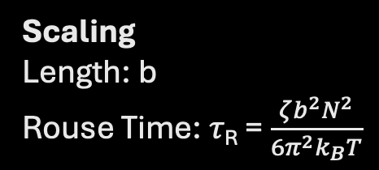


The Model: Triblock Copolymer in Electrolyte Solution
−
Scaling
Length: b
Rouse Time: 𝜏_{R} = $\frac{ζb^{2}N^{2}}{6π^{2}k_{B}T}$
S
+
B
A₁
+
A₂
+
−
−
Hydrophilic
Charged
Hydrophobic
Neutral
Hydrophilic
Charged
+
+
−
$$N_{A1}$$
$$N_{B}$$
$$N_{A2}$$
Notes:
Highlight solvent (membrane not melt) and charge

Slide 6
dynamical Self-Consistent Field Theory
𝜀_{Bs}
Dynamical partition function
𝜀_{BB}
𝜀_{AB}
𝜀_{AS}
𝜀_{SS}
𝜀_{AA}
Saddle point approximation
Single chain in a dynamic mean field
Many interacting chains
Notes:
“powerful multi-scale approach that allows us to access long time and length scales while maintaining single chain conformations”
“self-assembly”

Slide 7
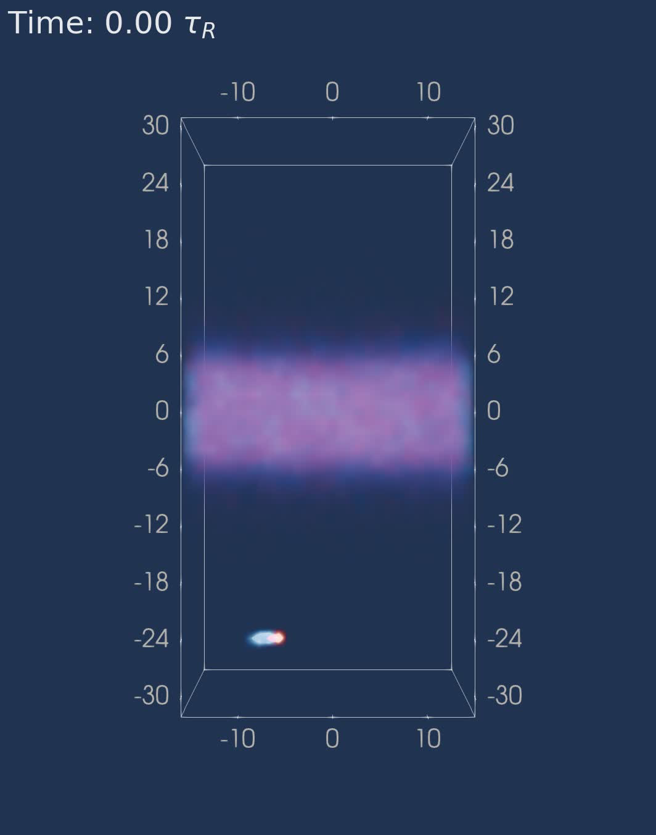
Neutral Membrane
Formation
x
y
z
solvent
Charge | 0.0e
𝜀_{AA} | 0.075
𝜀_{AB} | 0.075
𝜀_{AS} | 0.09
𝜀_{BB} | 0.085
𝜀_{BS} | 0.09
𝜀_{SS} | 0.075
N_{A1}-N_{B}-N_{A2} | 8-32-8
n | 220
solvent
Notes:
PERIODIC
"first things is to form a stable POLYMER membrane"
Back up slide with equations, and one with force definitions

Slide 8

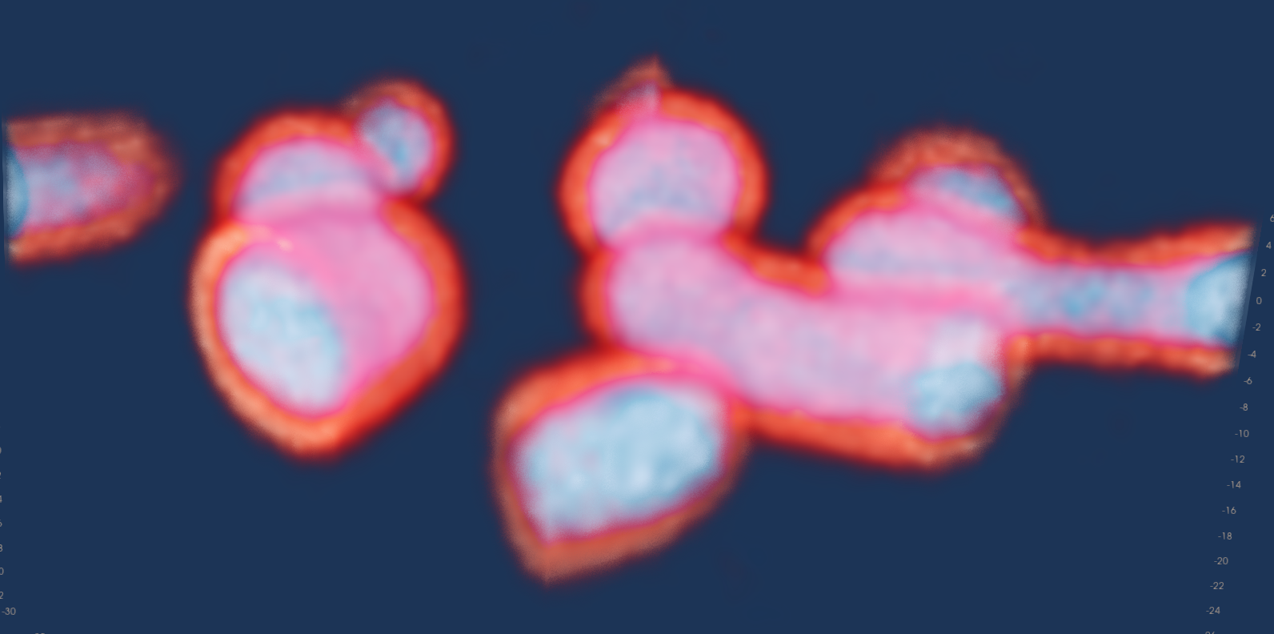
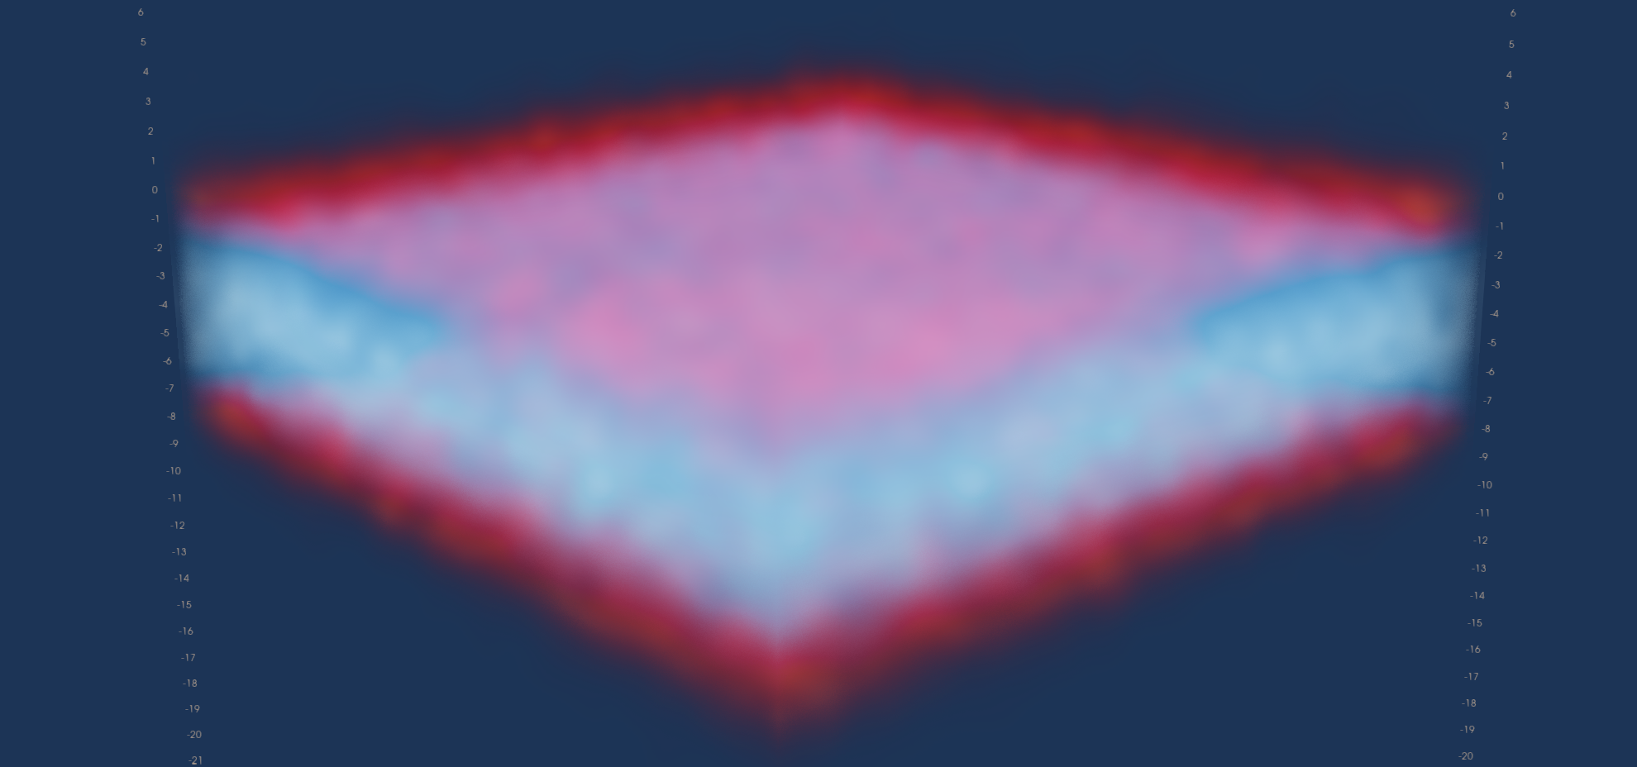



Membrane Stress, 𝜎
x
y
z
n<n_{equ}
n=n_{equ}
n>n_{equ}
𝜎_{xx}=𝜎_{zz}
𝜎_{xx}<𝜎_{zz}
𝜎_{xx}>𝜎_{zz}

Slide 9
Stress vs. Density
 | N_{A}-N_{B}-N_{A} | Charge /e
● | 16-32-16 | 0.0
● | 16-32-16 | 0.5
◼︎ | 8-32-8 | 0.5
◼︎ | 8-32-8 | 0.0
Debye length = 1b
Notes:
Units on axes
"8-32-8 is symmetric"

Slide 10
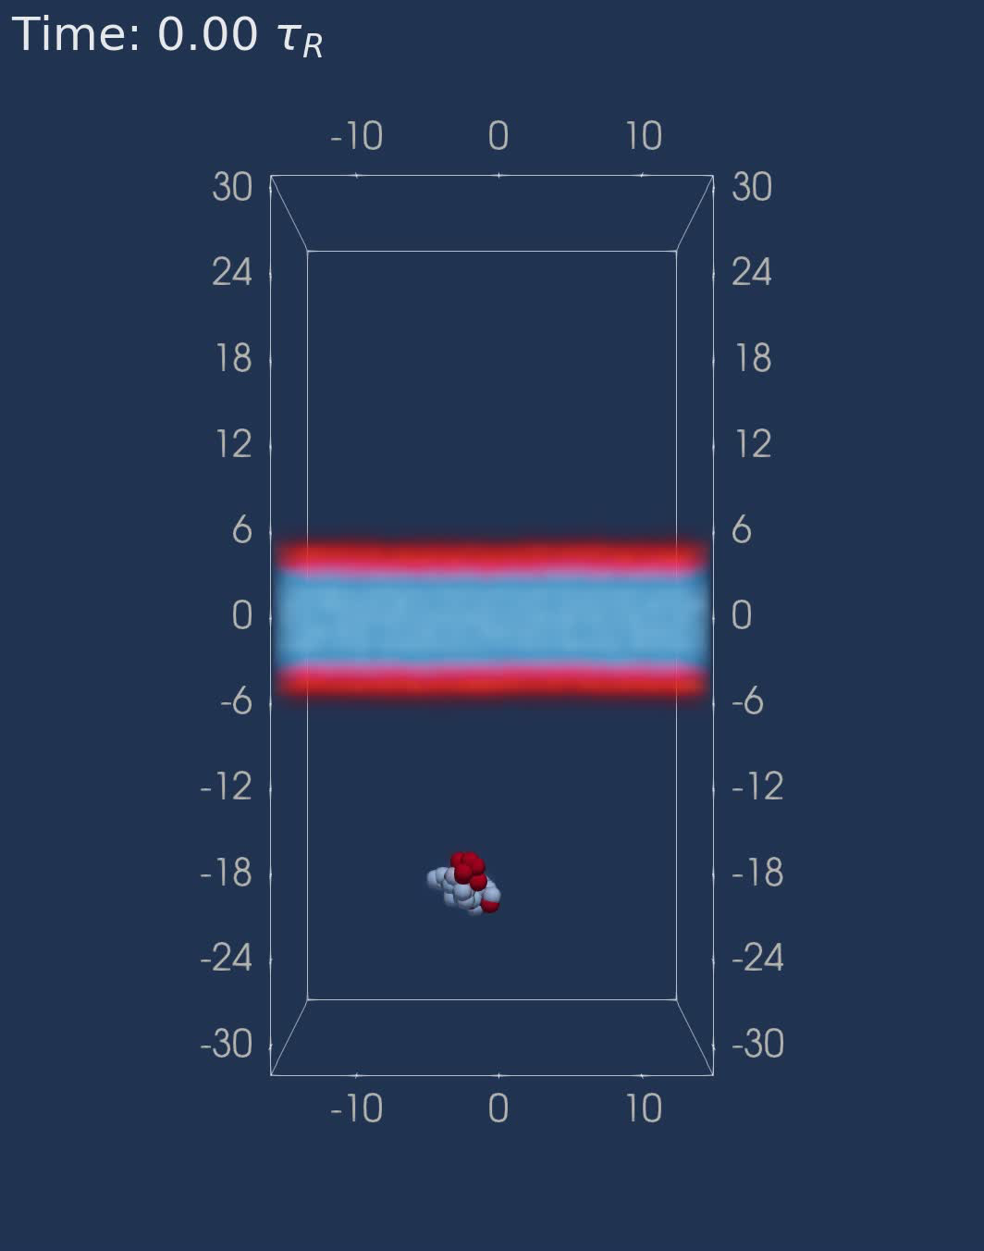
Neutral Polymer Insertion
x
y
z
Charge | 0.0e
𝜀_{AA} | 0.075
𝜀_{AB} | 0.075
𝜀_{AS} | 0.09
𝜀_{BB} | 0.085
𝜀_{BS} | 0.09
𝜀_{SS} | 0.075
N_{A1}-N_{B}-N_{A2} | 8-32-8
n | 220
Notes:
put b on axis

Slide 11
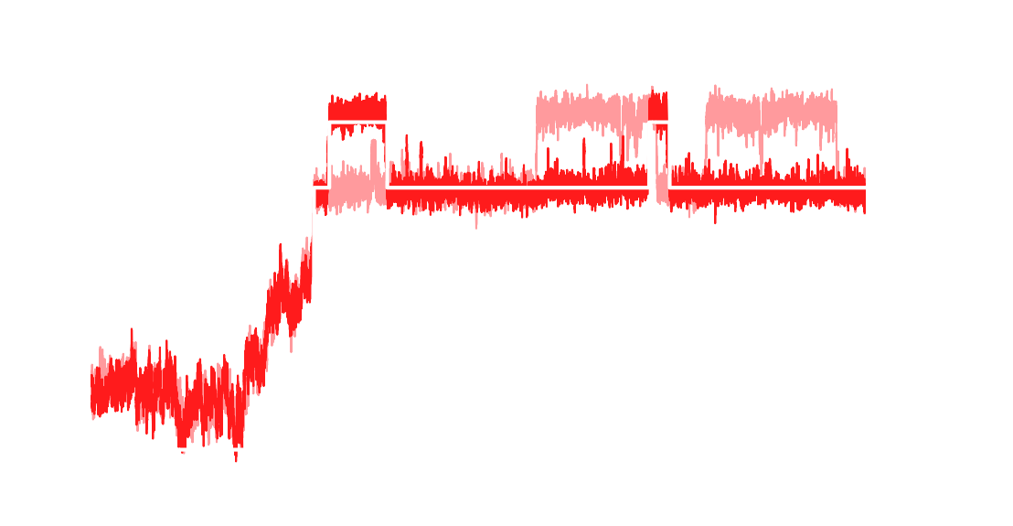
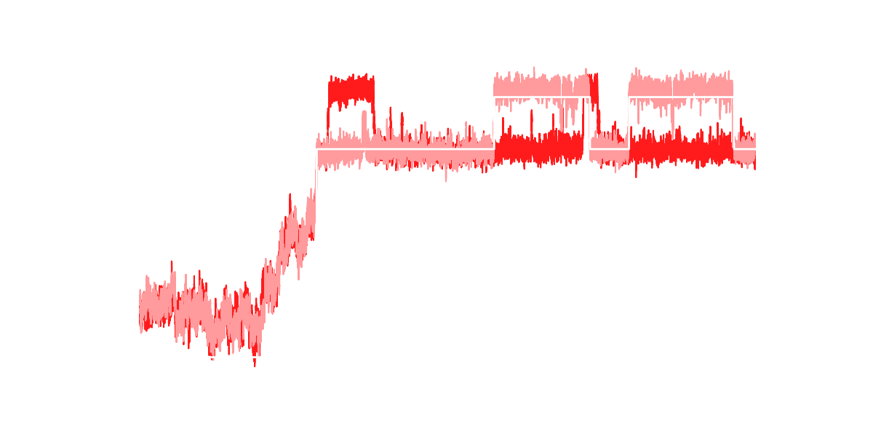



Neutral Polymer Block Centers of Mass
A₂
A₁
Charge | 0.0e
𝜀_{AA} | 0.075
𝜀_{AB} | 0.075
𝜀_{AS} | 0.09
𝜀_{BB} | 0.085
𝜀_{BS} | 0.09
𝜀_{SS} | 0.075
N_{A1}-N_{B}-N_{A2} | 8-32-8
n | 220
z Position / b
Jump time
Time / 𝜏_{R}
Notes:
emphasize algorithm: back up slide
how long / many simulations

Slide 12
Neutral Membrane Charged Membrane
0.0e / bead
0.173 chains/b²
0.5e / bead
0.148 chains/b²
Density /b⁻³
Solvent
A Block
B Block
Debye length = 1b
Position /b

Slide 13
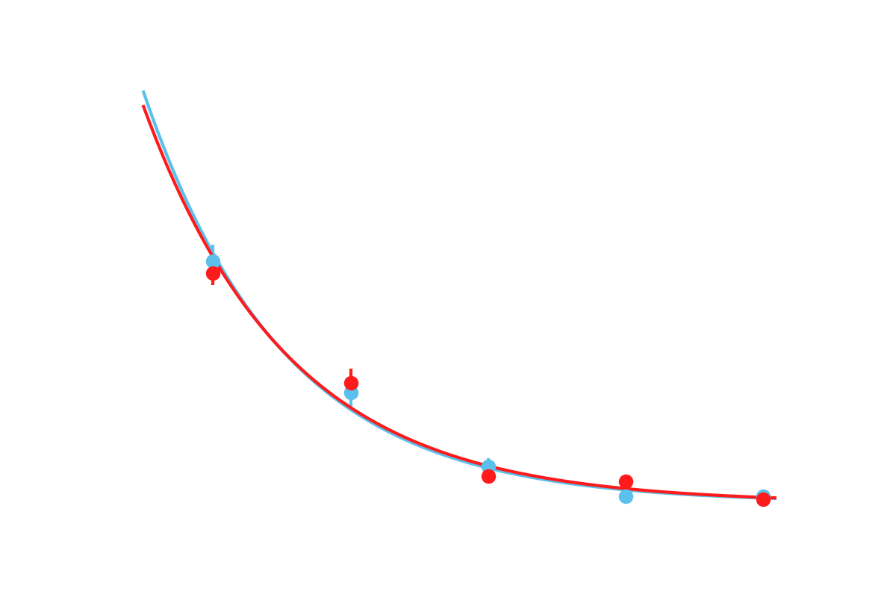


Jump Time Distribution
Adding polymer charge?
Increasing forces?
Detergent molecules?
Charge | 0.0e 0.5e
Total points | 225 120
𝜀_{AA} | 0.075
𝜀_{AB} | 0.075
𝜀_{AS} | 0.09
𝜀_{BB} | 0.085
𝜀_{BS} | 0.09
𝜀_{SS} | 0.075
N_{A1}-N_{B}-N_{A2} | 8-32-8
$$y\sim e^{−0.4x}$$
Characteristic decay time $≈2.5τ_{R}$
Notes:
Intro graph, how did you make it
define blue and red: legend

Slide 14
Conclusions
Developed dynamical self consistent field theory for polyelectrolyte solutions
Simulated stable membranes in different charge states
Created a routine to categorize polymer conformations
Analyzed jump time distribution for charged and neutral membranes
Questions?

Slide 15
Categorization: Directional Gating

Slide 16
Numerical Process
Particle positions
Solvent field
Charge density
Number density
Time
Poisson-Boltzmann equation
Mean-field Interparticle force
Electric Potential
New particle positions
New solvent field
Notes:
Introduce any needed symbols

Slide 17
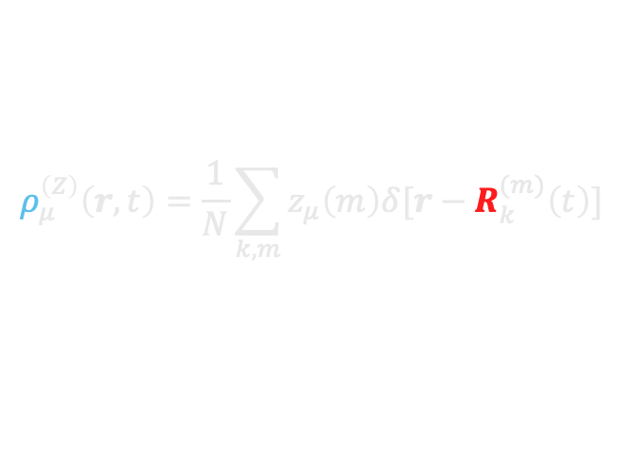
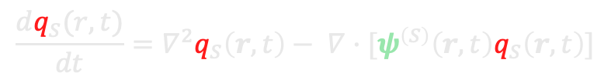
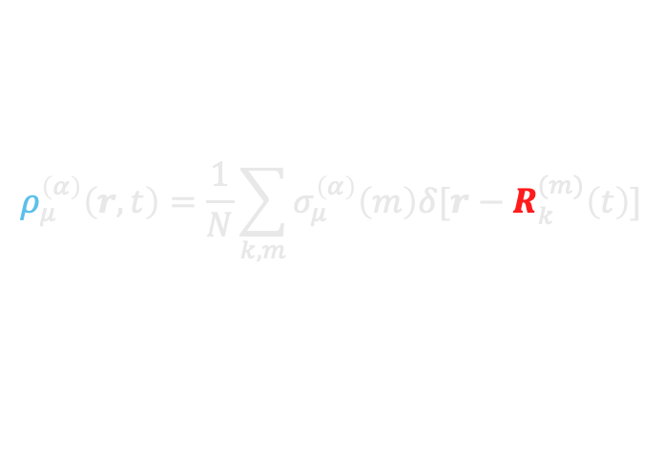
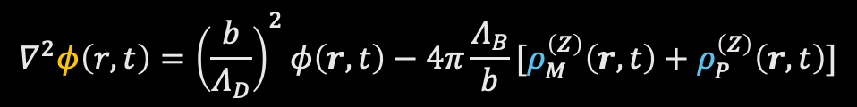
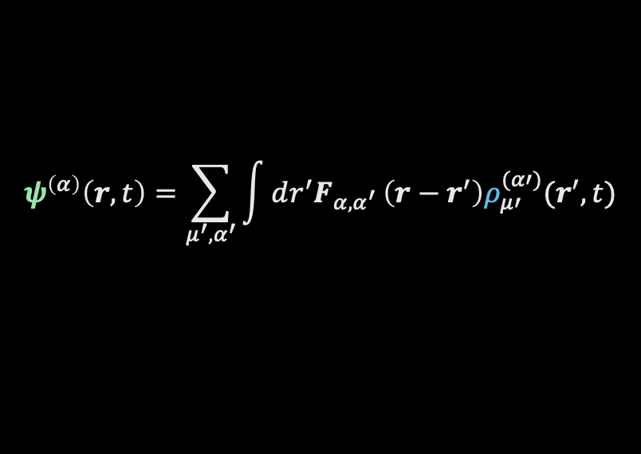
Mean Field Equations
$$ρ_{μ}^{\left(α\right)}\left(r,t\right)=\frac{1}{N}\sum_{k,m}{σ_{μ}^{\left(α\right)}\left(m\right)δ[r−R_{k}^{(m)}\left(t\right)]}$$
$$ρ_{μ}^{\left(Z\right)}\left(r,t\right)=\frac{1}{N}\sum_{k,m}{z_{μ}\left(m\right)δ[r−R_{k}^{(m)}\left(t\right)]}$$
$$ψ^{\left(α\right)}\left(r,t\right)=\sum_{μ^{′},α^{′}}{\int{dr^{′}F_{α,α^{′}}}}\left(r−r^{′}\right)ρ_{μ′}^{(α′)}(r^{′},t)$$
$$∇^{2}φ\left(r,t\right)={\left(\frac{b}{Λ_{D}}\right)}^{2}φ\left(r,t\right)−4π\frac{Λ_{B}}{b}[ρ_{M}^{\left(Z\right)}\left(r,t\right)+ρ_{P}^{\left(Z\right)}\left(r,t\right)]$$
$$\frac{dR_{μ}^{(k,m)}}{dt}=σ_{μ}^{\left(A\right)}\left(m\right)ψ^{\left(A\right)}\left(R_{μ}^{\left(k,m\right)}(t),t\right)+σ_{μ}^{\left(B\right)}\left(m\right)ψ^{\left(B\right)}\left(R_{μ}^{\left(k,m\right)}(t),t\right)−z_{μ}\left(m\right)∇φ\left(R_{μ}^{\left(k,m\right)}\left(t\right),t\right)+S_{μ}^{\left(k,m\right)}\left(t\right)+f_{μ}^{\left(k,m\right)}\left(t\right)$$
$$\frac{dq_{S}(r,t)}{dt}={∇^{2}q}_{S}\left(r,t\right)− ∇·[ψ^{\left(S\right)}\left(r,t\right)q_{S}\left(r,t\right)]$$

Slide 18


Stress:
Chain 𝓁
let us quantify the stability of the membrane.
Stress
The stress, 𝜎, in the 𝛽 direction, due to a force in the 𝛼 direction is measured by bond lengths
𝛽
$${\overset{⃑}{B}}_{m}$$
𝛼
$$σ_{α, β}=\frac{1}{n(N−1)}\sum_{l=0}^{n}{\sum_{m=0}^{N−1}{B_{m,α}B_{m,β}}}$$
Notes:
make this backup

