Slide 1

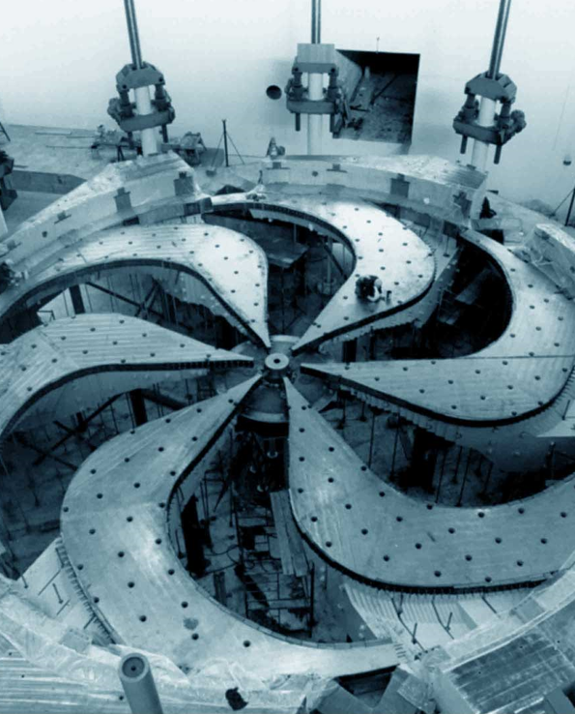

How Proton Therapy and Photon Therapy Affect Secondary Cancer Rates
Peter Dasiukevich
Supervisors: Sebastian Tattenberg, Cornelia Hoehr
Collaborators: Abdelkhalek Hammi
Notes:
Change title to abstract title

Slide 2









Disclosures
PD is the recipient of the UK Turing Scheme
ST is the recipient of a Mitacs Accelerate Fellowship
TRIUMF receives funding via a contribution agreement with the National Research Council of Canada

Slide 3
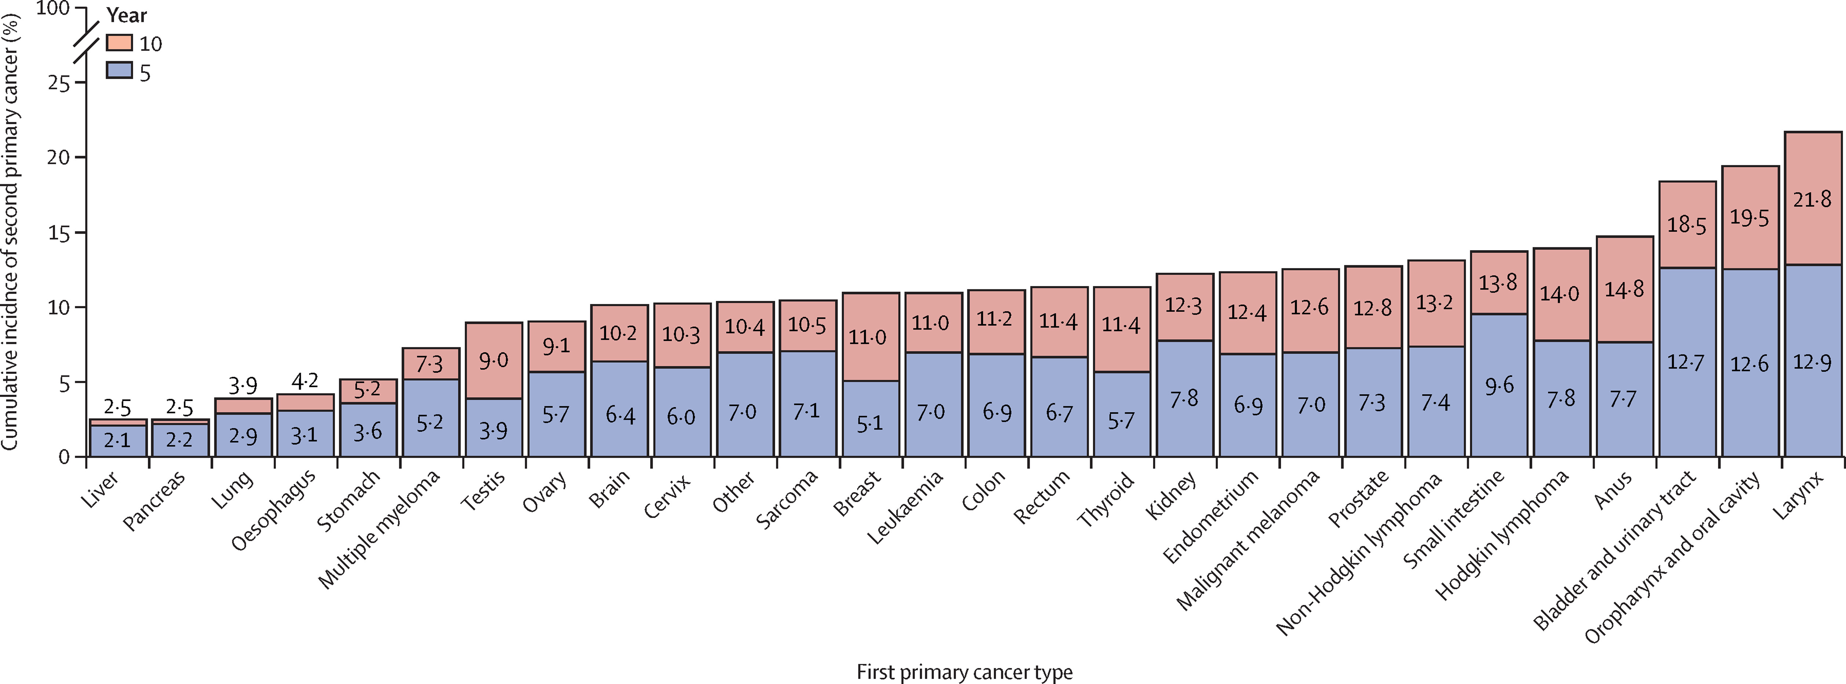
Project Motivation
Dose deposited in healthy tissue increases secondary cancer rates.
Reducing this dose reduces secondary cancer rates .
https://www.thelancet.com/journals/lanonc/article/PIIS1470-2045%2823%2900538-7/fulltext
Notes:
Explain blue and red in figure

Slide 4
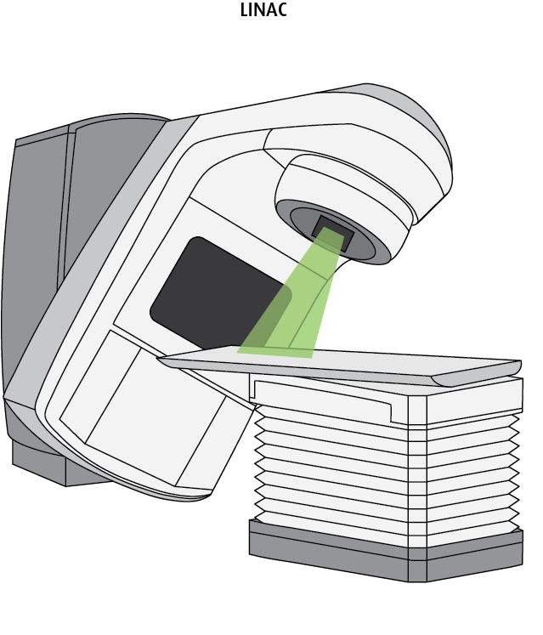
External Beam Radiotherapy
External Beam Radiotherapy (EBRT) aims to destroy the cancer by firing a beam of radiation at the tumour.
EBRT is the focus of this project.
https://cancer.ca/en/treatments/treatment-types/radiation-therapy/external-radiation-therapy
Notes:
Maybe include TRIUMF slide before this, Mention there are several types of cancer treatment

Slide 5
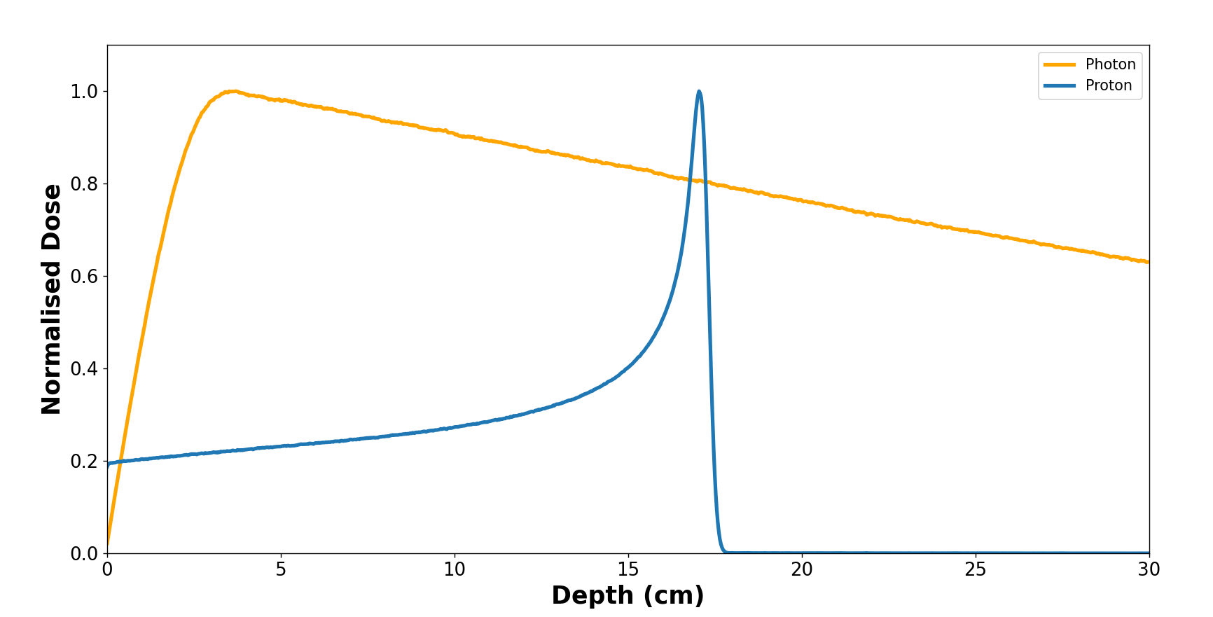
External Beam Radiotherapy
EBRT is traditionally done using a beam of photons, however proton therapy has recently been gaining interest due to its ability to deposit dose more locally.
Notes:
replace legend with symbols, (maybe black and dashed)

Slide 6
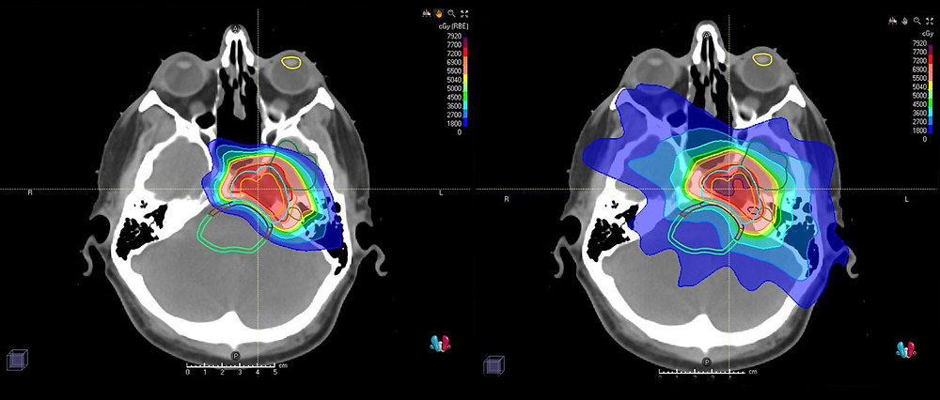
Dose Distributions
Proton Therapy
Photon Therapy
https://www.hopkinsmedicine.org/news/articles/2020/05/proton-therapy-delivers-targeted-treatment-to-brain-and-spinal-cord-tumors

Slide 7
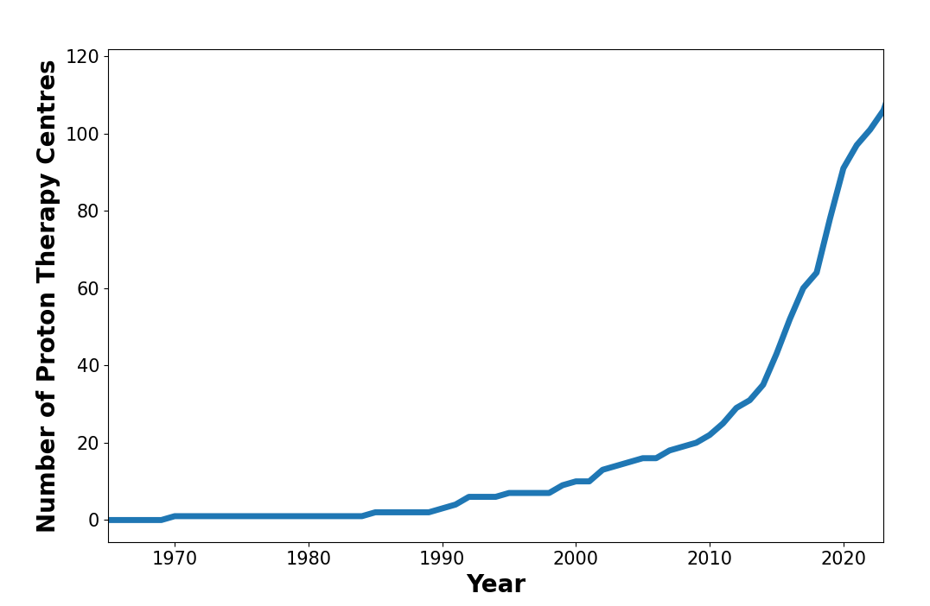
Motivation
Lack of secondary cancer data regarding proton therapy.
However, using simulations the risk of secondary cancers developing from EBRT can be calculated.
Notes:
Reduce text include figure for first point (number of facilities against time)

Slide 8
Aim
Aim: By using simulations calculate and compare the chance of a patient developing secondary cancer for photon therapy and proton therapy.

Slide 9
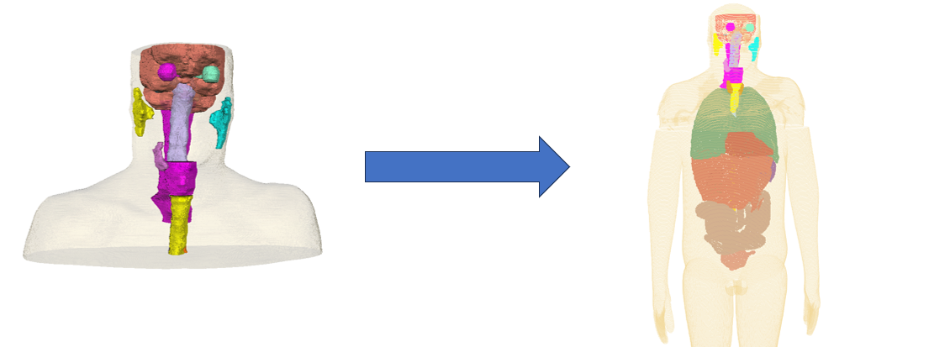
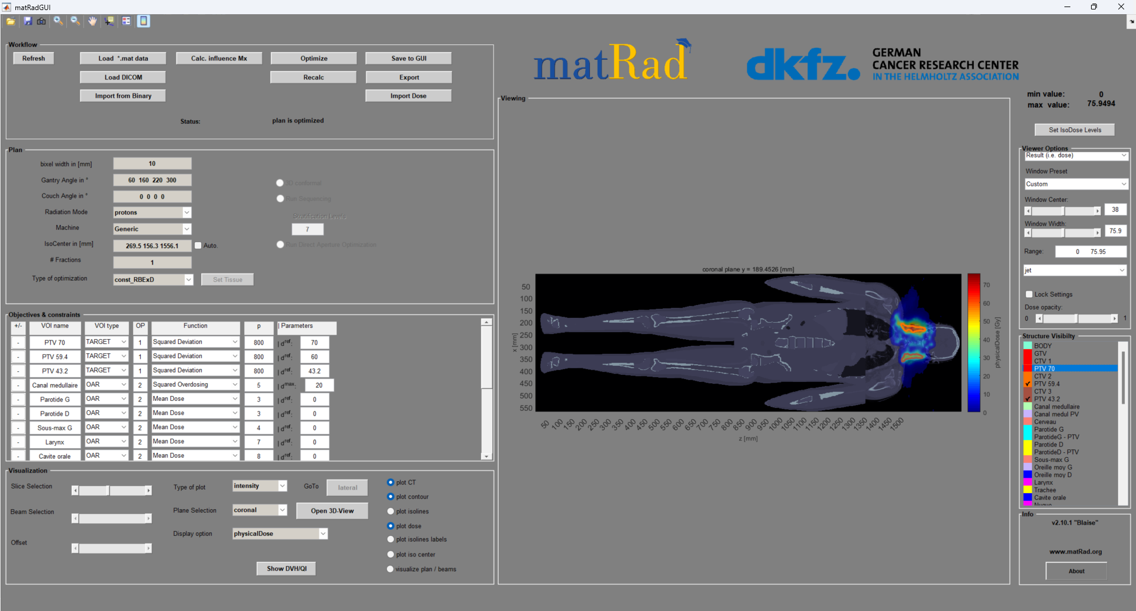
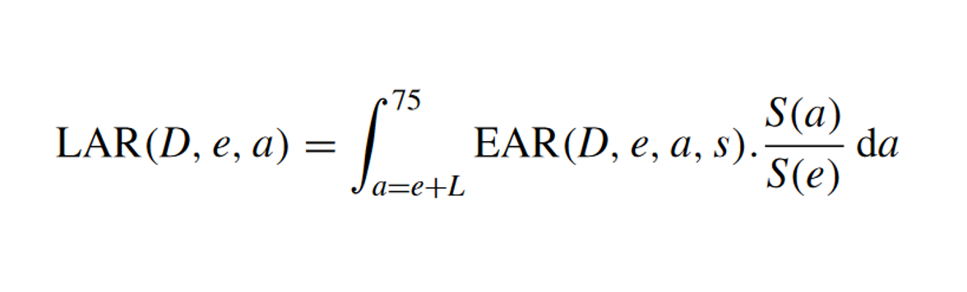
Workflow
1. Combine Full Body Phantom to the CT
2. Create a Treatment Plan using matRad
3. Calculate the chance of secondary cancer
Notes:
Mention patient CT is what we’re using

Slide 10
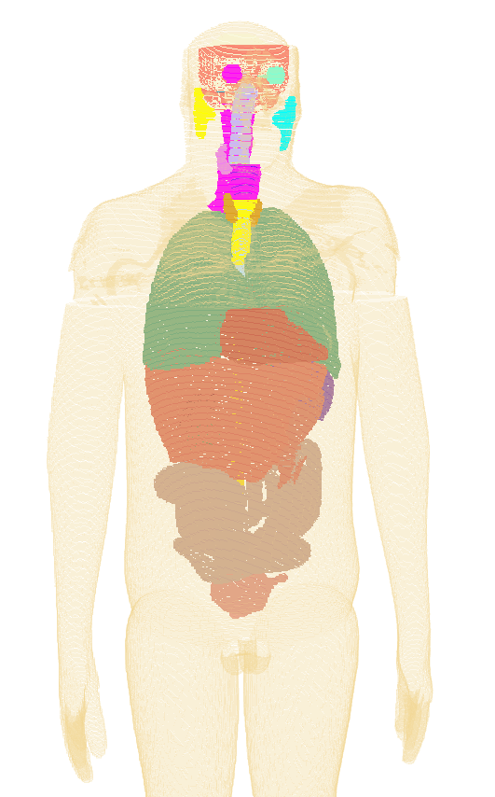
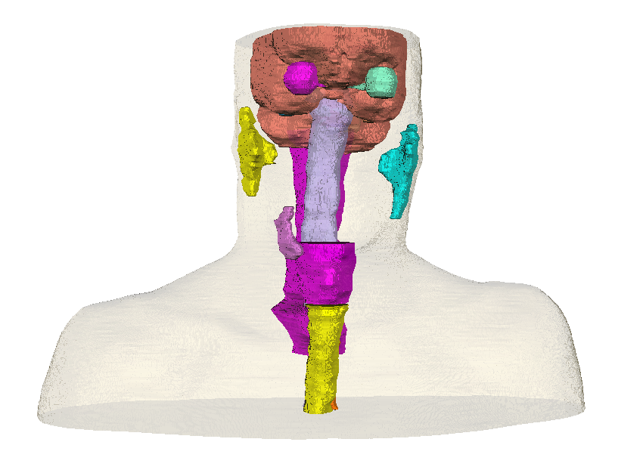
Workflow
1. Combine Full Body Phantom to the CT
Notes:
Expand on the patient computed tomography scan, why we need it and what it is.

Slide 11
Workflow
2. Create a Treatment Plan using matRad
Notes:
show whole screen then split into segments – Show plan, show objectives then show dose distribution, Label sections Plan Objectives Results

Slide 12
Workflow
2. Create a Treatment Plan using matRad
Notes:
show whole screen then split into segments – Show plan, show objectives then show dose distribution, Label sections Plan Objectives Results

Slide 13
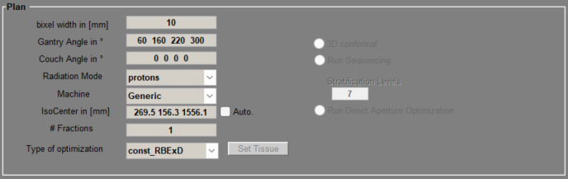
Workflow
2. Create a Treatment Plan using matRad
Notes:
Change photo to whole body ct, include tumours, show whole screen then split into segments – Show plan, show objectives then show dose distribution

Slide 14
Workflow
2. Create a Treatment Plan using matRad
Notes:
show whole screen then split into segments – Show plan, show objectives then show dose distribution, Label sections Plan Objectives Results

Slide 15
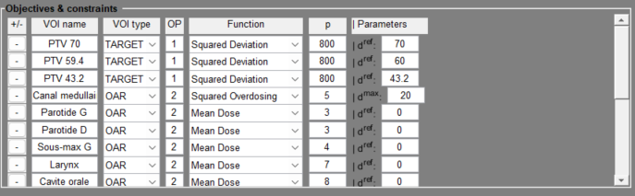
Workflow
2. Create a Treatment Plan using matRad
Notes:
Change photo to whole body ct, include tumours, show whole screen then split into segments – Show plan, show objectives then show dose distribution

Slide 16
Workflow
2. Create a Treatment Plan using matRad
Notes:
show whole screen then split into segments – Show plan, show objectives then show dose distribution, Label sections Plan Objectives Results

Slide 17
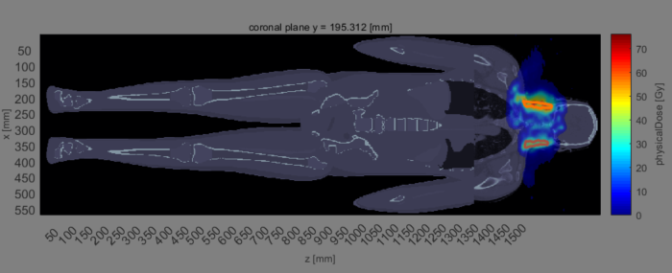
Workflow
2. Create a Treatment Plan using matRad
Notes:
Change photo to whole body ct, include tumours, show whole screen then split into segments – Show plan, show objectives then show dose distribution

Slide 18
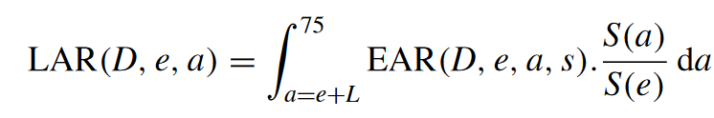
Workflow
3. Calculate the chance of Secondary Cancer using the Dose Distribution
EAR – Excess risk of developing secondary cancer at a given age.
LAR – The total excess risk in a patient’s lifetime of developing secondary cancer.
Notes:
Mention it is for organs

Slide 19
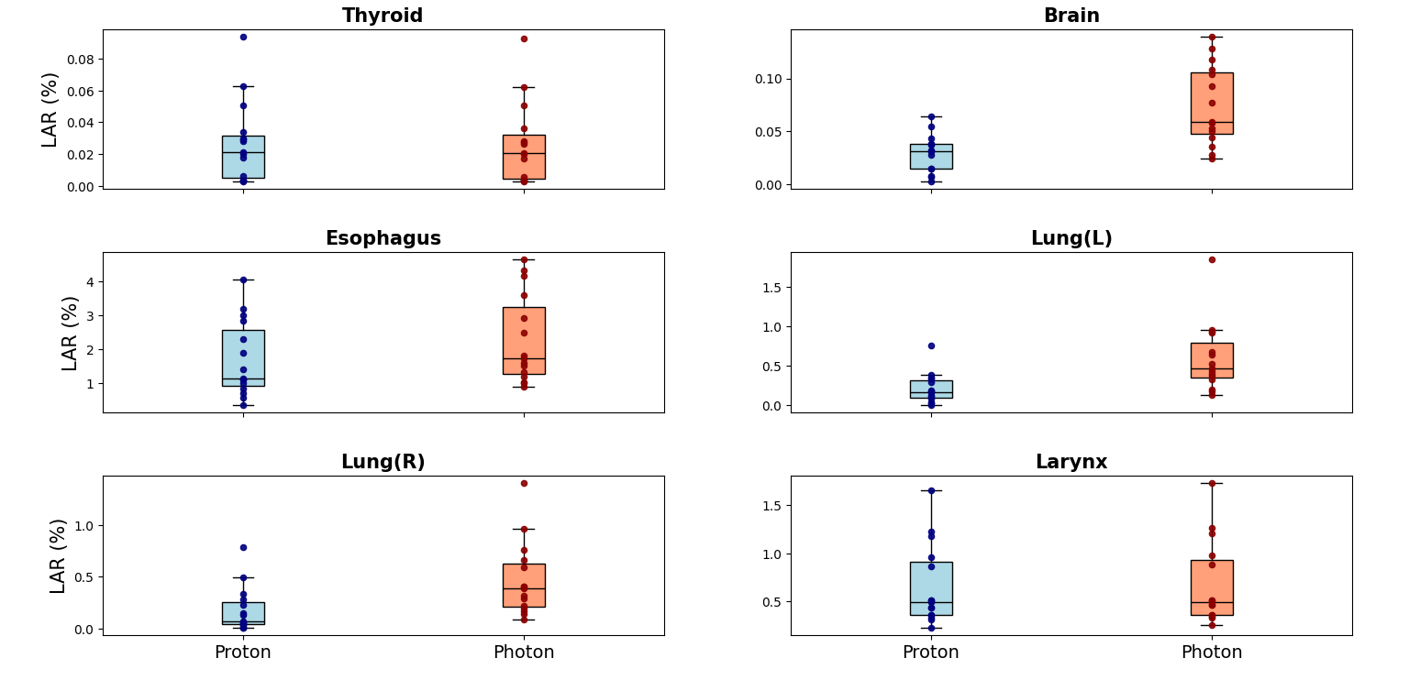
Results
Notes:
maybe have each row have the same y axis scale, explicitly explain the boxplot make it obvious (maybe label everything in the boxplot show just one figure first to let them understand the figure)

Slide 20
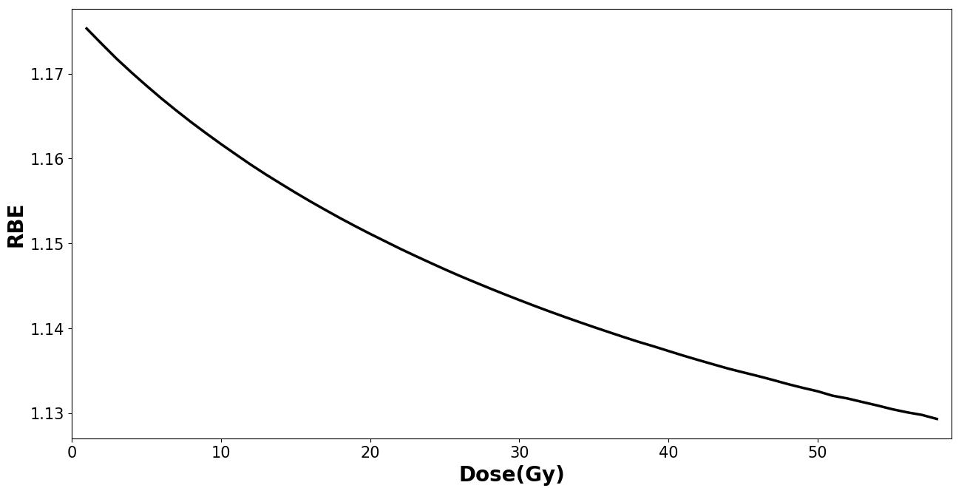
Proton Limitations
In the clinic protons are assumed to have a Relative Biological Effectiveness (RBE) of 1.1.
Notes:
Maybe consider reversing order of figure and text

Slide 21

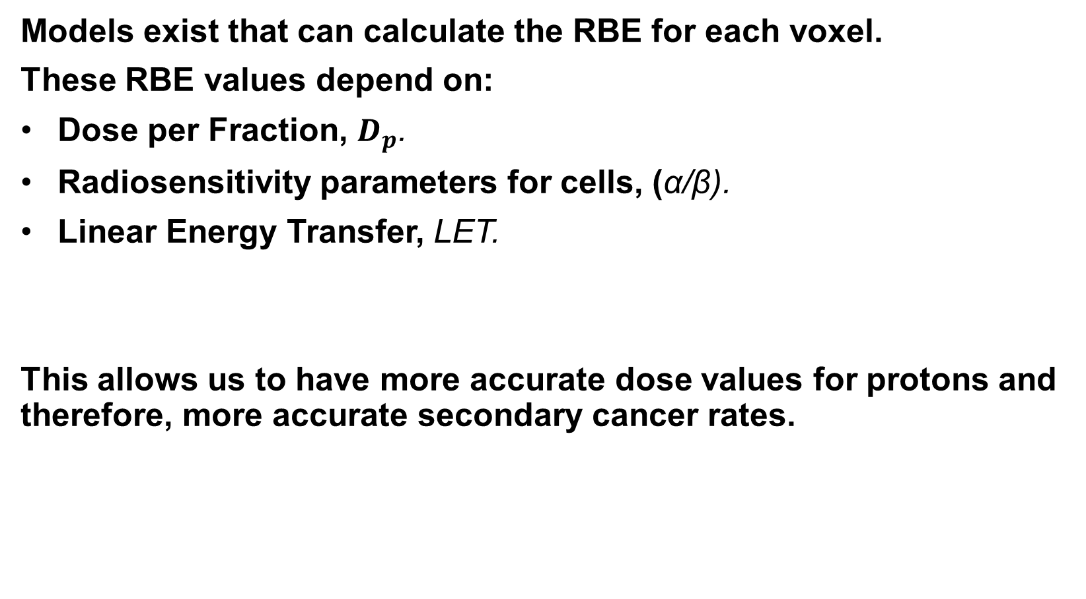
Variable RBE
Models exist that can calculate the RBE for each voxel.
These RBE values depend on:
Dose per Fraction, $D_{p}$.
Radiosensitivity parameters for cells, (α/β).
Linear Energy Transfer, LET.
This allows us to have more accurate dose values for protons and therefore, more accurate secondary cancer rates.
Notes:
Alpha/beta – radiosensitivity for cells, Make appear

Slide 22
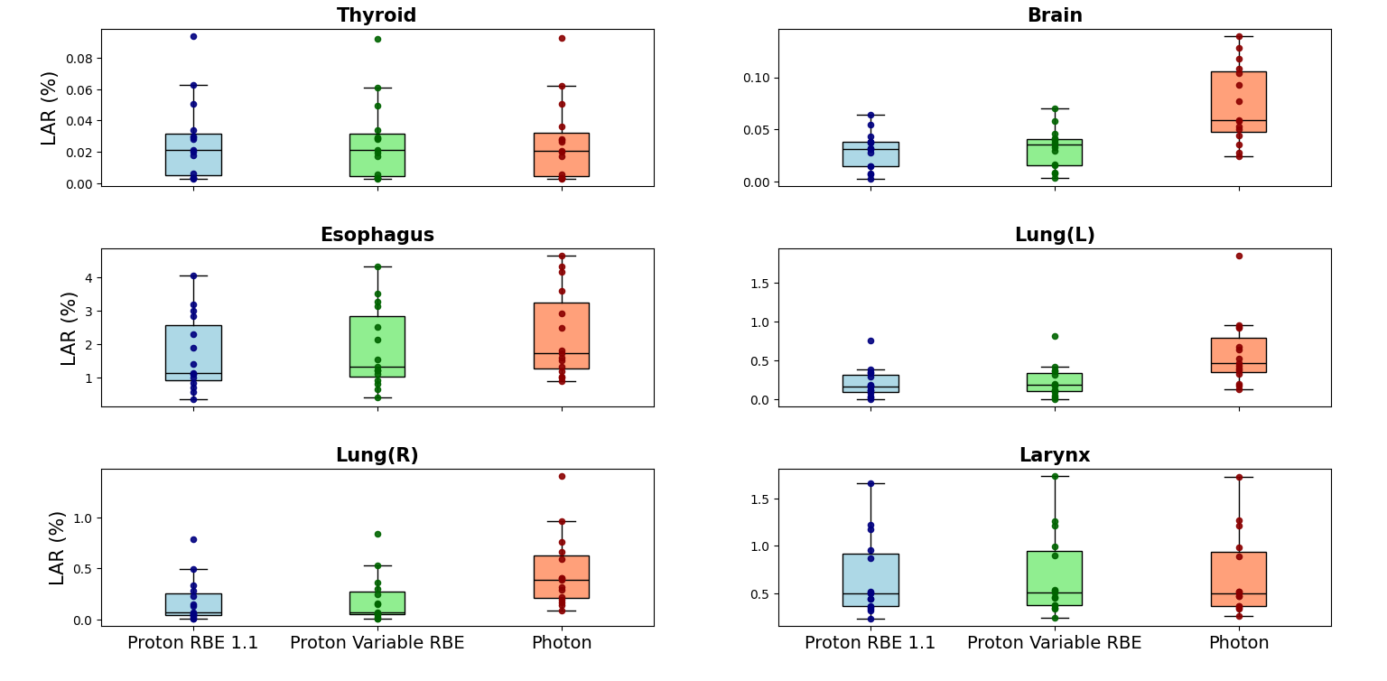
Results

Slide 23
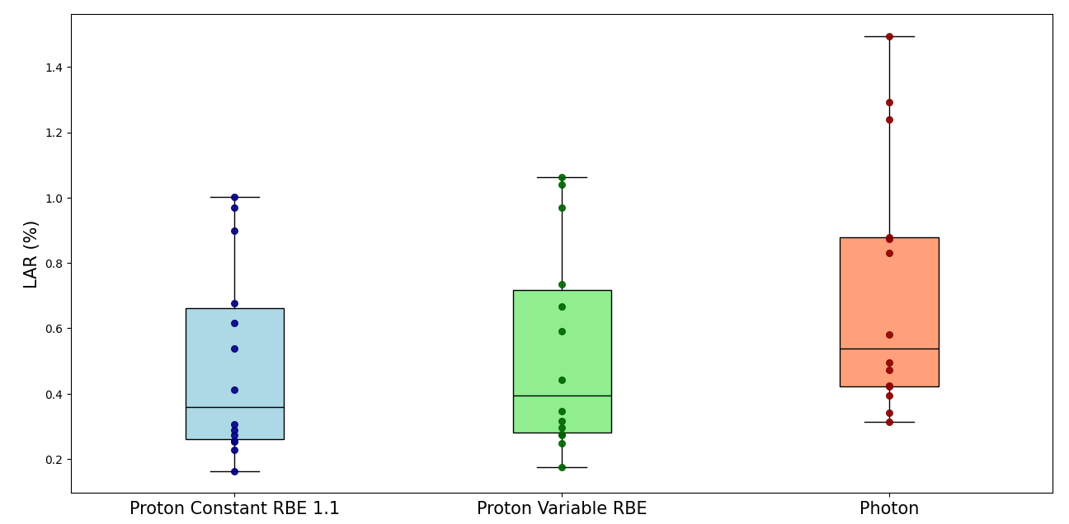
Results Combined

Slide 24
Discussion
Averaged across all patients and organs, photons when compared to constant RBE protons, were 1.8 times more likely to cause secondary cancer.
Taking into account variable RBE this number is reduced to 1.6.
Differences between modalities weren’t seen in organs very close to the tumour.
Notes:
Mention exclusion of thyroid and brain

Slide 25
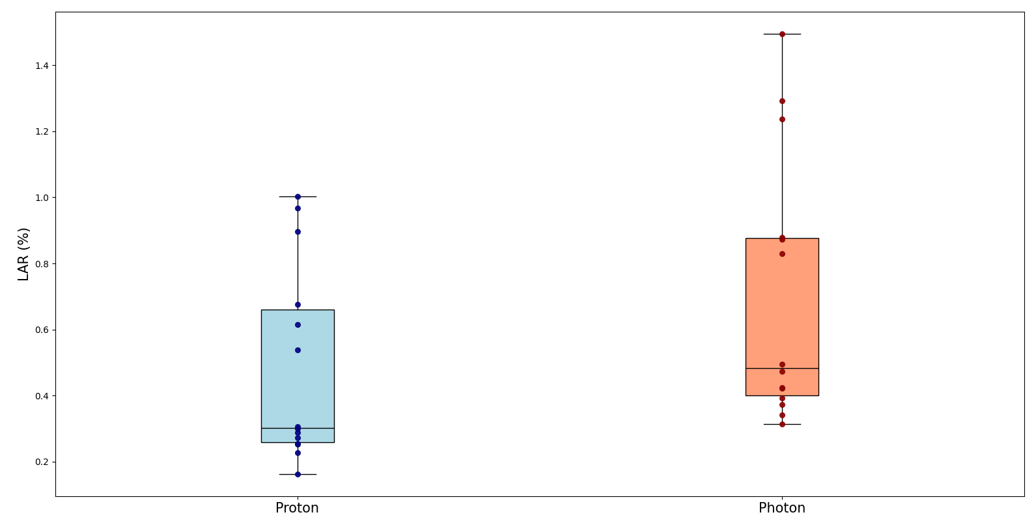
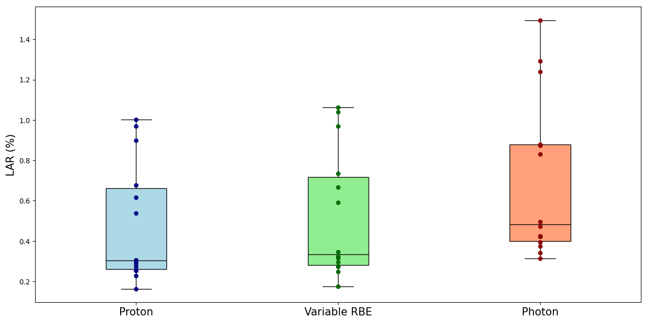
Conclusion
A full body patient CT can be used as a phantom to give insight on the secondary cancer rates in organs outside the patient CT.
Proton therapy on average has a significantly lower chance of causing secondary cancer when compared to photons.
When including variable RBE models, the secondary cancer rates for proton therapy become worse but are still lower than photon therapy values.
Notes:
Include another image for second point, make text cover half the slide, make figures same size, consider reducing text

Slide 26
Thank you!
Email: pdasiukevich@triumf.ca
Notes:
Include Email

Slide 27
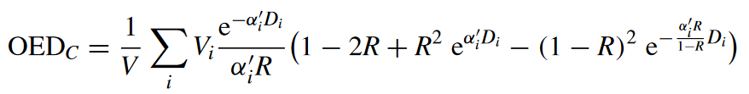
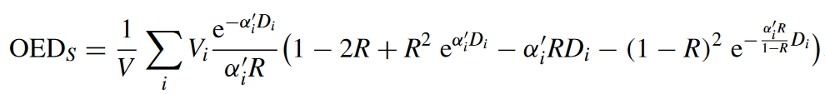
Extra
Sarcoma
Notes:
Add RBE equation and EAR

Slide 28
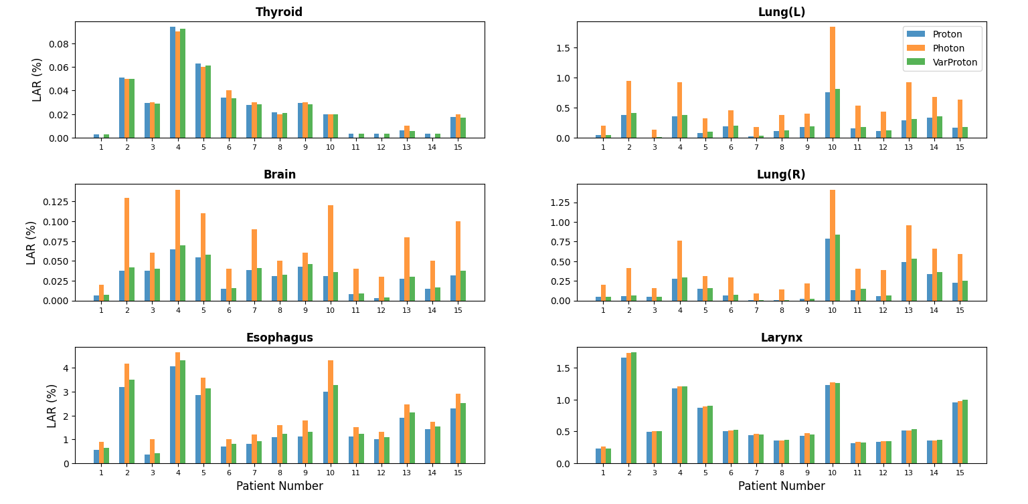
Extra
Sarcoma
Notes:
Add RBE equation and EAR

