Slide 1
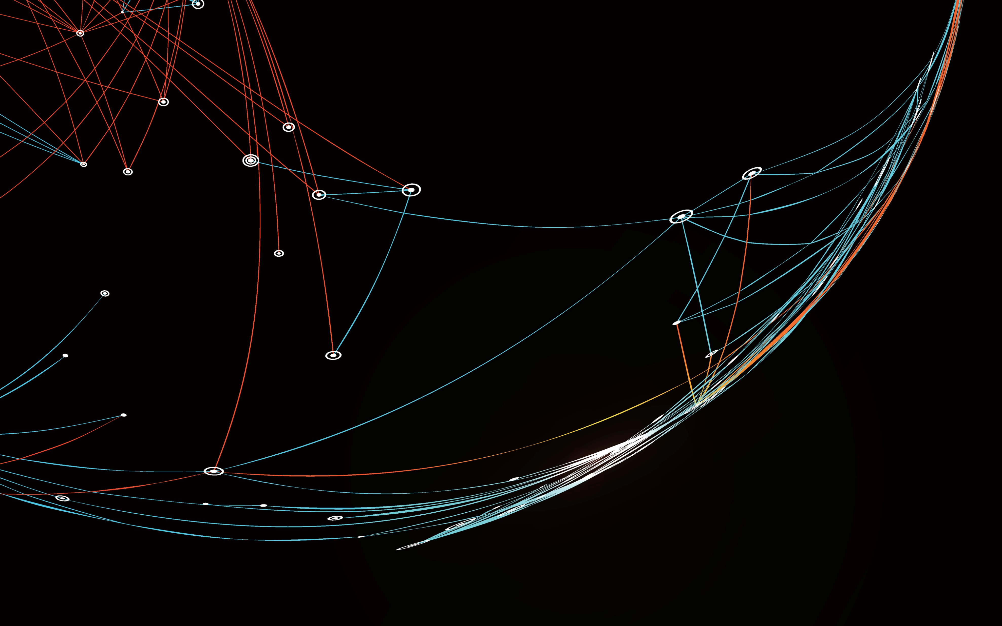
Estimating applied force on tissue using light
Lee D. Sikstrom, David W. Holdsworth
CAP Congress 2024
27 May 2024

Slide 2
Acknowledgements
Supervisor
David Holdsworth
Lab Members
Sydney Wilson
Kyle Wilson
Alex Kopacz
Jaques Milner
Hristo Nikolov
Steve Pollmann
Joseph Umoh
David Ng
Advisory Committee
Ali Khan
Mel Boulton
Christopher Ellis
Sources of Funding
Samitt Family
Ontario Research Fund (Research Excellence)
Ontario Graduate Scholarship
SPIE Education Scholarship

Slide 3
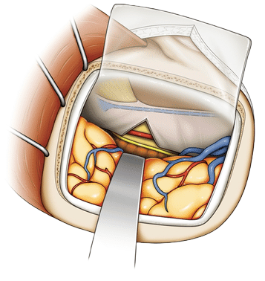
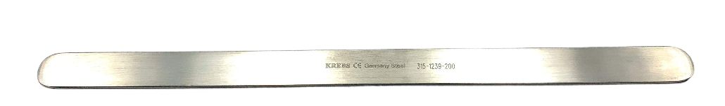
Brain Retraction
Spatula
Skull
Over 40% have complications²
5-10% clinical deficits²
Qualitative
Surgeons are guided by feel¹
Brain
Retractor
Image Credit: Medikrebs.com
Image Credit: Uda, K., et al. Neurosurg Rev 45, 1617–1624 (2022).
2 E. Roca and G. Ramorino, Neurosurg Rev 2023 Vol. 46 Issue 1

Slide 4
Current Solutions
Not replaced spatula type retractors
Spatula type most widely used retractor¹
Mechanical force sensors
Inflatable balloons or boots
Patient positioning
Chemical relaxation
1 E. Roca and G. Ramorino, Neurosurg Rev 2023 Vol. 46 Issue 1
Notes:
Go over this very quickly – main point is that these solutions are not used – plain metal retractor still the most widely used

Slide 5
Need
Spatula type retractor that will protect healthy tissue
easy to use
fit into surgical workflows
monitor retraction force

Slide 6

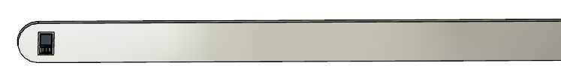
Proposed Solution
Sensor contact force is a confounding variable for reflectance optical measurements of tissue:
Near-Infrared Spectroscopy (NIRS)
Photoplethysmography (PPG)
We propose that contact force on vascularized tissue can be estimated from reflectance optical sensors
Notes:
Add note to highlight what reflected optical measurements are
Shorten up proposed solution – Don’t go into details about sensor in this portion – Save it for the next section

Slide 7
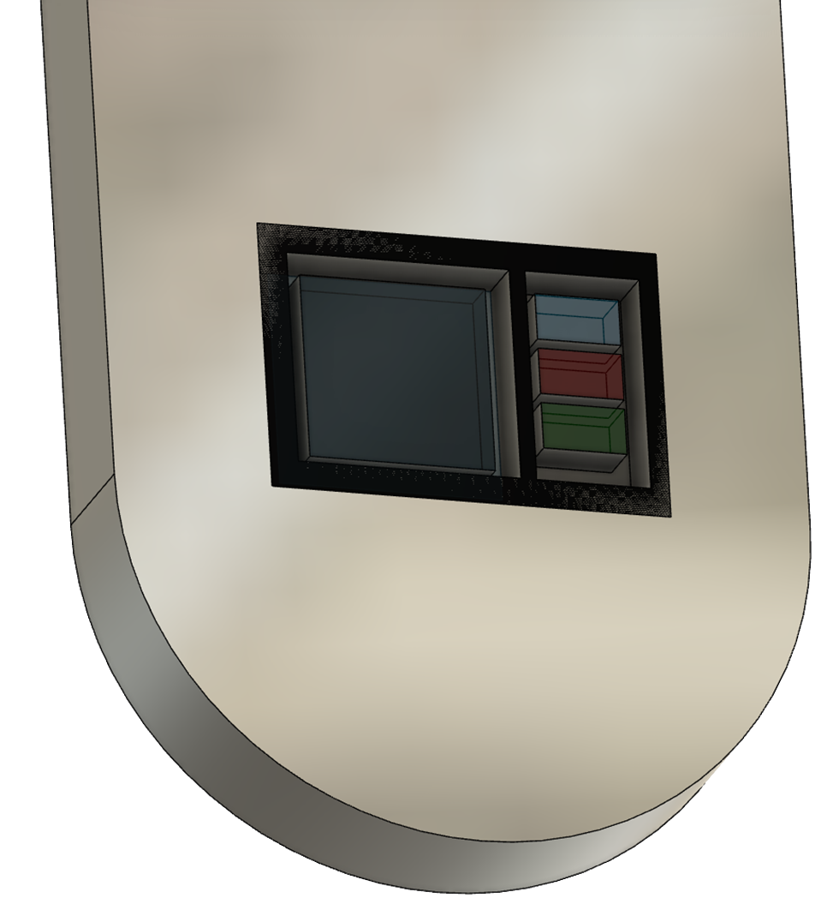
Proposed Solution
Optical Sensor
Spatula Type Retractor

Slide 8
Objective
      Can applied force to vascularized tissue be predicted from reflected optical signal sensors?
      What sensing parameters are optimal?
Notes:
Change from PPG optical signals to single pixel images

Slide 9
Approach
Complex relationship between optical signals and applied force
Use machine learning
What model is best?
How well does it do?
Notes:
Explicitly state that this relationship is a critical one - > will not work with another material.

Slide 10
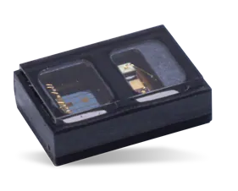
Optical Sensor
Ultra Miniature: 2.9 x 4.3 x 1.4 mm
3 Programmable high current LED drivers
3 LEDs: 880 nm, 660 nm, 530 nm
PIN photodiode
19-bit resolution
Ambient light cancellation
Generates 3 channel single pixel images
MAXM86161
Image Credit: analog.com
Notes:
Potentially don’t need, or reduce information on this slide
This slide could be moved to the Proposed solution section to replace some of the slides there.

Slide 11
Data Collection
Readily accessible vascularized tissue
  Index finger
240,000 data points (n=1)

Slide 12
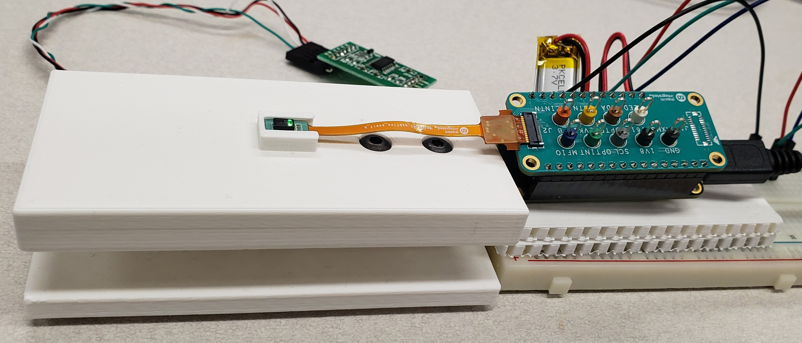
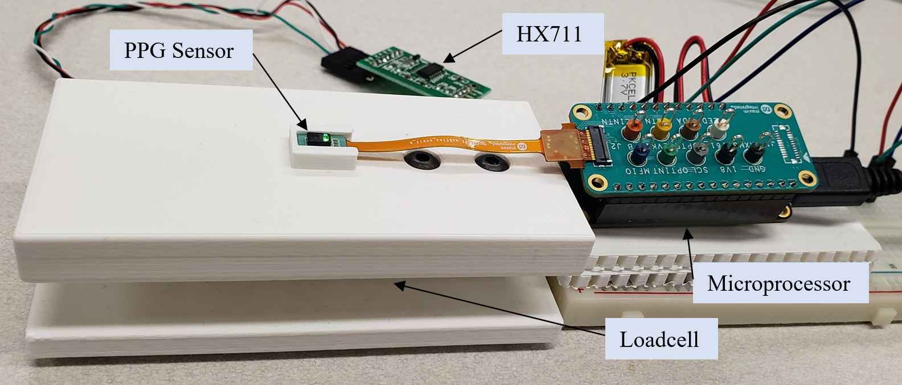
HX711
Optical Sensor
Microprocessor
Loadcell
Notes:
Comment about loadcell only being for training of the model.
Change PPG Sensor to imager or single pixel imager

Slide 13
Single Pixel 3 Channel Images
Green
Infrared
Red
Force
Force
Force
Force
Corresponding Force Value

Slide 14

80% Training
20% Testing
Green
Prediction
Infrared
Force
Machine
Learning
Compare
Red
Force
Notes:
Change discrete time series to an overlapping series of rectangles, each varying in intensity to represent the image “value”. Can leave the loadcell values, as that is not a series of images

Slide 15
Model Results
Performance
Ease of Implementation
RAM Optimization
Notes:
Comment surprising results -> many models to choose from. Underlies that there is a fundamental relationship between force and reflected optical signals from vascularized tissue.

Slide 16


Sensing Parameters
Imaging Rate
LED Current Tissue Depth
  Collected 20,000 data points for each parameter setting
Notes:
Change PPG to imaging parameters?

Slide 17
Imaging Rate
Optimal
Notes:
Results are what we expected due to the frequency of changes in the circulatory system. The Lower output at higher data rates due to the HX711 data rate limitations.

Slide 18
LED Current
Optimal
Photodiode Saturation

Slide 19
Random Forest Performance
Used optimized sensing parameters
Collected 20,000 data points with 80/20% split
Grid search for best random forest hyperparameters

Slide 20
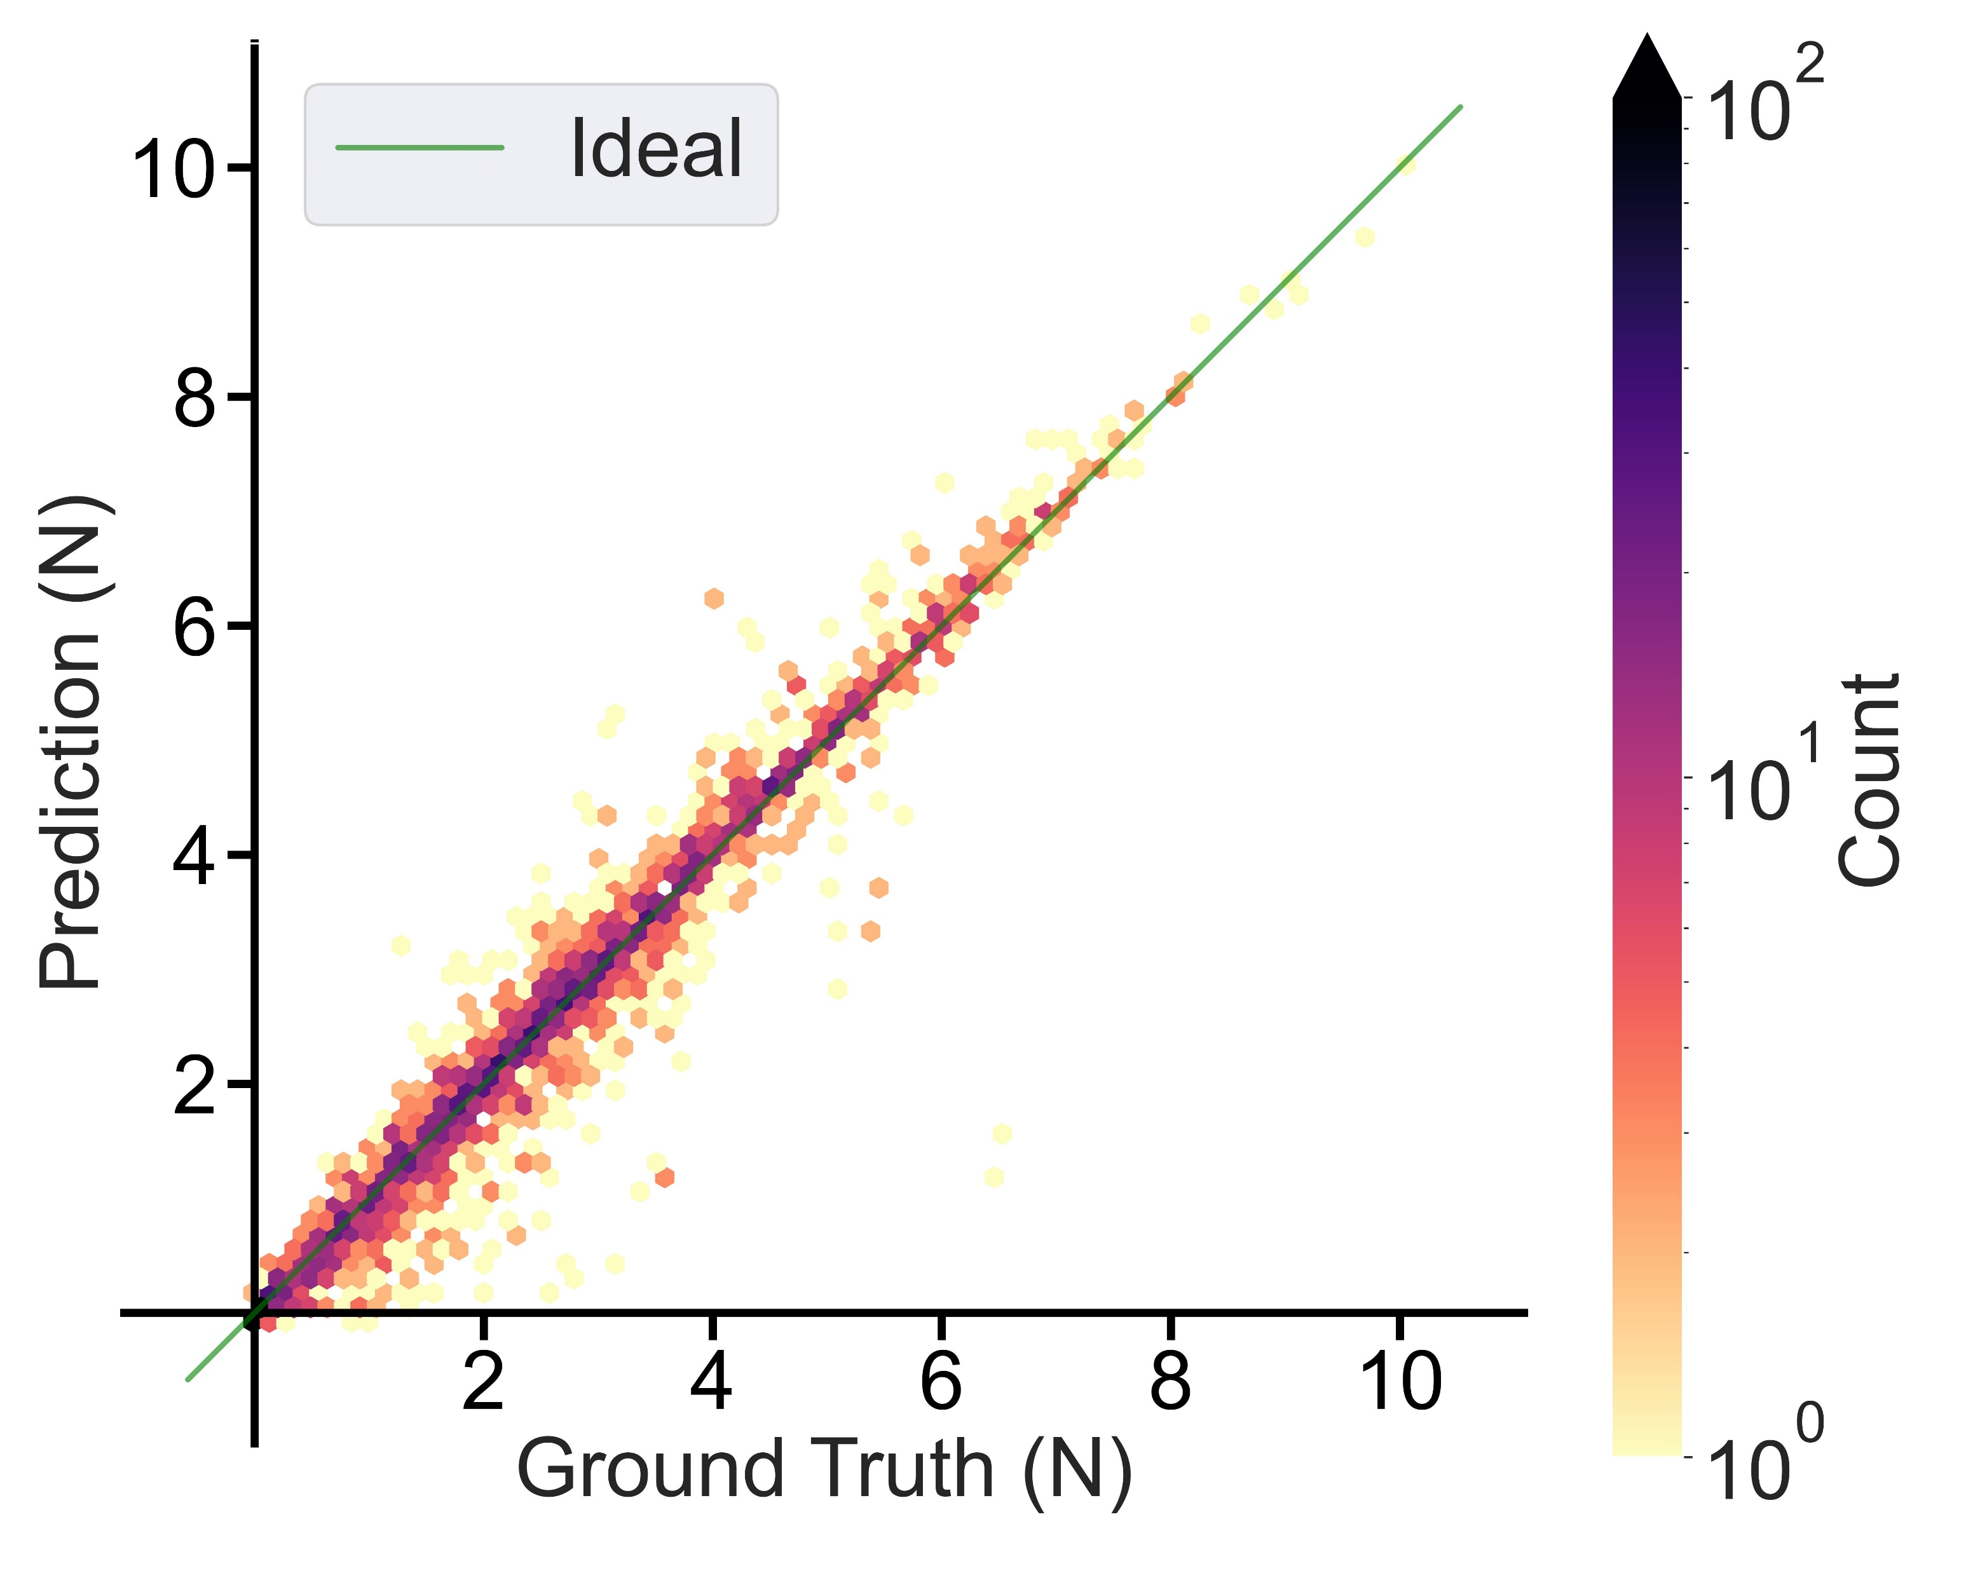
Random Forest Results
Very Good Results
R²: 0.97
P-value < 0.0001
Slope: 1.007 ±0.003

Slide 21
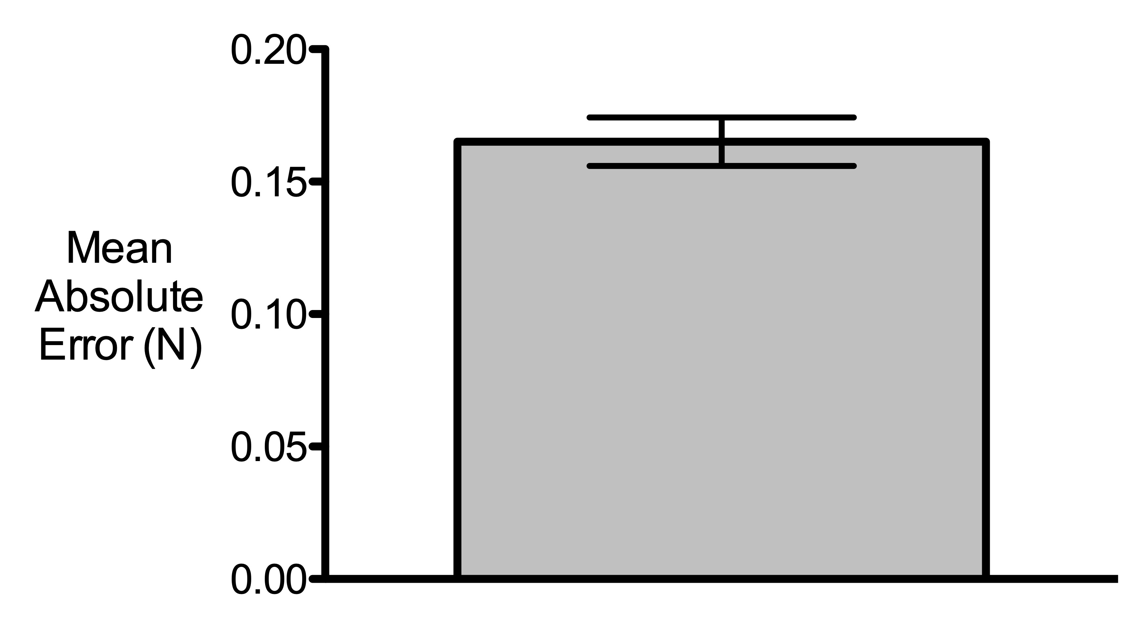
Errors
RMSE: 0.34 N
|Median|: 0.057 N
|Mean|: 0.165 N
95% CI: 0.156 - 0.174 N
Notes:
Do absolute mean average or RMS – not true mean. Double check what was used in Prism.

Slide 22



Conclusions
Random forest model is suitable
Imaging parameters:
30-60 Hz
up to 50 mA LED current
Applied force on vascularized tissue can be estimated with reflected optical signals
Notes:
Imaging instead of PPG

Slide 23

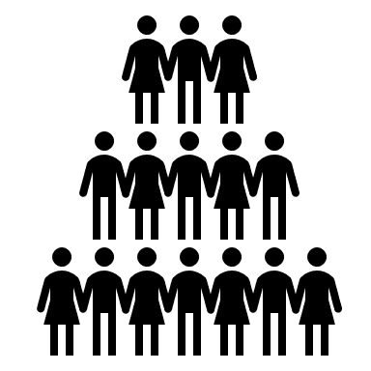



Limitations
Future Work
One Participant
More Participants
Finger
In Vivo
Porcine

Slide 24



Thank You
lsikstro@uwo.ca

