Slide 1
Ion Extraction Tests for Barium Tagging
Raad Shaikh
Supervisor: Dr. Razvan Gornea
M.Sc. Particle Physics, Carleton University
CAP 2024

Slide 2
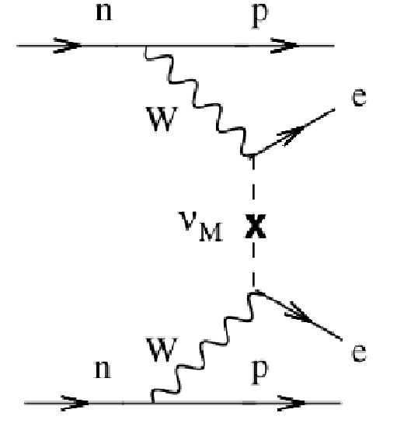
Neutrinoless double-beta decay (0vββ)
2n --> 2p⁺ + 2e⁻ + 0ν̄
If 0vββ is observed, neutrinos must be their own antiparticle (Majorana fermion)
Half-life of the 0vββ process will also tell us the effective majorana mass of neutrinos
F.T. Avignone III et al., Double Beta Decay, Majorana Neutrinos, and Neutrino Mass
Notes:
Something that could tell us a lot about neutrinos is this hypothesized process of 'neutrinoless double beta decay'. Here we have 2 neutrons decaying to 2 protons, two beta particles, and zero neutrinos – this is only possible if neutrinos are their own antiparticles, also known as a majorana fermion. Which is interesting! also, observing this process and measuring the half-life would tell us about the effective mass of the neutrino, which oscillation experiments don't tell us (they only tell us about the difference in masses of flavours).

Slide 3
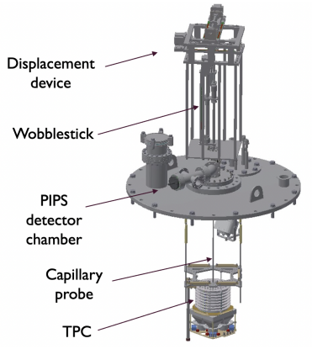
Barium Tagging
EXO: Enriched Xenon Observatory : Liquid Xe in Time Projection Chamber (TPC)
Looking for ¹³⁶Xe → ¹³⁶Ba²⁺ + 2e⁻ (+ 0ν̄)
Presence of Barium ion rules out all non-double beta decay backgrounds!
@Carleton: Displacement device manoeuvres a capillary probe to the decay location and quickly extracts LXe volume with the Ba ion
Capillary delivers the Ba ion to detection/identification apparatus (McGill, TRIUMF)
Development of a Displacement Device for Ion Extraction from Liquid Xenon. R. Elmansali, 2023

Slide 4
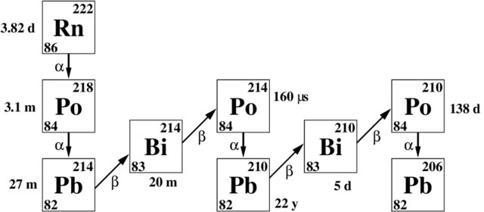
Species to be Tested
Barium identification is its own problem. Initial studies focused on just transferring ions
Rn-222 source: radioactive decays are easy to detect
Po-218 and Po-214 are the ions to look for (α-decay)

Slide 5
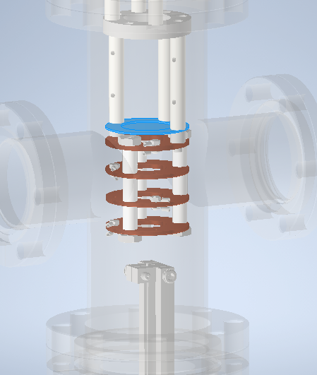
Untargeted ion extraction
Initial testing of the setup with Rn-222 in argon gas (less technically demanding than LXe, so suitable for prototype test)
Inject TPC with Rn, attempt to transfer ionic decay products to a detector chamber via capillary
Pressure differential to maintain gas flow from TPC to detector chamber: 1.2 bar and 0.8 bar respectively
Electric field guides ions onto a Passivated Implanted Planar Silicon (PIPS) detector
When ions decay, PIPS detects energy from the resulting alpha particle
Detector Chamber
PIPS
Field rings
Capillary
TPC below (off-screen)

Slide 6
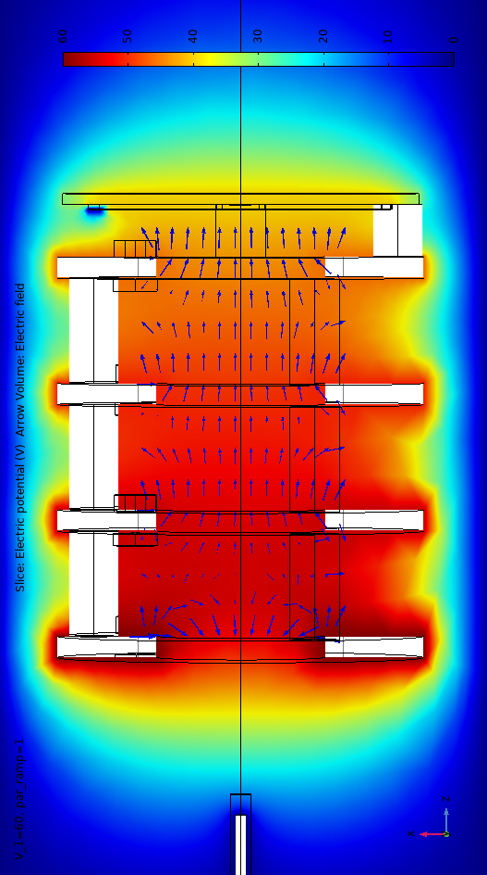
Electric field
(COMSOL) Electric field and Gas flow simulations: Dr. R. Collister
Radon-222 is a neutral atom, diffuses throughout
Polonium-218 and Polonium-214 are ions:
  If they were outside the field, they stay outside
  If they are brought inside the field, they get swept down to the PIPS and stay there
  "Brought inside" meaning riding the gas flow from the capillary
  Another possibility: radon decaying inside the field...
PIPS
Capillary

Slide 7
Background problem
PIPS sees (decay energy of) ions from two sources:
  Ions transferred from the TPC through the capillary (signal)
  Ions resulting from the progeny of radon that was already present in the detector chamber (background)
To properly interpret ion transfer results, we need an understanding of this background

Slide 8
Simulation
Due to geometry and obstructions, the visible solid angle to the PIPS detector is difficult to calculate
Monte-Carlo simulation of creation and movement of alpha particles in the detector chamber
  How many events will be detected?
  What should the observed energy spectrum look like?

Slide 9
Method
Make a 3d model of the interior of the detector chamber
Populate the space with Rn and Po decay events, with random locations
Each decay produces alpha particle in a random direction
Check whether this alpha particle successfully hits the PIPS detector or not
Compute what fraction of decays are successfully detected
Compile a list of distances that they traveled through argon, and thence derive the energy spectrum seen on PIPS

Slide 10
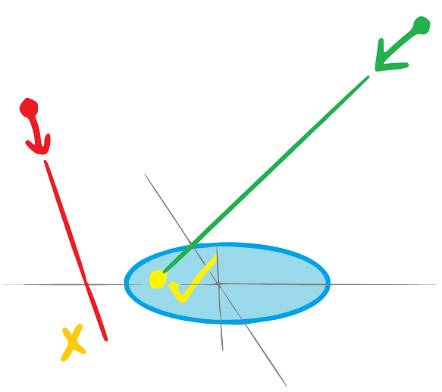
Collision detection (1)
First 'cut':
Is the alpha particle headed in the right direction overall?
PIPS located on z=0 plane with radius 1cm
Find xy position that alpha would have at z=0
Reject if >1cm from origin

Slide 11
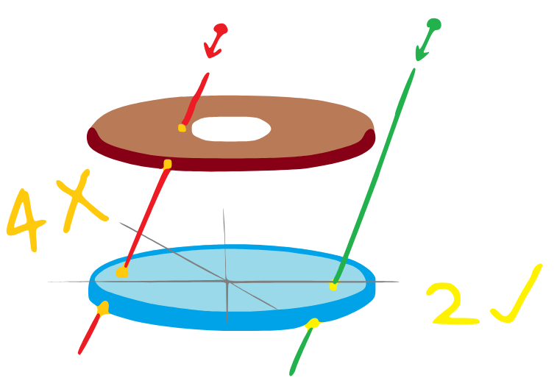
Collision detection (2)
Next step:
Export detector chamber model as STL, solid surfaces are represented as polygons
Import into Python (numpy-stl)
For each decay event, for each surface polygon, check if they intersect (ray-tracing algorithm e.g. Moeller-Trumbore)
Iff the ray intersects exactly two polygons (top and bottom of PIPS) then it is a 'success'

Slide 12
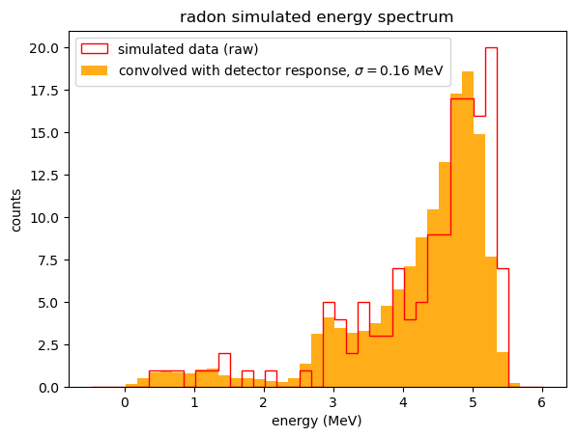
Energy loss
From earlier calculation we get a list of lengths the decay alphas had to trudge through (in 0.8 bar Argon)
From ASTAR we get dE/dx
Numerically integrate to get energy lost as function of length
Apply this function to the list of lengths to get a list of observed energies
Radon depicted here: sharp cutoff at 5.5 MeV with low-energy tail, as expected
Some Poloniums stuck to PIPS, have monoenergetic spectrum
Detector has a resolution ~160 keV, simulated results must be convolved with a gaussian to account for this spread

Slide 13
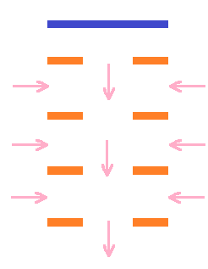
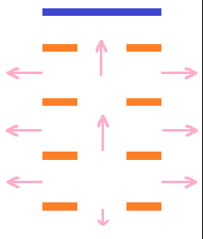
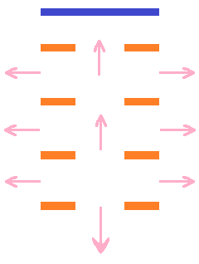
Experimental study of Background
Background processes to study with simulation and compare
PIPS
Field rings
Reverse Field
Field direction is reversed. Ions cannot enter, and any ions formed inside are directed away from the PIPS
Deflection Field
Ions formed inside the field are collected, but ions coming from the capillary cannot enter the field region and bounce away
Transfer field
Ions that make it through the capillary enter the field region and are directed onto the PIPS for collection

Slide 14
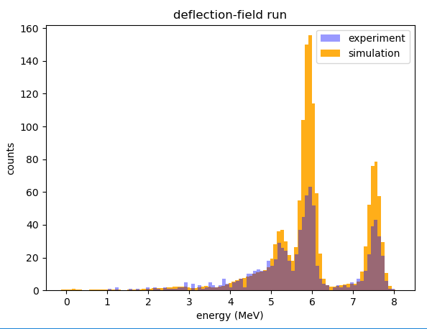
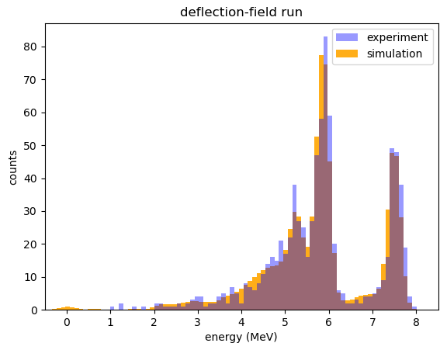
Deflection field
Adjusted
by hand
Discrepancies:
Polonium monoenergetic peaks lower than expected – perhaps due to inefficient collection by the field
Not all of the Polonium daughters are ions
Notes:
Neutralisation rate and the fraction of the positive 218Po-clusters in air
P Pagelkopf, J Porstendörfer - Atmospheric environment, 2003
https://inspirehep.net/literature/1744857
88% in air, 37% in LAr

Slide 15
Summary
Barium tagging provides good background rejection for neutrinoless double-beta decay
To extract Barium efficiently, ion transfer through capillary being studied
Simulation developed to model the test setup
Discrepancies indicate we need to improve our understanding of the processes involved

Slide 16
Thank you for listening!
Carleton Ba-Tagging Team:
  Supervisor: Dr. Razvan Gornea
  Lab members: Dr. Robert Collister, Mr. Ryan Elmansali

Slide 17
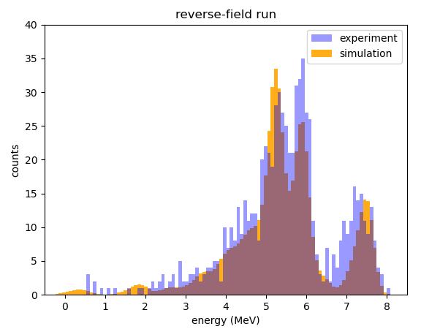
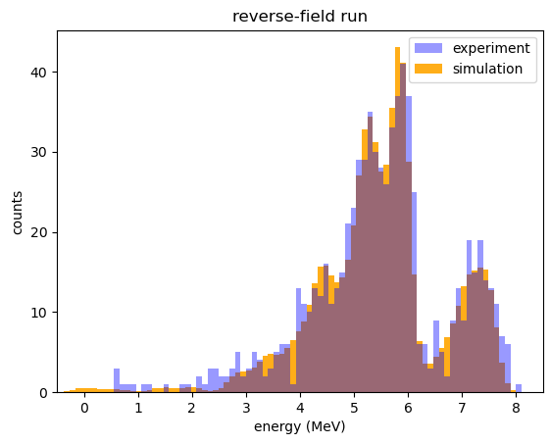
Reverse field
Simulation vs experimental observations
Adjusted
Discrepancies:
Po214 has a relatively high-energy tail, modeled as due to plating out on the field rings
Po218 monoenergetic peak higher than expected, not understood

Slide 18
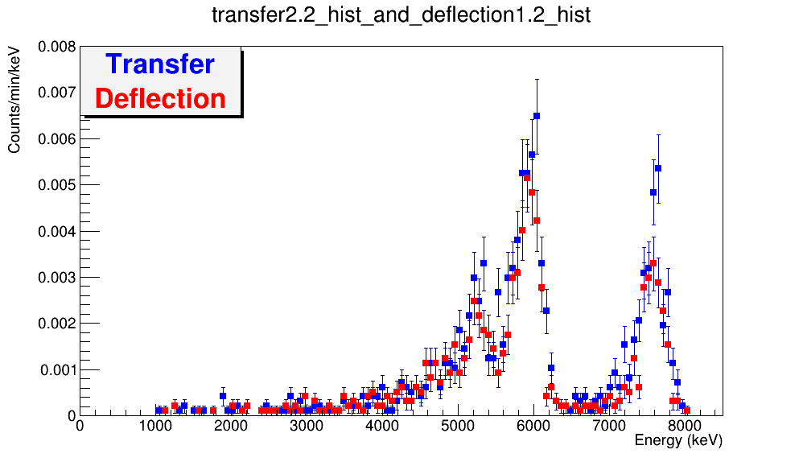
Notes:
Transfer 330 756
Deflection 296 531
+/- like 20-30

Slide 20
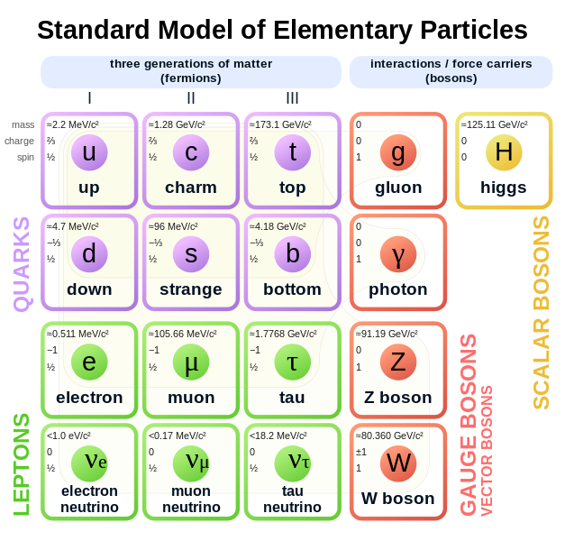
Neutrinos – why study them?
MissMJ (Wikimedia)
Neutrinos oscillate between flavours: hence they must have mass
Major blow to otherwise splendid Standard Model (where they are massless)
Investigate neutrinos further – e.g. how much mass exactly?
Notes:
The story starts with neutrinos, which are interesting things because despite the standard model predicting them to be massless, we recently discovered that they exhibit flavour oscillations and thus have mass. Which raises the question, how much mass exactly? What else are they hiding?

Slide 21
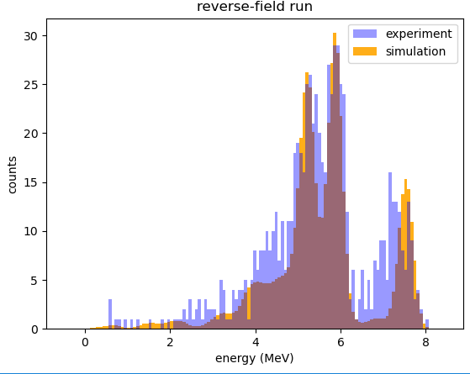
[INCOMPLETE]
Reversed field: ions in the field are swept away instead of towards the pips, so we shouldn't see monoenergetic po218/214 - but we still do? Make manual adjustments to understand the discrepancy
Left to right: po210, po218, po214 (rn222 is almost washed out)
Show simulational and experimental results
Compare, explain differences
Reverse, deflection, transfer field conditions
Experimental results made us realise we need to account for Po210 too
Future work
This is already too long...

Slide 22
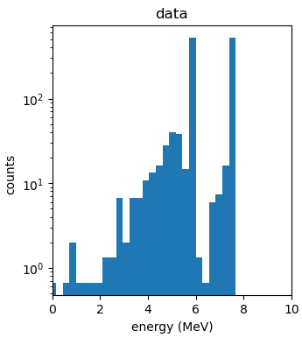
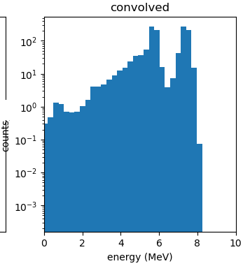
Simulation results
5 kBq source, data collected over one day. Solve rate equations to get number of decay events for each species
Putting this in simulation gives the following energy spectrum
Polonium stuck to PIPS contributes large monoenergetic peaks
Detector has a spread of 0.475 MeV

Slide 23
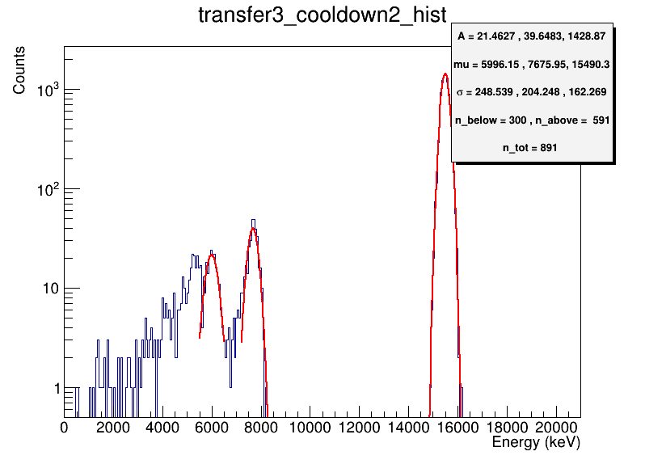
Observations
Observed Polonium counts: 300, 600
Expected: 700, 700
Unaccounted factors:
  Radon plate-out
  Polonium gets neutralized after formation
  Ion collection efficiency of the field is not perfect
  Po-214 may be fed by Pb/Bi atoms
Next steps in progress:
  Use scintillation produced by the decay radiation for a better understanding

Slide 24
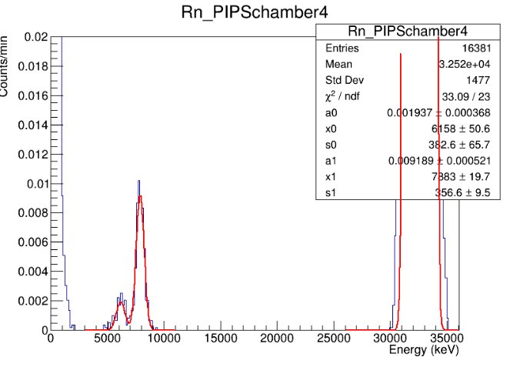
Observations
Observed Polonium counts: 100, 450
Expected: 1500, 1500
Possible reasons:
  Polonium gets neutralized after formation
  Ion collection efficiency of the field is not perfect
  Po-214 may be fed by Pb/Bi atoms
Next steps in progress:
  Use scintillation produced by the decay radiation for a better understanding

