Slide 1
Guide-coating facility for the TUCAN EDM experiment
2024 Canadian Association of Physicists Congress
Abeer Zahra
University of Manitoba, Canada
Supervisor: Dr. Russell Mammei

Slide 2

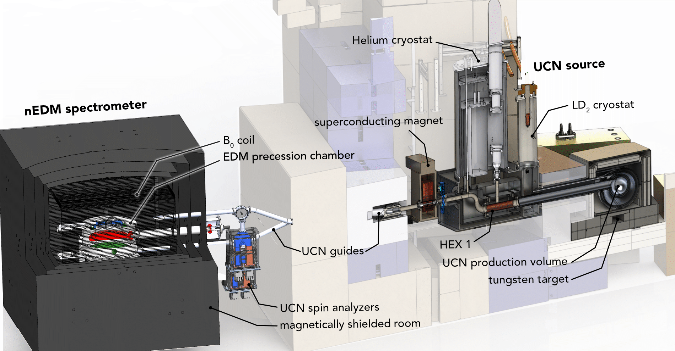
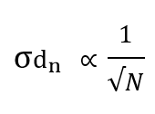
TUCAN EDM experiment
They transport UCNs from the source to the experimental set-up
Statistical Uncertainty:

Slide 3
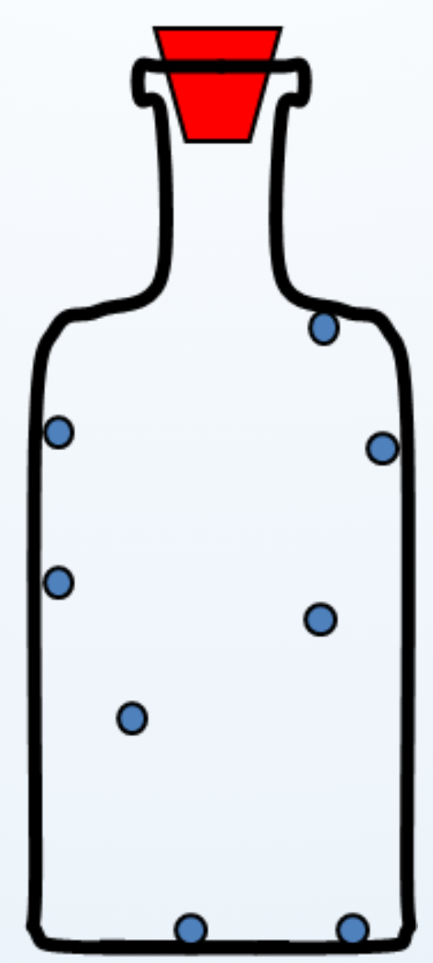
Ultracold Neutrons (UCN)
Neutrons that are moving so slowly that they bounce off surfaces and can be bottled.
Ultracold neutrons (UCNs) have very low energies, below 300 neV. At such low energies, they are affected by magnetic, gravitational, and material potentials-strong force, that can be achieved in a laboratory environment.
– v < 8 m/s = 30 km/h
– T < 4 mK (−273.15 °C)
– K.E. < 300 neV

Slide 4
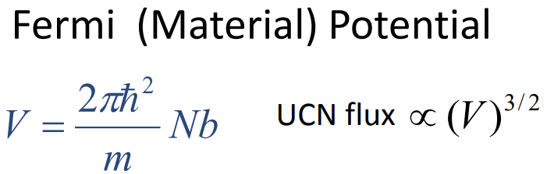
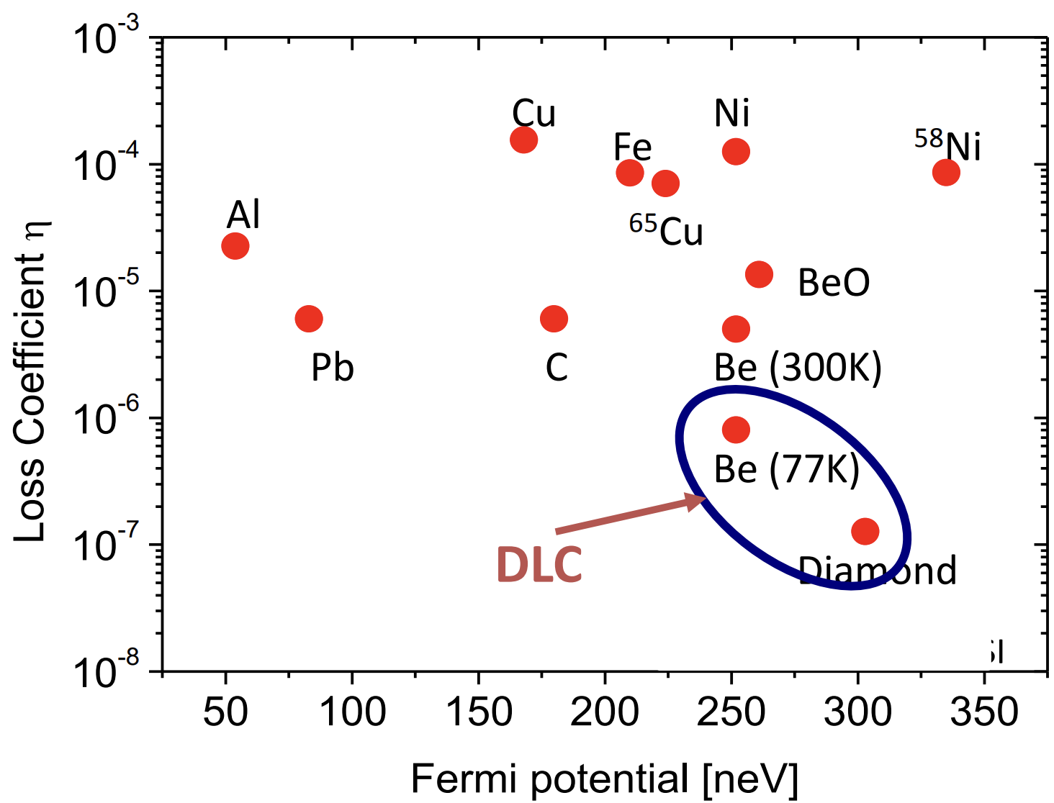
Graph of loss per bounce versus fermi potential
where,
V- Fermi potential
m- mass of the neutron
N- No. density of nuclei of material (no. ofnnuclei/unit vol.)
b- scattering length (strength of interaction between neutron & material nuclei
UCN flux- No. of UCNs/unit area/unit time
Notes:
B’coz of N- DLC so high

Slide 5
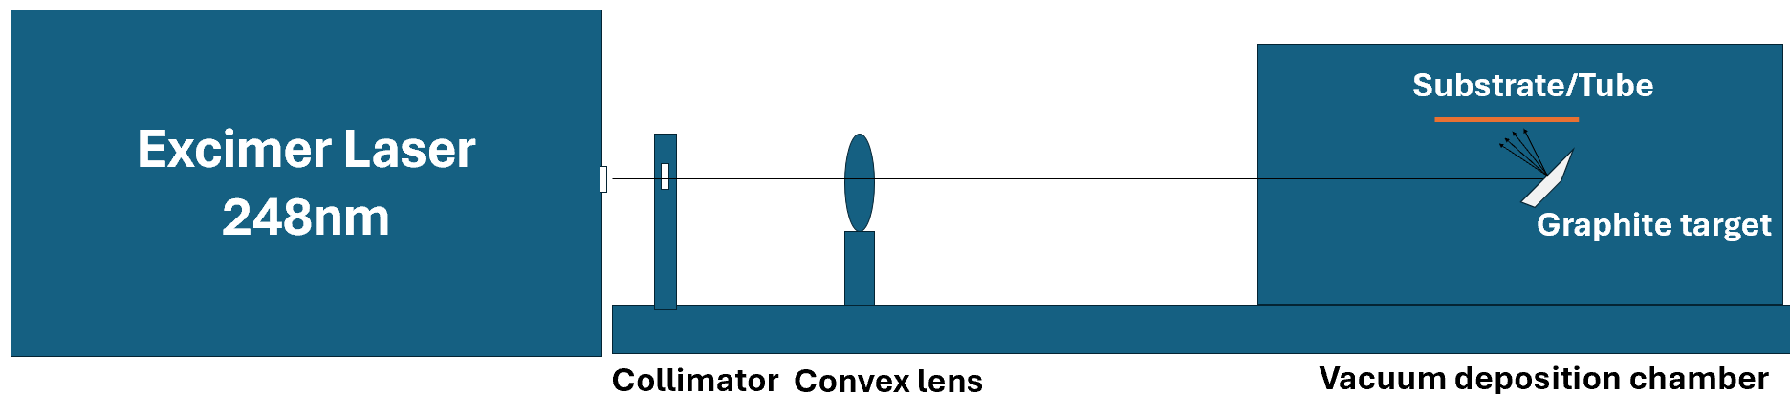
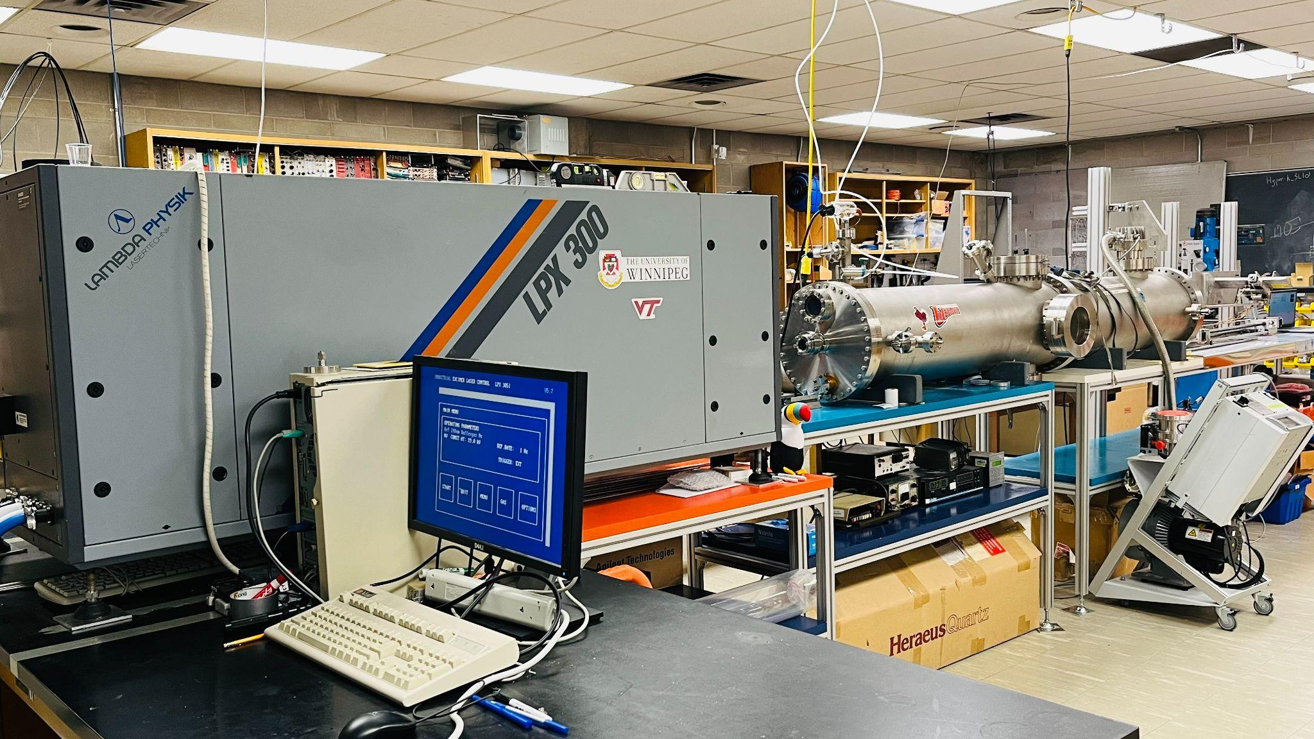
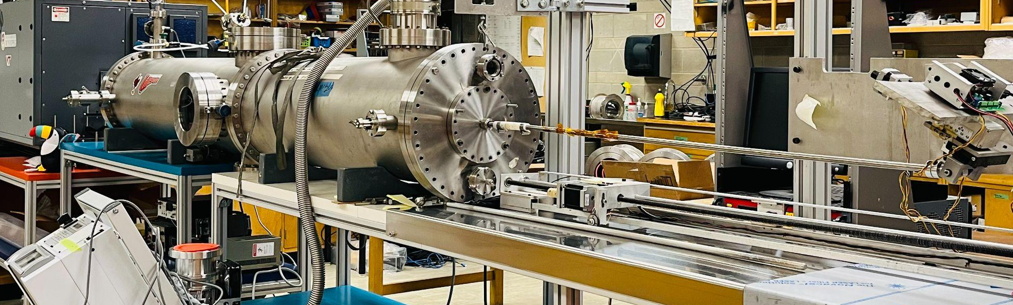
Pulsed Laser Deposition Facility at University of Winnipeg

Slide 6
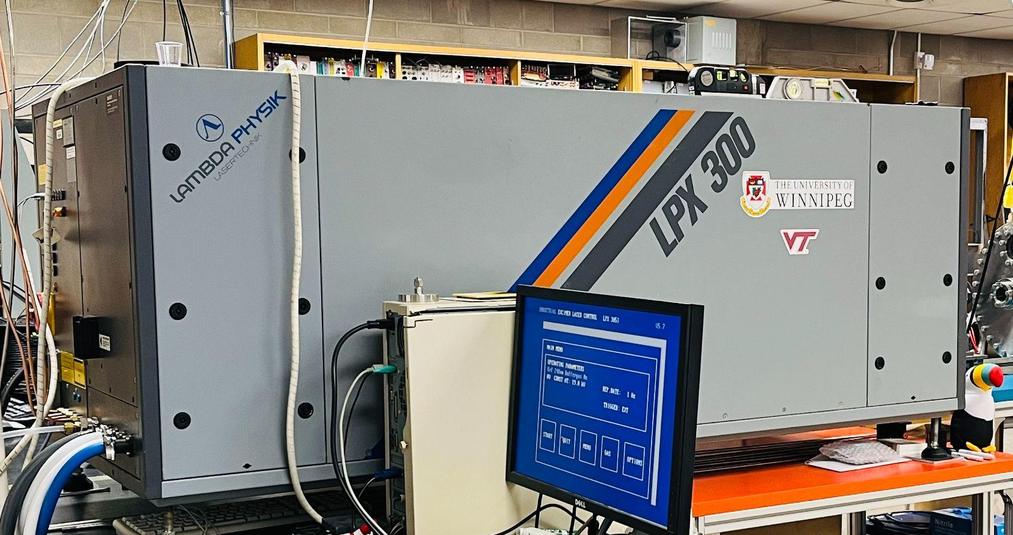
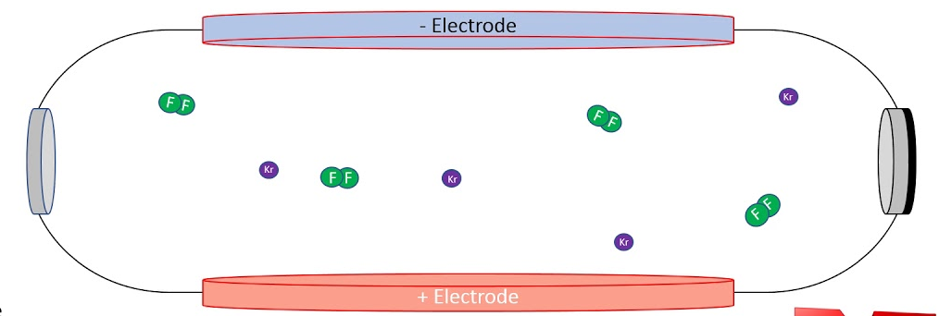
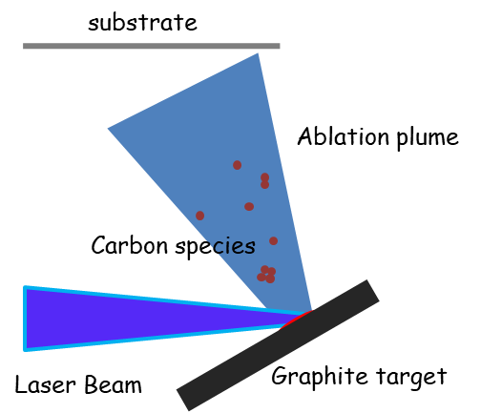
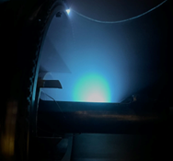
Excimer laser 248nm
-HV discharge creates meta-stable KrF dimer.
-A KrF dimer relaxes, emitting a UV photon which stimulates the other dimers to emit a UV photo too.
-Produces ~1J/pulse of 248 nm light.
Real carbon plasma plume
Notes:
krf dimer operate 248nm, produce 1j/pulse

Slide 7
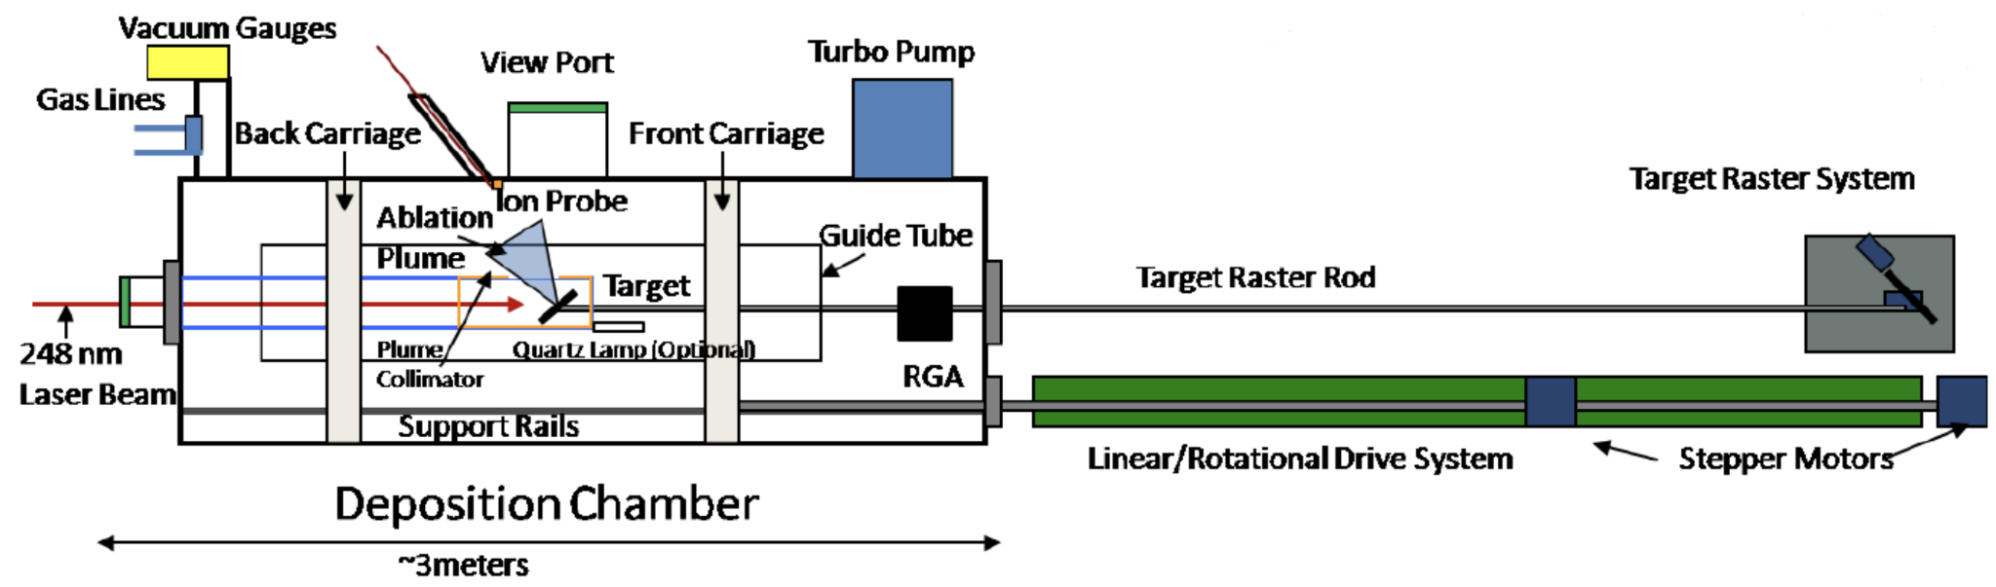
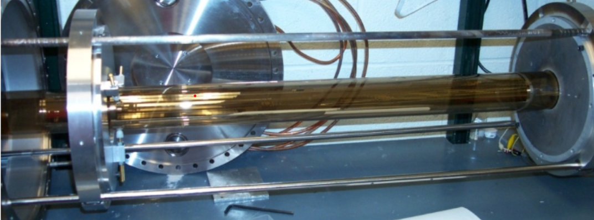
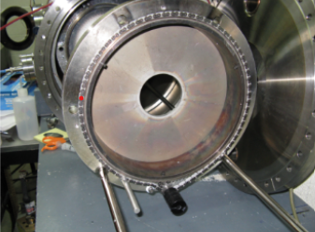
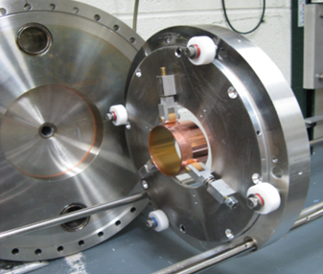
Tube coating chamber
Translation: linear bearings/shafts
Rotation: Chain driven rotational bearing
Carriage system
Front carriage
Back carriage

Slide 8
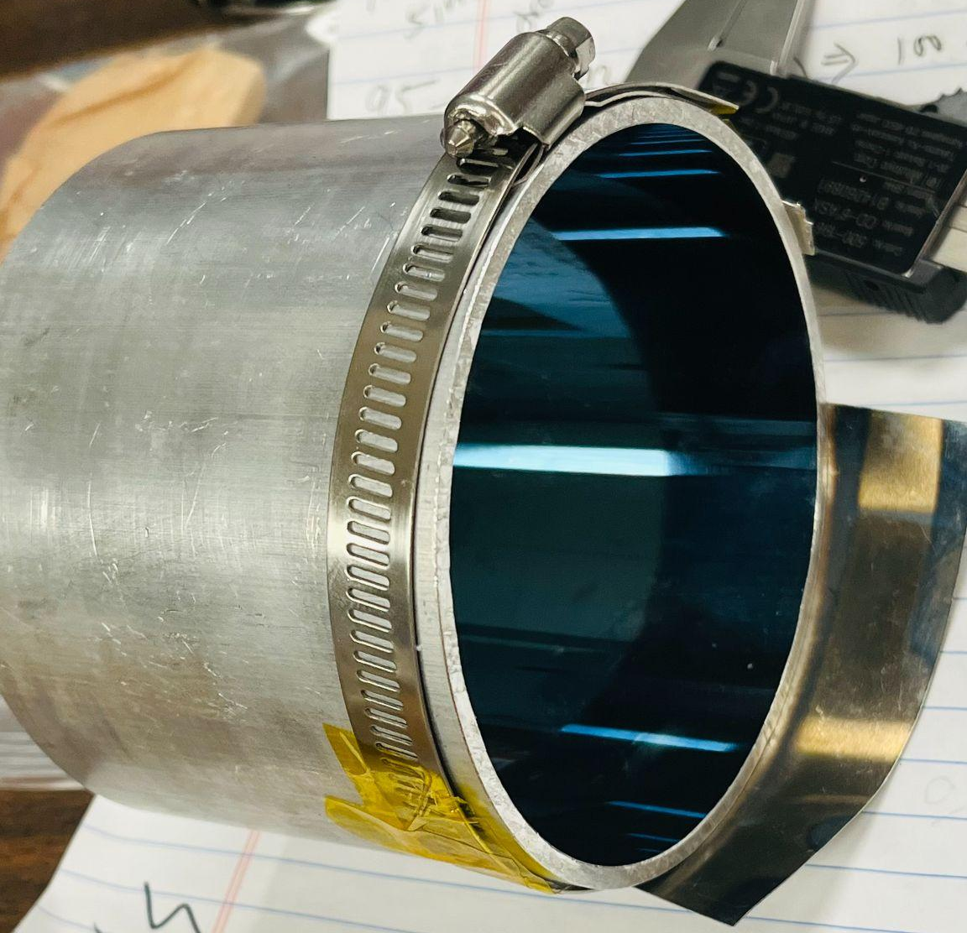
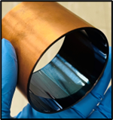
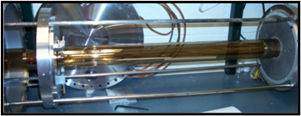
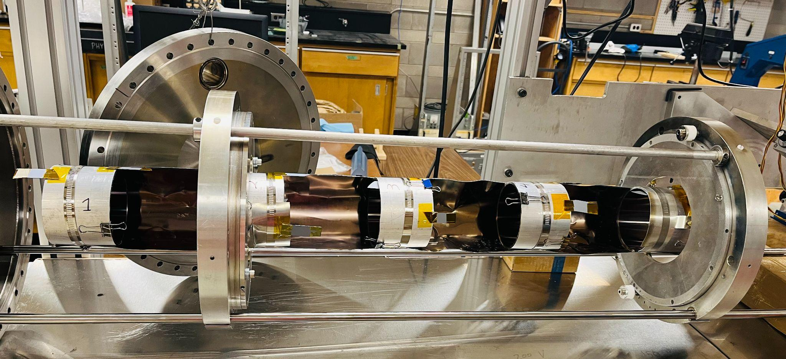
Some DLC coated samples
Various parts that can be coated:
Tubes | ~1”-9” inner diameters/ ~1m long
Rods | ¼ and ½” outer diameters/ ~1m long
Plates | ~5” discs to (30” dia. a year from now)
Aluminum (left) and Copper (right) DLC-coated samples
1 m long DLC coated quartz tube
Train of DLC-coated Al tubes
Notes:
Use si witness stip as use as quality control etc

Slide 9
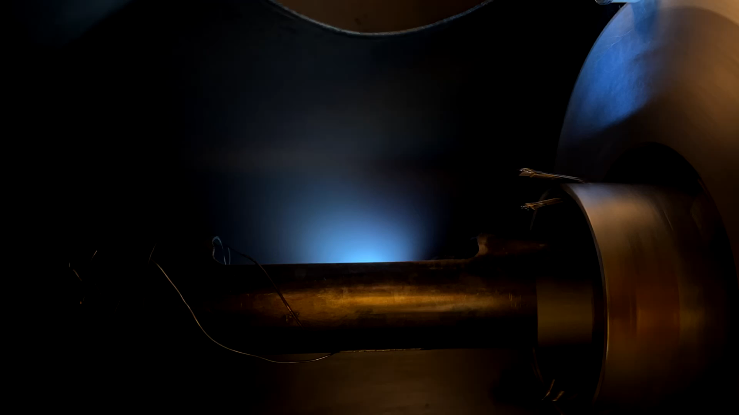
Video of DLC coating- Al tube

Slide 10
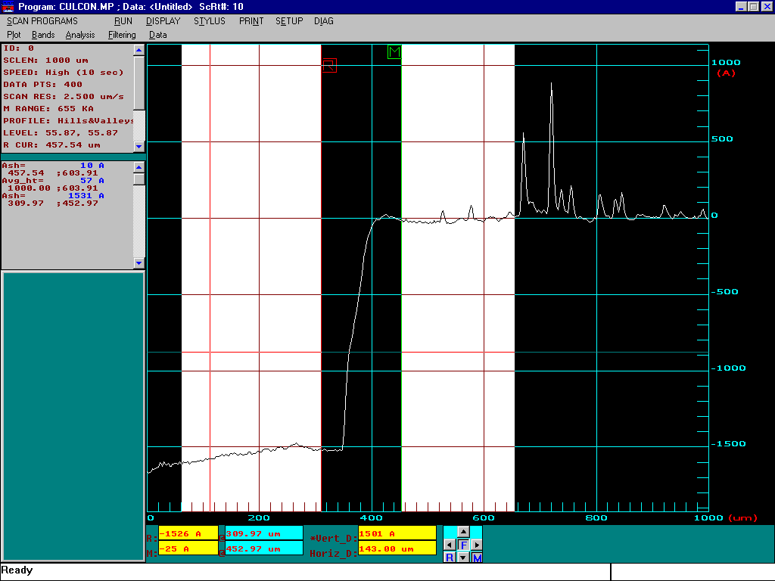
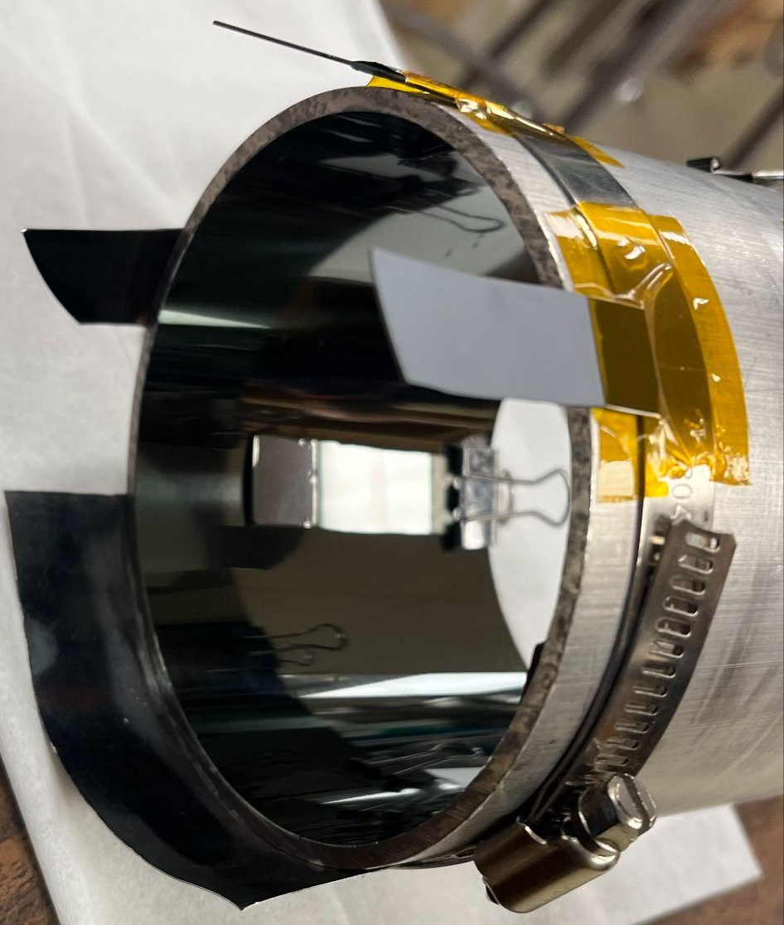
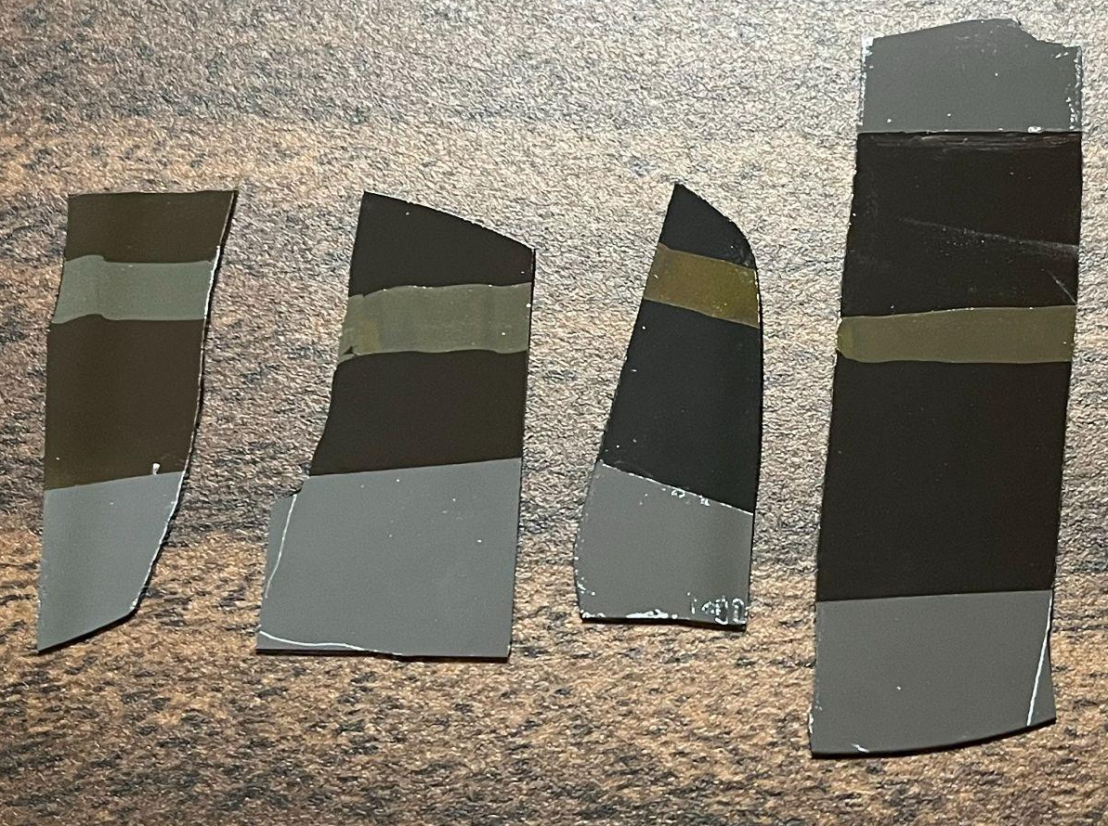
Coating analysis
Film Property | Surface Science Technique
Thickness | Profilometry, Ellipsometry, Depth profiles
Density/Fermi Potential | SANS, XPS, XRR
Elemental composition | XPS, SEM-EDS
Surface roughness | AFM, 2D profilometry
Step height measurement
-We use a stylus profilometer to measure the thickness and surface roughness of the DLC coatings accurately.
-The TUCAN EDM experiment needs DLC films that are > 150 nm.
-Basheer Algohi will be talking XPS analysis on tuesday in the poster session
Si witness strip along each tube
Notes:
SEM- EDS (Energy Dispersive Spectroscopy)
XPS- X-ray Photoelectron spectroscopy
AFM- Atomic Force Microscopy
XRR (X-ray Reflectometry)
SANS (small-angle neutron scattering)

Slide 11
Status and Future
-2024 Summer —Optimize DLC on Aluminum:
Multilayer coating: Chromium (Cr) then DLC- for better adhesion, vary laser energy on target (spot size and laser energy), collimate parts of the ablation plume, etc.
-Fall 2024: produced several 1 m long DLC coated tubes.
-Winter/Spring 2024: Test with UCN at JPARC or TRIUMF.
-Goal to be in UCN Guide production for TRIUMF in 2025.

Slide 12
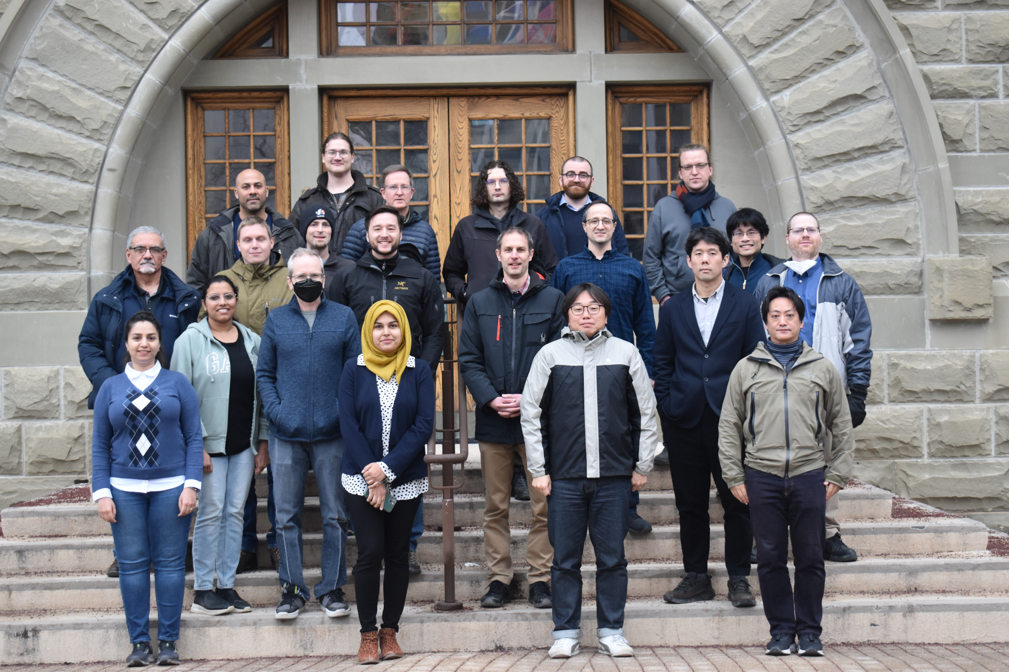
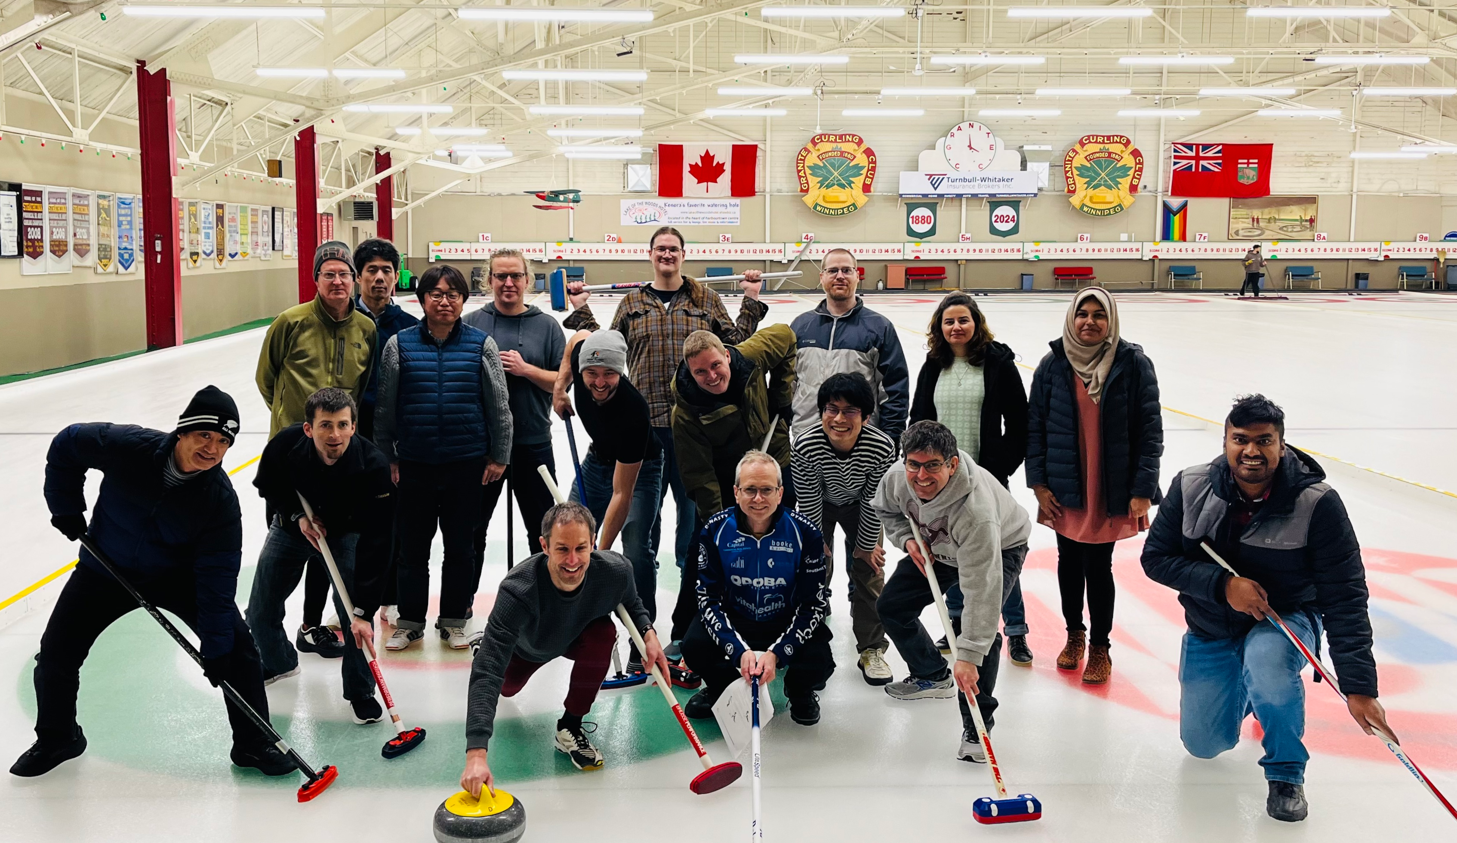
Collaboration meeting at University of Winnipeg, Feb 2024

Slide 13


Guide Coating Facility is open for Collaboration and providing coatings for your experiment-
Russell Mammei:
r.mammei@uwinnipeg.ca
Abeer Zahra:
zahraa@myumanitoba.ca
Thank you!

Slide 15
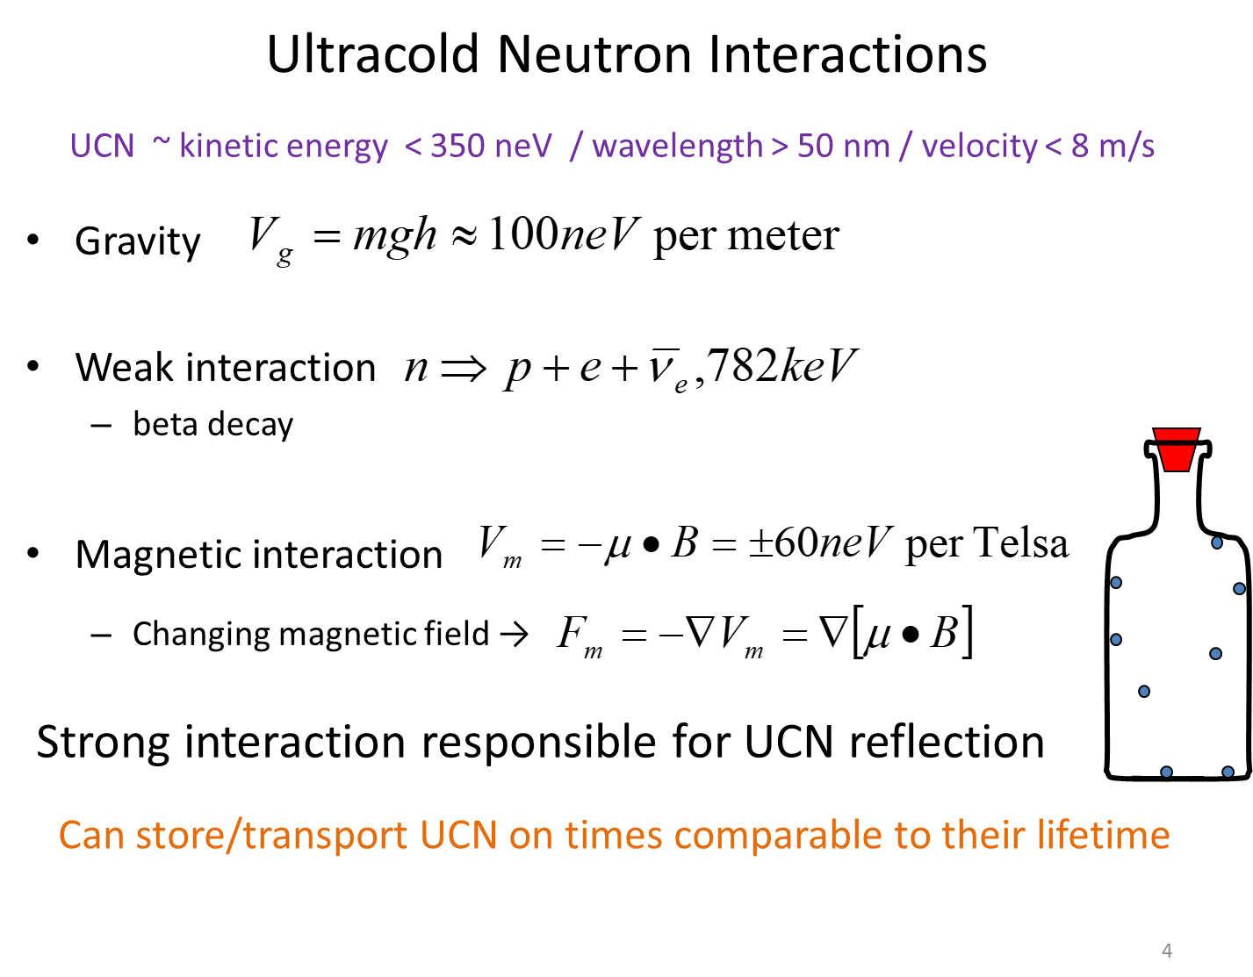
Residual gas analyzer
Notes:
More density-aim.

Slide 16
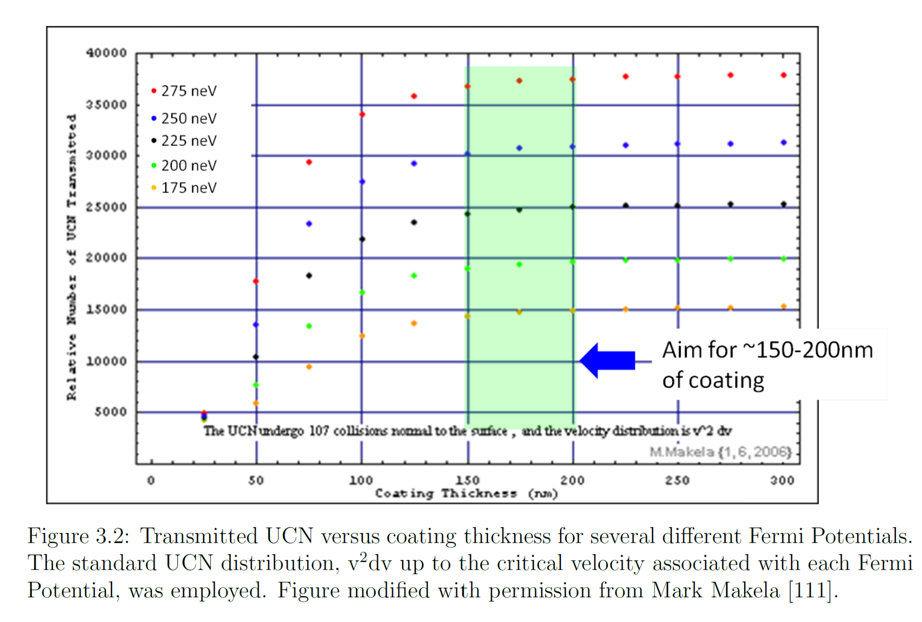
The TUCAN EDM experiment needs DLC films that are > 150 nm.
From 1st yr quantum mechanics:
UCNs have very low kinetic energy, so they are very sensitive to potential barriers. DLC coating acts like a potential barrier.
DLC thickness greater than 150 nm ensures-
-Neutrons don't tunnel through the barrier (keeping more neutrons contained)
-The potential barrier is high enough to keep the neutrons trapped.
Notes:
at 150nm-zero transmission of a potential barrier shows that we need atleast 150nm

