Slide 1



Measurement of SiPM External Crosstalk in a LXe Detector
David Gallacher
PhD Candidate – Brunner Neutrino Lab
McGill University
2024 CAP Congress - May 27th
Notes:
Notes from local group practice:
Finished in 11, spend more time on slides 8,9 and 10 explaining figures
Update plot on slide 4 to only show relevant curves for the plot, make sure line styles are bold to emphasize

Slide 2
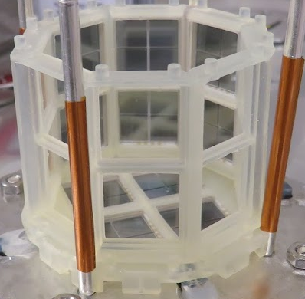
LXe detectors & SiPMs
Liquid Xenon (LXe) is a scintillating material that produces ultraviolet light from radiation interactions
Silicon photomultipliers (SiPMs) are solid-state single-photon counting sensors
We use SiPMs to count photons from radiation in LXe to perform a proportional energy measurement
Fig: Hamamatsu VUV4 Packages in LoLX detector during installation

Slide 3
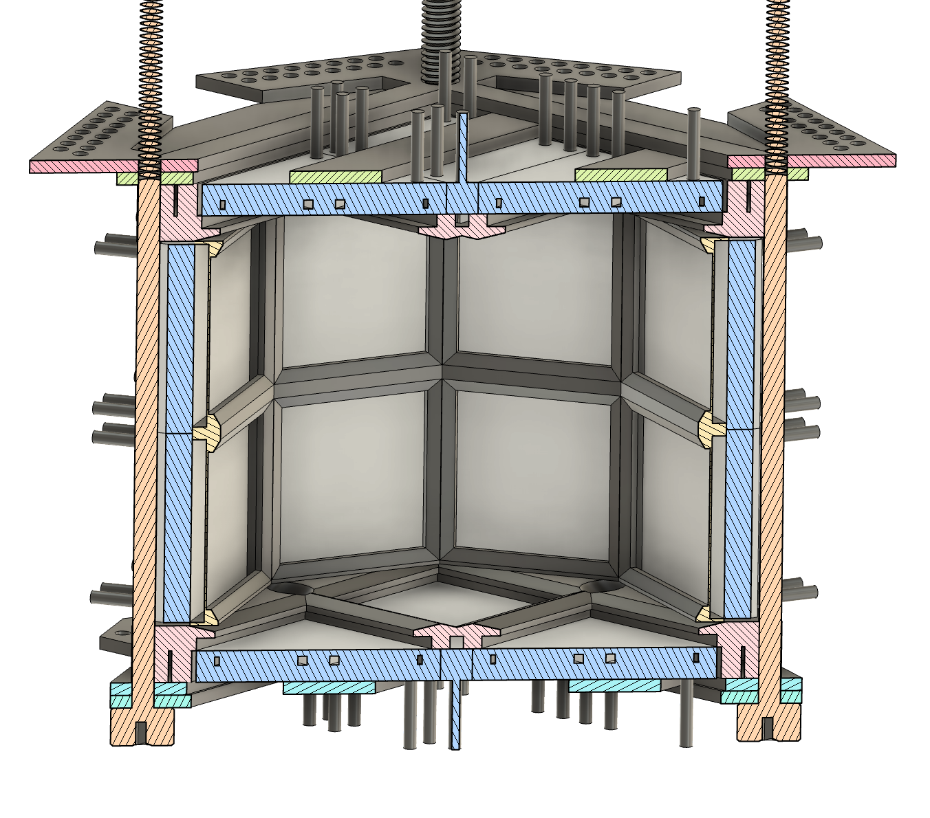
Sr90/Y90 Decay
Light only Liquid Xenon (LoLX) is a modular small-scale LXe experiment
  📍 McGill University
Two experimental phases to date:
  Phase-1 – This Talk
  Phase-2 (See Alex Li’s Talk [M2-1-3:00])
Phase-1 employed 96 Hamamatsu SiPMs in an octagonal prism geometry
  Equipped with a ⁹⁰Sr beta source needle
~4 cm
Fig: Cross-section of LoLX Phase-1 Detector

Slide 4
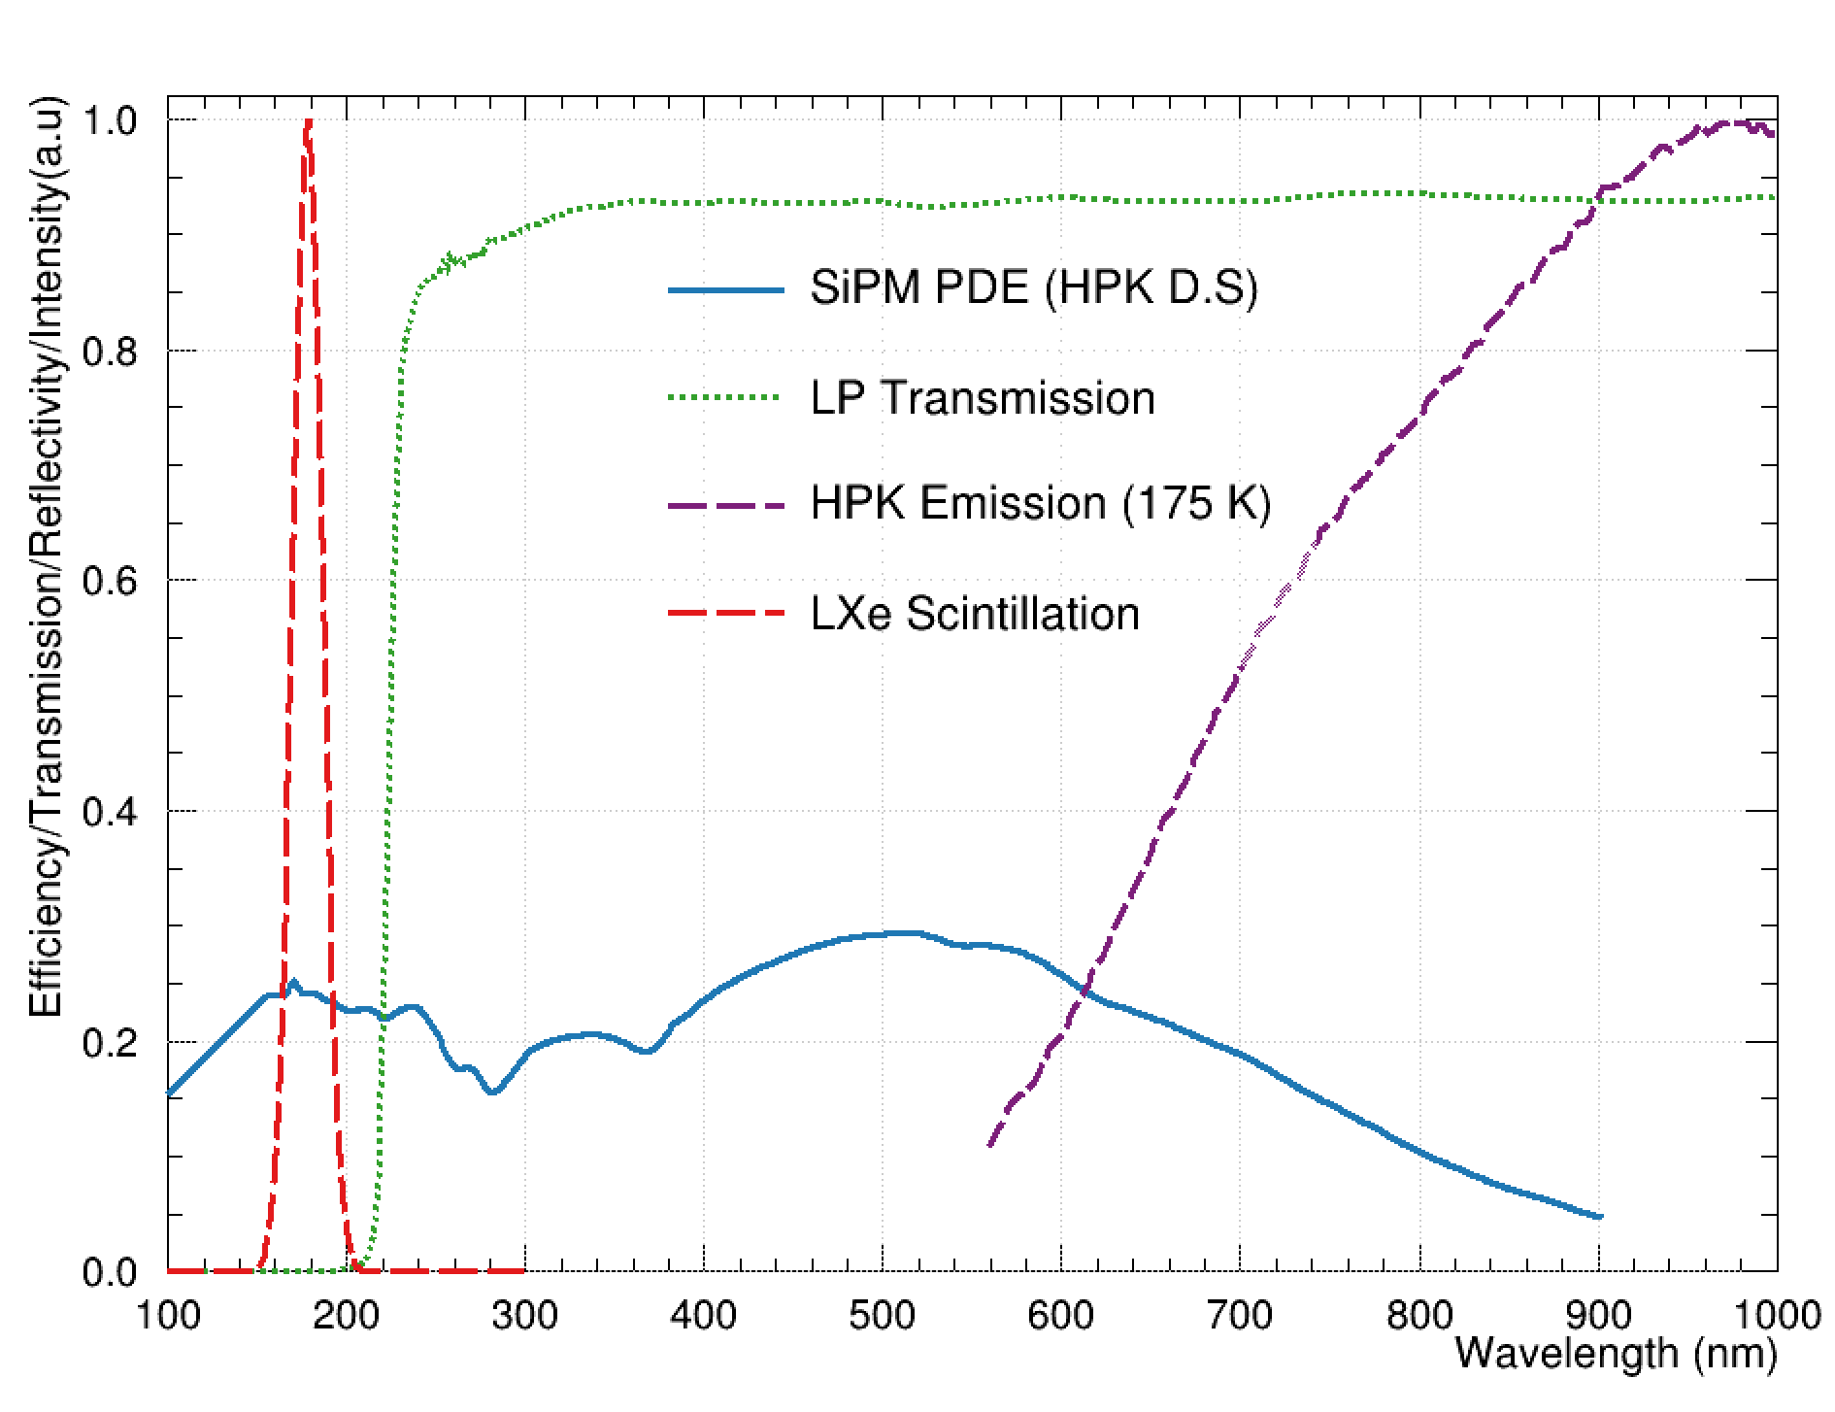
SiPMs are grouped in packages of 4
23/24 packages are covered by optical filters
  22x >220 nm longpass filters
  1x 175 nm bandpass filter
Filters separate LXe scintillation from SiPM External Crosstalk
Fig: Overview of wavelength-dependent optical properties in LoLX

Slide 5



SiPM External Crosstalk
Legend
⁹⁰Sr Needle
Longpass Filter
Bandpass Filter
Unfiltered
Initial Photon
eXT Photon
During the SiPM detection process near-infrared (NIR) photons are produced
These photons may escape the SiPM and be detected elsewhere
  Known as SiPM External Crosstalk or ExCT
This is a source of correlated avalanches (CA)
Our goals:
  Characterize SiPM ExCT in a LXe detector
  Create a simulation model of ExCT to predict impact on future LXe detectors
*Not to scale

Slide 6
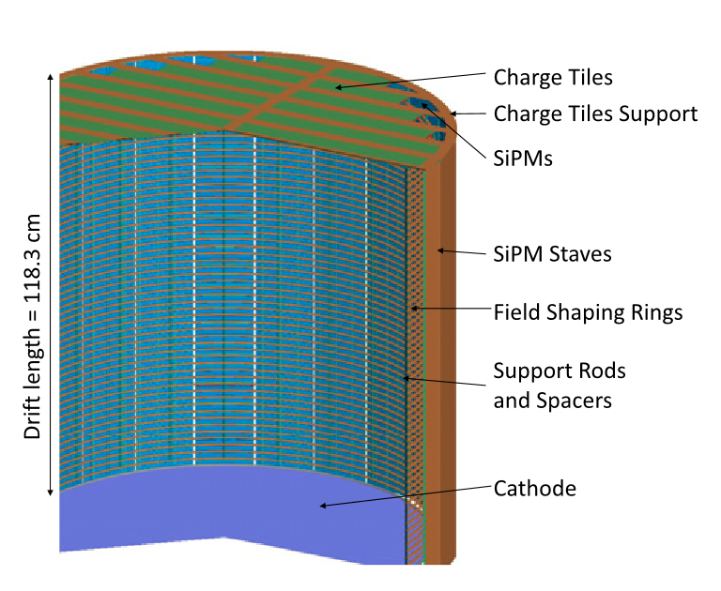
What’s the impact?
Next generation rare event search experiments will use large quantities of SiPMs
  Neutrino-less double beta decay (nEXO)
  Dark Matter (ARGO/DS20K)
Cylindrical geometries enhance ExCT impact
Need to evaluate the impact of SiPM ExCT on energy resolution, threshold and position reconstruction
Fig: Rendering of nEXO TPC design, SiPM barrel faces inward with ~50k devices

Slide 7


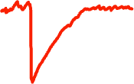

Measuring SiPM ExCT with LoLX
Intensity
Search Window
To measure SiPM ExCT we look at time
Signature of ExCT is two pulses in time coincidence from two different channels
We look late in the event window for correlated delayed pulses
Time
Source Channel
eXT Source
Candidate
Target
Channel
Coincidence Window

Slide 8
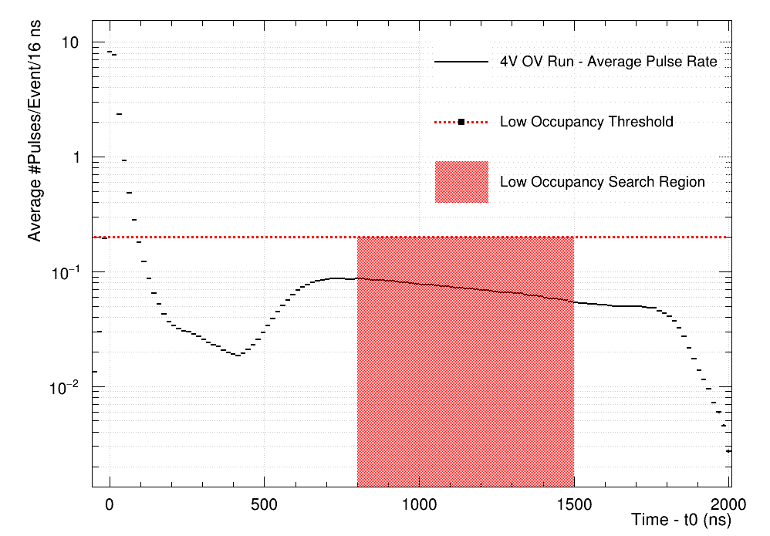
Measuring SiPM ExCT with LoLX
To measure SiPM ExCT we look at time
Signature of ExCT is two pulses in time coincidence from two different channels
We look late in the event window for correlated delayed pulses
PRELIMINARY
Fig: Occupancy for all channels in LoLX, search window is [800,1500 ns] post trigger

Slide 9
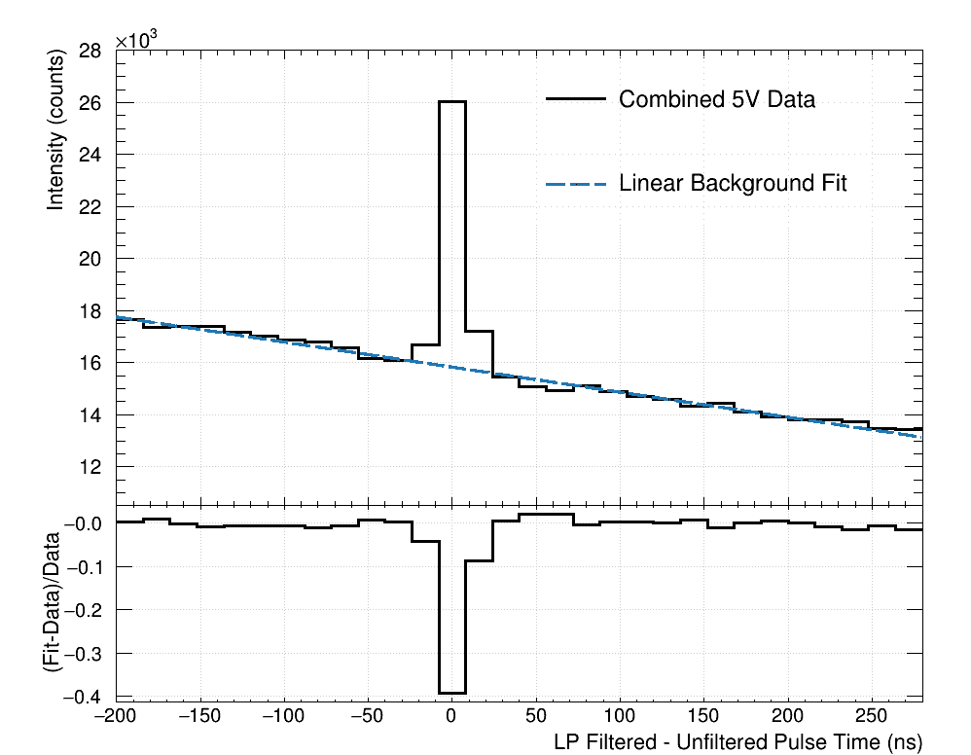
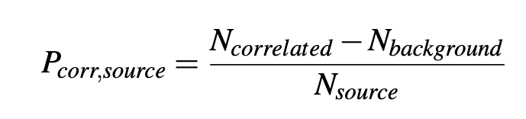
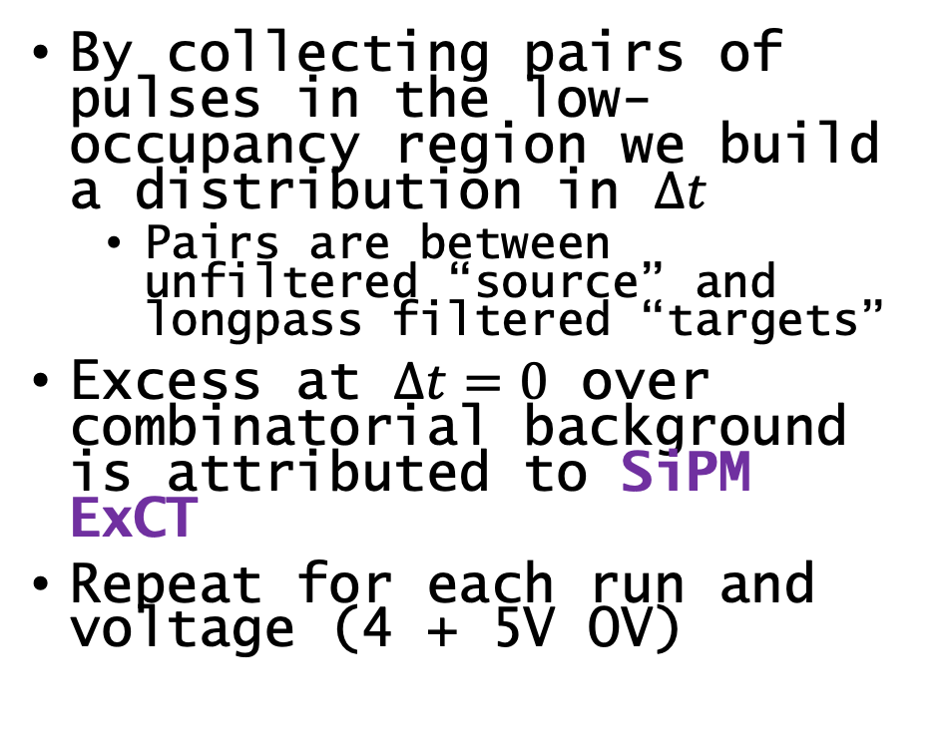
How do we see ExCT?
By collecting pairs of pulses in the low-occupancy region we build a distribution in $∆t$
  Pairs are between unfiltered “source” and longpass filtered “targets”
Excess at $∆t=0$ over combinatorial background is attributed to SiPM ExCT
Repeat for each run and voltage (4 + 5V OV)
PRELIMINARY
Fig: Fit to summed delta-time distribution for all 5V data summed

Slide 10
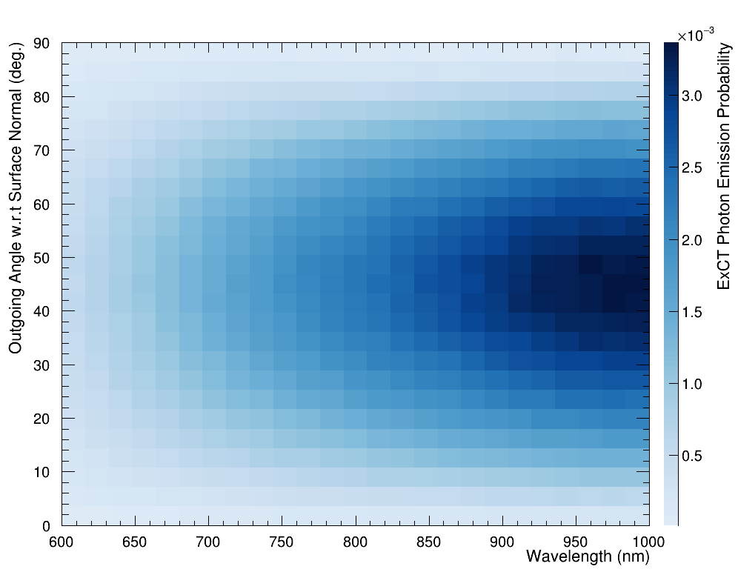
ExCT simulation model
Simulations of SiPM ExCT carried out using custom GEANT4 physics extensions
Similar implementation to fluorescence in GEANT4
  For each “detected” photon, we trigger ExCT process and produce photons to track through detector
Photons are produced “at source” (Within Silicon) with a “Mean emission intensity”
  ~97% of photons produced in Si do not escape the SiPM
  Using input from TRIUMF measurements of ExCT and detailed SPAD simulations†
  Randomly sample each photon property and determine if it escapes
Distribution of escaping ExCT photons shown to the right
PRELIMINARY
Fig: Distribution of simulated emitted ExCT photons, normalized to proportion
of emitted photons in the outgoing hemisphere (2π)
† K. Raymond et. al. 2024 (2402.09634)

Slide 11
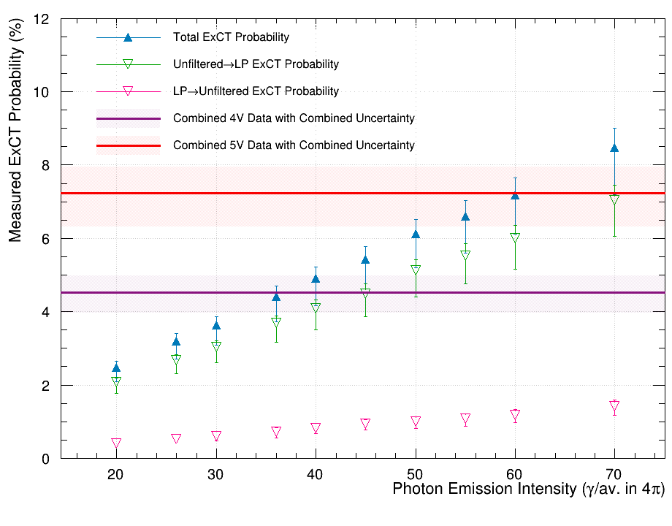
What do we see?
First sweep over simulated ExCT intensities
  Mean # of Photons/Avalanche (#ph/av.)
Compare the measured ExCT yield with simulation results
  Interpolate simulation curve for #ph/av. produced at each voltage
Determine #ph/av. emitted from simulations
PRELIMINARY

Slide 12
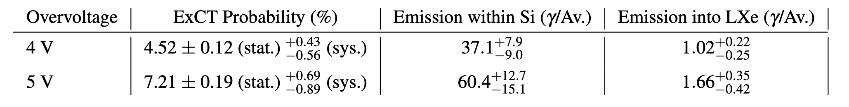
What do we see?
PRELIMINARY
Probabilities are for detecting ExCT from any unfiltered to any longpass filtered channel in LoLX
Emission reported as internal (before escaping) and external (transmitted into LXe)
Systematic uncertainties dominate over statistical at ~10% from data and ~20% from simulations
Ex-situ measurements reported values 39.2 +/- 9.3 ph/av. and 1.23 +/- 0.43 in LXe†
† K. Raymond et. al. 2024 (2402.09634)

Slide 13
Outlook and next steps
Manuscript for this work is nearing completion, keep an eye out soon!
Building on the simulation method here, we will evaluate the impact of SiPM ExCT for nEXO
Follow up measurements with faster timing and angular dependence planned in LoLX Phase-2
SiPM ExCT measured directly in a LXe detector
Developed a GEANT4 simulation method for characterizing ExCT
Good agreement between simulation and data with nominal inputs
Measurement of ExCT emission intensity are within uncertainty of ex-situ measurements†
† K. Raymond et. al. 2024 (2402.09634)

Slide 14






Thank you for your attention from the LoLX Collaboration!

Slide 15
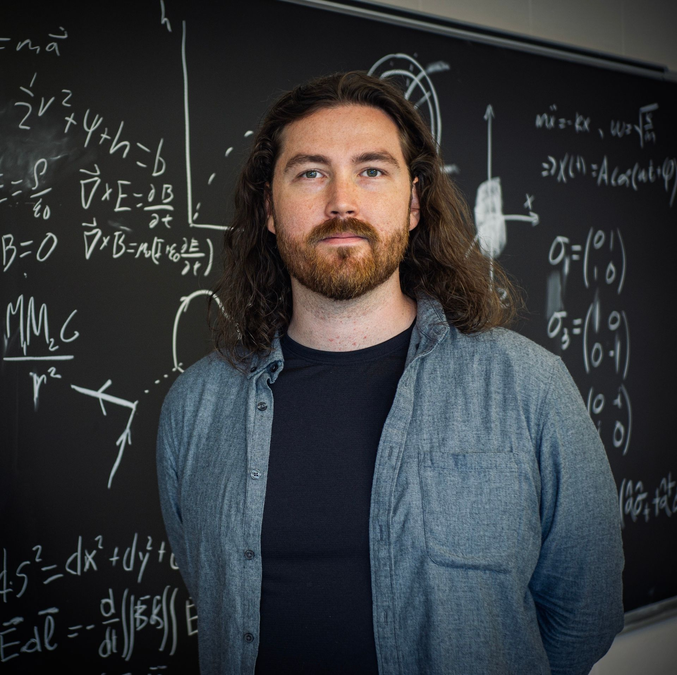


Questions?
How to find me:
DavidGallacherPhysics.com
Please reach out to get in touch!
David.Gallacher@mail.mcgill.ca

Slide 16
Backup slides

Slide 17
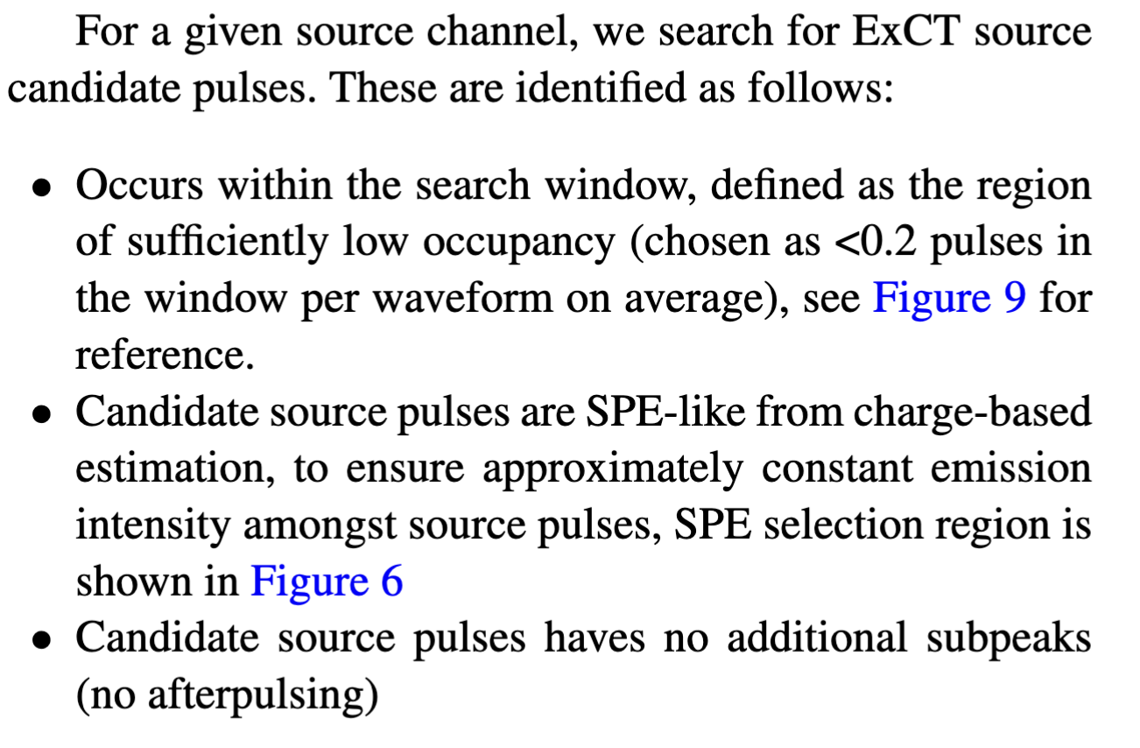
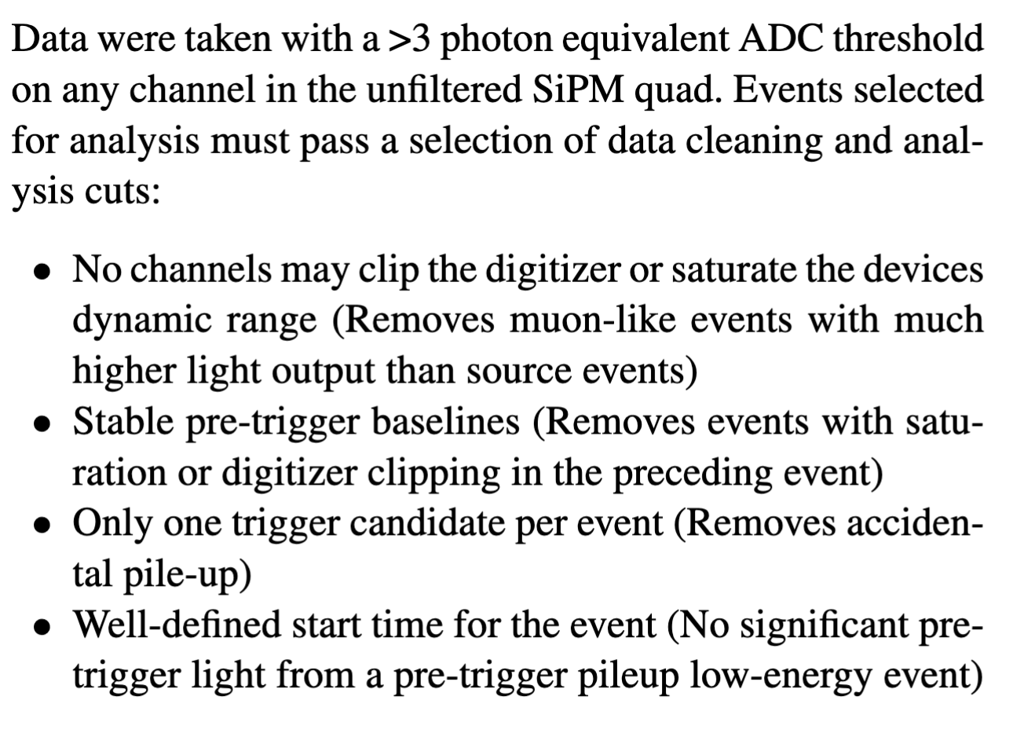
Backup – Event and Pulse Selection
Excerpts from paper draft (in Review, preliminary)

Slide 18
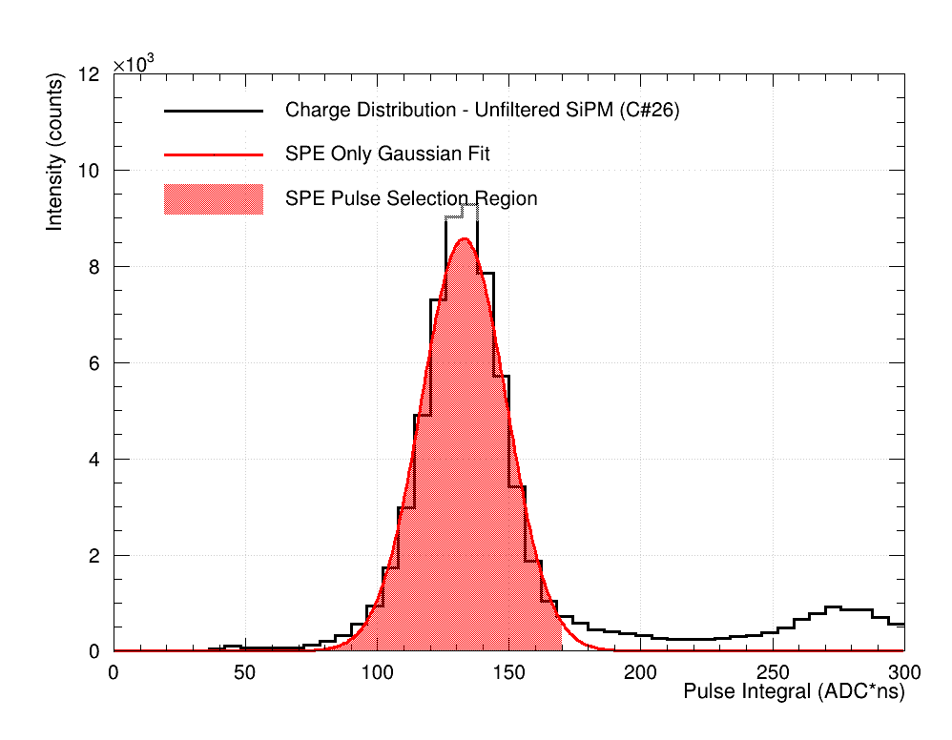
Backup – SPE Selection
Maximize our signal/background by using the Unfiltered SiPMs as the “Source” and 220 nm cutoff filtered channels as “Targets”
To ensure nominal ExCT intensity, we select SPE pulses for source candidates
SPE selection is done by gaussian fits to each channel with 90% acceptance region
No after-pulsing permitted

Slide 19
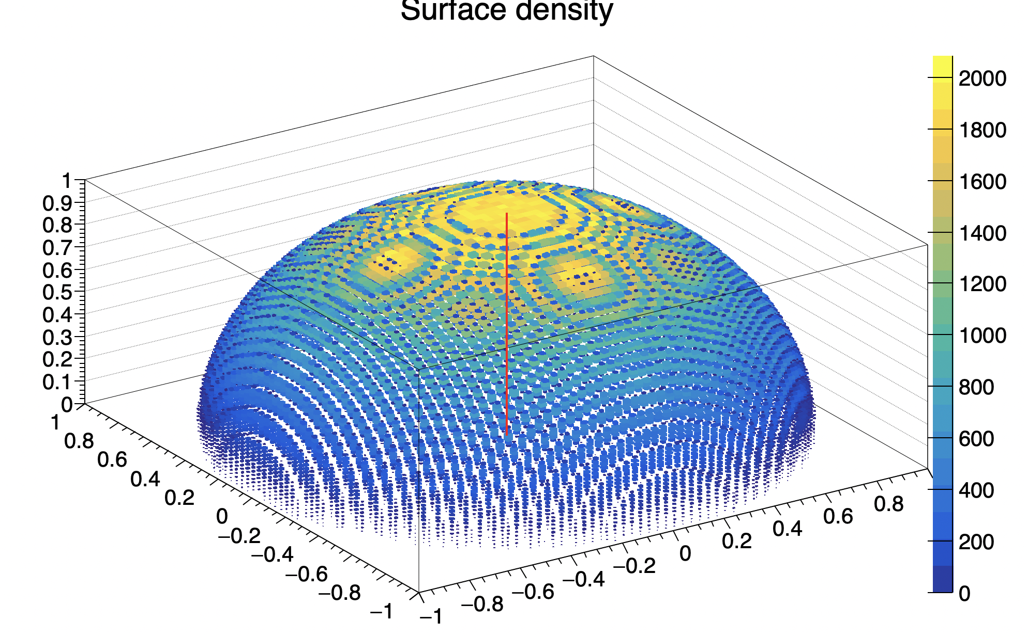
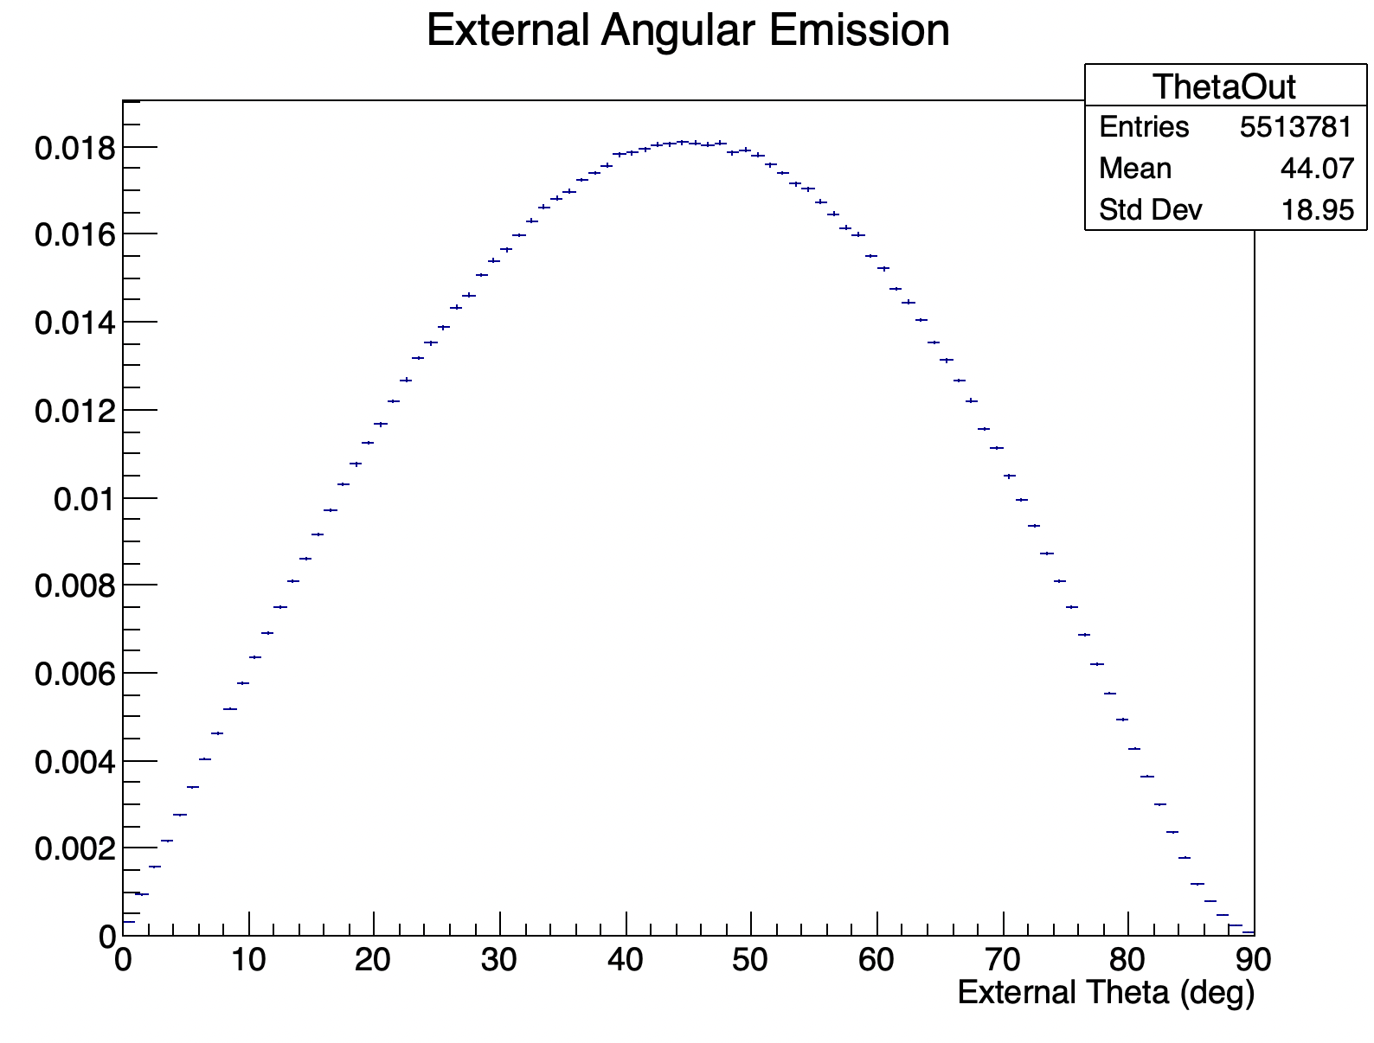
Backup – Simulation Details
Surface normal

Slide 20
Backup – LoLX outline
Legend
Top
Longpass Filter
Bandpass Filter
No Filter
Side
Bottom

Slide 21
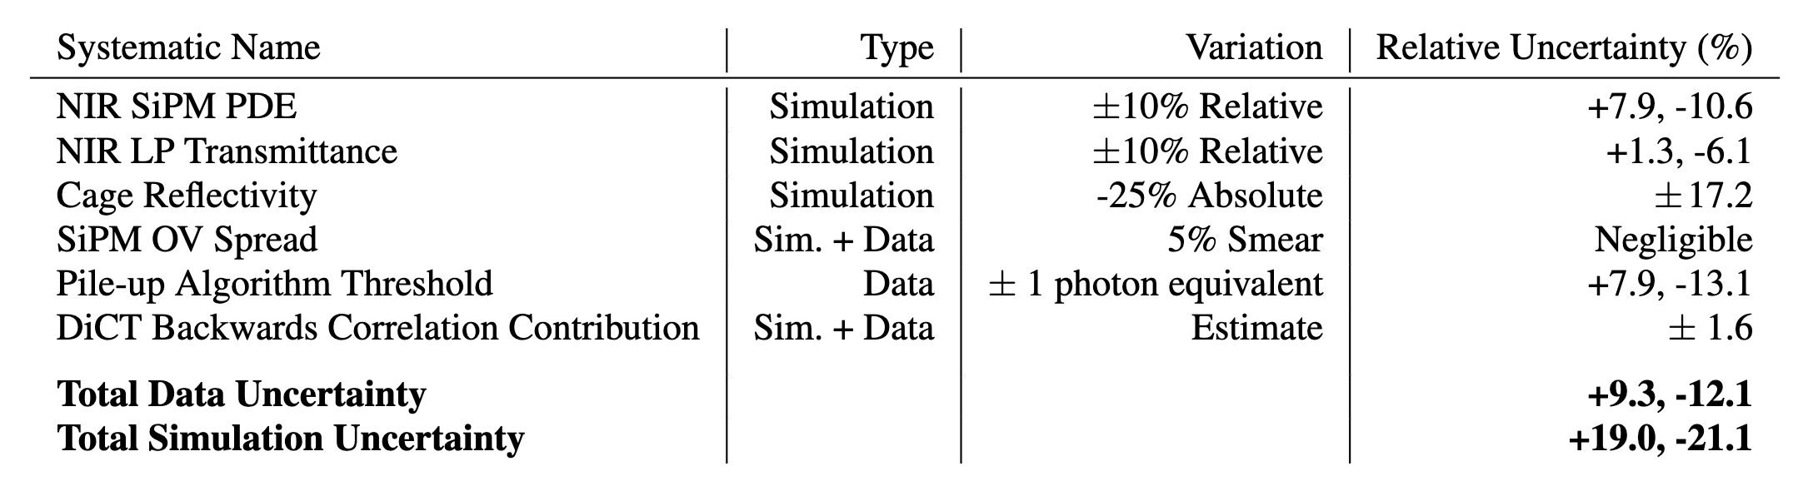
Backup – Systematic Budget

Slide 22
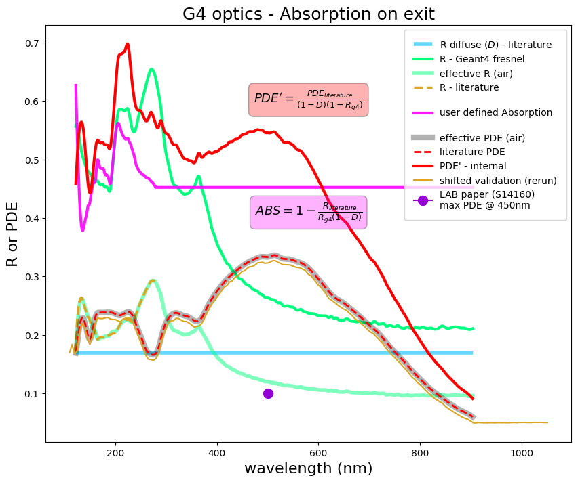
lolxsim: VUV4Volume
eXT photons generated in the gap to avoid doubling optics at boundaries(shift 0.2mm along surface normal)
Photons detected at Si boundary
Quartz Window (h= 0.5mm)
LXe
LXeBuffer (h= 0.05 mm)
2.5 mm
SiO2 (h= 110 nm)
5.9 mm
Ceramic
Silicon_SD (h= 0.05 mm)
*not to scale
15 mm

Slide 23
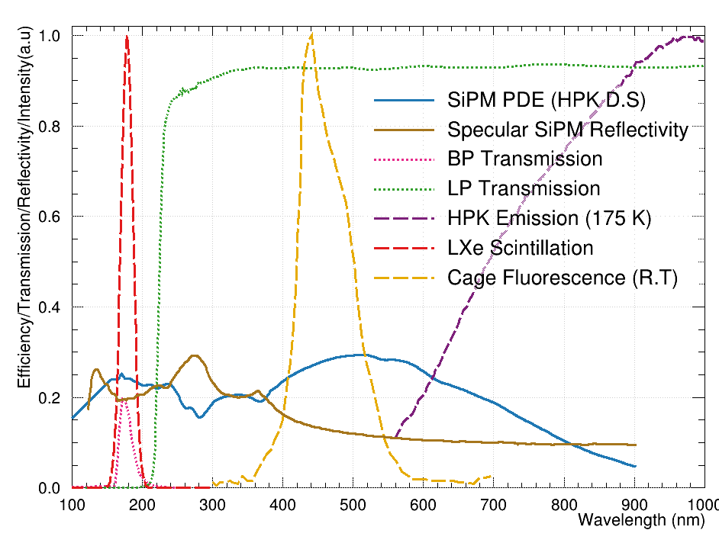
Backup

Slide 24
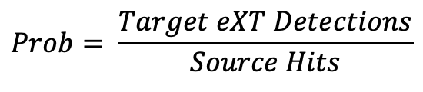
Backup- Simulation Details
Source
In our data measurements we measure “total correlation probability”
This includes “Direct” correlation
  Source->Target
Also includes “Backwards” correlation
  Target->Source
For simulations, we measure both independently
Source->Target
  Enable ExCT Simulation ONLY for source
Target->Source
  Enable ExCT Simulation for all EXCEPT source
Sum of two contributions is the “Total Correlation Probability”
From simulations we see roughly ~16% contribution of backwards correlation to total
  Stable across many simulation configurations, driven by solid-angles and transport efficiency + emission angular distribution
1
$$θ_{12}^{s}$$
$$θ_{12}^{t}$$
Target
2
$$Prob= \frac{Target eXT Detections}{Source Hits}$$
In simulation, we use the MC truth information, so estimates have no background

