Slide 1


The NEWS-G dark matter experiment: Shifting from LSM to SNOLAB data
Jean-Marie Coquillat
CAP conference, London ON
May 27th, 2024

Slide 2
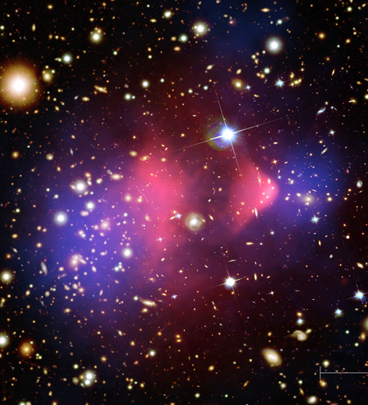
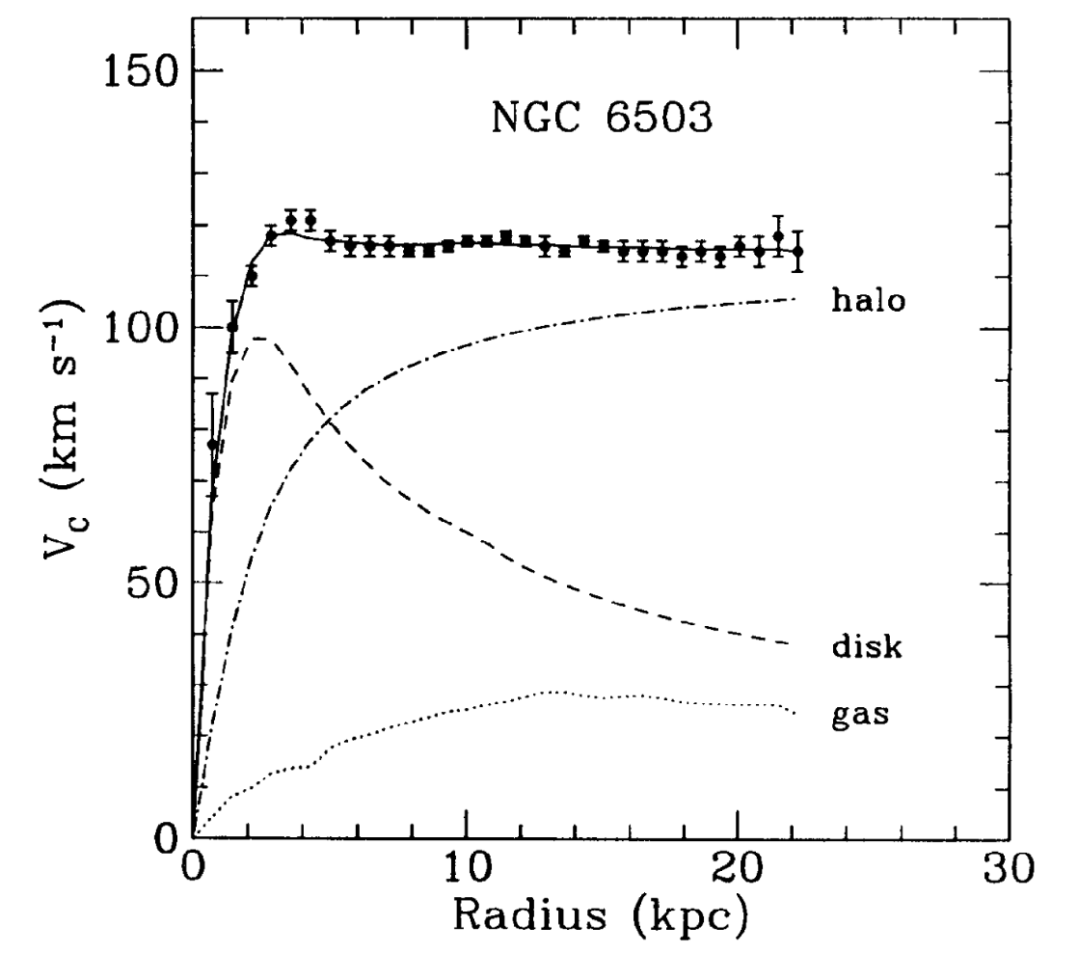
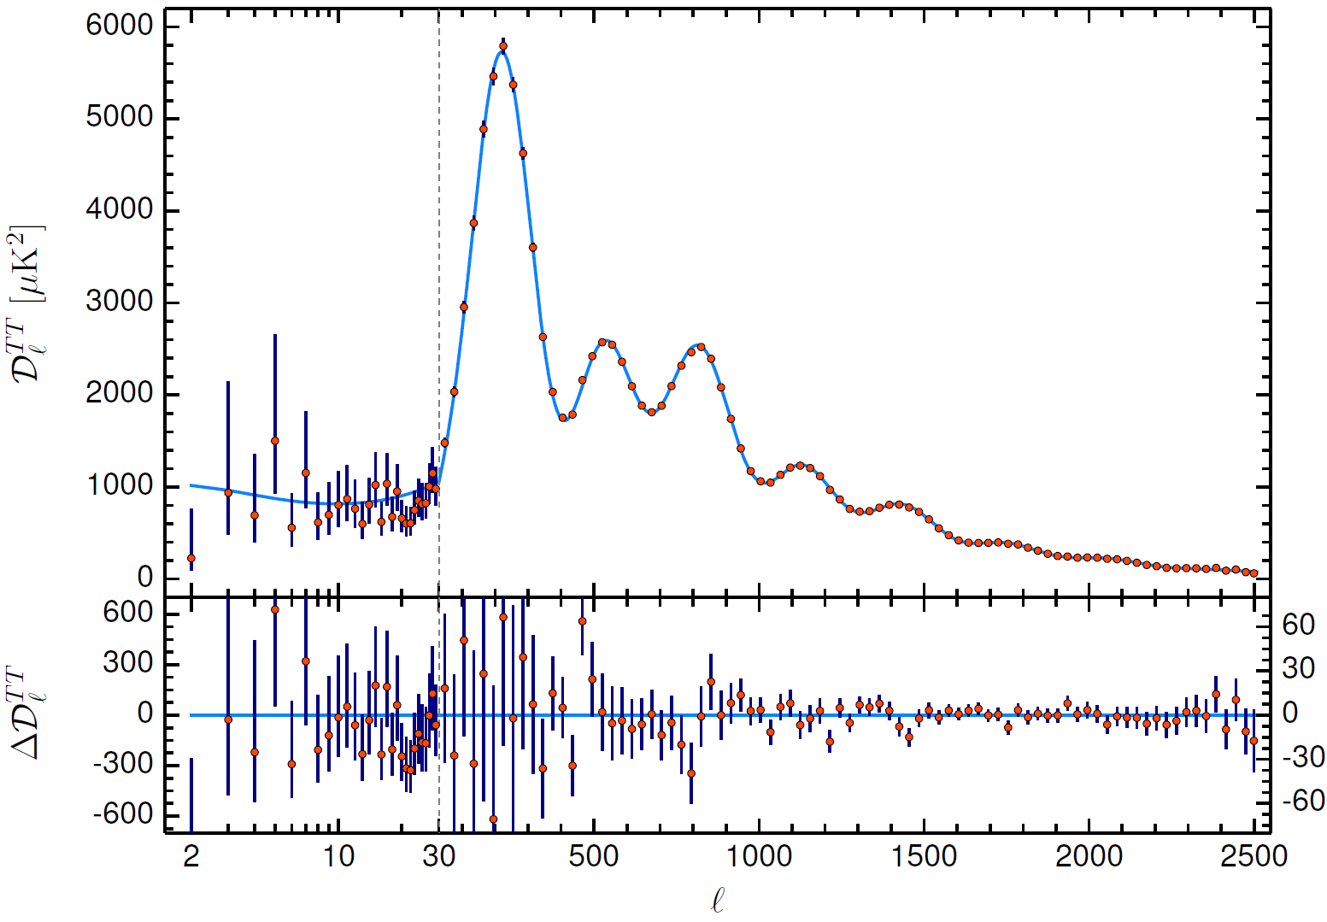
Dark matter theory
Dark matter (DM) evidence:
  First Zwicky (1933): Visible mass of galaxies much lower than expectation from virial theorem.
  Rotation curves have velocities stay higher than expected from Kepler’s 3rd law.
  Fits on the CMB show 85% of the Universe’s mass as non-baryonic matter
  Gravitational lensing shows the actual mass distribution of galaxies. Most of the Bullet cluster’s mass is invisible and less interacting.
2

Slide 3
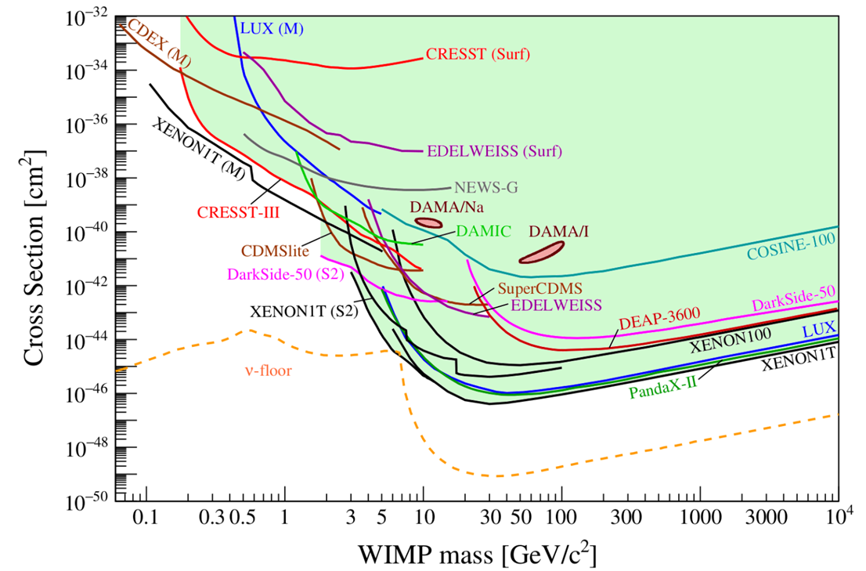
Low mass WIMP search motivation
Given the absence of canonical WIMPs, there is motivation to look at the parameter space left at lower masses (~0.1-1 GeV) for WIMP-like dark matter candidates.
arXiv:2104.07634 [hep-ex]
3

Slide 4
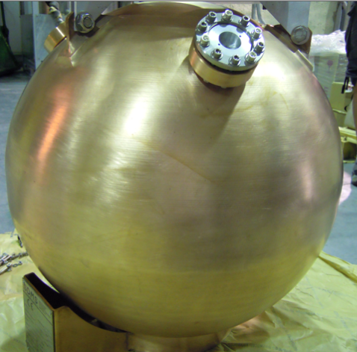
NEWS-G and SPCs
The SEDINE detector
The NEWS-G experiment uses spherical proportional counters (SPC) to search for low mass dark matter.
SPCs are metallic spheres filled with gas, with a central anode producing a radial electric field.
The last dark matter limits are from the SEDINE detector (60 cm diameter) at the Laboratoire Souterrain de Modane (LSM) in 2017.
The latest detector, S140, is a 140 cm of diameter copper sphere which took data at the LSM in 2019, before being shipped to SNOLAB where it is currently taking data since 2022.
doi: 10.1016/j.astropartphys.2017.10.009
4

Slide 5
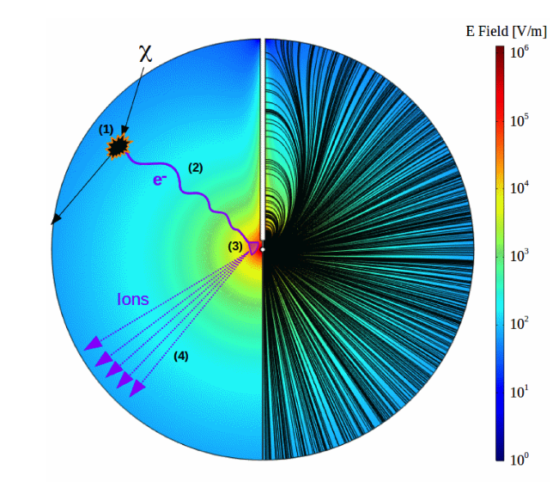
How an SPC works:
Atomic recoil causes ionization of the gas.
Primary electrons drift towards the central anode.
Townsend avalanche near the anode amplifies the signal.
Drifting secondary ions induce a current on the anode.
doi: 10.1016/j.nima.2019.162390
5

Slide 6
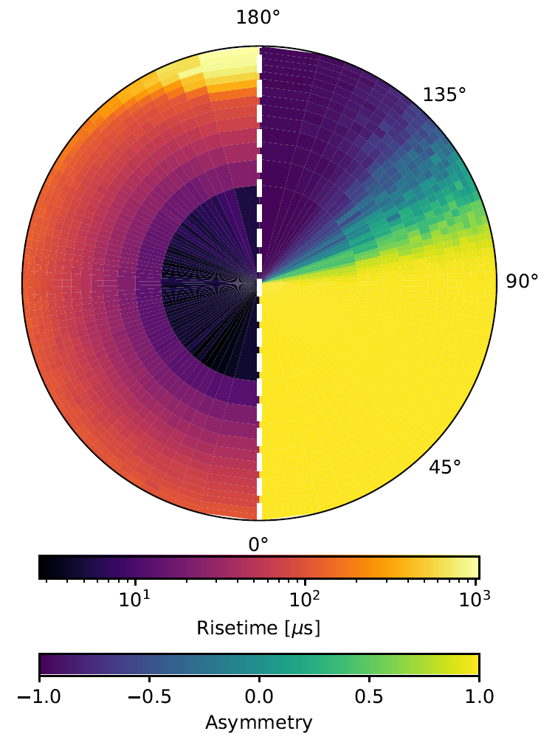
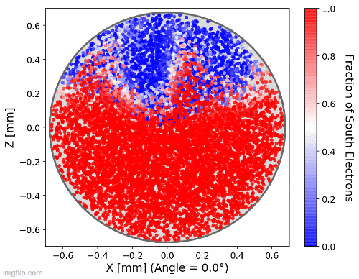
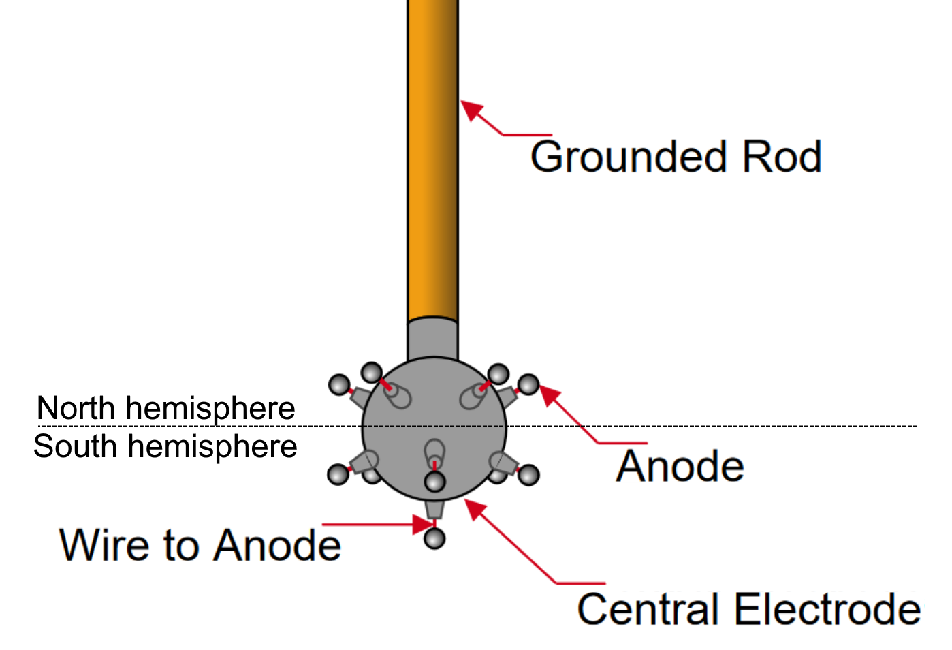
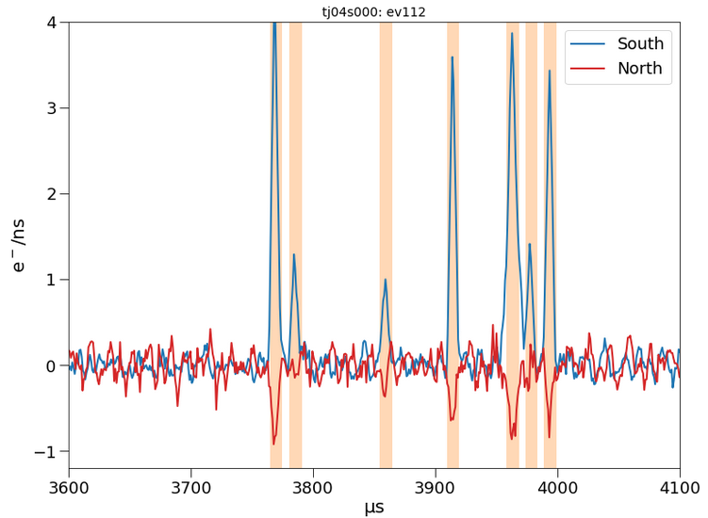
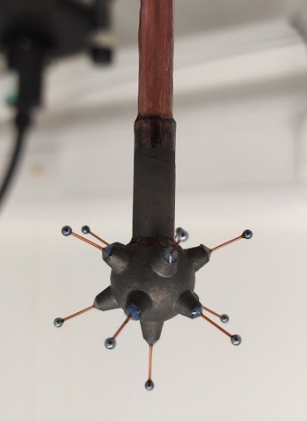
arXiv:2301.05183
Sensor (achinos)
NEWS-G now uses a multi-anode sensor that can achieve high gain while keeping a strong electric field at a high radius.
The sensor is divided in two channels connecting the anodes of each hemisphere.
A signal on one channel induces a negative signal on the other one (Shockley-Ramo effect).
About 2/3 of the volume leads to the south anodes, due to the effect of the rod on the electric field.
doi:10.1088/1742-6596/2156/1/012059
Only pure south events are kept as candidate events.
6

Slide 7
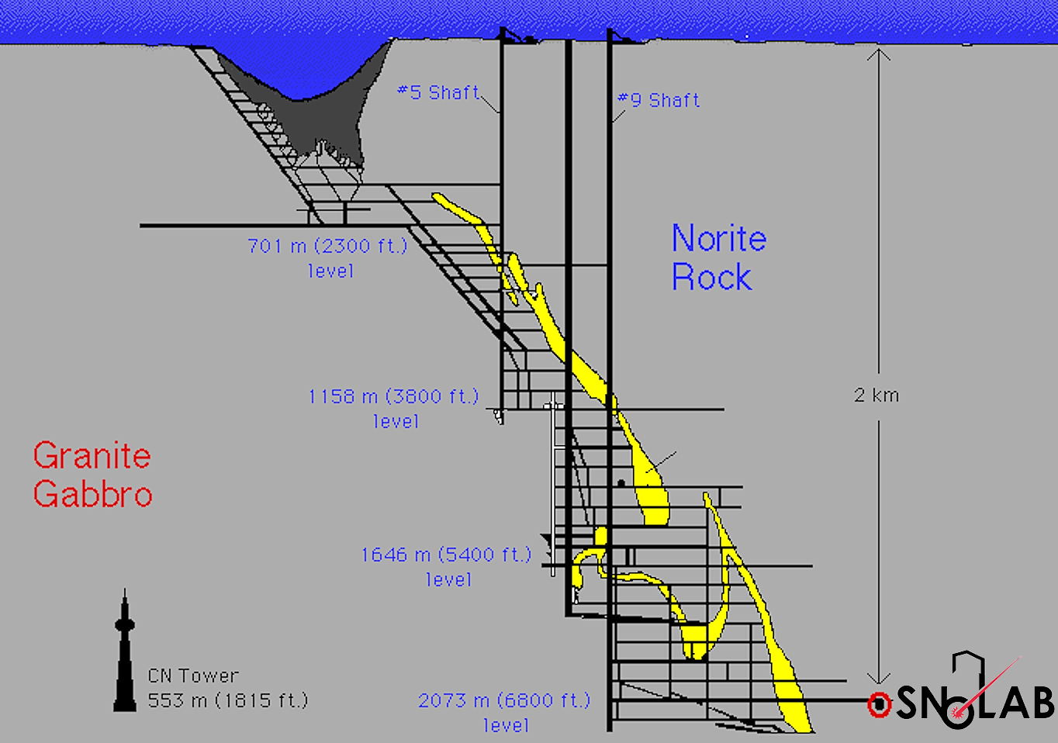
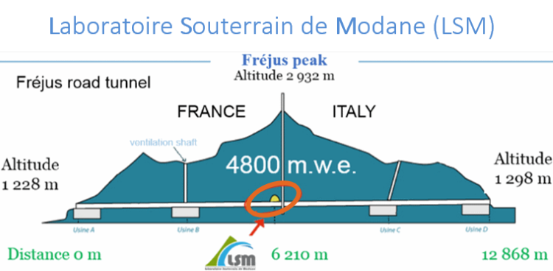
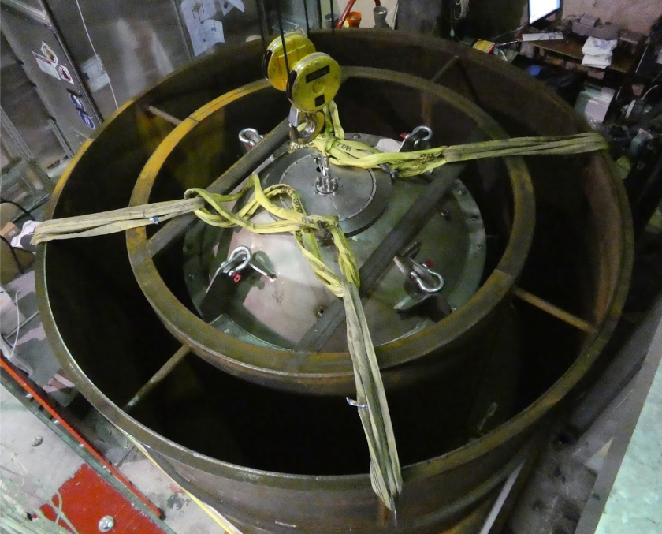

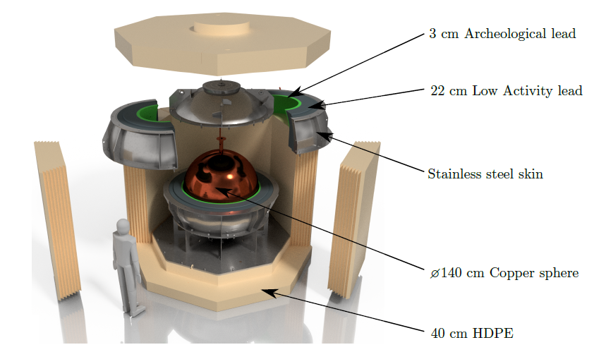

Shielding and data taking with S140
The sphere is made of C10100 copper, with the inner 0.5 mm being electroformed ultra-pure copper.
Lead, archeological lead and polyethylene (PE) make the shielding, although water was used at the LSM since the PE shield was unfinished.
10 days of physics data taken
in 135 mbar of CH₄ at the LSM
before the detector was shipped
to SNOLAB.
More time in SNOLAB to try more
gas mixtures. Already 2 weeks
with 1 bar of Ne + 2%CH₄. Now
taking Ar + 5% CH₄ data.
SNOLAB detector paper
doi:10.1088/1748-0221/18/02/T02005
7

Slide 8
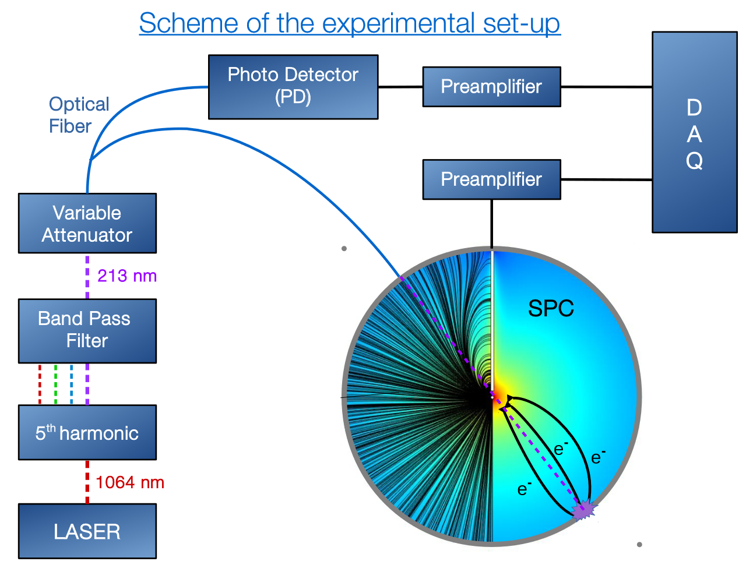
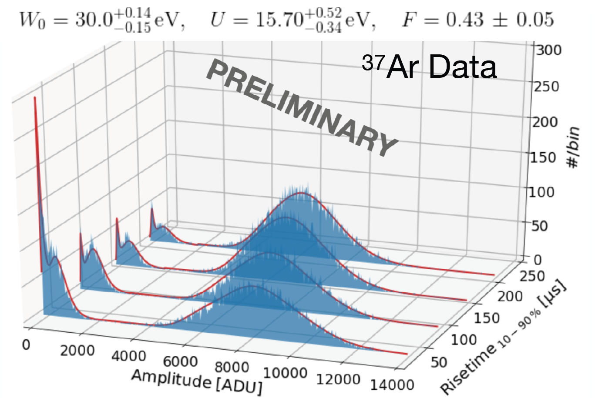
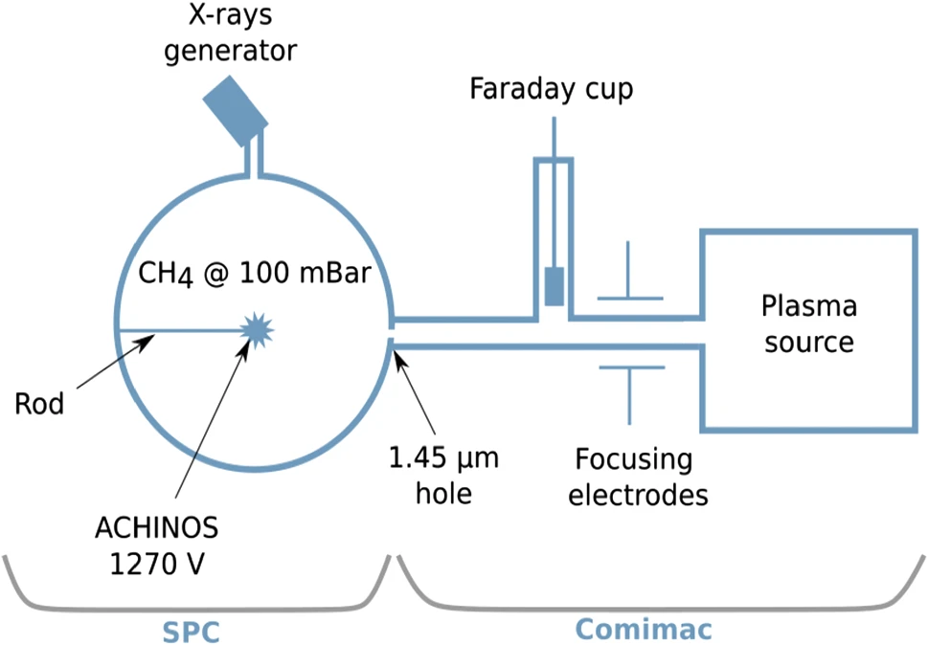
Calibration
A UV laser is directed at the inner copper surface of the sphere and releases electrons though the photoelectric effect. The UV light also goes to a photodetector so the laser events can be tagged.
Some argon-37 is released inside the sphere, and the gas diffuses in the whole volume. This isotope is radioactive and has two peaks that enable energy calibration.
Ionization yield (W-value) for CH₄ measured at Queen’s University.
The nuclear quenching factor was
measured at COMIMAC as well as
obtained from literature W-values.
New lower energy quenching factor
measurements are planned at UdeM
and RMTL, with the backing detector
currently being built.
270 eV peak
2.8 keV peak
Poster on QF from Neha Panchal
Talk from Mayank Arora tomorrow
doi:10.1088/1742-6596/2156/1/012059
doi:10.1140/epjc/s10052-022-11063-9
8

Slide 9
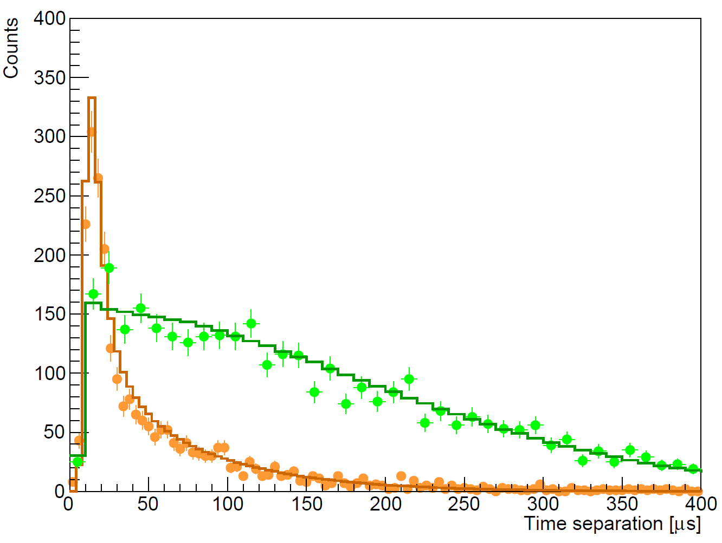
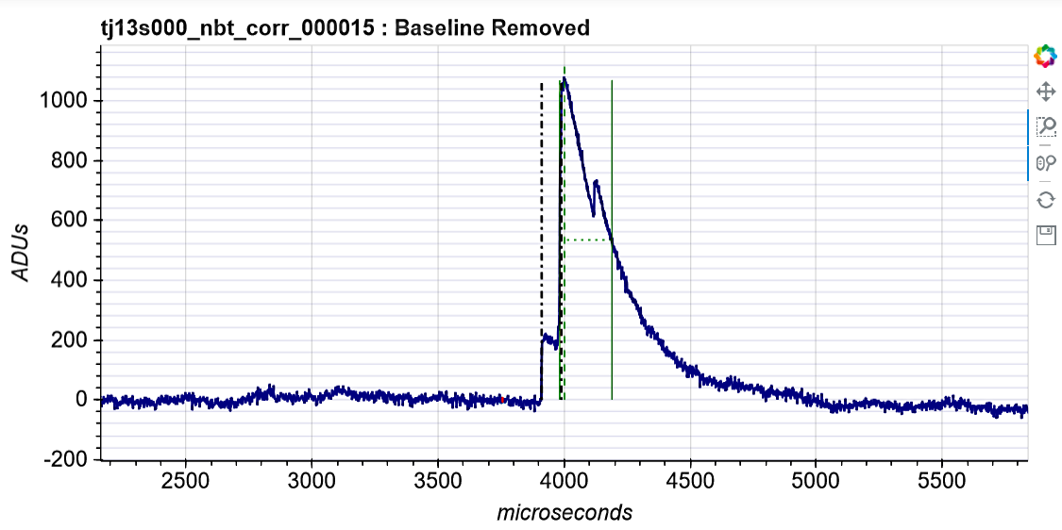
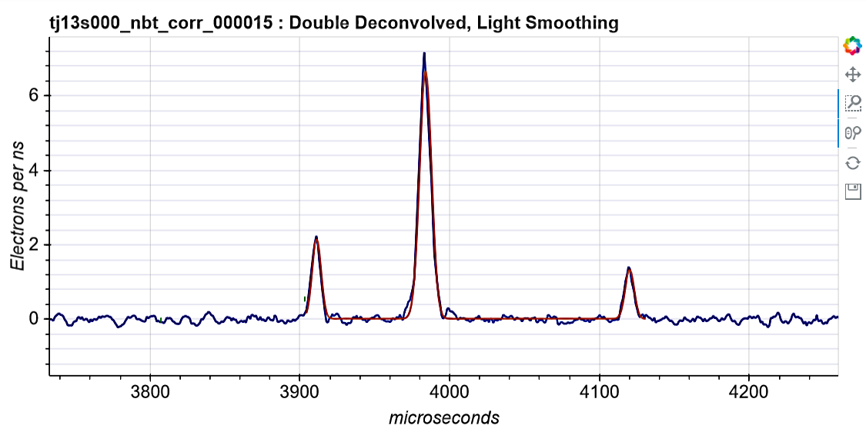
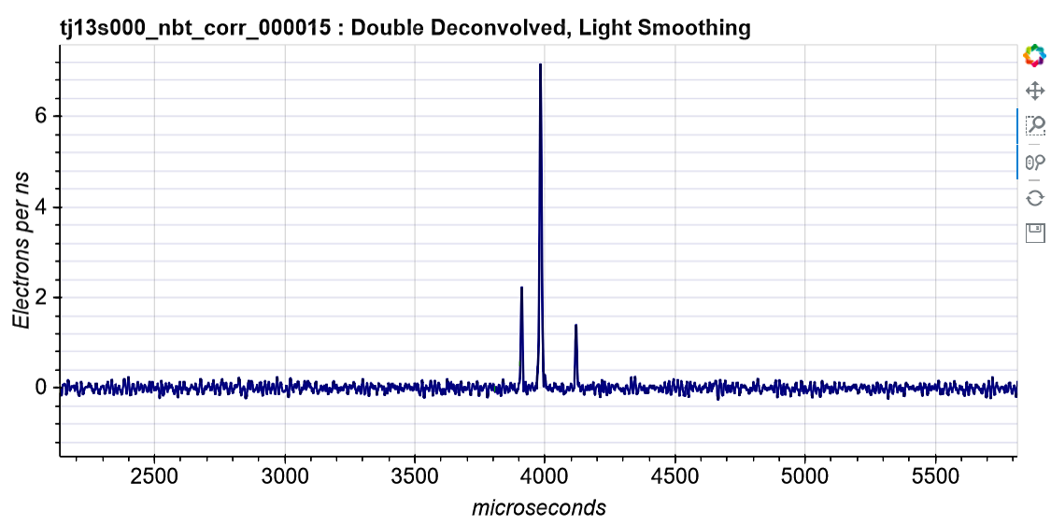
Peak counting and time separation
scipost_202210_00005v1
The exponential decay of the preamplifier and the ion response are deconvolved from the raw signal.
It is possible to count individual primary electrons.
Surface events experience more diffusion than volume events, which causes the time separation between the first and last peak to be larger.
VOLUME (³⁷Ar)
SURFACE (laser)
DOUBLE-DECONVOLUTION
Talk on denoising from Annabelle Makowski in ~10min
9

Slide 10
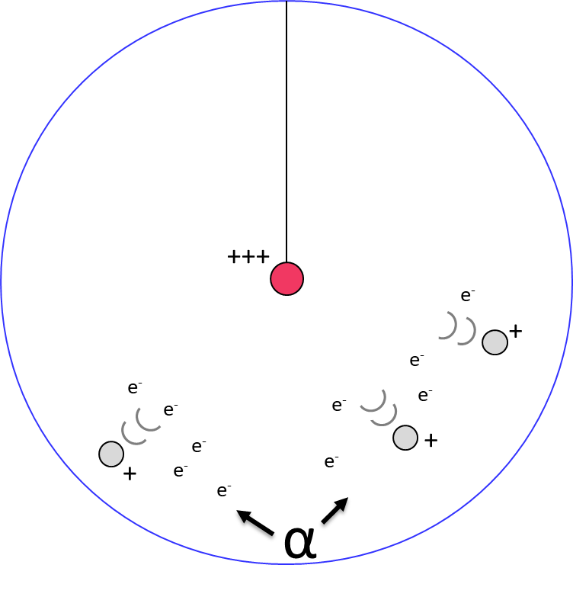
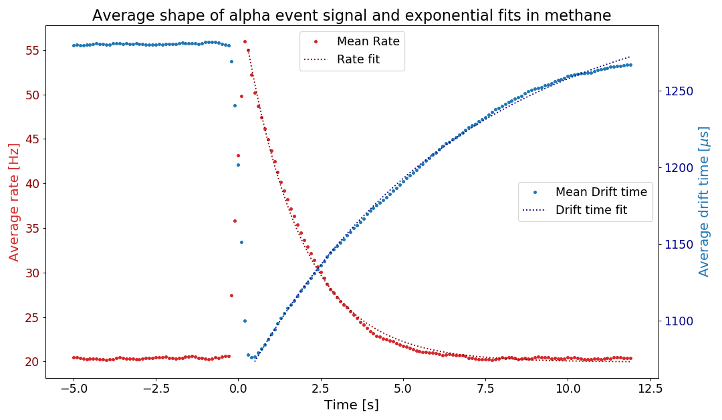
Alpha contamination
There is ~25 mHz of alphas from either ²²²Rn or ²¹⁰Po contamination in the copper surface.
Alphas ionize a lot of gas and create a space charge that disturbs the electric field, and changes the electron drift time.
Probably due to attachment, a high rate of low energy events keep happening for around 5s after each alpha.
We remove most of the low-energy background due to alphas with a 5s cut after each one, keeping 85-90% of the total time.
DRIFT TIME
Methane
135 mbar
1630 V
RATE
10

Slide 11
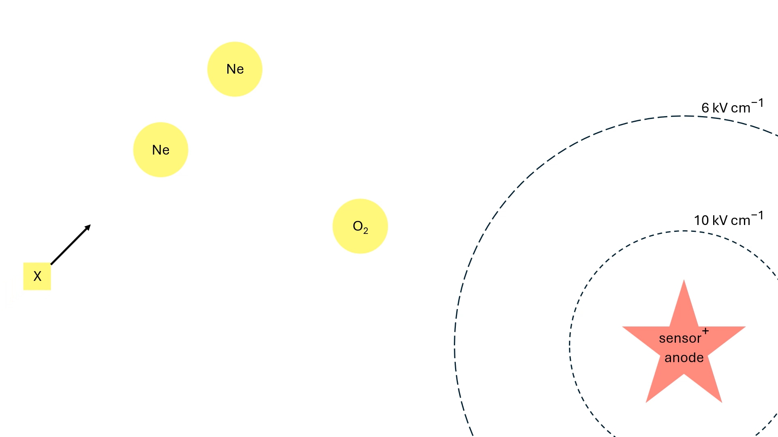
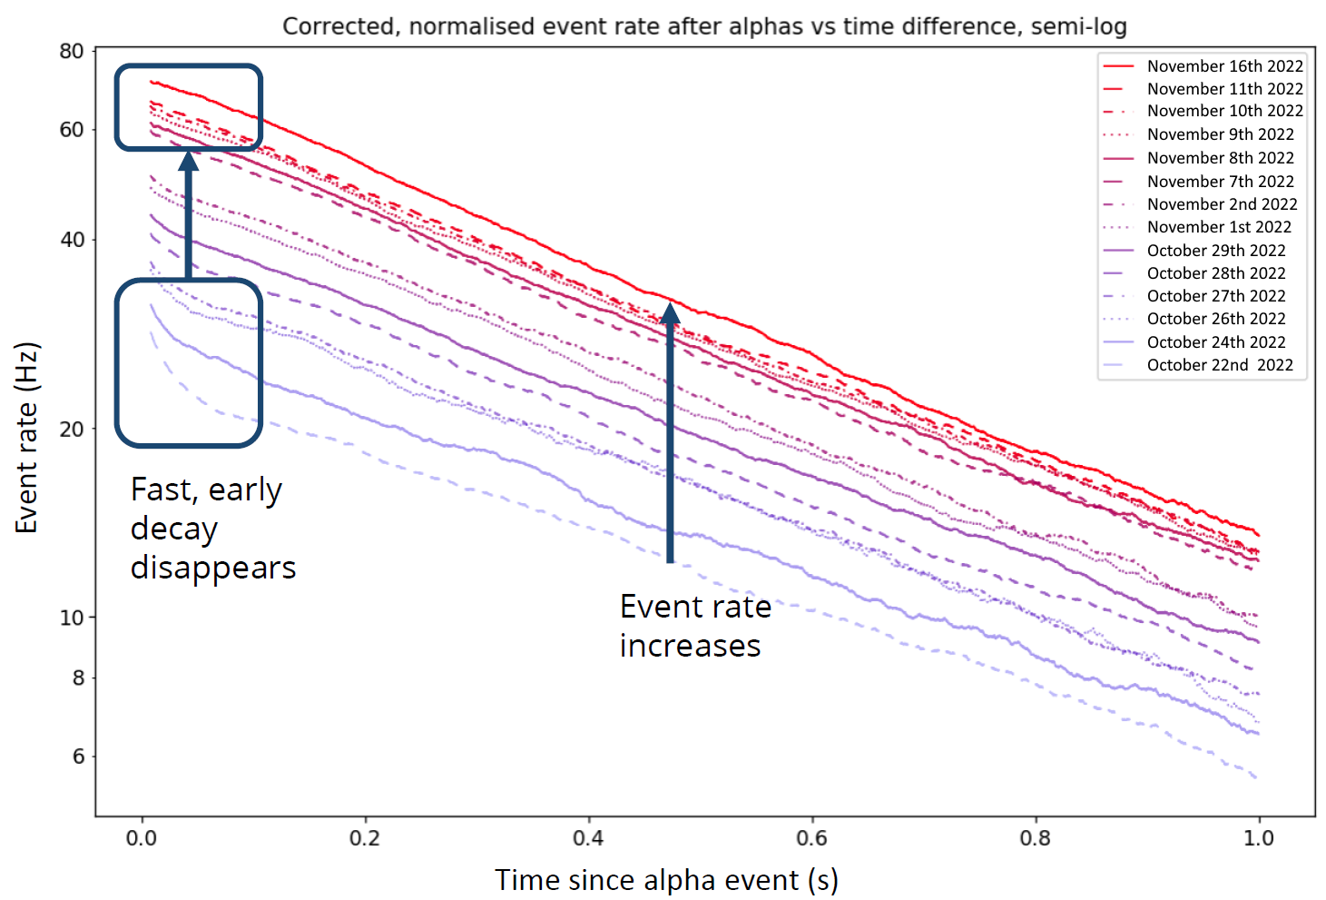
Alphas in SNOLAB
SNOLAB still has an alpha background with a similar rate. Etching of the inner surface has not removed the alphas.
The increased rate of events after alphas is correlated with the impurity of the gas.
The leading theory is that negative ions cause the delayed signals in the seconds after alpha events.
J. Clarke
11

Slide 12
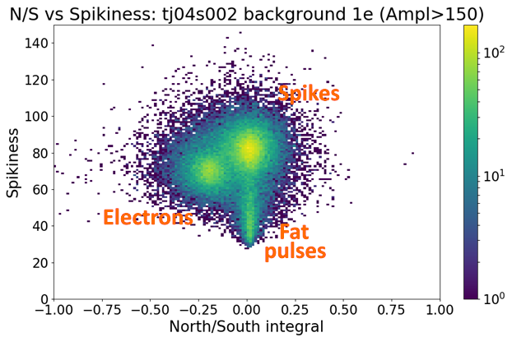
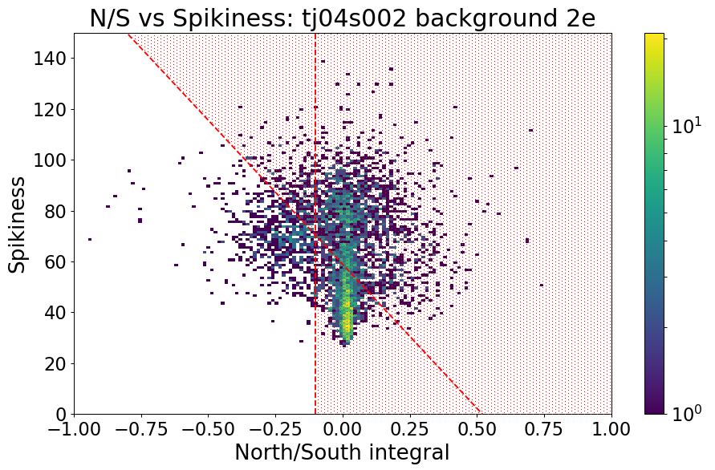
Pulse shape discrimination
In the LSM, there were spurious pulses caused by electronic discharges in the data.
Those can be discriminated from physical events with two different methods:
  Spurious pulses are either measurably spikier or wider than physical events.
  Spurious pulses do not cause a negative induced pulse on the opposite channel.
Around 95% of the spurious pulses are removed with cuts usings theses discriminants, while still keeping 77% of the physical events.
In SNOLAB, spurious pulses have been less numerous due to having more time to fix the electronics and remove them from the source.
Wide
12

Slide 13
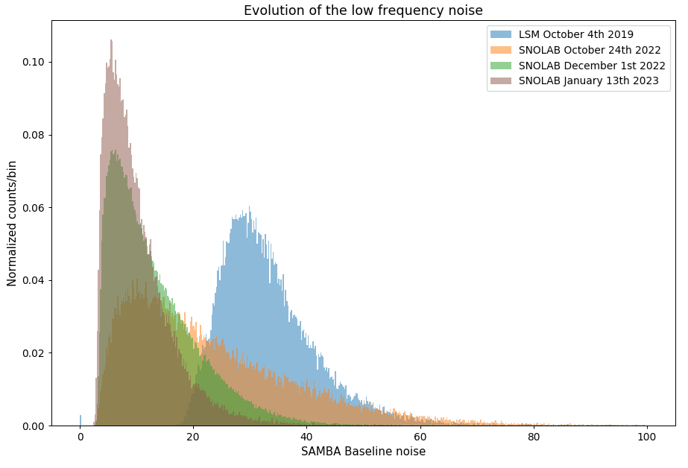
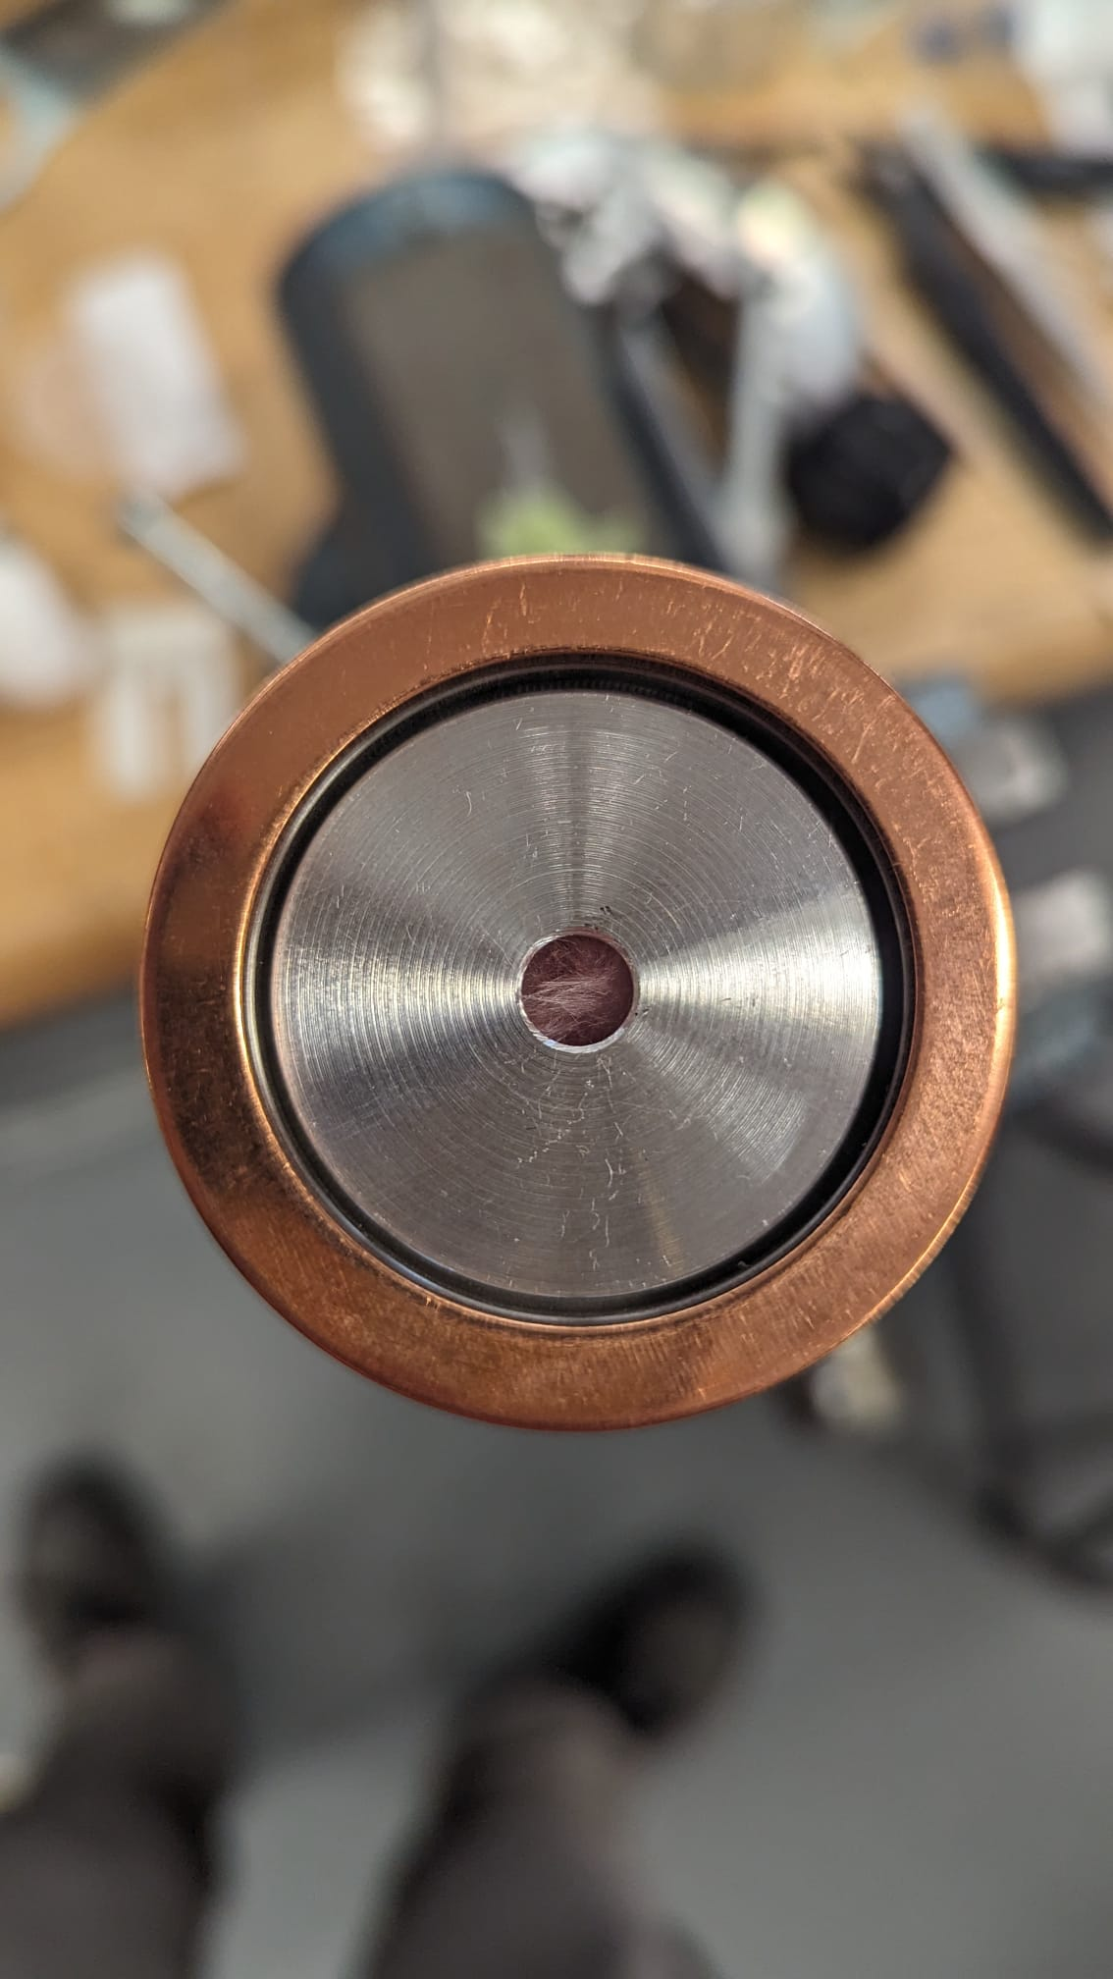
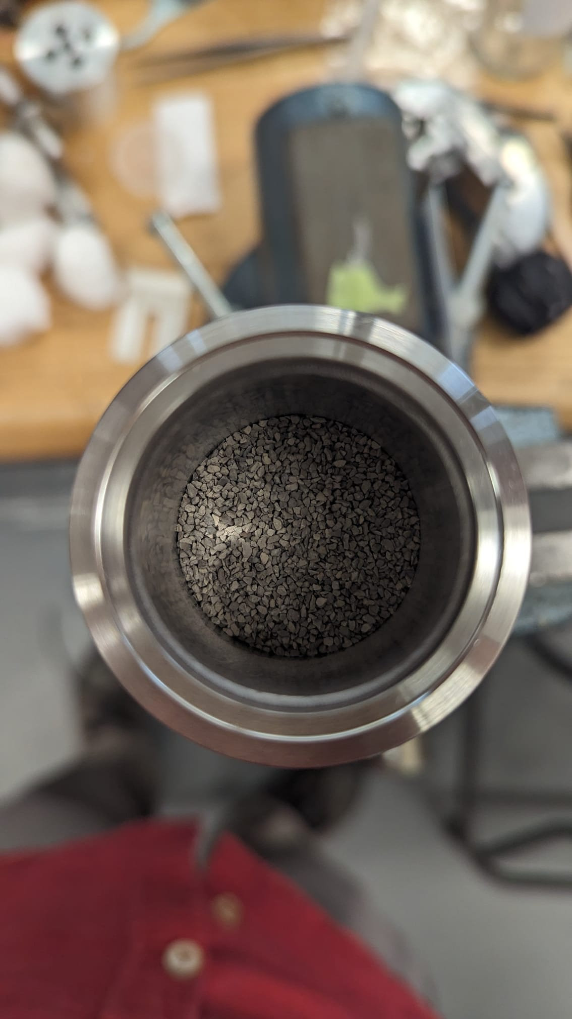
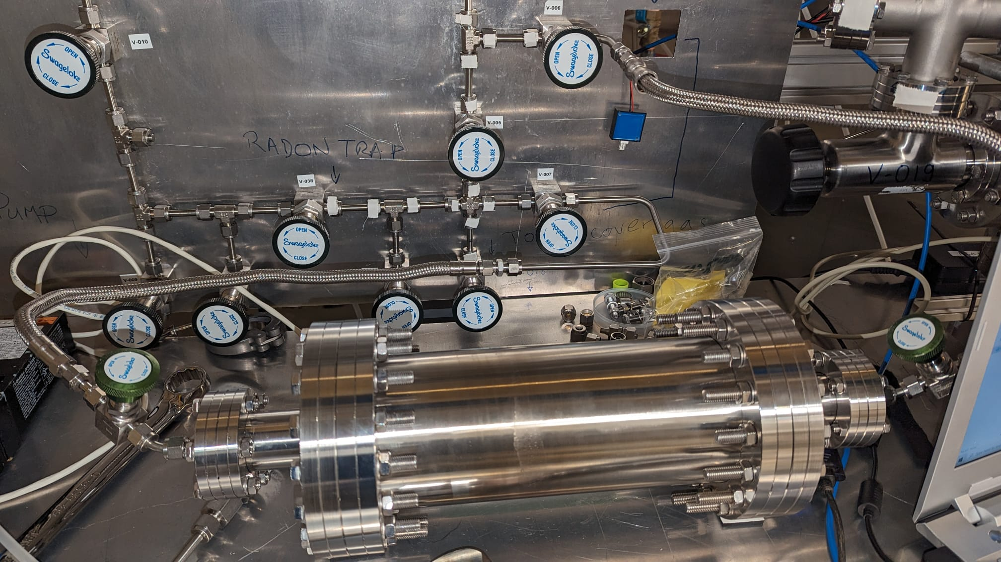
Noise and data taking
Improvements from LSM:
Trigger on three channels (North, South, PD) instead of only one at a time
Reduced noise
Better gas purity
Gas purifier from University of Birmingham
  Oxygen removal from copper balls and molecular sieve
Silver zeolite radon trap from University of Alberta
  New installation this week after adjustments
Time to try multiple gas mixtures:
Ne+2%CH₄, Ar+CH₄, Ne+7%CH₄, CH₄, He+CH₄ etc.
Radon trap
Gas purifier
13

Slide 14
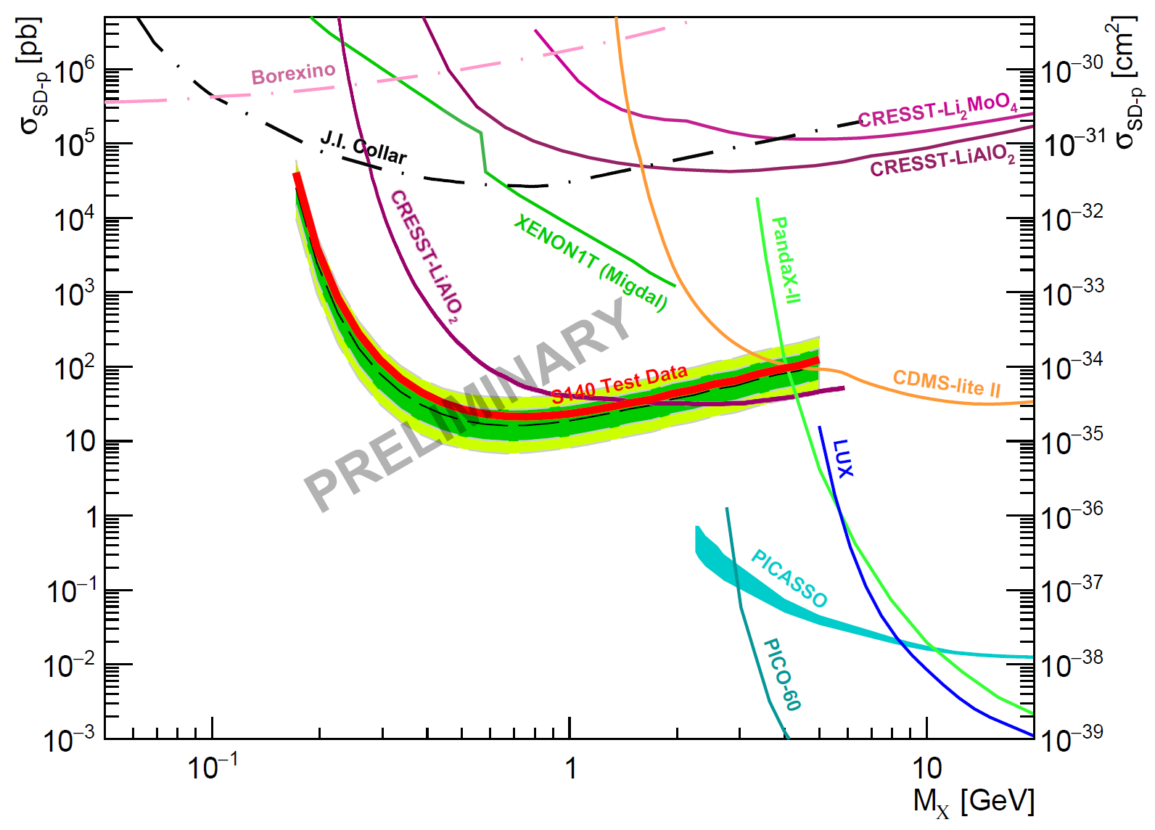
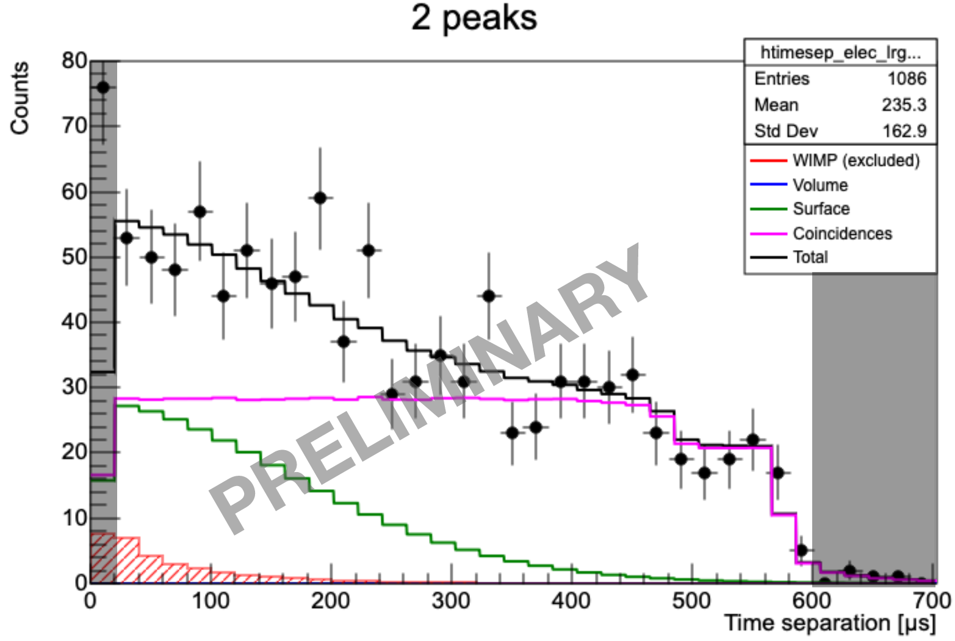
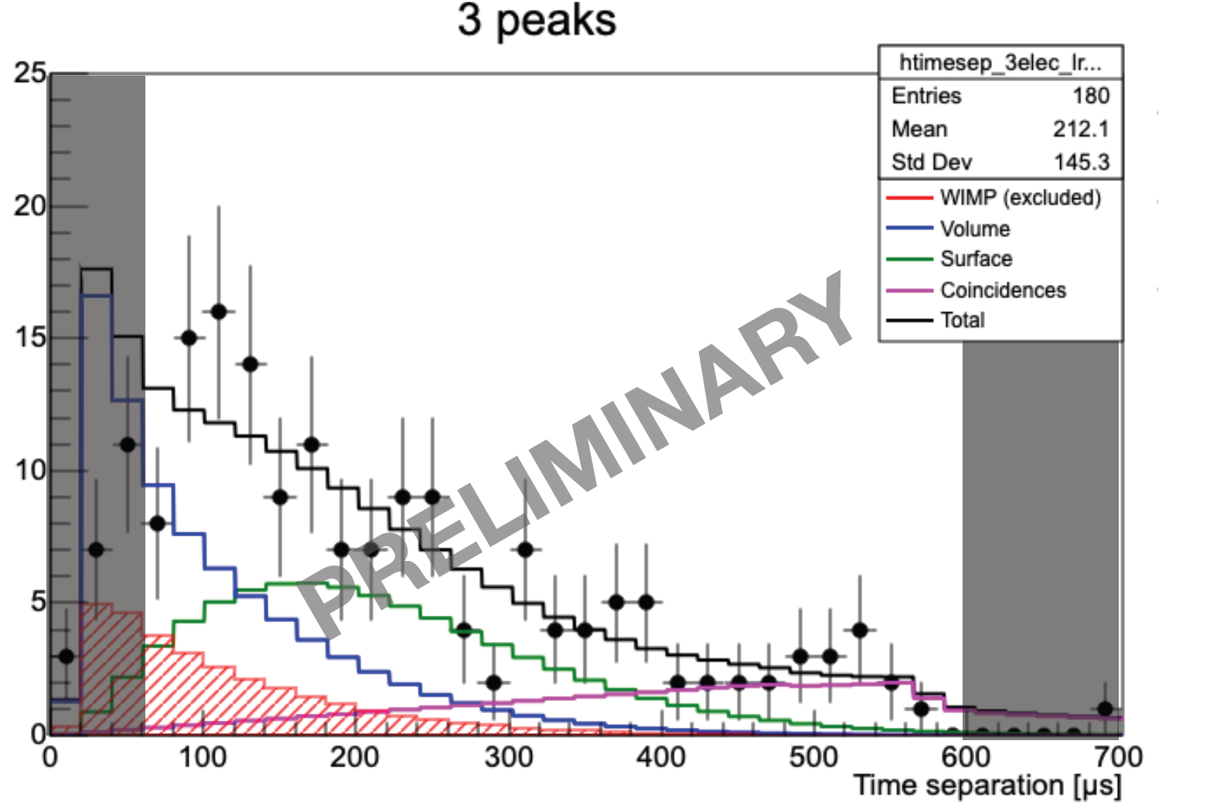
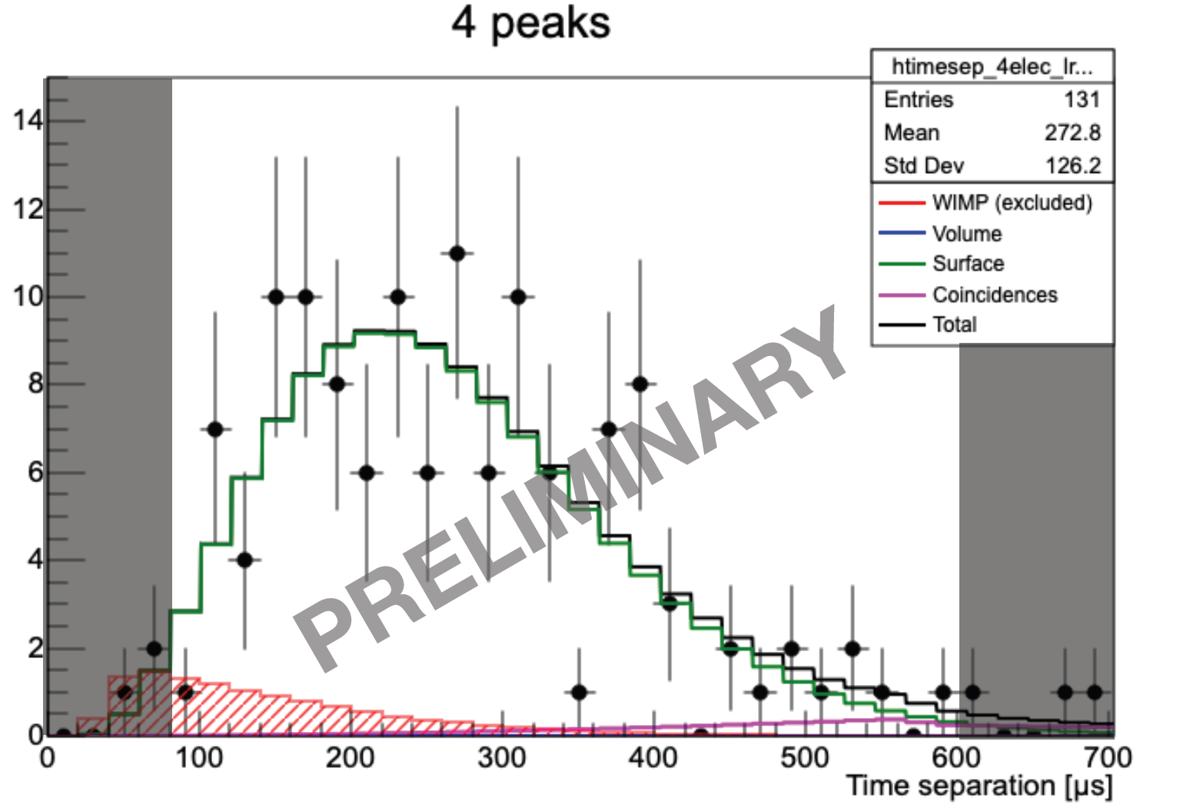
LSM preliminary limits
30% of the full data was set aside as a test data before the rest is unblinded.
Profile likelihood fits of the test data were made for 2-3-4 peak data
Fits with contributions from surface background, coincidences and WIMP signal.
No significant WIMP signal was detected. WIMP exclusions limits with ~0.12 kg·days of data
Strongest constraints for the proton spin-dependent interaction in the 0.2 - 1.5 GeV range.
Final blind data results to come soon:
paper currently in internal review.
scipost_202210_00005v1
14

Slide 15
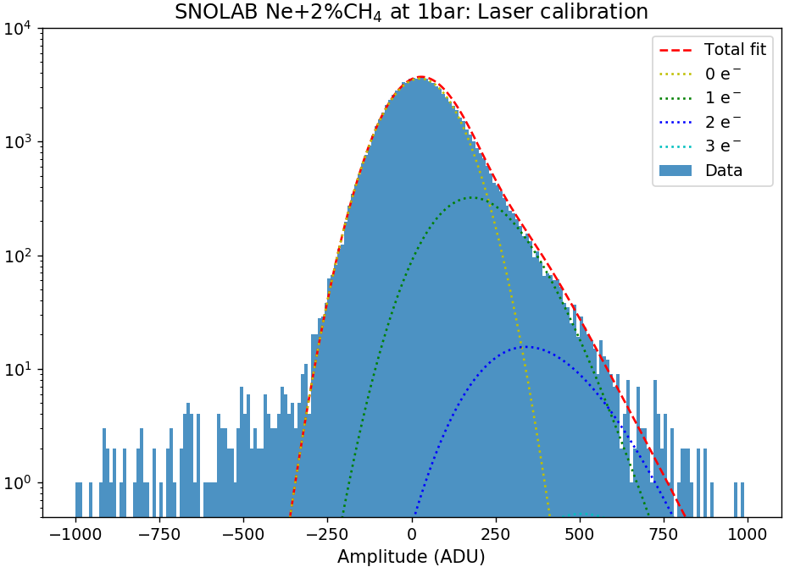
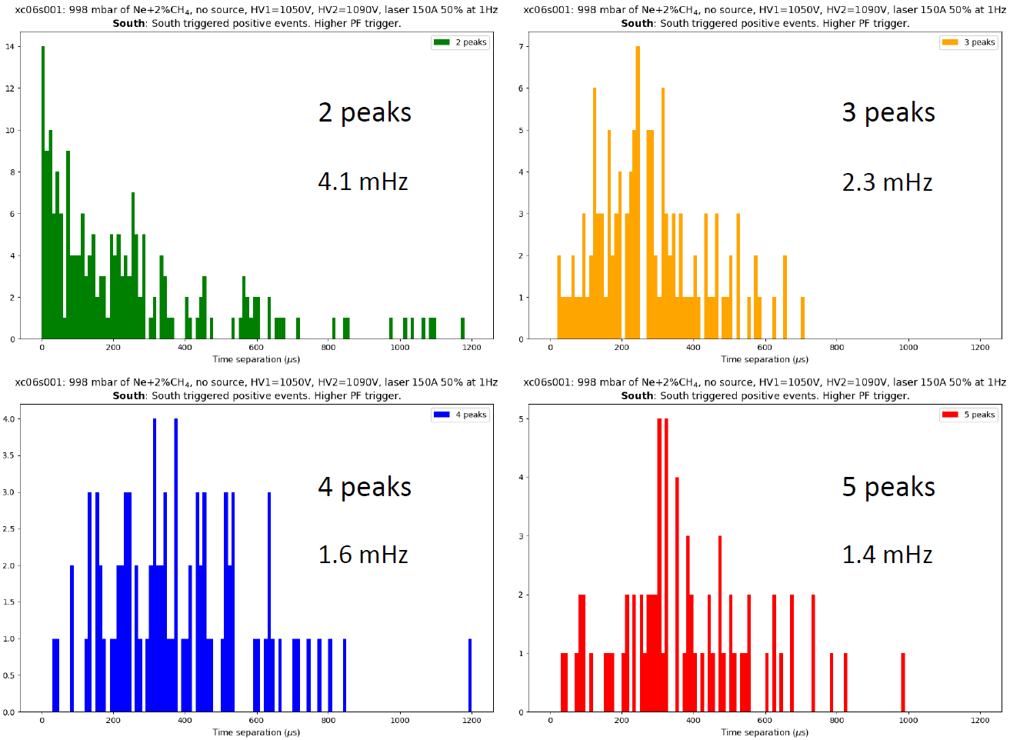
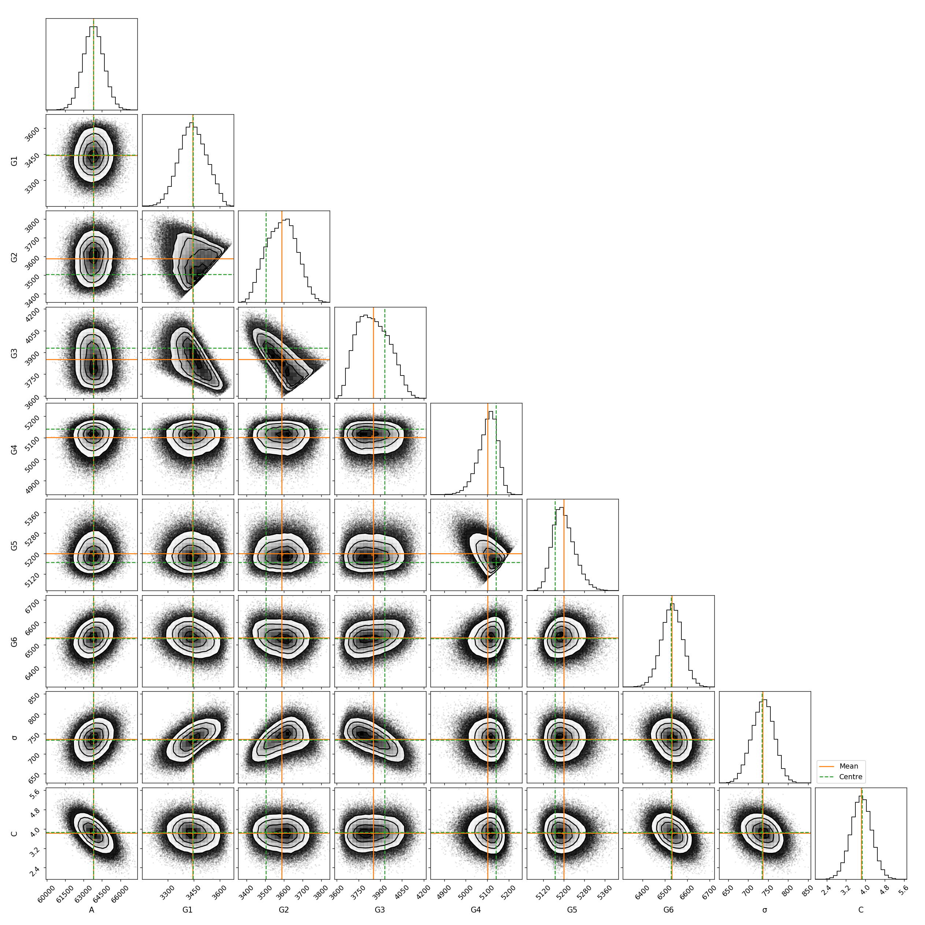
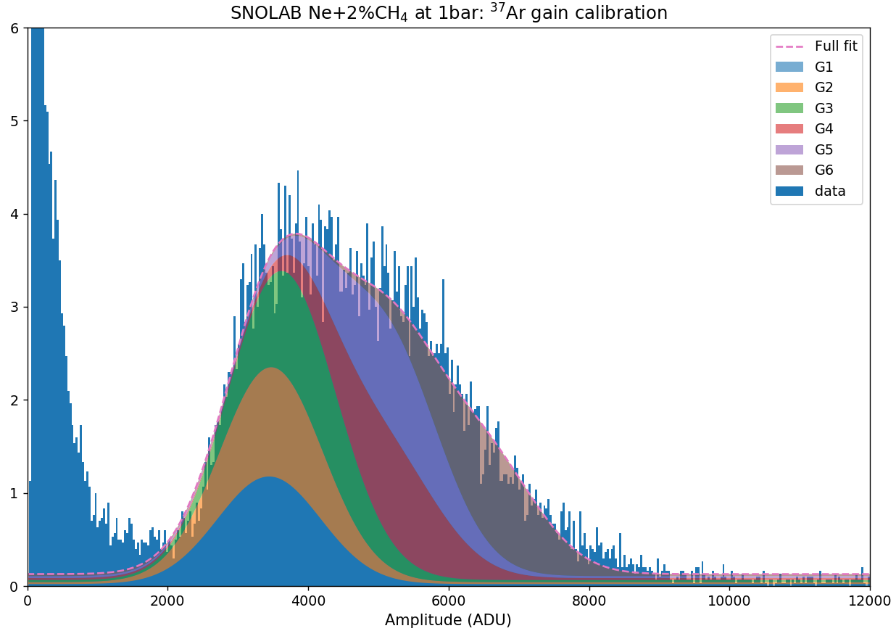
SNOLAB data analysis
Here are some preliminary results from the neon data taken in Winter 2023:
Laser calibration fits show the contributions from all numbers of primary electrons.
MCMC fits of ³⁷Ar data show the different gains of each southern anode of the sensor.
Physics test data hints at a lesser contribution from the single-electron background compared to the LSM.
15

Slide 16
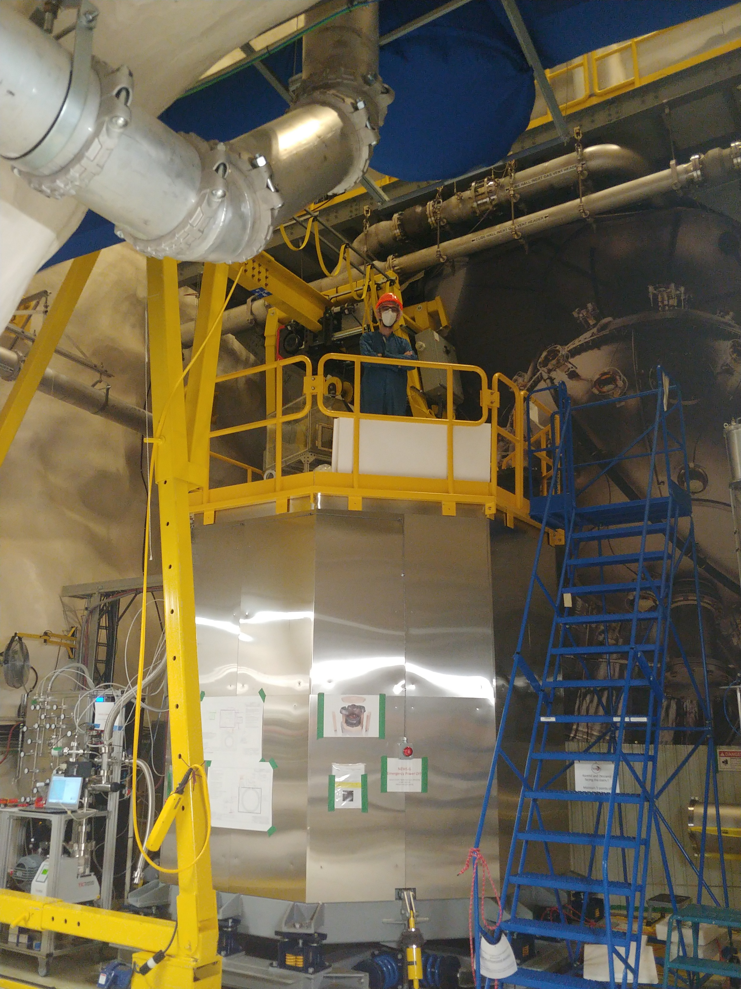
Conclusion
NEWS-G and SPCs well suited for low mass dark matter search.
LSM data able to set new SD-p WIMP constraints with CH₄.
Currently taking improved physics data at SNOLAB.
Expecting even better results from the SNOLAB data.
16

Slide 17







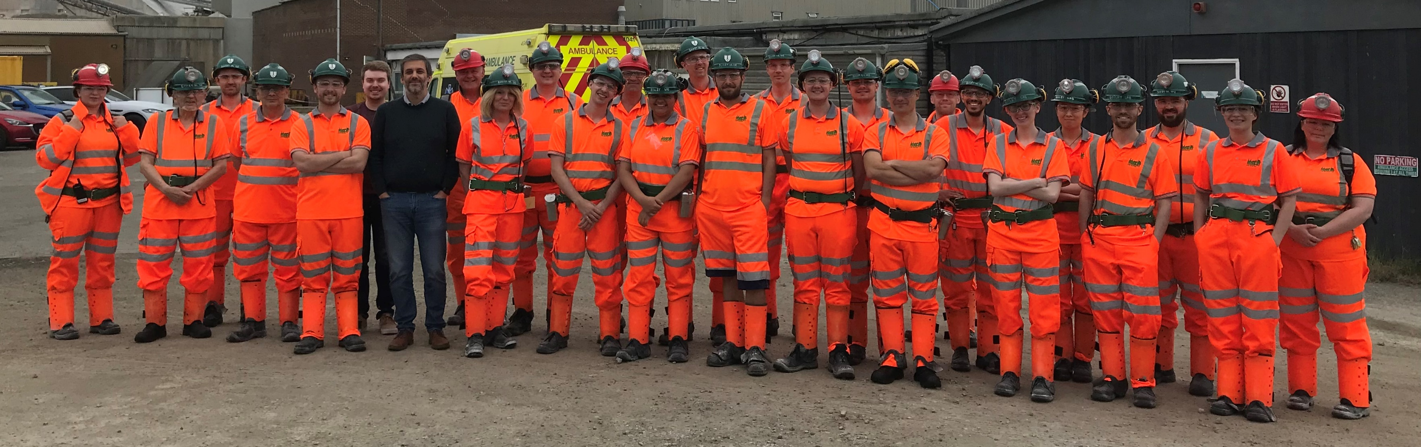




Thank you!

Slide 18
Extra slides

Slide 19
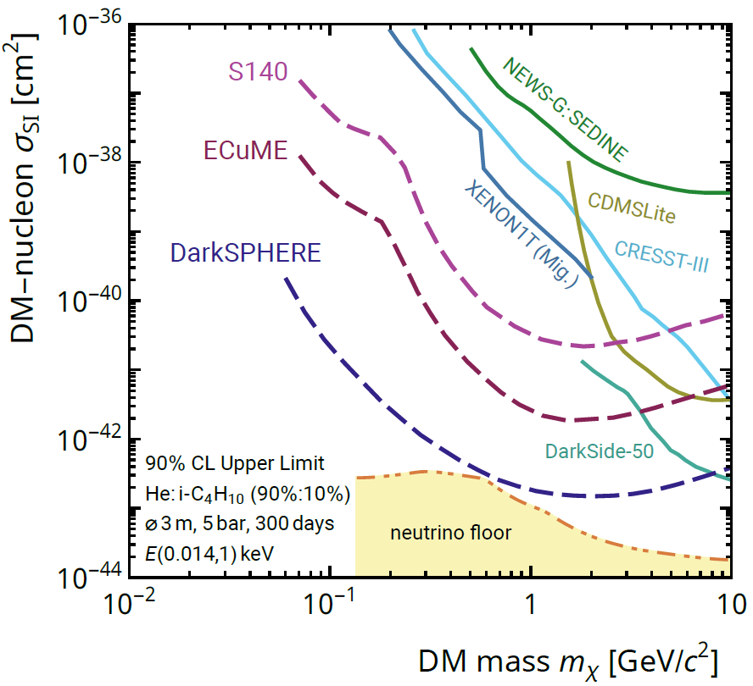
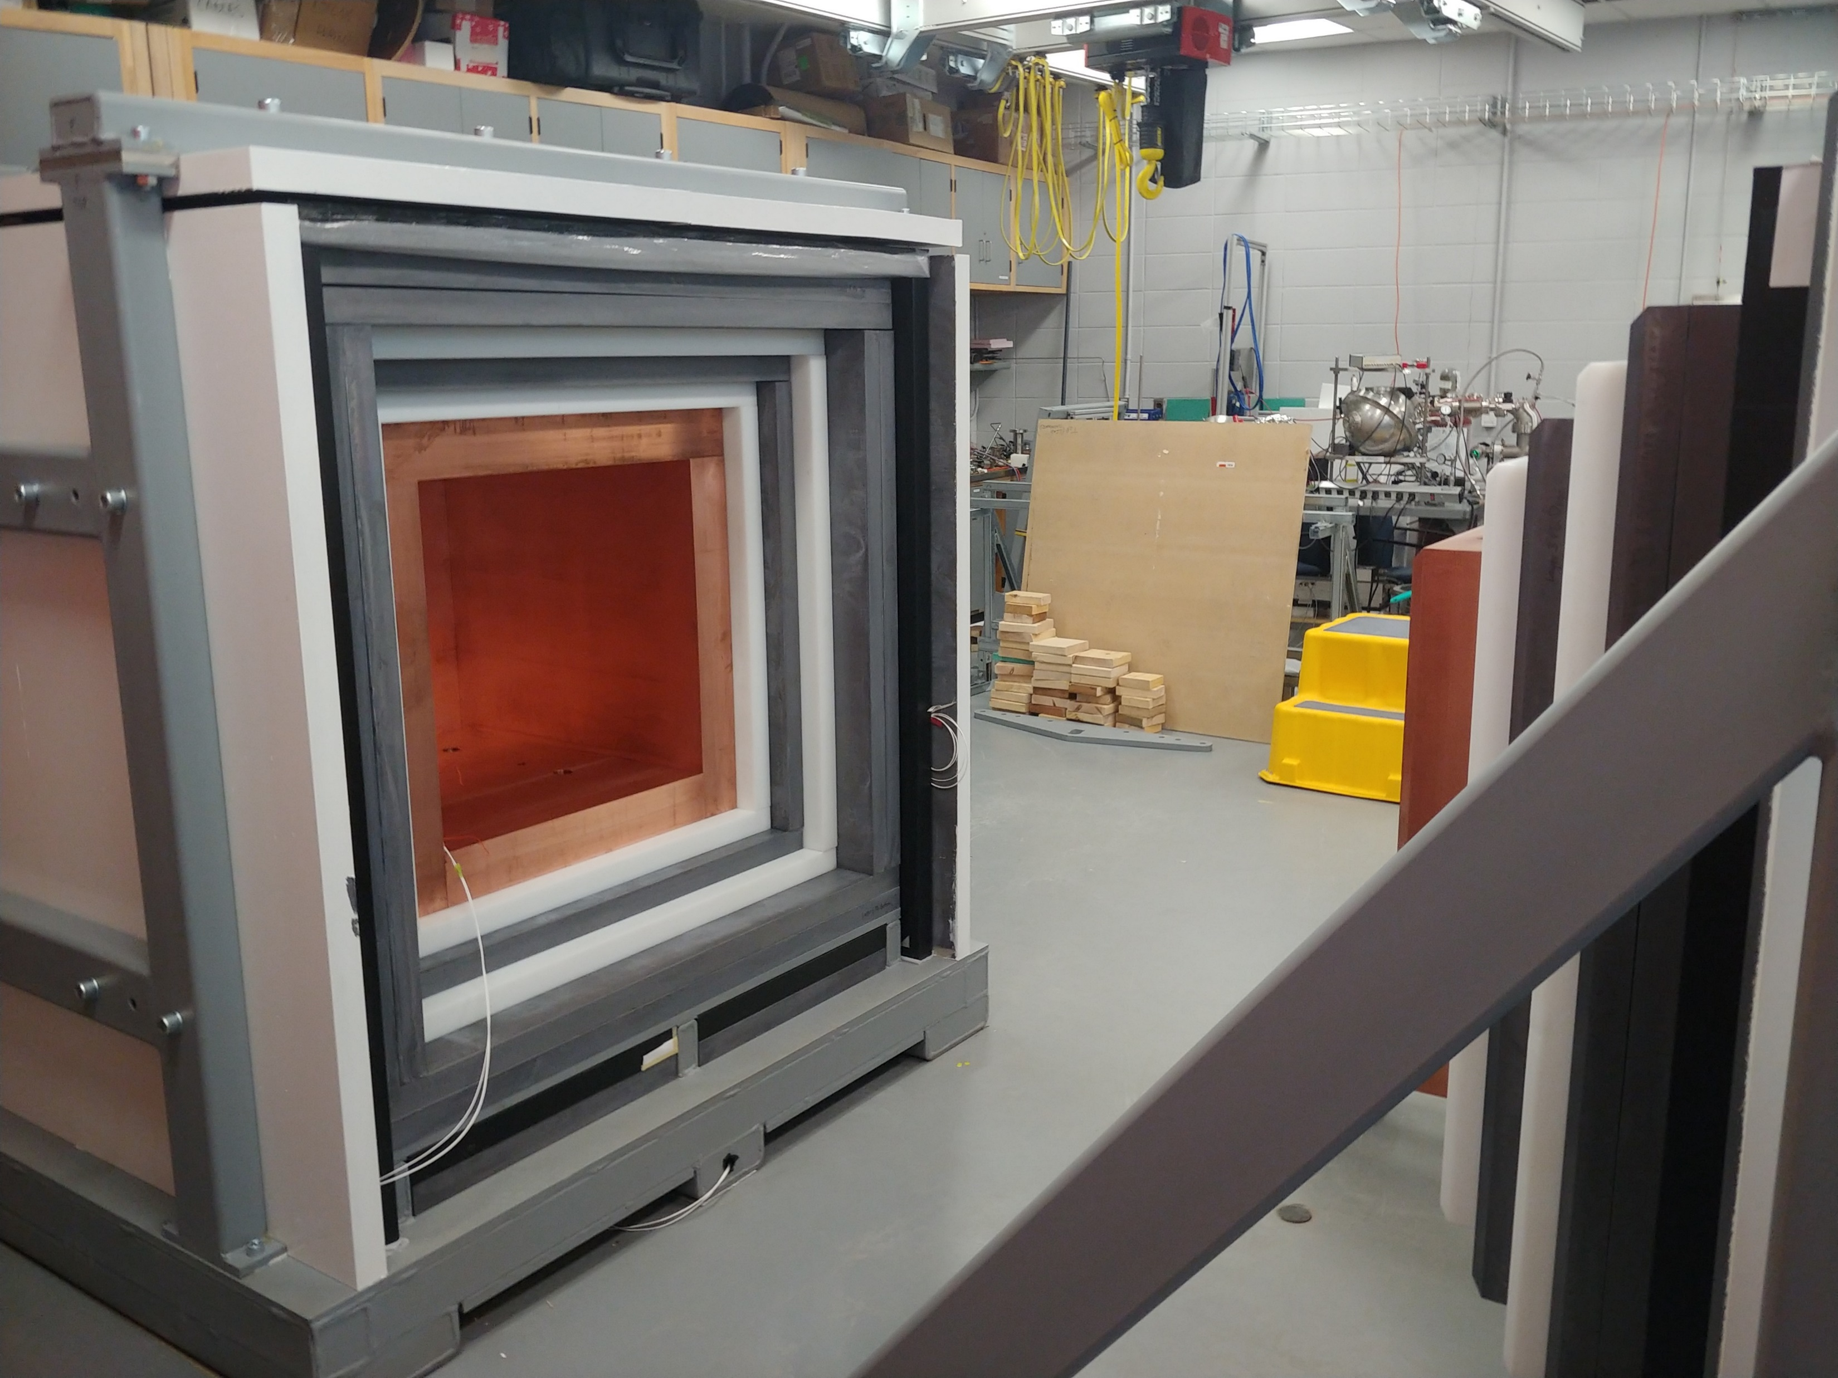
Future projects
ECuME (& miniECuME):
  Fully underground electroformed 140 cm of diameter copper sphere in SNOLAB.
  (tests ongoing at PNNL)
DarkSPHERE:
  Fully electroformed 3m of diameter sphere in a water shield.
  (under consideration)
NEWS-G3:
  Shield at Queen’s University intended for CEνNS detection at nuclear reactors.
  (shield completed, started testing)
arXiv:2301.05183
19

Slide 20
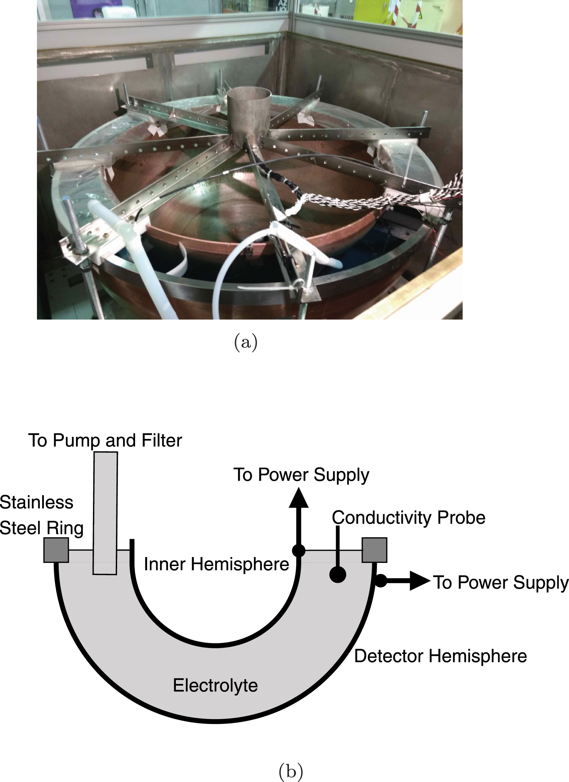
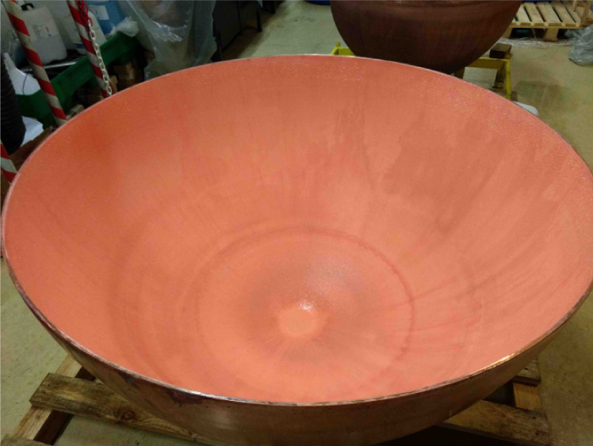
Making the sphere, electroforming, etching

Slide 21
Birmingham Purifier
  oxygen removal
  copper balls + molecular sieve
  installed at SNOLAB
  few 10mBq radon
Radon trap
  silver zeolite
  tested at UoA
  in 10cm long, 10mm diameter SS pipe
  installed at SNOLAB
    too much resistance for circulation
    wider and 5x larger trap under construction (in CF40 pipe (34mm diameter))

Slide 22
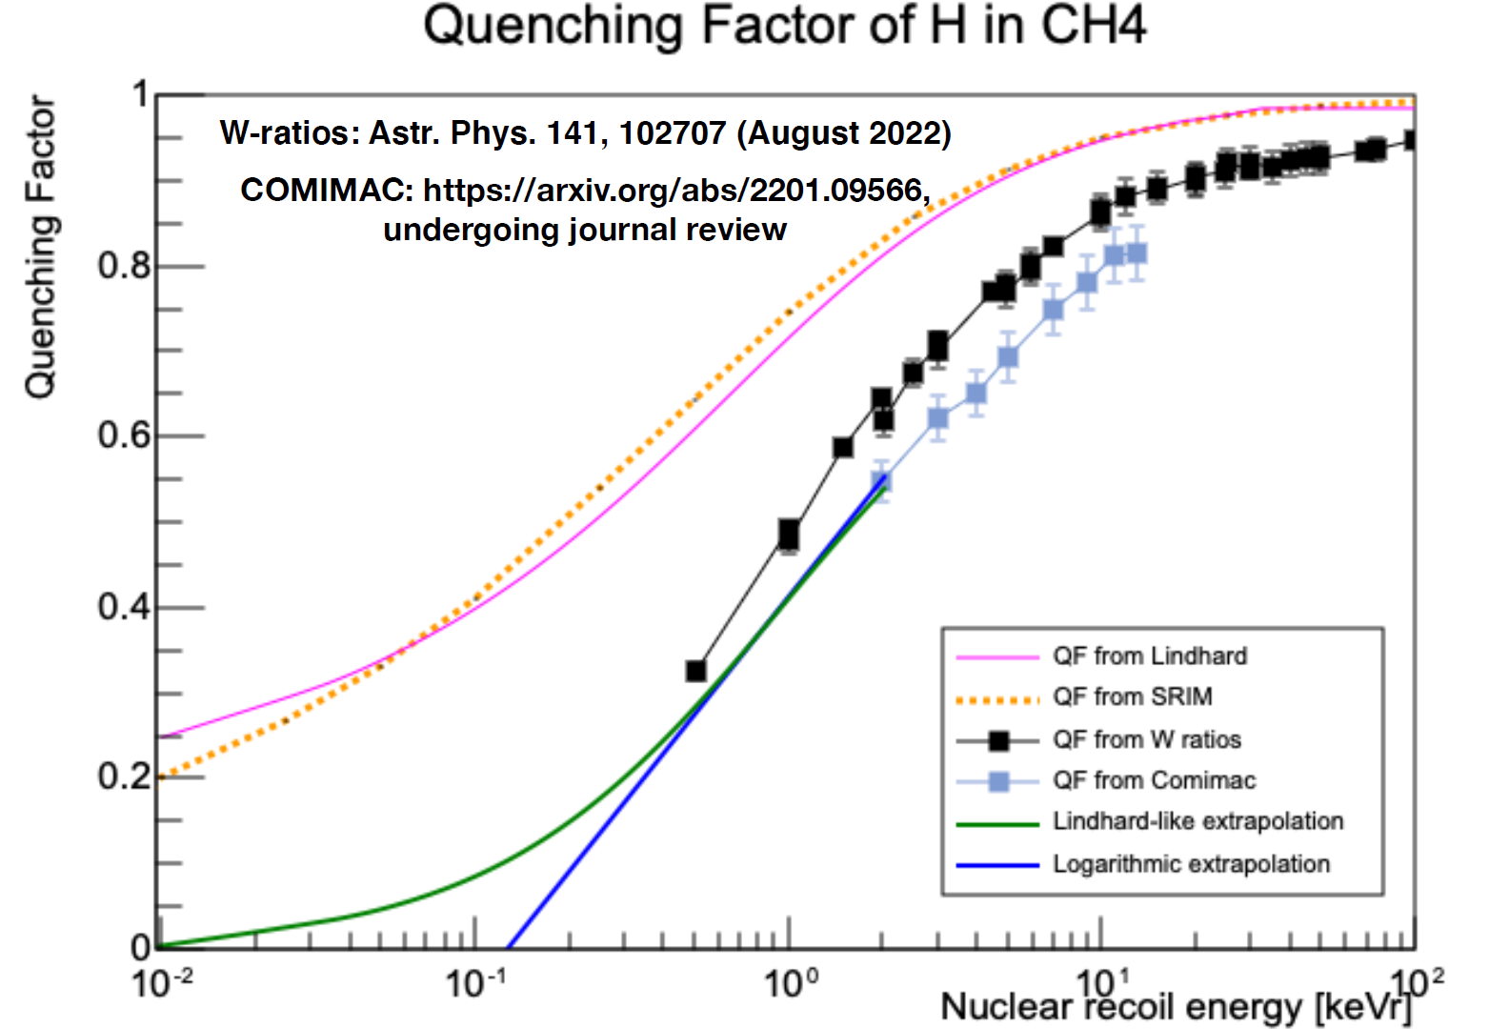
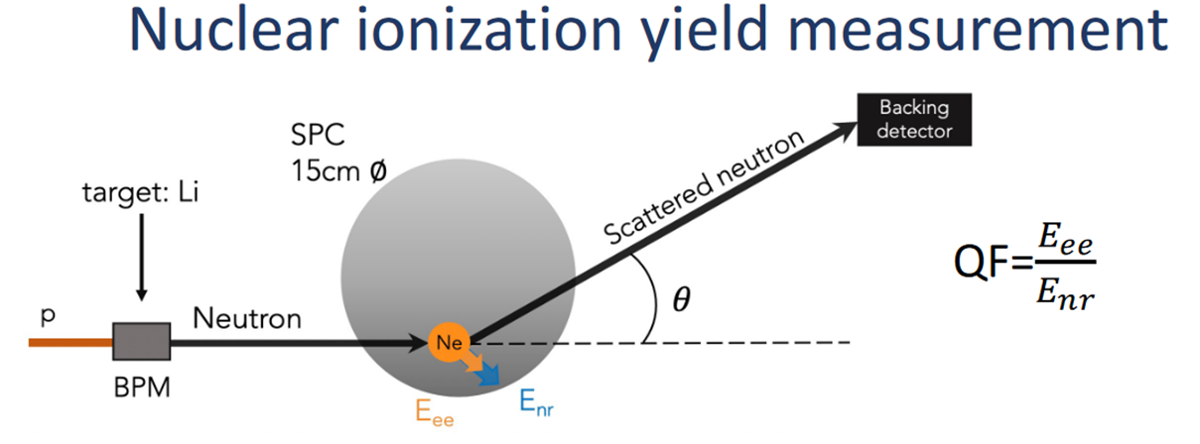
Quenching factor

Slide 23
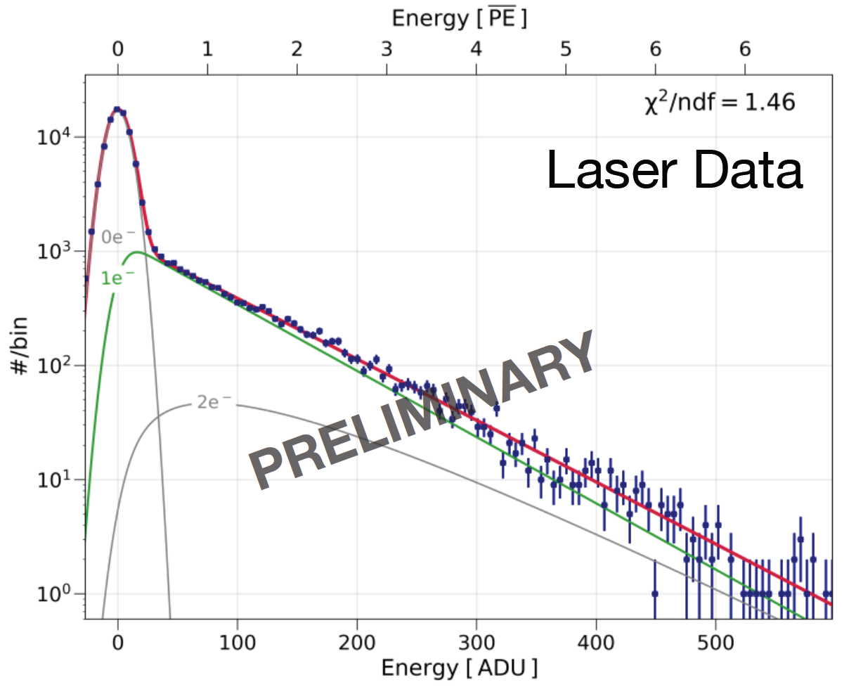
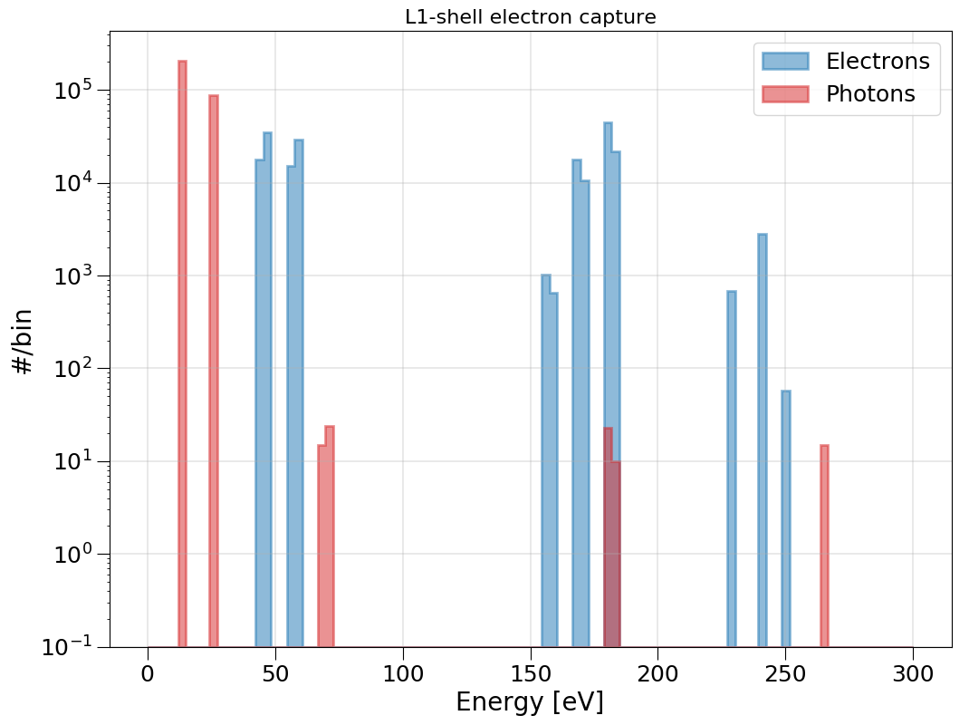
Gas mixture and calibration (laser and ³⁷Ar)
doi:10.1088/1742-6596/2156/1/012059

Slide 24

Double deconvolution
Double deconvolution
Integration
The ballistic deficit is the signal amplitude that gets underestimated due to the exponential decay of the preamplifier.
The full amplitude (energy) is retrieved by doing a double deconvolution of the raw signal, and then integrating the pulses.
24

Slide 25






Alpha background
There is ²¹⁰Po contamination in the copper surface, which causes alphas that ionize a lot of gas. All the ions create a space charge that disturbs the electric field, and changes the electron drift time. For some still unknown reason, a high rate of low energy events keep happening for around 5s after each alpha.
Electron drift time
Total rate of events
The saturated alpha signals can be broken up and difficult to detect, but using the drift time, rate of events and decreasing baselines, we can identify alphas and remove most of the low-energy background due to them with a 5s cut after each alpha, keeping 85-90% of the total time.
25

Slide 26





Spikiness
1st comparison method
Spikiness
$$Spk=\frac{Max signal derivative}{Peak height}$$
Probable
electron event
Probable spike event
26

Slide 27



North/South integral ratio
2nd comparison method
N/S ratio
$$N/S=\frac{North DD2 integral}{South DD2 integral}$$
Probable
electron event
Probable spike event
27

Slide 28





Linear Fisher discriminant
Optimal comparison:
Combining both methods
Separation $J\left(ω\right)=\frac{(μ_{1}−μ_{2})²}{N_{1}{\left(σ_{1}\right)}^{2}+N_{2}(σ_{2})²}$
New axis $τ_{i}=ω^{t}x_{i}^{t}$
ω=[−0.678619815,−76.8674863]
Spk NS
28

Slide 29


Fits to the physics data
Wide
The separation between electron and spike events is weaker at lower energies.
Wide pulses are another dominant background of unknown origin in the data.
A cut on N/S removes fat pulses (dominant in 2-peak data) and a Fisher discrim. cut removes spikes.
29

Slide 30

SNOLAB noise

Slide 31


SNOLAB space charge

Slide 32



³⁷Ar
laser
event

Slide 33

Radon Plate-out and the Effects of Airflow and Electric Charge for Dark Matter Experiments - Scientific Figure on ResearchGate. Available from: https://www.researchgate.net/figure/Uranium-238-decay-chain-As-shown-in-Figure-2-the-decay-chain-of-238-U-involves-the_fig2_377611580 [accessed 23 May, 2024]

