Slide 1


Machine Learning for Signal Processing in the NEWS-G Experiment
Annabelle Makowski, Supervised by Ryan Martin and Guillaume Giroux
May 27th, 2024
CAP Conference, London, ON

Slide 2
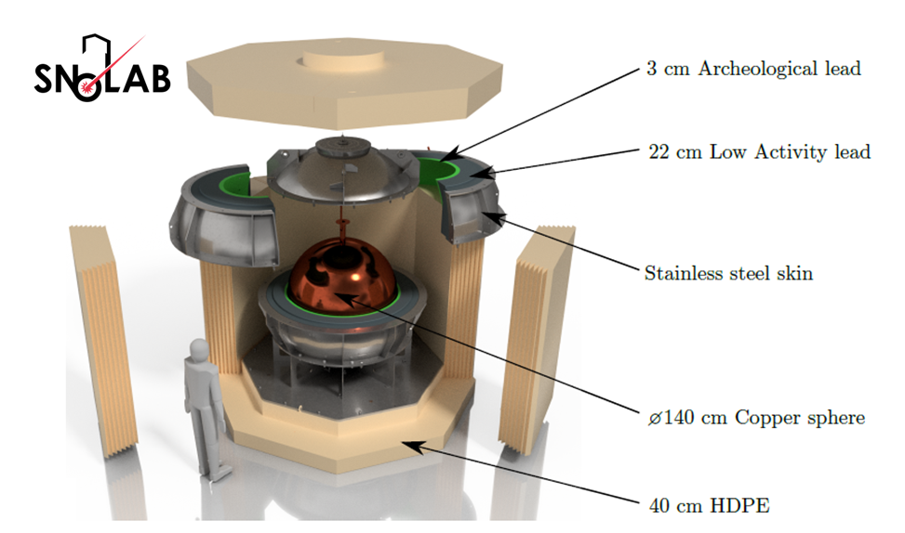
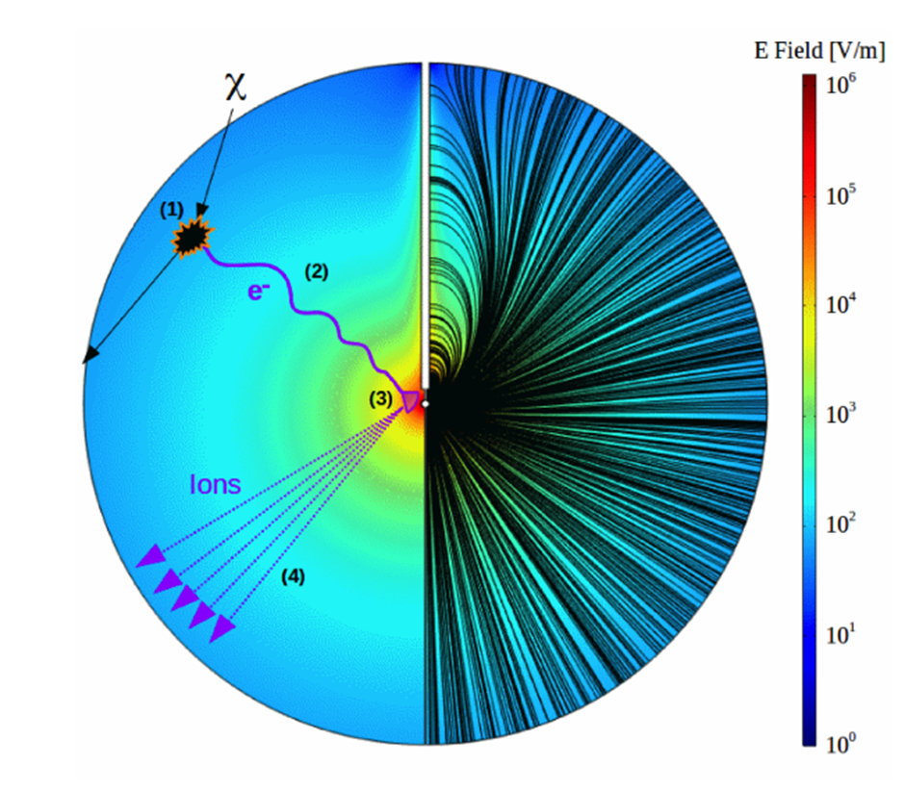
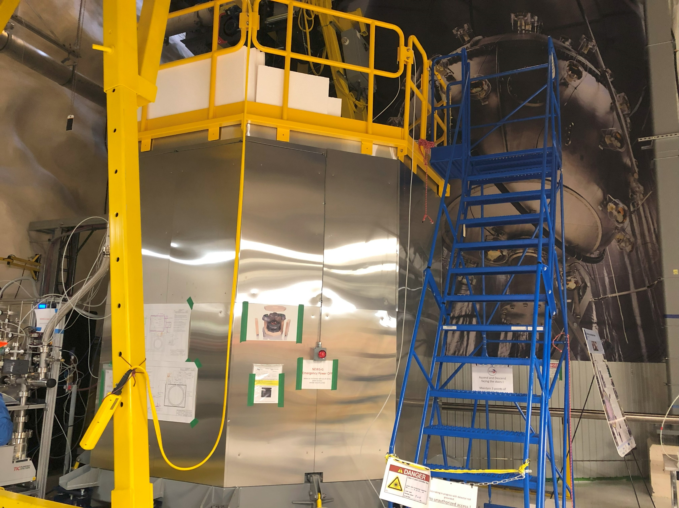
About the NEWS-G Experiment
The NEWS-G experiment uses SPCs (spherical proportional counters) for low-mass dark matter searches.
Most recent detector S140 (SNOGLOBE) is a 140 cm diameter sphere, located at SNOLAB 2 km underground and is currently being used to take data.
The sphere is filled with a light gas mixture. Incoming particles cause the gas molecules to ionize, and secondary ions induce a current on the central anode.
CAP 2024-05-27, Annabelle Makowski 2
Notes:
1. We are searching for WIMPs as dark matter candidates.
2. (Copper sphere)The sphere is surrounded by layers of shielding (type of lead, polyethylene) that stop unwanted background from entering the sphere.
3. Very light gas targets means we are sensitive to low-mass particles (WIMPS). The freed primary electrons drift towards the central anode. A Townsend avalanche closer to the anode causes the signal to become amplified. This produces secondary electron-ions pairs. Then, the secondary ions induce a current, giving the signal.

Slide 3
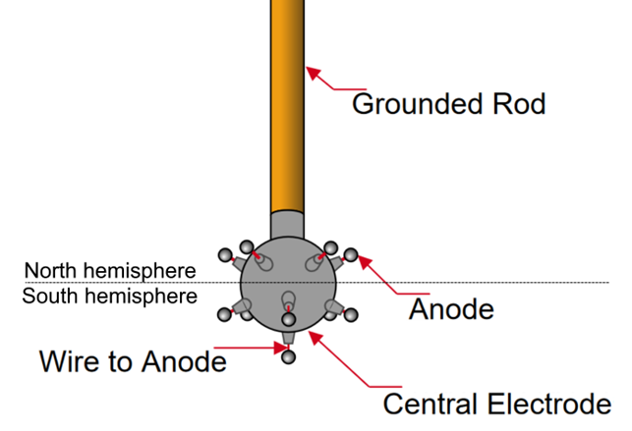
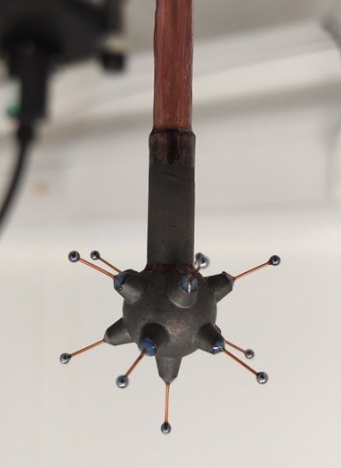
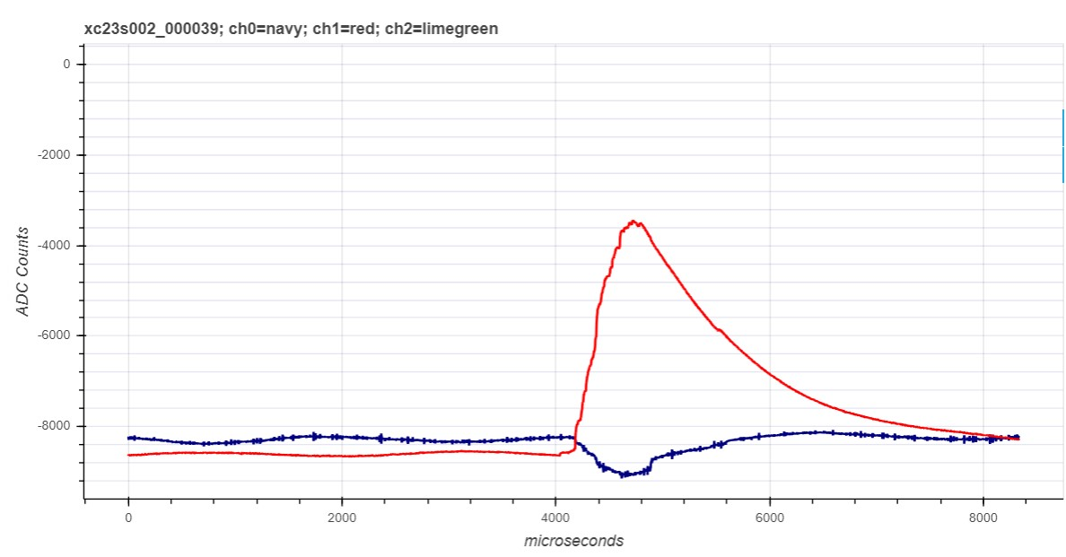
Data Processing
The central anode sensor is divided into two channels: north and south.
Signals from the detector are processed by a double deconvolution algorithm, which involves some smoothing.
Data analysts must identify event populations from their pulse shapes and sizes.
Neural networks can be applied to improve this processing.
CAP 2024-05-27, Annabelle Makowski 3

Slide 4
Machine Learning for signal processing
Advantages
Would likely be quicker and more efficient than traditional analysis methods.
Removes human bias of manually selecting processing parameters.
Any pulse shapes can be fed to the network, the model doesn’t have to know what kind of pulses to expect. In this scenario, the data is unlabeled, and this is called unsupervised learning.
Challenges
Generating appropriate training data can be a challenge. Machine learning models are very sensitive to even slight changes in datasets.
It can take time to fine-tune the parameters of the network and find an appropriate network structure to use.
CAP 2024-05-27, Annabelle Makowski 4

Slide 5
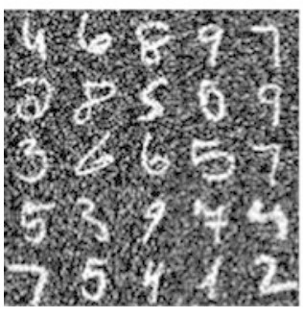
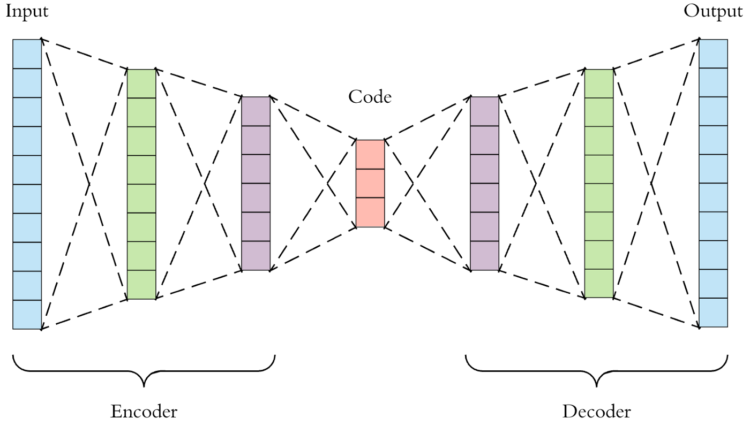
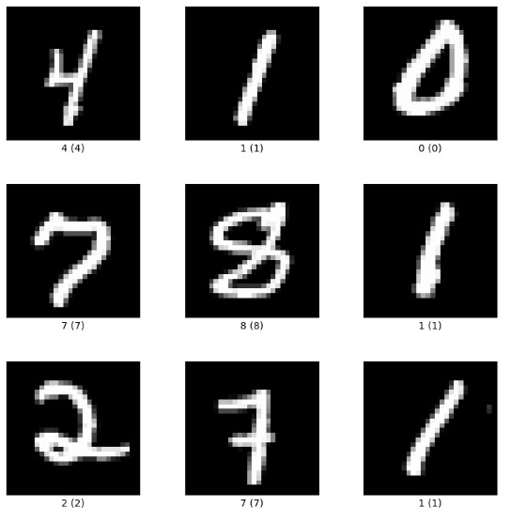
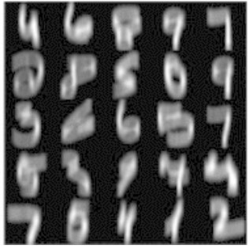
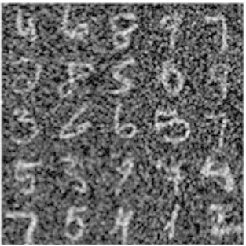
Applications of Convolutional Autoencoders
Image denoising
The MNIST Database of Handwritten Digits
Learning Sparse Feature Representations Using Probabilistic Quadtrees and Deep Belief Nets
CAP 2024-05-27, Annabelle Makowski 5

Slide 6
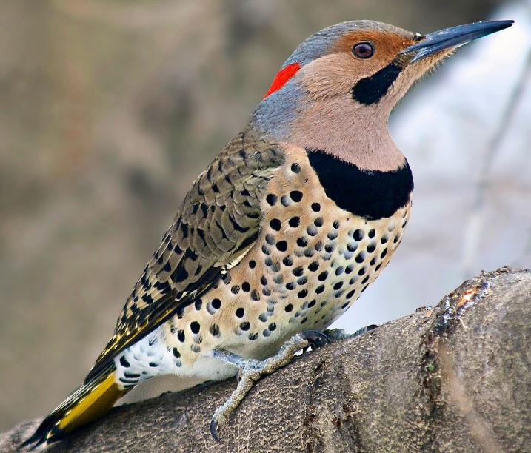

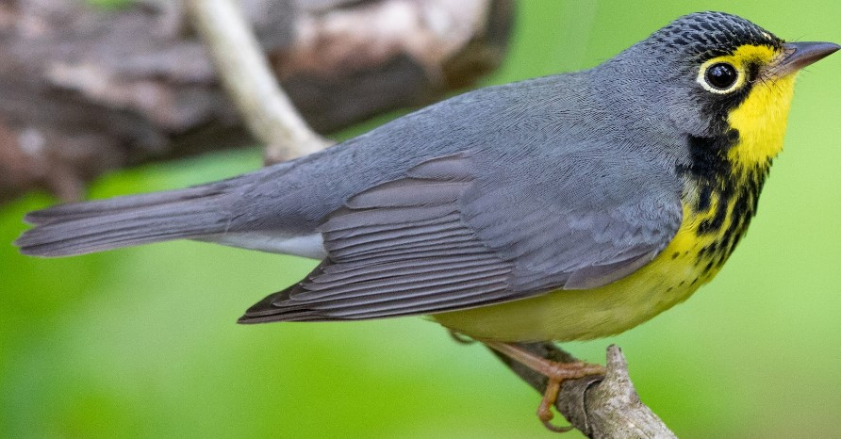
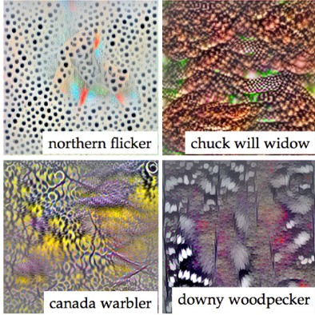
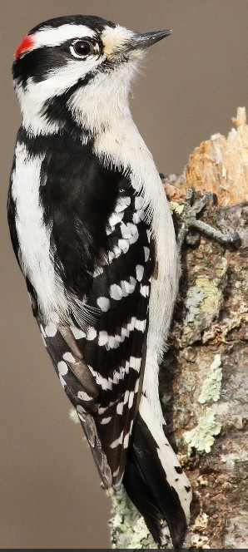
Applications of Convolutional Autoencoders
Image Classification, image reconstruction
Northern Flicker
Feature extraction
Bilinear CNNs for Fine-grained Visual Recognition, Tsung-Yu Lin et al.
CAP 2024-05-27, Annabelle Makowski 6

Slide 7
Training the Convolutional Autoencoder Network
Prepare training data
Normalization
Augmentation
CAP 2024-05-27, Annabelle Makowski 7

Slide 8
Training the Convolutional Autoencoder Network
Prepare training data
Clean-to-clean training
Normalization
Clean pulses are input, the same clean pulses are output
Augmentation
The model learns what clean pulses look like
CAP 2024-05-27, Annabelle Makowski 8

Slide 9
Training the Convolutional Autoencoder Network
Prepare training data
Clean-to-clean training
Test the trained model
Normalization
Clean pulses are input, the same clean pulses are output
Test on noisy and clean pulses
Augmentation
Test on different pulse shapes
The model learns what clean pulses look like
CAP 2024-05-27, Annabelle Makowski 9

Slide 10
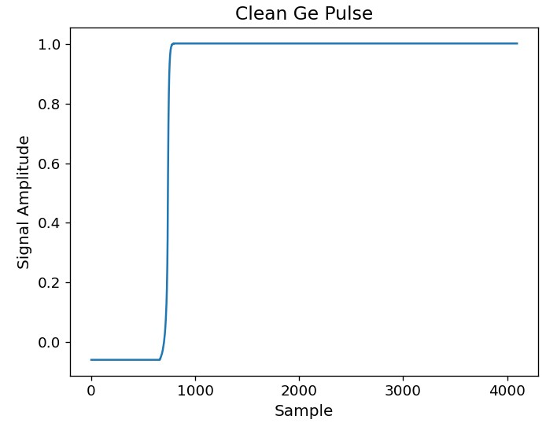
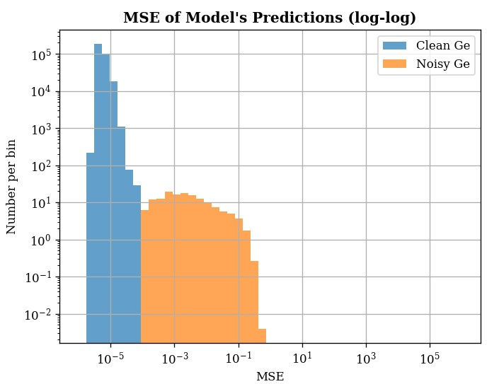
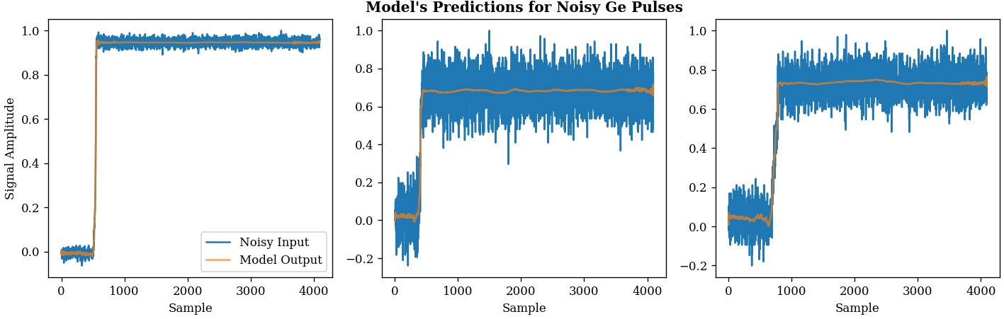
Germanium Pulse Training
As an initial proof of concept, the model trained on clean Ge pulses and tested on noisy Germanium pulses.
  There is much more of this data-type available for training.
Simulated clean pulses modeled from a high purity Germanium detector, with real noise added to create noisy pulses.
Trained on 2.8 million Ge pulses.
CAP 2024-05-27, Annabelle Makowski 10
Notes:
Delete this page

Slide 11
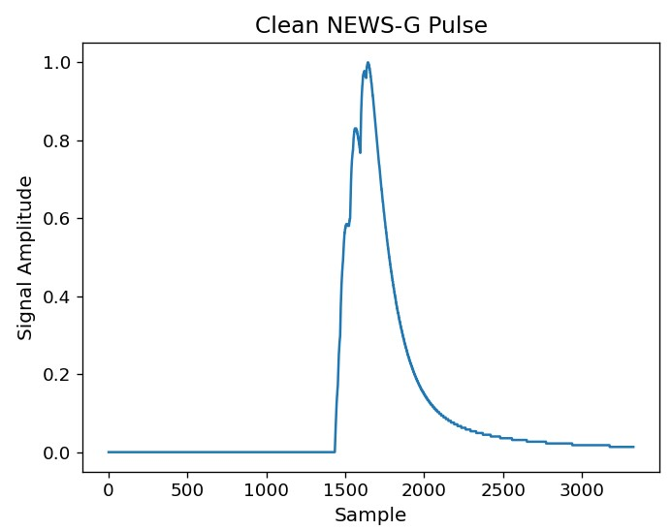
Applying the Model to NEWS-G SPC Pulses
These pulses have a different shape, characteristic of single electron signals from SPCs.
Training data generated by simulating an SPC detector, where noisy pulses have real noise added to the clean simulated pulses.
Training data had to be prepared carefully:
  If there is too much variation in the baseline of the pulses, the model will not calculate training metrics. In the other extreme, if there is too little variation, the model will not reconstruct the baseline of the pulse correctly.
  Also want the model to not reconstruct electronic noise present in some pulses.
CAP 2024-05-27, Annabelle Makowski 11
Notes:
Delete this page

Slide 12
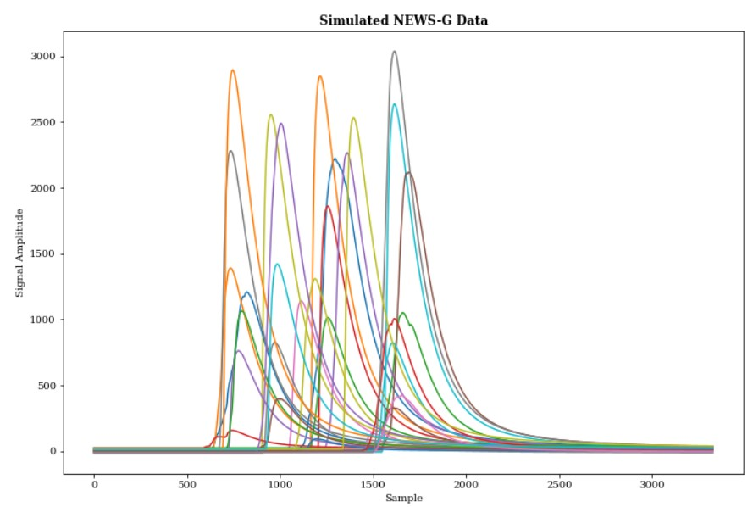
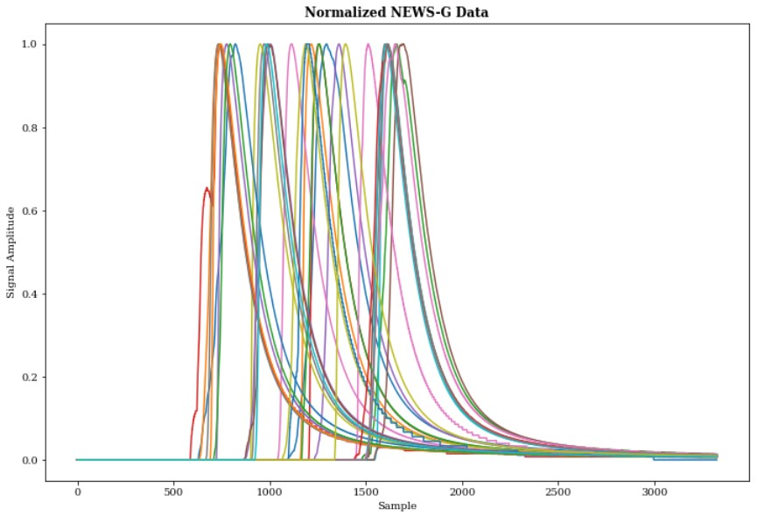
Preparing the NEWS-G Training Data
The pulses from the simulations have a wide range of amplitudes. The model will have trouble with this much variation in the input, so the amplitude of all pulses must be normalized.
CAP 2024-05-27, Annabelle Makowski 12
Notes:
Delete this page

Slide 13
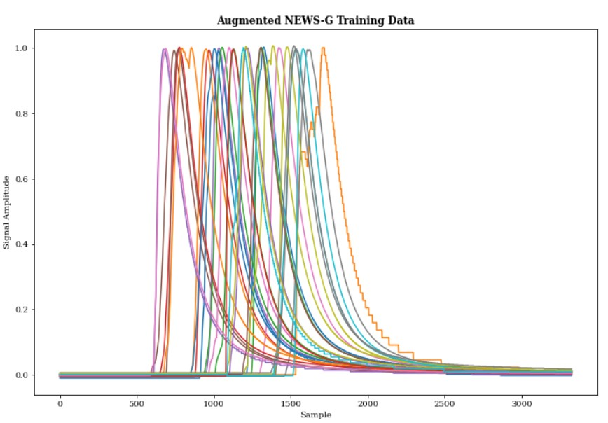
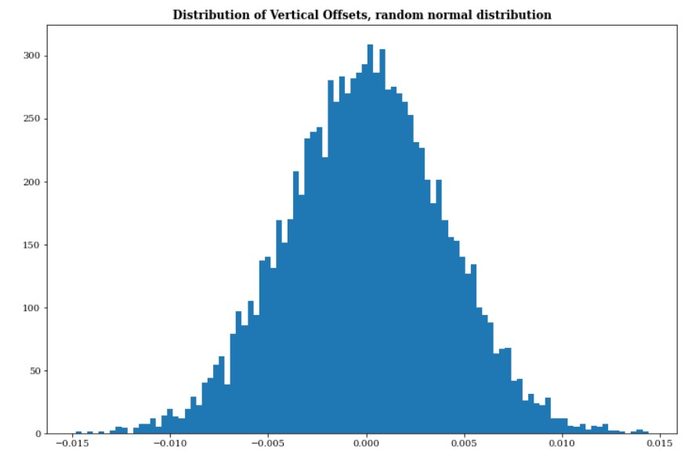
Preparing the NEWS-G Training Data
The normalization removes the variation in vertical shifts. This is applied again via a generated random normal distribution.
These variations are important to help the model learn what variations to expect in the real data.
CAP 2024-05-27, Annabelle Makowski 13
Notes:
Delete this page

Slide 14
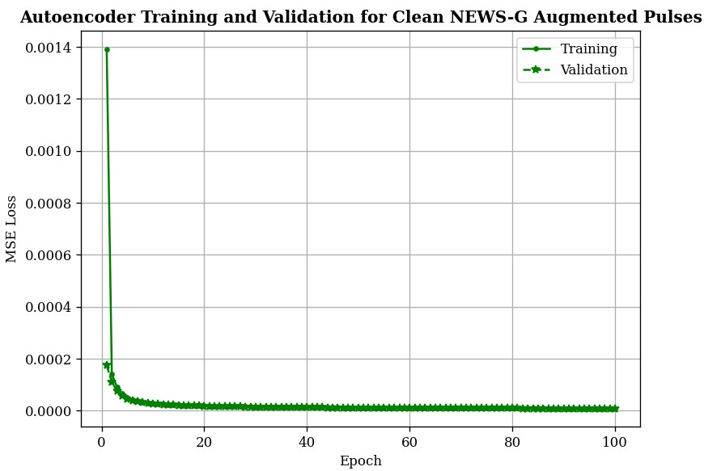
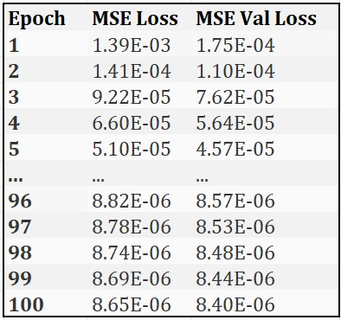
NEWS-G Pulse Training Results
Trained on 700,000 augmented NEWS-G pulses for 100 epochs, takes ~13 hours to complete.
Mean Squared Error Loss – how the model’s predictions are measured.
  A better prediction = less loss.
CAP 2024-05-27, Annabelle Makowski 14
Notes:
Delete this page

Slide 15
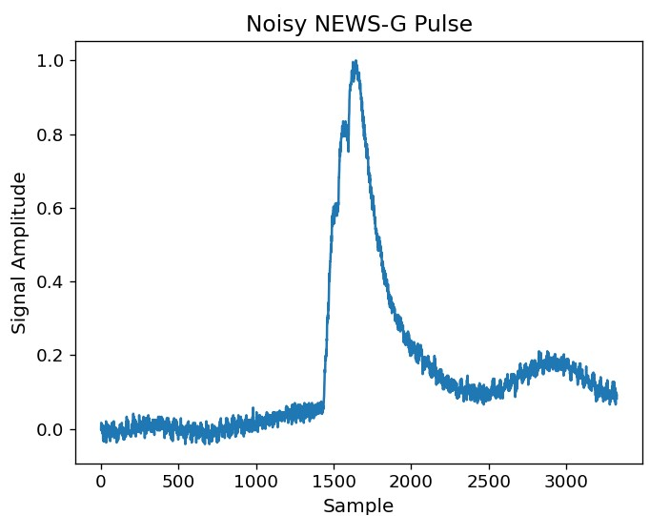
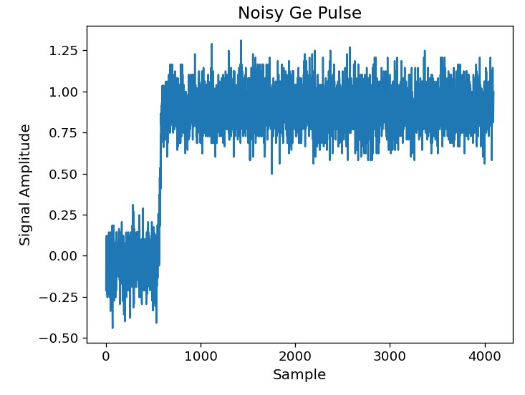
Testing the Model
Have four possible pulse types. Can give all of these to the model for testing. Also use the Ge pulses to see how the model performs on a different pulse shape type than what it trained on.
All test data was normalized to have amplitudes of 0-1. However, this normalization is not always exact.
Test Datasets:
6,985 clean Ge pulses
6,985 noisy Ge pulses
10,000 clean NEWS-G pulses
10,000 noisy NEWS-G pulses
CAP 2024-05-27, Annabelle Makowski 15
Notes:
Delete this page

Slide 16
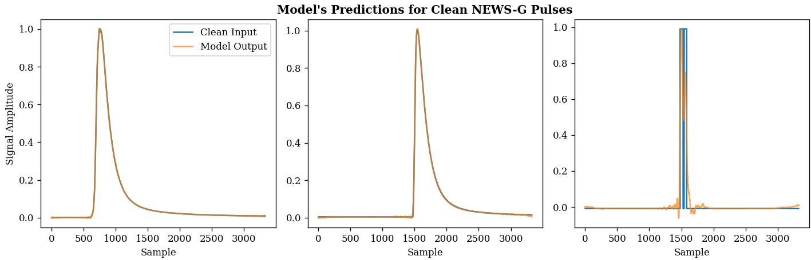
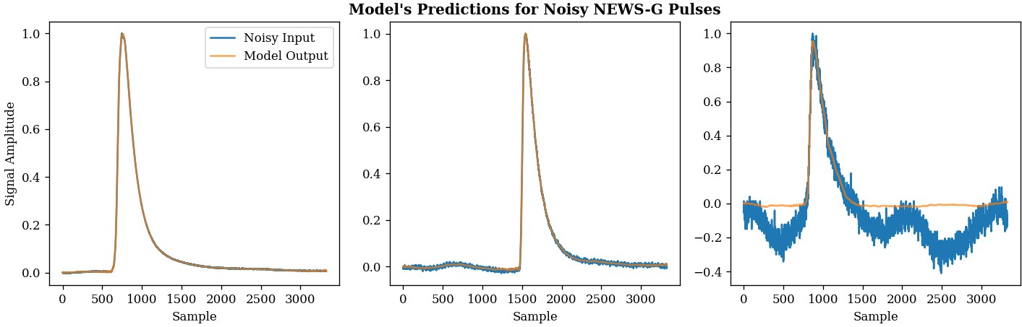
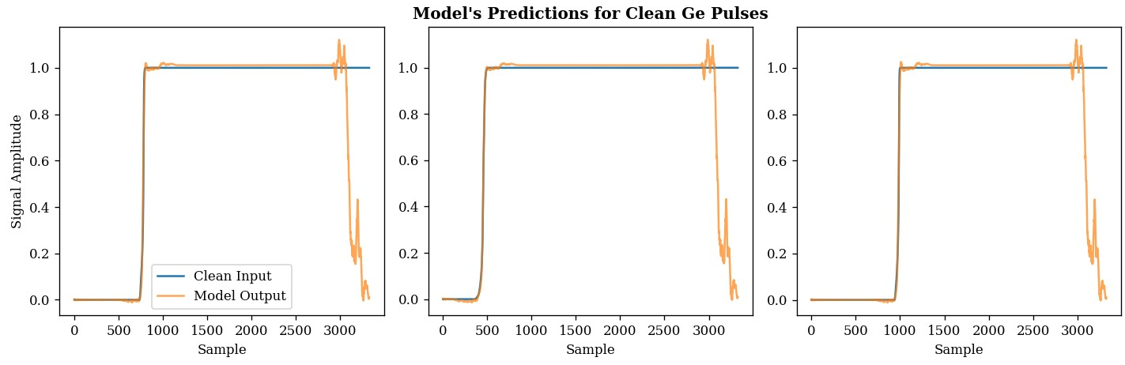
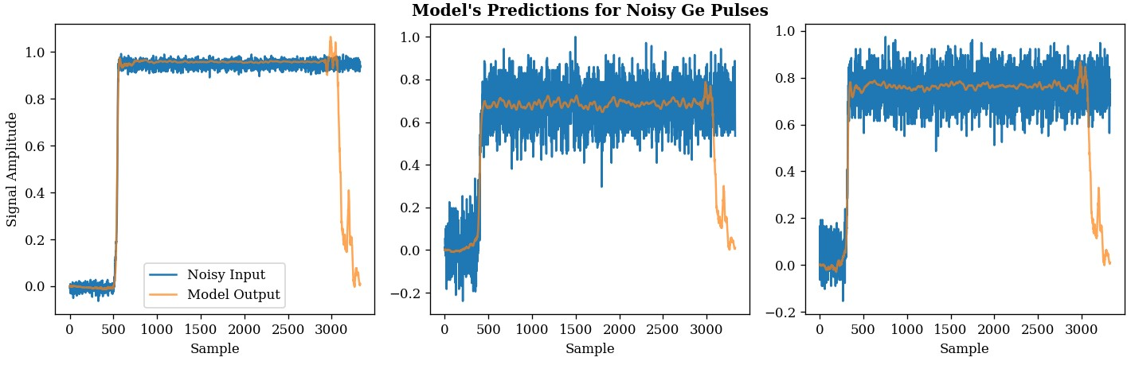
Test Results
NEWS-G Pulse Predictions
Ge Pulse Predictions
Since this model was trained on clean NEWS-G pulses, it is expected that it would have the best predictions on this pulse type.
CAP 2024-05-27, Annabelle Makowski 16

Slide 17
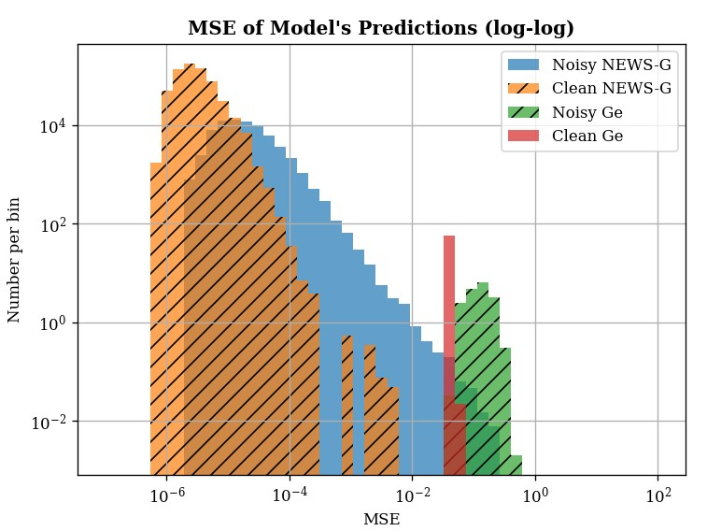
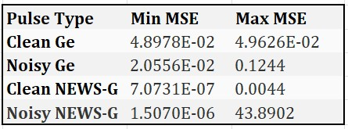
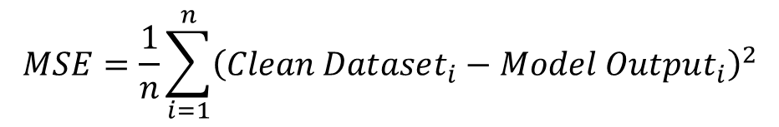
Comparing the Model’s Outputs
The model had the best predictions on clean NEWS-G pulses, since these are the same pulse type that the model trained on.
There are clear areas of different pulse shapes in the MSE. This is a good indication that the model could be used to identify different event populations and filter out unwanted pulses in the data.
$$MSE=\frac{1}{n}\sum_{i=1}^{n}{{\left(Clean Dataset_{i}−Model Output_{i}\right)}^{2}}$$
CAP 2024-05-27, Annabelle Makowski 17

Slide 18
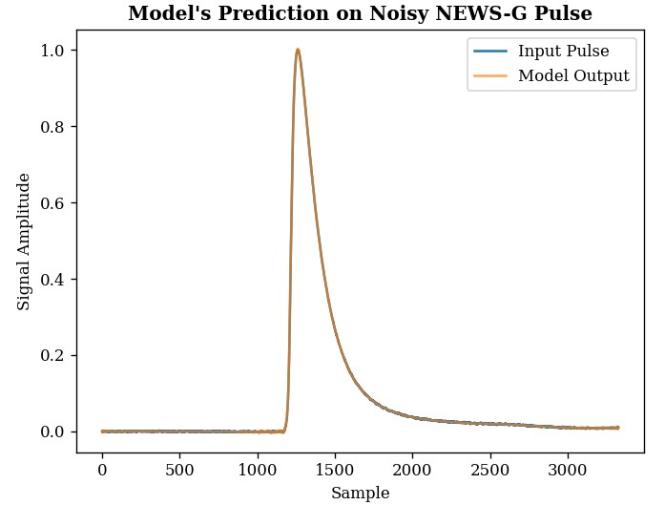
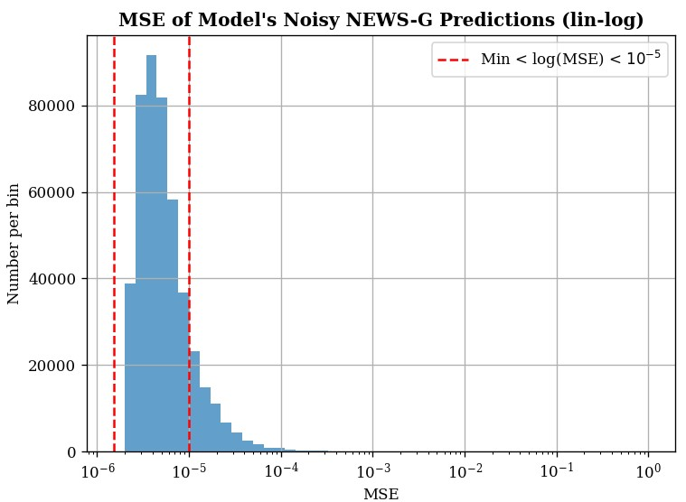
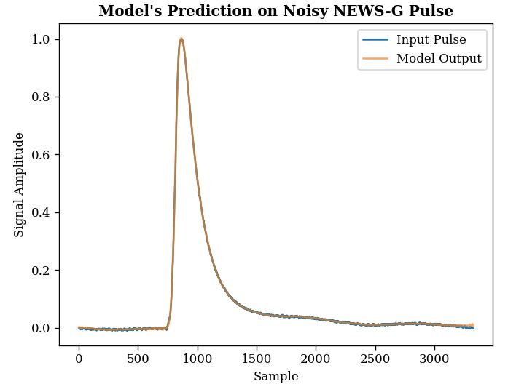
Examining Different Pulse Shapes at Different MSE’s
Minimum MSE Pulse
CAP 2024-05-27, Annabelle Makowski 18

Slide 19
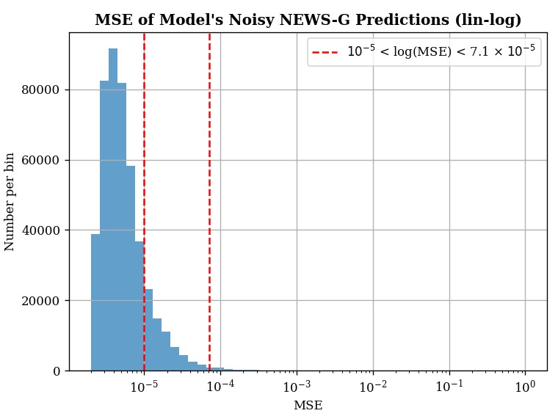
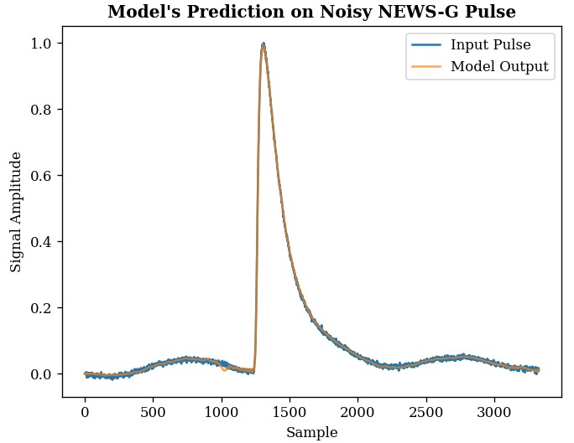
Examining Different Pulse Shapes at Different MSE’s
CAP 2024-05-27, Annabelle Makowski 19

Slide 20

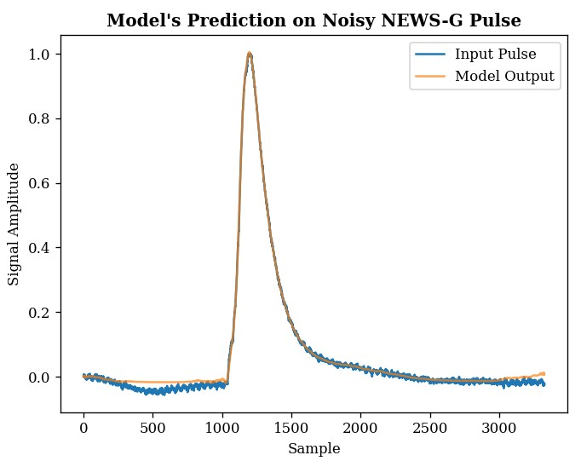
Examining Different Pulse Shapes at Different MSE’s
CAP 2024-05-27, Annabelle Makowski 20

Slide 21
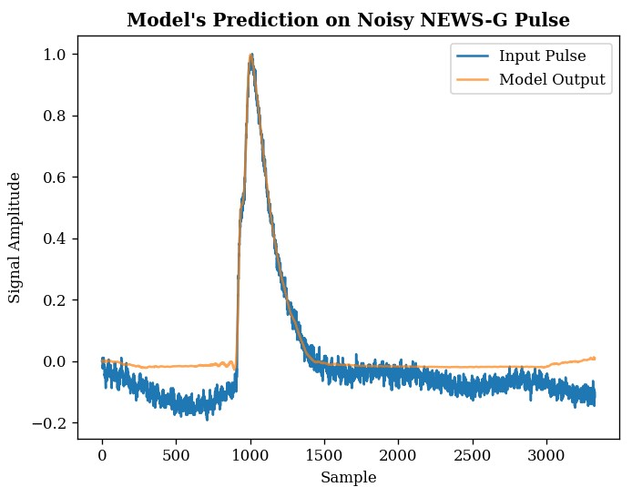
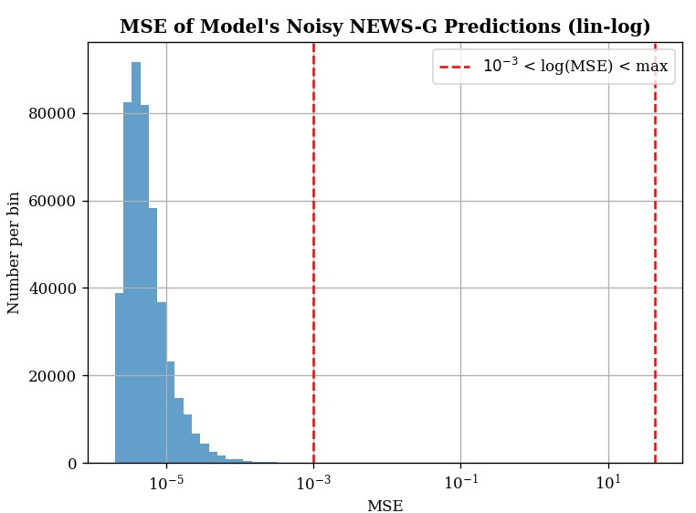
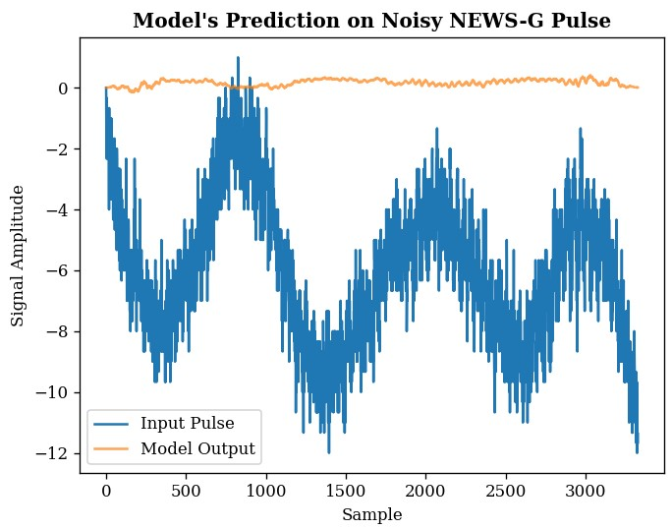
Examining Different Pulse Shapes at Different MSE’s
Maximum MSE Pulse
CAP 2024-05-27, Annabelle Makowski 21

Slide 22
Conclusions
The model’s predictions heavily rely on the input data being as similar as possible to the data it was trained on.
This is beneficial for data cleaning and filtering out non-physics pulses, since the model will have worse predictions for pulse types that differ from the training data. The model is also unsupervised, so non-physics pulse shapes do not need to be known ahead of time.
Once trained on one type of clean data, the model can de-noise that data type much better than other data types.
The model training may have to be further modified to reduce how noise is affecting the model’s predictions.
The next step is to test the model on real SPC data. Currently these tests were only done using simulated data.
CAP 2024-05-27, Annabelle Makowski 22

Slide 23

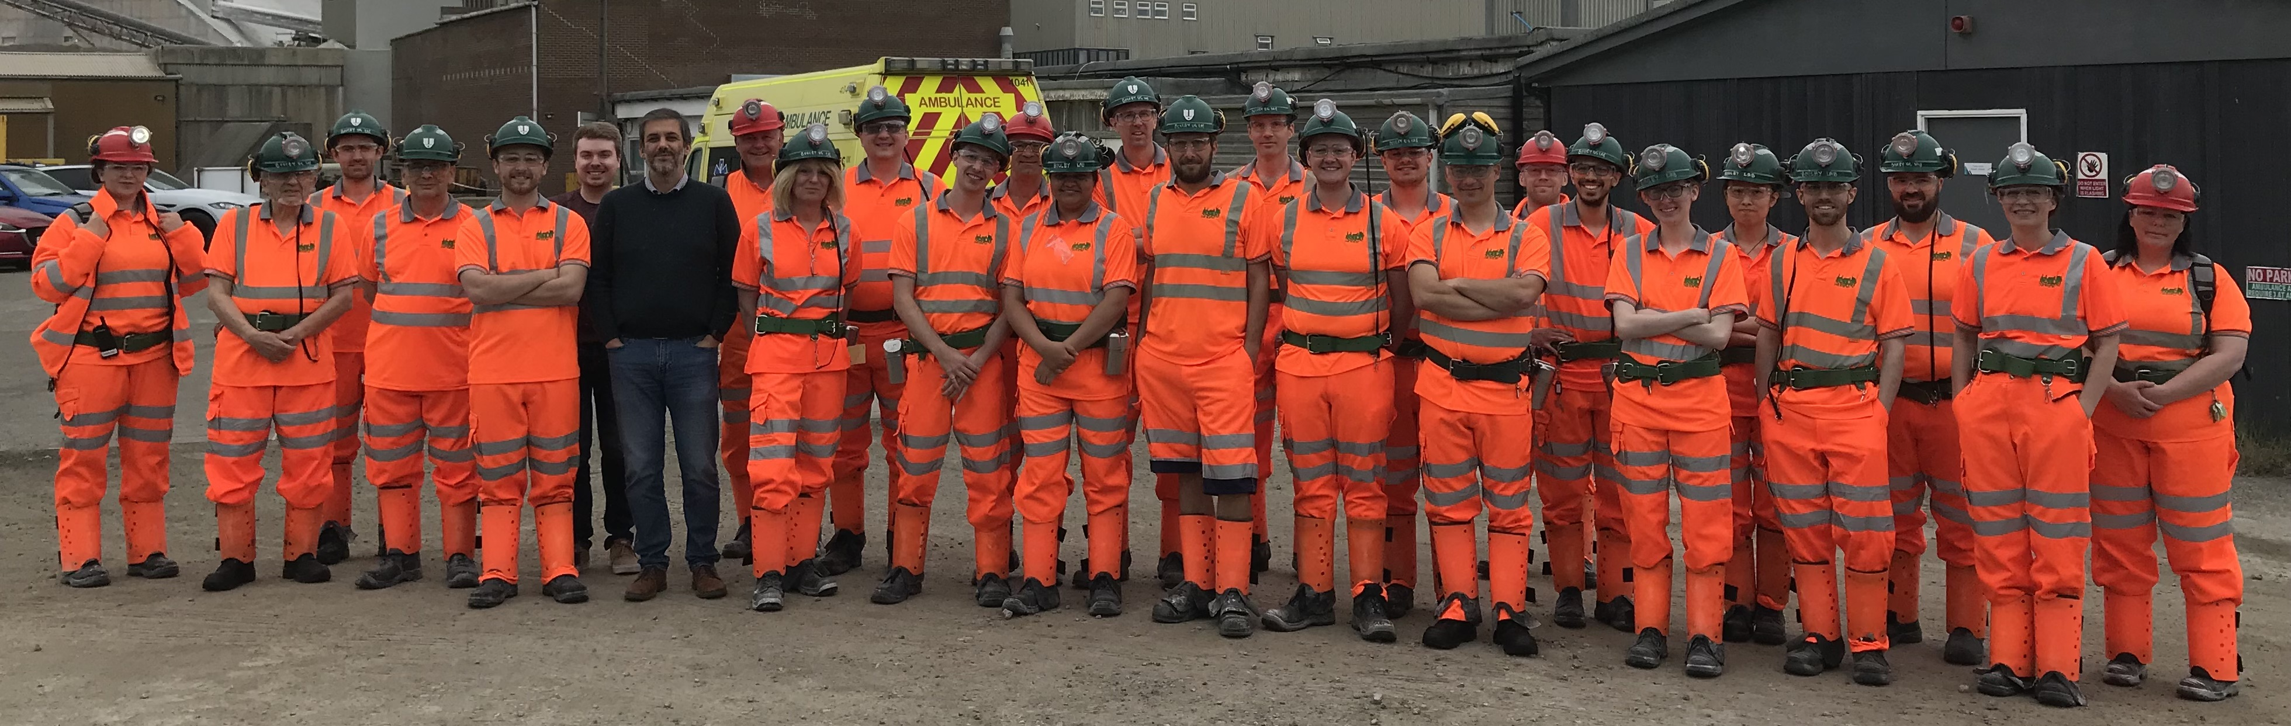
Thank you!
CAP 2024-05-27, Annabelle Makowski 23
Notes:
Delete this page

Slide 24
Extra Slides
CAP 2024-05-27, Annabelle Makowski 24
Notes:
Delete this page

Slide 25
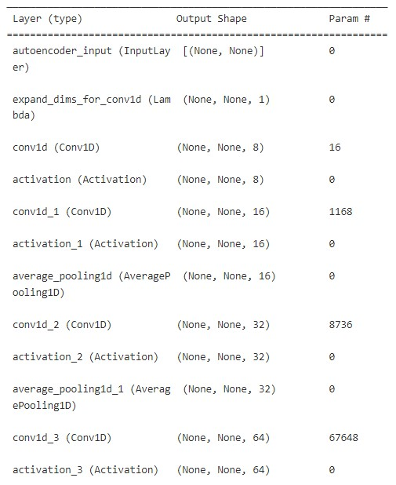
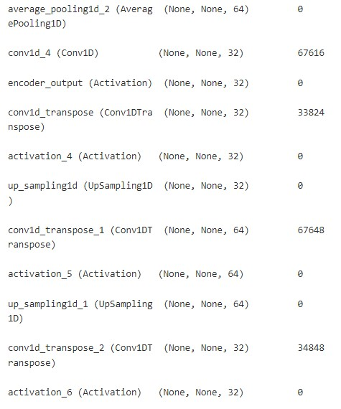
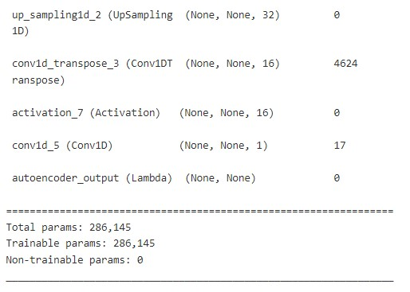
Model Summary
CAP 2024-05-27, Annabelle Makowski 25

