Slide 1







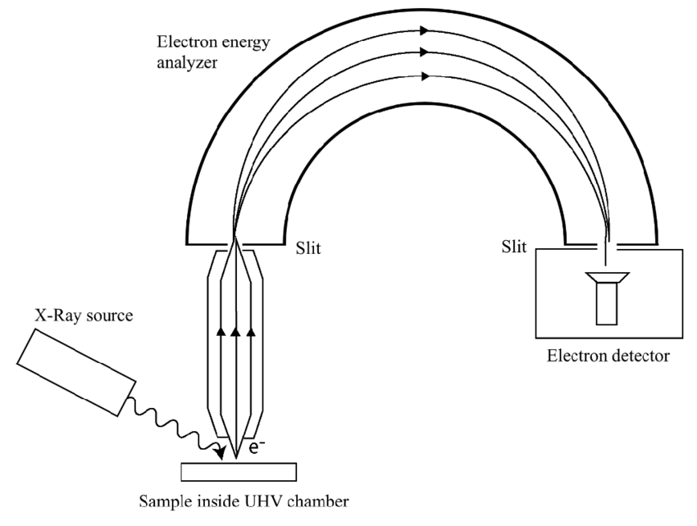
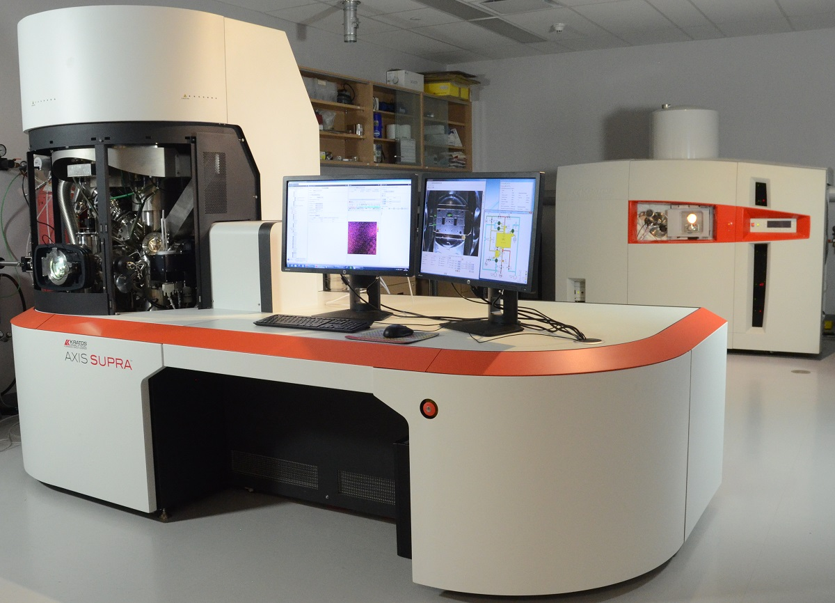
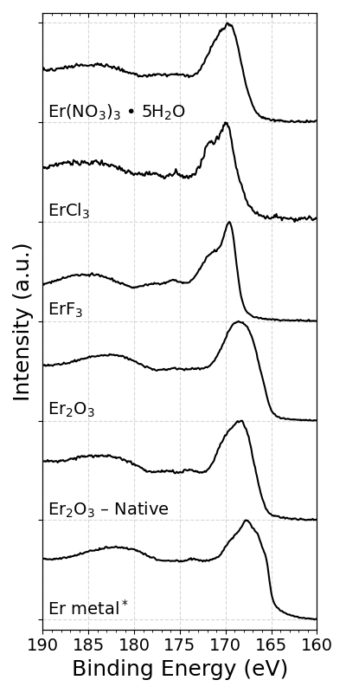
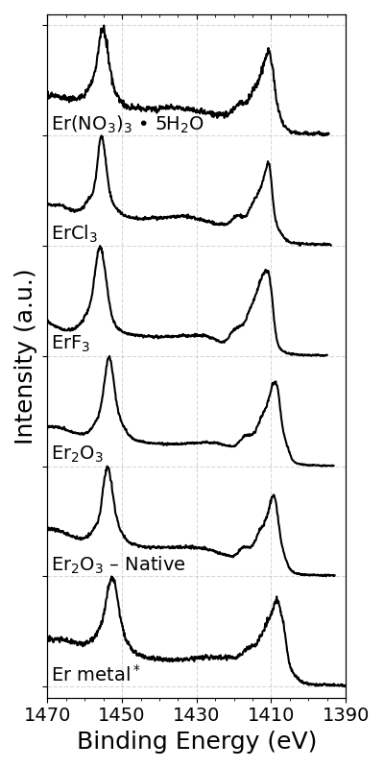
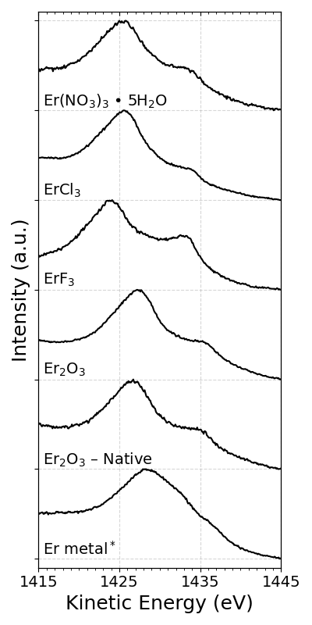



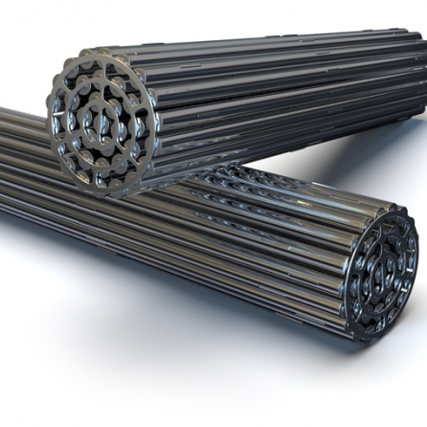
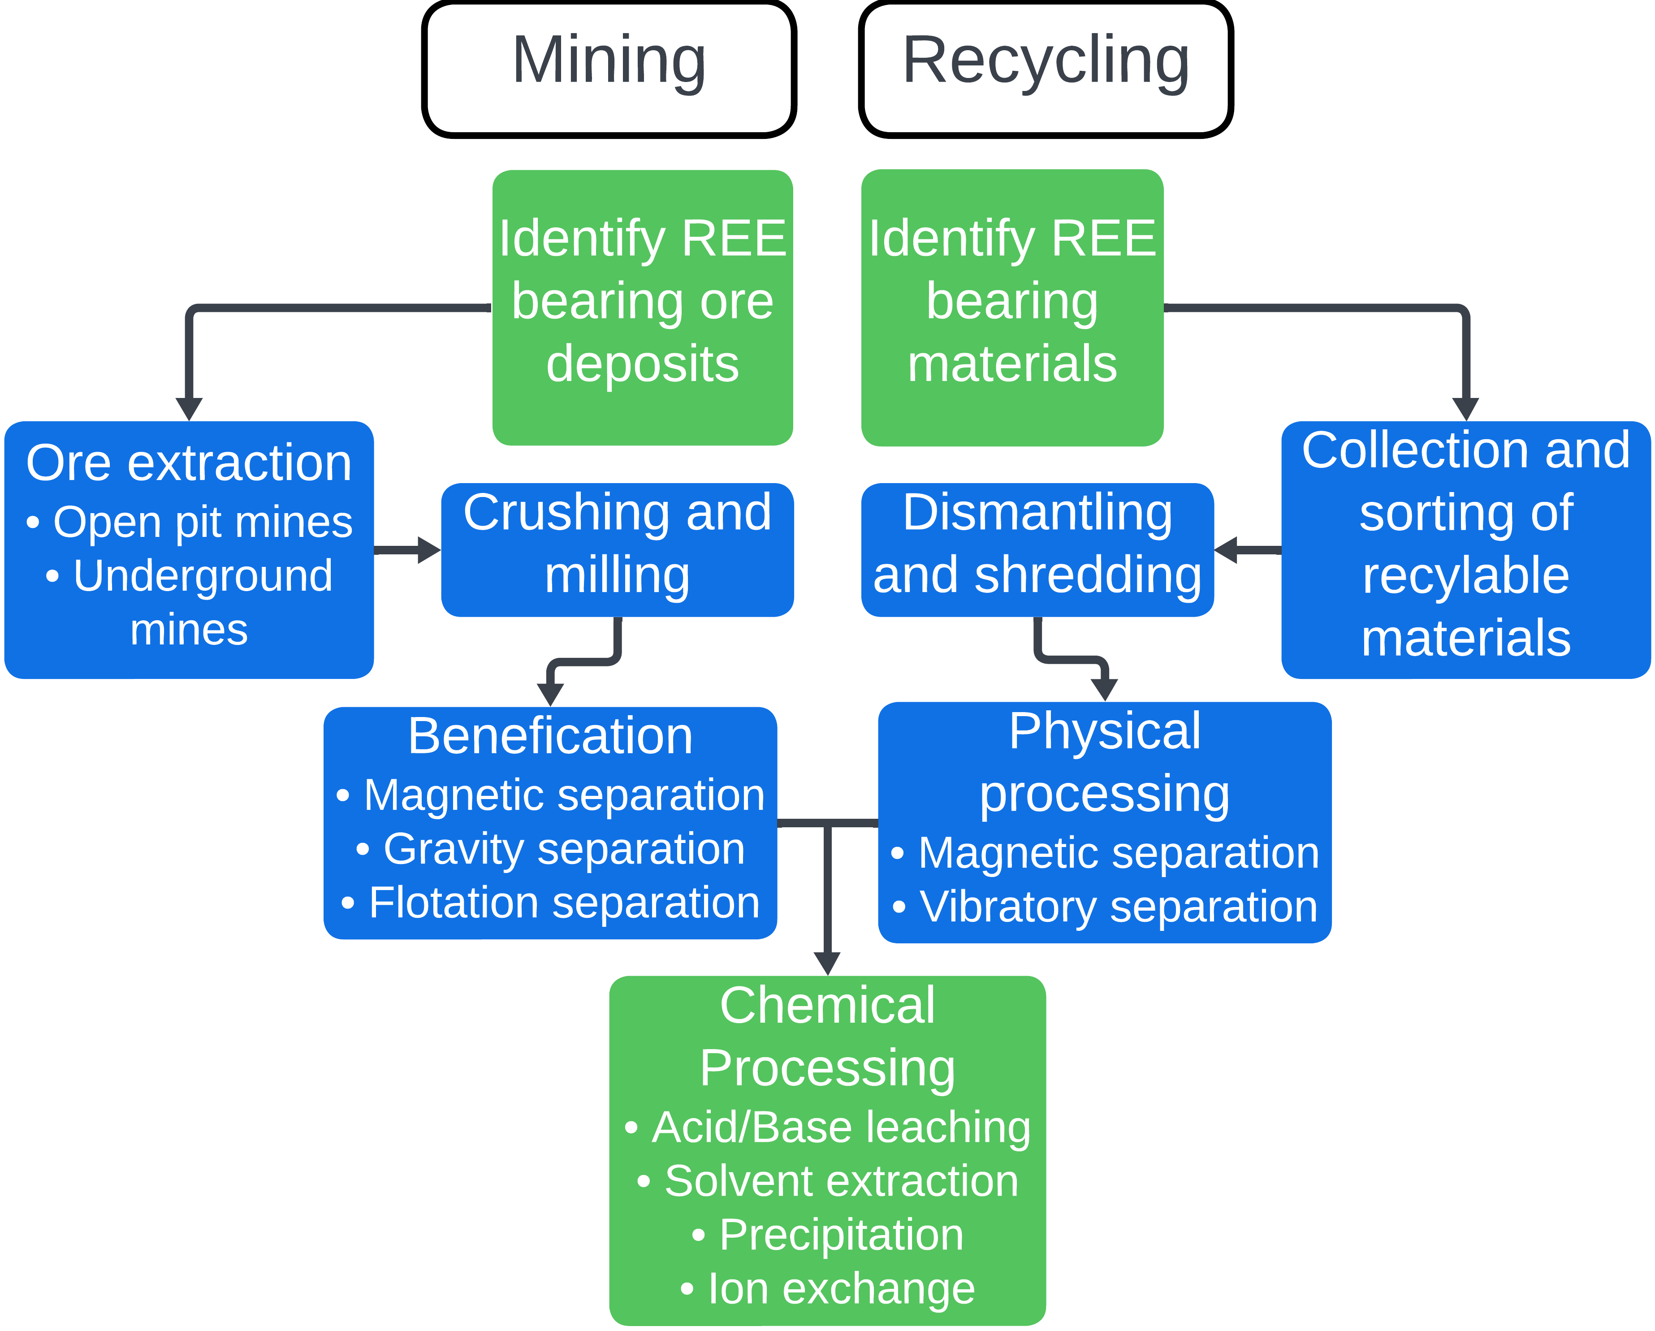
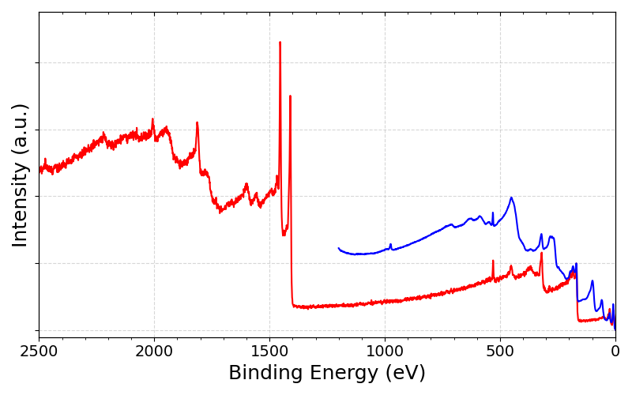
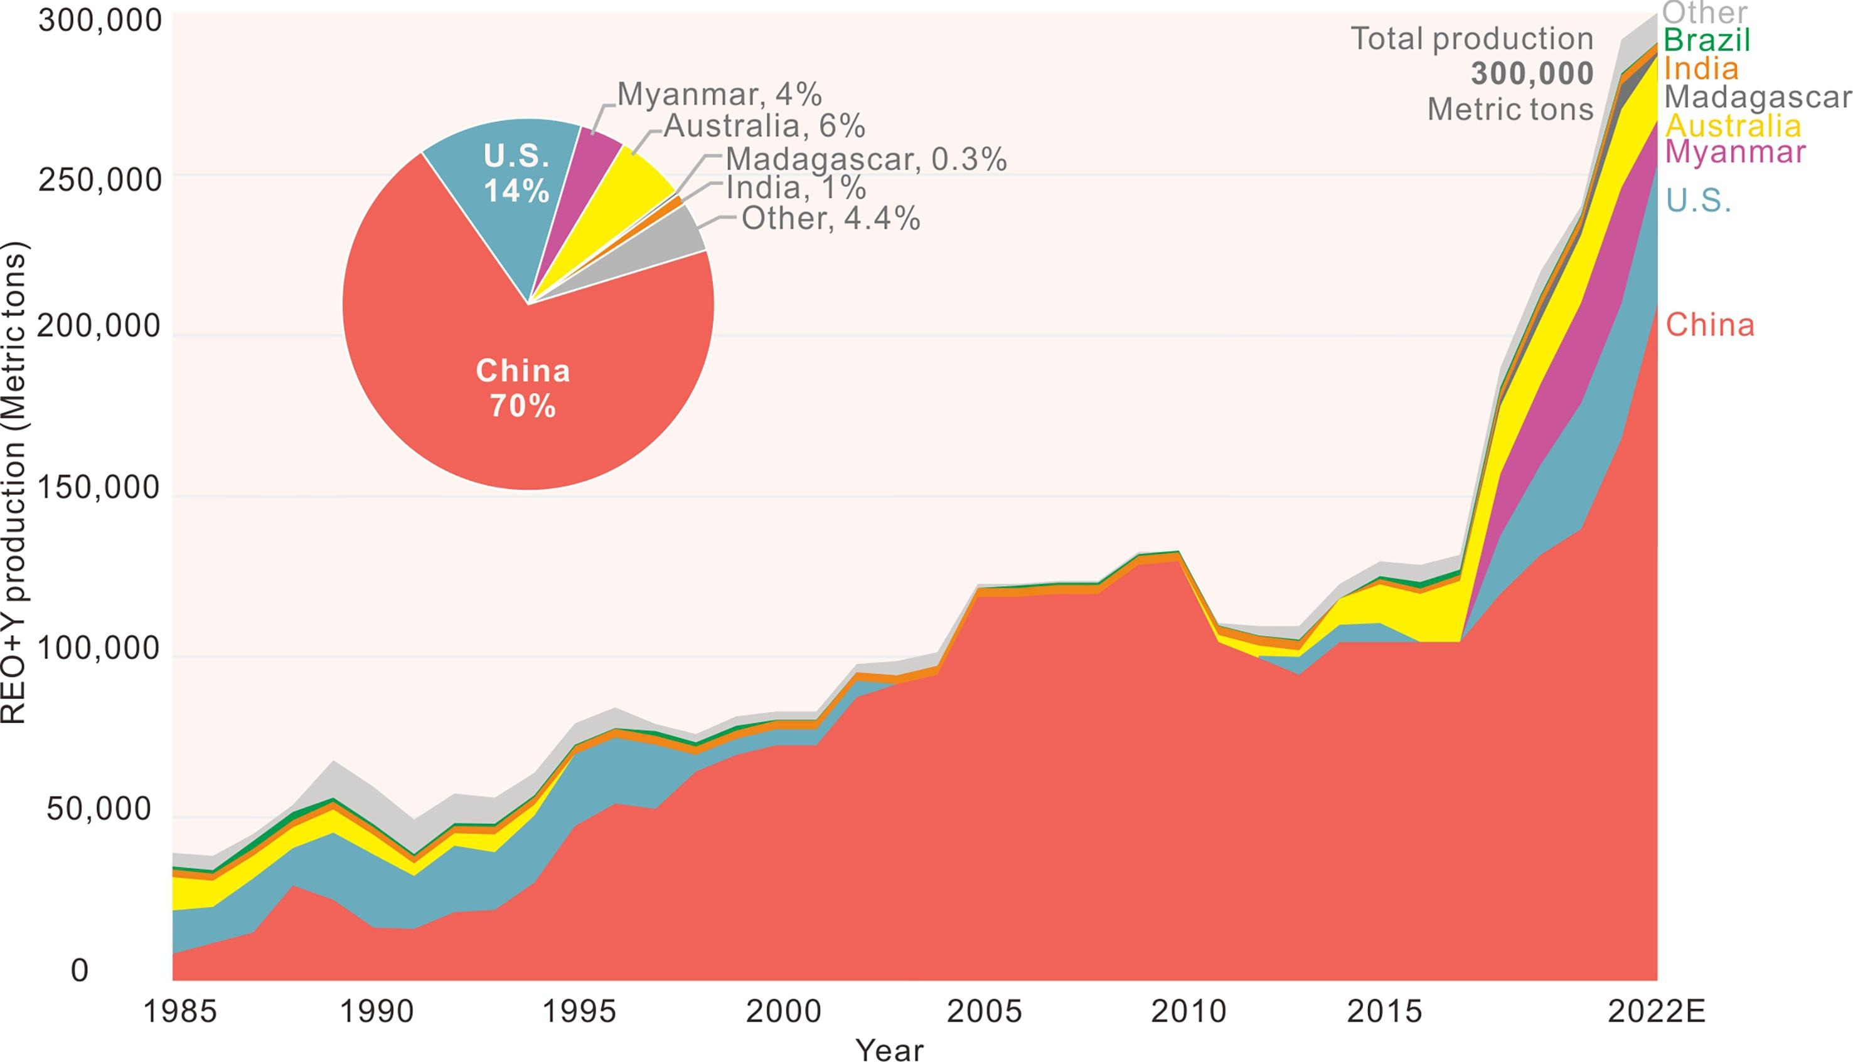
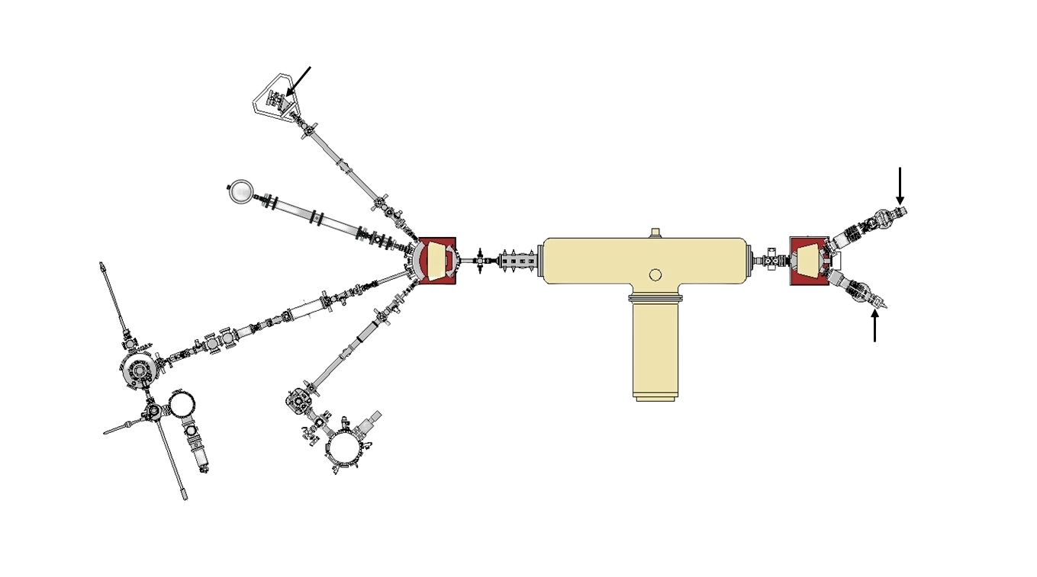
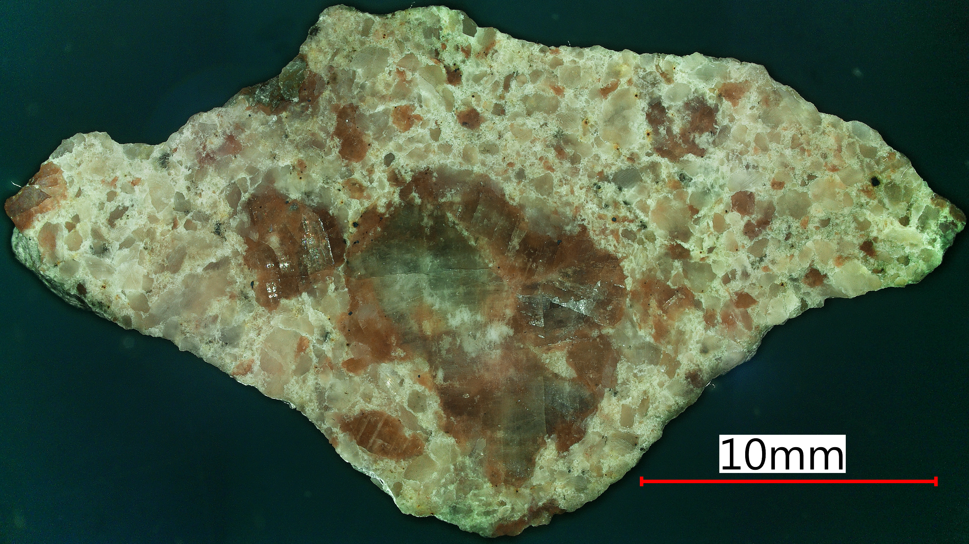
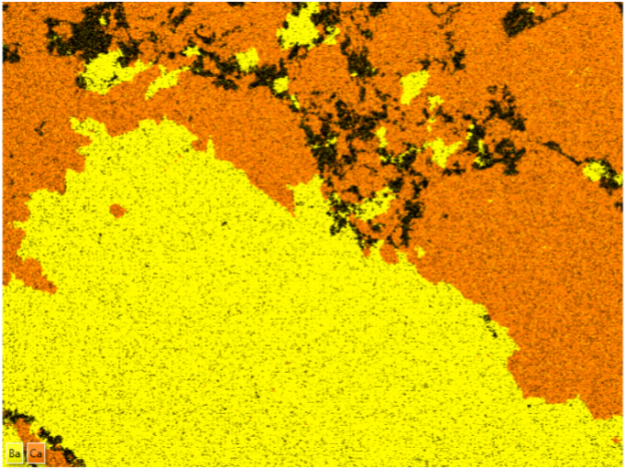
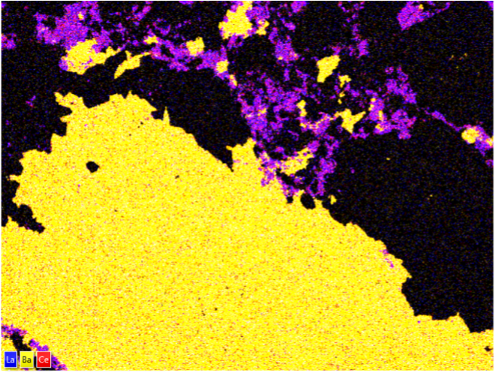
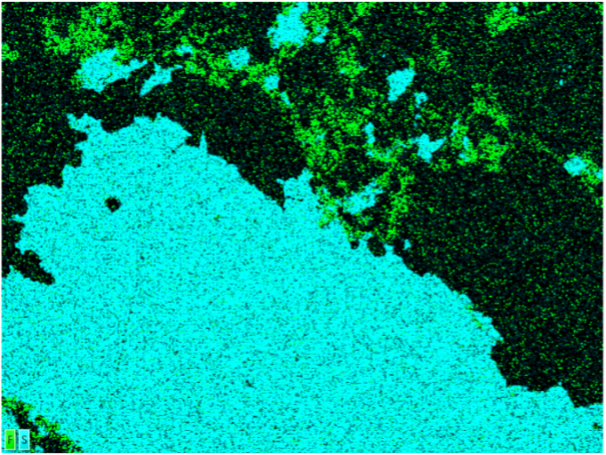
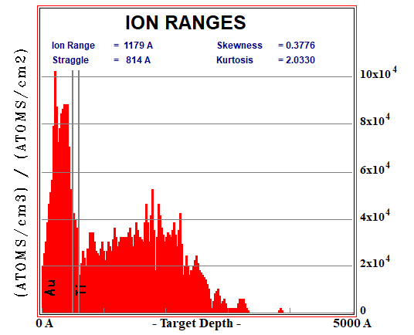
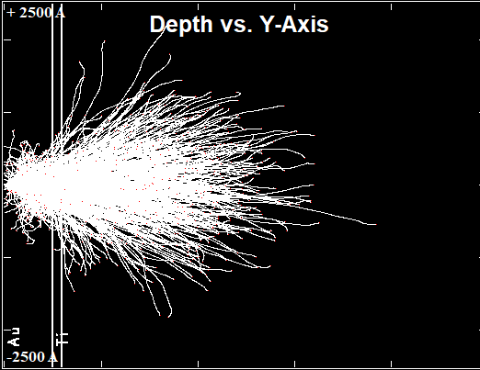

A Multimodal Approach Towards Advancing the Characterization and Analysis of Erbium
Sage Buchanan^{1,2}, Dr. Lyudmila Goncharova^{2,3}, Dr. Mark Biesinger^{1,3}
¹Surface Science Western, The University of Western Ontario, London N6G 0J3, ON, Canada
²Department of Physics and Astronomy, The University of Western Ontario, London N6G 2V4, ON, Canada
³Department of Chemistry, The University of Western Ontario, London N6A 3K7, ON, Canada
A Multimodal Approach Towards Advancing the Characterization and Analysis of Erbium
Sage Buchanan^{1,2}, Dr. Lyudmila Goncharova^{2,3}, Dr. Mark Biesinger^{1,3}
¹Surface Science Western, The University of Western Ontario, London N6G 0J3, ON, Canada
²Department of Physics and Astronomy, The University of Western Ontario, London N6G 2V4, ON, Canada
³Department of Chemistry, The University of Western Ontario, London N6A 3K7, ON, Canada
Research Fund
Goal: To enhance the detection, chemical state identification, and recovery capabilities of erbium and other critical rare earth minerals for improved mineral security and economic stability
Results – XPS
$$B.E. =hν −(K.E. + φ)$$
Introduction
*Critical Minerals:^{[1]}
“Have few or no substitutes
Are strategic and somewhat limited commodities; or
Are increasingly concentrated in terms of extraction and, even more, in terms of processing location”
XPS is used to elucidate the chemical states of REE’s within each ore or material. To accurately identify these chemical states, reference spectra of pure REE compounds are needed. These compounds exhibit complex structures and suffer from various broad overlapping Auger peaks in regions of interest, thus higher energy X-rays (Ag L𝛼) are also being utilized.
Erbium is one of the Rare Earth Elements (REE’s), the only class of critical minerals* common to all member nations of the Minerals Security Partnership.^{[1]} REE’s are essential to support our advancing and increasingly sustainability focused economies with applications in all major energy industries, electric vehicles (EV’s), advanced consumer electronics, catalysts, and many other areas.
Production challenges and geopolitical tensions are creating supply chain risks for REE’s. To maintain responsible resource management and disposal strategies, it is crucial to have a comprehensive understanding of the properties and quality of REE-containing materials.
This work is an effort to advance current methodologies surrounding the analysis and characterization of REE’s, with a focus on erbium. We present preliminary Rutherford Backscattering Spectroscopy (RBS) results on creating ion-implanted calibration standards for erbium Secondary Ion Mass Spectrometry (SIMS) analyses, and in-depth X-ray Photoelectron Spectroscopy (XPS) studies of erbium standards and REE-containing minerals of significance.
a)
Er 4d
b)
Er 3d
c)
Er M4VV
They are important, and there are risks with their supply chains
Applications of REE’s:
                Permanent magnets
                Generators, motors, EV’s, MRI’s
          Electronics
              LED’s, cell phones, batteries, IR optics, LCD screens, speakers
          Catalysts
            Catalytic converters
            Energy
            Nuclear control rods, solar cells, wind turbines, fossil fuel refining
Change in peak structures
Satellites
Rare Earth Element Supply Chains
Global supply of REE’s is still largely monopolized by China, as shown in Figure 1. While a few other countries are (re)emerging as REE producers, Canada currently produces no REE’s commercially and the U.S. remains >95% reliant on imports for their current REE consumption.^{[1, 2]}
As demand rapidly increases, it is essential to enhance the feasibility and efficiency of REE production through both mining and recycling. Current recovery estimates from mined ores range from 50-80%^{[4]}, which we aim to improve upon, alongside strengthened recycling efforts by advancing our abilities to detect and quantify the chemical states of REE’s using calibration standards and analyzing reference materials.
Peaks shift with chemical state
Figure 5: Normalized spectra of the a) Er 4d, b) Er 3d, and c) Er M4VV peaks from each erbium standard compound measured. Main peak positions are highlighted with the dotted red lines to show the shifts observed with changes in chemical state. *Surface oxide is still observed in Er metal, noted by the presence of the O 1s peak (Figure 6) and rounded Er 4d structure.^{[6]}
Al K𝛼 – 1486.6 eV
Er 3d_{3/2}
With Al K𝛼 X-rays, Er Auger peaks interfere with many peaks of interest, notably the C 1s peak
Different chemical states exhibit energy shifts and structural changes in all main peaks
Complex structure and satellites are observed in Er 4d and Er 3d peaks
Higher energy X-ray’s shift Auger peaks and give rise to stronger photoelectron peaks
Curve-fitting of peak envelopes with constraints should be employed for more accurate speciation
Elemental ratios from survey quantification and counterion peaks must also be considered and compared to the expected chemistry and stoichiometry
All high-resolution spectra are charge corrected to the alkyl-type component of C 1s at 284.8 eV
Ag L𝛼 – 2984.3 eV
Er 3d_{5/2}
O KLL
Er 3p_{1/2}
Er 3p_{3/2}
Er MNN
Er MNN
Er MNN
O 1s
Er MNN
Strong Er 3d peaks visible
O KLL
Er 4s
Er 4p
Er 4d
Increased yield
Increased efficiency
Increased viability
Decreased cost
Decreased time
Decreased waste
C 1s
Er M5VV
Auger peaks ‘shift’ to higher binding energy
Er M4VV
By improving our ability to detect and accurately identify REE’s, we support the critical initial and final steps in both streams of the REE supply chain.
Figure 1: Global mine production by country of yttrium-containing rare earth oxides. Reprinted with permission from Liu et al. [3]
Figure 6: Survey scan spectra of Ar₅₀₀+ sputter-cleaned Er metal taken with Al K𝛼 (blue) and Ag L𝛼 (red)
X-ray sources. Spectra are normalized to the Er 4d peak at 168 eV. Auger peaks are marked in green.
Results – Ion Implantation and RBS
Bastnaesite, (Ce, La, Y)CO₃F
Conclusions and References
RBS chamber
Ion implantation is being tested as a method to create calibration standards for SIMS analyses as known concentrations can be implanted.
Our method involves:
Using SRIM^{[5]} simulations to inform implant conditions
Implanting Er⁺ ions into Si wafers shielded by removable masks via the Tandetron accelerator
  Masks are used to achieve desired implant depths
Conducting RBS with He⁺ ions to analyze the depth profiles of the implanted wafers and to evaluate for beam damage and/or contamination
a)
b)
                Improvements on methods of detecting, identifying, and quantifying REE’s such as XPS can inform and enhance recovery procedures to strengthen REE supply chains from both mining and recycling
                Ion implantation with RBS verification could be a promising method to develop custom calibration standards for SIMS analyses in a semi-affordable and efficient fashion – more testing is needed
                Light REE’s were found in interstitial regions between the associated barite (BaSO₄) and calcite (CaCO₃) mineral grains
                [1] Service Canada. “The Canadian Critical Minerals Strategy.” (2022)
                [2] U.S. Department of the Interior “Mineral Commodity Summaries” (2023)
                [3] S.L. Liu et al. Ore Geology Reviews 157 (2023):
                [4] T. McNulty et al. MRS Bulletin 47, no. 3, 258–266 (2022)
                [5] J.F. Ziegler et al. Nuclear Instruments and Methods in Physics Research Section B: Beam Interactions with Materials and Atoms 268, no. 11, 1818–1823 (2010)
                [6] J.F. Moulder et al. Handbook of X-ray Photoelectron Spectroscopy (1992)
ERD chamber
Duoplasmatron source
Raster scanner
High energy magnet
Tandetron accelerator
Injector
magnet
10 mm
Ba
Ca
1 mm
Implant chamber
Quadrupoles
c)
d)
MEIS chamber
Implant
apertures
1 m
Sputter source
(Er₂O₃)
Molecular Beam Epitaxy systems
Ba
La
Ce
1 mm
F
S
1 mm
Etched off with aqua regia (3HCI + HNO₃) after implanting
1000
C
Figure 7: a) An optical image of a cross-section of bastnaesite, the red box indicates where Energy Dispersive X-ray maps were taken of b) barium (yellow) and calcium (orange), c) barium (yellow), lanthanum (blue), and cerium (red), and d) fluorine (green) and sulfur (cyan).
a)
Avg. Depth: 1179 Å
Straggle: 814 Å
Depth vs. Y-axis
b)
x10⁴
O
Si
10
Er⁺
Er distribution
Ti
BaSO₄
100
Er
8
Au
CaCO₃ +
(Ce, La)CO₃F
(Atoms / cm³ ) / (Atoms / cm²)
6
Yield
Au and Ti remain trapped
Table 1: XPS survey scan atomic percentages from different areas on the bastnaesite surface. Rare earths detected are highlighted in yellow.
4
10
Acknowledgements
2
x
z
Au (50 nm)
  This work is supported by Natural Science and Engineering Research Council of Canada (NSERC) Discovery Grants as well as funding from the Canadian Foundation for Innovation and Ontario Research Fund for the Kratos AXIS Supra spectrometer. The mineral samples analyzed in this work were supplied by the Dana Collection, courtesy of the Richard W. Hutchison Geoscience Collaborative Suite. Special thanks to Jack Hendriks for assistance in operating the Tandetron Accelerator, Dr. Todd Simpson and Tim Goldhawk from the Western nanofabrication facility for the implant mask depositions and initial mask removal, and Dr. Jeffrey Henderson for assistance in XPS and EDX analyses and processing.
1
300
400
500
600
700
800
900
1000
Au
Ti
Si
0
y
Si
Ti (10 nm)
200
Energy (keV)
0
Target Depth (Å)
5000
Figure 2: SRIM^{[5]} simulations of implanting Er⁺ ions into Au/Ti/Si showing a) the concentration of Er⁺ ions with target depth and b) Monte-Carlo simulated paths the implanted ions take in the y-z plane.
Figure 3: An exaggerated model of the Er⁺ into Si implantation layer structure. Au and an adhesive Ti layer were used as a temporary mask to intentionally stop the ions nearer to the surface of the Si substrate.
Figure 4: Curve-fit RBS spectrum of the Si wafer after Er⁺ implantation and aqua regia etching to remove the Au/Ti masking layer.
Notes:
Countries with common critical mineral designation:
- Canada
- USA
- The European Union
- United Kingdom
- Japan
- Australia
- India
- South Korea
- South Africa
Bastnaesite enriched in barium, maybe some barium oxides?
Strontium also found in association with barite
Will try aqua regia next to etch out gold and titanium as nitric, sulfuric, and hydrochloric acids and potassium iodide didn’t work

