Slide 1

Efficacy of the Writing Integrated Teaching (WIT) Program in Undergraduate Physics Laboratory Courses
Brian Wilson, Ania Harlick, Morgan Watson

Slide 2
Outline
WIT program
Laboratory Courses at UofT
Survey Design and Results
Implementation of Changes
Lessons Learned

Slide 3
Writing Integrated Teaching (WIT) Program
Arts & Sciences program at University of Toronto that provides TA funding and other resources to support student learning through writing
Focus is on discipline-specific writing
Physics joined WIT in 2022 to focus on lab courses
Lead TA (Serene Shum) helped with redesigning writing guidelines, developing a writing workshop, rubric development, TA training in giving better feedback, benchmarking grading standards

Slide 4
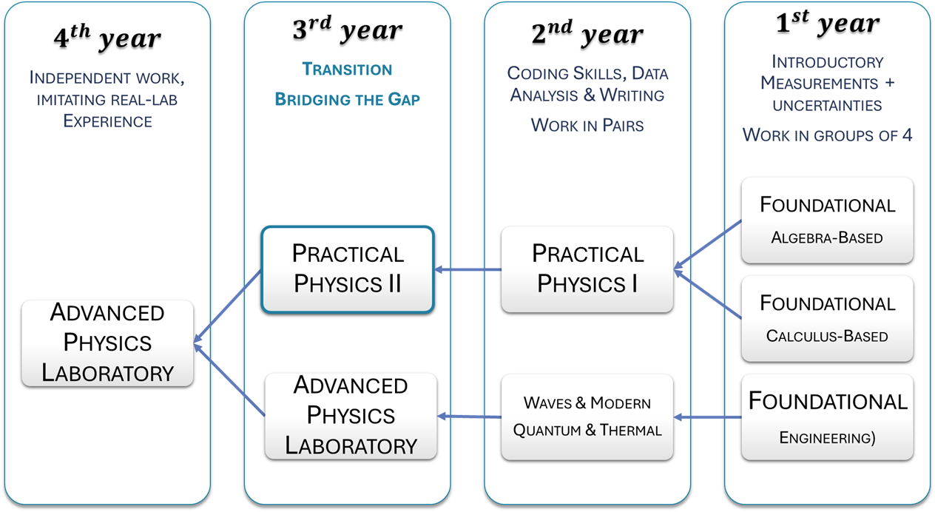
Lab Sequence

Slide 5
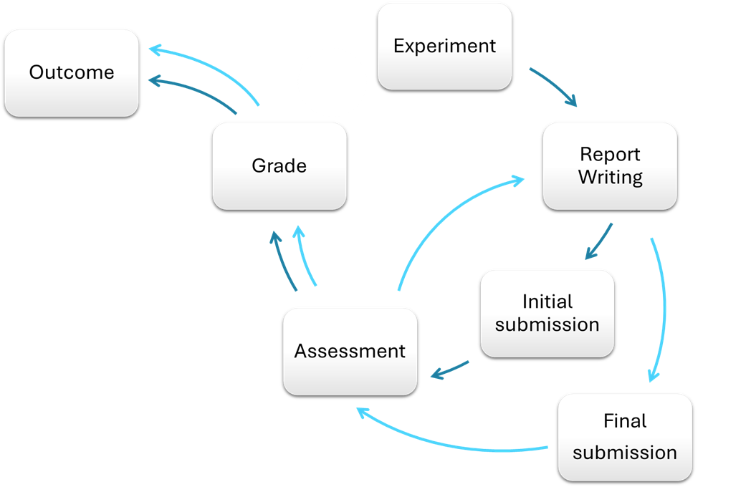
Building in space to improve.
Submission procedure for any laboratory report.

Slide 6

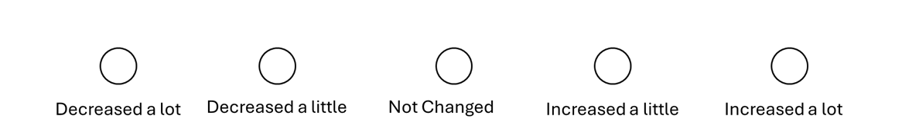
Data Collection
Two surveys – beginning and end of the semester
  Likert scale [0-10] questions to self-assess experience and levels of confidence related to various elements of writing:
  PLANNING
  CLARITY
  BREVITY
  EDITING
  WORD CHOICE
  USE OF THE ACTIVE VOICE
  USE OF TENSES
  Likert scale questions included in the final survey to allow students reflect on the change of confidence since the beginning of the semester
  Inquiry about resubmissions and usefulness of the feedback, resources, and WIT program

Slide 7
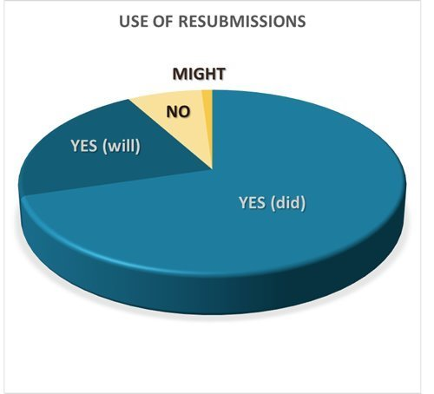
Review and resubmit
All students who said NO quoted workload as a reason.
MIGHT indicated satisfaction with current grade but left the possibility for the future.
YES quoted improvement of grade as a main reason, with improvement of work and easy fixes suggested in distant seconds.

Slide 8
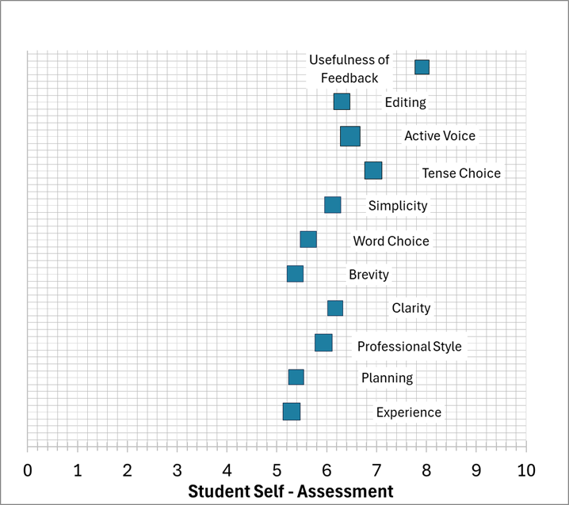
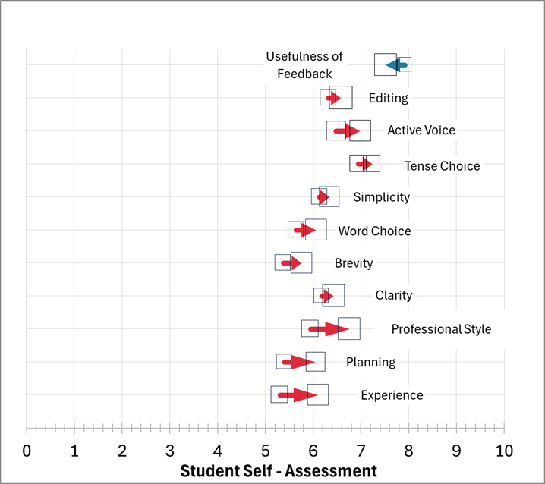
Student Self-Assessment
Student self-assessment of their writing-related skills and the usefulness of feedback at the beginning and at the end of the semester.

Slide 9
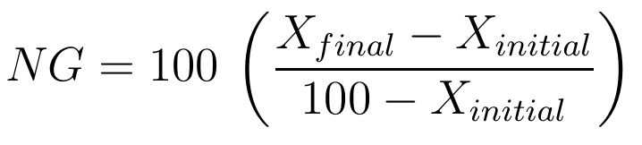
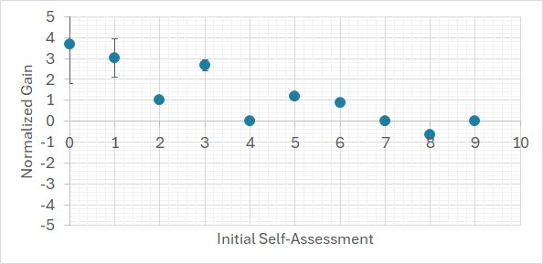
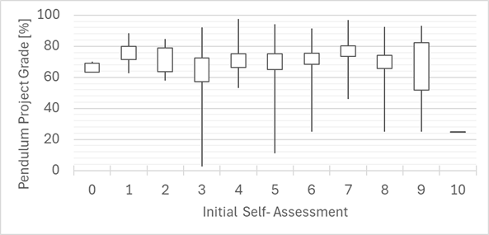
Experience
Normalized change in the student self-assessment of their experience in writing reported at the end of the semester and at the beginning of the semester.
Percentage grade received by students on the final project (2023) as a function of students' initial self-assessment of their experience in writing, The boxes represent average grade with uncertainty, lines indicate grade distribution

Slide 10
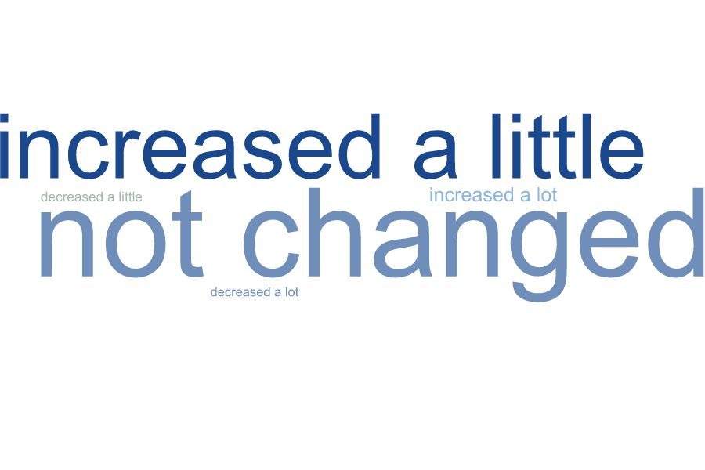
Student Self-Assessment
Word cloud of the Likert-scale choices assessing the change in students' confidence of planning, brevity, word and tense choices, use of active voice and editing.
Student self-assessment of their writing-related skills and the usefulness of feedback at the beginning of the semester.

Slide 11
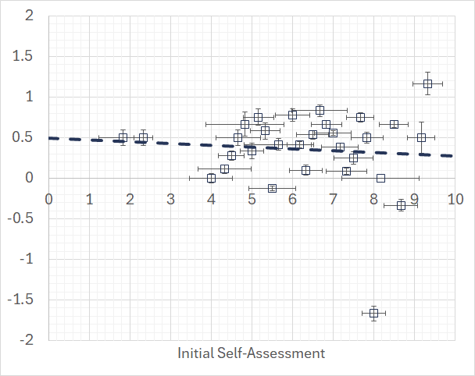
Relative Change
-2
-1
0
+1
+2
Normalized gains (dotted line) and relative gains (dashed line) for all categories. Initial self-assessment is averaged over all categories.

Slide 12
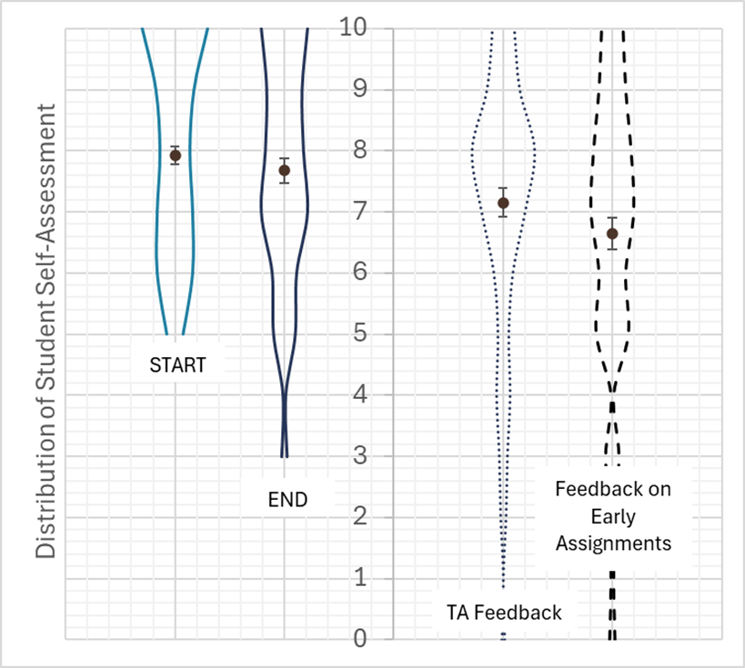
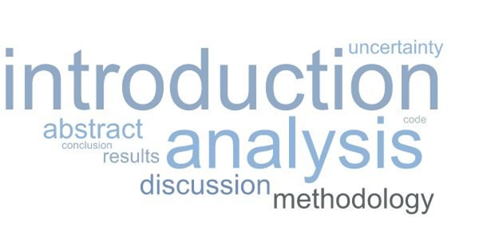
Feedback
Word cloud depicting the report elements identified as most difficult to write.
Most common reason, across the board was curating the content, editing and discrepancies in TA expectations.

Slide 13
Changes for 2023-2024
Devoted in-class time (~20 minutes per group) for individual, oral feedback from TA to students
Provided resubmission attempts for most assignments from the start of the course (next year: all?)
Refined TA training about marking and feedback
Refined rubrics, increased effort to get students to read rubrics

Slide 14
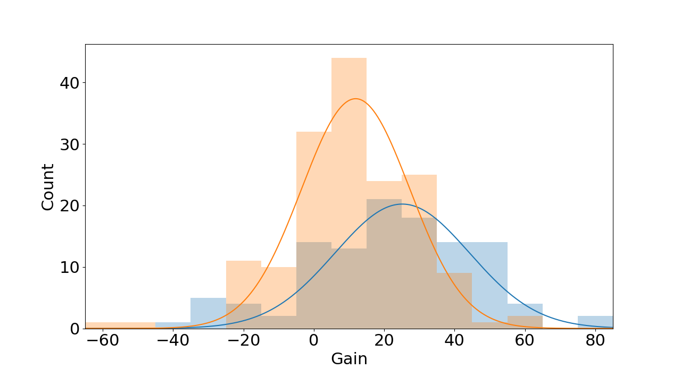
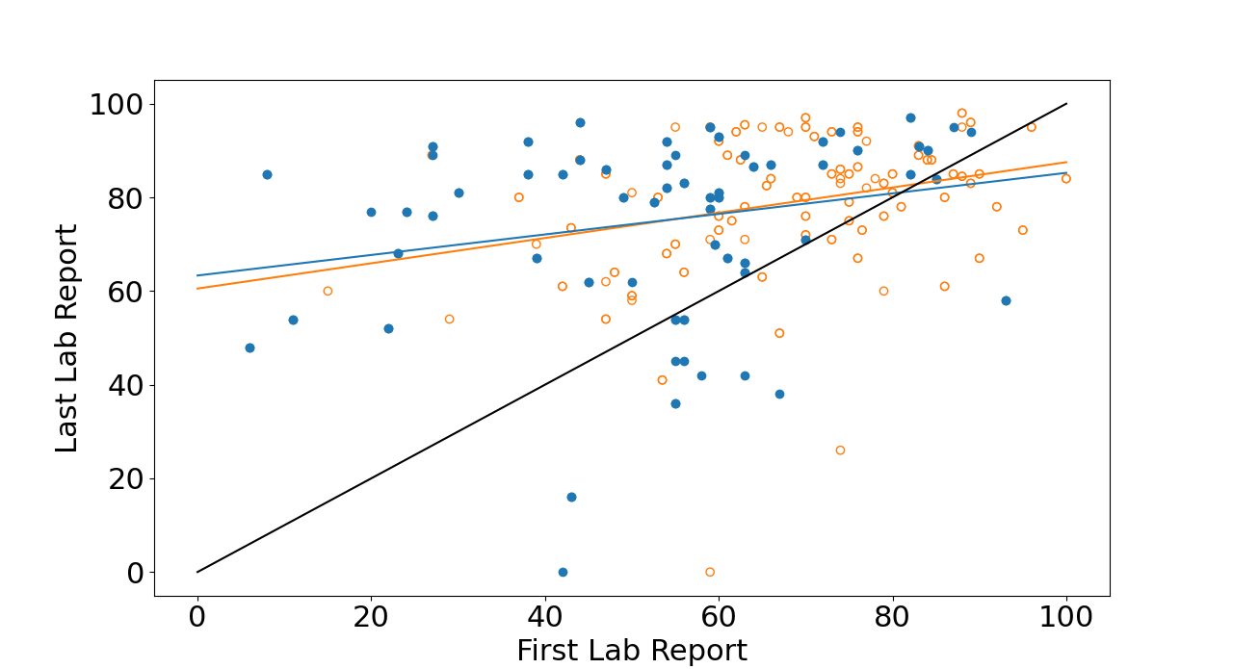
Grades for 2023 (orange) versus 2024 (blue)
Histogram of relative gains between the first lab report and last lab report (first drafts for both). 2023 (orange) has a mean of 10. 2024 (blue) has a mean of 22. Grades are on a 100-point scale.
Scatterplot of the raw data used on the left plot. The black line is the line of zero gain. Linear best fit lines are nearly identical.

Slide 15
Lessons learned
Technical writing is a difficult skill to acquire by osmosis
  Workshops, lectures, how-to documents, practice are useful, but...
Students want (and need) quality feedback, and they need to engage with the feedback
Assistance (e.g. the WIT program) to implement this is invaluable
Oral feedback leads to higher quality engagement

