Slide 1

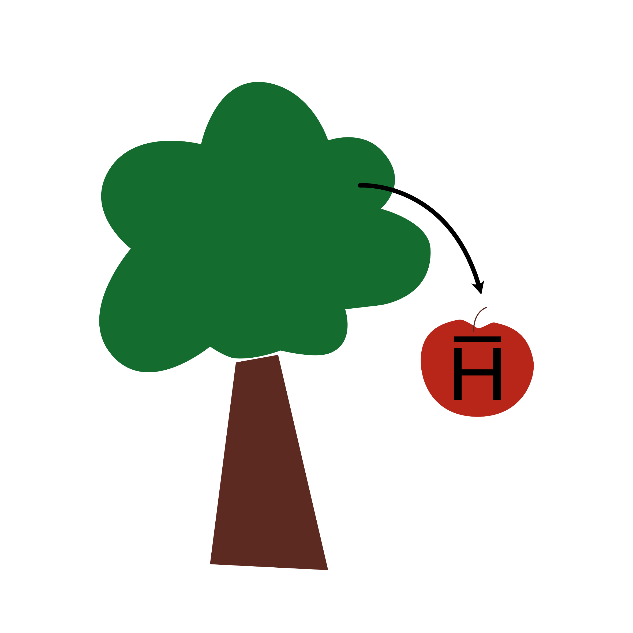

Deeply Learning the Position Reconstruction of Antihydrogen Annihilations in ALPHA-g
The Canadian Association of Physicists Congress 2024
Presented by Ashley Ferreira on May 27th, 2024

Slide 2
Matter
Electron (-)
Antimatter Crash Course
Antimatter has the opposite charge
Equal amounts of matter and antimatter produced during the Big Bang
When a particle and its antiparticle meet, they annihilate
Our world is dominated by matter
This observed imbalance is not well understood and is motivation to study properties of antimatter
Proton (+)
Hydrogen
Antimatter
Positron (+)
Antiproton (-)
Graphic inspired by
www.popularmechanics.com/science/a25908/how-to-make-and-trap-antimatter/
Antihydrogen

Slide 3

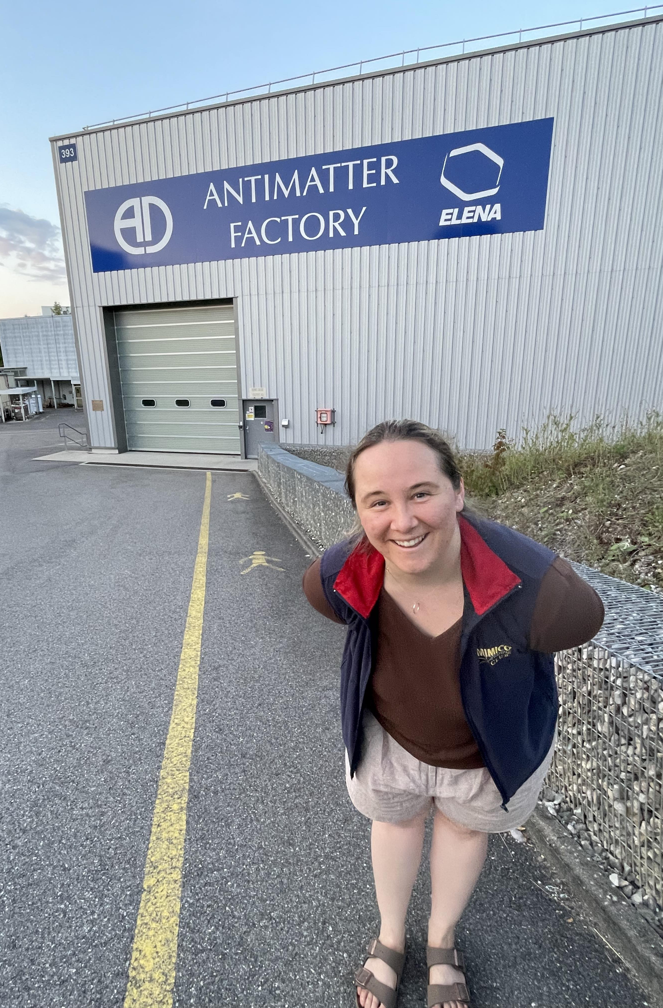
Making Antimatter at CERN
Graphic taken from
home.cern/science/accelerators/accelerator-complex

Slide 4
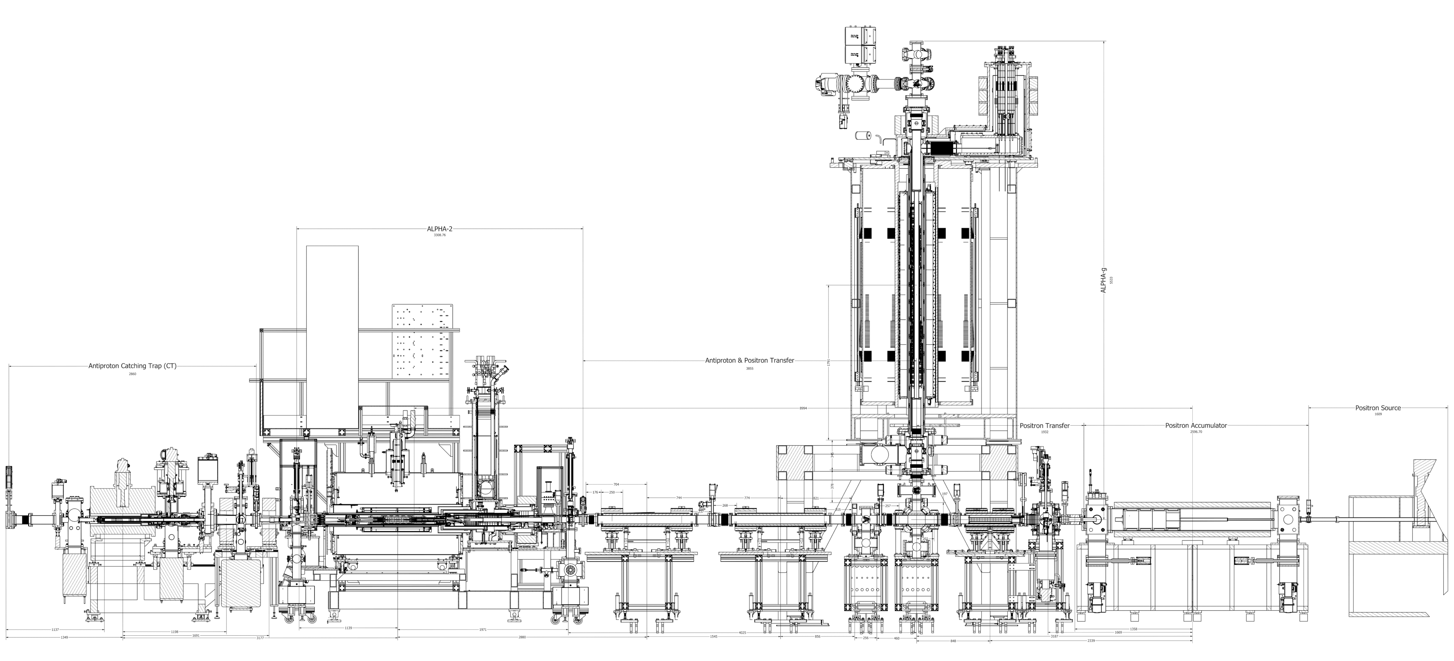
ALPHA-g
ALPHA Design
(Antihydrogen Laser Physics Apparatus)
Graphic taken from alpha.web.cern.ch/experimental-cycle

Slide 5
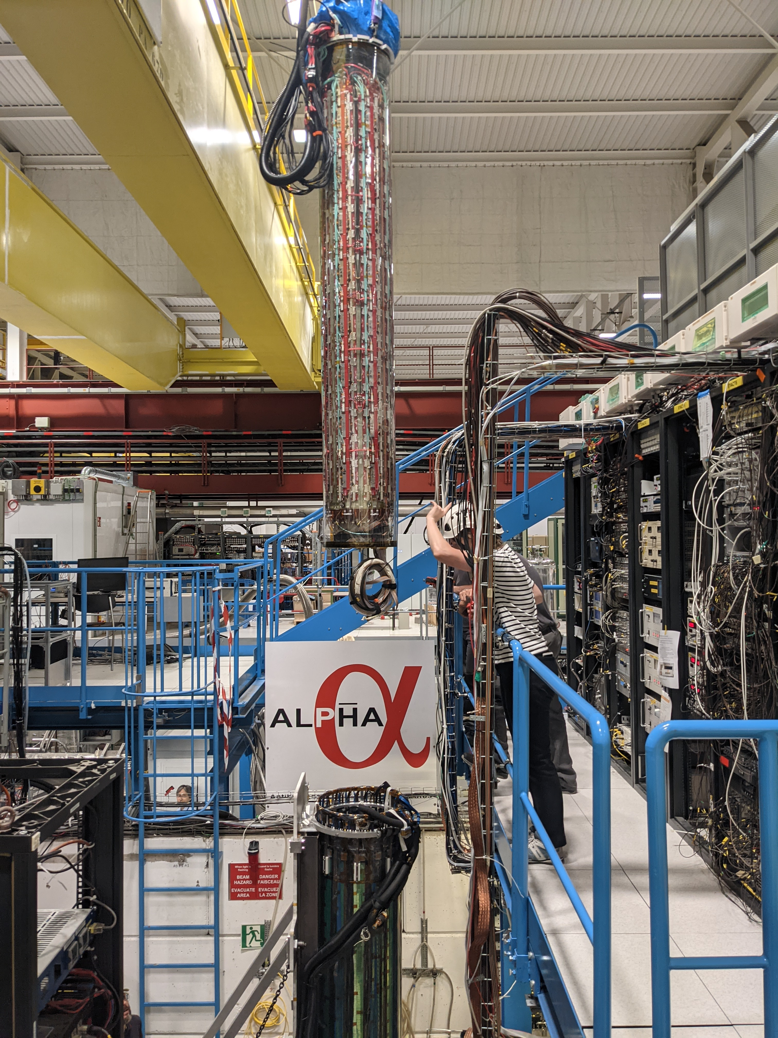

ALPHA-g Experiment
Aims to perform the 1st direct measurement of the effect of gravity on antimatter to determine its weight to within 1% precision
Antihydrogen held in magnetic trap and when released, it hits the sides and annihilates
The annihilation position is reconstructed from the electrical signals in the radial Time Projection Chamber (rTPC)
Then, the general idea is
rTPC
$$g=2∆d/t^{2}$$
Fun fact: the rTPC was built at TRIUMF!

Slide 6
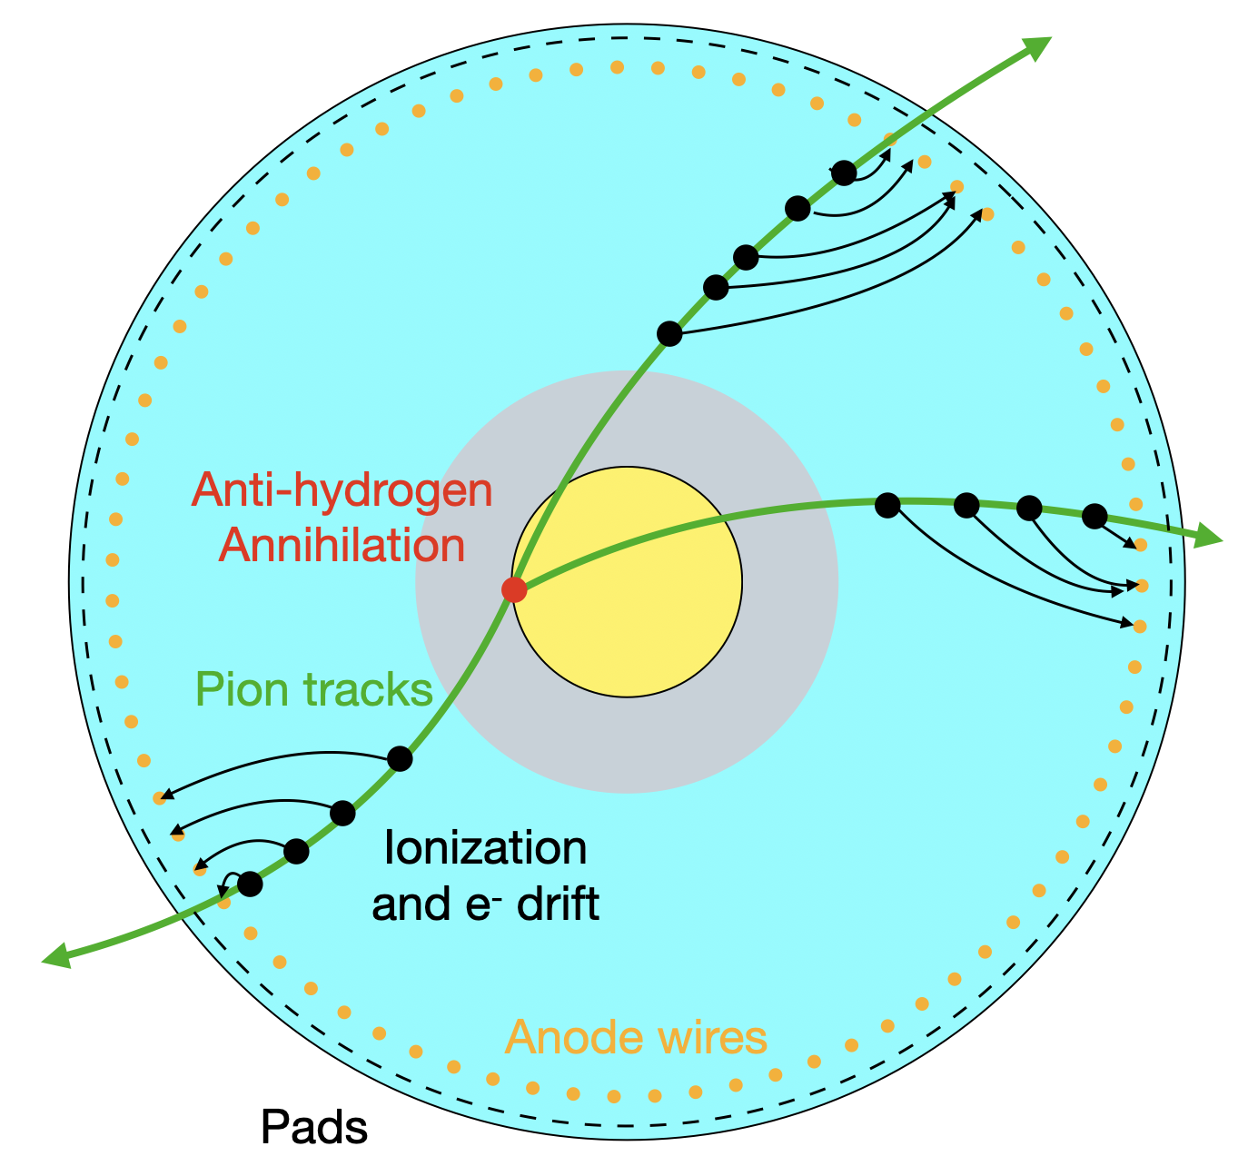
Cross-section of the rTPC
Current Reconstruction Method
Antiproton annihilations generate charged pions that ionize surroundings gas
We can reconstruct these 3D positions called spacepoints
Spacepoints are grouped together to reconstruct pion tracks
Tracks are fit with 3D helix functions
Helices fit to find annihilation position
Vacuum
“helix fit” method
Gas
Graphic + much of this explanation
taken from Gareth Smith, TRIUMF

Slide 7
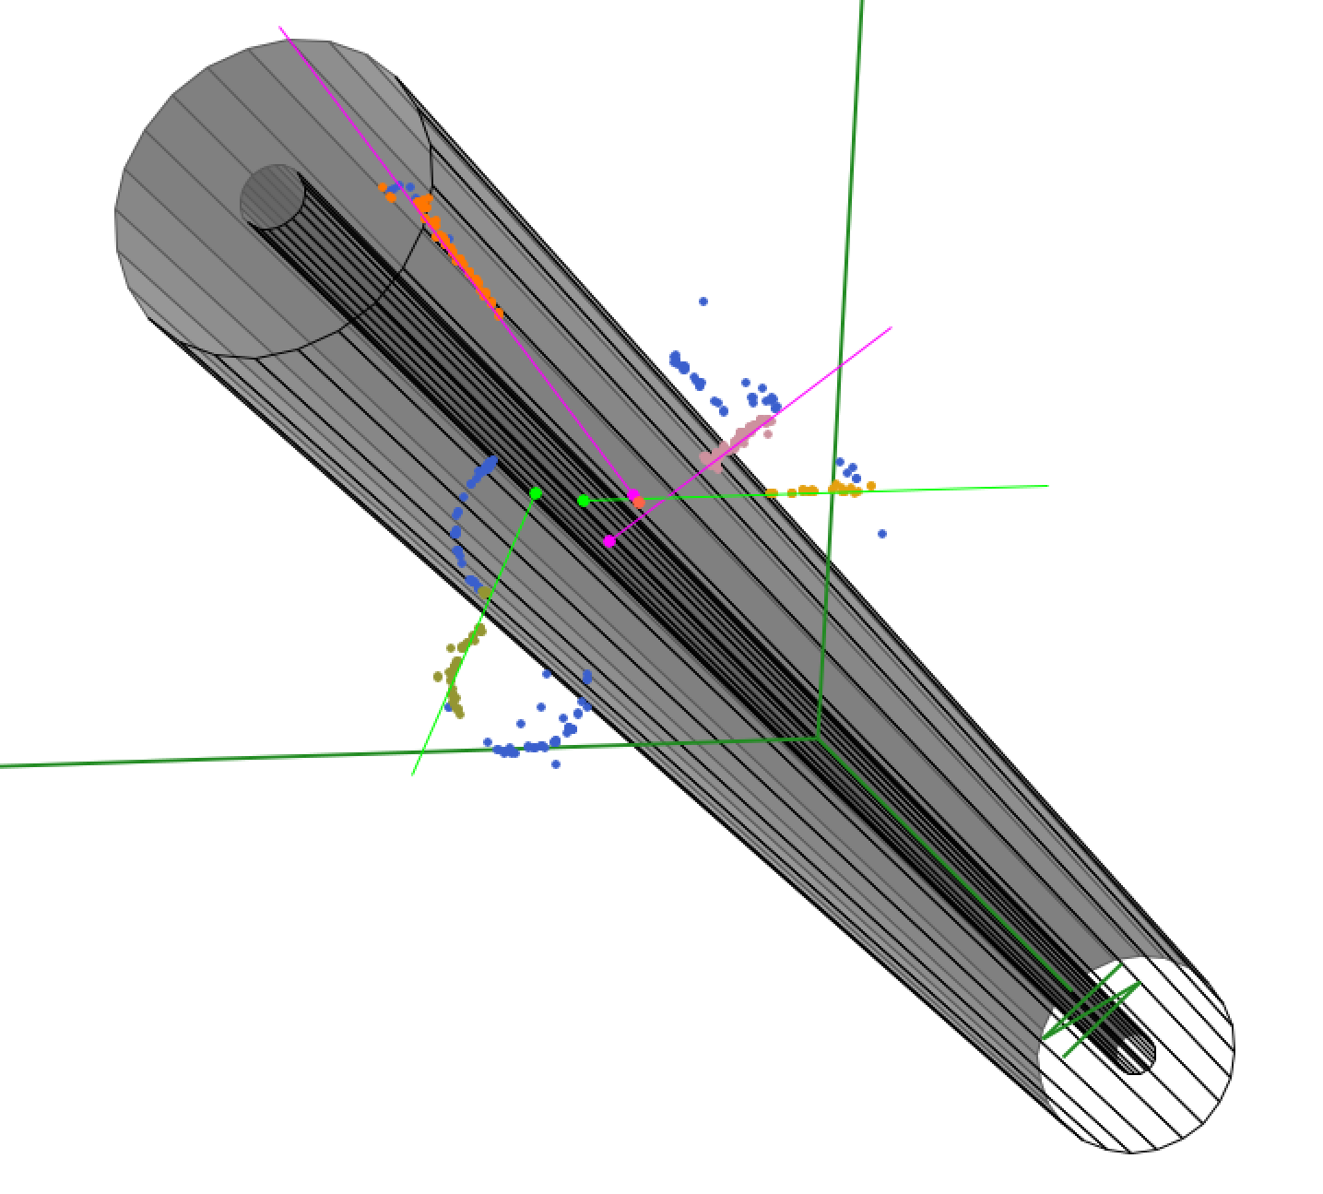
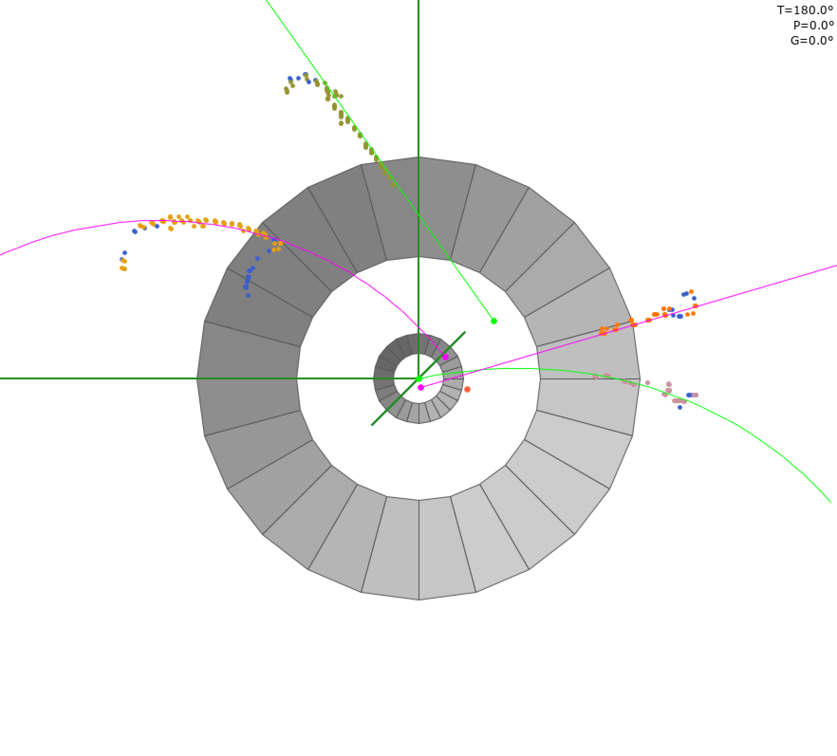
Event Display
Helix fit method is very successful and outputs predictions ~90% of the time on real data
Graphic from Gareth Smith, TRIUMF & Phil Harvey, Queen's University

Slide 8
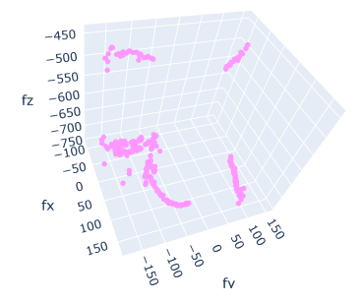
Project Goal
event spacepoints
rTPC
input
PointNet deep learning model
output
Z = - 625 mm
(0,0,0)
[mm]
.
The annihilation happened at this vertical position
[mm]
The ideal model is one that can take in 3D point sets directly
y [mm]
We care most about the z-position for gravity studies
Data from Monte Carlo simulations is used
If this works, we can investigate :
Extending this to predicting the (x,y,z) position of the annihilation; and
Try using more raw forms of data than the spacepoints to help with steps earlier on in the reconstruction pipeline

Slide 9
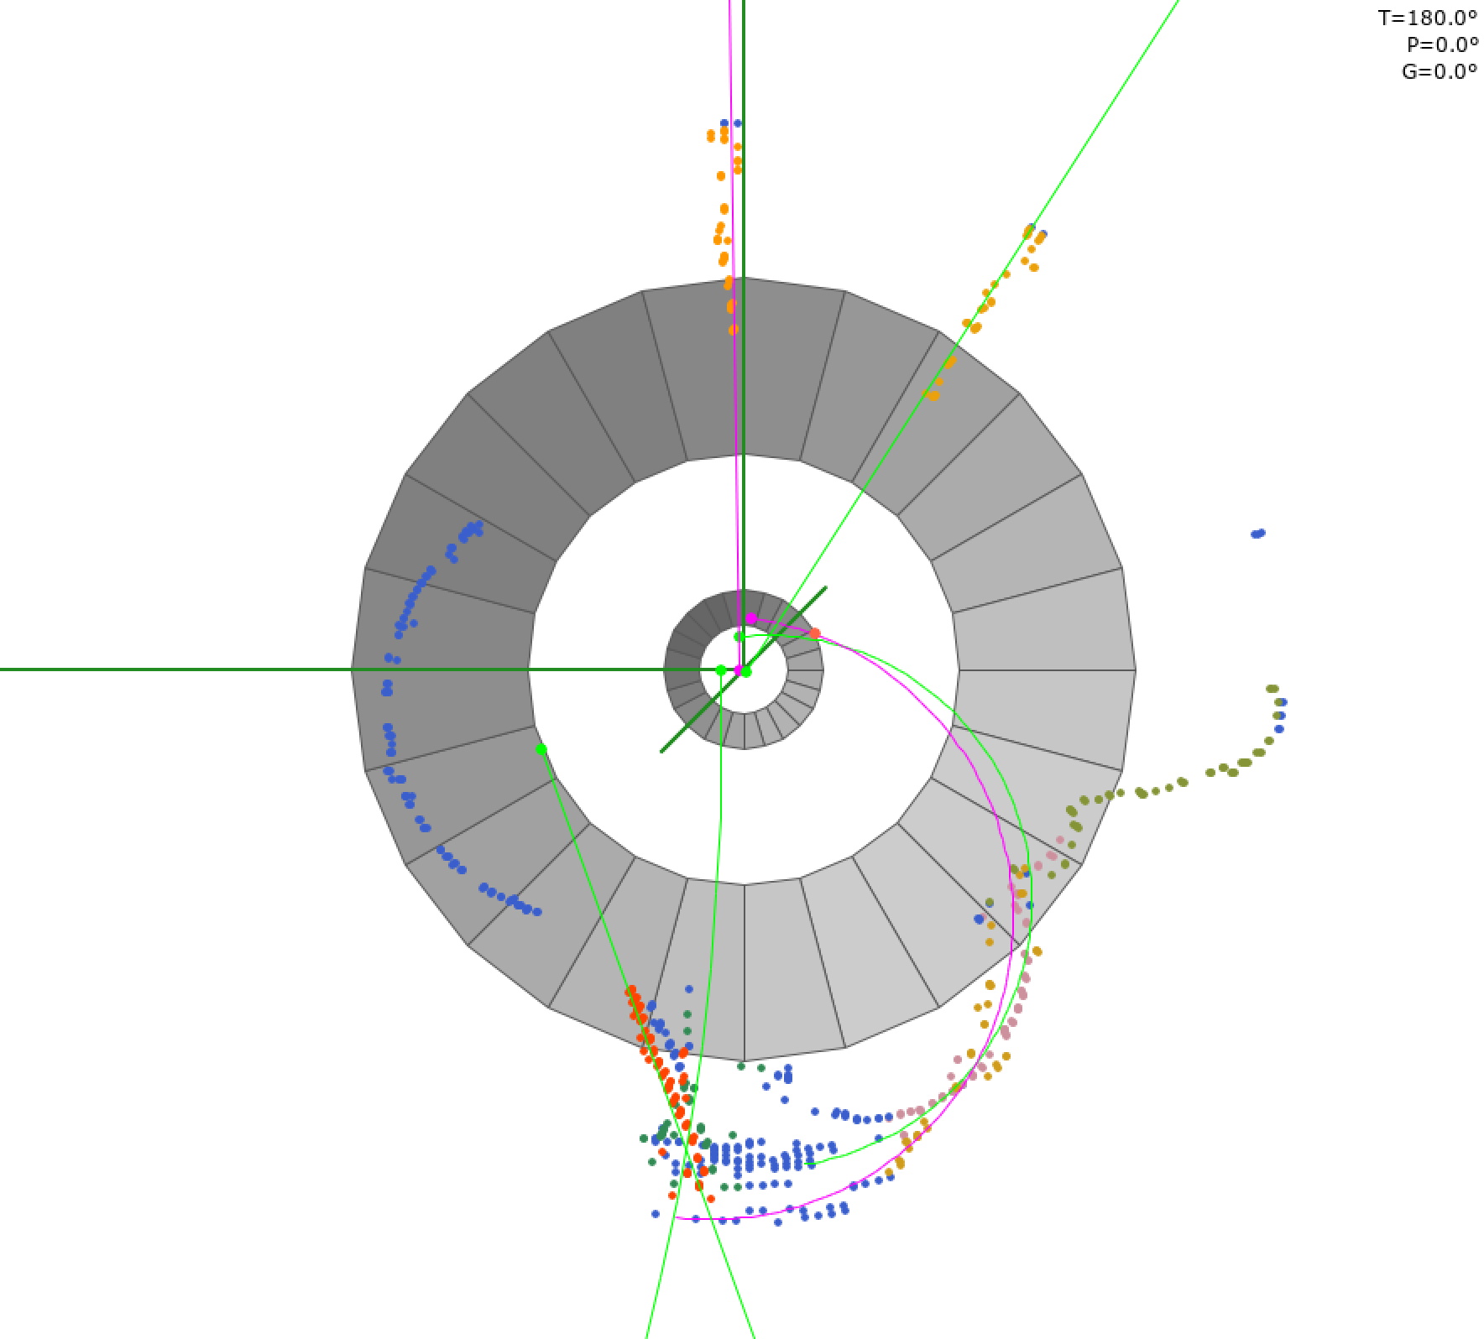
Why this Deep Learning Project?
Not reliant on recognition of tracks to utilize information from spacepoints
Potential to improve upon helix fit performance by squeezing more out of the data
Can help cross-check helix fit method
It always outputs a z-position prediction (even if not accurate…)
Points have not been fit (helix fit has improved since)
Which could be helpful when helix fit method is unable to make prediction
Graphic from Gareth Smith, TRIUMF & Phil Harvey, Queen's University

Slide 10
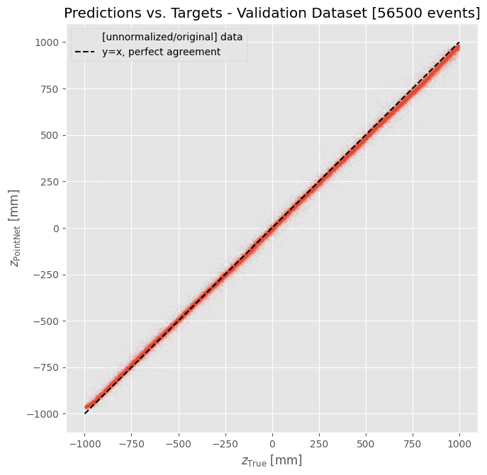
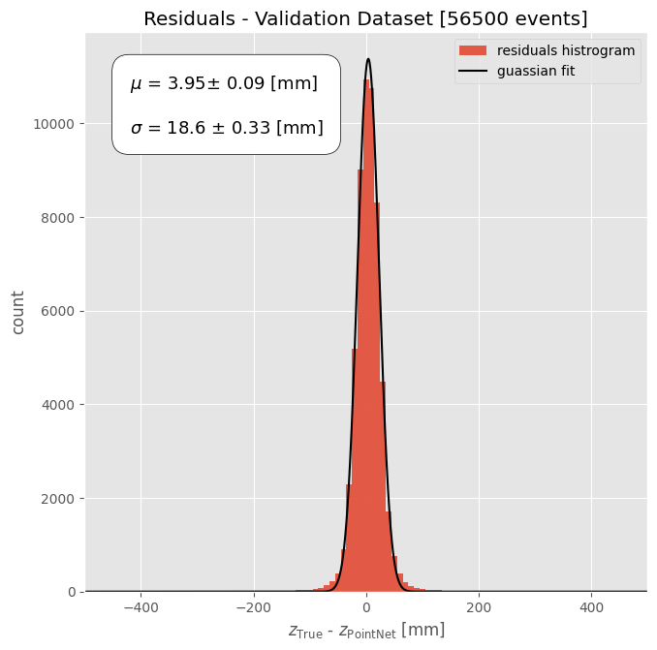
Preliminary Deep Learning Results
Results and fit uncertainties are preliminary
Predicted Z [mm]
Count
Mission accomplished, eh? Performance is good, speed is almost instantaneous, and the model always outputs a predicted annihilation z-position.
56,500 events in 39s (loading & predictions) = 0.69 ms/event
(4 data loader workers, NVIDIA GeForce RTX 2080 Ti GPU)
True Z [mm]
True Z – Predicted Z [mm]

Slide 11
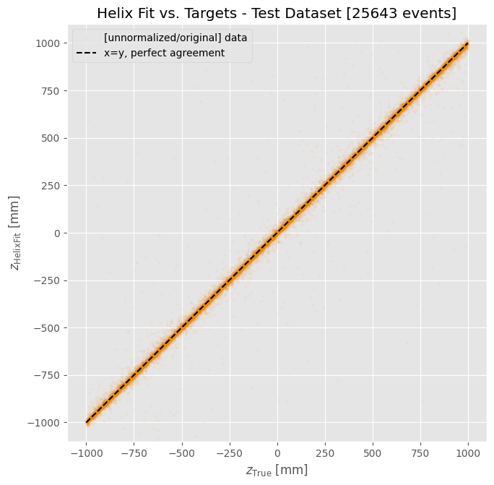
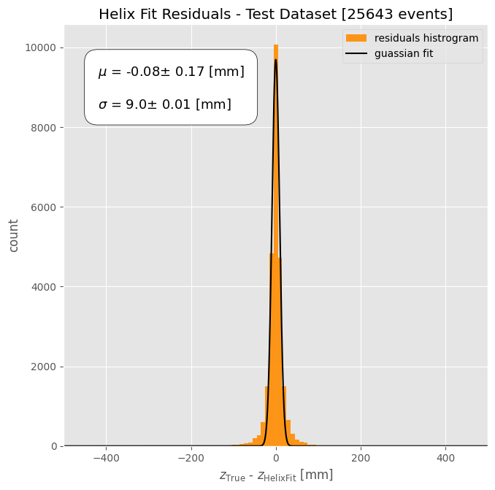
Helix Fit Results
Results and fit uncertainties are preliminary
Helix Fit Z [mm]
Count
We want to beat this.
True Z [mm]
True Z – Helix Fit Z [mm]

Slide 12
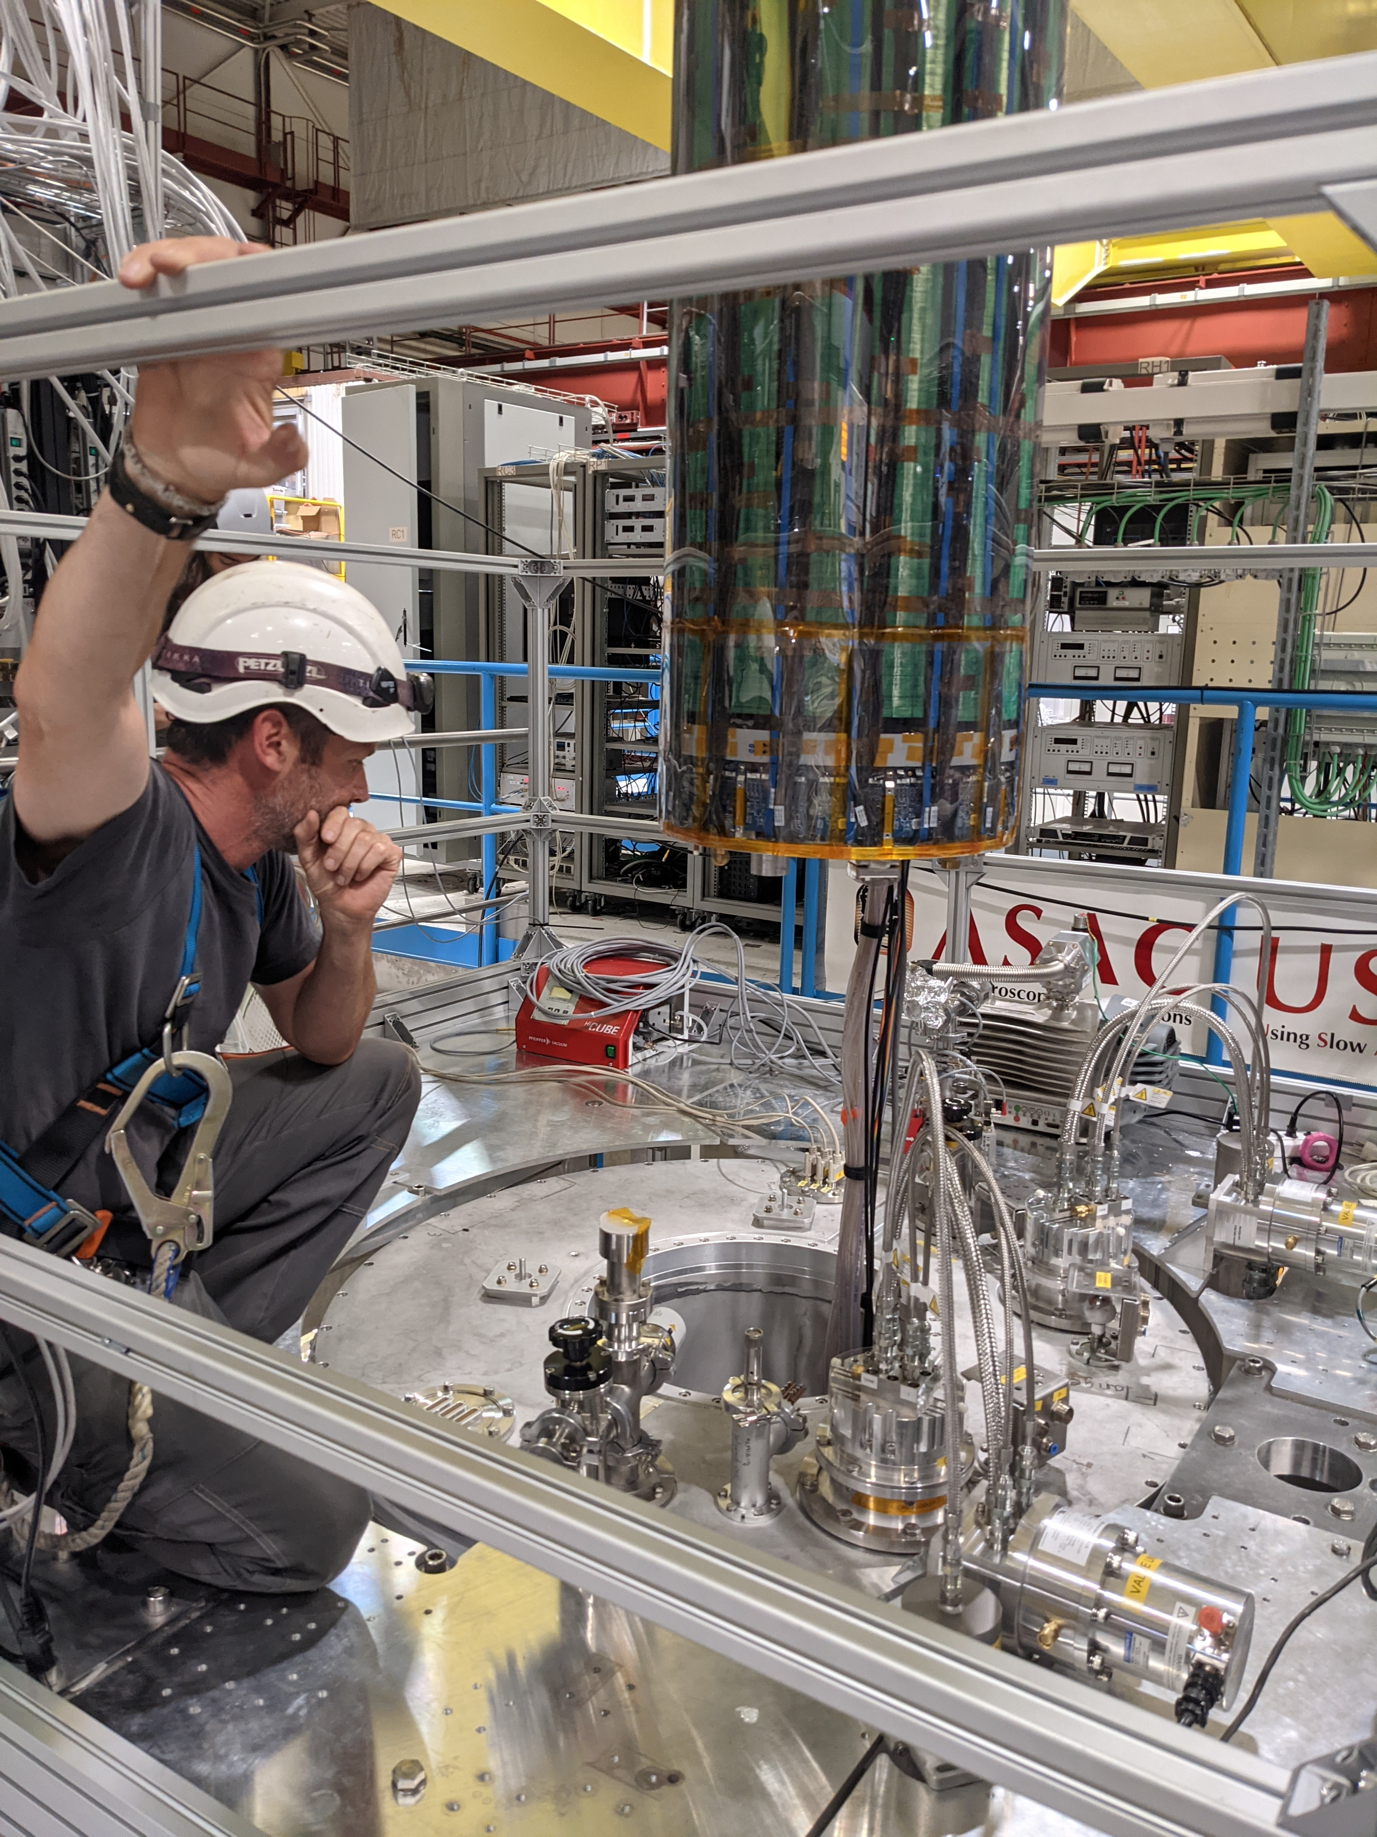
Future Work
Get deep learning model performing as well as possible on simulation data (more data + tunning)
This may mean exploring new ways to preprocess the data, or changing the model itself
Evaluate and improve performance on real data
Possible extensions:
Train model for a more complex task (e.g. predicting full Cartesian co-ordinates)
Explore track segmentation
Uncertainty estimations or implementing confidence threshold below which the prediction is unreliable

Slide 13
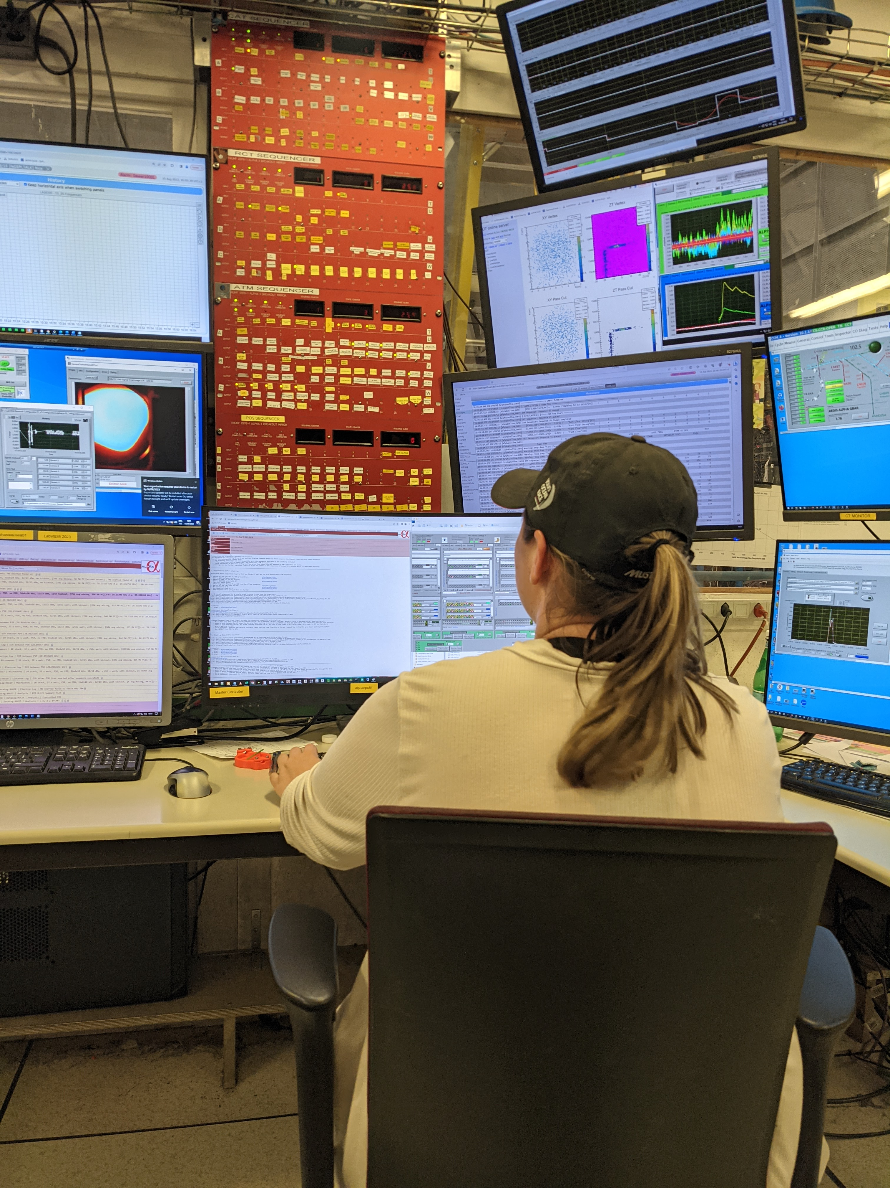



Conclusion & Acknowledgements
Promising initial results from this deep learning approach
Could be good option to compliment the helix fit method
&
+
Richard E. Azuma Fellowship
ALPHA AI team specifically:
Makoto Fujiwara, Andrea Capra, Lars Martin, Wojtek Fedorko, Gareth Smith, Daniel Duque, Yukiya Saito, Anqi Xu, Anna Muyan Li.
For funding my trip to here as part of the Canadian Astroparticle physics Summer Student Talk Competition
This group has provided me with ample guidance and resources, without them my summer project would not have been possible.

Slide 14
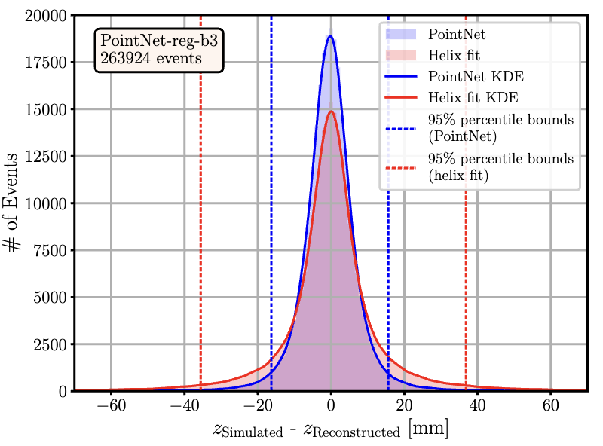
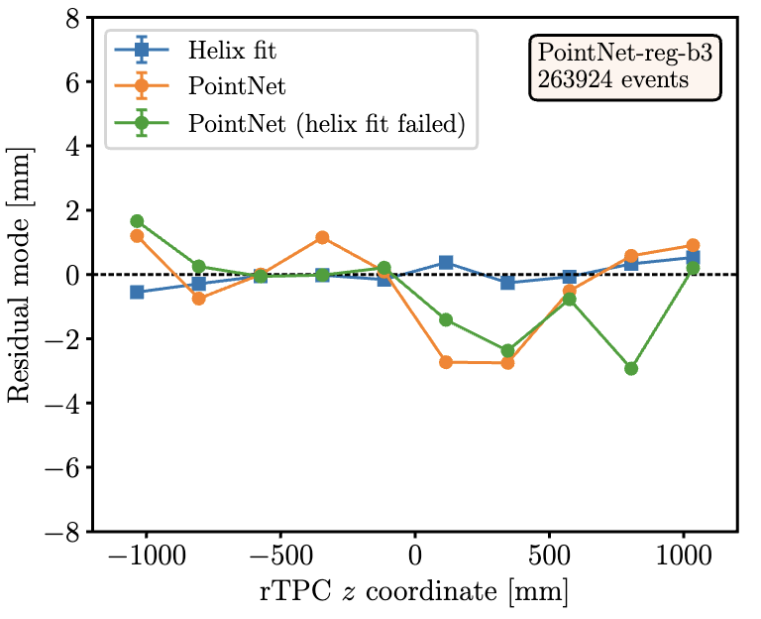
More Recent Results
Some ALPHA AI team progress after my summer!
Helix fit improving too (not reflected in comparison)
Able to beat helix fit on resolution ☺
Still some issues with z-bias ☹
Super preliminarily, lots of results were achieved and this is just a sample

Slide 15
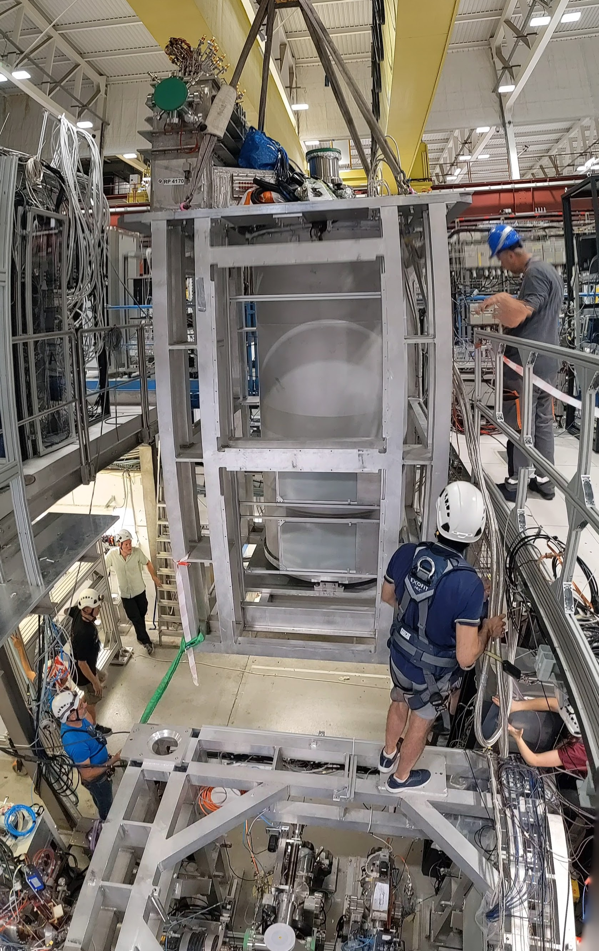
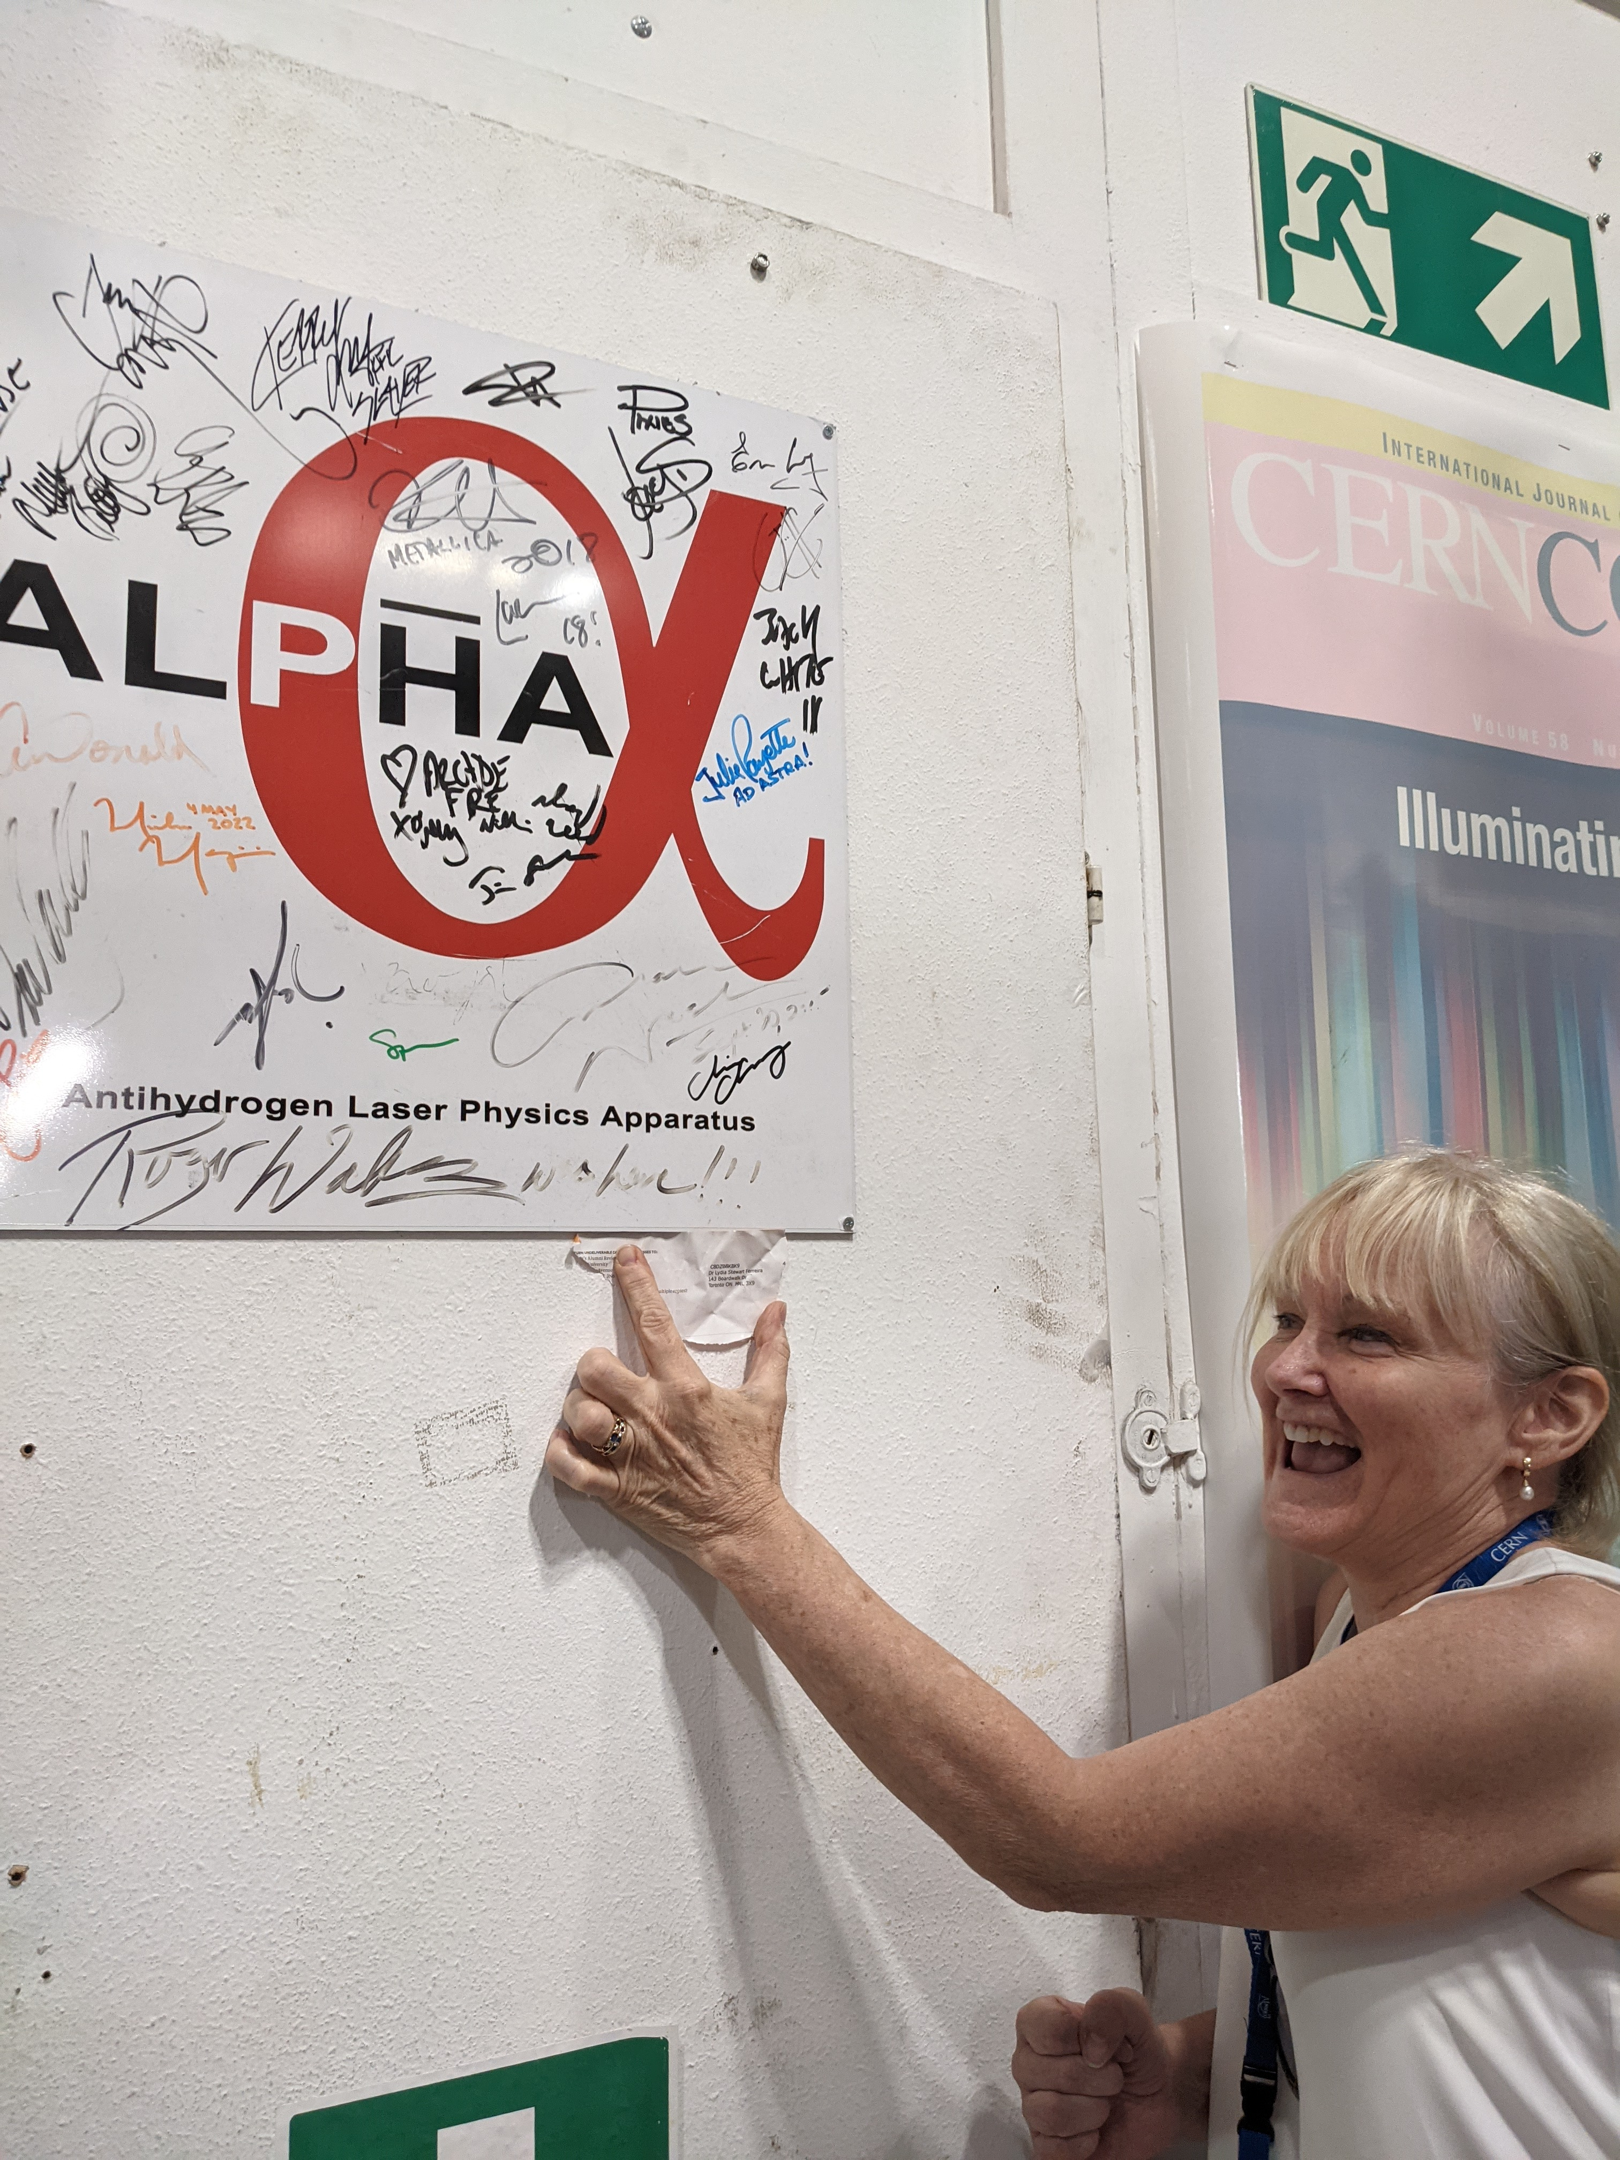
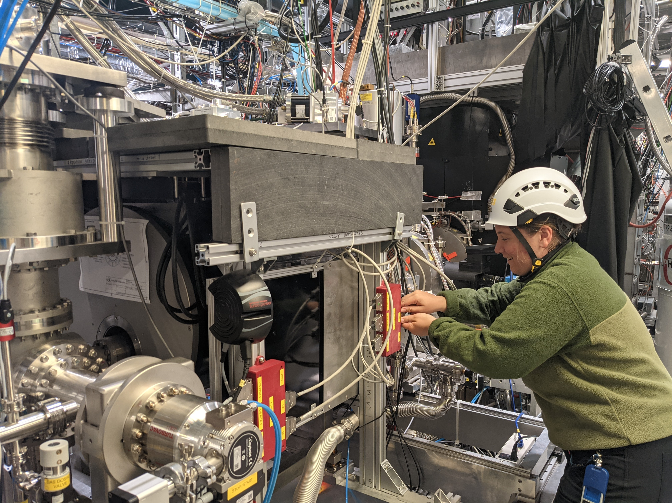
Possible Questions
Can you tell us a bit more about PointNet?
Can you discuss the training process?
Can you think of ways to reduce the z-bias in results?
Where can I go to learn more about ALPHA-g?
Thank you!
Questions?

Slide 16
Backup Slides
Ashley Ferreira May 27th, 2024

Slide 17



ALPHA-g Resources
ALPHA Collaboration website TRIUMF ALPHA Group website Recent BBC short-documentary

Slide 18
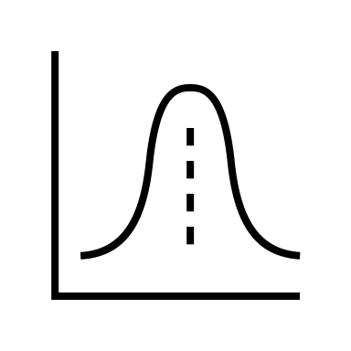
Current Normalization Scheme:
Removing Z-Bias
z = 1
≠
z = 0.8
z = 0.1
Add more examples to training data at the extremes
If that doesn’t work, change the normalization to remove this systematic error
Currently we normalize data so top of detector is 1 and bottom is -1
Same event at +500 mm ≠ -500 mm
Safest guess is towards 0 mm
z = -0.1
z = -0.8
z = -1
Alternative:
z = ~ +1
z = ~ -1
or
z = ~ +1
+ 50 mm
- 50 mm
z = ~ -1
(keeps scale information)

Slide 19
simulation data
total of 188,336 events
simulation data
Partitioning the Data
this + reformatting
= preprocess data
data used to tune the model
(86 %)
data used to evaluate model once all tuning done (14 %)
random shuffle
test data (100%)
training data (70%)
validation data (30%)
to rigorously assess the final performance of the model on unseen data
directly trained on by model, the only case where the true values are given to model
check if model is actually learning + decide how to improve model
model given only spacepoints and not learning, just making predictions

Slide 20
Deep Learning Method
* model architecture itself contains hyperparameters like dropout and bottleneck size
simulation data
*
repeat for another epoch
load training data
train the model
monitor loss
pick model with best validation loss
TRIUMF-ML1 server
load validation data
evaluate the model
do further analysis of performance
*
*
preprocess data
sample spacepoints for equal input size
normalize data
define a batch size
define a loss function for model to minimize during training
define an optimizer
pick a learning rate
*
split data into training, validation, & test sets
reformat data
tune hyperparameters and repeat all affected steps
* = contains hyperparameters

Slide 21
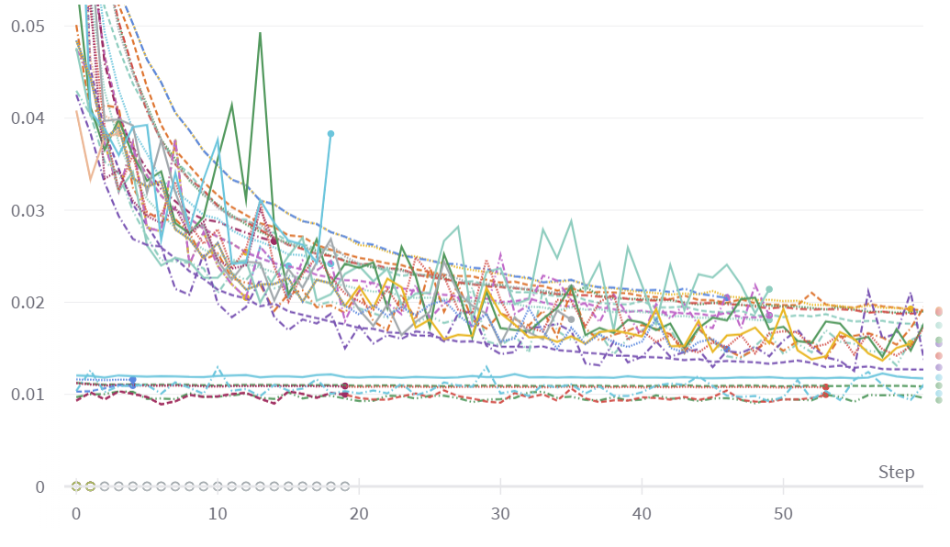
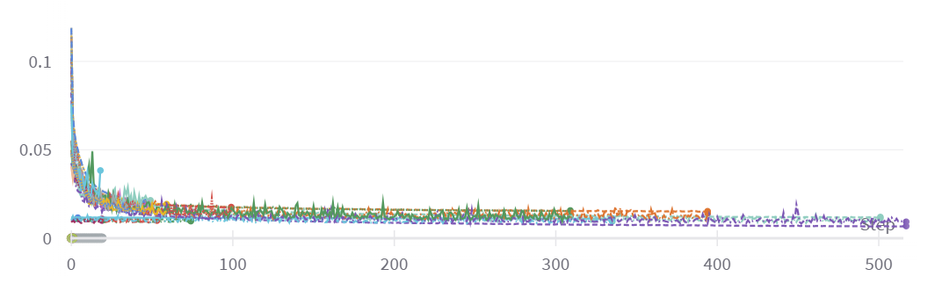
Hyperparameter Tuning
Tracked my experiments with Weights & Biases platform
Plot shows the loss curves from recent training runs (coloured)
Tuning hyperparameters provides improvements but reach similar loss plateau
Training existing models more
(that’s why they start with low loss)
Mean Absolute Error Loss
Epoch

Slide 22
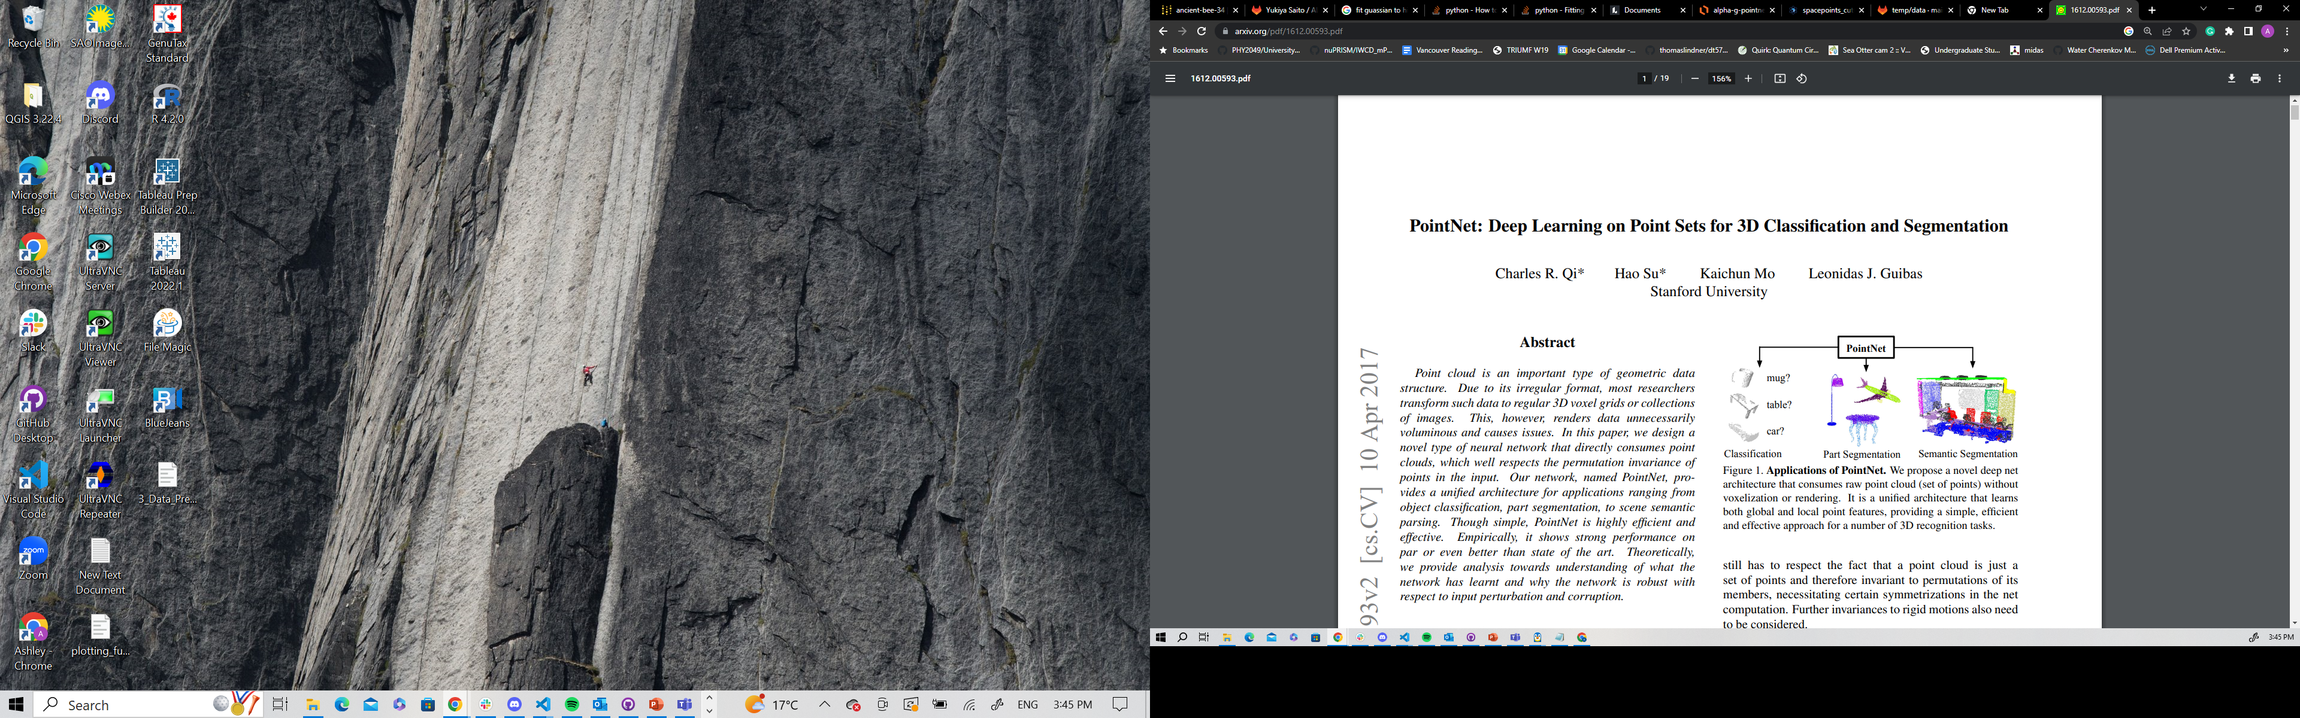
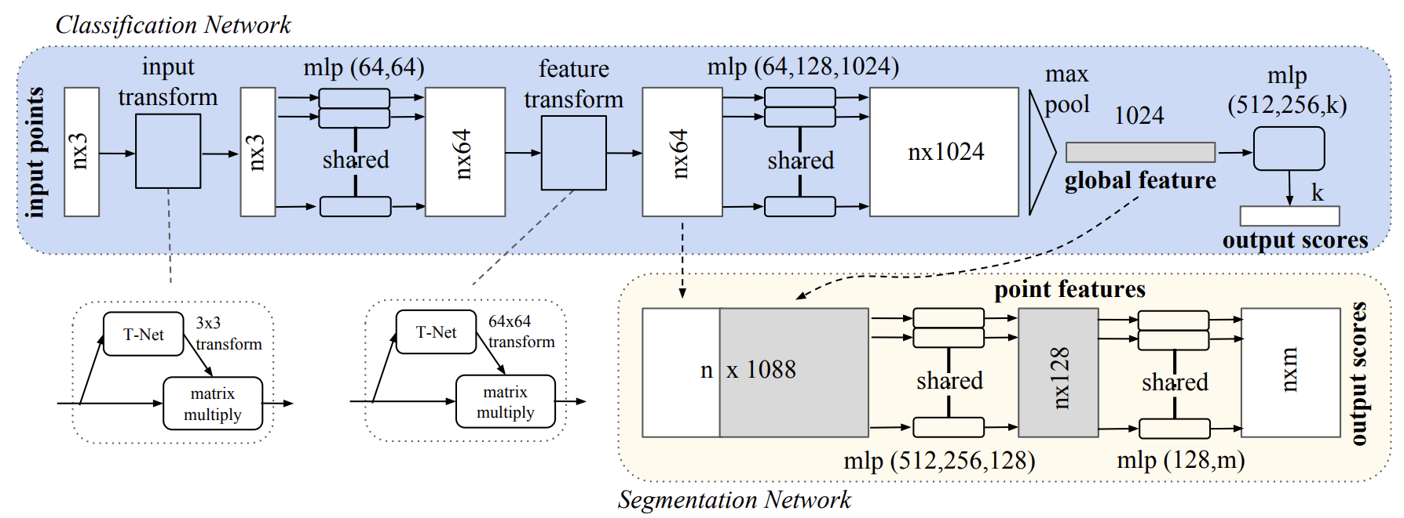
PointNet: Deep Learning on Point Sets for 3D Classification and Segmentation
https://arxiv.org/abs/1612.00593
Neural Network based architecture
Segmentation capability could aid with track identification but has not been implemented yet
Changed the final layer of the network to do regression instead of classification

Slide 23
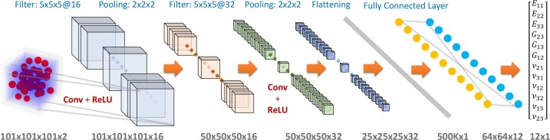
Deep Learning Model Architecture Options
Track reconstruction-based methods → challenging task (a lot of people already working on this, 651 teams for TrackML challenge)
2D Convolutional Neural Network (CNN) by projecting 3D points onto 2, 2D images → loss of potentially important special information
Extend 2D grid methods (like CNN) to 3D → computationally expensive
PointNet ++ and other derivates → more complicated to get up and running
So, we pick PointNet as a good starting point.

Slide 24
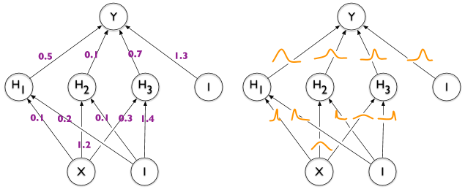
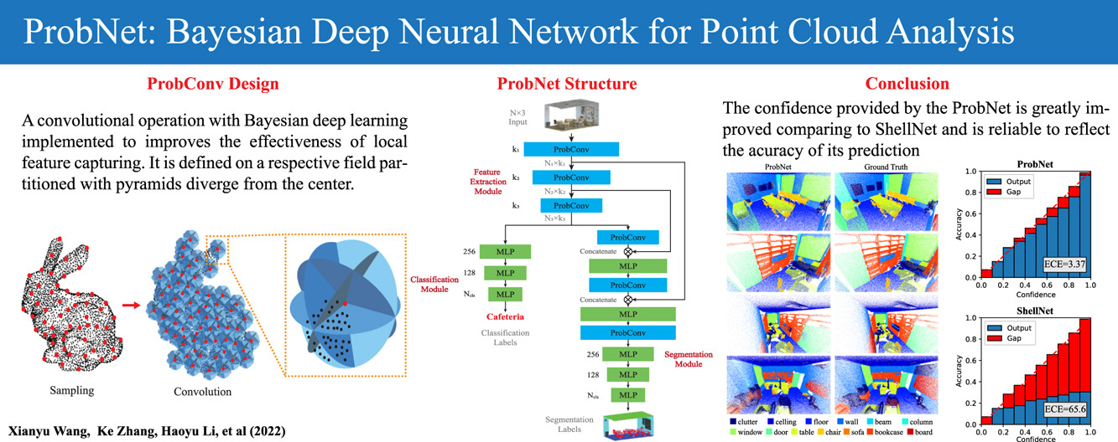
BNNs
Uncertainty Estimation
https://neptune.ai/blog/bayesian-neural-networks-with-jax
https://www.sciencedirect.com/science/article/abs/pii/S0097849322000565

Slide 25
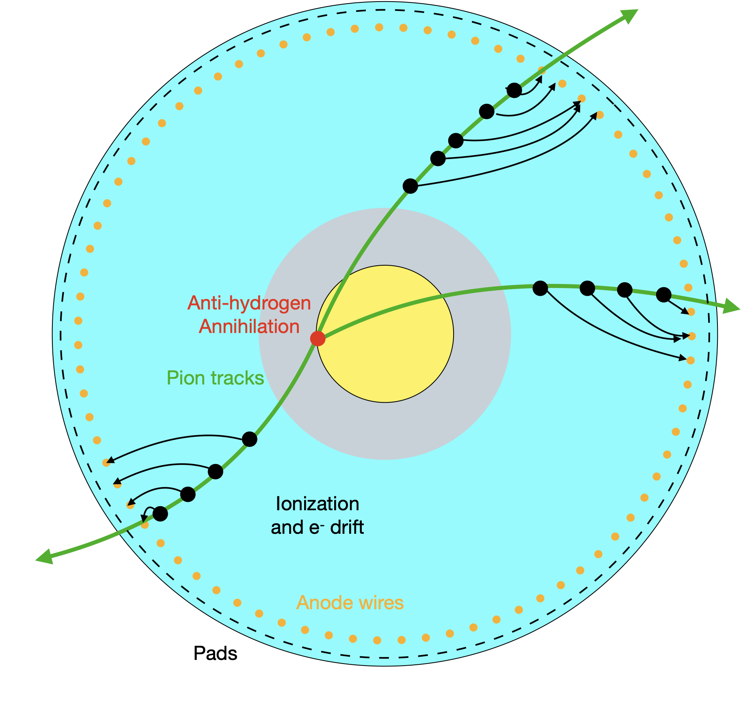
Cross-section of the rTPC
Current Reconstruction Method
Antiproton annihilations generate charged pions that ionize surroundings gas
Signal from pads and wires are deconvolved to find the arrival time of each electron
Time-projection used to find radial ionization positions
Resulting 3D positions points are called spacepoints
Spacepoints are grouped together to reconstruct pion tracks
Tracks are fit with 3D helix functions
Helices used to fit an annihilation position
Vacuum
Gas
“helix fit” method
Graphic + much of this explanation taken from Gareth Smith, TRIUMF

