Slide 1
Simulating barium ion motion in liquid xenon for a future Ba-tagging upgrade of nEXO
Megan Cvitan
CAP Congress 2024
27/05/2024

Slide 2
Simulating barium ion motion in liquid xenon for a future Ba-tagging upgrade of nEXO
Megan Cvitan
CAP Congress 2024
27/05/2024
Notes:
Hello everyone, my name is Megan and I’m a PhD student at McMaster based at TRIUMF, and today I will be giving an overview of my masters thesis work on, simulating barium ions in liquid xenon for a future barium tagging upgrade of nexo.

Slide 3
Agenda
The nEXO Experiment and barium (Ba) tagging
Accelerator-driven ion source and ion extraction developments at TRIUMF
COMSOL simulation groundwork
Systematic studies
  Probe bias
  Ion initial distance from probe
  Using non-liquid xenon (LXe) media
Notes:
- I will start with the concept of barium tagging, introducing the accelerator driven ion source at triumf, and highlight some of the main comsol simulation results and their implications for our upcoming experiment.

Slide 4
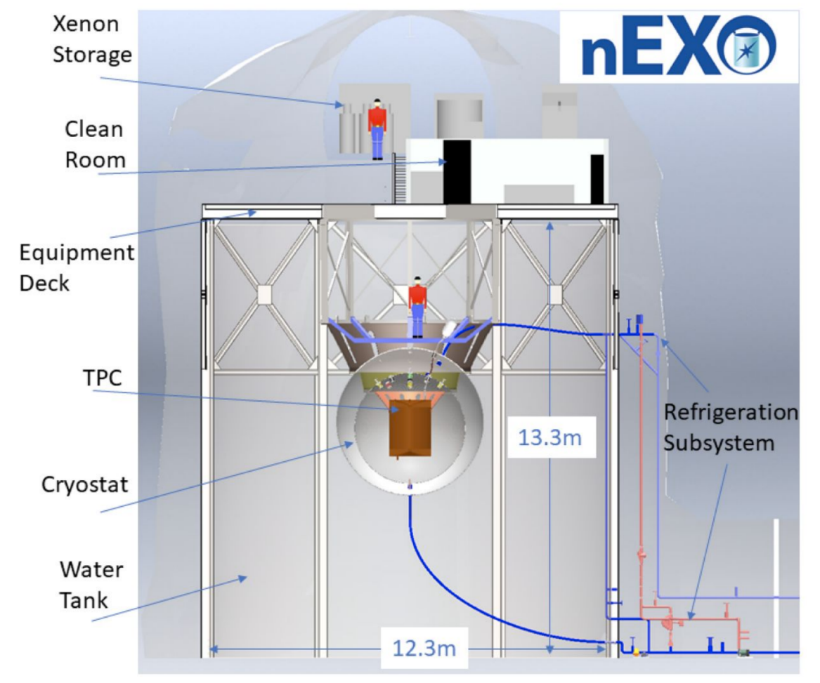
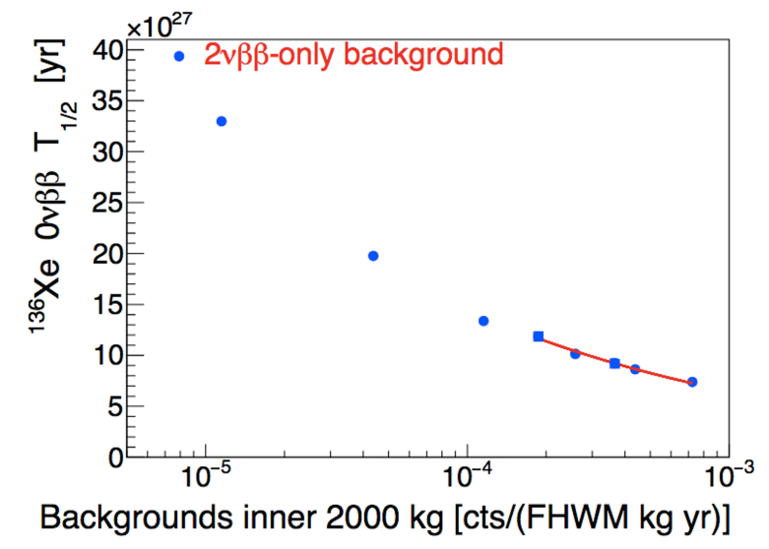
The nEXO Experiment
Proposed next generation 5-tonne liquid xenon Time Projection Chamber (TPC)
Search for 0νββ in ¹³⁶Xe as a tool to study neutrino mass
If 100% Ba-tagging
efficiency (!)
[Phys. Rev. C. 97 065503 (2018)]
Artist’s rendition of the nEXO experiment, planned for construction ∼2 km underground at SNOLab
The nEXO detector sensitivity to 0νββ half-lives
Notes:
First, a quick recap on what is the nEXO experiment?
nEXO is a proposed tonne scale liquid xenon experiment searching for a hypothetical nuclear decay known as 0vbb decay, where observation would open the door to a variety of new physics, such as the neutrino mass.
On the left we have an artist’s rendition of the detector and shown on the right is a plot of the projected nEXO detector sensitivity to 0νββ half-lives as a function of different background models in the inner most 2 tonnes of liquid xenon over 10 years of data-taking.
A challenge in the search for 0νββ is the suppression of background events. In future upgrades of the nEXO detector, there may be a possibility to essentially completely suppress background events, except those from 2νββ, by extracting and identifying the 136Xe-decay daughter nucleus 136Ba.
This background rejection technique called Ba-tagging is under development as a potential future upgrade to the nEXO detector. In this scenario, with perfect efficiency, the detector’s sensitivity could be increased by a factor of 2-3 compared to the baseline models, denoted by the red curve.

Slide 5
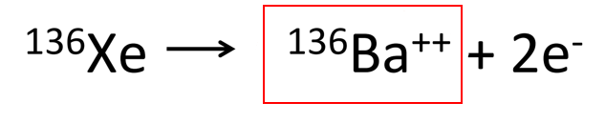
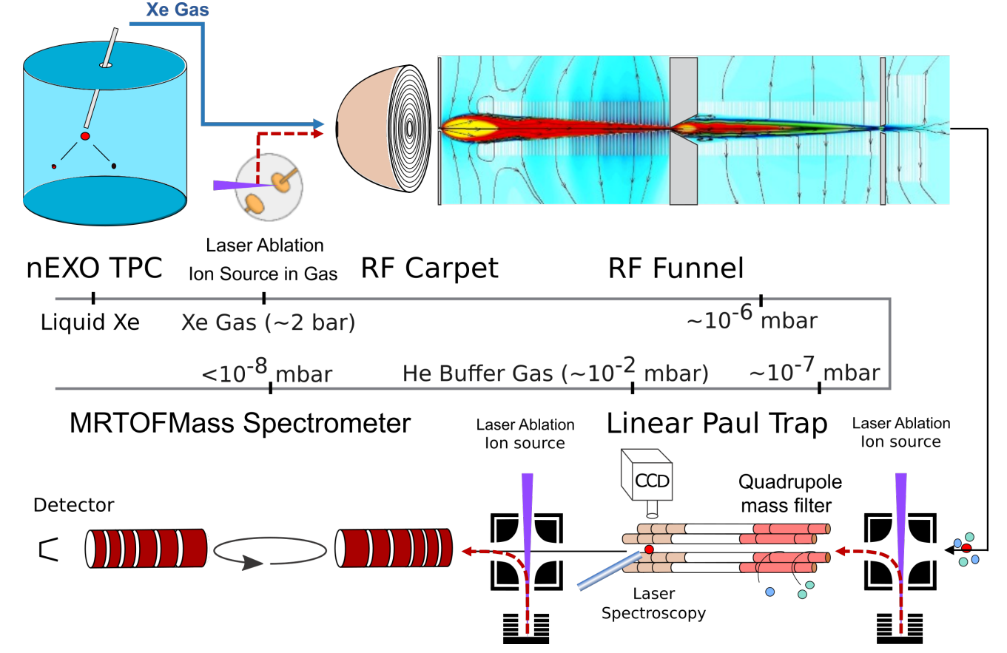

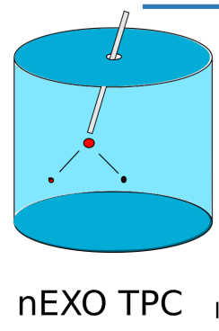


A Proposed Future nEXO Upgrade with Ba-tagging
Goal: identify ββ-decay product in ¹³⁶Xe
Localize event
Event of interest? Near Q-value?
Extract ion from xenon volume
  Not well-understood yet
  Create new tools to explore this step
Identify ion, is it Ba?
To test extraction approaches: need a characterized in-liquid Xe Ba-source
$→$ ISAC-II (Isotope Separator and Accelerator) at
Need reliable, high-quality in-liquid Xe Ba source
$→$ Need ISAC-II at TRIUMF
Notes:
So, we are aiming to tag and identify the double beta decay product in xenon 136, which is barium 136
Doing so would unambiguously identify a candidate 0vbb event as a true double beta decay in the detector, and 0vbb can be separated from 2vbb from the energy spectrum, and it would improve the detection sensitivity of xenon-136 based experiments, like nexo, as it would essentially eliminate all gamma backgrounds
There are two extraction techniques being developed by the collaboration, the cryoprobe and the capillary approaches. Both of these ion extraction techniques would need to be tested with an in-liquid xenon barium source, and once established, the capillary approach would be applied in the first step of the Ba-tagging scheme seen here.
So at TRIUMF, we are developing an in-liquid xenon radioactive barium ion source to demonstrate ion extraction of Ba from LXe for the very first time.

Slide 6
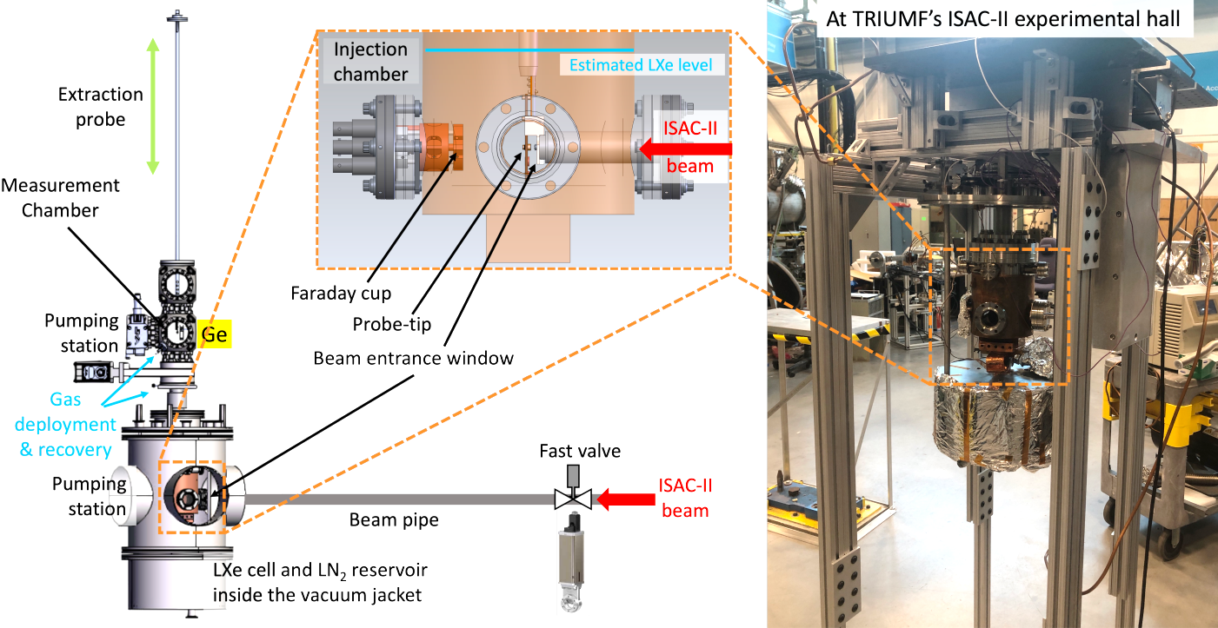
Ba-tagging at TRIUMF: Experimental Setup
Novel radioactive beam approach for ion implantation into LXe volume and subsequent extraction
Notes:
This is the experimental setup that we will use to perform ion implantation into Lxe for a subsequent extraction, which will act as a verification method for other Ba-tagging extraction approaches being pursued by the nEXO collaboration.
This apparatus will be coupled to a beamline at triumfs isac ll facility to stop radioactive ions in the beam into liquid xenon, and later demonstrate that it is possible to extract barium ions with an electrostatic probe and identify them from the liquid xenon.
So we have our radioactive ion beam, ideally in the isotope of pure cs 139, so we can mimick double beta decays in the liquid xenon volume when it decays into barium.
The beam ions will then penetrate a very thin beam window made of beryllium and make their way through the window and into the liquid xenon before stopping. Their stopping range is dependent on the incoming beam energy. For our purposes, the ions will reach a distance on the order of microns within the liquid xenon, after which they would be subjected to an electrostatic attraction from the biased probe tip, and the ions would collect on the probe.
After this, the probe will be removed from the chamber and placed in front of a germanium detector where gamma spectroscopy measurements will be performed to identify the presence of Ba collected on the probe through observing a characteristic 166 keV peak, for which GEANT simulations are currently under development.

Slide 7
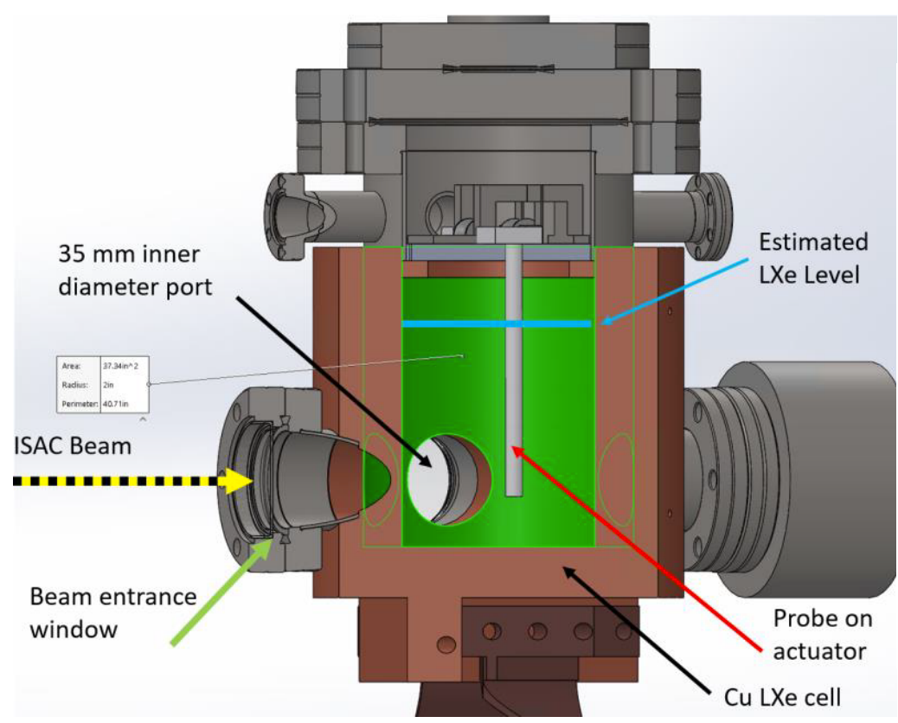
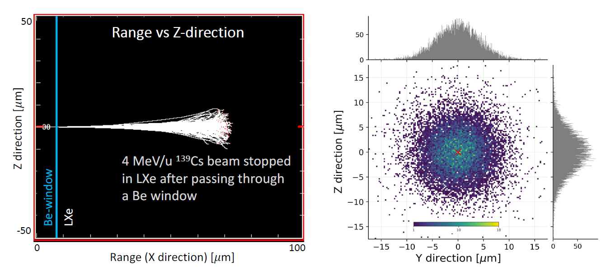
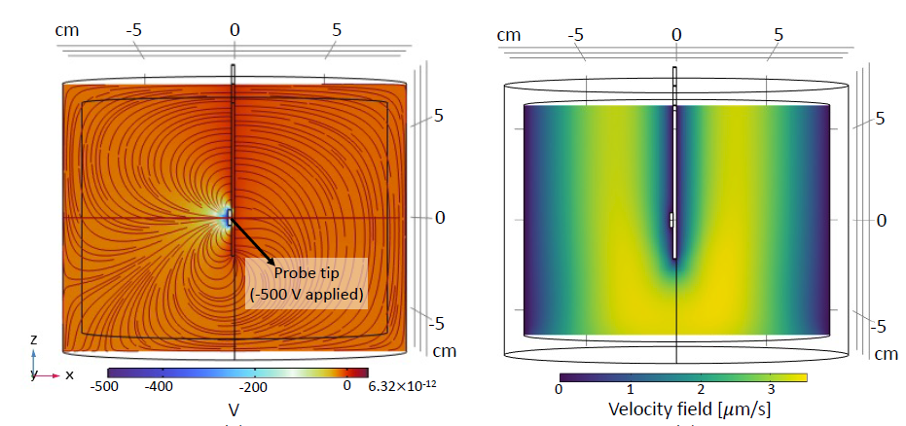
Ba-tagging at TRIUMF: Beam Ion Implantation
SRIM-generated Stopping Range
Implanted beam position profile relative to probe tip
ISAC ¹³⁹Cs beam
Notes:
This is a closer look at a Monte-Carlo SRIM simulated Cs-139 beam penetrating the Be window with an energy of 4 MeV/u, which is an achievable energy for us at the TRIUMF-ISAC facility.
The ions come to a stop at about 60 microns from the Be window in this example. From a different view point, facing the beam head on, the plot on the right shows the radial straggle of the ions after being implanted into LXe. Come experiment time, this beam spot is ideally placed if it is centred on the probe tip axis.

Slide 8
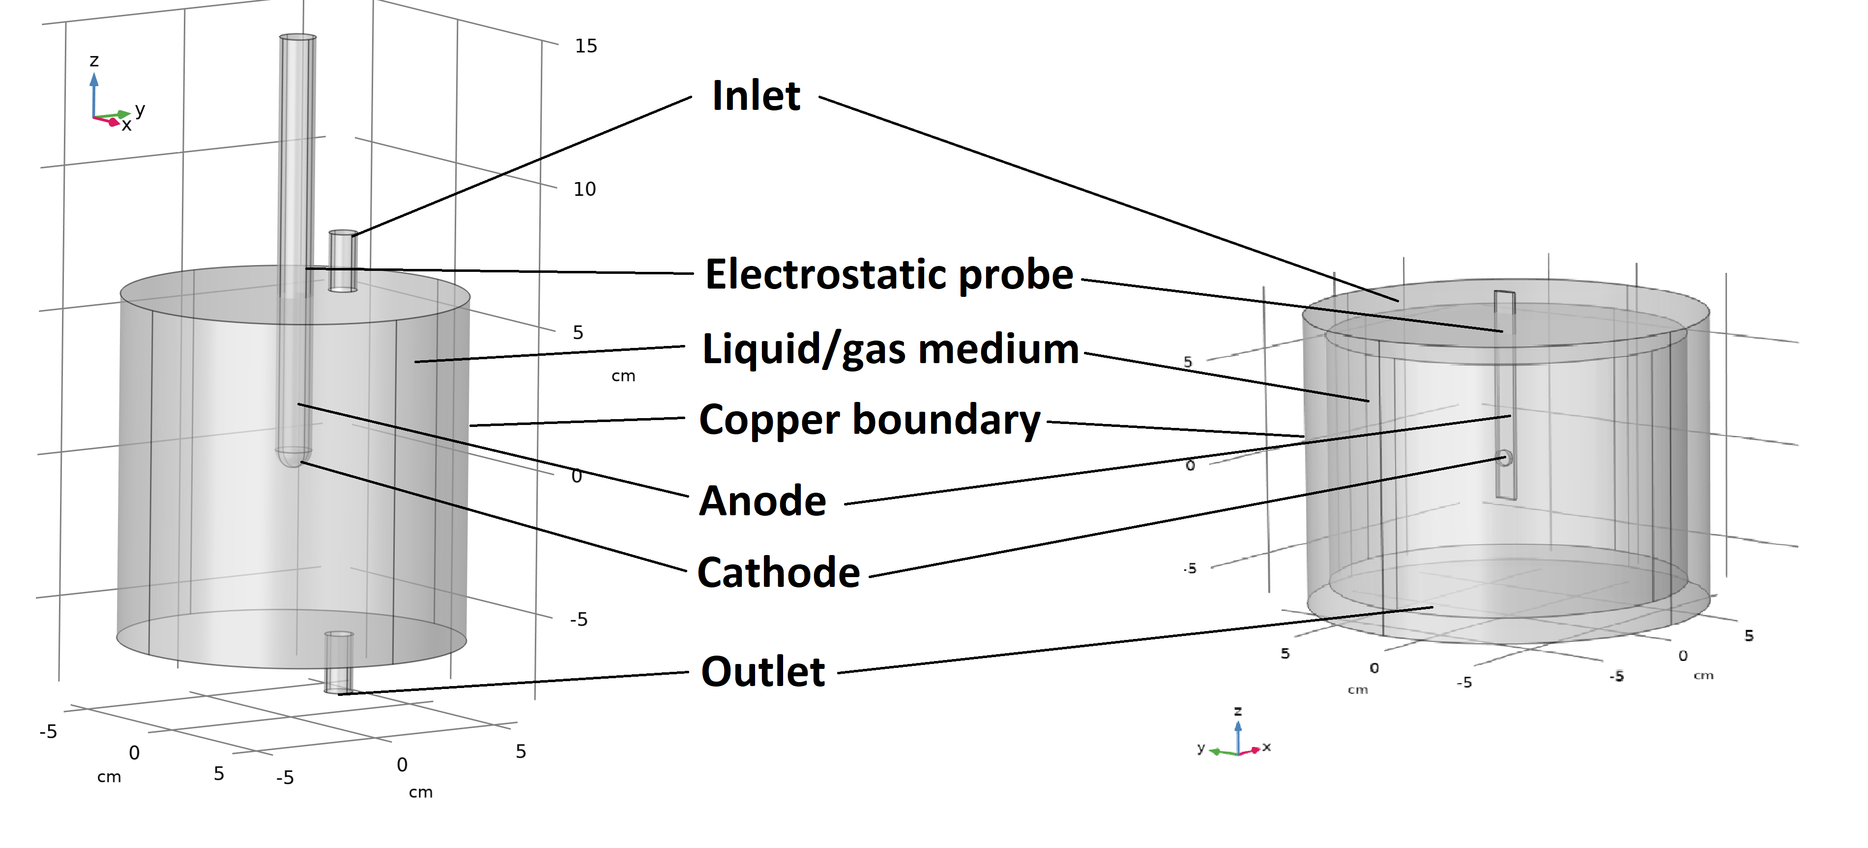
COMSOL Multiphysics Simulation Geometry
How to attract ions onto a DC biased probe for extraction?
Investigate this with two different models, depending on the simulation needs
Model B
Model A
Notes:
- Now we will switch over to simulations, to help answer the question about how to attract the barium ions onto a biased probe, so that we can later extract it
- A diagram of the liquid xenon cell within the apparatus is shown here, and I use two simplified models to simulate the ion motion in comsol, which is a finite element analysis software program. The two models have the same general features, with slight differences depending on the type of simulation run.
- Model a is equipped with the capability to vary the magnitude of the fluid velocity field on one side, and it has a rounded probe tip. I used this for general ion motion studies
- And model b has a flat probe with a biased substrate feature, similar to the real-life probe we already have, and a symmetric liquid xenon fluid flow field on all sides of the probe. This model was usually used for systematic studies. Since model B’s probe shape more closely matches the real-life probe within the experimental setup, I will focus on showing simulations performed with this model only today.

Slide 9
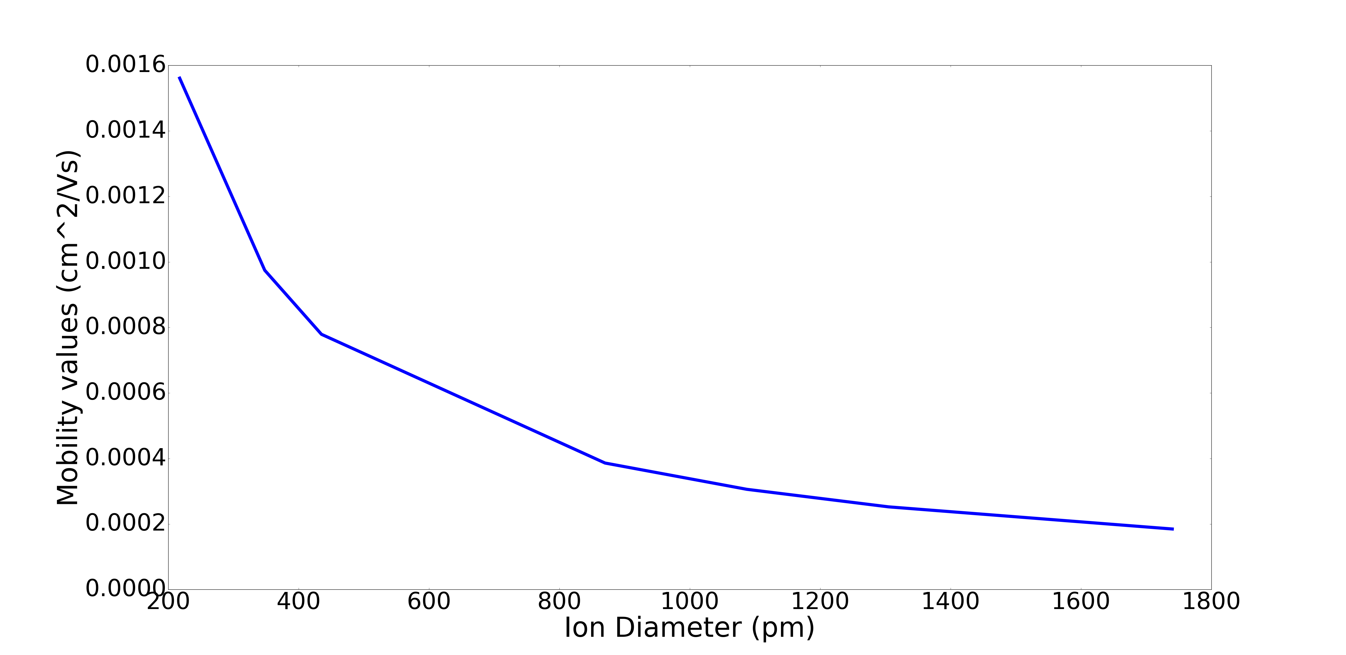

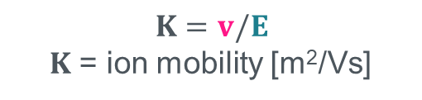
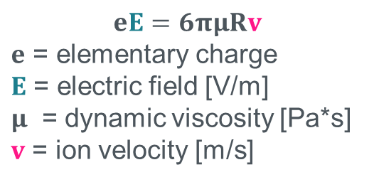
Basis for Ion Motion in COMSOL Model: Setting the Ion Mobility
Set the ion mobility by varying the ion diameter
The mobility of ¹³⁹Ba⁺ in LXe is 2.11e-4 cm²/Vs
Encapsulates the “Clustering Effect” of Ba ions in LXe
$$eE=6πμRv$$
$e$ = elementary charge
$E$ = electric field [V/m]
$μ$ = dynamic viscosity [Pa*s]
$v$ = ion velocity [m/s]
Ion Mobility [cm²/Vs]
$$K=v/E$$
$K$ = ion mobility [m²/Vs]
Ion Diameter $(2R)$ [pm]
[S.-C. J. et al. Phys. D: Appl. Phys. 42 (2008), E. Bainglass et al. Mobility and clustering of barium ions and dications in high pressure xenon gas. Physical Review A 97(6) (2018).]
Notes:
The first, and most important step in simulating is to set the ion mobility value of the ion-liquid pair.
This refers to the differential speeds at which ions migrate through a medium under the influence of an electric field, and is essentially a measure of friction linked to the time that it takes the ions to travel a certain distance.
From a computational perspective, the ion mobility acts as an all-encompassing value describing an ion’s motion in a fluid. However, there is no direct way to set this value in COMSOL, so instead I equate the electric and drag forces to set the ion diameter to make sure that the ions behave appropriately and most realistically within the given medium using an experimentally measured mobility value of singly charged Ba ions in LXe.
Also, when Ba ions propagate through Lxe, they undergo a “clustering effect", likely as a result of the electrostrictive pressure, meaning, the Ba ions’ effective radius increases in LXe, from one or more layers of Xe atoms around the ion solidifying, forming a cluster-like structure. Setting the ion mobility this way allows for the program to incorporate this effect.

Slide 10
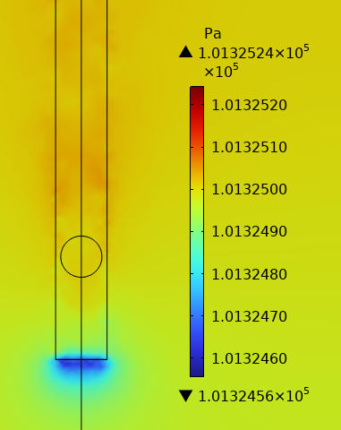

Typical COMSOL Multiphysics Solutions
Electrostatics and fluid dynamics converged solutions
$\vec{E}$-field converges at probe tip
Minimal flow field
Keeping constant pressure
Notes:
- Once the desired ion mobility is configured, and all of the environmental parameters such as temperature and viscosity are set, then the simulation computes the induced electric field lines in the LXe and the electric force experienced by the positive Ba ions, by solving a modified version of Gauss’ law for dielectric media and Faraday’s law of electrostatics.
- The electric field is on the left, showing the field’s direction lines all converging to the probe tip. In this case, only a portion of the probe tip is biased.
- On the other hand, finding a convergent fluid dynamics model required the system to have a circulating fluid, which means the simulation started with defining the inlet and outlet flow features prior to using a Laminar flow model by solving a variation of the Stokes equations without inertial terms. The pressure gradient between the two features was kept small. This condition creates a representative scenario of the flow state that we will have when taking data where the LXe medium is broadly at rest.

Slide 11
Simulation Results
Notes:
- With these solutions, the trajectories of Ba ions can be modelled by the COMSOL module “particle tracing for fluid flow”, and we can build an intuition for some of the experimental parameters such as the probe bias and the initial position of the ions within the liquid xenon.

Slide 12
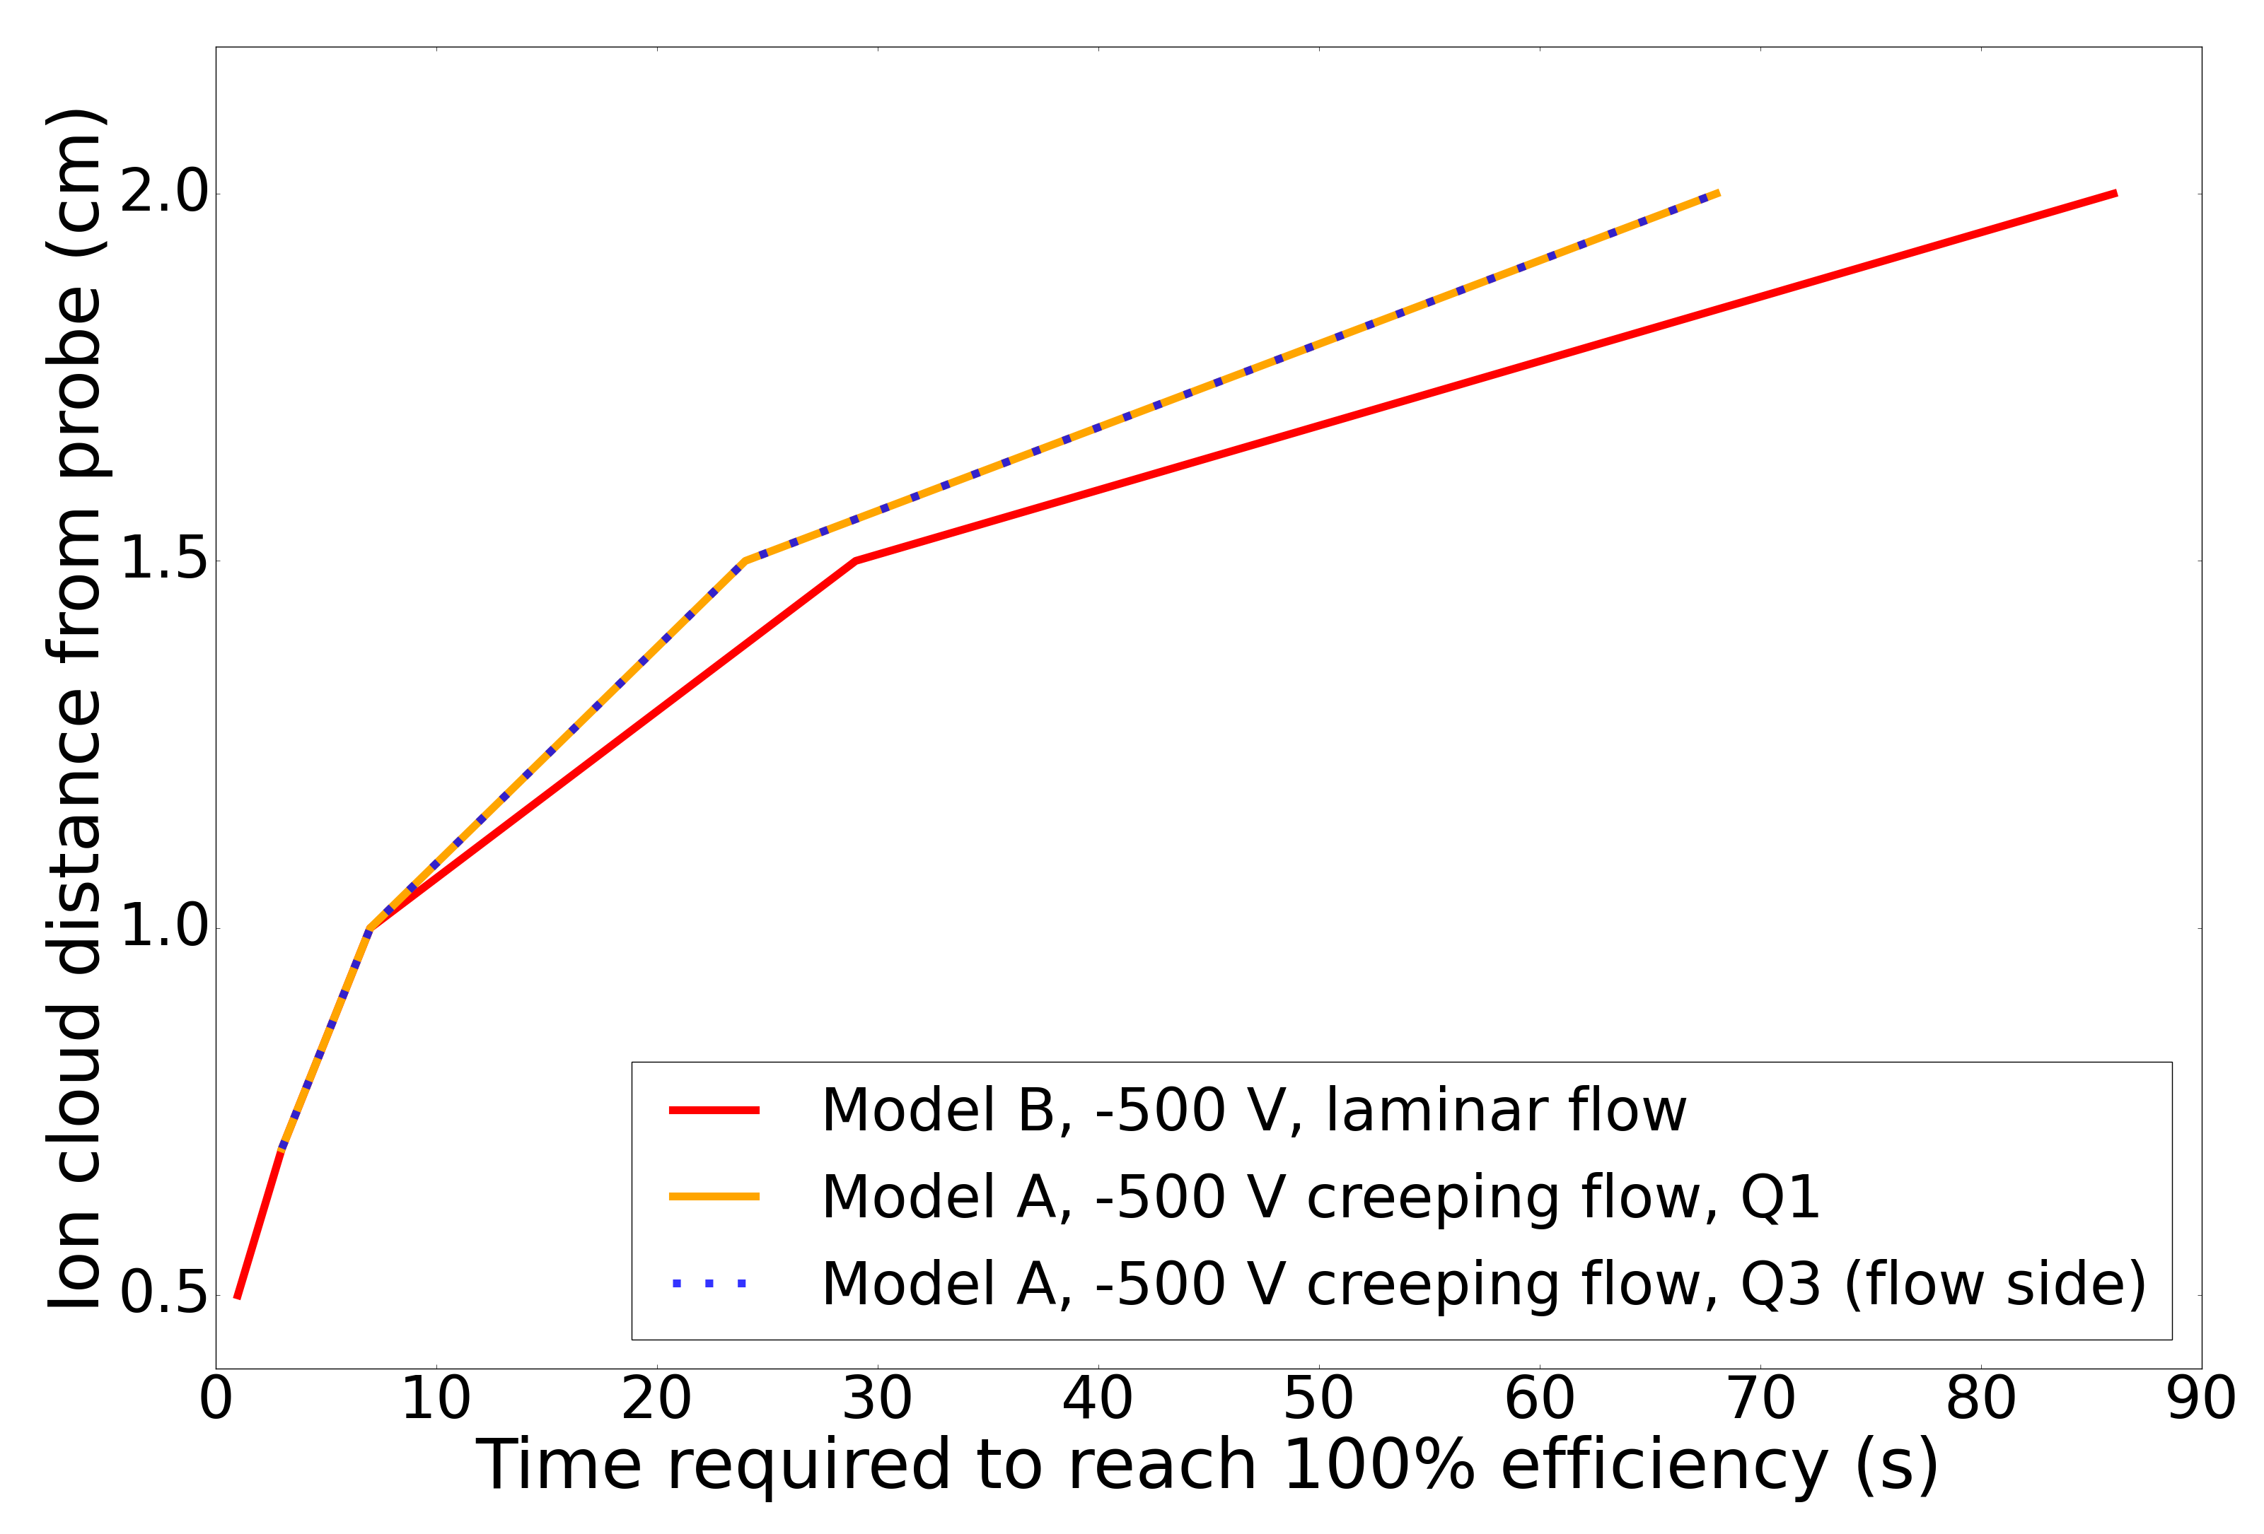
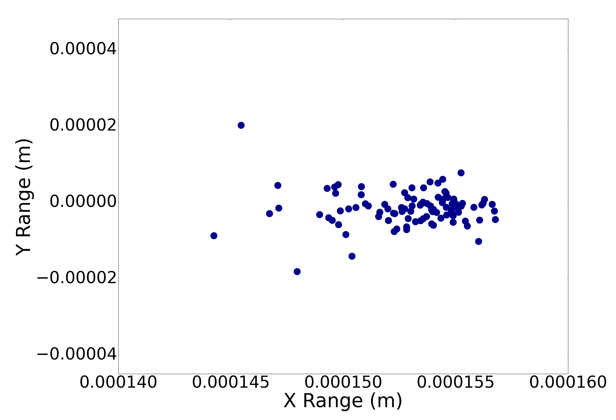
Initial Ion Position Effect on Extraction Efficiency
SRIM distribution of 100 ¹³⁹Ba⁺ ions
Notes:
Using a srim generated ion distribution, passed into the model, the ion cloud initial distance from the probe is varied for a few different situations. For model a, the probe biased to -500 V and the ions are released at the same distance magnitudes, but on opposite sides of the probe, where one run is subjected to small velocity fields and the other side has negligible flow. The same efficiency curves appear for ions released from either of these quadrants, showing that the fluid field doesn’t affect the ion extraction efficiency for short distances from the probe tip, hence when subjected to small velocity fields. The ions were also released from the same distances in model b, which was solving a slightly less sensitive and restrictive flow model, and the trend is almost the same.
Other simulations show that the fluid velocity field would have implications on the extraction efficiency at larger distances, especially in a liquid medium; however, distances larger than 2 cm are not applicable to the experimental setup, since the beam will be implanted much closer than this maximum distance studied.

Slide 13
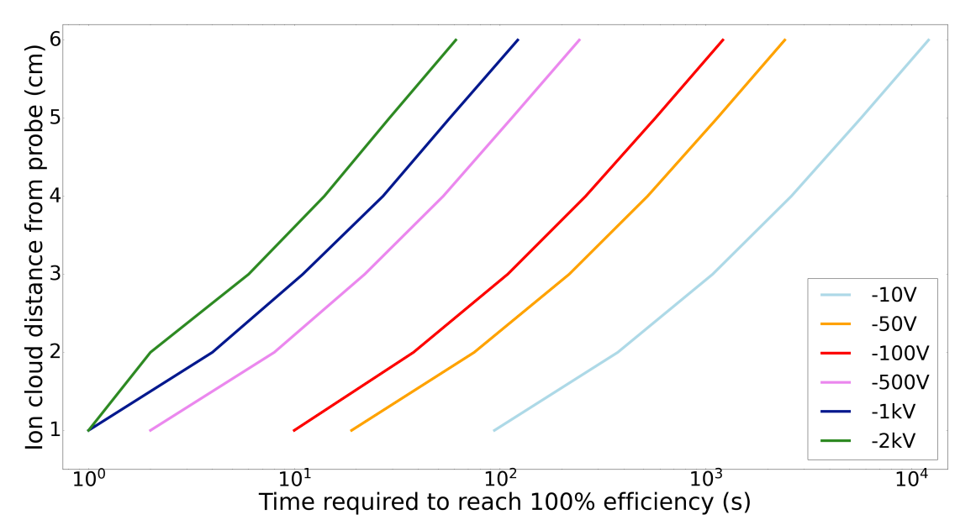
Probe Bias Sweep and Extraction Efficiency for Ba⁺ in Argon Gas
Simulated with ion mobility of ¹³⁹Ba⁺ in Ar at 273 K & 1 atm = 2.32 cm²/Vs
Notes:
This same ion distribution was used to study the effects of probe bias on the extraction efficiency, for other materials such as argon gas. As part of a phased approach to commissioning the setup, the plan is to first try to implant Ba ions into a vessel filled with argon gas, to allow for fine tuning of the probe controls and pressure readouts. As such, the simulations were repeated for argon gas, as well as for a collection of different probe biases.
As expected, the ions travel to the probe much faster when a larger voltage is applied to the probe tip, especially at larger initial distances from the probe, which again would depend on the beam energy used to deposit the ions. Also, the vessel’s radius is about 5 cm in length.
As a result, not all of these simulated settings are practical for experimental purposes, but it would allow us to benchmark the initial data taken.

Slide 14
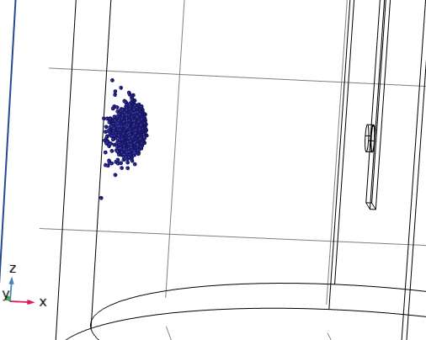

Summary & Outlook
Search for 0νββ in ¹³⁶Xe with nEXO and implications on neutrino mass measurements
Development of in-LXe Ba-source for testing ion extraction methods
Role of ion mobility definitions in setting realistic COMSOL simulation environments
Quantitative studies on how LXe fluid velocity, probe bias, and ion distance from probe vary the ion extraction efficiency
Future simulations can incorporate
  Field shaping rings, and studies on the Ba ion accumulation on the probe tip
  Particle-particle interactions
15,000 ions in GAr, released from edge of vessel
Notes:
To conclude, today I went over the role of ba-tagging in a future upgrade of the nexo experiment, and the ion extraction testing system required to develop this technology. I discussed the groundwork for the COMSOL simulations performed for the accelerator driven Ba ion source under development at TRIUMF, and some extraction efficiency simulation results. These simulations can build in complexity, with some possibilities to add in field shaping rings or other types of forces or interactions later on.
Thank you for listening, and I open the floor for any questions!

Slide 15



Acknowledgements: nEXO is a Worldwide Effort
Thank you to the nEXO Ba-tagging Teams at TRIUMF, McGill and Carleton Universities!

Slide 16
Backup Slides

Slide 17
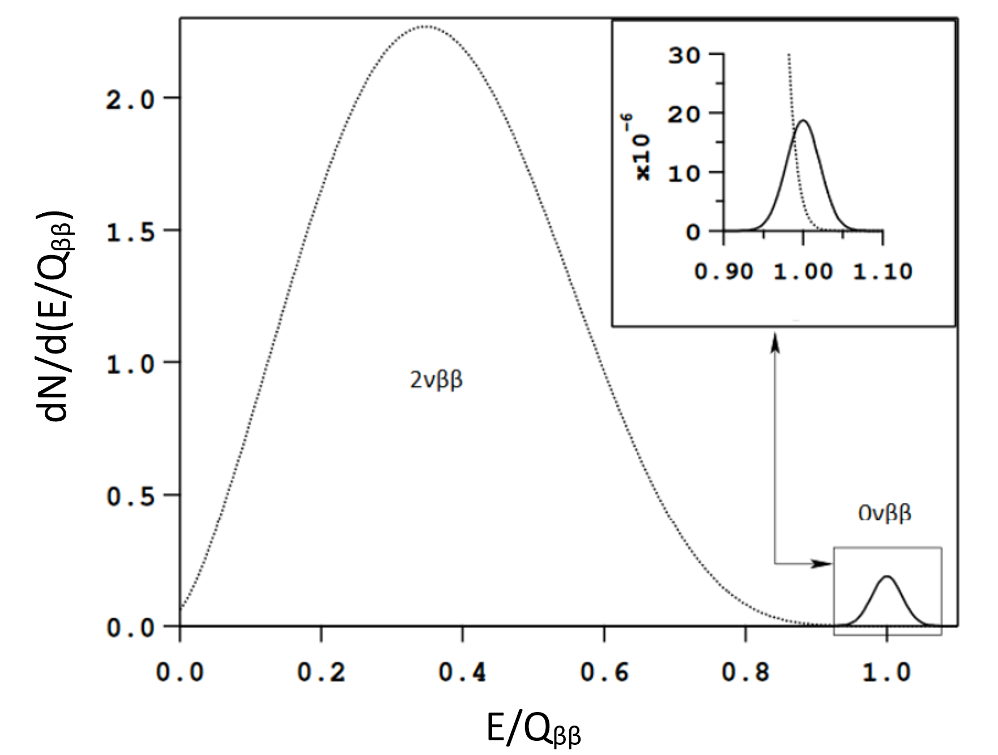

Slide 18
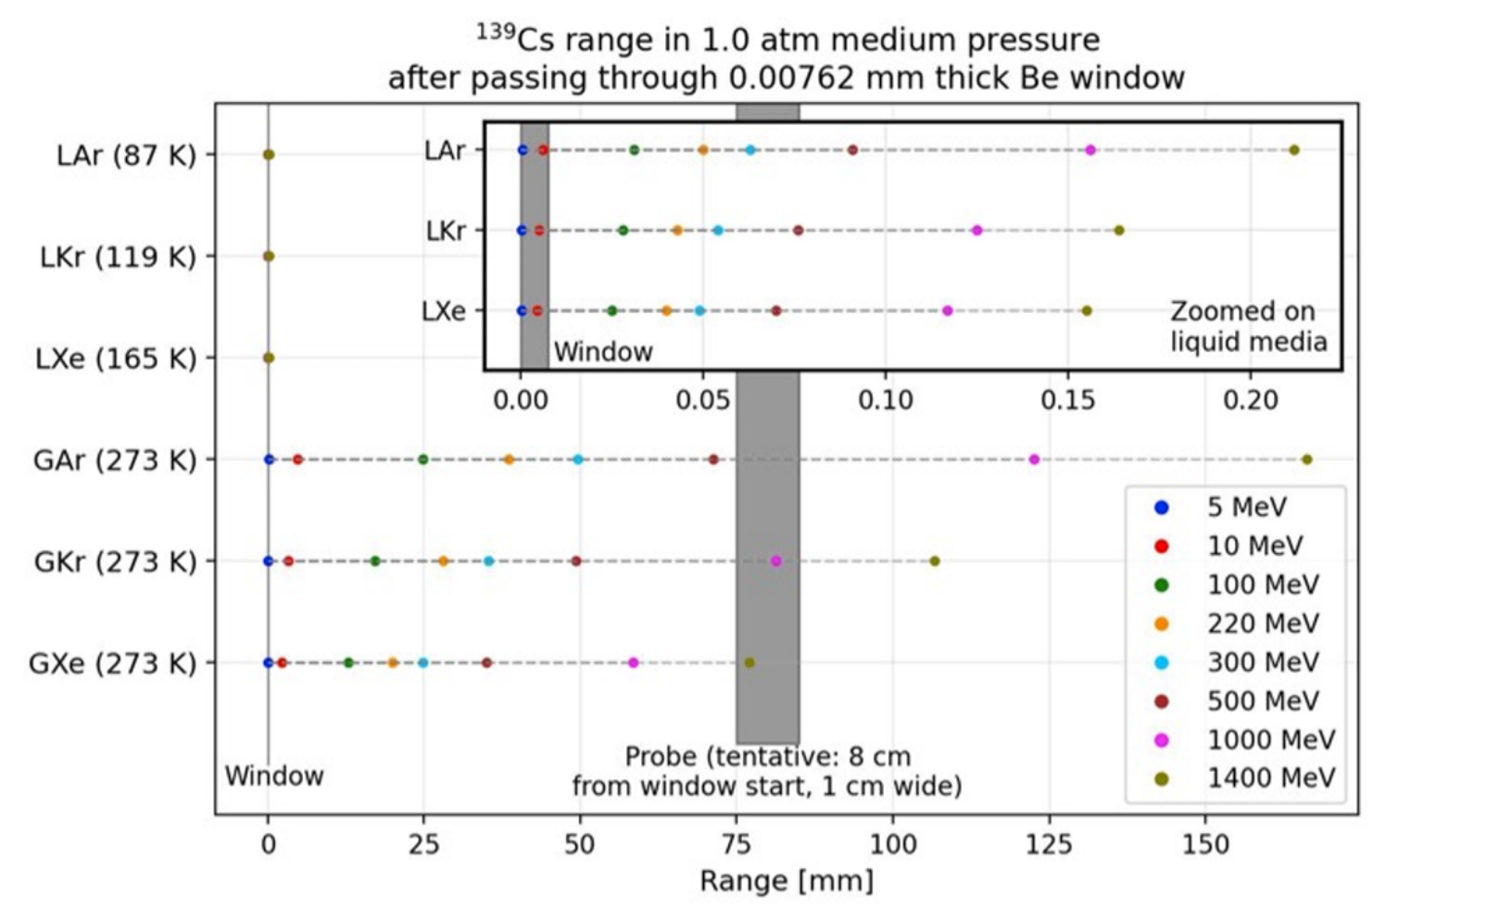
Taken from [5]

Slide 19
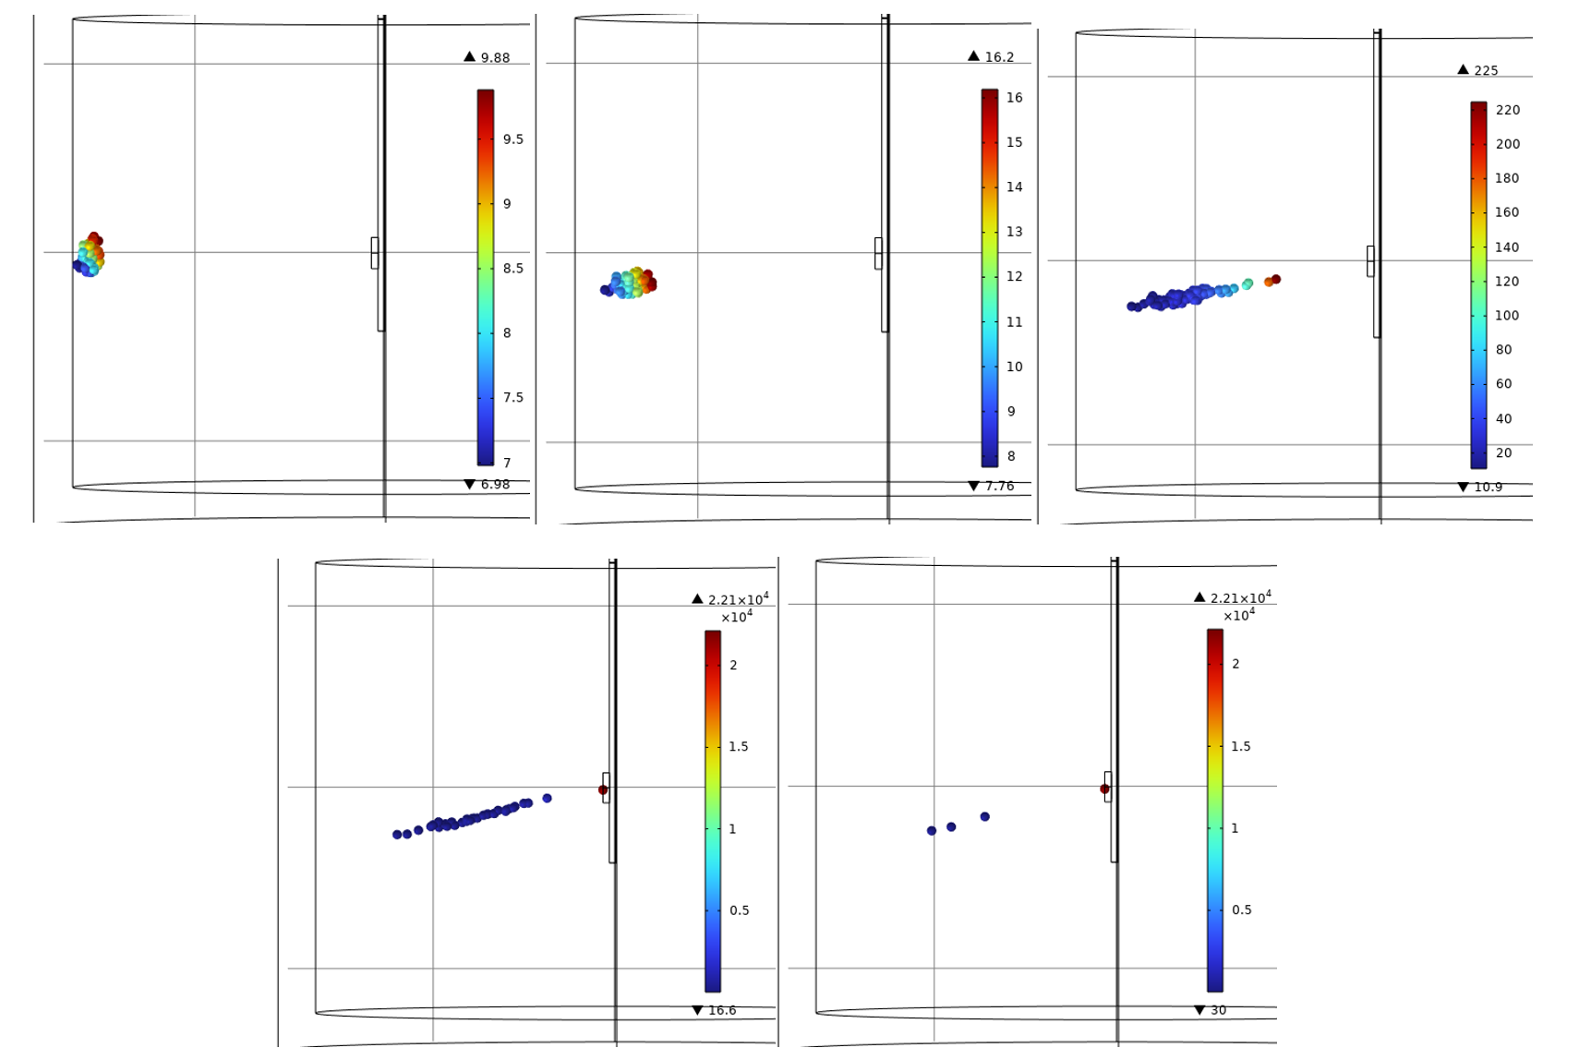
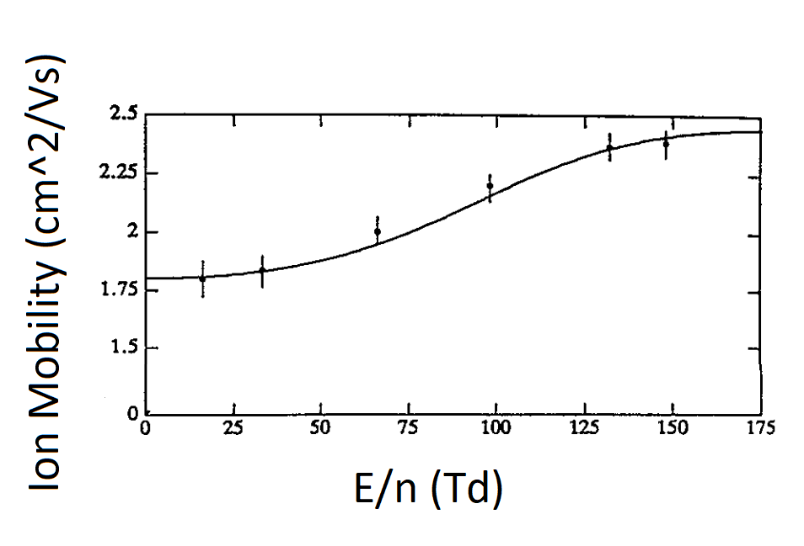
Simulating Ba ion motion in argon gas
K = 1.80 cm²/Vs
Corresponding ion diameter of 4.49 pm [4]
1 atm, 273 K
100 Ba ions
-500 V bias

