Slide 1
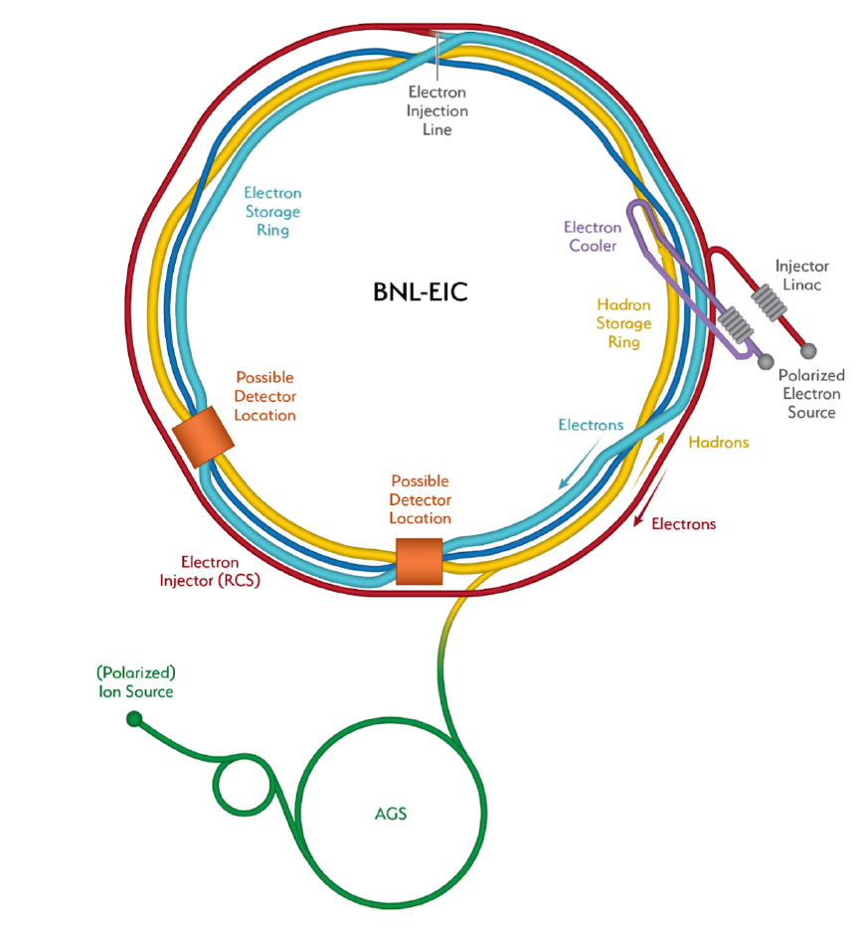

A Canadian Accelerator Contribution to the Electron Ion Collider
EIC
Robert Laxdal
Deputy Director, Accelerator Division
TRIUMF, Canada
Collaborators:
TRIUMF: O. Kester, P. Kolb, N. Smith, Z. Yao
U. Manitoba: W. Deconinck, M. Gericke, S. Longo, J. Mammei
U. Regina: G. Huber, Z. Papandreou
Mt Allison: D. Hornidge
UVic: T. Junginger

Slide 2
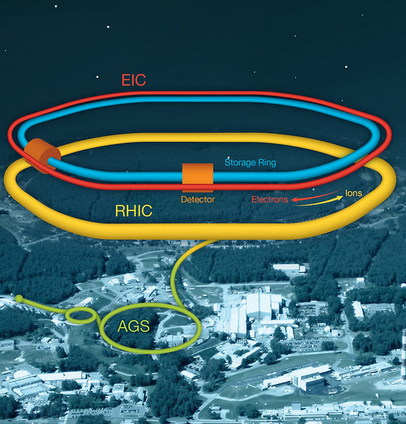
Electron Ion Collider
The EIC at Brookhaven will be the next international discovery machine.
The EIC accelerator design is based on the existing RHIC Complex
Hadron storage ring 40-275 GeV (based on existing RHIC)
Electron rapid cycling synchrotron 0.4- 18 GeV new in RHIC tunnel
Electron storage ring 2.5–18 GeV new ring in RHIC tunnel
High luminosity interaction region

Slide 3
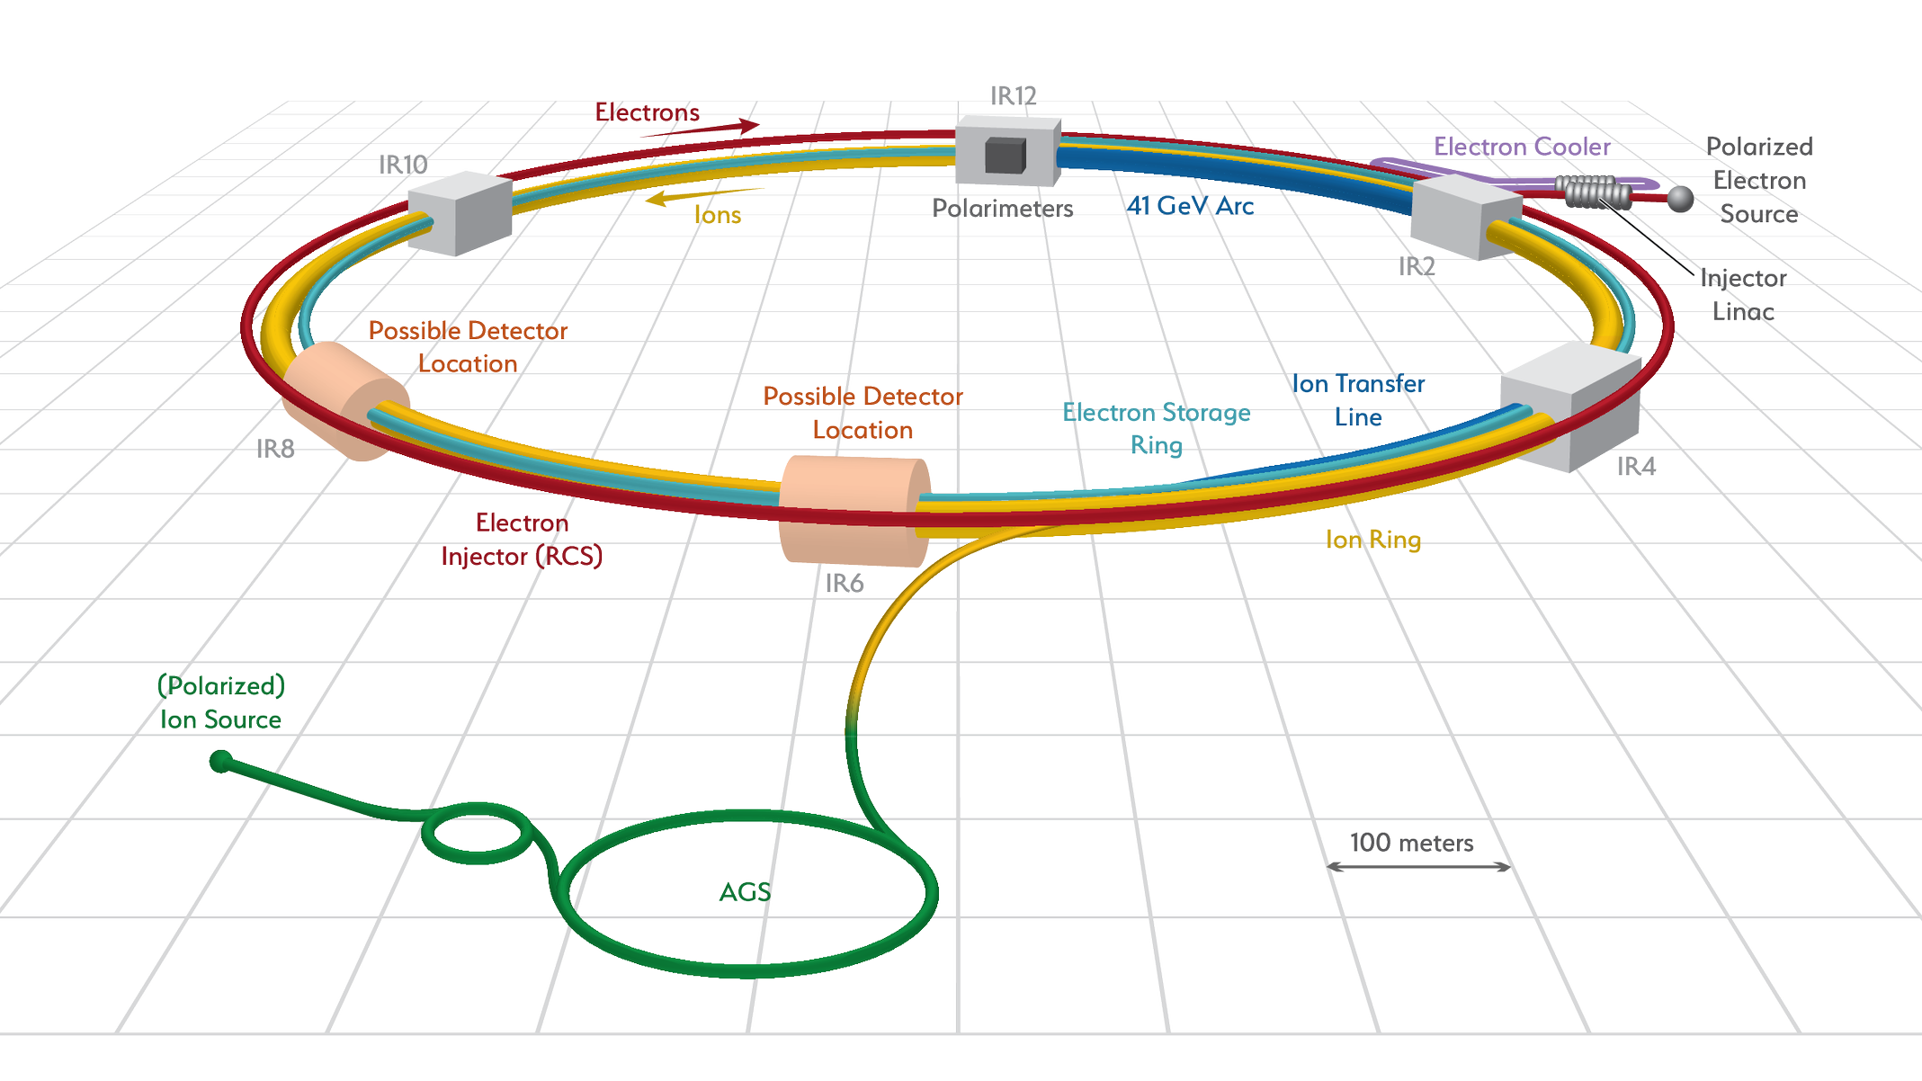
EIC Accelerator R&D scope overview
  The EIC offers significant challenges in accelerator technology
Electron
Fast Kicker
Cooler Electron Source
Cooler SRF
ESR cavity
500 kW Forward Power Coupler
Polarized Electron Source
Higher order Mode (HOM) damper
Proton Injection
Fast Kicker
Crab cavities
IR magnets and vacuum chmabers

Slide 4

TRIUMF and the EIC accelerator
  Accelerator science at TRIUMF provides Canada with a world-class platform in beam physics and instrumentation, secondary particle production, and Superconducting RF (SRF) technologies.
  Together with the Canadian subatomic physics community we are developing a five-year plan informed by 20-year vision that includes support for international projects like the EIC.
  Discussions with EIC have identified the crab cavities as a possible in kind contribution from Canada

Slide 5
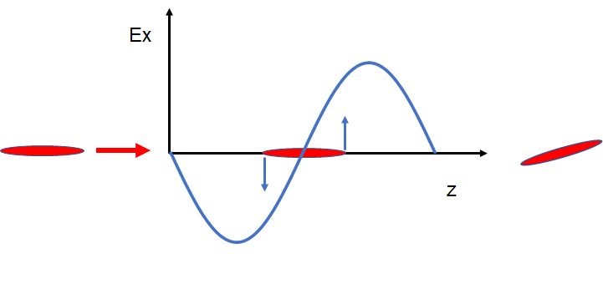
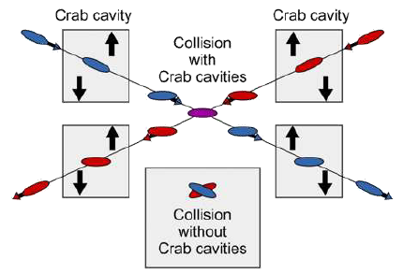
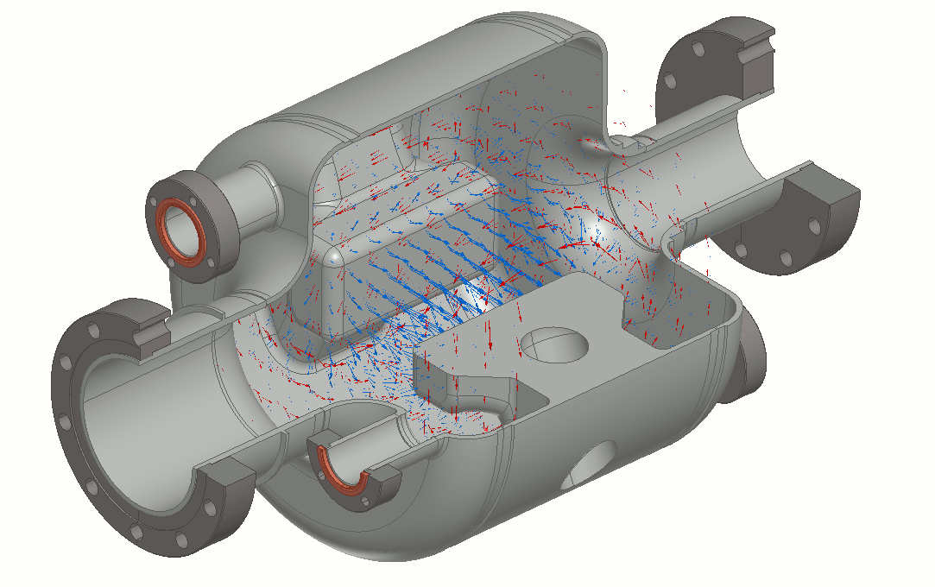
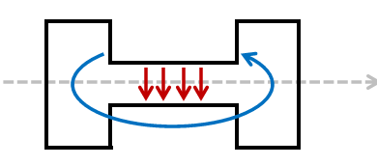
What is a crab cavity?
A crab cavity is designed to produce a deflecting (rather than accelerating) electro-magnetic rf field.
A charged particle bunch passing through the cavity at the zero-crossing will experience a transverse skewing (crabbing) so the bunch is rotated to be at an angle with respect to the beam path
This skewing compensates for the crossing angle at the collision point and increases the probability of collision (luminosity)

Slide 6
EIC CRAB Cavities
The EIC requires crab cavities on both the hadron storage ring (HSR) and the electron storage ring (ESR)
HSR – long bunch, high rigidity
  requires eight 197MHz crab cavities and four 394MHz cavities to linearize the deflection
ESR – short bunch, low rigidity
  requires two 394 MHz cavities
The performance of the crab cavities is critical to the success of EIC – they increase luminosity by a factor of 10
Our proposal keys on the 394 MHz cavities as the Canadian contribution
 | Voltage/cavity Vt (MV) |  | No. of cavities
System | HSR | ESR | HSR | ESR
197 MHz | 8.5 | - | 8 | -
394 MHz | 2.4 | 2.9 | 4 | 2
25 mrad
394MHz
197MHz

Slide 7
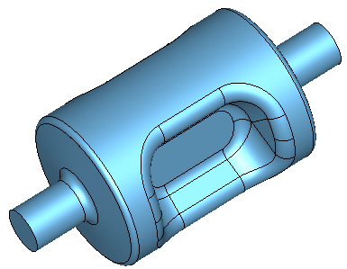
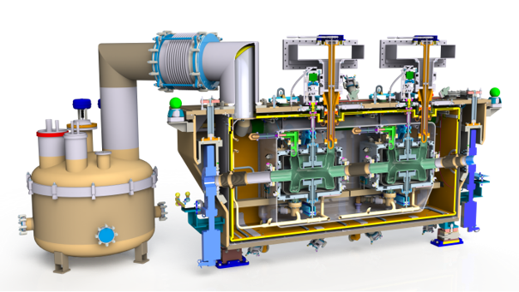
Challenge 1: Large crossing angle -> high voltage -> SRF technology
36 cm
Given the high crossing angle (25mrad) and limited space strong deflecting voltages are required
This precludes the use of normal conducting structures as the dissipated power would be too high (~1 MW for RT vs a few Watts for SRF)
The cavities will be made from Niobium (Tc=9.2K) and operated at 2K
The cavities will be housed in cryomodules for thermal isolation
54 cm

Slide 8
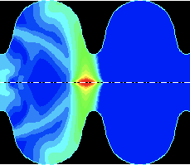
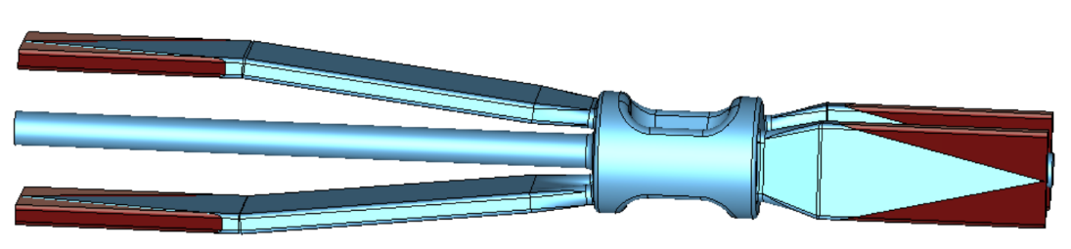
Challenge 2: High beam current and short bunches -> HOM excitation
High intensity charged particles passing through an rf cavity can excite additional rf field modes in addition to the fundamental crabbing mode
In EIC these higher order modes (HOMs) represent considerable power (10s of kW in e-ring) that must be removed from the cavity and delivered to an external load – under study at TRIUMF
394 MHz Crab Cavity with waveguide HOM extraction to damped loads

Slide 9
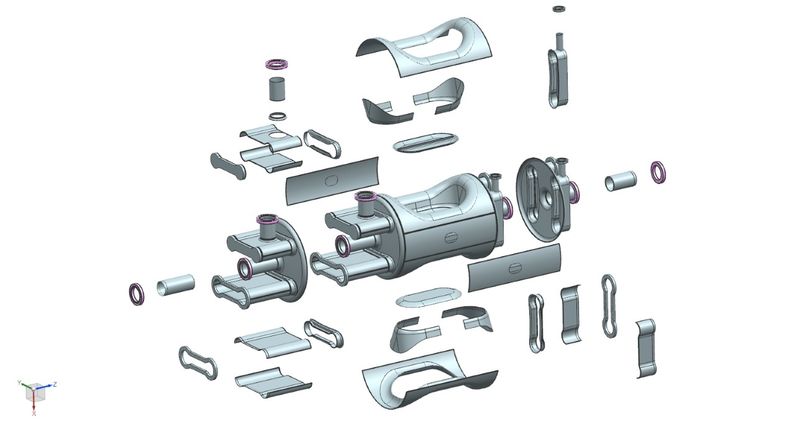
Challenge 3: Complex cavity shape
Crab cavities have complex shapes further complicated by additional ports and waveguides for HOM extraction
Requires many unique forming/machining and electron beam welding steps

Slide 10
TRIUMF’s SRF Capabilities

Slide 11
TRIUMF is Canada’s particle accelerator centre.
A wide variety of accelerator technologies populate the campus.
Our strategy is to use internal projects and external collaborations as springboards to expand core competencies or gain new ones.
ISAC-II
High energy
ARIEL
ISAC-I
Low and
medium
energy
Isotope Cyclotrons
elinac
520 MeV
Cyclotron

Slide 12
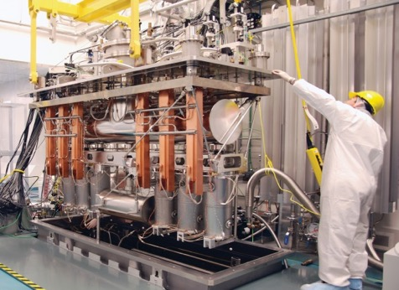
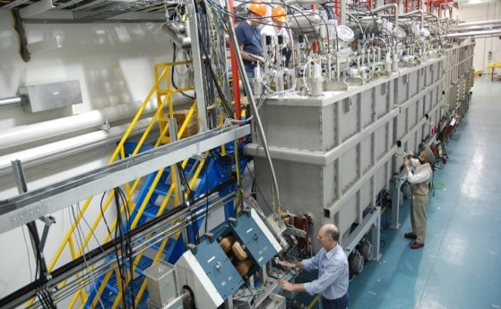
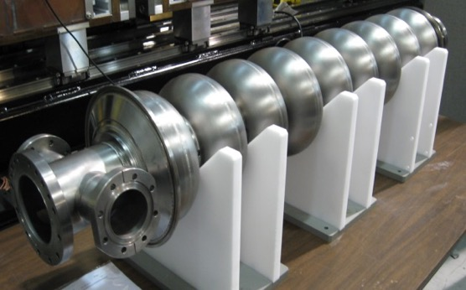
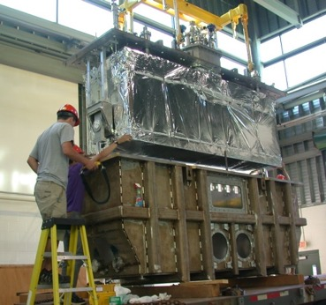
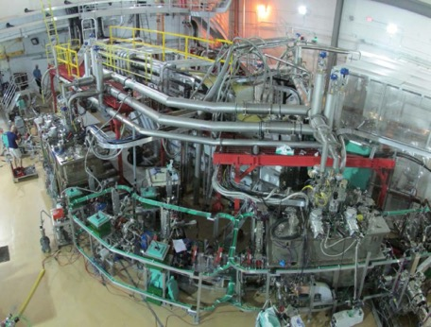
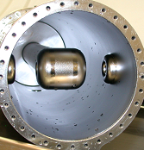
SRF Technology at TRIUMF since 2001 –> In house linear accelerators
40MV ISAC-II SRF heavy ion linac
@ 106 and 141 MHz
in operation since 2006
30MV ARIEL SRF 10mA electron linac
@ 1.3 GHz
first beam 2014

Slide 13
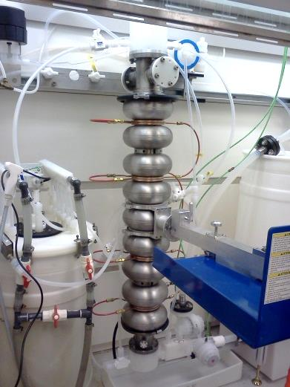
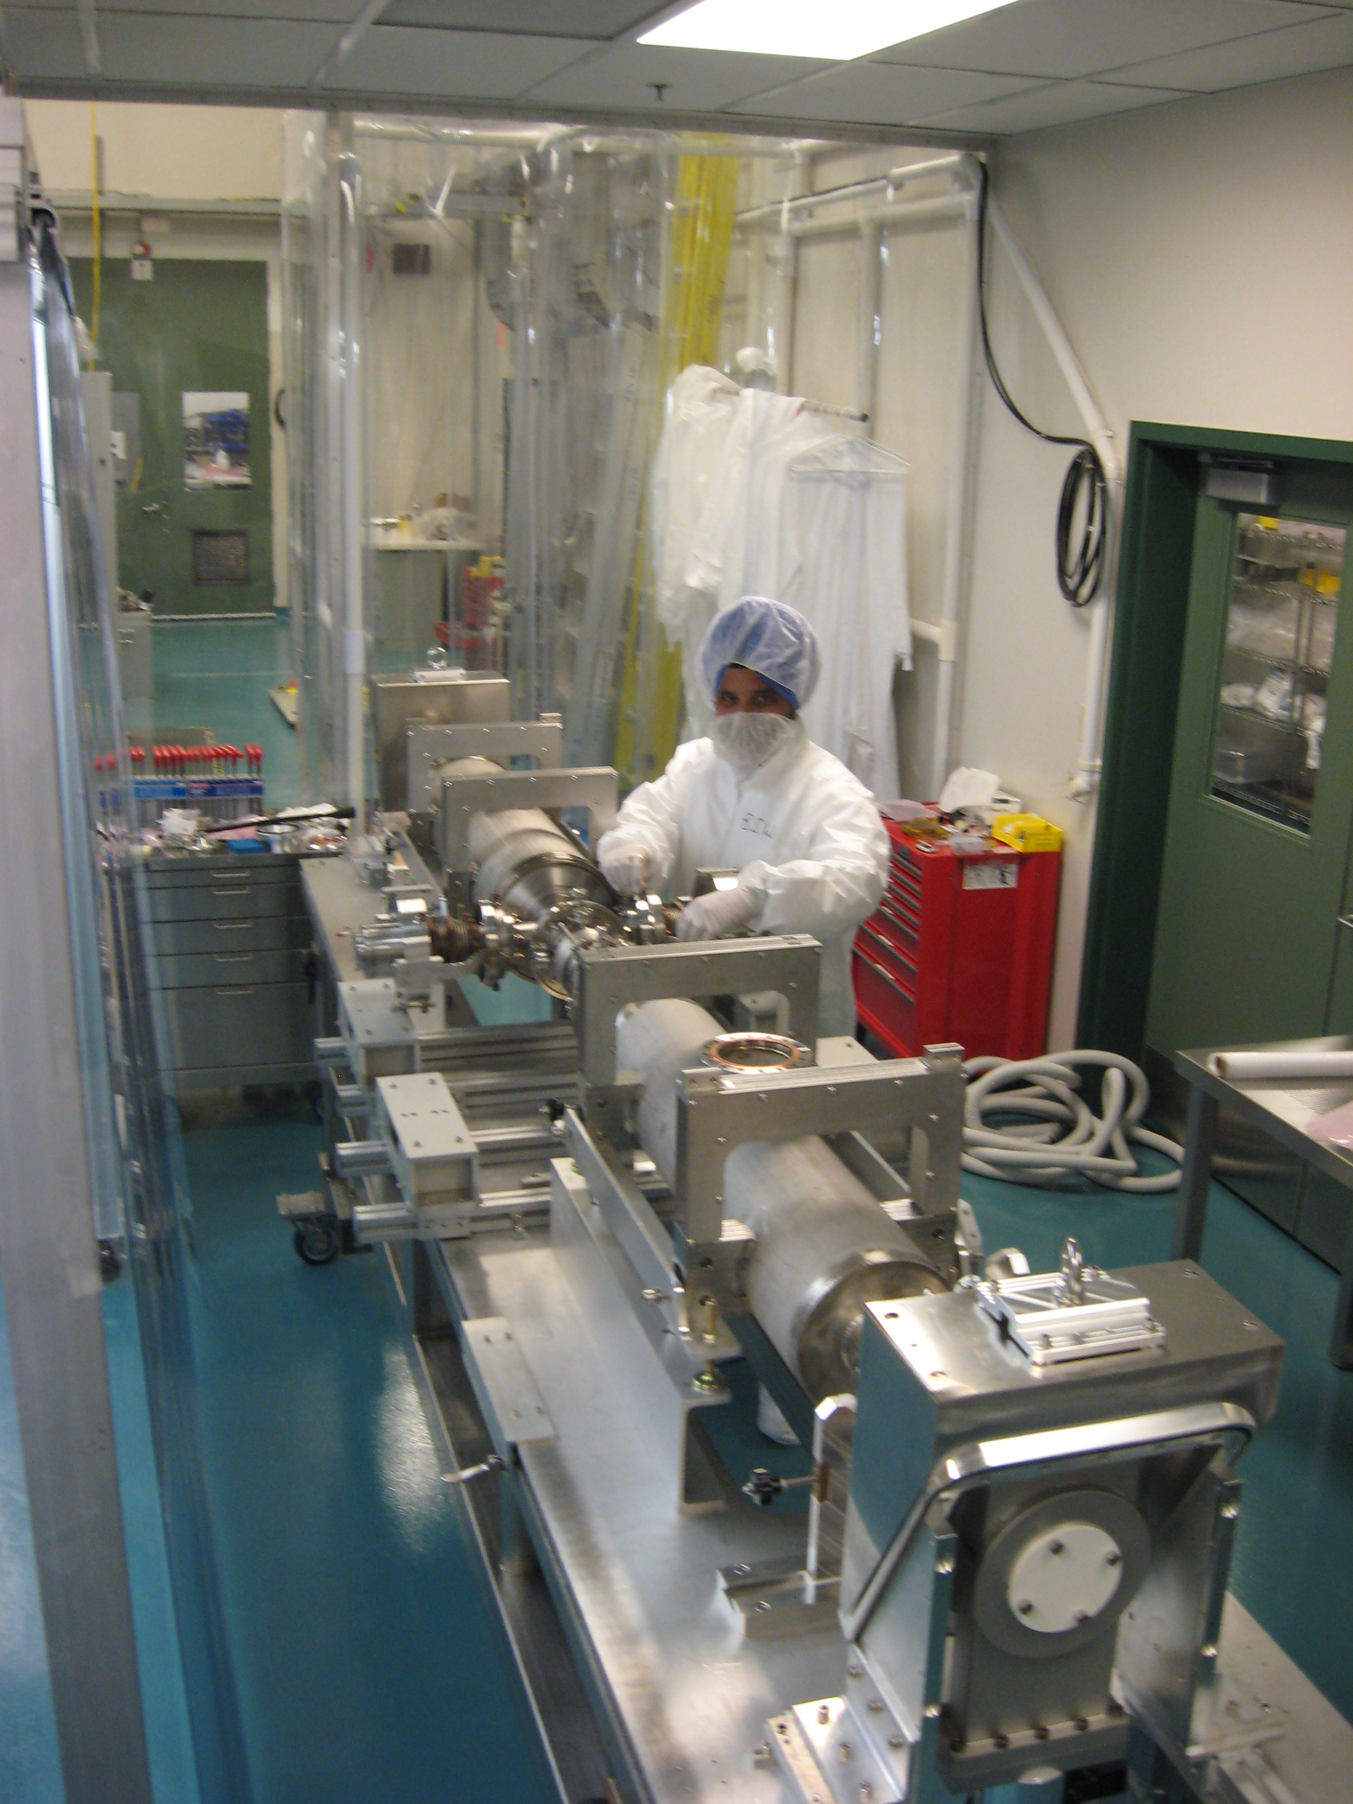
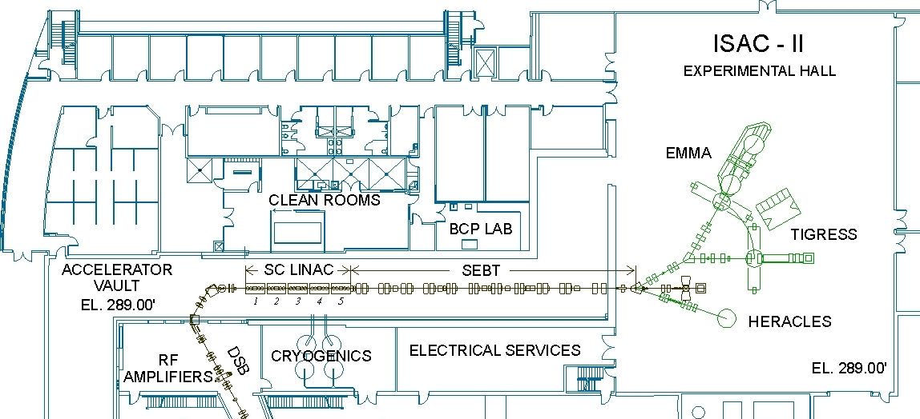
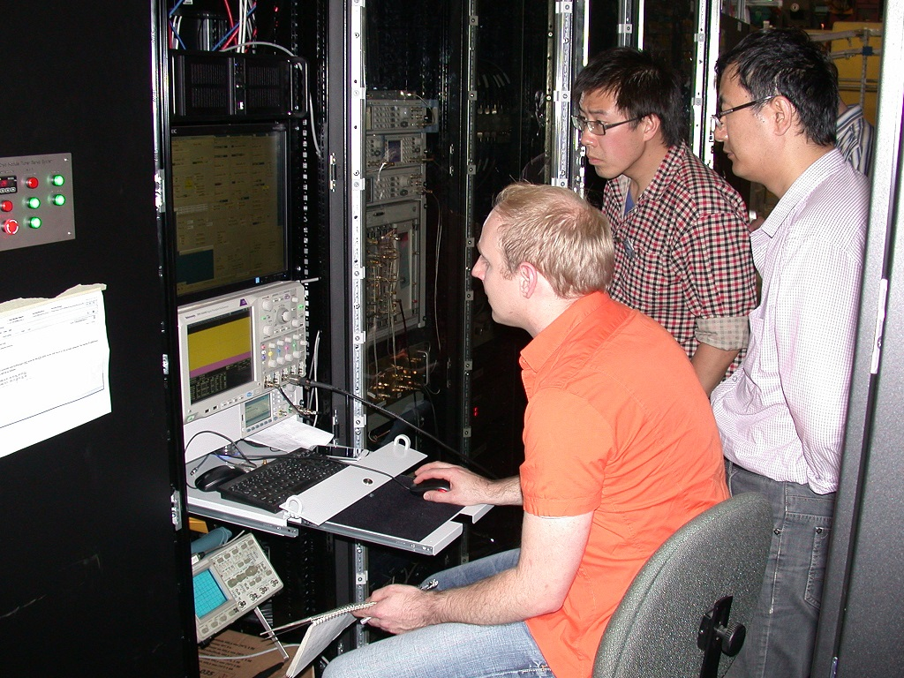

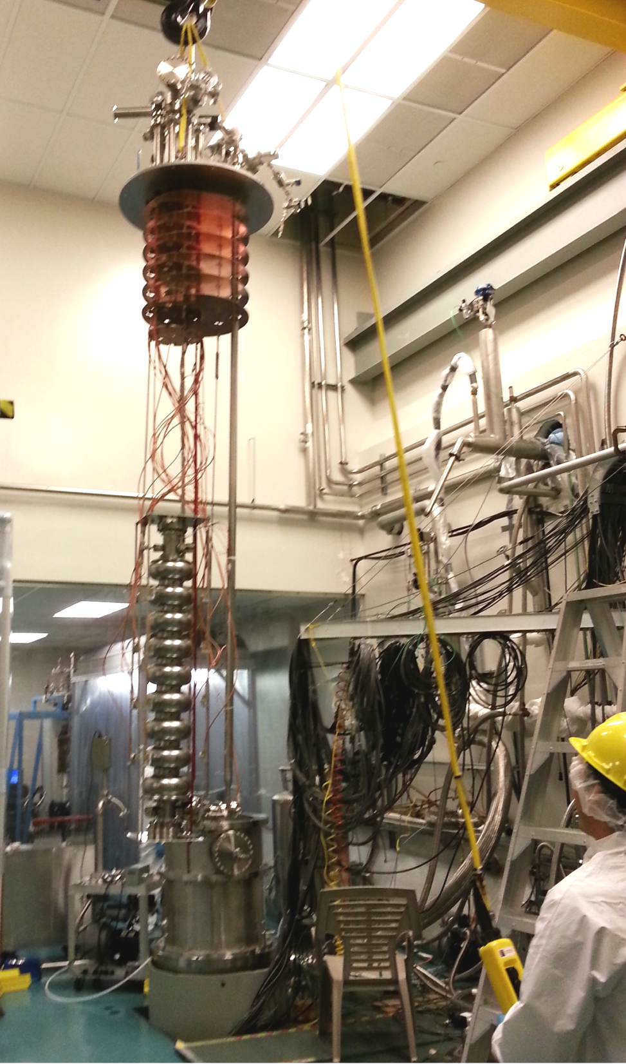
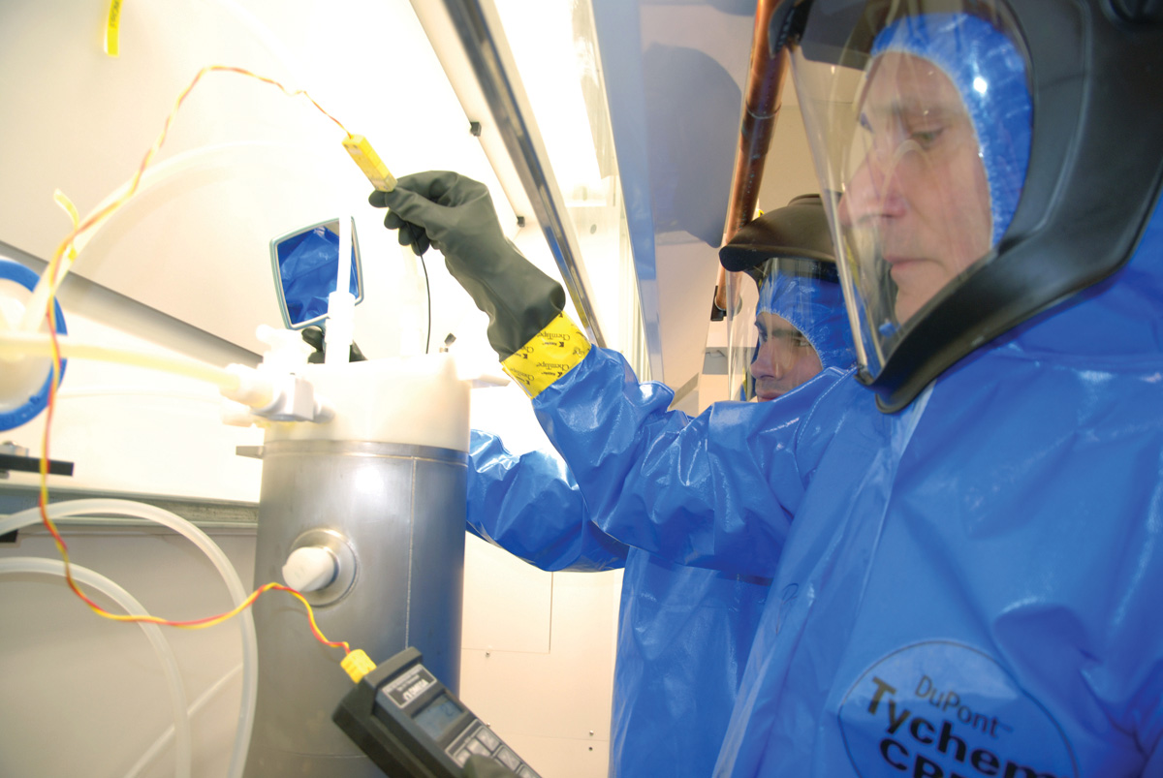
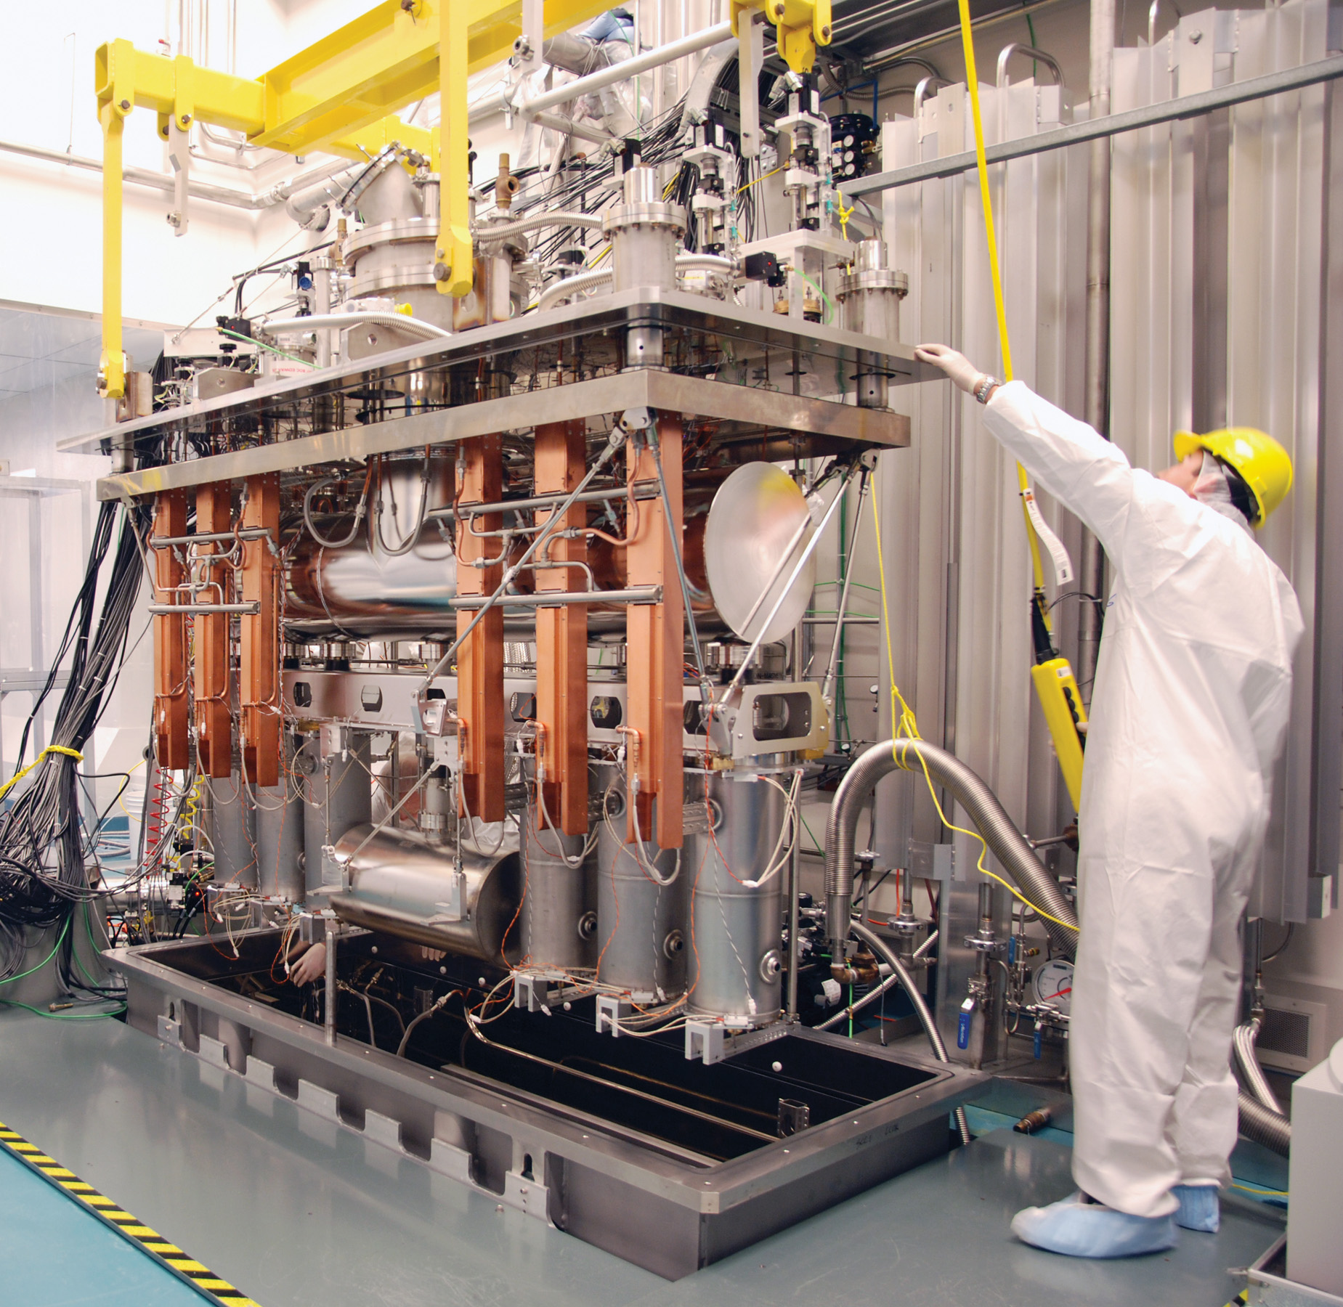
SRF Facilities
The SRF lab supports the in-house accelerator program, SRF research and external collaborations
Dirty assembly
Clean room
RF
HPWR
Prep room
Cryo-testing
Clean assembly
BCP

Slide 14
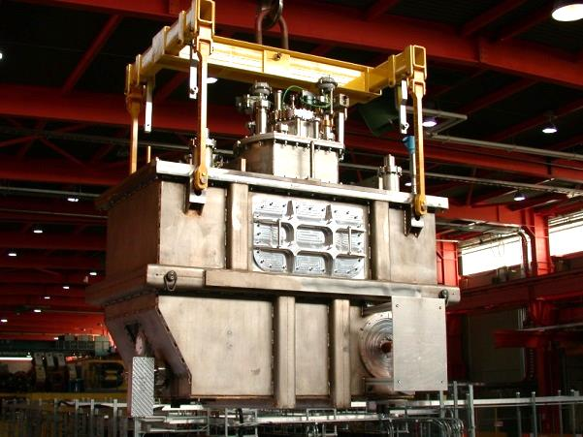
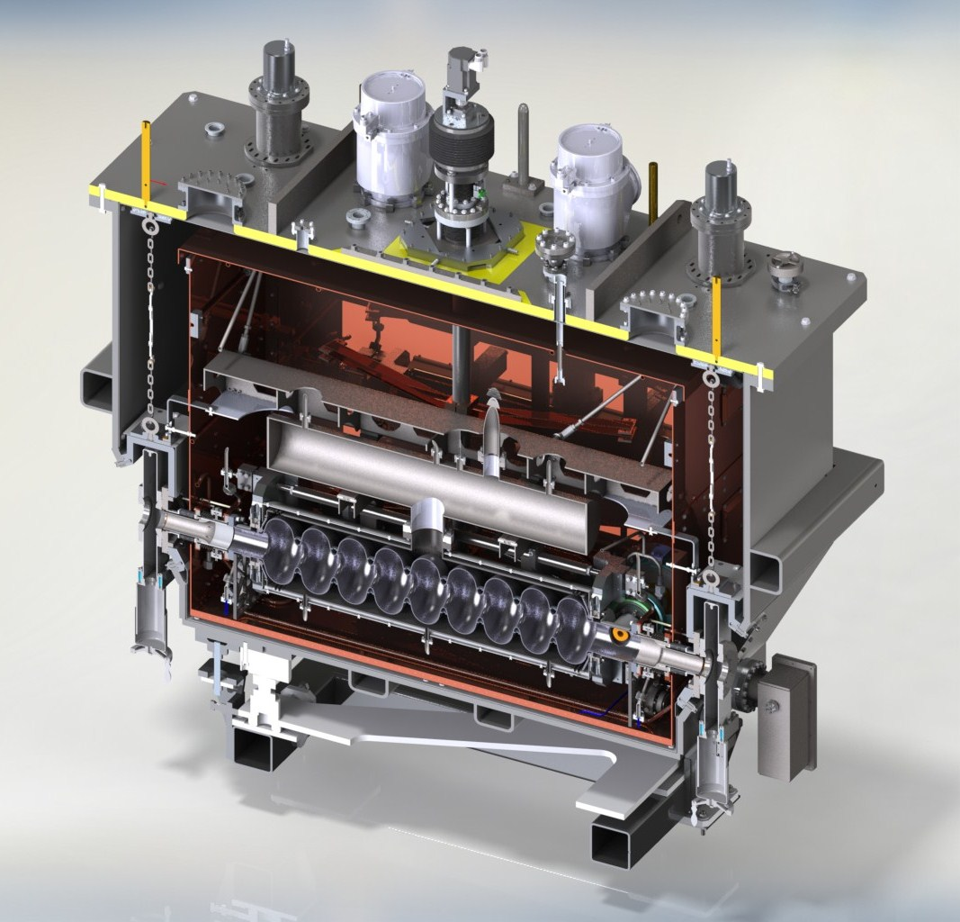
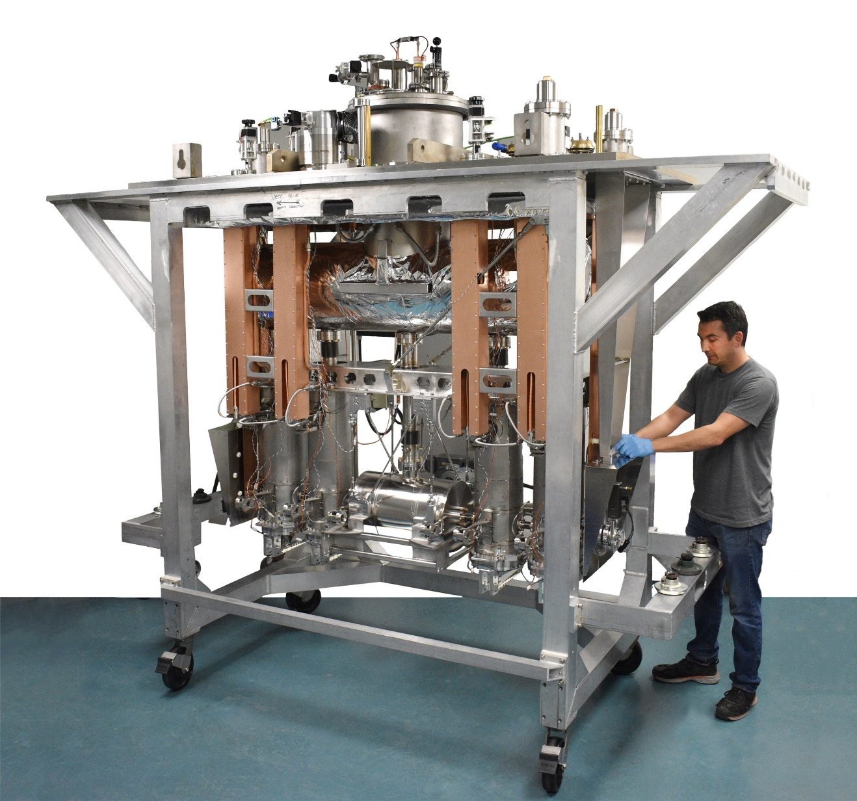
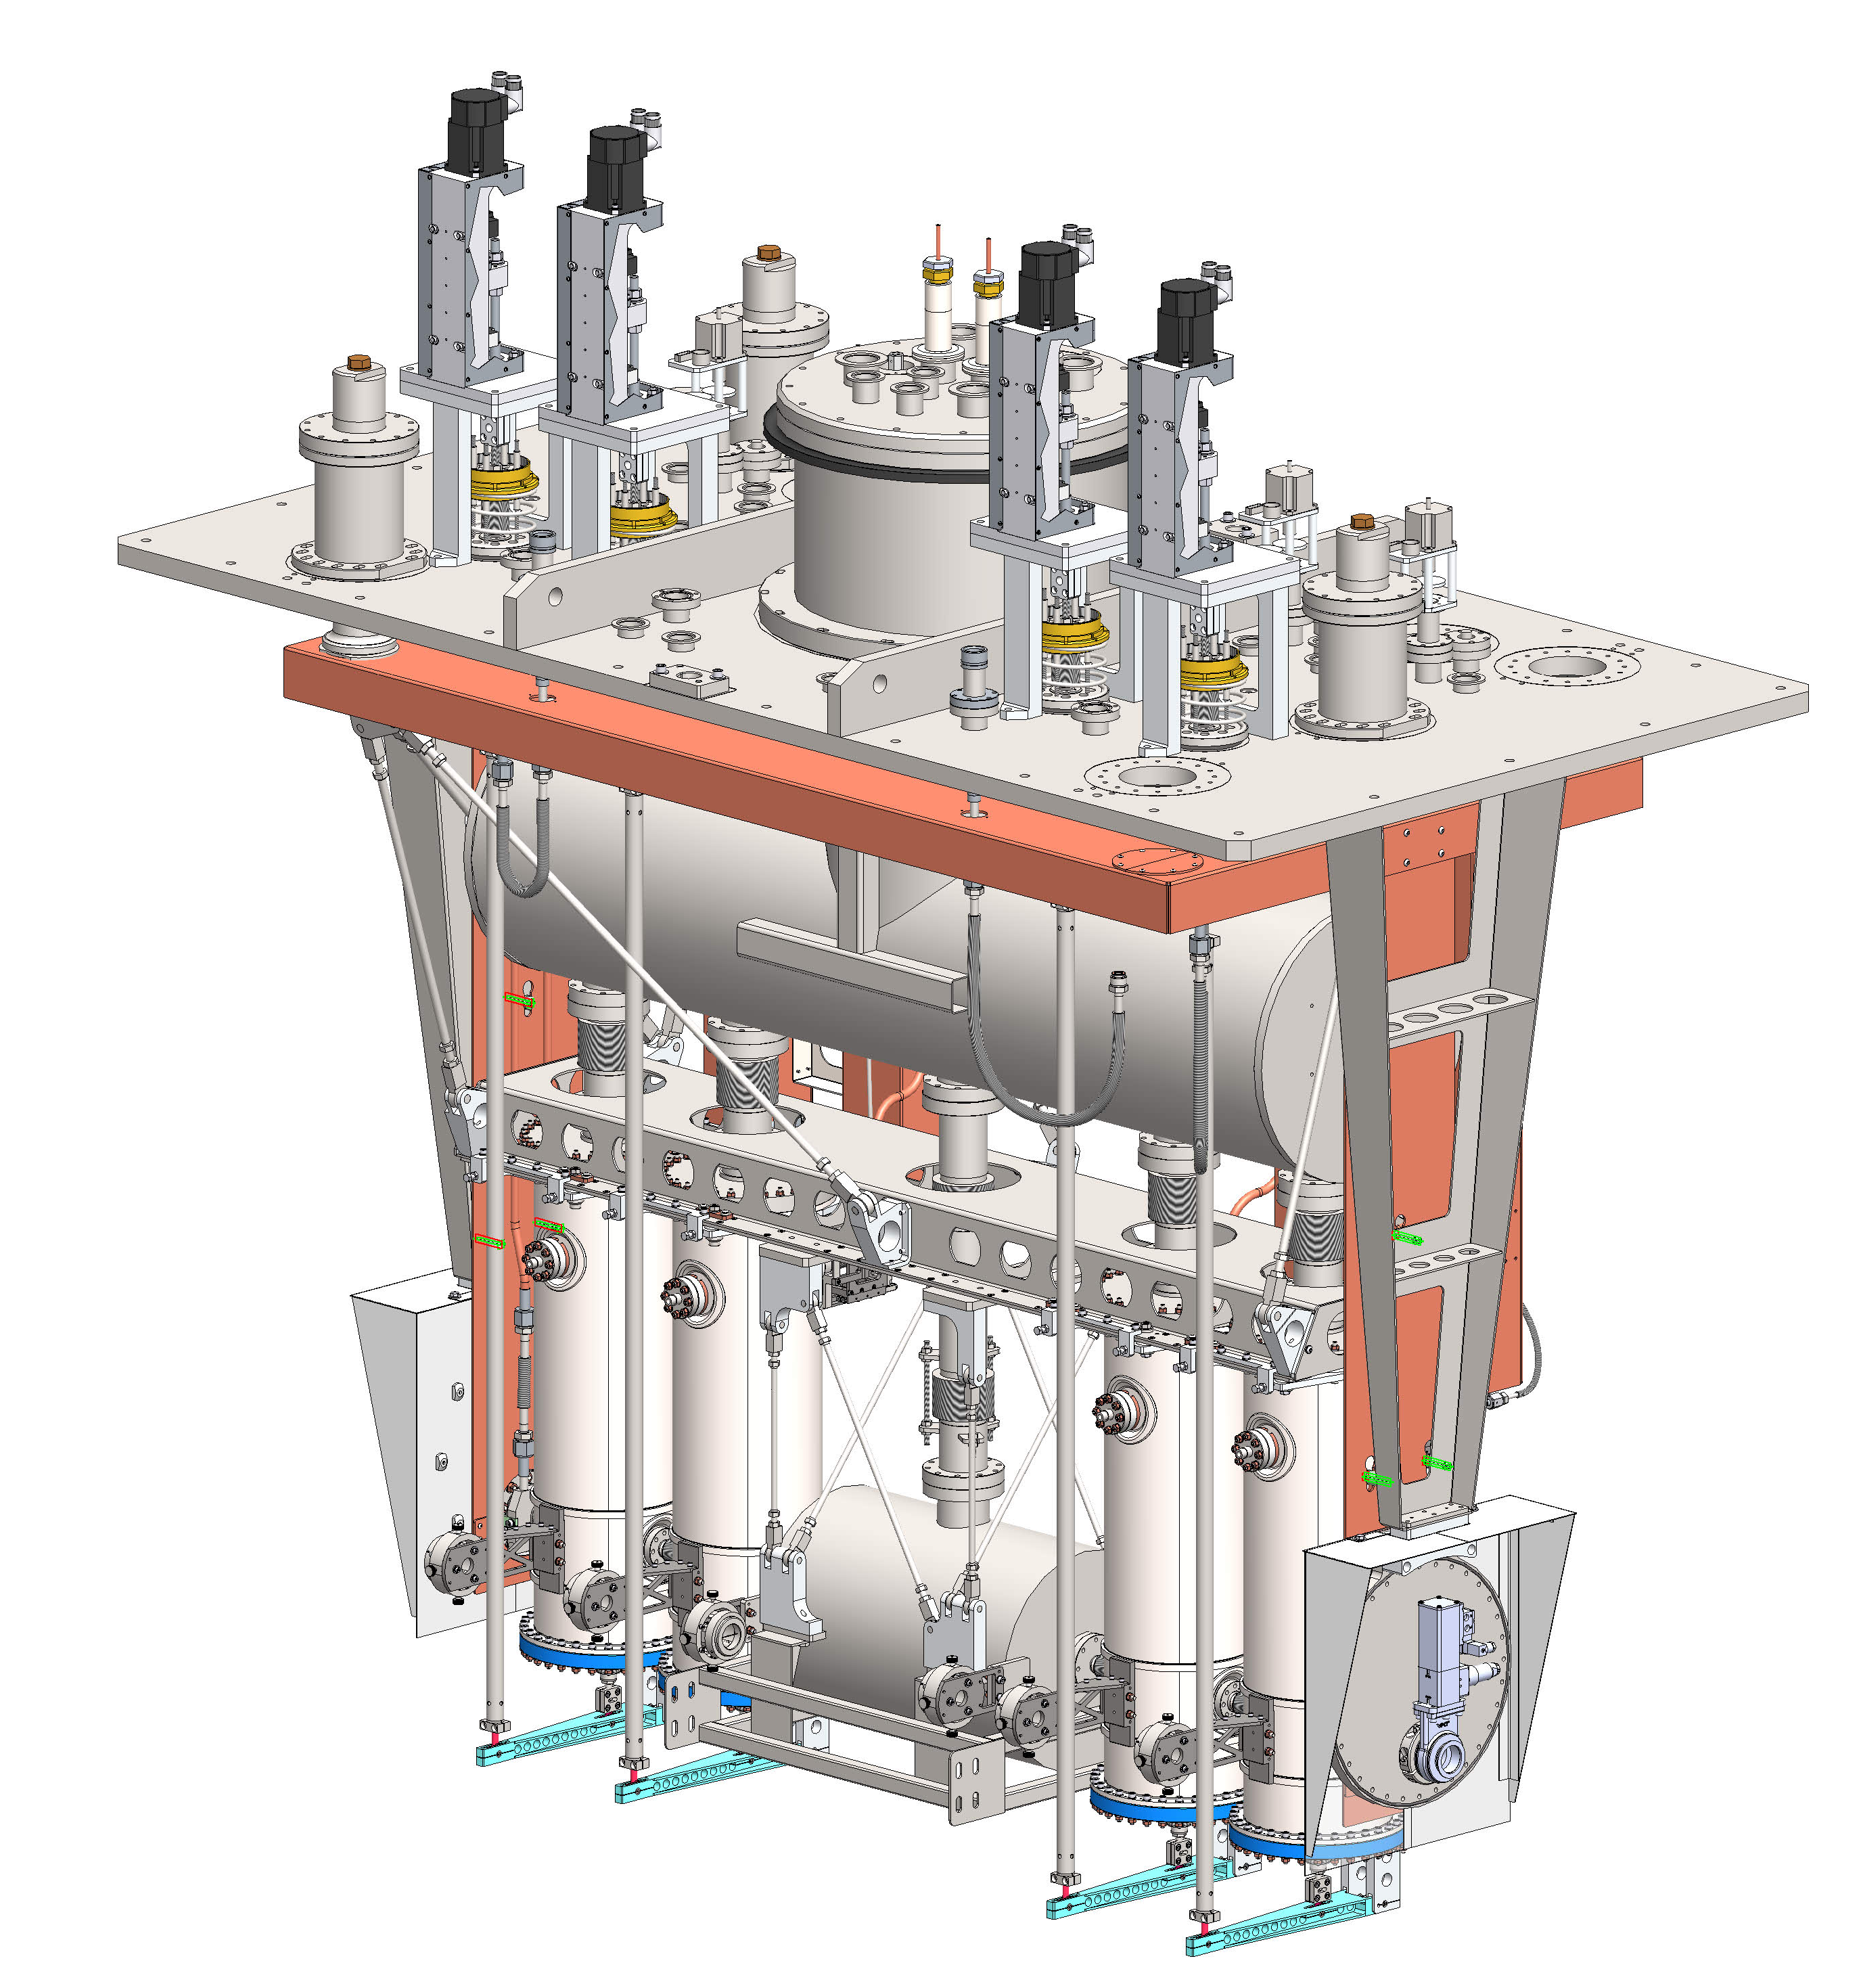
TRIUMF and VECC (India)
An electron cryomodule was designed and fabricated at TRIUMF and shipped to VECC in 2018
A heavy ion cryomodule was designed and fabricated at TRIUMF and shipped to VECC in 2022

Slide 15



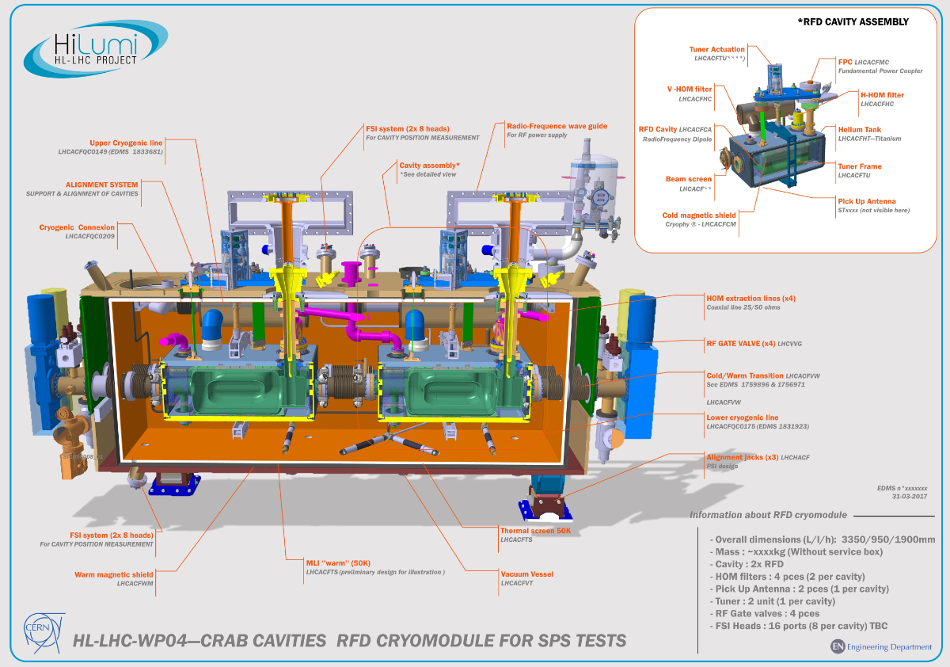
TRIUMF and CERN
As a Canadian contribution to the Hi-Luminosity upgrade project at CERN, TRIUMF will fabricate, qualify and ship five crab cavity cryomodules to CERN (2025-27)
  Ten 400MHz crab cavities will be received from US collaborators starting later this year
The project supplies critical infrastructure to CERN, supporting both the HL-LHC and the Canadian particle physics community
15

Slide 16
The Proposal

Slide 17


Canadian contribution to EIC
The Canadian subatomic physics community is strongly supporting participation in the EIC program. In the 2022–2026 Canadian Subatomic Physics Long Range Plan, the community named the EIC as a “flagship program with broad outcomes.”
A Canadian collaboration with EIC Canada, TRIUMF and University partners is pursuing a CFI proposal in the 2025 IF competition.
The proposal leverages technical know-how at TRIUMF, engages Canadian industry in cutting edge accelerator technology while training next generation HQP.

Slide 18
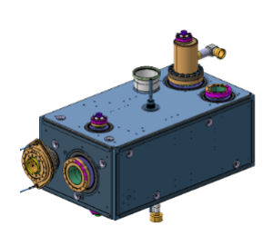
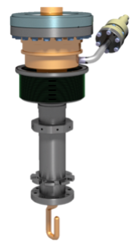
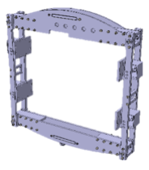
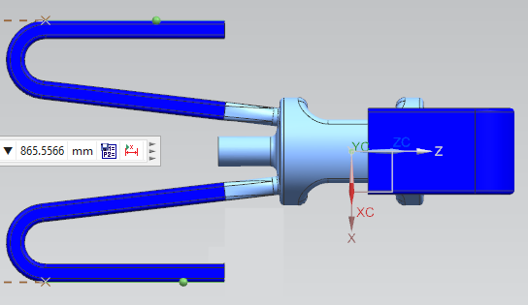
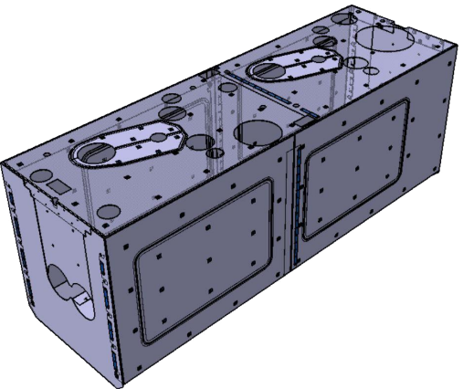
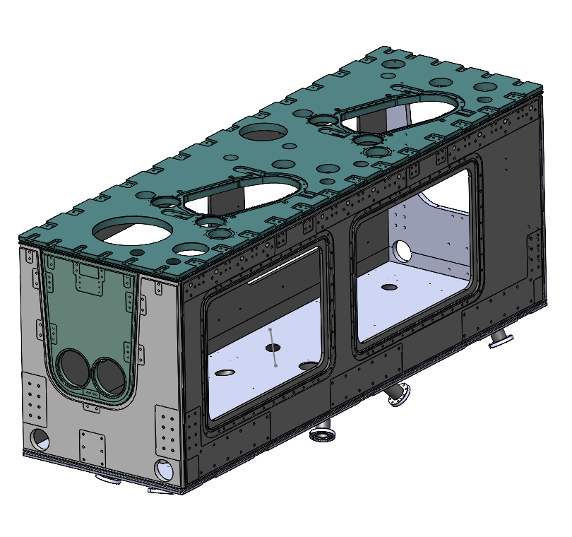
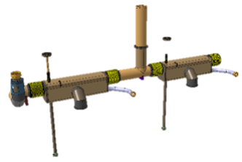
Scope for EIC contribution
We propose to deliver scope on the 394 MHz crab cavity system for the HSR and ESR.
SRF Cavity package: (6)
Design including HOM mitigation schemes
Niobium cavity fabrication plus jacket and cold magnetic shield
Fundamental Power Couplers (FPC) and HOM mitigation schemes (waveguide or coupler).
Rf tuner
Cryomodule package: (4)
Outer vacuum chamber (OVC)
thermal shield, mu-metal
cryogenic piping
fabricated in industry
assembled and qualified at TRIUMF.
Cavity
Jacketing
FPC
Tuner
HOM mitigation
Thermal screen and mu metal
OVC
Cryo-piping
Assembly

Slide 19
Budget
The total project cost is estimated to be ~14M$ with capital costs of about 5M$ for cavity systems, 5M$ for cryostating and 1M$ for infrastructure upgrades at TRIUMF.
Cavity package components | Unit cost | No. | Sub-total
Bare cavities | 400,000 | 6 | 2,400,000
Helium jacket | 75,000 | 6 | 450,000
fundamental power coupler | 75,000 | 6 | 450,000
HOM couplers | 25,000 | 24 | 600,000
tuner | 120,000 | 6 | 720,000
cold magnetic shield | 20,000 | 6 | 120,000
qualification | 5,000 | 24 | 120,000
Sub-total |  |  | 4,860,000
Summary table | Capital | Labour | In kind | Total
Cavities | 4,860,000 | 250,000 | 1,000,000 | 6,110,000
HSR CMs | 2,868,000 | 150,000 | 1,000,000 | 4,018,000
ESR CMs | 2,202,000 | 100,000 | 600,000 | 2,902,000
Infrastructure upgrade | 1,000,000 | 150,000 | 100,000 | 1,250,000
Travel | 120,000 | 0 | 0 | 120,000
Sub-total | 11,050,000 | 650,000 | 2,700,000 | 14,400,000

Slide 20
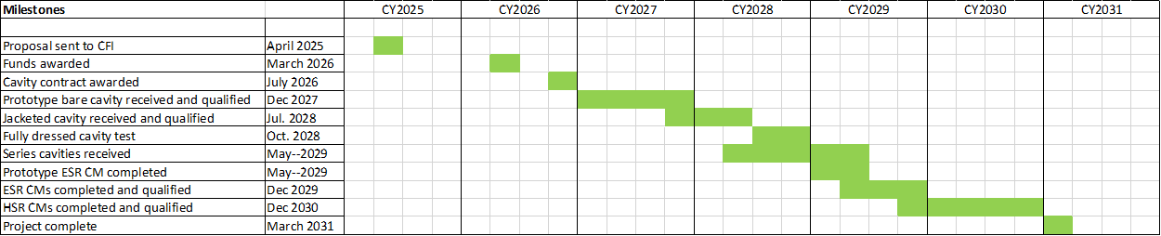
Funding and Timeline
The timeline would be framed by the CFI funding process with deliverables to EIC in 2029-2030.

Slide 21
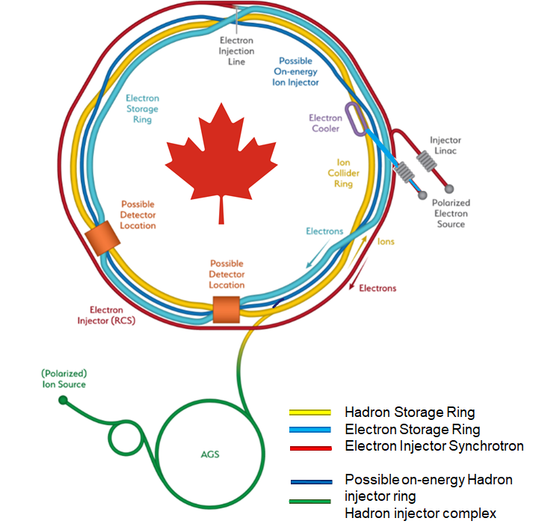
Summary
The crab cavities are critical elements that offer a ten-fold increase in the EIC luminosity
The technical scope offers unique challenges in design, fabrication, assembly and testing across rf modeling, superconducting rf, custom manufacture and cryogenics.
The project supports both the EIC and the CINP community while leveraging and augmenting TRIUMF’s core competence in cutting edge accelerator technology and offering opportunity to Canadian industry in advanced accelerator technology.
Collaborators welcome!

Slide 22
Thank you!
Merci!

