Slide 1
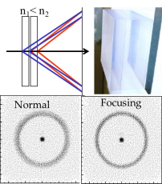
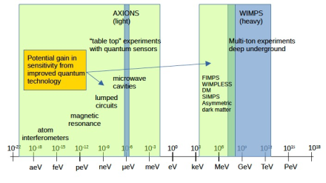
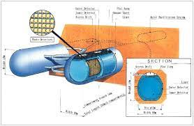
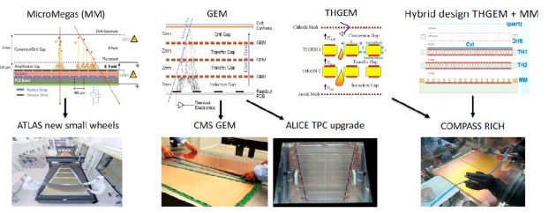
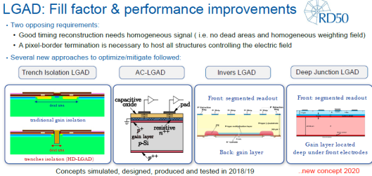
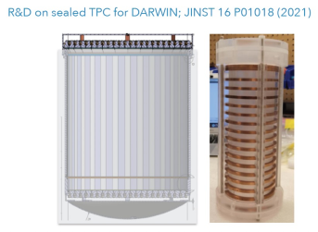
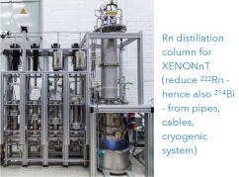
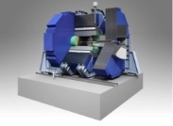
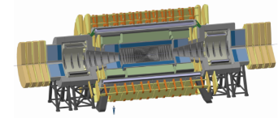
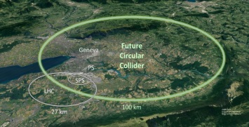
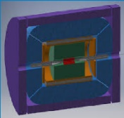
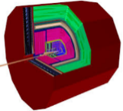

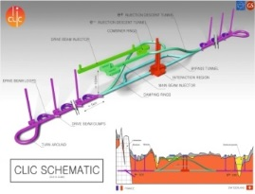
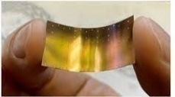
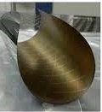
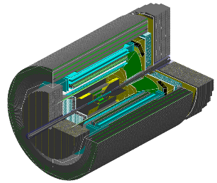
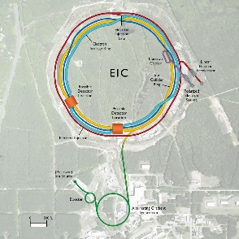


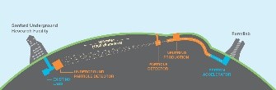
Detector R&D plans: the ECFA R&D Roadmap
P. Allport
Birmingham
FCC-UK-hh: Half-day Meeting
(Schuster Lab, Manchester , 8/07/2022)
European Strategy for Particle Physics
ECFA Detector R&D Roadmap
Historical Perspective
Other Relevant European R&D Initiatives
Status of Implementation Planning
Conclusions

Slide 2
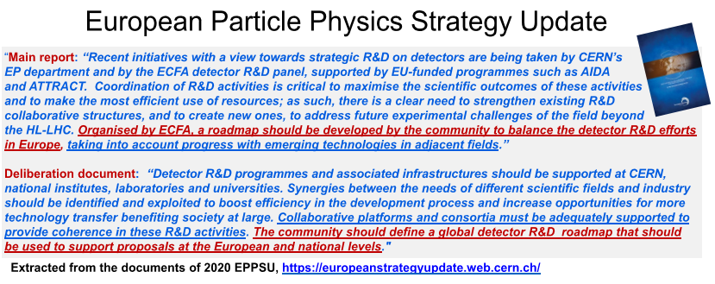

ECFA Detector R&D Roadmap
The input to the process is the European Particle Physics Strategy Update as adopted by CERN Council on 19 June 2020.

Slide 3
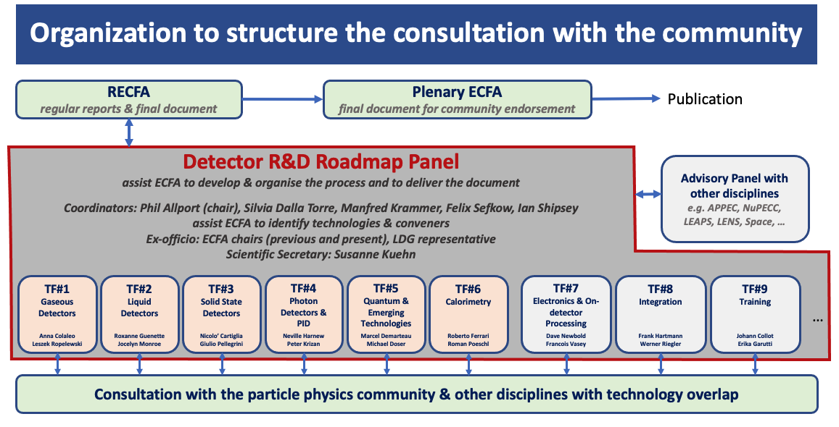
Detector R&D Roadmap Organisation
Restricted ECFA*
Regular reports & final document
Plenary ECFA
Approval of final document
*community feedback via RECFA delegates and National Contacts
For Roadmap process web pages see https://indico.cern.ch/e/ECFADetectorRDRoadmap
and introduction in the published document at http://cds.cern.ch/record/2784893/files/.

Slide 4
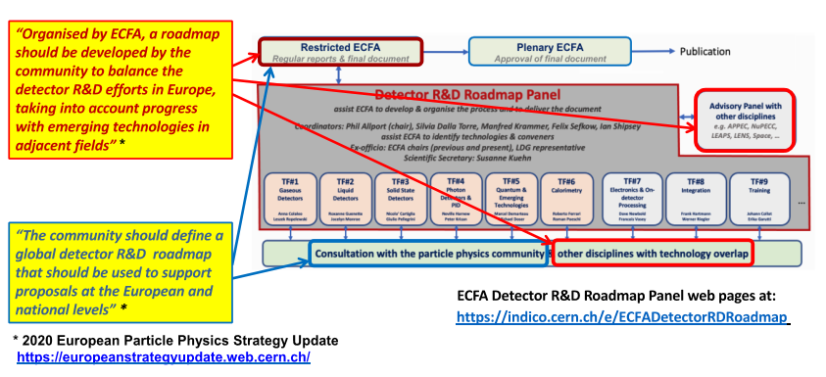
ECFA Detector R&D Roadmap

Slide 5
Broad Roadmap Topic Areas
Focus on the technical aspects of detector R&D requirements given the EPPSU deliberation document listed “High-priority future initiatives” and “Other essential scientific activities for particle physics” as input and organise material by Task Force.
Task Forces start from the future science programme to identify main detector technology challenges to be met (both mandatory and highly desirable to optimise physics returns) and estimate the period over which the required detector R&D programmes may be expected to extend.
Within each Task Force the aim is to propose a time ordered detector R&D programme in terms of capabilities not currently achievable.
Grouped targeted facilities/areas emerging from the EPPSU
Detector requirements for full exploitation of the HL-LHC (R&D still needed for LS3 upgrades and for experiment upgrades beyond then) including studies of flavour physics and quark-gluon plasma (where the latter topic also interfaces with nuclear physics).
R&D for long baseline neutrino physics detectors (including aspects targeting astro-particle physics measurements) and supporting experiments such as those at the CERN Neutrino Platform.
Technology developments needed for detectors at e⁺e⁻ Higgs-EW-Top factories in all possible accelerator manifestations including instantaneous luminosities at 91.2GeV of up to 5×10³⁶cm⁻²s⁻¹ and energies up to the TeV range.
The long-term R&D programme for detectors at a future 100 TeV hadron collider with integrated luminosities targeted up to 30ab⁻¹ and 1000 pile-up for 25ns BCO.
Specific long-term detector technology R&D requirements of a muon collider operating at energies going up to 10 TeV and with a luminosity of the order of 10³⁵ cm^{–2} s^{–1}.

Slide 6
Broad Roadmap Topic Areas
Grouped targeted facilities/areas emerging from the EPPSU
Detector developments for accelerator-based studies of rare processes, DM candidates and high precision measurements (including strong interaction physics) at both storage rings and fixed target facilities, interfacing also with atomic and nuclear physics.
R&D for optimal exploitation of dedicated collider experiments studying the partonic structure of the proton and nuclei as well as interface areas with nuclear physics.
The very broad detector R&D areas for non-accelerator-based experiments, including dark matter searches (including axion searches), reactor neutrino experiments and rare decay processes, also considering neutrino observatories and other interface areas with astro-particle physics.
Facilities needed for detector evaluation, including test-beams and different types of irradiation sources, along with the advanced instrumentation required for these.
Infrastructures facilitating detector developments, including technological workshops and laboratories, as well as tools for the development of software and electronics.
Networking structures in order to ensure collaborative environments, to help in the education and training, for cross-fertilization between different technological communities, and in view of relations with industry.
Overlaps with neighbouring fields and key specifications required for exploitation in other application areas
Opportunities for industrial partnership and technical developments needed for potential commercialisation

Slide 7
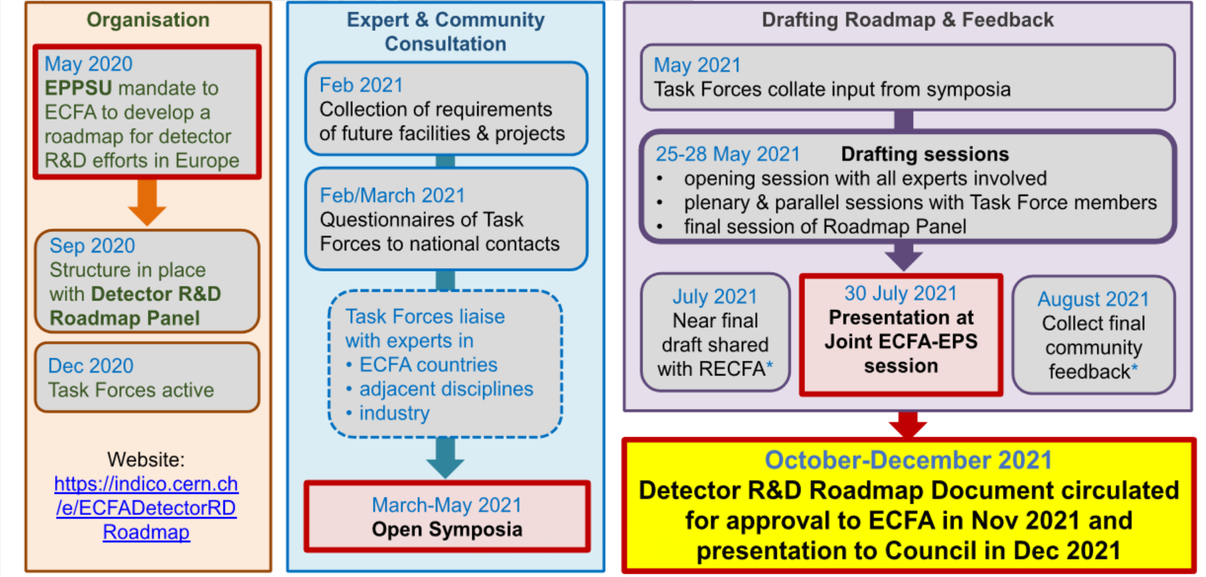
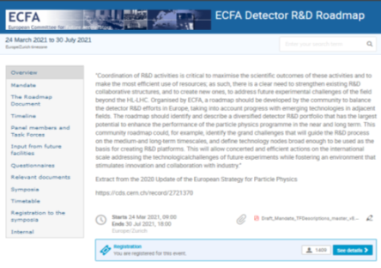
ECFA Detector R&D Roadmap Process
Many more details at: https://indico.cern.ch/e/ECFADetectorRDRoadmap,
plenary ECFA presentation (https://indico.cern.ch/event/1085137/)
and in published documents (http://cds.cern.ch/record/2784893/files/).

Slide 8
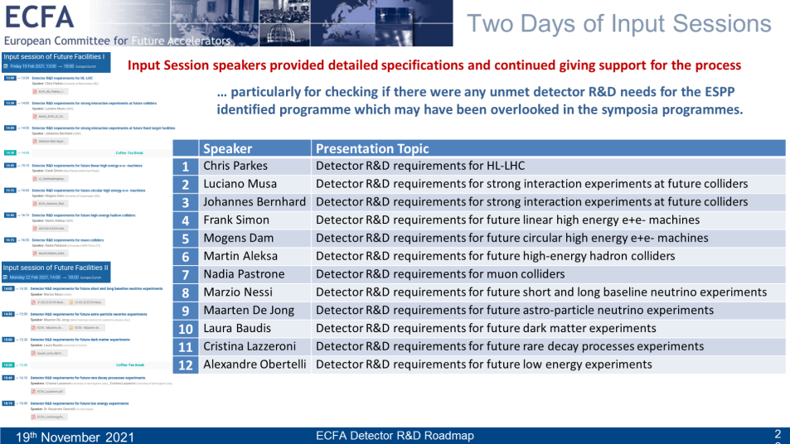
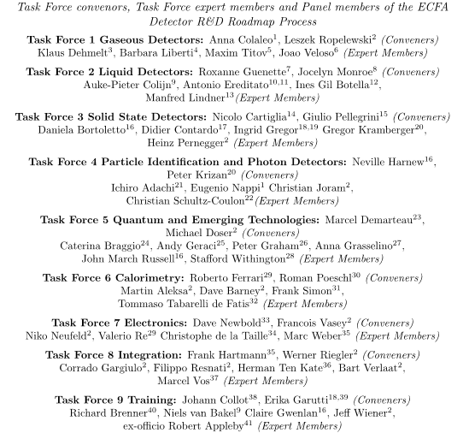
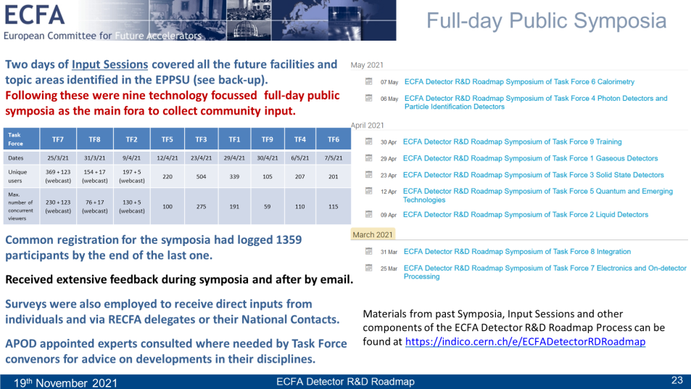
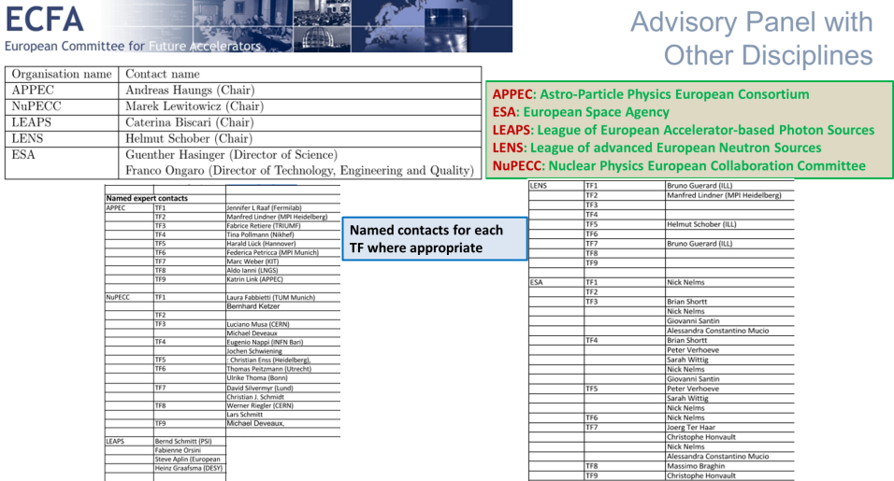
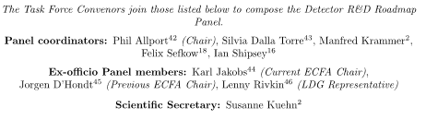
ECFA Detector R&D Roadmap Process
Process involved: 67 authors; 12 expert Input Session speakers; ECFA National Contacts; respondents to the Task Force surveys; 121 Symposia presenters; 1359 Symposia attendees and 44 APOD TF topic specific contacts.
ECFA National Contacts
National Contacts ECFA
Country | Name
Austria | Manfred Jeitler
Belgium | Gilles De Lentdecker
Bulgaria | Venelin Koshuharov
Croatia | Tome Anticic
Cyprus | Panos Razis
Czech Republic | Tomáš Davídek
Denmark | Mogens Dam
National Contacts ECFA
Country | Name
Finland | Panja Lukka
France | Didier Contardo
Germany | Lutz Feld
Greece | Dimitris Loukas
Hungary | Dezso Varga
Italy | Nadia Pastrone
Israel | Erez Etzion
Netherlands | Niels van Bakel
Norway | Gerald Eigen
Poland | Marek Idzik
Portugal | Paulo Fonte
Romania | Mihai Petrovici
Serbia | Lidija Zivkovic
Slovakia | Pavol Strizenec
Slovenia | Gregor Kramberger
Spain | Mary-Cruz Fouz
Sweden | Christian Ohm
Swtizerland | Ben Kilminster
Turkey | Kerem Cankocak
United-Kingdom | Iacopo Vivarelli
Ukraine | Nikolai Shulga
CERN | Christian Joram
https://indico.cern.ch/e/ECFADetectorRDRoadmap

Slide 9

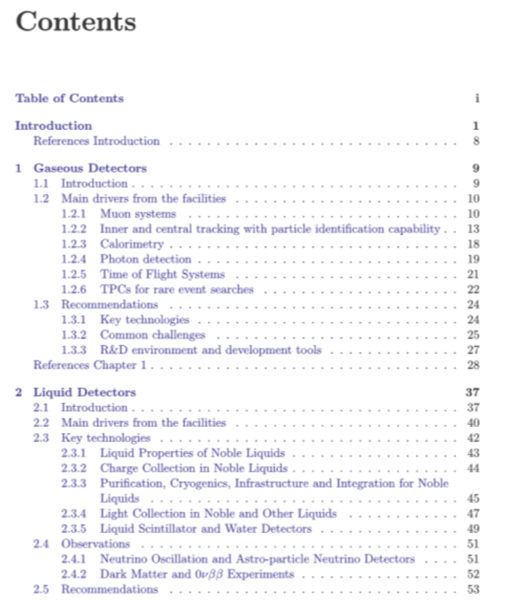
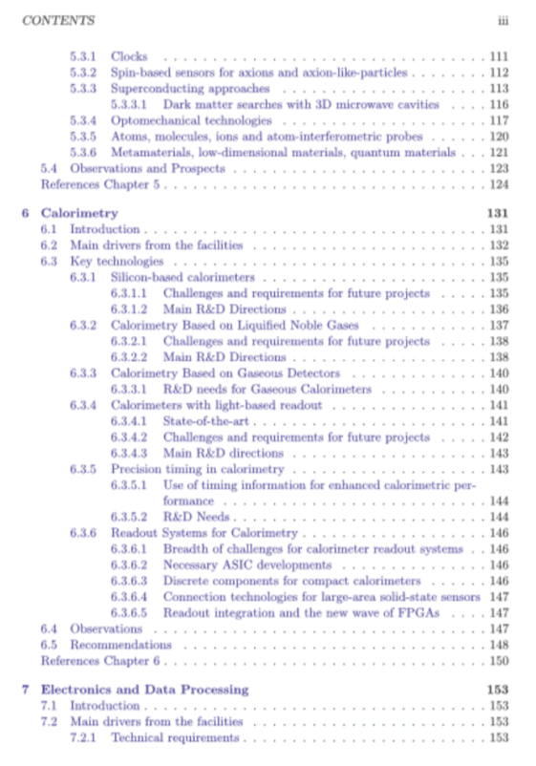
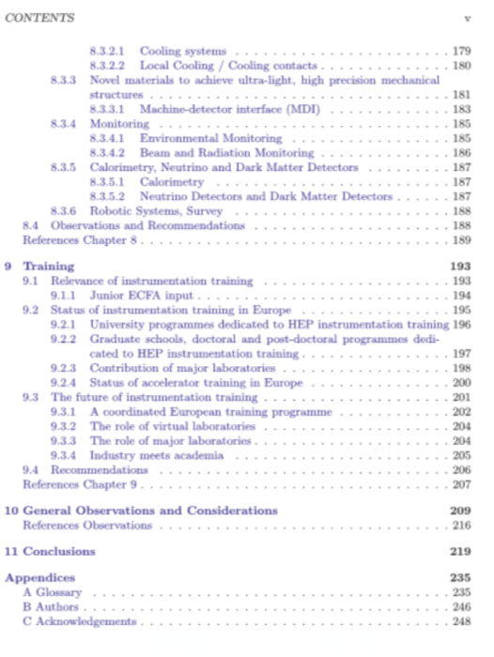
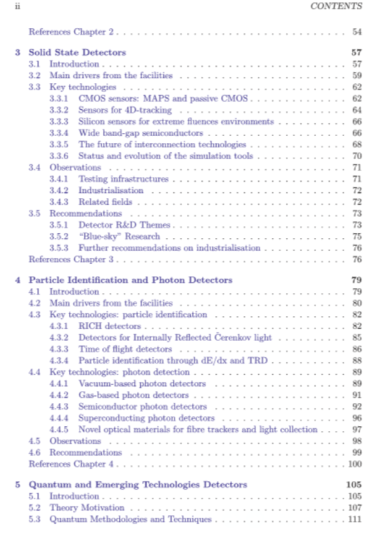
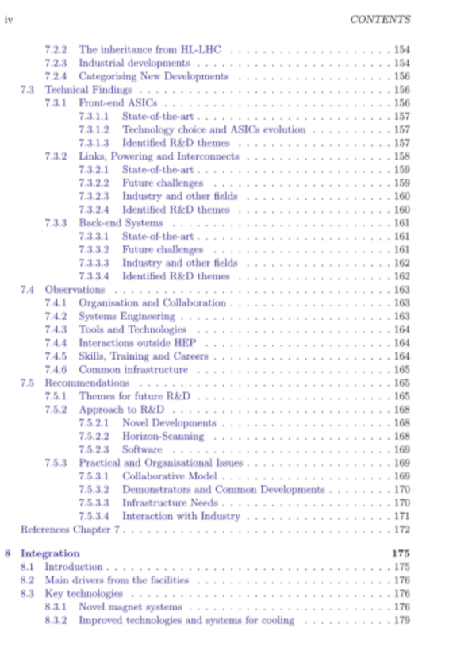

European Detector R&D Planning
The outcomes are summarised in a 250 page main document and an 8 page
synopsis for less specialist readers. A key guiding policy has been trying to ensure that:
Detector R&D readiness should not be the determining factor in the future of particle physics
http://cds.cern.ch/record/2784893/files/

Slide 10

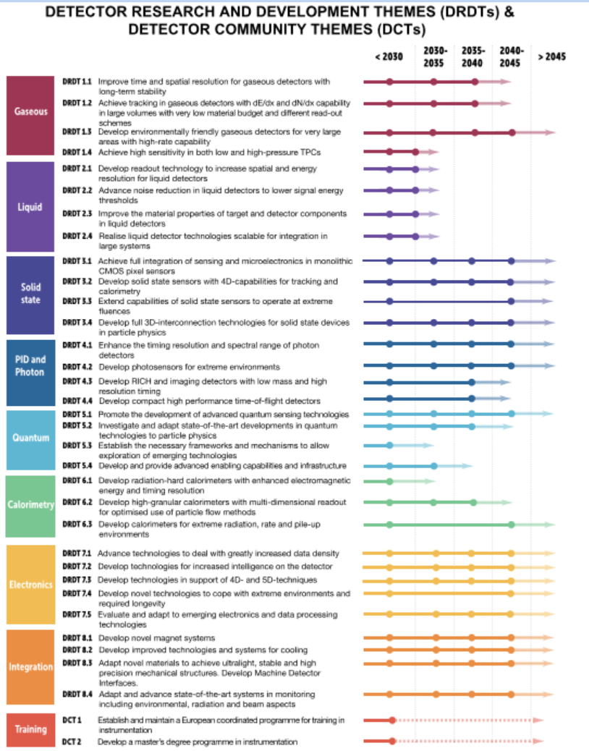
ECFA Detector R&D Roadmap
http://cds.cern.ch/record/2784893/files/Synopsis%20of%20the%20ECFA%20Detector%20R%26D%20Roadmap.pdf?version=1

Slide 11
ECFA Detector R&D Roadmap
http://cds.cern.ch/record/2784893/files/Synopsis%20of%20the%20ECFA%20Detector%20R%26D%20Roadmap.pdf?version=1
  The most urgent R&D topics in each Task Force area are identified as Detector R&D Themes.
  The timeframes for activities in these areas are illustrated in this figure from both the brochure and the main document.
It is not to be implied that further R&D is not needed but the schedule for future faculties in this area that need it are not currently defined
Stepping stones are shown to represent the R&D needs of facilities intermediate in time.
The faded region acknowledges the typical time needed between the completion of the R&D phase and the readiness of an experiment at a given facility.
→ See “Results of the 2021 ECFA Early-Career Researcher Survey on Training in Instrumentation” ECFA ECR Panel arXiv:2107.05739

Slide 12
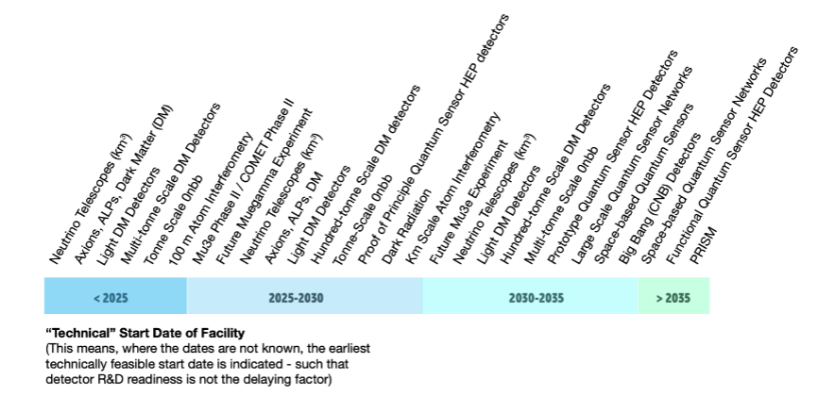
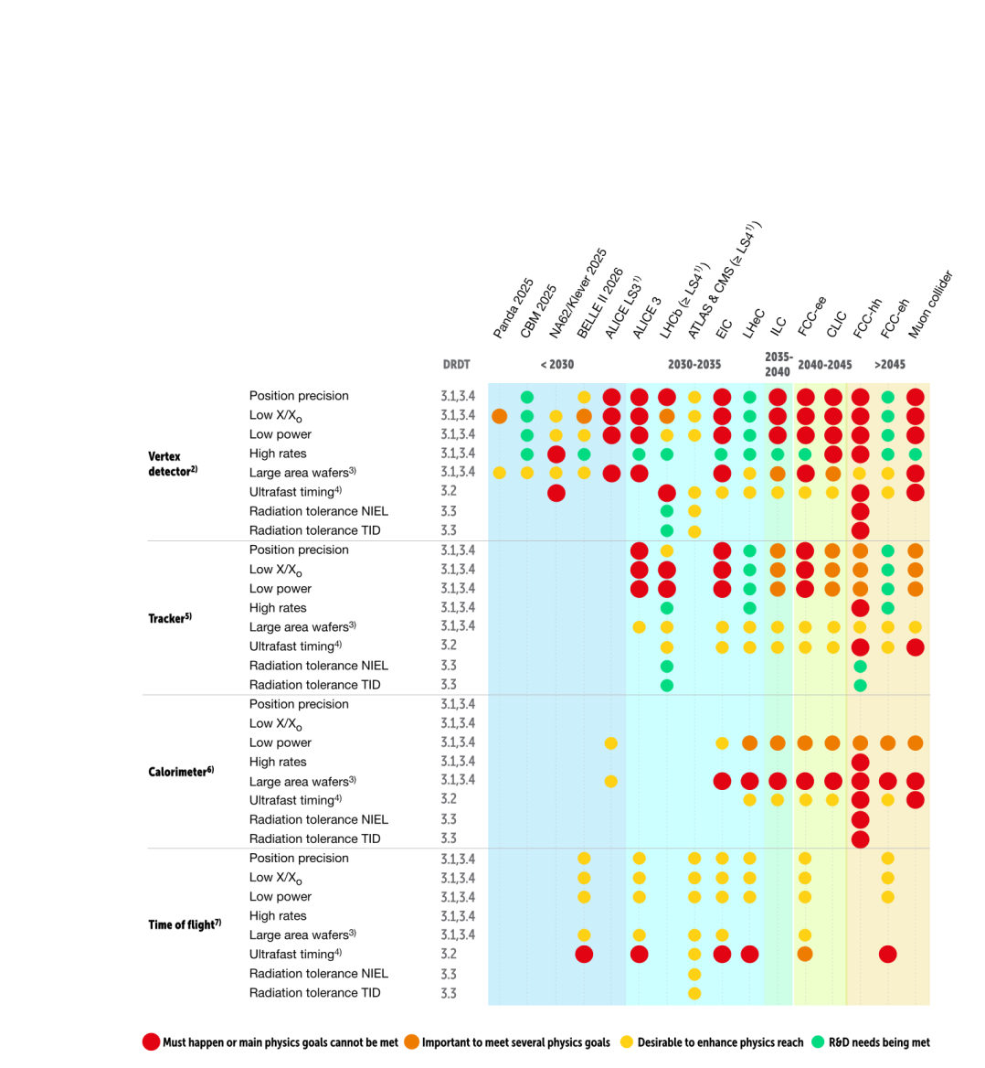
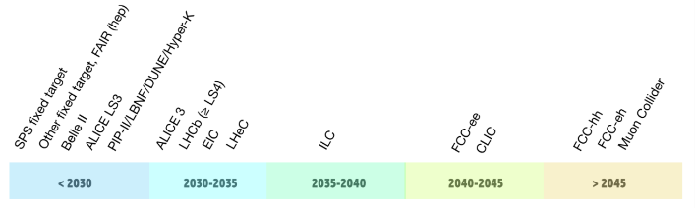
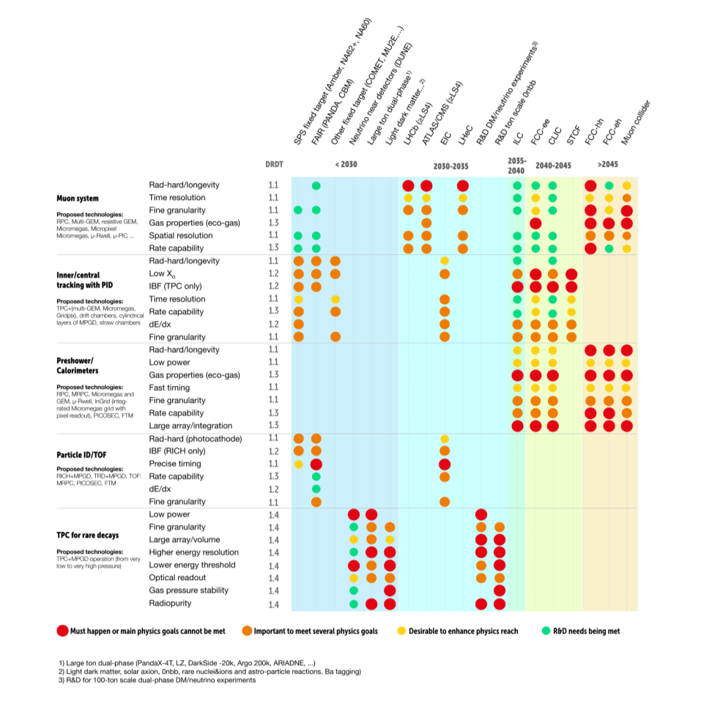
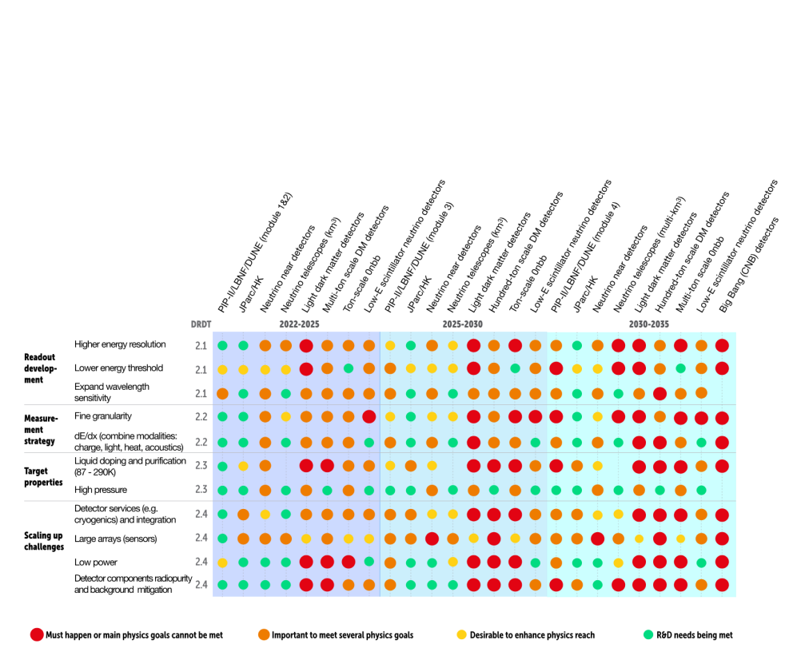
ECFA Detector R&D Roadmap
Plenary ECFA presentation at https://indico.cern.ch/event/1085137/contributions/4562906/
attachments/2349055/4006852/Plenary%20ECFA%20Detector%20R%26D%20Roadmap.pptx
The dates used in these diagrams have a deliberately low precision, and are intended to represent the earliest ‘feasible start date’ (where a schedule is not already defined), taking into account the necessary steps of approval, development and construction for machine and civil engineering. They do not constitute any form of plan or recommendation, and indeed several options presented are mutually exclusive.
Furthermore, the projects mentioned here are usually limited to those mentioned in the EPPSU, although it should be noted that detector R&D for other possible future facilities is usually aligned with that for programmes already listed.
(Based on the authors’ best
understanding start 2021)
Example non-accelerator dates (not complete)
TF3:
Solid State
Detectors
TF1:
Gaseous
Detectors
TF2:
Liquid
Detectors

Slide 13
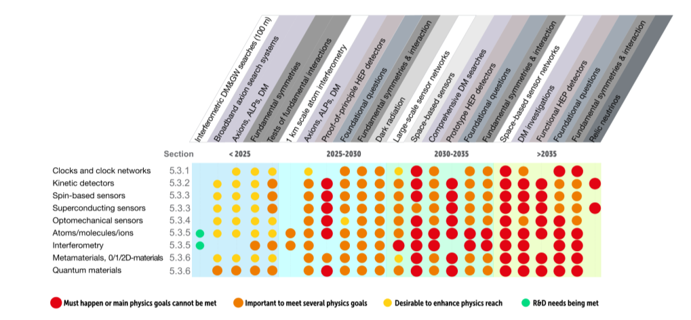
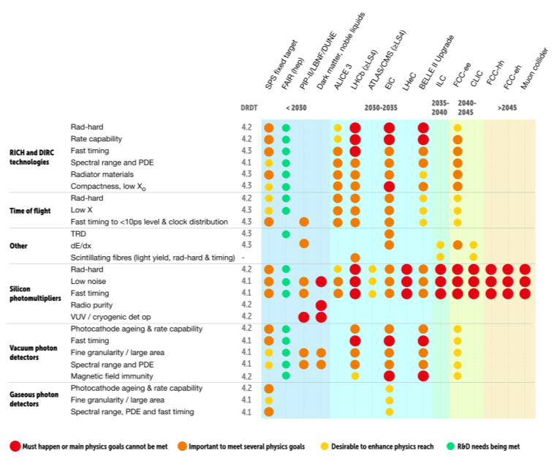
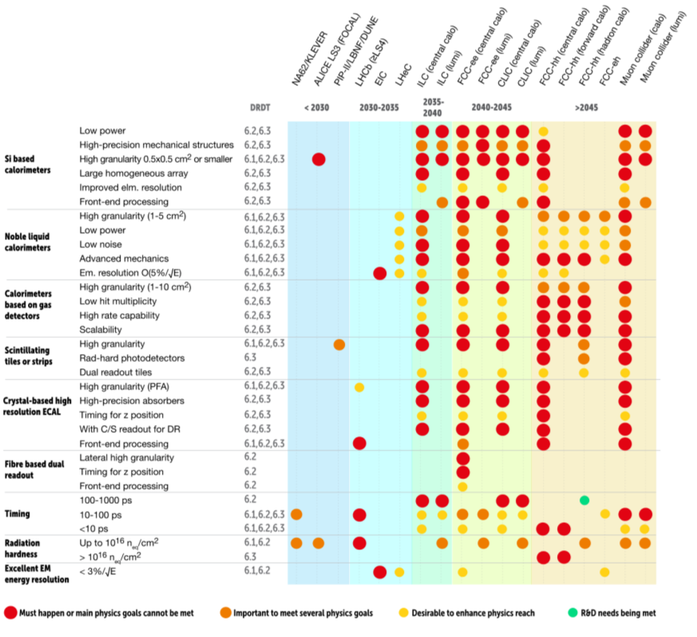
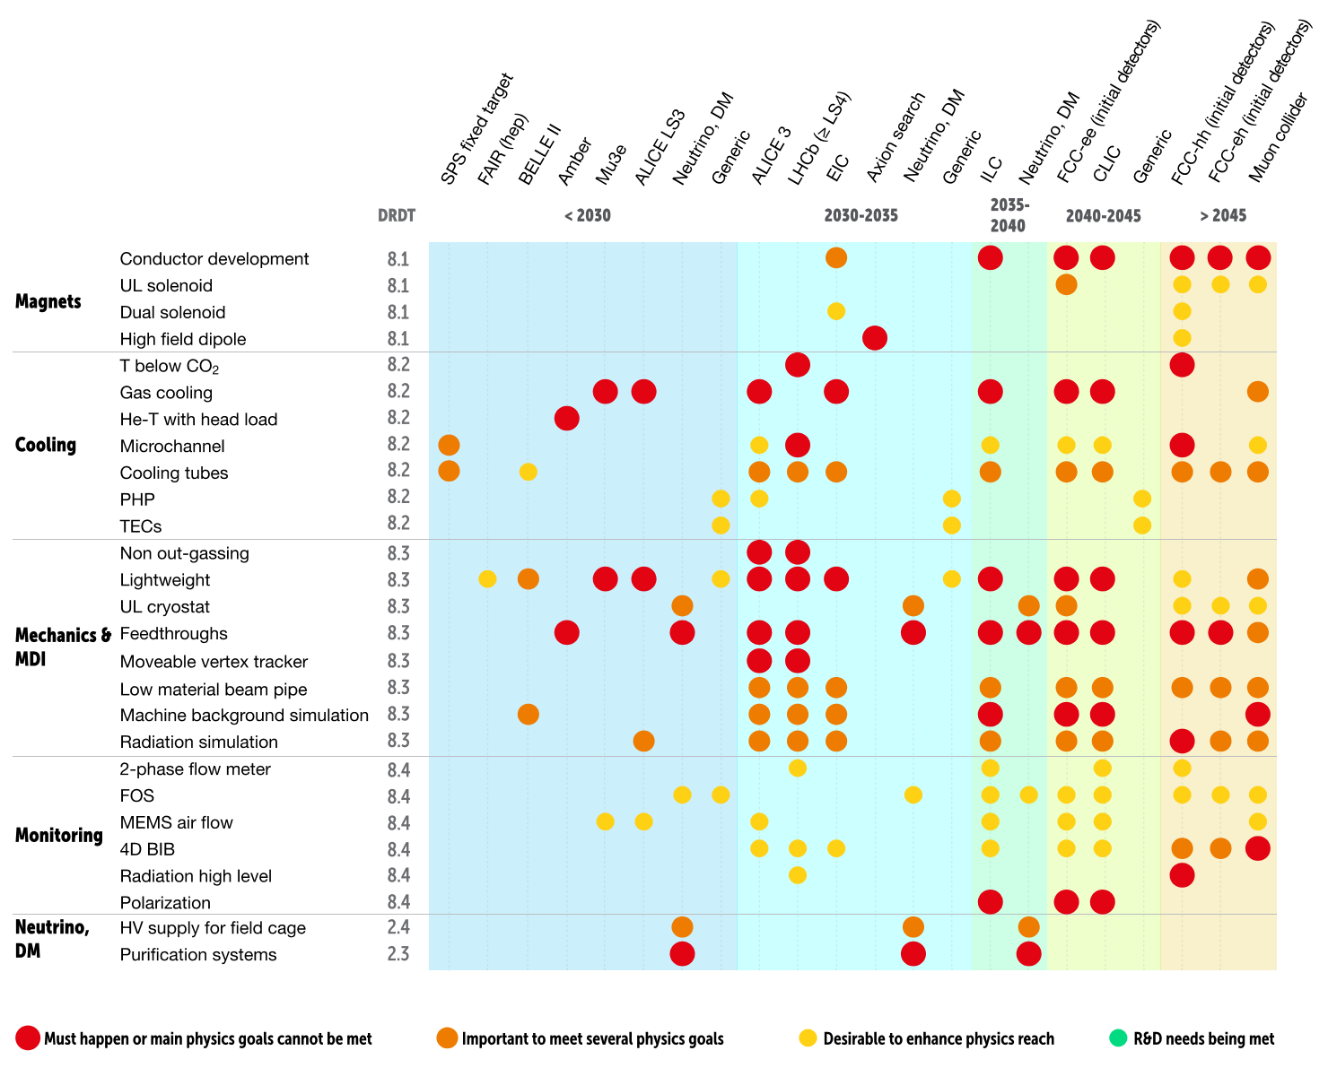
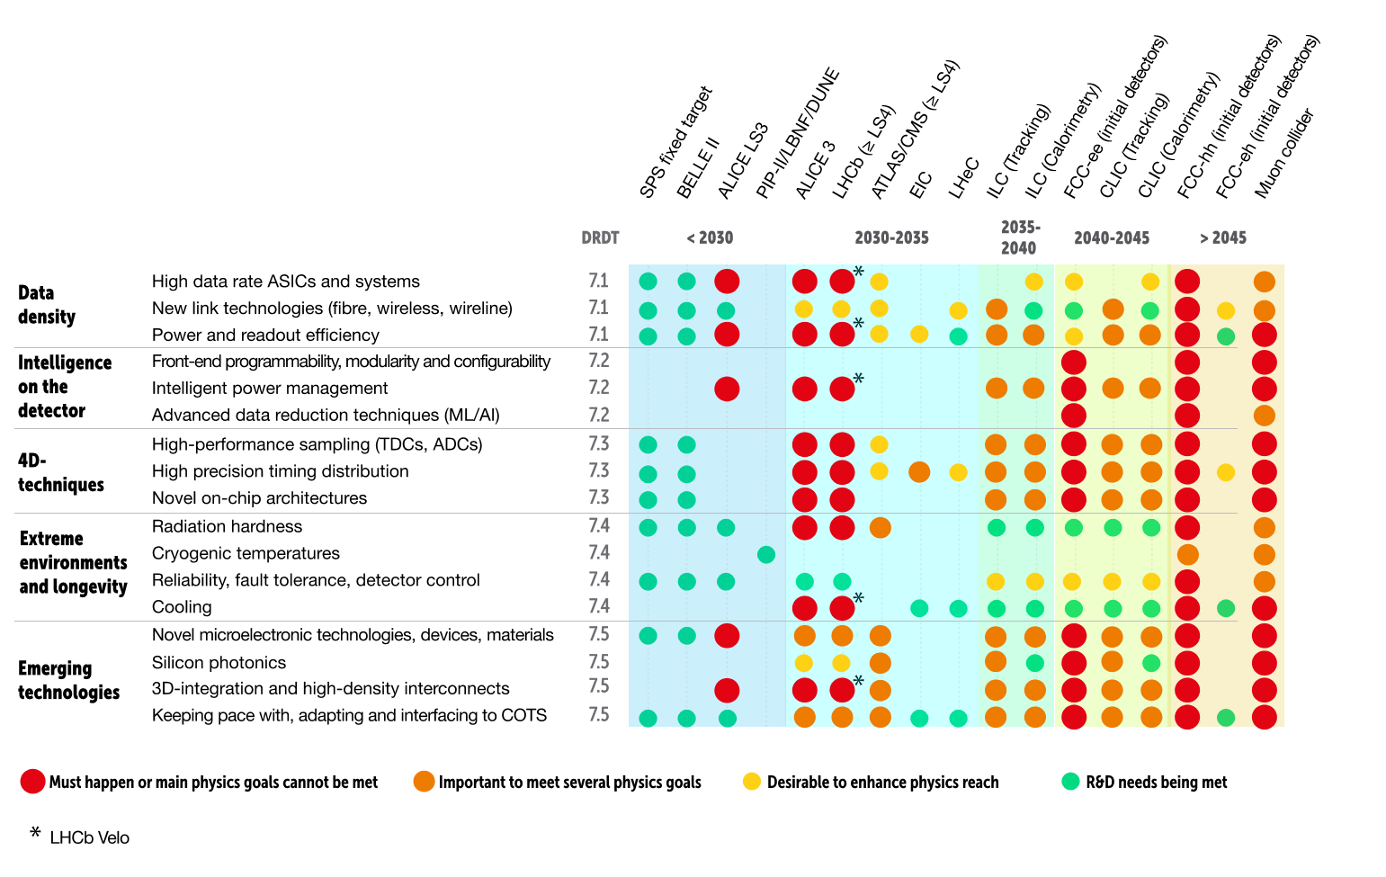
ECFA Detector R&D Roadmap
Plenary ECFA presentation at https://indico.cern.ch/event/1085137/contributions/4562906/
attachments/2349055/4006852/Plenary%20ECFA%20Detector%20R%26D%20Roadmap.pptx
TF4:
Photon
Detectors
& PID
TF5:
Quantum & Emerging Technologies
TF6:
Calorimetry
TF8:
Integration
TF7:
Electronics & On-detector Processing

Slide 14
ECFA Detector R&D Roadmap
Plenary ECFA presentation at https://indico.cern.ch/event/1085137/contributions/4562906/
attachments/2349055/4006852/Plenary%20ECFA%20Detector%20R%26D%20Roadmap.pptx
In addition to the Detector R&D Themes described above and discussed in each chapter the following General Strategic Recommendations are made under the following headings.
  GSR 1 - Supporting R&D facilities
  GSR 2 - Engineering support for detector R&D
  GSR 3 - Specific software for instrumentation
  GSR 4 - International coordination and organisation of R&D activities
  GSR 5 - Distributed R&D activities with centralised facilities
  GSR 6 - Establish long-term strategic funding programmes
  GSR 7 - Blue-sky R&D
  GSR 8 - Attract, nurture, recognise and sustain the careers of R&D experts
  GSR 9 - Industrial partnerships
  GSR 10 - Open Science

Slide 15
ECFA Detector R&D Roadmap
Plenary ECFA presentation at https://indico.cern.ch/event/1085137/contributions/4562906/
attachments/2349055/4006852/Plenary%20ECFA%20Detector%20R%26D%20Roadmap.pptx
GSR 1 - Supporting R&D facilities
It is recommended that the structures to provide Europe-wide coordinated infrastructure in the areas of: test beams, large scale generic prototyping and irradiation be consolidated and enhanced to meet the needs of next generation experiments with adequate centralised investment to avoid less cost-effective, more widely distributed, solutions, and to maintain a network structure for existing distributed facilities, e.g. for irradiation
GSR 2 - Engineering support for detector R&D
In response to ever more integrated detector concepts, requiring holistic design approaches and large component counts, the R&D should be supported with adequate mechanical and electronics engineering resources, to bring in expertise in state-of-the-art microelectronics as well as advanced materials and manufacturing techniques, to tackle generic integration challenges, and to maintain scalability of production and quality control from the earliest stages.
GSR 3 - Specific software for instrumentation
Across DRDTs and through adequate capital investments, the availability to the community of state-of-the-art R&D-specific software packages must be maintained and continuously updated. The expert development of these packages - for core software frameworks, but also for commonly used simulation and reconstruction tools - should continue to be highly recognised and valued and the community effort to support these needs to be organised at a European level.
GSR 4 - International coordination and organisation of R&D activities
With a view to creating a vibrant ecosystem for R&D, connecting and involving all partners, there is a need to refresh the CERN RD programme structure and encourage new programmes for next generation detectors, where CERN and the other national laboratories can assist as major catalysers for these. It is also recommended to revisit and streamline the process of creating and reviewing these programmes, with an extended framework to help share the associated load and increase involvement, while enhancing the visibility of the detector R&D community and easing communication with neighbouring disciplines, for example in cooperation with the ICFA Instrumentation Panel.

Slide 16
ECFA Detector R&D Roadmap
Plenary ECFA presentation at https://indico.cern.ch/event/1085137/contributions/4562906/
attachments/2349055/4006852/Plenary%20ECFA%20Detector%20R%26D%20Roadmap.pptx
GSR 5 - Distributed R&D activities with centralised facilities
Establish in the relevant R&D areas a distributed yet connected and supportive tier-ed system for R&D efforts across Europe. Keeping in mind the growing complexity, the specialisation required, the learning curve and the increased cost, consider more focused investment for those themes where leverage can be reached through centralisation at large institutions, while addressing the challenge that distributed resources remain accessible to researchers across Europe and through them also be available to help provide enhanced training opportunities.
GSR 6 - Establish long-term strategic funding programmes
Establish, additional to short-term funding programmes for the early proof of principle phase of R&D, also long-term strategic funding programmes to sustain both research and development of the multi-decade DRDTs in order for the technology to mature and to be able to deliver the experimental requirements. Beyond capital investments of single funding agencies, international collaboration and support at the EU level should be established. In general, the cost for R&D has increased, which further strengthens the vital need to make concerted investments.
GSR 7 – “Blue-sky” R&D
It is essential that adequate resources be provided to support more speculative R&D which can be riskier in terms of immediate benefits but can bring significant and potentially transformational returns if successful both to particle physics: unlocking new physics may only be possible by unlocking novel technologies in instrumentation, and to society. Innovative instrumentation research is one of the defining characteristics of the field of particle physics. “Blue-sky” developments in particle physics have often been of broader application and had immense societal benefit. Examples include: the development of the World Wide Web, Magnetic Resonance Imaging, Positron Emission Tomography and X-ray imaging for photon science.

Slide 17
ECFA Detector R&D Roadmap
Plenary ECFA presentation at https://indico.cern.ch/event/1085137/contributions/4562906/
attachments/2349055/4006852/Plenary%20ECFA%20Detector%20R%26D%20Roadmap.pptx
GSR 8 - Attract, nurture, recognise and sustain the careers of R&D experts
Innovation in instrumentation is essential to make progress in particle physics, and R&D experts are essential for innovation. It is recommended that ECFA, with the involvement and support of its Detector R&D Panel, continues the study of recognition with a view to consolidate the route to an adequate number of positions with a sustained career in instrumentation R&D to realise the strategic aspirations expressed in the EPPSU. It is suggested that ECFA should explore mechanisms to develop concrete proposals in this area and to find mechanisms to follow up on these in terms of their implementation. Consideration needs to be given to creating sufficiently attractive remuneration packages to retain those with key skills which typically command much higher salaries outside academic research. It should be emphasised that, in parallel, society benefits from the training particle physics provides because the knowledge and skills acquired are in high demand by industries in high-technology economies.
GSR 9 - Industrial partnerships
It is recommended to identify promising areas for close collaboration between academic and industrial partners, to create international frameworks for exchange on academic and industrial trends, drivers and needs, and to establish strategic and resources-loaded cooperation schemes on a European scale to intensify the collaboration with industry, in particular for developments in solid state sensors and micro-electronics.
GSR 10 – Open Science
It is recommended that the concept of Open Science be explicitly supported in the context of instrumentation, taking account of the constraints of commercial confidentiality where these apply due to partnerships with industry. Specifically, for publicly-funded research the default, wherever possible, should be open access publication of results and it is proposed that the Sponsoring Consortium for Open Access Publishing in Particle Physics (SCOAP³ ) should explore ensuring similar access is available to instrumentation journals (including for conference proceedings) as to other particle physics publications.

Slide 18
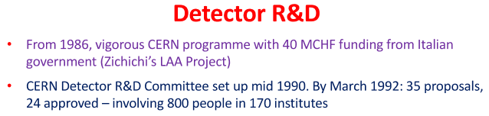
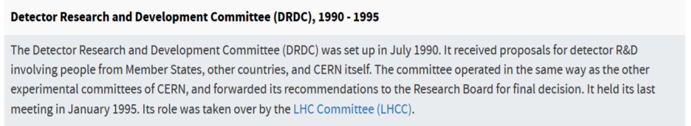
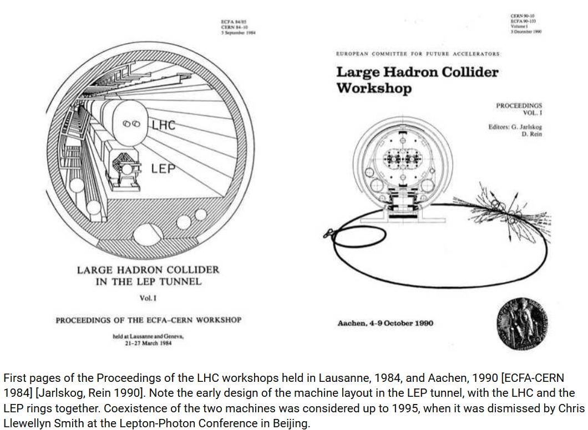
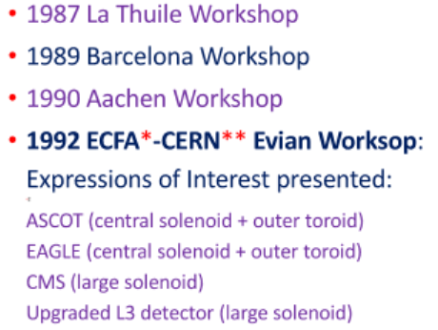

Proposed Implementation Structures Inspired by LHC DRDC Process
“Genesis of the LHC”
C. Llewellyn Smith, Phil Tran Roy Soc A373:20140037 (2016) http://dx.doi.
org/10.1098/rsta.2014.0037
RD53, RD51, RD50, RD42 and RD18 still particularly active

Slide 19

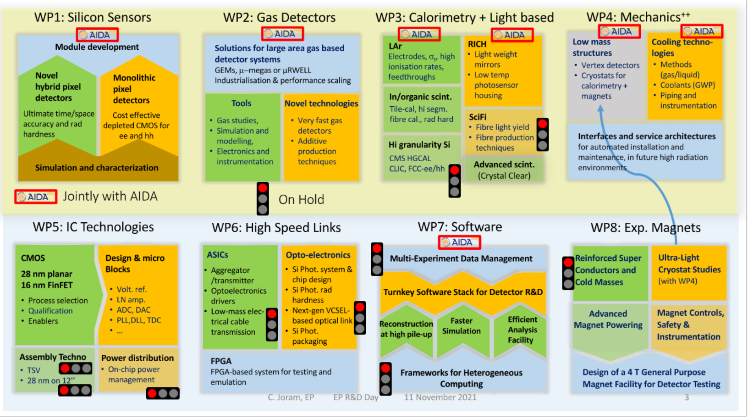
CERN EP R&D
Following tradition of DRDC (LHC Phase-0), White Paper R&D (LHC Phase-I)
Target beyond approved LHC upgrades: e.g. EIC, ILC, FCC-ee/eh/hh, …
Strong links/overlap with RD51, RD50, RD42, RD18, AIDAinnova, ATTRACT
See materials at https://ep-rnd.web.cern.ch/.

Slide 20
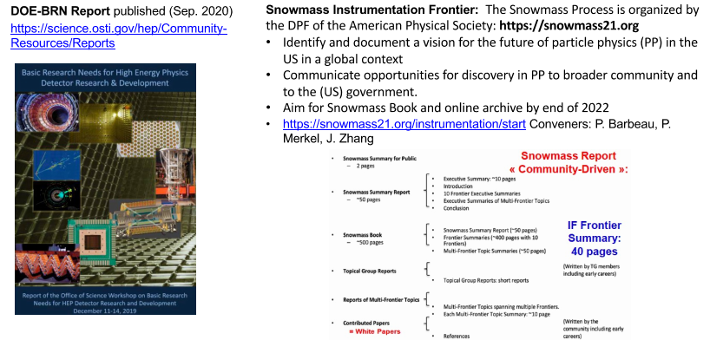


US and EU International R&D Programmes
EURO-LABS: (See https://home.cern/news/news/cern/cerns-horizon-europe-projects-flying )
(See: https://aidainnova.web.cern.ch/work-packages)
Detector R&D Topics

Slide 21
Proposed Implementation Structures Inspired by LHC DRDC Process
RRB implementation proposal at: https://indico.cern.ch/event/1133070/contributions/
4805134/attachments/2430530/4161870/ECFA_RRB_Detector_Roadmap_2022.04.25.pdf
ECFA proposes to organise long-term R&D efforts into newly established Detector R&D (DRD) Collaborations supported by strategic funding (as recommended: GSR4, GSR5, GSR6)
Detector technology areas: larger DRD collaborations should be considered
DRD Collaborations should be anchored at CERN → CERN recognition; DRD label
Take full account of existing, well-managed and successful ongoing R&D collaborations and other existing activities (current RDs, CERN EP R&D programme, EU-funded initiatives, collaborations exploring particular technology areas for future colliders, … )
The formation of new DRD collaborations should adopt a community-driven approach;
  propose this could be supported by existing ECFA Detector R&D Roadmap Task Forces;
  aim to initiate this year, with full process established over coming year, leading to creation of new structures with ramp up to full funding for strategic R&D by 2026.
Research topics, budget, milestones, etc., would have to be adapted as rolling grants for long-term R&D lines
Possible review structure under discussion with Funding Agencies, SPC and CERN Council

Slide 22
Conclusions and Observations
  Major R&D funding for the LHC detector R&D programme was in place from 1986.
  The ECFA Detector R&D Roadmap starts from the principle of needing to identify the mission critical detector R&D for all the future programmes considered as viable options in the 2020 Update to the European Strategy for Particle Physics.
  Mission critical for different facilities means different things:
    For HL-LHC beyond LS2, (mainly ALICE and LHCb) ultra-thin sensors and supports; PID + ToF; high rate gaseous detectors; rad-hard CMOS; ultra-fine granularity timing; rad-hard LGAD; rad-hard ECAL; SiPMs; fast-timing R/O; 28nm CMOS; low power; 100Gbps; … (see presentations by C. Parkes and L. Musa at https://indico.cern.ch/event/994685/).
    For FCC-hh, even though the timescales are long, some of the challenges go so far beyond the most extreme HL-LHC requirements that it needs to be acknowledged that even identifying the most promising approaches is currently problematic.
    ─ Some requirements can exploit intermediate “milestones” but an approach to extreme radiation hardness in particular needs a dedicated programme.
    ─ Even developing the required test facilities requires significant investment.
  Multi-decadal R&D lead-times should be anticipated for the most demanding technology aspects to be confident that detector readiness does not become the limiting factor in meeting the scientific ambitions of the particle physics community and fully exploiting the very large accelerator expenditure.

