Slide 1
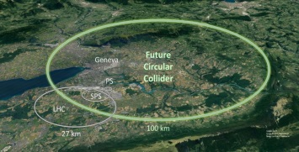

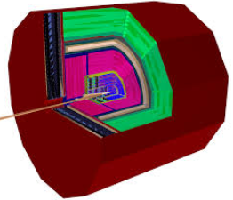
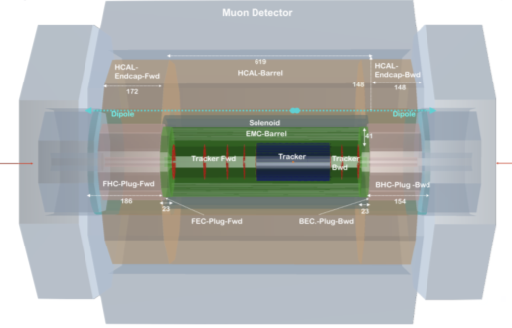
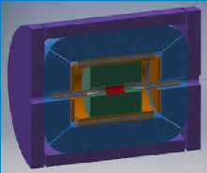

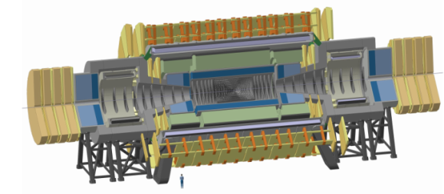
FCC R&D: Detector Developments
P. Allport
(Birmingham 1/12/2021)
https://fcc-cdr.web.cern.ch
Detector Concepts
  FCC-ee
  FCC-eh
  FCC-hh
R&D Organisation
Sub-systems
  Vertex
  Tracking
  Calorimetry
  PID, Photodetectors and Microelectronics
  Muons, Magnets and Integration
Conclusions and Observations

Slide 2
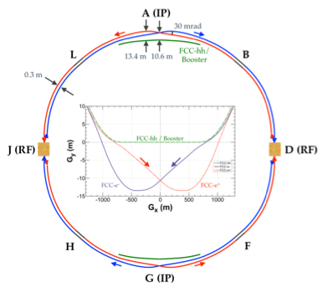
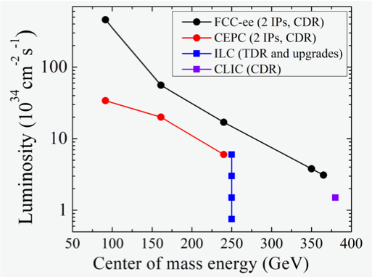
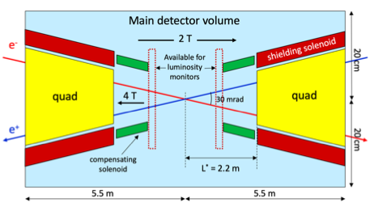
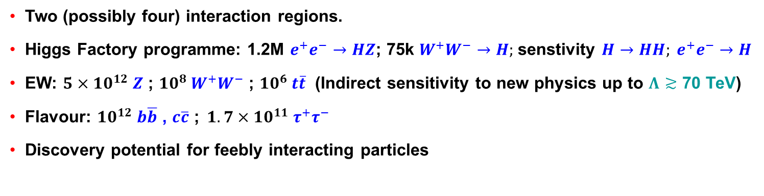
FCC-ee
(https://fcc-cdr.web.cern.ch/#FCCEE)
Two (possibly four) interaction regions.
Higgs Factory programme: 1.2M $e^{+}e^{−}→HZ$; 75k $W^{+}W^{−}→H;$senstivity $H→HH; e^{+}e^{−}→H$
EW: ${5×10}^{12} Z$ ; ${10}^{8} W^{+}W^{−}$ ; ${10}^{6} t\overline{t}$ (Indirect sensitivity to new physics up to $Λ≳$ 70 TeV)
Flavour: ${10}^{12} b\overline{b}$ , $c\overline{c}$ ;${ 1.7×10}^{11} τ^{+}τ^{−}$
Discovery potential for feebly interacting particles
See Mogens Dams (19/2/21)
https://indico.cern.ch/event/994685/

Slide 3
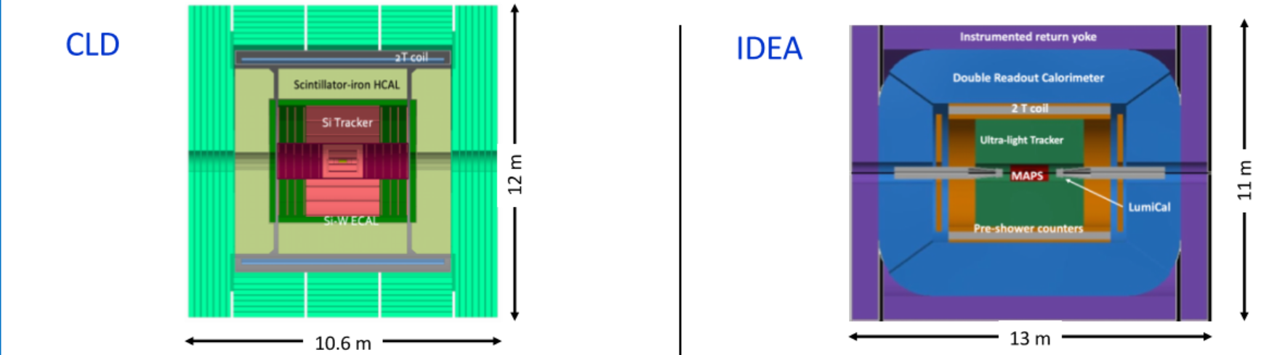
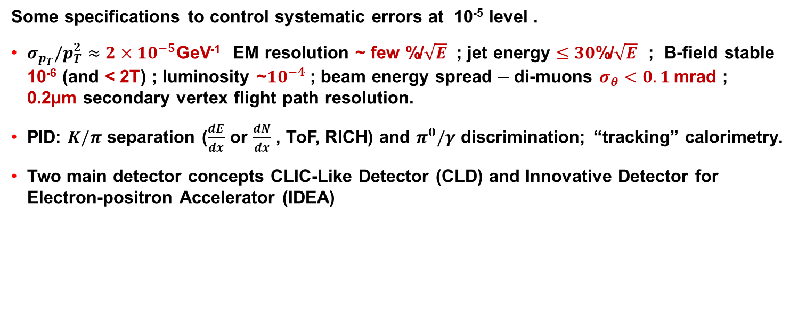
FCC-ee
Some specifications to control systematic errors at 10⁻⁵ level .
$σ_{p_{T}}/p_{T}^{2}≈2×{10}^{−5}$GeV⁻¹ EM resolution ~ few %/$\sqrt{E}$ ; jet energy $≤30$%/$\sqrt{E}$ ; B-field stable 10⁻⁶ (and < 2T) ; luminosity ~${10}^{−4}$ ; beam energy spread ─ di-muons $σ_{θ}<0.1$ mrad ; 0.2µm secondary vertex flight path resolution.
PID: $K/π$ separation ($\frac{dE}{dx}$ or $\frac{dN}{dx}$ , ToF, RICH) and $π^{0}/γ$ discrimination; “tracking” calorimetry.
Two main detector concepts CLIC-Like Detector (CLD) and Innovative Detector for Electron-positron Accelerator (IDEA)
Mogens Dams (19/2/21) https://indico.cern.ch/event/994685/

Slide 4
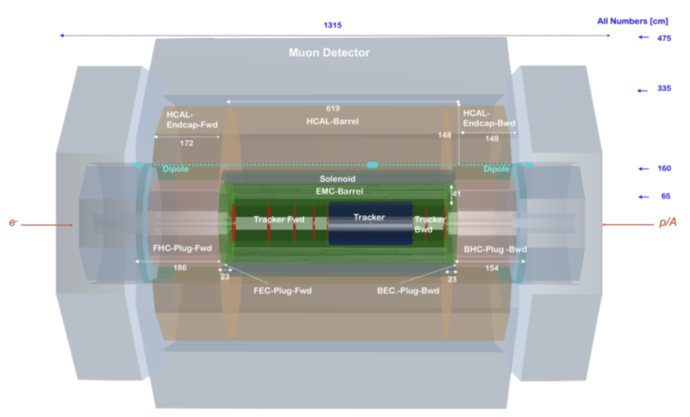
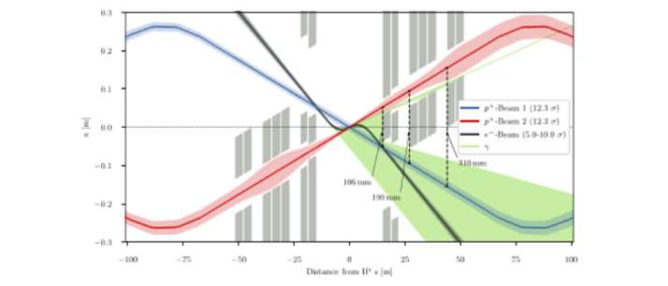
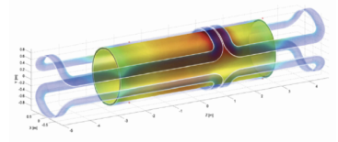
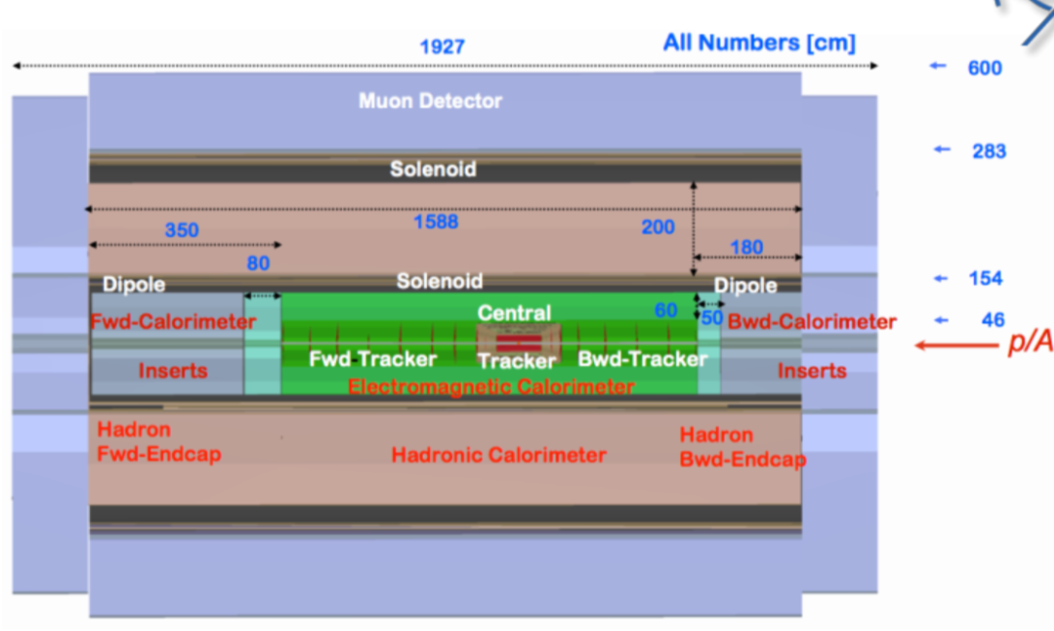
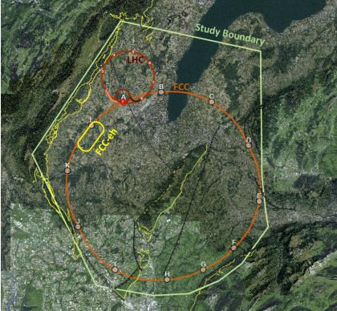
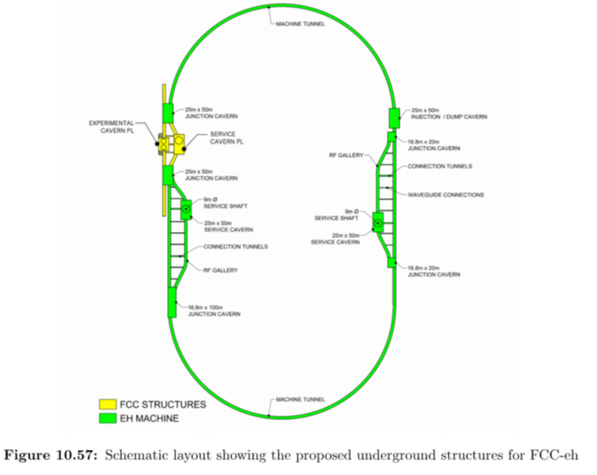
FCC-eh
Complex magnet configuration
Solenoid Detector Magnet (3.5T)
Dual dipole magnets (0.15 – 0.3 T) throughout detector region (|z| < 14m) to guide and bend electron beam
For FCC-eh scaled up version of
proposed LHeC detector
https://arxiv.org/abs/2007.14491
See also Luciano Musa (19/2/21)
https://indico.cern.ch/event/994685/

Slide 5
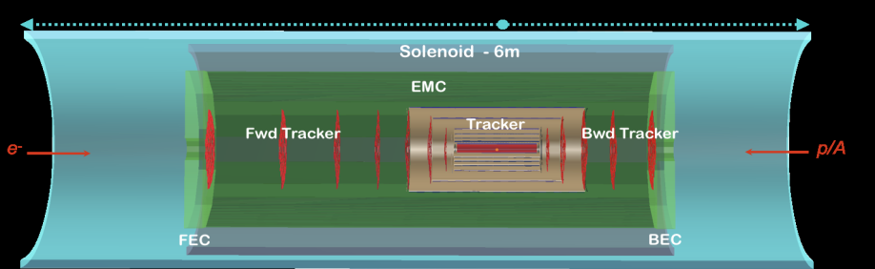
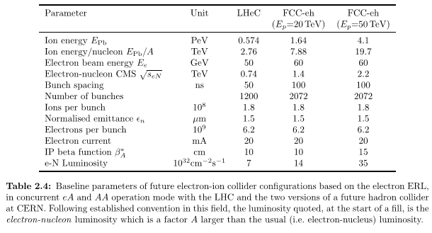
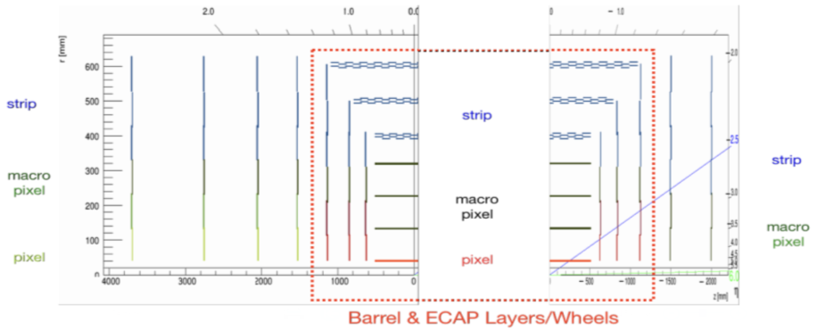
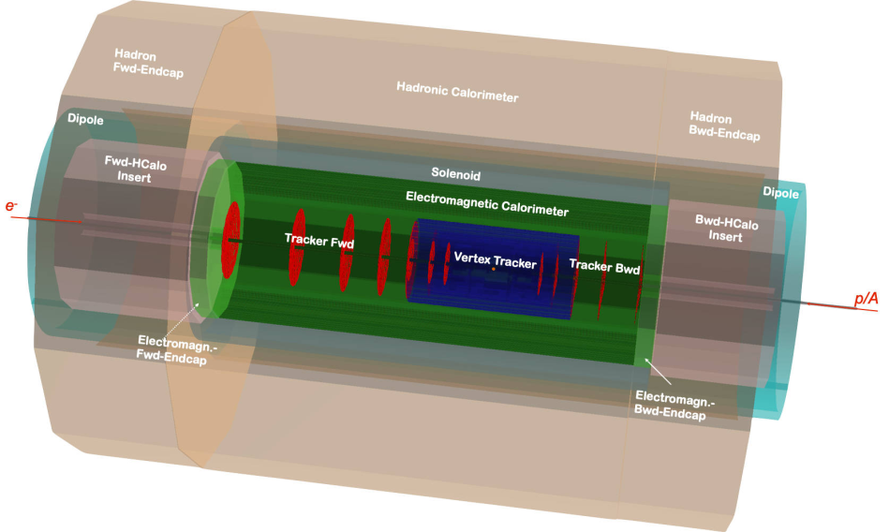
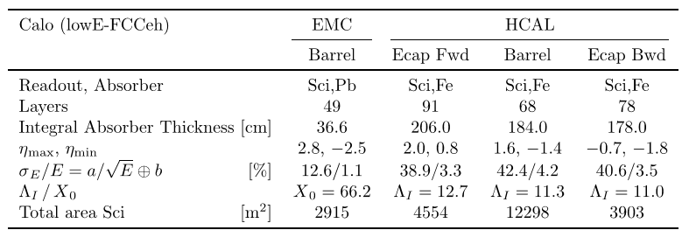
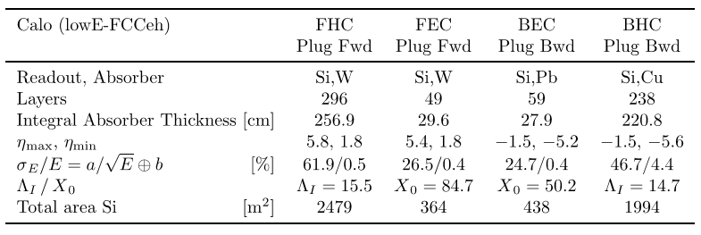
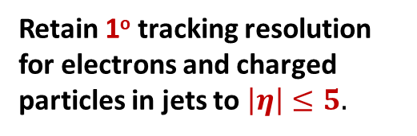
FCC-eh
CERN-ACC-Note-2020-0002
https://arxiv.org/abs/2007.14491
Retain 1º tracking resolution for electrons and charged particles in jets to $\left|η\right|≤5.$

Slide 6
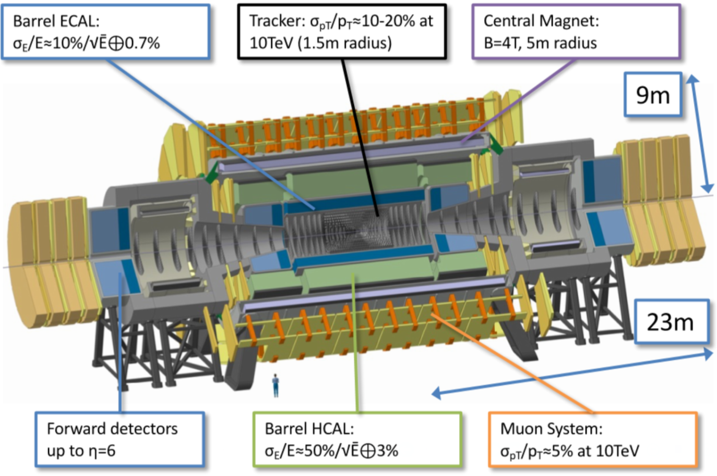
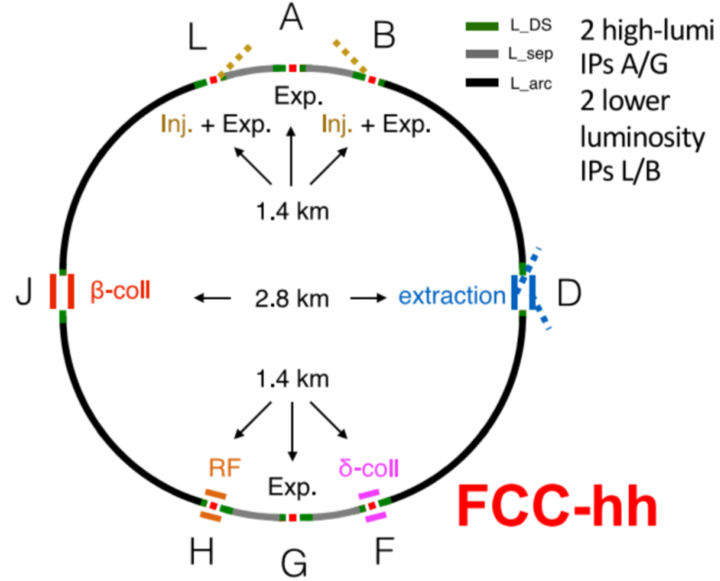
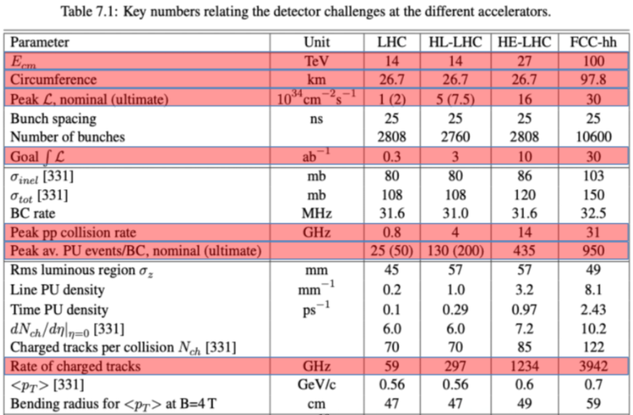
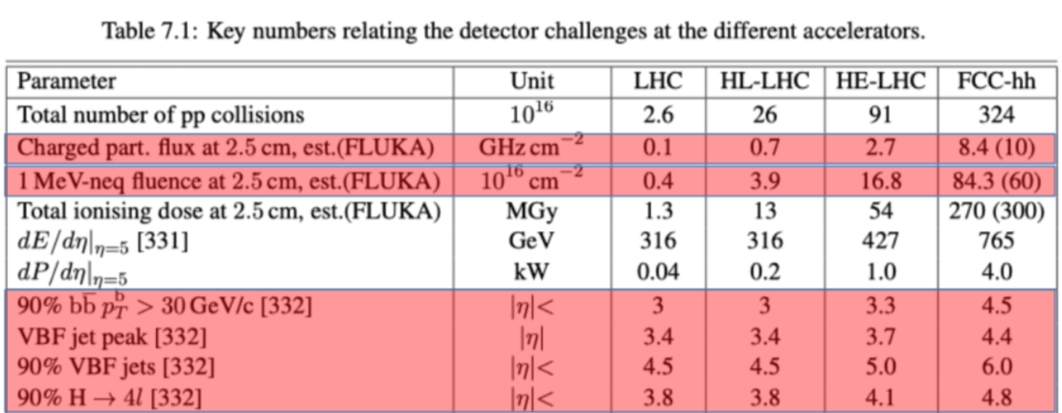
FCC-hh
See Martin Aleksa (19/2/21) https://indico.cern.ch/event/994685/
(https://fcc-cdr.web.cern.ch/#FCCHH)

Slide 7
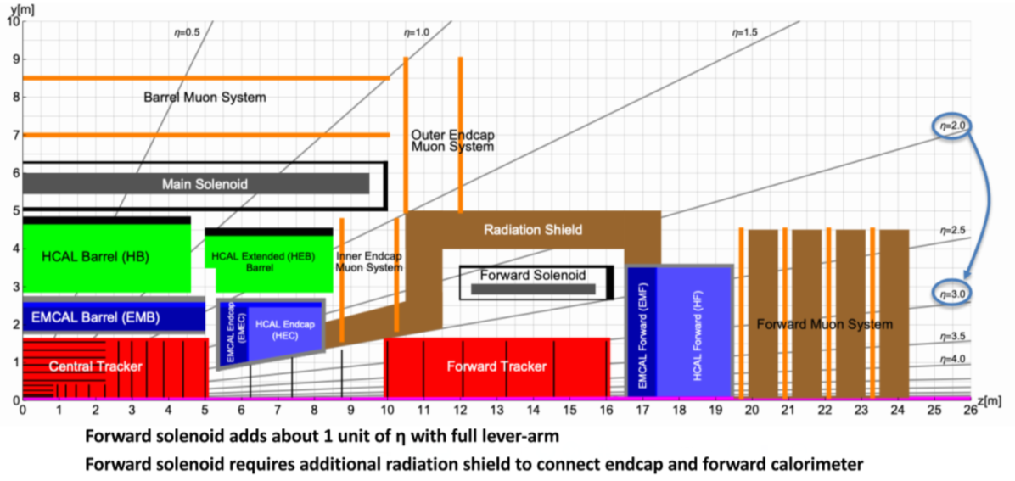
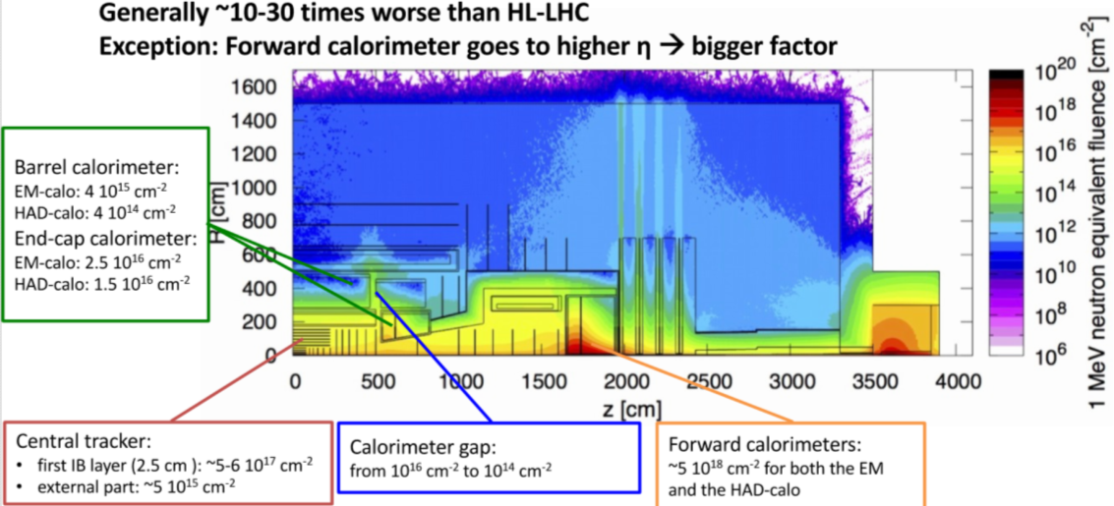
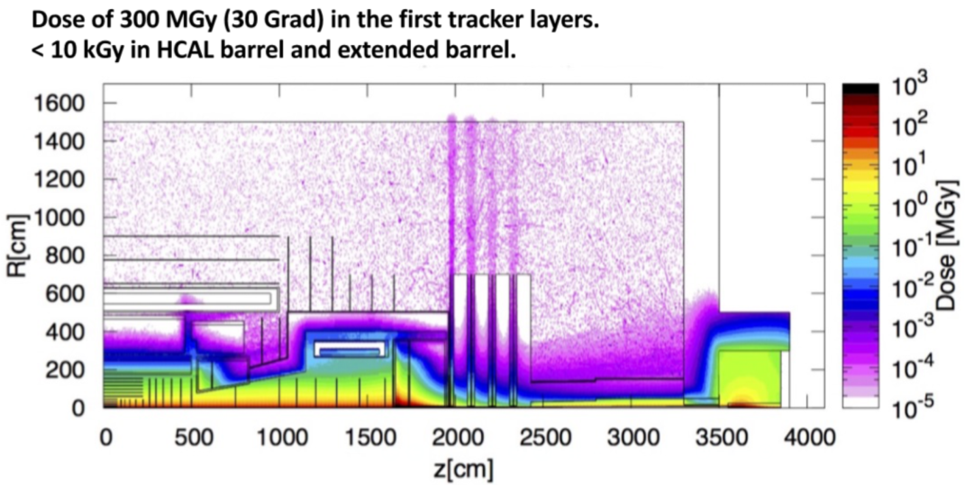
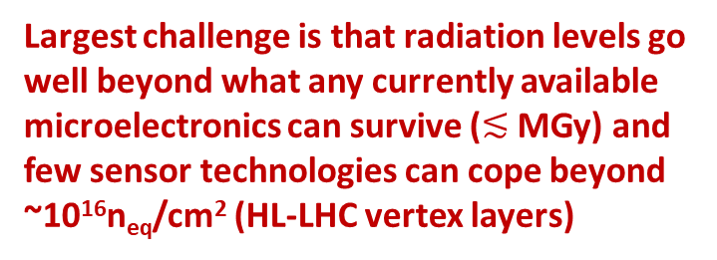
FCC-hh
See Martin Aleksa (19/2/21) https://indico.cern.ch/event/994685/
Largest challenge is that radiation levels go well beyond what any currently available microelectronics can survive ($≲$ MGy) and few sensor technologies can cope beyond ~10¹⁶n_{eq}/cm² (HL-LHC vertex layers)
Aim of FCC-hh CDR was to prove that with known detector techniques the primary physics goals could be met (see
https://fcc-cdr.web.cern.ch/#FCCHH)
However, these radiation levels mean
no actual technologies currently exist to instrument much of the detector volume

Slide 8
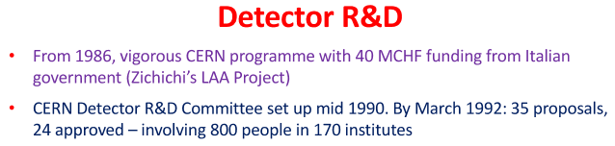
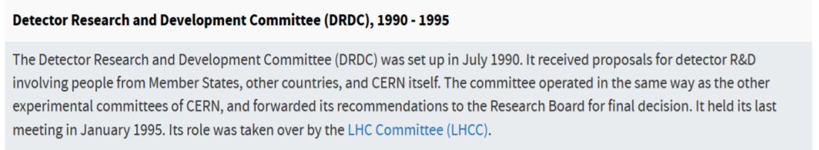
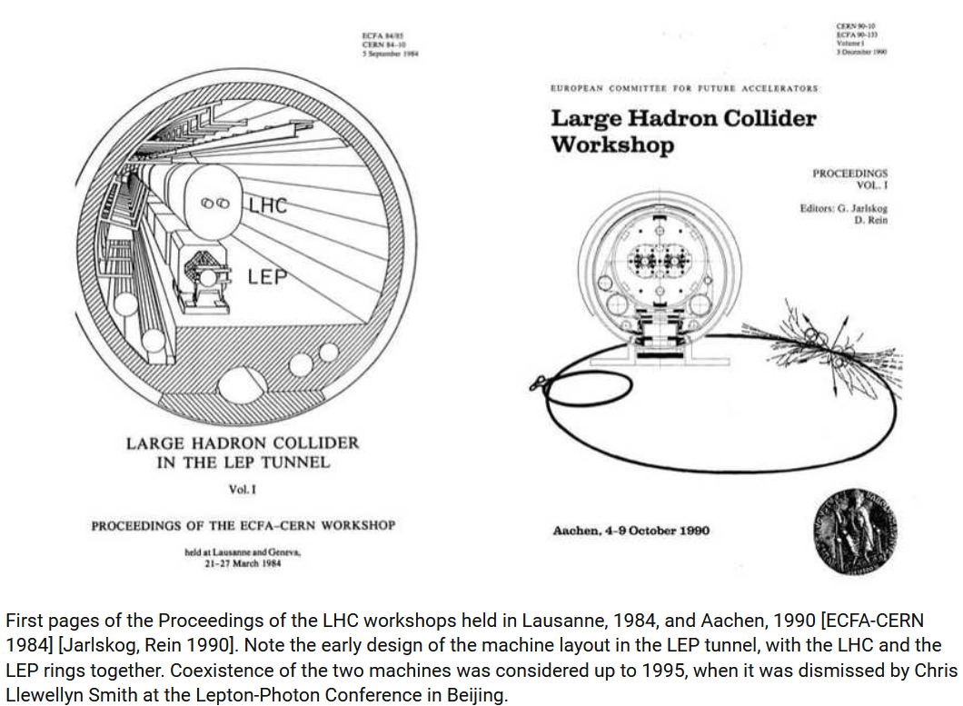
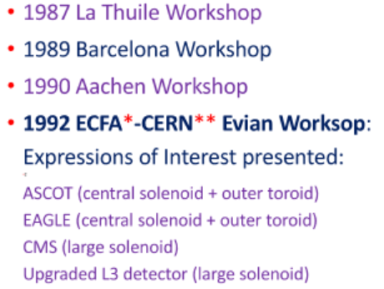
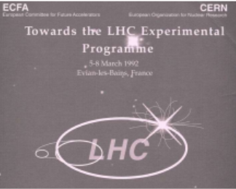
We’ve been here before ….
“Genesis of the LHC”
C. Llewellyn Smith, Phil Tran Roy Soc A373:20140037 (2016) http://dx.doi.
org/10.1098/rsta.2014.0037

Slide 9

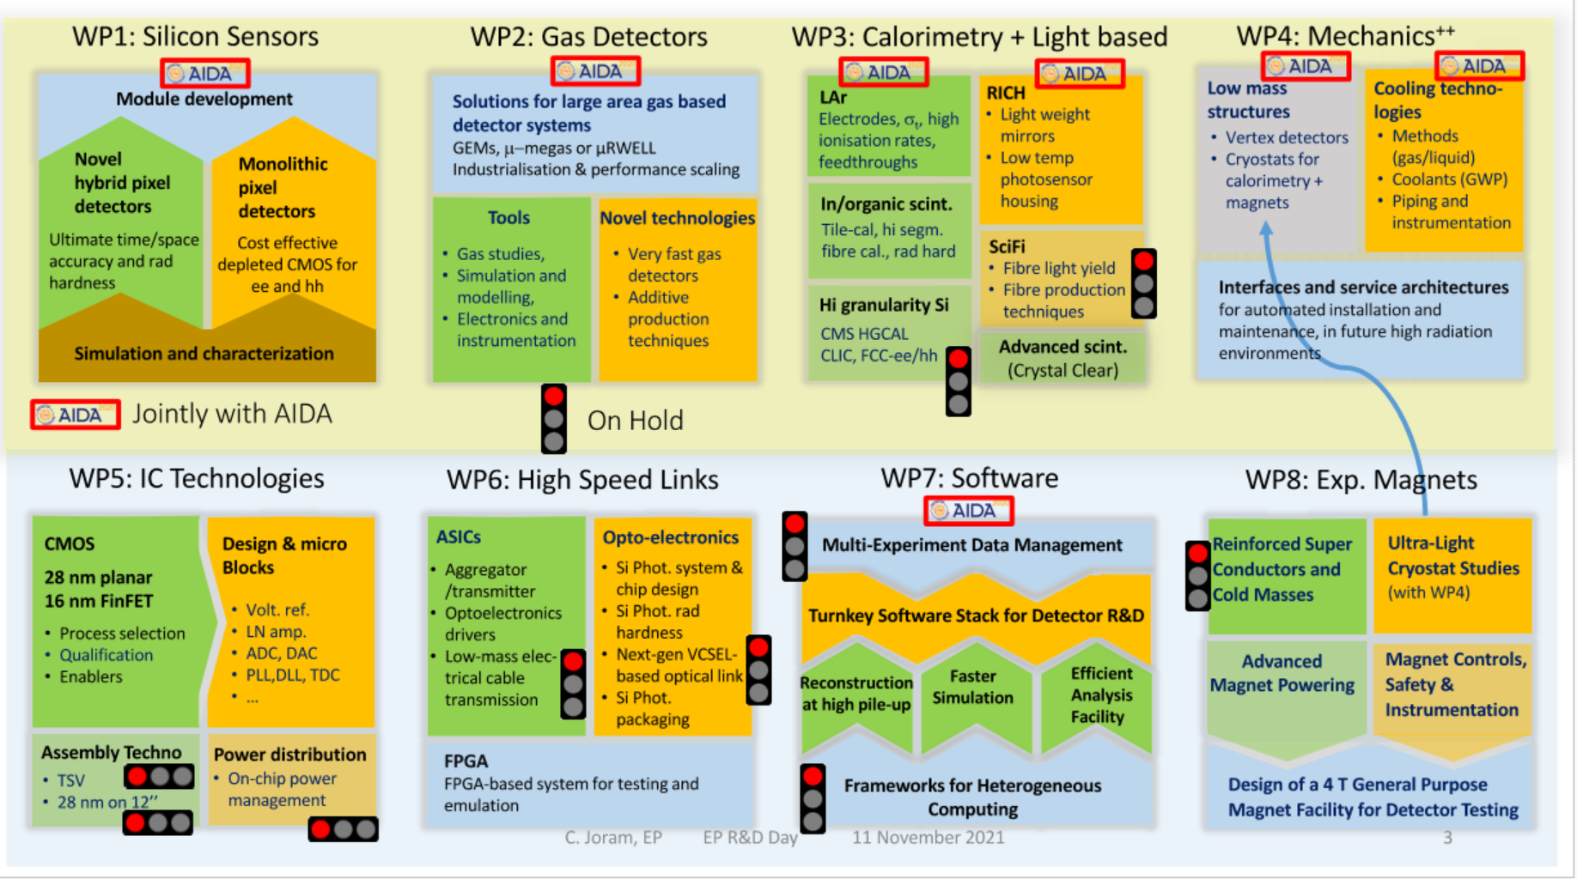
CERN EP R&D
Following tradition of DRDC (LHC Phase-0), White Paper R&D (LHC Phase-I)
Target beyond approved LHC upgrades: e.g. FCC-ee/eh/hh
Strong links/overlap with RD50, RD51, RD18 and AIDAinnova
See materials at https://ep-rnd.web.cern.ch/.

Slide 10
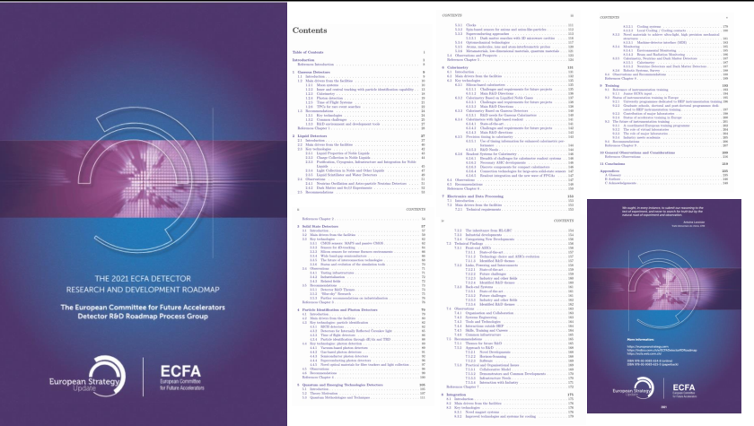
ECFA Detector R&D Roadmap
See detailed information at: https://indico.cern.ch/e/ECFADetectorRDRoadmap and
recent presentations at 19/11/21 ECFA (https://indico.cern.ch/event/1085137/)
Detector R&D readiness should not be the determining factor in the future of particle physics

Slide 11

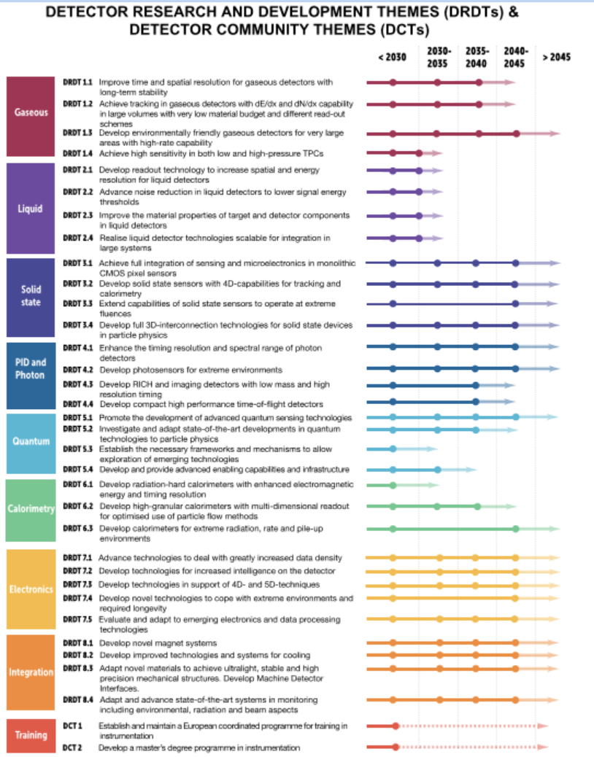
ECFA Detector R&D Roadmap
FCC-hh/eh
FCC-ee

Slide 12
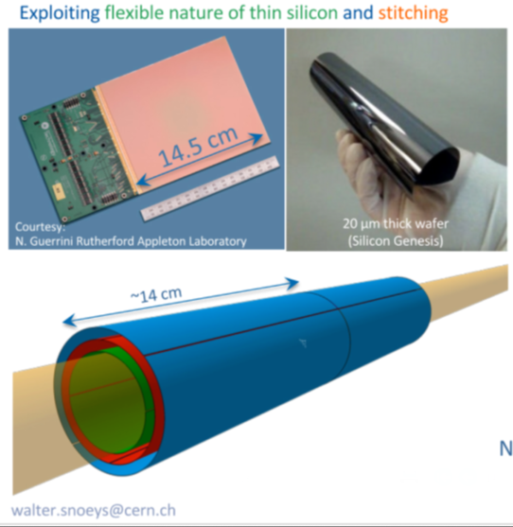
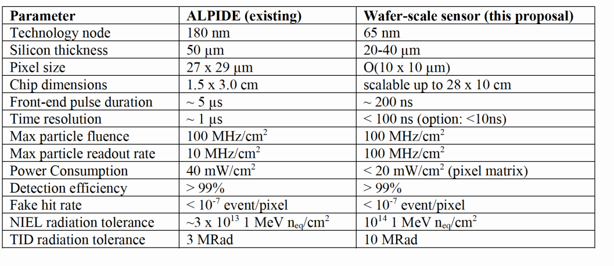
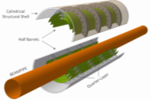
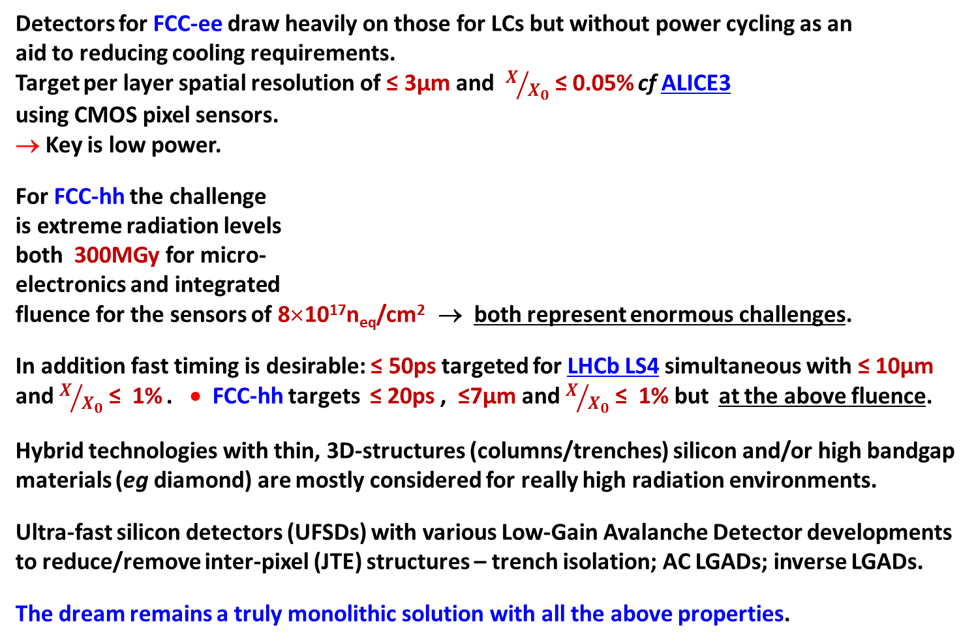
Vertex Detectors
Detectors for FCC-ee draw heavily on those for LCs but without power cycling as an aid to reducing cooling requirements.
Target per layer spatial resolution of ≤ 3µm and $X/{X_{0}}$≤ 0.05% cf ALICE3
using CMOS pixel sensors.
→ Key is low power.
For FCC-hh the challenge
is extreme radiation levels
both 300MGy for micro-
electronics and integrated
fluence for the sensors of 8×10¹⁷n_{eq}/cm² → both represent enormous challenges.
In addition fast timing is desirable: ≤ 50ps targeted for LHCb LS4 simultaneous with ≤ 10µm and $X/{X_{0}}$≤ 1% . • FCC-hh targets ≤ 20ps , ≤7µm and $X/{X_{0}}$≤ 1% but at the above fluence.
Hybrid technologies with thin, 3D-structures (columns/trenches) silicon and/or high bandgap materials (eg diamond) are mostly considered for really high radiation environments.
Ultra-fast silicon detectors (UFSDs) with various Low-Gain Avalanche Detector developments to reduce/remove inter-pixel (JTE) structures – trench isolation; AC LGADs; inverse LGADs.
The dream remains a truly monolithic solution with all the above properties.

Slide 13
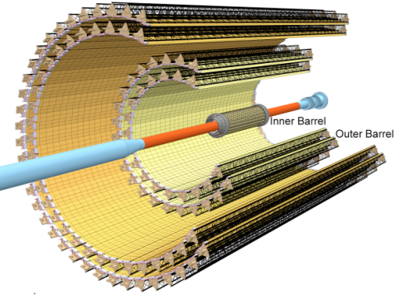
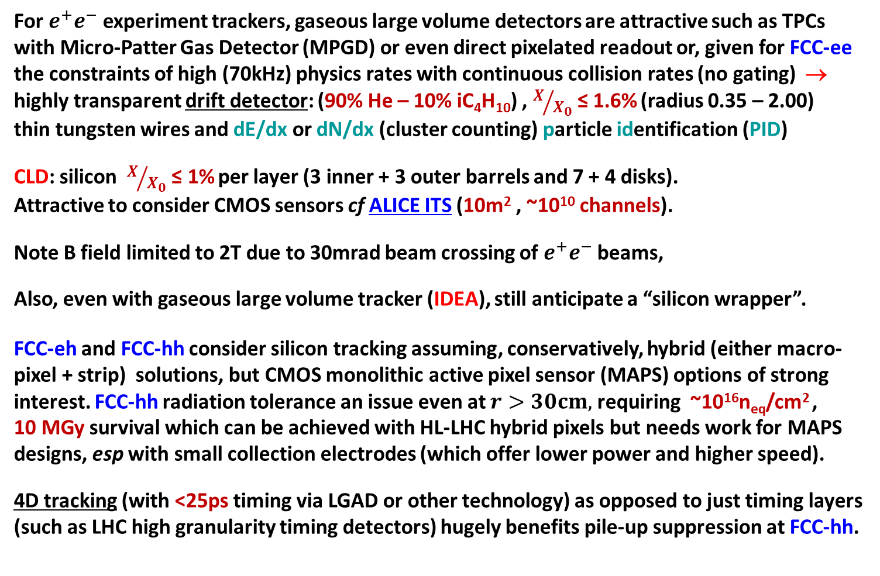
Tracking Detectors
For $e^{+}e^{−}$ experiment trackers, gaseous large volume detectors are attractive such as TPCs with Micro-Patter Gas Detector (MPGD) or even direct pixelated readout or, given for FCC-ee the constraints of high (70kHz) physics rates with continuous collision rates (no gating) → highly transparent drift detector: (90% He – 10% iC₄H₁₀) , $X/{X_{0}}$≤ 1.6% (radius 0.35 – 2.00) thin tungsten wires and dE/dx or dN/dx (cluster counting) particle identification (PID)
CLD: silicon $X/{X_{0}}$≤ 1% per layer (3 inner + 3 outer barrels and 7 + 4 disks).
Attractive to consider CMOS sensors cf ALICE ITS (10m² , ~10¹⁰ channels).
Note B field limited to 2T due to 30mrad beam crossing of $e^{+}e^{−}$ beams,
Also, even with gaseous large volume tracker (IDEA), still anticipate a “silicon wrapper”.
FCC-eh and FCC-hh consider silicon tracking assuming, conservatively, hybrid (either macro-pixel + strip) solutions, but CMOS monolithic active pixel sensor (MAPS) options of strong interest. FCC-hh radiation tolerance an issue even at $r>30cm,$ requiring ~10¹⁶n_{eq}/cm² , 10 MGy survival which can be achieved with HL-LHC hybrid pixels but needs work for MAPS designs, esp with small collection electrodes (which offer lower power and higher speed).
4D tracking (with <25ps timing via LGAD or other technology) as opposed to just timing layers (such as LHC high granularity timing detectors) hugely benefits pile-up suppression at FCC-hh.

Slide 14
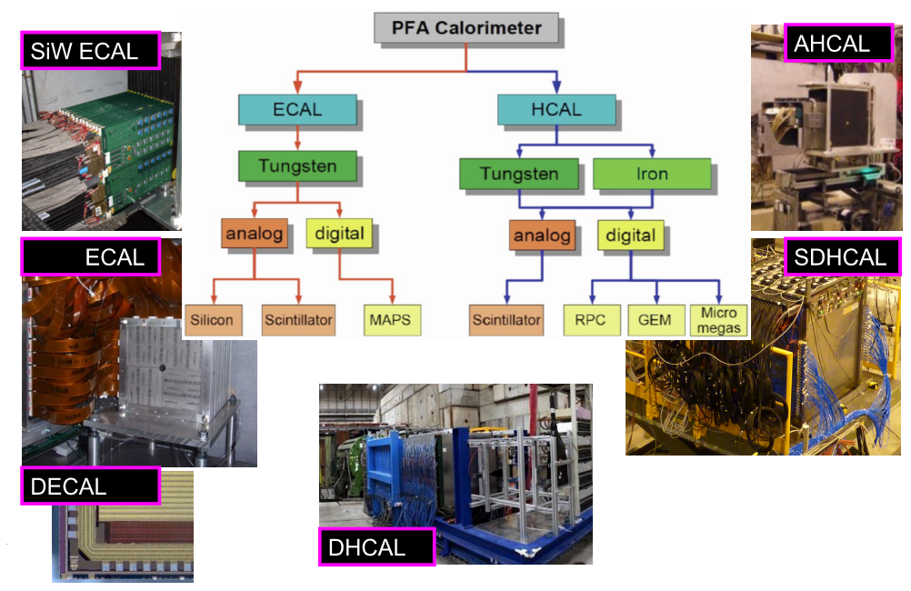
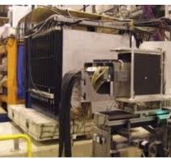

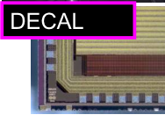

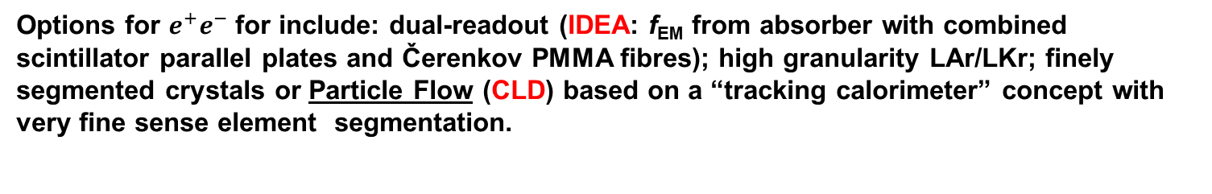
Calorimetry
Options for $e^{+}e^{−}$ for include: dual-readout (IDEA: f_{EM} from absorber with combined scintillator parallel plates and Čerenkov PMMA fibres); high granularity LAr/LKr; finely segmented crystals or Particle Flow (CLD) based on a “tracking calorimeter” concept with very fine sense element segmentation.
ScW
(see for example
9th October 2020
EP Detector Seminar https://indico.cern.ch
/event/960851/)
With thanks for help to Roman Pöschl, Fabrizio Salvatore and Nige Watson

Slide 15




Calorimetry
eh: combination of scintillator and absorber
and silicon with W, Pb and Cu for forward
hh: issues include unprecedented doses,
massive size and huge particle flux
LAr ECAL
and Forward
$$≤{10\%}/{\sqrt{E}}$$
Sci tiles + steel barrel HCAL
$$\sim {40\%}/{\sqrt{E}}$$
(cf ATLAS)
SiW/Pb ECAL (cf CMS HGCal) and digital ECAL with CMOS studied as futuristic barrel option with enhanced PF capabilities
(see M. Aleksa et al. arXiv:1912.0996).

Slide 16

PID, Photodetectors and Microelectronics
Although not in the layouts shown, additional dedicated compact PID concepts highly desirable (eg Detection of Internally Reflected Čerenkov light, Time of Flight, …)
Note: precision timing (ToF; 4D tracking), ultra-high granularity and improved signal resolution all come at a cost in terms of data handling, processing, complexity and power.
These inevitably require exploiting the latest advances in commercial photodetectors, microelectronics and high-speed links.
However, increasing sophistication, entry
cost and complexity demand radically
different approaches to those historically
adopted by the HEP community.
CERN EP R&D WP5
Kostas Kloukinas 11/11/21
The need for bespoke solutions for even
modest radiation or magnetic fields is a further
problem as these are not commercial drivers,
with HEP at best a niche low volume market.
Much of the ECFA Detector R&D Roadmap is dedicated to discussion of the need for better
organisation and coordination across Europe to cope with these considerable challenges.
Combining signatures from different devices and improved online intelligence, along with many aspects of data analysis, can also benefit greatly from cutting edge AI developments.

Slide 17
Muons, Magnets and Integration
  Upgrades to a number of systems used at the LHC for tracking, muon spectroscopy and triggering have taken advantage of the renaissance in gaseous detectors (esp MPGDs)
  Gaseous detectors remain the most-cost effective route to instrumenting very large areas where rates are still low compared with central tracking and offer very competitive timing through Multi-gap Resistive Plate Chambers (MRPCs) and Fast Timing MPGS (FTMs).
  However challenges remain in terms of pushing spatial and temporal resolution without compromising long-term stability and adopting more eco-friendly gas mixtures.
  Investigation of novel superconductors for magnet systems as well as support of expert design capabilities and modelling software for future experiments is vital.
  Cooling technologies for cryogenics and low-mass heat removal from on-detector electronics and semiconductor sensors require dedicated generic R&D activities.
  Ultra low mass, stable, precision mechanics and machine detector interface design are major topics, particularly to realise the physics goals of FCC-ee and FCC-eh.
  Novel materials and enhanced radiation testing capabilities will be vital for FCC-hh.
  Evaluation infrastructures, teat-beams, access to advanced engineering tools and personnel, retention and training of detector experts and much more are detailed in the ECFA Detector R&D Roadmap as mandatory to the success or the FCC programme as well as the long-term health of experimental particle physics as a whole.

Slide 18
Conclusions and Observations
  Major R&D funding for the LHC detector R&D programme was in place from 1986.
  The ECFA Detector R&D Roadmap starts from the principle of needing to identify the mission critical detector R&D for all the future programmes considered as viable options in the 2020 Update to the European Strategy for Particle Physics.
  Mission critical for different facilities means different things:
    For FCC-hh, at the energy frontier, it may mean finding technologies that function adequately for long enough given the extreme conditions and requirements.
    For FCC-ee/eh, at the luminosity frontier, the issue is not to be systematics limited by the detector performance such that the unprecedented statistical precision is wasted.
  The FCC programme as envisaged in the updated European Strategy for Particle Physics represents an exciting but very challenging future for particle physics in Europe.
  Without the required investment in detector R&D the opportunities this offers will be squandered – installing a LEP experiment at the FCC-ee would be as pointless as installing a LHC experiment at the FCC-hh.
  → Lead times of at least 20 years should be anticipated for the more demanding technology aspects and in some cases (eg sensors or microelectronics for FCC-hh) it is not even currently clear what would be the best direction to go in to meet the most extreme radiation-hardness specifications.

Slide 19
BACK-UP

Slide 20

ECFA Detector R&D Roadmap

Slide 21

ECFA Detector R&D Roadmap

Slide 22

ECFA Detector R&D Roadmap

Slide 23

ECFA Detector R&D Roadmap

Slide 24

ECFA Detector R&D Roadmap

Slide 25

ECFA Detector R&D Roadmap

Slide 26

ECFA Detector R&D Roadmap

Slide 27


Silicon Sensor Technology Developments .
Many different silicon detector technologies for particle tracking have been developed over the last four decades.
Applications of silicon strip and pixel-based particle tracking detectors - Nature Reviews Physics - https://doi.org/10.1038/s42254-019-0081-z Allport2019ER
What is remarkable is that every decade the instrumented areas have increased by a factor of 10 while the numbers of channels in the largest arrays have increased by a factor of 100.
This despite other specifications for readout speed, spatial resolution, reduced multiple scattering (minimal total material including cooling and services) and radiation hardness also becoming much more demanding

Slide 28






Commercial Microelectronics Evolution
Data Storage
Transistors/mm²
ADC pJ/conversion
Bandwidth
Historically showed doubling times of < 2 years but now slowing.
However, particle physics lags significantly behind commerical state-of-the-art because of additional constrants
F Faccio: https://indico.cern.ch/event/468486

Slide 29




Particle Flow Considerations
  In addition to vertexing, silicon detectors are widely assumed to be an important option for outer tracking either for a fully silicon “compact” tracker (often with high field) or outside a gaseous tracking volume (as “silicon wrapper” see for example Attilio Andreazza: https://indico.cern.ch/event/838435/contributions/3672992/ attachments/1970363/3277344/LargeSiliconSystems_v2.pdf at 3rd FCC Workshop).
  Silicon detectors also technology of choice where high radiation, high speed or high granularity requirements; either in collider or fixed target experiments.
  The PFA concept requires excellent extrapolation of charged tracks into the calorimeter layers as well as high spatial resolution on EM showers (including resolving photons from high energy $π^{0}$decays) and the start of hadron showers.
  Silicon layers (with tungsten or lead absorber) are also a leading candidate for such high granularity calorimeters, at least as far as the technology can be cost effective.
Calorimeter
Pre-Shower
Silicon
Tracker

Slide 30



SiW ECAL CMOS MAPS Motivation
  Current hybrid strip and pixel costs are still a major consideration (ATLAS Upgrade costs from Attilio Andreazza “Large Silicon Systems” at 3rd FCC Workshop, CERN January 2020, referenced above)
  Even CMS HGCAL silicon module costs ~4CHF/cm² (40kCHF/m²) would still need to come down further for many thousand m² (» 10⁷cm²) array to become affordable
  NB partially mitigated by cost savings from reducing ECAL thickness (eg for FCC-hh) to < 20cm and removing need for cryostat with respect to LAr. (Depending in inner radius, could reduces total cost of HCAL, magnet system and muon spectrometer by up to factor of 2)
  Excellent PFA capabilities but difficult to match LAr for cost, radiation-hardness and EM energy resolution
  For a hybrid silicon system (such as the CMS HGCAL), at some stage the price of polished high- $ρ$wafers could set a lower limit to what overall costs might be possible with separate thick depleted silicon substrate (although other options may exist)
  For both vertexing and outer tracking, thinking for silicon technology at future colliders is moving towards the use of CMOS Monolithic Active Pixel Sensors
11th FCC - ee Workshop — M. Aleksa

Slide 31




SiW ECAL CMOS MAPS Motivation
  Currently, CMOS Imaging Sensors represent a ~20B$ business internationally (https://www.marketsandmarkets.com/Market-Reports/cmos-image-sensor-market-252212367.html) and market expected to continue growing rapidly driving down prices for such detectors
  Although existing CMOS sensor array (such as for ALICE ITS Monolithic Active Pixel Sensor) cost estimates can typically be ~5-10 times* those for CMS HGCAL, expect prices could be significantly lower for much larger orders and as a function of time, while integration of electronics within the sensor also reduces cost of full system
  Prototypes (see later) demonstrate concept of digital ECAL with same CMOS fabrication line that CERN and collaborators have shown, with appropriate design and processing, is now delivering radiation hardness to > 10¹⁵n_{eq}/cm²
ALPIDE
. *
ALICE-TDR-017 (~10¹⁰ Channels 10m²)
CMOS costs ~200kCHF/m² also suggested: Attilio Andreazza (private communication)

Slide 32






ALICE FoCal MAPS R&D
T. Peitzmann: “R&D for the ALICE-FoCal Detector Proposal -Towards Truly High-Granularity Calorimeters”, CERN Detector Seminar 25/10/19
24 layer MIMOSA CMOS sensor calorimeter Si-W stack
1.5mm W
244 GeV electron: very high single particle hit rate in shower core
Good energy resolution but lower than simulations, particularly at higher energies
New ALPIDE CMOS sensor based 3cm×3cm area 24 layer stack
Single shower position resolution obtained from width of residuals
A. de Haas, et al., “The FoCal prototype - an extremely fine-grained electromagnetic calorimeter using CMOS pixel sensors”, JINST13(2018) P01014

Slide 33







ALICE FoCal ALPIDE Test Beam
DESY Test Beam (Nov 2019)
EPICAL-2 layer prototype at LTU
Online data displays
Raw hits already show very reasonable longitudinal shower profiles
EPICAL-2
Full test beam analysis results expected imminently.

Slide 34

Small Diode CMOS Prototyping
Developments with STFC CMOS Sensor Design Group (CSDG) in technology also used for ALPIDE and MALTA developments by CERN
Walter Snoeys FCC workshop CERN, Jan 14, 2020

Slide 35






Applications of Large Format Sensors
Developments with STFC CMOS Sensor Design Group (CSDG) in technology also used for ALPIDE and MALTA developments by CERN
“Evaluation of a pixelated large format CMOS sensor for x‐ray microbeam radiotherapy” Medical Physics, 2020
CSDG have also developed many applications of large format sensors for space, electron microscopy, x-ray detection and medical imaging.
In radiotherapy, FLASH (2-40 Gy in less than 500ms) and Mini-beam or Micro-beam (sub mm) treatments currently very exciting as found to greatly improved sparing of healthy tissue (both x-ray and hadrons)
One recent example using the LASSENA senor shows resolution (contrast) better than film with
fast (34fps) real time image
Needs further development
For use at hadron facilities
S. Flynn, T Price. (NPL and UoB)
225 kV, 1.65 Gy/min, Helmholtz Research Centre in Munich
Microbeam slit system
https://doi.org/10.1002/mp.13971
100µm
25µm

Slide 36
Small collection electrode development
The small collection electrode design has a very small detector capacitance that allows to design a compact, low power FE → small pixels and low material
  <5fC for small electrode vs. a few hundred fC for large electrode
Radiation-hardness is challenging, significant effort to develop process modifications (CERN/TJ collaboration)
Different readout architectures explored for low power readout at high rate
  MALTA: novel asynchronous architecture
  TJ-MONOPIX: synchronous column drain architecture
Estimated power consumption of ITk full scale 2x2 cm² DMAPS
MALTA
TJ-MONOPIX
LF-MONOPIX
https://doi.org/10.1088/1748-0221/14/06/C06019

Slide 37




CERN TJ Developments
  From ALPIDE, CERN has further developed the radiation hardness of the TJ process
  Similar results with other processes and designs
  Excellent for fast, full signal collection, as well as radiation hardness suitable for hadron colliders
Walter Snoeys
FCC workshop
CERN, Jan 2020

Slide 38



More Observations on CMOS Costs
  Getting prices for commercial CMOS Imaging Sensors (CIS) not so easy, but entry costs (NRE, design, etc) are progressively higher with smaller feature size, so R&D prototyping expenses make it highly advantageous to have more common developments.
  Cost per transistor, rather than cost per area, tends to be what Moore’s law scaling drives down most quickly (but we do not need cutting edge).
  (Clearly for our purposes, we care about larger area, as well as greater functionality, unlike the main commercial drivers)
https://www.nber.org/chapters/c13897

Slide 39















Historical Development of Silicon Sensor Arrays .
600m²
10⁴m² = 1 hectare
Every decade: instrumented areas have increased by a factor of 10 while the numbers of channels in the largest arrays have increased by a factor of 100.

Slide 40












Historical Development of Silicon Sensor Arrays .
The highest channel count arrays are based on pixelated detectors.
For hybrid pixel sensors connection to the electronics requires flip-chip technologies.
Two orthogonal projections
True space-points
10
Monolithic Active Pixel Detectors
STAR
Hybrid Pixel
Detectors
Hybrid Pixel Readout ASICs

Slide 41






Radiation Effects: Sensors and Electronics
Hybrid silicon detectors (pixels/strips) signal output drops with irradiation to very high doses
Bulk damage (measured in units of 1MeV equivalent neutrons/cm² (assuming scaling with non-ionising energy loss) drives the deterioration of sensors.
For microelectronics worry about total ionising dose.
(65nm CMOS - RD53) can start to see significant deterioration above 500Mrad (5MGy) ◊Many different effects◊
1.1×10¹⁵n_{eq}/cm²
Example of radiation expected at High Luminosity
LHC (HL-LHC)
(Typically apply 1.5 safety factor)
n⁺ strips
in p⁻ bulk
Strips
1.9×10¹⁶n_{eq}/cm²
Pixels
For Monolithic CMOS sensors initially target ~10¹⁵n_{eq}/cm²
5×10⁵Gy
Fluence (10¹⁴n_{eq}/cm²)
1.3×10⁷Gy
niel
Federico Faccio: PMOS turn-on V_{g} https://indico.cern.ch/event/468486/

Slide 42





MAPS: HV/HR-CMOS Detectors
Commercial CMOS Image Sensors offer possible dramatic decrease in costs (Monolithic Active Pixel Sensors)
MAPS can deliver very low power consumption at low R/O speeds, possibly <100mW/cm² i.e. simple water cooling
  Ultra low material budget (cf ALICE ITS upgrade: <0.5% for inner layers, <1% for outer layers)
  But these devices limited in speed and radiation hardness
  Current and near future MAPS for heavy ion experiments
    integration time up to 4μs (noise, electron diffusion)
    radiation resistance up to few 10¹³ n_{eq}cm⁻²
Major developments in HV/HR-CMOS → deep depletion region with charge collection by drift not diffusion → huge improvements in collection speed and radiation hardness
Can usually either have small collecting node (and therefore faster and low noise) but shallow charge collection or deplete from the deep n-well with larger signal produced in up to 100μm of silicon but higher capacitance (→more noise & slower)
Modified process with junction in substrate
See presentation
https://indico.cern.ch/event/803258/contributions/3582758/ by Heinz Pernegger

