Slide 1








The FCC Feasibility Study
Michael Benedikt, CERN
on behalf of the FCC collaboration and FCCIS DS team
LHC
PS
SPS
FCC
http://cern.ch/fcc
Work supported by the European Commission under the HORIZON 2020 projects EuroCirCol, grant agreement 654305; EASITrain, grant agreement no. 764879; ARIES, grant agreement 730871, FCCIS, grant agreement 951754, and E-JADE, contract no. 645479
photo: J. Wenninger

Slide 2
ESPP Update 2020 “High-priority future initiatives”
      An electron-positron Higgs factory is the highest-priority next collider. For the longer term, the European particle physics community has the ambition to operate a proton-proton collider at the highest achievable energy.
      “Europe, together with its international partners, should investigate the technical and financial feasibility of a future hadron collider at CERN with a centre-of-mass energy of at least 100 TeV and with an electron-positron Higgs and electroweak factory as a possible first stage.
      Such a feasibility study of the colliders and related infrastructure should be established as a global endeavour and be completed on the timescale of the next Strategy update..”

Slide 3

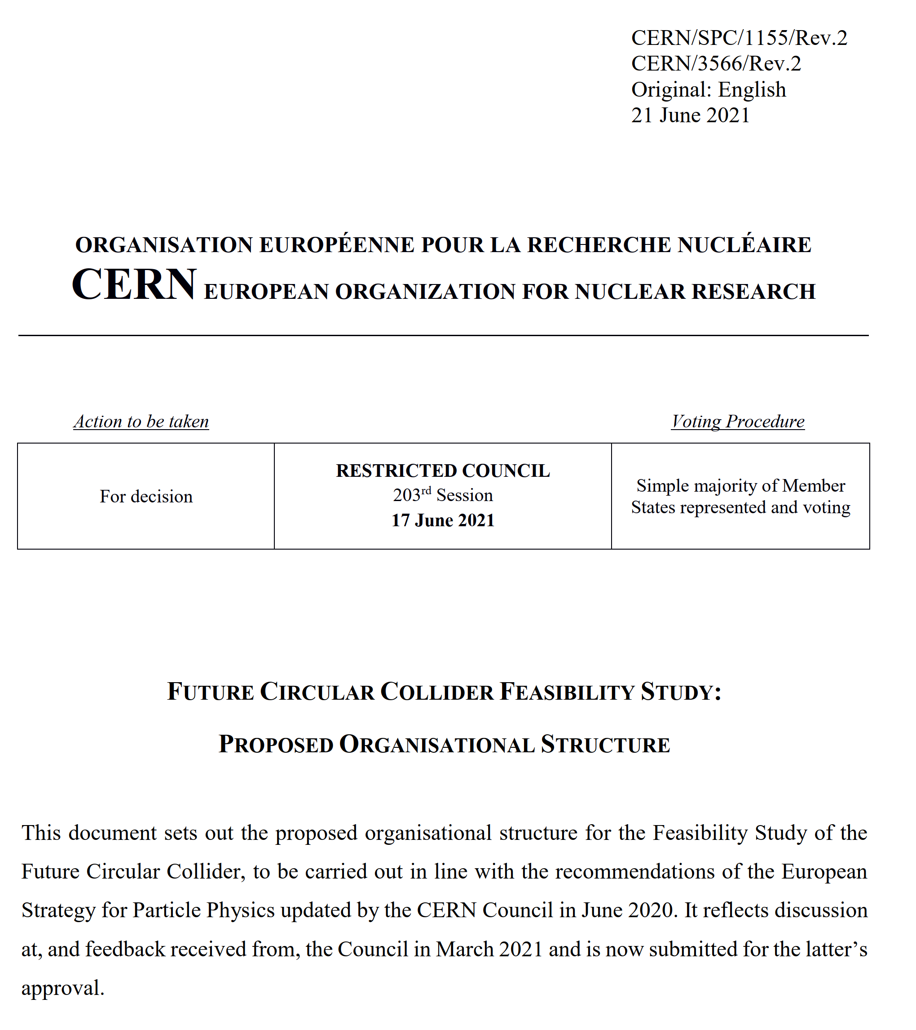
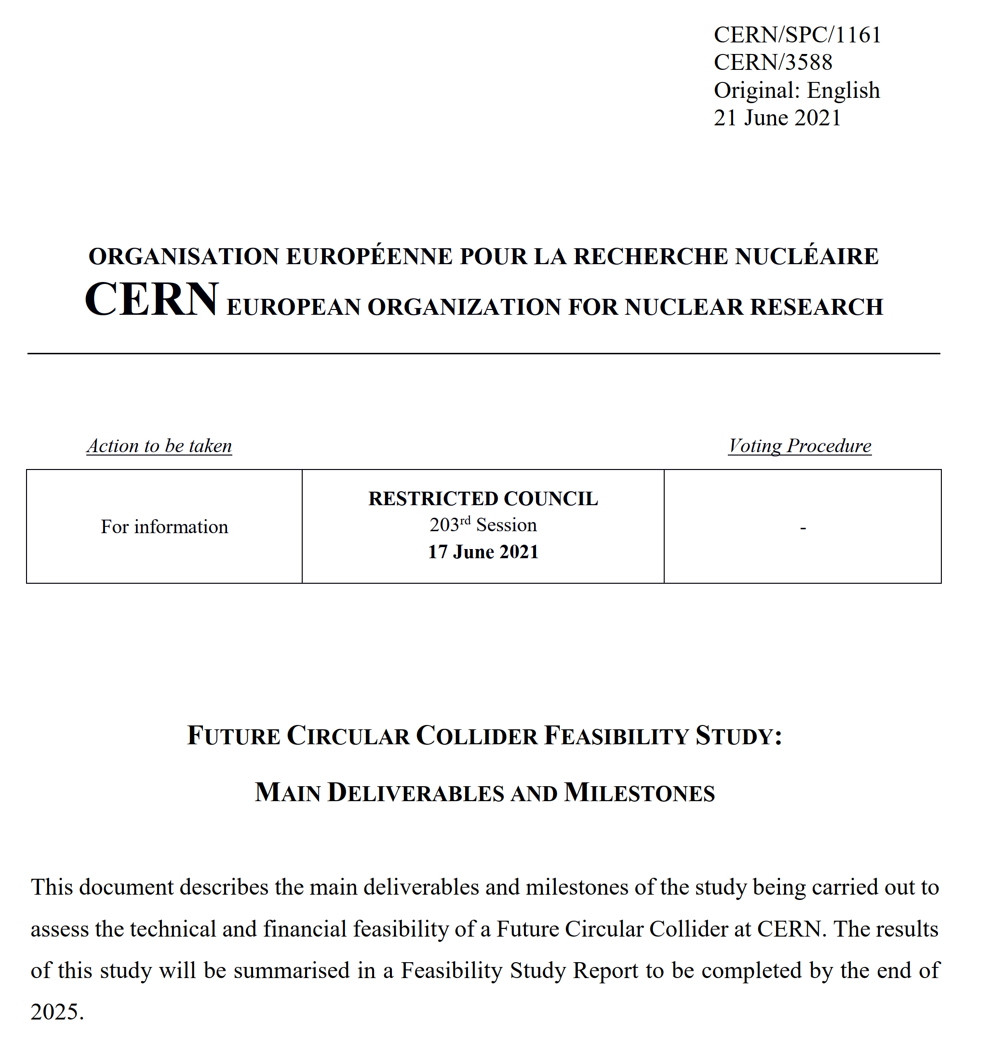
FCC FS Council Documents, June ‘21
Organisational Structure of the FCC Feasibility Study
http://cds.cern.ch/record/2774006/files/English.pdf
Main Deliverables and Timeline of the FCC Feasibility Study
http://cds.cern.ch/record/2774007/files/English.pdf

Slide 4
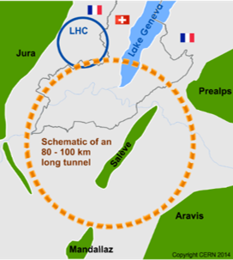
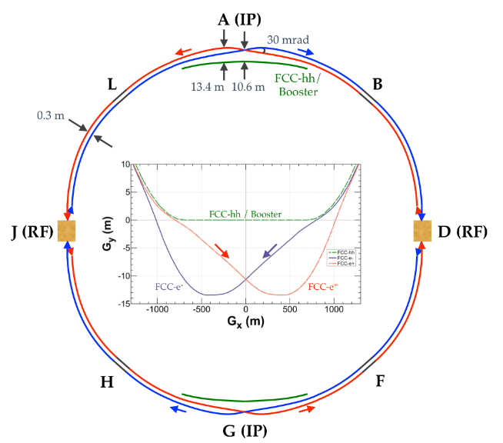
The FCC integrated program
inspired by successful LEP – LHC programs at CERN
complementary physics, common civil engineering and technical infrastructures, building on and reusing CERN’s existing infrastructure, FCC integrated project allows seamless continuation of HEP after HL-LHC
Phase 1 : FCC-ee
collisioneur electron - positon
usine à Higgs, Z, W, ttbar
Phase 2 : FCC-hh
collisioneur proton - proton
frontière des hautes énergies
FCC-hh
FCC-ee
2020 - 2040
2040 - 2055
2060 - 2090

Slide 5
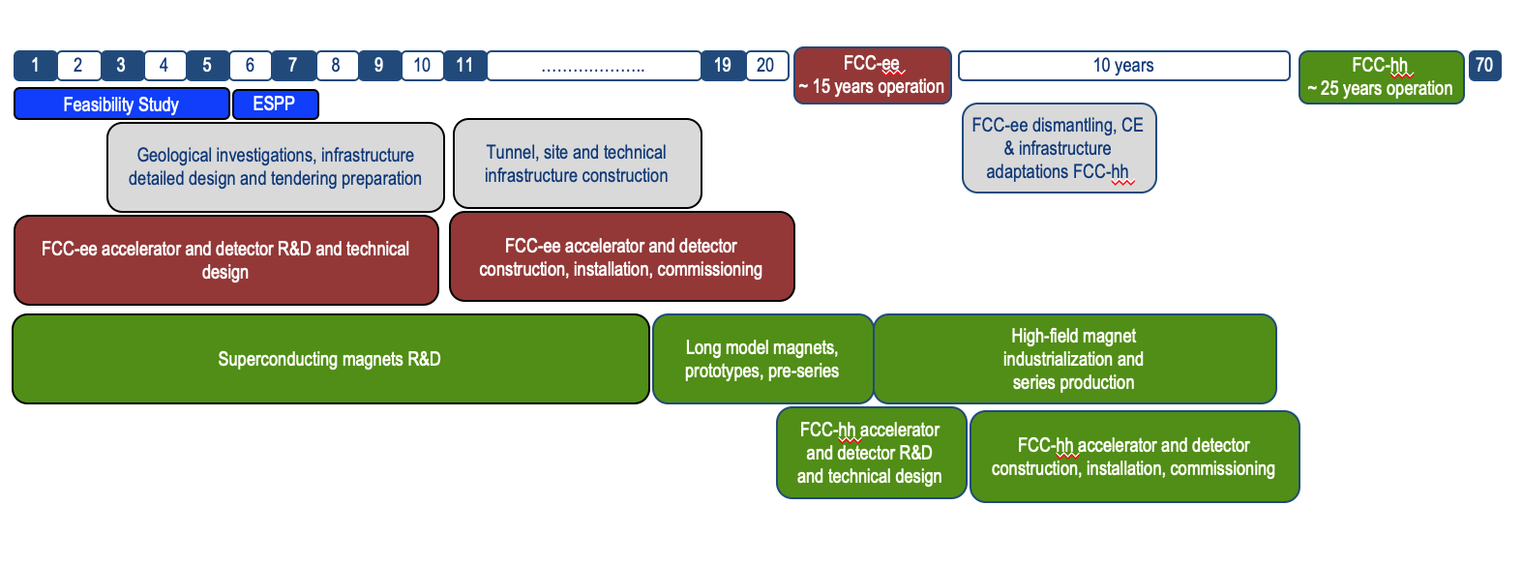
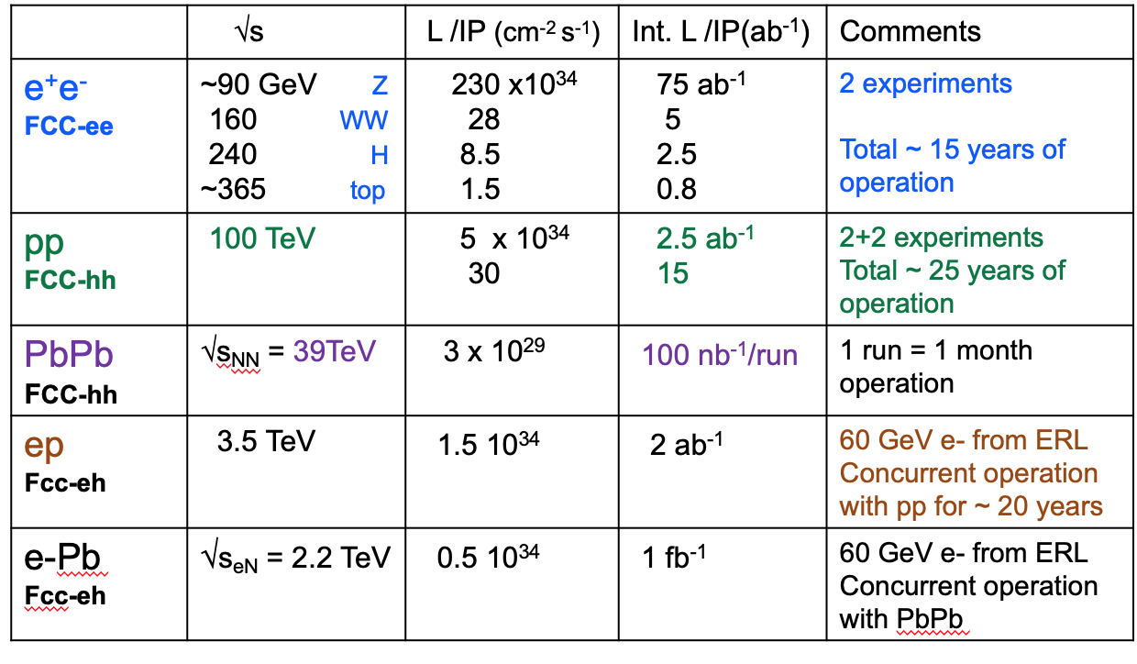
Timeline of the FCC integrated programme
Technical
schedule
2-4 experiments
20-30
Feasibility Study: 2021-2025
If project approved before end of
decade → construction can start
beginning 2030s
FCC-ee operation ~2045-2060
FCC-hh operation 2070-2090++
F. Gianotti

Slide 6
FCC Feasibility Study (2021-205): high-level objectives
demonstration of the geological, technical, environmental and administrative feasibility of the tunnel and surface areas and optimisation of placement and layout of the ring and related infrastructure;
pursuit, together with the Host States, of the preparatory administrative processes required for a potential project approval to identify and remove any showstopper;
optimisation of the design of the colliders and their injector chains, supported by R&D to develop the needed key technologies;
elaboration of a sustainable operational model for the colliders and experiments in terms of human and financial resource needs, as well as environmental aspects and energy efficiency;
development of a consolidated cost estimate, as well as the funding and organisational models needed to enable the project’s technical design completion, implementation and operation;
identification of substantial resources from outside CERN’s budget for the implementation of the first stage of a possible future project (tunnel and FCC-ee);
consolidation of the physics case and detector concepts for both colliders.
Results will be summarised in a Feasibility Study Report to be released at end 2025
F. Gianotti

Slide 7



Feasibility Study Timeline
2021 |  |  |  | 2022 |  |  |  | 2023 |  |  |  | 2024 |  |  |  | 2025
Q1 | Q2 | Q3 | Q4 | Q1 | Q2 | Q3 | Q4 | Q1 | Q2 | Q3 | Q4 | Q1 | Q2 | Q3 | Q4 | Q1 | Q2 | Q3 | Q4
CDR baseline design adaptations for
new implementation scenario
Status reports &
study planning ,
FCC Week & Review : implementation, baseline design, organisation, communication
high-risk areas site investigations, environmental evaluation & impact study with host states
FCCW & mid-term review:
general coherency, CDR cost update
detailed design towards CDR
FCC Week & Review: key technology R&D programs
FS Report
Release FSR
Project cost update

Slide 8
H2020 DS FCC Innovation Study 2020-24
Topic | INFRADEV-01-2019-2020
Grant Agreement | FCCIS 951754
Duration | 48 months
From-to | 2 Nov 2020 – 1 Nov 2024
Project cost | 7 435 865 €
EU contribution | 2 999 850 €
Beneficiaries | 16
Partners | 6
Beneficiaries
Partners

Slide 9
Objectives of FCCIS (Description of Action)
O1: Design a circular luminosity frontier particle collider with a research programme to remain at the forefront of research
O2: Demonstrate the technical and organizational feasibility of a 100 km long, circular particle collider
O3: Develop an innovation plan for a long-term sustainable research infrastructure that is seamlessly integrated in the European research landscape
O4: Engage stakeholders from different sectors of the society
O5: Demonstrate the role and impact of the research infrastructure in the innovation chain, focusing on responsible resource use and managing environmental impacts

Slide 10
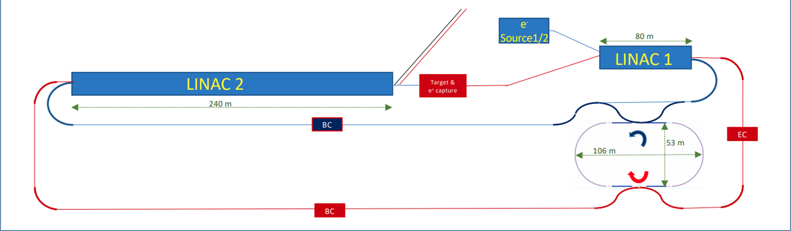
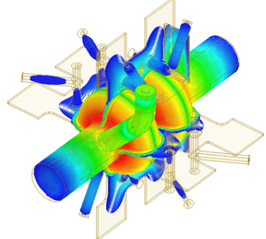
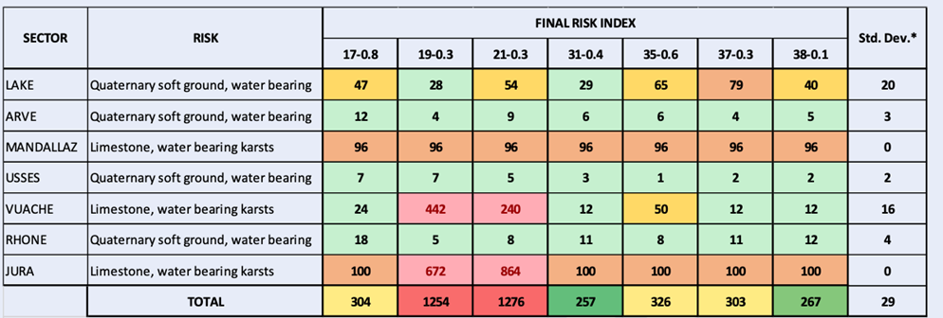
Technical reviews on injector, RF, placement in 2021
SRF:
study alternative RF frequency of 600 or 650 MHz (synergies with EIC, JLEIC, PIP-II, CEPC); explore heavily damped cavity concept with slotted waveguides as option for all energies.
FCC-ee injector: new layout (single energy in linac, higher e+ prod. energy) ; linac extension ~20 GeV
Placement:
minimizing the risk → new baseline layout, C=91.1 km;
full 4-superperiodicity & symmetry, compatible with 2 or 4 IPs for FCC-ee

Slide 11
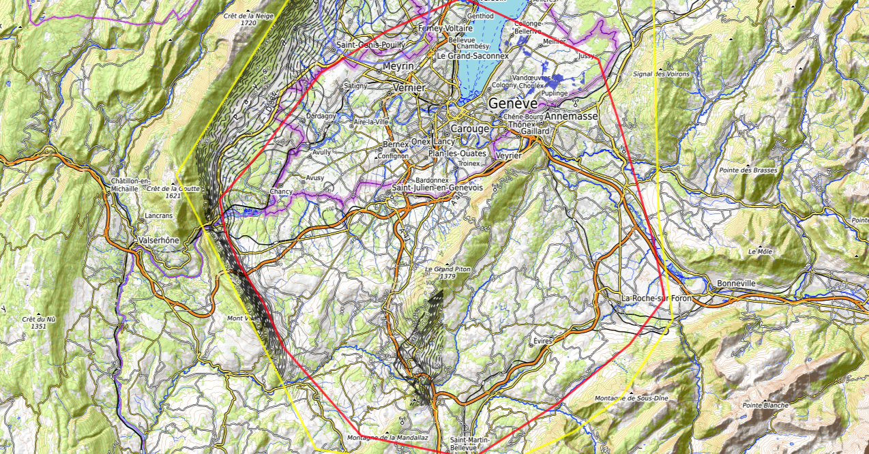
Constraints
Placements studies (i)
J. Gutleber, V. Mertens
Discouraged due
to likely oppositions
Densely urbanized
and agriculture/nature
Strict landscape protection
and re-naturalization areas
Jura limestone
Protected forest
Densely urbanized
and emerging areas
Densely urbanized
Clustered residential
areas and farm areas
Terrain difficult to
access and water
reservoirs
Known water reservoirs and
protected nature in CH
(legal + technical reasons)
Water protection and
natural zones without
developed access
Densely urbanized
and emerging areas
(some spots possible)
Water protection zones,
landscape protection zones,
altitudes
High mountains (900 m)
north of Fillière river valley
Vuache limestone
and faults
Likely major opposition:
local urbanistic planning
for traffic calming &
nature protection
High altitudes
Densely populated

Slide 12
Placements studies (ii)
J. Gutleber, V. Mertens
CERN Prevessin
SPS BA4
LHC Pt8 area
GE public plot in Bellevue
GE public plot in Pallanterie
Target areas
GE public plot in Présinge
Challex area south of D884
Permit north of D884, east of
water bearing layer zone.
Permit entering swiss territory
conntected by access tunnel
CERN
Meyrin site
Selected plots south of
Cranves-Salves
Selected plots south of
Bonne
West of A40 at Arve
Charvonnex, Villy
Between A41,
railroad and
route d’Annecy.
South of A410
Some plots in Contamine
sur Arve
Vulbens south of water
Protection zone until A40
North & south of
A410 at selected
Places to be
analysed
individually
Some plots in Arenthon
North of Roche-s.-Foron,
industrial area and Etaux
Dingy north up to A40,
except water protection
zones
700 m altitude line at
Roche-s.-Foron railroard
Minzier area outside
forests, which are
Inaccessible on mountains
One 3 ha unprotected location
at D2 in Fillière valley
North-east of
Choisy
North of Ollières, few selected locations

Slide 13
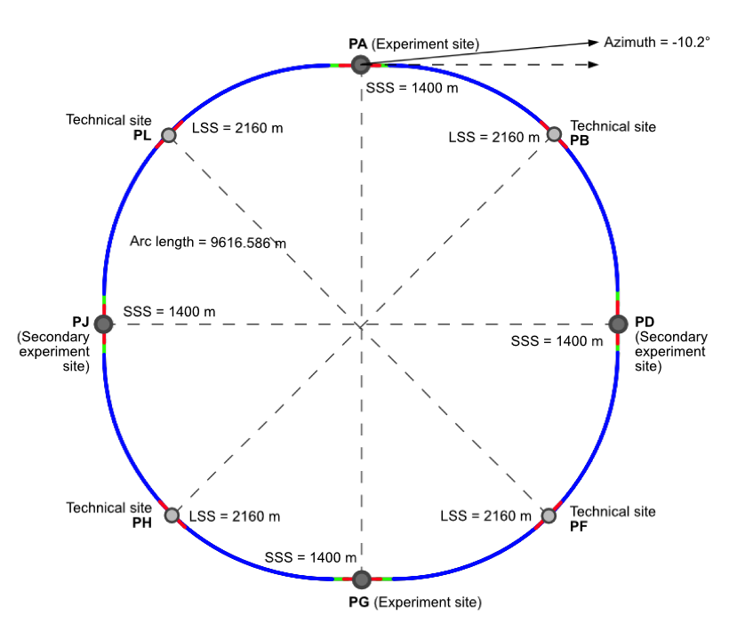
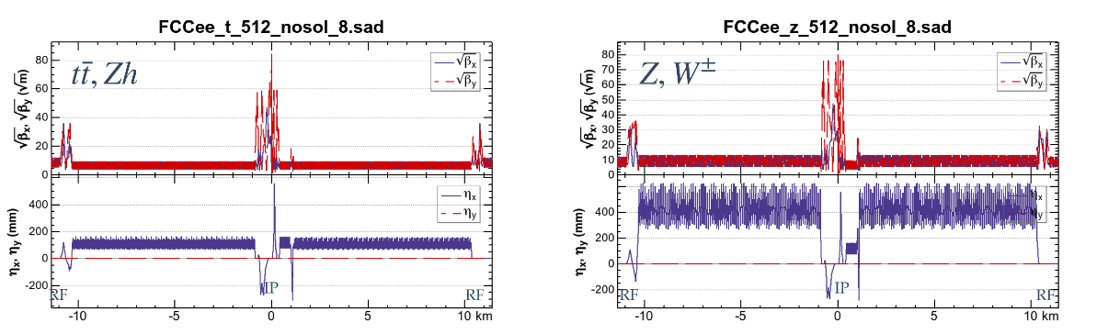
new “lowest risk” placement/optics allows 4 exp’s
8 surface sites
4-fold symmetry
and
4-fold superperiodicity
FCC-ee 2 or 4 Ips
FCC-hh 4 IPs
FCC-ee beam optics for ¼ ring
K. Oide
C=91 km

Slide 14
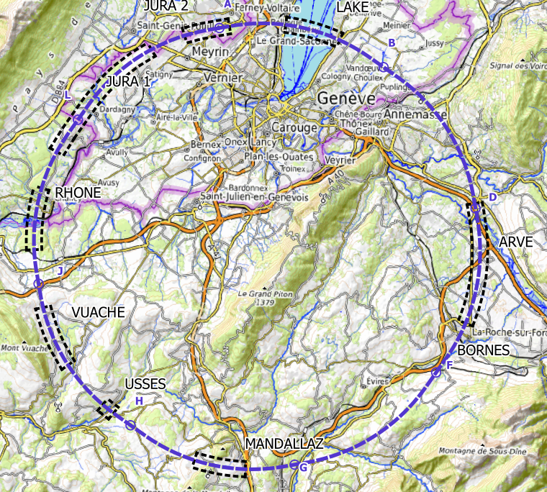
Plans for high-risk area site investigations
  Jura, Vuache (3 Areas)
  Top of limestone
  Karstification and filling-in at the tunnel depth
  Water pressure
  Lake, Rhône, Arve and Usses Valley (4 Areas)
  Top of the molasse
  Quaternary soft grounds, water bearing layers
  Mandallaz (1 Areas)
  Water pressure at the tunnel level
  Karstification
  Bornes (1 Area)
  High overburden molasse properties
  Thrust zones
  Site investigations planned for mid 2023 – mid 2025:
  ~40-50 drillings, 100 km of seismic lines

Slide 15
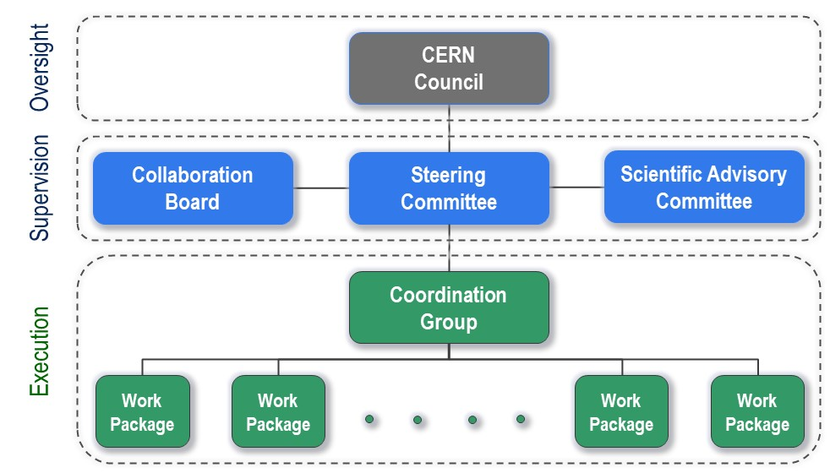
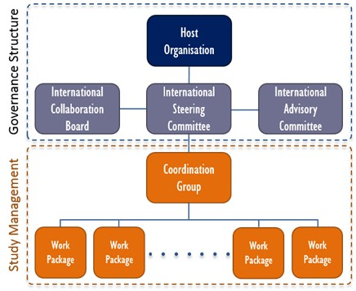
FCC Feasibility Study - organisational structure
  New structure very similar to the first phase of the FCC Study (2014-2020), leading to the Conceptual Design Report as input to the ESPPU.
  Classical structure common to CERN projects.

Slide 16
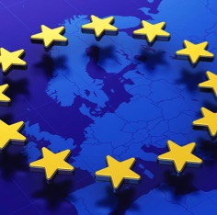
Status of Global FCC Collaboration
Increasing international collaboration as a prerequisite for success:
links with science, research & development and high-tech industry will be essential to further advance and prepare the implementation of FCC
147
Institutes
30
Companies
34
Countries
EC
H2020

Slide 17

FCC Feasibility Study – coordination team and contact persons
EU Projects
NN
Study Support Unit
IT: Sylvain Girod
Procurement: Adam Horridge
Quality control: NN
Resources: Sylvie Prodon
Scheduling, quality mangement: NN
Secretariat: Julie Hadre
Collaboration building
Emmanuel Tsesmelis
Study Support and Coordination
Study Leader: Michael Benedikt
Deputy Study Leader: Frank Zimmermann
Communications
Panagiotis Charitos, James Gillies
Physics, Experiments and Detectors
Patrick Janot
Gavin Salam
Physics programme
Matthew McCullough, Frank Simon
Accelerators
Tor Raubenheimer
Frank Zimmermann
Project organisation model
Technical Infrastructures
Klaus Hanke
Host State processes and civil engineering
Timothy Watson
Organisation and financing models
Paul Collier (interim)
FCC-ee collider design
Katsunobu Oide
FCC-hh design
Massimo Giovannozzi
Technology R&D
Roberto Losito
FCC-ee booster design
Antoine Chancé
FCC-ee injector
Paolo Craievich, Alexej Grudiev
FCC-ee energy calibration polarization
Alain Blondel, Jorg Wenninger
FCC-ee MDI
Manuela Boscolo, Mike Sullivan
Integration
Jean-Pierre Corso
Geodesy & survey
Hélène Mainaud Durand
Electricity and energy management
Jean-Paul Burnet
Cooling and ventilation
Guillermo Peon
Cryogenics systems
Laurent Delprat
Computing and controls infrastructure, communication and network
Dirk Duellmann
Safety
Thomas Otto
Operation, maintenance, availability, reliability
Jesper Nielsen
Transport, installation concepts
Cristiana Colloca
Administrative processes
Friedemann Eder
Placement studies
Johannes Gutleber, Volker Mertens
Environmental evaluation
Johannes Gutleber
Tunnel, subsurface design
John Osborne
Surface sites layout, access and building design
Detector concept
Mogens Dam
Physics performance
Patrizia Azzi, Emmanuel Perez
Software and computing
Gerardo Ganis, Clément Helsens
Financing model
Florian Sonnemann
Procurement strategy and rules
In-kind contributions
Operation model
Paul Collier, Jorg Wenninger

Slide 18

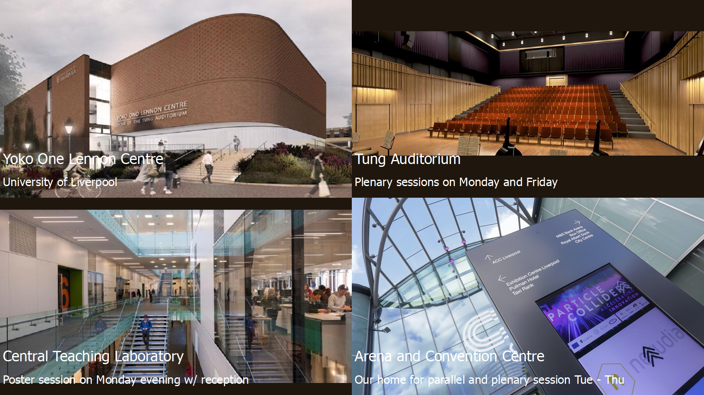

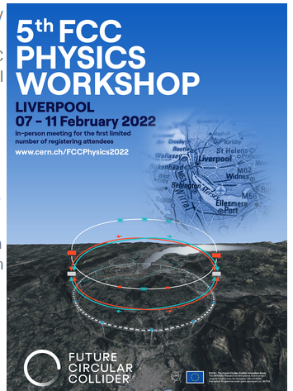
FCC Physics Workshop 7-11 February 22
Liverpool, UK
number of in-person participants limited to ~160 (first come -- first served)
- registration fee: 300£
- broadcast on zoom

Slide 19

FCC Week 2022
In Paris 30 May to 3 June 2022
We are looking forward
to seeing you there !

Slide 20
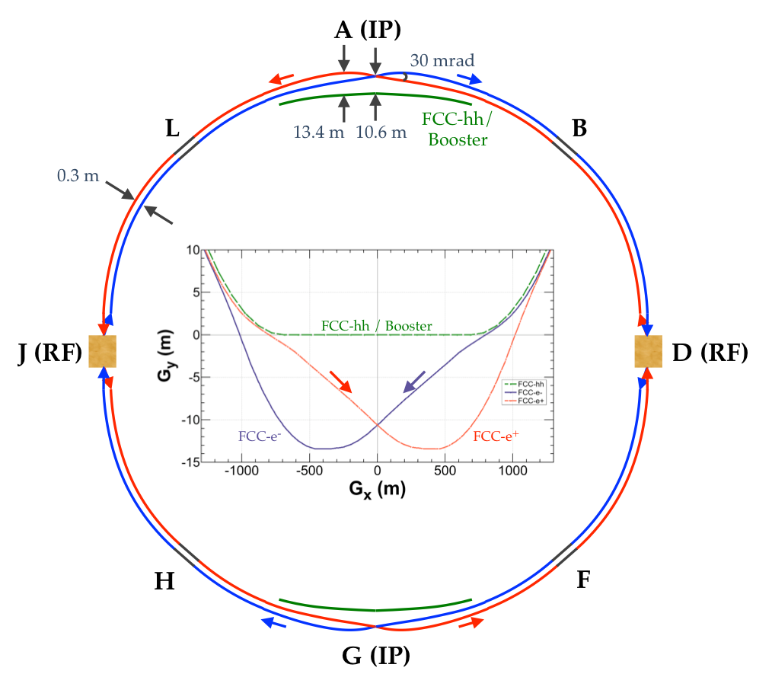
FCC-ee basic design choices
Double ring e+ e- collider
Common footprint with FCC-hh, except around IPs
Asymmetric IR layout and optics to limit synchrotron radiation towards the detector
2 IPs, large horizontal crossing angle 30 mrad, crab-waist collision optics (alternative layouts with 4 IPs under study now)
Synchrotron radiation power 50 MW/beam at all beam energies
Top-up injection scheme for high luminosity Requires booster synchrotron in collider tunnel

Slide 21
FCC-ee collider parameters (stage 1)
parameter | Z | WW | H (ZH) | ttbar
beam energy [GeV] | 45 | 80 | 120 | 182.5
beam current [mA] | 1390 | 147 | 29 | 5.4
no. bunches/beam | 16640 | 2000 | 393 | 48
bunch intensity [10¹¹] | 1.7 | 1.5 | 1.5 | 2.3
SR energy loss / turn [GeV] | 0.036 | 0.34 | 1.72 | 9.21
total RF voltage [GV] | 0.1 | 0.44 | 2.0 | 10.9
long. damping time [turns] | 1281 | 235 | 70 | 20
horizontal beta* [m] | 0.15 | 0.2 | 0.3 | 1
vertical beta* [mm] | 0.8 | 1 | 1 | 1.6
horiz. geometric emittance [nm] | 0.27 | 0.28 | 0.63 | 1.46
vert. geom. emittance [pm] | 1.0 | 1.7 | 1.3 | 2.9
bunch length with SR / BS [mm] | 3.5 / 12.1 | 3.0 / 6.0 | 3.3 / 5.3 | 2.0 / 2.5
luminosity per IP [10³⁴ cm⁻²s⁻¹] | 230 | 28 | 8.5 | 1.55
beam lifetime rad Bhabha / BS [min] | 68 / >200 | 49 / >1000 | 38 / 18 | 40 / 18

Slide 22
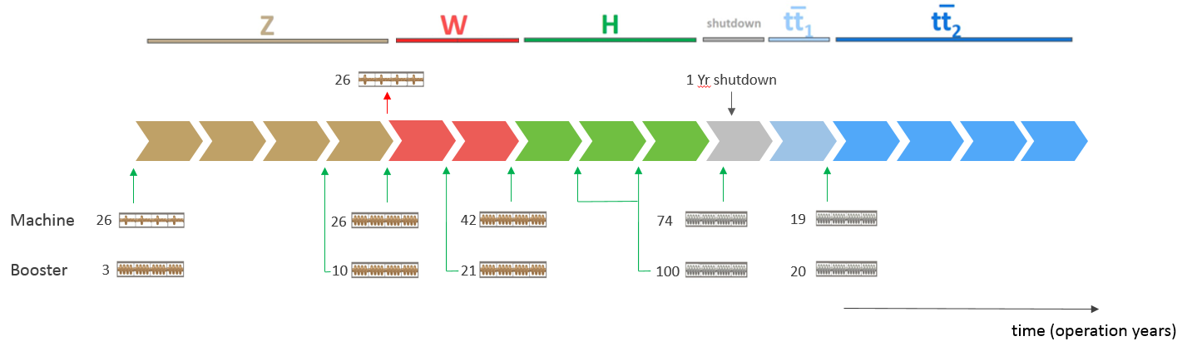
FCC-ee RF staging scenario
“Ampere-class” machine
three sets of RF cavities to cover all options for FCC-ee & booster:
high intensity (Z, FCC-hh): 400 MHz mono-cell cavities (4/cryom.)
higher energy (W, H, t): 400 MHz four-cell cavities (4/cryomodule)
ttbar machine complement: 800 MHz five-cell cavities (4/cryom.)
installation sequence comparable to LEP ( ≈ 30 CM/shutdown)
WP | V_{rf} [GV] | #bunches | I_{beam} [mA]
Z | 0.1 | 16640 | 1390
W | 0.44 | 2000 | 147
H | 2.0 | 393 | 29
ttbar | 10.9 | 48 | 5.4
“high-gradient” machine
Notes:
“Continuous flow” operation: succession of 8 months operation, 4 months installation shutdown (LEP-like)
Three sets of cavities to cover all options (+ booster):
high intensity (Z, FCC_hh): 400 MHz mono-cell cavities, ≈1MW RF source
high energy (H, t): 400 MHz four-cell cavities -> will be used for the W machine
booster and t machine complement: 800 MHz four-cell cavities (400 MHz would do the job as well)
High energy set for the W-machine not optimal (20-30% reduction of beam current) – building & installing 48 specialized CM would impact more (>>1 year delay)
Optimize the re-use of the 100MW, 400MHz RF power & controls hardware installed for the ‘Z-machine’
design an easily adaptable and modular RF power distribution system

Slide 23
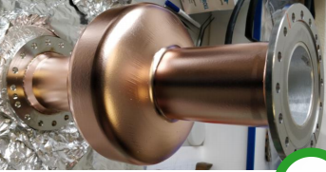
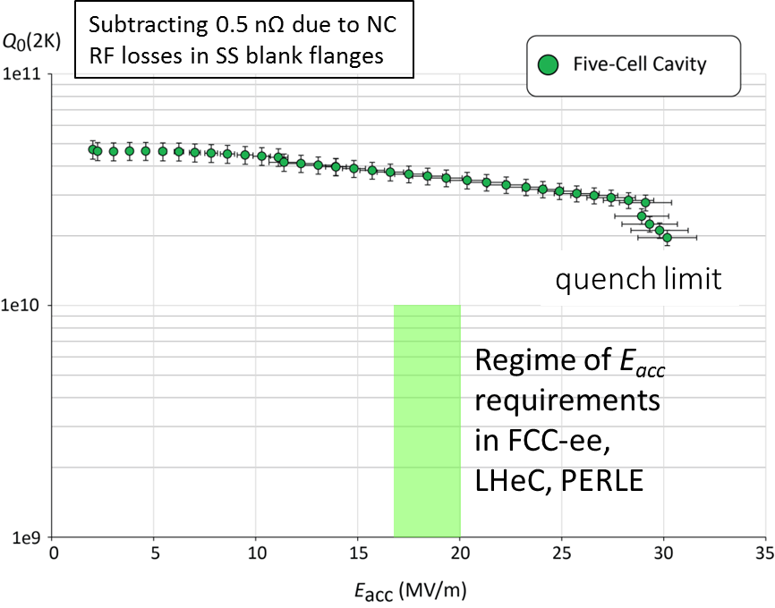
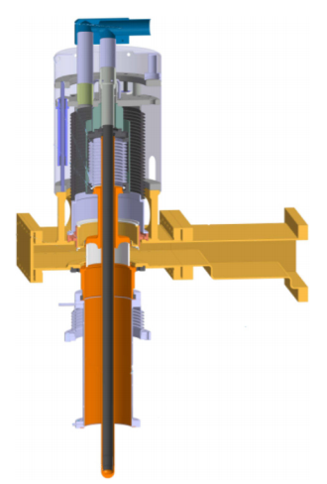
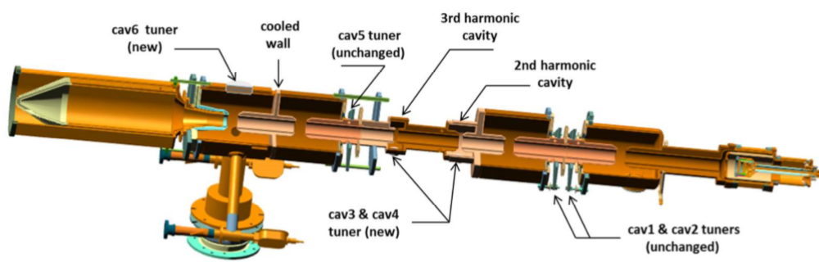
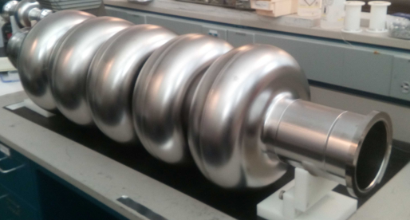
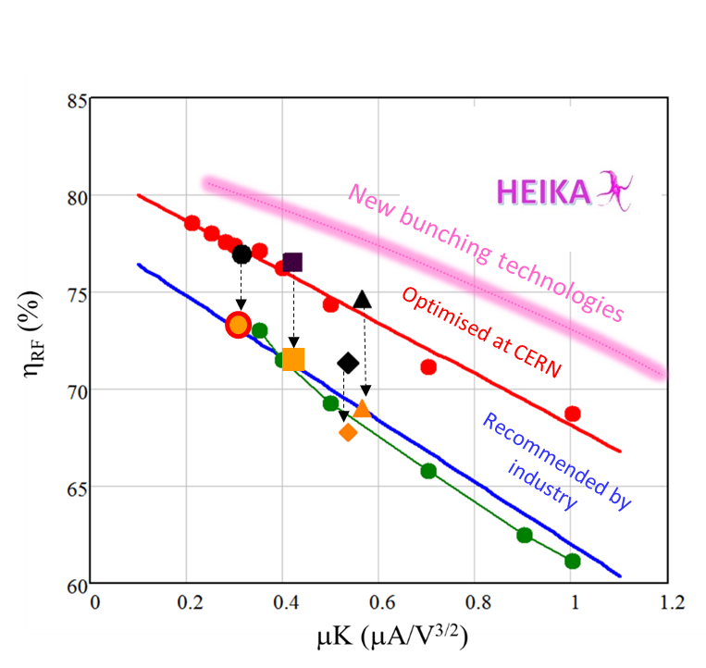
FCC SRF R&D Program Structure in a Nutshell
Cavity Studies
Optimized Cavity Shape, Technology and Operating Temperature (complexity, power consumption, Q_{o}, E_{acc})
Design 1- & 4-cell Cavities
Beam-Cavity Interaction
Cavity Control System (LLRF)
SRF & Substrate Technologies
Improved Cavity Engineering: New SC Materials, Novel Fabrication Methods, Substrate Surface Preparation, Coating Techniques
Fabrication & Testing of 1-l & 4-cell cavities for new cryomodule
Collaboration with international Partners
Cryomodule Development
Engineering design of 400 MHz cryomodule including ancillaries
Building a 2 cavity CM which can host 1-/4-cell 400 MHz cavities
R&D Collaboration with int’l Partners (e.g. JLAB)
800 MHz CM: Profit from Ongoing Development @ PERLE in Paris
FPC & HOM RF Couplers
Improved design, fabrication and testing of 400 MHz Fundamental Power Coupler (FPC)
FPC R&D towards 1MW CW fixed/movable FPC
‘Adjustable’ FPC (external large adaptation of Q_{ext})
HOM coupler production
RF Power Sources
novel klystron bunching methods
LHC klystron retrofit as proof of principle
prototype design, fabrication and testing

Slide 24
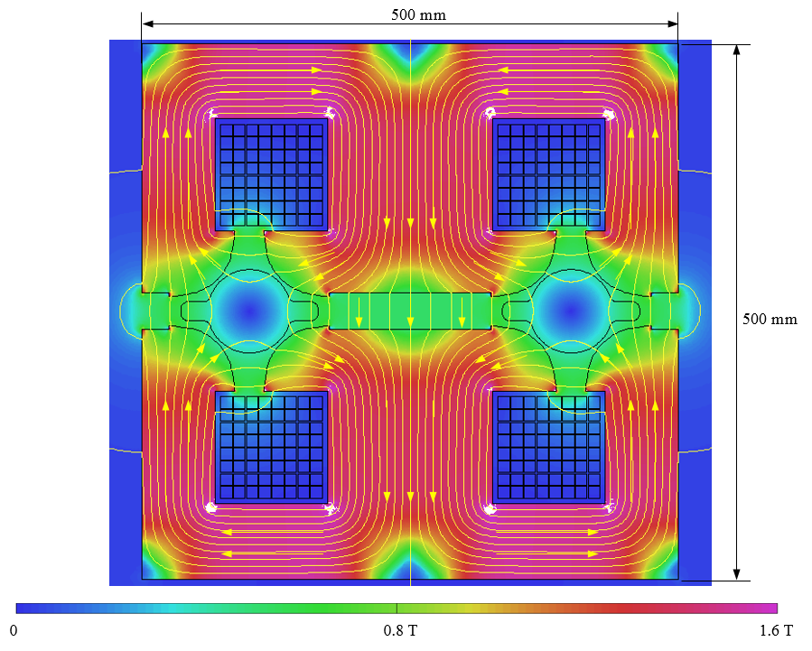
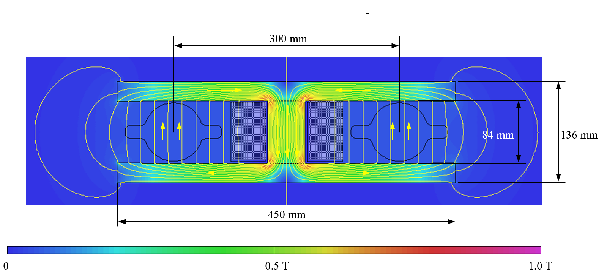
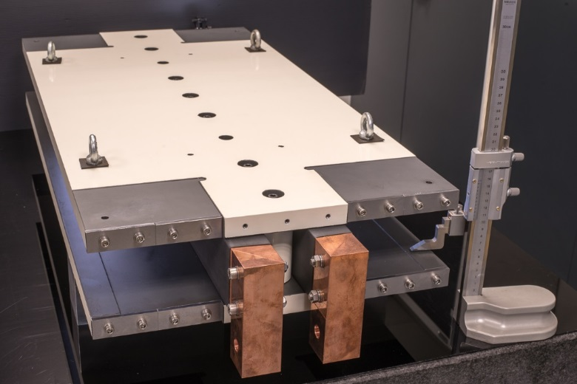
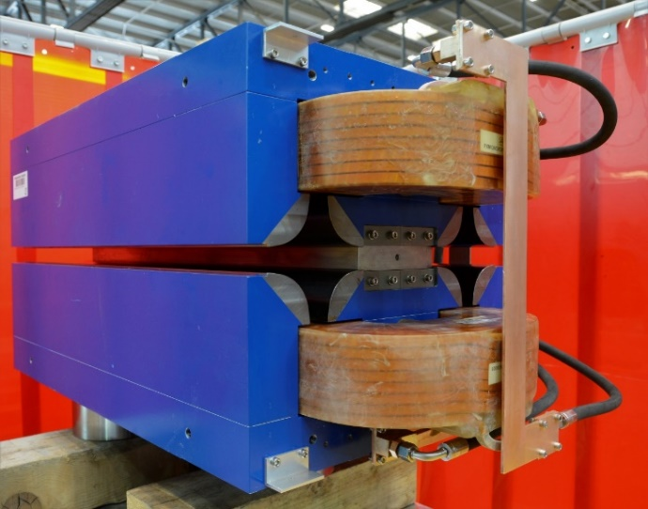
Prototypes of FCC-ee low-power magnets
Twin-dipole design with 2× power saving
16 MW (at 175 GeV), with Al busbars
Twin F/D arc quad design with 2× power saving
25 MW (at 175 GeV), with Cu conductor
prototype
prototype

Slide 25

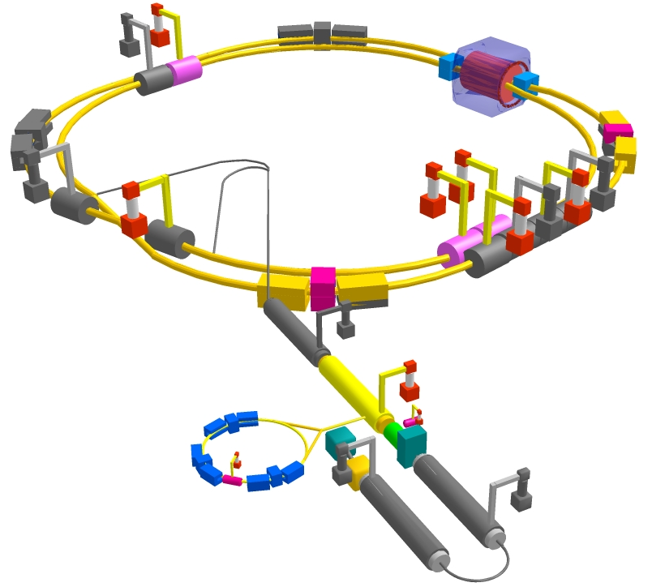
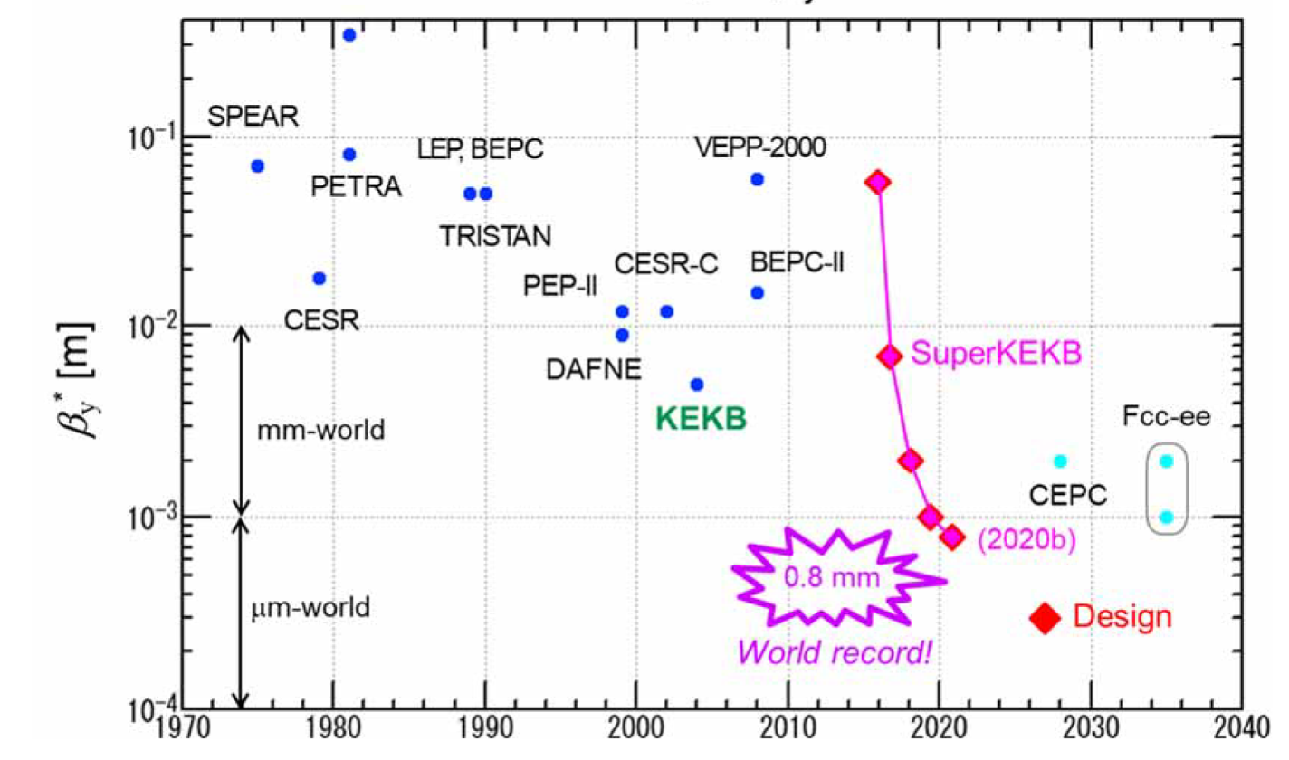
SuperKEKB – pushing luminosity and β*
Design: double ring e⁺e⁻ collider as B-factory at 7(e⁻) & 4(e⁺) GeV; design luminosity $\sim$8 x 10³⁵ cm⁻²s⁻¹; β_{y}* $\sim$0.3 mm;
nano-beam – large crossing angle collision scheme (crab waist w/o sextupoles); beam lifetime$\sim$5 minutes; top-up injection;
e⁺ rate up to $\sim$ 2.5 10¹² /s ; under commissioning
M. Tobiyama, K. Oide
SuperKEKB is demonstrating FCC-ee key concepts
β_{y}* = 0.8 mm achieved in both rings – using the
FCC-ee-style “virtual” crab-waist collision scheme
Y. Funakoshi, Y. Ohnishi, K. Oide
new world record L = 3.12 x 10³⁴ cm⁻²s⁻¹ on 22 June ‘21

Slide 26
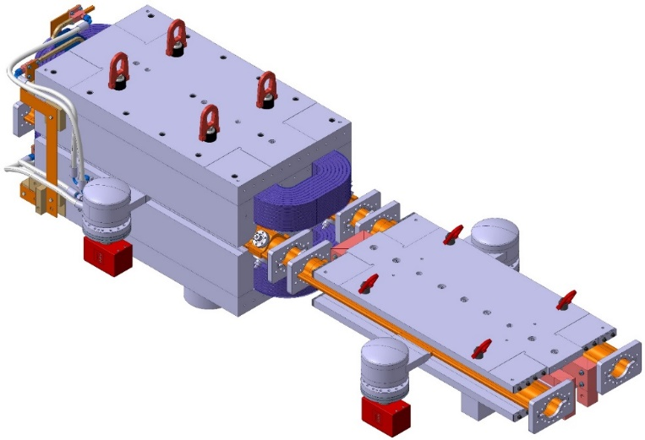
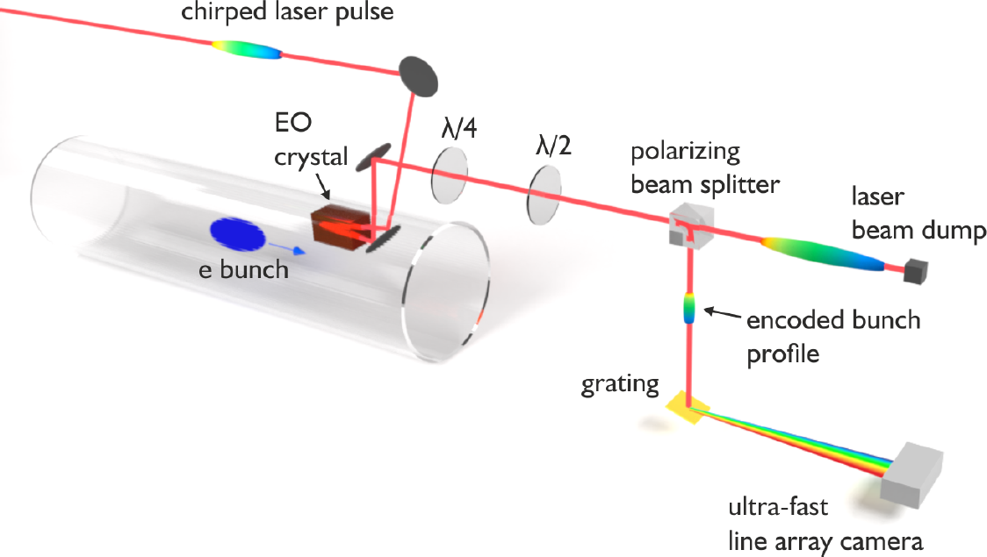
FCC key deliverables: prototypes by 2025
FCC-ee complete arc half-cell mock up
including girder, vacuum system with antechamber + pumps, dipole, quadrupole + sext. magnets, BPMs, cooling + alignment systems, technical infrastructure interfaces.
key beam diagnostics elements
bunch-by-bunch turn-by-turn longitudinal charge density profiles based on electro-optical spectral decoding (beam tests at KIT/KARA) ; ultra-low emittance measurement (X-ray interferometer tests at SuperKEKB, ALBA) ; beam-loss monitors (IJCLab/KEK?) ;
beamstrahlung monitor (KEK); polarimeter ; luminometer
A.-S. Müller
bunch electric field at the crystal
changes the laser pulse polarization

Slide 27
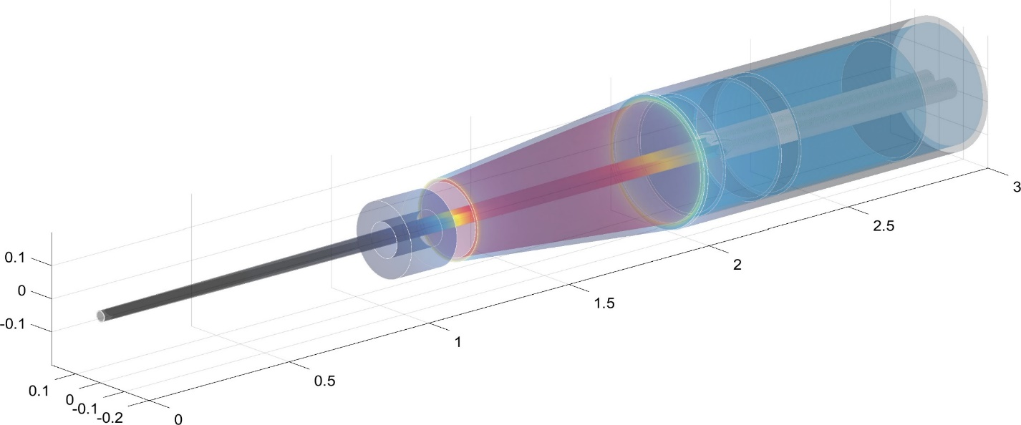
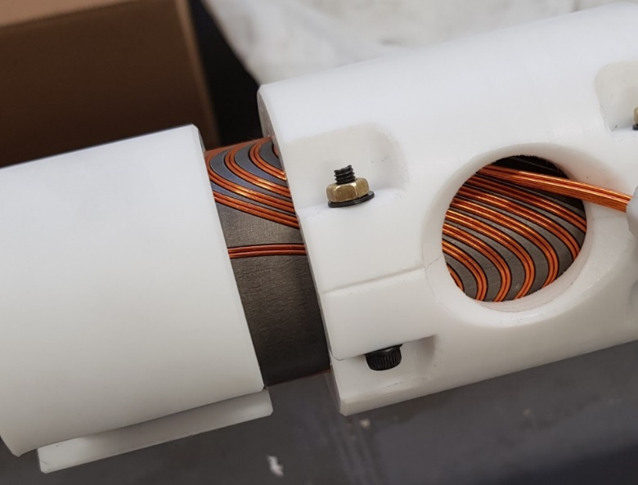
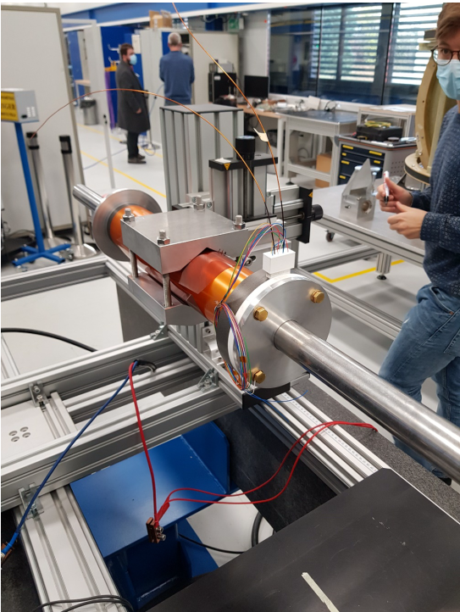
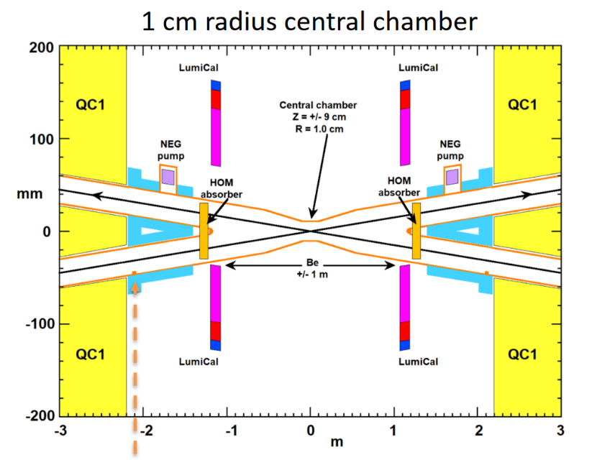
FCC-ee Machine Detector Interface
screening
solenoid
challenging integration:
2 T detector solenoid,
luminosity monitor
(Bhabha scattering),
compensation &
shielding solenoids
M. Dam,
A. Bogomyagkov,
E. Levichev,
M. Koratzinos
Compensating solenoid
FF quads
Lumical
100 mrad
IP
M. Boscolo,
A. Novokhatski,
M. Sullivan
prototype Q1
canted cosine theta
with fringe field
correction,
using LHC SC cable
field measurement
at warm
narrow central chamber
with 1 cm radius,
also avoids trapped modes
M. Koratzinos

Slide 28
FCC hh basic design choices
dual aperture superconducting magnets
two high-luminosity experiments (A & G)
two other experiments (L & B) combined with injection upstream of experiments
two collimation insertions
  betatron cleaning (J)
  momentum cleaning (F)
extraction/dump insertion (D)
RF insertion (H)
Injection from LHC (~3 TeV) or scSPS (~1.2 TeV)
Alternative layouts under study

Slide 29
FCC-hh (pp) collider parameters (stage 2)
parameter | FCC-hh |  | HL-LHC | LHC
collision energy cms [TeV] | 100 |  | 14 | 14
dipole field [T] | 16 |  | 8.33 | 8.33
circumference [km] | 97.75 |  | 26.7 | 26.7
beam current [A] | 0.5 |  | 1.1 | 0.58
bunch intensity [10¹¹] | 1 | 1 | 2.2 | 1.15
bunch spacing [ns] | 25 | 25 | 25 | 25
synchr. rad. power / ring [kW] | 2400 |  | 7.3 | 3.6
SR power / length [W/m/ap.] | 28.4 |  | 0.33 | 0.17
long. emit. damping time [h] | 0.54 |  | 12.9 | 12.9
beta* [m] | 1.1 | 0.3 | 0.15 (min.) | 0.55
normalized emittance [μm] | 2.2 |  | 2.5 | 3.75
peak luminosity [10³⁴ cm⁻²s⁻¹] | 5 | 30 | 5 (lev.) | 1
events/bunch crossing | 170 | 1000 | 132 | 27
stored energy/beam [GJ] | 8.4 |  | 0.7 | 0.36

Slide 30
worldwide FCC Nb₃Sn program
Main development goal is wire performance increase:
J_{c} (16T, 4.2K) > 1500 A/mm² →50% increase wrt HL-LHC wire
Reduction of coil & magnet cross-section
5400 mm²
3150 mm²
~1.7 times less SC
After 1-2 years development, prototype Nb₃Sn wires from several new industrial FCC partners already achieve HL-LHC J_{c} performance
~10% margin
HL-LHC
~10% margin
FCC ultimate
FCC conductor development collaboration:
Bochvar Institute (production at TVEL), Russia
Bruker, Germany, Luvata Pori, Finland
KEK (Jastec and Furukawa), Japan
KAT, Korea, Columbus, Italy
University of Geneva, Switzerland
Technical University of Vienna, Austria
SPIN, Italy, University of Freiberg, Germany
2019/20 results from US, meeting FCC J_{c} specs:
Florida State University: high-J_{c} Nb₃Sn via Hf addition
Hyper Tech /Ohio SU/FNAL: high-J_{c} Nb₃Sn via artificial pinning centres based on Zr oxide.

Slide 31

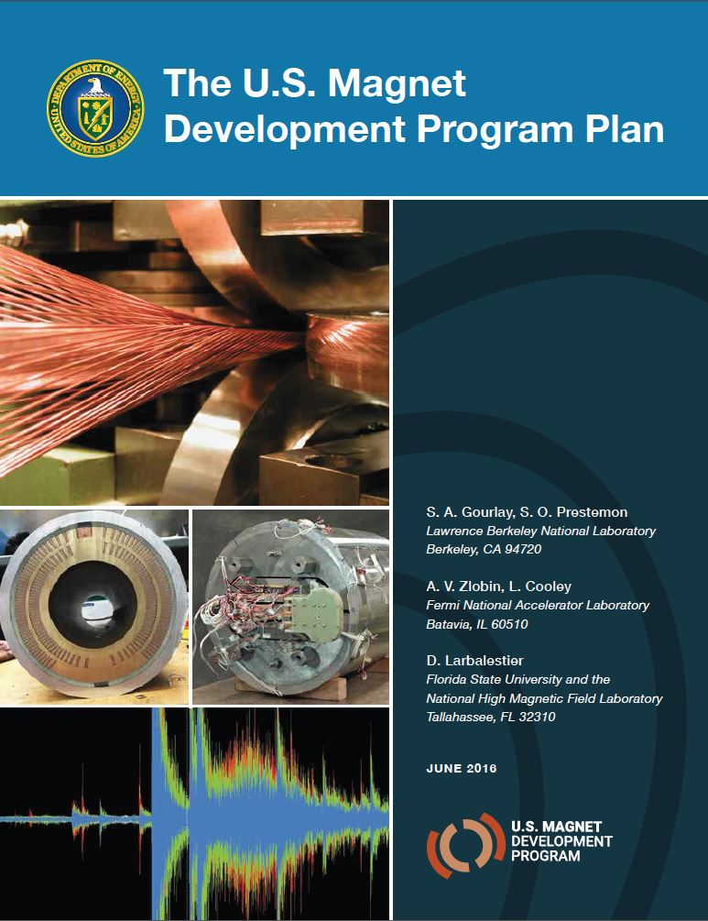
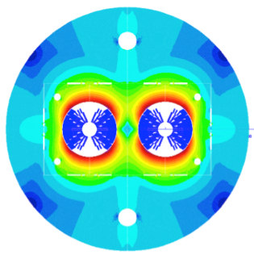
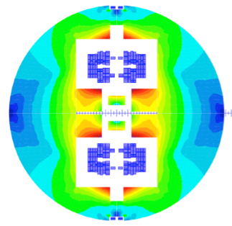

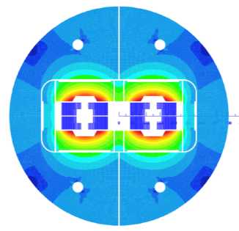
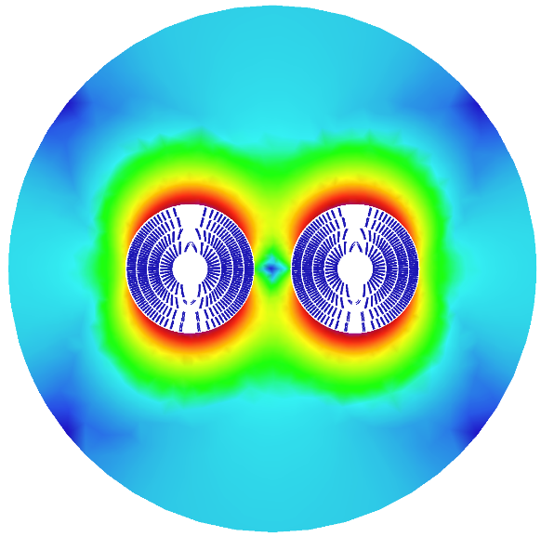
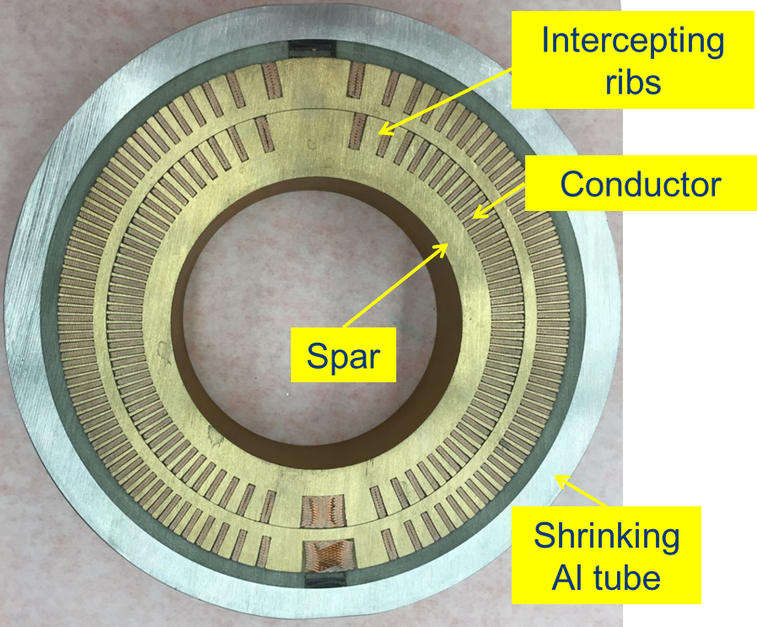
16 T dipole design activities and options
H2020
Swiss contribution
Cos-theta
Common coils
Canted
Cos-theta
Blocks
INFN
CIEMAT
LBNL
CEA
PSI
FNAL
Short model magnets (1.5 m lengths) will be built until 2025

Slide 32
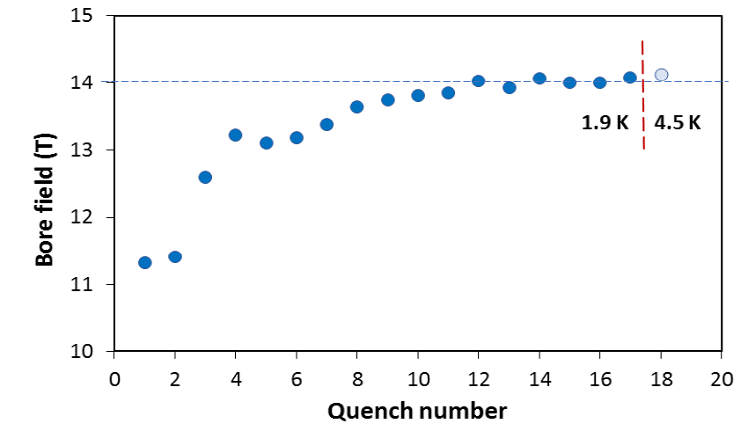
US – MDP: 14.5 T magnet tested at FNAL
84% on the laodline at 1.9 K
92% on the loadline at 4.2 K
60-mm aperture
4-layer graded coil
15 T dipole demonstrator
Staged approach: In first step pre-stressed for 14 T
Second test in June 2020 with additional pre-stress reached 14.5 T

Slide 33

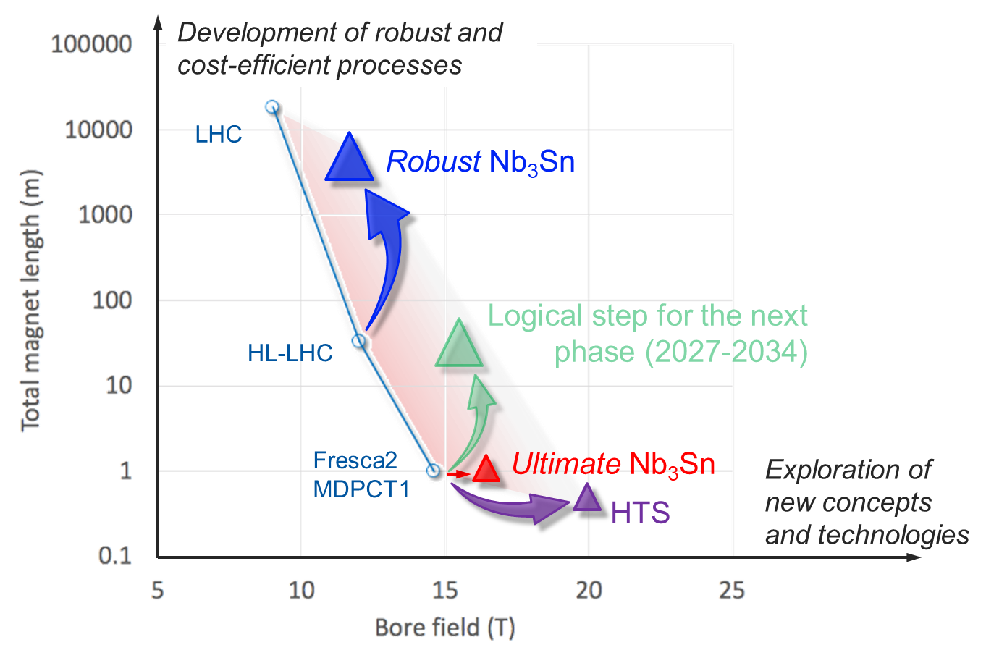
High Field Magnet program goals until 2027
    1. Develop Nb₃Sn magnets for collider-scale production, through robust design, industrial processes and cost reduction
    2. Demonstrate Nb₃Sn full potential in terms of ultimate performance (short model programs)
  3. Provide a proof-of-principle for HTS magnet technology

Slide 34
Conclusions accelerator development
FCC-ee is first stage of FCC integrated programme; first physics ~2040
FCC-ee design incorporates many lessons from recent & present e⁺e⁻ colliders, and goes further! SuperKEKB demonstrates key concepts
FCC-ee = efficient and sustainable collider at the e⁺e⁻ energy frontier: highest luminosity per input power, highest luminosity per construction cost, most precise energy calibration, and ultimate upgrade potentials (ERL-based FCC-ee, 100 TeV FCC-hh, …)
Prototypes of FCC-ee key components by 2025
Superconducting cable & high-field magnet programme prepares for 100 TeV proton-proton collider, FCC-hh, in the same tunnel, to begin operation around ~2060

Slide 35
Status and Outlook Feasibility Study
Following the European Strategy Update, the organization structure and major milestones and deliverables for the FCC Feasibility Study were approved by the CERN Council in June 2021.
Main activities concern the development and confirmation of a concrete implementation scenario in collaboration with host state authorities, accompanied by machine optimization, physics studies and technology R&D, performed via global collaboration and supported by the EC H2020 Design Study FCCIS, with the goal to demonstrate feasibility by 2025/26.
Long term goal: world-leading HEP infrastructure for 21st century to push the particle-physics precision and energy frontiers far beyond present limits.

