Slide 1

A Canada-wide assessment of the gender gap in high school physics
June 21st, 2023
Eamonn Corrigan (He/Him)
PhD Candidate – Department of Physics
University of Guelph

Slide 2
How are we doing?
The gender gap in Canada’s high schools over time

Slide 3
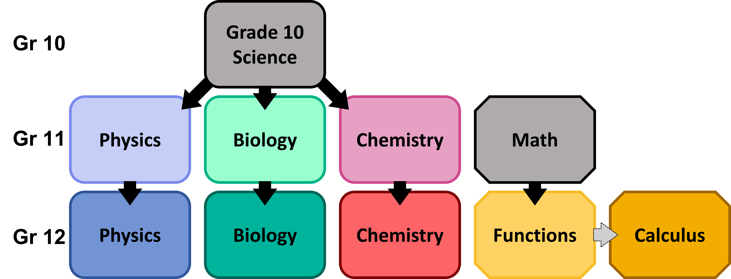
School Enrolment Dataset
Obtained 3-11 years of data from Ministries of Education
Reported total male and total female enrolments for all publicly funded secondary schools in each province
Data included grade 10-12 university stream Science and Math Courses required for undergraduate admissions
Data collected for the following courses (or equivalents)

Slide 4
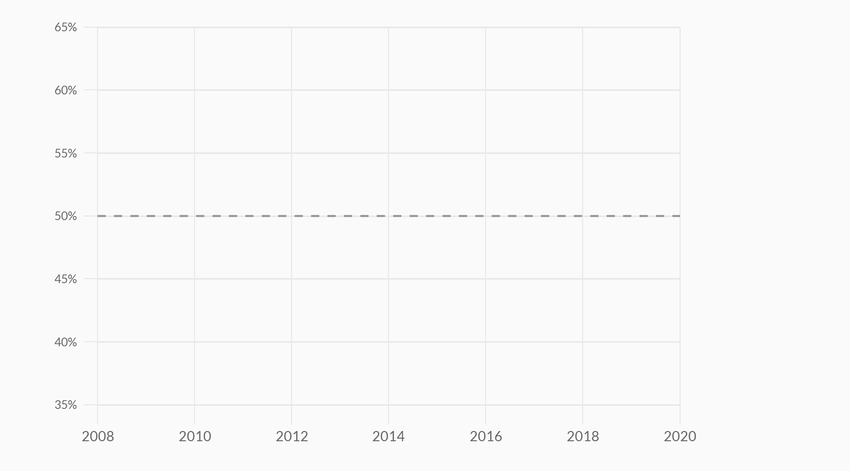
Canadian Enrolment Trends
Female Participation Over Time – Grade 11
Percentage of Female Students
Year

Slide 5
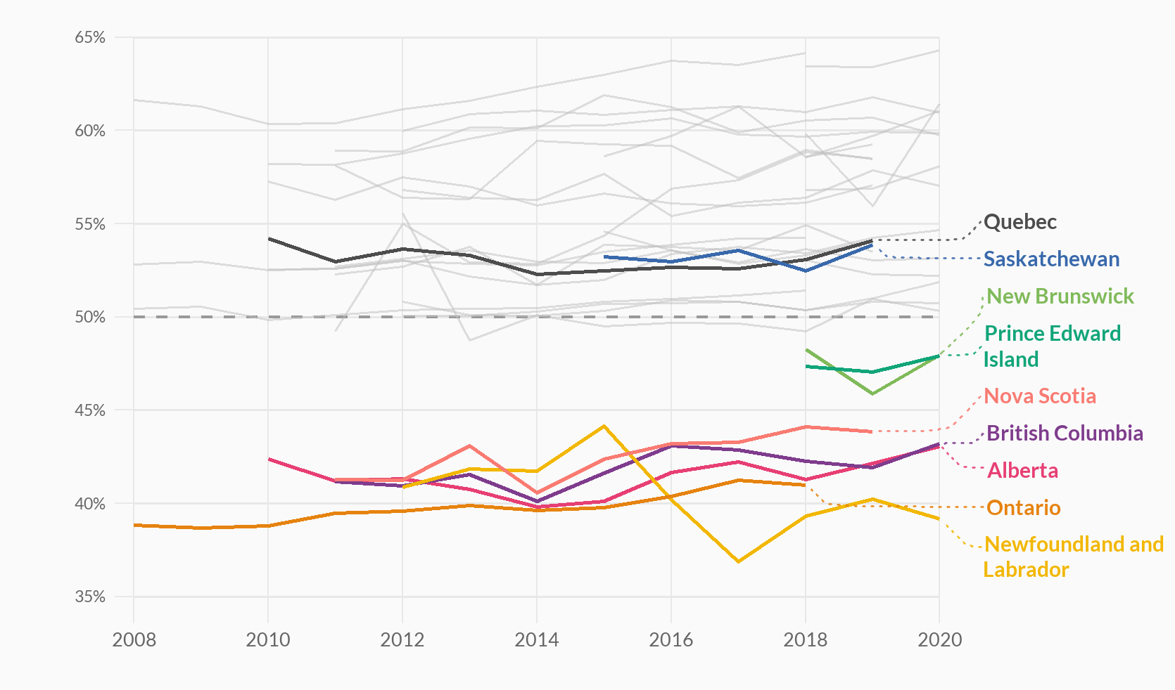
Canadian Enrolment Trends
Female Participation Over Time – Grade 11
Percentage of Female Students
The two provinces with distinctly different course pathways
3 of Canada’s 4 largest provinces are the lowest (62.5% of Canada)
Year

Slide 6
High School Curricula Differences
Quebec | Overlap | Saskatchewan
Gr. 11 Physics and Chemistry both required for most CÉGEP science programs | Mandatory Grade 10 Science Reduced Grade 11 Science courses | One gr. 11/12 science course required for graduation
Lead to reduced choice for students

Slide 7
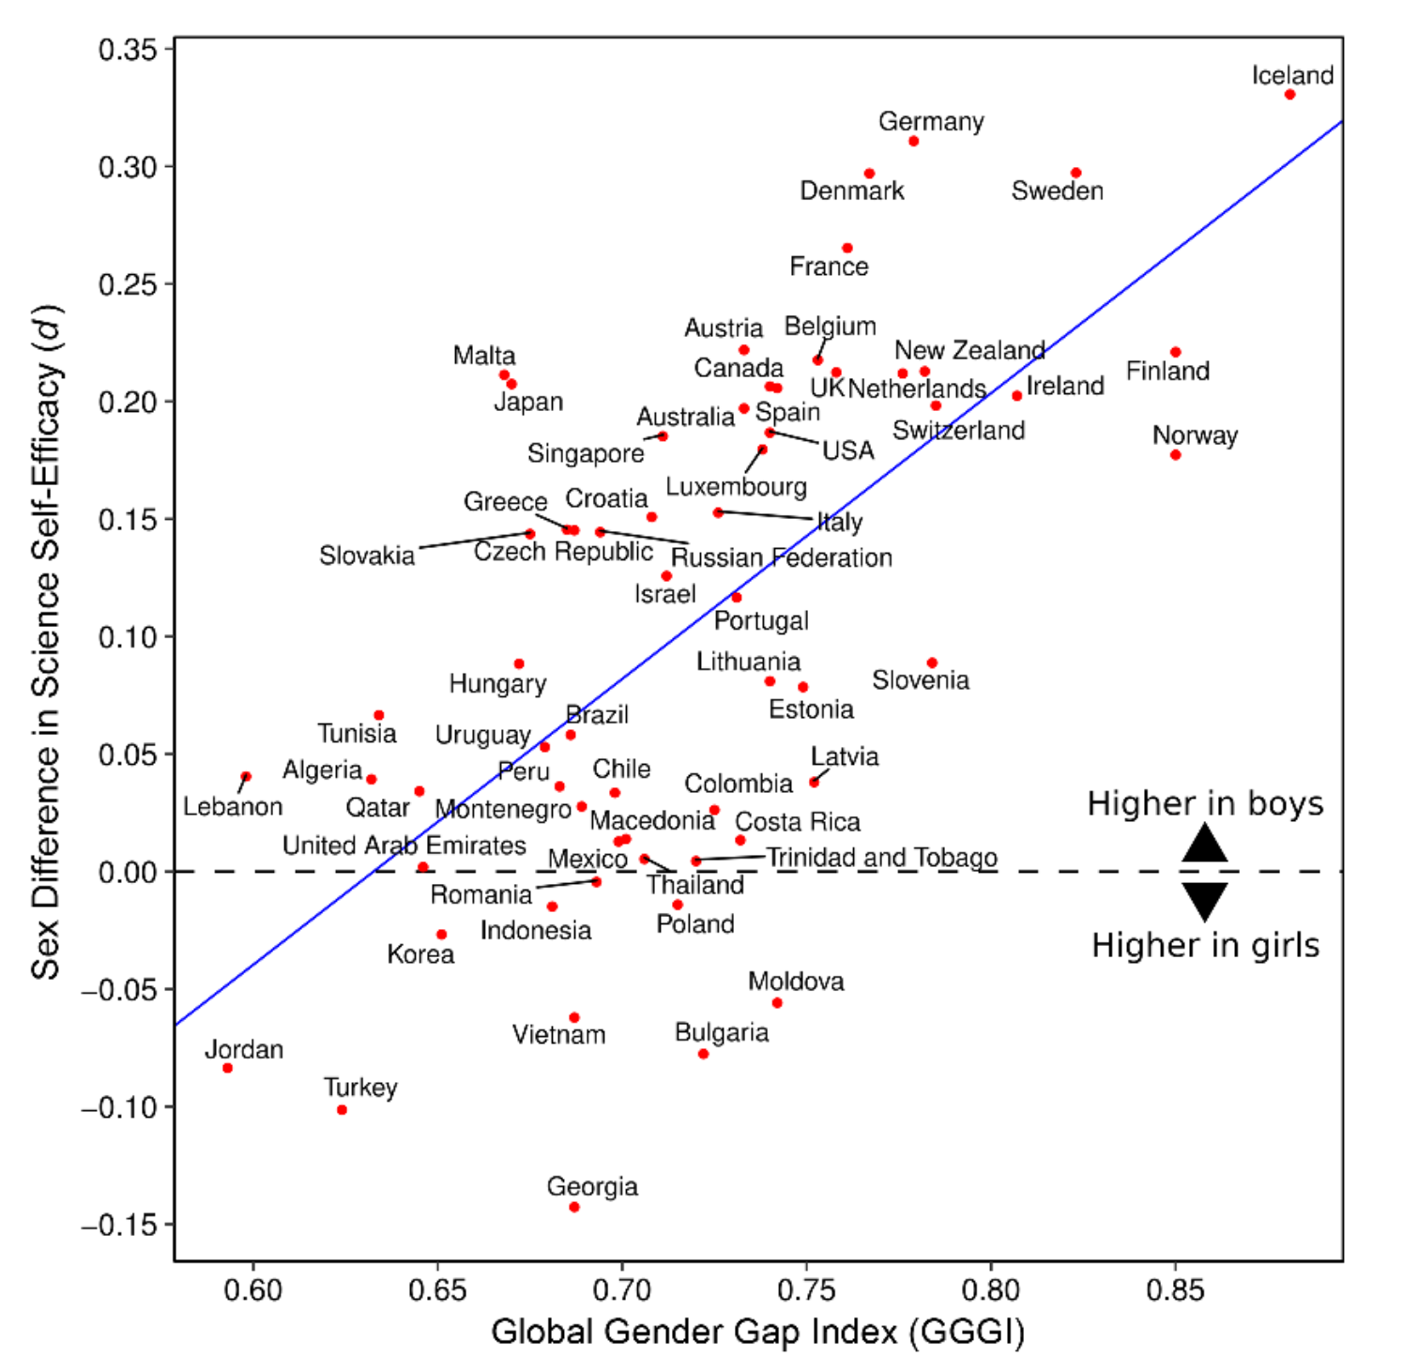
Evidence for Negative Self-Selection
Countries with higher levels of gender equity have larger gender gaps in STEM
Stoet & Geary (2018)

Slide 8
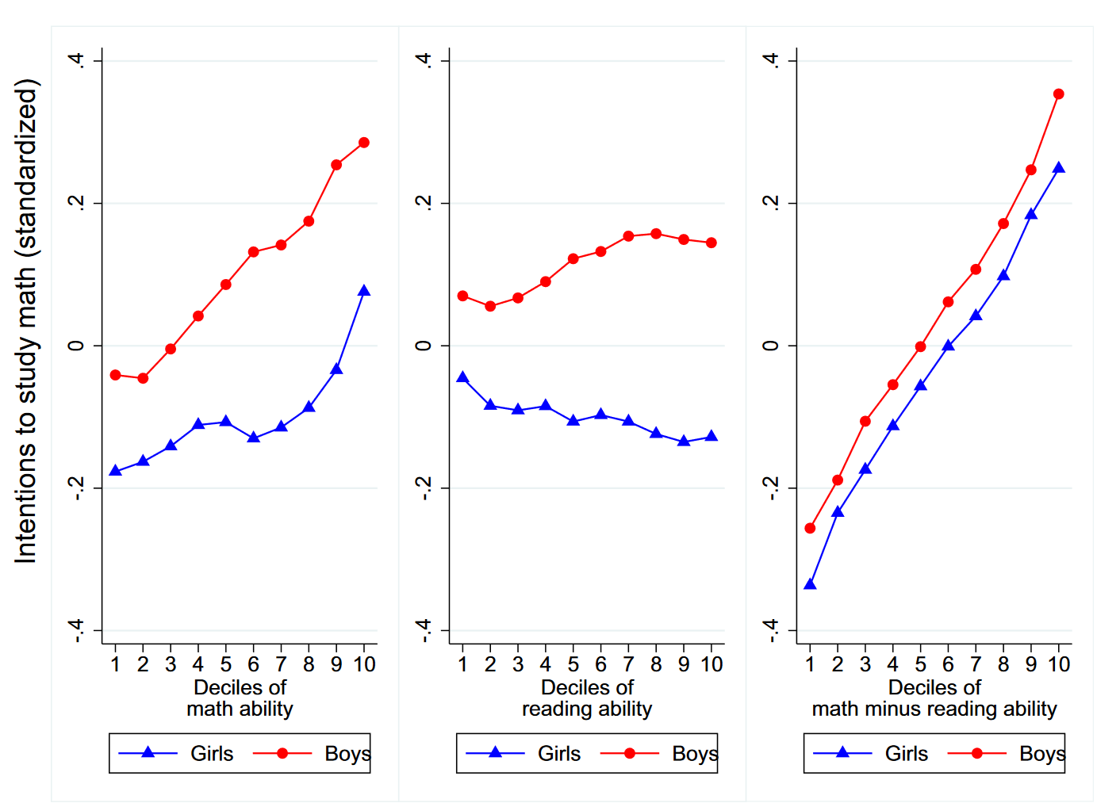
Evidence for Negative Self-Selection
Large gender gaps persists when at math and reading ability separately
Controlling for the difference in reading vs. math ability accounted for ~75% of the gender gap
Breda & Napp (2019)

Slide 9
The Impact of Student Choice
Comparing Ontario’s Public and Catholic Schools

Slide 10
Ontario’s Two-Part School System
The same,
STEM curriculum
graduation requirements
population of students
Four required religion courses
No required religion courses
Public Schools
Catholic Schools
Context: Ontario students require 30 courses to graduate

Slide 11




Comparing Public and Catholic Schools
Using Census data, we controlled for school demographics
Internal Context
Proportion of racialized and Indigenous people
Family Context
Parental education
Socioeconomic status
Immigration status
School Context
Continuation in Other STEM courses

Slide 12
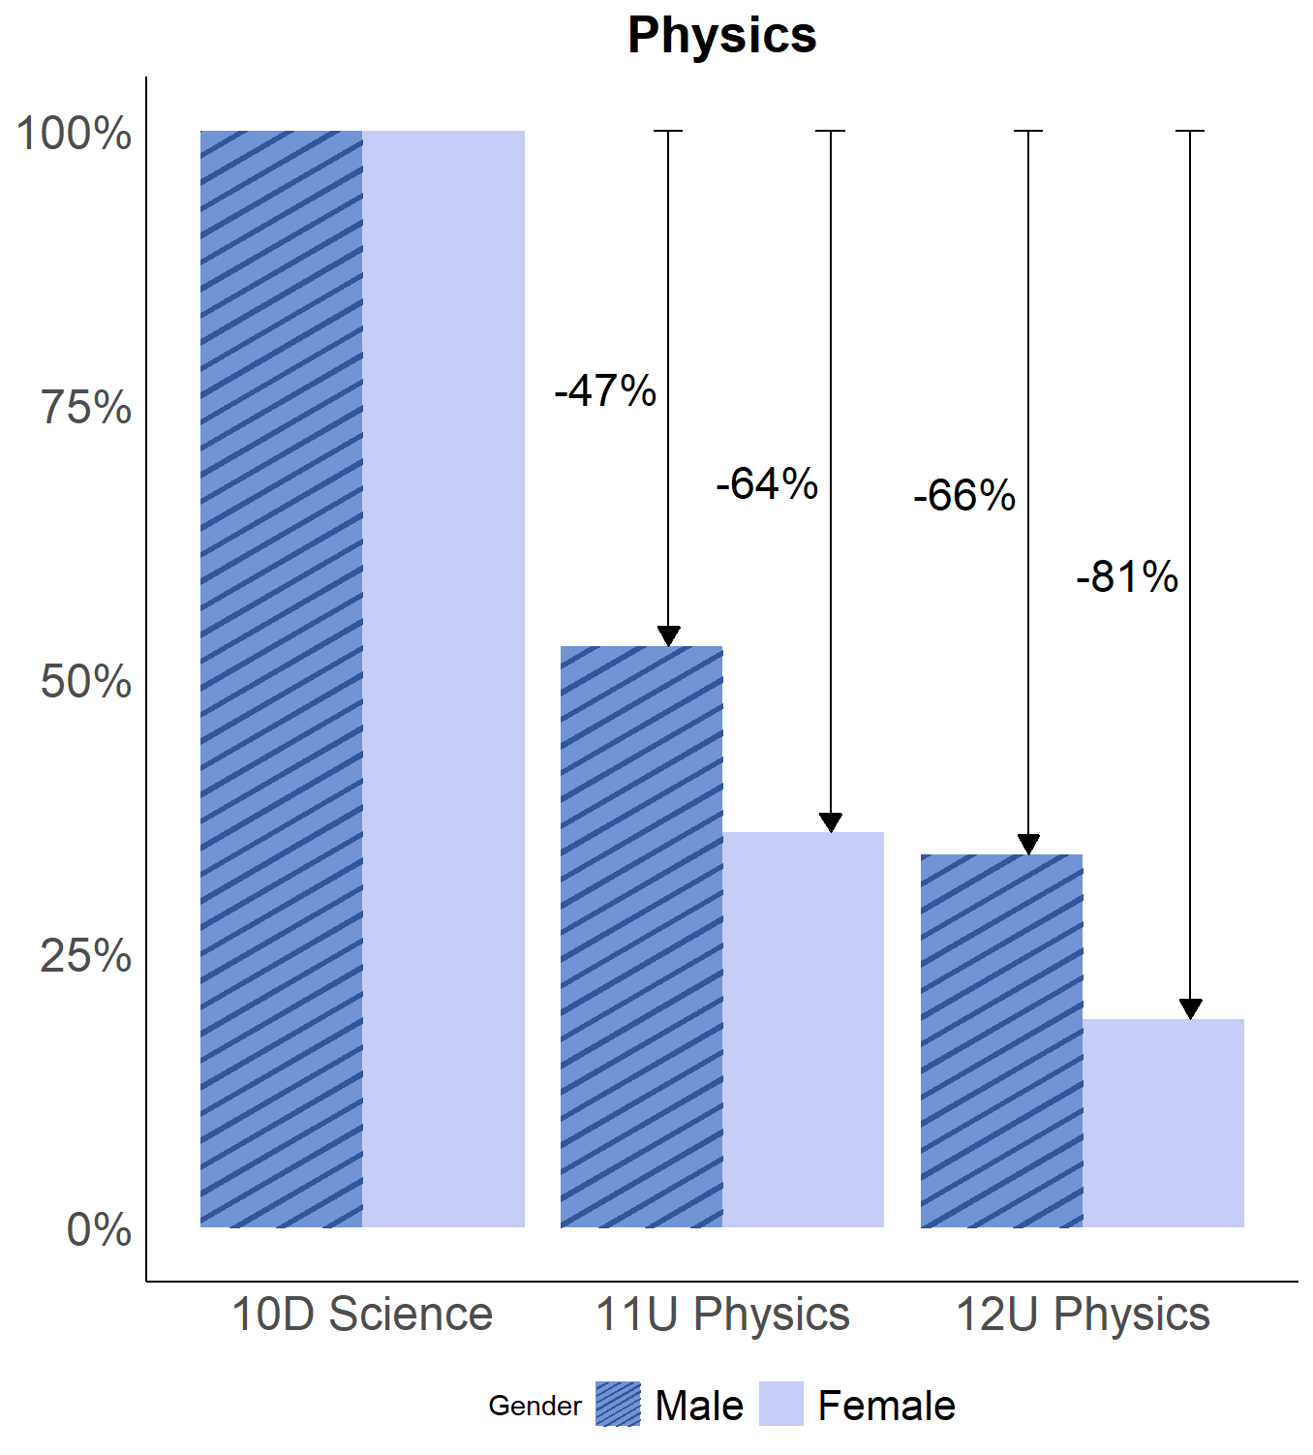

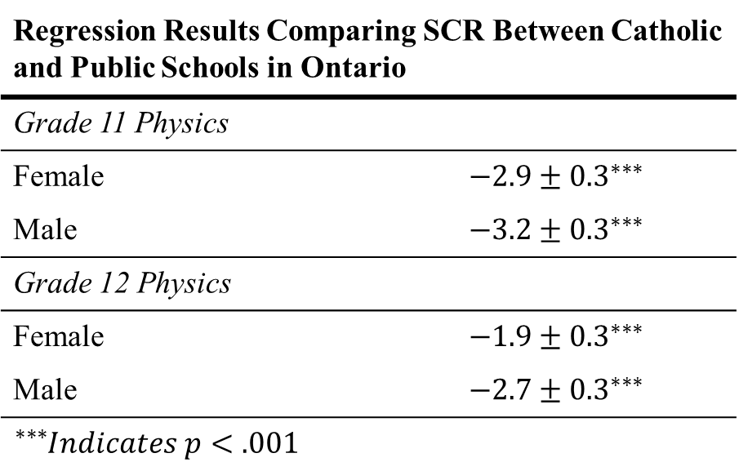

Student Continuation Rate at Public and Catholic Schools
Student Continuation Rate
Regression Results Comparing SCR Between Catholic and Public Schools in Ontario | Estimate
Grade 11 Physics
Female | $$−2.9±{0.3}^{∗∗∗}$$
Male | $$−3.2±{0.3}^{∗∗∗}$$
Grade 12 Physics
Female | $$−1.9±{0.3}^{∗∗∗}$$
Male | $$−2.7±{0.3}^{∗∗∗}$$
${}_{}^{∗∗∗}Indicates p<.001$
$$p=.49$$
$$p<.001$$

Slide 13
Conclusions
Progress Has Been Made
Gender representation in Canadian high schools has been improving, albeit slowly
Interprovincial Differences
Large gaps exist between provinces; may be attributable to structural differences in high school curricula
Course Choice Can Make an Impact
Data suggest their may be a negative correlation between amount of choice and female representation in physics

Slide 14
Questions, Comments, Thoughts?

Slide 15
Extra Slides
I thought you might ask…

Slide 16
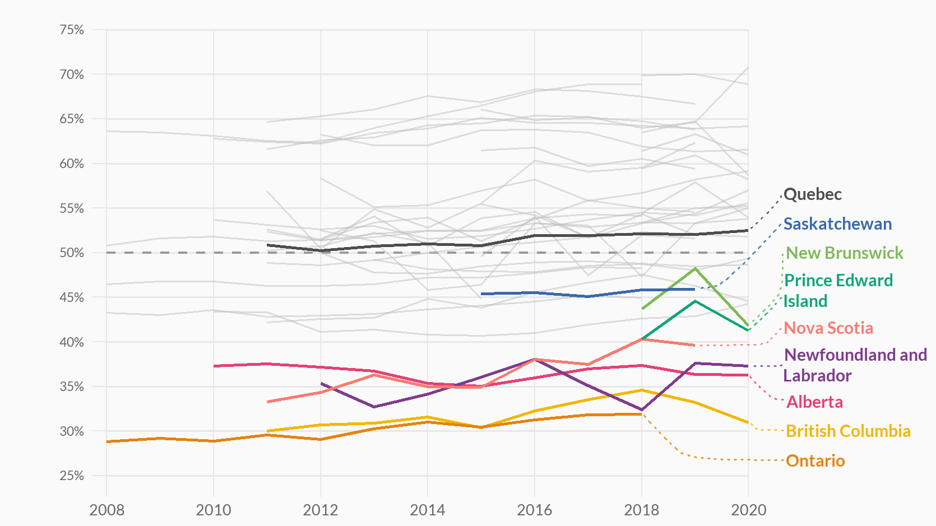
Canadian Enrolment Trends
Female Participation Over Time – Grade 12 Physics
Percentage of Female Students
The two provinces with distinctly different course pathways
3 of Canada’s 4 largest provinces are the lowest (62.5% of Canada)

Slide 17
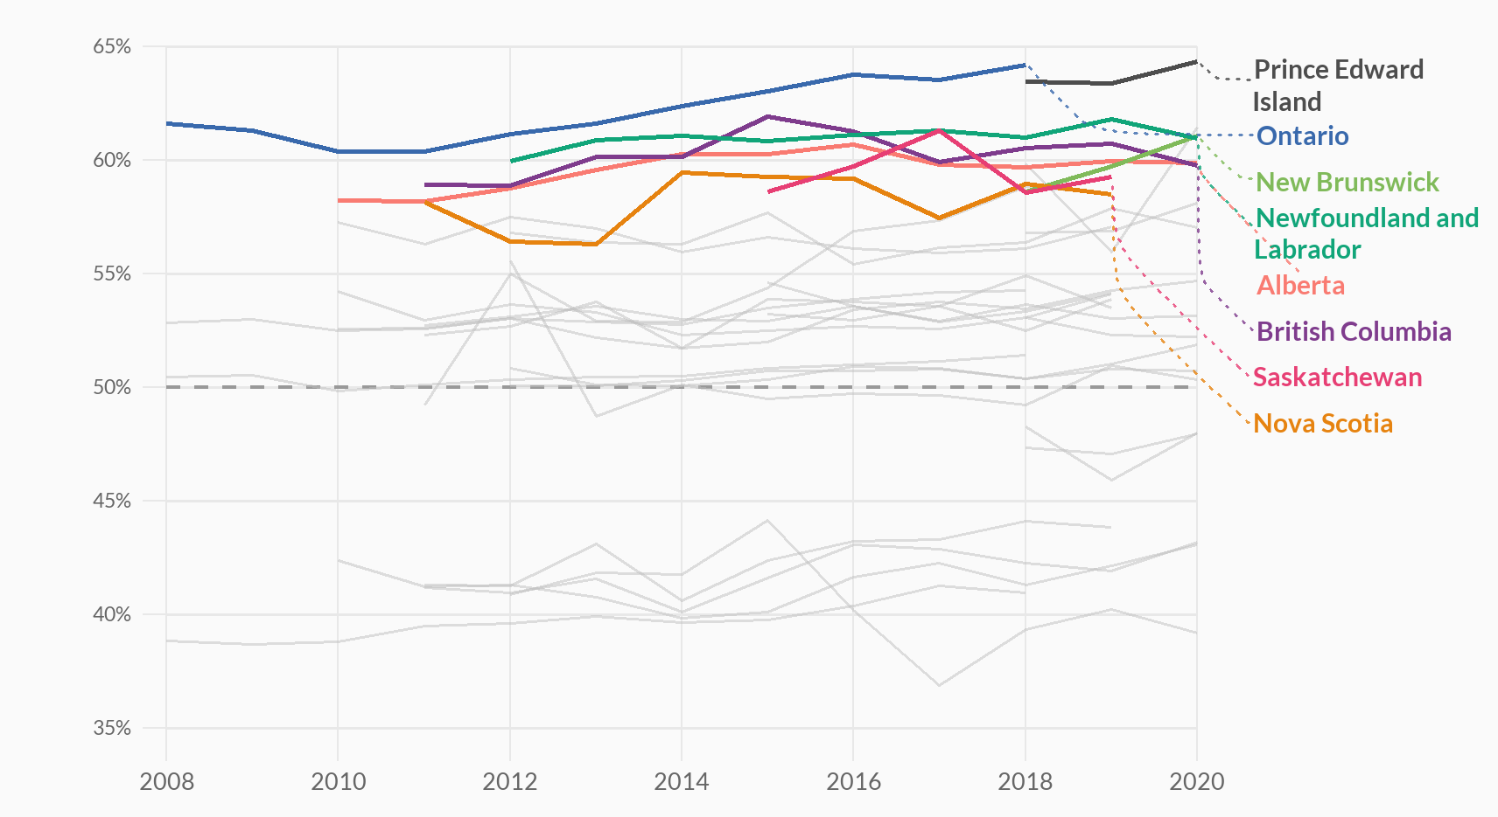
Ontario Enrolment Trends
Female Proportion Over Time – Grade 11 Biology

Slide 18
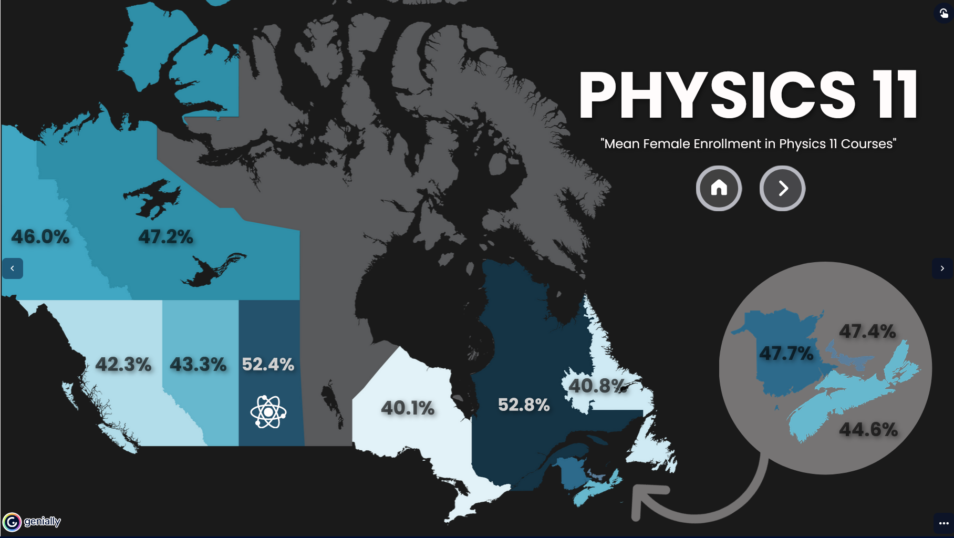
Data Visualization Project
Interactive web app
Let’s visitors explore stats nationwide (for different STEM courses)
Data also available for individual provinces (for all STEM courses we have)
Notes:
Go to the visualization app to briefly demo it

Slide 19
Check Out The Visualization
Visit:
https://tinyurl.com/STEMviz

