Slide 1
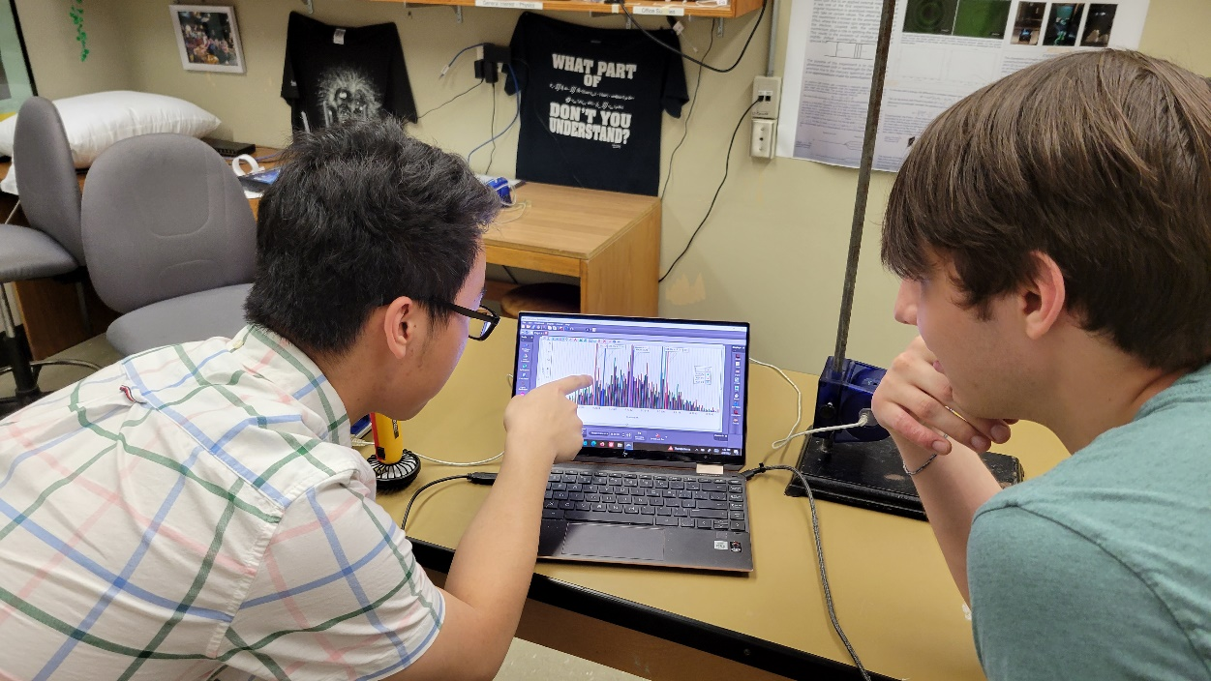
Laboratory Exercise Illustrating Mean Error
Todd Fugleberg
CAP Conference 2023 - DPE

Slide 2
Overview
Random Error
Standard Deviation
Error of the Mean
Experimental Set-up
Taking Data
Illustration of Standard Deviation
Illustration of Mean Error
Conclusion

Slide 3
Random Error
Many measurements physics labs involve random error
Random Error: measurements fluctuate in unpredictable way
  random air currents
  fluctuations in digital meters
Solution:
  take multiple measurements
  calculate mean value
  mean value = experimental value of measurement
Question: What is the uncertainty in this value?

Slide 4
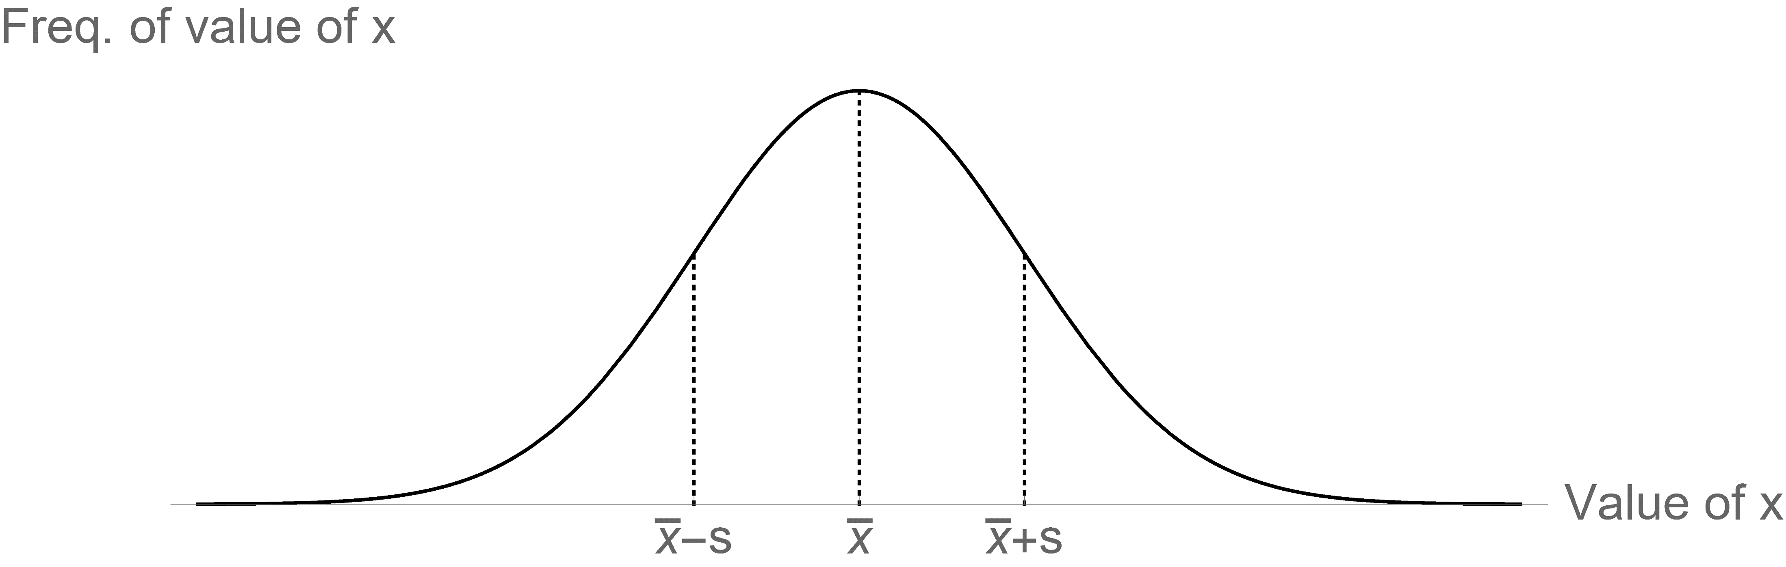
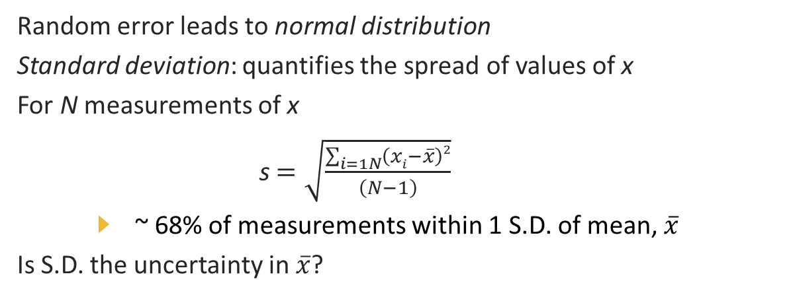

Standard Deviation (S. D.)
Random error leads to normal distribution
Standard deviation: quantifies the spread of values of x
For N measurements of x
s $=\sqrt{\frac{\sum_{i=1N}{\left(xi−\overline{x}\right)2}}{\left(N−1\right)}}$
  ~ 68% of measurements within 1 S.D. of mean, $\overline{x}$
Is S.D. the uncertainty in $\overline{x}$?
No!

Slide 5
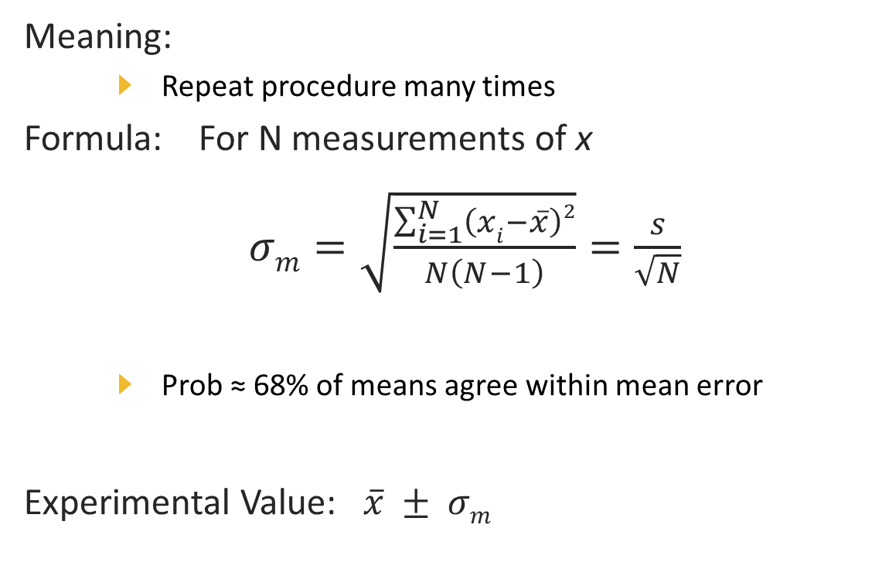
Mean Error (Error of the mean)
Meaning:
  Repeat procedure many times
Formula: For N measurements of x
$σm=\sqrt{\frac{\sum_{i=1}^{N}{\left(xi−\overline{x}\right)2}}{N\left(N−1\right)}}=\frac{s}{\sqrt{N}}$
  Prob ≈ 68% of means agree within mean error
Experimental Value: $\overline{x} ± σm$

Slide 6
Conceptual Difficulty
Graph of continuous function
  doesn’t look like data
Standard deviation vs mean error
  students confuse the two
Black box formula
  What does “mean error” mean?

Slide 7
Requirements for Practical Illustration
Simple and easy visualizable measurement
Able to generate random errors
Able to take large # of measurements quickly
Able to quickly display histogram of data with
mean value and standard deviations
Able to display overlapping histograms of data sets

Slide 8
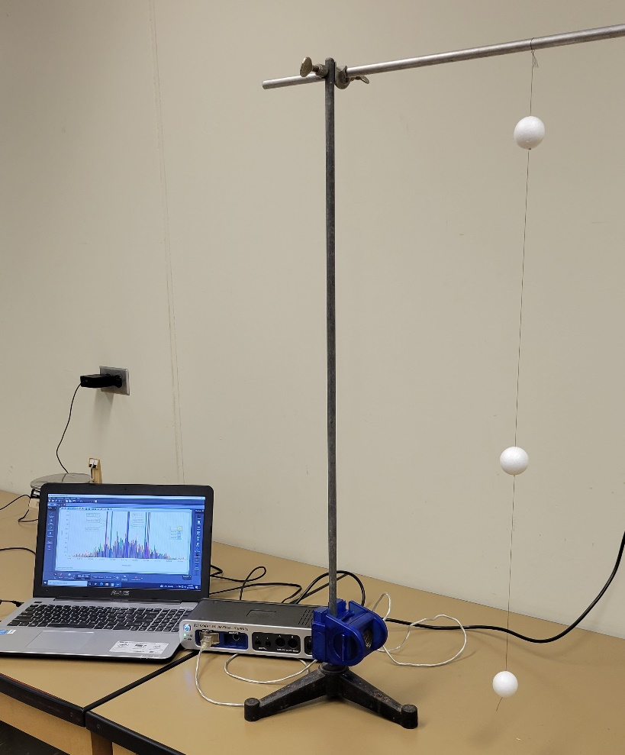
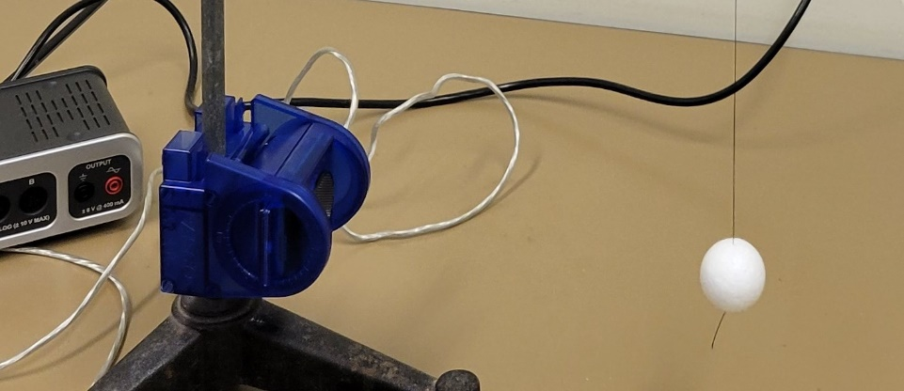
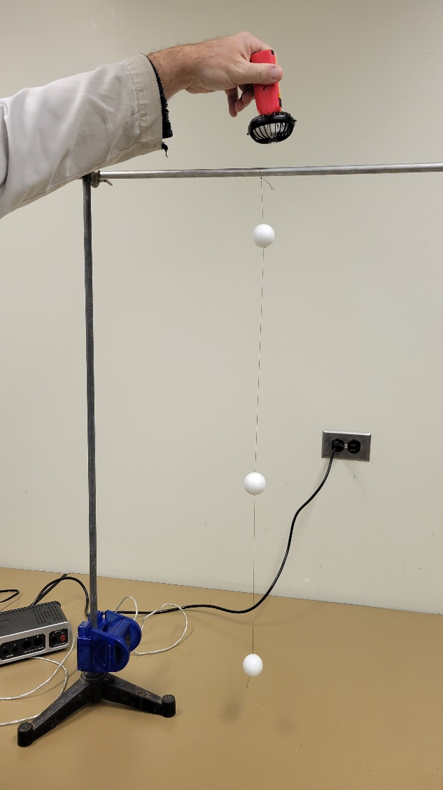
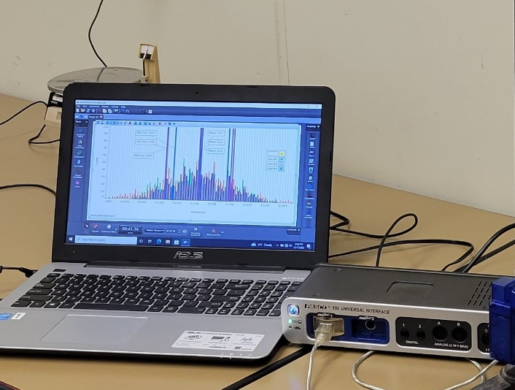
Experimental Setup
Triple pendulum of styrofoam
balls on string
PASCO ® motion sensor
  return time of ultrasonic pulse
PASCO Capstone® data acquisition software
Small battery-powered fan to create random air movements

Slide 9
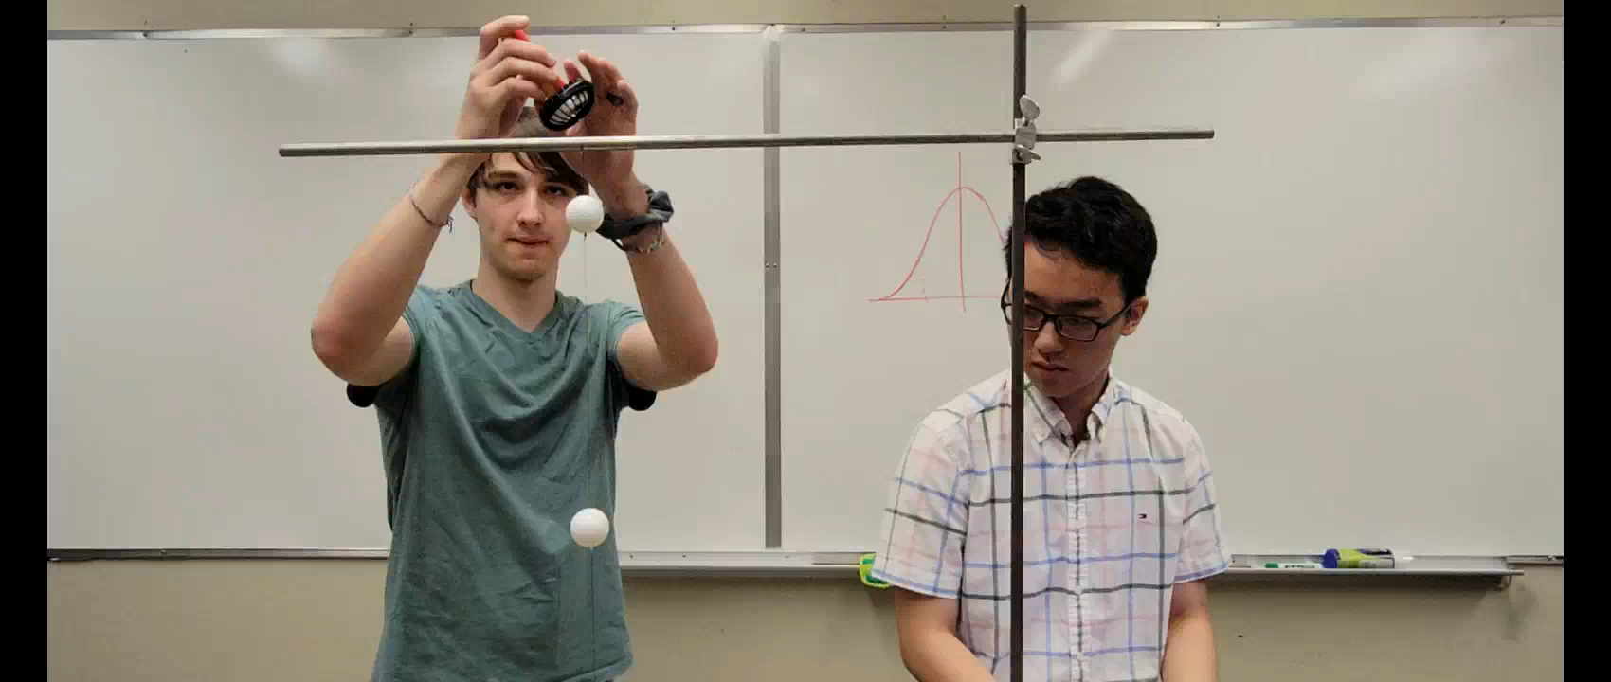
Procedure

Slide 10
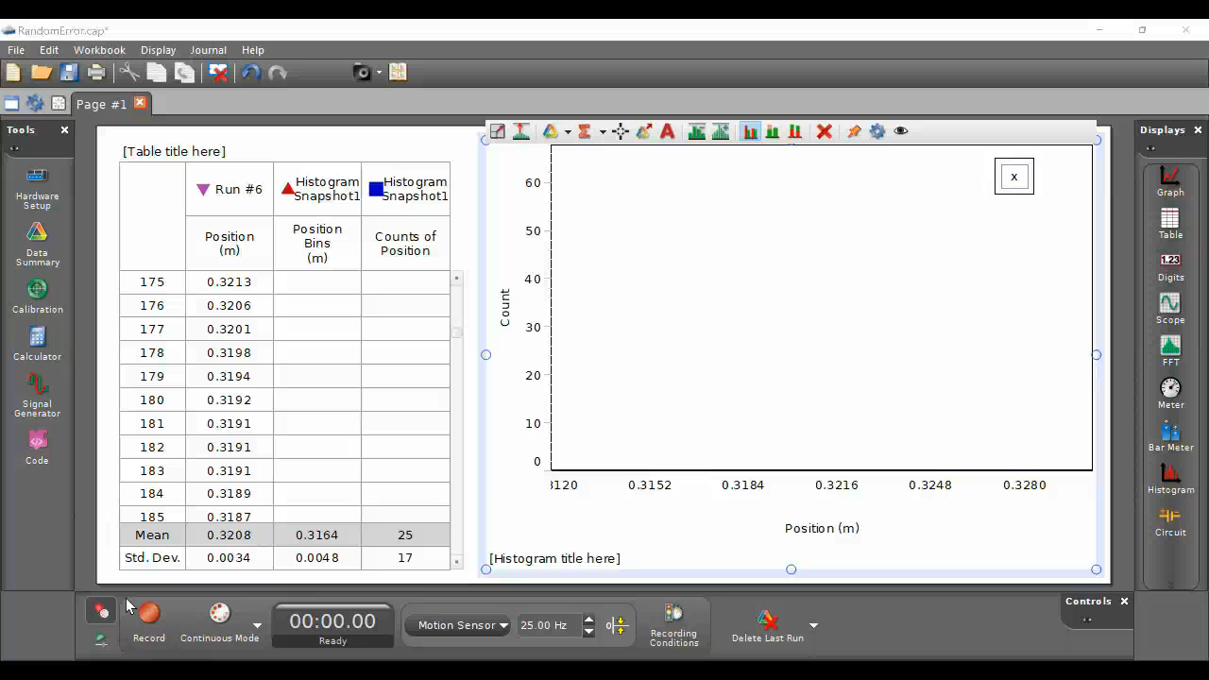
Taking Data

Slide 11
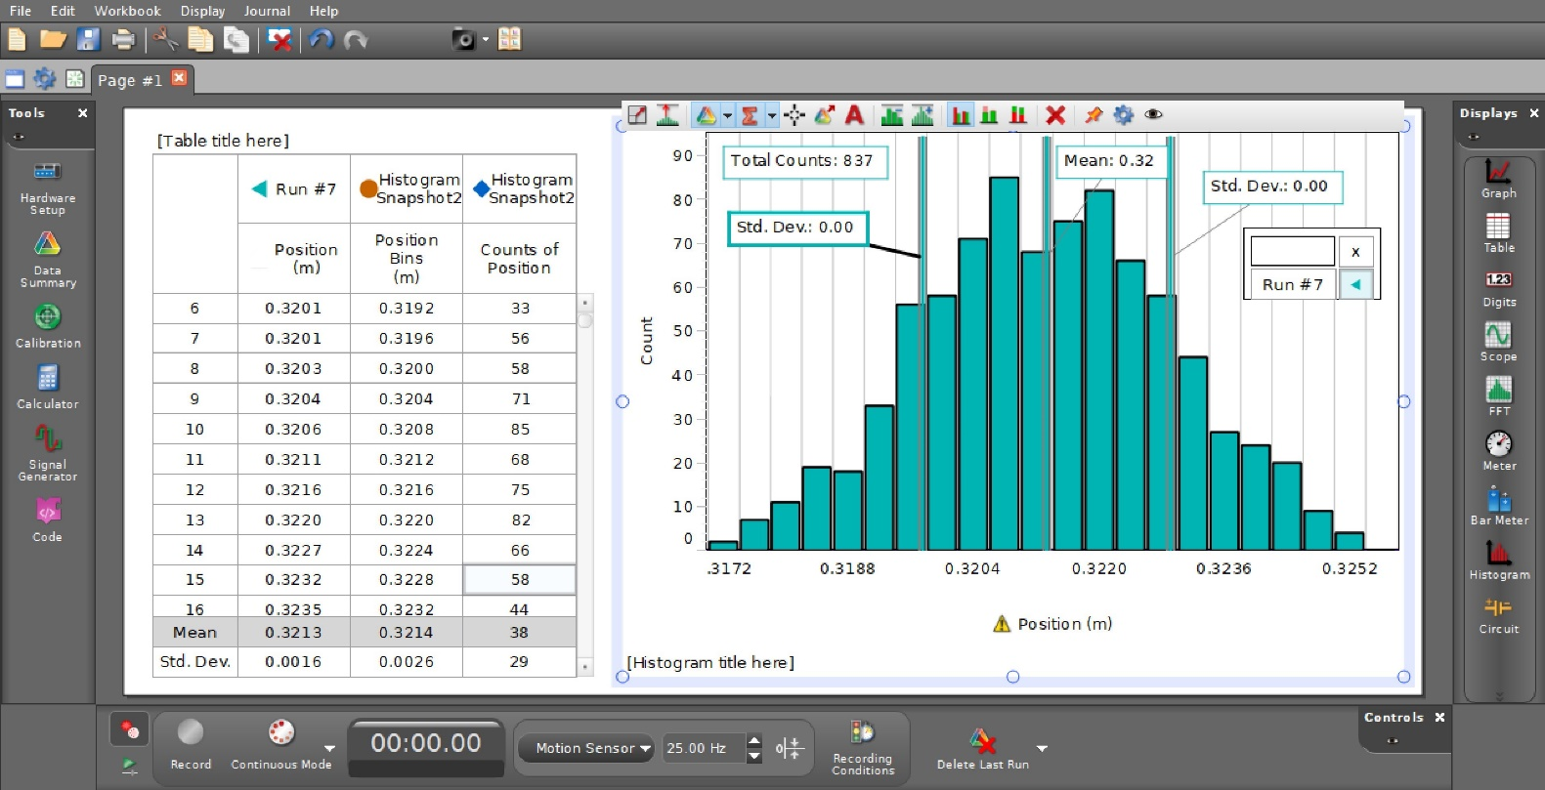
Single Run Analysis

Slide 12
Standard Deviation
Mean value: 32.13 cm
Standard Deviation: 0.16 cm
Range: 31.97 cm - 32.29 cm
Counts within 1 S.D:
58+71+85+68+75+82+66+58 = 563
Total Counts: 837
Frac of counts within 1 S.D. : 0.673 ~ 0.68

Slide 13
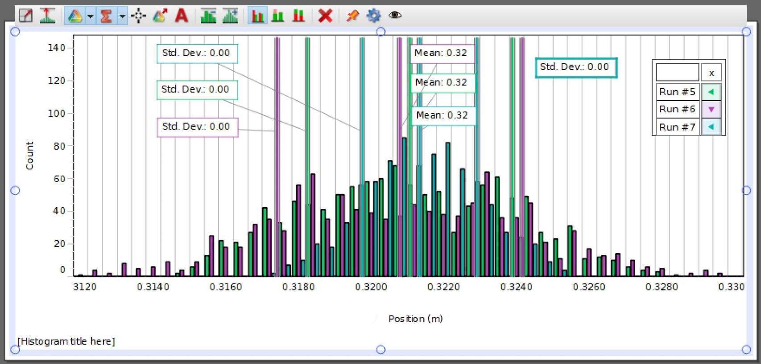
Multiple Data Sets

Slide 14
Comparison of Multiple Runs
 | Run #5 | Run #6 | Run #7
Mean | 32.11 cm | 32.08 cm | 32.13 cm
Total | 1157 | 1079 | 837
Standard Deviation | 0.28 cm | 0.34 cm | 0.16 cm
Mean Error | 0.005 cm | 0.010 cm | 0.008 cm
Mean – Mean Error | 32.105 cm | 32.07 cm | 32.122 cm
Mean + Mean Error | 32.115 cm | 32.09 cm | 32.138 cm
Runs #5 and #7 almost agree within mean errors
  almost 2 out of 3
But mean values agree quite closely
  much closer than standard deviation!

Slide 15
Results
Individual data runs
  ~ 68% of data points fall within 1 S.D of mean
  very consistently
Multiple data runs
  2 out of 3 mean values agree within mean errors
  somewhat consistently
Students clearly see different meanings of standard deviation and mean error
Most students can finish within an hour

Slide 16
Summary
In this exercise students
  see simple, concrete example of random error
  test definition of standard deviation
  test definition of mean error
  compare and contrast the two values
Anecdotal results:
  more students understand diff. between standard deviation and mean error
  mean error not just black box
Controlled study in future?

Slide 17
Thanks!
Any Questions?

