Slide 1


Accelerated 2D Multislice MRI with Hyperpolarized ¹²⁹Xe in Human Lungs
Samuel Perron, Matthew S. Fox,
& Alexei V. Ouriadov
June 19th, 2023
Physics in Medicine and Biology (DPMB)
M2-3 MRI - 1

Slide 2
DISCLOSURES
We acknowledge support from the Natural Sciences and Engineering Research Council of Canada (NSERC); grant number R5942A04

Slide 3
Roadmap
  Motivation
  Background of Technique
  In-Vitro MRI
  In-Vivo Lung MRI
  Future Work

Slide 4
Motivation
  Hyperpolarized xenon-129 has recently been FDA approved for human lung imaging.
  Several key issues still need to be addressed or have recently surfaced:
Patients with non-healthy lungs cannot hold their breath for long
Pressure to limit scan time
Increasing costs of ¹²⁹Xe gas

Slide 5
Motivation
Background
  Hyperpolarized xenon-129 has recently been FDA approved for human lung imaging.
  Several key issues still need to be addressed or have recently surfaced:
Patients with non-healthy lungs cannot hold their breath for long
Pressure to limit scan time
Increasing costs of ¹²⁹Xe gas
  We have recently shown¹ that accelerated MRI using Compressed-Sensing (CS) and the Stretched-Exponential Model (SEM) is able to:
Provide significant increases in SNR without increasing scan duration
Lower the required amount of ¹²⁹Xe to a third of typical dose for lung imaging
1 - Perron, S. et al., ISMRM (2022)

Slide 6
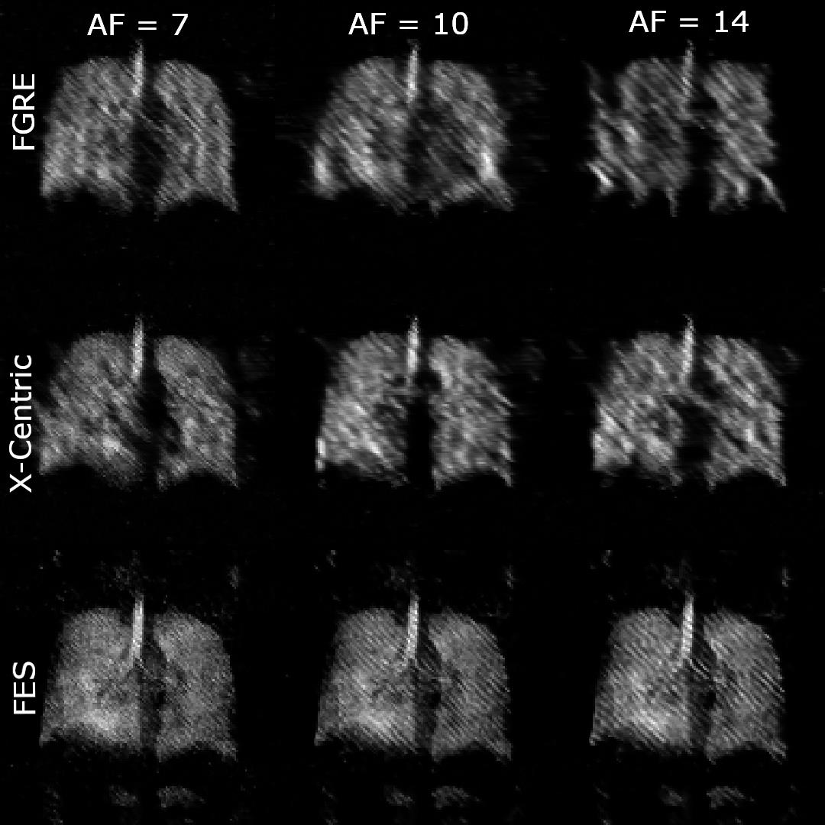
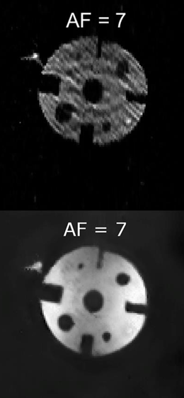
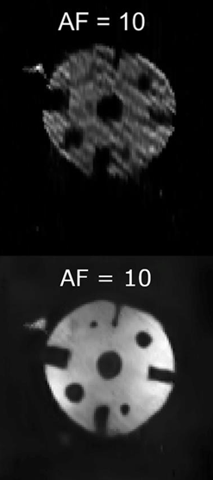
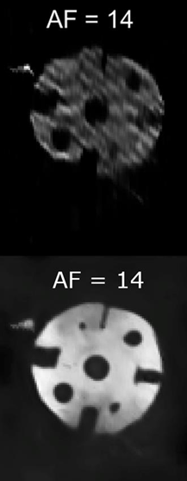
Artefact Removal - Phantom
Retrospective Undersampling
¹H MRI at 0.074 T - undersampled FGRE
3.0 T - inhaled hyperpolarized ¹²⁹Xe
Remove Artefacts

Slide 7
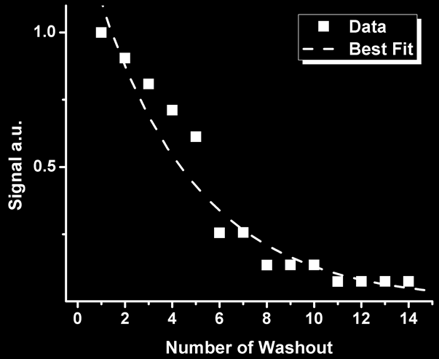

Fitting to Stretched-Exponential Model
$$S\left(n\right)=S_{0}e^{−{\left(nr^{′}\right)}^{β}}$$
β : heterogeneity index (0 < β < 1)
n : image number
r’ : apparent fractional-density parameter
Fit using Abascal Method²
2 - Abascal, J. et al. IEEE Trans Med Imaging. (2018)

Slide 8
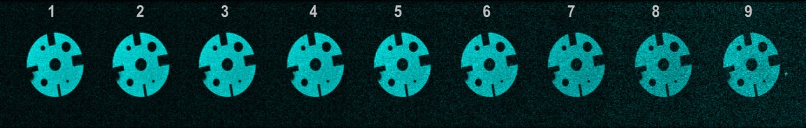
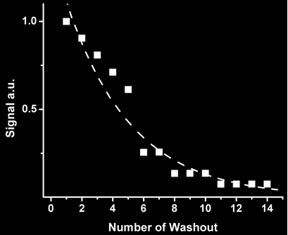
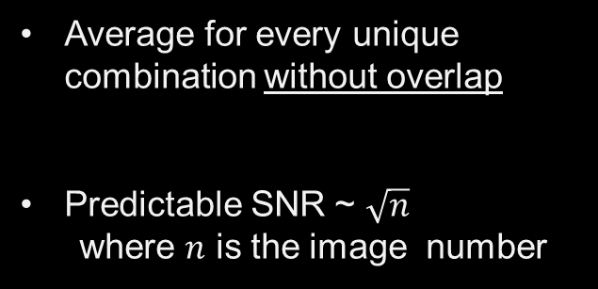
Averaging Pattern
9
9
8
8
7
7
6
6
5
Average for every unique combination without overlap
Predictable SNR ~ $\sqrt{n}$
where 𝑛 is the image number
5
4
4
3
3
2
2

Slide 9
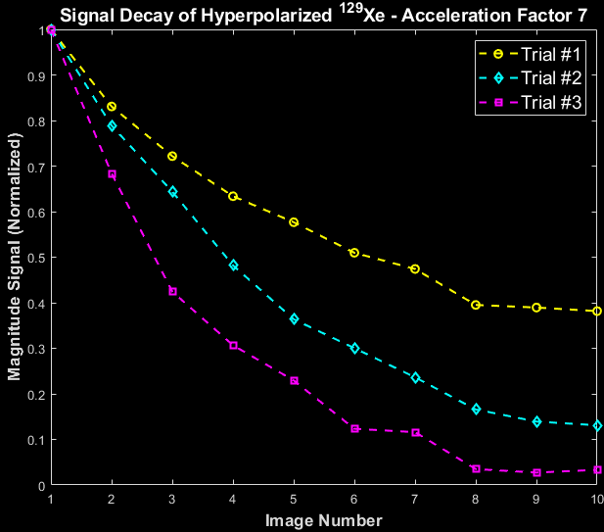
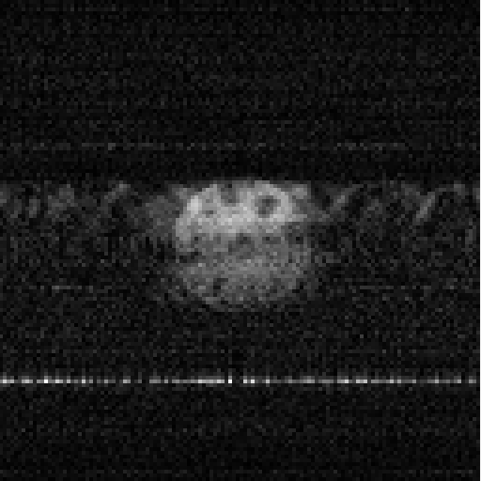
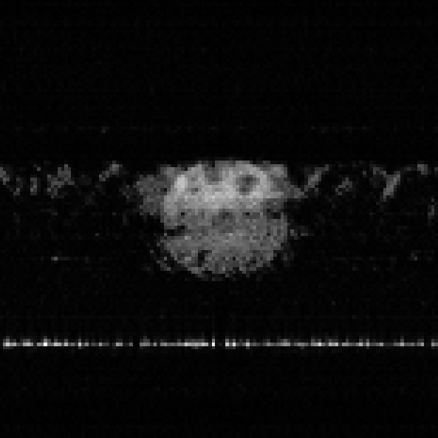
¹²⁹Xe Phantom Results – 74mT
Undersampled
Reconstruction
RF Interference

Slide 10
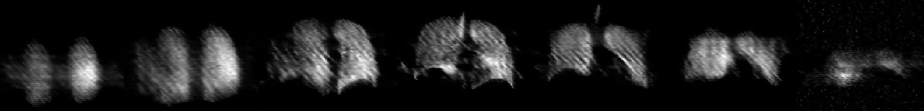
Human Lungs – 7x Acceleration
7 seconds total scan time
× 9
× 9
× 9
× 9
× 9
× 9
× 9
~5x SNR increase over fully-sampled images
63 images acquired in a single breath-hold!
Acquired with centric-out Fast Gradient Recalled Echo (FGRE)

Slide 11
Moving Forward
Develop and implement undersampled X-Centric and Frequency-Encoding Sectoral
2
Build human lung training dataset for artefact removal neural network
1

Slide 12
THANK YOU

