Slide 1
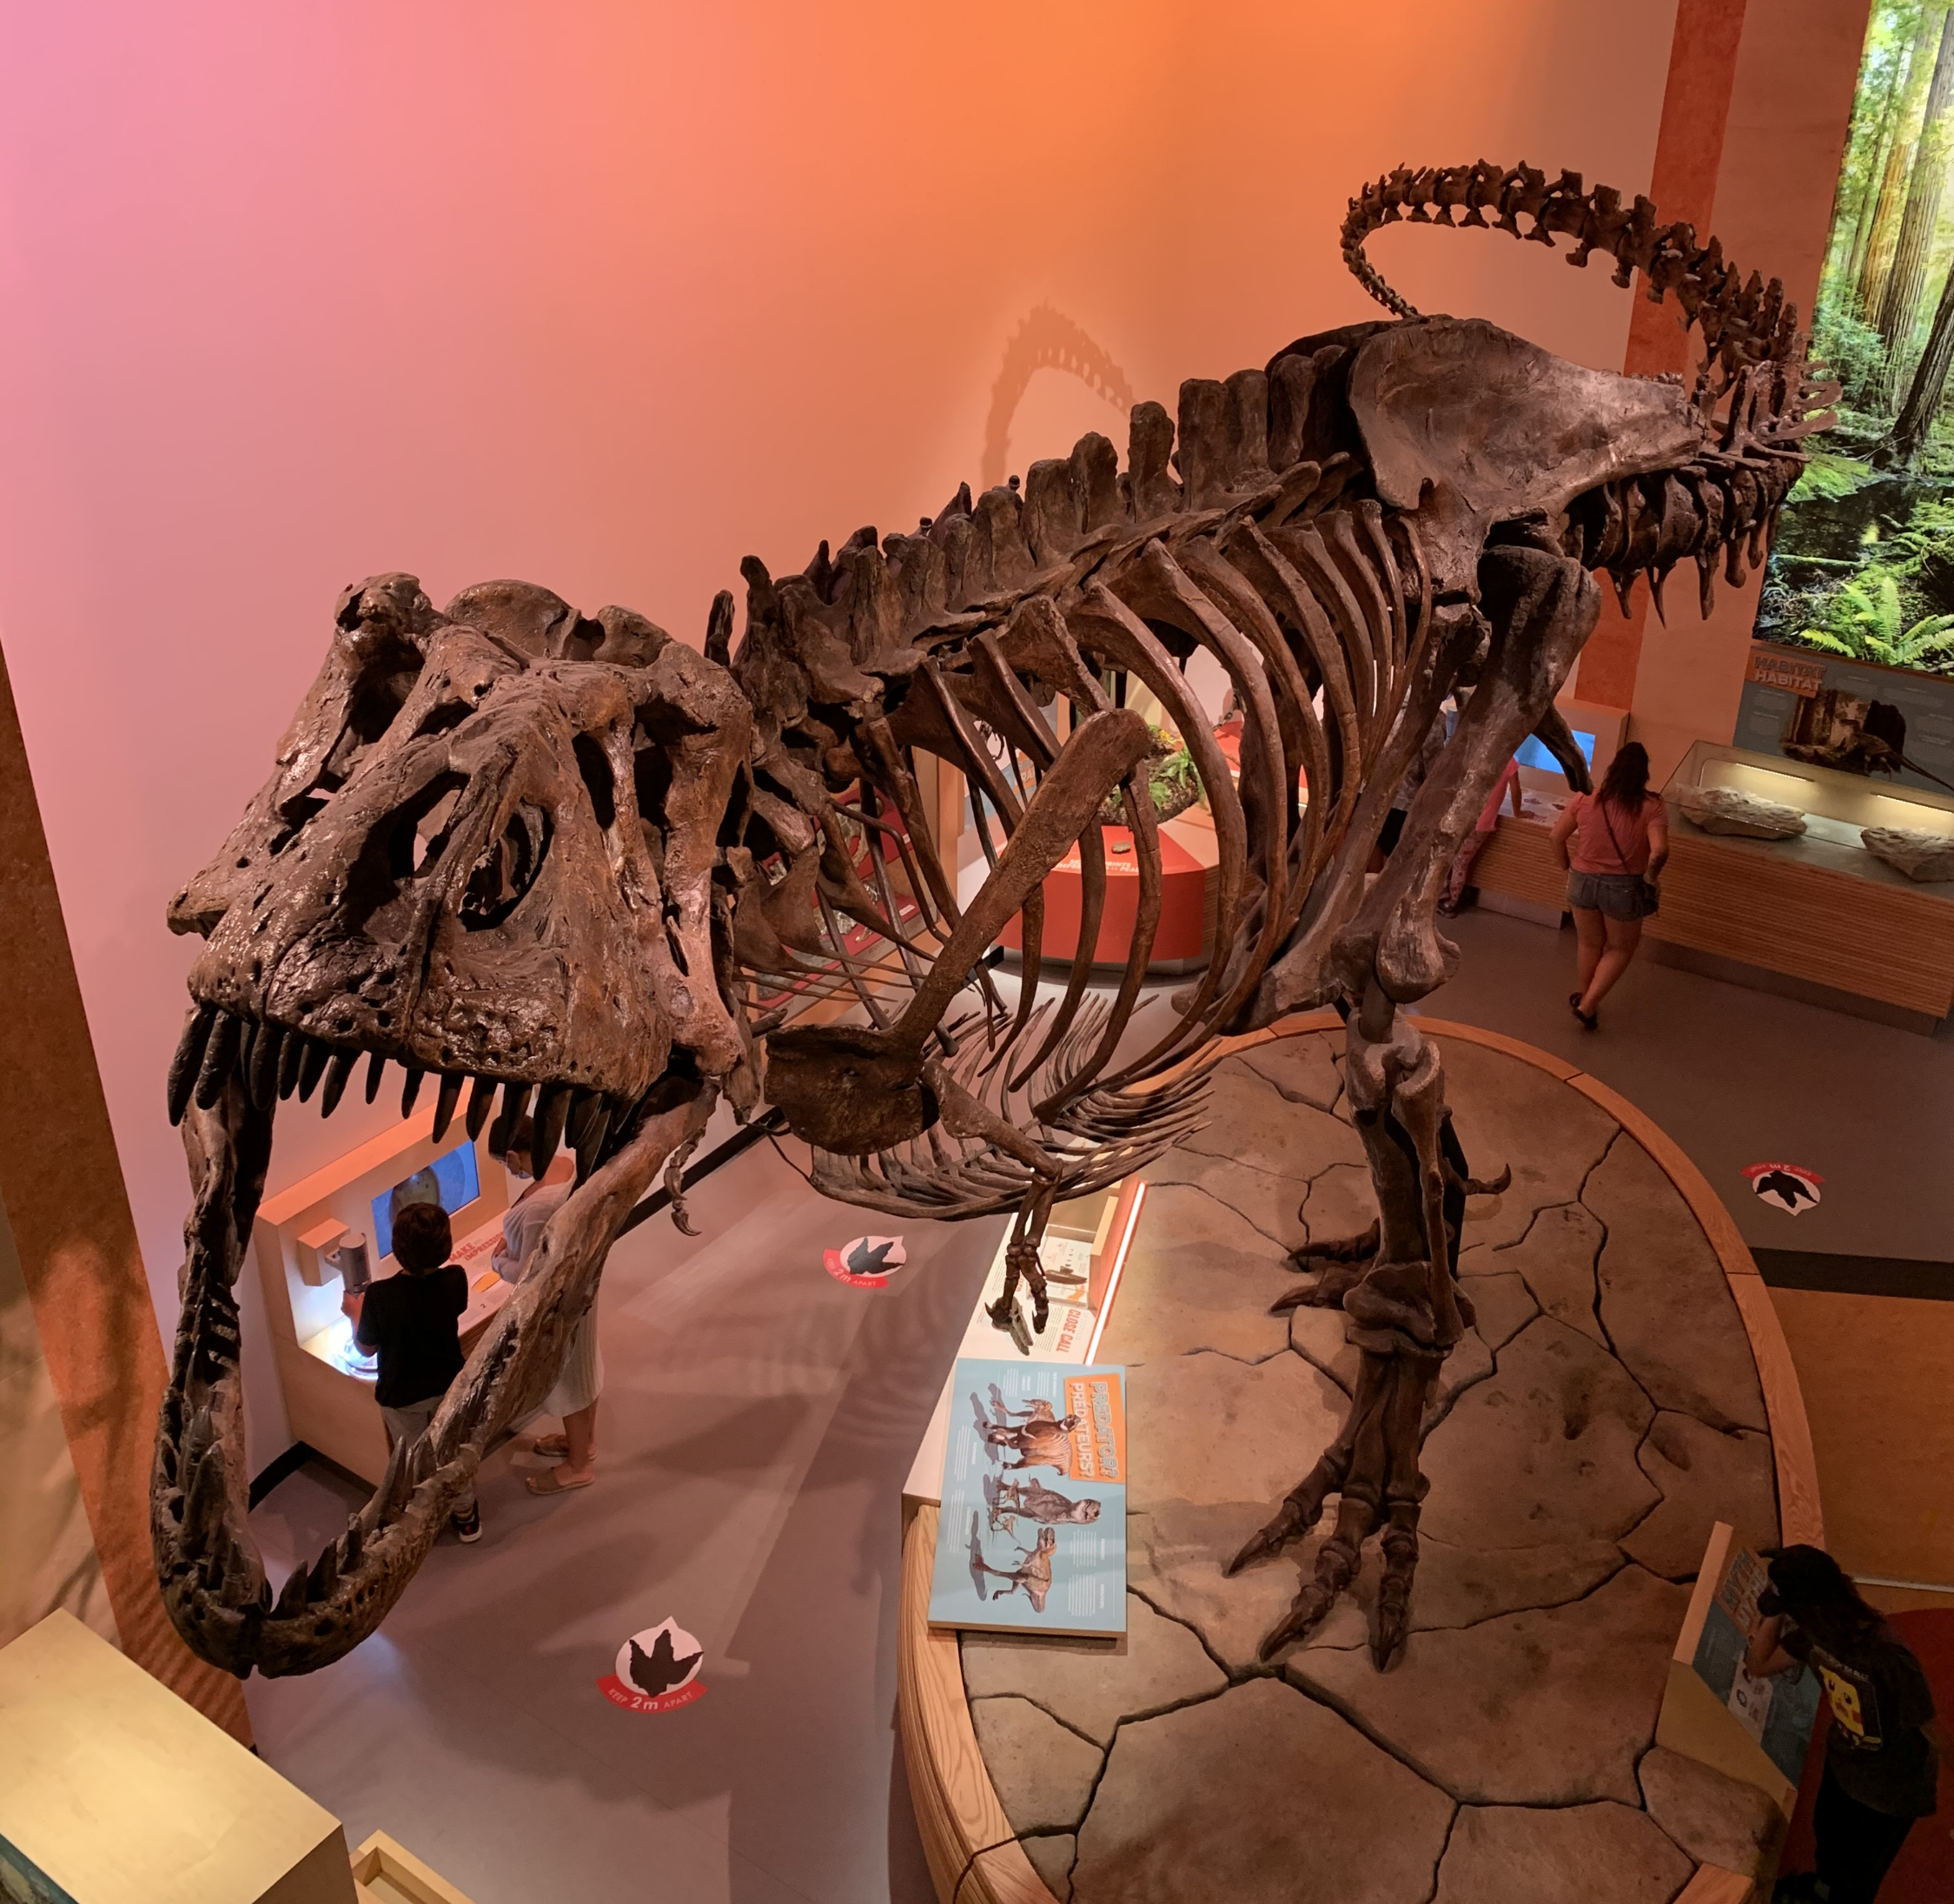

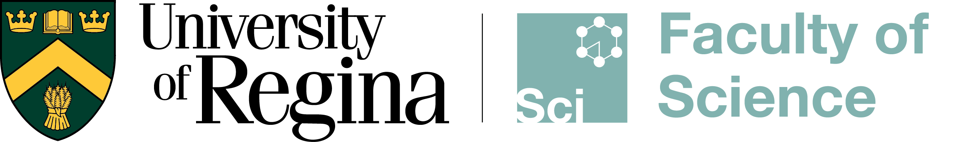
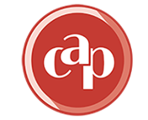
Probing for blood vessel preservation in Tyrannosaurus rex using synchrotron radiation
Jerit L. Mitchell, MSc student
June 21, 2023
Notes:
Hello everyone, I am Jerit Mitchell, a Master’s student at the University of Regina. Today I am going to be talking about Probing for blood vessel preservation in Tyrannosaurus rex using synchrotron radiation

Slide 2
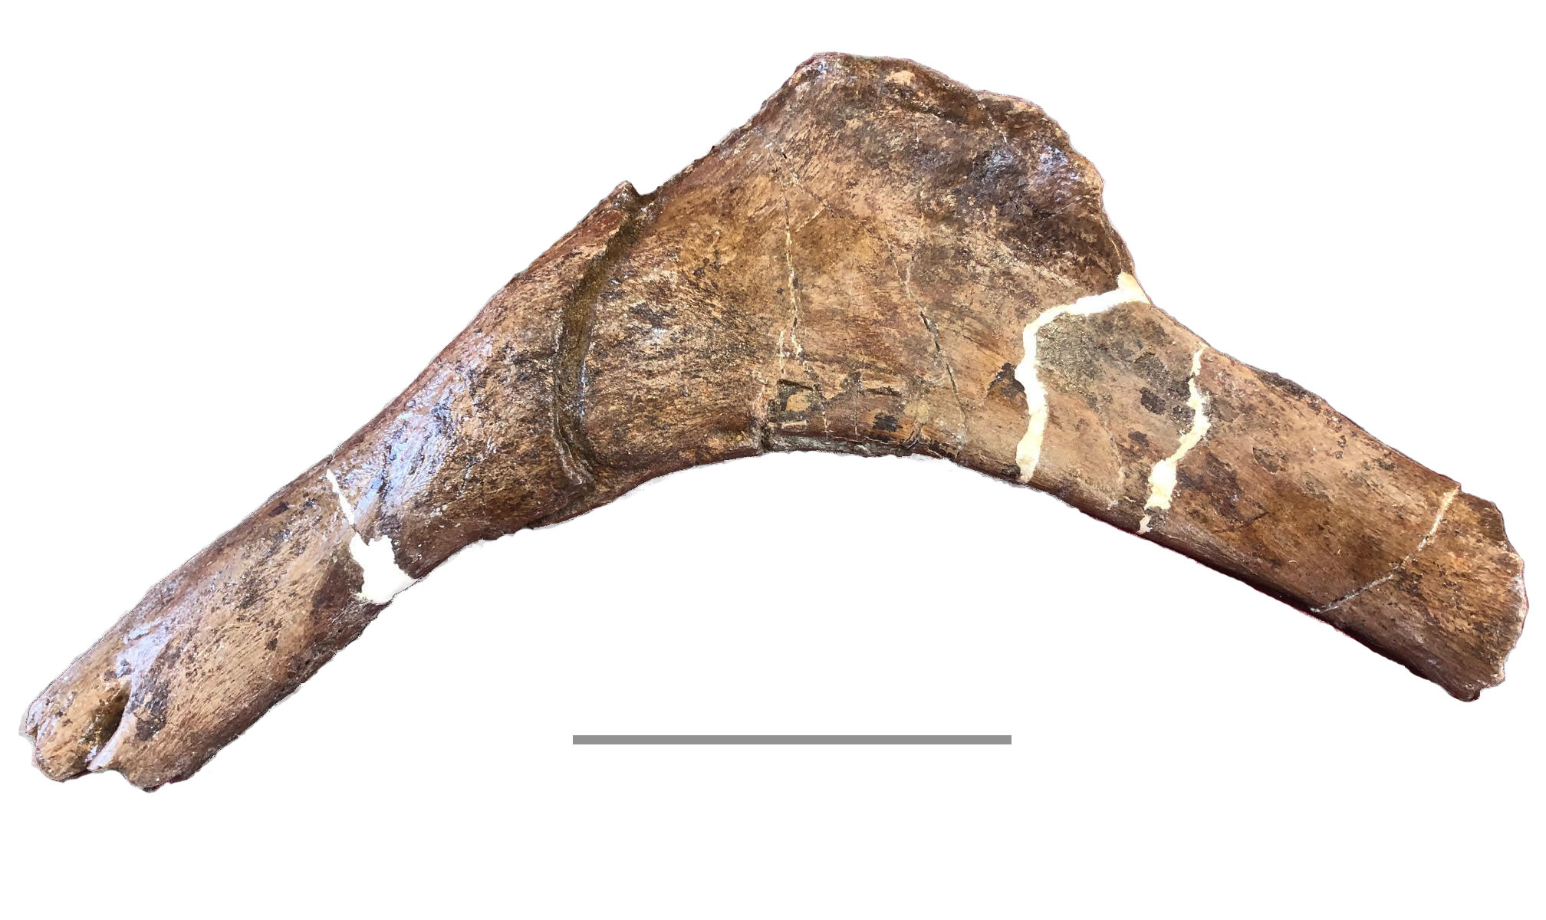
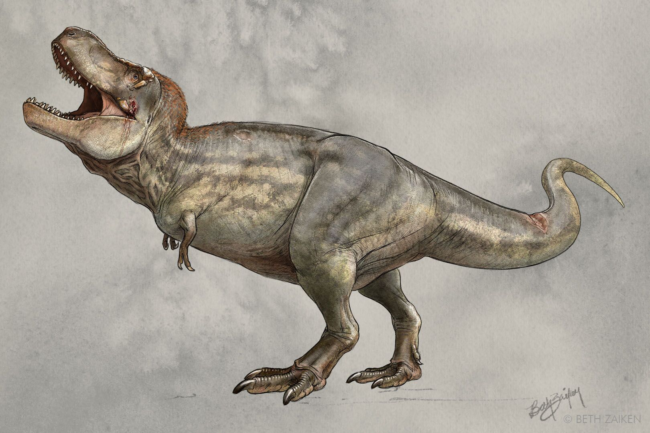
Motivation
Rib
Fracture
Preservation of million-year-old fossils is rare...
Even rarer are preserved soft tissues or original organic material...
10 cm
Hard tissues: bones and teeth
Soft tissues: skin, scales, feathers, pigments, muscles, blood vessels, etc.
"Scotty"
Problem: We need a sensitive probe for finding traces of soft tissues in fossils
Facts about Scotty
Largest T. rex ever discovered
Found in Southern Saskatchewan in 1991
From the Cretaceous period , ~67 Ma
Bones show many injuries
2
Notes:
So I want to start off by saying that fossilization is a rare process.
Switching gears, I want to talk about Scotty. So Scotty is a T. rex specimen part of the Royal Saskatchewan Museum.
And if you are wondering where the name Scotty came from. It was from the celebratory drink the excavation team had the night they found the skeleton. So, Scotty unfortunately must have had a hard life as his bones show multiple injuries, like the rib bone here with a giant fracture. This is the sample we will be probing

Slide 3
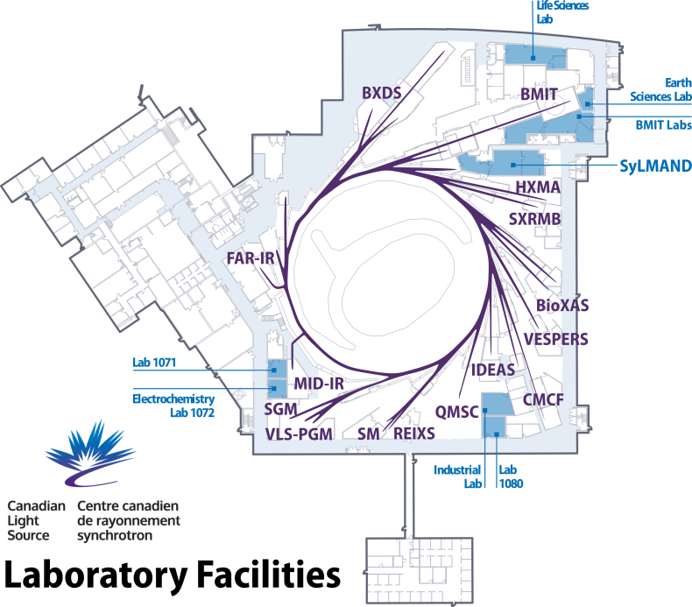
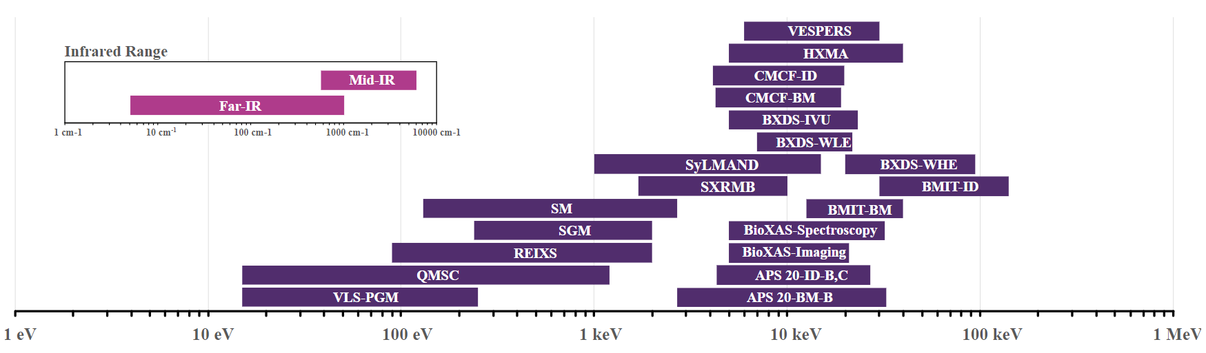
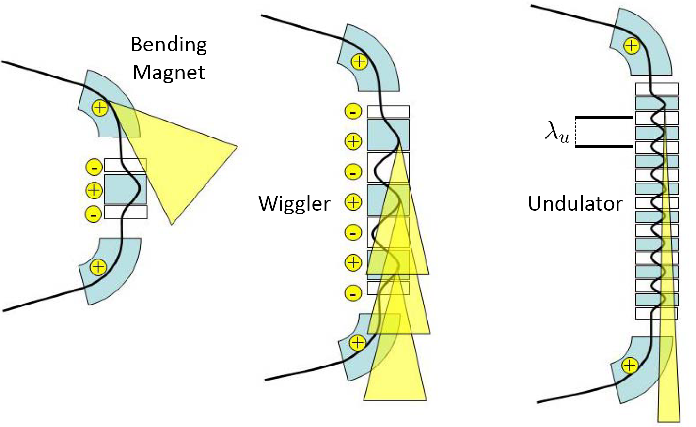
Synchrotron Radiation
Synchrotron radiation is produced when relativistic charged particles are bent (centripetal acceleration)
high intensity light with small beam sizes
better resolution and faster data collection
The radiation can be produced with a simple dipole bending magnet or specialized insertion devices
3
Notes:
Intro: The sensitive probe we are going to be using is synchrotron radiation.
This radiation can be produced in specialized synchrotron light facilities, such as the Canadian Light Source which I will be take advantage of for my results. Electrons are accelerated and then circle in a storage ring until they are used by beamlines.
Modern light sources have many beamlines that feature specialized setups that have varying energy ranges, beam sizes and intensities, in order to solve specific proplems. Most of the radiation produced ends up in the X-ray range of the electromagnetic spectrum.

Slide 4
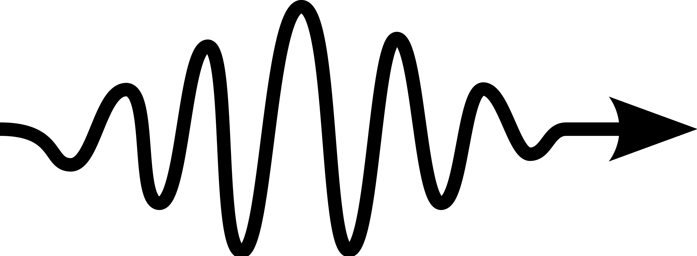
Interactions of radiation in matter
Atomic Fluorescence
Secondary electrons
Auger electrons
e-
e-
M shell
Incident X-rays
Reflected X-rays
L shell
Transmitted X-rays
K shell
Kα
Lα
Refracted X-rays
Incident electrons
Back scattered electrons
e-
e-
Kβ
Scattered/Diffracted
X-rays
(Elastic and Inelastic)
Bremsstrahlung X-Rays
4
Notes:
So what happens when an X-Ray interacts with our rib bone?
There is also auger electron emission where the excitation energy is transferred to an outer shell electron.
End. As you can see there is a rich amount of information that can be pulled out of bulk matter. We are going to use many of these interactions to look for soft tissues in Scotty’s bones.

Slide 5
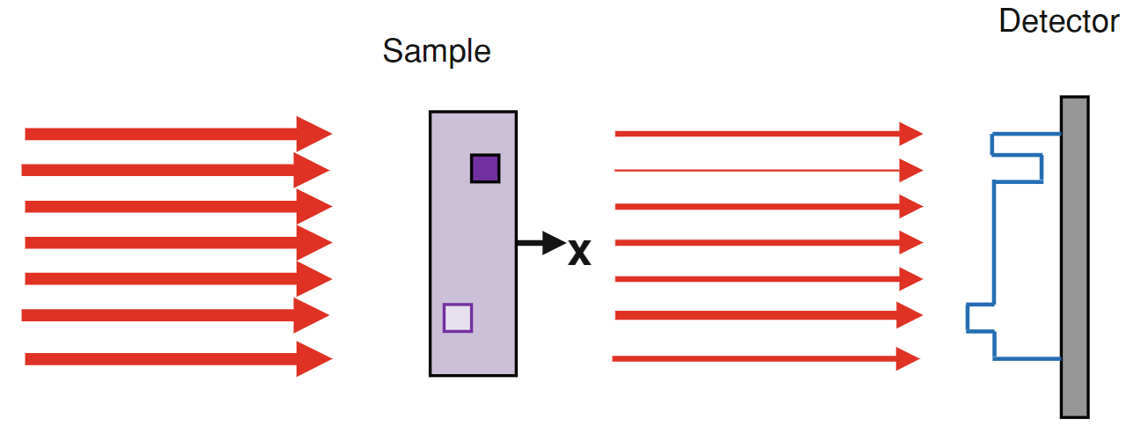
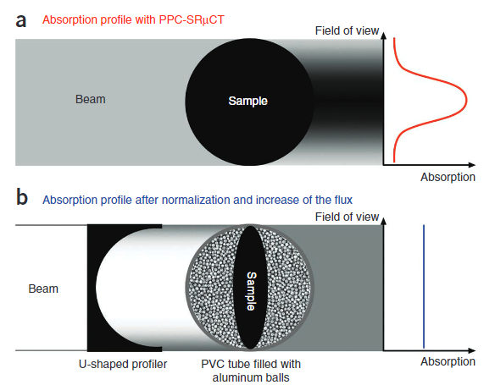
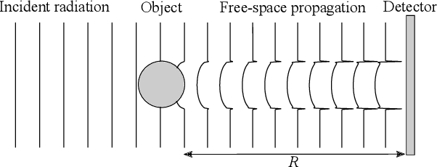
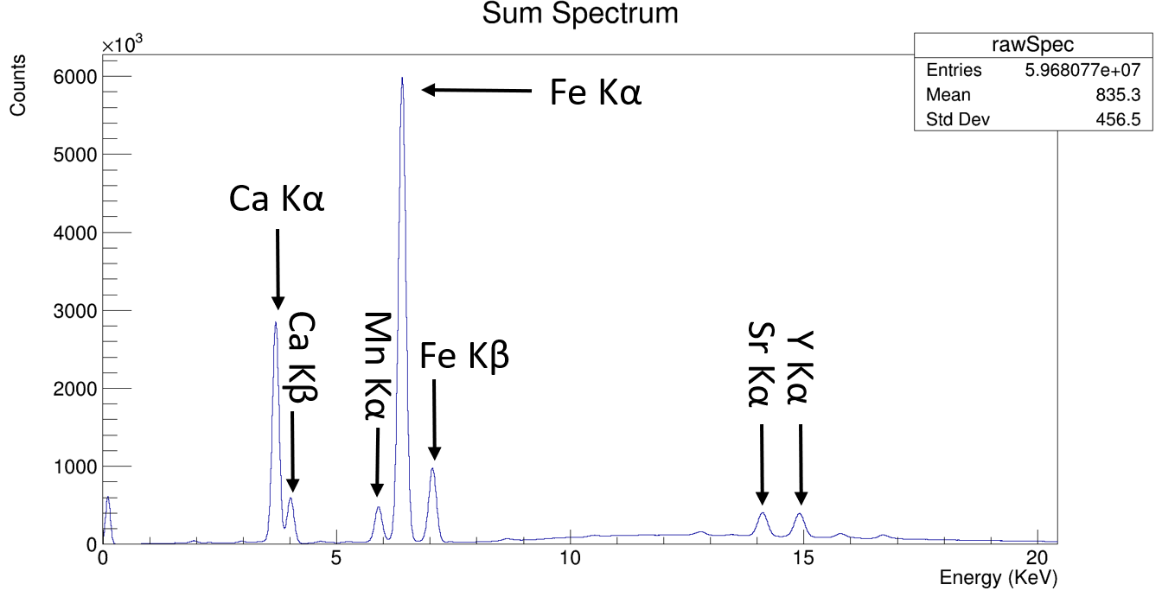
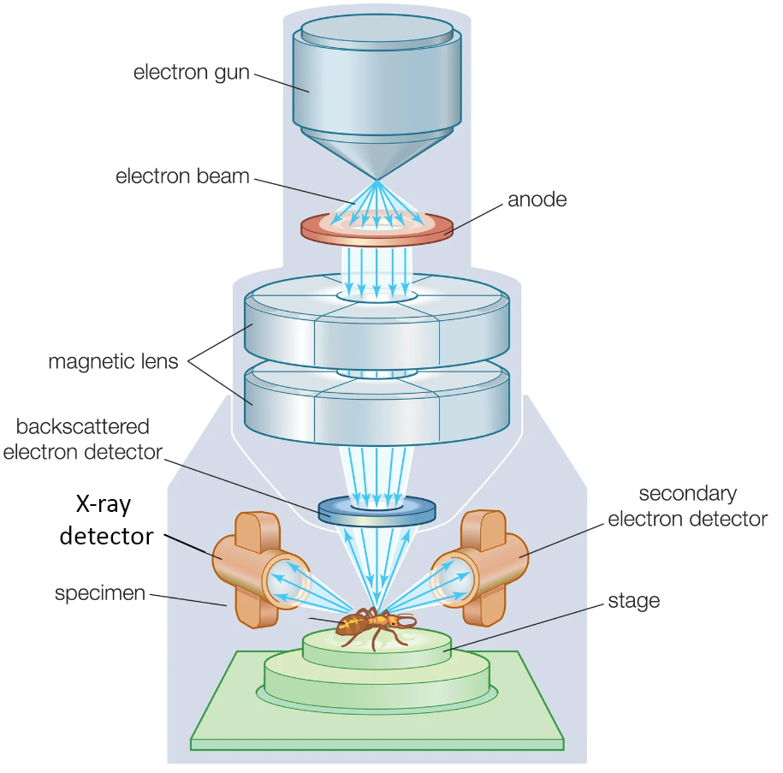
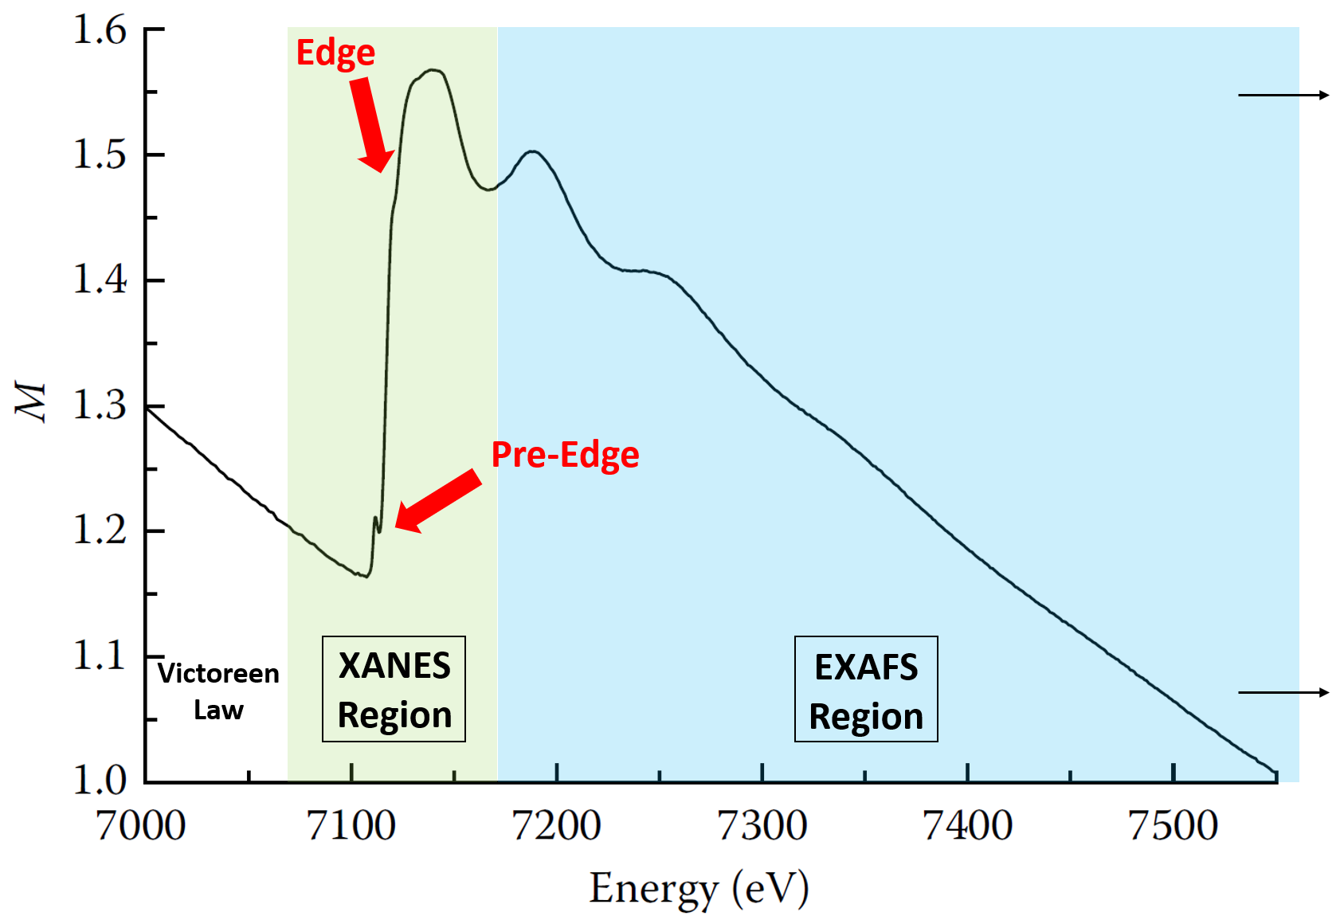
Techniques used: a mix of imaging and spectroscopy
Computed Tomography (CT) with propagation phase contrast (PPC) and photon homogenization
X-ray Fluorescence (XRF) with chemical mapping
X-ray Absorption Near Edge Structure (XANES) with linear combination fitting
Scanning Electron Microscopy (SEM) with secondary and back scattering electron imaging (SE, BSE) and XRF
All techniques are non-destructive, which is crucial for precious fossils
5
Notes:
Intro. So getting to the specific techniques we are going to use.
So when X-rays transmit through a sample the amount of transmitted photons is dependent on the density of the sample at each point. You can then rotate your sample taking hundreds of projection images, which can be reconstructed into orthogonal slices. This essentially provides a 3D density model of the sample.
X-rays can also refract. So phase shifts can take place particular at changes in index of refraction in the sample. If you set your detector far enough away from the sample interference fringes build up. This is called propagation phase contrast, and it is critical to providing contrast on edges of small structures.
Lastly, is photon homogenization. So for large, dense bones we need to crank up the energy and flux to have any kind of photon transmission. The problem is that thinner areas in the field of view of the detector will have too much photon transmission that can overload the detector. The solution is to add beads of a similar density that surround the sample, as well as a metal profiler in order to normalize the absorption in the field of view of the detector. This was critical for scanning the rib bone.
Next up is x-ray fluorensce, which results in a spectrum like the one here with peaks for the various transitions of the elements present in the sample. If you measure an XRF spectrum for a grid of points, we can create a chemical intensity map by integrating the transition peak of interest..
We are also using X-ray absorption spectroscopy, particularly XANES. X-rays generally less absorbed for higher energies. However, when there is enough energy to ionize the particular atom, there is a sharp rise in the absorption seen here. We are interested in the edge region here as it gives information about the local chemical structure such as the oxidation state of the element.
Lastly, there is Scanning electron microscopy, which is not synchrotron based, but also useful. An SEM provides detection of secondary, backscattered, and fluorescence xrays.

Slide 6
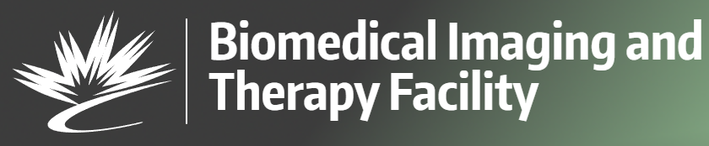
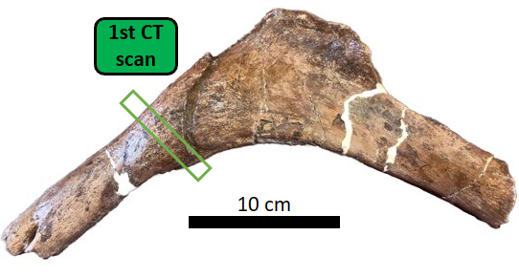
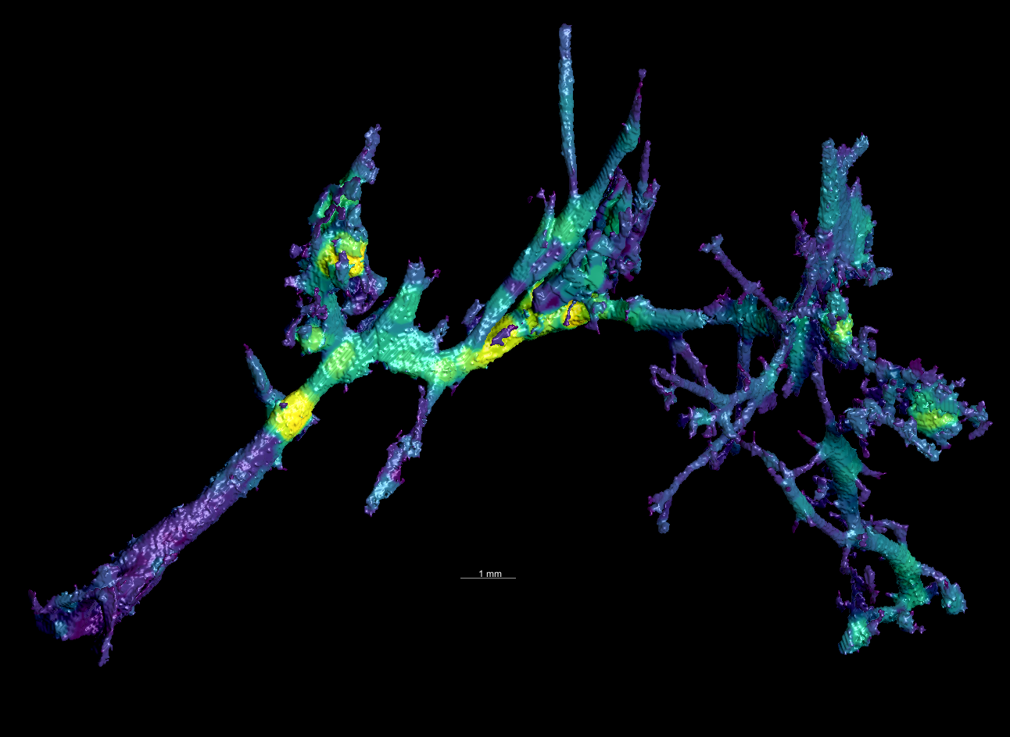
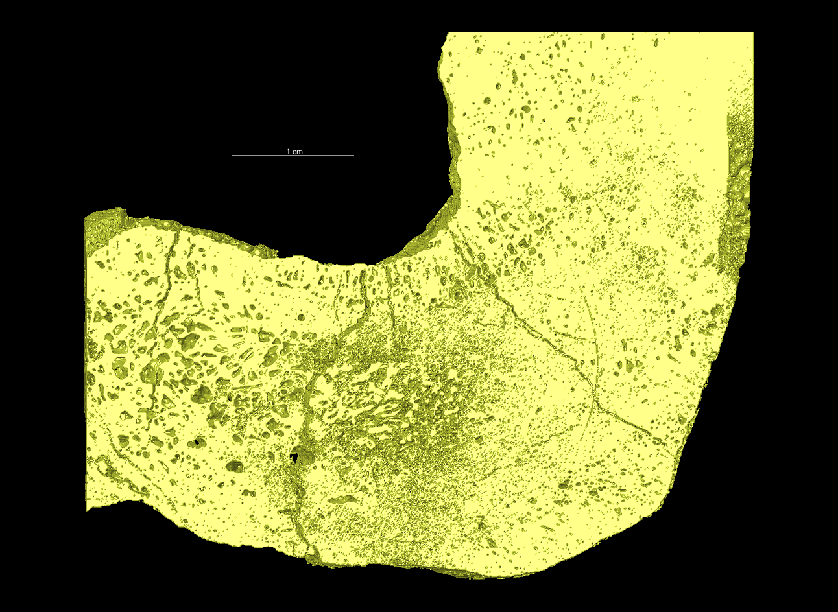
CT 3D reconstruction
1 cm
1 mm
Large Vascular Structure!
6
Notes:
Now, finally getting to some of the results. We start with CT scanning that was taken at the Biomedical Imaging and Therapy beamline at the Canadian Light Source. Here is the resultant 3D model of the cross sectional scan. But the beauty of CT is that we can image inside the bone, and here I was able to pull out what appears to be a large vascular structure. It is extensive, meandering and branching out, just like blood vessels do, and is partially hollow. The brighter areas are infilled with dense material.

Slide 7
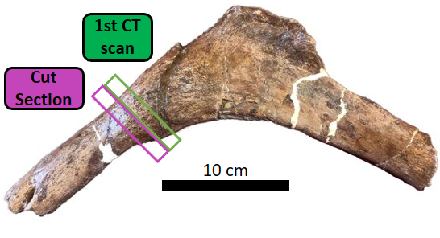
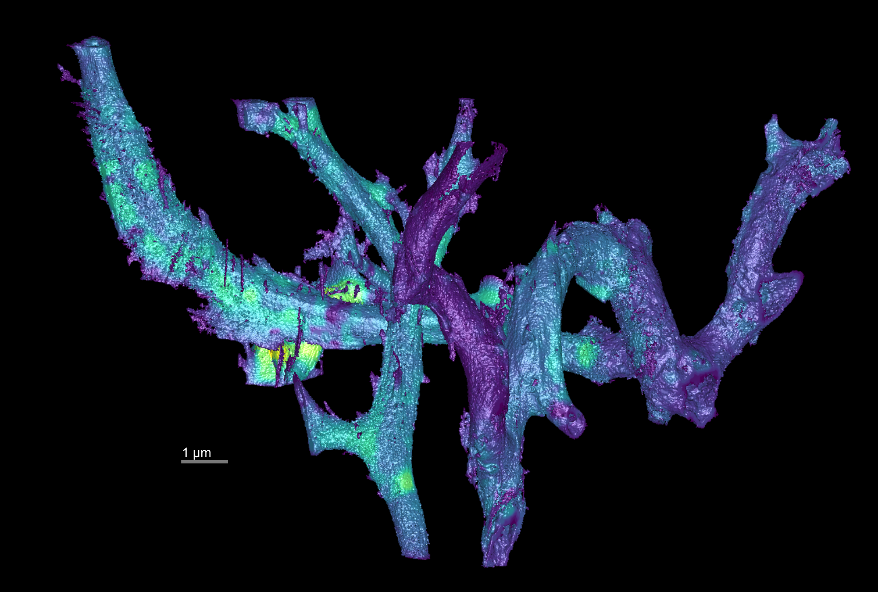
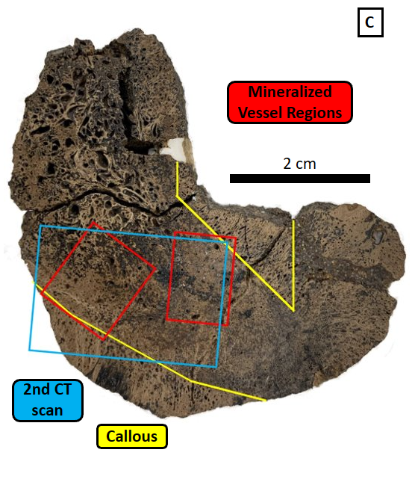
CT 3D reconstruction
1 mm
7
Notes:
Now we wanted to make sure this was not a fluke and we knew we want to do chemical analysis, so we did have to cut into the bone to produce a cut cross section. We first CT scanned it, and what do you know more large vascular structures.

Slide 8
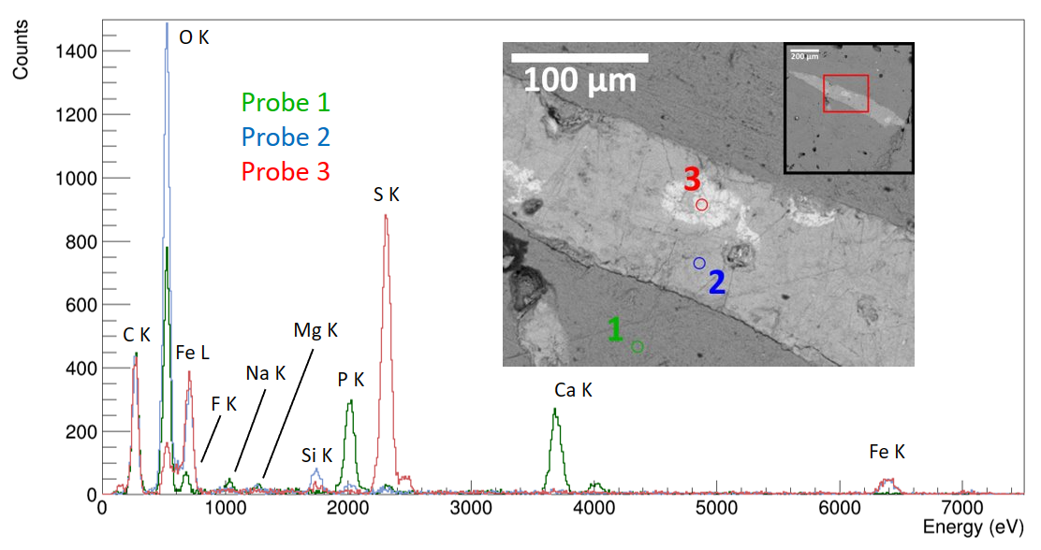

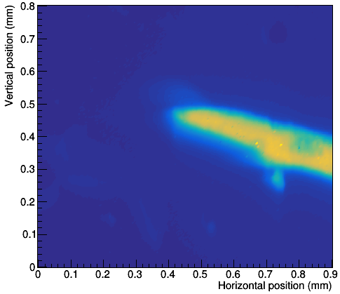
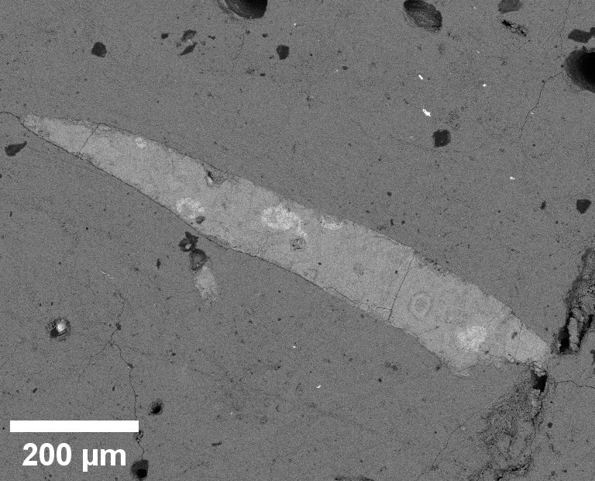
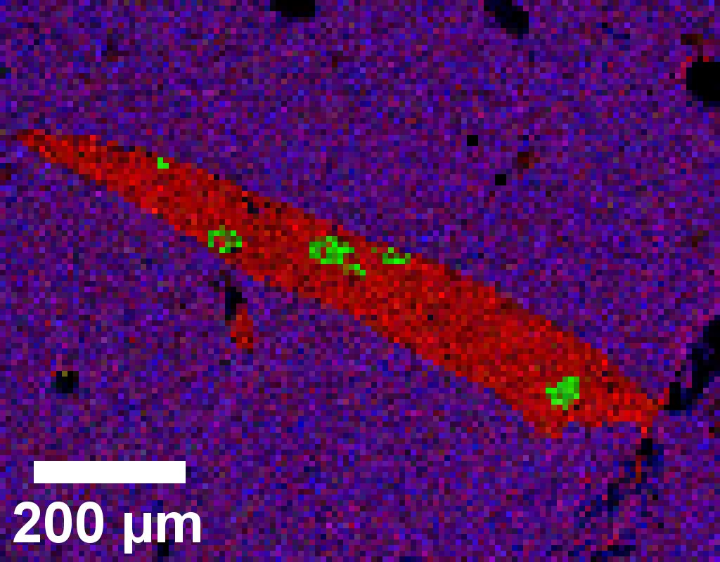
SEM/XRF Analysis
The vascular structure is extremely rich in iron
1
Other major contributing elements: oxygen, sulphur
Fe kα
BSE
O S Ca
8
Notes:
So, if we have preserved blood vessels, what are they made up of?
We are using the VESPERS beamline at the Canadian Light Source, as well as the SEM at the University of Regina for this.
First we have a backscattering electron image of the vessel. Here the brighter areas correspond to atoms of higher atomic number. Zooming in on the vessel, we have probed three location using XRF.

Slide 9
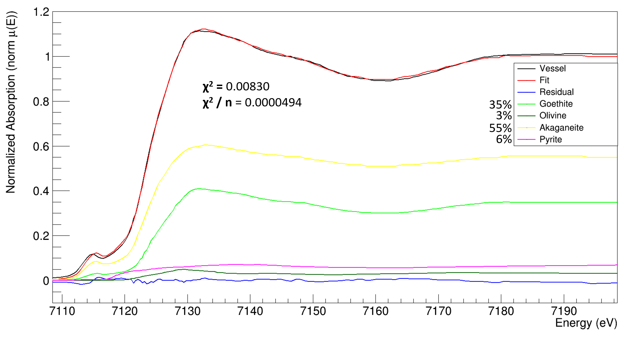

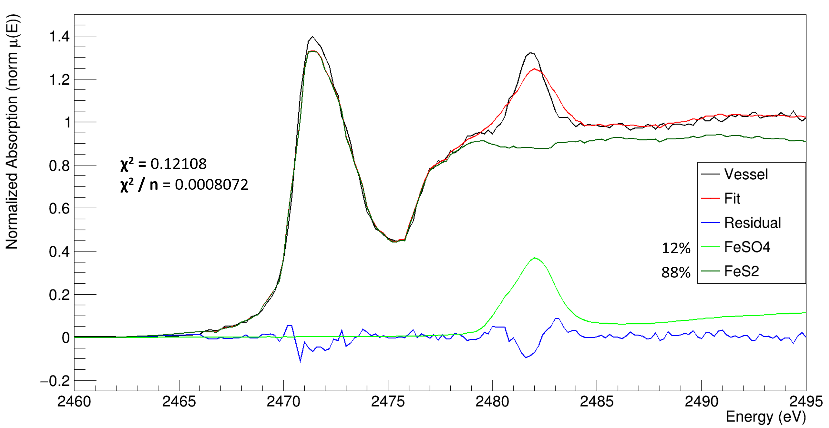
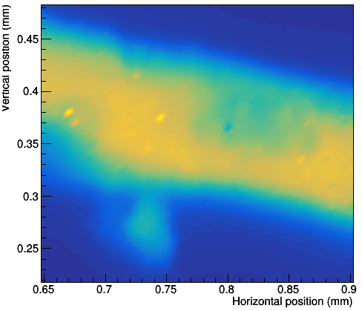
Vessel XANES Fe K-Edge LCF
Fe⁺³
XANES
Analysis
Apply Linear Combination Fitting (LCF) using up to 10 iron mineral references
Goethite/Akaganeite (FeO(OH)) constitutes most of the vessel
Iron in the form of 3+ oxidation state is uncommon in fossil mineralization
Pyrite (FeS₂) is present in small patches in the vessel
Vessel XANES S K-Edge LCF
S⁻²
S⁺⁶
Fe Probe
S Probe
Fe kα
Fe kα
9
Notes:
So we know from an atomic level what the vessels are made of, but what about at a molecular level?
We are using the Soft X-ray micro characterization beamline at the Canadian Light Source for these measurements.

Slide 10
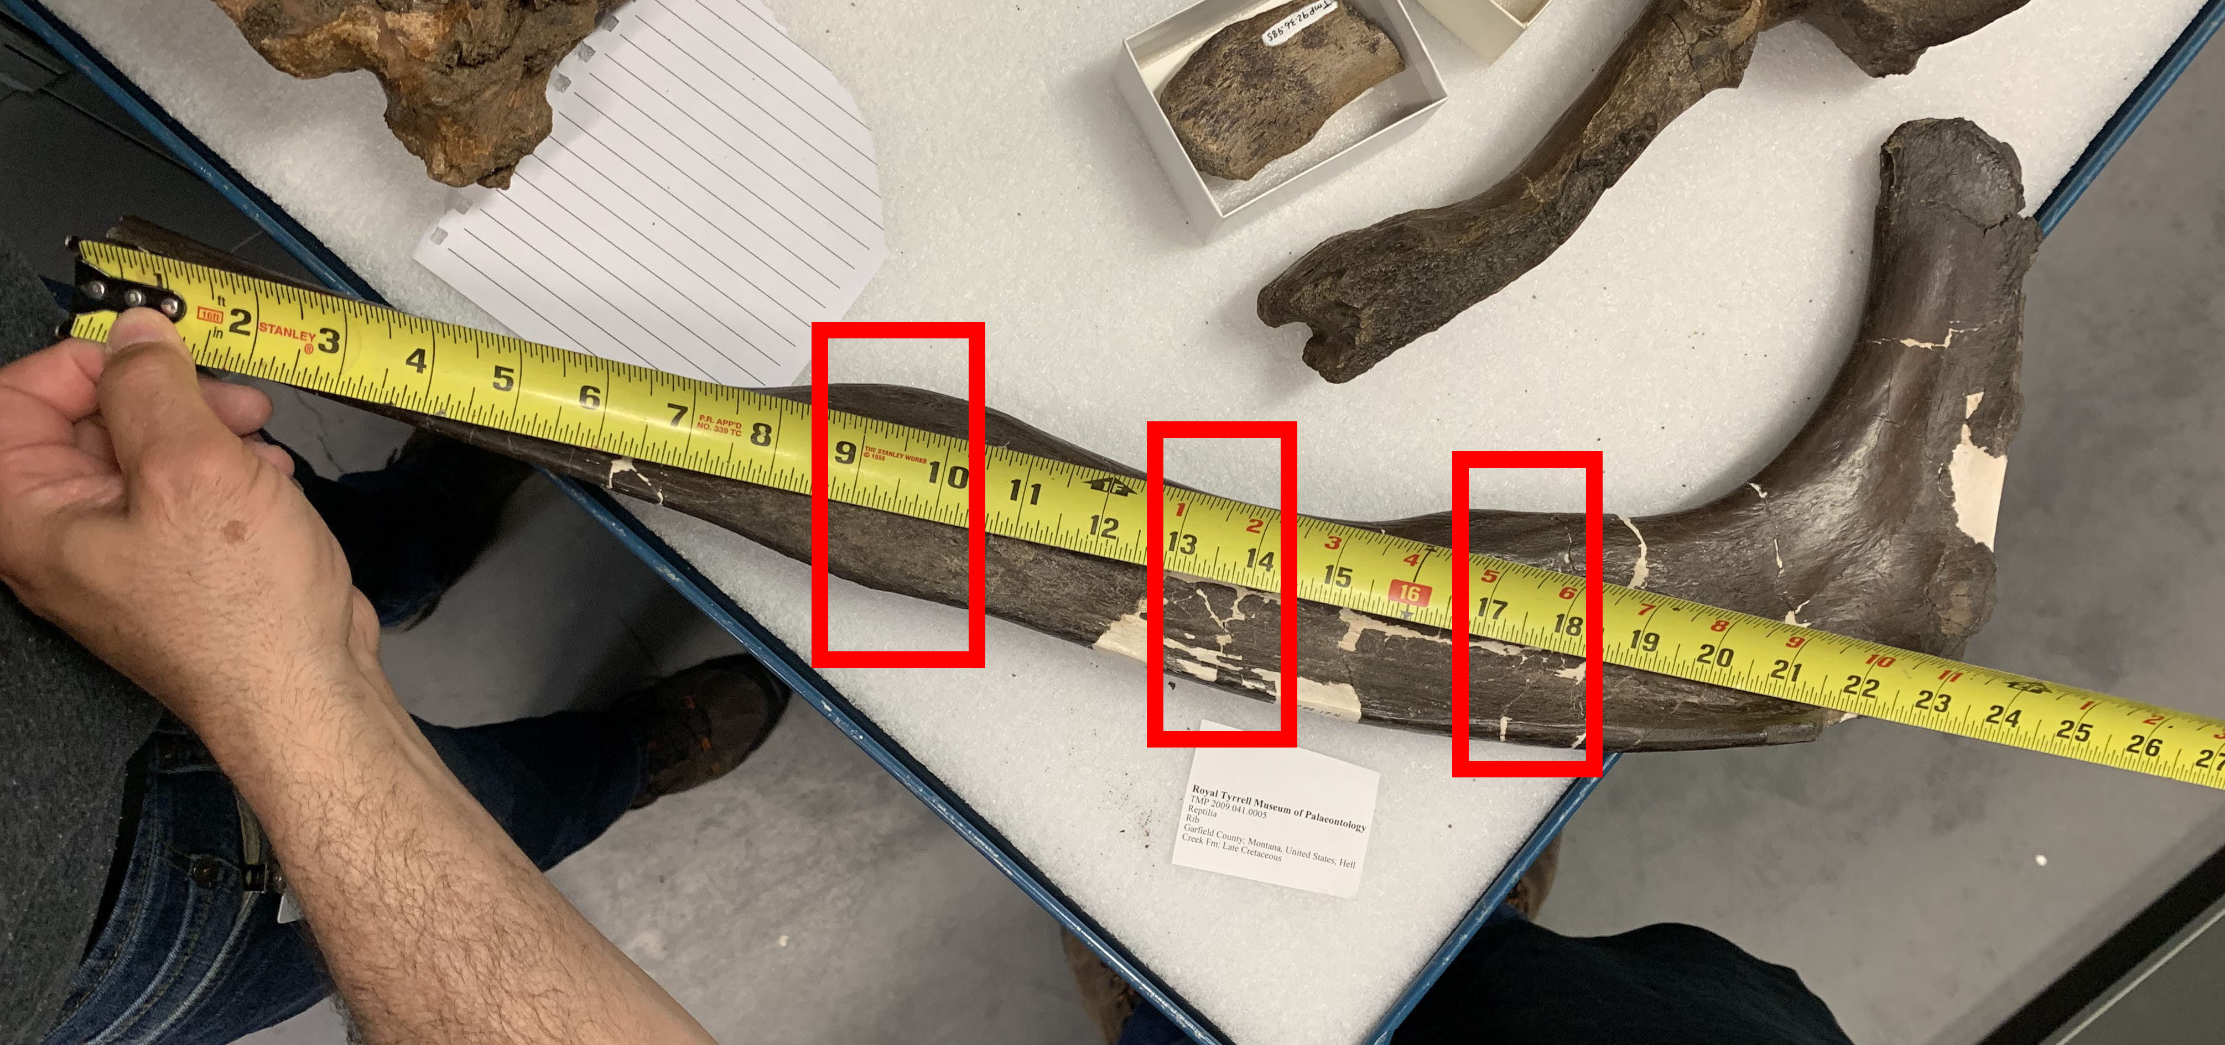
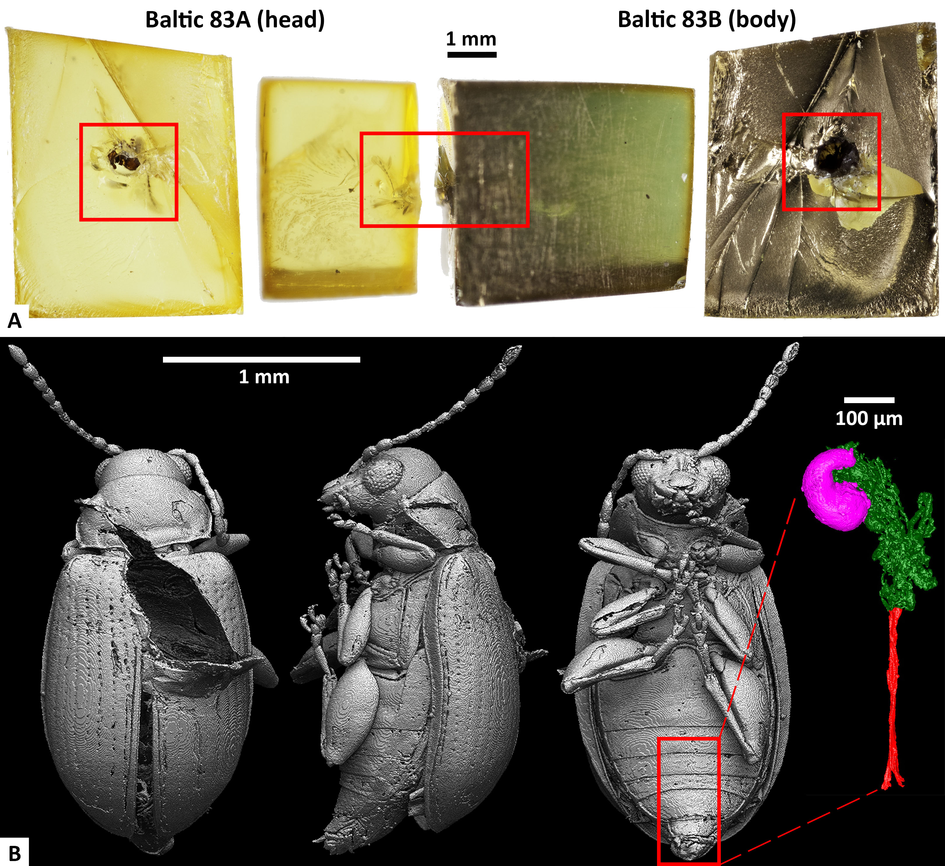
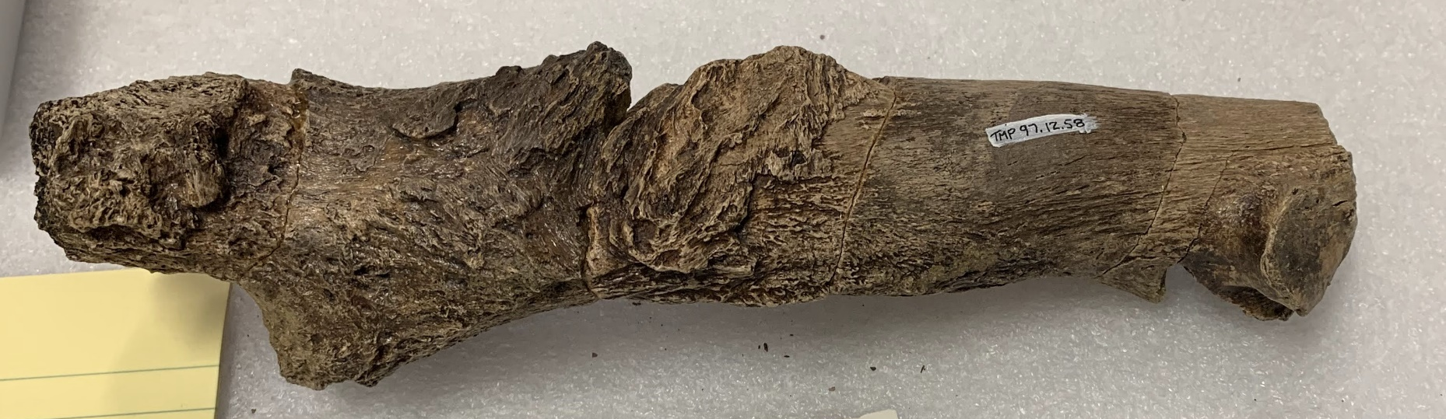
Conclusions
Future work
Iron in the form of goethite (FeO(OH)) is related to exceptional soft tissue preservation
Soft tissue preservation in fossils is more common than conventionally believed, as long as we know where to look and the have the right tools to probe for it.
Test if this level of preservation is found in other pathogenic bones (bones with injury or disease).
Compare the vascular activity to modern relatives
Other studies
Looking at soft tissue and organic preservation in insects trapped in amber
https://www.nature.com/
articles/s41598-023-32557-w
10

Slide 11
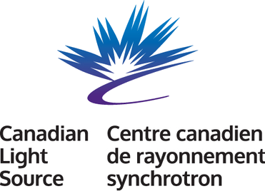

Acknowledgements
Thank you to:
My supervisors Dr. Mauricio Barbi and Dr. Ryan McKellar
Co-authors: Ian Coulson, Andris Bukejs, Vitalii I. Alekseev, Hans C.E. Larsson, Adam Slipinski
Canadian Light Source beamline scientists
Funding from MITACS Accelerate and Friends of the Royal Saskatchewan Museum
11
Notes:
And with that, thank you for listening, and I am happy to take any questions.

Slide 12
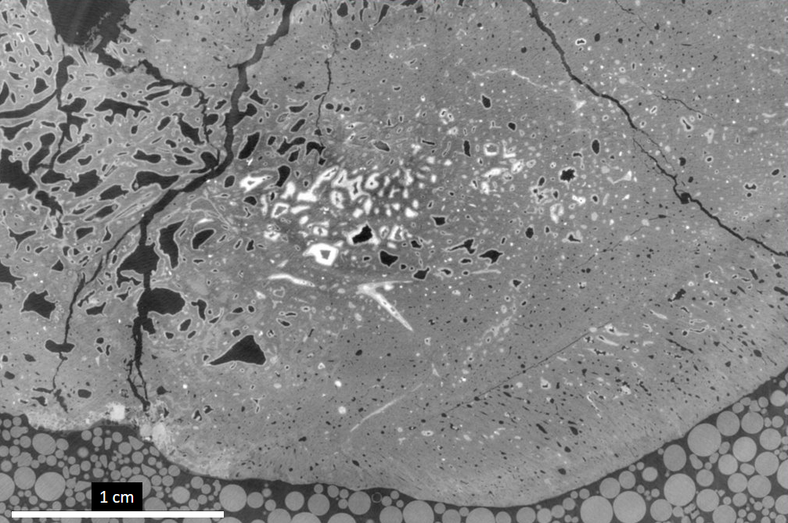

Slide 13
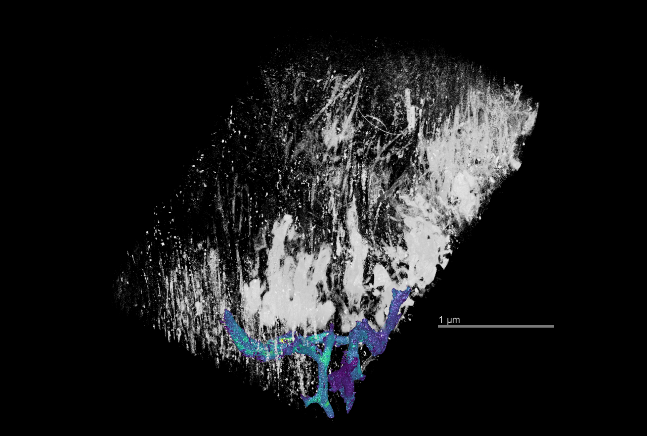
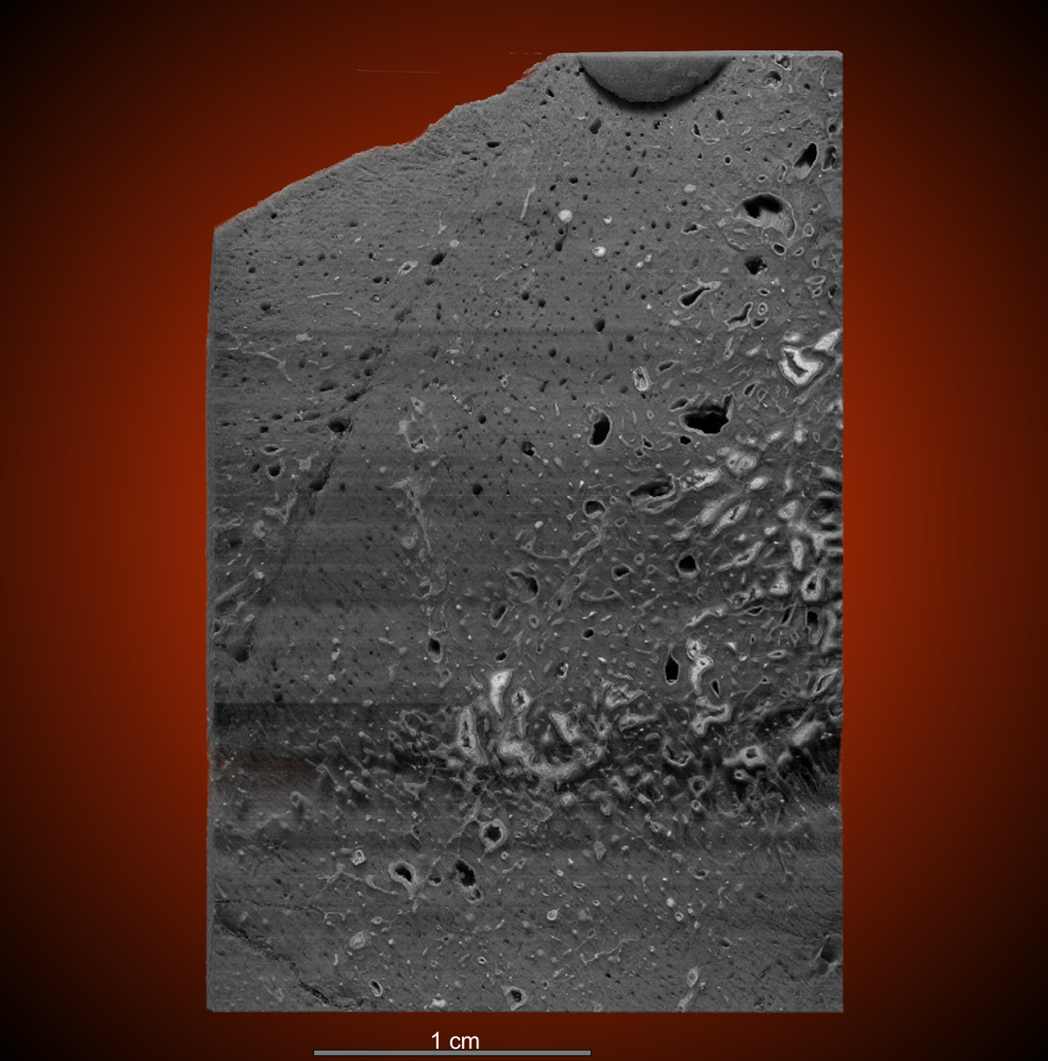
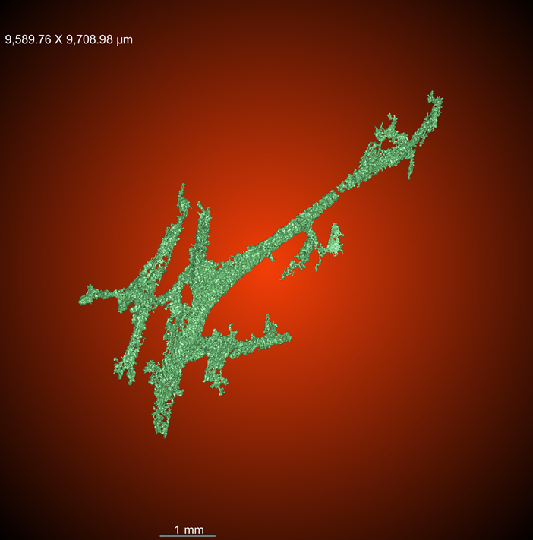

Slide 14
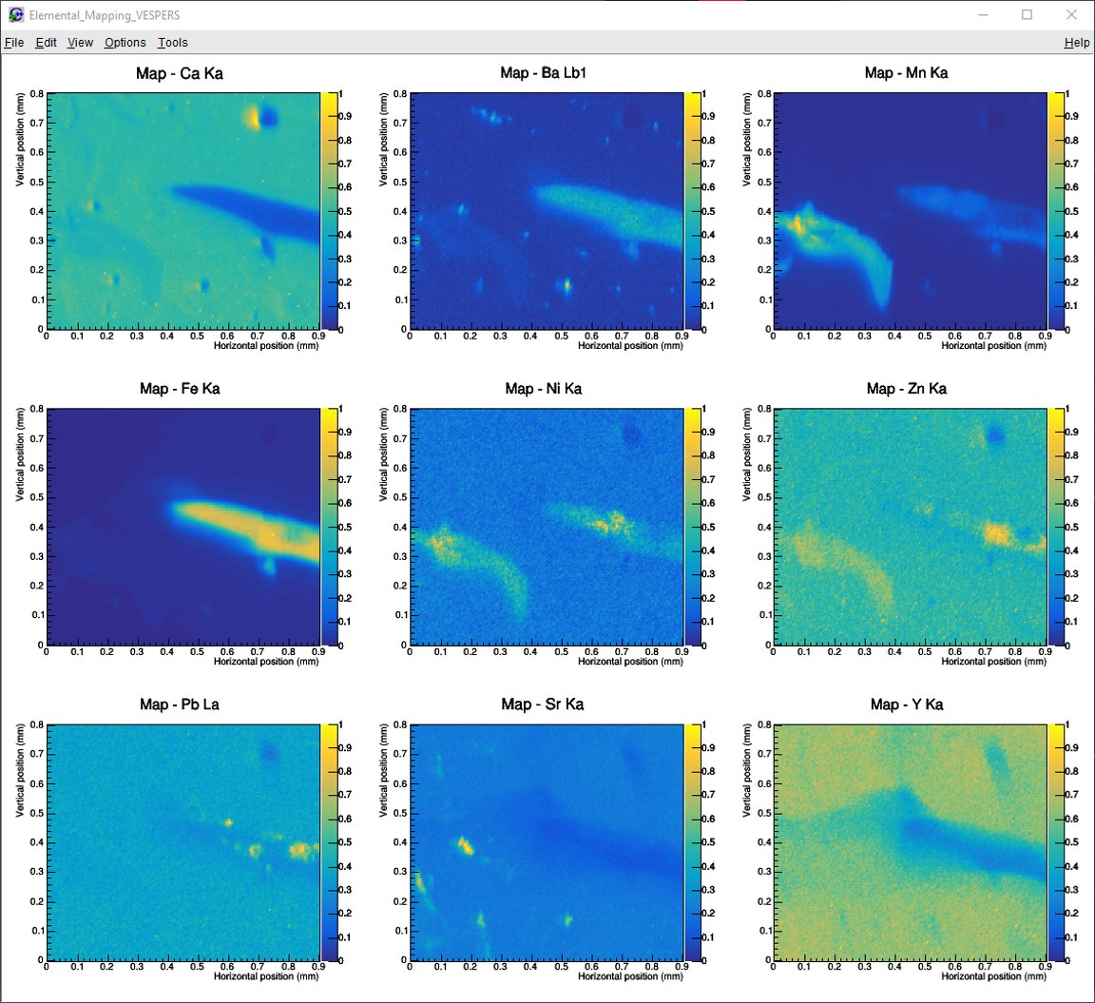

Slide 15
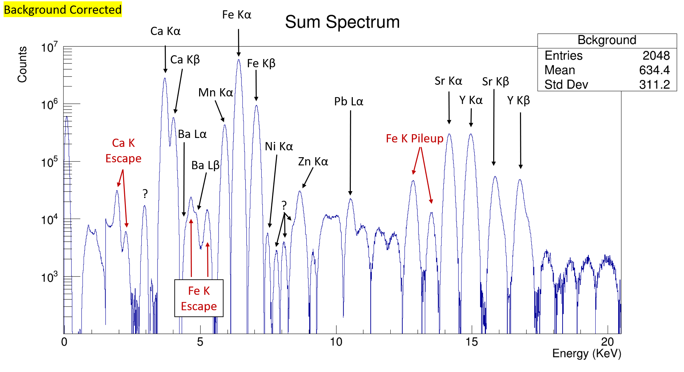
VESPERS - Vessel

Slide 16
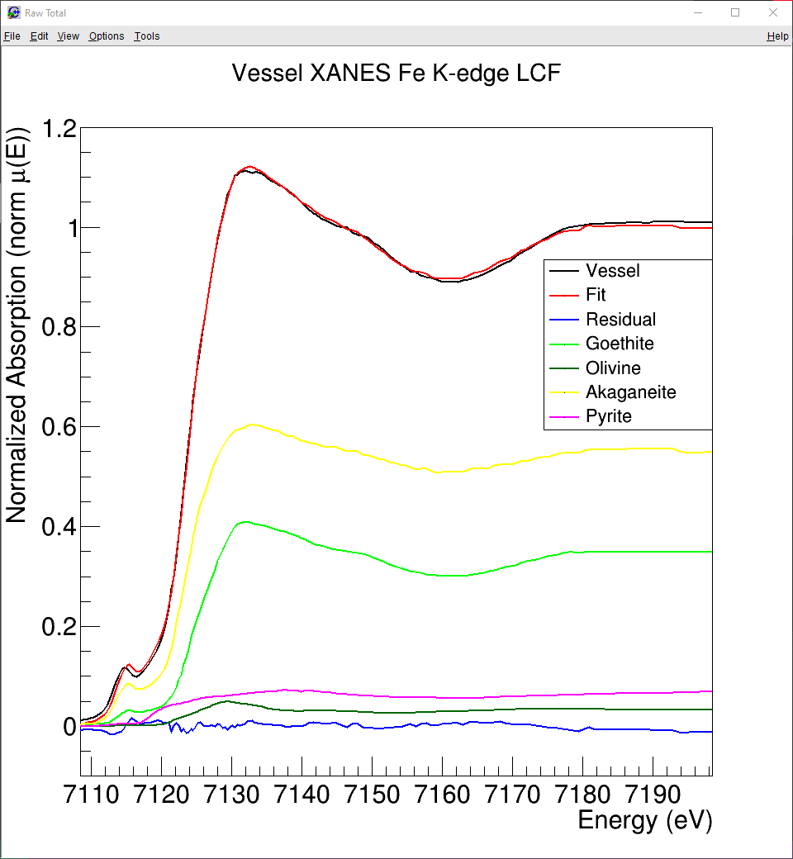
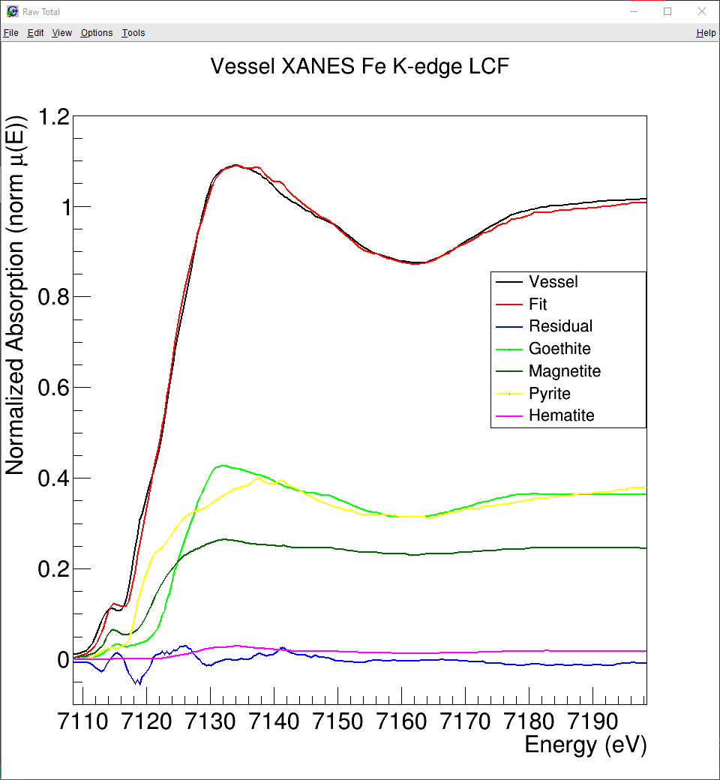
χ² = 0.00830
χ² / n = 0.0000494
χ² = 0.03736
χ² / n = 0.0002198
35%
3%
55%
37%
6%
25%
36%
2%

Slide 17
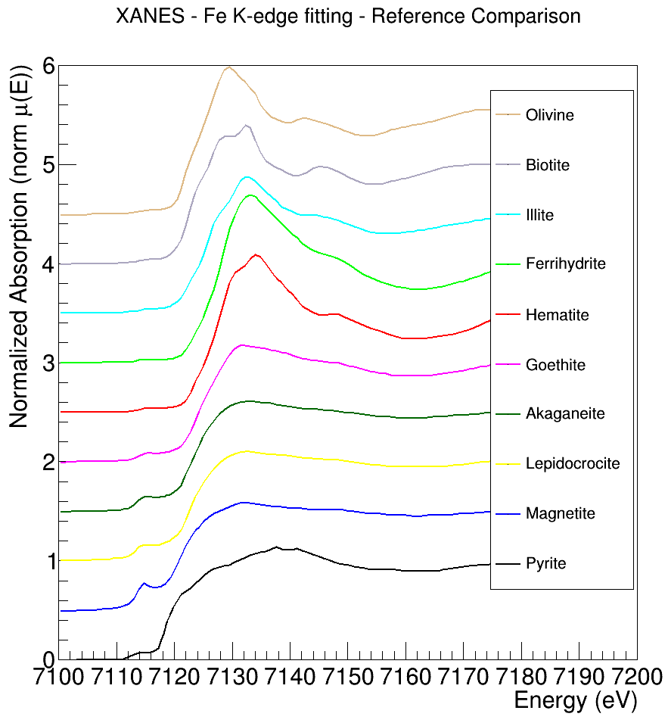

Slide 18
