Slide 1

The liquid deuterium moderator for TUCAN
See also:
M. McCrea, T2-6
S. Vanbergen, T4-6
TRIUMF Ultra-Cold Advanced Neutron collaboration
Jeff Martin
The University of Winnipeg
Land acknowledgement
We acknowledge that we are gathered on ancestral lands, on Treaty One Territory. These lands are the heartland of the Métis people. We acknowledge that our water is sourced from Shoal Lake 40 First Nation.

Slide 2

TRIUMF Ultracold Advanced Neutron (TUCAN) Source
Concept:
  Use superfluid helium (He-II) to convert cold neutrons into ultracold neutrons.
  Couple the He-II directly to a spallation source of neutrons and cold moderators that can be optimized fully.
  Transport UCN to a room-temperature neutron EDM experiment located farther away from the neutron source and cryogenic systems.
We have been operating this system first at RCNP Osaka, then at TRIUMF. We are now completing a new upgrade, scaling up the previous system with several key improvements to reach world-record UCN performance.
A major part of this upgrade is a new liquid D₂ cold neutron moderator.

Slide 3
What is deuterium?
Hydrogen atom (H)= nucleus of one proton, which is orbited by an electron.
Hydrogen molecule (H₂) = two hydrogen atoms in a covalent bond.
Deuteron (d) = one proton and one neutron bound together in a stable nucleus.
Deuterium atom (D) = deuteron, which is orbited by an electron.
Deuterium molecule (D₂) = two deuterium atoms in a covalent bond
Hydrogen/deuterium gas = think of the Hindenburg
At about 20 K or so, both hydrogen and deuterium become a liquid (LH₂, LD₂).
At about 4 K, helium becomes a liquid (He-I); below 2.7 K it becomes a superfluid (He-II).
Slow moving, free neutrons (n) are what we want to make, ultracold neutrons or UCN. Kinetic energy < 300 neV.

Slide 4
UCN production and losses in superfluid ⁴He
Production:
  Incident CN @ 1 meV
  excites one phonon
  Golub and Pendlebury, 1975, 1977
  Multiphonon excitation
  give additional production.
Losses:
  Loss rate dominated by 2-phonon upscattering ~ T⁷
  T = 1.1 K gives τ_{UCN} = 64 s
  We must keep the superfluid much colder than T_{λ}
Korobkina et al., PLA 301 (2002) 462
Courtesy O. Zimmer
Leung et al., PRC 93, 025501 (2016)
Maximize 1 meV neutrons;
Minimize losses, heat.

Slide 5
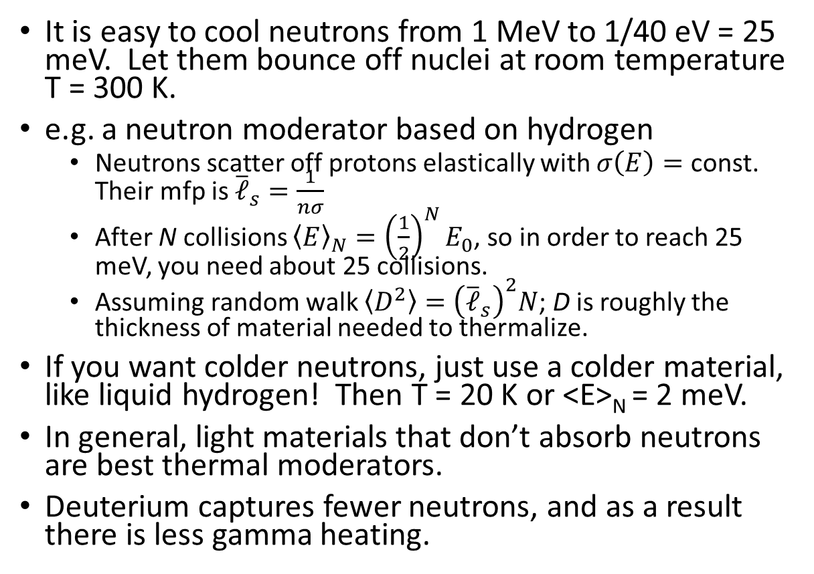
How to cool neutrons from 1 MeV to 1 meV?
It is easy to cool neutrons from 1 MeV to 1/40 eV = 25 meV. Let them bounce off nuclei at room temperature T = 300 K.
e.g. a neutron moderator based on hydrogen
  Neutrons scatter off protons elastically with $σ\left(E\right)=$ const.
  Their mfp is ${\overline{ℓ}}_{s}=\frac{1}{nσ}$
  After N collisions ${\left\langle E\right\rangle }_{N}={\left(\frac{1}{2}\right)}^{N}E_{0}$, so in order to reach 25 meV, you need about 25 collisions.
  Assuming random walk $\left\langle D^{2}\right\rangle ={\left({\overline{ℓ}}_{s}\right)}^{2}N$; D is roughly the thickness of material needed to thermalize.
If you want colder neutrons, just use a colder material, like liquid hydrogen! Then T = 20 K or <E>_{N} = 2 meV.
In general, light materials that don’t absorb neutrons are best thermal moderators.
Deuterium captures fewer neutrons, and as a result there is less gamma heating.

Slide 6
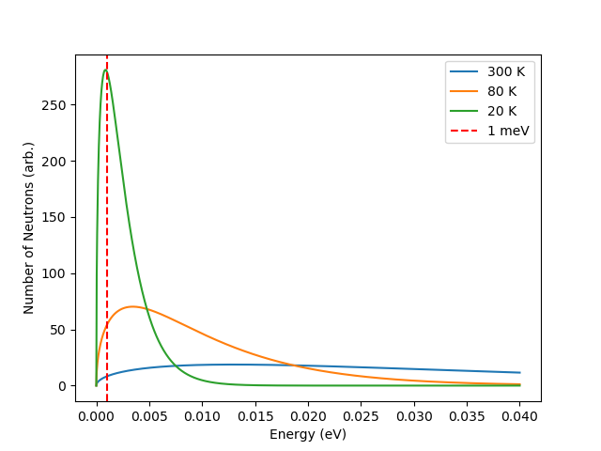
Why LD₂?
Maxwell-Boltzmann energy distribution (neutrons in thermal equilibrium with a material at temperature T)
Relative to LH₂:
  The scattering cross-section is smaller (bad)
  The absorption cross-section is MUCH smaller
  (great!) leading to fewer losses and less gamma
  heating of the nearby superfluid.
Relative to D₂O:
  No problem with the oxygen in D₂O.
  Crystal structure makes D₂O vibrate, even at low temperatures. In previous experiments, we deduced that T = 80 K for neutrons in much colder D₂O.
  Burping is a problem for D₂O. Progressive radiation damage to the crystal stores energy eventually leading to a catastrophic warm up.
Issues for LD₂:
  Cryogenics, safety: engineering!

Slide 7
Neutron production and heat load requirements
W. Schreyer, et al., NIM A 959 (2020) 163525.
Heat load to LD2 is 60 W instantaneously.

Slide 8
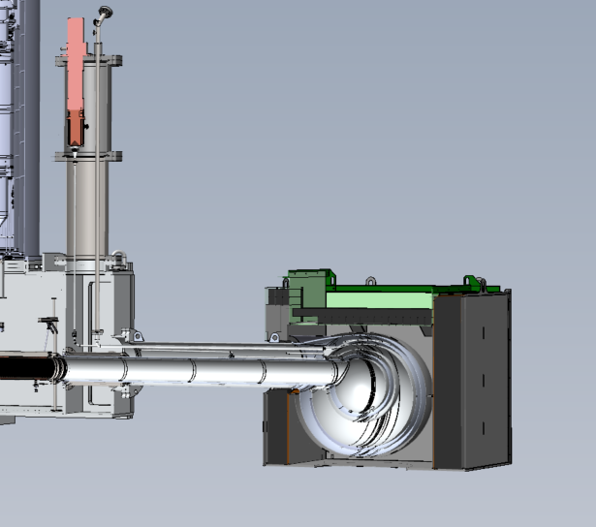



How to keep it cold?
LD₂ thermosyphon (natural circulation system)
To Ballast
Features: single-phase, no moving parts
Cold
Cryocooler + HEX
for $t⟶∞$
T(s,t) (K)
HEX
Heat
Distance along thermosyphon loop (m)
~ 60W for 40μA current (inst.)
Hot
  Time-dependent thermodynamic model by Kiera Augusto and Shawn Stargardter

Slide 9
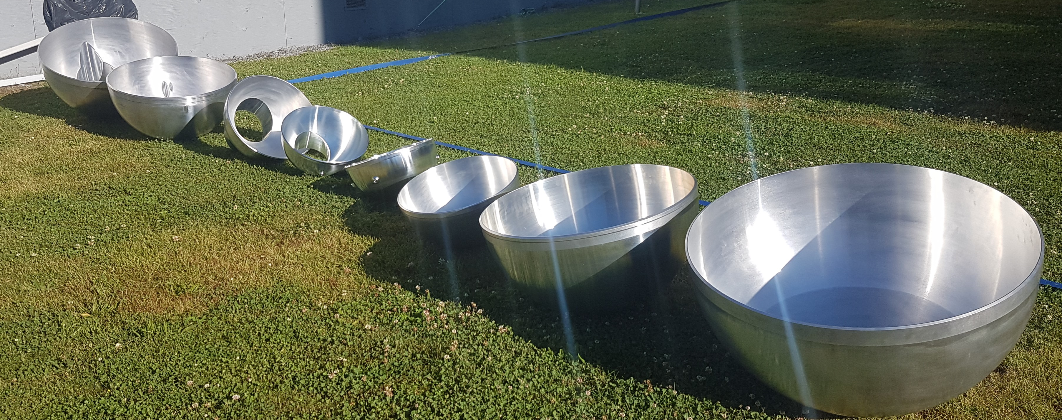
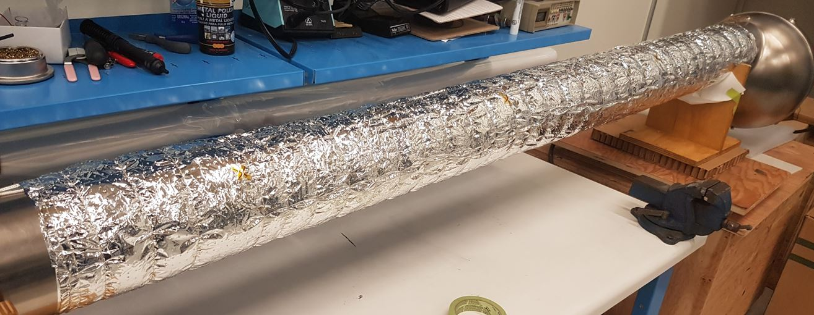
Construction Status
2219 Aluminum Domes
Innermost vessel “Wall 1” completed (it has even been tested with ultracold neutrons!)
Now preparing and assembling the layers of the other vessels; the next layer to be assembled is the LD₂ layer.
“Wall 1” in kapton super-insulation, all sensors installed
Thermal shock tests with LN2

Slide 10
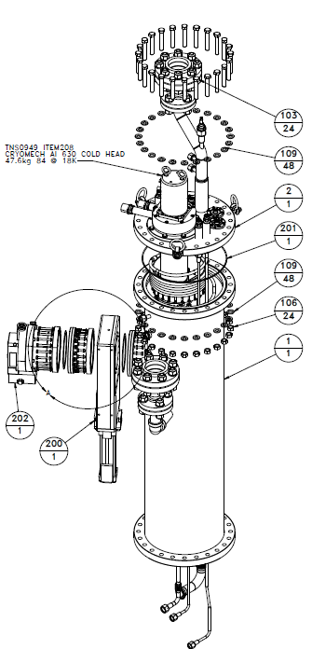
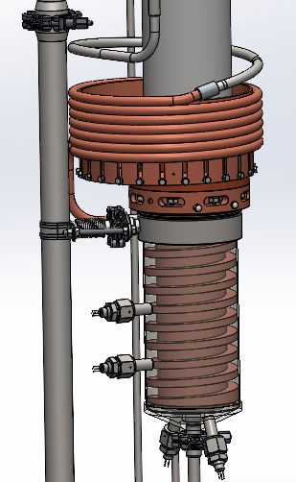
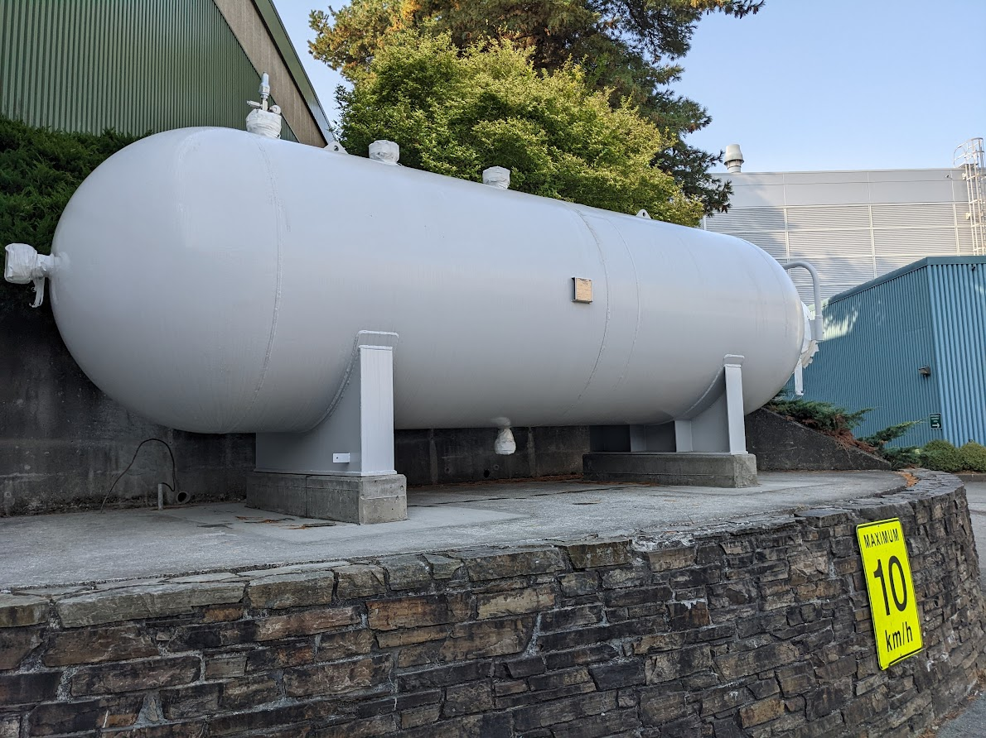
LD2 Cryostat – C. Marshall, et al. (TRIUMF)
Expert review of the LD2 system - Completed Oct 2022.
Detailed drawings are now complete.
Many parts starting to come together.
D2 storage tank installed October 2022
LD2 purifier design
LD2 Heat exchanger section
LD2 cryostat assembly
Gas handling design

Slide 11
Summary and final thoughts
The TUCAN source needs a large flux of 1 meV neutrons, so that they can downscatter in superfluid helium and become ultracold.
An LD₂ moderator at 20 K has been optimized to provide the 1 meV neutrons.
The system relies on a thermosyphon design to cool the LD₂.
The technical design of the LD₂ moderator is nearing completion, with the component pieces (cryostat, heat exchanger, purifier, …) being prepared for construction.
The LD₂ system will be completed in 2024.

Slide 12
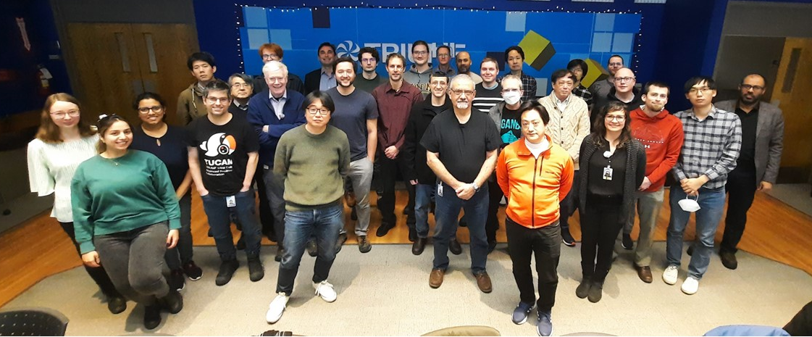
Thank you!
Collaboration meeting January 2023

Slide 14
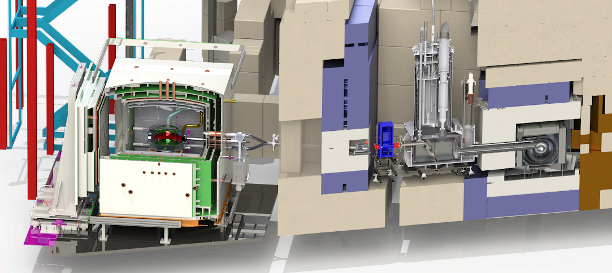
TUCAN source and EDM Experiment
Enable search for neutron EDM with 1 x 10⁻²⁷ ecm precision.
EDM experiment
UCN source
3.4 m
View of future facility at TRIUMF

Slide 15
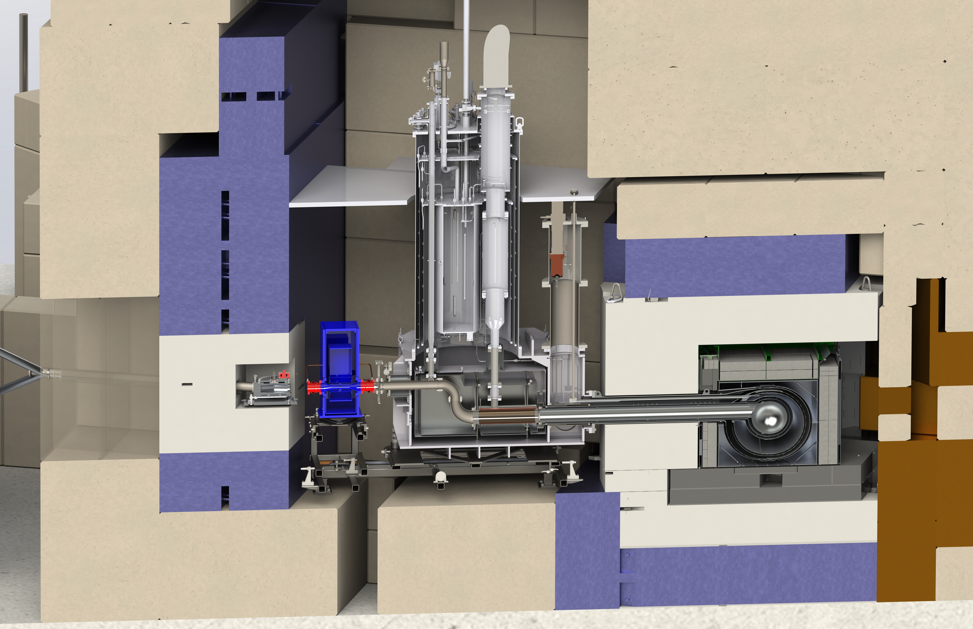
Horizontal source upgrade
Shielding
He-II cryostat (tested in Japan, at TRIUMF)
LD₂ cryostat (designed)
To nEDM
Tail section (constr.)
Target
Superconducting polarizer
(previous project, Japan)
Cryo-connection box (with vendor, Canada)
³He-⁴He heat exchanger (prototype, Japan)

Slide 16
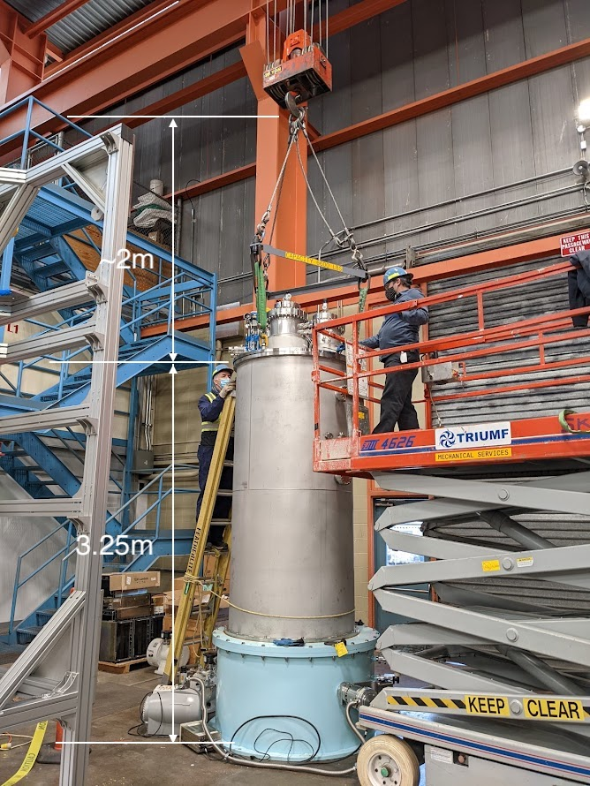
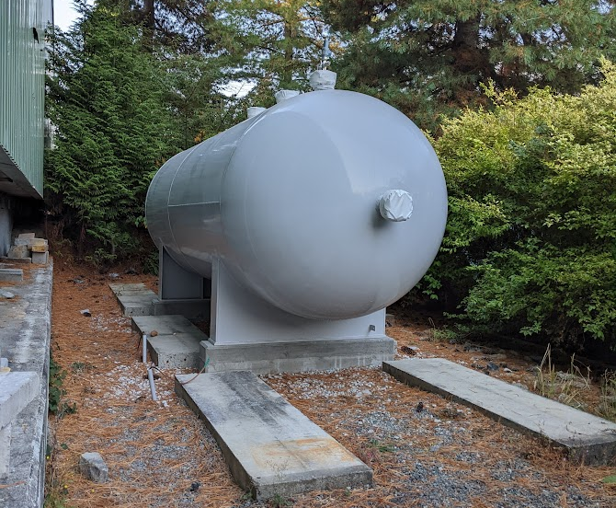
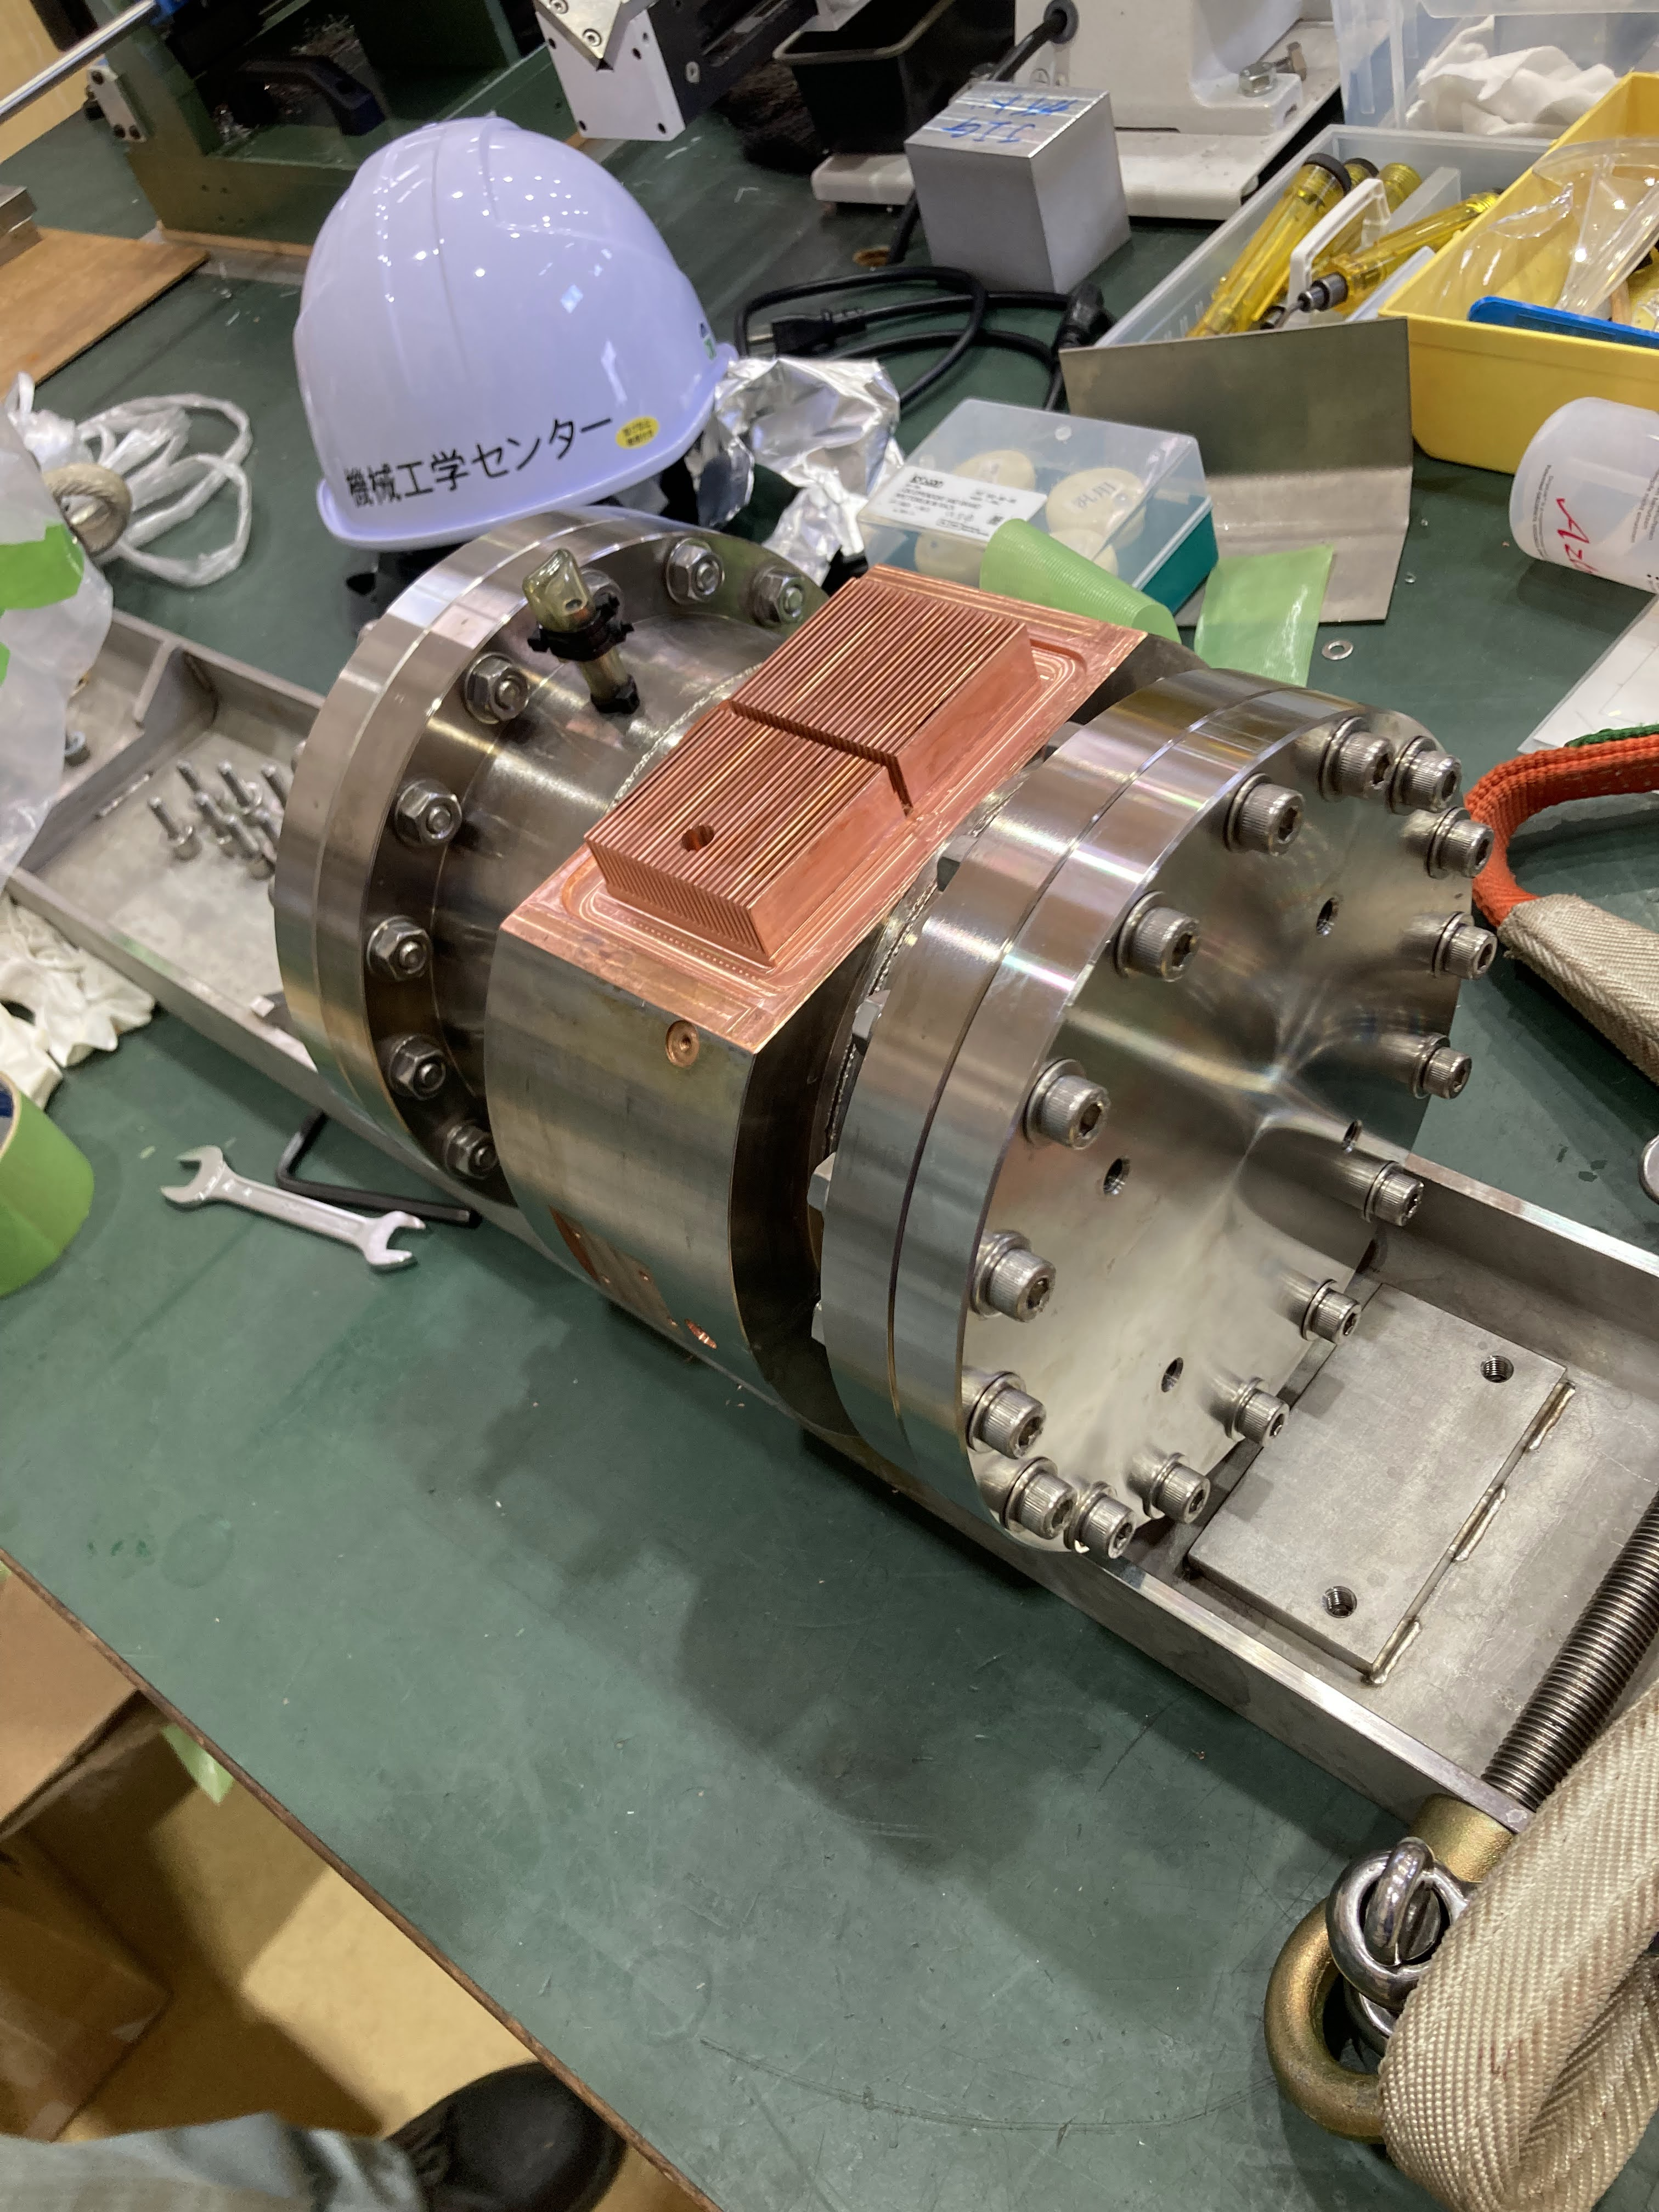
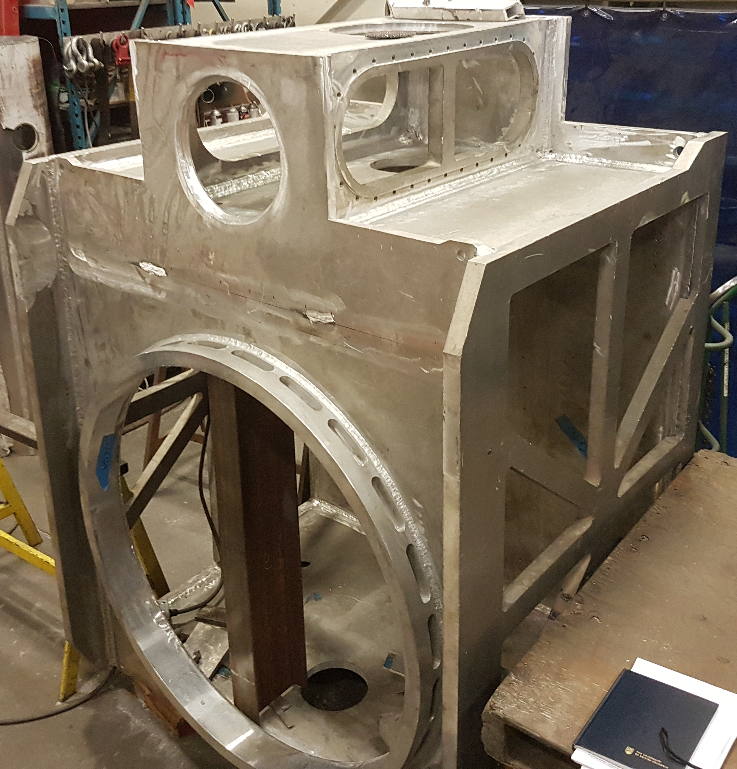
Horizontal source upgrade
Shielding
He-II cryostat (tested in Japan, at TRIUMF)
LD₂ cryostat (designed)
To nEDM
Tail section (constr.)
Target
Superconducting polarizer
(previous project, Japan)
Cryo-connection box (with vendor, Canada)
³He-⁴He heat exchanger (prototype, Japan)

Slide 17
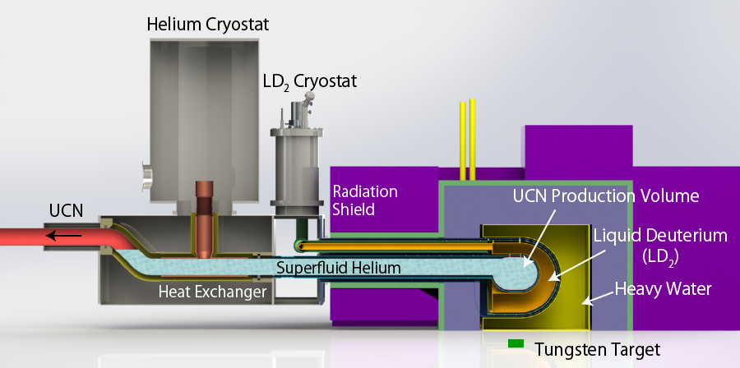
TUCAN Source Upgrade Concept and Goals
LD₂ moderator
  increase cold neutron flux at 1 meV (×2.5)
Helium Cryostat with high cooling power
  production volume (×3)
  proton beam power (×50)
    0.5 kW -> 20 kW
    heat load on superfluid : 8.1 W
      include heat deposit on vessel
  superfluid helium temperature (×1/3)
    T_{He-II} = 1.2 K (0.8 K@RCNP)
    Storage lifetime : ～ 30 sec
Estimated source performance
  production rate: 1.4 x 10⁷ UCN/s
  UCN density
    6×10³ UCN/cm³ @ production
    ～220 UCN/cm³ @ measurement
3He pumping
liquid ³He
20 K
300 K
proton beam (20 kW)

Slide 18
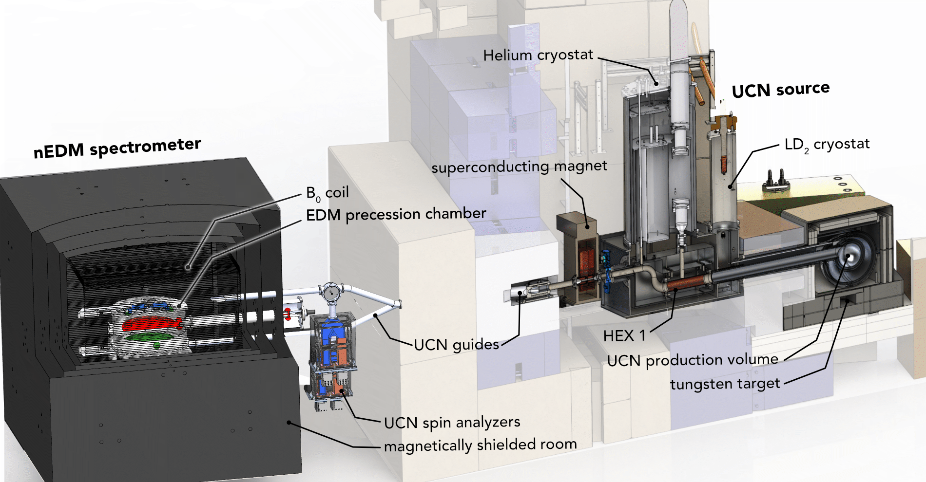

Slide 19
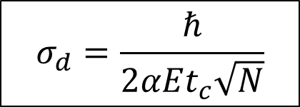
TUCAN Sensitivity Estimate
UCN production rate | 1.4×10⁷ UCN/sec
UCN loaded into EDM cell | 220 pol. UCN/cm³ | 14M UCN
UCN detected at end of cycle | 23 pol. UCN/cm³ | 1.4M UCN
Compare to typ 15,000 UCN detected at previous best expt. (ILL/PSI), and 121,000 UCN projected for n2EDM
N. Ayres, et al. arXiv:2101.08730
S. Sidhu, et al. arXiv:2212.04958
$$σ_{d}=\frac{ℏ}{2αEt_{c}\sqrt{N}}$$
E = 12.5 kV/cm
t_{c} = 188 s
α = 0.6 (visibility)
σ_{d} = 2 x 10⁻²⁵ ecm/cycle
To reach statistical sensitivity of σ_{d} = 1×10⁻²⁷ ecm
400 days of running required

