Slide 1


June 20th, 2023
Rotational Effects
on Fisher Information
of Thermal Black Hole Parameter
CAP Congress 2023, UNB
Everett PAtterson
1

Slide 2
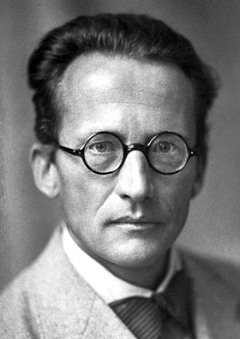
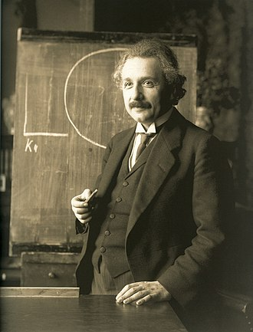
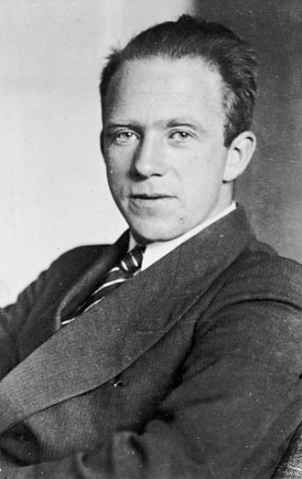
Introduction
RQI as an approach to reconcile Q+G
  How does relativity affect QI processes?
  Using QI processes to probe relativistic systems
  Mostly QFT in curved spacetime
Thermal states are an important feature of the
quantum vacuum in curved spacetime
  E.g., Hawking radiation, Unruh effect
Fisher information (FI) is used in Relativistic Quantum Metrology (RQM) to guide the
development of experimental set ups.
  Here we use it to ‘probe’ spacetime
2
Notes:
Semiclassical gravity
Best playgrounds for Q+G effects are BHs
E: Albert Einstein – Wikipedia
S: Erwin Schrödinger – Wikipedia
H: Werner Heisenberg - Wikipedia

Slide 3
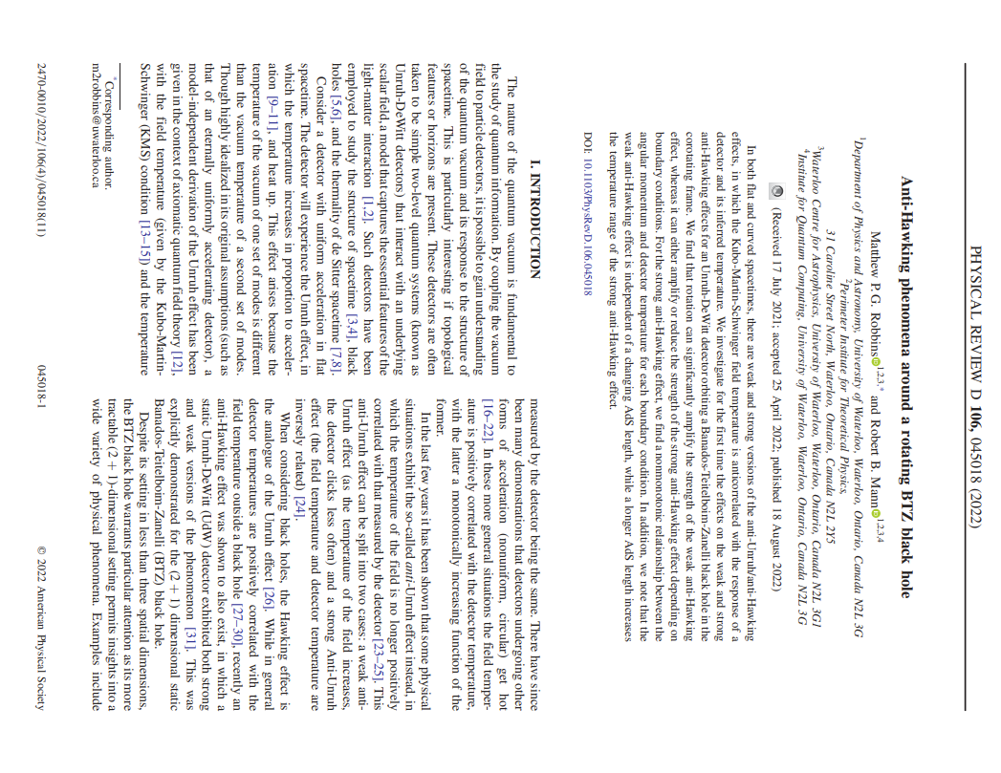
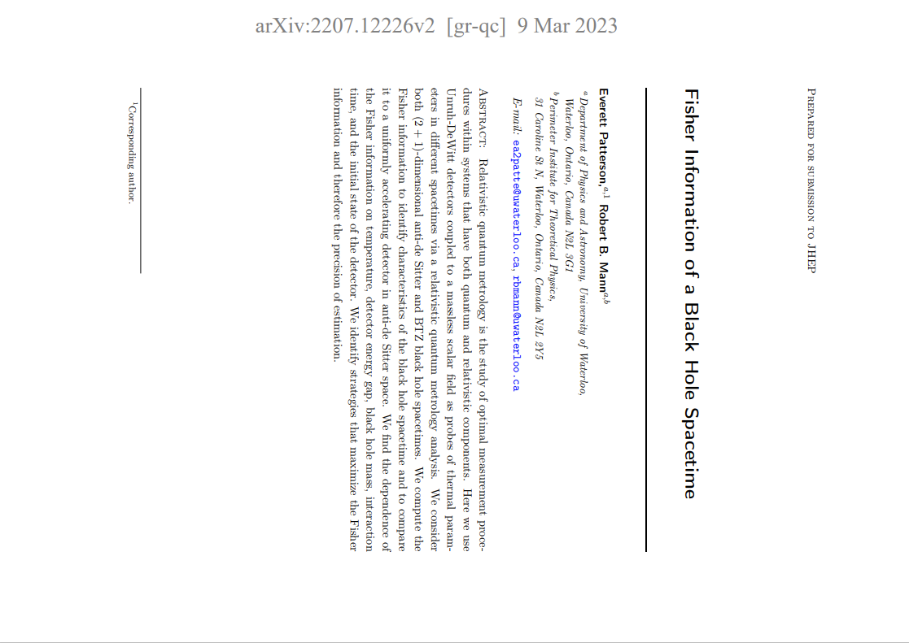
Previous Work
Good understanding of FI in 4-d dS and AdS, and 3-d AdS and BTZ
  BH mass effect
Want to explore FI behaviour in *rotating* BH spacetime
  Known quantum vacuum effects
  (1) Improve ‘measurement’ procedures
  (2) Act as a spacetime discriminant
3

Slide 4
Theory
Most general approach to RQI requires 3 characters:
  Particle detector(s) – single UDW detector
  QFT in the underlying spacetime – massless scalar field in RBTZ
  Framework under consideration – (Thermal) Fisher information (some OQS in the background)
4
Notes:
FI: Included for completeness, ultimately dependent on the Response Rate seen below
UDW: Emphasize energy gap
RR: Mention Wightman function
Image sum: Relates AdS to BTZ

Slide 5

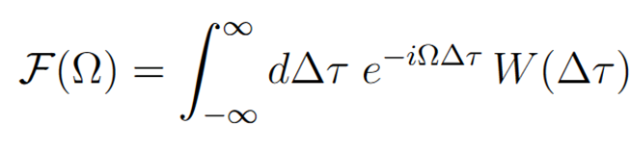
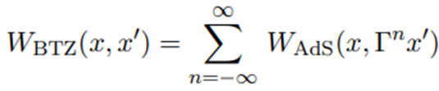
Theory
FI Definition
Unruh-DeWitt (UDW) detector, interaction Hamiltonian:
While the FI definition may seem a little messy, by using the Open Quantum Systems paradigm, it is solely dependent on the Response Rate [40] of the UDW detector:
BTZ Wightman function is related to AdS by image sum [44]:
5
Notes:
FI: Included for completeness, ultimately dependent on the Response Rate seen below
UDW: Emphasize energy gap
RR: Mention Wightman function
Image sum: Relates AdS to BTZ

Slide 6

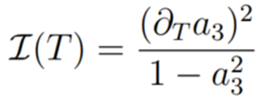
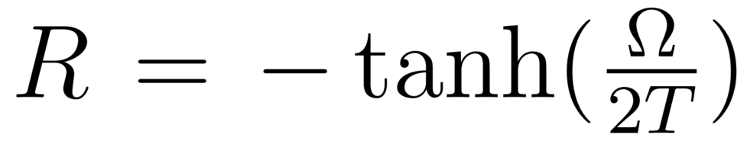
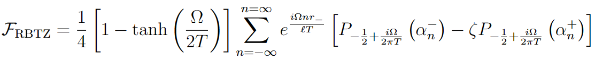
Theory
θ is the initial state of detector
‘A’ depends on Response Rate
FI Definition where
While the FI definition may seem a little messy, by using the Open Quantum Systems paradigm, it is solely dependent on the Response Rate [40] of the UDW detector:
  Where
When τ→∞, ‘R’ describes Fisher info
6
Notes:
RR: Expressed here for rotating BTZ spacetime
RR: Image Sum, Legendre Polynomials

Slide 7
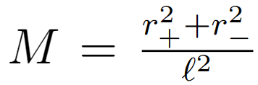

Response Rate – In more detail
inner radius
Same Response Rate, but bigger:
  Where
Note the Radii are what distinguish the black hole spacetimes
The BTZ mass and angular momentum can be expressed in terms of these radii:
outer radius
7
Notes:
RR: Energy gap, Temperature, Legendre polynomial, Boundary condition, Mass
Radii: r- <= r+

Slide 8
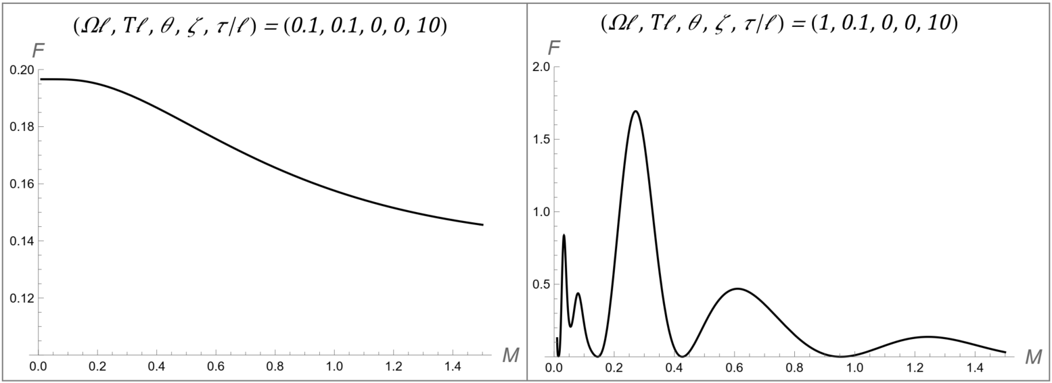
[2207.12226] Fisher Information of a Black Hole Spacetime (arxiv.org)
Static BTZ
Cold, Ω > T
When Ω = T, we see a monotonic decrease in the FI for increasing mass
Whereas for Ω ≠ T, we see an oscillatory behaviour
This suggests that ‘tuning’ the detector to the mass and temperature can indeed improve estimation
8

Slide 9
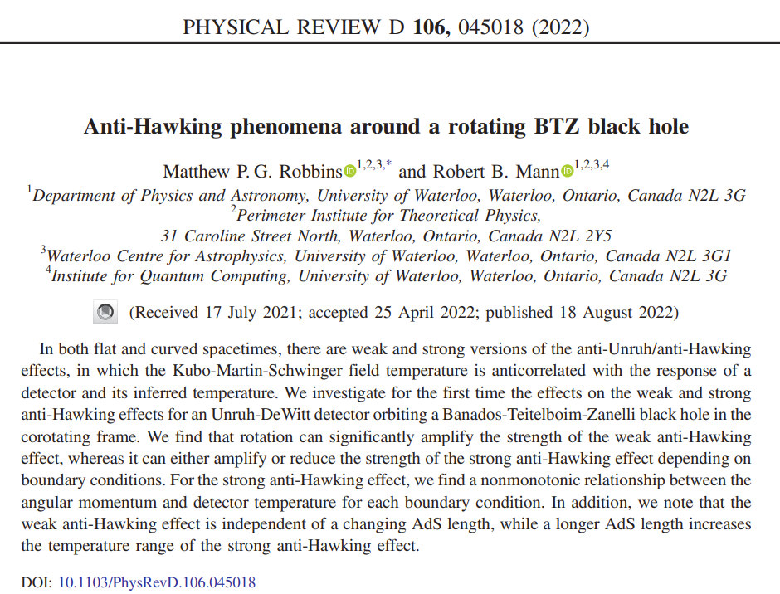
Previous work
Why Rotating Black Holes:
Rotating BTZ Black Holes have exhibited
  Amplification of Entanglement Harvesting
  Most pronounced for small black holes
Also demonstrate
  Anti-Hawking effect
  Dependent on BH mass
  Very dependent on spacetime boundary conditions
[2107.01648] Anti-Hawking Phenomena around a Rotating BTZ Black Hole (arxiv.org)
[2010.14517] Entanglement Amplification from Rotating Black Holes (arxiv.org)
9

Slide 10
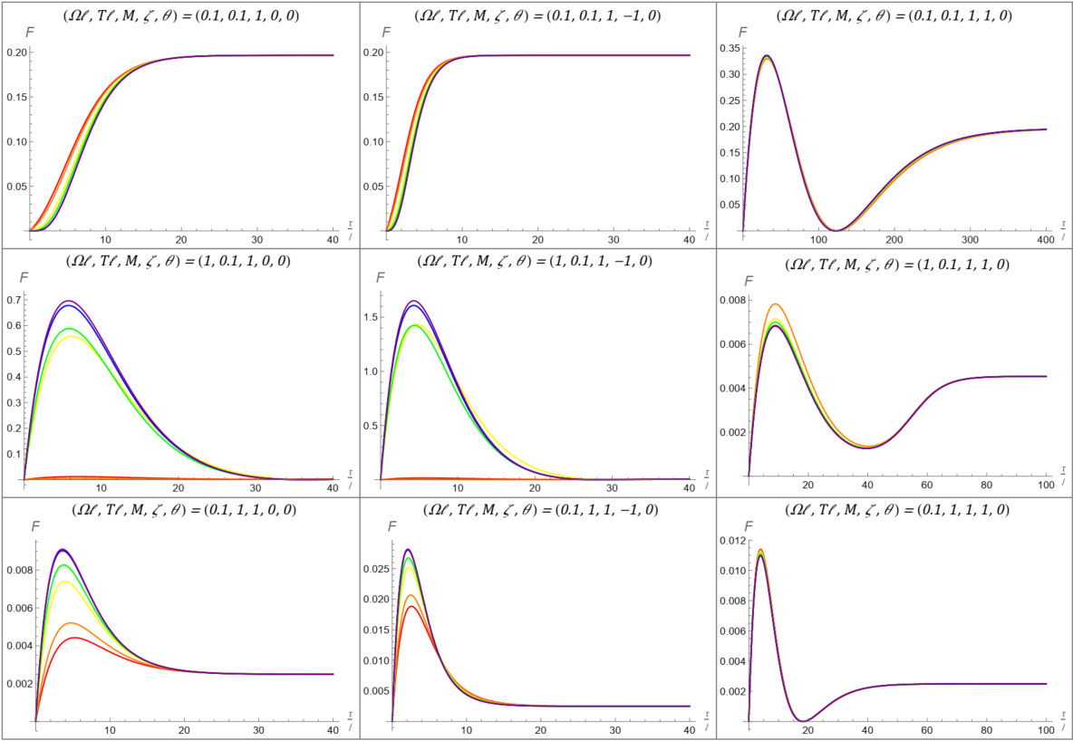
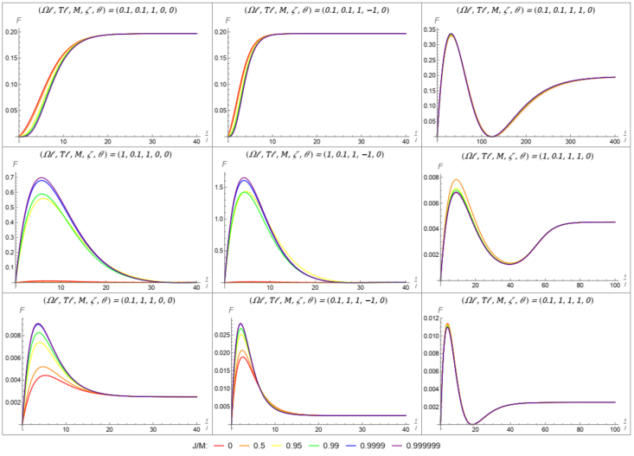
Rotating BTZ for M=1,
Varying J/M
Of note:
When (Ω, T) = (0.1, 0.1), varying J leaves the FI mostly unchanged
When (Ω, T) = (1, 0.1) aka Cold,
  Increasing J leads to dramatic increase in FI for transparent (ζ = 0) and Neumann (ζ = -1) boundary conditions,
    Most dramatic between J=0.5M and J=0.95M
  But a slight decrease for Dirichlet (ζ = 1) boundary condition
When (Ω, T) = (0.1, 1) aka Hot,
  Increasing J leads to increase in FI for transparent
  (ζ = 0) and Neumann (ζ = -1) boundary conditions,
    Though not so dramatic
  And still a slight decrease for Dirichlet (ζ = 1) boundary condition
Transparent (ζ = 0)
Neumann (ζ = -1)
Dirichlet (ζ = 1)
(Ω = T)
(Ω > T)
(Ω < T)
10

Slide 11
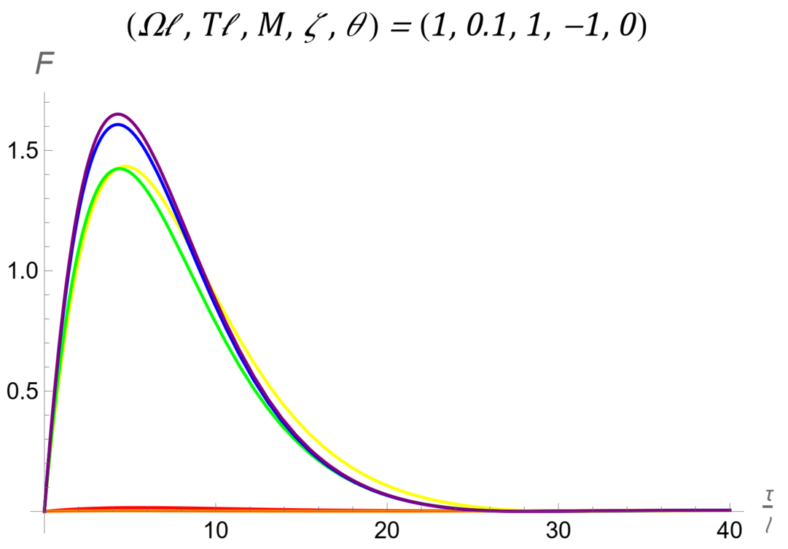
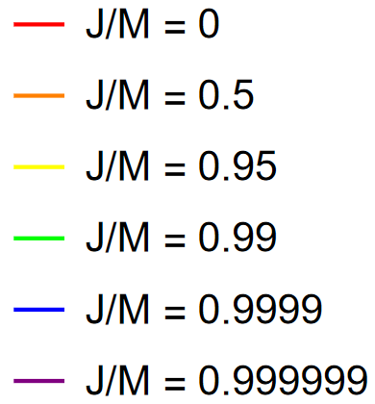
Rotating BTZ for M=1,
Varying J/M
Of note:
When (Ω, T) = (0.1, 0.1), varying J leaves the FI mostly unchanged
When (Ω, T) = (1, 0.1) aka Cold,
  Increasing J leads to dramatic increase in FI for transparent (ζ = 0) and Neumann (ζ = -1) boundary conditions,
    Most dramatic between J=0.5M and J=0.95M
  But a slight decrease for Dirichlet (ζ = 1) boundary condition
Hot is similar to Cold
11

Slide 12
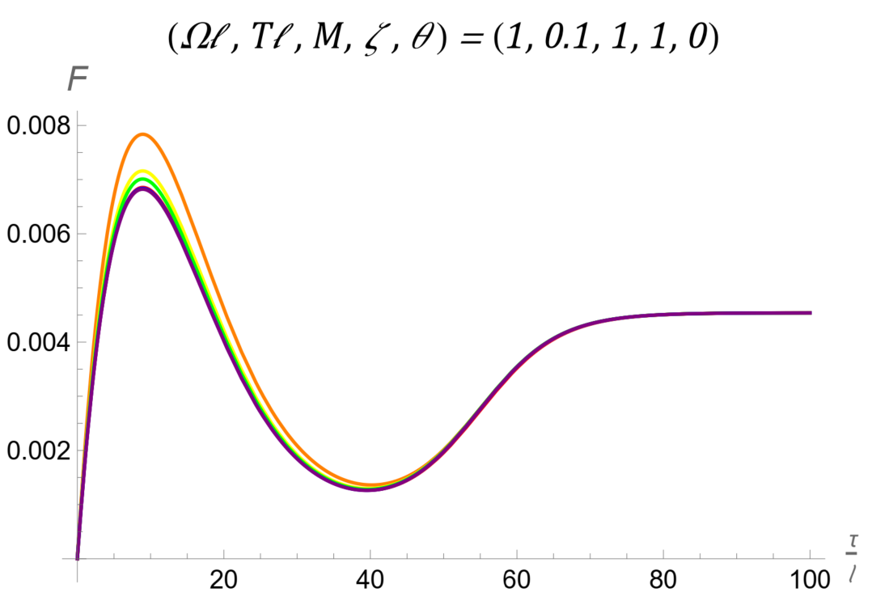
Rotating BTZ for M=1,
Varying J/M
Of note:
When (Ω, T) = (0.1, 0.1), varying J leaves the FI mostly unchanged
When (Ω, T) = (1, 0.1) aka Cold,
  Increasing J leads to dramatic increase in FI for transparent (ζ = 0) and Neumann (ζ = -1) boundary conditions,
    Most dramatic between J=0.5M and J=0.95M
  But a slight decrease for Dirichlet (ζ = 1) boundary condition
Hot is similar to Cold
12

Slide 13
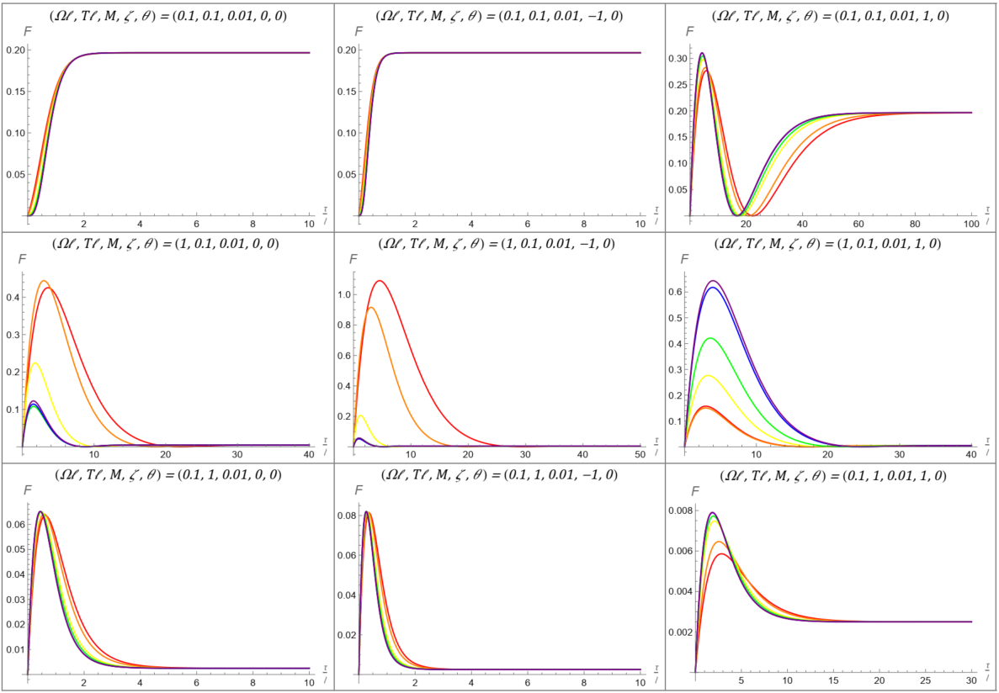
Rotating BTZ for M=0.01,
Varying J/M
Of note:
Transparent (ζ = 0)
Neumann (ζ = -1)
Dirichlet (ζ = 1)
The distinction in the FI based on the boundary condition (ζ) persists
However, when (Ω, T) = (1, 0.1) aka Cold,
  increasing J leads to significant decrease in FI for transparent (ζ = 0) and Neumann (ζ = -1) boundary conditions,
  but an increase for Dirichlet (ζ = 1) boundary condition
When (Ω, T) = (0.1, 1) aka Hot,
  increasing J leads to slight shift in the time of the maximal FI for all boundary conditions
  but still a slight decrease for Dirichlet (ζ = 1) boundary condition
(Ω = T)
(Ω > T)
(Ω < T)
13

Slide 14
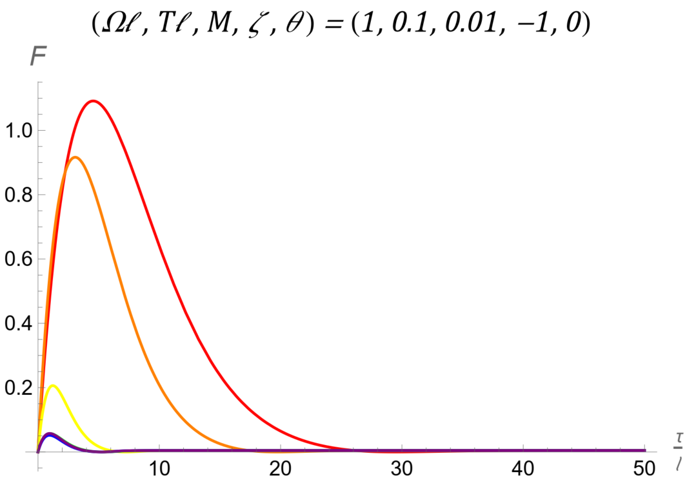

Rotating BTZ for M=0.01,
Varying J/M
Of note:
The distinction in the FI based on the boundary condition (ζ) persists
However, when (Ω, T) = (1, 0.1) aka Cold,
  increasing J leads to significant decrease in FI for transparent (ζ = 0) and Neumann (ζ = -1) boundary conditions,
  but an increase for Dirichlet (ζ = 1) boundary condition
When (Ω, T) = (0.1, 1) aka Hot,
  increasing J leads to slight shift in the time of the maximal FI for all boundary conditions
  but still a slight decrease for Dirichlet (ζ = 1) boundary condition
14

Slide 15
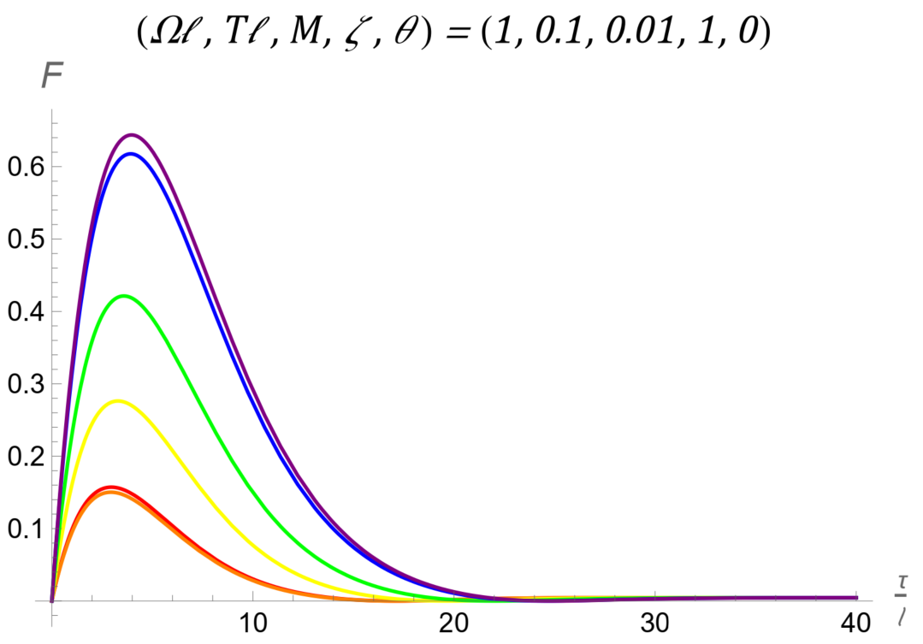
Rotating BTZ for M=0.01,
Varying J/M
Of note:
The distinction in the FI based on the boundary condition (ζ) persists
However, when (Ω, T) = (1, 0.1) aka Cold,
  increasing J leads to significant decrease in FI for transparent (ζ = 0) and Neumann (ζ = -1) boundary conditions,
  but an increase for Dirichlet (ζ = 1) boundary condition
When (Ω, T) = (0.1, 1) aka Hot,
  increasing J leads to slight shift in the time of the maximal FI for all boundary conditions
  but still a slight decrease for Dirichlet (ζ = 1) boundary condition
15

Slide 16

Conclusion
We find that
Varying the angular momentum J/M does lead to change in the FI, especially for near extremal rotation
It can both significantly amplify or de-amplify the FI depending on
  the boundary condition ζ and
  the BTZ mass M
  more like anti-Hawking results than entanglement harvesting
Future work:
Quantum Fisher information [52] analysis in 2+1 Dimensions
More realistic Fisher information analysis: 3+1 Dimensional Spacetimes
16
Notes:
- More like AH (because single detector?)

Slide 17
Thanks!!
Thank you
Cited work by EP:
[2207.12226] Fisher Information of a Black Hole Spacetime (arxiv.org) ,
Analysis of the Thermal Fisher Information in 2+1 Dimensional Black Hole Spacetimes (uwaterloo.ca)
Everett Patterson, PhD Student
University of Waterloo + IQC
Email: ea2patterson@uwaterloo.ca
17

Slide 18
References
18

Slide 19

Supplementary Slides
Rotational Effects on Fisher Information of Thermal Black Hole Parameter
Everett Patterson
CAP Congress 2023, UNB
June 20, 2023

Slide 20



Fisher information
Quantification of the parameter estimation problem,
Given , the set of possible values for the observable and underlying parameters, respectively,
Estimator is said to be unbiased if Expectation Value = True Value of Parameter
FI Definition
Cramér-Rao bound
i

Slide 21







Unruh-DeWitt (UDW) Detector
Two-level quantum system with states and separated by an energy gap
Conformally couple to massless scalar field, , via interaction Hamiltonian:
Where , .
Has response function ,
And response rate , where .
ii

Slide 22



Spacetimes
First consider AdS₃, then BTZ
AdS₃ stems from induced metric on a 3-d hyperboloid
  Where is the AdS length
Embedded in 4-d flat geometry
  With coordinates
iii

Slide 23
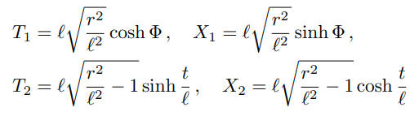


Spacetime – AdS₃
Transformations
Metric
Wightman
iv
Notes:
Emphasize the squared distance

Slide 24
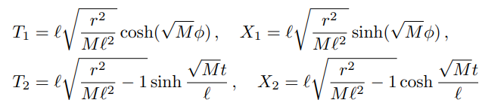



Spacetime – Stationary BTZ
Transformations with:
Metric
Wightman
v

Slide 25




Spacetime – Rotating BTZ
Very similar to Stationary BTZ
Metric:
  Where , , and and are the inner and outer radii,
  is the angular momentum.
Wightman
vi

Slide 26
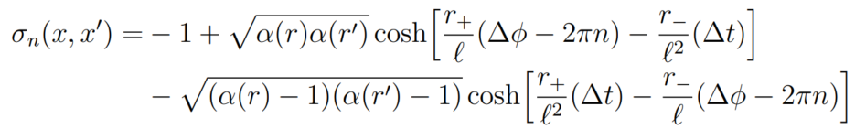

Spacetime – Rotating BTZ
Wightman function appears to be unchanged
But the squared distance is now
  Where
  And
vii

Slide 27

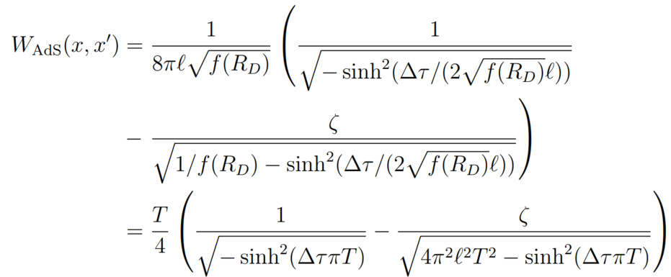

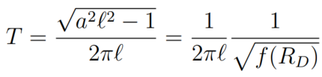
Derivations – AdS Response rate
For AdS, we consider the constantly accelerating trajectory
  Corresponding to a stationary detector in Rindler coordinates
The Wightman function is then given by
  Where we substituted by the KMS
  temperature
viii

Slide 28

Derivations – AdS Response rate
The response rate can then be expressed as
  Where we performed the substitution
Performing the integrals, we find that
ix

Slide 29



Derivations – Stationary BTZ Response rate
For BTZ, we consider the stationary detector trajectory
  Where is the redshift factor
Following a very similar approach to that employed in Ads, we find that the response rate is given by
  Where
x

Slide 30

Derivations – Rotating BTZ Response rate
For BTZ, we consider the co-rotating detector trajectory
  Where is the redshift factor
Once more, following a similar approach to that employed in AdS, we find that the response rate to be
  Where
xi

Slide 31
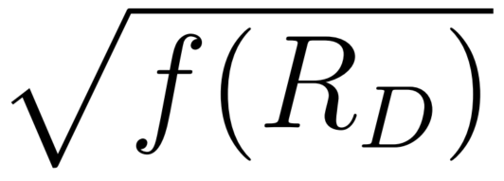
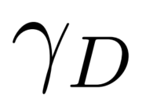
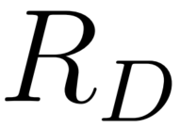
Derivations – Spacetimes
For AdS, we consider the constantly accelerating trajectory
  Corresponding to a stationary detector in Rindler coordinates
For Stationary BTZ, the detector trajectory is stationary:
For Rotating BTZ, the detector trajectory is co-rotating:
In these, and are the redshift factors in the appropriate spacetimes and are dependent on the radial position of the detector,
xii

Slide 32






Derivations – Fisher Information
Overall Hamiltonian
von Neumann eq.
                States:
Master equation of Kossakowski-Lindblad form
State of the detector
Describes time-evolution of detector
xiii

Slide 33



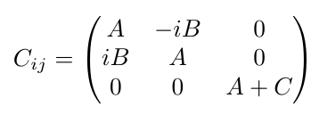

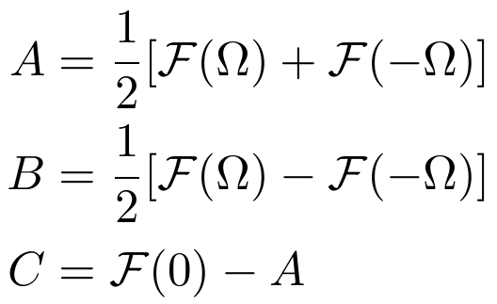
FI Derivation
In more detail…
Kossakowski matrix elements depend on the response rate
xiv

Slide 34





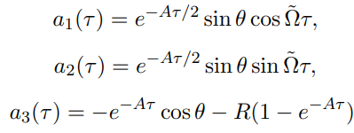

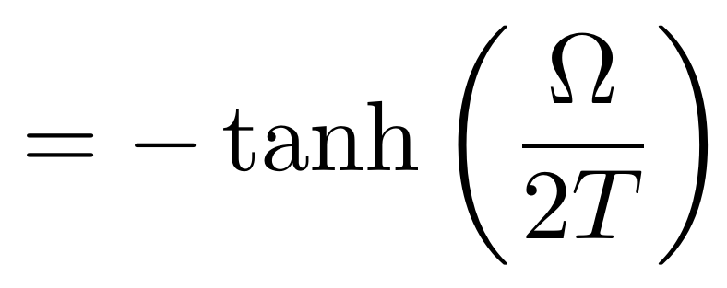
Fi Derivation
Surprisingly, admits an analytic solution
Given the initial state , parametrized by
We have , where
The third Bloch vector term is dependent on a ratio of Kossakowski matrix elements
xv
Notes:
a<1 in general, i.e., non-unitary evolution – Bloch vector
\sigma = Pauli matrices
Note R is the same in all of our set ups!
Important for large time limit!!

Slide 35






FI Derivation
Fisher information
  For 2-d system
  Where
Thus, , which for us will be
Parameters at play: and
Fisher Information
Temperature
BTZ Mass
Angular momentum
Energy gap
Boundary condition
Initial state
AdS length
xvi
Notes:
FI: Integral becomes Sum
Note: We actually scale I by T^2 scale purposes.
Missing J

Slide 36
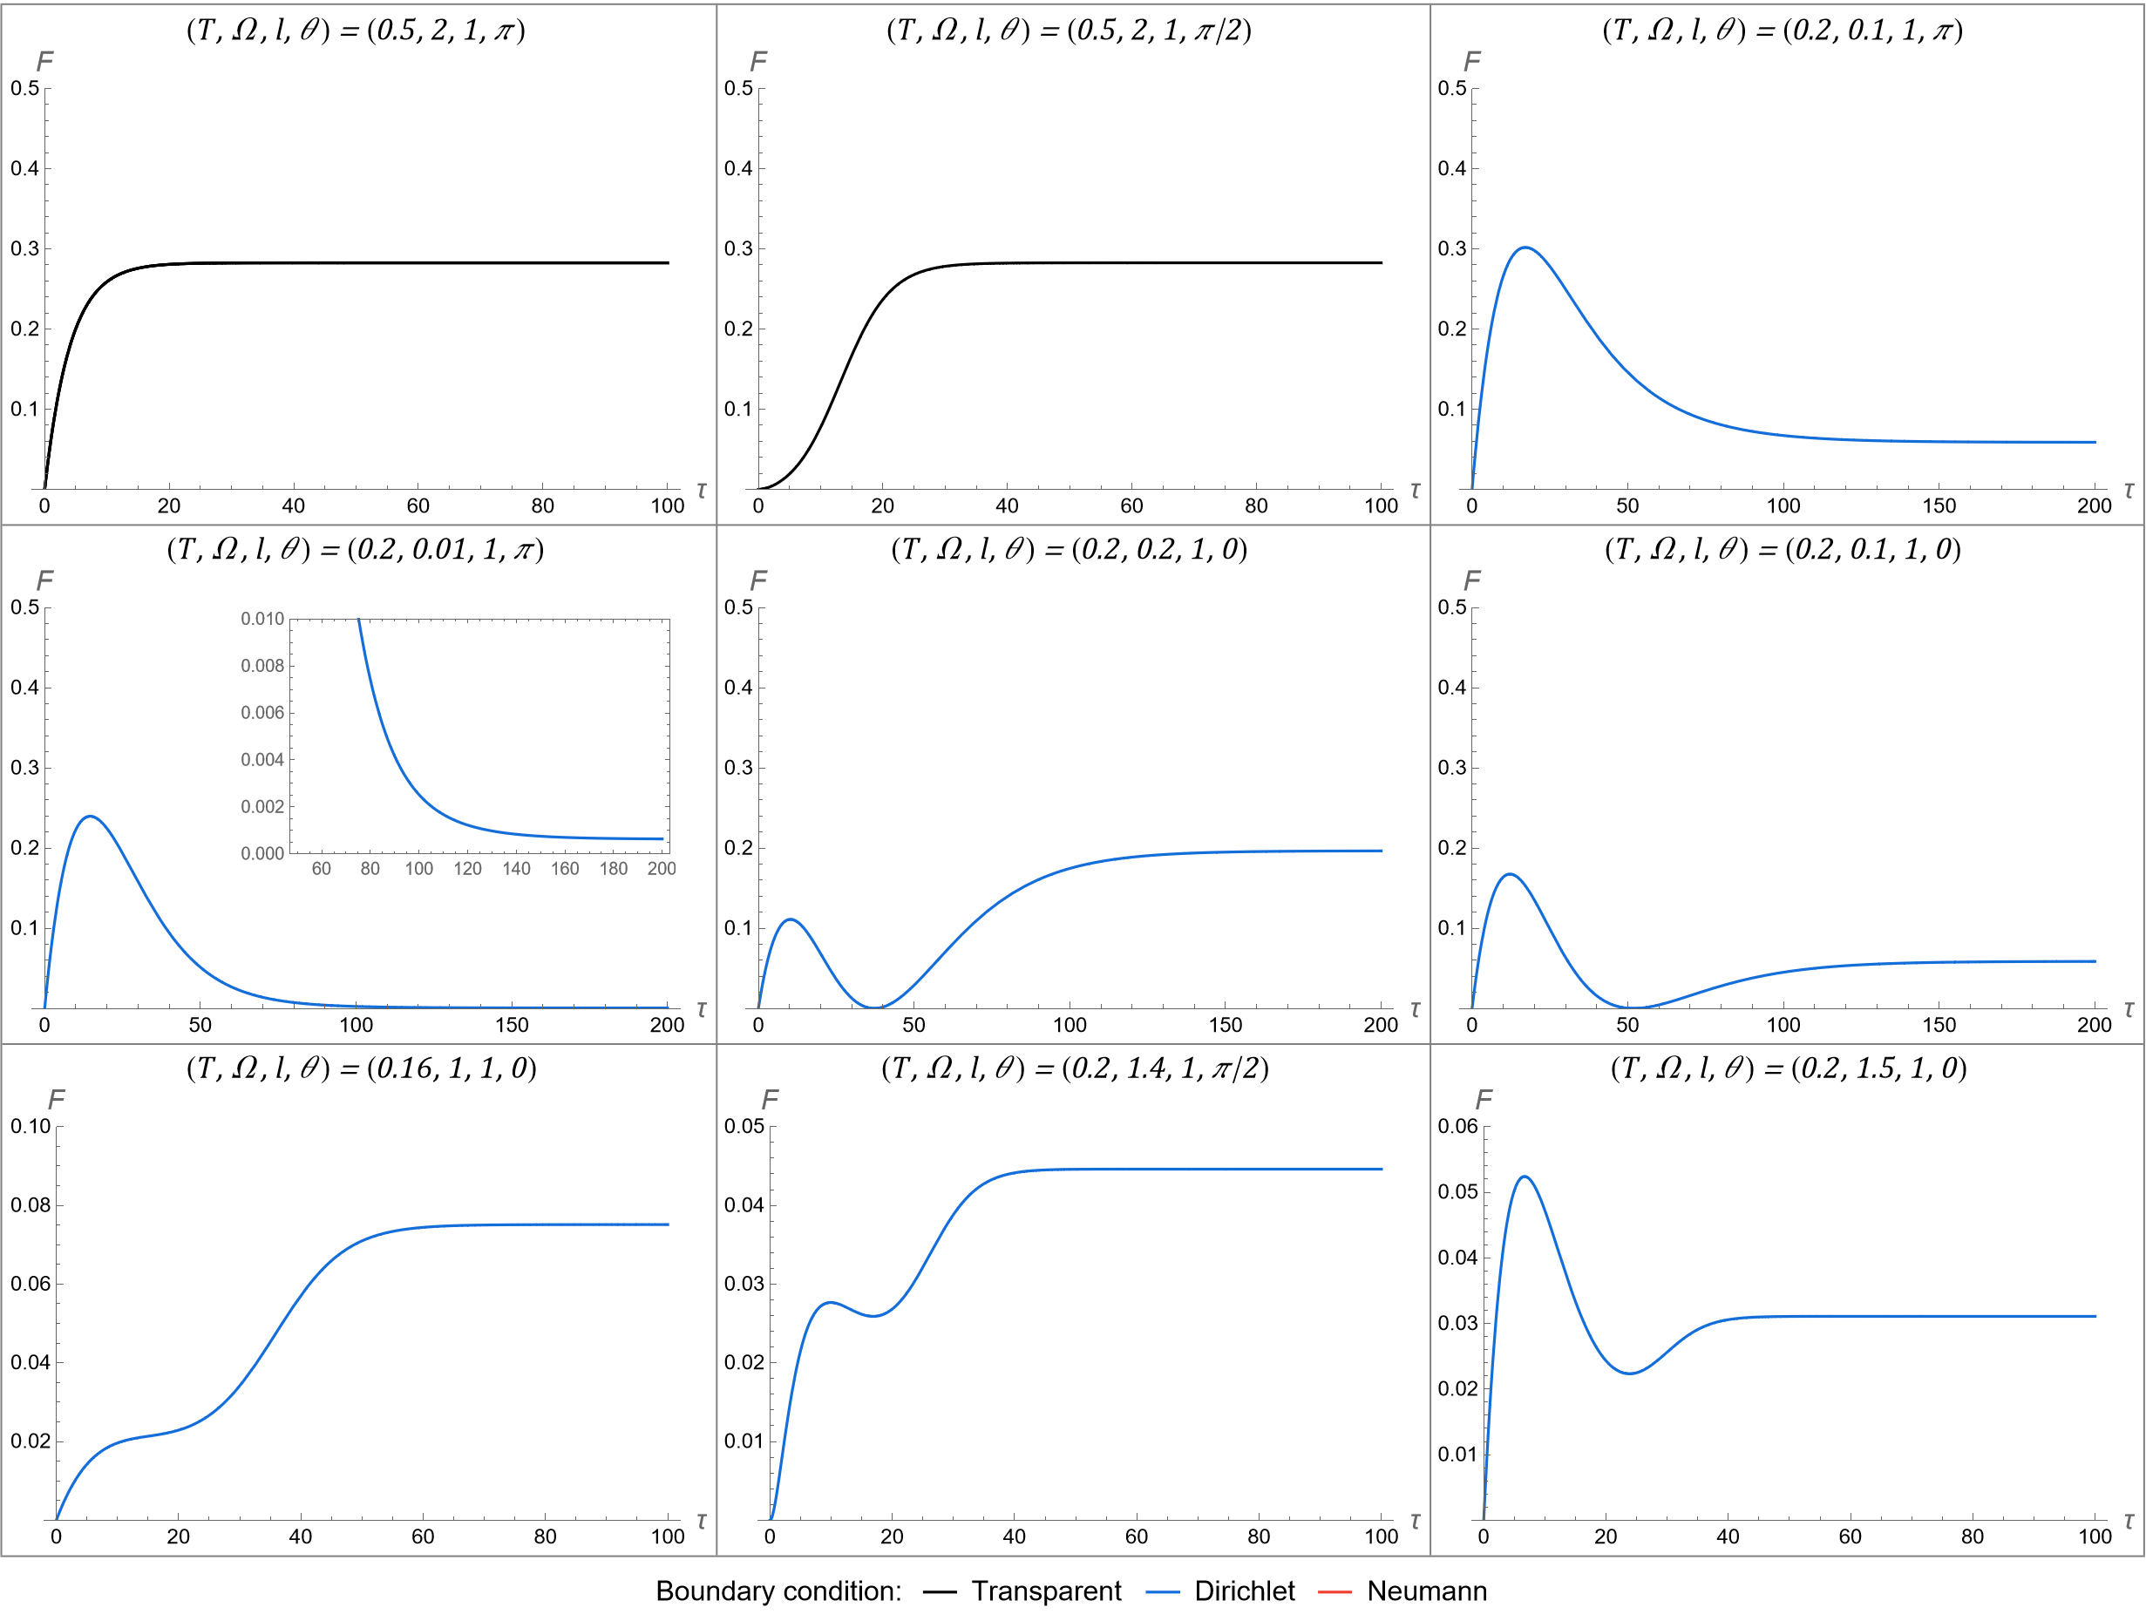
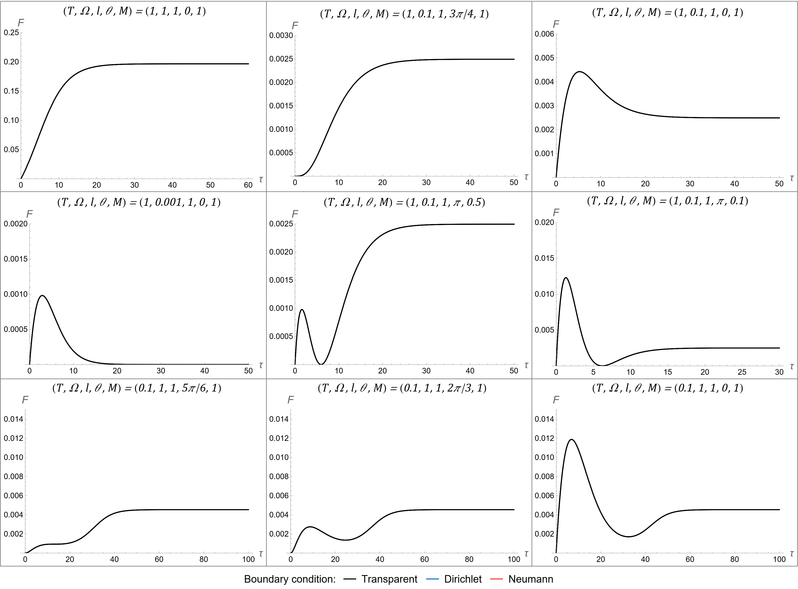
AdS
BTZ
There are 8* distinct qualitative behaviours
  Behaviour 4 is the same as behaviour 3
Curve colour indicates boundary condition
  Black = Transparent (ζ=0)
  Blue = Dirichlet (ζ=1)
  Red = Neumann (ζ=-1)
Same 8 qualitative behaviours are present in BTZ
All can be achieved using only the transparent boundary condition and M=1
xvii

Slide 37
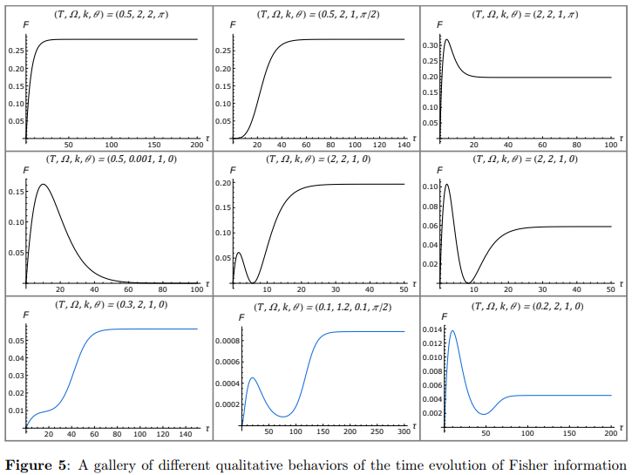
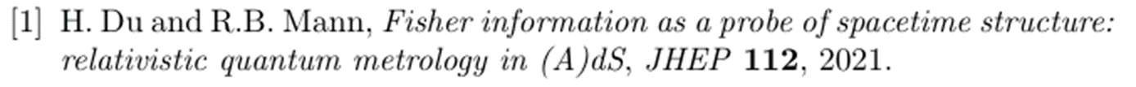

4-d AdS
3-d AdS
There are 8 distinct qualitative behaviours
  Behaviour 4 is the same as behaviour 3
Curve colour indicates boundary condition
  Black = Transparent (ζ=0)
  Blue = Dirichlet (ζ=1)
  Red = Neumann (ζ=-1)
xviii
Notes:
In 3+1 D lots of transparent boundary condition; in 2+1 mostly Dirichlet (or Neumann)

Slide 38
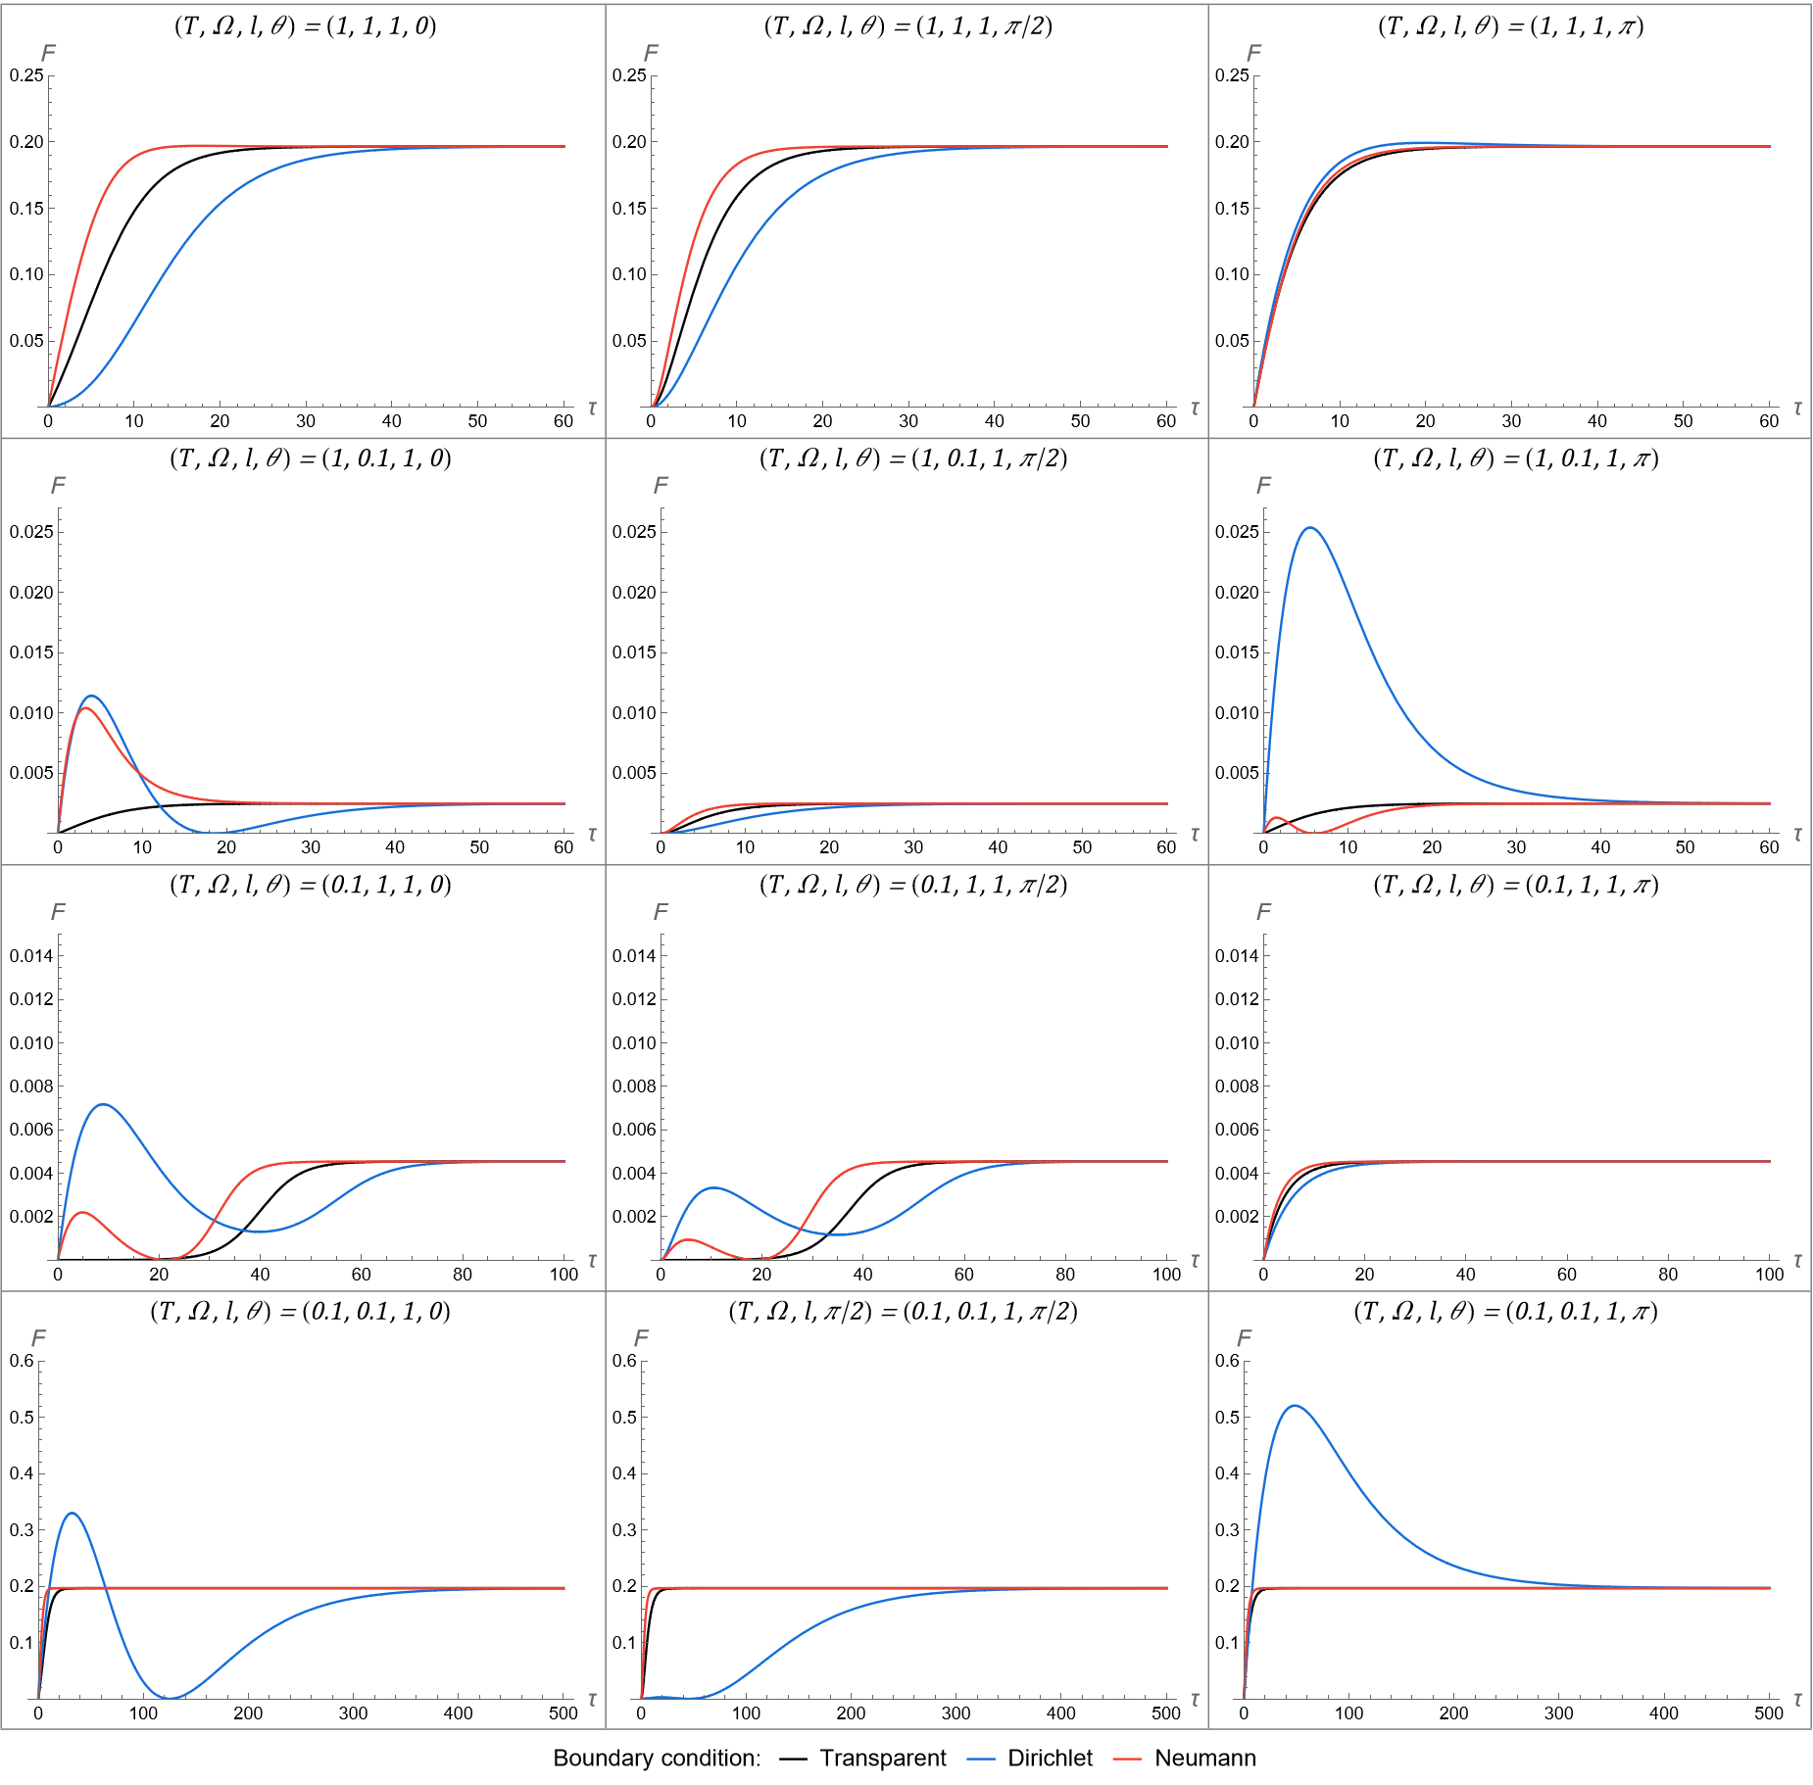
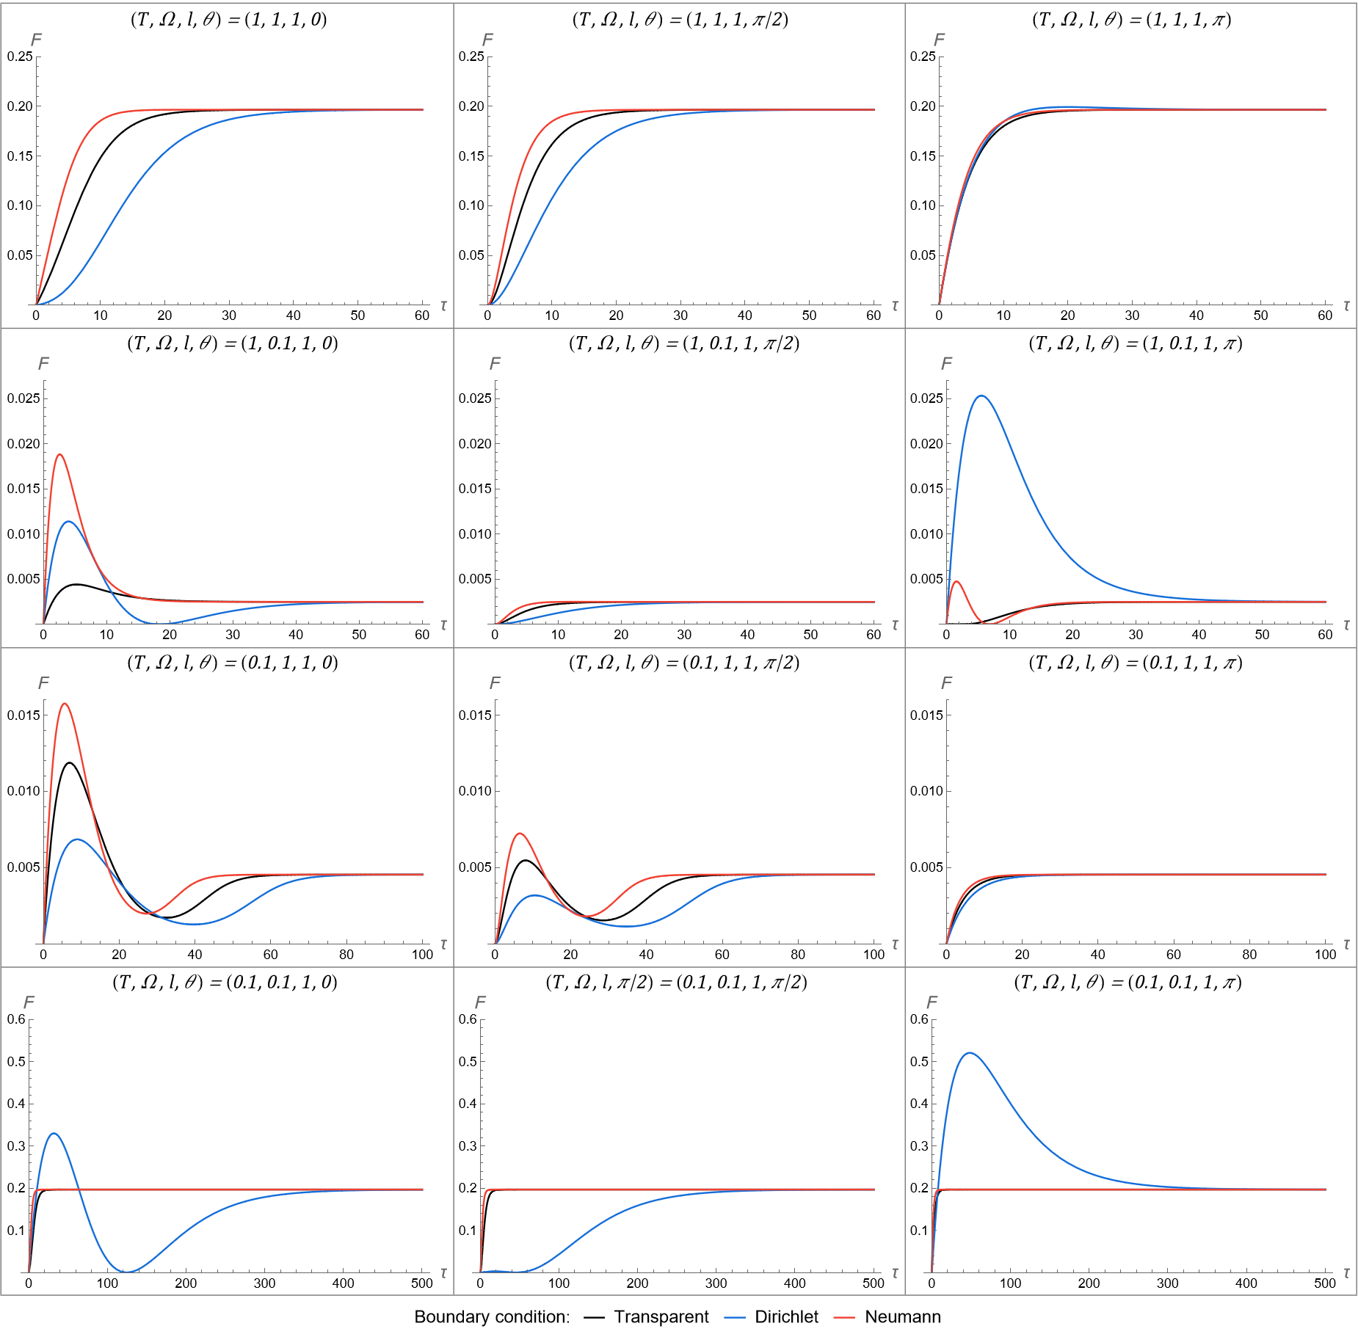
AdS
BTZ
Rows have fixed Ω,T
Columns have fixed θ
xix
Notes:
curvature, k, = 1; mass, M, = 1;
Varying mass will probably have some impact
Omega=T unchanged between plots
Transparent boundary condition gets more exciting!

Slide 39
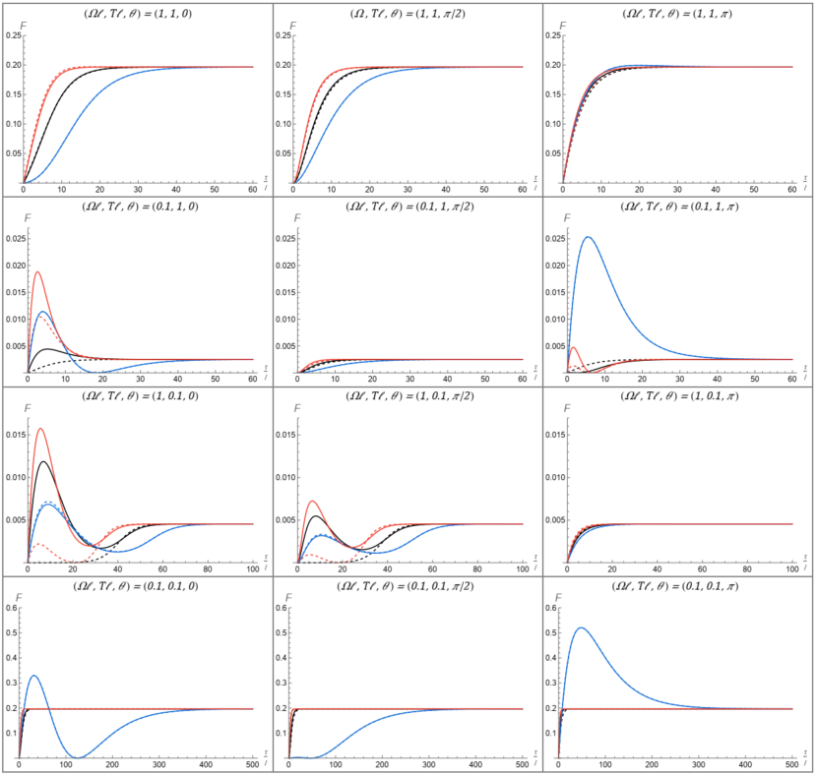
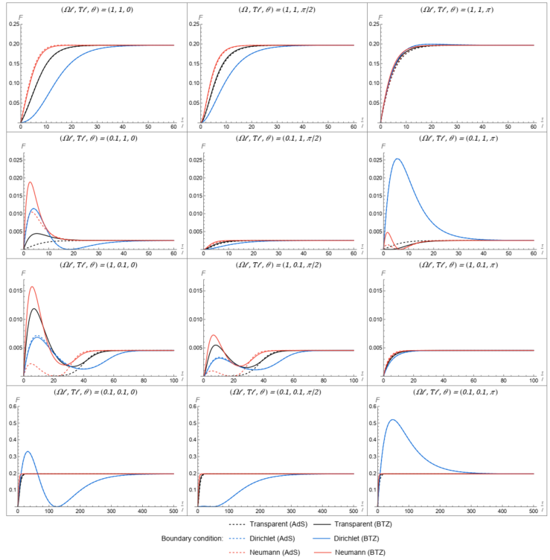
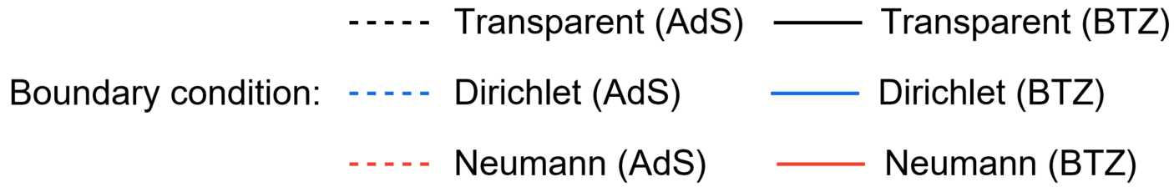
AdS vs. BTZ
Of note:
θ = 0
θ = π/2
θ = π
AdS is dashed lines; BTZ is solid lines
When Ω=T, AdS and BTZ coincide
  As shown in 1st and 4th row
When Ω ≠ T, discrepancy between AdS and BTZ
  ‘Hot’ when Ω=0.1 < T=1
    Dirichlet actually coincides here
  ‘Cold’ when Ω=1 > T=0.1
    Qualitatively distinct behaviours present for all boundary conditions
BTZ mass is fixed at M=1 here
  What if we vary the mass…
(Ω, T) = (1, 1)
(Ω, T) = (0.1, 1)
(Ω, T) = (1, 0.1)
(Ω, T) = (0.1, 0.1)
xx
Notes:
Note: Discrimination

Slide 40
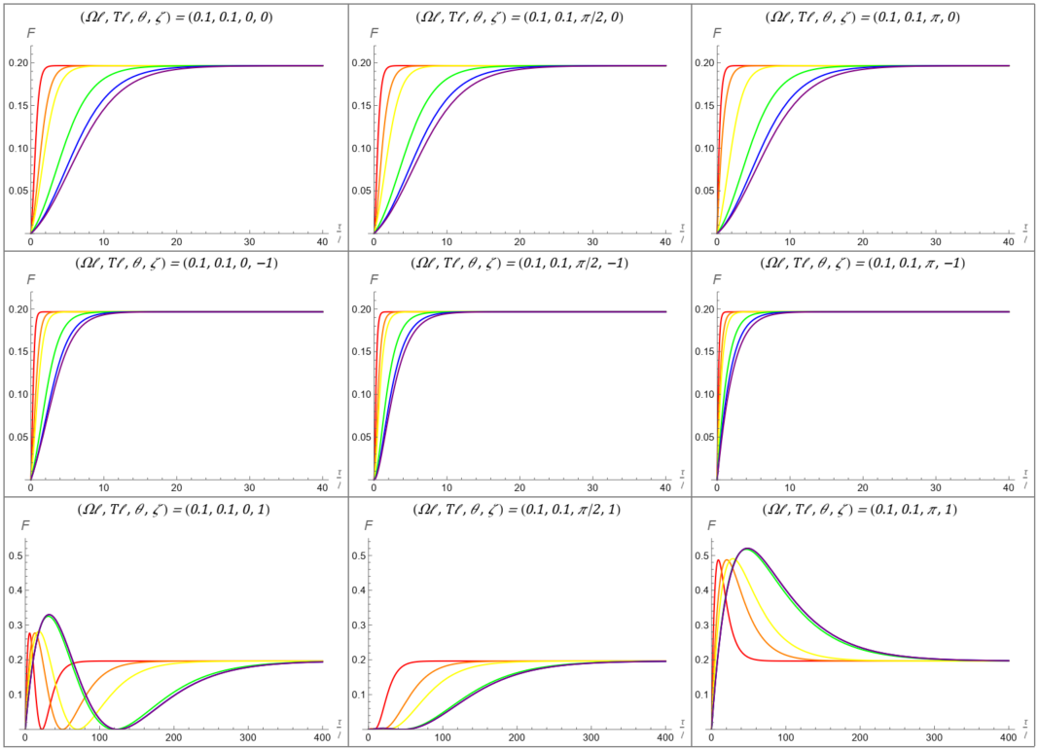
BTZ for Ω=T =0.1
Of note:
θ = 0
θ =π/2
θ = π
Different masses are represented by different colours
  Increasing mass from M=0.01 to M=1.5 corresponds to moving along the rainbow spectrum (ROYGBV)
Here we have Ω=T -> likely more simple
  No (significant) change in qualitative behaviour
Increasing M seems to shift curve right
Slight amplification at times
  between 0.1 and 0.5 (yellow-> green)
ζ = 0
ζ = -1
ζ = 1
xxi

Slide 41
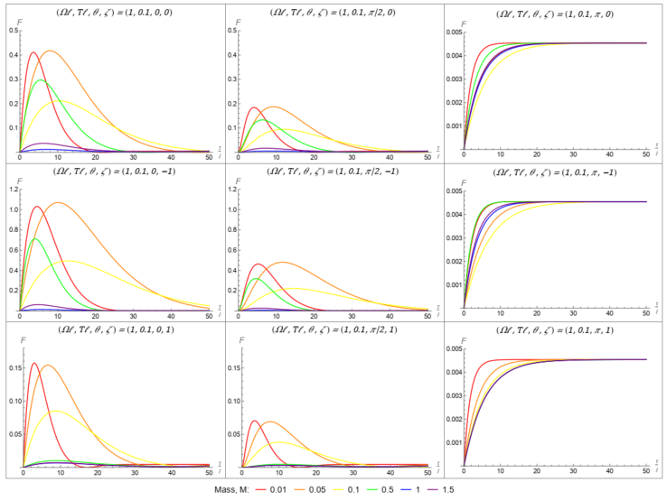
BTZ for Ω > T ‘Cold’
Of note:
θ = 0
θ = π/2
θ = π
Different masses are represented by different colours
  Increasing mass from M=0.01 to M=1.5 corresponds to moving along the rainbow spectrum (ROYGBV)
No clear trend in Fisher information alongside the changing mass
Most drastic behaviour appears again between 0.1 and 0.5 (yellow-> green)
ζ = 0
ζ = -1
ζ = 1
xxii

Slide 42
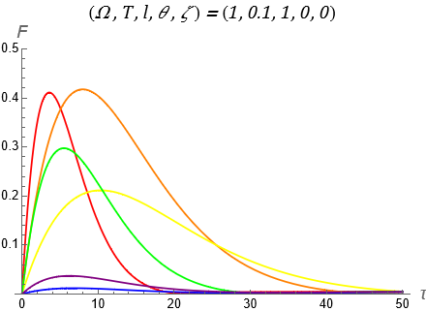
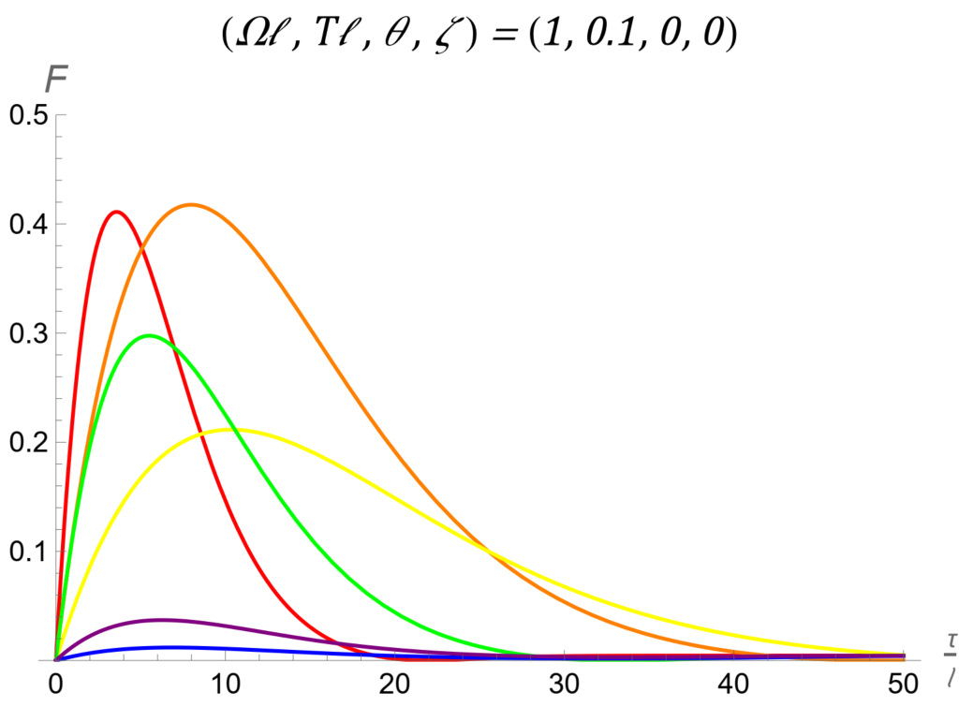

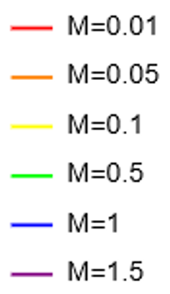
BTZ for Ω > T ‘Cold’
Of note:
Different masses are represented by different colours
  Increasing mass from M=0.01 to M=1.5 corresponds to moving along the rainbow spectrum (ROYGBV)
No clear trend in Fisher information alongside the changing mass
Most drastic behaviour appears again between 0.1 and 0.5 (yellow-> green)
ZOOMED
xxiii

Slide 43
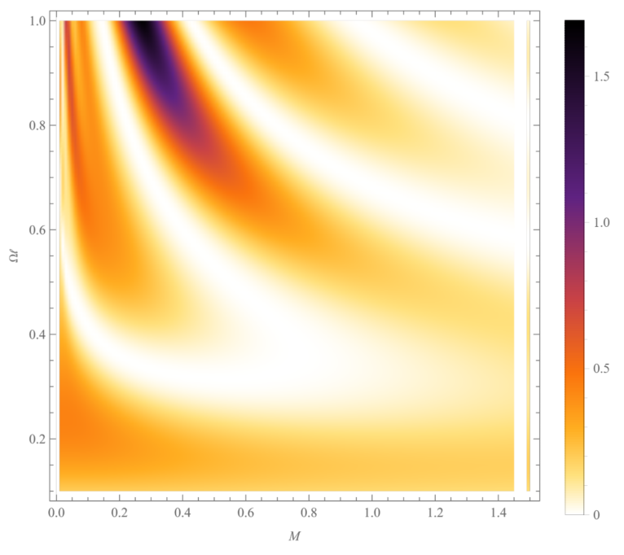
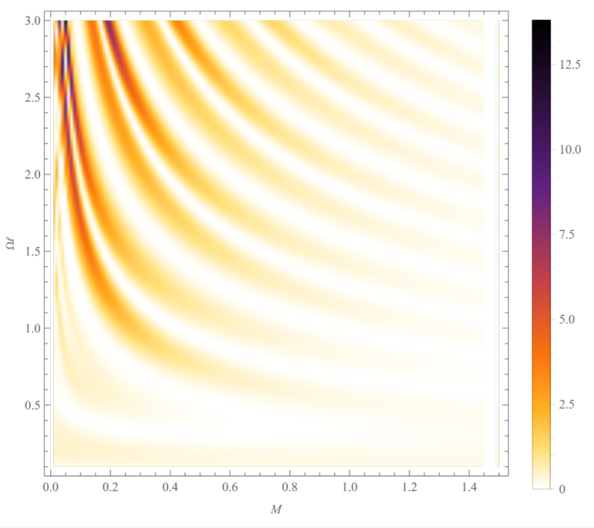
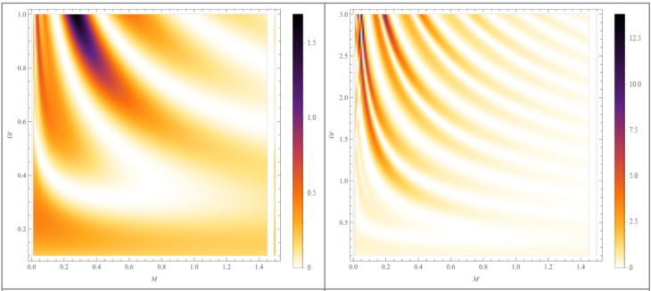
Fixed time, varying mass - Density Plots
Oscillatory behaviour can be seen in the ‘wave’ pattern
For larger Ω, we see even greater amplitudes and more oscillations
Note the change in scale
xxiv

Slide 44
Bonus Content
Rotational Effects on Fisher Information of Thermal Black Hole Parameter
Everett Patterson
CAP Congress 2023, UNB
June 20, 2023

Slide 45

Bonus Content – What is the Defn of QFI
In essence QFI is the maximal FI obtained over all possible measurements
Notes:
- Taken from HFZF 18

Slide 46
Bonus Content – Boundary conditions
Dirichlet
  The field vanishes at the boundary
Neumann
  The field’s normal derivative vanishes at the boundary
Transparent
  This is described in detail in a 1978 PRD paper by Avis, Isham, and Storey.
  It is a little peculiar in its definition, but it enables conservation of energy, angular momentum, etc.

Slide 47


BTZ; ell=1 , Omega=T=0.1
BTZ; ell=10 , Omega=T=0.1
Notes:
Large M -> Little change

Slide 48


BTZ; ‘cold’, varying M
BTZ; ‘hot’, varying M

