Slide 1



Status of the McDonald Institute and role in the Canadian Astroparticle Physics Landscape
IPP AGM Meeting at CAP
June 23/2023
By Tony Noble
tony.noble@mcdonaldinstitute.ca

Slide 2















The current role of the McDonald Institute
A partnership of 8 Universities and 5 institutes, the McDonald Institute:
Is a globally recognized centre for research and learning,
Coalesces Canadian and international expertise in underground particle astrophysics
Benefits from the unique SNOLAB facility to deliver world-leading science
Supports the Canadian R&D activities (rather than infrastructure)

Slide 3
Period of grant, nominally Sept 2016 – August 2023. Just 2 months to go !
But:
  One extra year to spend down most funds (including all funds at partner Institutions). → Aug 2024.
  No significant science spending anticipated thereafter. Aug 2024 is when our funding to the community winds down.
  We have also been granted a “no cost extension” until March 2026 as a result of Covid. This will be used to wind down the Institute following the spending at the partners, the spending at Queen’s, and support key positions through the transition from CFREF to the “next iteration”.
  We have now received all the funding we expect from CFREF
Annual science budget currently about 8 M$. On track to complete as described above.

Slide 4
Basic Research Support at Partner Institutions: What I call “University Support”
15 new faculty members across Canada (plus their research support).
This also spawned new faculty positions at partner institutions.
R&D support to Institutions: SNOLAB Astroparticle Physics Projects (from Jodi’s list)
Project | Support? | Project | Support? | Project | Support?
SNO + |  | SuperCDMS |  | nEXO | 
HALO |  | DEAP 3600 |  | PICO 500 | 
CUTE |  | News-G |  | SBC | 
Xe-Still |  | PICO 40 |  | Legend-1000 | 
Damic |  | Sensei |  | OSCURA
Plus: Multi-messenger (P-ONE/ICECUBE)
Strong support for Theory
Technology development (advanced photon counting, low background technologies, engineering)

Slide 5
Basic Research Support at Partner Institutions: What I call “University Support”
15 new faculty members across Canada
This also spawned new faculty positions at partner institutions.
Example 1: SuperCDMS:
“Base funding” roughly (I am told) equivalent to NSERC operations award
Research Faculty supported completely by MI:
  Miriam Diamond (Toronto)*
  Alan Robinson (Montreal)
  Wolfgang Rau (TRIUMF)
* New Canadian group in astroparticle physics
Plus at Toronto*:
Pekka Sinervo
Ziqing Hong
And recent developments*:
CITA
Dunlap Institute

Slide 6
Basic Research Support at Partner Institutions: What I call “University Support”
15 new faculty members across Canada
This also spawned new faculty positions at partner institutions.
Example 2 Theory:
Substantial growth in the field:
Research Faculty supported completely by MI:
  Joe Bramante (Queen’s)*
  Aaron Vincent (Queen’s)*
  Yue Zhang (Carleton)
* New group in astroparticle theory
Followed by:
Nassim Bozorgnia (York/Alberta, 2020/2022)
Katelin Schutz (McGill, 2021)
Sheda Ipek (Carleton, 2021)
Gopolang Mohlabeng (SFU, 2023)
And new focus in astroparticle physics theory from many established researchers.

Slide 7
Competitive Research Support supporting Astroparticle Physics across Canada
102 HQP Positions supported through pooled funding competition
Ramped up to about 30 HQP supported at any one time.
131 “HQP Years”

Slide 8
Competitive Research Support supporting Astroparticle Physics across Canada
102 HQP Positions supported through pooled funding competition
9 FRVF awards (Frontier Research Venture Fund)
Cross Disciplinary Internships 12 to date (2020 – 2023)
13 different institutions supported to date

Slide 9
Research Outputs the past fiscal year:
157 Papers by members supported by MI
Over 500 total papers/presentations/proceedings/other scholarly works to date
Significantly advanced progress in experimental program – MI has been instrumental in accelerating progress.

Slide 10
The MI is also active in:
Supporting implementation of best practices in EDII, → new position: Manager for EDII Capacity Development. Available as a resource to the community (already working with PICO, nEXO, …)
HPQ training, (Professional development courses open to everybody)
Visiting scientist/HQP exchanges,
supporting recruitment and retention,
fostering collaborative research and cross disciplinary research.
MI also provides seed funding for new “high risk high gain” research initiatives.
Education (2 summer schools CAPSS and GRIDS),
Outreach (school curriculum, lecture series, camps, visitor centre, …)
Innovation/knowledge translation
We try to provide the “complete package” in support of all necessary ingredients for big science campaigns on behalf of the research community.

Slide 11
Summary thoughts on current CFREF:
The McDonald Institute plays a very important role in the SAP ecosystem, with a mandate to connect and support astroparticle physics research.
Whereas SNOLAB is funded to support the infrastructure, and integration of international projects into the lab, the McDonald Institute is providing support for the initial development and science delivery, primarily at the Universities.
The Institute also provides the community with professional and administrative support with expertise in education/outreach, communications, hqp recruitment, retention and training, EDII best practices etc …. All important aspects of big science that are difficult to include at the individual project level.
The intellectual capacity within Canada is being partially sustained at the Universities as they assume full responsibility for the faculty members.

Slide 12
Sustaining the McDonald Institute
Our CFREF proposal was recommended, but not funded.
  It made it all the way through to the final round, and even though it got great scores, and was recommended for funding, it was not funded. It appears that the last lens applied was the commercialization lens, and this was not our focus.
  The main focus of the CFREF application was for the engineering and technical resources required at the Universities to enable Canadian Scientists to take significant leadership roles on major international projects, benefiting from facilities like SNOLAB and ONC. Like a very large, pan-Canadian MRS
  Plus a lot of other features, and a broadening of the scientific scope
We are now working with government to see if there is another way of funding this outside of CFREF (not a good fit), MSI (we were deemed a thematic institute and hence ineligible), NSERC (we are too big),….

Slide 13
“Process”
The government has been very open, helpful and supportive. Encouraging.
They have recognized there is a gap, and are willing to work with us to try to find a solution.
We have met with ISED, Minister Champagne’s office, PMO, finance, Canada’s Chief Scientist, the presidents of NSERC, CFI, TIPS (CFREF), plus MPs in Kingston and Sudbury.
The long term solution might be through the MRFF (Major Research Facilities Framework).
  There was some hope this might have been tabled in Parliament in June, but that didn’t happen. It will take time to get it defined and approved, then operationalized, then competitions launched. This is too far into the future.
Notes:
`

Slide 14
Today’s Outlook
The government has been willing to work with us on what might be bridging funding. Reduced in scope and duration to 60M$ over 5 years.
They had suggested we get a full proposal (something Finance could assess) by “The end of June before parliament rises”.
  We were aiming for a submission by Friday June 23rd, which would allow some time in Ottawa selling the proposal.
  However, parliament rose early (Wednesday this week), and also ISED policy advisors suggested the end of summer would be better. This may still allow us to get something into the fall economic update (mini budget), although the full budget in March seems more likely to me.
  The risk with any delay would be a possible change in Government and hence policy.
We will rethink our strategy early next week but won’t be submitting anything immediately.
Notes:
`

Slide 15
Universities and Institutions expressing an interest in partnering with Queen’s and contributing to this new CFREF initiative included:
Queen’s
Alberta
UBC
Carleton
McGill
Montreal
Sherbrooke
Simon Fraser
Toronto
Victoria
CIFAR
CITA
IPP
PI
SNOLAB
TRIUMF
And there are opportunities for this to grow yet as we continue to define the program with colleagues across Canada.

Slide 16

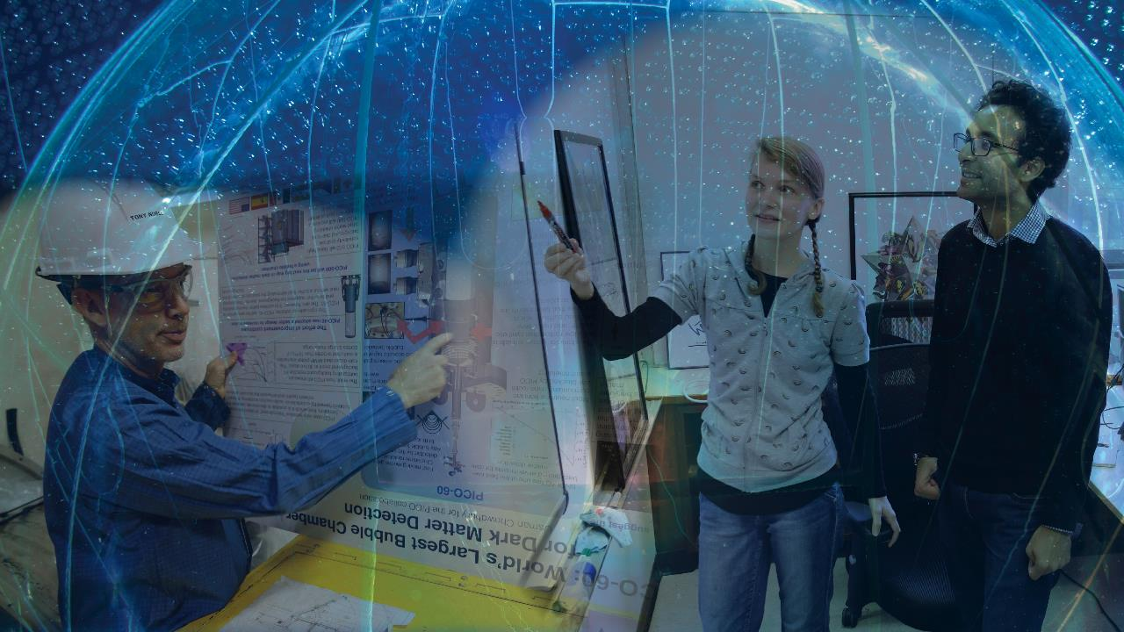
Thank-You tony.noble@mcdonaldinstitute.ca

