Slide 1
Measuring the gravitational free-fall of antihydrogen
CAP2023
Tim Friesen (He/Him/His)
on behalf of the ALPHA collaboration
Assistant Professor
Department of Physics and Astronomy, University of Calgary
June 20, 2023

Slide 2
ALPHA
Goal: Precision measurements of antihydrogen atoms
Spectroscopy:
CPT symmetry?
1S – 2S (4.2 x 10⁻¹⁵ in H)
Ground state HFS (1.4 x 10⁻¹² in H)
Lamb shift (3 x 10⁻⁶ in H)
nS – n’S/P ?
Gravity:
Test the Weak Equivalence Principle with free-fall experiments

Slide 3

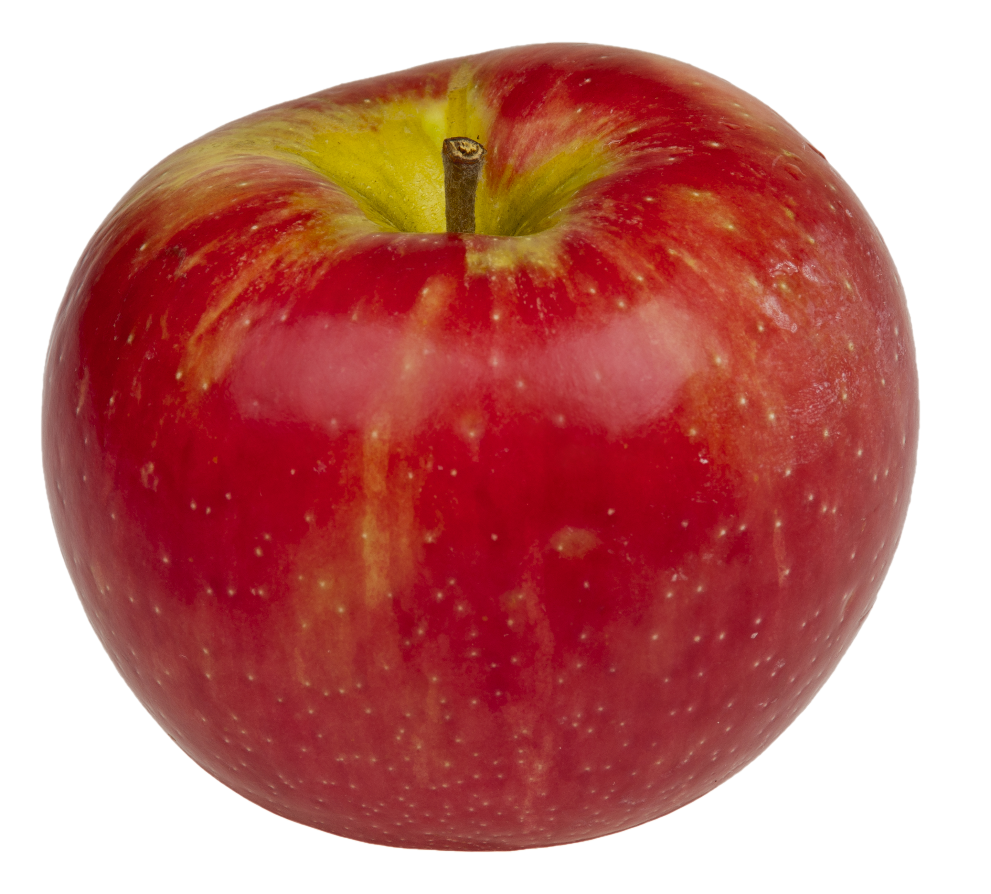
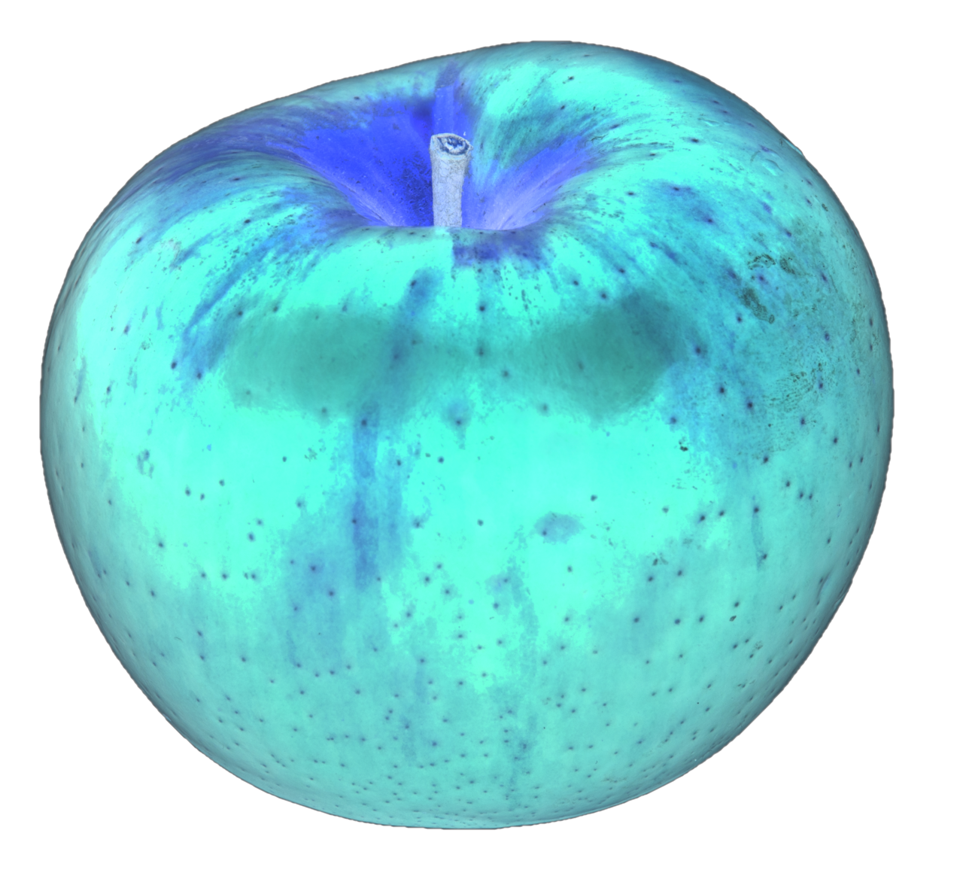

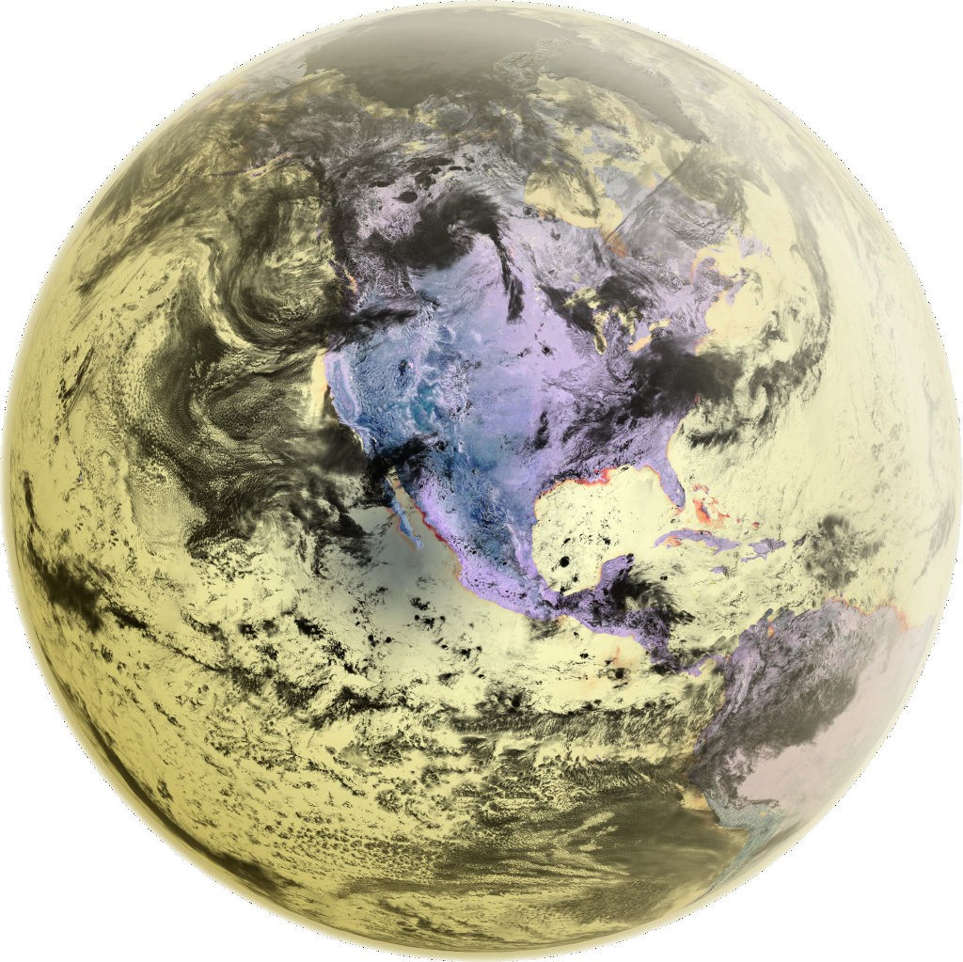
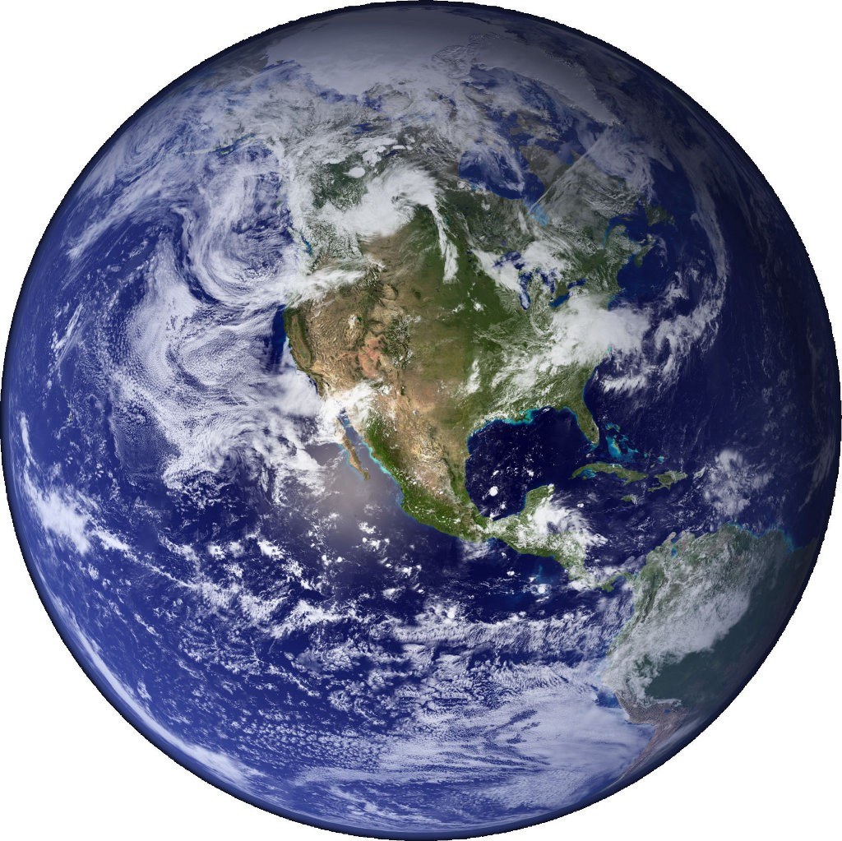
ALPHA
Goal: Precision measurements of antihydrogen atoms
Spectroscopy:
1S – 2S (4.2 x 10⁻¹⁵ in H)
Ground state HFS (1.4 x 10⁻¹² in H)
Lamb shift (3 x 10⁻⁶ in H)
nS – n’S ?
Gravity:
Test the Weak Equivalence Principle with free-fall experiments
?
Earth
Anti-Earth
Earth
(under CPT)

Slide 4
ALPHA
Goal: Precision measurements of antihydrogen atoms
Spectroscopy:
1S – 2S (4.2 x 10⁻¹⁵ in H)
Ground state HFS (1.4 x 10⁻¹² in H)
Lamb shift (3 x 10⁻⁶ in H)
2S – nS
Gravity:
Test the Weak Equivalence Principle with free-fall experiments
Approach: Trap antihydrogen in a magnetic minimum neutral atom trap.

Slide 5

ALPHA experiment

Slide 6
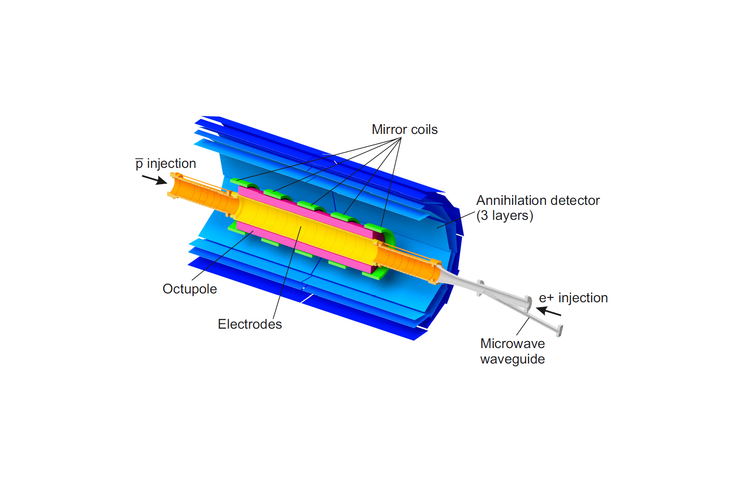
Producing and trapping antihydrogen
B = 1 T

Slide 7
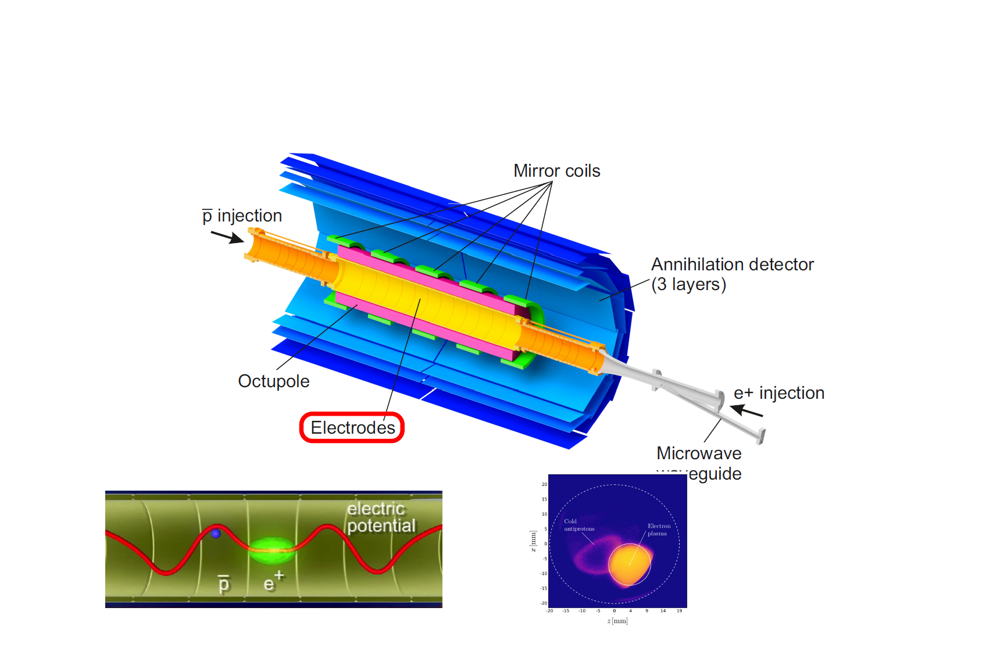
Producing and trapping antihydrogen
B = 1 T

Slide 8
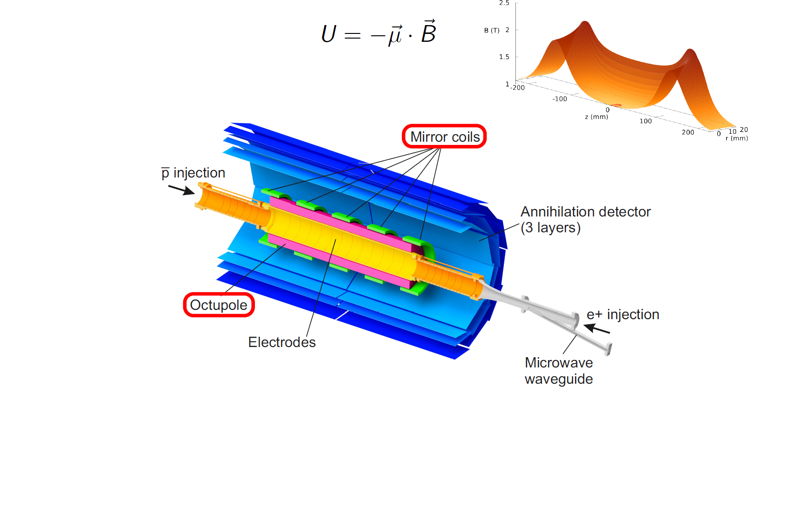
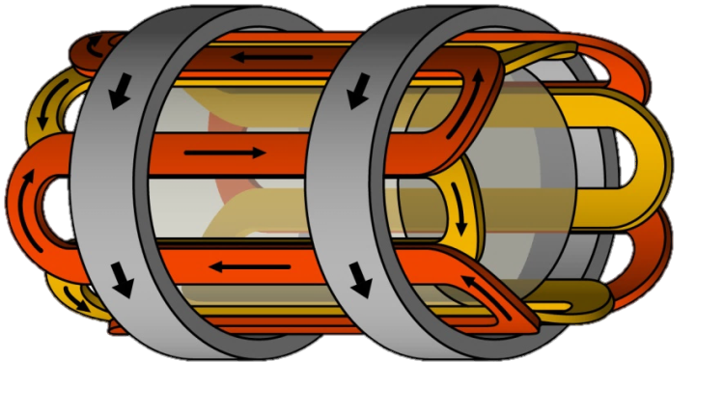

Producing and trapping antihydrogen
$$ΔU≈0.5 K$$
B = 1 T

Slide 9
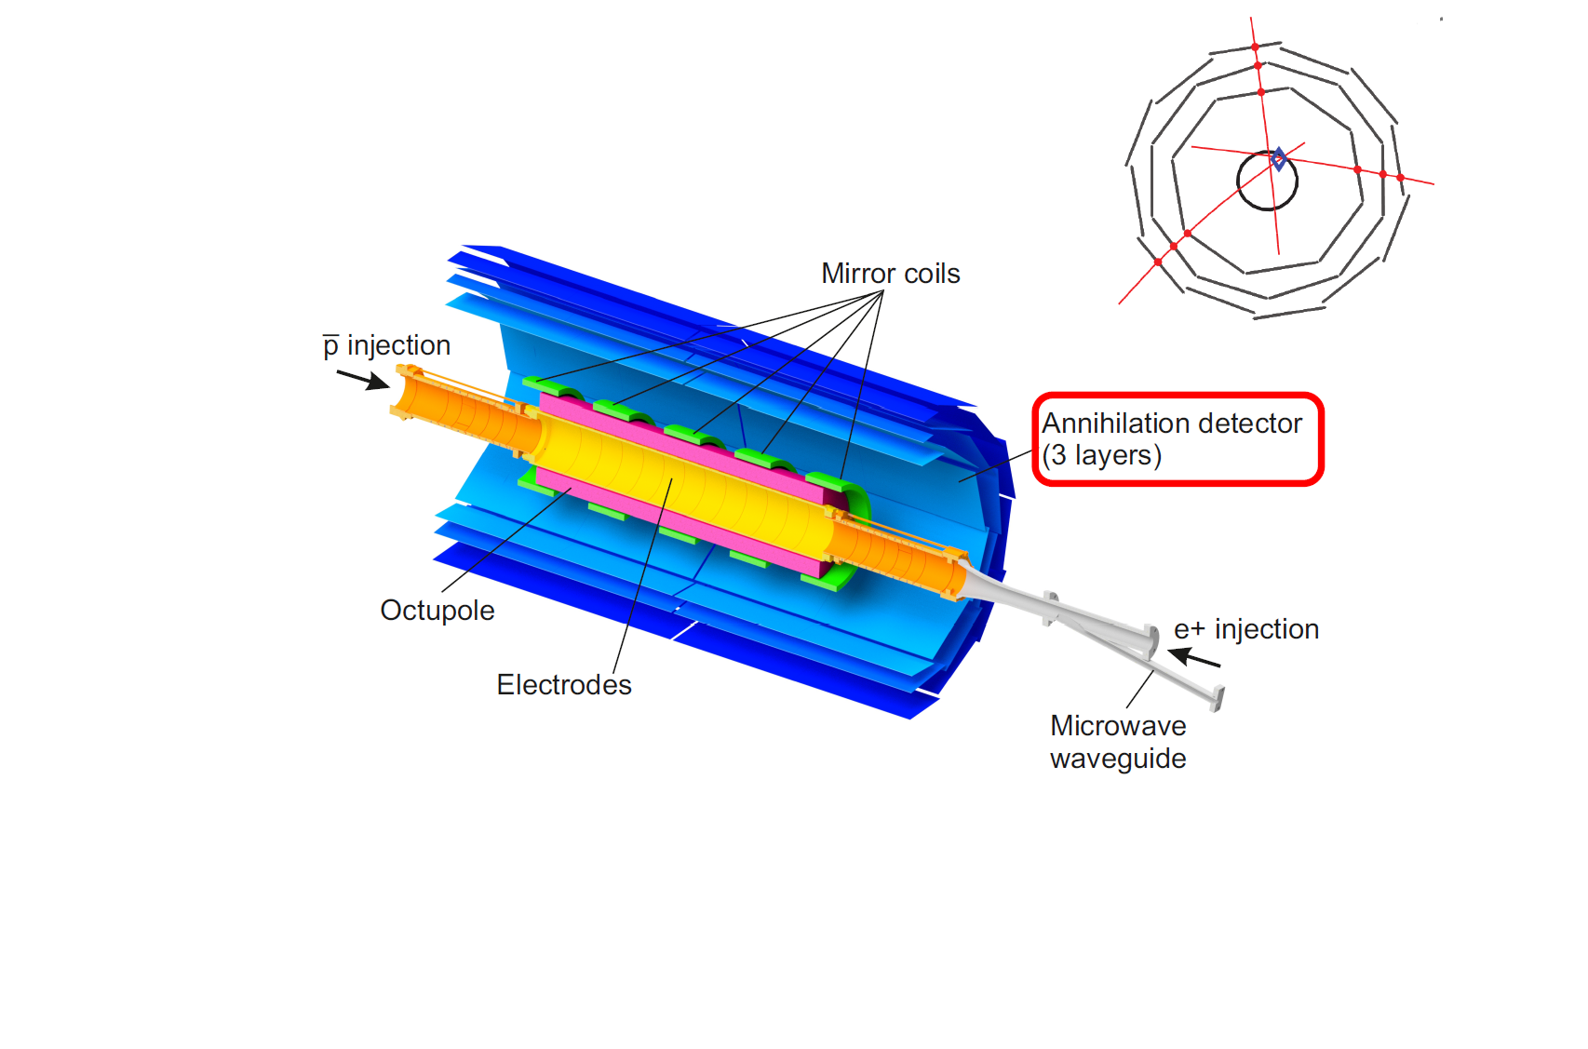
Producing and trapping antihydrogen
B = 1 T

Slide 10
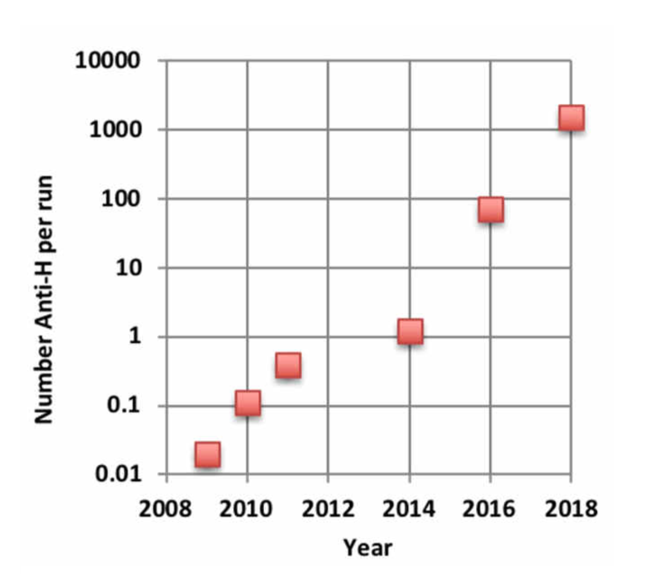
Producing and trapping antihydrogen
Improvements to antihydrogen trapping [Nature Comm. 8, 681 (2017)]
B = 1 T
Can accumulate anti-atoms
(~2500 over 17 hours)

Slide 11
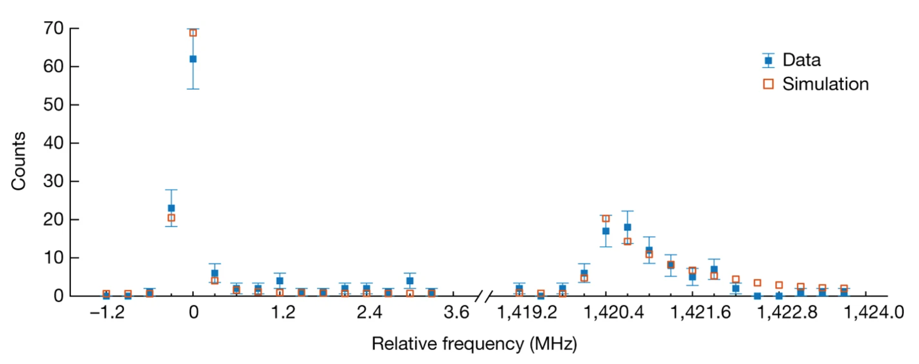
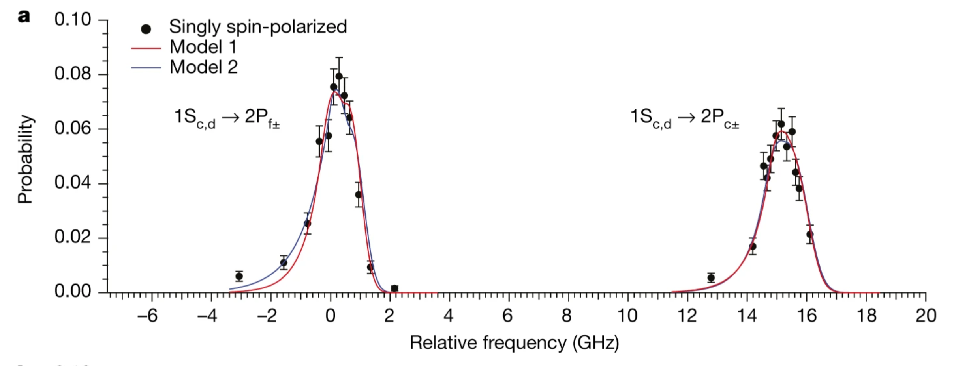
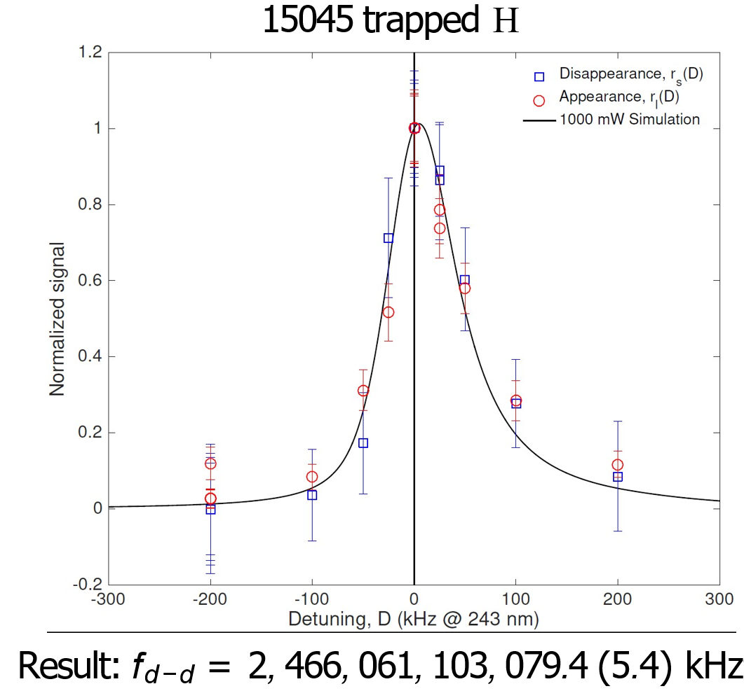
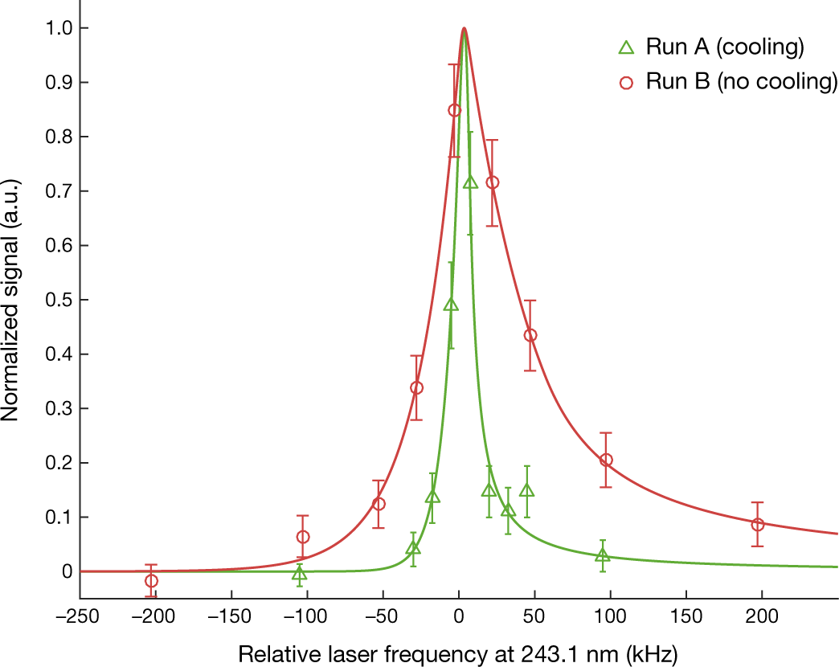
Antihydrogen spectroscopy
Hyperfine spectrum [Nature 548, 66 (2017)]
Fine structure [Nature 578, 375 (2020)]
1S – 2S spectroscopy [Nature 557, 71 (2018)]
Laser Cooling [Nature 2021]

Slide 12
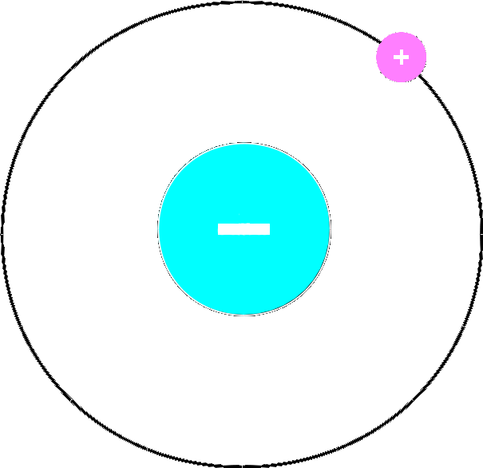

$$\overline{H}$$
?

Slide 13
Antihydrogen + gravity: ALPHA-g

Slide 14
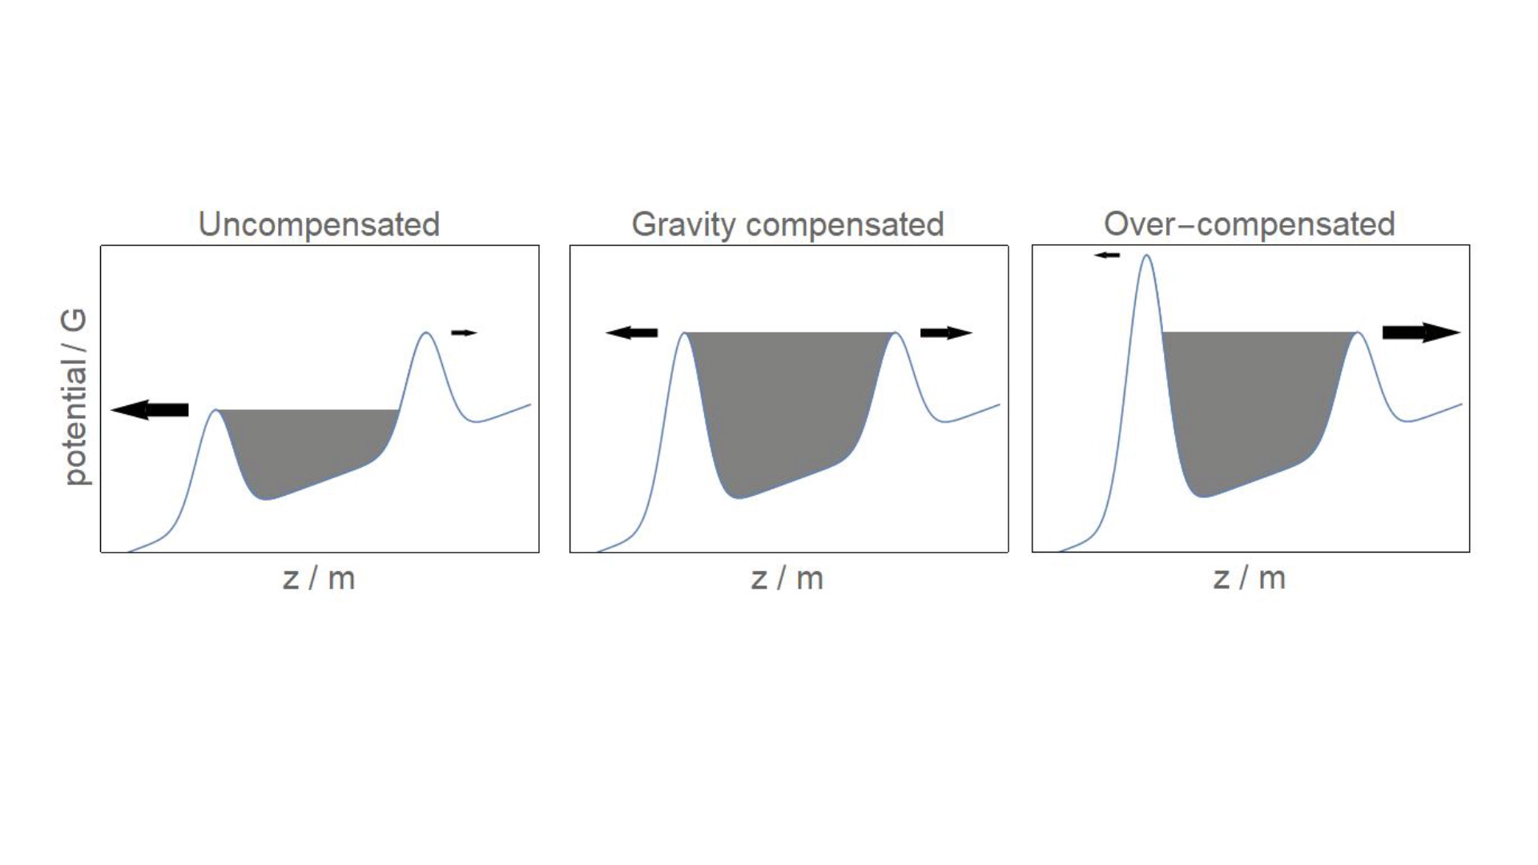
Measuring the effect of gravity

Slide 15
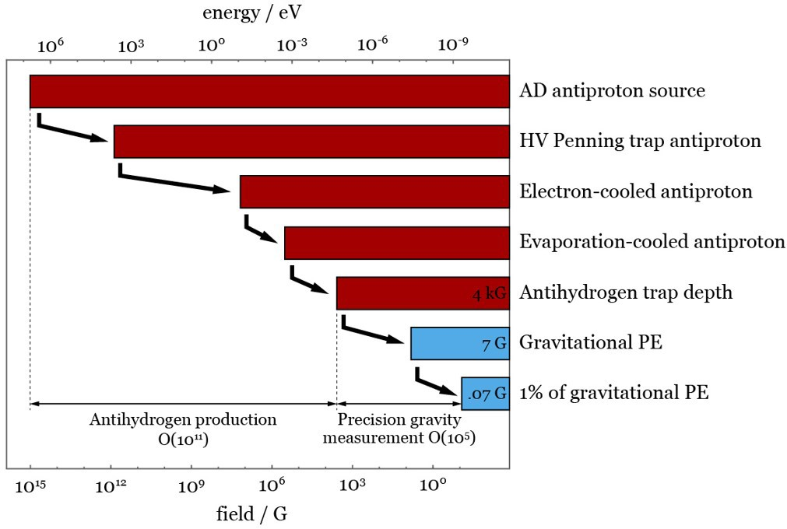
The challenge
Image: Chukman So

Slide 16
Magnetic traps
Image: Chukman So

Slide 17
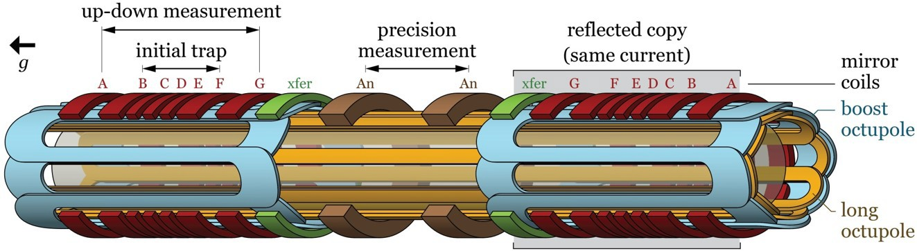
Magnetic traps
Image: Chukman So
Image: Chukman So
17 superconducting circuits with 34 HTS current leads

Slide 18
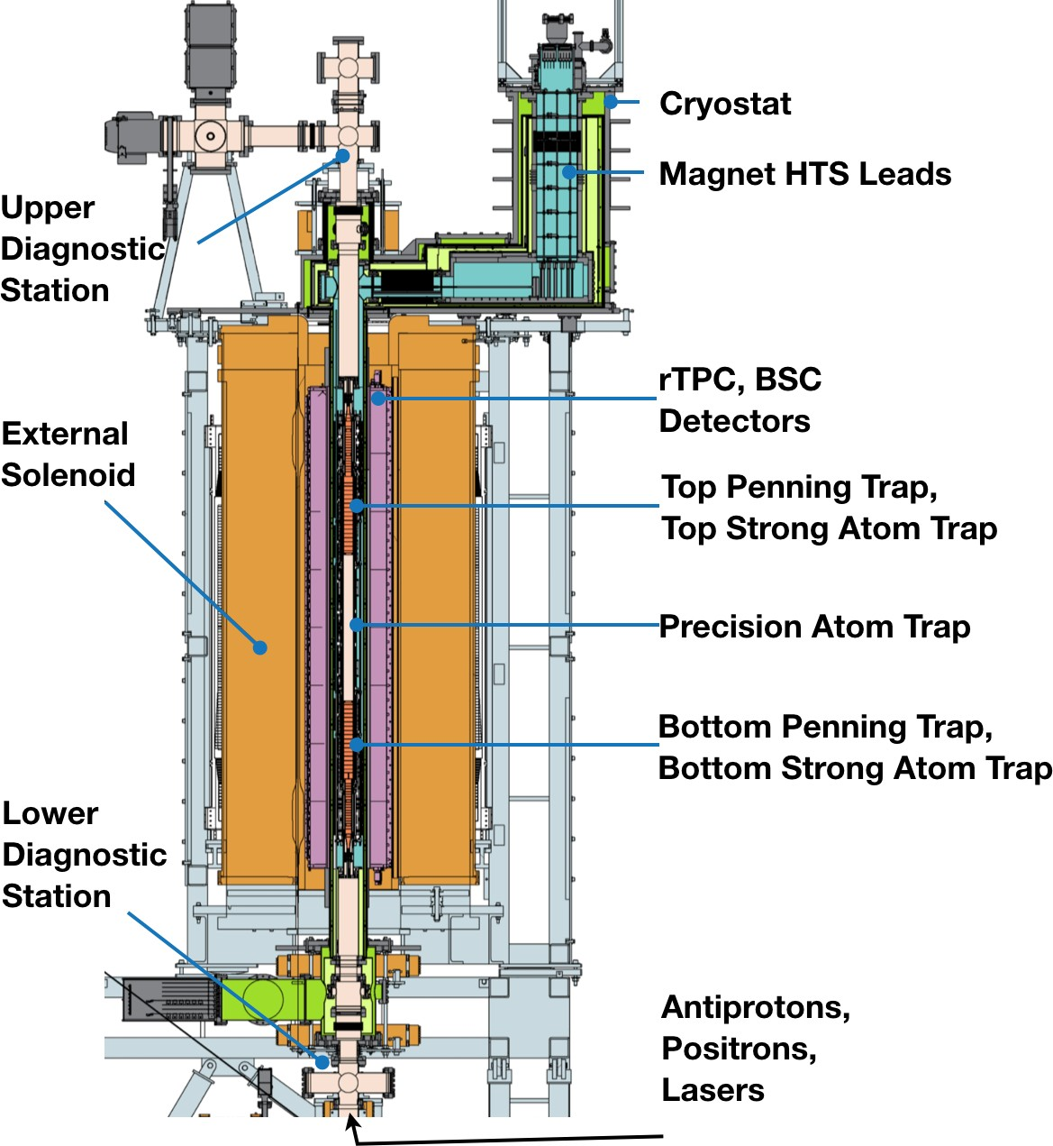
ALPHA-g schematic
~3 m

Slide 19
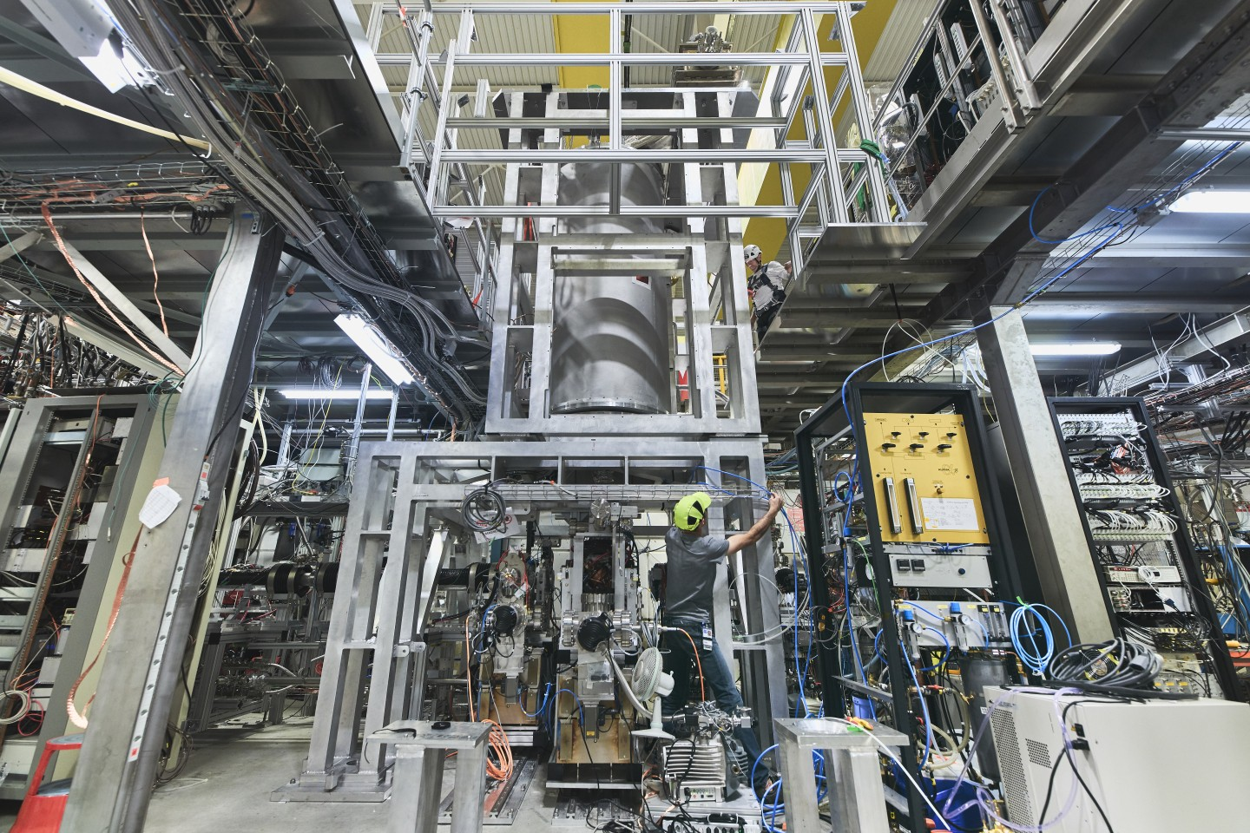
ALPHA-g reality

Slide 20
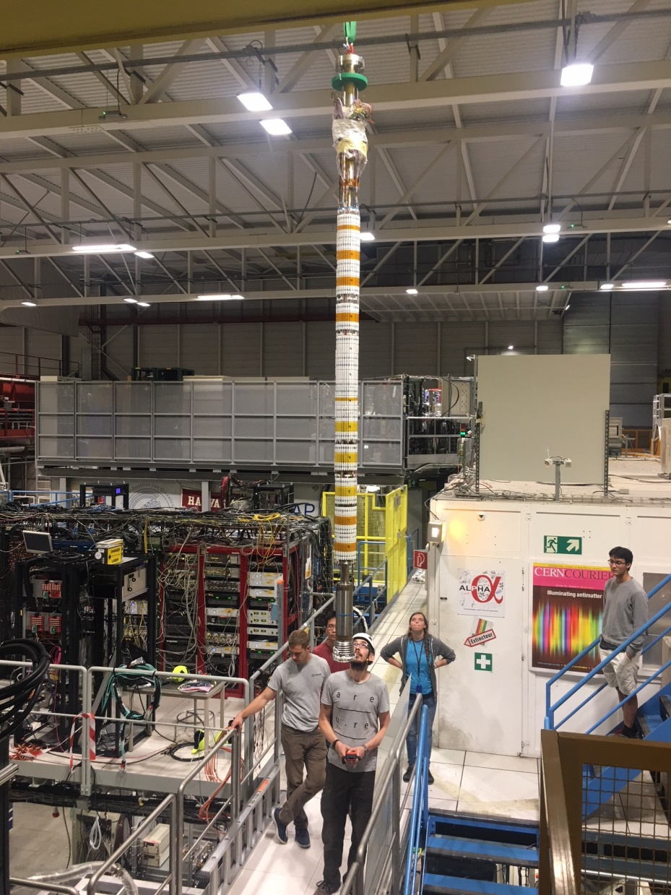
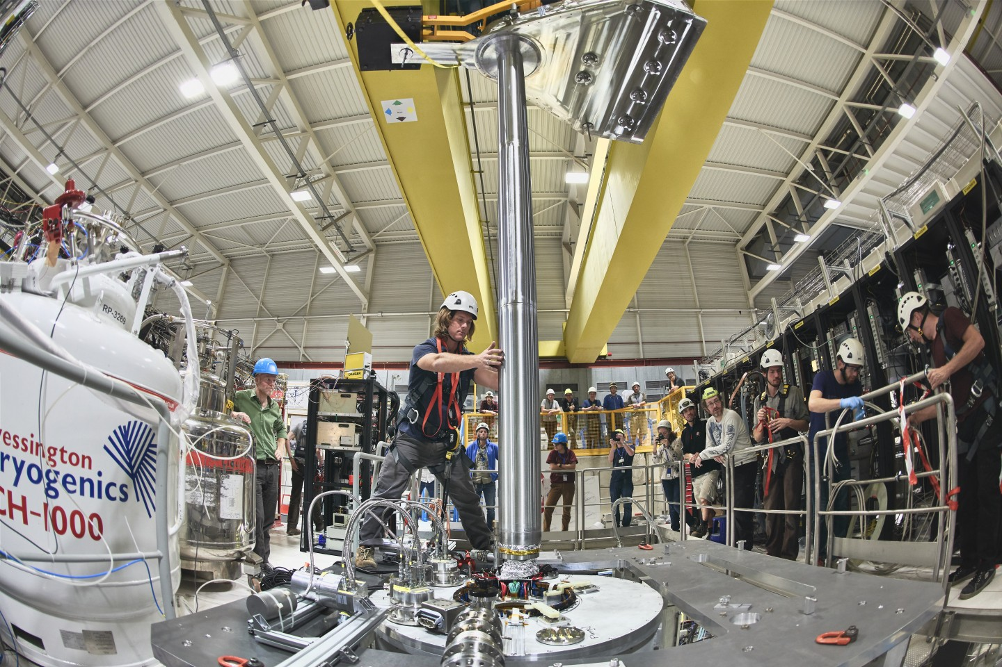
ALPHA-g reality
LHe Cryostat
Inner
magnets
~1.5 m

Slide 21
“up-down” measurement
Only coils A + G + bottom octupole

Slide 22
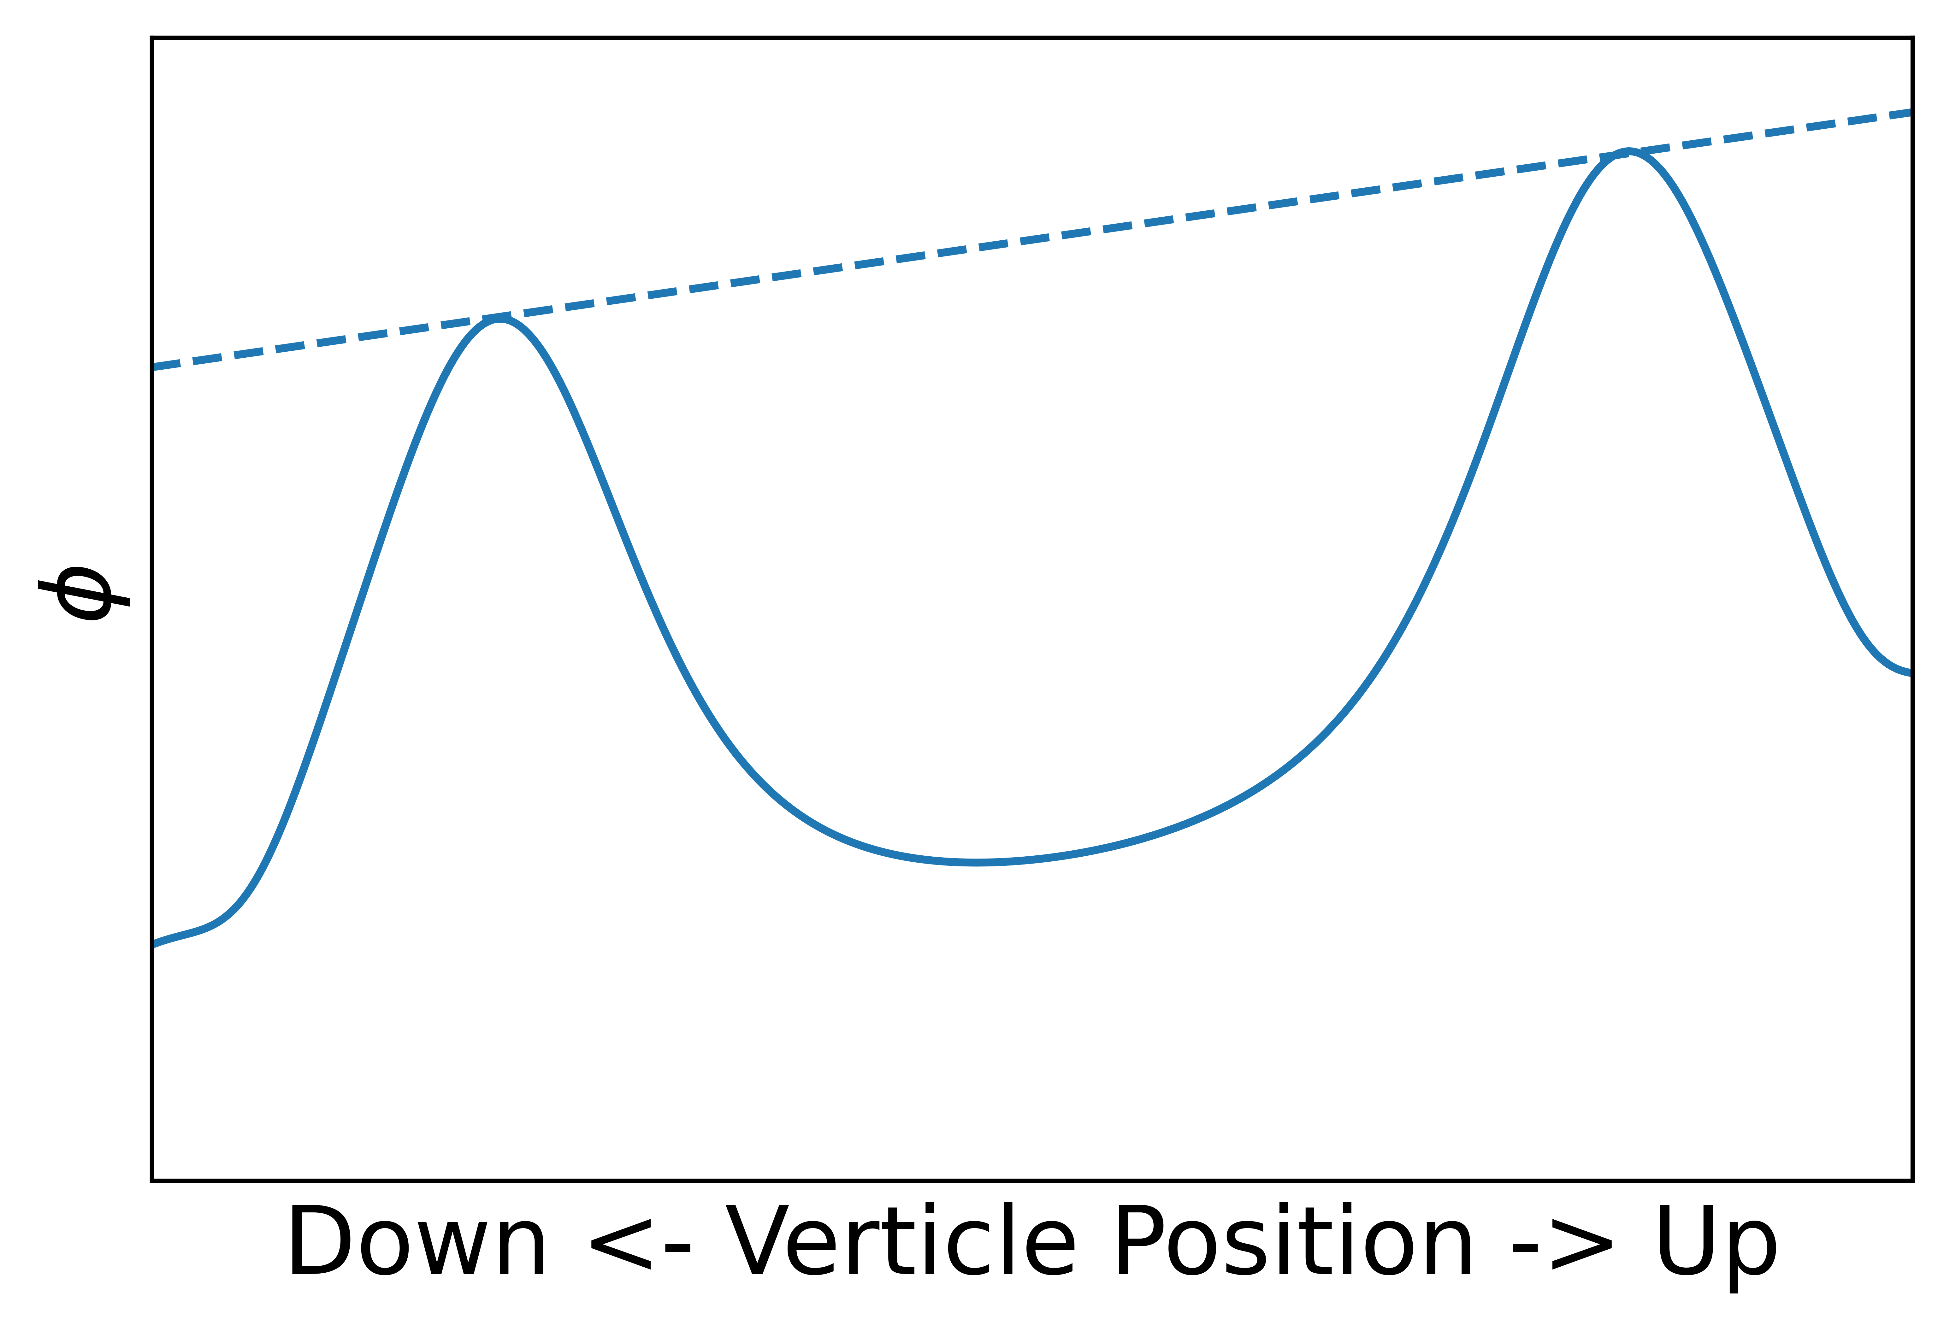



“up-down” measurement
Only coils A + G + bottom octupole
$$φ=μ_{B}B − mgh$$
$$∆φ=−mg∆h$$
$$∆B \sim 4 × {10}^{−4} T$$

Slide 23
Magnetic field measurements
Down
Coil A
Coil G
Octupole
Penning trap electrodes
Image: Adam Powell

Slide 24
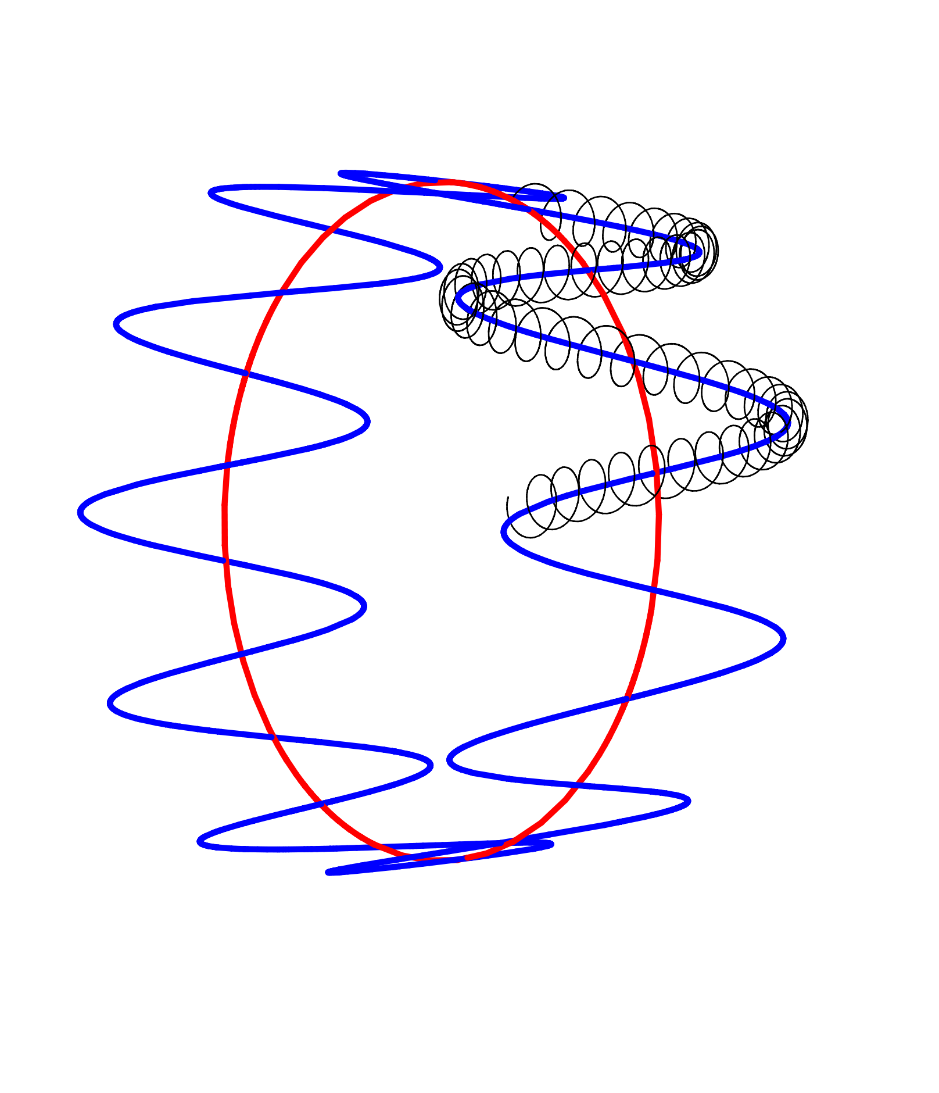
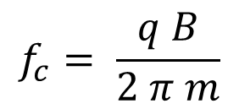
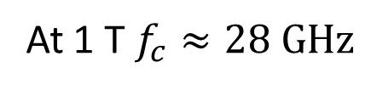
Electron cyclotron resonance magnetometry
$$f_{c}= \frac{q B}{2 π m}$$
B
At 1 T $f_{c}≈28 GHz$

Slide 25
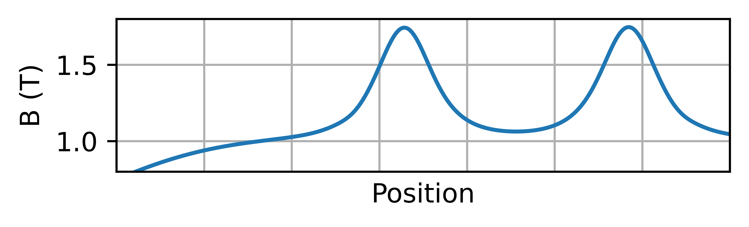
Electron cyclotron resonance
e-
Image: Adam Powell

Slide 26
Electron cyclotron resonance
e-
Image: Adam Powell

Slide 27
Electron cyclotron resonance
e-
Image: Adam Powell

Slide 28

Electron cyclotron resonance
$μ$Waves
e-
Image: Adam Powell

Slide 29
Electron cyclotron resonance
e-
Image: Adam Powell
Electron Cyclotron Resonance (ECR) Magnetometry with a Plasma Reservoir
E. D. Hunter, A. Christensen, J. Fajans , T. Friesen, E. Kur, and J. S. Wurtele (2019)

Slide 30
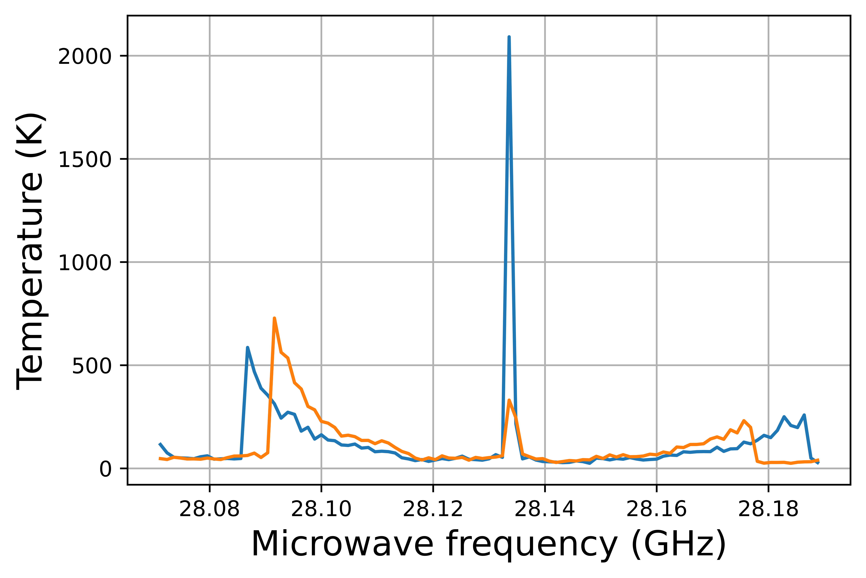
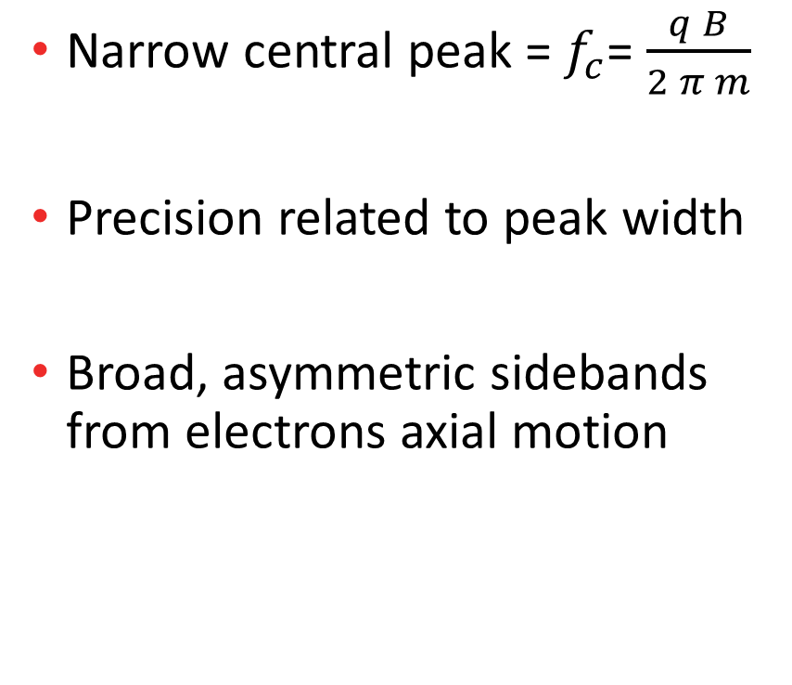
Electron cyclotron resonance
Image: Adam Powell
Narrow central peak = $f_{c}$= $\frac{q B}{2 π m}$
Precision related to peak width
Broad, asymmetric sidebands from electrons axial motion

Slide 31
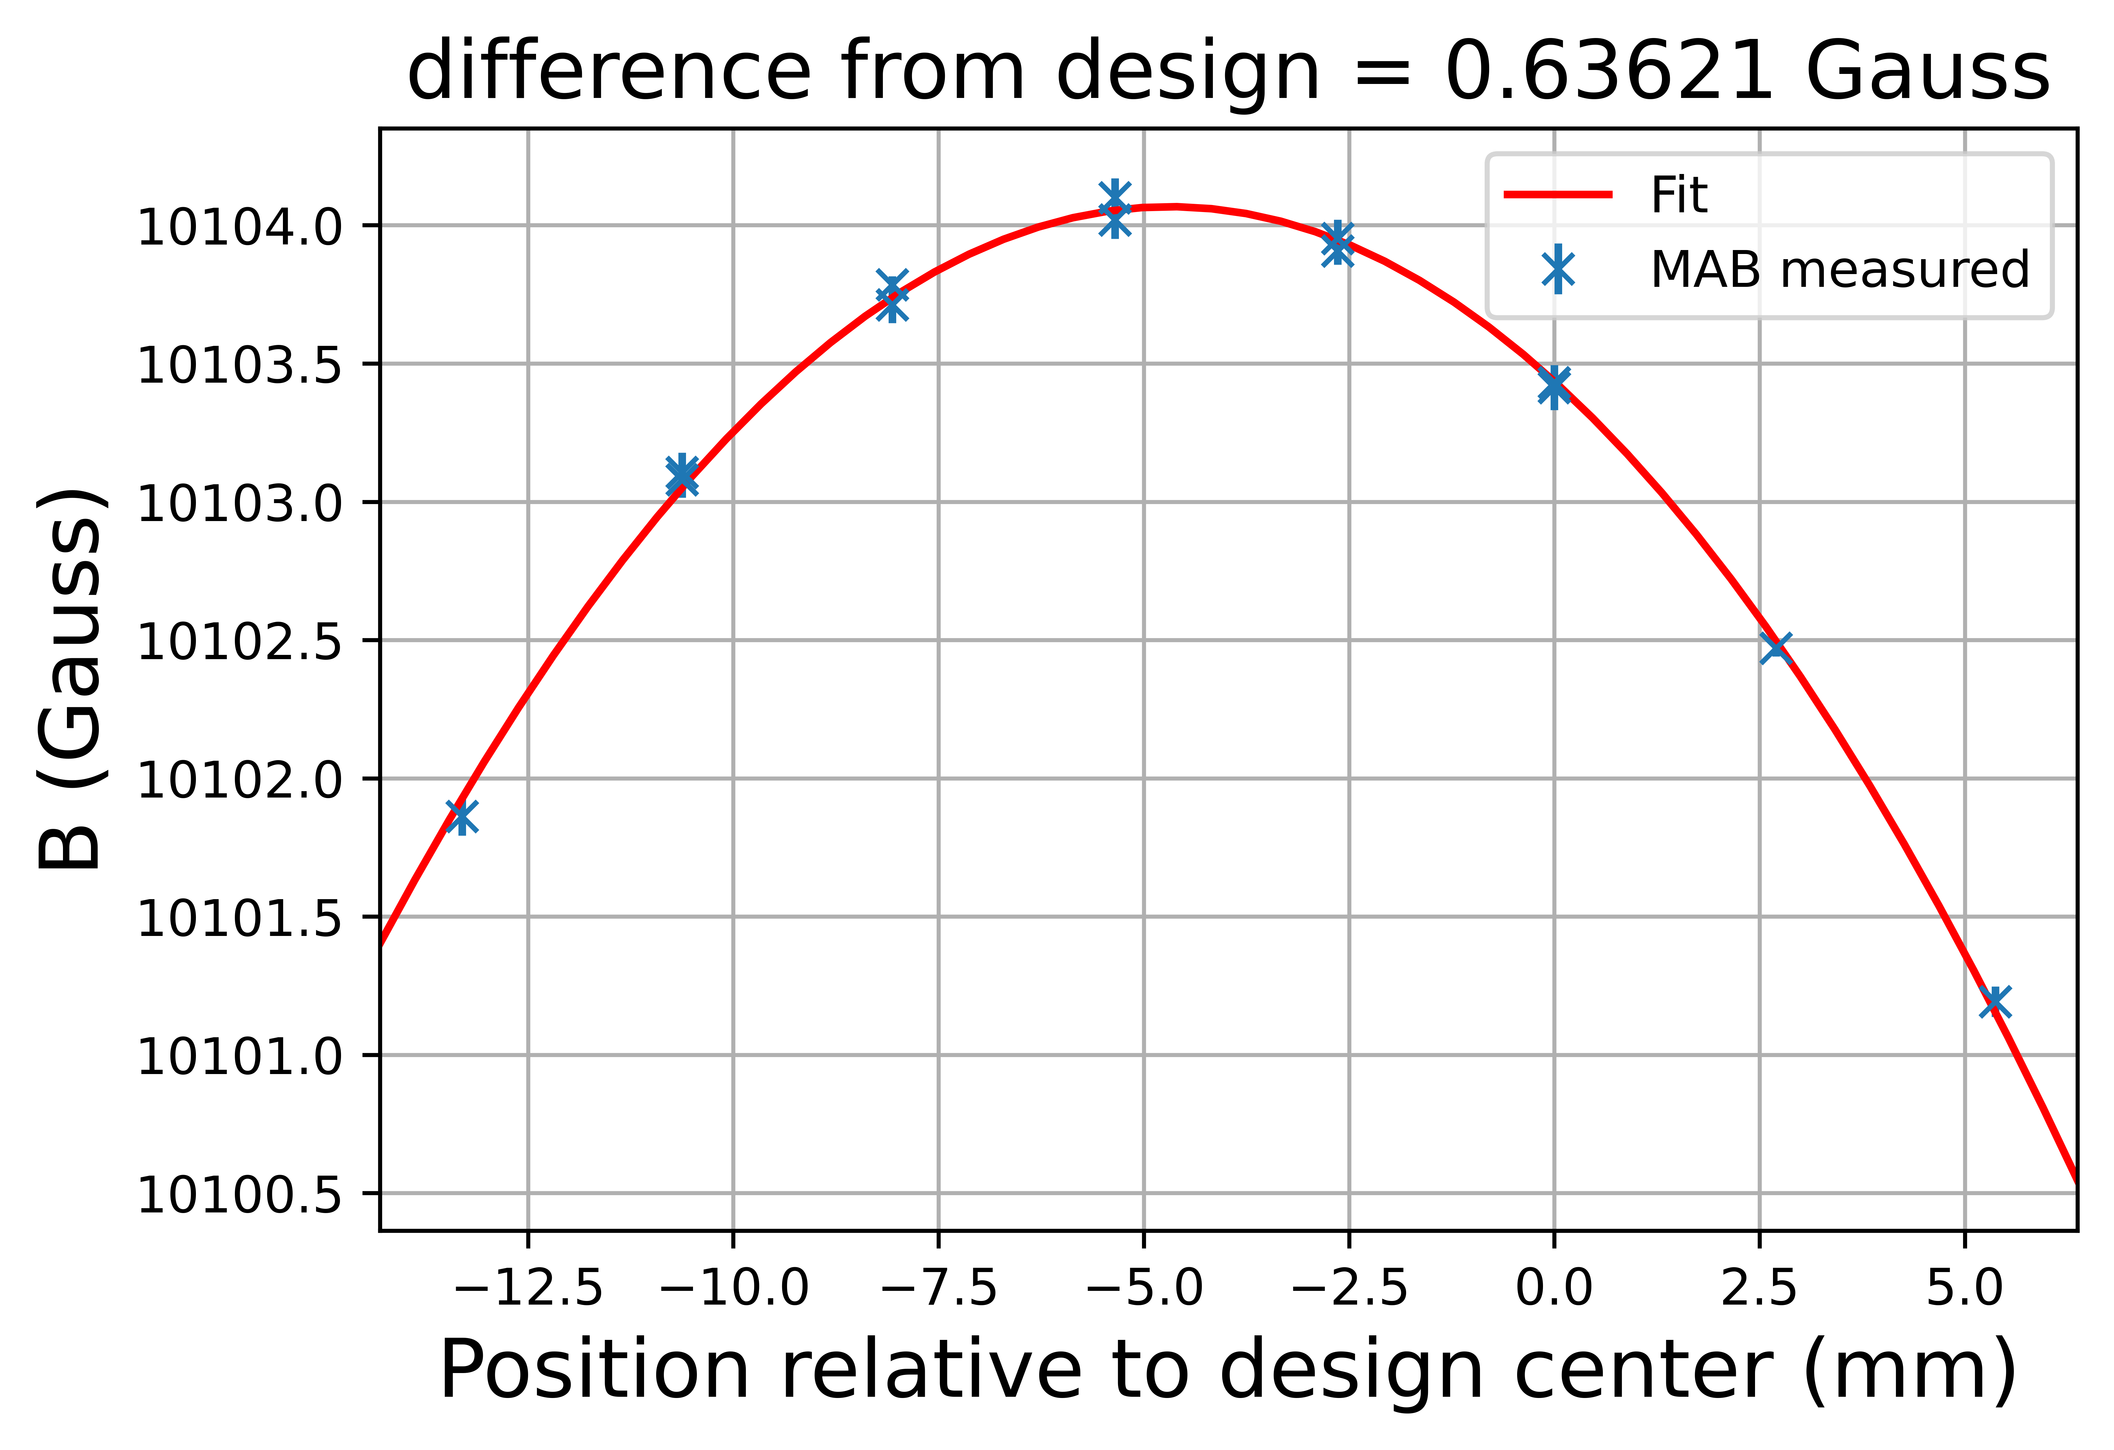
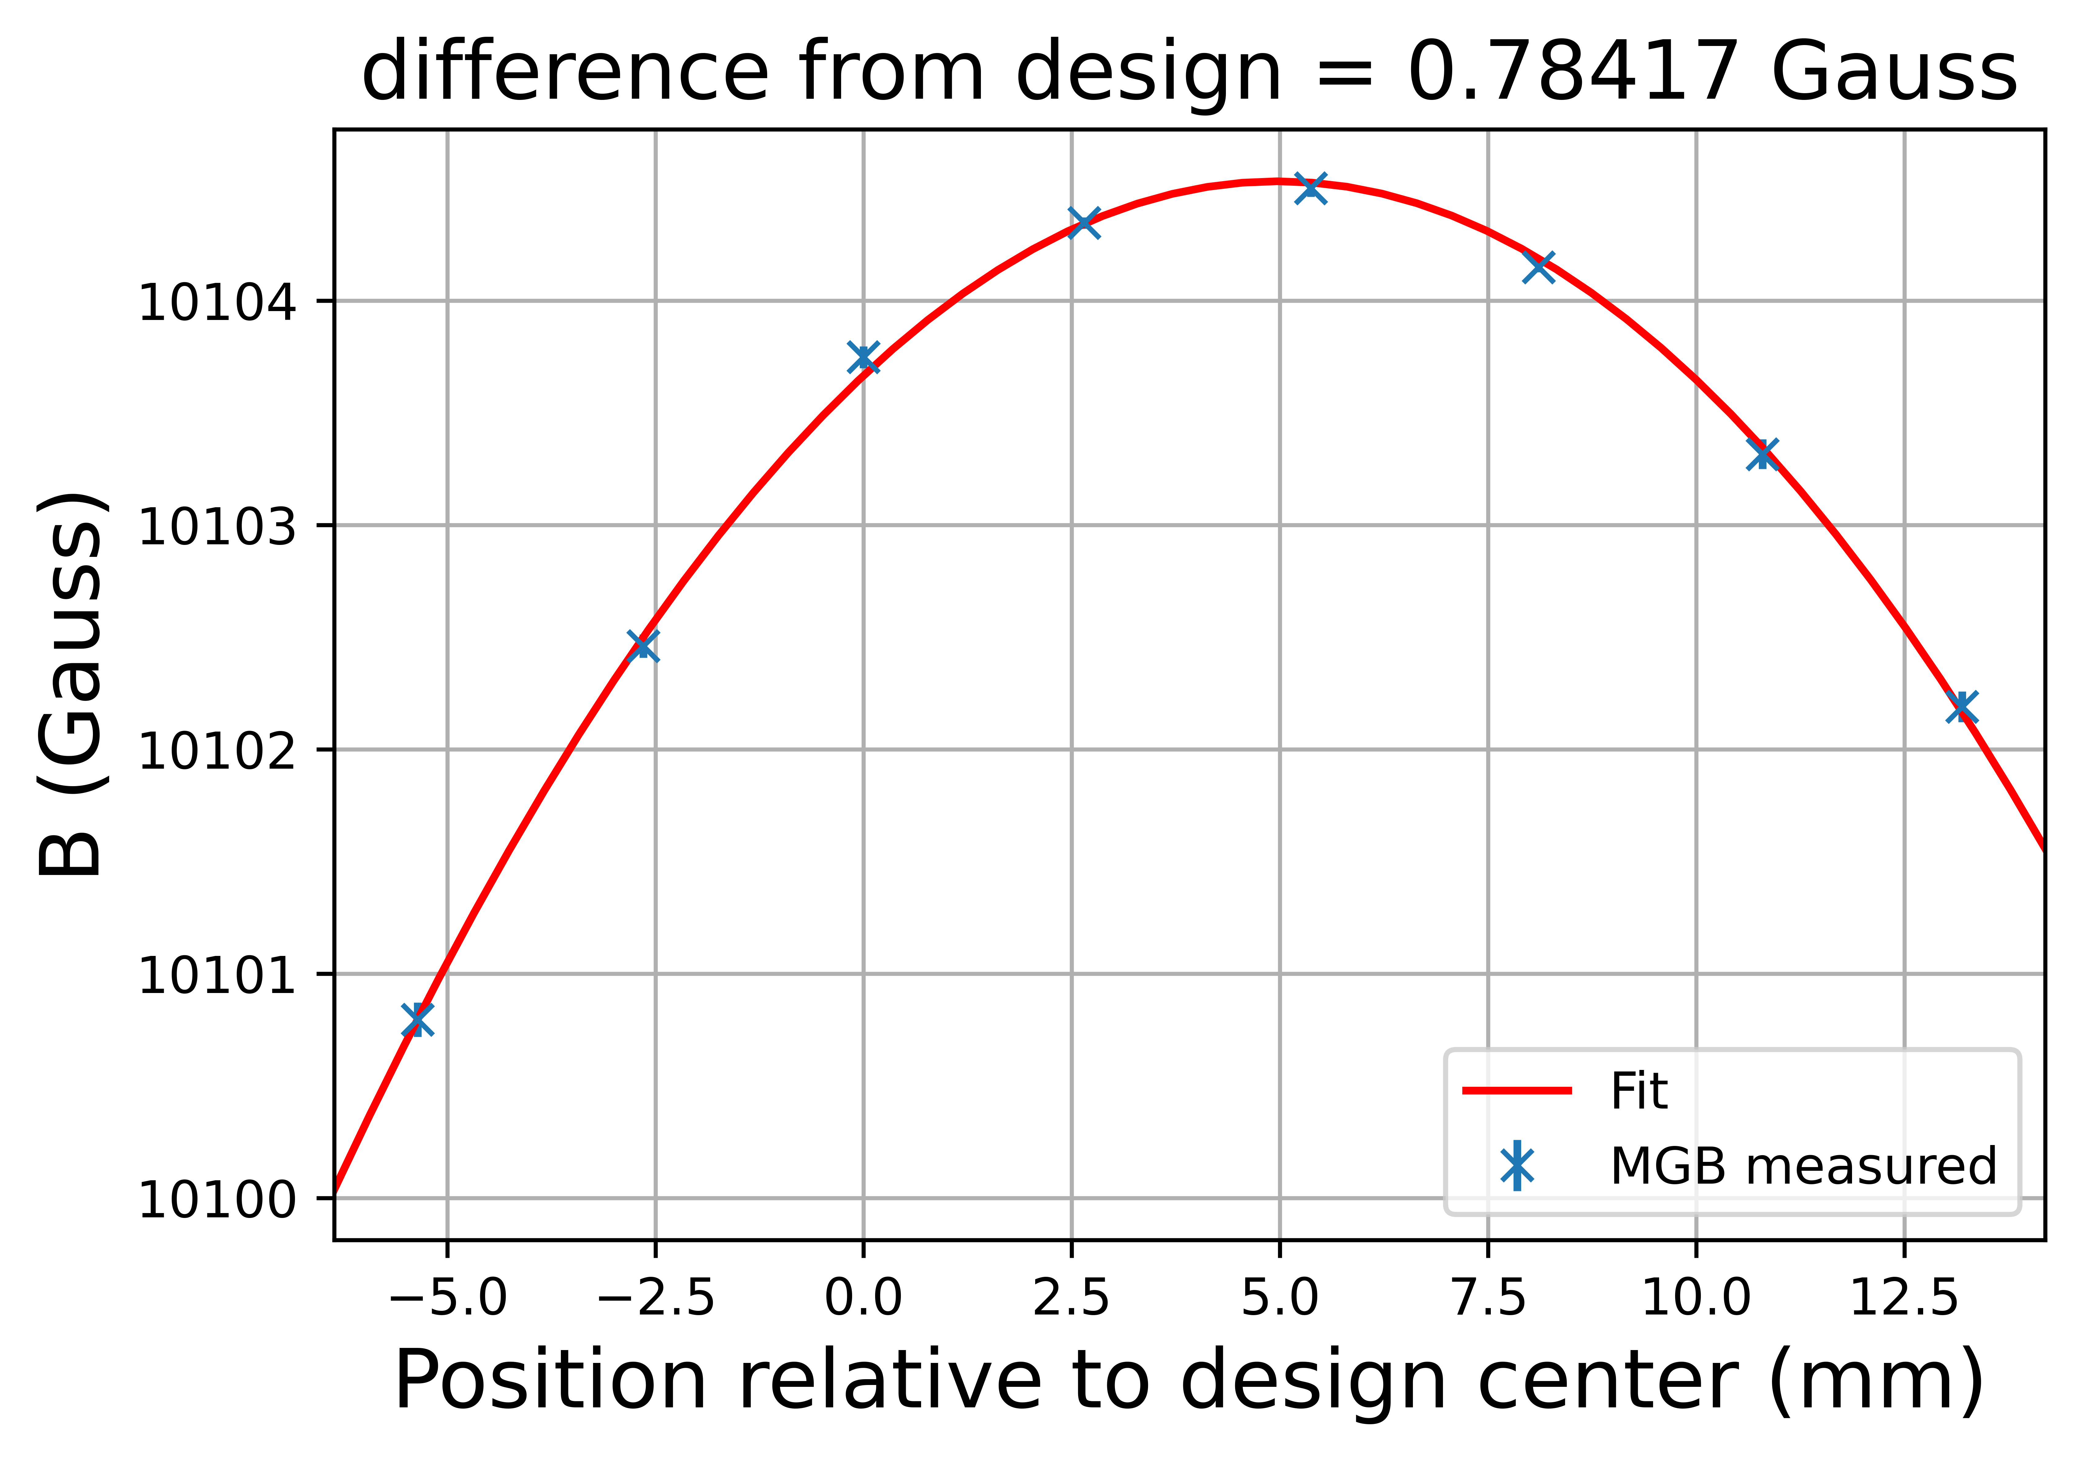
Electron cyclotron resonance
Image: Adam Powell
Image: Adam Powell

Slide 32
“up-down” measurement scheme
Accumulate antihydrogen atoms
Slowly ramp down the end mirror coils, maintaining bias
Record annihilations going up or down
Repeat for various bias values
ECR field measurements at start and end of mirror ramp
Extensive offline magnetometry measurements

Slide 33
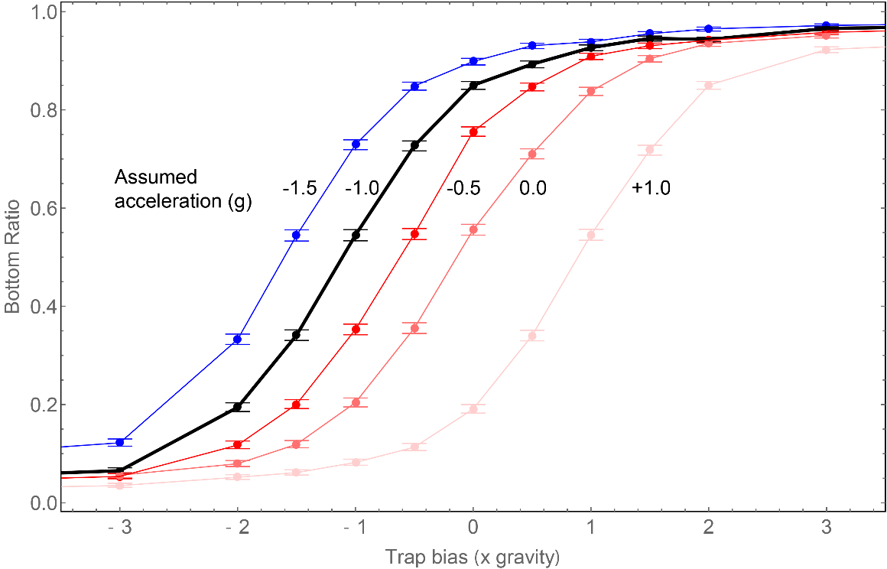
Simulated results
ALPHA Preliminary
Image: Chukman So

Slide 34
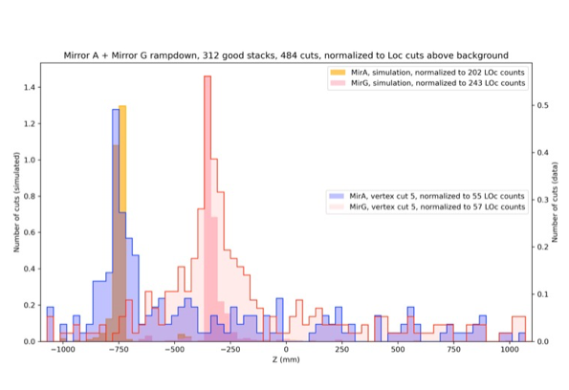
Proof of principle
Blue: Trap bias 10x gravity
Red: Trap bias –10x gravity
ALPHA Preliminary
DOWN

Slide 35
ALPHA-g status and prospects
In 2022 we completed a set of experiments at various biases. Analysis in progress…
Future precision:
  Slower ramps
  Improved background rejection
  Improved magnetometry
  Validation of simulations
  Colder antihydrogen (laser cooling, adiabatic cooling)

Slide 36
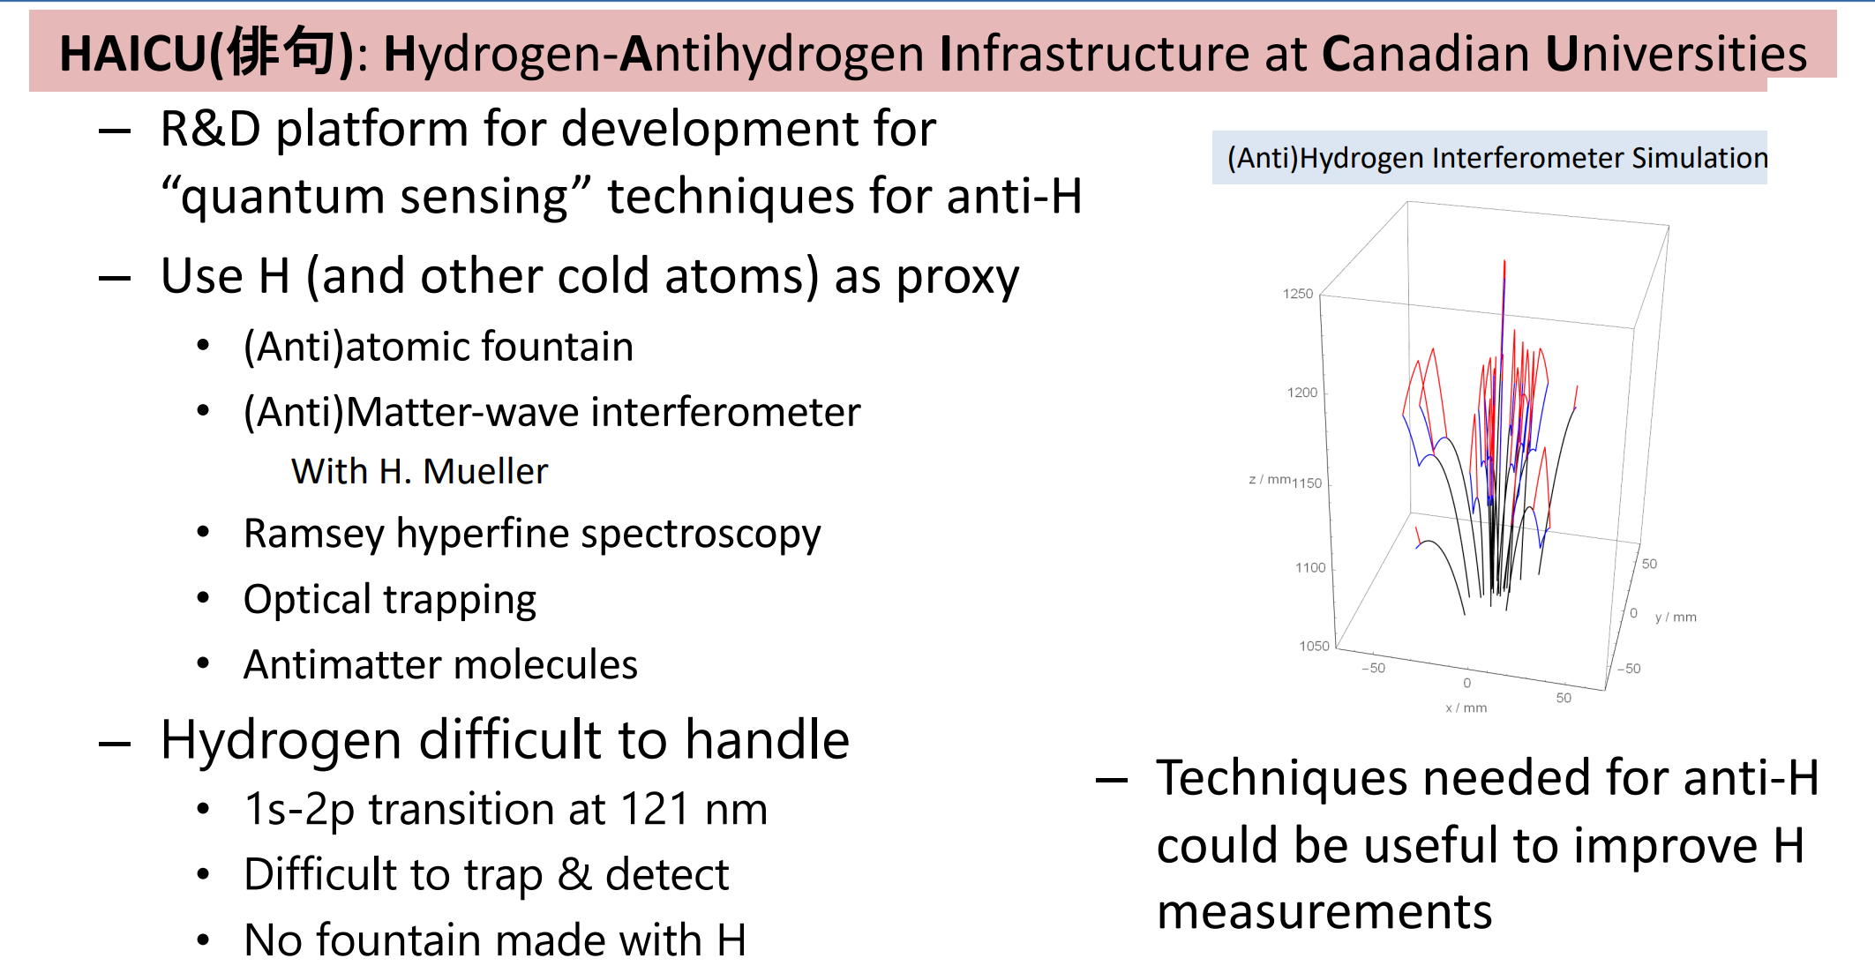

Slide 37
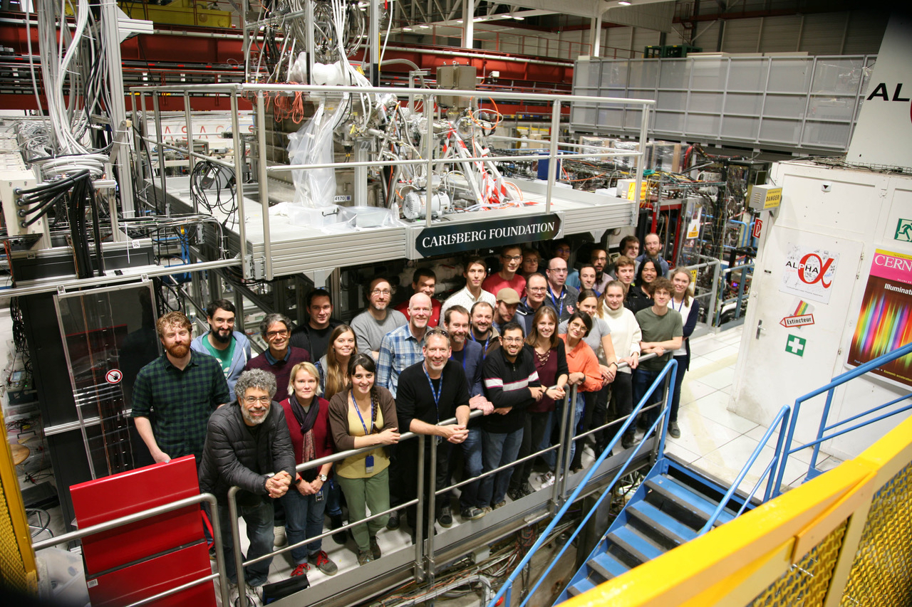
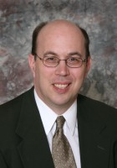
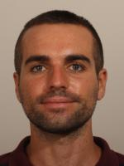
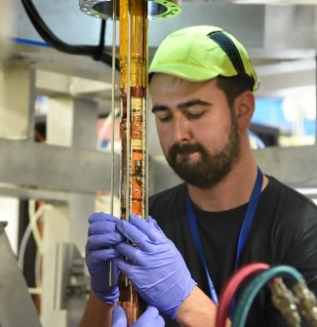

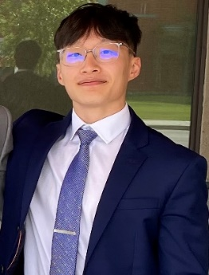
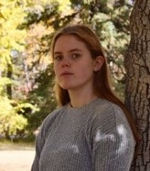




Thanks!
Tim Friesen
timothy.friesen@ucalgary.ca
ALPHA
Alberto Jesus Uribe Jimenez
Pooja Woosaree
Abbygale Swadling
Prof.
R.I. Thompson
Adam Powell
Jay Suh

Slide 38
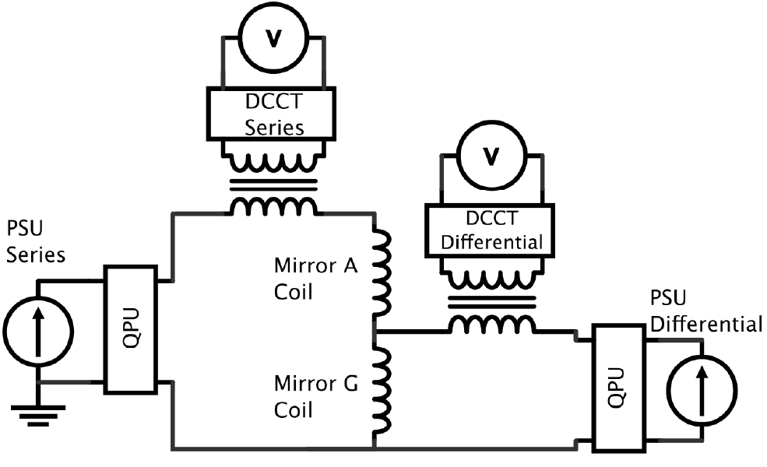
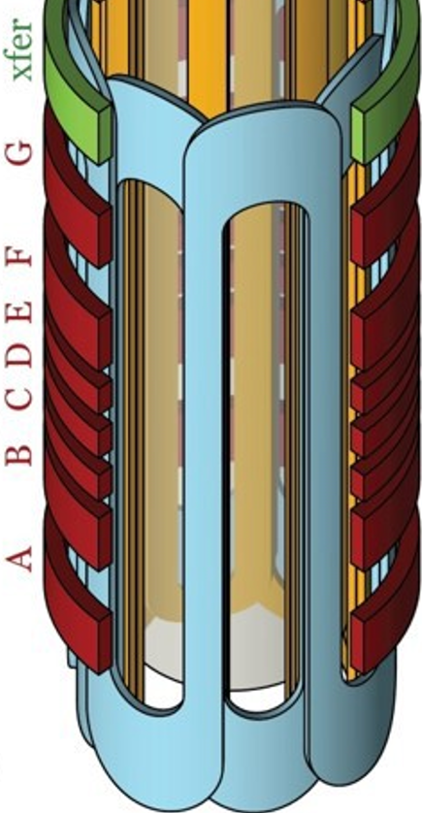
Magnet control
0 – 70 A
0 – 0.1 A
(1 mA precision)

Slide 39
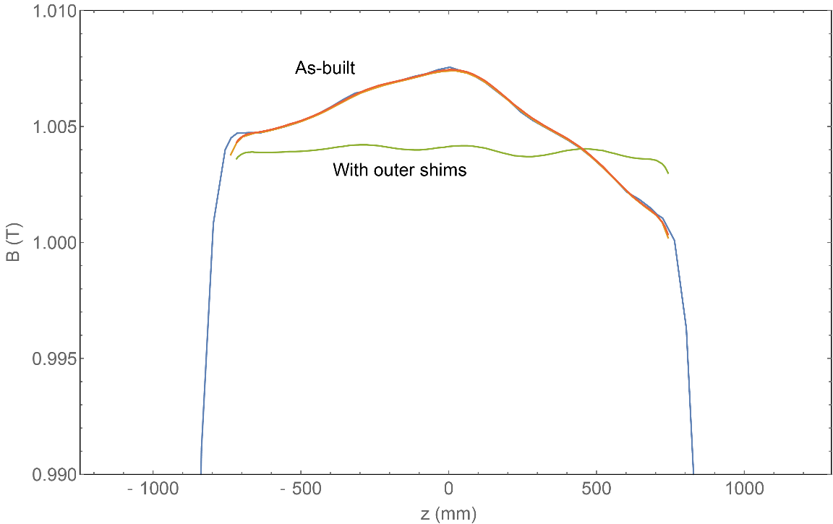
Background solenoid uniformity
As-built: 20 G non-uniformity
With outer shims: ~4 G non-uniformity
(As measured with hollow solenoid using NMR magnet probes)

Slide 40
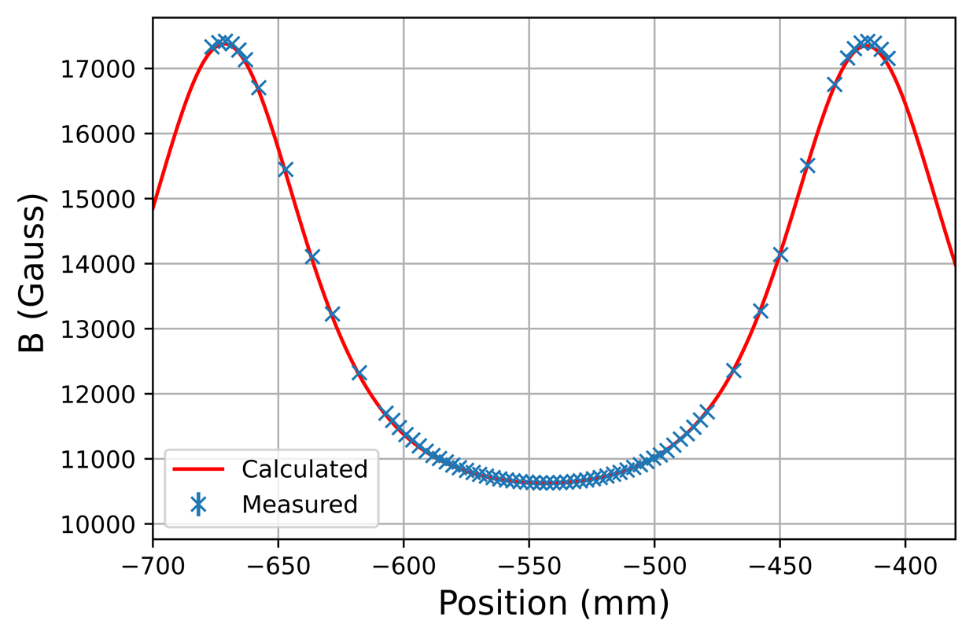
Electron cyclotron resonance

Slide 41
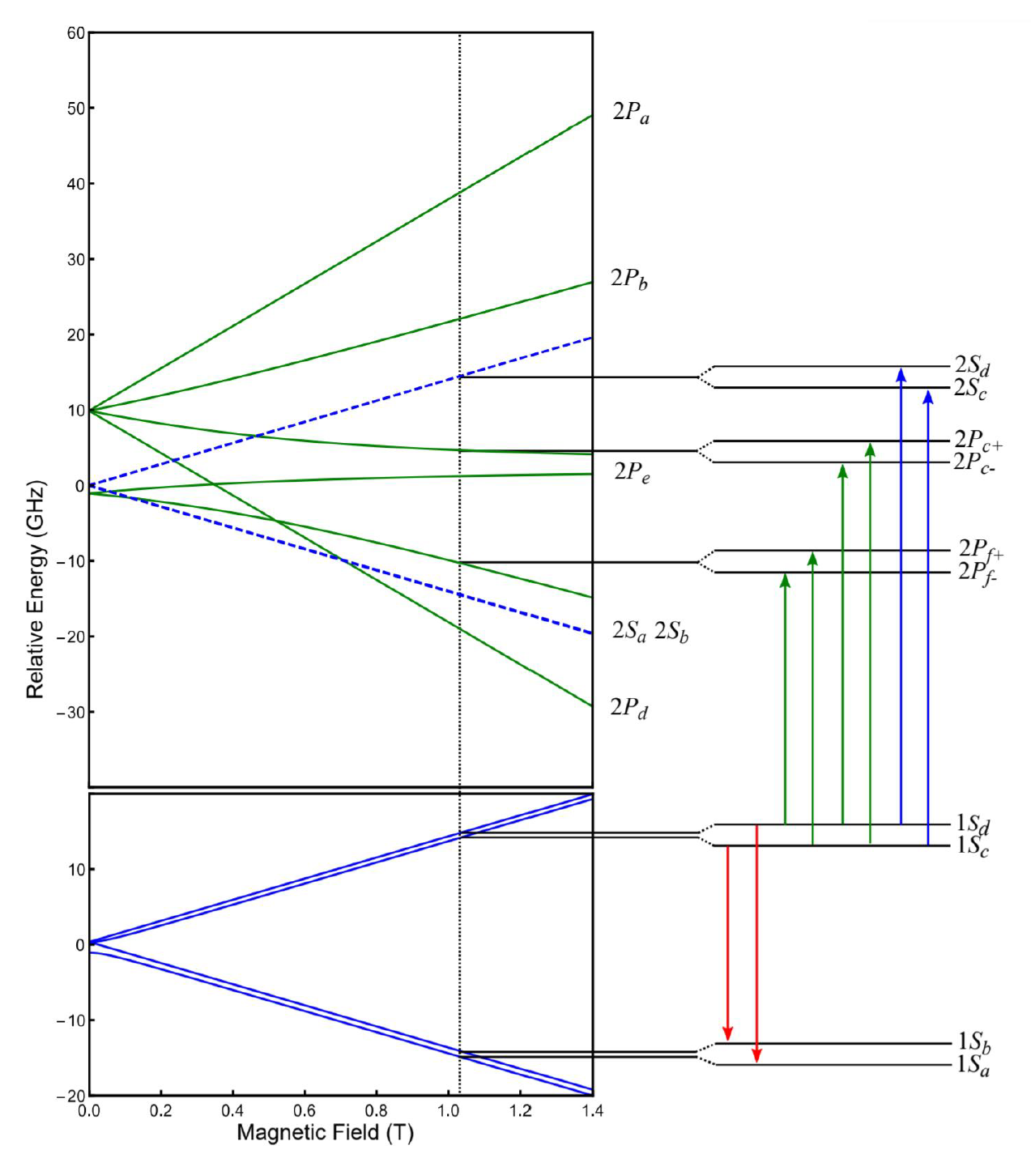
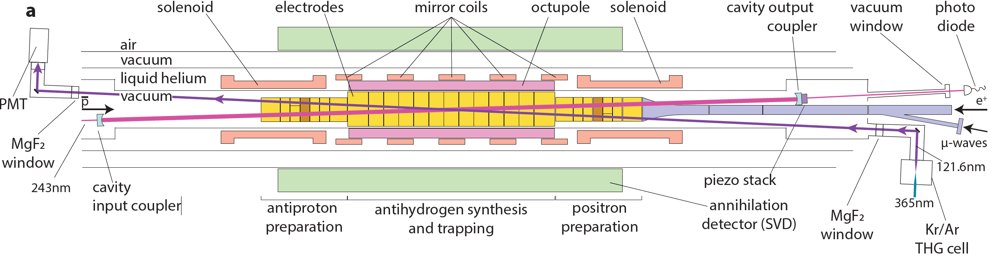
Antihydrogen spectroscopy

Slide 42
Antihydrogen spectroscopy
Hyperfine spectrum [M. Ahmadi et al, Nature 548, 66 (2017)]
Fine structure [M. Ahmadi et al, Nature 578, 375 (2020)]
1S – 2S spectroscopy [M. Ahmadi et al, Nature 557, 71 (2018)]

Slide 43
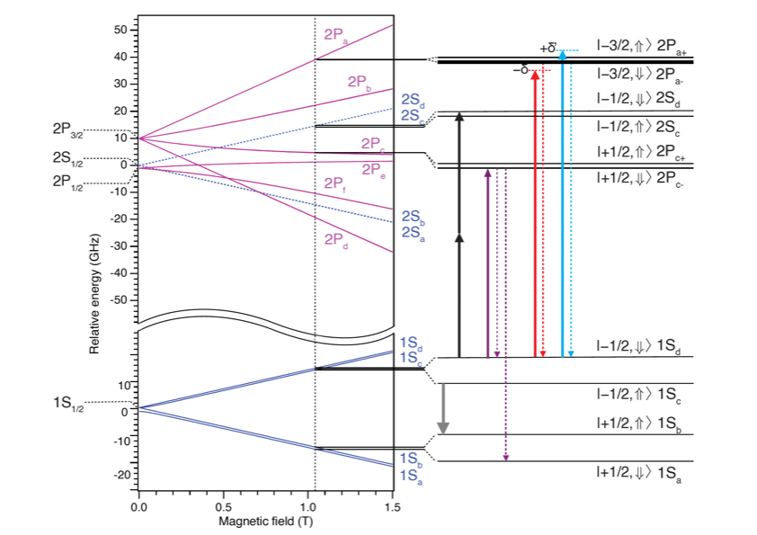
Laser cooling antihydrogen
Pulsed 121.6 nm generated by THG:
Approx. 15 ns pulse length
Approx. 2 - 10 nJ per pulse
10 Hz repetition rate
Detuned -220 MHz for cooling
Notes:
I’ve been working on this field for >20 yrs; clearly trapping of antihydrogen was a major breakthrough, which enabled series of measurements with anti-H, whose precision now is approaching that of H

Slide 44
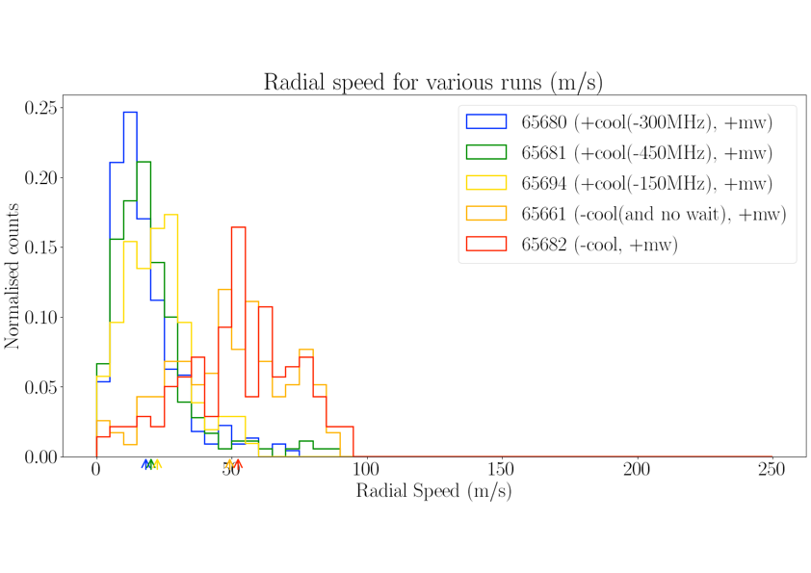
Laser cooling antihydrogen
C. J. Baker et al, Nature 592, 35 (2021)
Notes:
I’ve been working on this field for >20 yrs; clearly trapping of antihydrogen was a major breakthrough, which enabled series of measurements with anti-H, whose precision now is approaching that of H

Slide 45
Antihydrogen spectroscopy
Coming soon:
Lamb shift
2s –> 2p
1s-2p:1.6x10⁻⁸
Nature 561, 211 (2018)
Nature 578, 375 (2020)
1s-2s: 4x10⁻¹⁵
PRL 107, 203001 (2011)
1s-2s: 2x10⁻¹²
Nature 541, 506 (2017)
Nature 557, 71 (2018)
HFS: 9x10⁻⁶(Prelim.)
Nature 483, 439 (2012)
Nature 548, 66 (2017)
Notes:
I’ve been working on this field for >20 yrs; clearly trapping of antihydrogen was a major breakthrough, which enabled series of measurements with anti-H, whose precision now is approaching that of H

Slide 46
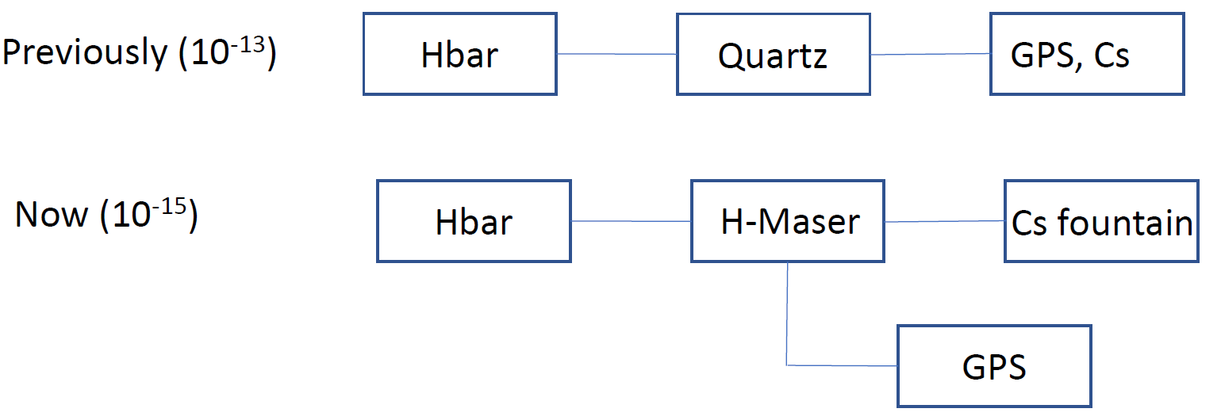
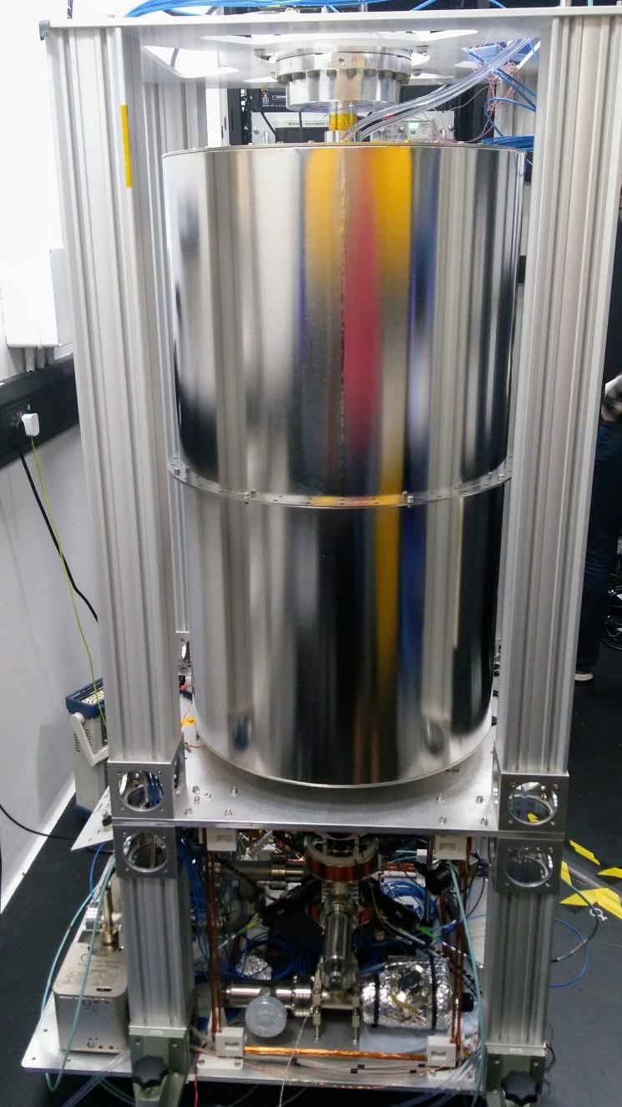

Toward higher precisions
Laser cooling: Upgraded 121 nm system (5x repetition rate, 4x pulse energy)
1S – 2S: New frequency metrology

Slide 47
Toward higher precision spectroscopy
Laser cooling: Upgraded 121 nm system (5x repetition rate, 4x pulse energy)
1S – 2S: New frequency metrology, laser cooling
HFS: Vastly improved magnetic field stability, improved magnetometry
More antihydrogen!

Slide 48

ALPHA-g schematic

