Slide 1



Characterization of Laser-Driven Photon Emission in Silicon Photomultipliers
Juliette M.J. Martin
TRIUMF, The University of Edinburgh
CAP Congress
June 8th, 2022
Juliette Martin, TRIUMF/The University of Edinburgh
CAP Congress 2022
1

Slide 2
Outline
The Silicon Photomultiplier
Cross-Talk
Optical cross-talk studies at TRIUMF
Results
Juliette Martin, TRIUMF/The University of Edinburgh
CAP Congress 2022
2

Slide 3
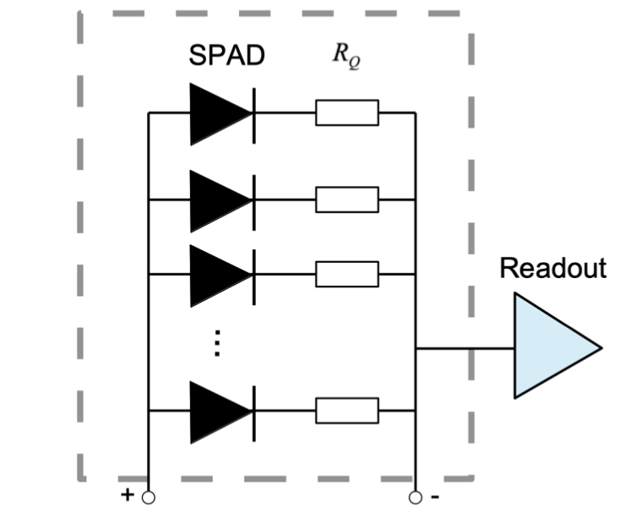
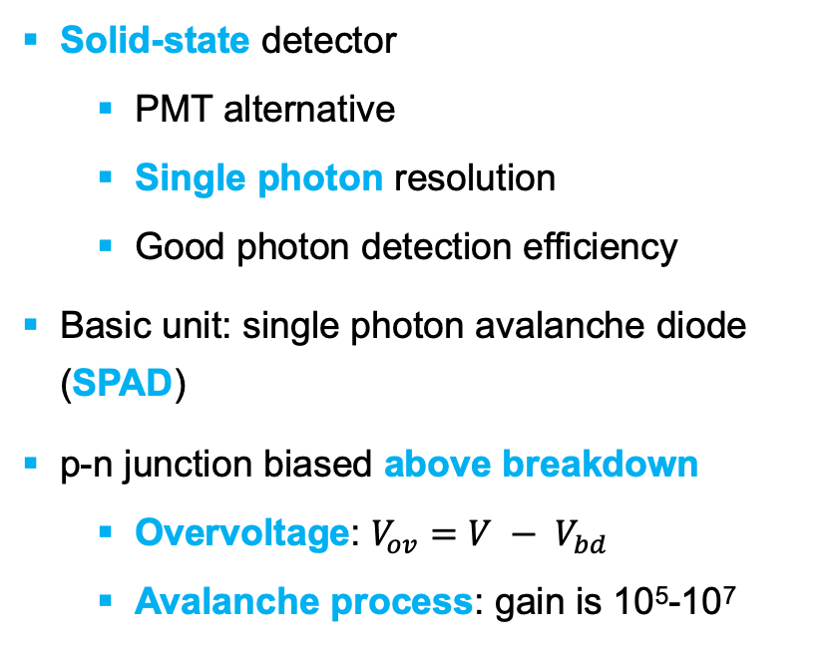
What is a Silicon Photomultiplier (SiPM)?
Solid-state detector
  PMT alternative
  Single photon resolution
  Good photon detection efficiency
Basic unit: single photon avalanche diode (SPAD)
p-n junction biased above breakdown
  Overvoltage: ${V_{ov}=V − V}_{bd}$
  Avalanche process: gain is 10⁵-10⁷
Juliette Martin, TRIUMF/The University of Edinburgh
CAP Congress 2022
3

Slide 4

SiPM signal detection: SPAD level
External cross-talk
$$hν$$
Surface coating
Trench
Internal cross-talk
Sensor
Secondary avalanche
Avalanche
Juliette Martin, TRIUMF/The University of Edinburgh
CAP Congress 2022
4

Slide 5
Cross-Talk
Secondary photon by-product of avalanche mechanism
Systematic effect on detector background
Must be quantified for use in rare-event searches (e.g. nEXO)
Is photon emission significant?
Juliette Martin, TRIUMF/The University of Edinburgh
CAP Congress 2022
5

Slide 6
MIEL at TRIUMF
SiPM Microscope for Injection and Emission of Light.
Setup developed at TRIUMF
  Study spectral features of SiPM emission
  Geographical location of light emission
Two SiPMs: FBK VUV-HD3.6, HPK VUV4
  nEXO candidate photodetectors
Juliette Martin, TRIUMF/The University of Edinburgh
CAP Congress 2022
6

Slide 7
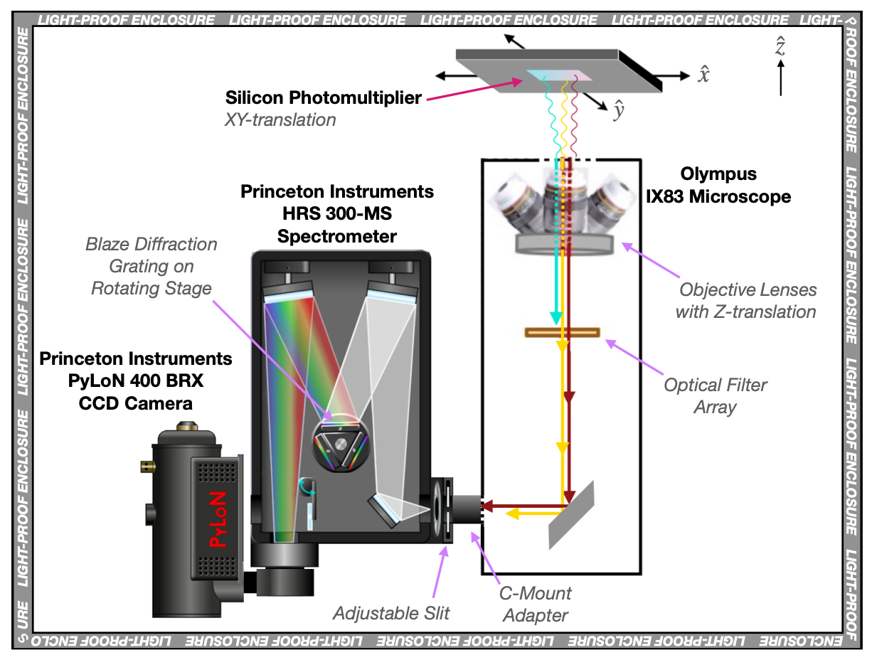
MIEL at TRIUMF
Previous studies explore emission of SiPM in dark conditions
Additions:
  Cryogenic cooling: reduce dark noise, replicate conditions in cryo experiments (nEXO etc)
  Laser injection system: stimulate emission of secondary photons at variety of wavelengths
Juliette Martin, TRIUMF/The University of Edinburgh
CAP Congress 2022
7

Slide 8
MIEL laser injection system
SiPM
Collimated laser beam
Dichroic mirror
Longpass filter
Microscope objective
Juliette Martin, TRIUMF/The University of Edinburgh
CAP Congress 2022
8
Notes:
550 nm longpass filter
was inserted along the IX83 light path to cut any 2nd-order spectrometer features from wavelengths below 550 nm (this combination is hereafter called NIR Spectroscopy mode)

Slide 9
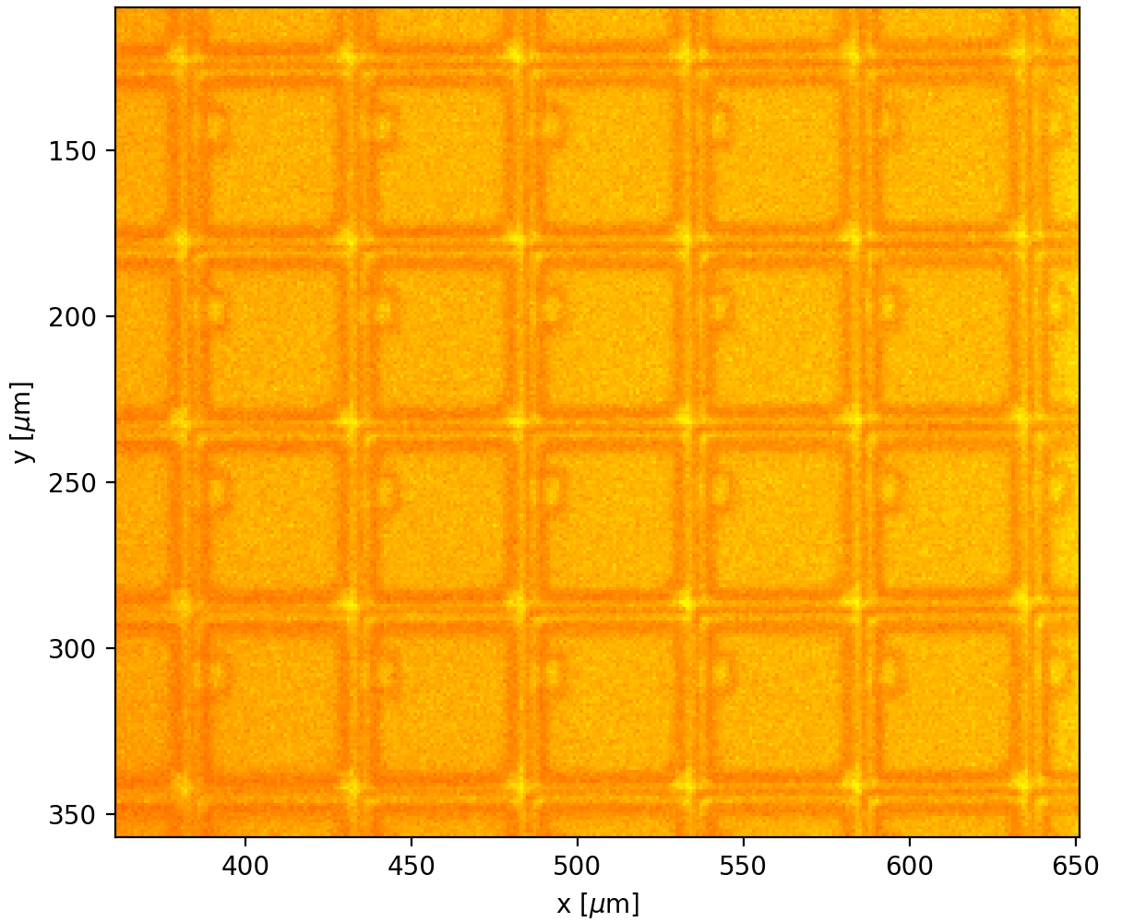
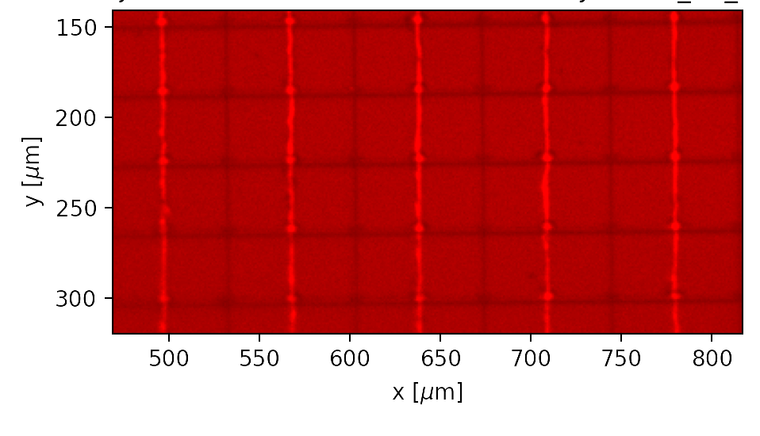
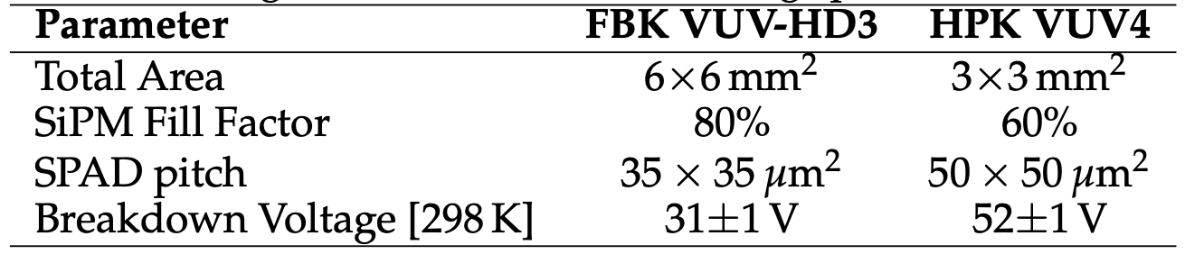
HPK and FBK photosensors
HPK VUV4
FBK VUV-HD3.6
Juliette Martin, TRIUMF/The University of Edinburgh
CAP Congress 2022
9

Slide 10
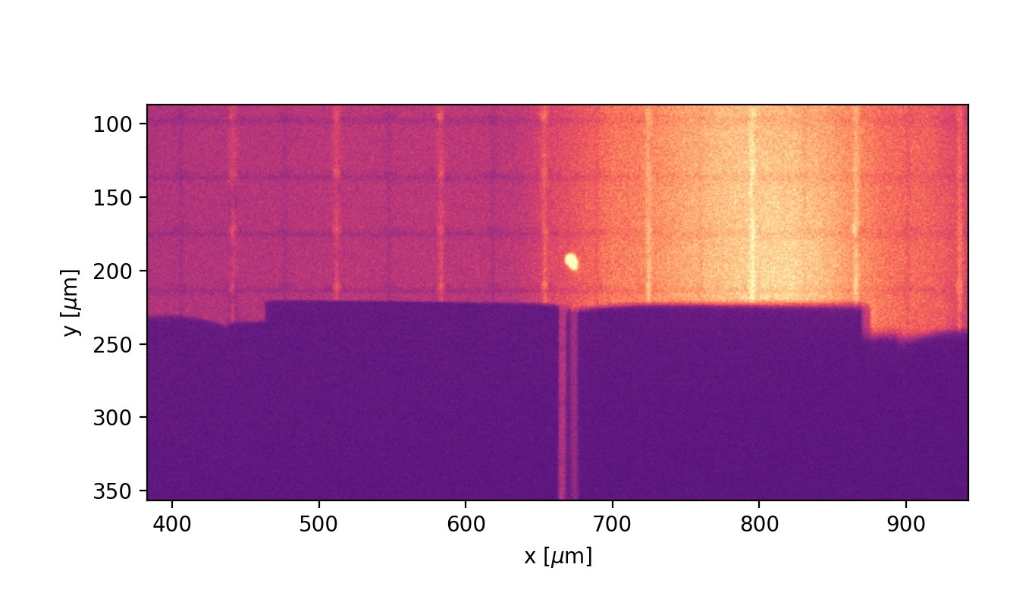
Laser beam positioning: FBK
Laser: 444nm wavelength
Centre beam on SPAD
Close slit over SiPM for spectra
Open for emission maps.
Juliette Martin, TRIUMF/The University of Edinburgh
CAP Congress 2022
10

Slide 11
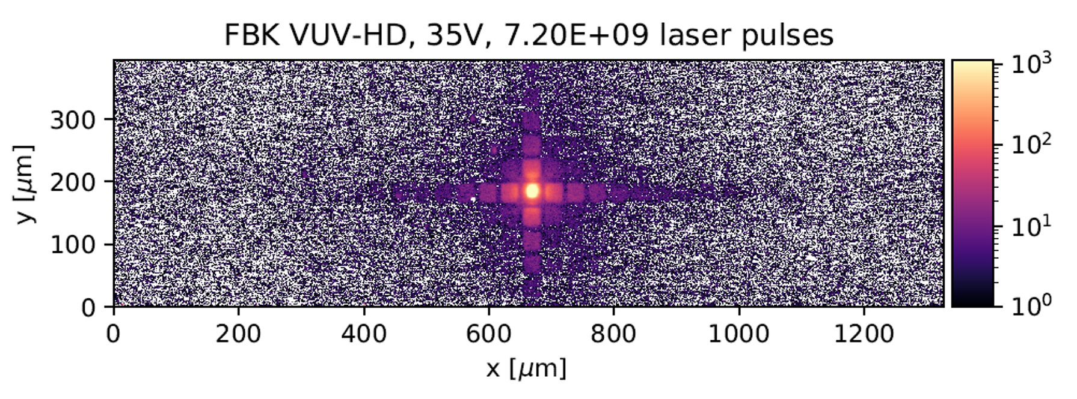
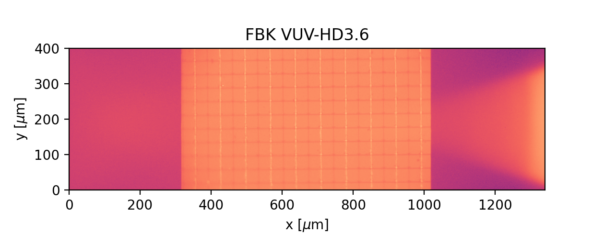
Emission Microscopy Images: FBK
ADC counts
Polysilicon trenches in FBK – less photon absorbance
Reflection
“Light guiding” effect observed
Juliette Martin, TRIUMF/The University of Edinburgh
CAP Congress 2022
11

Slide 12
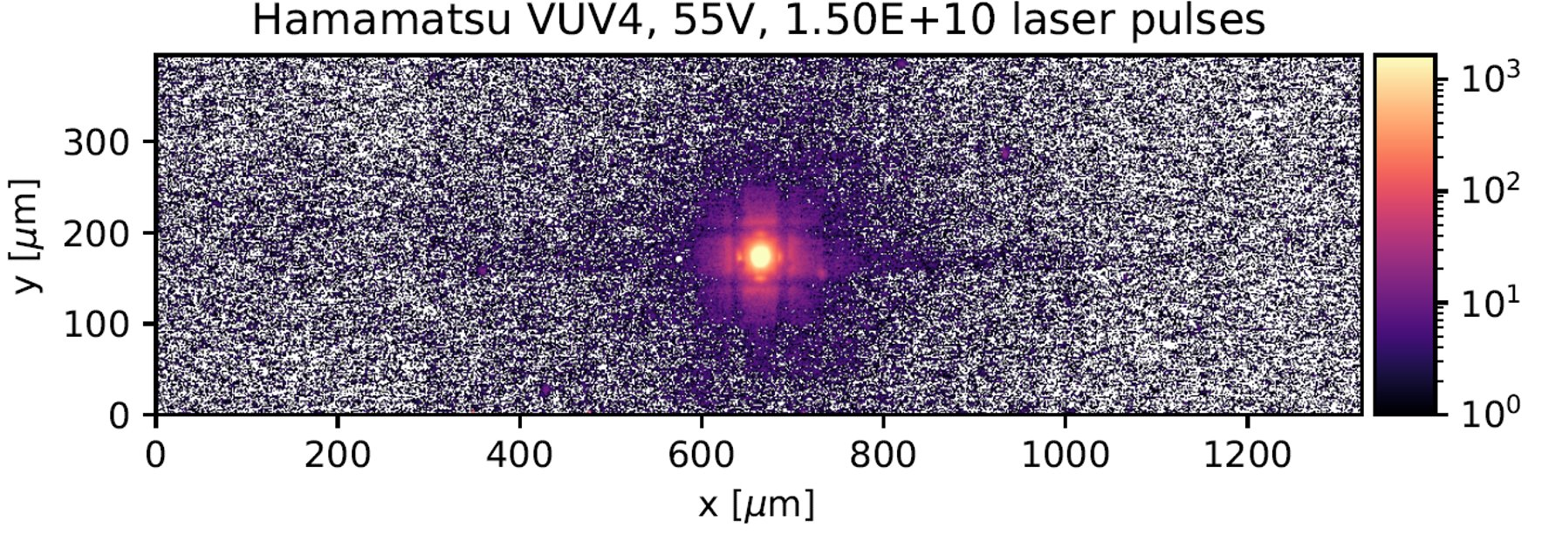
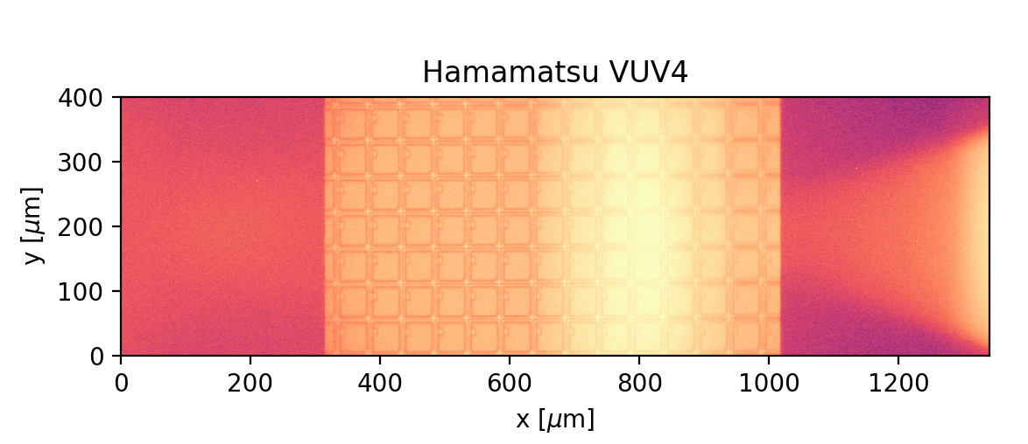
Emission Microscopy Images: HPK
ADC counts
HPK has tungsten trench
Photon absorption
No distinct ‘cross’ pattern
Juliette Martin, TRIUMF/The University of Edinburgh
CAP Congress 2022
12

Slide 13
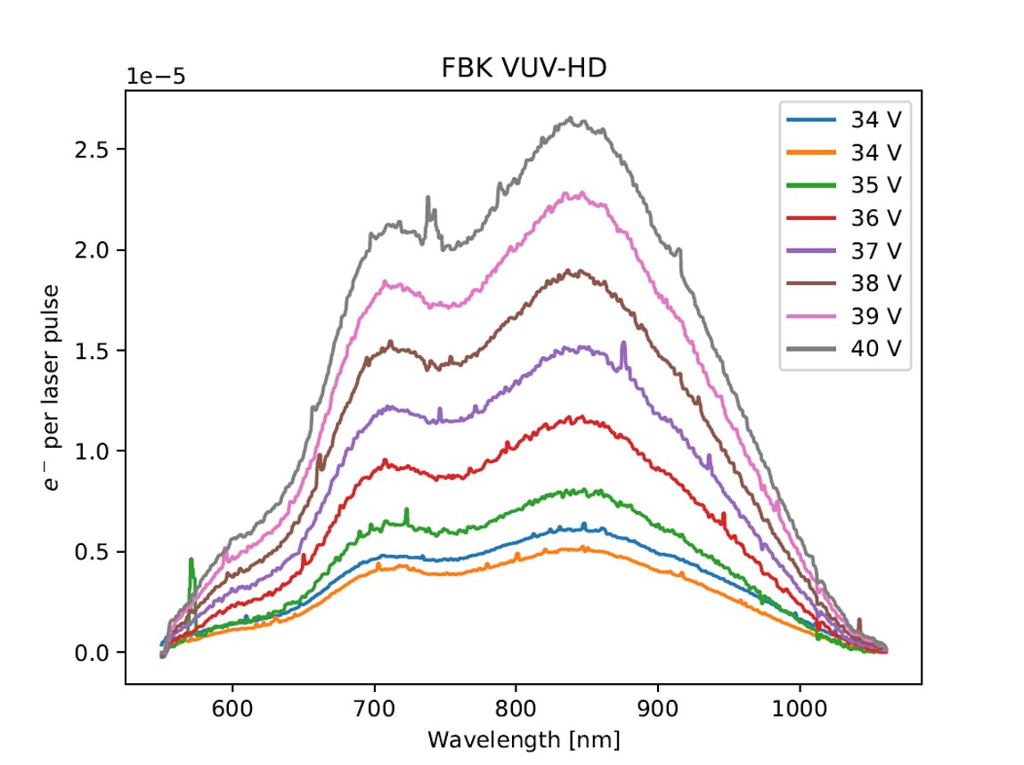
Spectra: FBK
Raw spectrum
Uncorrected for system efficiency
Rudimentary cosmic removal
550nm longpass filter
Evidence of thin-film interference due to SiO₂ coating.
PRELIMINARY
Juliette Martin, TRIUMF/The University of Edinburgh
CAP Congress 2022
13

Slide 14
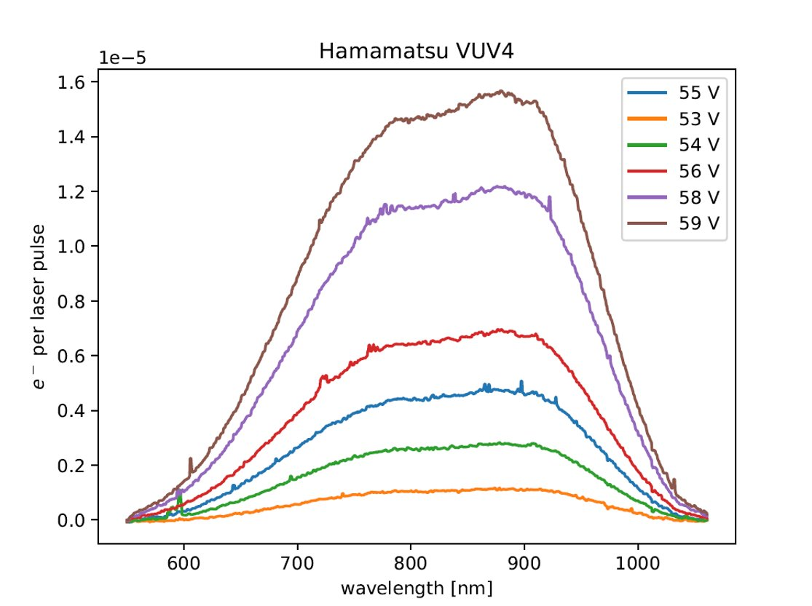
Spectra: HPK
Raw spectrum
Uncorrected for system efficiency
Rudimentary cosmic removal
550nm longpass filter
Fewer oscillation than FBK – thinner coating.
PRELIMINARY
Juliette Martin, TRIUMF/The University of Edinburgh
CAP Congress 2022
14

Slide 15
Summary
Stimulated two SiPM with 444nm laser
Obtained raw spectral distributions
Emission maps reflect differences in structure between SiPMs
Juliette Martin, TRIUMF/The University of Edinburgh
CAP Congress 2022
15

Slide 16
Ongoing and future work
D. Minchenko, 8th June, 16:15 in MDCL 1110
More effective cosmic removal
Error analysis
Active simulation efforts to model photon transport in SiPM
Correct spectra for system efficiency – intensity calibration
Correct for finite numerical aperture – simulation
Is the level of photon emission a problem for future experiments?
Stay tuned!
Juliette Martin, TRIUMF/The University of Edinburgh
CAP Congress 2022
16

Slide 17
Acknowledgements
Supervisor: F. Retière
K. Raymond (SFU, TRIUMF)
PHAAR group at TRIUMF
Juliette Martin, TRIUMF/The University of Edinburgh
CAP Congress 2022
17

Slide 18
Thank you!
Merci!
Contact
juliettem@triumf.ca
Juliette Martin, TRIUMF/The University of Edinburgh
CAP Congress 2022
18

Slide 19
Backup

Slide 20
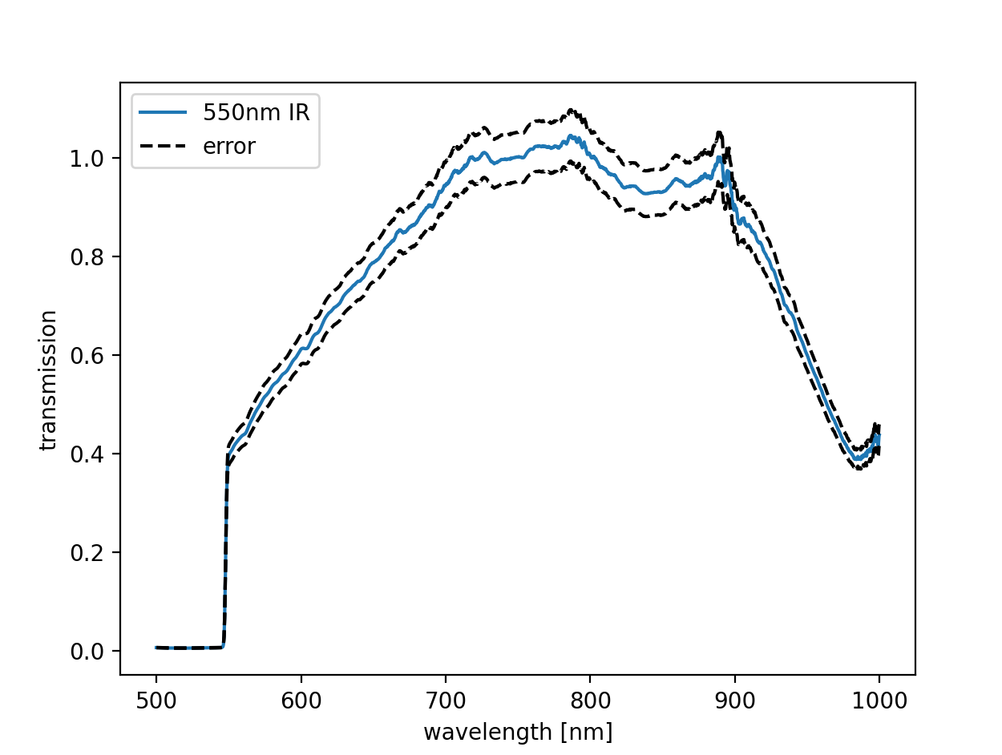
Efficiency curve
Calibrate spectrometer using PI IntelliCal ® source.
Wavelength and intensity calibrations computed.
Spectra produced treated with efficiency curve
Rudimentary error analysis, potential wavelength miscalibration

