Slide 1
Diversifying Talent in Quantum Computing
Ella Meyer, Project Manager

Slide 2

Background: What is DTQC?
Diversifying Talent in Quantum Computing
Partnership between:
  UBC Geering Up
  Stewart Blusson Quantum Matter Institute
  Canadian Digital Tech Supercluster
  D Wave
  Microsoft
3-year capacity building program

Slide 3
Goals of the Project
Build a diverse talent base for the field of quantum computing
Reach 1000 students and educators with content
Early education and focus on underrepresented communities
  Women
  Indigenous youth

Slide 4
Why quantum computing?
Emerging field with huge potential for growth
Have the opportunity to influence composition of talent pool
Lower barrier to entry/demystify topic
BC is a hot spot of this emerging industry

Slide 5
Overview of Project Components
Camps
Workshops
Local Events
Indigenous Outreach
Professional Development
In-school Courses
Podcast
Quantum Ambassador Program
Public Outreach Talks
Online Resources

Slide 6
Three broad categories
Content
Teaching
Community

Slide 7
CONTENT

Slide 8
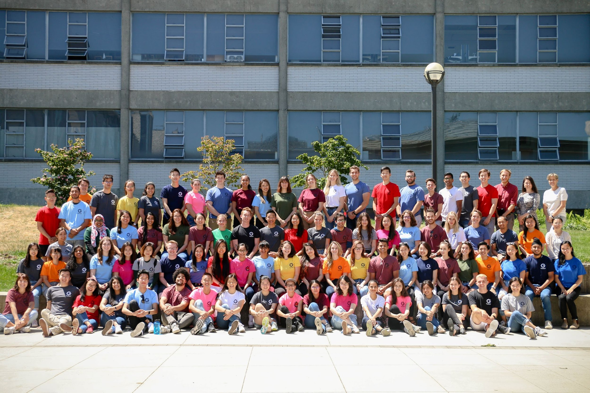
Summer Camps
Ideal for project work
24 camps are using quantum content this summer!
7 online, 17 in person

Slide 9
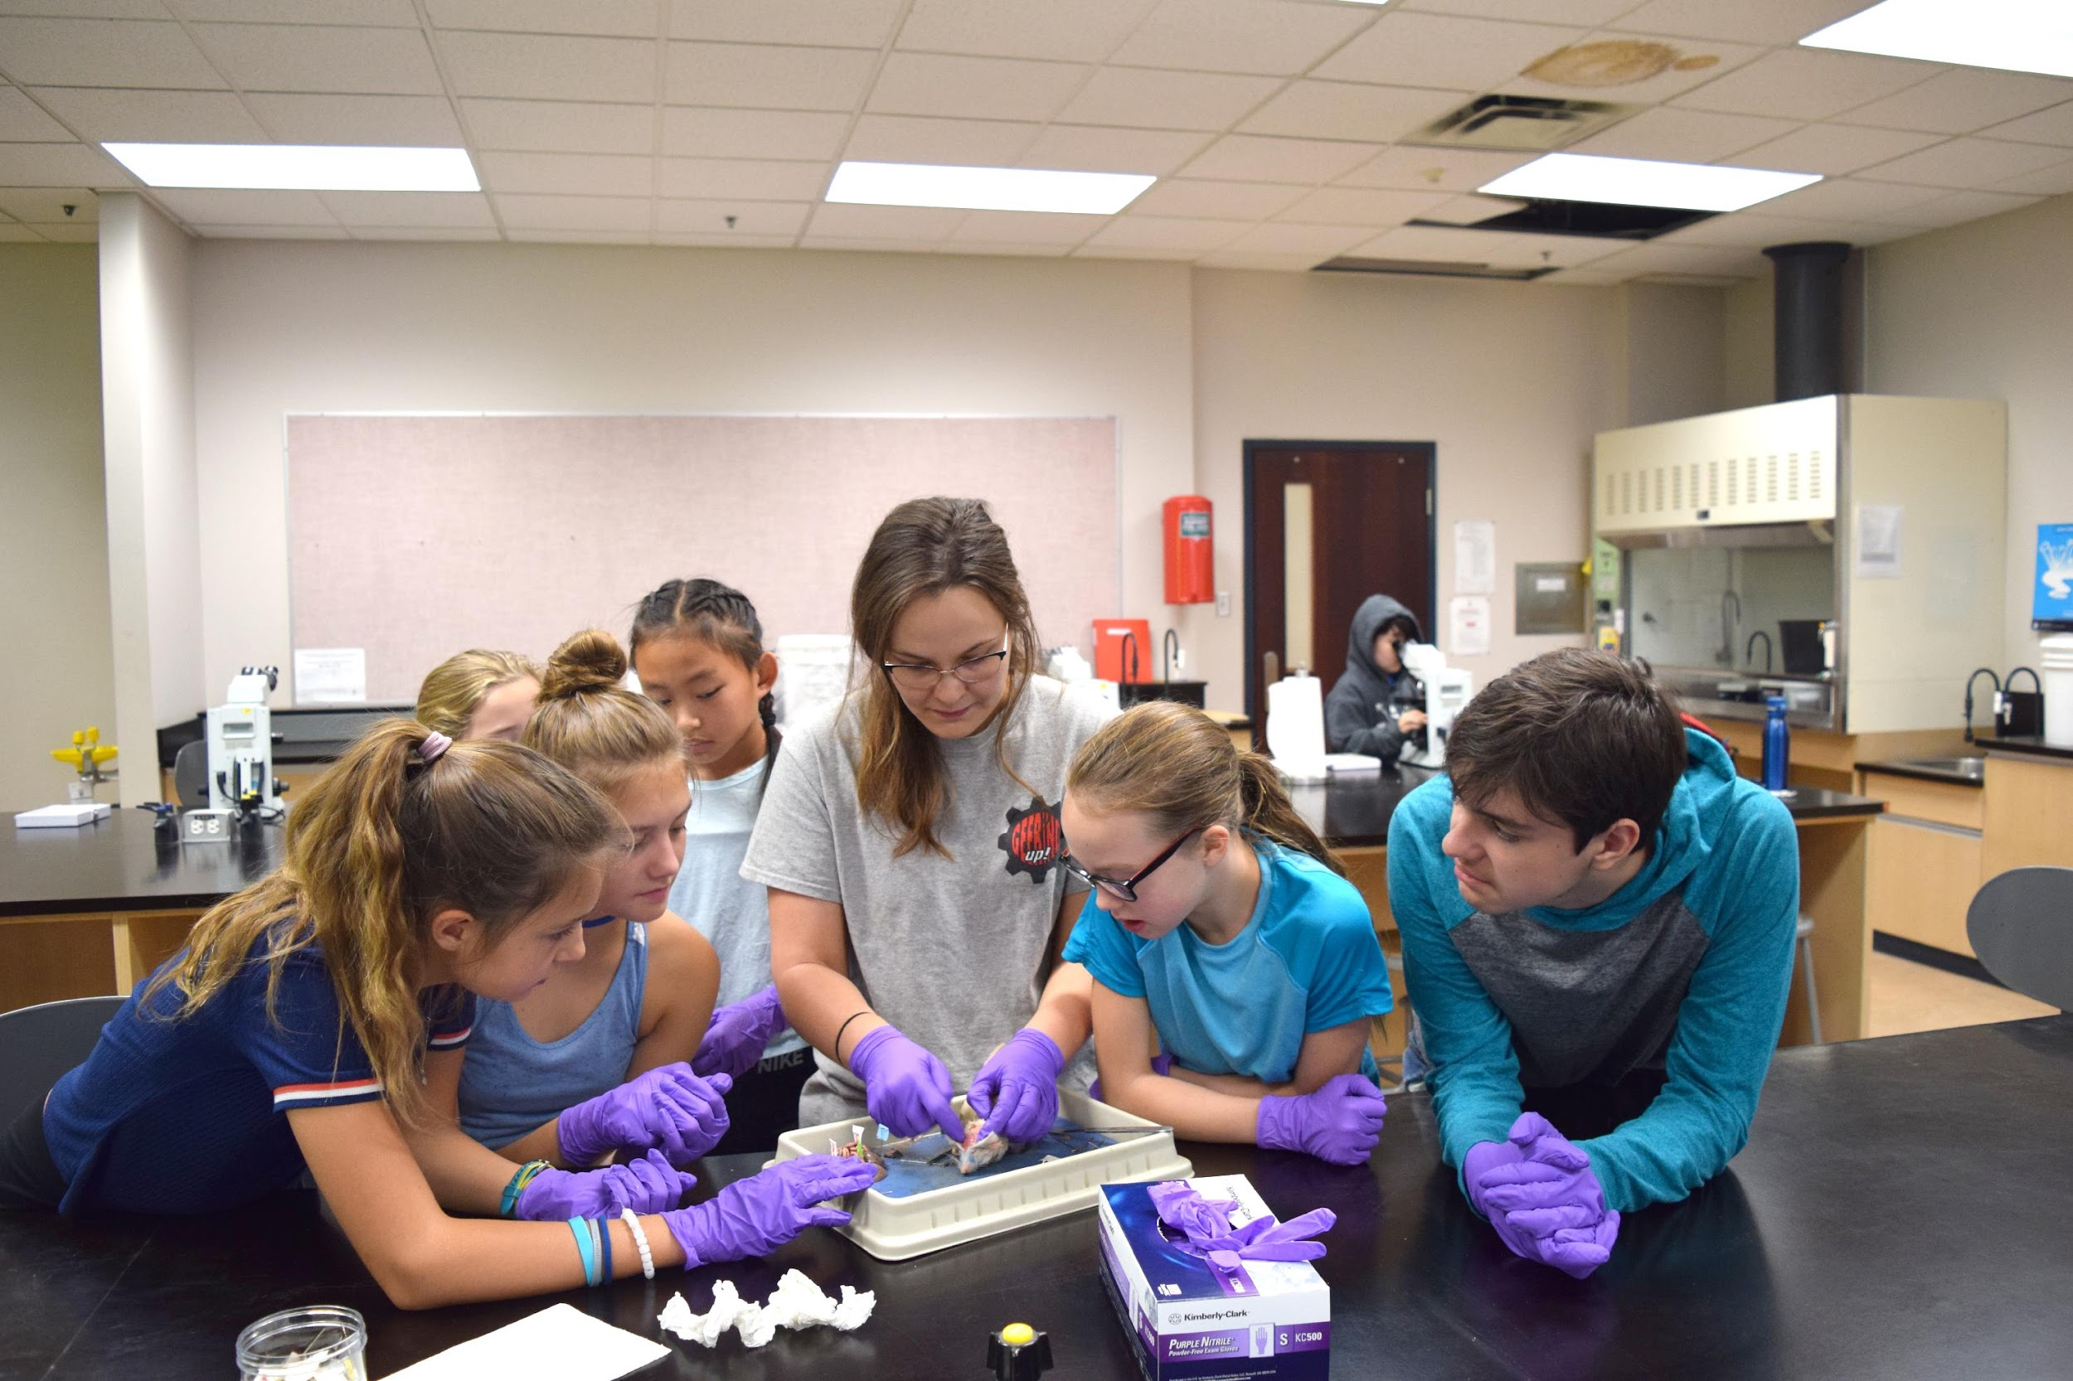
​
Workshops​
In-school delivery ​
24 booked this year
Short-form content ​

Slide 10
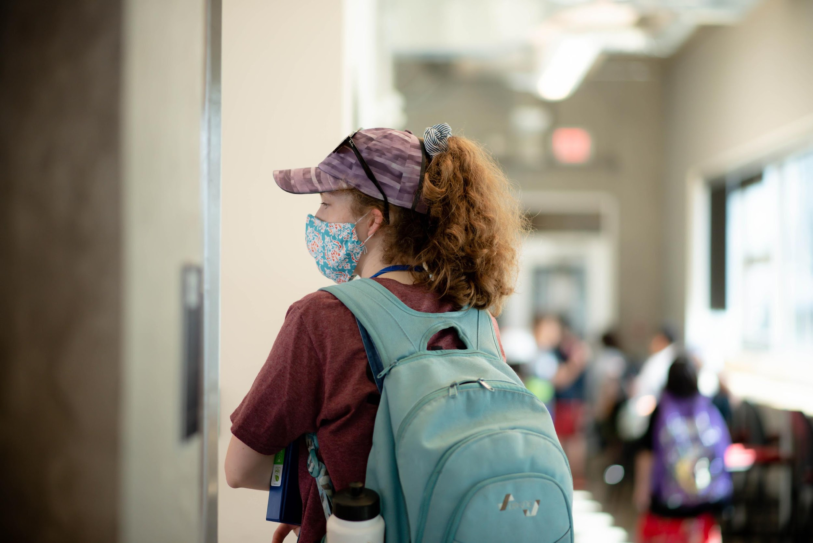
Local Events
More focused on design
Longer form content

Slide 11
TEACHING

Slide 12
Professional Development
Creating education support materials (games, video games, app)
Launching online course for teachers on quantum computers (August 2022)
  6-10 hour long, self-directed
  Focuses on basic concepts and teachable activities for classrooms
Take-home activity lessons at Professional Development sessions

Slide 13
Masterclass to Collaboration: University of Ottawa
A 12-week course (February to May 2022)
introducing grade 9-12 students to quantum computing
Originally ran as an online Masterclass
In partnership with the University of Ottawa, the content became an accredited high school course
Content being adapted to BC curriculum!

Slide 14
COMMUNITY

Slide 15

Quantum Bits: The Podcast
4 episodes out!
Expert guests
36% female and non-binary listenership
Season 2 being planned and edited

Slide 16
Quantum Ambassador Program
High school students particularly interested in quantum computing
Given opportunity to connect with industry, academics in the field
Volunteer or teach at our quantum computing camps
Aims to grow quantum peer community, give students additional resources

Slide 17
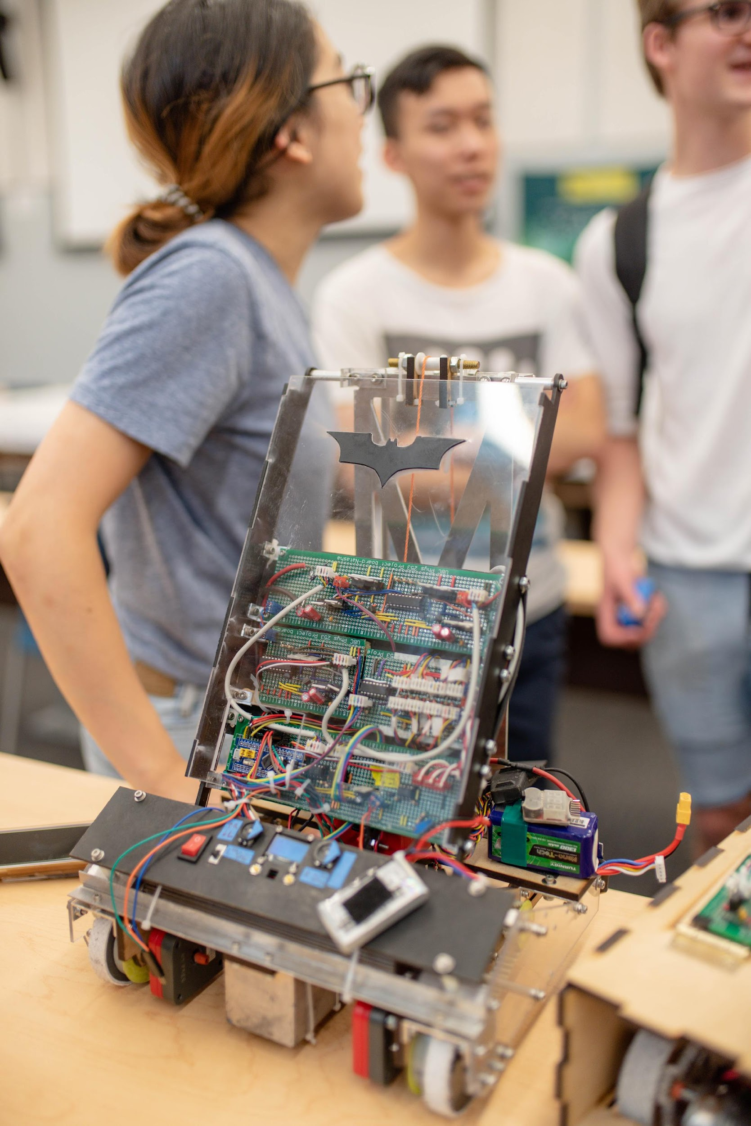
What have we achieved?

Slide 18
Key Metrics
Over 1350 students and educators reached!
  over 525 girls
Outreach:
  Scheduled for 13 Indigenous communities by end of year
  1 Black youth community
Over 85 educators reached across North America
First accredited high school course in Quantum Computing in Canada
Notes:
Gitga'at First Nation
Ditidaht First Nation
Xaxli'p First Nation (Lillooet)
Lax Kw'Alaams Band
Wei Wai Kum First Nation
Lil'wat Nation (Mount Currie)
Ditidaht First Nation
Kwadacha Nation
Tsay Keh Dene First Nation
Penticton Indian Band
Great Light Healing Community Services Society (Surrey, Black Youth)
Tsawwassen First Nation
Tobacco Plains Indian Band
Queen Alexandra Elementary School (Vancouver, Indigenous and low-income youth)
Sts'ailes (Formerly Chehalis Indian Band)
Great Light Healing Community Services Society (Black Youth)

Slide 19
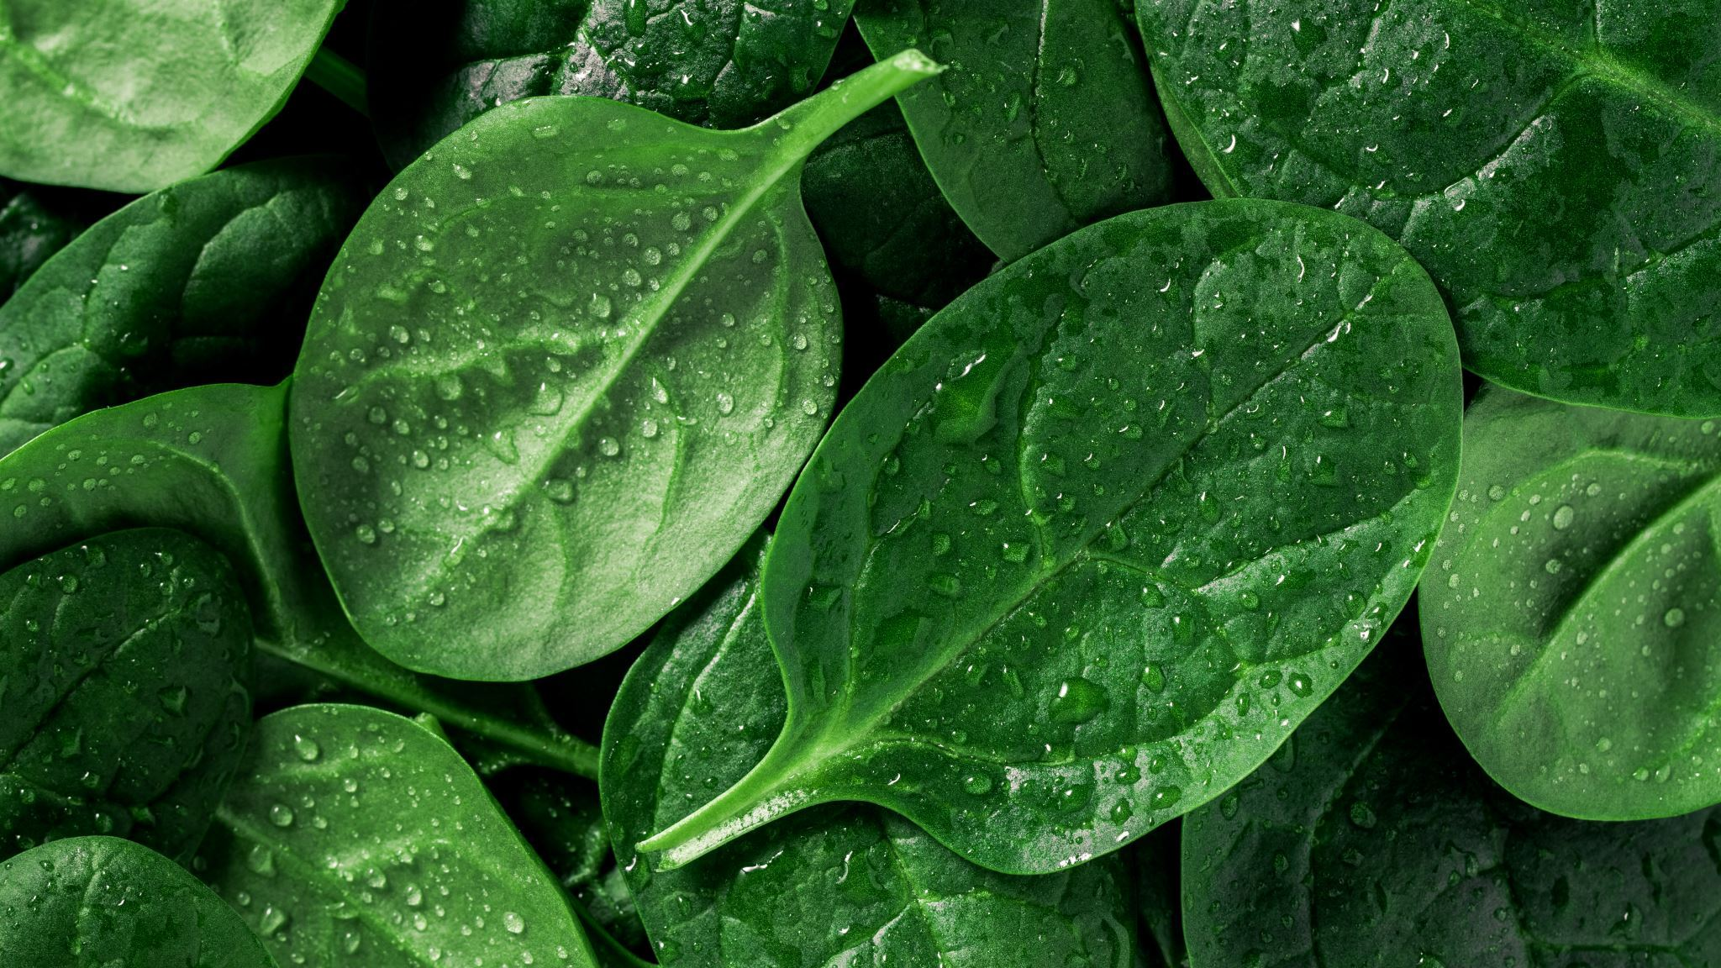
What works best;
The spinach Smoothie

Slide 20
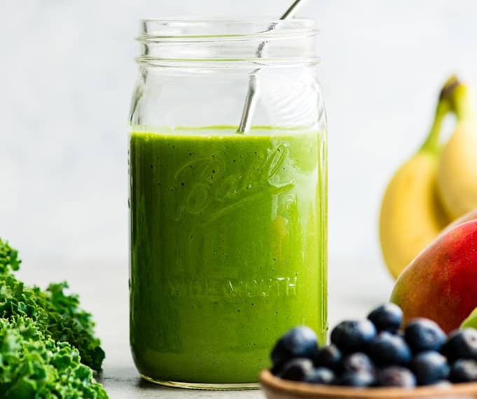
What's the "spinach smoothie?"
Notes:
Have you ever tried to put vegetables in a smoothie for a kid? Or alternatively, have you ever tried to give medication to your dog by hiding it in in a cube of cheese?
Fundamentally, it is about making the activity SUPER FUN and having them learn something through it.

Slide 21
How to make learning FUN;
Teaching quantum gates kids
We want to talk about quantum gates: but how? They're just kids!
Step 1: Start with what they know!
  How do we use words like AND, OR, and NOT in speech?
Step 2: Draw a parallel
  Computers use those words too!

Slide 22
How to make learning FUN
Step 3: make it interactive
  This is where I love Turing Tumbles or breadboarding
Step 4: Sneak in the vegetables
  Get the students to write down different outcomes
  This is a truth table in disguise!
Notes:
Note to play video of Turing tumbles after this

Slide 23
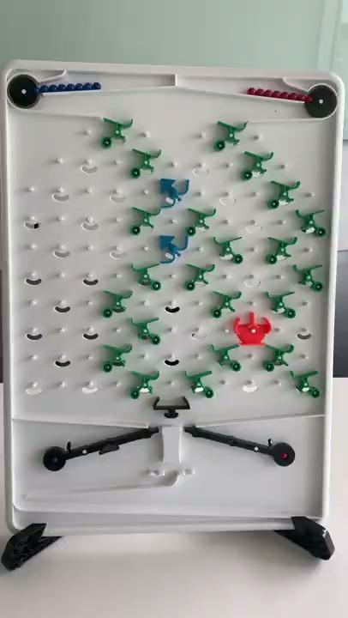
Notes:
We let the kids design a circuit where they only catch a blue marble if both blue arrows are pointed to the right.

Slide 24
Bit 1 Direction | Bit 2 Direction | Colour of caught marble
Left | Left | Red
Right | Left | Red
Left | Right | Red
Right | Right | Blue
Example with a Turing Tumble

Slide 25
Bit 1 | Bit 2 | Output
0 | 0 | 0
1 | 0 | 0
0 | 1 | 0
1 | 1 | 1
Example with a Turing Tumble

Slide 26
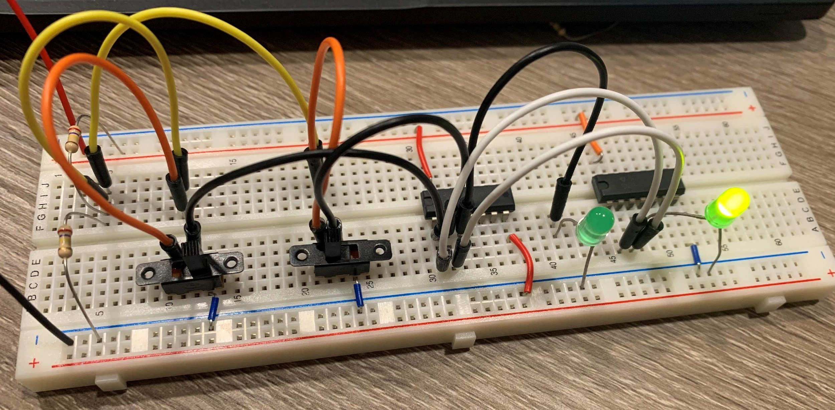
For older students, we use breadboards!
This is a half adder circuit. We let them play with the switches and see how the LEDs respond.

Slide 27
How to make learning FUN
Last step: Take the quantum leap
  Now that they are comfortable with the ideas, make it quantum
  Use drag-and-drop circuits (like IBM)

Slide 28
How to make learning FUN
Bonus step: Gamify
  Have them challenge the quantum circuit with their classical circuit!

Slide 29
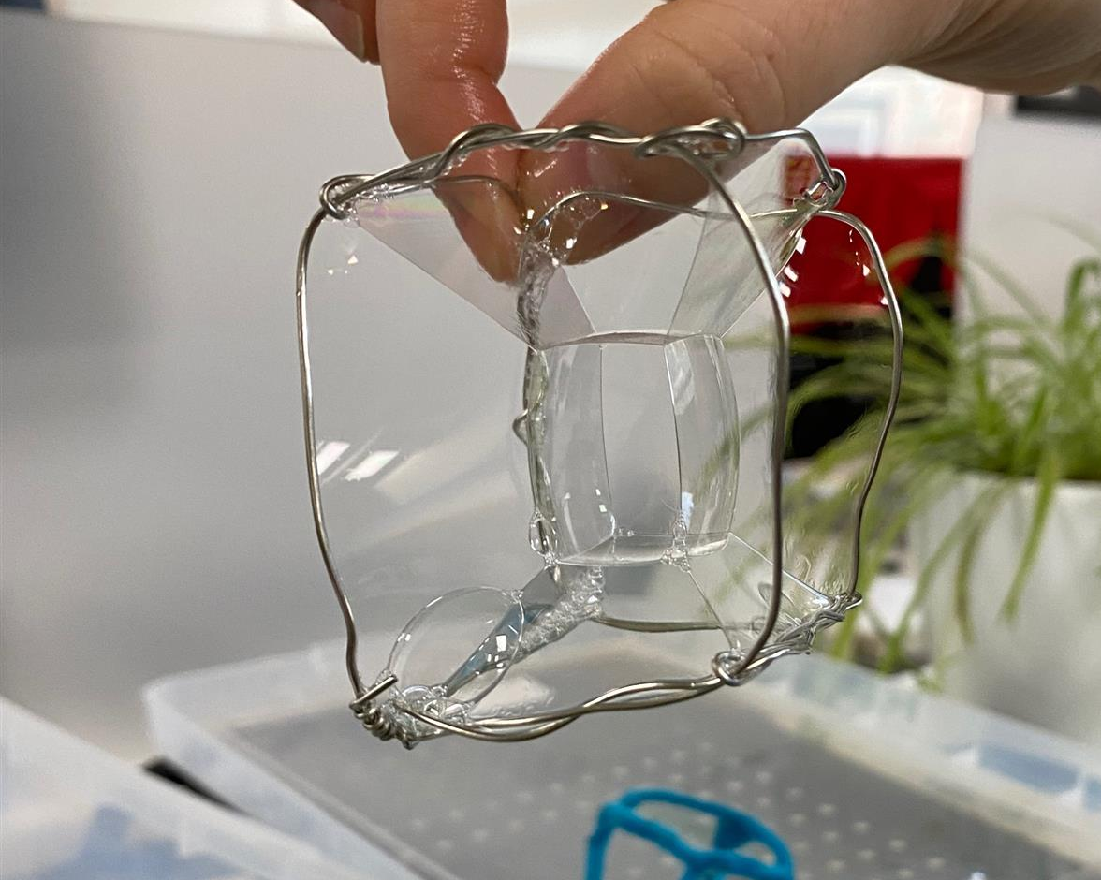
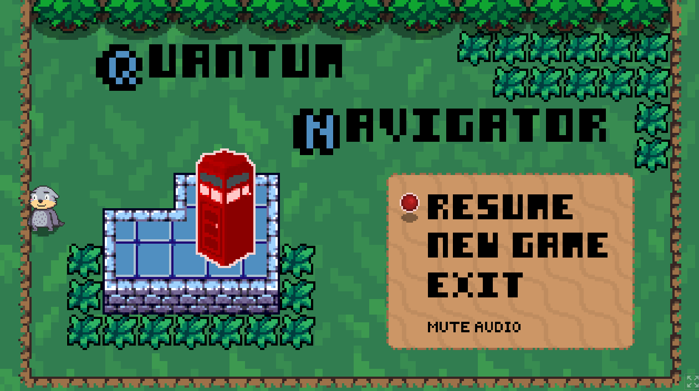
My favorite activities for teaching quantum!
Quantum soap bubbles
Making apps
Drag and drop coding
Video games
Turing Tumbles (analog, marble-powered computers)
Building circuits
Playing games on the Quantum Hub

Slide 30
Opportunities for Engagement and Collaboration
Curriculum for programs
workshops, camps, events
Collaboration on future projects
Design activities together
Support our students at your schools
Support high school and undergrad students to continue in the field!

Slide 31
Thank you!
Contact:
Ella.meyer@ubc.ca
Quantum.geeringup@ubc.ca

