Slide 1


Using synchrotron radiation techniques as a tool in invertebrate paleontology
Jerit Mitchell, MSc student
University of Regina
June 8
CAP Congress 2022
Notes:
Hello everyone, I am Jerit Mitchell, a Master’s student from the University of Regina. Today I will be talking about “Using synchrotron radiation techniques as a tool in invertebrate paleontology”.

Slide 2
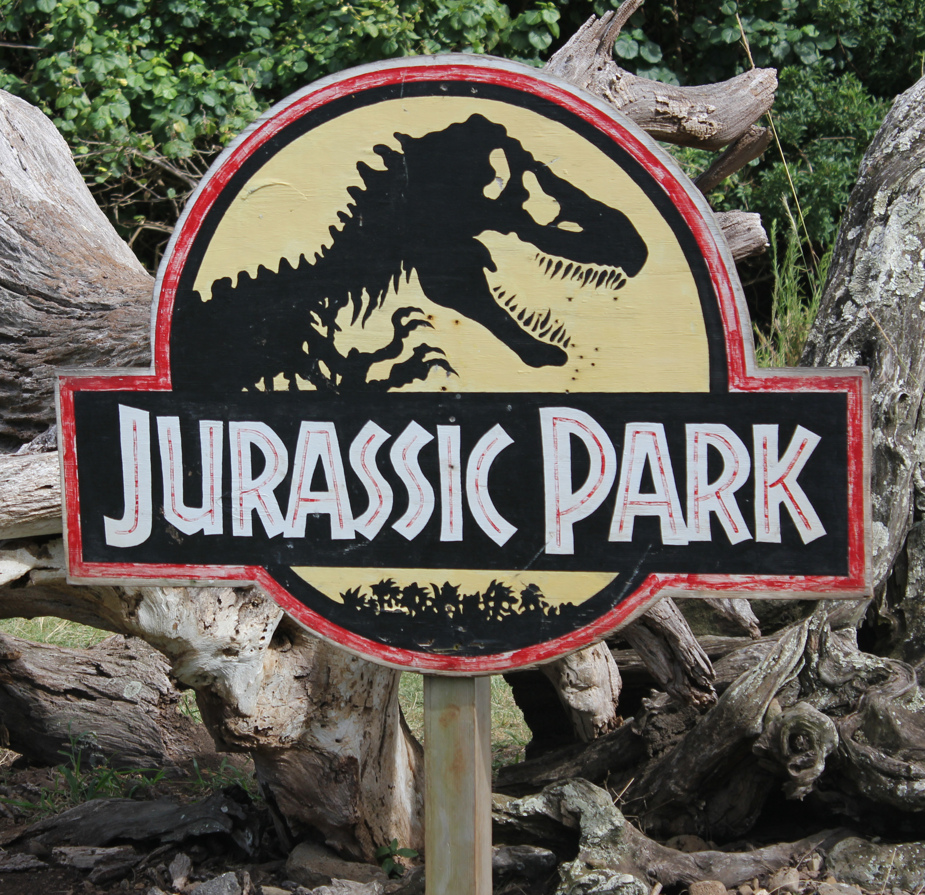
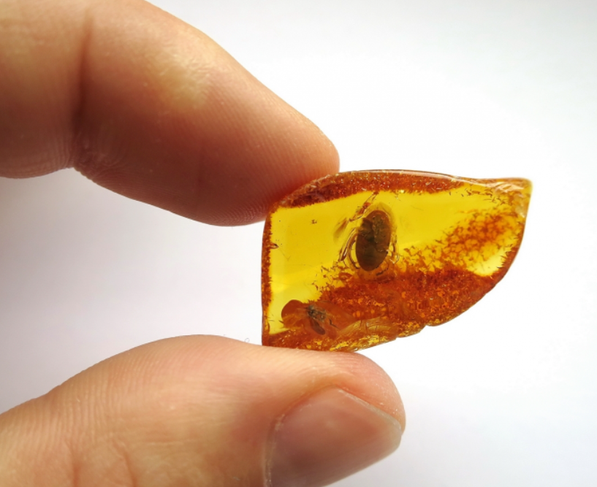
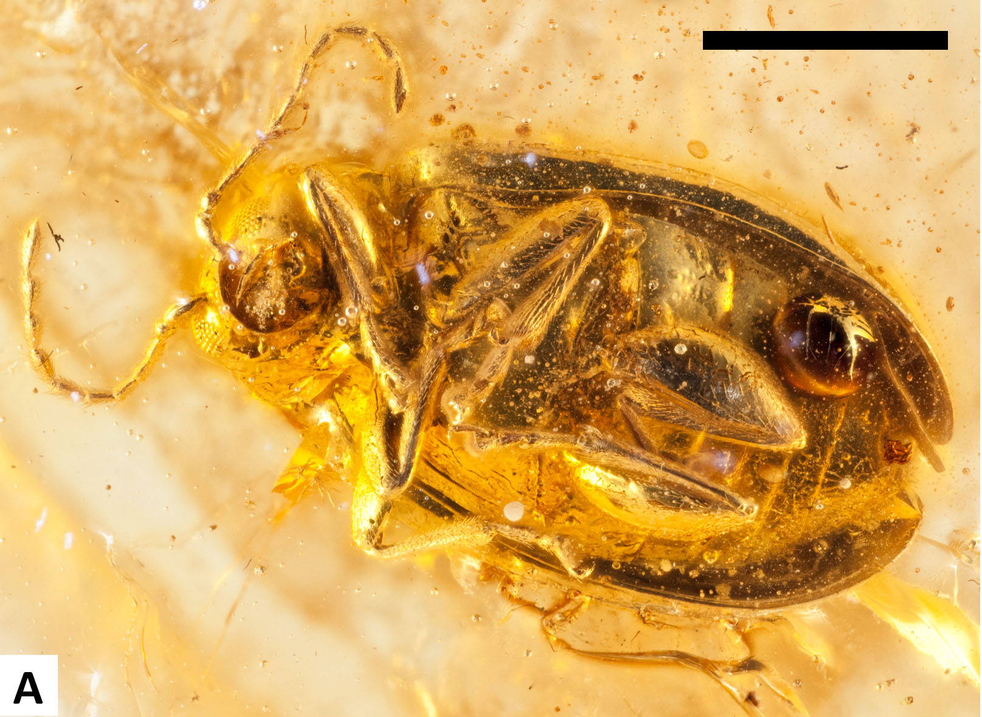
Motivation
Paleontology research has become increasingly analytical in the last decade, employing techniques and analysis usually governed by chemists and physicists
Insects make up 80% of known species and give information on diversity of life on Earth millions of years ago.
What is Amber?
Amber is fossilized tree resin
Small creatures can get trapped before the resin hardens.
Similar properties to glass, which acts as a shield for inclusions.
Best preservation of organic, soft tissue material in life-like 3-D
Jurassic Park: Fact or Fiction?
Turtle Beetle from Baltic Amber (44 million years old)
Scale Bar = 1mm
Leaf Beetle from Baltic Amber.
Notes:
So, starting off what does physics have to do paleontology? Paleontology research has be revolutionized in the past decade due to easy access to high energy experimentation and analysis usually bound to the realm of chemists and physicists. In paleontology, dinosaurs get most of the attention, but invertebrates makeup an overwhelming majority of all species and can be more telling of evolutionary history than vertebrates. For this talk I will focus on insects, particularly those that are found trapped in ancient pieces of amber.
Amber is fossilized tree resin, and can contain small creatures that get trapped in the sticky resin before it hardens. Amber has similar properties to glass, so it has good insulation and antibiotic properties that act as a shield for inclusions. Amber allows much better preservation of fossils compared to those found embedded in rock and soils layers. It preserves the original life like 3D position of insects, and most likely to preserve organic material.
At this point I should address the elephant in the room, or should I say dinosaur in the room. Are we trying to recreate Jurassic park? Not exactly. The premise of Jurassic Park is reasonable in the fact that if we were to recreate the dinosaurs, extracting DNA from amber would be the most likely place to find it. However, proper DNA is not known to preserve in amber past 100,000 years. Other organic molecules can be preserved over millions of years, and that will be the focus of the rest of the talk.

Slide 3
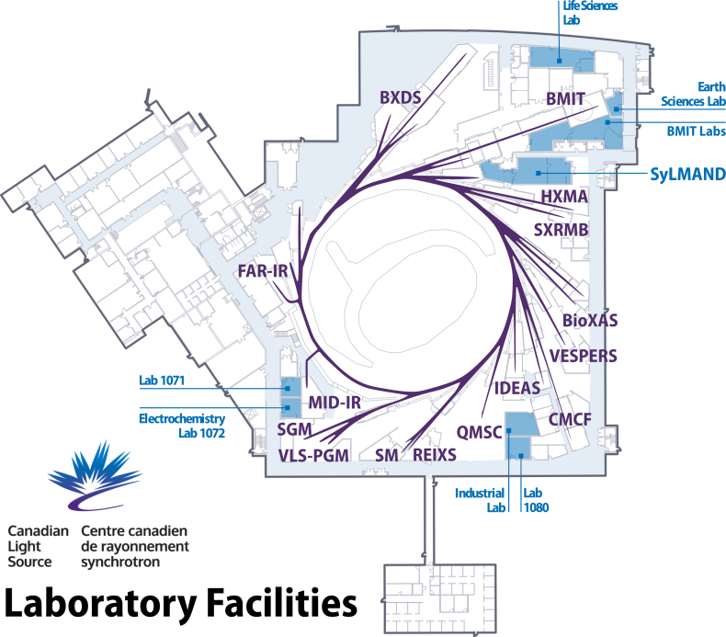
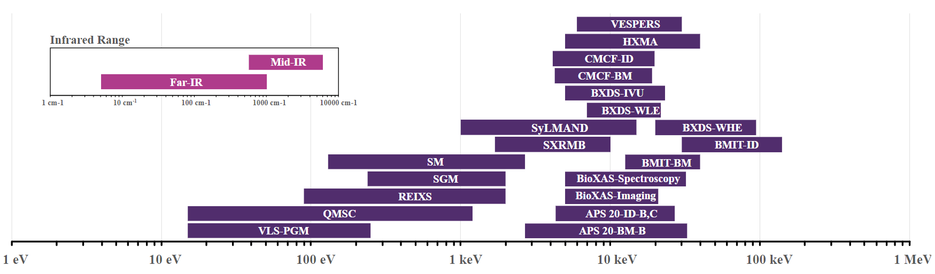
The Synchrotron Advantage
Synchrotron radiation is produced by acceleration of charged particles in specialized light source facilities
Synchrotron radiation is useful since its:
Suited for wide range of analysis using specialized beamlines
Non-destructive
High Brightness => better resolution + faster acquisition times
Useful for heterogeneous geological samples
Selected synchrotron techniques:
Computed Tomography (CT)
Fourier Transform Infrared Spectroscopy (FTIR)
X-Ray Fluorescence (XRF)
Notes:
Most of our experiments revolve around using a synchrotron light source facility. This is specialized synchrotron that exploits the radiation produced from orbiting electrons in a ring. For our analysis, are work is done at the Canadian Light Source facility at the University of Saskatchewan. The radiation produced can be customized for a given experiment through specialized beamlines, energy ranging from infrared to X-Rays and monochromatic or broadband. Imaging and chemical analysis can be completely non-destructive, which is relevant for fossils as we do not want to damage the few precious samples we have. Also, synchrotron light has extremely high intensity and brightness that leads to higher resolutions and faster acquisition times. Many of the samples in paleontology are heterogenous and structurally variable, so high resolution is critical.
Today I will talk about three synchrotron enhanced techniques performed on three different beamlines and how they are used to extract information in invertebrate paleontology.

Slide 4

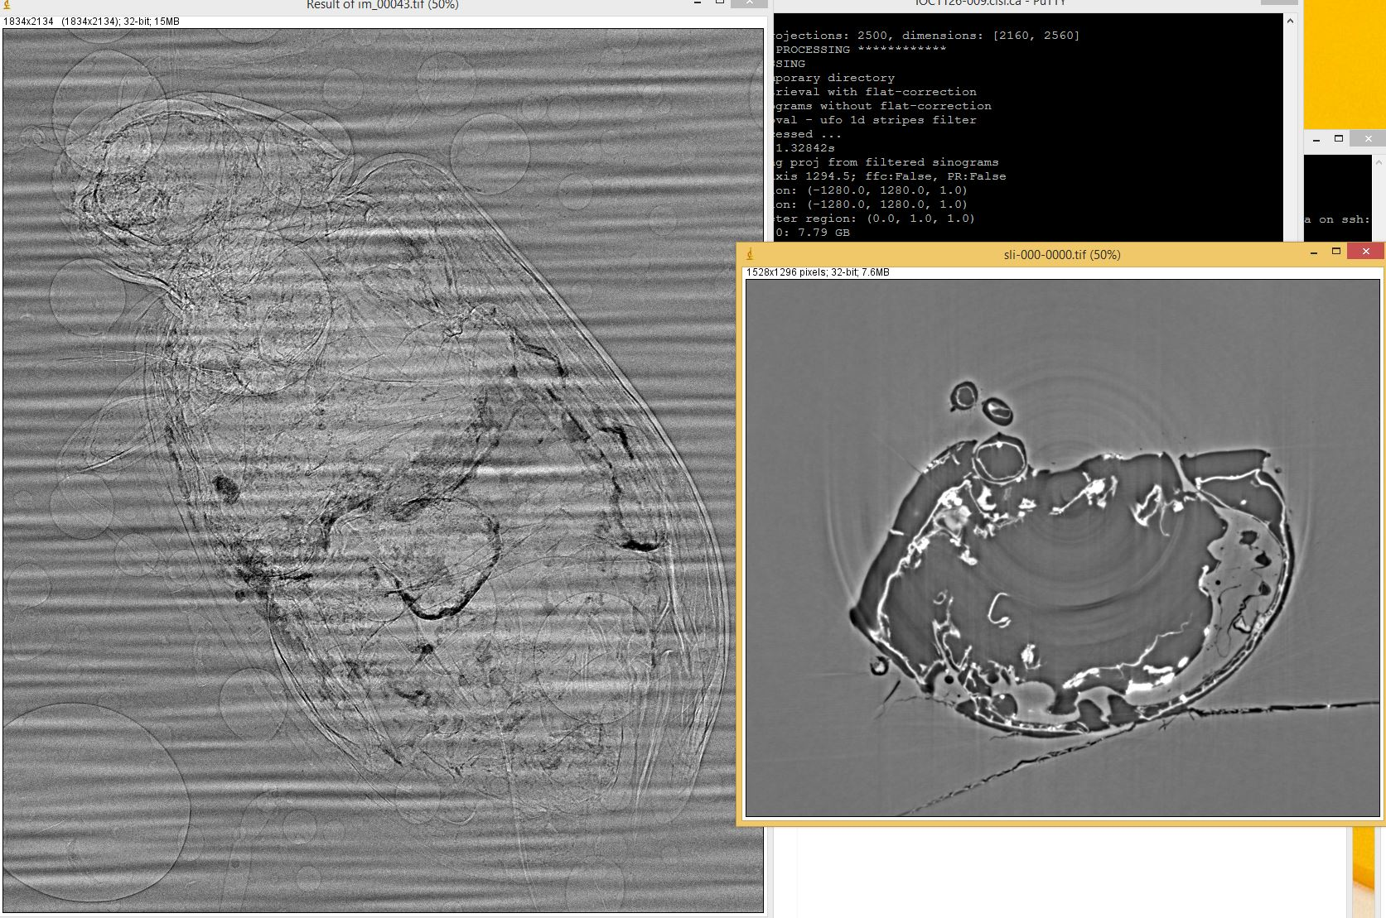
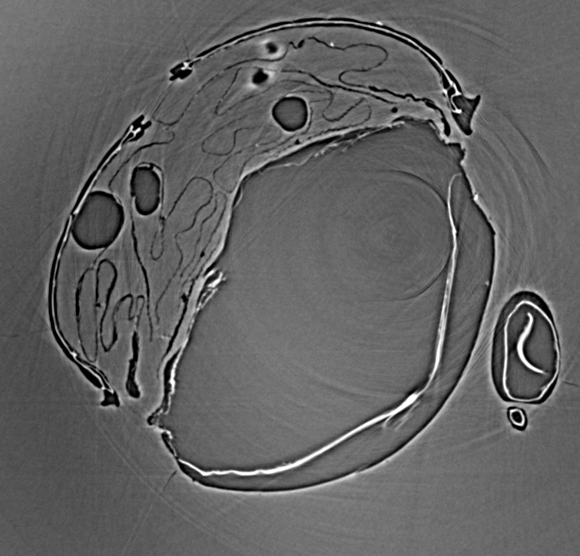
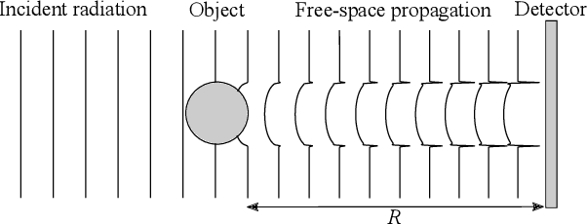
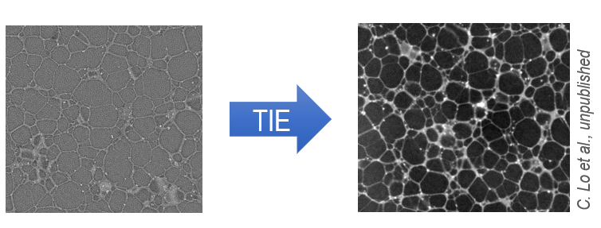
Computed Tomography (CT)
Physics Principles
CT Basics
Bulk X-Ray absorption through a sample, reconstructed over 180° in slices
Creates a lifelike 3D model containing density information
Propagation Phase Contrast (PPC)
Records interference of waves refracted from the sample in order to highlight structures with small changes in indices of refraction
Synchrotron light provides highly coherent X-Rays
Projection
CT Slice
F. Schaff et al., (2020)
Reconstruction
PPC
Notes:
Starting off with Computed Tomography or CT can be used to create a 3D model of an object. It uses the bulk absorption of high energy X-Rays through a sample. Taking hundreds of X-Ray projections in equal steps around 180 degrees, the projections can be mathematically reconstructed. The result is a series of 2D slices that make up a 3D data map of the density of the sample, with pixel resolutions in order of microns.
An important sub technique that is critical in insect CT is propagation phase contrast. X-Rays passing through the sample will be refracted as well as attenuated, and these refracted waves can be detected. The detector is moved farther away from the sample to increase the contrast of the resultant interference fringes. A synchrotron source is highly coherent, which will result in better resolved interference fringes at the detector. Ultimately, applying a PPC filter to a data set will highlight edges of structures, particularly of those that have small indices of refraction deltas. Insects exoskeletons are made up of very thin layers of similar density which makes resolving these details well suited for Phase Contrast Imaging. For our research we are using the Biomedical and Imaging and Therapy Facility or BMIT beamline at the Canadian Light Source.

Slide 5

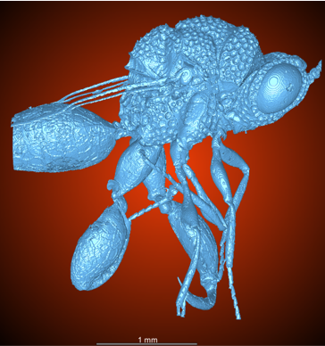
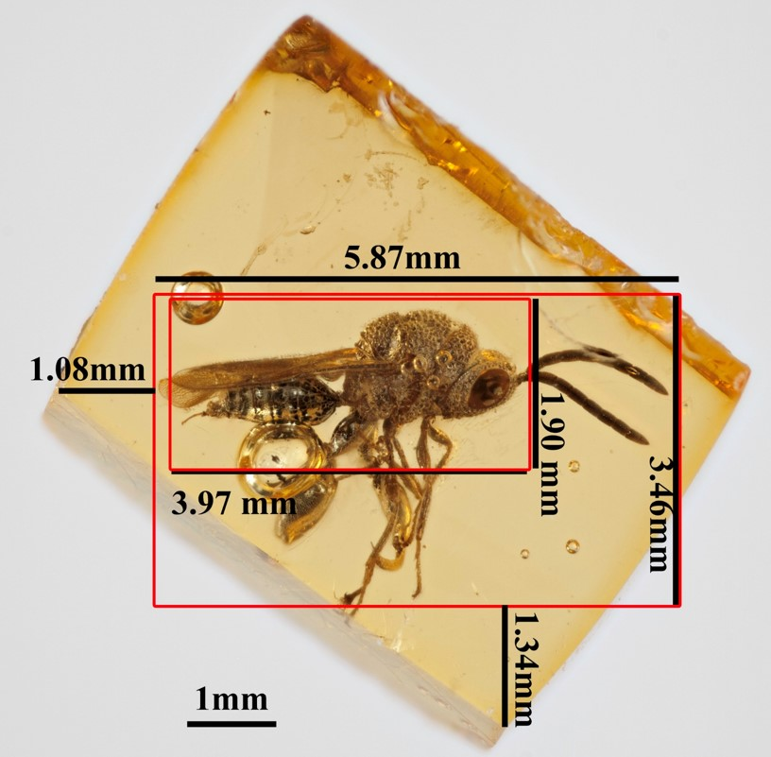
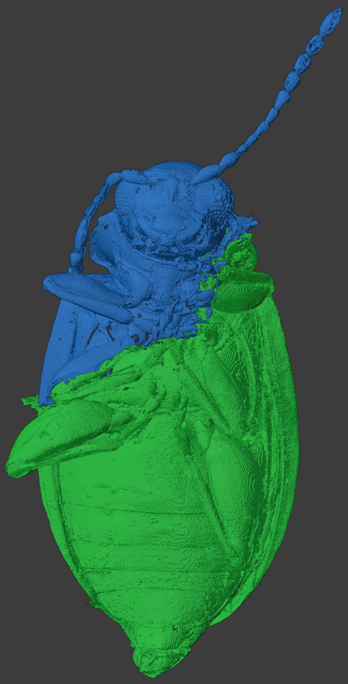
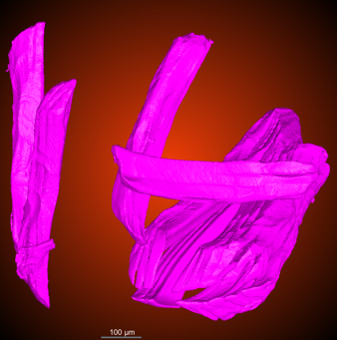
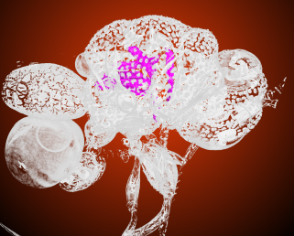
CT Results
Leaf beetle from Baltic Amber (44 Ma)
Genitalia is preserved, useful for taxonomy
Used for organic preservation studies
Wasp from Dominican Amber (16 Ma)
Better preservation than Baltic amber
Individual muscle fibers are preserved
Used for chemical studies
Flight Muscles
Leaf beetle
Chalcidoid wasp
Dom 19 (Chalcidoid wasp) (16 Ma)
Leaf Beetle (Chrysomelidae) (44 Ma)
Notes:
Getting to some results, we are going to look at two insects: a leaf beetle from Baltic Amber (44 million years old), and a chalcidoid wasp from Dominican amber (16 Million years old). Dragonfly is program used for rendering and visualizing the X-ray CT data. Using Dragonfly, by manipulating the data in 3-D one can create a model of just the insect by removing the amber as it is at a fixed density. Decay artifacts that may obscure the surface of the insect can be easily removed as well, as seen here in the wasp where there was a large bubble. We end up with highly detailed exteriors of the insects, with 9 micron voxel pixel size, including stippling patterns on the body and thin individual parts like legs and antennae.
The leaf beetle scan was actually composed of two separate amber pieces, since the amber sample was cracked open along the middle of the insect body in order to perform organic spectroscopy analysis which will be talked about next. The two separate CT scans of each side of the amber could be recombined digitally. Flakes from the outer exoskeleton were extracted from the dorsal side of the beetle as seen in this image.
A major benefit of CT is that we can also image the interior of the insect. Structures such as genitalia can also be preserved, which is useful for taxonomic analysis (determining what species it is). Here we have segmented out the female genitalia from this leaf beetle that shows up as a high density structure. There is also interesting high density structures structures inside the wasp. Since this amber is younger the preservation quality is generally better than in Baltic Amber. Inside the wasp, individual muscle fibers can be seen preserved within the limbs and body. In particular, large flight muscles can be found in the main body cavity and segmented out in brilliant detail.

Slide 6
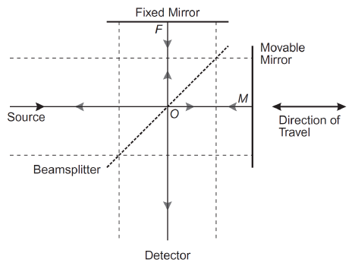
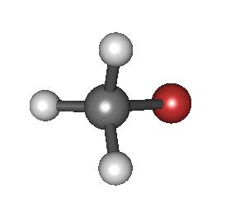
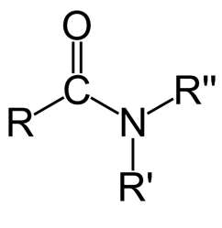


Infrared Spectroscopy (FTIR)
Physical Principles
IR Basics
Atomic bonds ≈ Harmonic oscillator with characteristic vibrational frequency
The main vibrational excitations for molecules occur in the infrared region (wavenumber range 4000 cm⁻¹ – 400 cm⁻¹)
Provides a finger prints for organic functional groups in a sample
Synchrotron Fourier Transform Spectroscopy
Using a polychromatic synchrotron IR beam can speed up spectral acquisition and improve signal-to-noise ratio
A Michelson interferometer is used with a movable mirror to record the spectrum in position space, which can be converted back to frequency space
“Stretching Mode ν_{s}”
Amide Functional Group
Sample
Notes:
Infrared Spectroscopy can be used to probe for organic signature in a sample. Molecules are made up of chemical bonds, which can be approximated by harmonic oscillators. Each form of bond has a characteristic vibrational frequency associated with it. The vibrational excitations of molecules occur in the infrared region of the electromagnetic spectrum. The most useful vibrational modes occur in the mid infrared region which by convention is represented by the wavenumber range of 4000 – 400 inverse centimeters. Probing a sample with infrared radiation there will absorption at corresponding wavenumbers related to a bond’s frequency, creating a spectrum. A sample may be made up of a combination of different bonds that form complex functional groups. One important functional group is known as amide, and this is commonly found in many organic substances.
One important advancement technique is Synchrotron Fourier Transform spectroscopy, which for our research is performed at the Mid-infrared beamline at the Canadian Light Source. In this case a synchrotron polychromatic Infrared beam is used to measure the entire spectrum at once which improves signal-to-noise ration and acquisition times. This is accomplished by the use of a modified Michelson interferometer setup. There will be an interference between two waves, one from a fixed mirror and one from a movable mirror that pass through the sample and gets detected. By moving the mirror and measuring the voltage at the detector we can determine the spectrum in position space. Through Fourier transform, the spectrum can then be converted to frequency space.

Slide 7
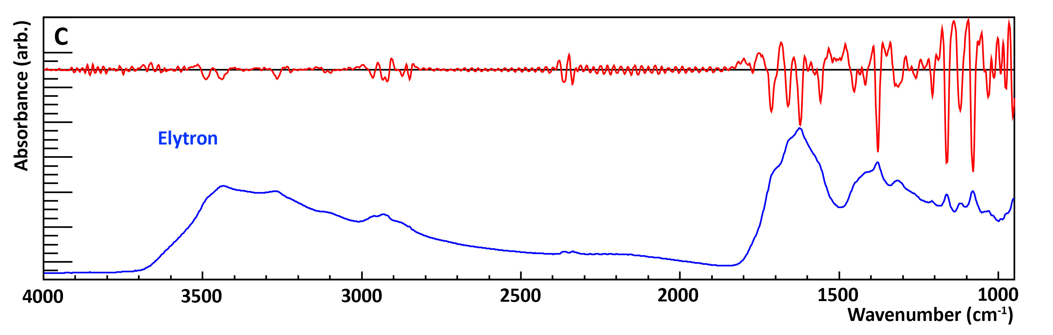
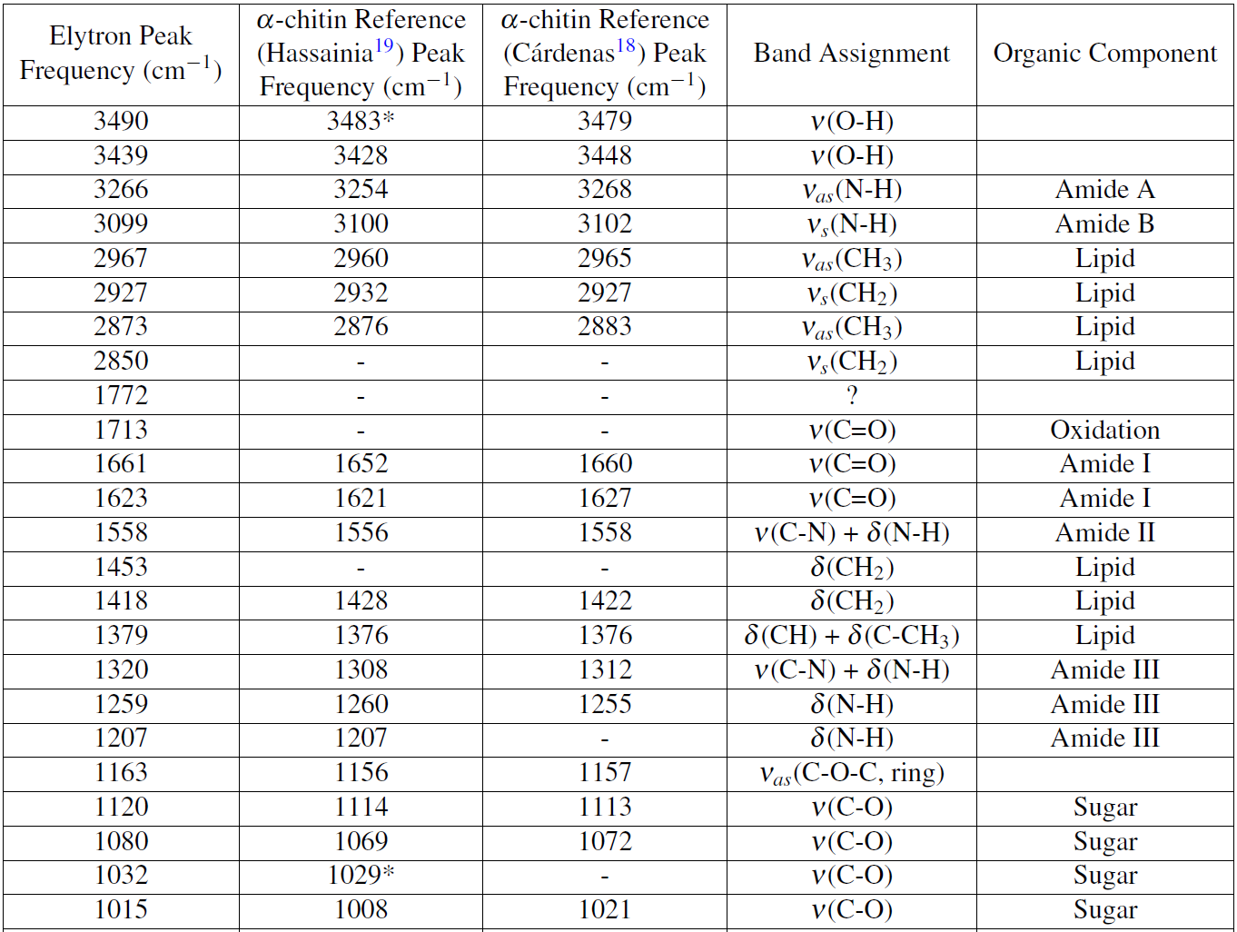
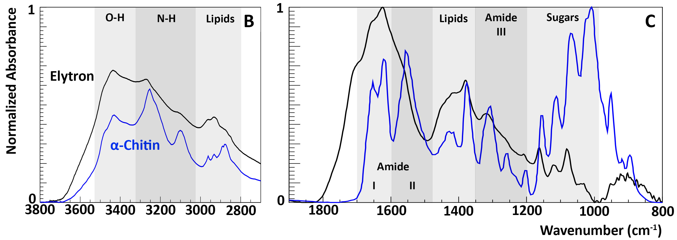
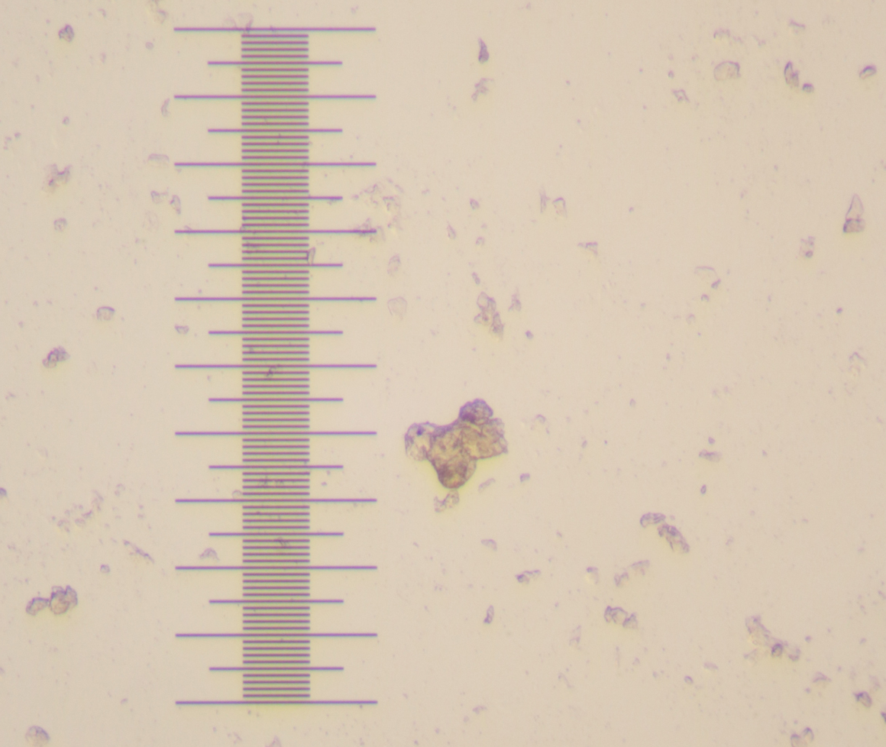
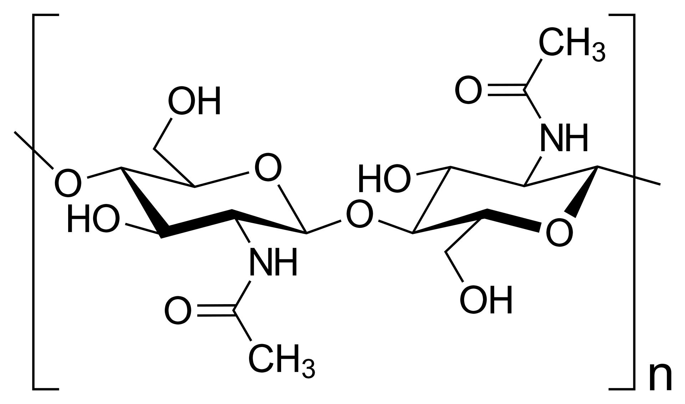
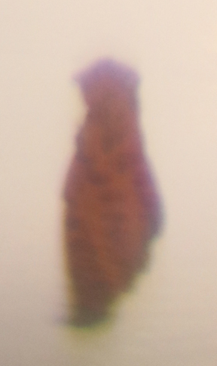
FTIR Results
Chitin
Chitin is a sugar-based molecule that strengthens insect exoskeletons
Organics will be altered through decay; broadening of peaks and introduction of new peaks in the IR spectrum
Oldest reported chitin from an insect (44 Ma), and is not highly degraded
Elytron
1mm
Notes:
Now for some results, we perform spectral analysis of a exoskeleton flake from the elytron, or wing case of the insect. This figure shows the elytron spectrum. Superimposed above it is a smoothed second derivative spectrum that is used to provide deconvolution of spectral peaks that overlap. The spectrum features peaks in the amide region, which means we have organic preservation. Chitin is a sugar-based molecule that is found in the exoskeleton of insects along with proteins. Almost every peak on the elytron spectrum can be explained directly by a standard chitin reference, as seen in the graphical comparison. A chart can be created that shows the position of peaks found from the second derivative spectrum compared to two chitin references. The relevant vibrational mode assignment and associated organic component is also given. The fossil peaks match well to the standard peaks.
Organic components in fossils decay over time, and as a result the infrared spectrum shows broadening of peaks as well as introducing new peaks. The peak at 1713 cm^-1 can be explained by oxidation of the sample as seen in experiments of modern chitin degradation. Due to this, it is difficult to analytically compare references, such as fitting to the reference spectrum, in particular for fossil remains. The position rather than the shape of peaks are the most reliable method of determining the relevant organic compounds. This finding of preserved chitin is significant as the oldest reported fossil chitin from an insect is 25 Ma. So, this work extends the range of preservation by twenty million years. Also, it appears to be the least degraded remains of any fossil chitin using infrared spectroscopy seen in literature. These results are part of work soon to be submitted as a manuscript.

Slide 8

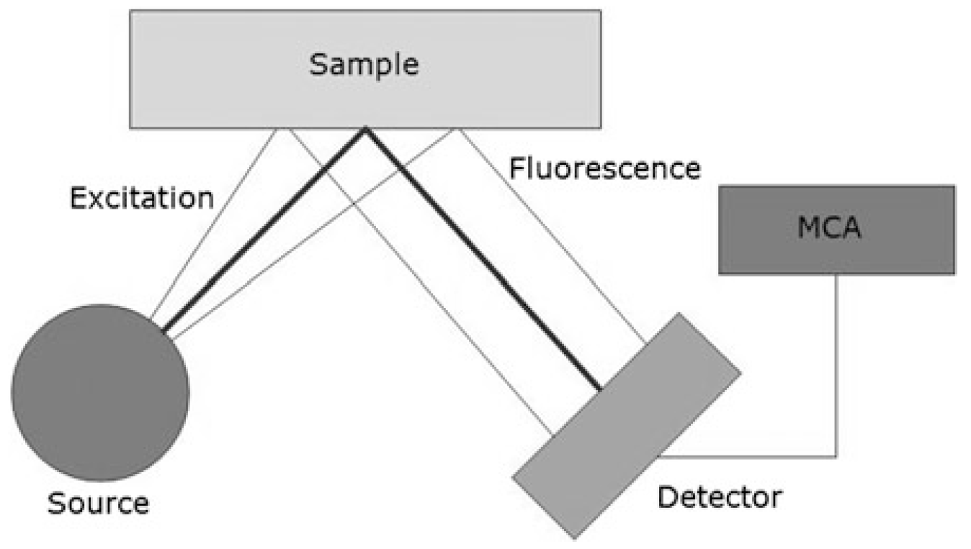
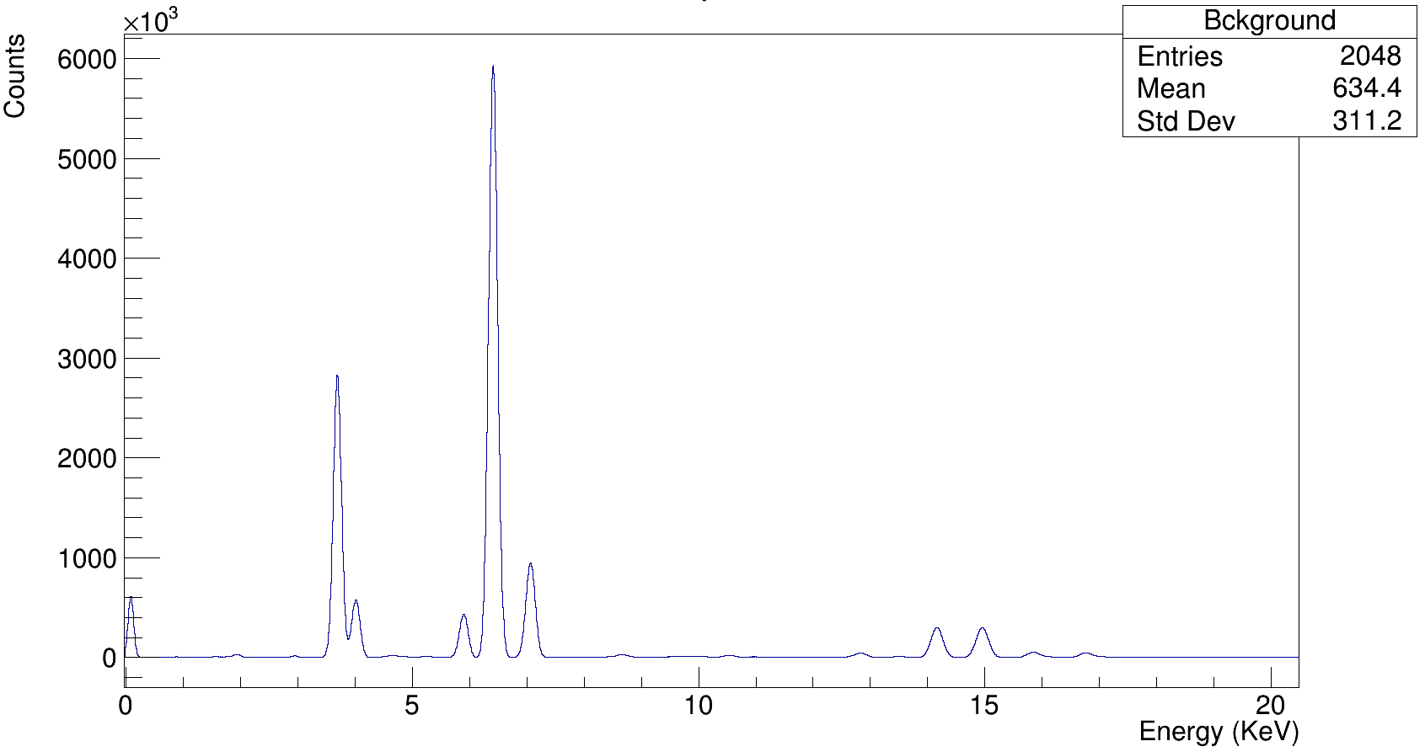
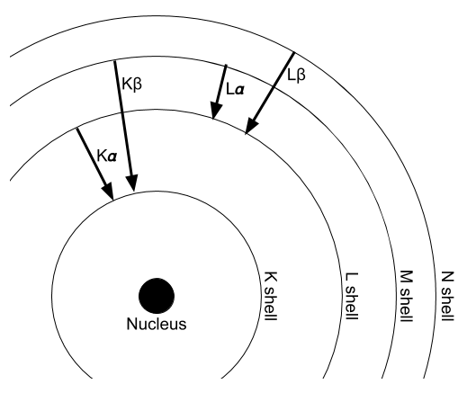
X-Ray Fluorescence (XRF)
Physical Principles
XRF Basics
Ionized atoms will de-excite, emitting characteristic characteristic fluorescent X-Rays
All of the emitted X-Rays from a sample enter a detector where their energy is recorded in a histogram
Chemical Mapping/Imaging
If the spectrum is measured at each location on a grid of points, we can create a chemical intensity map for a given element
Fossils are heterogeneous and important for how minerals track through fossilization
Fe Kα
Calculate area under peak
Notes:
X-Ray Fluorescence measurements can be used to determine the concentration of specific elements in a sample. Atoms in a sample, when ionized by incident X-ray of sufficient energy, can quickly de-excite by emission of a characteristic fluorescent photon in the X-Ray range. The transition energy for fluorescence is given by the difference in the orbital in which the knocked out inner shell electron and outer shell filling electron. The transition from the L shell to the K shell is known as the K alpha line, k beta for M to K shell transition and so on. The X-Rays from all element and transition contributions enter a solid state detector to determine their energy, creating a spectrum.
A very useful application of XRF is the ability to chemically image a sample. This is done by recording an XRF spectrum at each point on a grid of positional points. By integrating the spectral peak corresponding to a given element, such as this iron k alpha peak, a map of the intensity of such an element can be created. This is particularly useful for fossils as we can track original minerals and those that are related to preservation of structures, all non-destructively. We performed XRF mapping at the SXRMB beamline at the Canadian Light Source.

Slide 9
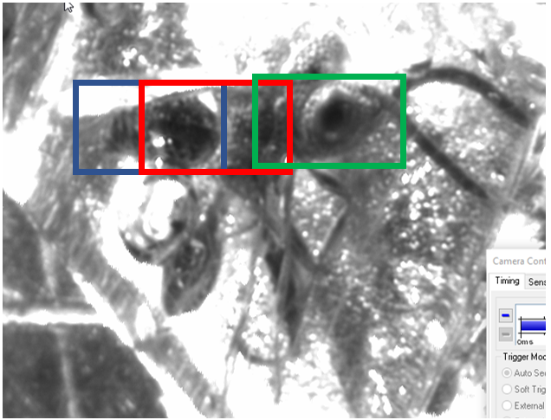
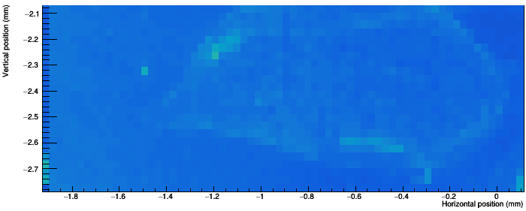
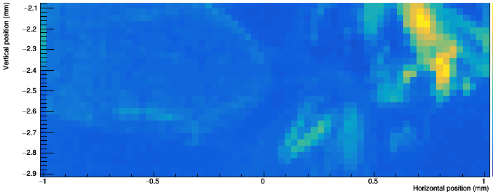
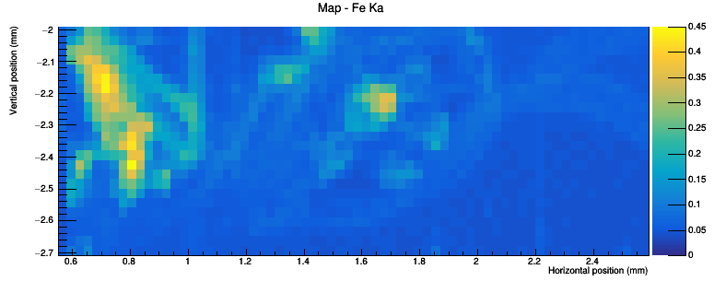
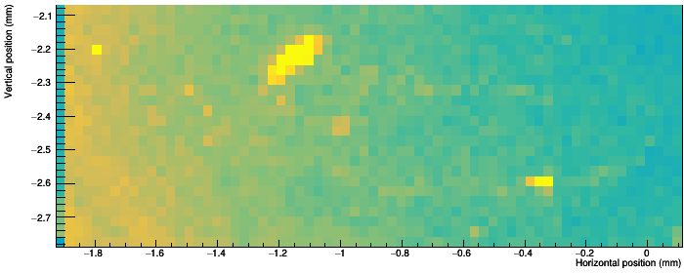
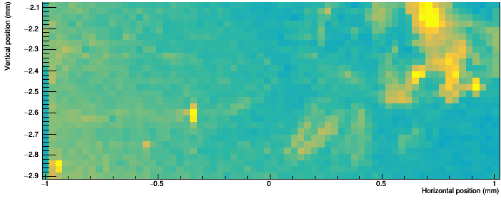
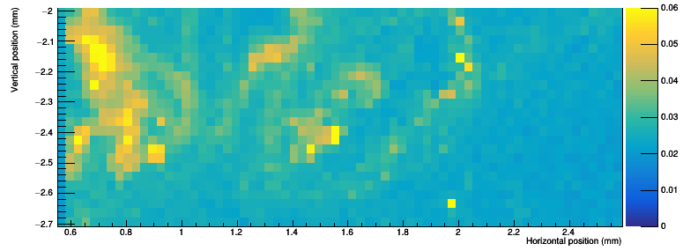
XRF Results
1
2
3
High concentrations of iron and copper, other elements negligible
Iron is related to preservation of soft tissues. The flight muscles show up as extremely rich in iron.
Copper can show original colour patterns of insect exoskeletons. It is associated with the iron here.
Fe Kα
Cu Kα
Notes:
For an application of XRF chemical mapping we took a look at the wasp from Dominican amber. The amber was polished to as close to the surface as the insect as possible in order to reduce contribution of amber to the spectra. The maps correspond to positions along the main body of the wasp. There appeared to be high concentrations of only two elements, iron and copper. The maps for the iron and copper K alpha transitions are shown here with 30 micron resolution. Most interestingly, the largest hotspot of iron in located inside the thorax of the insect. From the CT scan we know we have large high density flight muscles located there, which corresponds exactly to the iron uptick. We can speculate that this iron is related to the excellent preservation of these soft tissue structures, which has been seen in a few other studies involving preserved proteins.
Insects in amber generally lose their bright colours as their exoskeleton is altered during decay. Copper is another element of interest since it is related to chemical pigments, which could provide information of original colour patterns of the insect. Here the copper signature seems to be correlated with iron. These flight muscles structures might also preserve original or altered colours.

Slide 10
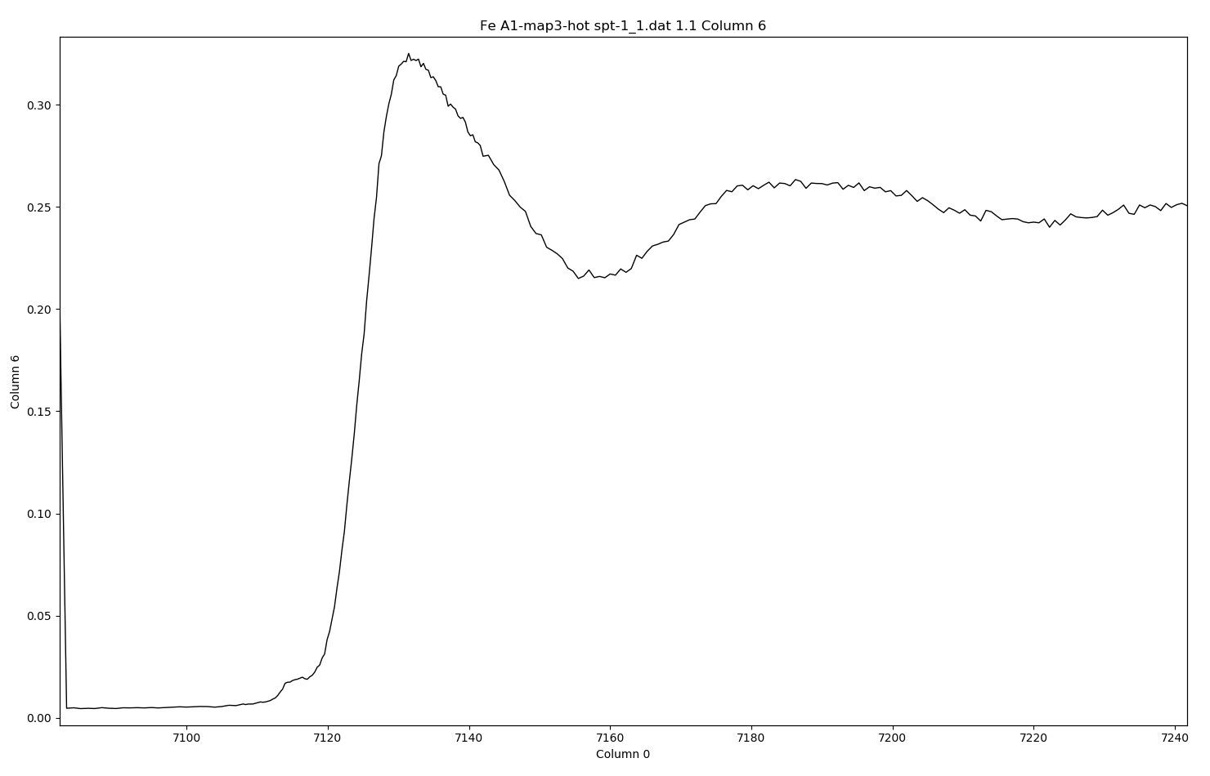
Conclusions
Synchrotron radiation can be used to improve resolution and acquisition times of a wide collection of imaging and chemical analysis techniques that are non-destructive for precious fossils
Using CT, we can model objects and their interior in 3D with micron resolution:
  We were able to digitally extract ancient insects that are trapped amber allowing us to understand their evolution and structure
Using FTIR, we can characterize organic signatures in a sample:
  We were able to find organic chitin preserved in a 44 Ma beetle, extending the temporal range for this level of preservation
Using XRF, we can determine qualitatively and quantitatively the elemental composition of a sample
  We were able to determine possible mechanisms of preservation of muscle fibers in a 19 Ma wasp related to high concentrations of iron and copper
Other techniques include:
Synchrotron X-Ray Absorption Near Edge Structure (XANES)
Normalized Absorption
Organic material and soft tissues may be more commonly preserved in fossils than conventional paleontology states
Energy (eV)
Notes:
Roughly go over results. The Canadian Light source provides many different techniques, and another one we are using is X-Ray Absorption Near Edge Structure (SR-XANES). This allows us to probe deeper into the chemical structure of the sample. For example looking at the Iron absorption k-edge for the wasp flight muscle fibers, we can determine the valence state of the iron, and possible the compound the iron is apart of. This is part of ongoing analysis.

Slide 11



Acknowledgements
References
Thank you to:
My supervisors:
Dr. Ryan McKellar
Dr. Mauricio Barbi
Canadian Light Source and beamline scientists
Dr. Andris Bukejs for taxonomic analysis
MITACS Accelerate for funding
P. Griths, J. Haseth. (2007)."Fourier Transform Infrared Spectrometry", Second Edition. Wiley.
B. C. Smith. (2011)."Fundamentals of Fourier Transform Infrared Spectroscopy". CRC Press.
M. Haschke. (2014)."Laboratory Micro-X-Ray Fluorescence Spectroscopy: Instrumentation and Applications". Springer.
B. Beckho, B. Kanngieer, N. Langho, R.Wedell, H.Wol. (2008)."Handbook of Practical X-Ray Fluorescence Analysis". Springer.
Notes:
And that is all, here are some acknowledgments and references, and I am happy to take any questions.

Slide 12

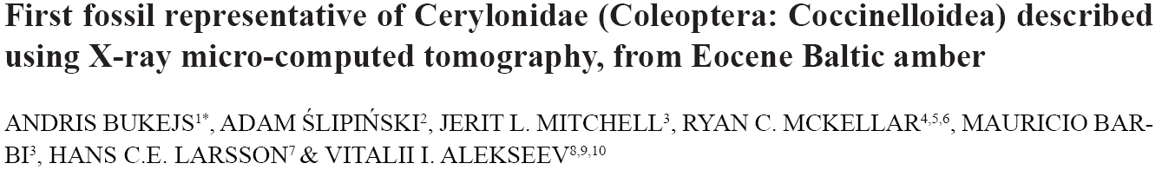
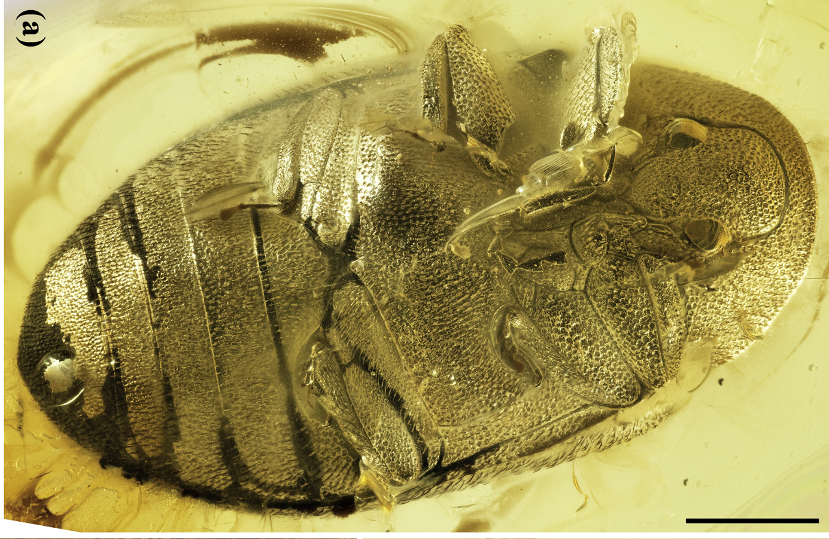
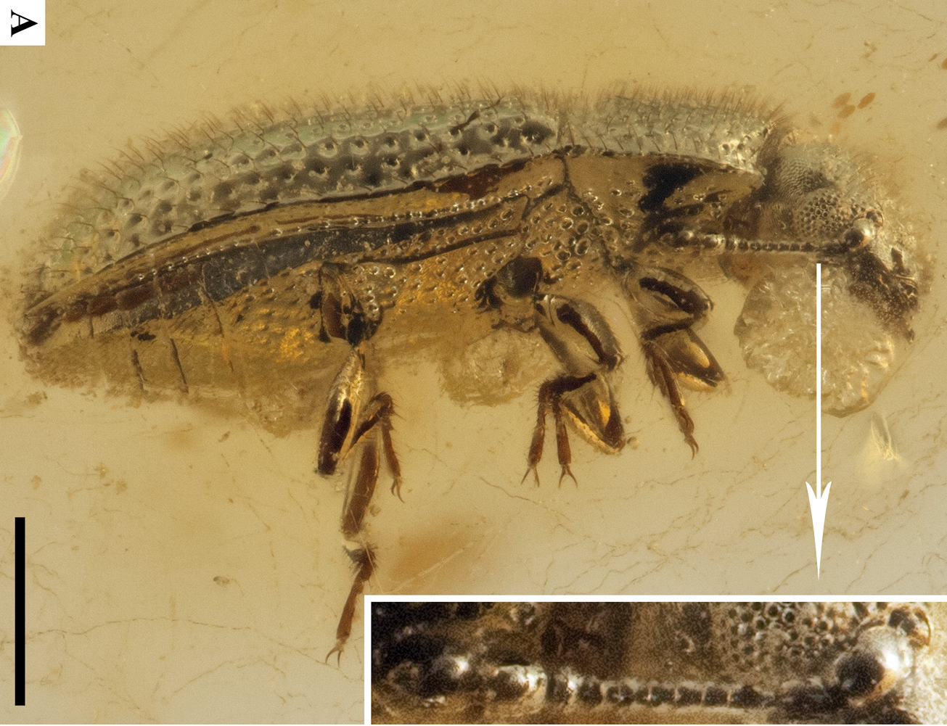
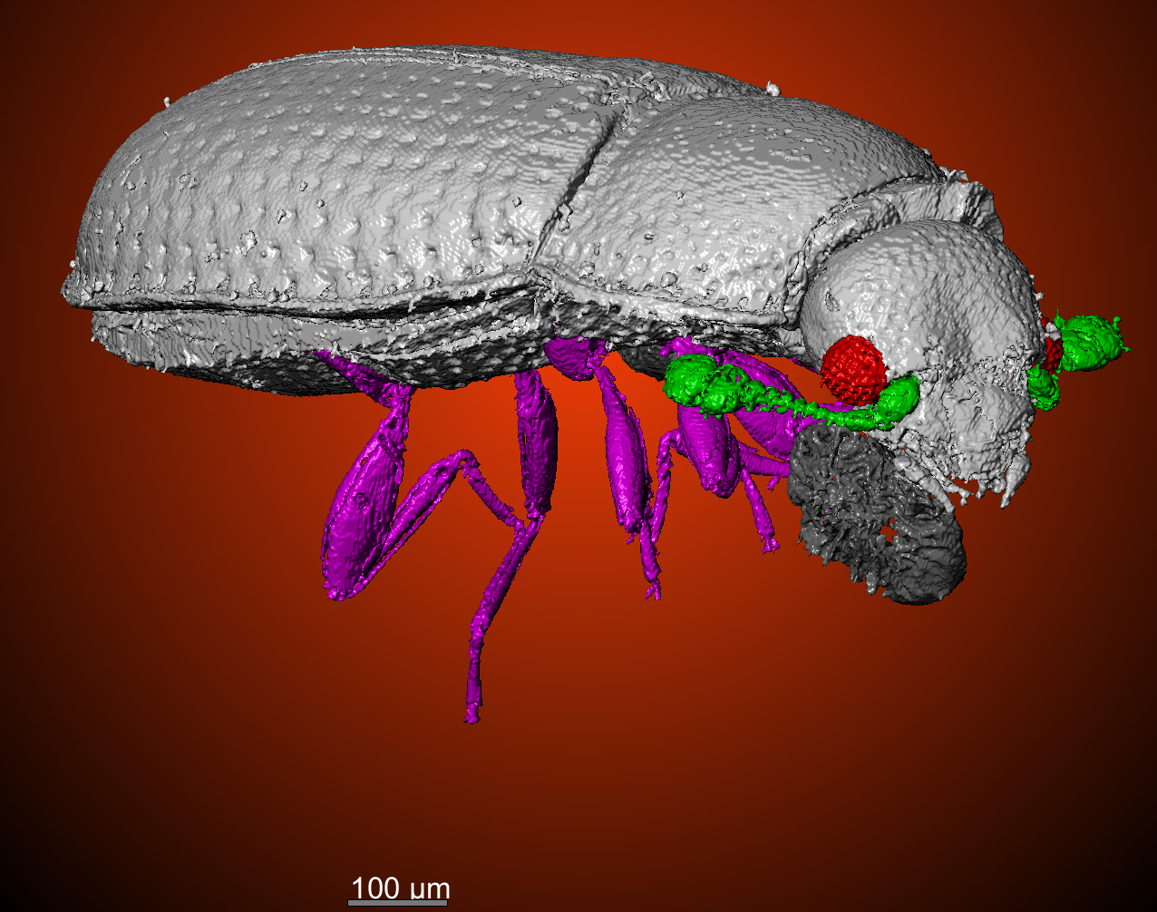
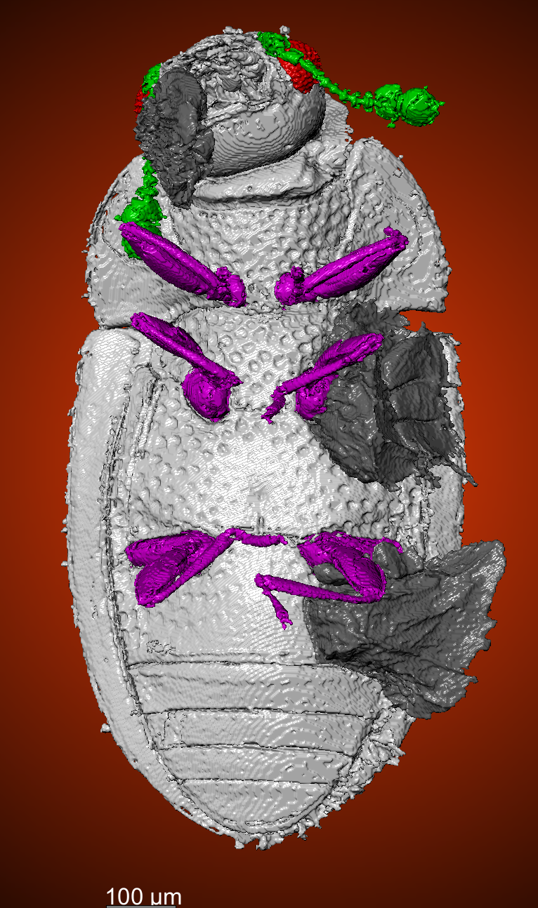
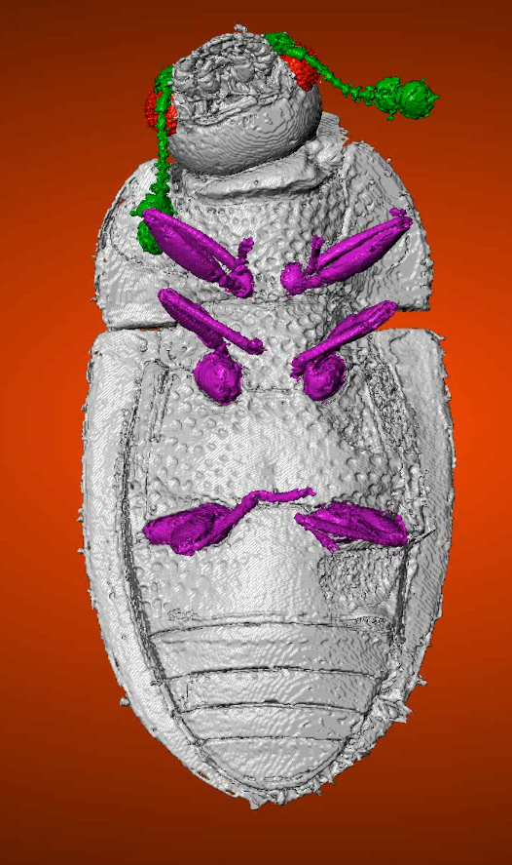
CT Results
Insects from Baltic Amber (44 Ma)
Amber and decay artifacts can be removed using 3D rendering software
Two new fossil species!
Videos?
Minute Bark Beetle
Turtle Beetle
Minute Bark Beetle (Cerylonidae) (44 Ma)
Turtle Beetle (chelonariidae) (44 Ma)
Genitalia is critical to taxonomic analysis
Notes:
Getting to the results, we are looking at two beetles from Baltic amber, which are 44 million years old. I am using the program Dragonfly which is a platform for visualizing X-ray CT data. Using Dragonfly, by manipulating the 3-D model I am able to segment out the amber as it is at a fixed density providing true to scale models of the two insects. Decay artifacts that may obscure the surface of the insect can be easily removed as well, as seen here in a bark beetle. Individual parts like legs and antennae can be highlighted and are useful for characterizing the insect. The beauty of CT is that we can also image the interior of the insect. Most importantly is looking if the genitalia of the insect is still preserved. For the turtle beetle it was still preserved in situ, and this makes determining the specific species of an insect straightforward. For the bark beetle the genitalia was dislodged and was floating inside the body cavity, but could still be recovered in the CT data as a high density structure. These specimens are part of two published articles for fossil taxonomy, where the CT scans confirmed they are never before seen fossil species.

Slide 13
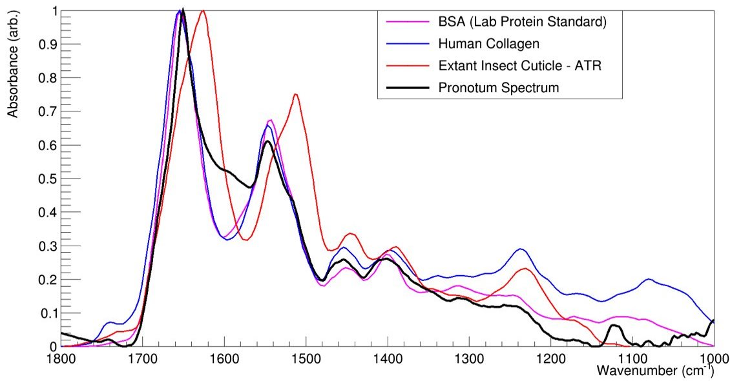
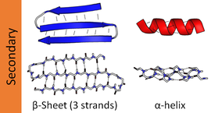
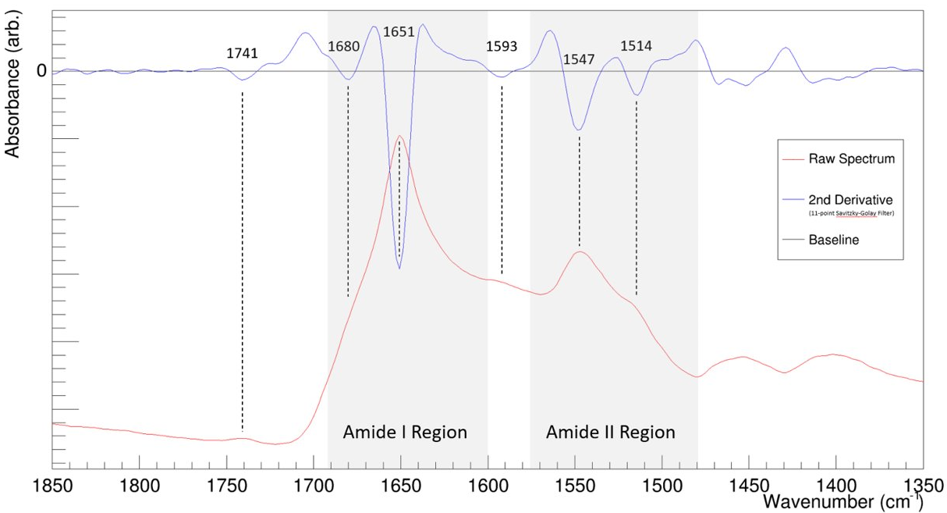
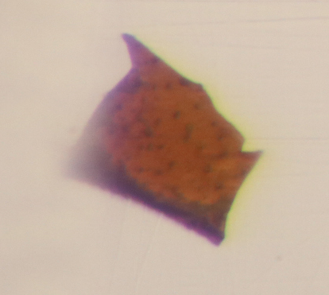
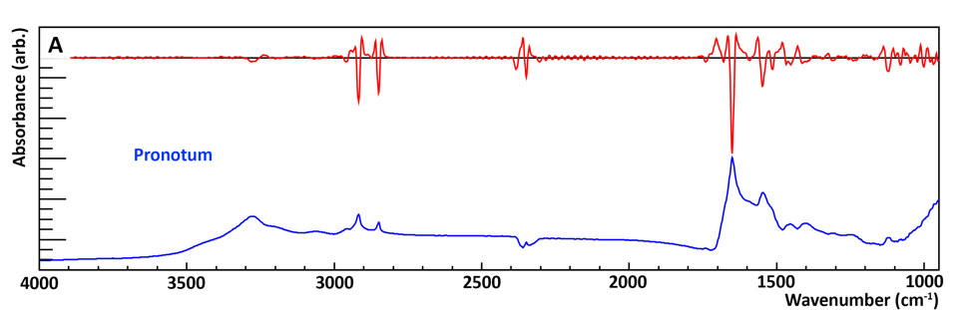
FTIR Results
β-sheet
α-helix
The spectral second derivative can be used to deconvolute peaks
Amides contain sub bands due to transition dipole coupling => can give info on protein secondary structure
This spectrum contains predominantly α–helix structure and therefore is likely due to a human contaminant
Pronotum
1mm
β-sheet
α-helix
β-sheet
α-helix
Notes:
We are going to look at some FTIR spectroscopy from the flakes extracted from the leaf beetle earlier in order to look for preserved proteins. In blue we have an example of an infrared spectrum from the pronotum, or section of the head of the beetle. Superimposed above it is a smoothed second derivative spectrum that is used to provide deconvolution of spectral peaks that overlap. At first glance the spectrum is reminiscent of protein, by comparing to different protein references. Zooming into a lower frequency region of the spectrum features peaks expected in the Amide region. Amide bands split into sub bands due to transition dipole coupling. The Amide I peak is dominated by the mode at 1651 cm-1, which is known as the α–helix band, with small contribution to β-sheet at 1680 cm^-1. These sub bands can also explain the secondary structure of proteins, represented by the way the molecules are aligned, shown here. Looking more carefully at the pronotum spectrum compared to different protein references it is clear that the protein source is not from the beetle itself. The spectrum in black matches well to human and lab protein references, with dominant α–helix structure on Amide peaks. However, modern beetle proteins from exoskeletons are β-sheet dominated. Therefore the spectrum represents a contaminant.

