Slide 1
The Lambert W Function and its
Applications to Metamaterials
Shreyas Suresh, Jeyasitharam J, P.C. Deshmukh (IIT Tirupati, India)
Ken Roberts, N. Jisrawi*, and Sree Ram Valluri ( University of Western Ontario)
Date of CAP conference: 8/June/2022
*Presenter.

Slide 2
OUTLINE
1) what are Gradient Index Metamaterials (GIM)?
2) Applications of the Lambert W (LW) Function.
3) The two plane method (2PM): Examples → LW.
4) Xu(1) waveguide with GIM.
g) Application of 2PM to GIM ⇒ LW solutions
6) Future work!

Slide 3
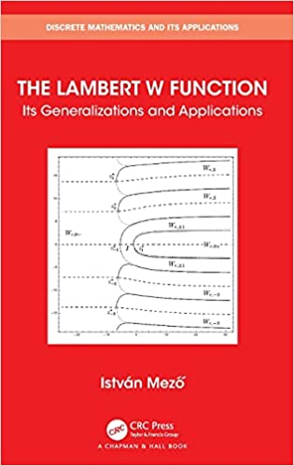
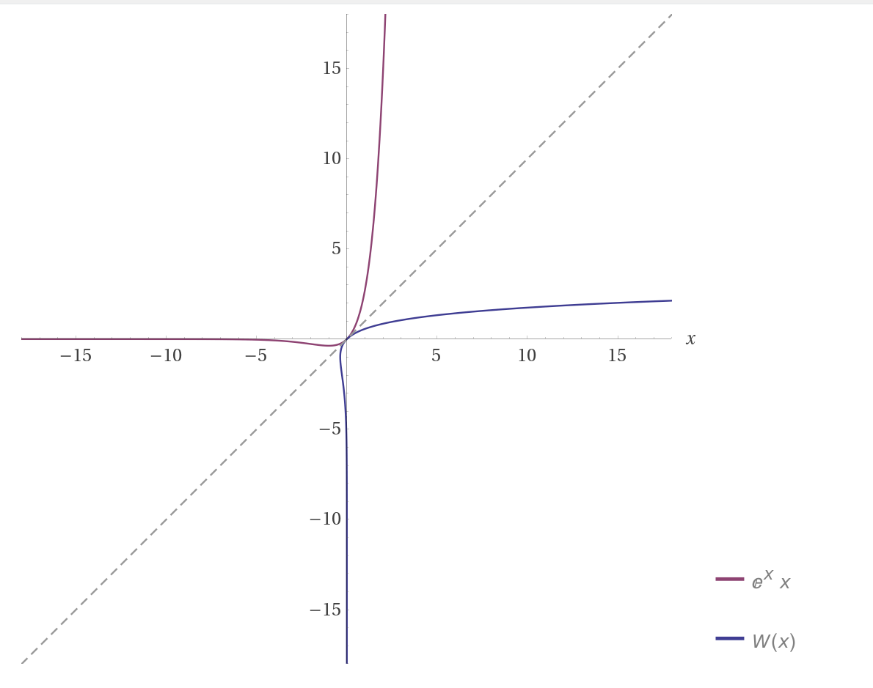
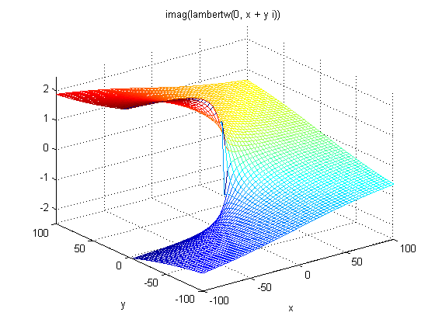
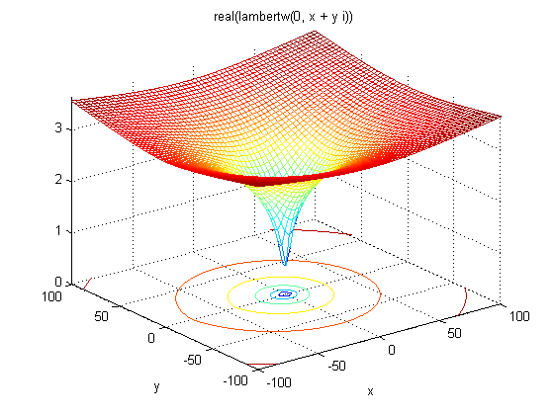
The Lambert W Function
If y = xe^{x}, The Lambert W function is defined as the inverse of function y(x) and termed as W(x). i.e. W(x)e^{W(x)} = x, where W(x) is the Lambert W function.
A new book by István Mező was just published The Lambert W Function: Its Generalizations and Applications
References: NIST Handbook, (2010, section 4.13) and R.M. Corless et al., Advances in Computational Mathematics 5(1996)329-359.

Slide 4
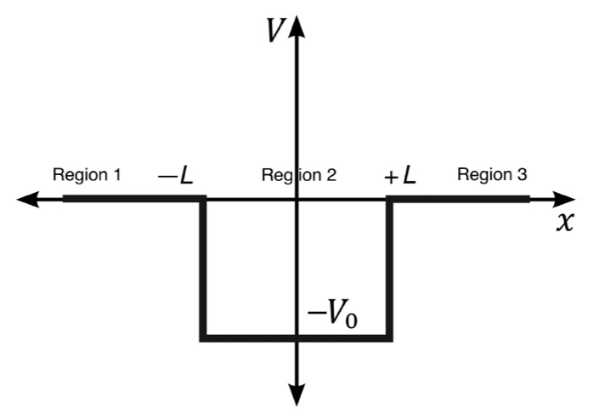
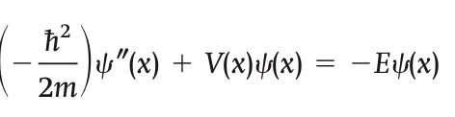
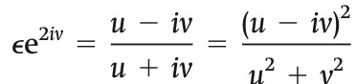
Example Application: Quantum Finite Square Well (FSW)
Applying boundary conditions and making change of variables, one comes up with:[ u and v are dimensionless]
V(x) = -V₀ , for L < x < L,
and V(x)= 0 for all other values of x.
→ Solution in terms of the Lambert W functions can be then obtained geometrically in two separate complex planes.
The quantized energy states are clearly identified.
References: Roberts and Valluri, Arxiv 1403.6685 (2014) and Roberts and Vallluri, CJP (2017)

Slide 5
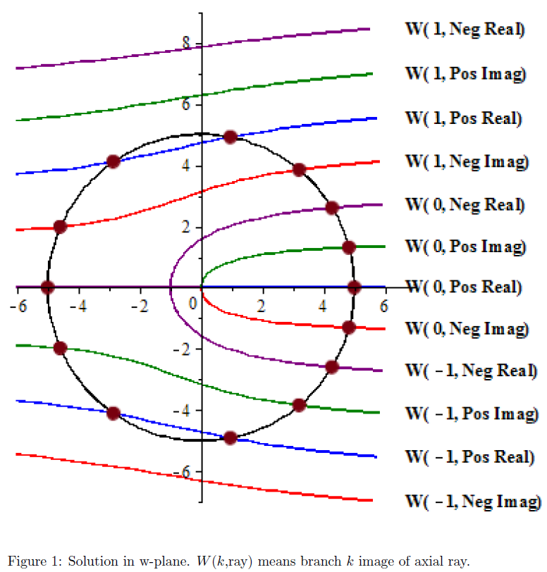
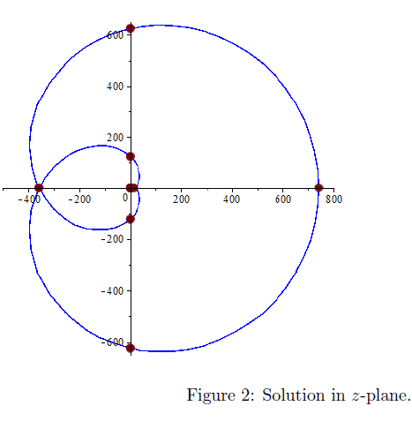
Finite Square Well Solution by Transformation
z = We^{W}
References: Roberts and Valluri, Arxiv 1403.6685 (2014) and Roberts and Valluri, CJP (2017).

Slide 6
Examples of the application of the LW function method
Finite Square Well [ Ref: Roberts and Vallluri, CJP (2017) ] (above!)
Quantum Double Finite Square Potential [Ref: Bharatbhai et al. Journal of Physics Communications, 4(6), 065001]
Step Index Planar Waveguide [Ref: Bharatbhai et al. Journal of Physics Communications, 4(6), 065001]
Now we apply the same method to the Graded Index Materials Waveguide.

Slide 7
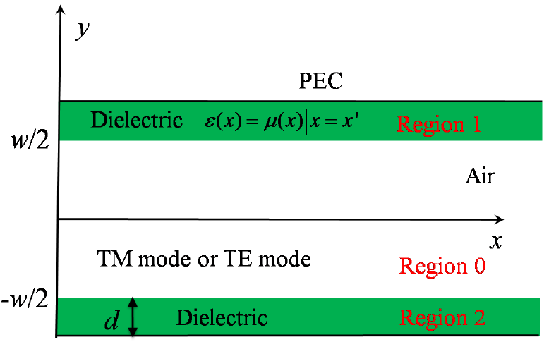

Gradient Index Metamaterials (GIM) Waveguides
Model description:
As depicted in the figure, core of thickness ‘w’, with refractive index (RI) = 1 (air gap). Dielectric on either side with thickness ‘d’. Extends symmetrically from origin along x - axis of total length ‘L’. Outside dielectric, region is considered a perfect electrical conductor. Each dielectric is a GIM with RI varying as,
with, x₀= -L/2
-L/2 ≤ x ≤ L/2
References: Xu et al (2013)

Slide 8
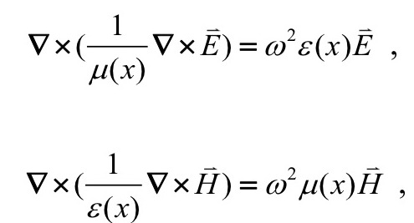
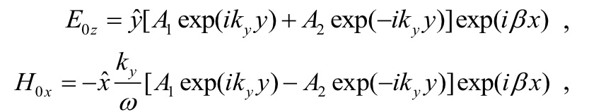
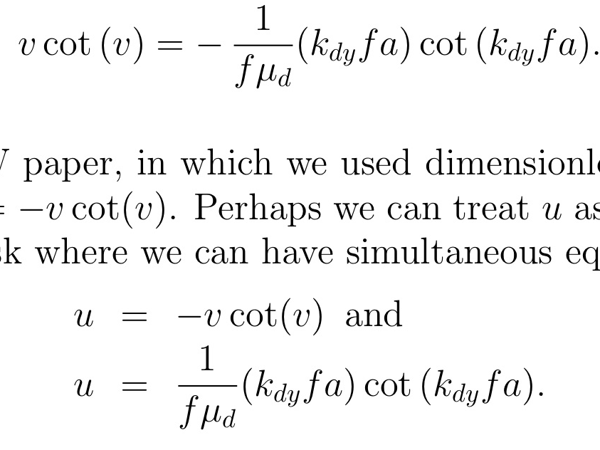
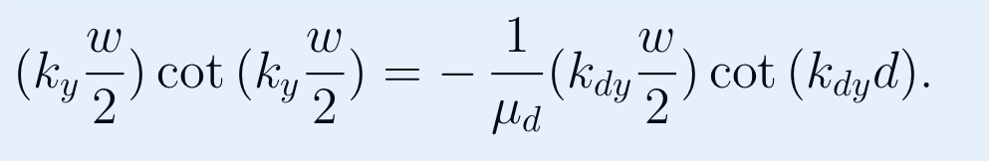

Maxwell’s Equations for Cavity Resonances
Depending on the region, you get plane wave solutions like these:
TE →
TM →
For odd TE:
$$−v_{0}\tan\left(v_{0}\right)=−\frac{1}{fn}v_{d} cot⁡(v_{d})$$

Slide 9


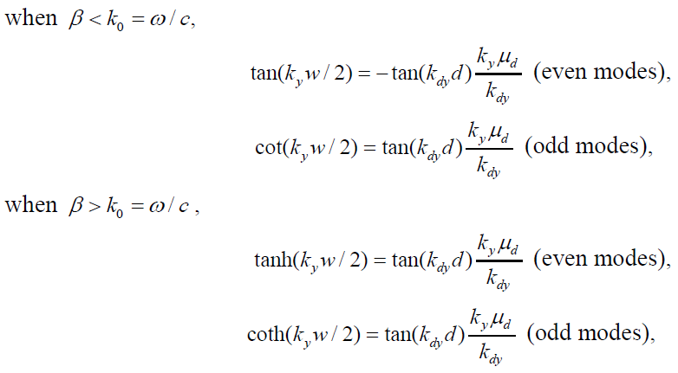
An Example from Xu, et al., for Odd TE Modes
β = x-component of wave vector
k_{y}= y-component of wave vector in region 0
k_{dy}= y-component of wave vector in region 1/2

Slide 10
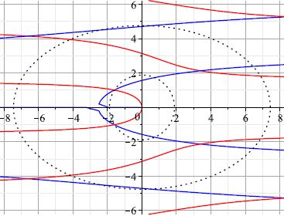
TE Odd Modes
  v₀ = k_{y}(w/2)
  v _{d} = dk_{dy}
  u = β(w/2)
  f = 2d/w
-v₀tan(v₀) = -(v_{d} /nf)cot(v_{d})
u² + v₀² = R₀² where R₀ = k₀w/2
u² + (v_{d}/f)² = (R₀/n)²
  LHS = -ve of lambert line, corresponding to image of imaginary axis from T-plane (red)
  RHS = scaled lambert line, image of positive axis from T-plane (blue)

Slide 11
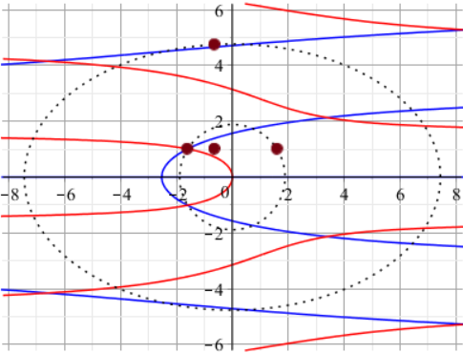
Solution for TE odd mode when β < k_{o}
Solution for TE odd mode when β < k_{o} is obtained from
the intersection of modified lambert lines.
Points on ellipse and circle are obtained by drawing
Vertical and horizontal lines from intersection point from which β_{a} value is calculated.
-v₀tan(v₀)= -(v_{d} /nf)cot(v_{d})
u² + v₀² = R₀² where R₀ = k₀w/2
u² + (v_{d}/f)² = (R₀n)²

Slide 12
Conclusion
The Xu, et al analysis of GIM waveguide may be a useful viewpoint for waveguides with non-constant refractive indexes.
For each x-value along waveguide's gradient of refractive index, we can look at the standard modes, such as odd TE modes.
Scaled Lambert lines provide a way to interpret the analytical situation visually.
In three dimensions, with refractive index as a third dimension, we can look at lines which represent solutions, as intersections of sheets of scaled Lambert lines with sheets (cylinders and squashed cones) arising from the circular constraints.
Perhaps this interpretation will help us understand and work with GIM waveguides in various applications.
* There is the analogy of conservation of mechanical energy?
Note relationship to U-turn.

Slide 13
References
Roberts, K., & Valluri, S. R. (2017). Tutorial: The quantum finite square well and the Lambert W function. Canadian Journal of Physics, 95(2), 105-110.
Bharatbhai, N. H., Deshmukh, P. C., Scott, R. B., Roberts, K., & Valluri, S. R. (2020). Lambert W function methods in double square well and waveguide problems. Journal of Physics Communications, 4(6), 065001.
Xu, Y., Gu, C., Hou, B., Lai, Y., Li, J., & Chen, H. (2013). Broadband asymmetric waveguiding of light without polarization limitations. Nature Communications, 4(1), 1-8.
Xu, Y., & Chen, H. (2011). Total reflection and transmission by epsilon-near-zero metamaterials with defects. Applied Physics Letters, 98(11), 113501.

Slide 14
Future work
Look at TM modes, etc.
Revisit Harsh’s paper and redo the analysis
Transforming to the z-plane: What is in there?
Ask for suggestions!

Slide 15
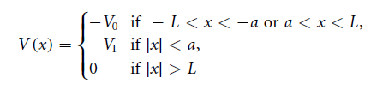
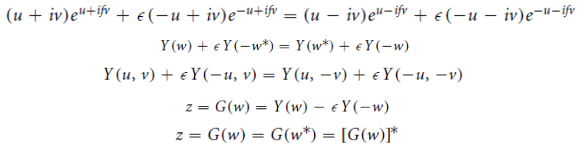



Double Potential Well
For the Double Potential Well, we obtain a more complicated expression. The Lambert-W function provides a simplified approach in generating the required smooth mapping.
References: Bharatbhai, et al (2020).

Slide 16
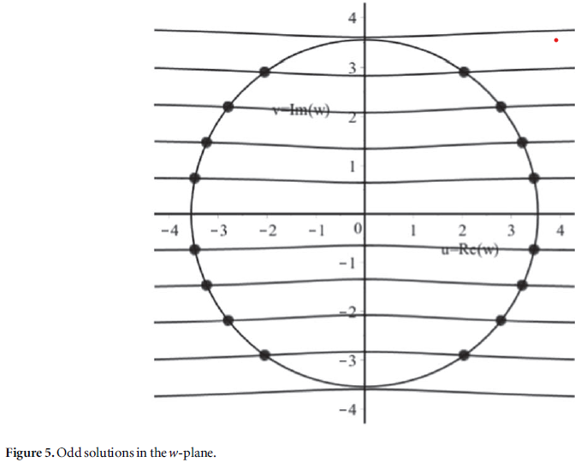
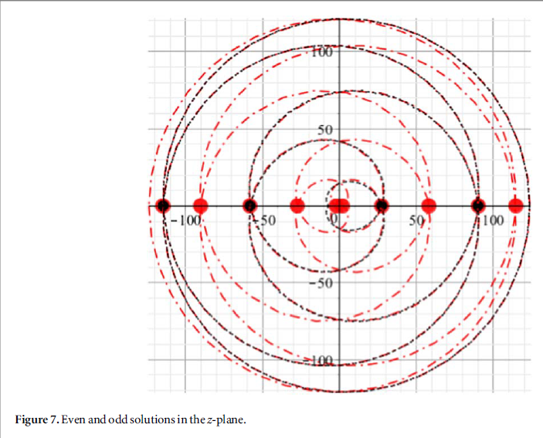
Double Potential Well
References: Bharatbhai, et al (2020).

Slide 17
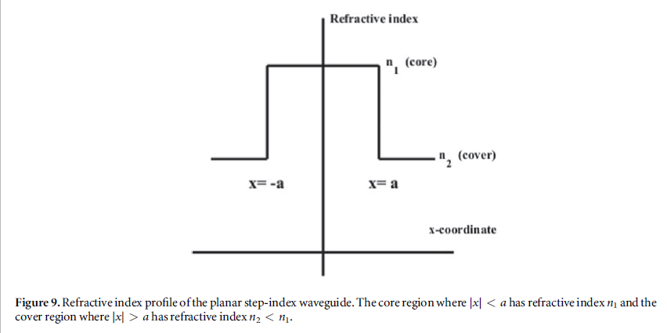
Step Index Waveguide
Solutions obtained for the step index waveguide model, upon solving the maxwell’s equations with the appropriate boundary conditions gives a geometric analytic visualization similar to that of the 1-D FSW model.
References: Bharatbhai, et al (2020).

Slide 18
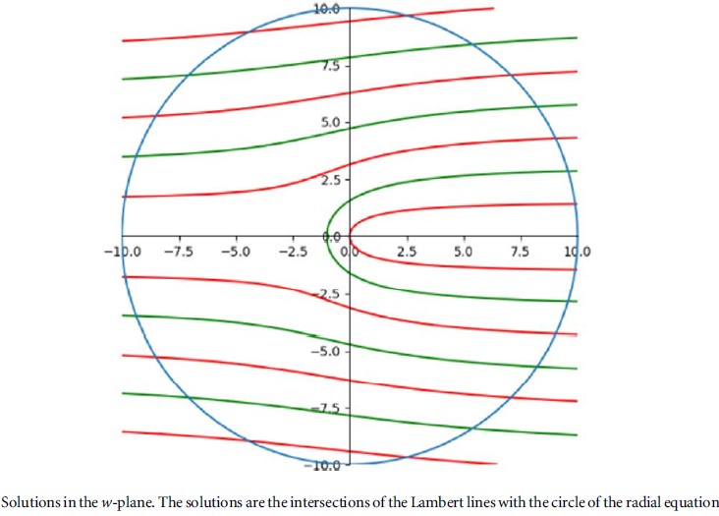
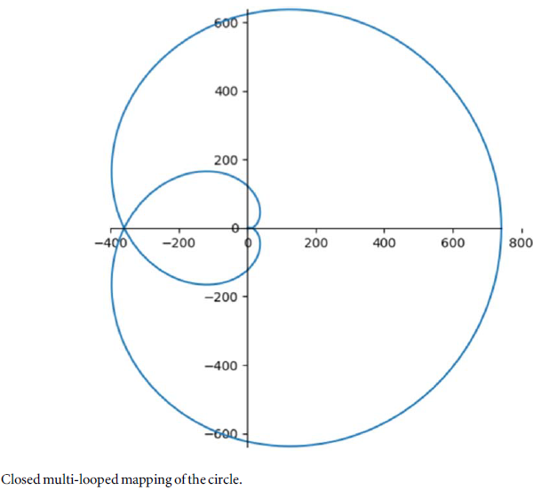
Step Index Waveguide

Slide 19
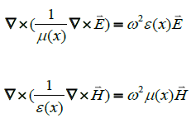
How Xu et al arrived in TE and TM modes eqn
The solutions to the equations above are difficult to obtain analytically, However the solutions are easy to obtain when we consider a fixed position (x = x’ ) replacing the GIMs with homogeneous materials, allowing us to treat ε and μ as constants.

Slide 20



How Xu etal arrived in TE and TM modes eqn
Taking propagation along x-axis and solving the equations for TE modes
Region 0,
Region 1,
Region 2,

Slide 21
TE: odd and even modes
β = x-component of wave vector
k_{y}= y-component of wave vector in region 0
k_{dy}= y-component of wave vector in region 1/2

Slide 22
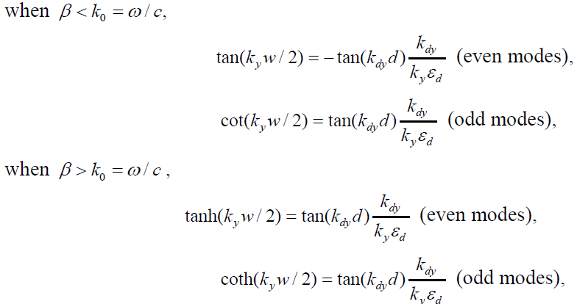
TM: odd and even modes
β = x-component of wave vector
k_{y}= y-component of wave vector in region 0
k_{dy}= y-component of wave vector in region 1/2

Slide 23
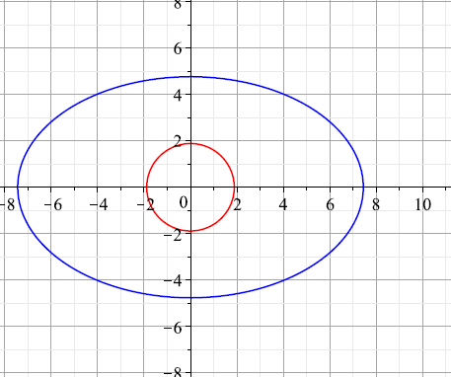
Plots of the S16 equations,
u² + v₀² = R₀² where R₀ = k₀w/2
u² + (v_{d}/f)² = (R₀/n)²

Slide 24
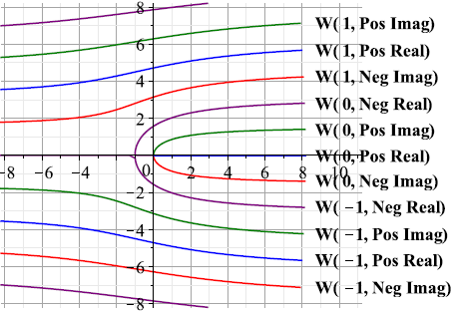
Lambert Lines
t = se^{s}, where s = u + iv, plot below shows the inverse map of t = f(s), the lambert lines

