Slide 1
Surface Relaxation of Vapor Deposited Polystyrene Glasses
Outline
Background:
  Glasses and stable glasses
  Physical vapor deposition
Experimental methods:
  Surface perturbations by gold nanoparticles
  AFM measurements
Results and discussions
Junjie Yin
James Forrest Lab
Physics, University of Waterloo

Slide 2
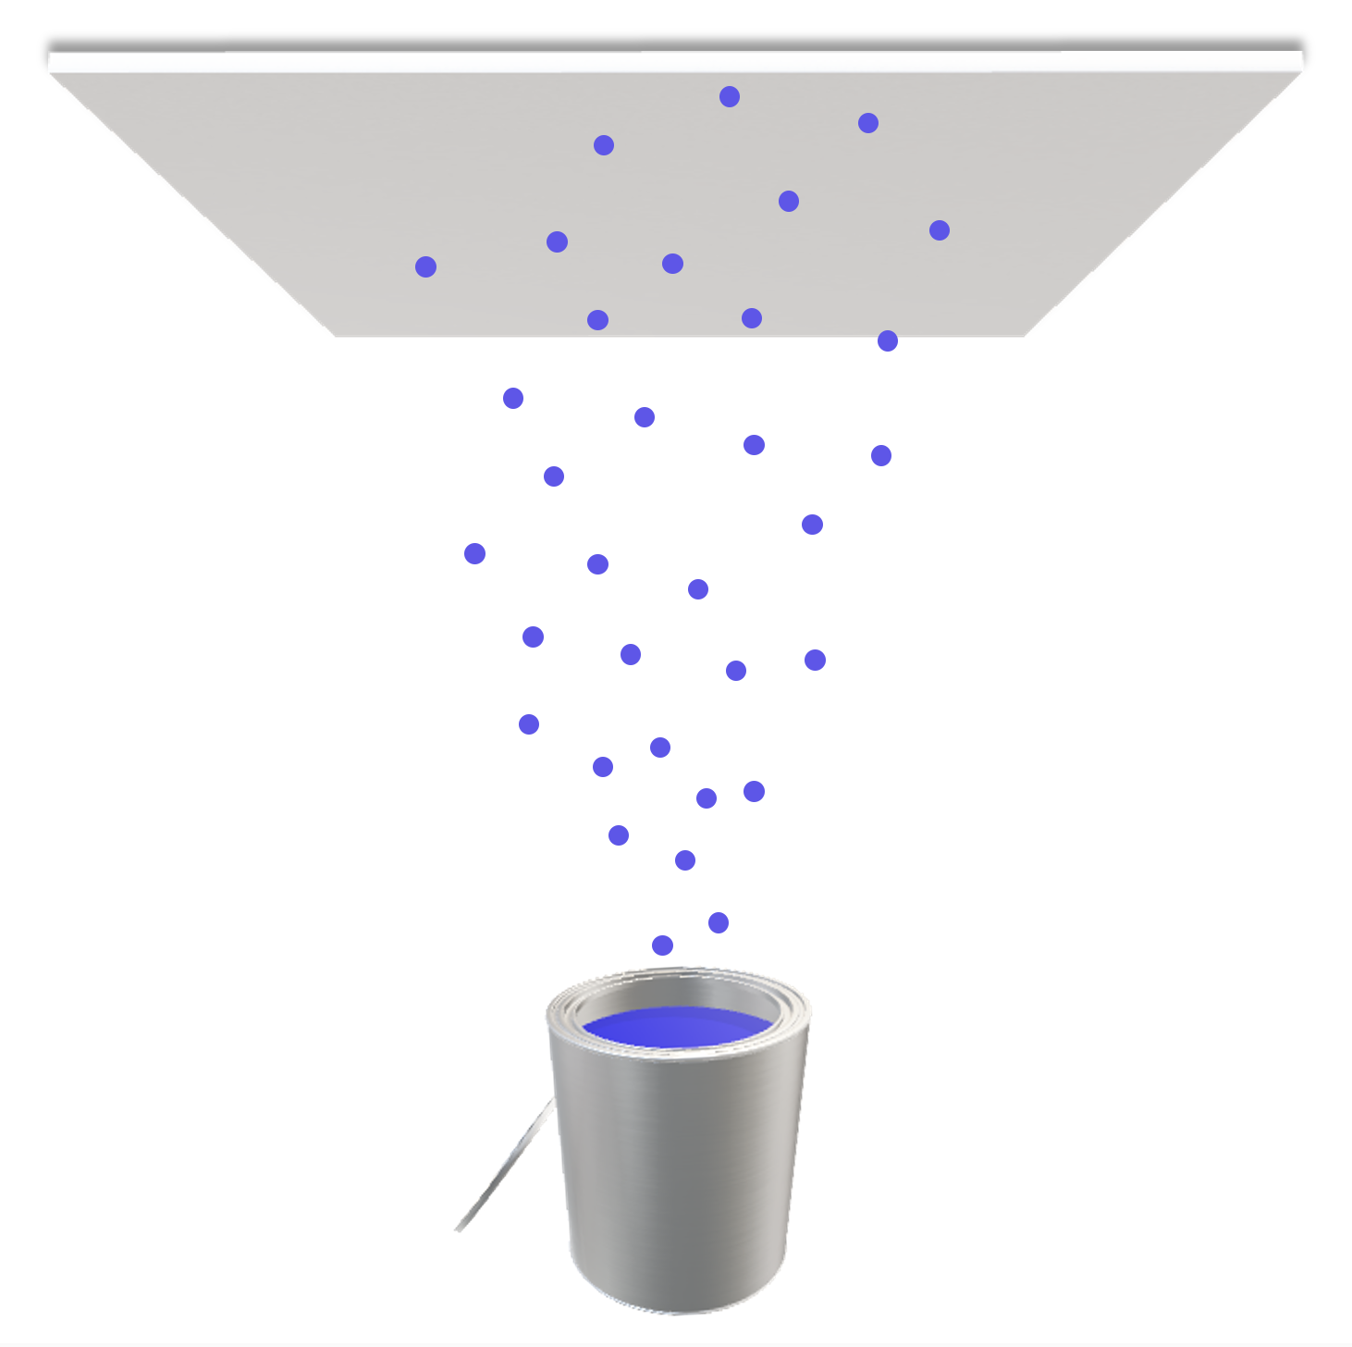
Glass and stable glass
L. Berthier, M. D. Ediger (2016), Physics Today, 69, 1, 40
substrate
3-5 nm mobile layer
S, H, or V
glass
substrate
source
Temperature

Slide 3
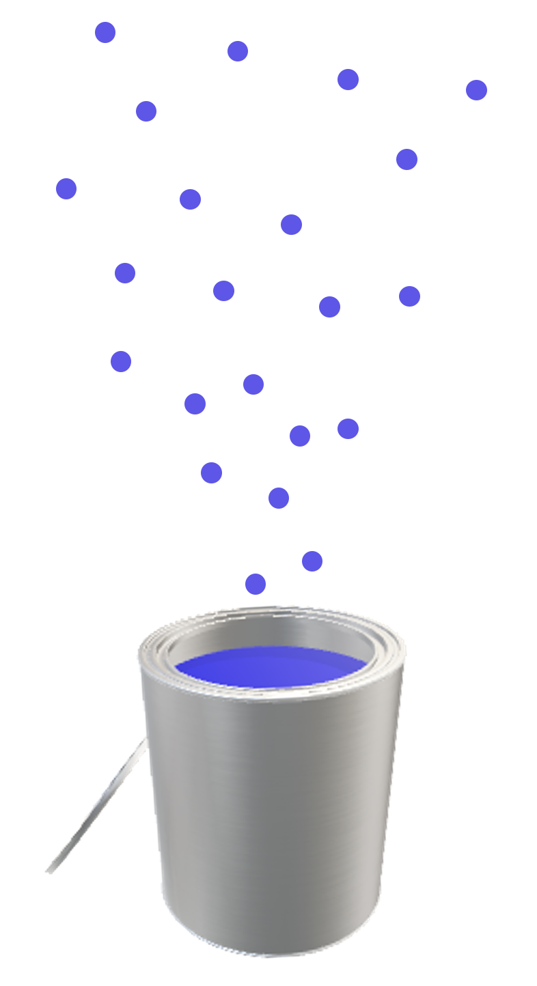
Glass and stable glass
L. Berthier, M. D. Ediger (2016), Physics Today, 69, 1, 40
substrate
glass
3-5 nm mobile layer
S, H, or V
source
Temperature

Slide 4
Glass and stable glass
L. Berthier, M. D. Ediger (2016), Physics Today, 69, 1, 40
S, H, or V
source
Temperature

Slide 5
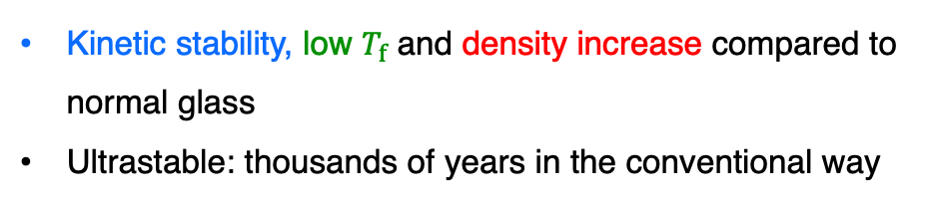



Small molecules
Polymers
S.F. Swallen, et al. (2007), Science, 315 353-356
A. Raegen, J. Yin, Q. Zhou, & J. A. Forrest (2020). Nature Materials, 19(10), 1110-1113.
M.D. Ediger (2017), J. Chem. Phys., 147, 210901
Difficulties:
Low vapor pressures
Sensitive to thermal degradation
Possibilities:
Start with small N
Successful distillation of PS (N of 3–17), PEO (N of 7–13) and PMMA (N ~ 7)
Atactic PS:
No crystal ground state
Surface dynamics well studied
indomethacin (molecular glass)
$$∆ρ$$
$$T_{onset}$$
$$T_{f}$$
Kinetic stability, low $T_{f}$ and density increase compared to normal glass
Ultrastable: thousands of years in the conventional way

Slide 6


Vapor-deposited PS stable glasses
Zhang, Y., & Fakhraai, Z. (2017). Physical review letters, 118(6), 066101.
PS glass film prepared by PVD, N = 9
Stable glass compared to regular glass:
Increased density ✓
Bulk kinetic stability ✓
Surface properties ?
$$T_{g}=318 K$$
$$T_{f}=298 K$$
mobile surface layer
glass
substrate

Slide 7
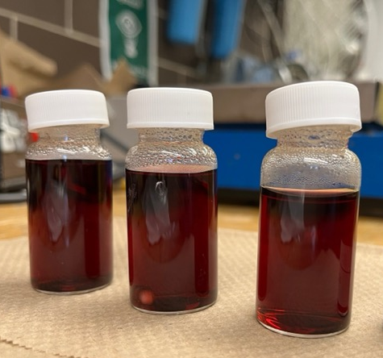
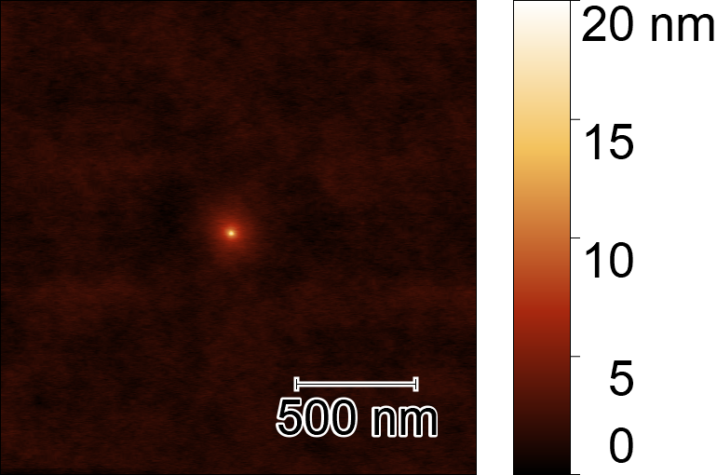
Experimental methods
Vapor deposition
Prepare stable PS glass films through PVD, and rejuvenate a portion of them
AuNPs
Introduce 20nm size AuNPs on as-deposited and rejuvenated glasses
AFM measurements
At different temperatures, monitor surface relaxation with AFM
rejuvenated
glass
stable glass

Slide 8
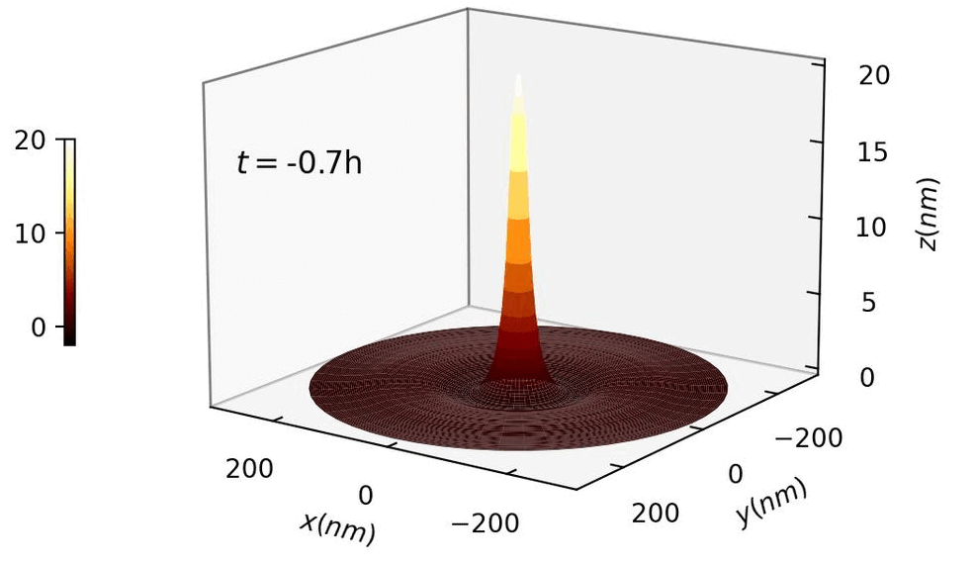
AuNPs on vapor-deposited PS surface
3-5 nm mobile layer
glass
(rejuvenated PVD film of PS, isothermally treated at $T_{g}−5 K$)
substrate

Slide 9
Surface evolution in two stages
Stage 1: material build up
Stage 2: embedding
Embedding is slower for stable glass
Slower bulk dynamics

Slide 10
Quantifying surface properties: peak width/diameter at h=0nm
Stage 1: material build up
peak width
Power law relationship with evolution time.

Slide 11
t^{1/4} scaling
Both as-deposited films and rejuvenated films follow t^{1/4} scaling.

Slide 12
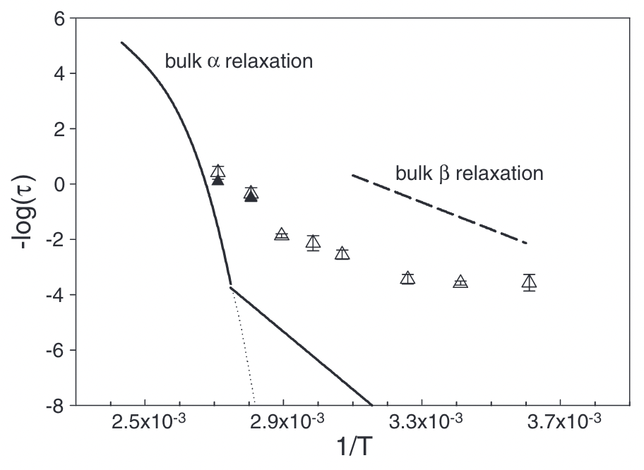

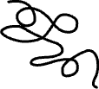
Characteristic time of relaxation
Dhinojwala, et al. (1994). J. Chem. Phys, 100(8), 6046-6054.
Fakhraai, Z., & Forrest, J. A. (2008). Science, 319(5863), 600-604.
vapor-deposited
spin-cast
T_{g}
T_{g}
Surface dynamics is independent of bulk stability.
Short chain, vapor deposited films are similar to long chain, spin-cast films, showing universal behaviours.

Slide 13
Conclusion
PVD enables us to prepare equilibrated samples in the glassy state.
First measurements on surface relaxation of vapor-deposited PS glasses.
Surface response is similar between stable (equilibrated) and rejuvenated (fresh) PVD films, and both are similar to spin-cast films.
To do
Compare with numerical solutions and learn about the surface mobility.
Characterize stable glass films with varying thicknesses and stabilities to explore their effect on surface properties.

