Slide 1
BSM Neutrino Physics in Weak Nuclear Decay
Kyle Leach
Department of Physics | Quantum Engineering | Nuclear Engineering
Colorado School of Mines
2022 CAP Congress - Hamilton, ON
June 8, 2022

Slide 2
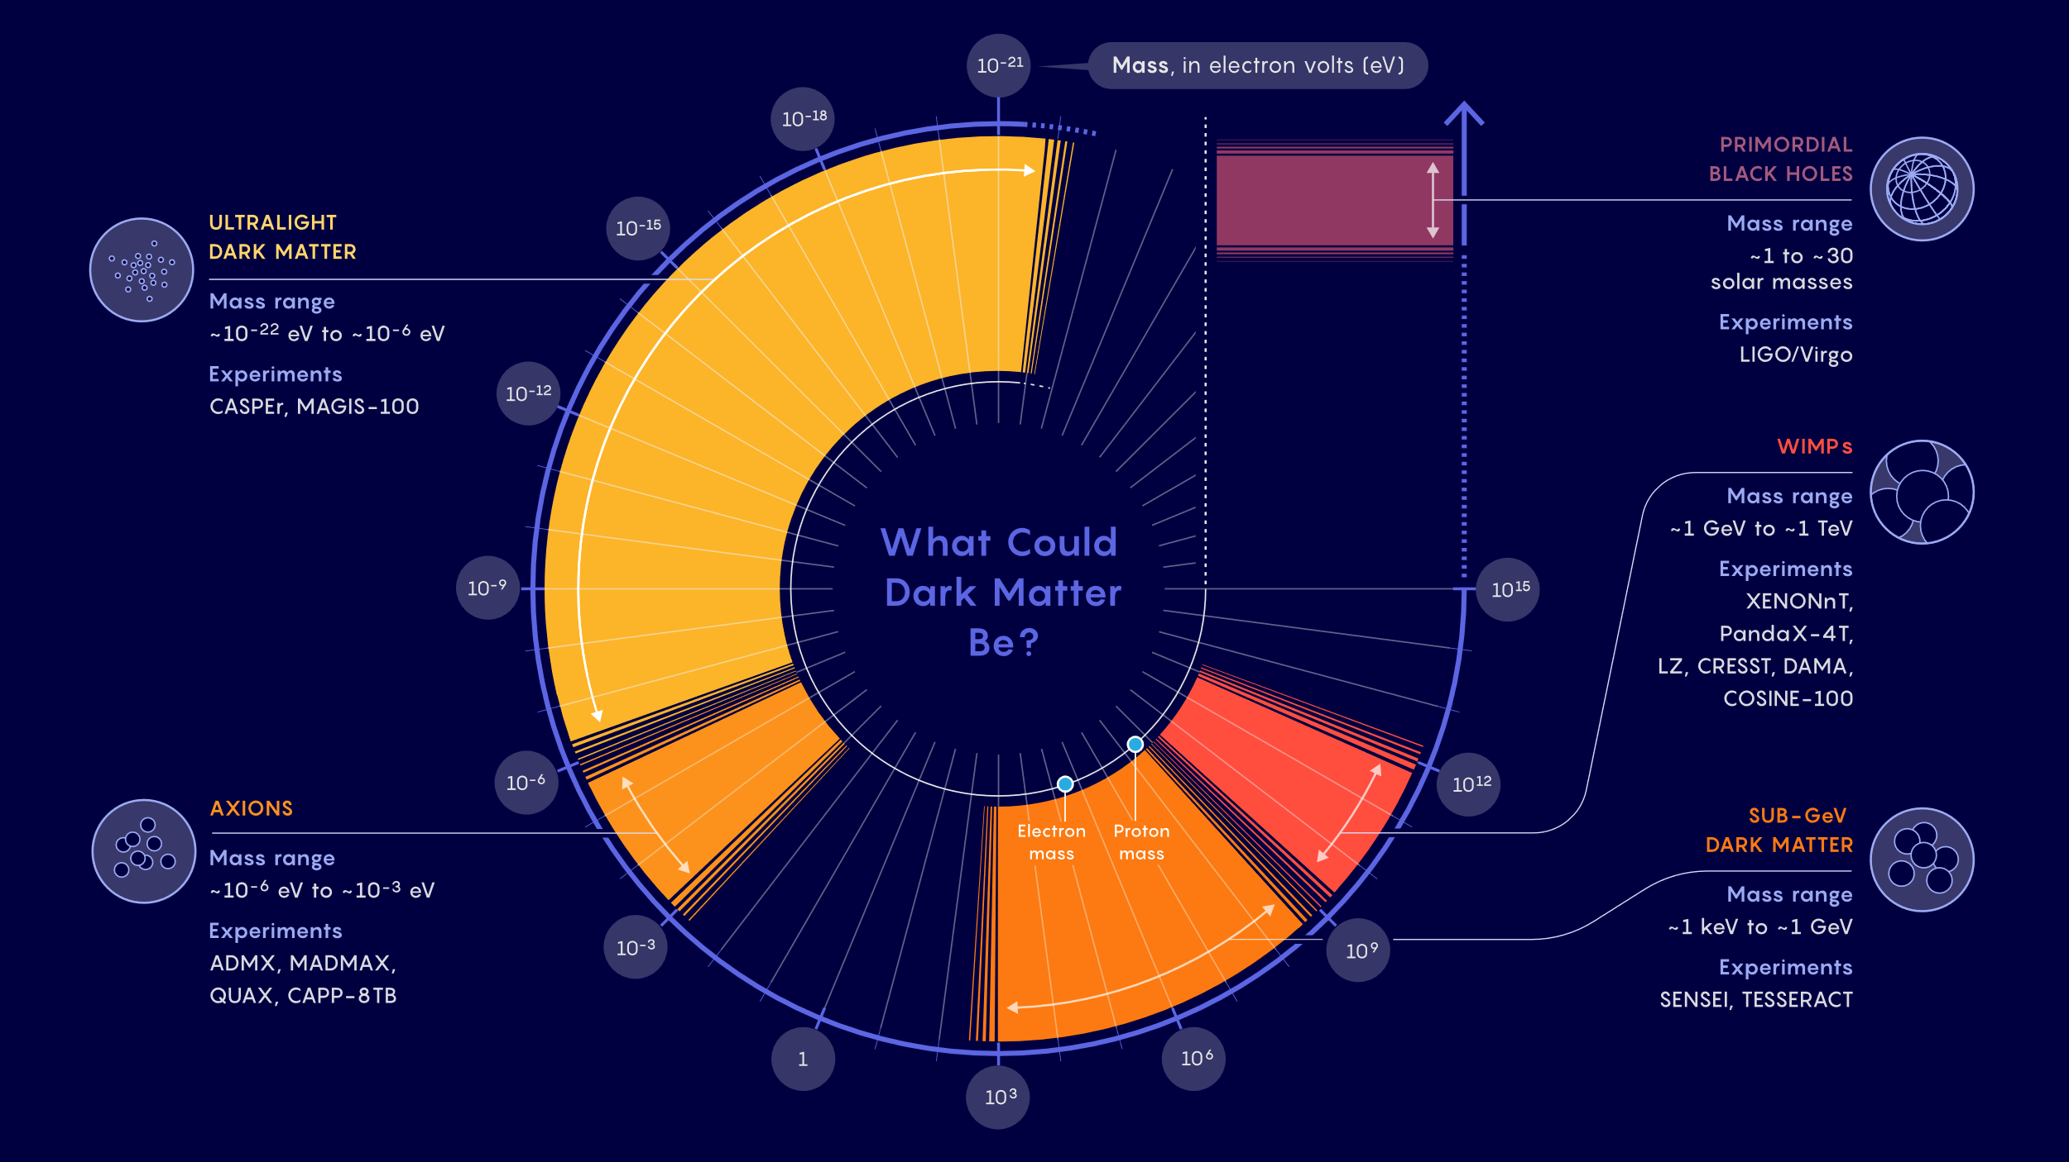
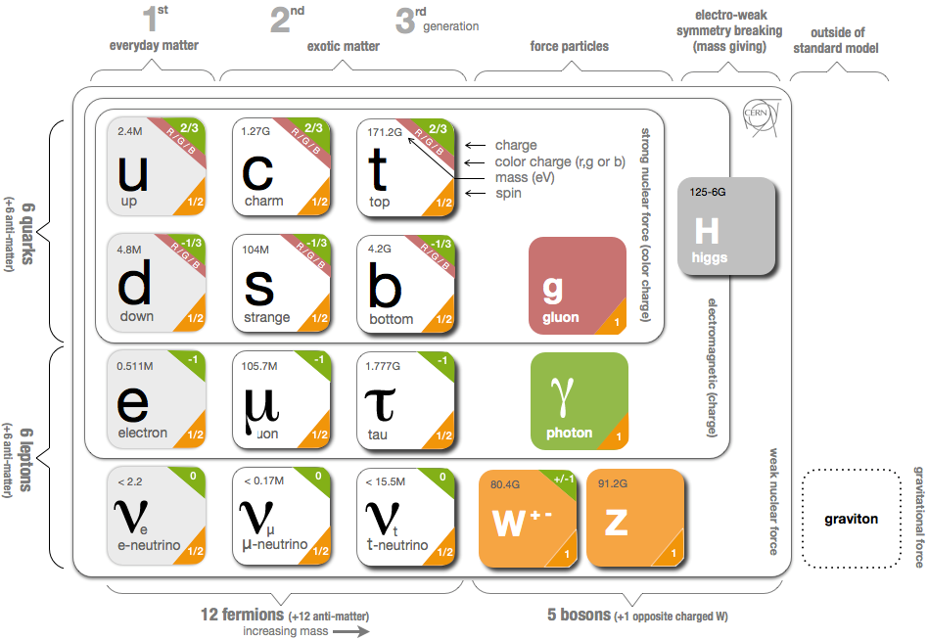
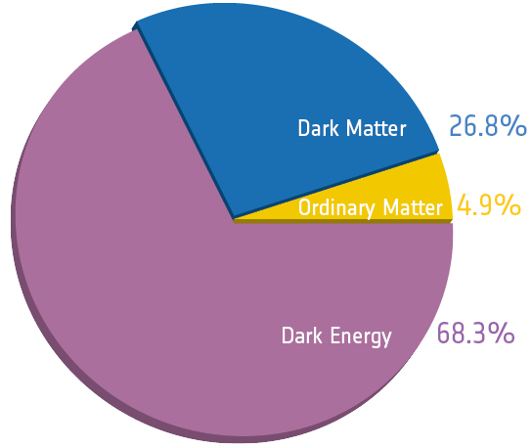
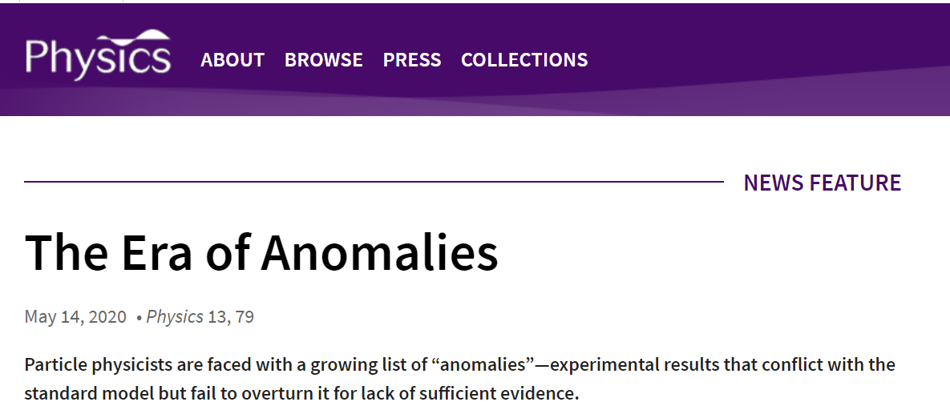
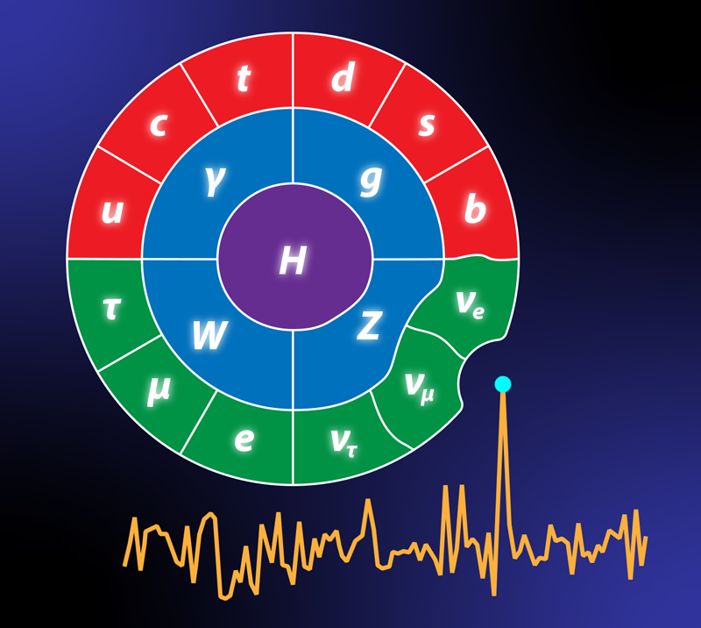
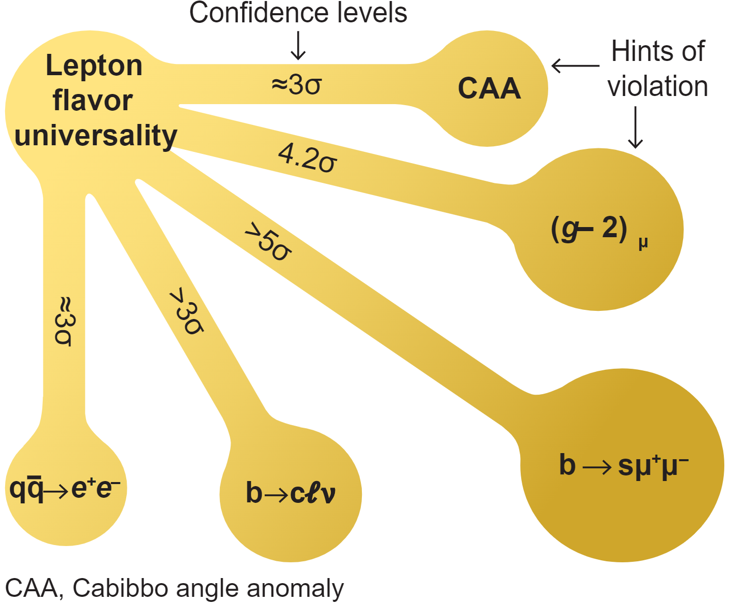
New Physics: What is it and Where do we Search?
Image credit: Planck Collaboration
Where does all this lead?
Extensions to the SM are unavoidable
Tantalizing hints of new physics but conflicting data
Most new scenarios hint at particles in the“Dark Sector”
Image credit: Quanta Magazine
A. Crevellin and M. Hoferichter, Science 374, 1051 (2021)
K.G. Leach – BSM Neutrino Physics via Weak Nuclear Decay
2022 CAP Congress – Hamilton, ON
June 8, 2022

Slide 3

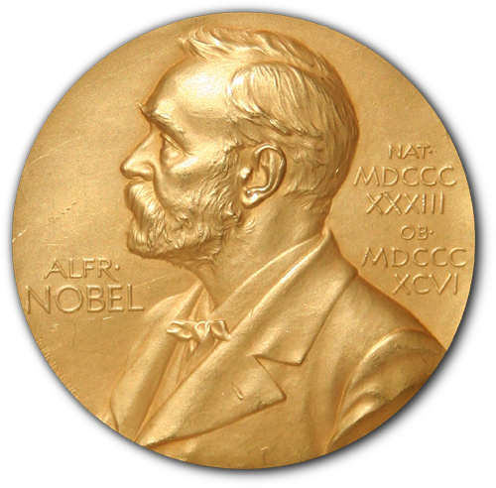
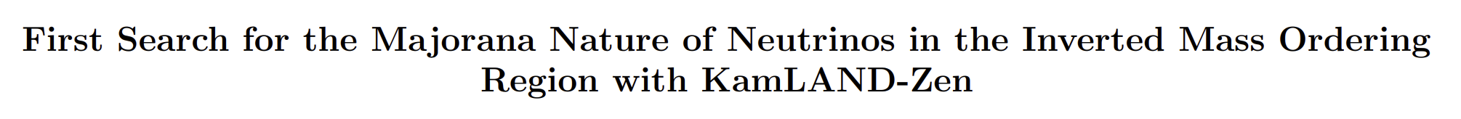
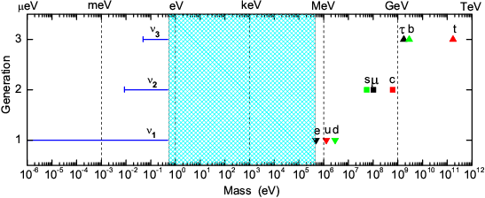
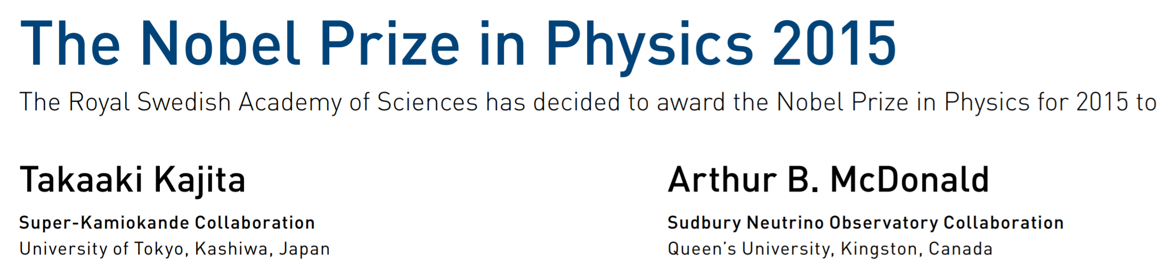
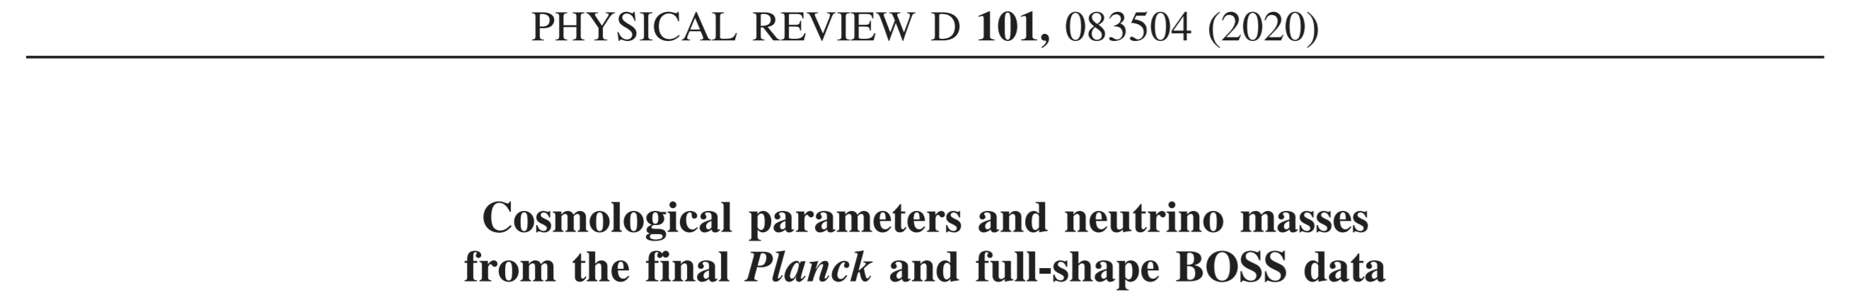
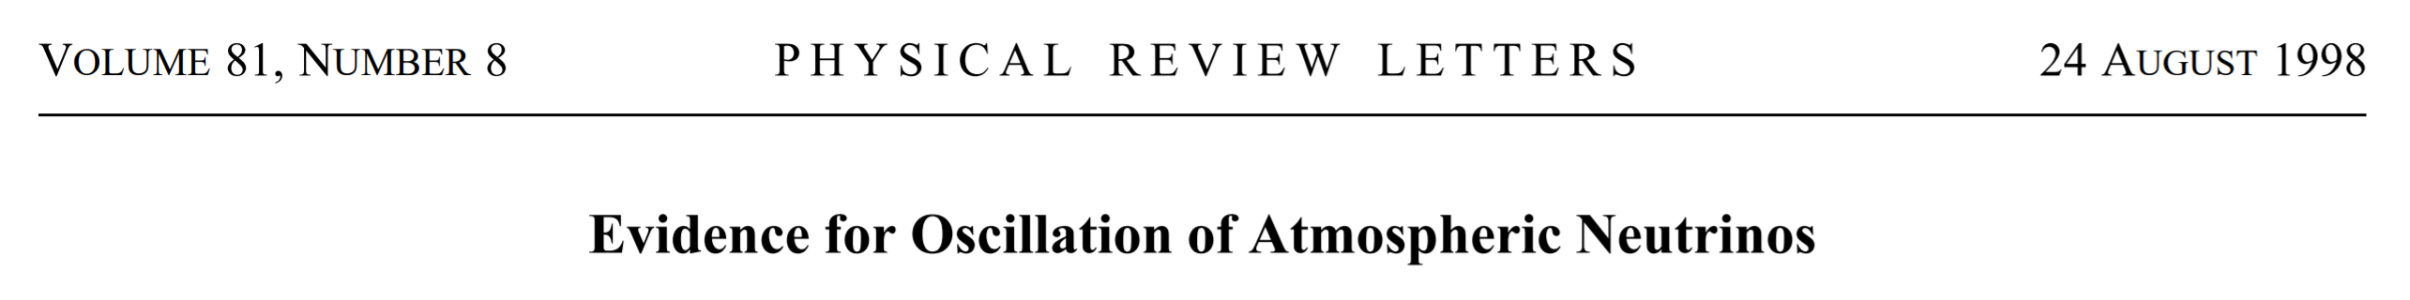
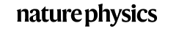

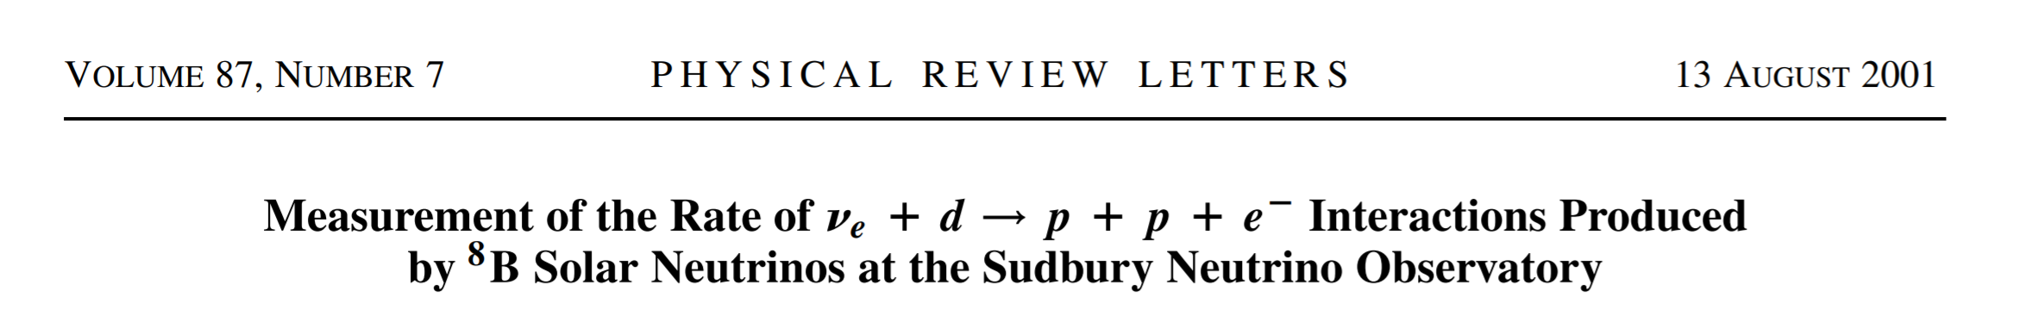
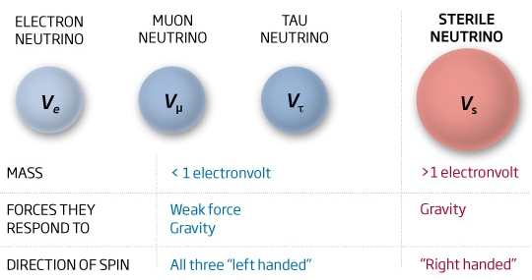
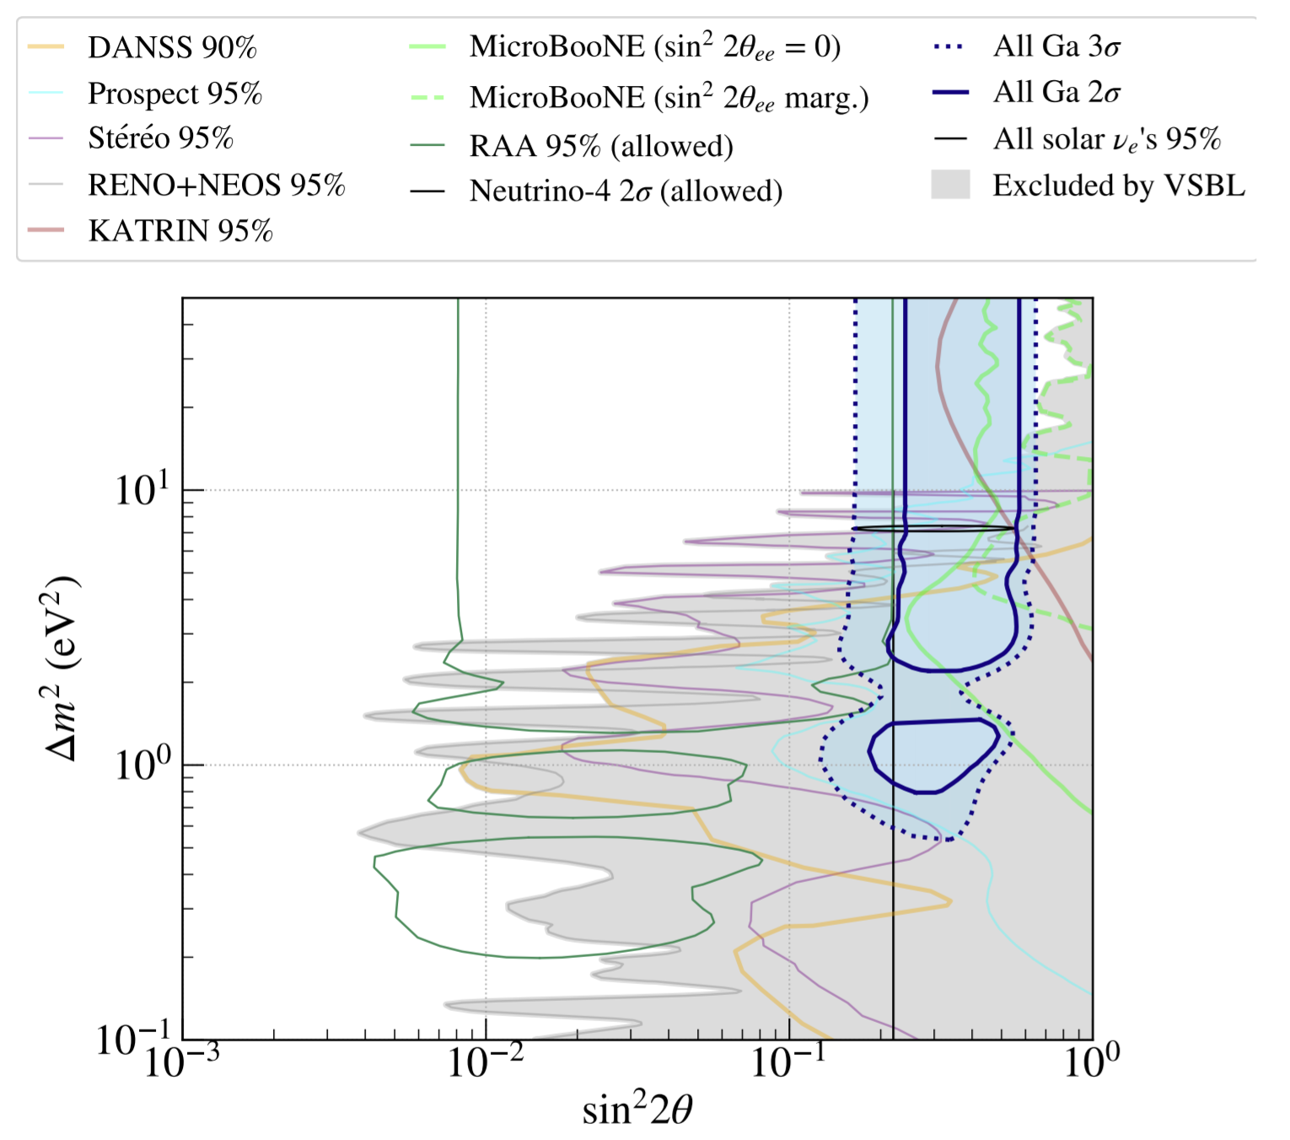
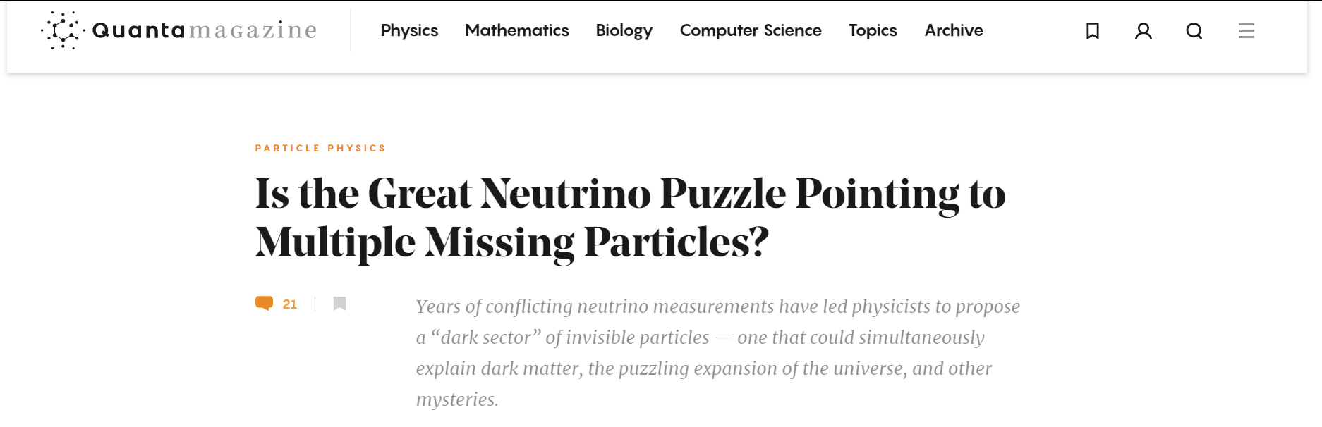
Putting the Puzzle Together
2016
2203.02139
m_{ββ}< 35-156 meV
Σm_{ν} < 160 meV **
m_{νe}< 800 meV
The Dark Matter Problem
The Standard Model
Masses are VERY Light
arXiv: 2201.07364
(2022)
Non-Zero Neutrino Masses
Hints of Sterile Flavours
Baryon Asymmetry of the Universe
K.G. Leach – BSM Neutrino Physics via Weak Nuclear Decay
2022 CAP Congress – Hamilton, ON
June 8, 2022

Slide 4
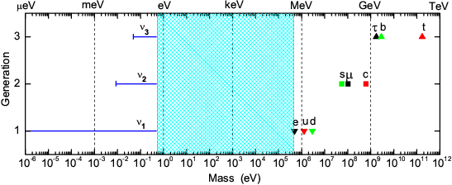
Open Questions in the Neutrino Sector
Why are these masses so small relative to the other Fermions?
What is the mass hierarchy?
How many mass states are there?
What is the absolute mass scale?
Do they violate CP symmetry?
Are they Dirac or Majorana Fermions?
Are there additional “sterile” neutrino flavours?
As a community, we attack these questions using a wide variety of probes:
Cosmological observations
Accelerators
Direct detection
Precision beta decay
K.G. Leach – BSM Neutrino Physics via Weak Nuclear Decay
2022 CAP Congress – Hamilton, ON
June 8, 2022

Slide 5
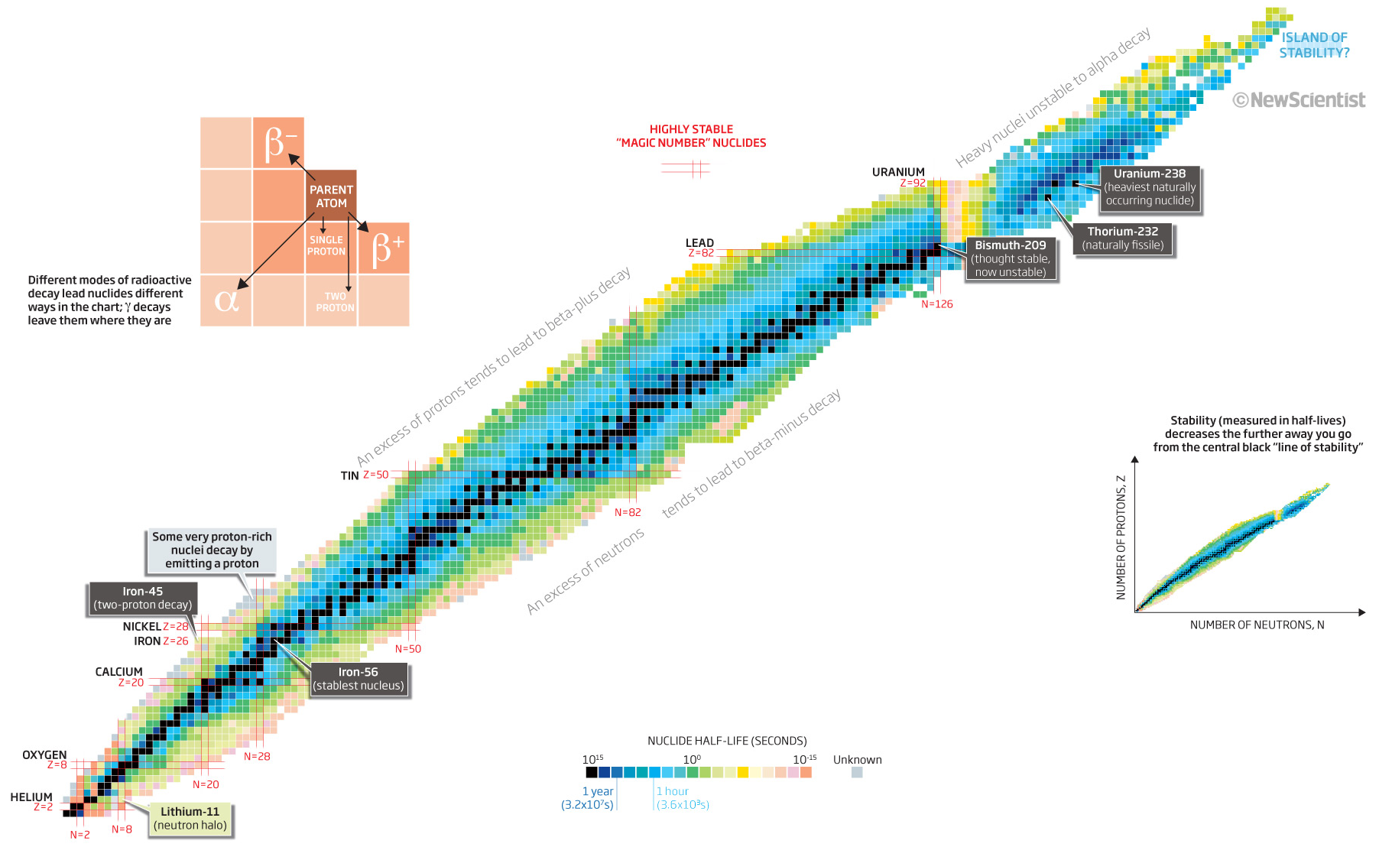
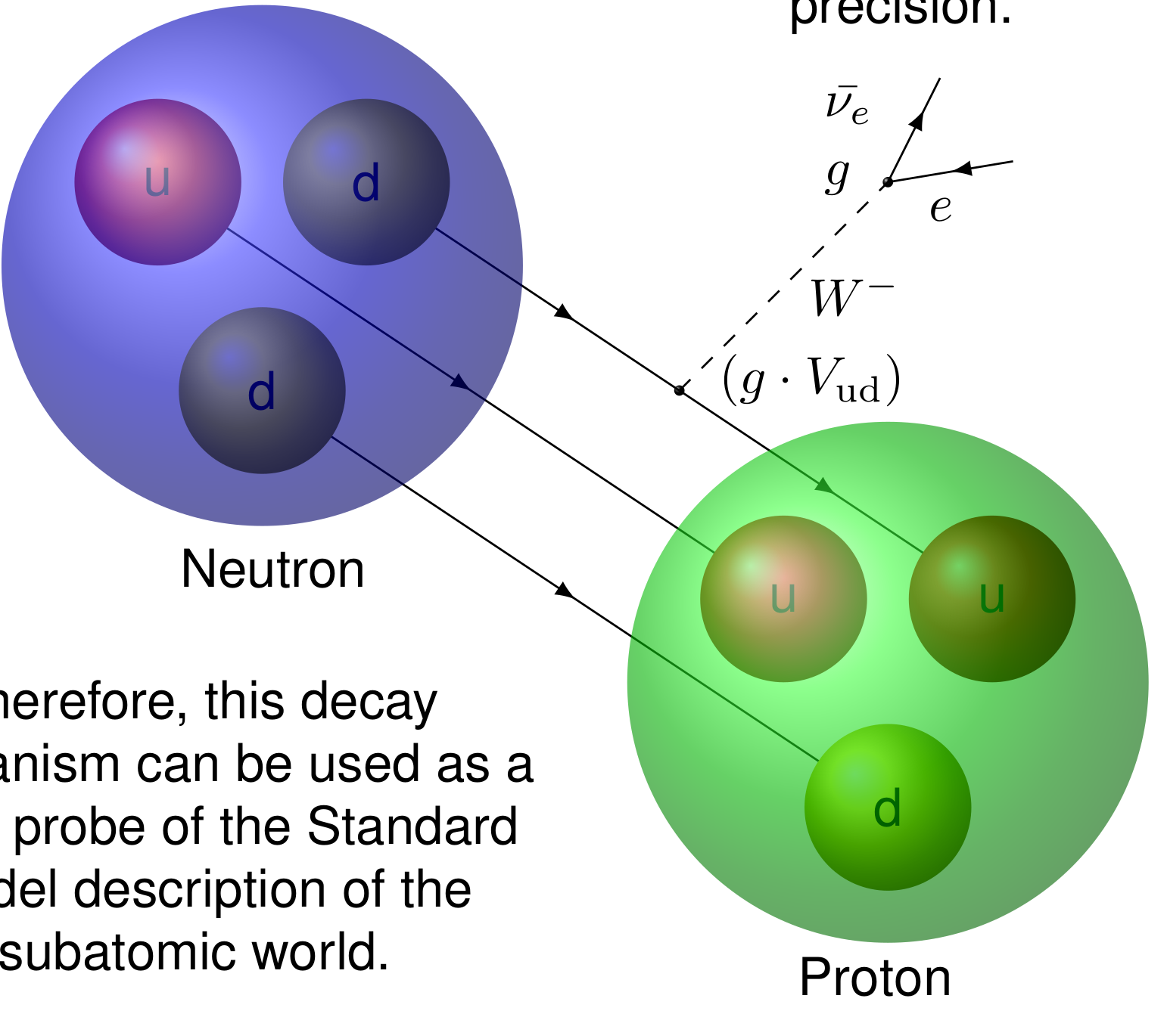
Creating New Physics in the Laboratory with Rare Isotopes
Weak Nuclear Decay is among the MOST sensitive BSM physics probes:
Pure energy-to-matter conversion: spontaneous matter creation
Complex, but understood systems (nuclear and atomic)…in most cases
More than 3500 different systems for case selection
Exceptional experimental control possible (precision atomic methods, etc.)
χ
P. Walker, New Scientist Magazine (2011)
K.G. Leach – BSM Neutrino Physics via Weak Nuclear Decay
2022 CAP Congress – Hamilton, ON
June 8, 2022

Slide 6
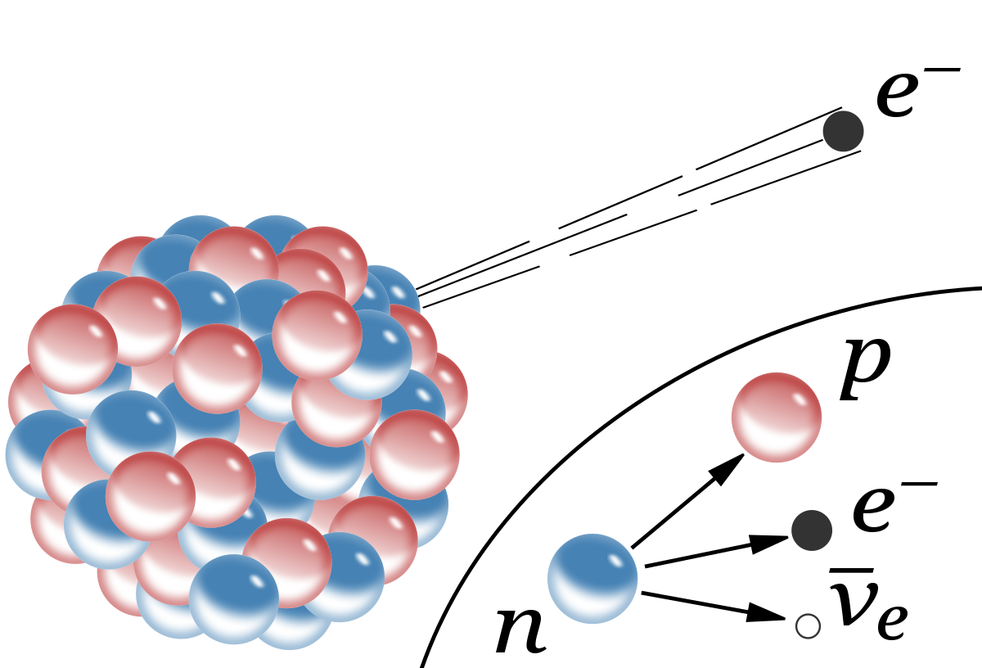
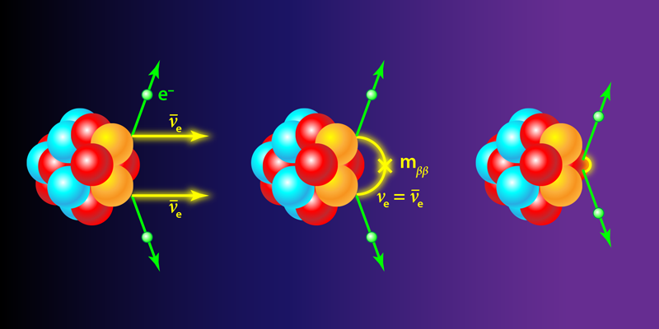
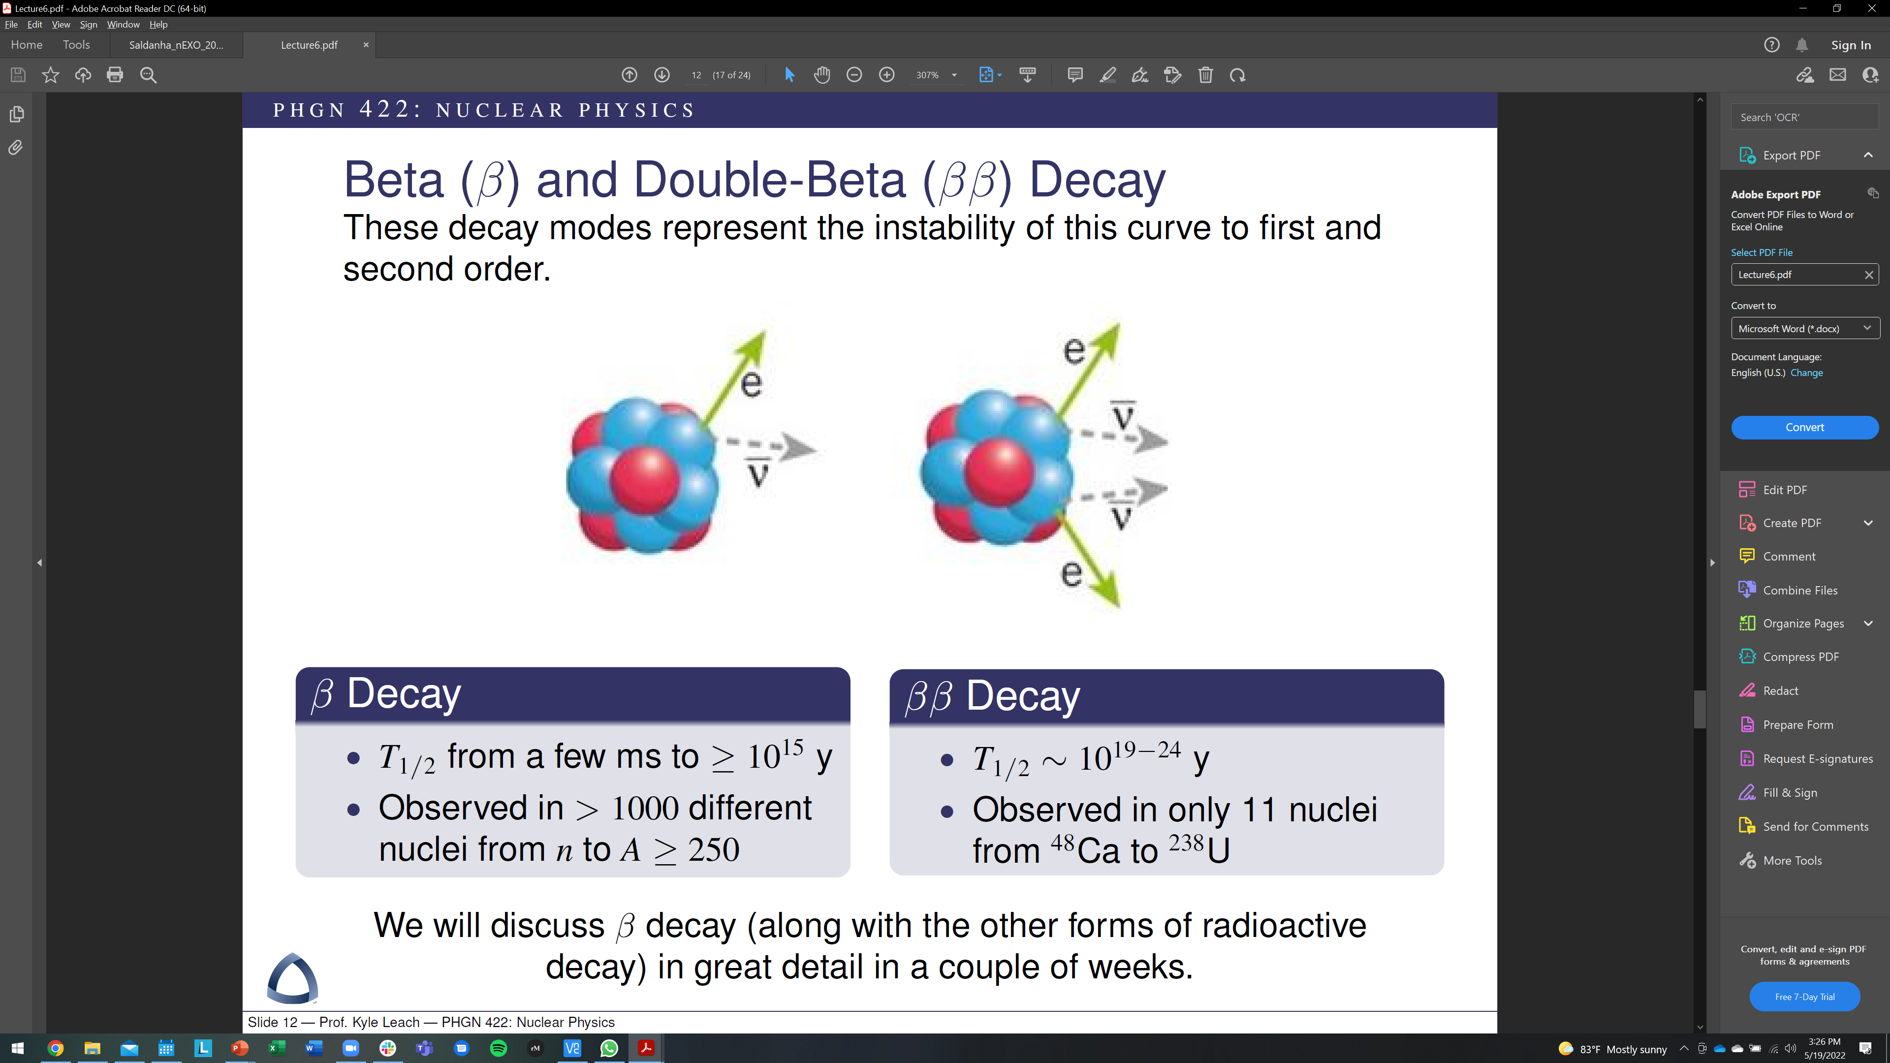
Need: Model Independent and Definitive Experiments
β/EC decay
ββ decay
Energy and momentum conservation
Model independent search for ANY new physics that couples to the neutrino mass
Direct observation of “neutrinoless” mode
Any observation of 0νββ is a smoking gun signature of BSM physics (ie. Majorana)
K.G. Leach – BSM Neutrino Physics via Weak Nuclear Decay
2022 CAP Congress – Hamilton, ON
June 8, 2022

Slide 7
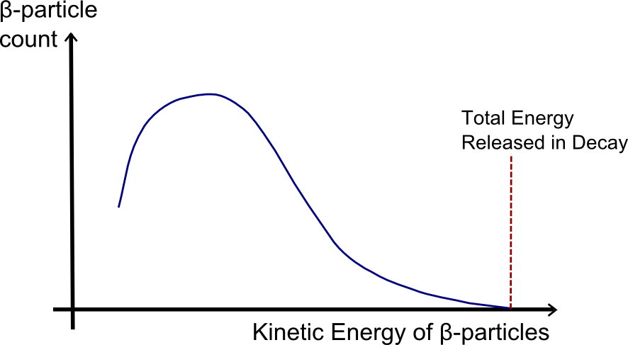
The Model Independent Nature of Beta Decay
Electron Energy Spectrum from 3-Body Decay (β^{+/-})
β⁻ Decay
Decay momentum reconstruction is a simple, model-independent approach to neutrino mass (heavy and light)
If any new physics couples to the neutrino mass, energies of the other particles in the decay will be altered and can be observed
Daughter
R. Davis, Phys. Rev. 86, 976 (1952)
R. Shrock, Phys. Lett. B 96, 159 (1980)
G. Finocchiaro and R.E. Shrock, Phys. Rev. D 46, R888(R) (1992)
M.M. Hindi et al., Phys. Rev. C 58, 2512 (1998)
Parent
Neutrino Counts
Electron Kinetic Energy
EC Decay
Recoil Energy Spectrum from 2-Body Decay (EC)
Daughter
β decay provides a sensitive, model independent probe of any new physics in the neutrino sector that couples to their mass states
Parent
Recoil Kinetic Energy
K.G. Leach – BSM Neutrino Physics via Weak Nuclear Decay
2022 CAP Congress – Hamilton, ON
June 8, 2022

Slide 8
Absolute Neutrino Mass Scale via β Endpoint Measurements
K.G. Leach – BSM Neutrino Physics via Weak Nuclear Decay
2022 CAP Congress – Hamilton, ON
June 8, 2022

Slide 9

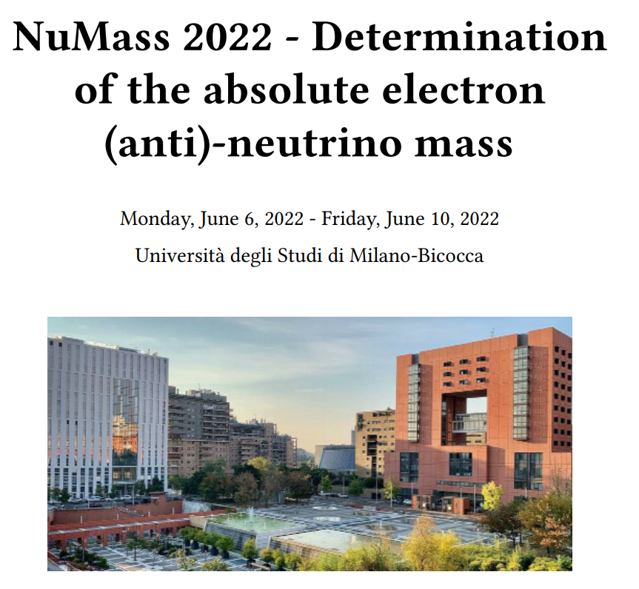
Neutrinos are a Hot Topic!
K.G. Leach – BSM Neutrino Physics via Weak Nuclear Decay
2022 CAP Congress – Hamilton, ON
June 8, 2022

Slide 10
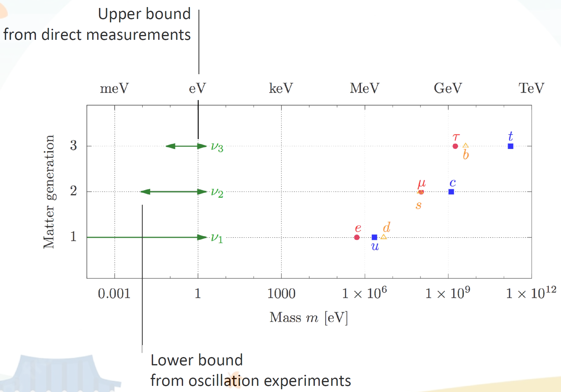
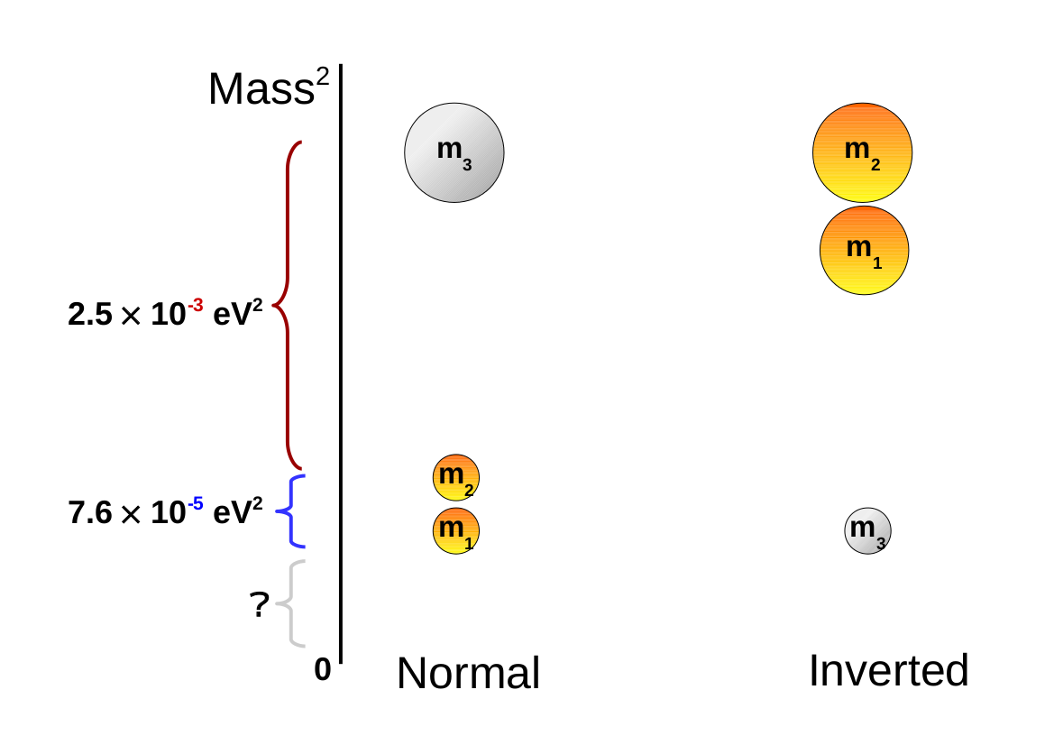
What is the Absolute Scale of the Neutrino Mass?
At least two of the mass states are non-zero
However, the absolute value for the lightest is not known → and thus the scale of the masses is not set
Slide Courtesy Thierry Lasserre
T2K
SNO
K.G. Leach – BSM Neutrino Physics via Weak Nuclear Decay
2022 CAP Congress – Hamilton, ON
June 8, 2022

Slide 11
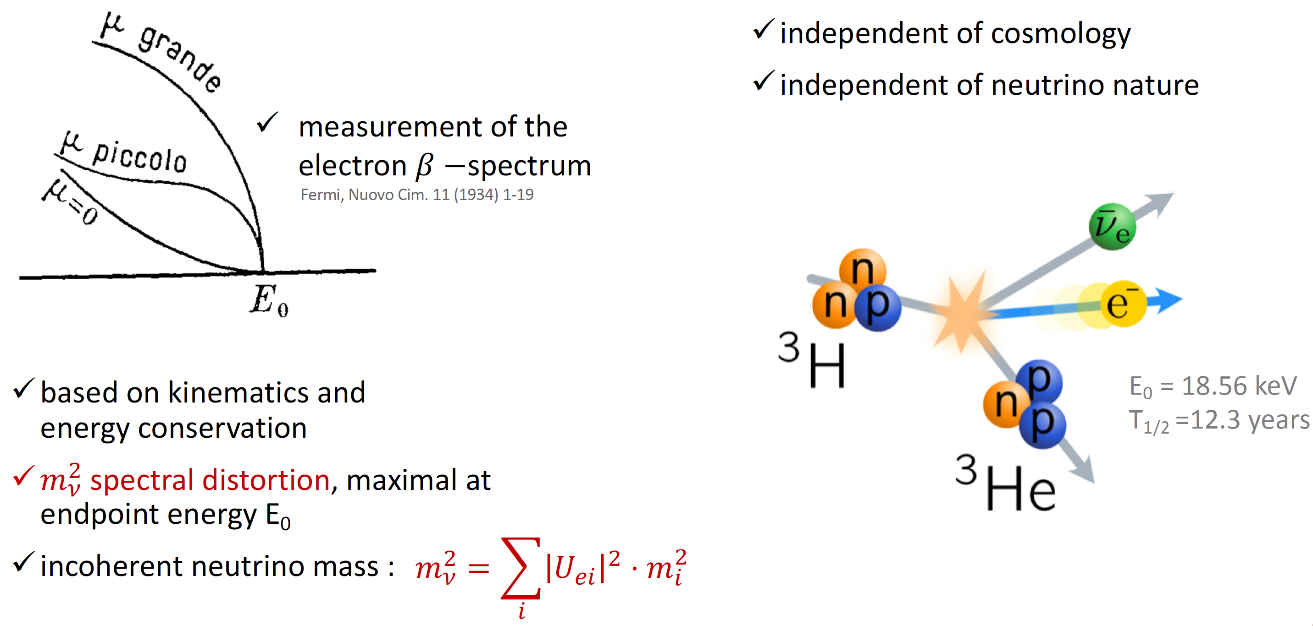
Beta Spectrum Endpoint Measurements
Slide Courtesy Thierry Lasserre
K.G. Leach – BSM Neutrino Physics via Weak Nuclear Decay
2022 CAP Congress – Hamilton, ON
June 8, 2022

Slide 12
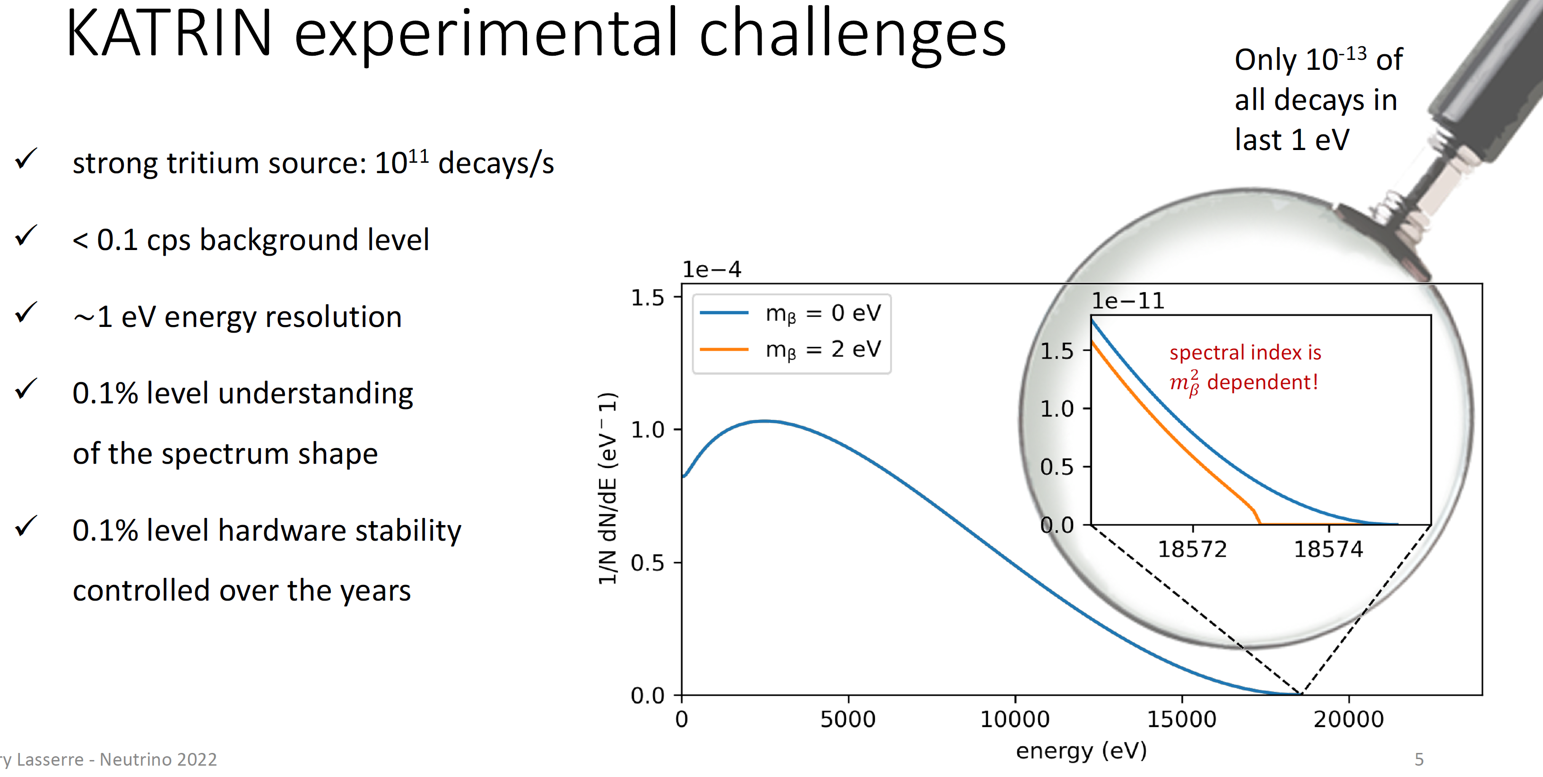
Precision Tritium Endpoint Measurement: KATRIN and Project-8
Slide Courtesy Thierry Lasserre
K.G. Leach – BSM Neutrino Physics via Weak Nuclear Decay
2022 CAP Congress – Hamilton, ON
June 8, 2022

Slide 13

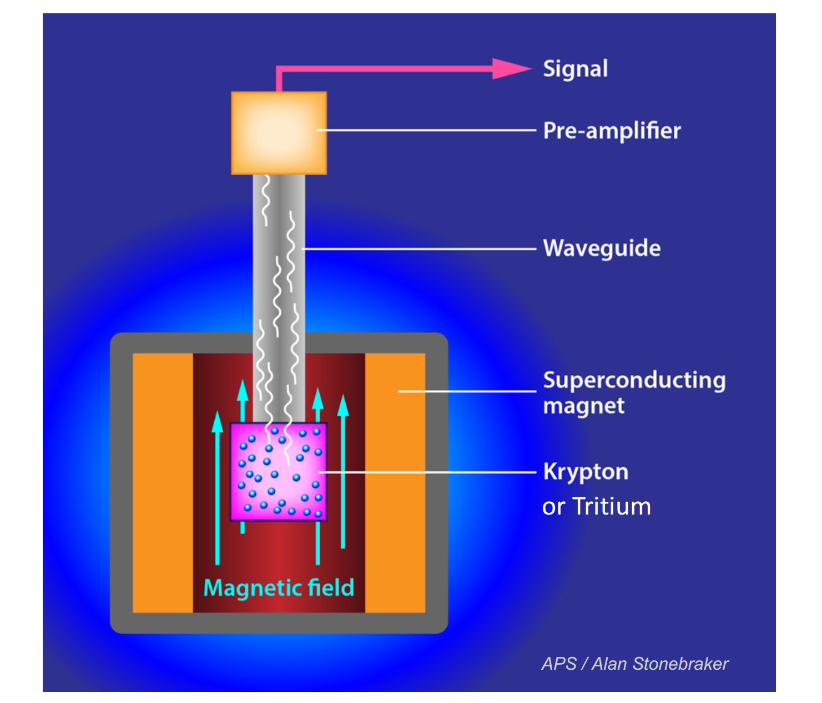

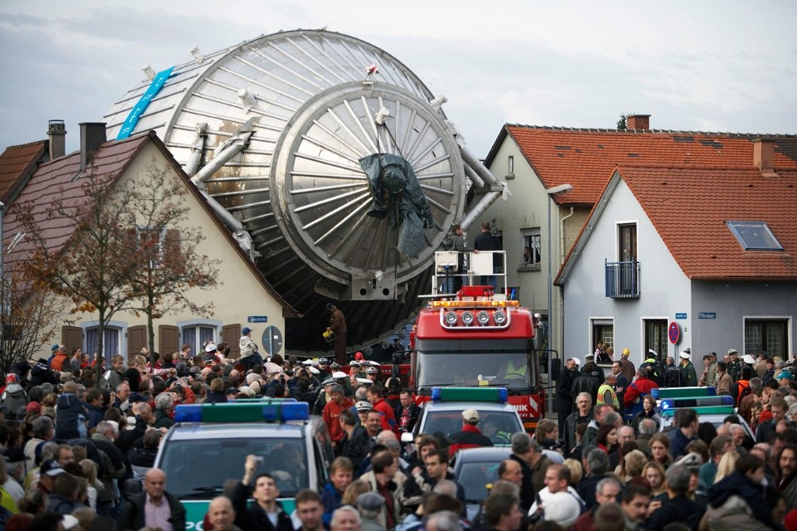
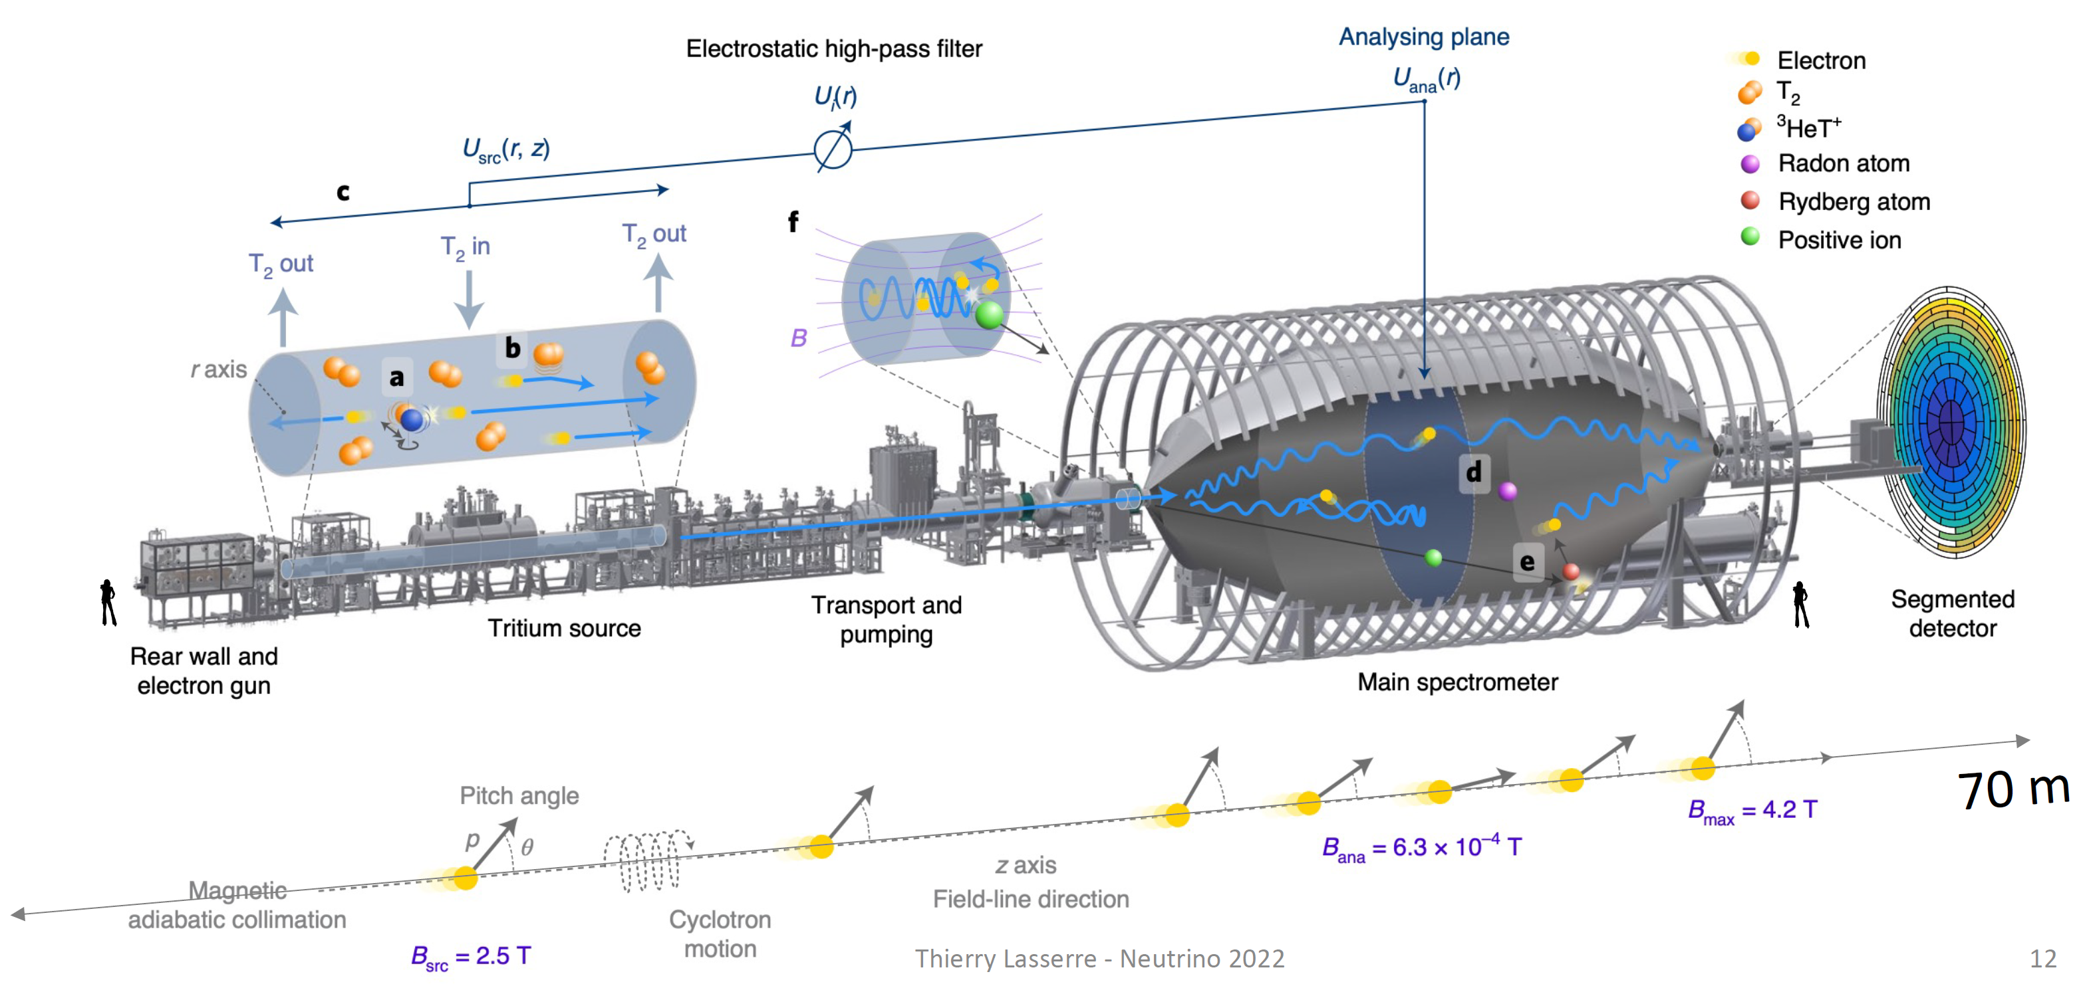
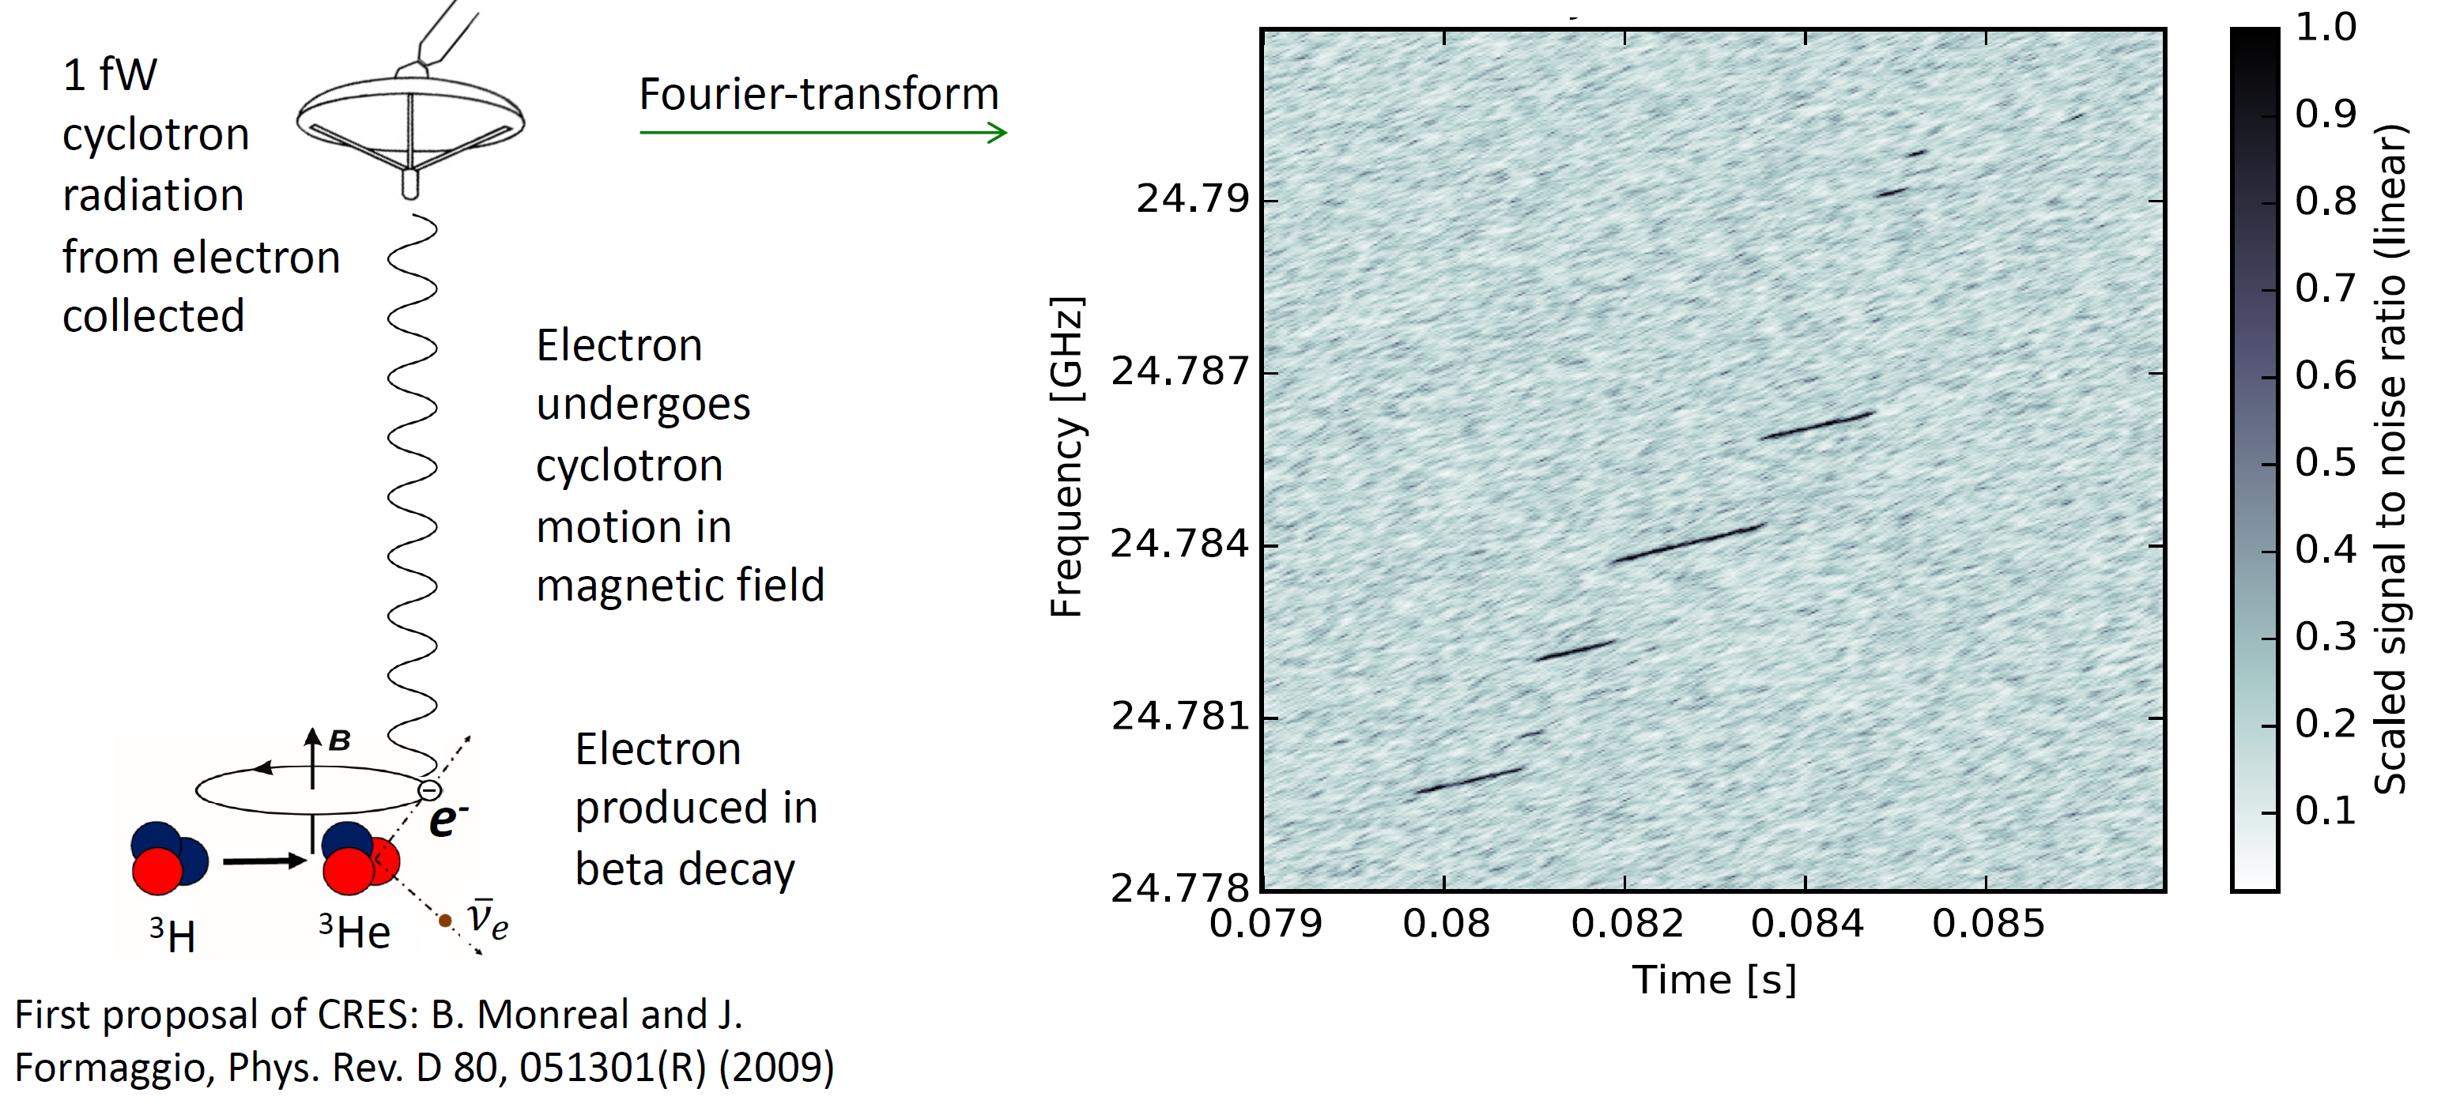
Precision Tritium Endpoint Experiments
Slide Courtesy Thierry Lasserre and Elise Novitski
K.G. Leach – BSM Neutrino Physics via Weak Nuclear Decay
2022 CAP Congress – Hamilton, ON
June 8, 2022

Slide 14
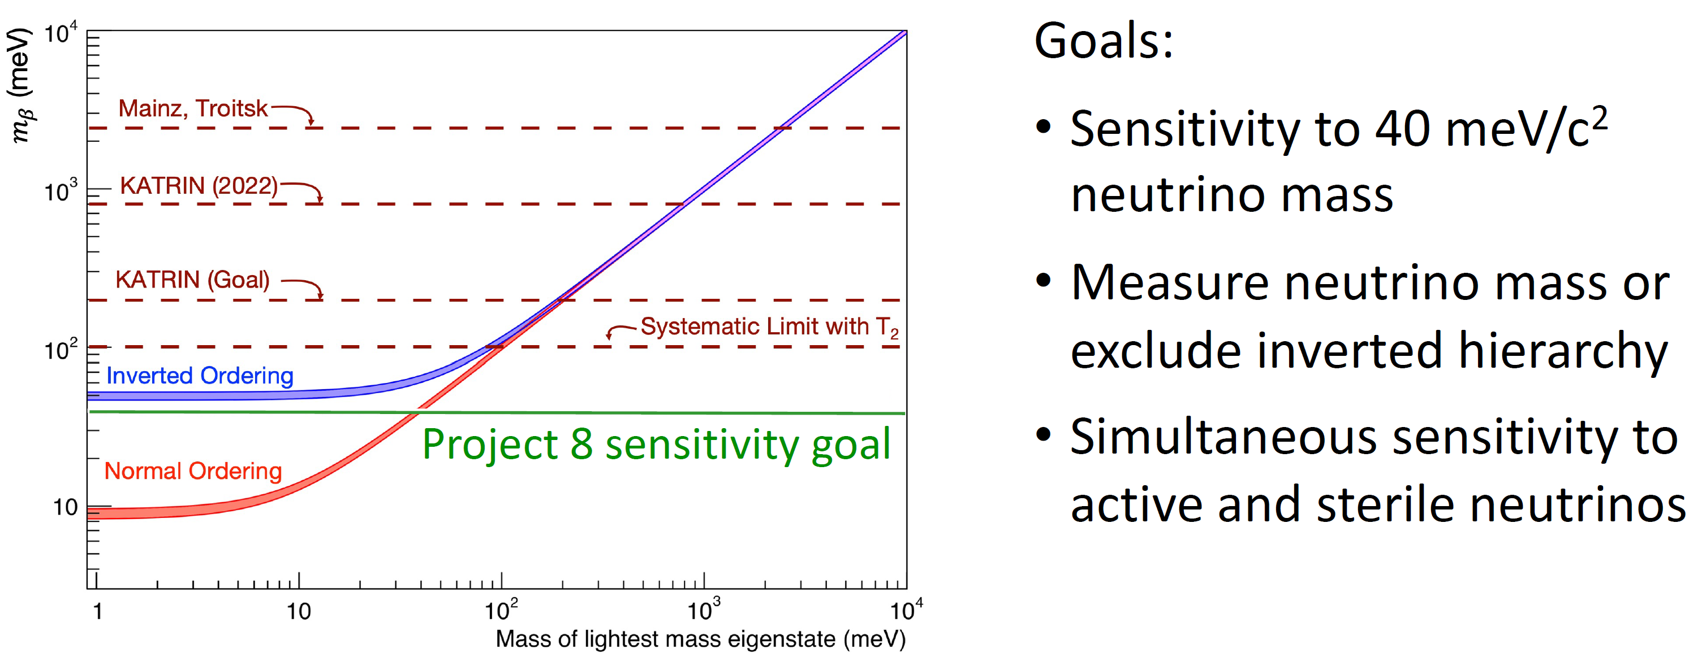
Where do we stand on Neutrino Masses from Tritium Decay?
m_{νe}< 0.8 eV
Slide Courtesy Elise Novitzki
K.G. Leach – BSM Neutrino Physics via Weak Nuclear Decay
2022 CAP Congress – Hamilton, ON
June 8, 2022

Slide 15
Search for Heavy (Mostly Sterile) Neutrino Mass States
K.G. Leach – BSM Neutrino Physics via Weak Nuclear Decay
2022 CAP Congress – Hamilton, ON
June 8, 2022

Slide 16
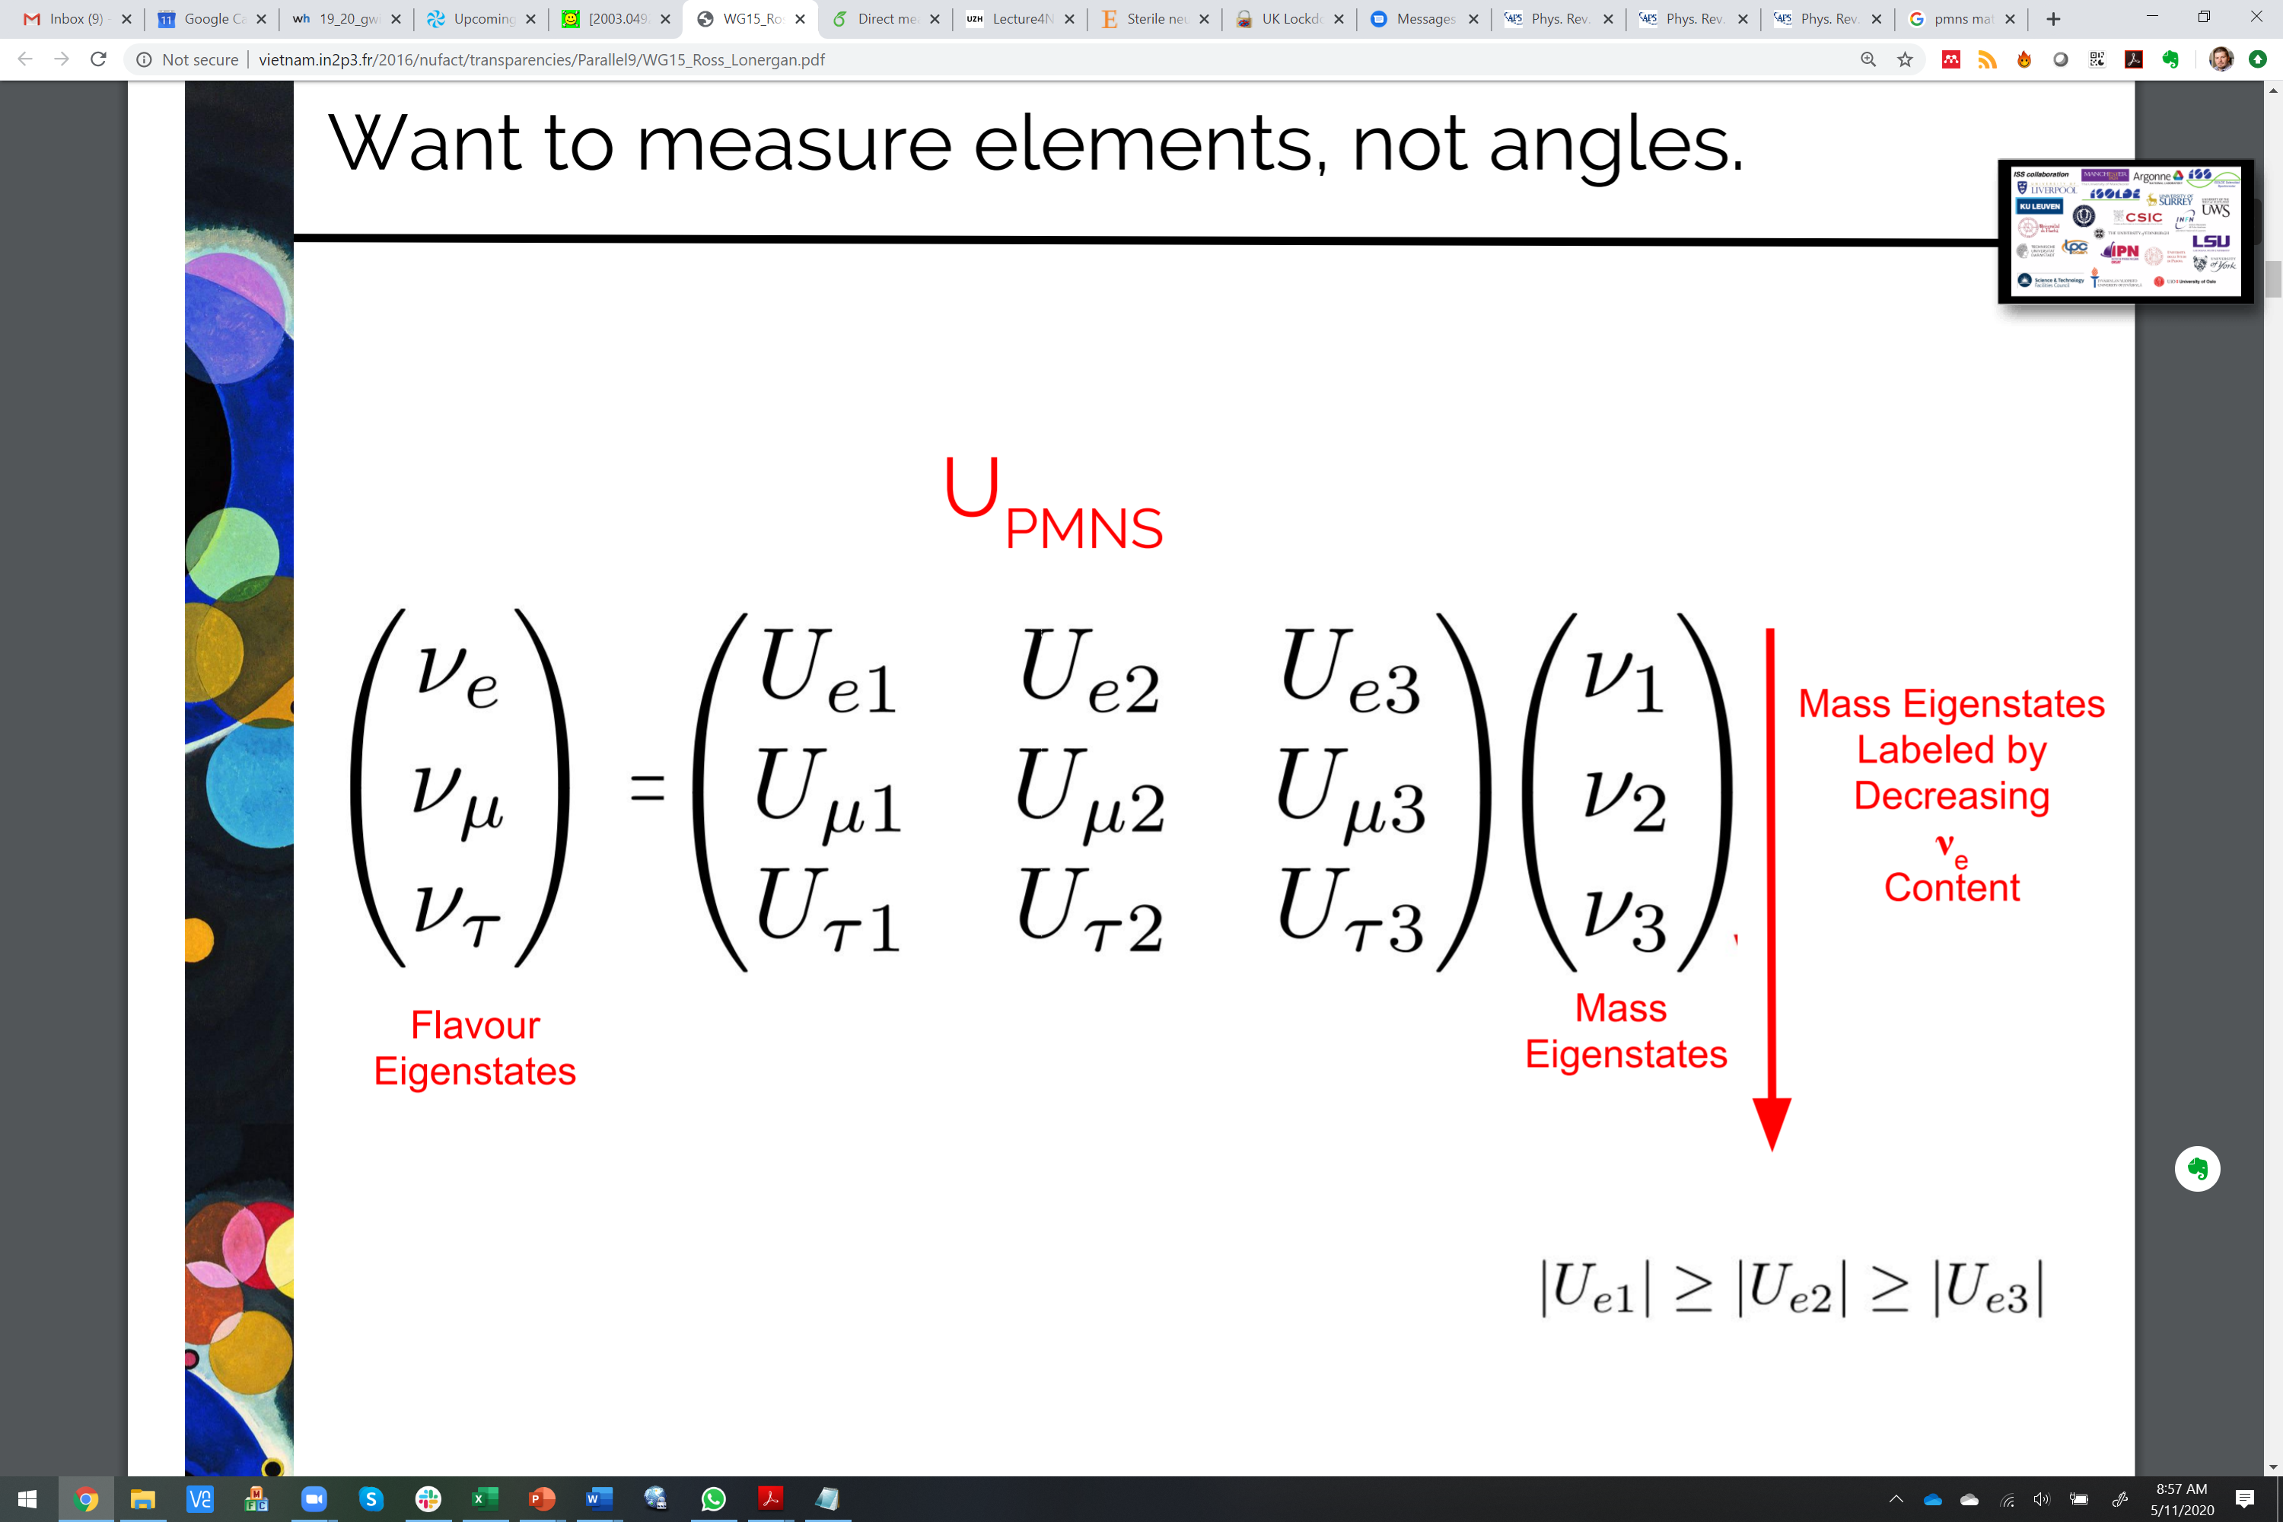
Heavy Neutrino Mass Studies via Coupling to ν_{e}
In EC/β⁺ and β⁻ decay, we study the relative coupling of the mass states to ν_{e} (ν_{e})
Momentum is conserved with the mass states, not flavor states
β⁺/β⁻ decay (3-body)
Endpoint from light (mostly active) neutrino mass states
1
Endpoint from (mostly sterile) neutrino mass state(s)
Counts
β⁻ decay
2
Electron Kinetic Energy
EC decay (2-body)
3
Recoil from heavy (mostly sterile) neutrino mass state(s)
Recoil from light (mostly active) neutrino mass states
Counts
β⁺/EC decay
heavy
Recoil Kinetic Energy
K.G. Leach – BSM Neutrino Physics via Weak Nuclear Decay
2022 CAP Congress – Hamilton, ON
June 8, 2022

Slide 17
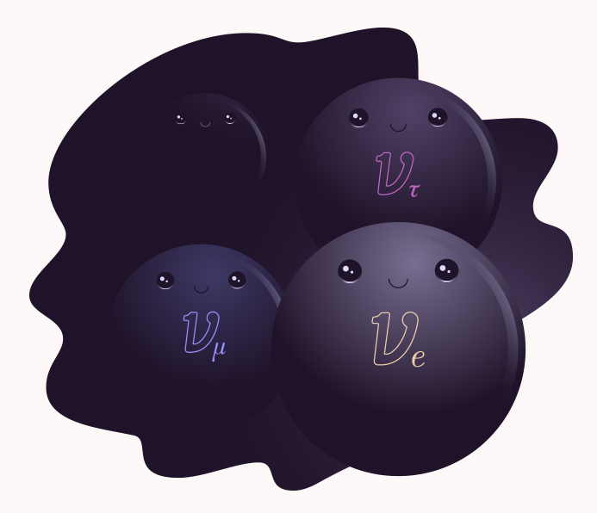
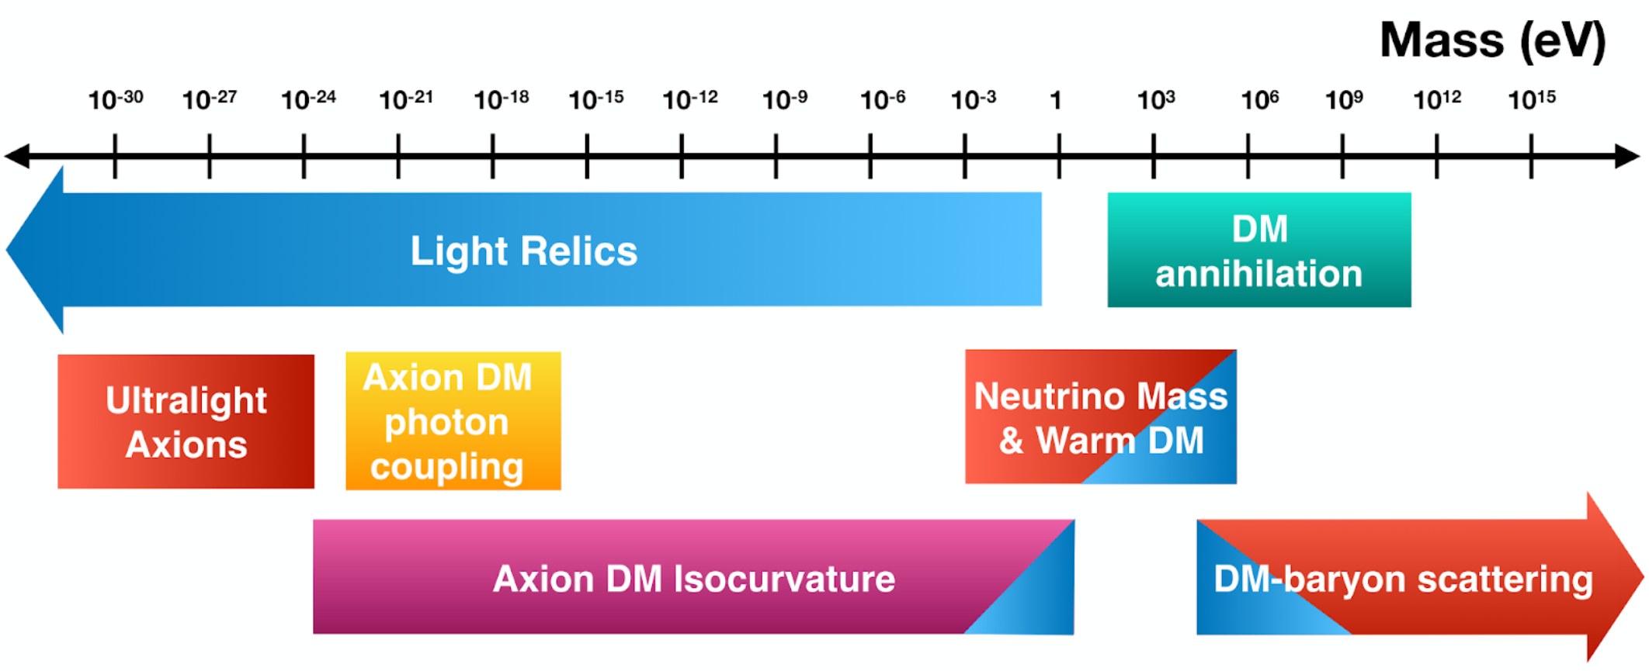
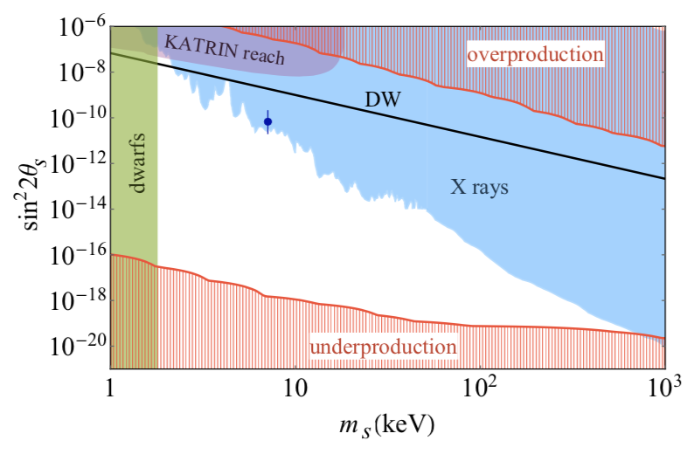
keV Neutrinos as Dark Matter
To generate mostly sterile mass states on the keV-MeV scale, additional new physics is required
…however, mass states in this region have τ≈τ_{universe} and could thus serve as some fraction of the observed DM in our universe
  Excellent candidates for warm dark matter
Dodelson and Widrow, PRL 72, 17 (1994)
Image Courtesy: Symmetry Magazine
Image courtesy: CMB-S4
B. Dasgupta and J. Kopp, Phys. Rep. 928, 1-63 (2021)
K.G. Leach – BSM Neutrino Physics via Weak Nuclear Decay
2022 CAP Congress – Hamilton, ON
June 8, 2022

Slide 18
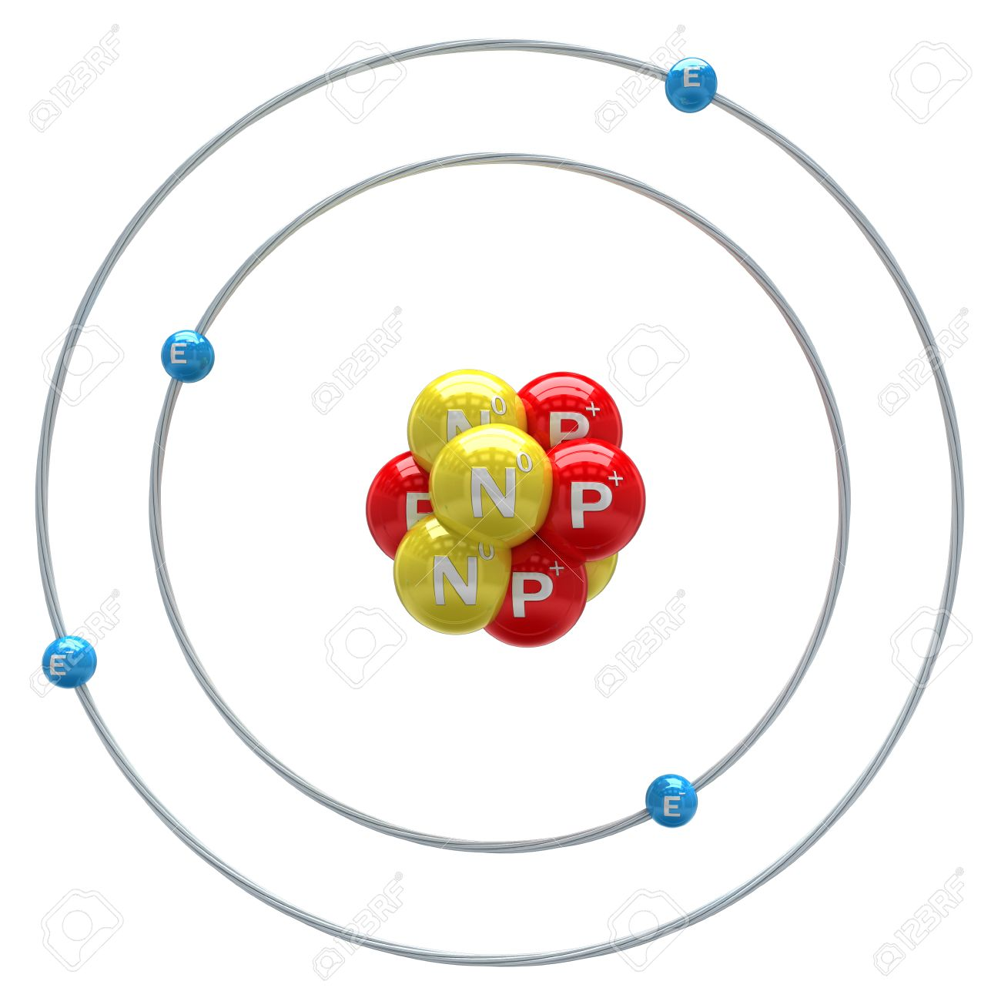
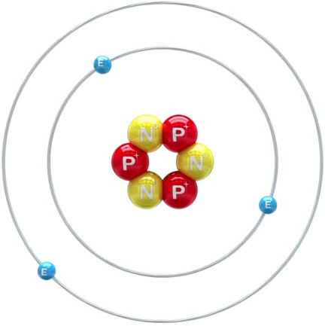
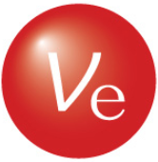
Neutrino Studies with the Electron Capture Decay of ⁷Be
⁷Be is the ideal case to search for heavy mass states (mostly sterile) using EC decay.
  Simple atomic and nuclear structure and largest Q-value (862 keV) of all pure EC cases
      Highest maximum recoil energy
E_{R} ~ 57 eV
Mass States
⁷Be (Z=4)
parent
⁷Li (Z=3)
daughter
⁷Li
1
E_{ν} ~ 862 keV
2
⁷Be
Recoil from heavy (mostly sterile) neutrino mass state(s)
Recoil from light (mostly active) neutrino mass states
3
Counts
The Challenge: Measure ⁷Li recoils at ~50 eV with a resolution of ~1 eV or better
??
Daughter Atom Recoil Kinetic Energy
K.G. Leach – BSM Neutrino Physics via Weak Nuclear Decay
2022 CAP Congress – Hamilton, ON
June 8, 2022

Slide 19
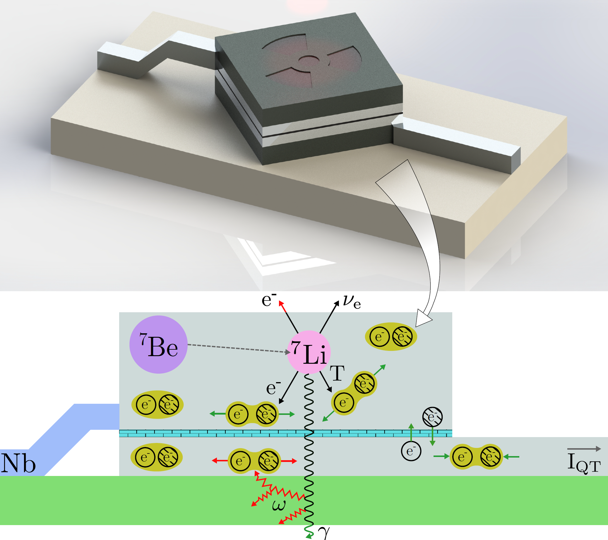
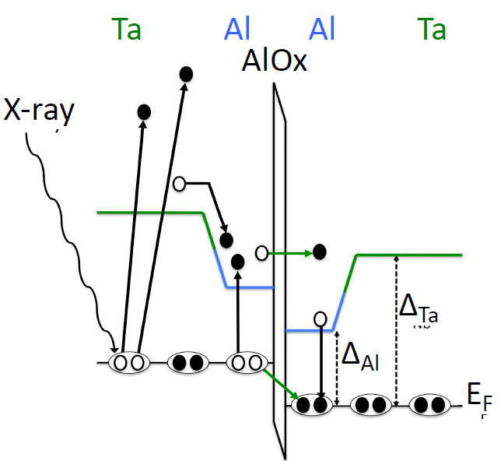
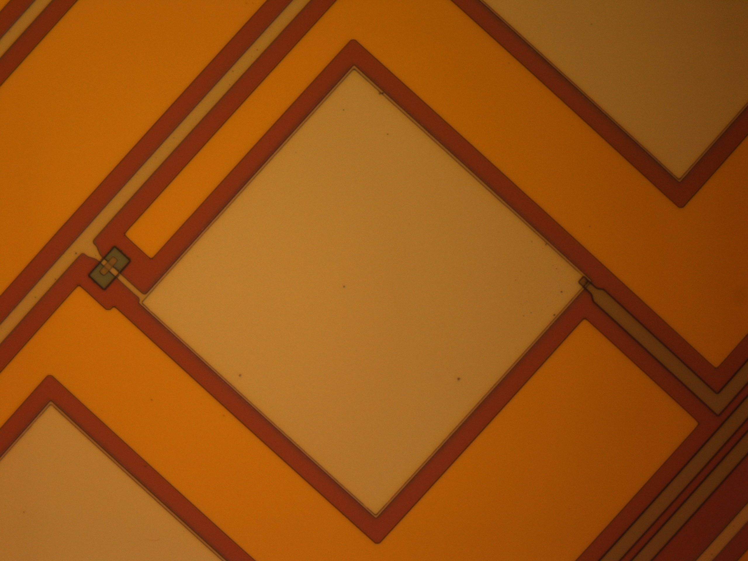
Superconducting Tunnel Junction (STJ) Quantum Sensing
Cryogenic-charge superconducting sensor
Superconducting energy gap Δ is of order ~meV
→ High Energy Resolution (~1 eV)
Timing resolution on the order of 10 μs, allowing for faster count rates than most superconducting sensors
→ “High” Rate (10⁴ s⁻¹ per pixel)
Allows us to probe weak couplings
~60% quasiparticles
~40% phonons
~200 nm
50 μm
K.G. Leach – BSM Neutrino Physics via Weak Nuclear Decay
2022 CAP Congress – Hamilton, ON
June 8, 2022

Slide 20


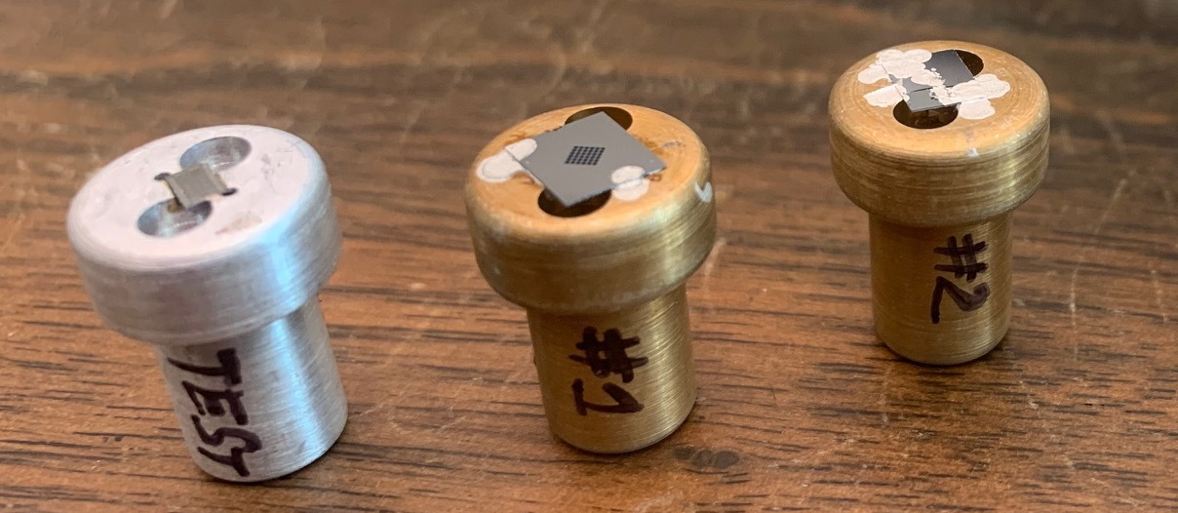
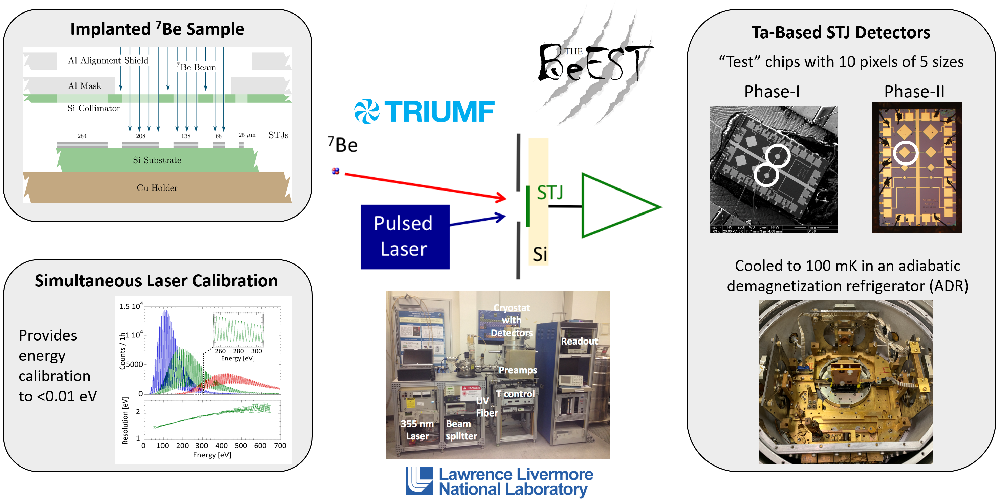

The BeEST Experiment
Rare-isotope implantation at TRIUMF-ISAC
Ta, Al, and Nb-based STJ Sensors
K.G. Leach and S. Friedrich, arXiv:2112.02029 (2021)
S. Friedrich et al., Phys. Rev. Lett. 126, 021803 (2021)
S. Fretwell et al., Phys. Rev. Lett. 125, 032701 (2020)
50 μm
K.G. Leach – BSM Neutrino Physics via Weak Nuclear Decay
2022 CAP Congress – Hamilton, ON
June 8, 2022

Slide 21
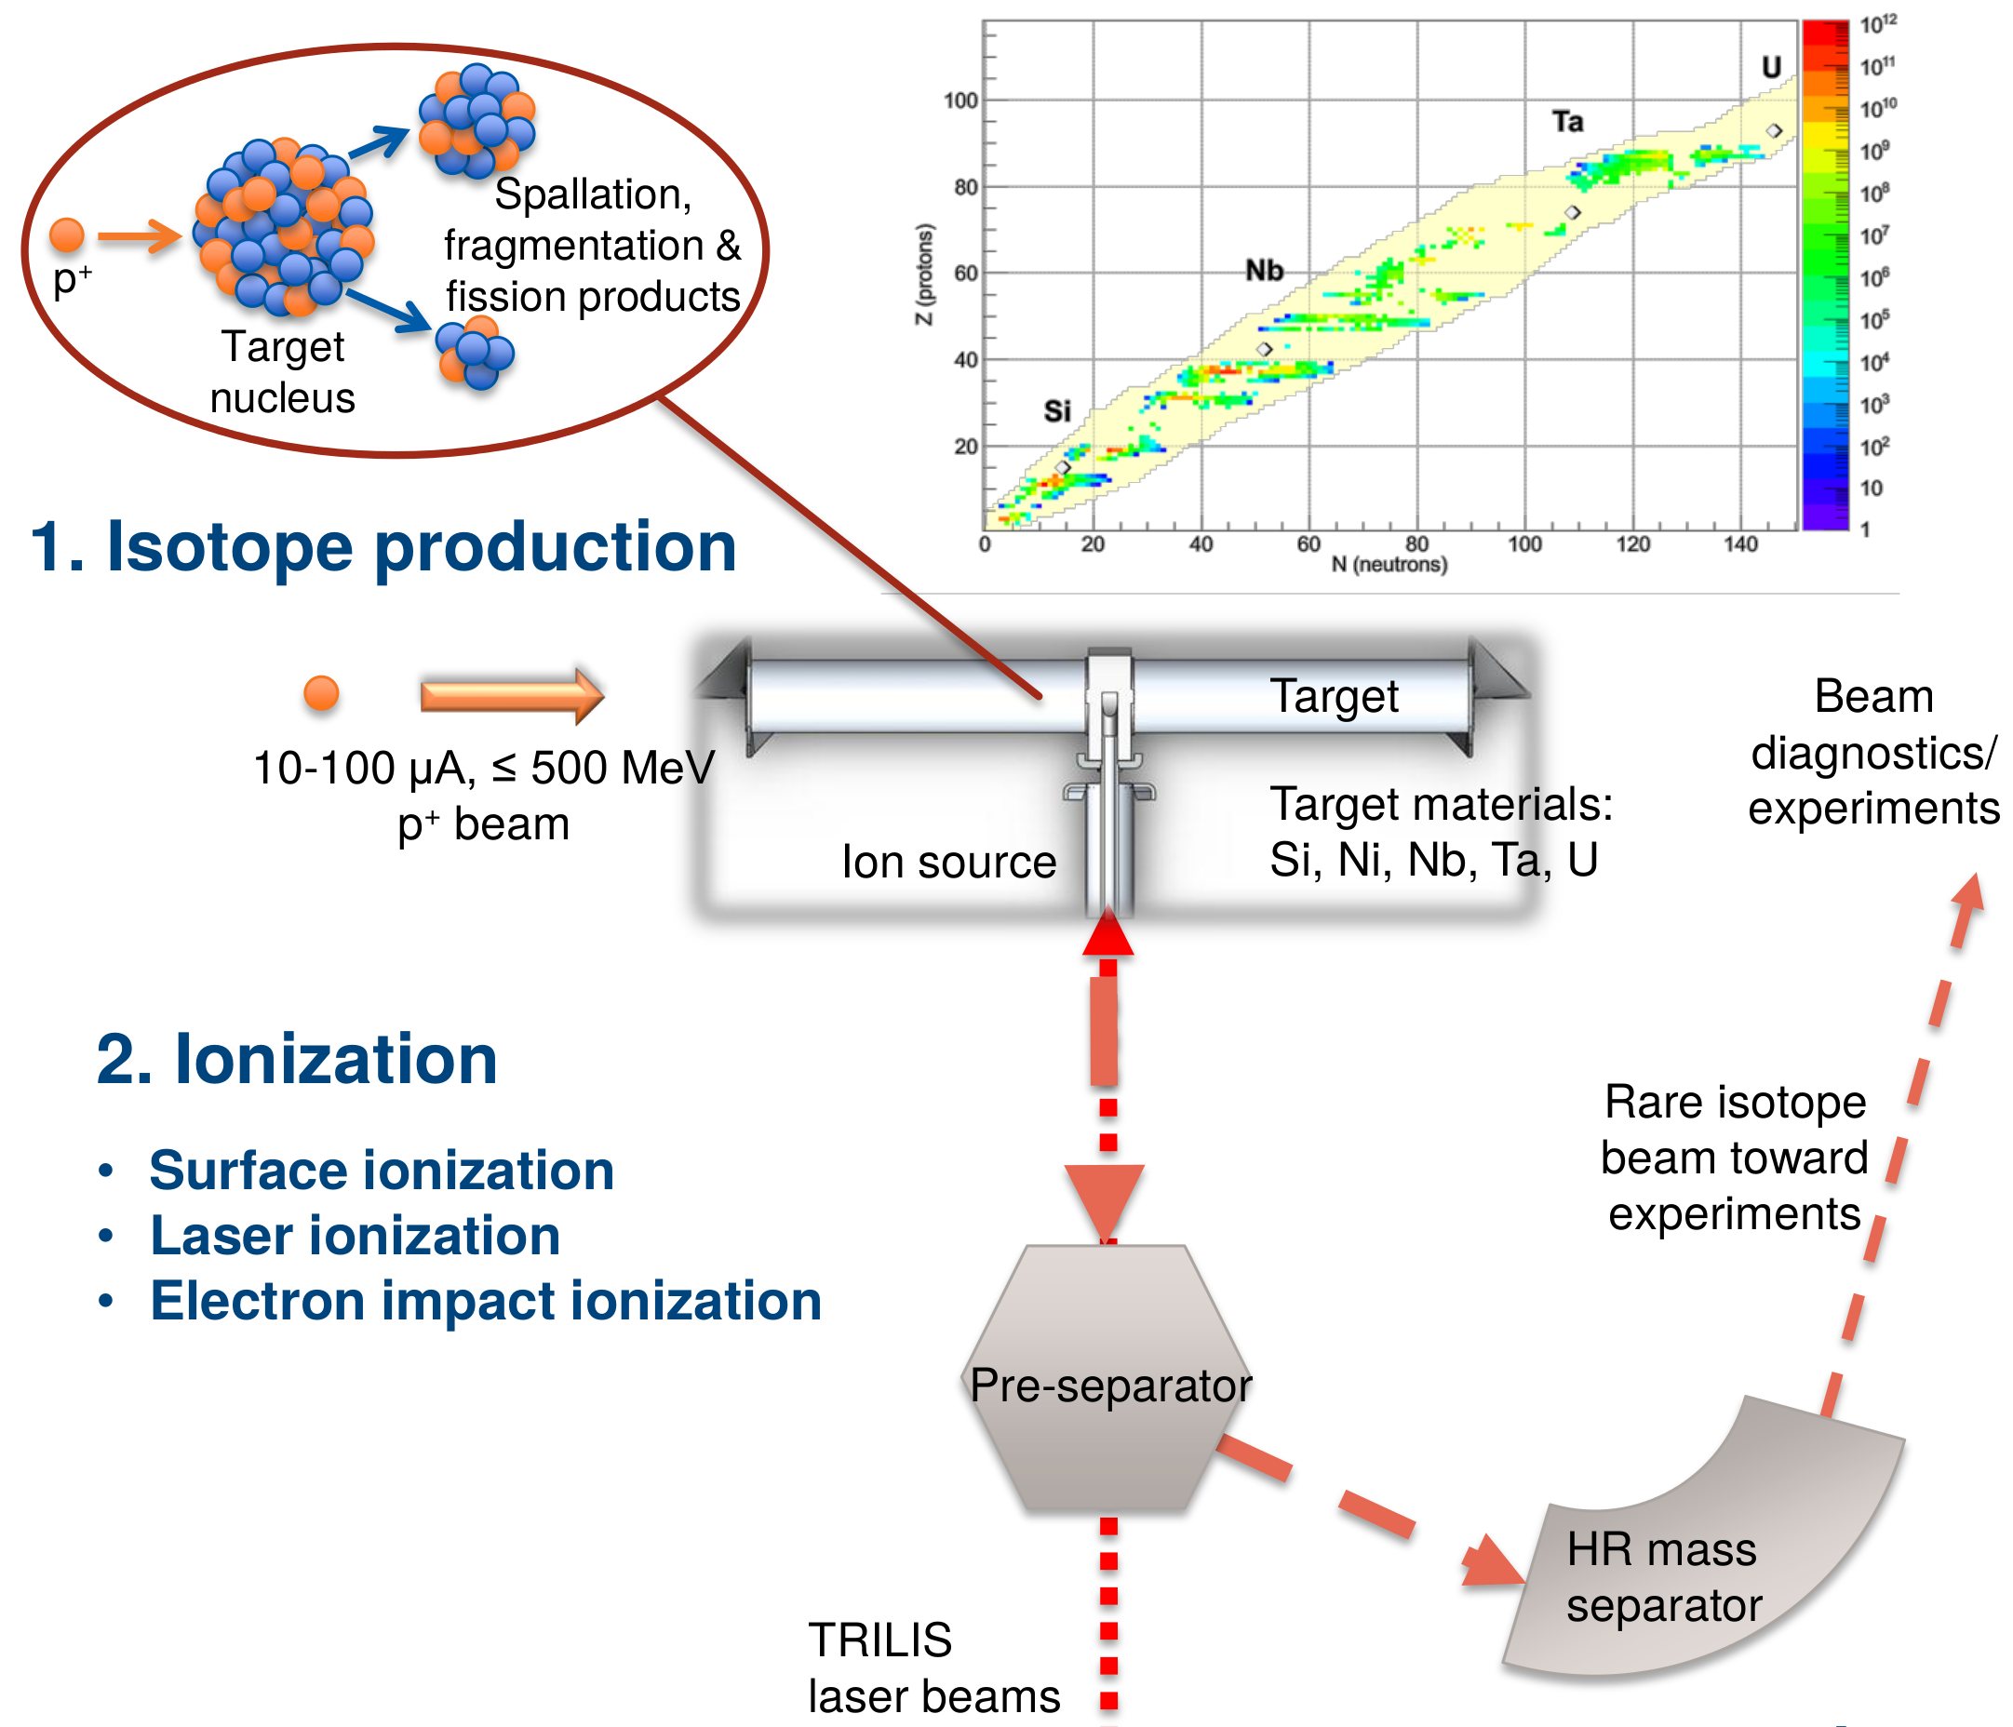
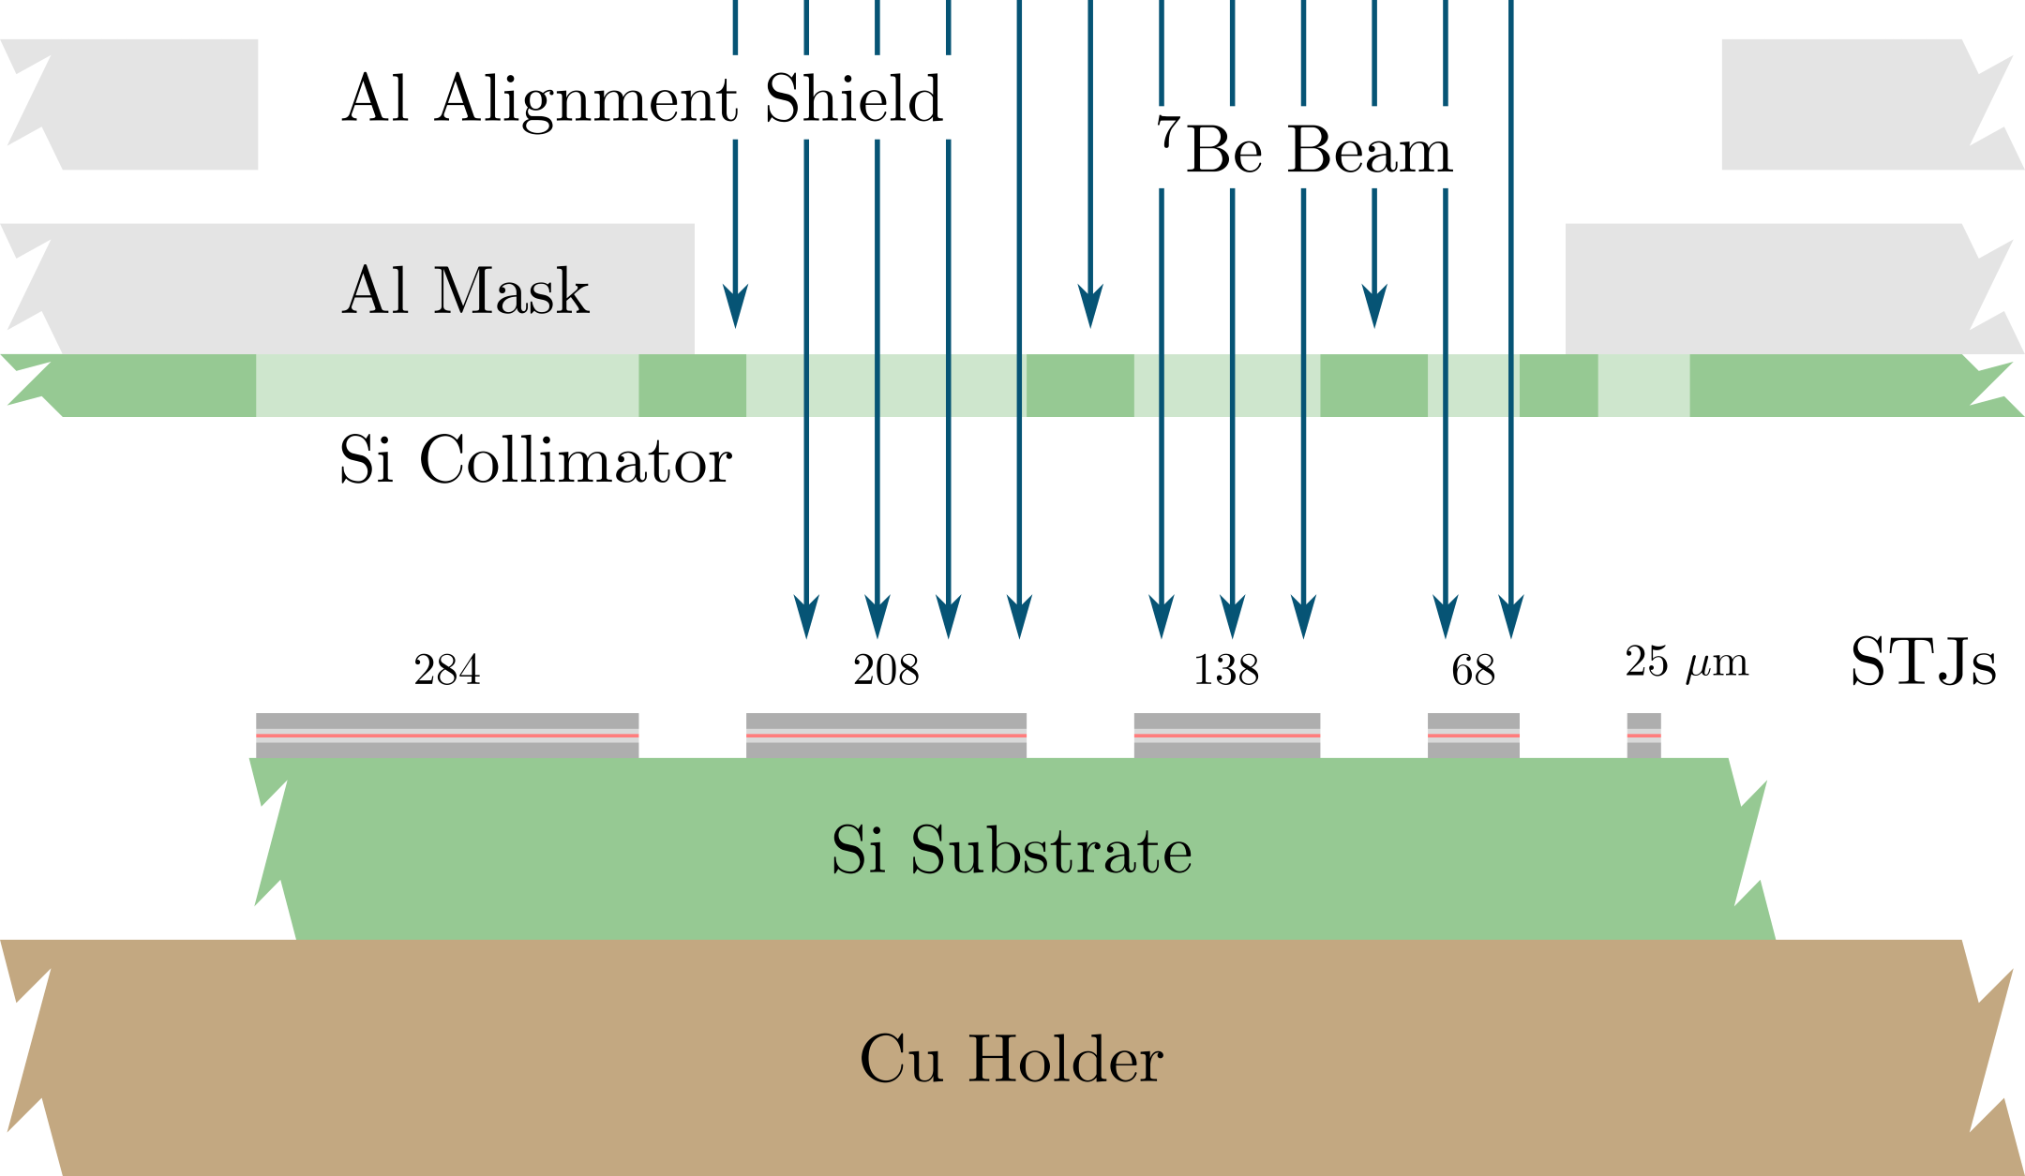
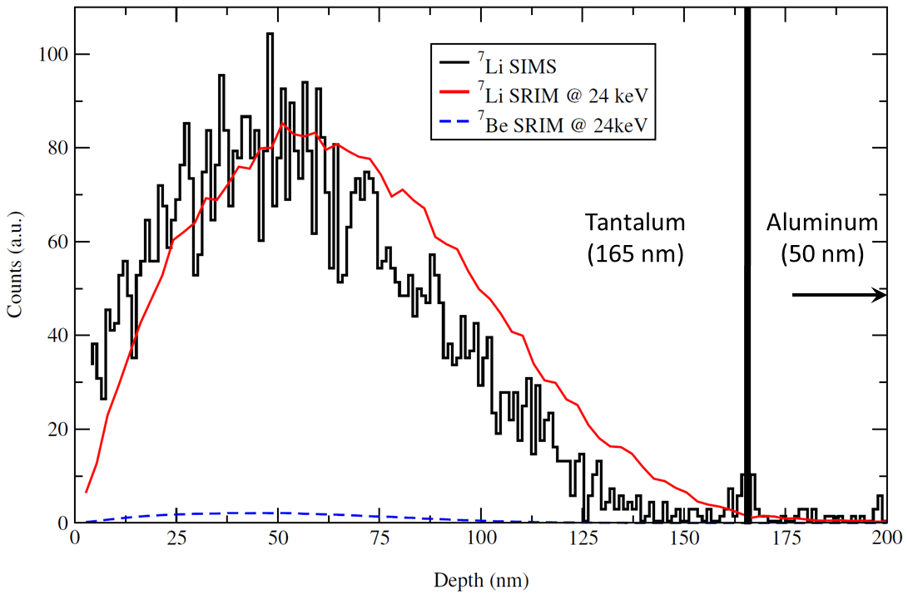
Producing the ⁷Be Sample via the ISOL Technique
Implant atoms “deep” into the top STJ layer to avoid unknown loss and surface effects
Slide Courtesy: J. Lassen
K.G. Leach – BSM Neutrino Physics via Weak Nuclear Decay
2022 CAP Congress – Hamilton, ON
June 8, 2022

Slide 22
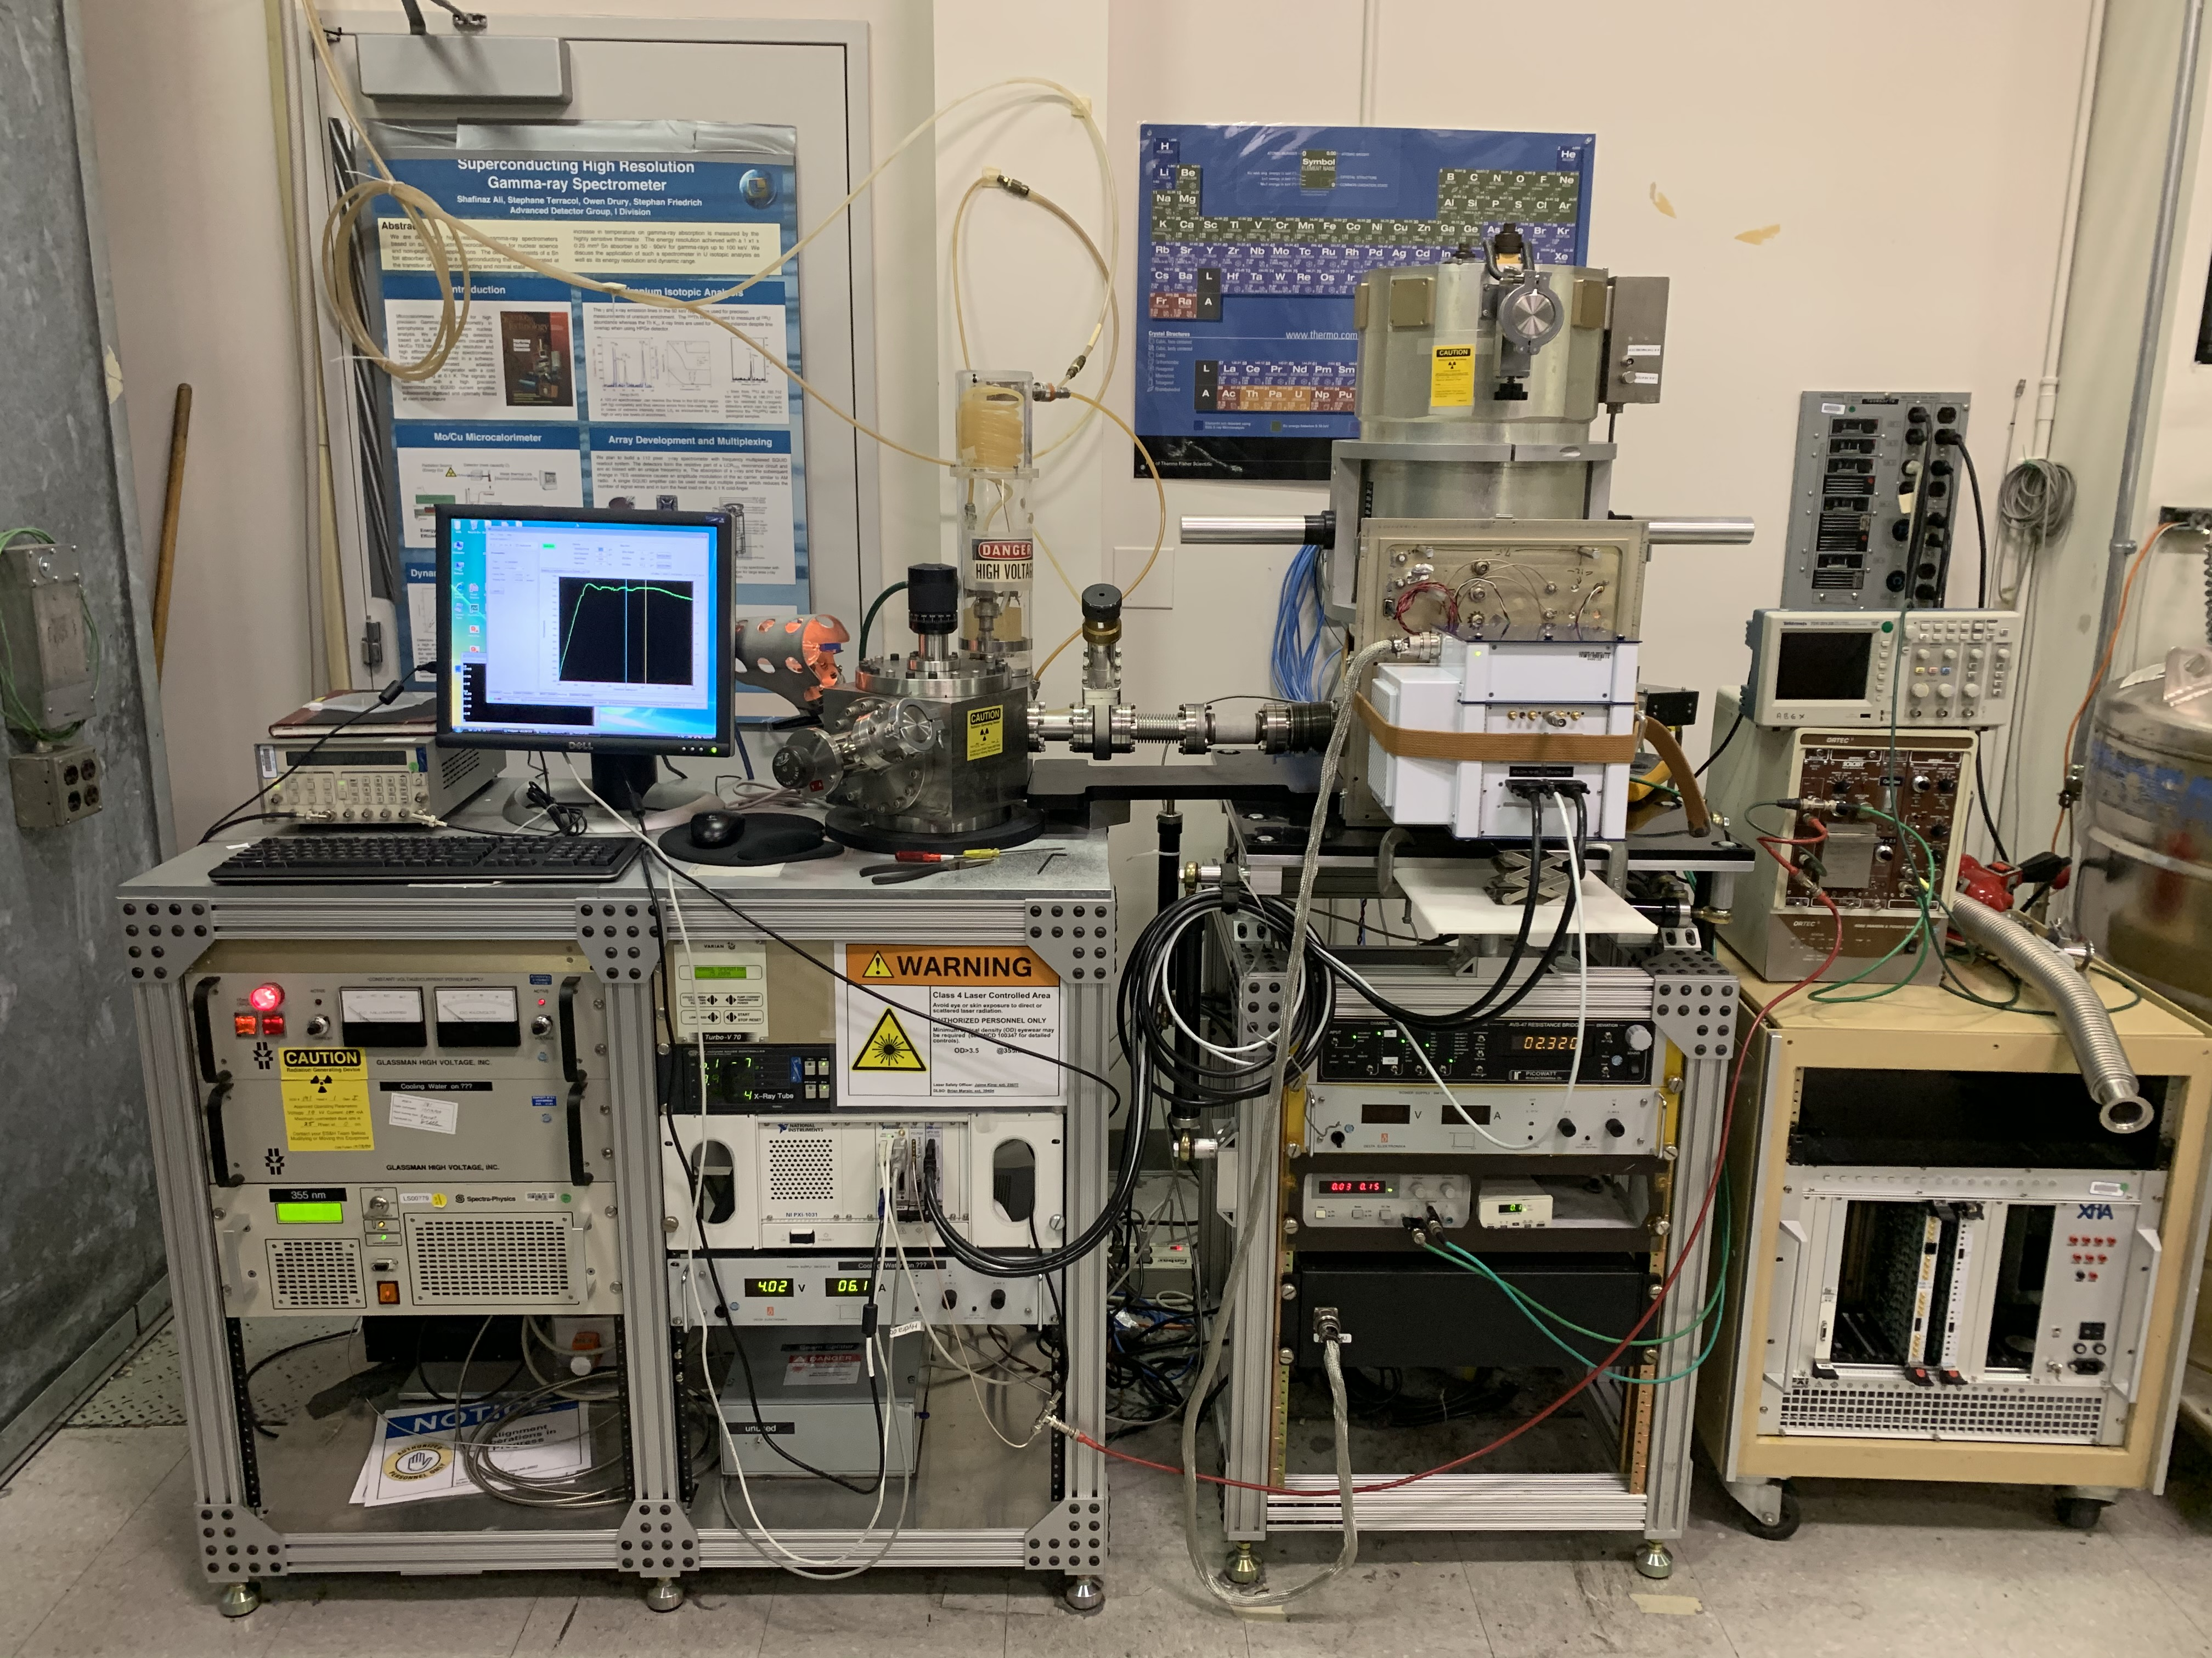

The BeEST Experiment
Rare-isotope implantation at TRIUMF-ISAC
Ta, Al, and Nb-based STJ Sensors
K.G. Leach and S. Friedrich, arXiv:2112.02029 (2021)
S. Friedrich et al., Phys. Rev. Lett. 126, 021803 (2021)
S. Fretwell et al., Phys. Rev. Lett. 125, 032701 (2020)
50 μm
High-precision In-situ calibration and characterization
Cooling (<0.1 K) and measurement in ADR at LLNL
S. Friedrich et al., J. Low Temp. Phys. 200, 200 (2020)
K.G. Leach – BSM Neutrino Physics via Weak Nuclear Decay
2022 CAP Congress – Hamilton, ON
June 8, 2022

Slide 23
STJ Performance and Characterization
Adiabatic Demagnetization Refrigerator
(ADR) – Base Temp ~70 mK
1 hour of data
Pulsed 355 nm (3.49965(15) eV) laser at 5 kHz fed through optical fiber to 0.1 K stage
Illumination of STJ provides a comb of peaks at integer multiples of 3.5 eV
Intrinsic resolution of our Ta-based devices is between ~1.5 and ~2.5 eV FWHM at ~10 – 200 eV
Stable response and small quadratic non-linearity (10⁻⁴ per eV)
Laser
S. Friedrich et al., J. Low Temp. Phys. 200, 200 (2020)
K.G. Leach – BSM Neutrino Physics via Weak Nuclear Decay
2022 CAP Congress – Hamilton, ON
June 8, 2022

Slide 24






Phases-I and –II: First Nuclear Recoil Experiments with STJs
E_{R} ~ 57 eV
⁷Be (Z=4)
parent
L-shell (2s)
⁷Li (Z=3)
daughter
68 x 68 μm²
K-shell (1s)
E_{ν} ~ 862 keV
S. Fretwell et al., Phys. Rev. Lett. 125, 032701 (2020)
K.G. Leach – BSM Neutrino Physics via Weak Nuclear Decay
2022 CAP Congress – Hamilton, ON
June 8, 2022

Slide 25

Precision Measurements of Effects in the Data
Nuclear recoils down to a few eV
Low-energy atomic effects: Auger, shake-up and –off from 10 – 60 eV
Requirement to model atomic and materials effects
K.G. Leach – BSM Neutrino Physics via Weak Nuclear Decay
2022 CAP Congress – Hamilton, ON
June 8, 2022

Slide 26

Atomistic Calculations of Chemical Shifts in Materials
Putting Be/Li in the sensors hybridizes the atomic orbits
These effects depend strongly on the specific local environment for the EC decaying atom
Detailed atomistic DFT calculations show that variations in the chemical energy shifts away from the vacuum case range from 1-5 eV.
A. Samanta, S. Friedrich, K.G. Leach, and V. Lordi, arXiv:2206.00150 (2022)
K.G. Leach – BSM Neutrino Physics via Weak Nuclear Decay
2022 CAP Congress – Hamilton, ON
June 8, 2022

Slide 27






Searching for Heavy Neutrinos in the BeEST Data
$$ΔE$$
Sterile neutrino will add a similar spectrum with:
1) Shifted recoil energy $ΔE(m_{s})$
2) Reduced amplitude ($A∝{\left|U_{e4}\right|}^{2})$
$$A$$
$$f\left(E\right)={\left[1−A\left(U_{e4}\right)\right] f}_{0}\left(E\right)+A(U_{e4}){ f}_{0}(E−ΔE)$$
Background:
Active neutrino
contribution
+ other background
Signal:
Sterile neutrino
contribution
${ f}_{0}$= EC spectral shape with active neutrinos
$$m_{s}=300 keV$$
$${\left|U_{e4}\right|}^{2}=5×{10}^{−2}$$
Slide Courtesy: Geon-Bo Kim (LLNL)
K.G. Leach – BSM Neutrino Physics via Weak Nuclear Decay
2022 CAP Congress – Hamilton, ON
June 8, 2022

Slide 28




First Limits from “Low-Rate” Phase-II Data
Phase-II data from a single 138x138 μm² STJ counting at low rate (~10 Bq) for 28 days
Recoil spectrum generated by pseudo-degenerate mass states from ~28 days of counting
Example of signal that would be generated by 300 keV neutrino with 1% mixing
K.G. Leach – BSM Neutrino Physics via Weak Nuclear Decay
2022 CAP Congress – Hamilton, ON
June 8, 2022

Slide 29

Projected Limits of the BeEST Experiment
Bryman 2019
(90% C.L.)
PRL 126, 021803 (2021)
Ta STJs
Al STJs
K.G. Leach – BSM Neutrino Physics via Weak Nuclear Decay
2022 CAP Congress – Hamilton, ON
June 8, 2022

Slide 30



Sensitive to ALL New Physics that Couples to Neutrino Masses
⁷Li
χ
Momentum reconstruction in EC decay is sensitive to any deviation from the SM recoil signal (e.g. Majoron emission)
⁷Be
D McKeen and KG Leach (2022)
K.G. Leach – BSM Neutrino Physics via Weak Nuclear Decay
2022 CAP Congress – Hamilton, ON
June 8, 2022

Slide 31















The BeEST
Connor Bray
David Diercks
Spencer Fretwell
Cameron Harris
Kyle Leach (Spokesperson)
Drew Marino
Caitlyn Stone-Whitehead
Sergio Oscar Nuñez Silva
Stephan Friedrich
Geon-Bo Kim
Vincenzo Lordi
Amit Samanta
Ryan Abell
Annika Lennarz
Peter Machule
Dave McKeen
Chris Ruiz
Pedro Amaro
Mauro Guerra
Jorge Machado
José Paulo Santos
Faculty/Staff
PDF
Graduate
Undergraduate
Adrien Andoche
Paul-Antoine Hervieux
Francisco Ponce
Leendert Hayen
Jack Harris
Bill Warburton
Robin Cantor
Ad Hall
Xavier Mougeot
Jens Dilling
K.G. Leach – BSM Neutrino Physics via Weak Nuclear Decay
2022 CAP Congress – Hamilton, ON
June 8, 2022

Slide 32
Neutrinoless Double Beta Decay
K.G. Leach – BSM Neutrino Physics via Weak Nuclear Decay
2022 CAP Congress – Hamilton, ON
June 8, 2022

Slide 33


Nuclear “Double” Beta Decay
Observed in cases where single β emission is energetically forbidden
These “stable” systems can still undergo the higher-order process of double β decay
Ruben Saakyan, Ann. Rev. Nucl. Part. Sci. 63, 503-529 (2013)
K.G. Leach – BSM Neutrino Physics via Weak Nuclear Decay
2022 CAP Congress – Hamilton, ON
June 8, 2022

Slide 34






Neutrinoless Double Beta Decay
Possible process that requires BSM physics:
Majorana nature of the neutrino
Lepton number violation
Signature is clean, and can provide powerful limits on new physics scales:
Two electrons with total energy Q
Determine effective Majorana mass of the neutrino
Measurements require large volumes of material (next-gen on the tonne-scale), and ultra-low-background experiments
⁷⁶Ge
¹³⁰Te
¹³⁶Xe
K.G. Leach – BSM Neutrino Physics via Weak Nuclear Decay
2022 CAP Congress – Hamilton, ON
June 8, 2022

Slide 35
0νββ Decay: The Smoking Gun Approach
Lepton number conservation is violated
Massive fermions exist that are neither matter or antimatter but something else (Majorana fermions)
The SM with the Majorana term is non-renormalizable → Thus the SM is definitely a low energy effective theory
There are other mass generating mechanisms in nature beyond the standard Higgs mechanism
Further, Majorana neutrinos are a prediction of the theory of Leptogenesis that may generate observed matter/anti-matter asymmetry of the Universe (if leptonic CPV)
K.G. Leach – BSM Neutrino Physics via Weak Nuclear Decay
2022 CAP Congress – Hamilton, ON
June 8, 2022

Slide 36

Interesting Search Region for 0νββ Decay
The ordering of the neutrino mass states is not known, only their relative splittings
Model predictions vary
Slide courtesy Ben Jones
K.G. Leach – BSM Neutrino Physics via Weak Nuclear Decay
2022 CAP Congress – Hamilton, ON
June 8, 2022

Slide 37

Backgrounds, Backgrounds, Backgrounds…..
Slide courtesy Ben Jones
K.G. Leach – BSM Neutrino Physics via Weak Nuclear Decay
2022 CAP Congress – Hamilton, ON
June 8, 2022

Slide 38
Conclusions
We appear to be on the cusp of discovering a rich physical sector that lies beyond the SM and our best approach is to search for new observables predicted in simple neutrino mass extensions – in particular sub-MeV neutrino mass states and its possible Majorana nature
Nuclear β decay is a powerful, model-independent probe of BSM physics that couples to the neutrino mass
A number of new technologies have driven this field forward and we are just at the very beginning of exploring this developing research space
Planned future work with superconducting sensors can expand this work to a larger range of quantum systems for addition BSM physics and applications!
K.G. Leach – BSM Neutrino Physics via Weak Nuclear Decay
2022 CAP Congress – Hamilton, ON
June 8, 2022

