Slide 1
Electron-Ion Collider accelerator development
Andrei Seryi, Jefferson Lab
EIC Project Associate Director for Accelerator Systems and International Partnership
Canadian Association of Physicists Congress
7 June 2022

Slide 2
Electron-Ion Collider Accelerator Development
The Electron-Ion Collider will be a new discovery machine for unlocking the secrets of the "glue" that binds the building blocks of visible matter in the universe. The EIC will consist of two intersecting accelerators, one producing an intense beam of electrons (Electron Storage Ring), the other a high-energy beam of protons or heavier atomic nuclei (Hadron Storage Ring), which are steered into collisions of spin-polarized beams in the Interaction Region. The EIC design will make use of existing ion sources, a pre-accelerator chain, a superconducting magnet ion storage ring, and other infrastructure of the Relativistic Heavy Ion Collider (RHIC) at Brookhaven National Laboratory. The Rapid Cycling Synchrotron will provide injection into ESR, while preserving beam polarization. The Strong Hadron Cooling system will preserve emittances of the proton beam during collision run. The EIC project has recently received Critical Decision 1 (CD-1) approval from DOE, and the project team is now working on the next milestone – CD-2. The EIC project will be delivered in a collaboration of domestic and international partners. In this talk, the status of EIC accelerator will be reviewed.
Acknowledgement: this talk includes materials from presentations of Tim Hallman (Associate Director of the DOE Office of Science for Nuclear Physics), Jim Yeck (EIC Project Director), Ferdinand Willeke (EIC Deputy Project Director and Technical Director), Elke Aschenauer and Rolf Ent (Co-Associate Directors for the Experimental Program), Erdong Wang, Alexei Fedotov, Gennadi Stupakov, Steve Benson and many other members of EIC project team

Slide 3


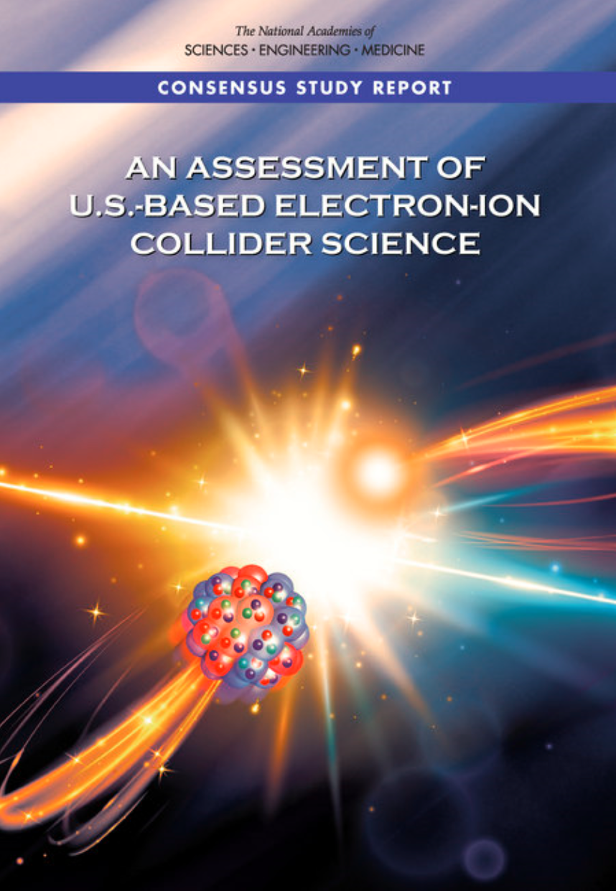
Project Requirements
Project Design Goals
High Luminosity: L= 10³³ – 10³⁴cm⁻²sec⁻¹, 10 – 100 fb⁻¹/year
Highly Polarized Beams: 70%
Large Center of Mass Energy Range: E_{cm} = 20 – 140 GeV
Large Ion Species Range: protons – Uranium
Large Detector Acceptance and Good Background Conditions
Accommodate a Second Interaction Region (IR)
Conceptual design scope and expected performance meets or exceed NSAC Long Range Plan (2015) and the EIC White Paper requirements endorsed by NAS (2018)
NSAC – U.S. Department of Energy Nuclear Science Advisory Committee
NAS – U.S. National Academies of Sciences, Engineering, and Medicine

Slide 4
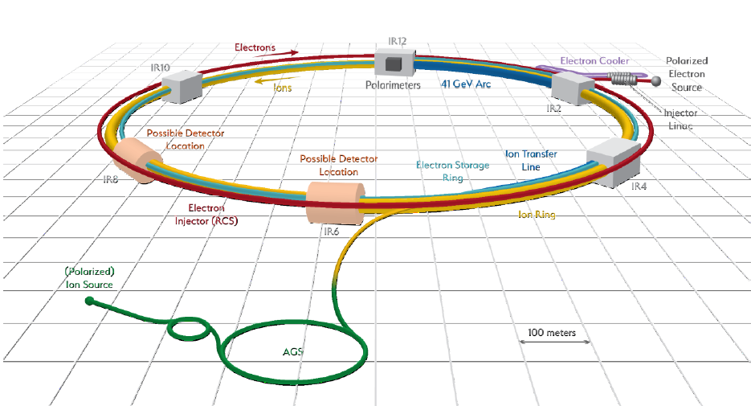
EIC project
The EIC mission need statement (CD-0) approved by DOE in Dec 2019
The EIC will be located at BNL and will be realized with TJNAF as a major partner. The realization of the EIC will be accomplished over the next decade at an estimated cost between $1.6 and $2.6 billion.
The CD1 approved in June 2021. The EIC team is working towards CD-2/3A in 2023
The EIC’s high luminosity and highly
polarized beams will push the frontiers
of accelerator science and technology
and provide unprecedented insights into the building blocks and forces that hold atomic nuclei together.
EIC scope includes the machine upgrade to RHIC asset and two interactions regions with one of the interaction regions outfitted with a major detector.
Message from Tim Hallman - Associate Director of the DOE Office of Science for Nuclear Physics:
The EIC will be a game-changing resource for the international nuclear physics community. DOE looks forward to engaging with the international community and the international funding agencies about potential collaborations and contributions to the EIC effort, in nuclear, accelerator and computer science.

Slide 5
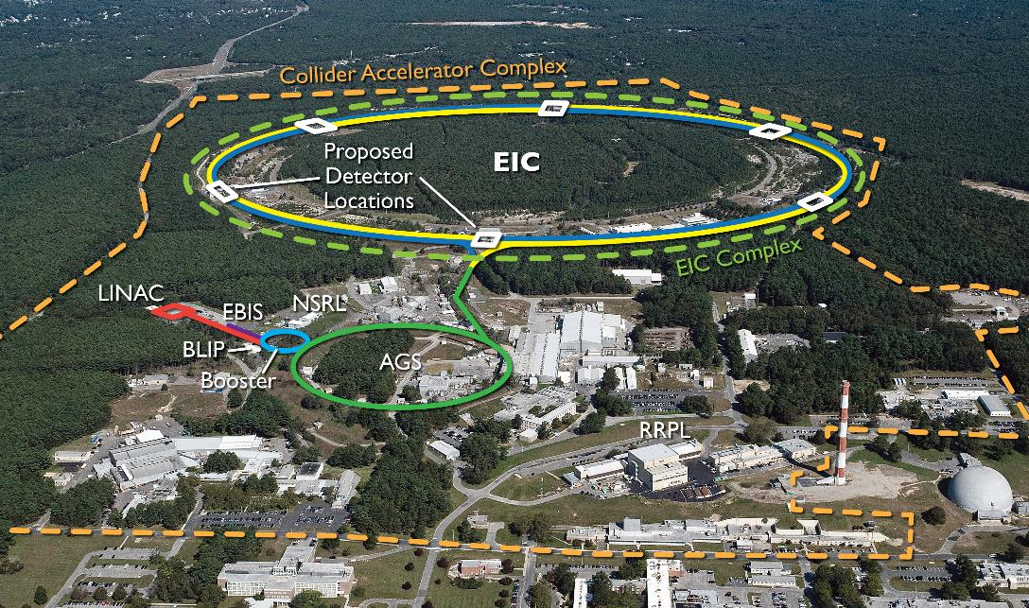
EIC Design Overview
EIC CDR: https://www.bnl.gov/ec/files/EIC_CDR_Final.pdf

Slide 6
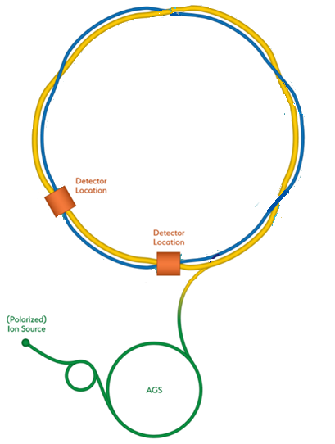
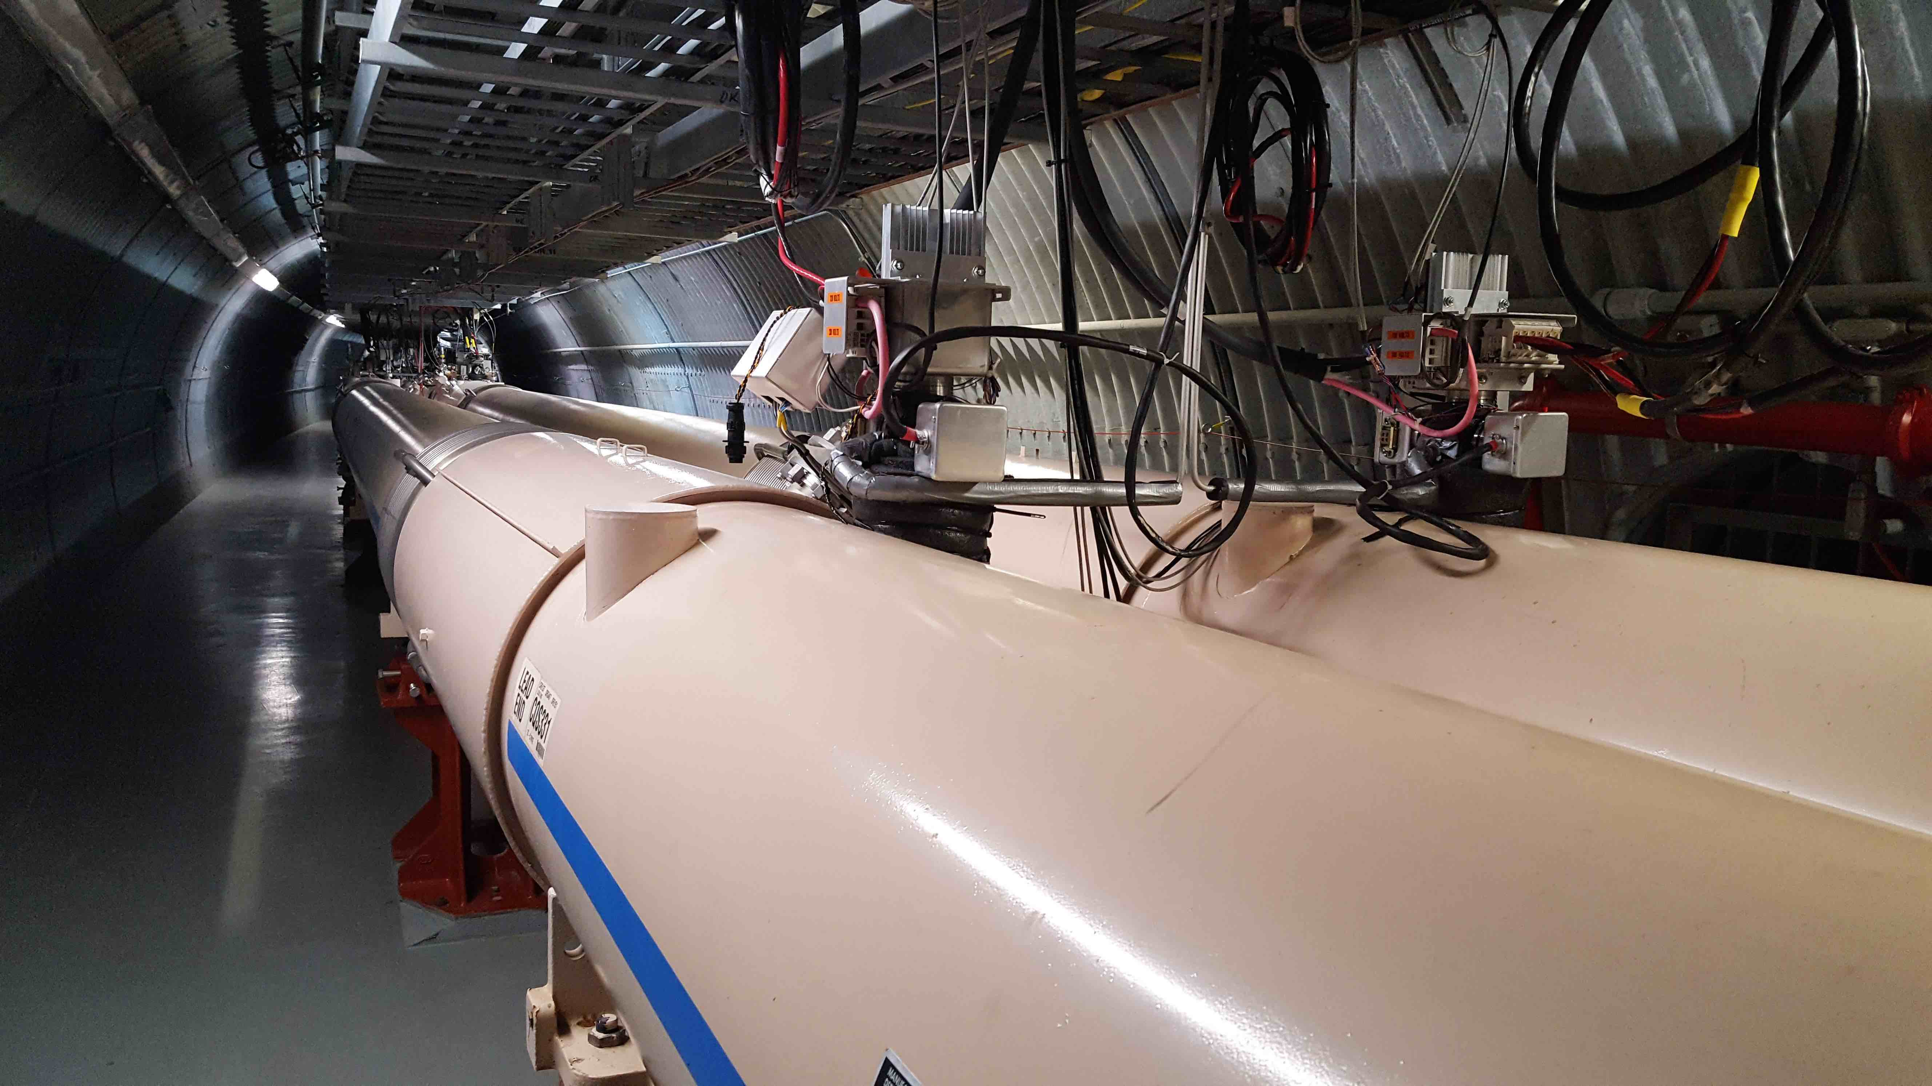
From RHIC to the EIC: RHIC
Existing RHIC facility
  Hadron collider (h=360)
  6-100 GeV/u ions
  100-250 GeV polarized protons
  Two independent rings
    Asymmetric operations include e.g. d-Au collisions
Constructed 1990-2000
Will operate to ~2025
C = 3833.845 m
h = 360
B_{max,dipole} = 3.5 T (SC)
19-cell FODO arcs

Slide 7
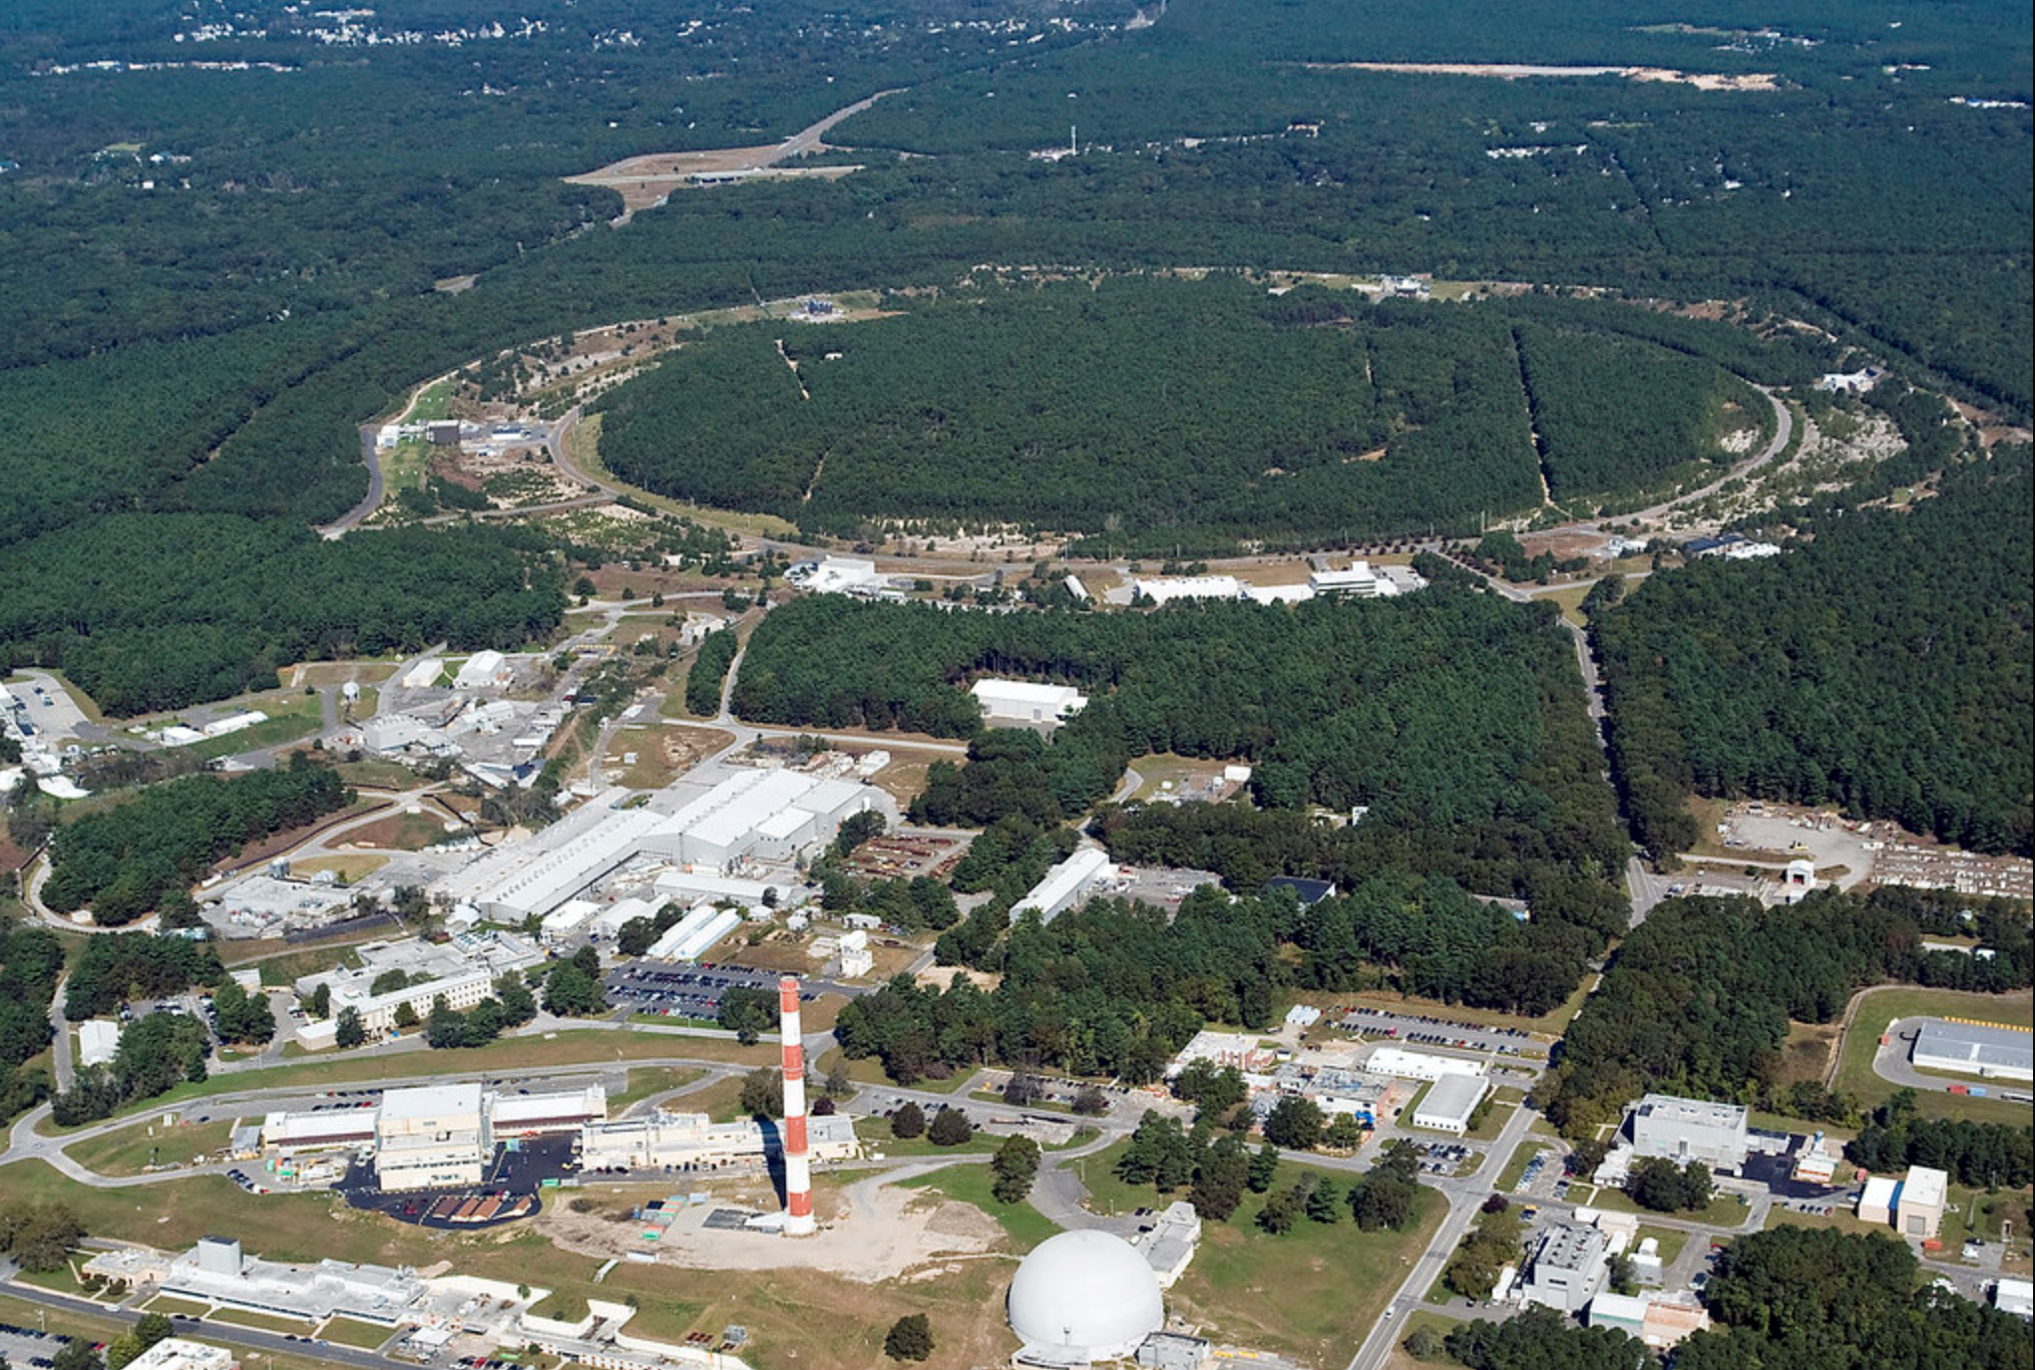
EIC Design Concept
Design based on existing RHIC facility
RHIC is well-maintained, operating at its peak
Hadron storage ring 40-275 GeV (existing)
  Many bunches (max 1160)
  Bright beam emittances (for hadrons)
  Need strong cooling
Electron storage ring 2.5–18 GeV (new)
  Many bunches (max 1160)
  Large beam current (2.5 A) ➔10 MW SR power
Electron rapid cycling synchrotron (new)
  1-2 Hz
  Spin transparent due to high periodicity
High luminosity interaction region(s) (new)
  Luminosities up to 10³⁴ cm⁻² s⁻¹
  Superconducting magnets
  25 mrad crossing angle with crab cavities
  Spin rotators (longitudinal spin)
  Forward hadron instrumentation
EIC

Slide 8
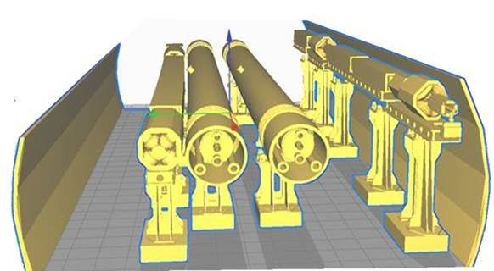
Tunnel Cross Section
All accelerators fit into the existing tunnel
Need several new equipment buildings
RHIC
RCS
eSR
Existing
RHIC
tunnel

Slide 9
HERA lessons
The first and only lepton-hadron collider, operated for physics 1992-2007
Collided 27.5 GeV spin polarized leptons (e+; e- ) with 920 GeV protons
Reached luminosity of 5x10³¹ cm⁻² s⁻¹
HERA lessons relevant for EIC
  Vertical beam-beam tune shift for lepton beam reached values planned for EIC
  The necessity to minimize synchrotron radiation in the IR, IR vacuum pressure, and to avoid halo of the proton beam
Total delivered luminosity about 1 fb⁻¹
B-Factories lessons
HERA at DESY
When B factories design started ~1990, e+e- colliders barely reached 10³² cm⁻²s⁻¹
PEP-II and KEKB aimed in their design to luminosity of 0.3 – 1 x 10³⁴ cm⁻² s⁻¹
  Achieved and even exceeded the goals
Approach: build-in necessary features to achieve high Lumi into the design
  Crossing angle and crab cavity; Local chromaticity correction; RF cavities and vacuum chamber compatible with ampere-scale beams; Bunch-by-bunch feedback; Continuous top-up injection
F. Willeke, HERA and the Next Generation of Lepton-Ion Colliders", in Proc. of EPAC'06 , Edinburgh, paper FRXBPA01

Slide 10
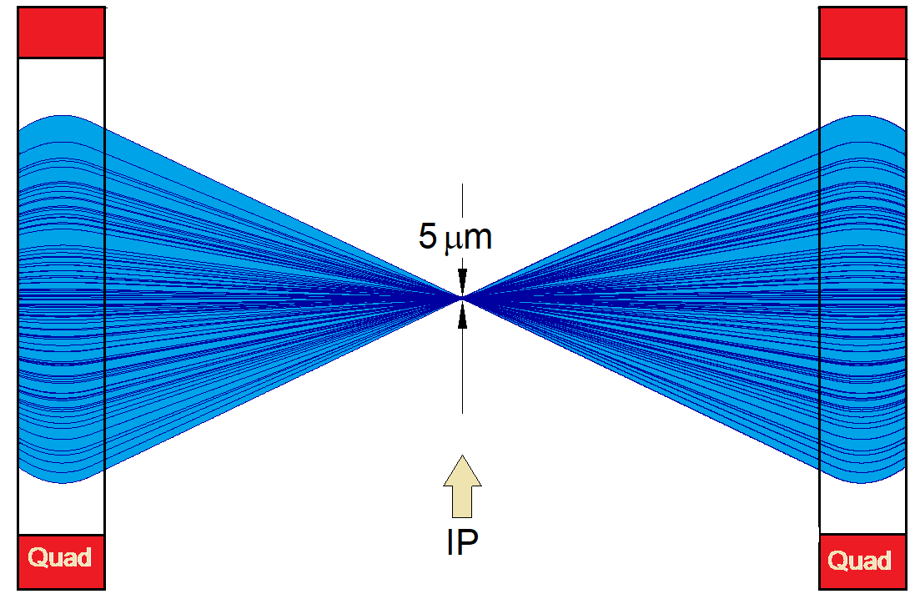
EIC achieves high luminosity L = 10³⁴ cm⁻²s⁻¹
Large bunch charges N_{e} ≤ 1.7·10¹¹, N_{p} ≤ 0.69·10¹¹
Many bunches, n_{b}=1160
  crossing angle collision geometry
  large total beam currents
  limited by installed RF power of 10 MW
Small beam size at collision point achieved by
  small emittance, requiring either:
- strong hadron cooling to prevent emittance growth
or frequent hadron injection
  and strong focusing at interaction point (small β_{y})
  flat beams σ_{x}/σ_{y} ≈ 10
Strong, but previously demonstrated beam-beam interactions
Δν_{p} = 0.01 demonstrated in RHIC
Δν_{e} = 0.1 demonstrated in HERA, B-factories
Strong focusing β_{y} =5 cm

Slide 11
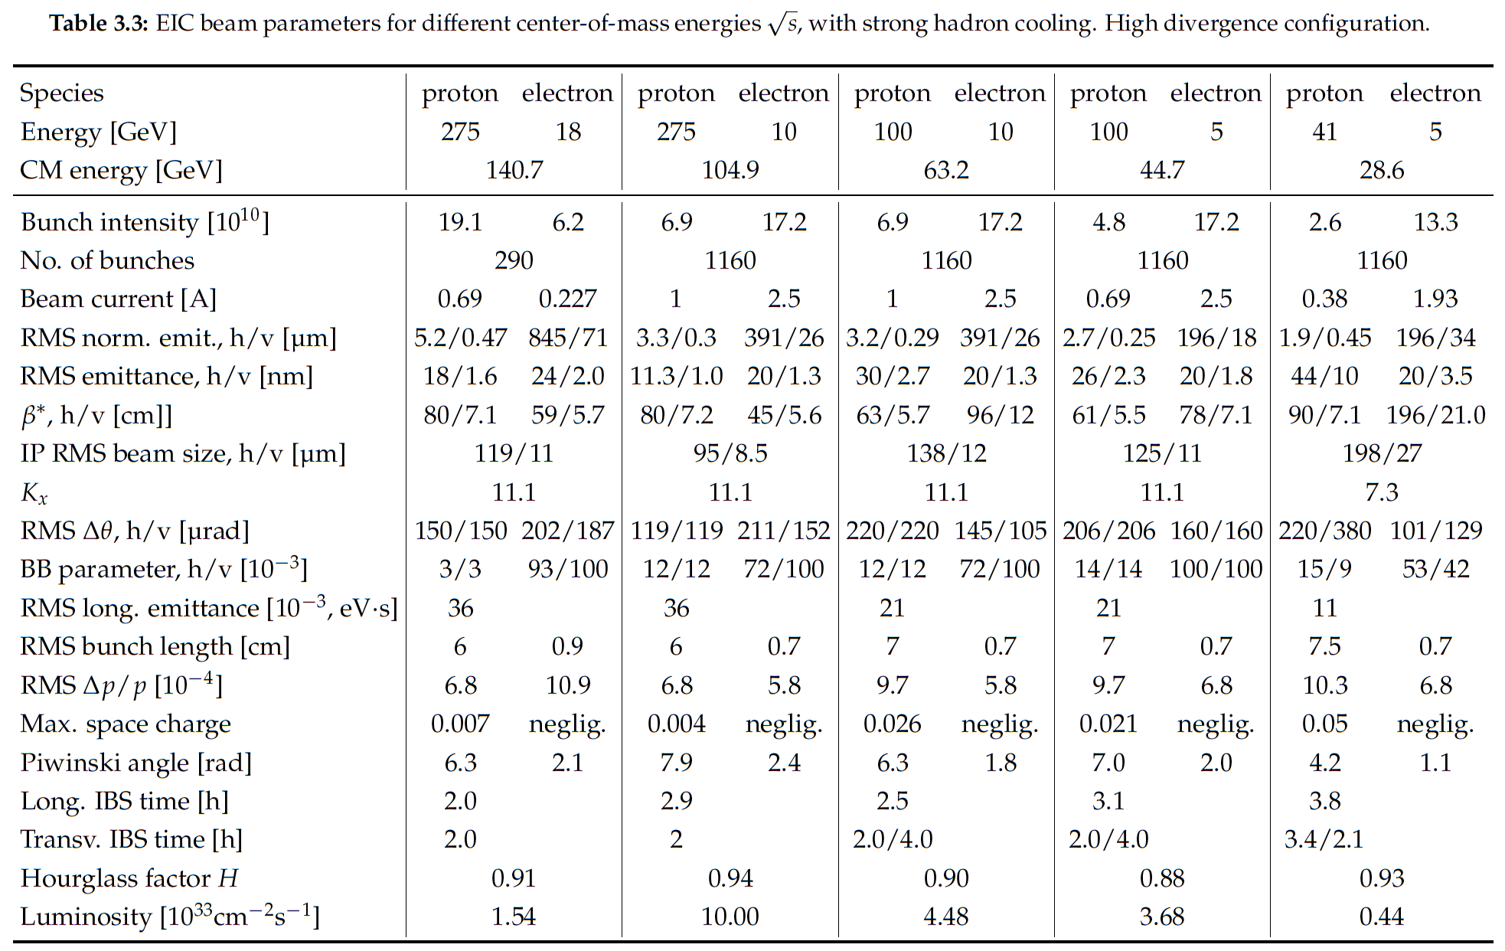
EIC Design Parameters

Slide 12
EIC Design Parameters
Notes:
LHC design 0.58A p (HL up to 1A), beam-beam parameter 3.4e-4 (3-5—3 HL-LHC)

Slide 13
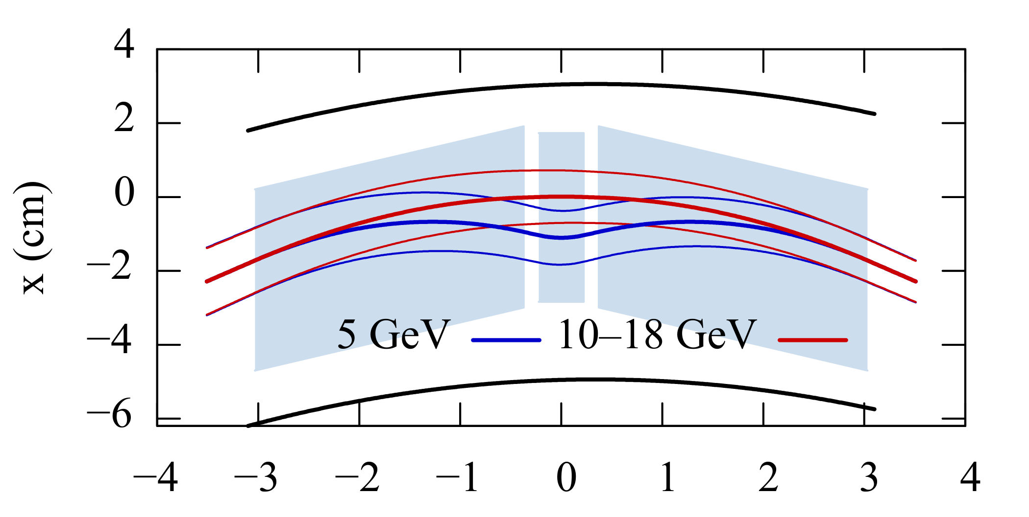
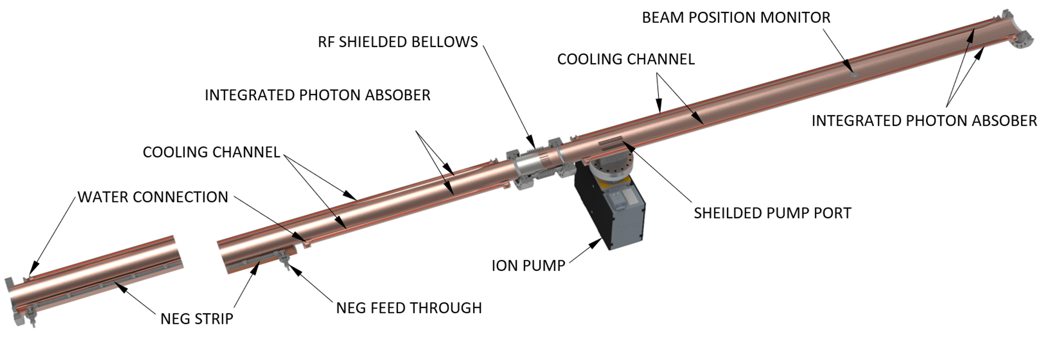
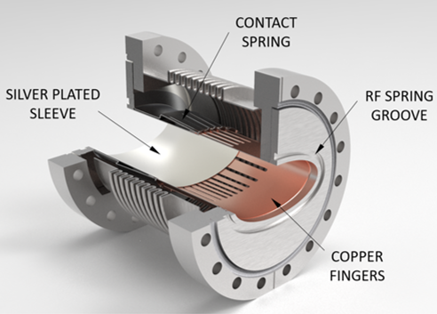
Electron Storage Ring
Above 10 GeV, all segments powered uniformly to reduce SR power
At 5 GeV, short center dipole provides a reverse bend to increase damping decrement
z(m)
Vacuum chamber:
OFE Copper
Multichannel extrusion
Pumping:
distributed NEGs
RF shielded bellows

Slide 14
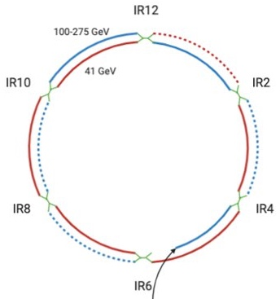
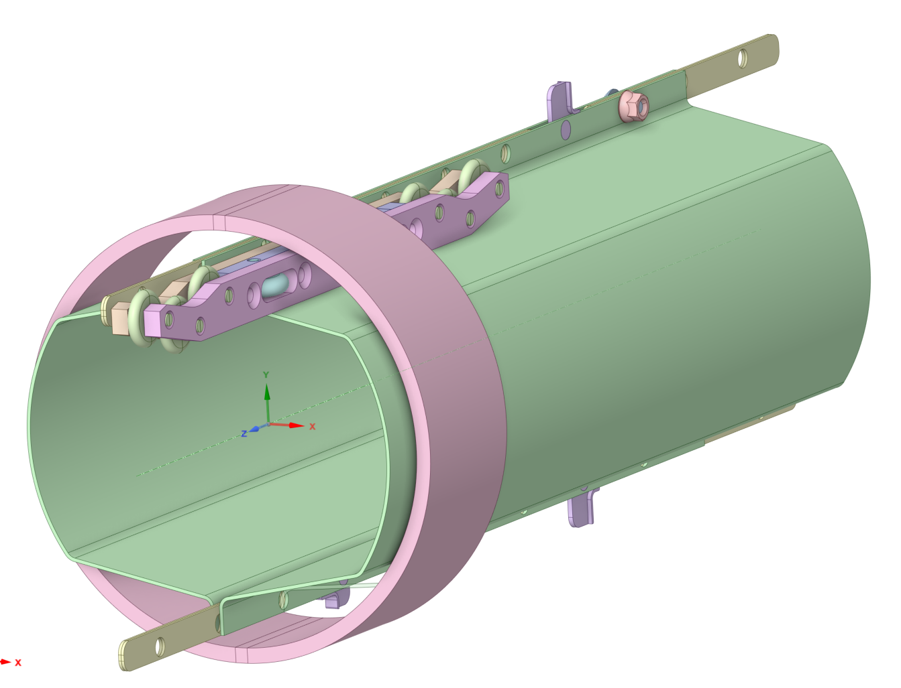
Hadron Storage Ring
Existing RHIC with superconducting magnets allow up to E_{p} = 275 GeV and down to E_{p} = 41 GeV
HSR pathlength must be reduced for 41 GeV ops to maintain f_{rev} and collisions
  Accomplished by using one RHIC blue ring arc as a pathlength adjustment bypass
  Requires reversing one arc of quench protection diodes
  Other hadron pathlength adjustments feasible with arc radial shifts
Hadron Ring Vacuum chamber upgrade:
Two main concerns towards existing RHIC vacuum pipes during EIC operation with higher current and shorter bunch length:
  Resistive-wall impedance
  e-cloud buildup
Solution: copper-clad stainless-steel screen + a-C thin film
  Cu significantly reduces surface resistivity, esp. at cryo
  a-C reduces secondary electron emission
conceptual design (being updated to active cooling) see next slide

Slide 15
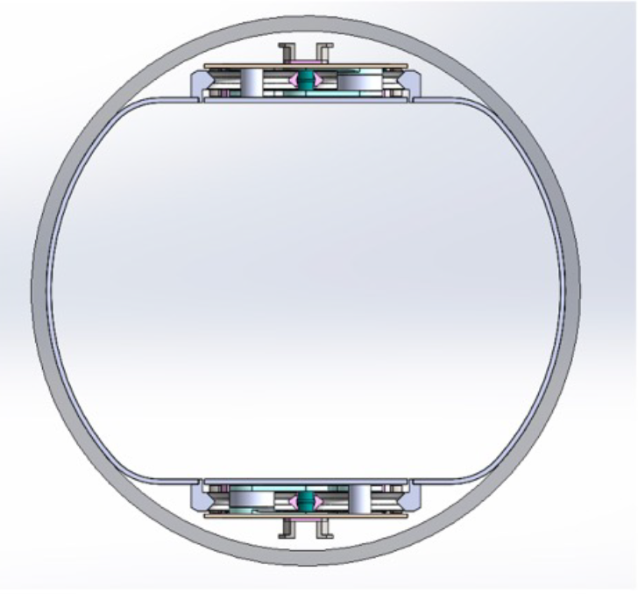
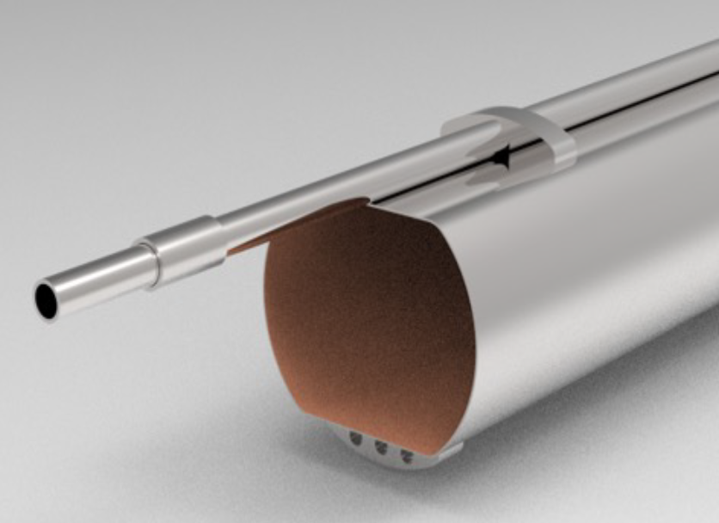
HSR Vacuum Liner
HSR vacuum liner cooling changed from passively cooled (contact with RHIC beam pipe) to actively cooled

Slide 16
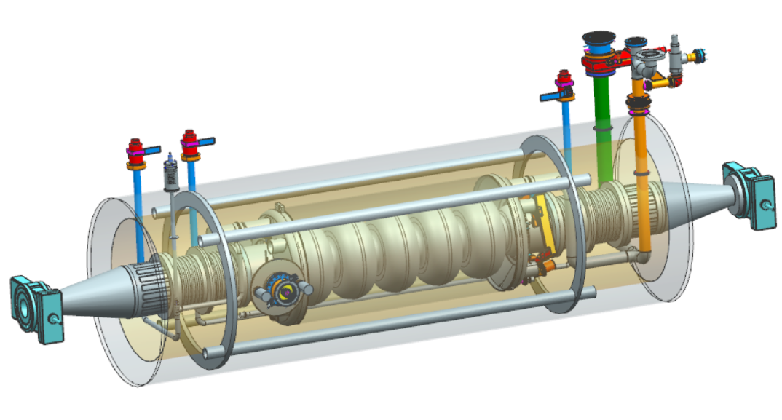
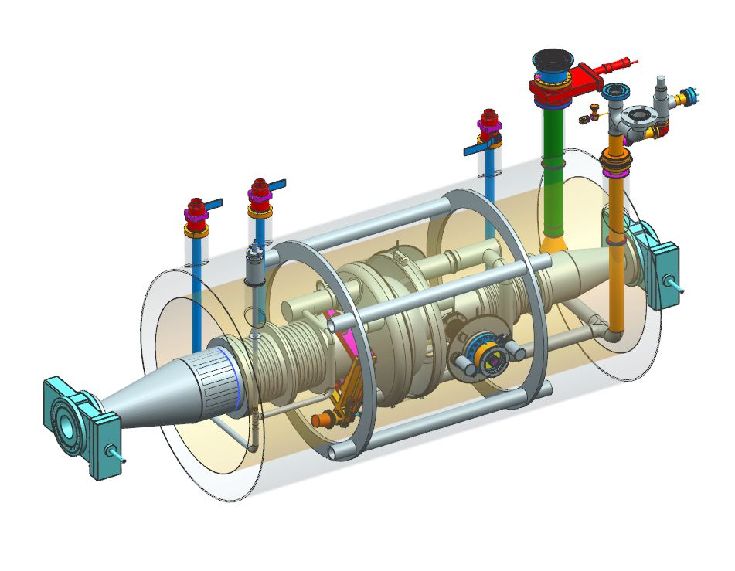
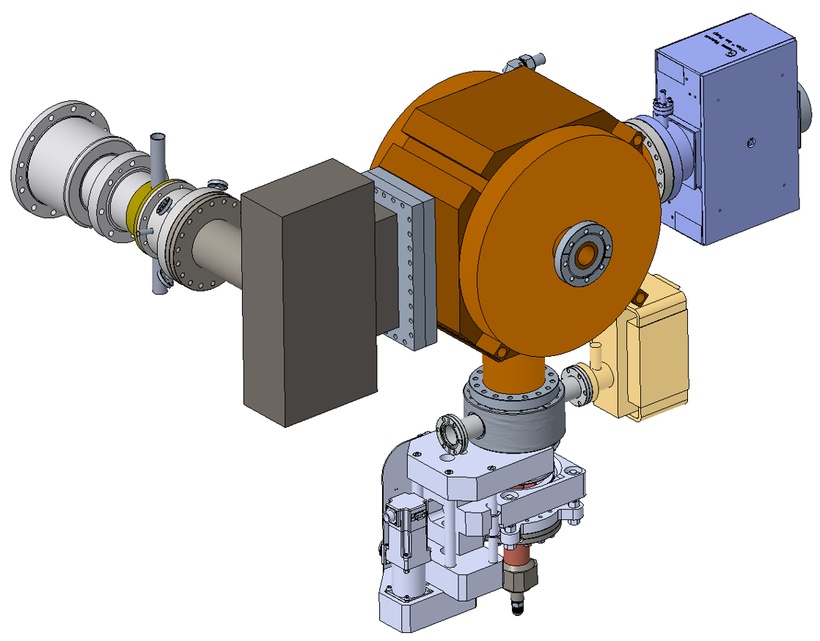
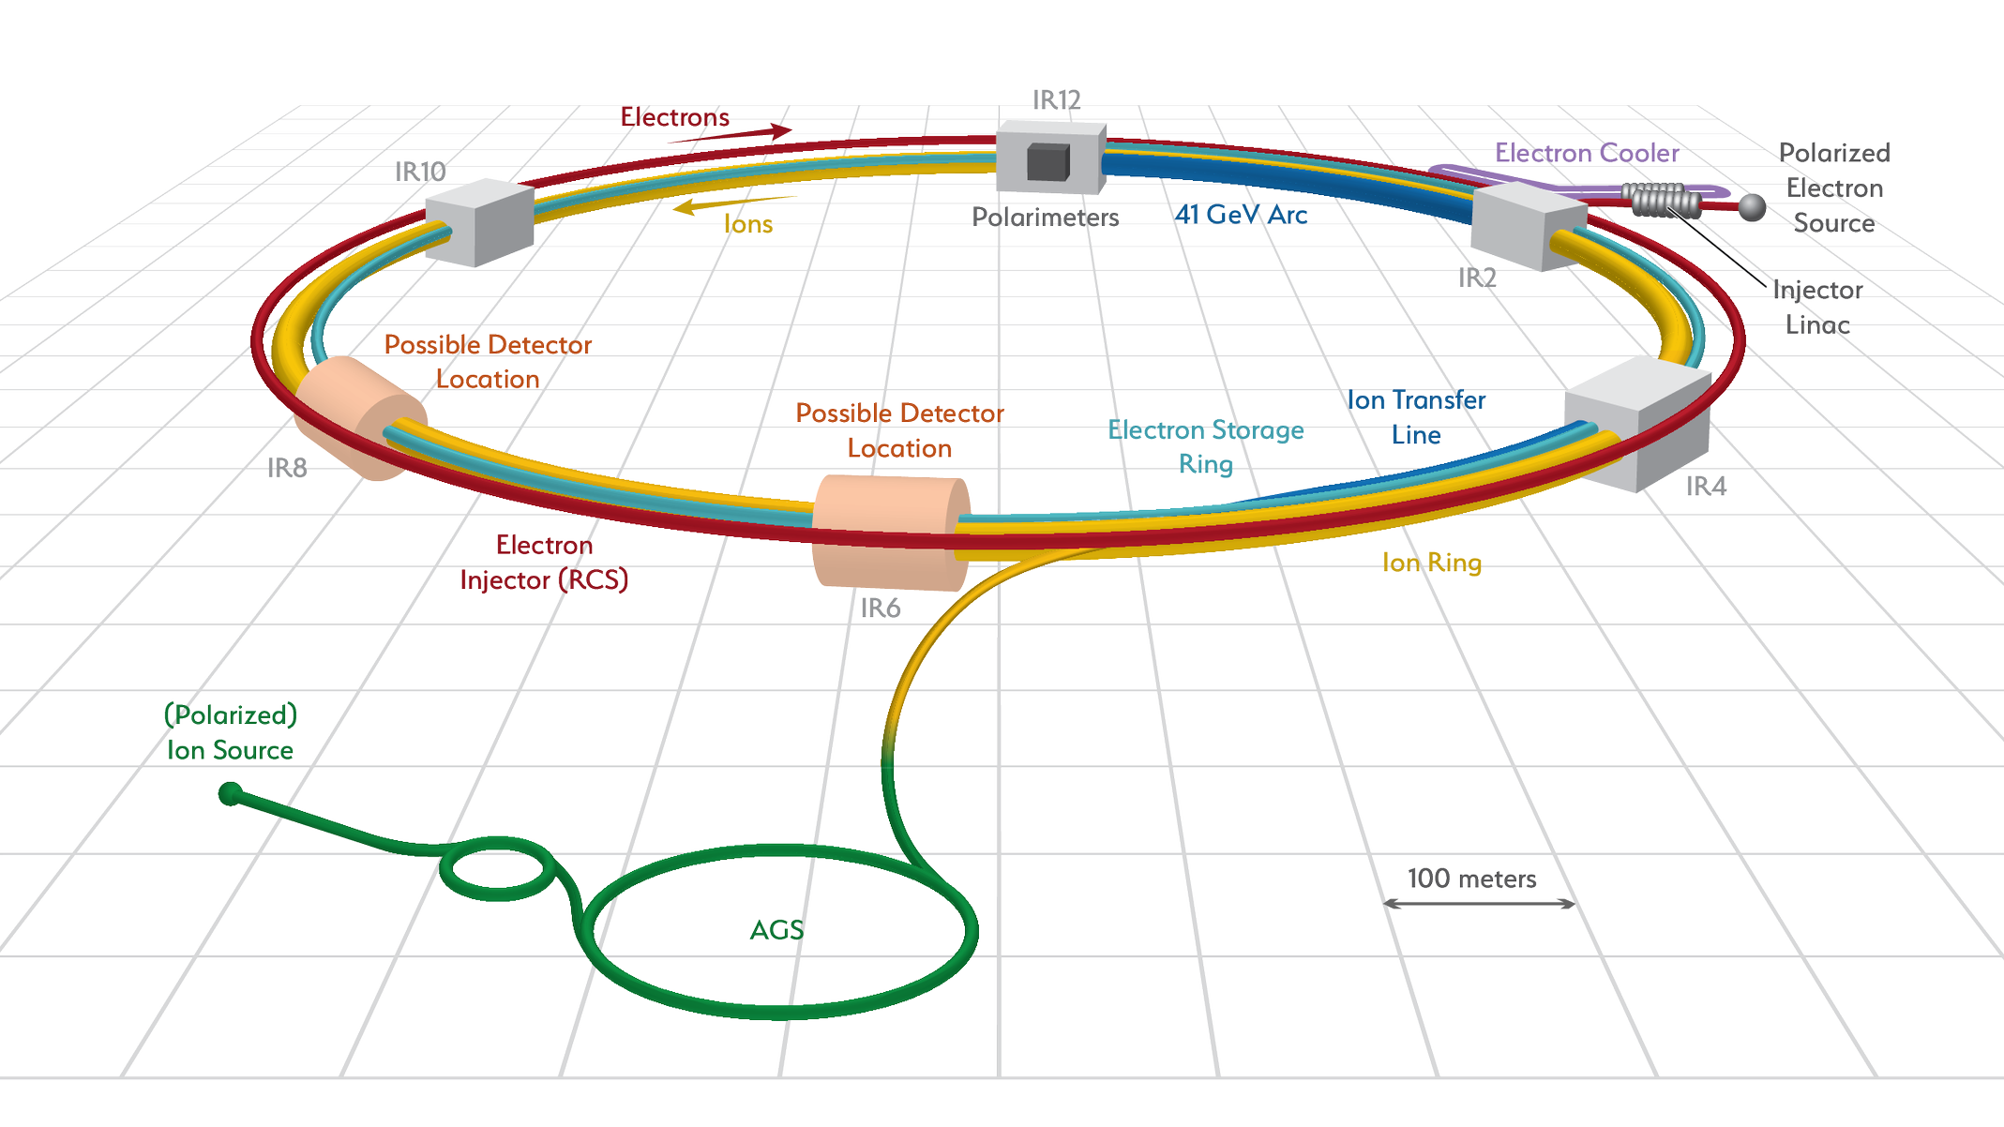
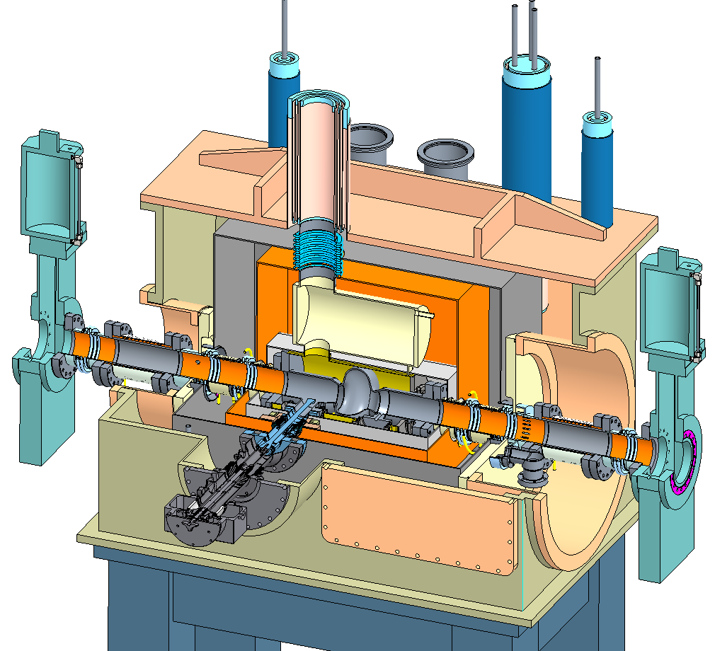
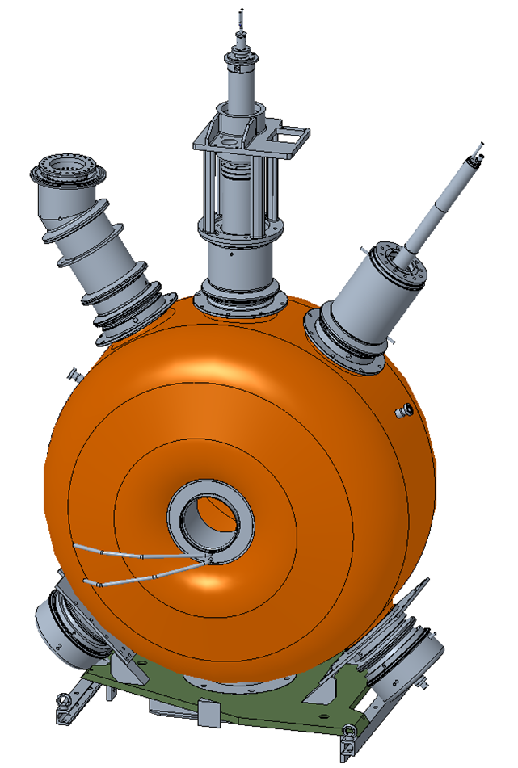
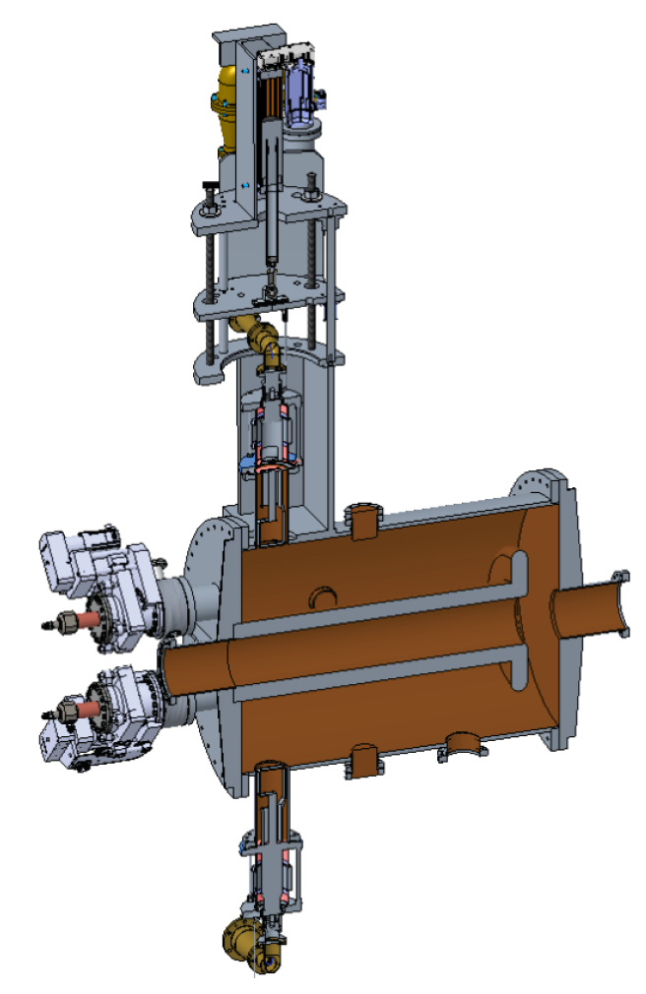
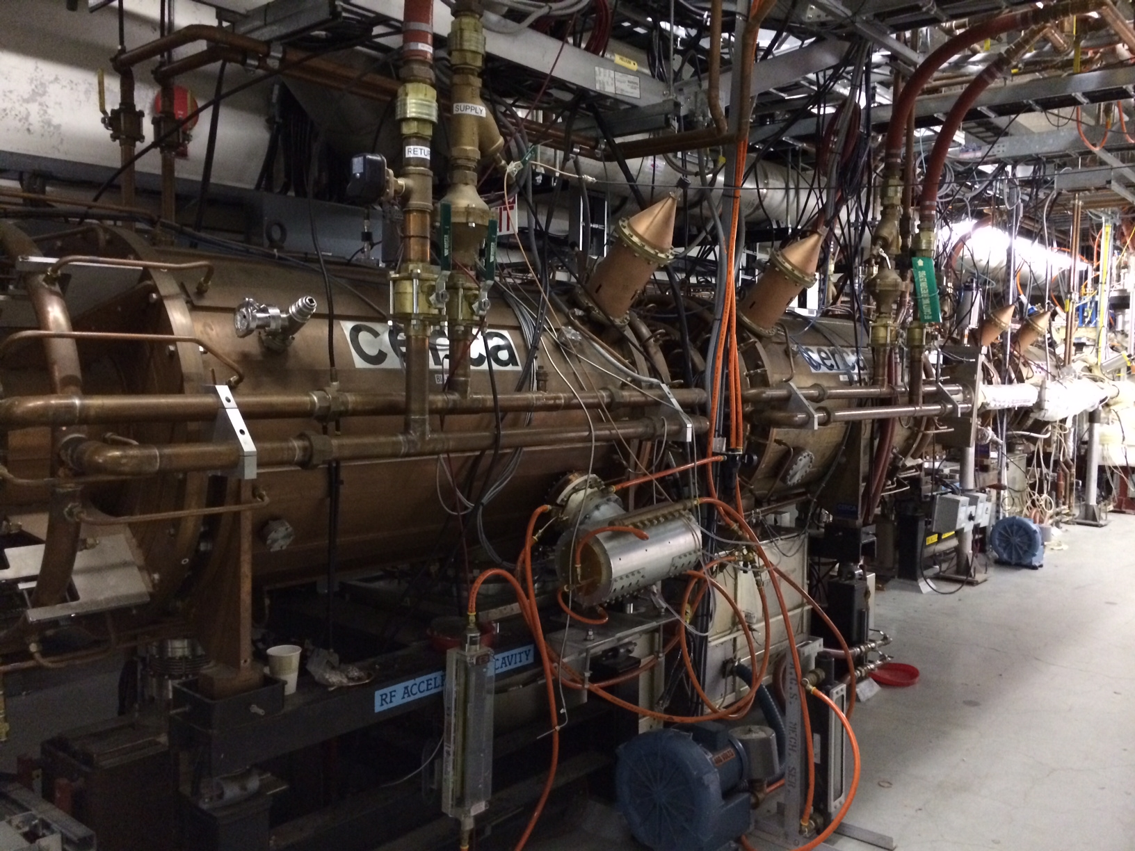
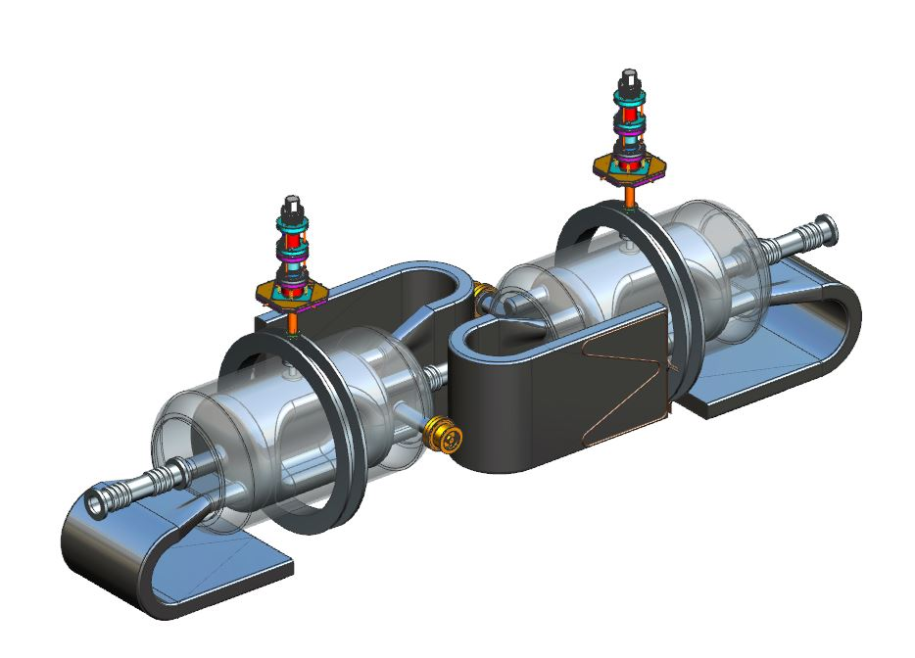
EIC RF systems
Hadron - 591 MHz bunch compression cavity
Hadron Cooling - 591 MHz acceleration cavity
Electron - 591 MHz electron storage cavity
Injector - 571 MHz bunch compression cavity
Electron - 1773 MHz 3rd harmonic cavity
Hadron - 197 MHz bunch compression cavity
Rapid Cycling Synchrotron - 591 MHz acceleration cavity
Hadron – 24.5 MHz acceleration cavity
Hadron – 49.2 MHz and 98.5 MHz bunch splitter cavity
Both rings –crab cavities

Slide 17
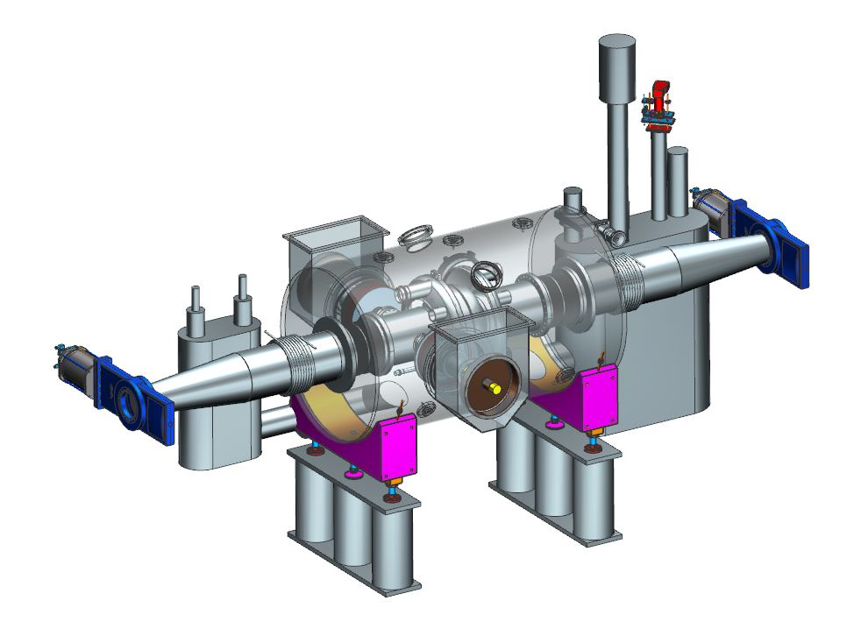
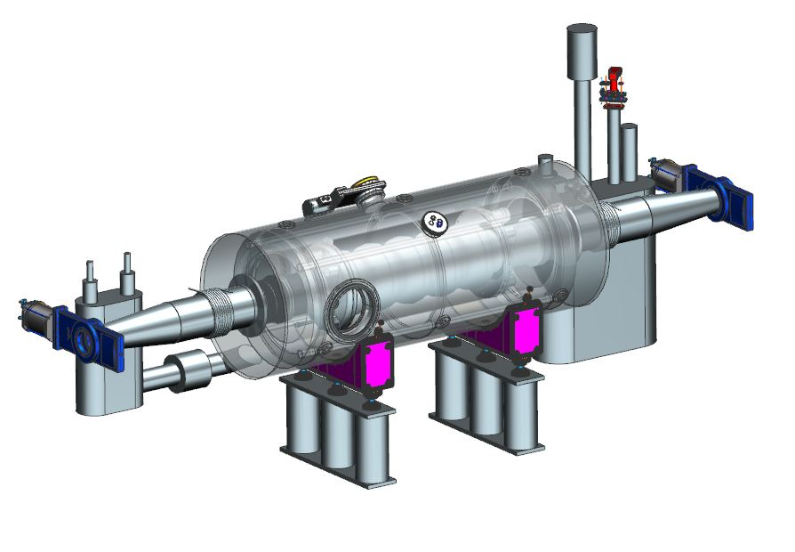
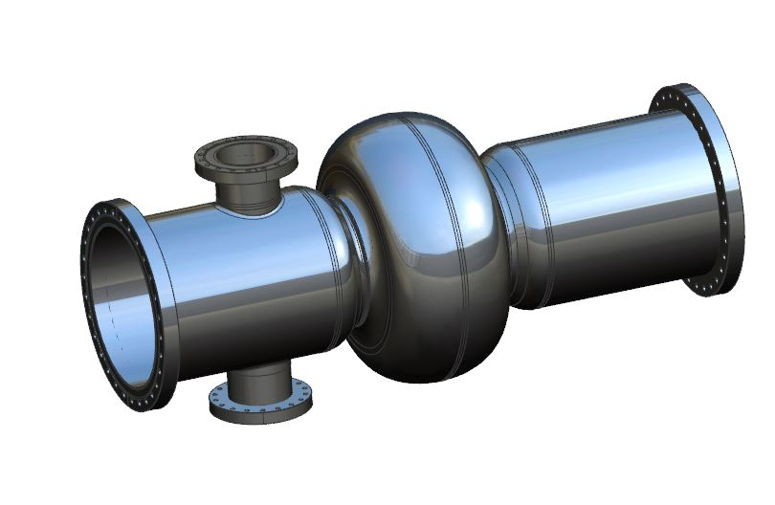
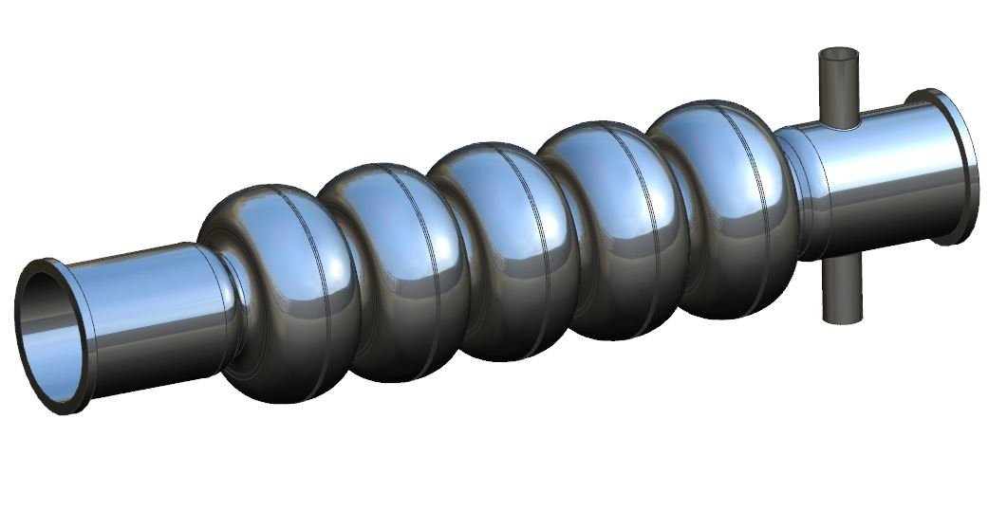
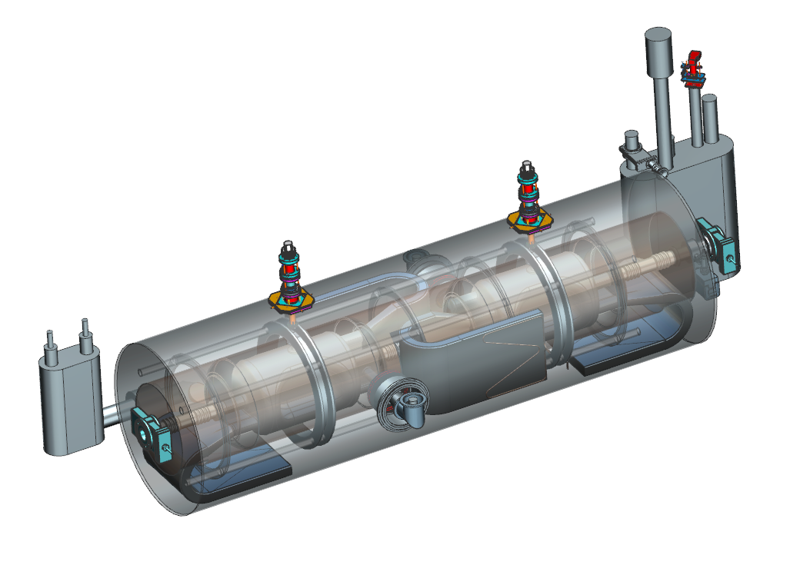
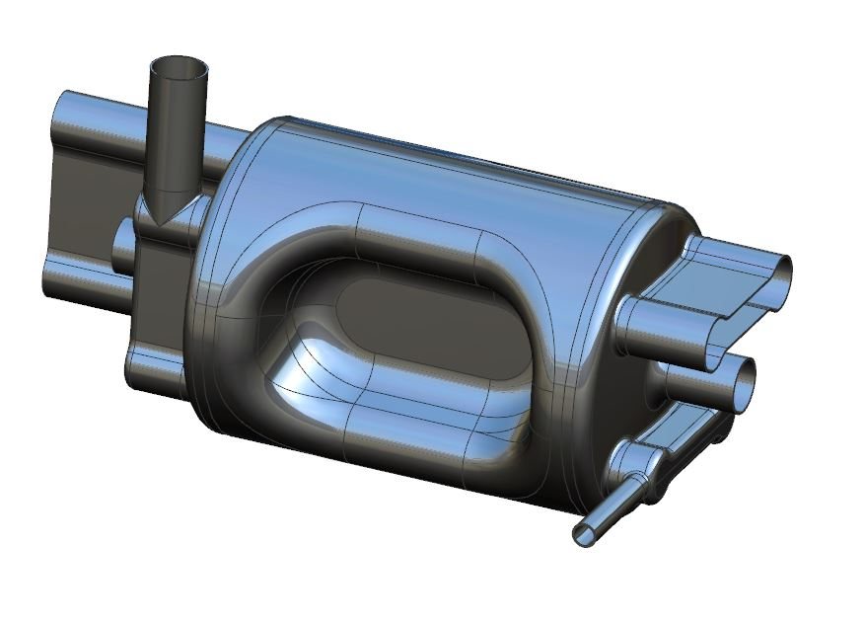
EIC SRF Cavities & Cryomodules
Several CM types required, total ~50
SRF cavities, 197-1773 MHz
  High RRR, fine grain, Niobium sheet cavities
  5 types, 3 elliptical and 2 non-elliptical, quantities ~ 4-20
Joe Preble, Kevin Smith, et al

Slide 18
The need for beam cooling – IBS
Intrabeam Scattering (IBS): Lorentz boosted Coulomb scattering inside bunches
Higher charge and smaller emittances increase IBS growth rate
  IBS can be partially mitigated by reducing dispersion and increasing energy spread
IBS rates for EIC parameters ~2 hour
Beam cooling methods needed to counteract IBS
Factor γ in Δp

Slide 19
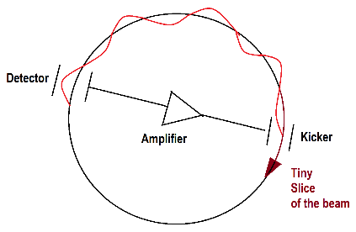
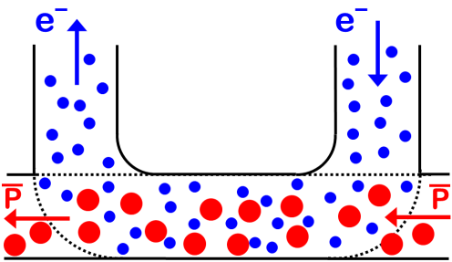
Conventional cooling methods and EIC
Electron cooling
Stochastic cooling
Cooling time:
τ ∝ C/σ_{z} * N/ΔF
Cooling gets much weaker at higher energy
Cooling gets much weaker for denser bunch
Either of these methods, if scaled to EIC parameters and stay within technically feasible range, will not provide sufficient cooling – they would be too weak
For EIC “Strong” hadron cooling is needed – cooling that will provide sufficiently high cooling rate for proton bunches at EIC parameters

Slide 20
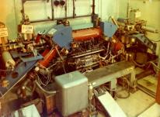
Electron Cooling
Budker G.I., Effective method of damping particle oscillations at proton antiproton storage rings, Atomic Energy 1967, v.22, №5, p.346
Electron cooling concept
When electron cooling idea was first presented (1966), the common opinion of the community was – “brilliant idea, but unfortunately non-realistic”
However, less than a decade later the electron cooling was operational
First e-cooler at INP, Novosibirsk, ~1974

Slide 21
Electron Cooling & Energy Recovery
Standard electron cooling use energy recovery
  For example, if we need 1A @ 1MeV electron beam*, it does not mean we need 1 MW power supply
Typical arrangements of e-cooler power supplies:
Proton beam
B
B
P
B
P
B
B
1A @ 50 kV
e-beam
U⁻
Cathode
Collector
Typical scheme of a standard electron cooler for low energy range (~several tens MeV of p energy)
1mA @ 1 MV
Losses of 1A e-beam due to interaction with p-beam or scattering are low
Thus, power of 1MV power supply is defined by e-beam losses and can be much lower than 1MW, just 1kW in example above
* Numbers are for illustration only

Slide 22
Taking Electron Colling to higher energy
Energy recovery is even more important for high energy electron cooling
Fermilab 4.3MeV electron cooling system (for 8 GeV antiprotons)
Achieved cooling times ~0.5 hours
The electron cooling time has a very unfavourable beam energy scaling ~γ^{2.5}
Mitigating scaling dependence by a) increasing cooling section length; b) higher electron current – has practical limits
For 41-257 GeV energy of EIC proton beam – standard electron cooling would be extremely challenging

Slide 23
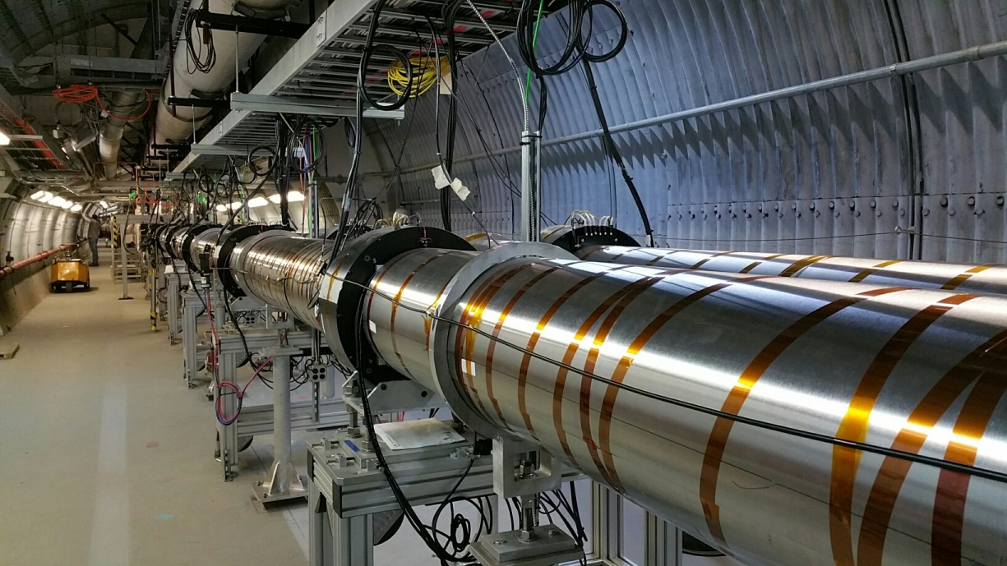
Getting electron cooling to higher energy
Low-Energy RHIC electron Cooler (LEReC) at BNL:
First e-cooler based on the RF acceleration of e-beam (of up to 2.6 MeV energy)
Observation of first cooling using bunched electron beam on April 5, 2019
LEReC will be used in RHIC Beam Energy Scan II for Low energy (√sNN = 7.7, 9.1, 11.5, 14.5, 19.6 GeV) Au+Au runs using electron cooling to increase luminosity
Cooling using bunched electron beam produced with RF acceleration is new, and opens the possibility of electron cooling at high beam energies
LEReC approach can be used for EIC as injection energy pre-cooler.
However, at collision energy enhanced/strong cooling mechanism is needed.
Alexei Fedotov, BNL

Slide 24
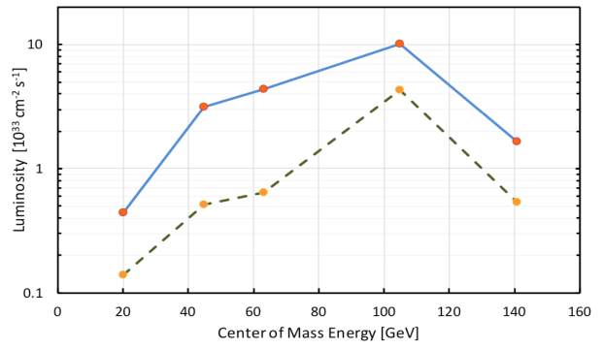
EIC cooling requirements
Luminosity of lepton-hadron colliders in the energy range of the EIC benefits strongly (factor ≈ 3-10) from cooling the hadron’s transverse and longitudinal beam emittance.
Cool the proton beam at 275 GeV and 100 GeV ; 41 GeV cooling under study.
IBS longitudinal and transverse(h) growth time is 2-3 hours. The cooling time shall be equal to or less than the diffusion growth time from all sources.
Must cool the hadron beam normalized rms vertical emittance from 2.5 um(from injector) to 0.3 um in 2 hours.
  Pre-cooling at injection (24GeV) with electron cooling is desired.
The cooling section must fit in the available IR 2 space.
with SHC
w/o SHC

Slide 25
Coherent Electron Cooling (CEC)
Like in stochastic cooling, tiny fluctuations in the hadron beam distribution (which are associated with larger emittance) are detected, amplified and fed back to the hadrons thereby reducing the emittance in tiny steps on each turn of the hadron beam
High bandwidth (small slice size)
Detector, amplifiers and kickers
For high energy protons, a large bandwidth (tens of THz) is required:
➔ Using an electron beam to detect fluctuations, to amplify and to kick.
CDR baseline Amplification: micro-bunched amplifier (MBEC)
E<E₀
H⁺
Modulator
E>E₀
Kicker
R₅₆
R₅₆
R₅₆
e⁻
We acknowledge there are other three amplification schemes

Slide 26
CeC pickup(modulator) and kicker
Coherent electron cooling is a variant of the stochastic cooling with the operational frequency range raised from ~GHz to tens of THz [Ref].
1-2 μm
The pickup and the kicker are implemented via the Coulomb interaction of the hadrons and electrons, γ_{e}= γ_{h}. Without amplification, the cooling rate is too small - the signal (the imprint in the e-beam) should be amplified.
The extent of the longitudinal wake is 1-2 microns – sets requirement on the path length match when e and p bunches are merged in the kicker
Ref: Derbenev, AIP Conf. Proc. 253, 103 (1992); Litvinenko, Derbenev. PRL, 102, 114801 (2009)

Slide 27
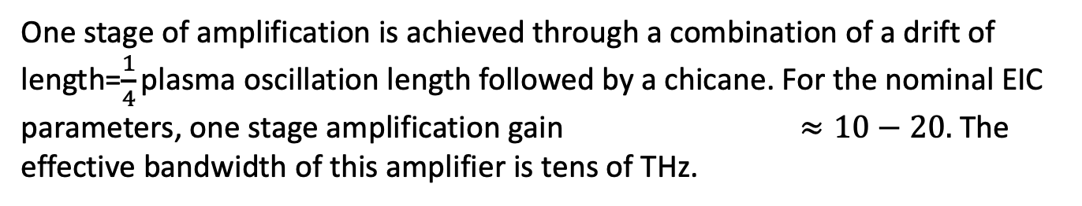
CeC amplification
Micro-bunched amplification (well known from FELs) is the effect selected for CeC amplification - MBEC (micro-bunched electron cooling)
One stage of amplification is achieved through a combination of a drift of length=$\frac{1}{4}$ plasma oscillation length followed by a chicane. For the nominal EIC
parameters, one stage amplification gain $≈10−20.$ The effective bandwidth of this amplifier is tens of THz.

Slide 28
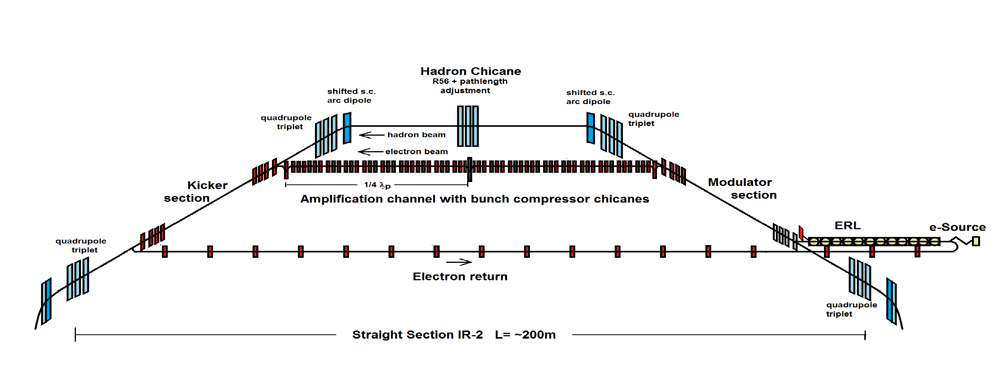
EIC Strong Hadron Cooling
Coherent Electron Cooling with μ-bunching amplification
The EIC cooler requires up to 150 MeV electron beams with average electron beam current of ~100 mA => 15 MW
  Requires use/design of a world-class SRF energy-recovery linac (ERL)
Electron/hadron beams separate and rejoin each other
  Wake extent 1-2 μm => path length accuracy and stability must be sub-micron
Electron beam must be extremely “quiet” (less than twice the shot noise)
  Avoid amplification of “shot noise”, no substructure in electron beam

Slide 29
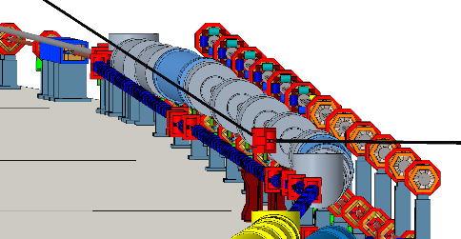
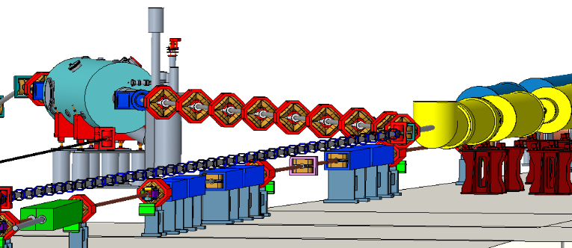
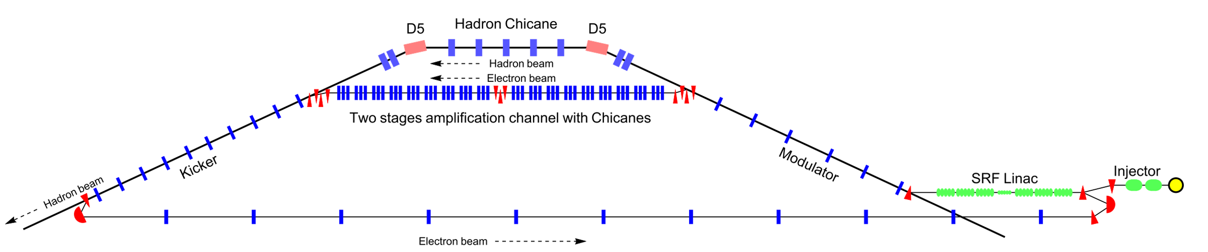
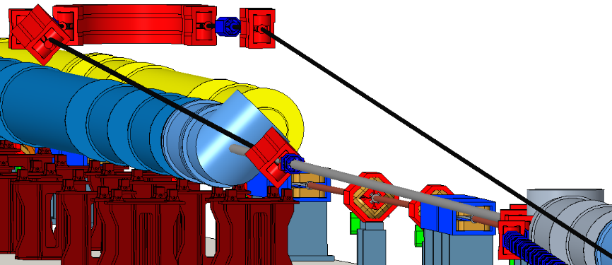
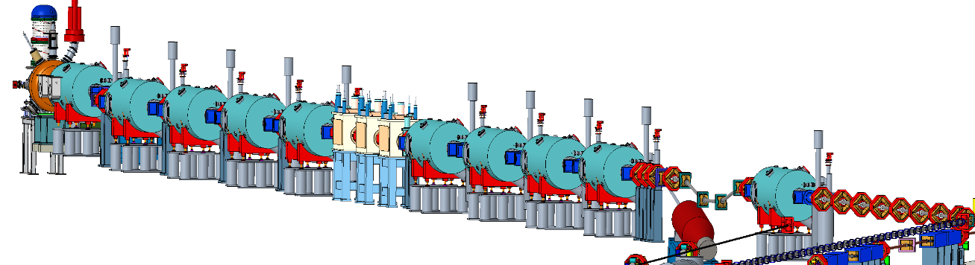
EIC Strong Hadron Cooling
Cooling theory and simulations, from 1D models to 3D models and simulations
Good progress in electron acceleration, beam-transport
Started studies of SHC integration with low energy pre-cooler (LEReC type)
CeC Proof of Principle experiment in progress, a lot of valuable knowledge gained, giving us confidence in design of SHC beamlines
Hadron chicane
Amplifier
Modulator
Kicker and
180 degree
return
Injector+ Linac

Slide 30
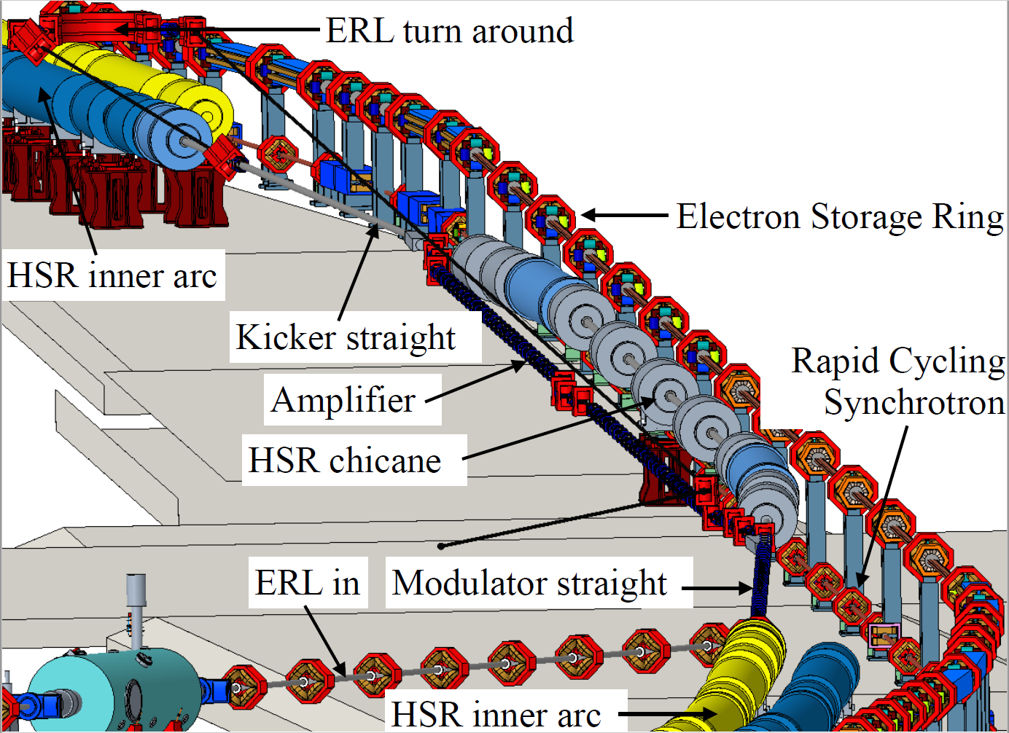
EIC Strong Hadron Cooling
Cooling theory and simulations, from 1D models to 3D models and simulations
Good progress in electron acceleration, beam-transport
Started studies of SHC integration with low energy pre-cooler (LEReC type)
CeC Proof of Principle experiment in progress, a lot of valuable knowledge gained, giving us confidence in design of SHC beamlines

Slide 31
From the committee report

Slide 32
EIC Requires Strong Hadron Cooling (SHC) to Deliver Science Program
Ultimate performance of the EIC is required to deliver the full EIC physics program and answer key NAS science questions
The Analysis of Alternatives has concluded that SHC is the best value solution to achieve ultimate EIC performance
Over the last years good progress in theory, supported by experiments, have significantly advanced understanding of SHC, strengthening its technical maturity
Although SHC is not required to achieve the threshold and objective KPP, having it as part of the EIC project will allow the EIC to attain its Ultimate Performance Parameters

Slide 33
EIC needs beam cooling for high performance
Performance metric: average luminosity
  Intrinsic ion emittance growth limits achievable initial and average luminosity
  Reduces average luminosity by at least factor 2-3 unless counteracted by strong hadron cooling (SHC)
  Ultimate performance peak luminosity of
  10³⁴ cm⁻² s⁻¹ requires hadron beam cooling
SHC is required to deliver the EIC physics program in a reasonable time
Assumption: electron
collision beam size matches
ion beam evolution

Slide 34
EIC beam cooling solution is SHC
EIC focusing SHC efforts on coherent electron cooling
  Coherent electron cooling is well-understood, with elements independently verified
  Would be similar accelerator technology breakthrough as going from incoherent light sources to free electron lasers
  Long time scale to fully develop, large EIC science benefit and wider benefits
    Coherent electron cooling benefits from ~10year of R&D investment, several experimental tests
SHC hardware is part of the EIC Project
  Supports the full EIC science potential
  Coherent electron cooling initial commissioning is part of project scope
  Provides time for further experiment and simulation input
  Classical electron cooling is being evaluated by project as risk mitigation
Assumption: electron
collision beam size matches
ion beam evolution

Slide 35
Ion source
Ions from He to U have been already generated in the Electron-Beam-Ion-Source ion source (EBIS), accelerated and collided in RHIC
EBIS can generate any ion beam from ³He to U for the BNL EIC
Existing EBIS provides the entire range of ion species from He to U in sufficient quality and quantity for the EIC
Ion Pairs
in the RHIC Complex
Zr-Zr, Ru-Ru (2018)
Au-Au (2016)
d-Au (2016)
p-Al (2015)
h-Au (2015)
p-Au (2015)
Cu-Au (2012)
U-U (2012)
Cu-Cu (2012)
D-Au (2008)
Cu-Cu (2005)

Slide 36
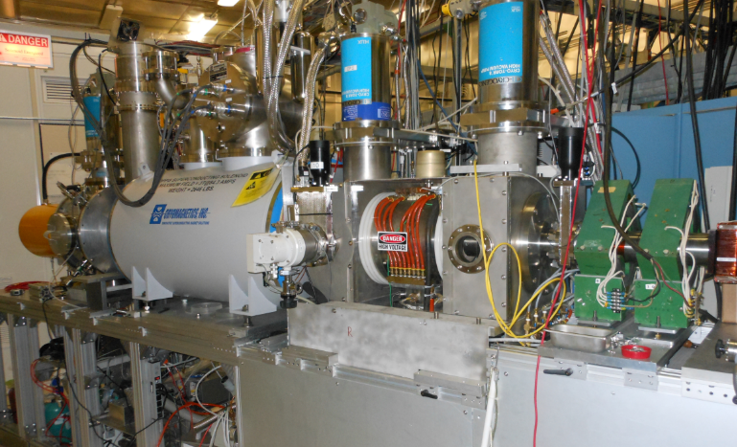
Optically pumped polarized ion source (OPPIS)
Used for RHIC p↑+p↑ program from 2000
Protons pickup polarized electrons in an optically pumped Rb vapor cell
Electron polarization of H atoms is transferred to protons in a magnetic field reversal region (Sona-transition)
H⁻ ions are produced then by passing through Na-cell
Polarized protons are obtained by charge exchange injection of H⁻ into the Booster
Several upgrades and modifications over years increasing polarization and intensity
up to 84% polarization
reliably 0.5 - 1.0 mA (max 1.6 mA)
up to 1・10¹² H⁻/pulse polarized H⁻ ions

Slide 37
Polarization preservation
Spin motion in accelerator: spin vector precesses around its guiding field along the vertical direction
B
Spin tune Qs: number of precessions in one orbital revolution: Qs = γG
  Anomalous g- factor for proton G= 1.793
beam
Depolarization due to resonances:
Imperfection resonances:
Qs = n
Intrinsic resonances:
Qs = nP +- Qy
Here n – integer, P – number of superperiods

Slide 38
Polarization preservation – Siberian snakes
Siberian snakes – special (e.g. helical) magnets that rotate spin (preserving orbit outside)
Full Siberian snakes flip spin 180 degrees. Two full snakes make Qs = 1/2
  Two full snakes control:
    Intrinsic resonances
    Imperfection resonances
Partial Siberian snake
  Break coherent build up of perturbation of spin
    Some control of imperfection resonances
Polarization kinematics of particles in storage rings.
Ya.S. Derbenev, A.M. Kondratenko (Novosibirsk, INP) Jun 1973.
Zh.Eksp.Teor.Fiz.64:1918-1929,1973

Slide 39
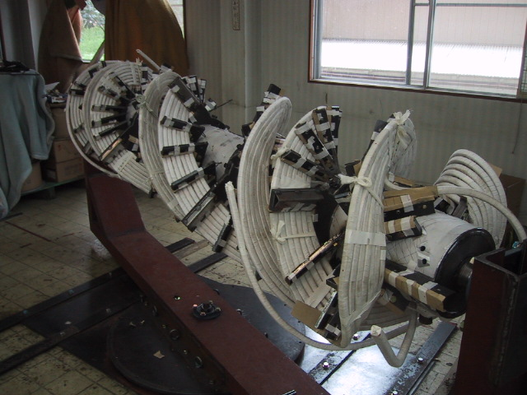
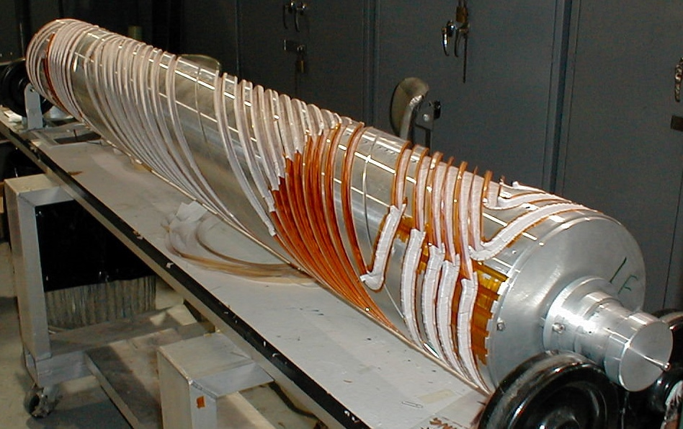
Polarization preservation – Siberian snakes
Siberian snakes in RHIC – two full snake than make Qs = ½
AGS – partial Siberian snakes
RHIC snake: 4T, 2.4m/snake, 360º twist, 100mm aperture
First Polarized Proton Collisions at RHIC. T, Roser, et al,
AIP Conference Proceedings 667, 1 (2003)
Magnet field in Snake
Warm partial AGS Snake
2.6 m
Particle orbit and spin trajectory
AGS
partial
snake

Slide 40
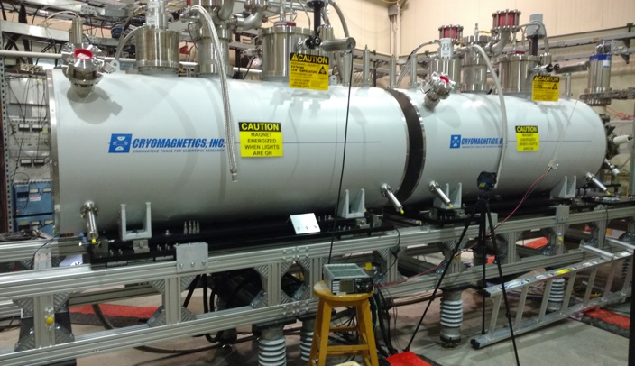
EIC Hadron Polarization
Existing p Polarization in RHIC achieved with “Siberian snakes”
Near term improvements will increase proton polarization in RHIC from 60% to 80%
³He polarization of >80% measured in source
80% polarized ³He in EIC will be achieved with six “snakes”,
Acceleration of polarized Deuterons in EIC 100% spin transparent
Need tune jumps in the hadron booster synchrotron
Electron beam ion source EBIS with polarized ³He extension

Slide 41
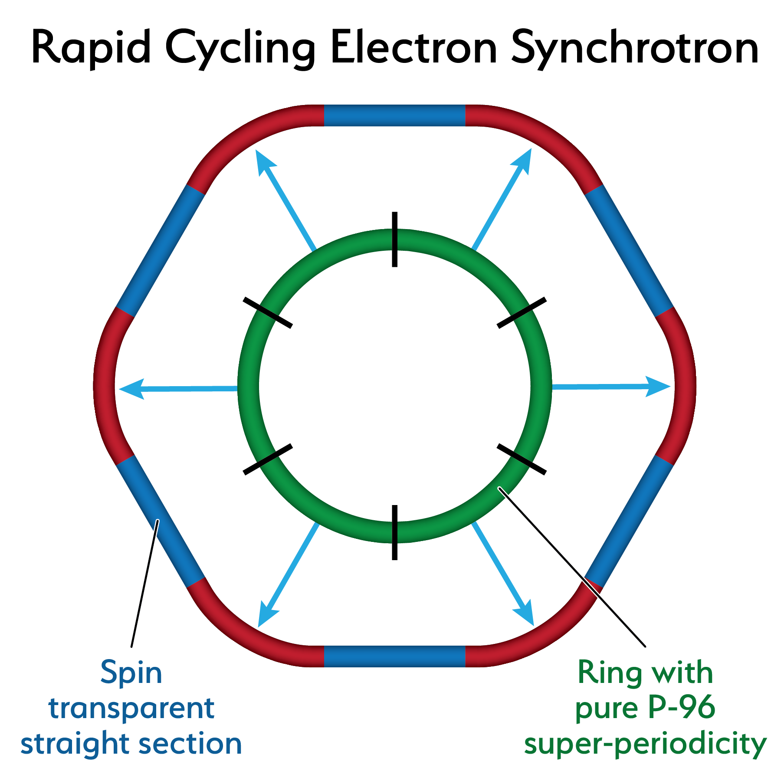
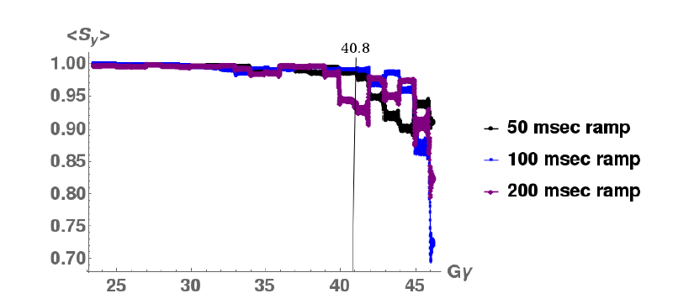
18 GeV Rapid Cycling Synchrotron enables high electron polarization in the electron storage ring
85% polarized electrons from a polarized source and a 400 MeV s-band linac
get injected into the fast cycling synchrotron in the RHIC tunnel
AGS experience confirms depolarization suppressed by lattice periodicity
RCS with high (P=96) quasi-periodicity arcs and unity transformations in the straights suppresses all systematic depolarizing resonances up to E >18 GeV
Good orbit control y_{cl.o.}< 0.5 mm; good reproducibility suppresses depolarization by imperfection resonances
➔ No depolarizing resonances during acceleration 0.4-18 GeV
no loss of polarization on the entire ramp up to 18 GeV (100 ms ramp time, 2 Hz)
RCS Design
RCS Polarization Performance confirmed by extensive simulations

Slide 42

High average polarization at electron storage ring of 80% by
Frequent injection of bunches on energy with high initial polarization of 85%
Initial polarization decays towards P∞ < ~50% (equilibrium of self-polarization and stochastic excitation)
At 18 GeV, every bunch is refreshed within minutes with RCS cycling rate of 2Hz
Need both polarization directions present at the same time
B P
Refilled every 1.2 minutes
B P
Refilled every 3.2 minutes
Re-injection
P_{av}=80%
P∞= 30%
(conservative)
P_{av}=80%
Re-injections

Slide 43

EIC High Luminosity with a Crossing Angle
Modest crossing angle of 25 mrad
  Avoid parasitic collisions due to short bunch spacing
  For machine elements, to improve detection
  Reduce detector background
However, crossing angle causes
  Low luminosity
  Beam dynamics issues
25 mrad
avoided by Crab Crossing
Then :
  Effective head-on collision restored
  Beam dynamic issues resolved
RF resonator (crab-cavity) prototypes built
and tested with proton beam in the CERN-SPS
- The EIC crab-cavity need large waveguide
ports to allow the trapped modes to escape

Slide 44





Interaction Region Concept
EIC detector must accept and measure all particles from the interaction. (Unlike existing collider detectors!)
Possible to get ~100% acceptance for the whole event
Central Detector/Solenoid
Ion beamline
Scattered Electron
Electron beamline
Dipole
Dipole
Forward (Ion) Detector
Particles Associated
with struck parton
Particles Associated
with Initial Ion

Slide 45





Interaction Region
Beam focused to β_{y} ≤ 5 cm @ σ_{y}= 5 μm, => L=10³⁴ cm⁻² s⁻¹
Manageable IR chromaticity and sufficient DA
Full acceptance for the colliding beam detector
Accommodates crab cavities and spin rotators
Synchrotron radiation and impedance manageable
Conventional NbTi SC magnets, collared & direct wind

Slide 46




Interaction Region
Direct wind s.c. coil production in progress

Slide 47


The EIC will benefit from two large existing detector halls in IR 6 and IR 8
Both halls are large and fully equipped with infrastructure such as power, water, overhead crane, ….
47
47
IR 8 detector hall with PHENIX detector (transitioning to sPHENIX)
IR 6 detector hall with STAR detector
Both IRs can be implemented simultaneously in the EIC lattice and be accommodated within beam dynamics envelope
2 IR’s: laid out identically or optimized for maximum luminosity at different E_{CM}
(Second IR and second detector are not in the project scope)

Slide 48
EIC Accelerator R&D Scope
Electron Fast Kicker
Cooler Electron Source
ESR (arc)
Vacuum Chamber
Cooler SRF
ESR Cavity
500kW FPC
Polarized e⁻ Source
HOM Damper
Proton Injection Fast Kicker
Crab Cavity
IR Magnet
IR
Vacuum Chamber

Slide 49





R&D Highlights
Polarized Electron Source Prototype
Spectacular performance shortly after start commissioning earlier this year, cathode lifetime very large under EIC operational conditions
Cathode cooled with FlourinertTM (C₆F₁₆,…)
Is the base for the 100mA gun for strong hadron cooling
EIC Crab cavity prototype: Choice was made to move forward with the RF kicker design
Conceptual design of the prototype well advanced
e-Vacuum R&D
Prototype of RCS Cu vacuum chamber and 3D rendering of the sliding bellow prototype design

Slide 50
EIC Partnerships
EIC is international from its conception
Collaboration on EIC design and construction –mutually beneficial, providing a gateway to EIC science, advancing accelerator science and technology
Possible contributions to the EIC accelerator could include the full range of accelerator design and hardware
  E.g. IR magnet design and construction, luminosity monitoring, RF R&D and construction, normal conducting magnets, critical vacuum components, feedback systems, polarimetry, contributions to the 2nd IR, beam-dynamics calculations, etc.
Detector will be constructed in international collaboration, with substantial contribution from partners
The Experimental Program Partnership Activities
  Expressions of Interest (EoI) submitted in 2020
  Call for Collaboration Proposals for Detector(s) - March 2021
  Collaboration Proposals Due – December 2021
  EIC Project Detector Defined – March 2022

Slide 51

Reference Schedule

Slide 52
International Engagement - Accelerator
Active engagement ramped up last summer through meetings with DOE and funding agency reps, Accelerator Workshops, and dialogue with potential partners
Collaborations contributing to both design and hardware that cover a broad range of WBS items are in development
Bi-lateral meetings now expand from EIC L1 management to L2 & L3 EIC experts for detailed technical discussion of possible in-kind scope
  Examples: Crab Cavity system information exchange meeting w/UK and Canada, meetings w/INFN-Accelerator collaboration on HSR vac. system, w/CERN on ESR vac. sys., etc.

Slide 53
Potential Accelerator Contributions
Italy, INFN
  HSR vacuum chamber inserts
Canada, TRIUMF
  SC Crab Cavity system
  Pulsed systems
UK, ASTEC & Cockcroft Inst.
  ERL components
France, IJCLab
  SHC ERL diagnostics
France, CEA Saclay
  IR SC magnets
  SC spin rotators
CERN, Switzerland
  ESR SC cryomodules joint design
  ESR high current elements joint design
Japan, KEK
  ESR collimation system
High level readiness of technical status
Possibly, first case for use of seed funds
High level readiness of technical status
Project is developing possibility of “Seed” funds for EIC international collaboration that can enable early start of EIC accelerator design efforts in partner countries
Recent & tentative:
Israel, SARAF
  RF power amplifiers, collimators, controls
Sweden, Uppsala Uni.
  SSPA

Slide 54
Summary
The EIC will be a discovery machine, providing answers to long-elusive mysteries of matter related to our understanding the origin of mass, structure, and binding of atomic nuclei that make up the entire visible universe
EIC project is underway aiming to start physics in about a decade
EIC will be state of the art collider pushing the frontiers of accelerator science and technology
The EIC project will work closely with domestic and international partners to deliver the EIC construction project and then begin EIC operations
Collaboration in EIC design, construction and scientific exploration is welcome!

