Slide 1
Mapping the Magnetically Shielded Room for the Neutron Electric Dipole Moment Experiment at TRIUMF
Presenter: Maedeh Lavvaf
Supervisor: Dr. Russell Mammei

Slide 2
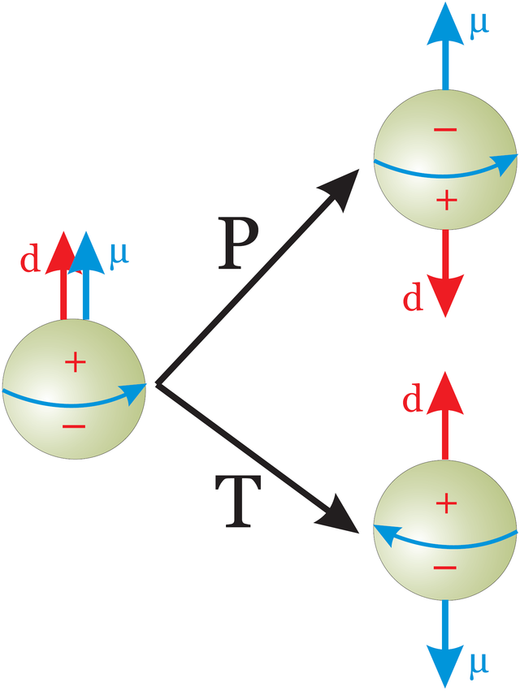
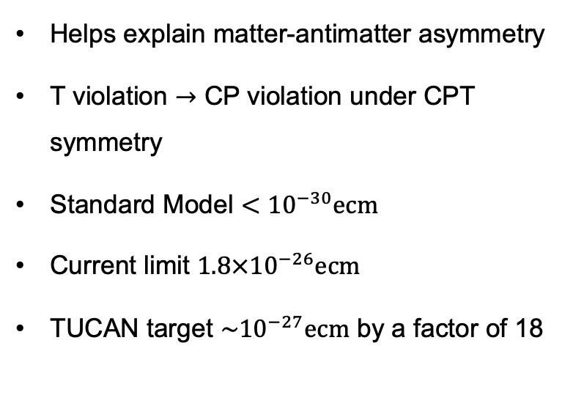
nEDM Experiment Motivation
Helps explain matter-antimatter asymmetry
T violation $→$ CP violation under CPT symmetry
Standard Model $<{10}^{−30}ecm$
Current limit $1.8×{10}^{−26}ecm$
TUCAN target $\sim {10}^{−27}ecm$ by a factor of 18
Electric dipole moment direction changes under parity, magnetic dipole moment under time-reversal

Slide 3
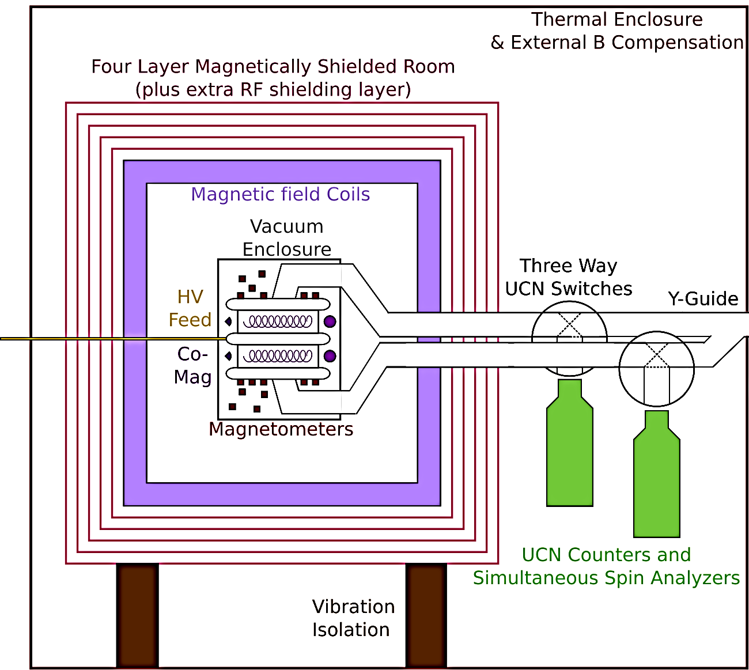



nEDM Experiment
Experimental technique:
Put UCN in a E and B fields
Search for a change in spin precession frequency upon E reversal
$$hν_{±}=2μ_{n}B ±2d_{n}E$$
$$E=10 kV/cm$$
$$B=1μT$$

Slide 4
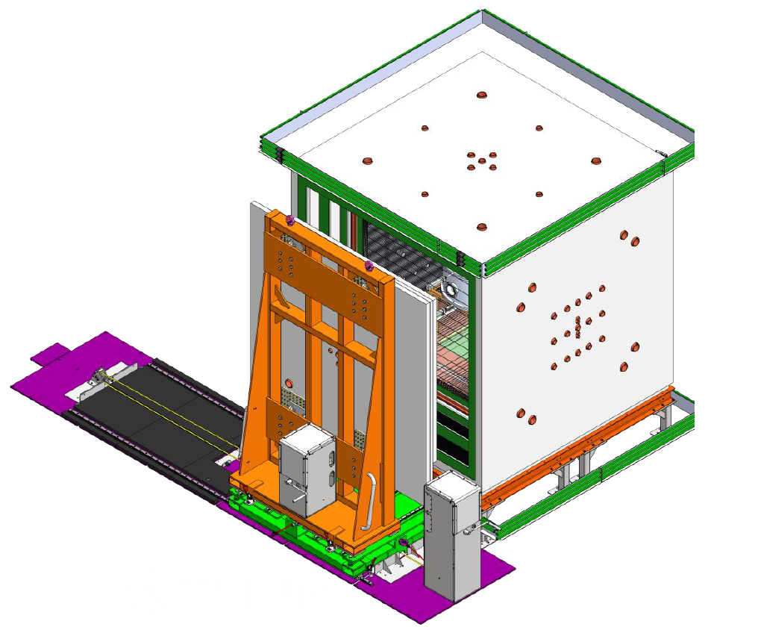
TUCAN MSR
Ambient magnetic field coils (AMC)
A Magnetically Shielded Room (MSR) is a multi-layer room built with high permeability material, such as mumetal, and high conductivity sheet materials, such as copper.
Shielding factor: 100000
Size:
- inner: 2.4 m^3
- outer: 3.5 m^3
Door
Holes
Motion winches

Slide 5
Mapping inside the MSR
Errors:
Perturb positions
B field errors
Vary the angle
Tilting of the stick
10 cm
R
L
240 cm
z
z
y
x
x

Slide 6
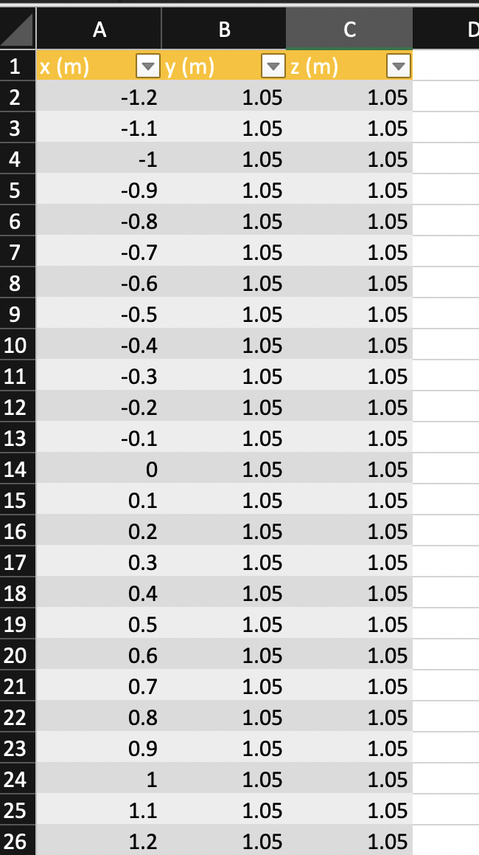
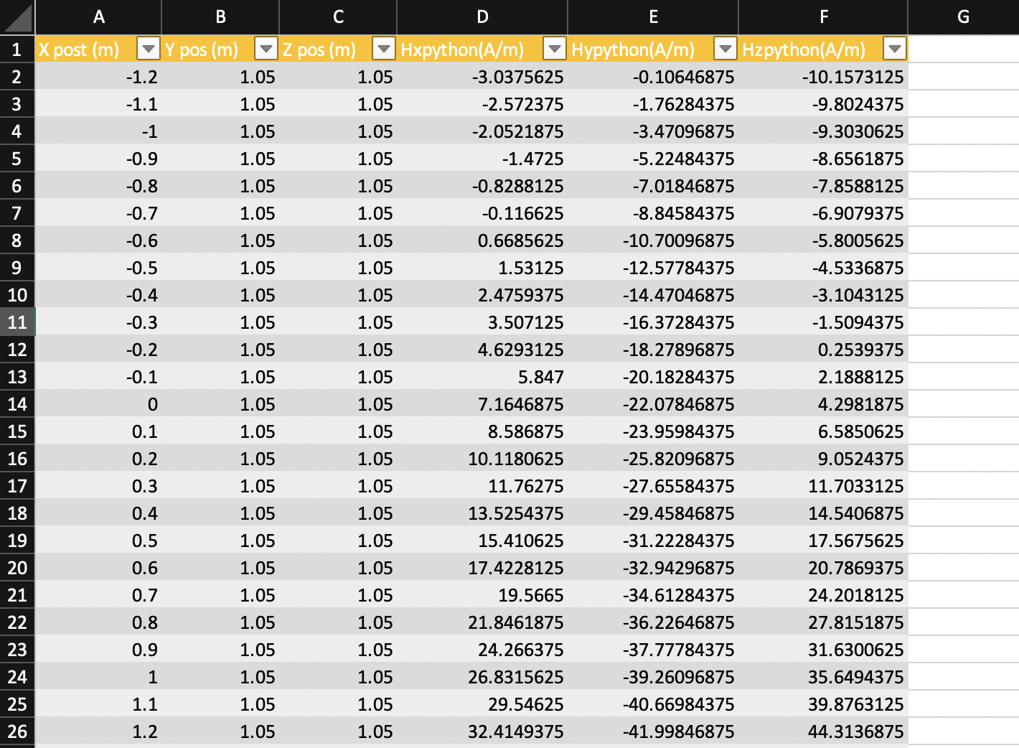
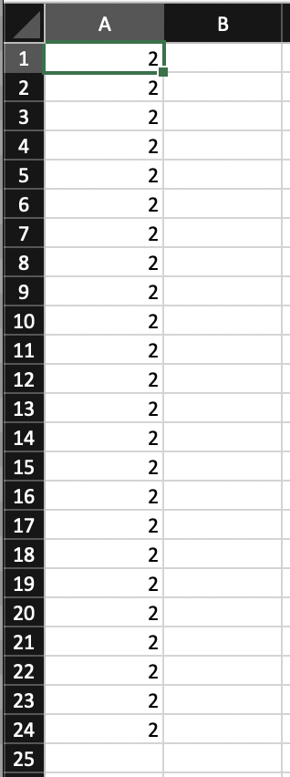
Generating field map and pseudoinverse method
438 points for 10 cm spacing
5th order glm = 2
Get back glms
Gl,m are the coefficients that describe the magnetic field in the volume by gradient.

Slide 7
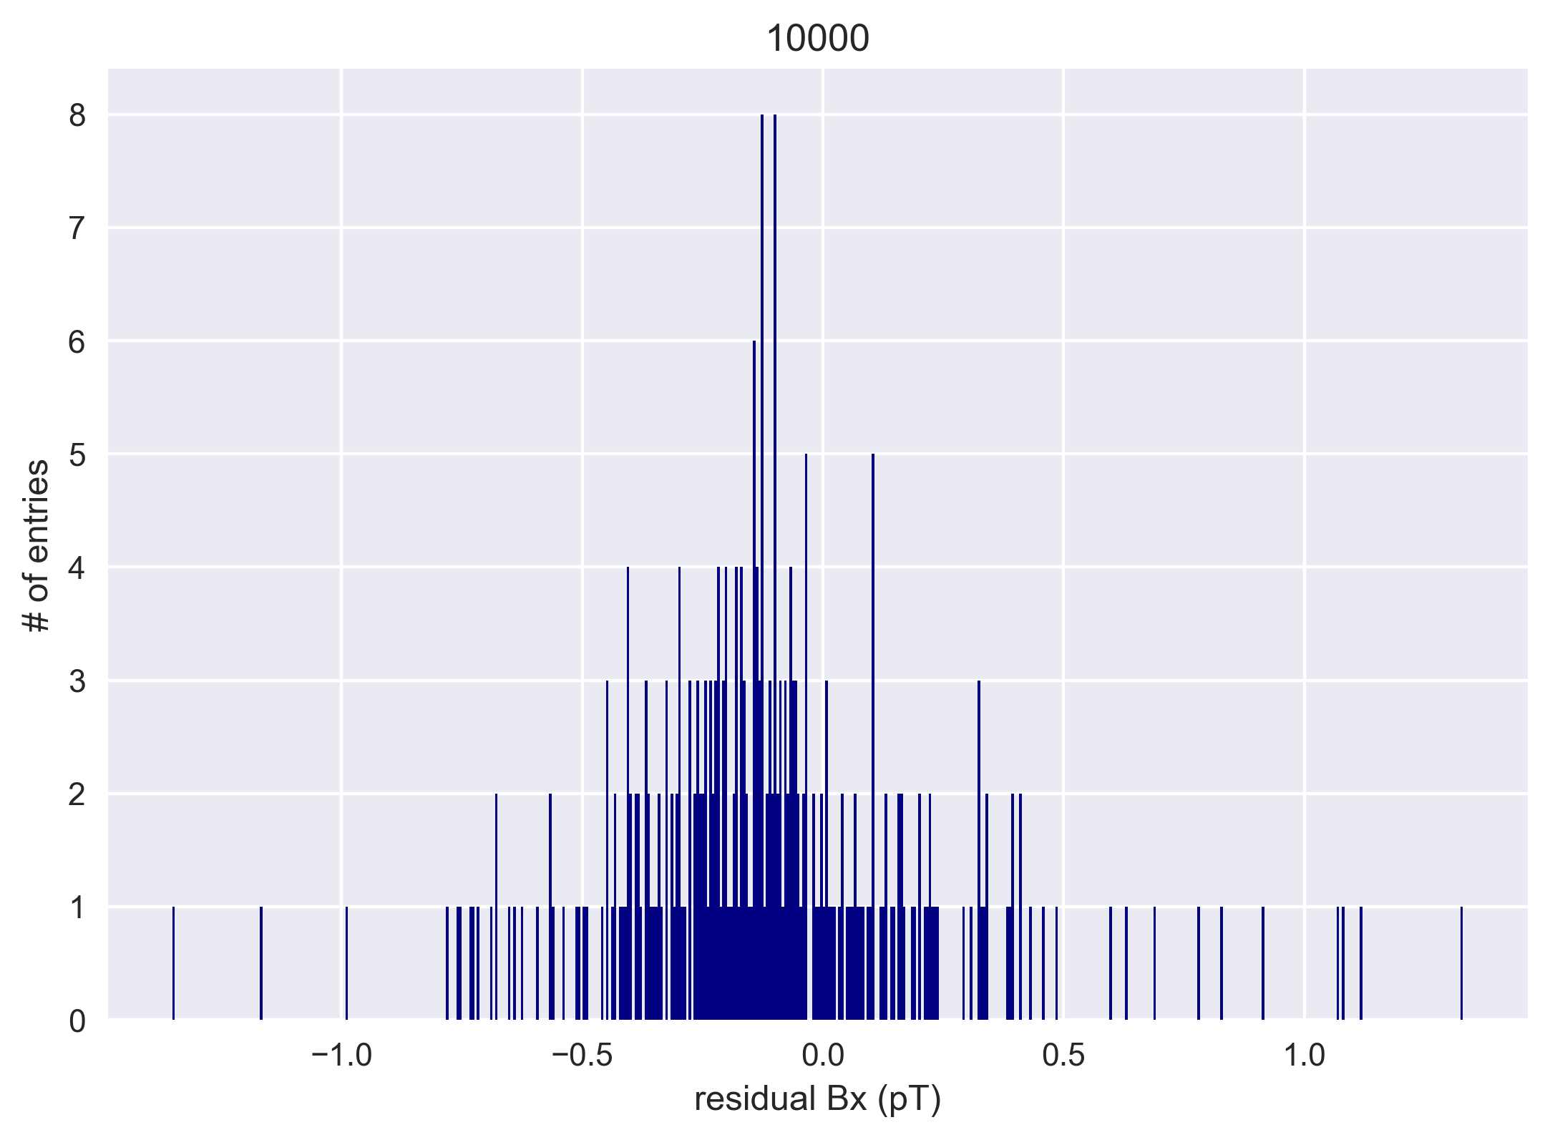
Adding errors
Munich MSR GLMs
True B Fields
Perturb either Fields or positions
Leastsquare fit
Get the Fit glms
Make the Fit B fields
Plot the residual of the True B field – Fit B fields at the true positions
Uniform errors for positions (0.1 cm)
1 time adding random errors
Std.dev = ﻿0.35381 pT

Slide 8
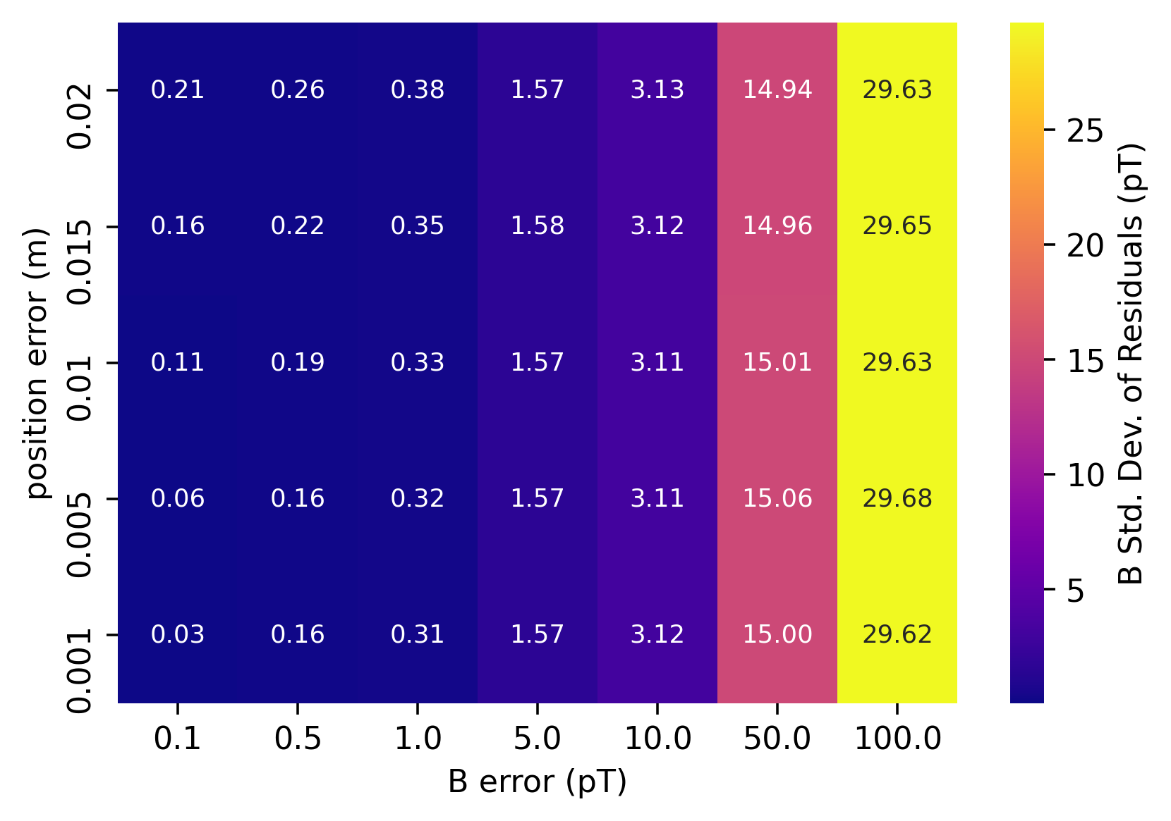
Errors effect
Std.dev becomes 2 times larger
(when B error is twice)
B error would be dominant after 1 pT error
We also rotate the sensor from -15 deg to 15 deg: max Std.dev in B was 1.5 pT
We tilted the end of the “stick” by 5 cm and Std.dev in B was 1.5 pT.
B error is the dominant error.
The position, rotation, and tilting errors are not gonna make a huge difference.

Slide 9
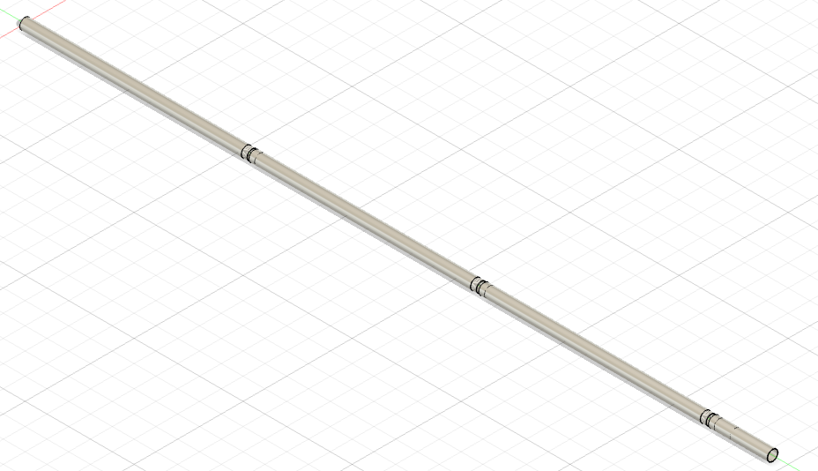
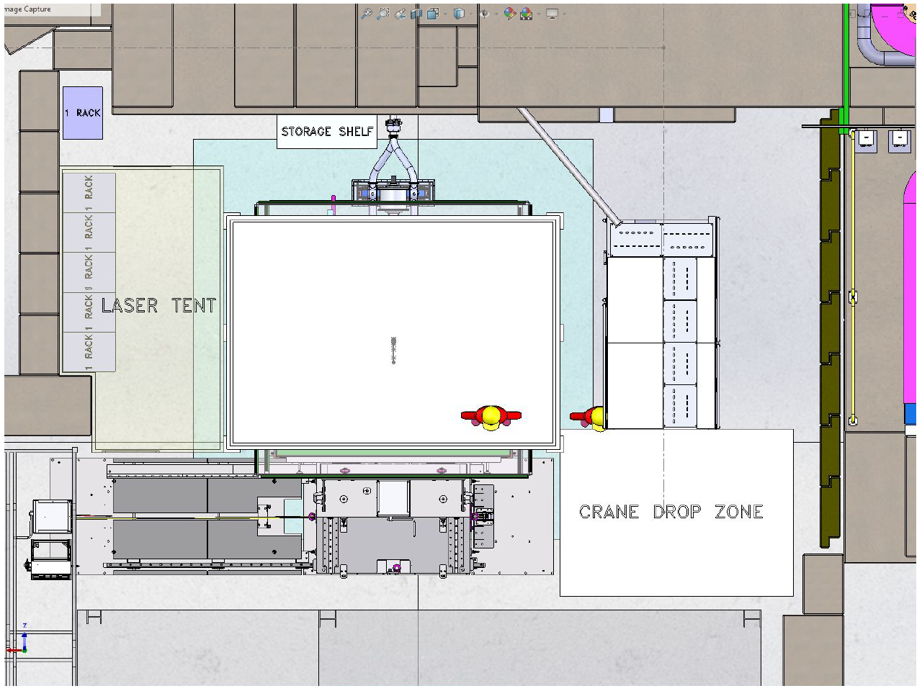
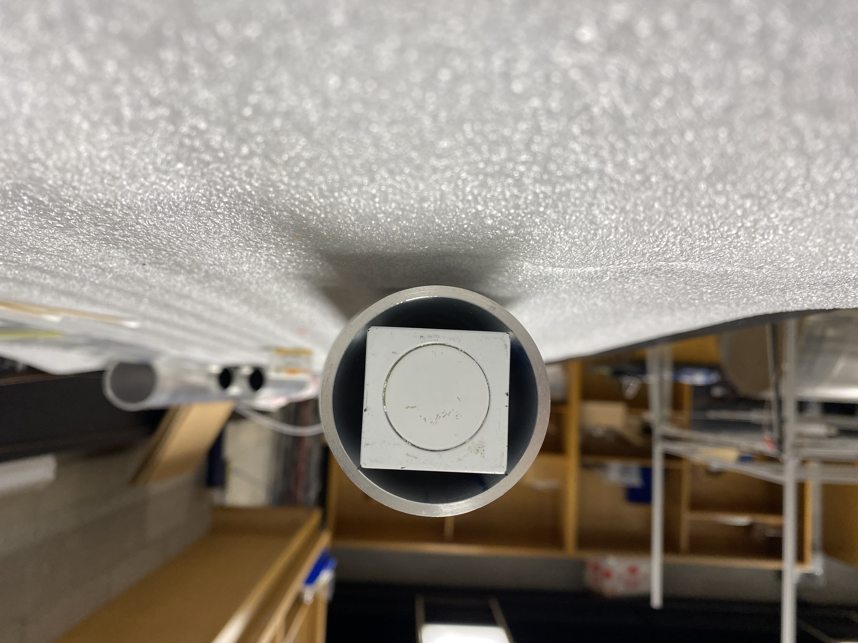
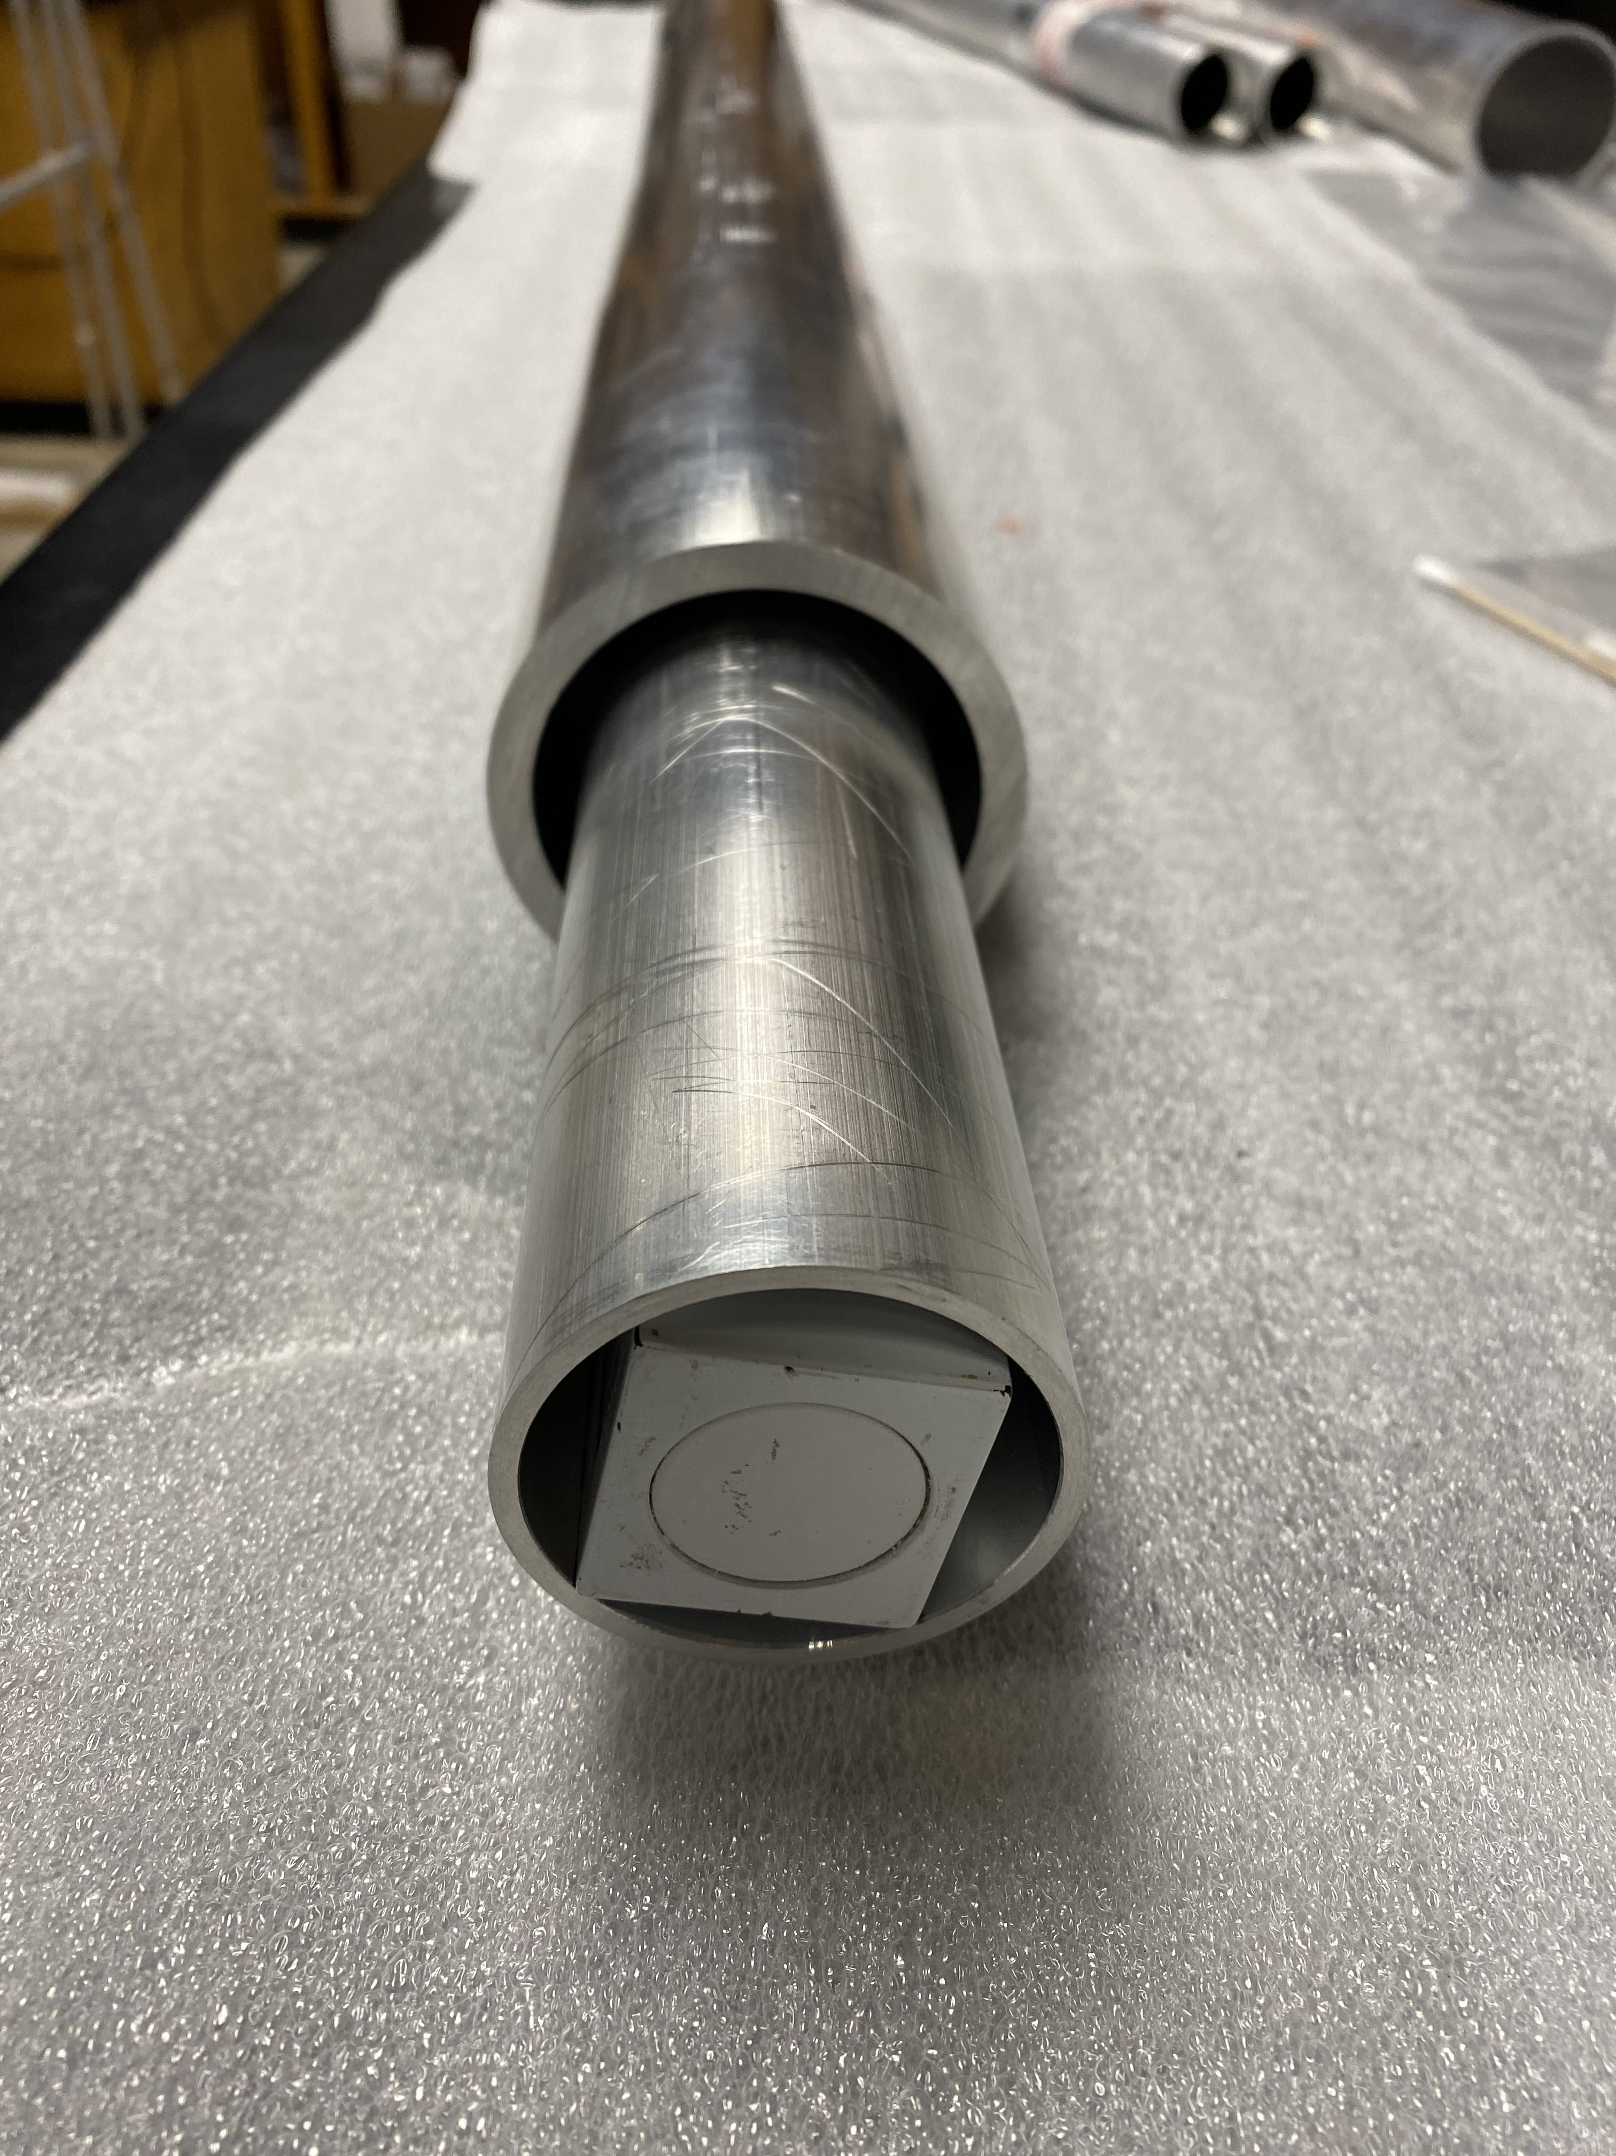
Mapping hardware
3.25 m
50 mm

Slide 10
MSR Project timeline
Task name | Date
Site Prep. | July to August (2022)
Door and base built | August to November (2022)
Layers built (degaussing, assessing shielding factor and magnetic hot spots at each layer) | November (2022) to April (2023)
All 5 layers degaussing | April (2023)
Cladding, light and floor | May (2023)
Testing performance/optimization | June (2023)
MSR build complete | June (2023)
Intensive mapping | July (2023)
Coils installation | Fall 2023

Slide 11
Conclusion
Trying to measure the nEDM 1.0e-27 ecm
Having a MSR to block ambient B field to do our experiment
My role:
- Measuring the performance of the MSR
- Developing the mapping system and its requirements
MSR should be ready to map next July

Slide 12
Thanks for your attention!

Slide 13
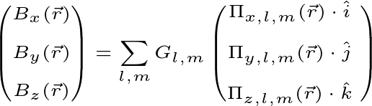

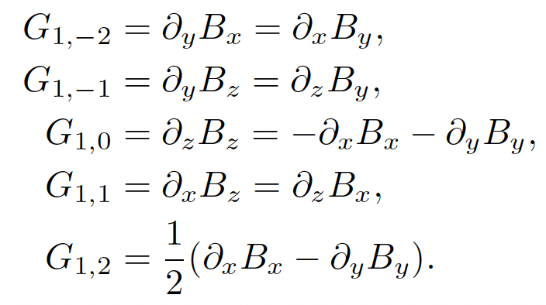
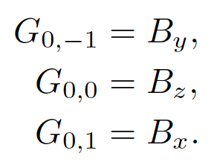

Decomposition into spherical harmonics
In free space,
$$∇^{2}Φ=0$$
Where Πi,l,m are the x, y, and z derivatives of the scalar basis functions. Gl,m are then the coefficients that describe the magnetic field in the volume by gradient.
l=0
l=1
Ref: C. Abel et.al, Phys. Rev. A 99, 042112 (2019)

