Slide 1





Impact of NH₃ consumption in a low frequency Ar-NH₃ atmospheric pressure DBD
Raphaël Robert, Luc Stafford, Françoise Massines
June 8th 2022
raphael.robert@umontreal.ca

Slide 2

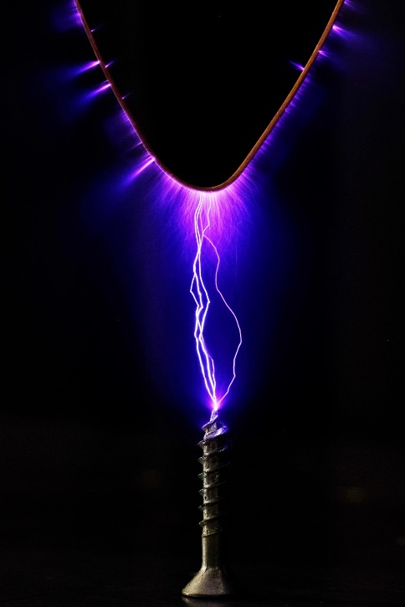
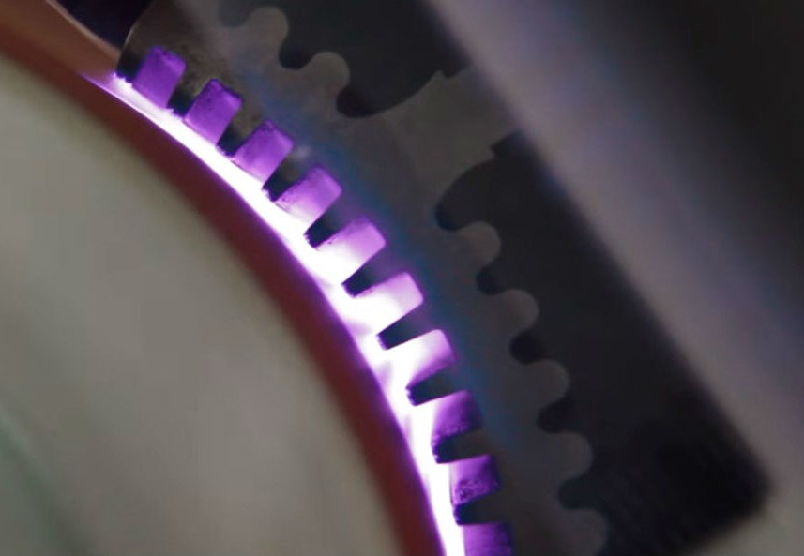
Plasma at atmospheric pressure and use of DBDs
DBD : Dielectric barrier discharge
In nature
T_{gas} ≈ 300 - 500 K
T_{gas} ≈ 5000 - 30 000 K
Charges are collected on dielectrics
Create an E opposite to the applied E
Discharge extinguishes due to dielectrics
In the laboratory
High ionization rate plasma (>1%) :
☑ Welding, depollution
Surface treatment
Thin film layer deposition
DBD ➔ limits the current flow
Prevents arc transition
☑ Treatment of large susbtrates
© Audren Dorval
LAPEX

Slide 3
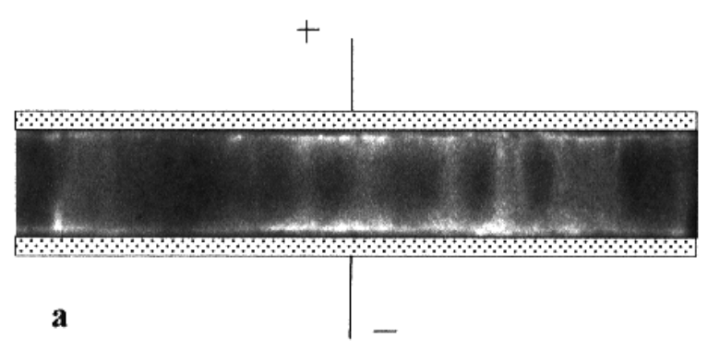
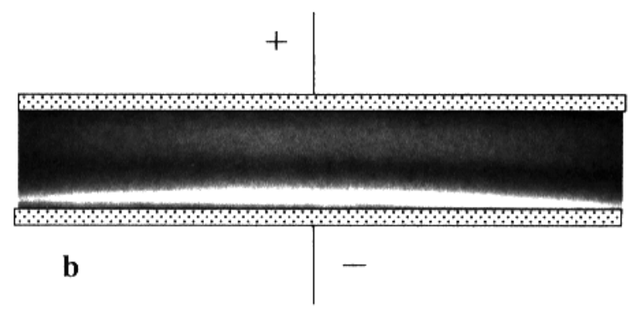
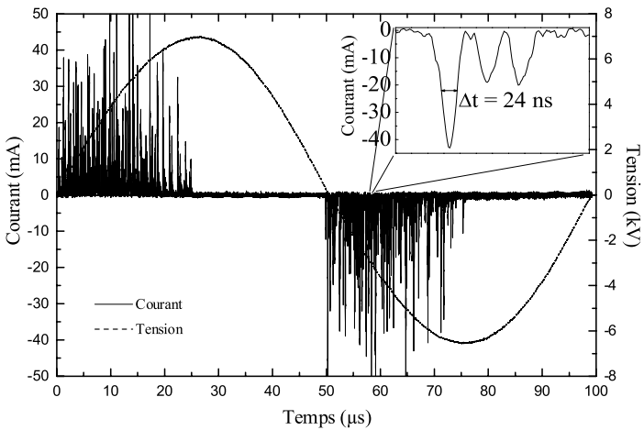
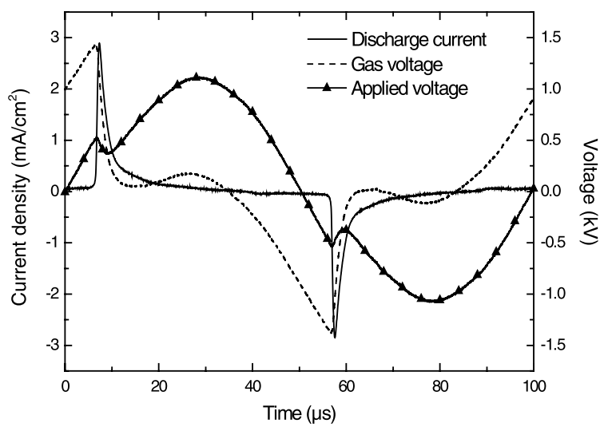
Homogeneous and filamentary discharge at atmospheric pressure
Plane to plane electrode at Atmospheric Pressure (AP) : 2 discharge regimes
Filamentary discharge
Homogeneous discharge
Max power density : 10 W.cm⁻²
Current density : 1-10 A.cm⁻²
Max power density : 1-5 W.cm⁻²
Current density : 1 mA.cm⁻²
Local energy deposit
Statistical surface treatment
Energy deposited on the whole electrode
Applied voltage, gas voltage and current as a function of time [1]
[1] F. Massines and G. Gouda, J. Phys. D. Appl. Phys., vol. 31, no. 24, pp. 3411–3420, 1998.
[2] N. Naudé, HAL Id : tel-00601053, p. 18, 2011.
Applied voltage, gas voltage and current as a function of time [1]

Slide 4
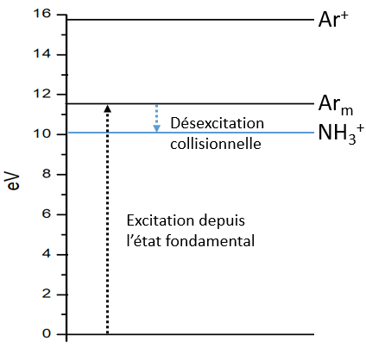
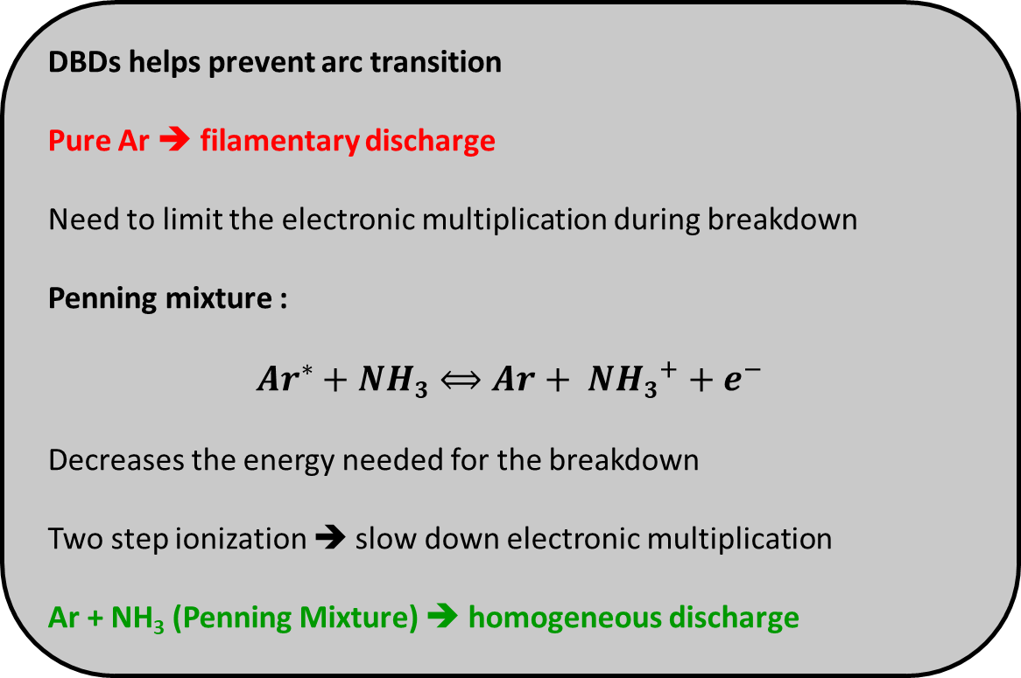
Use of Penning mixture
DBDs helps prevent arc transition
Pure Ar ➔ filamentary discharge
Need to limit the electronic multiplication during breakdown
Penning mixture :
$${Ar}^{∗}+NH3⟺Ar+ {NH3}^{+}+e^{−}$$
Decreases the energy needed for the breakdown
Two step ionization ➔ slow down electronic multiplication
Ar + NH₃ (Penning Mixture) ➔ homogeneous discharge
Collisional
de-excitation
Direct excitation
Dire
Energy levels for Ar and NH₃

Slide 5
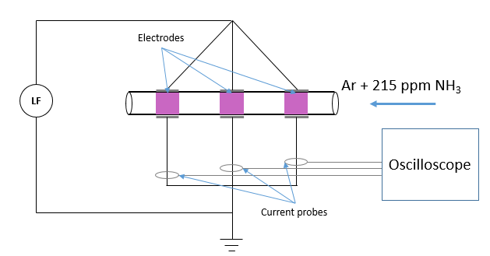
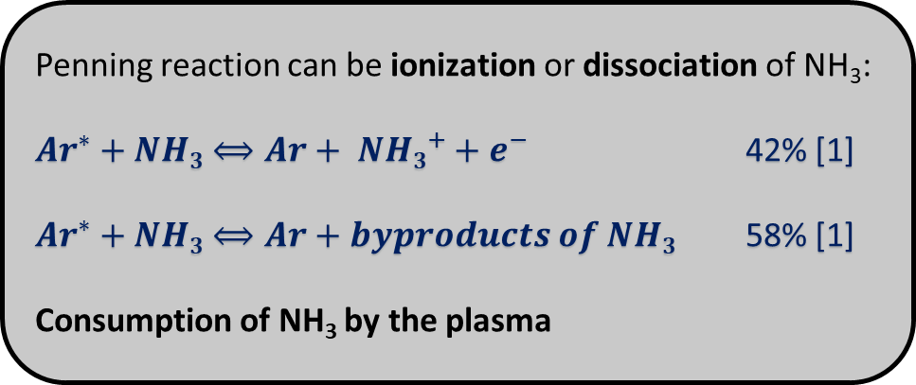
Consumption of NH₃ by the discharge
Penning reaction can be ionization or dissociation of NH₃:
${Ar}^{∗}+NH3⟺Ar+ {NH3}^{+}+e^{−}$ 42% [1]
${Ar}^{∗}+NH3⟺Ar+byproducts of NH3$ 58% [1]
Consumption of NH₃ by the plasma
2 mm gap
1 mm layer of quartz
50 kHz
3rd
1st
Byproducts of NH₃ : NH / N₂ / OH / NH₂
Experimental setup
[1] J. Balamuta, M. F. Golde, and Y. Ho, J. Chem. Phys., vol. 82, no. 7, pp. 3169–3178, 1983.

Slide 6
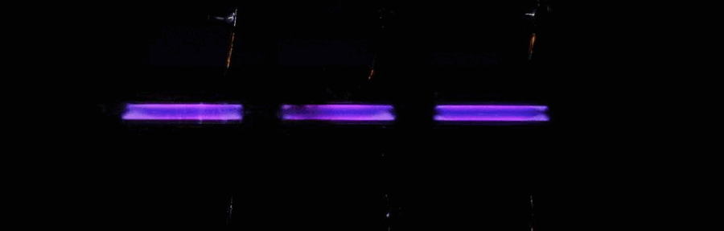
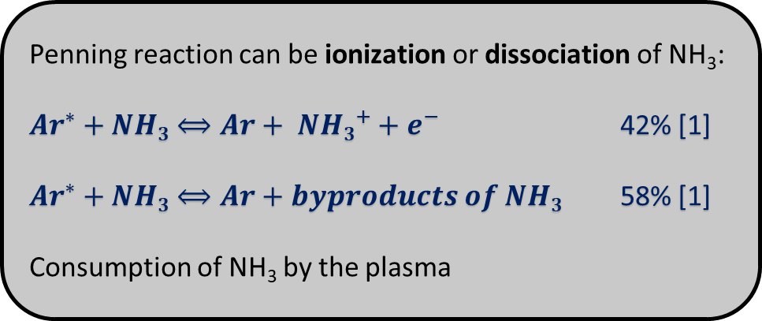
Consumption of NH₃ by the discharge
Penning reaction can be ionization or dissociation of NH₃:
${Ar}^{∗}+NH3⟺Ar+ {NH3}^{+}+e^{−}$ 42% [1]
${Ar}^{∗}+NH3⟺Ar+byproducts of NH3$ 58% [1]
Consumption of NH₃ by the plasma
280 ➔ 28 sccm
Ar + NH₃
3rd
1st
Current and voltage for the 1st and the 3rd discharge with 280 sccm flux
[1] J. Balamuta, M. F. Golde, and Y. Ho, J. Chem. Phys., vol. 82, no. 7, pp. 3169–3178, 1983.

Slide 7
Electrical signature of NH₃ consumption
Discharge current is affected by total flow of Ar + NH₃ (215 ppm)
Low flow ➔ No discharge
Medium flow ➔ Abnormal current peak (thin peak, slow decrease of the current)
High flow ➔ Typical glow DBD current peak
Current shape linked to the flow, via residence time of the Penning mixture
Flow : 28 sccm ➔ gas speed : 0,037 m.s⁻¹ ➔ residence time in the discharge : 0,38 s
Flow : 56 sccm ➔ gas speed : 0,074 m.s⁻¹ ➔ residence time in the discharge : 0,19 s
Flow : 168 sccm ➔ gas speed : 0,22 m.s⁻¹ ➔ residence time in the discharge : 0,063 s
Typical glow DBD ➔ below a residence time of 0,1 s
Current and voltage for as function of the Ar + NH₃ flux

Slide 8
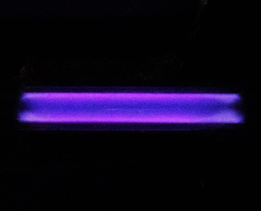

Optical signature of NH₃ consumption
280 sccm
56 sccm
Low flow ➔ NH₃ is consumed at the entrance of the discharge
Current peak indicates abnormal discharge
Optically, entrance of the plasma differs from exit
Measurement of the light intensity shows a temporal shift
1st discharge
1st discharge
Ar + NH₃
Picture of the 1st discharge cell
Combination of electrical and optical measurements
One single discharge ➔ Two behaviors
Intensity of the visible ligth on one discharge as function of time

Slide 9
Conclusion
Quantity of NH₃ is a key parameter in the physics driving Ar based homogeneous DBDs
NH₃ consumption induces :
Increase of breakdown voltage
Broadening of the discharge current peak
Two distinct discharge regimes ➔ a typical DBD glow and a low density glow (Townsend ?)
  Measurements as a function of space and inlet flow indicates a critical gas residence time for a typical DBD glow vs hybrid glow discharge
Ar + 215 ppm

Slide 10
Electrical signature of NH₃ consumption
Discharge current is affected by the total flow of Ar + NH₃ (215 ppm)
Low flow ➔ No discharge
Medium flow ➔ Abnormal current peak (thin peak, slow decrease of the current)
High flow ➔ Typical glow DBD current peak
Current shape linked to the flux via residence time Penning mixture
Flow : 28 sccm ➔ gas speed : 0,037 m.s⁻¹ ➔ residence time in the discharge : 0,38 s
Flow : 56 sccm ➔ gas speed : 0,074 m.s⁻¹ ➔ residence time in the discharge : 0,19 s
Flow : 168 sccm ➔ gas speed : 0,22 m.s⁻¹ ➔ residence time in the discharge : 0,063 s
Typical glow DBD ➔ below a residence time of 0,1 s
Current and voltage for as function of the Ar + NH₃ flux

Slide 11
Experimental details
2 mm gap
1 mm layer of quartz
3rd
1st
Current and voltage for the 1st and the 3rd discharge with 280 sccm flux
Breakdown on the 3rd electrode occurs later than the one on the 1st electrode
i.e. For a higher applied voltage
Confirms the consumption of NH₃ along the gas flow lines

Slide 12
Conclusion
Quantity of NH₃ is a key parameter in the physics driving Ar based homogeneous DBDs
Spacially resolved electrical measurements revealed that NH₃ consumption induces :
  Increase of breakdown voltage
  Broadening of the discharge current peak
Spacially resolved optical measurements revealed that NH₃ consumption induces :
  Two distinct discharge regimes ➔ a typical DBD glow and a low density glow (Townsend ?)
  Measurements as a function of space and inlet flow indicates a critical gas residence time for a typical DBD glow vs hybrid glow discharge
Ar + 215 ppm

Slide 13
Experimental details
Ar + 215 ppm
3rd
1st
Current and voltage for the 1st and the 3rd discharge with 280 sccm flux
Breakdown on the 3rd electrode occurs later than the one on the 1st electrode
i.e. For a higher applied voltage
Confirms the consumption of NH₃ along the gas flow lines

Slide 14
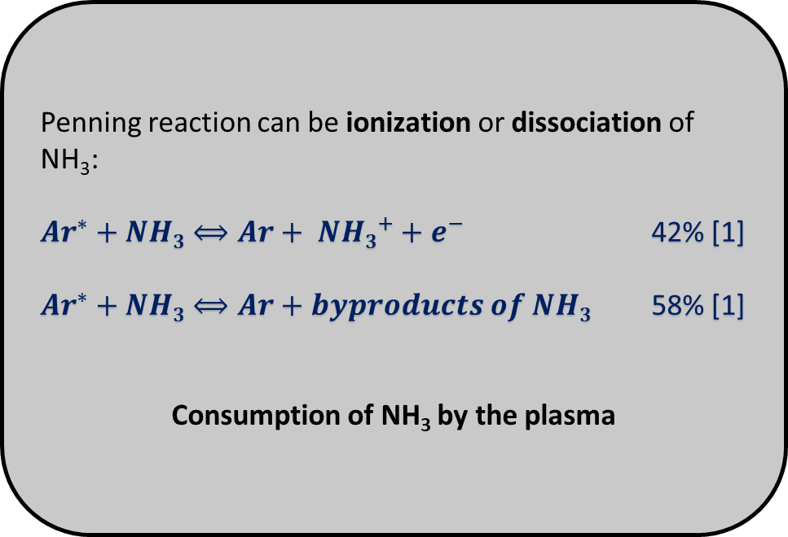
Consumption of NH₃ by the discharge
Penning reaction can be ionization or dissociation of NH₃:
${Ar}^{∗}+NH3⟺Ar+ {NH3}^{+}+e^{−}$ 42% [1]
${Ar}^{∗}+NH3⟺Ar+byproducts of NH3$ 58% [1]
Consumption of NH₃ by the plasma
2 mm gap
1 mm layer of quartz
3rd
1st
Experimental setup
[1] J. Balamuta, M. F. Golde, and Y. Ho, J. Chem. Phys., vol. 82, no. 7, pp. 3169–3178, 1983.

Slide 15
Conclusion
Quantity of NH₃ is a key parameter in the physics driving Ar based homogeneous DBDs
Spacially resolved electrical measurements revealed that NH₃ consumption induces :
  Increase of breakdown voltage
  Broadening of the discharge current peak$
Spacially resolved optical measurements revealed that NH₃ consumption induces :
  Two distinct discharge regimes ➔ a typical DBD glow and a low density glow (Townsend ?)
  Measurements as a function of space and inlet flow indicates a critical gas residence time for a typical DBD glow vs hybrid glow discharge regime low density glow (Townsend ?)
Once the discharge ignites, NH₃ is consumed; if the quantity of NH₃ is insufficient, the discharge changes its behavior as the dissociation of NH3 occurs.
This reasoning applies to all discharges with a controlled quantity of molecules in the carrier gas.
Perspectives :
Calculate NH₃ consumption as a function of residence time and applied power
Determine the minimum amount of NH₃ to inject into a discharge in order to have the same behavior from the entrance to the exit of the discharge
Ar + 215 ppm

Slide 16

What is a Plasma ?
Plasmas is the « 4th state of matter »
Composed by neutral, electrons, ions, radicals, photons
Electrodes
Ar + 215 ppm NH₃
LF
Oscilloscope
Current probes

Slide 17
Homogeneous and filamentary discharge at atmospheric pressure
On plane electrode at atmospheric pressure (AP) : 2 regimes of discharge
Filamentary discharge
Homogeneous discharge
Max power density : 10 W.cm⁻²
Current density : 1-10 A.cm⁻²
Max electron density : 10²⁰ m⁻³
Max power density : 1-5 W.cm⁻²
Current density : 1 mA.cm⁻²
Max electron density : 10¹⁷ m⁻³
Local energy deposit
Statistical treatment
Energy deposited on the all electrode size
Applied voltage, gas voltage and current as function of time [1]
[1] F. Massines and G. Gouda, J. Phys. D. Appl. Phys., vol. 31, no. 24, pp. 3411–3420, 1998.
[2] N. Naudé, HAL Id : tel-00601053, p. 18, 2011.
Applied voltage, gas voltage and current as function of time [1]

Slide 18
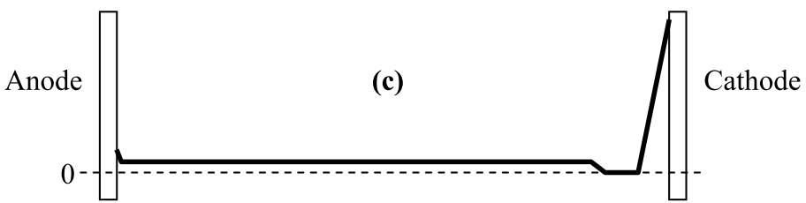
Atmospheric pressure glow DBD (APGD)
DBDs helps prevent arc transition
Homogeneous discharge
LF ignition time ≈ 10 % of the period duration
Ne_{max}: 10¹⁰-10¹¹ cm⁻³
Ni_{max}: 10¹⁰-10¹¹ cm⁻³
NAr^{m}_{max} : 10¹¹ cm⁻³
Current density_{max} : 5 à 20 mA.cm⁻²
T_{gaz} : 300 K
Electric field
Electric field along the gap in a APGD [2]
Power supply voltage, Vps, gas voltage, Vgas, and discharge current, as function of time [1]
[1] N. Naudé, “Etude électrique de la physique d ’ une décharge de Townsend à la pression atmosphérique et de son interaction avec un générateur : Modèle et Expérience To cite this version : HAL Id : tel-00601053,” p. 18, 2011.
[2] F. Massines, N. Gherardi, N. Naudé, and P. Ségur, “Glow and Townsend dielectric barrier discharge in various atmosphere,” Plasma Phys. Control. Fusion, vol. 47, no. 12 B, 2005.

Slide 19

Influence of NH3 quantity
Low flux ➔ NH₃ is consumed at the entrance of the discharge
Current peak indicates abnormal discharge
Optically, entrance of the plasma differs from exit
Measurement of the ligth intensity shows a temporal shift
1st discharge
Ar + 215 ppm
Picture of the 1st discharge cell
One single discharge ➔ Two behaviors
Intensity of the visible ligth on one discharge as function of time

