Slide 1


Streamer propagation at water surface: influence of gap distance and quantification of injected charge
A. Herrmann, J. Margot, A. Hamdan
Groupe de physique des plasmas
Université de Montréal

Slide 2
Outline
Introduction to streamer discharge
Experimental measures of the streamer properties propagating on a water surface
Prediction of the fundamental parameters of the discharge from the experimental measurements

Slide 3
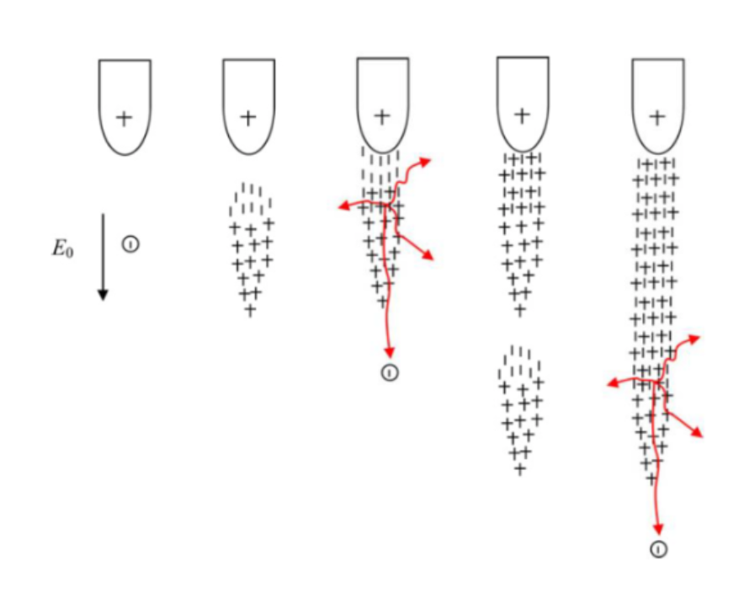
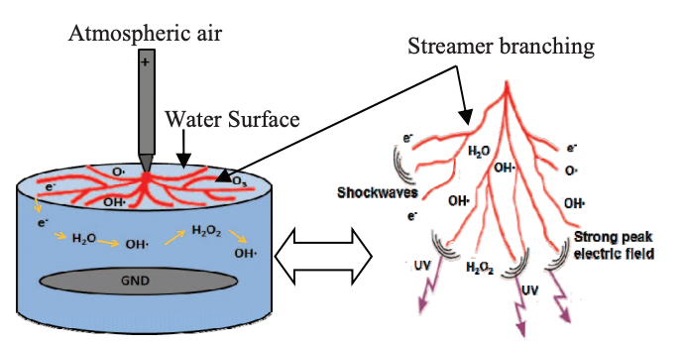
Introduction of Streamer and Streamer-water interaction
Streamer: a highly reactive discharge generating an intense space charge field and reactive species
Figure 1: Propagation of a positive streamer. A. Beroual et al (2016)
Figure 2: Example of a streamer discharge at water surface.
M. A. Halim et al (2017)

Slide 4
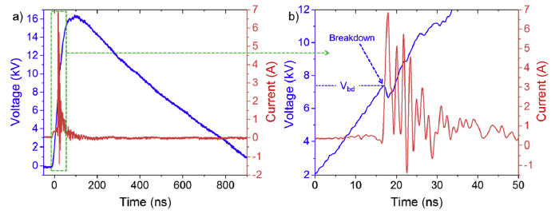
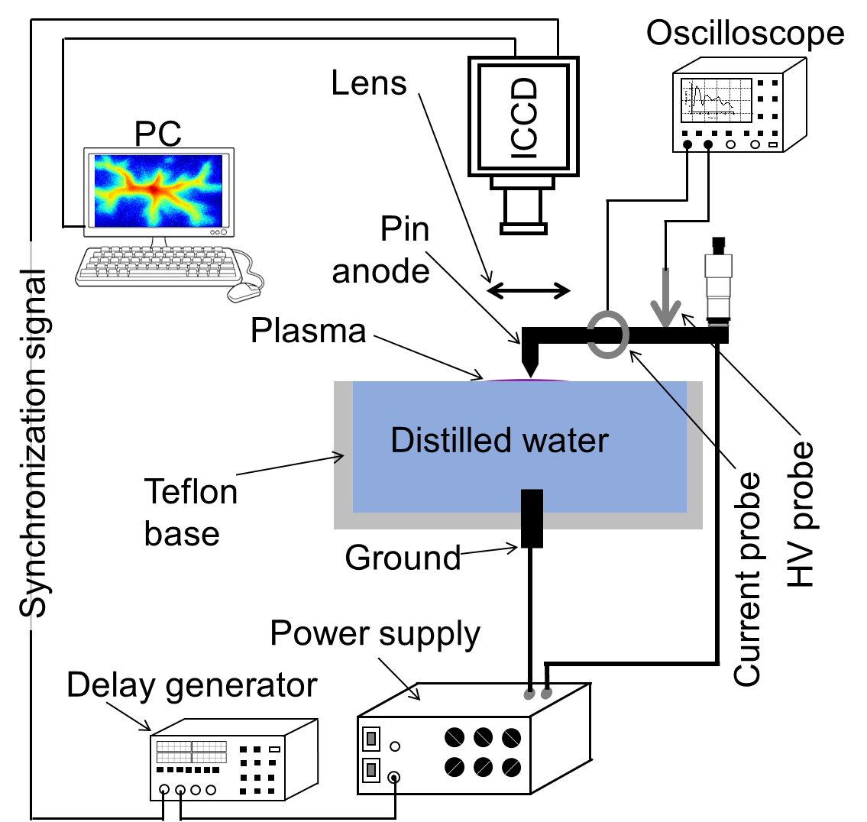



Experimental Setup
10 $μm <d_{gap}<\text{1000 }μm$
8 kV$<V_{applied}<\text{20} \text{kV}$
Figure 4: Electrical characteristics for a typical discharge.
A. Herrmann et al (2022)
$$Q_{total }=\int{I(t)}dt$$
Figure 3: Experimental setup.
A. Herrmann et al (2022)

Slide 5
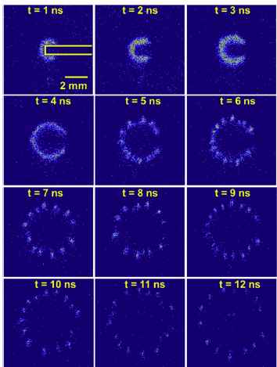
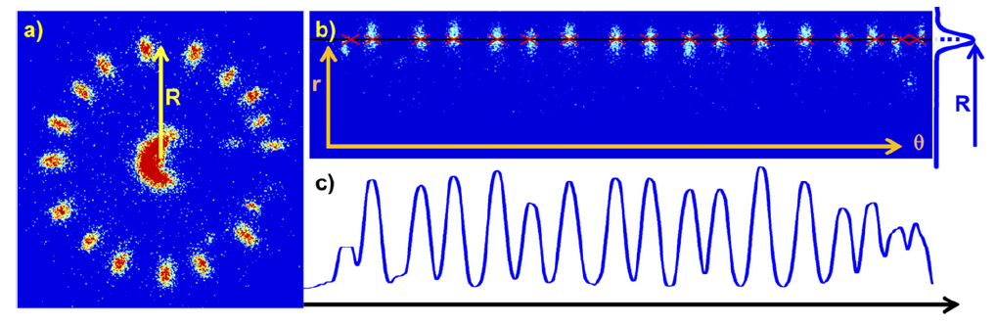
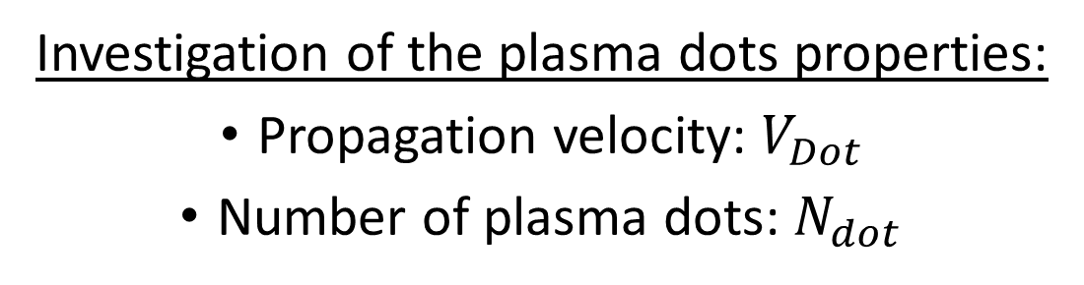
Quantification and propagation of the streamers
Investigation of the plasma dots properties:
Propagation velocity: $V_{Dot}$
Number of plasma dots: $N_{dot}$
Figure 6: 5 ns-integrated used to estimate the number of plasma dot. A. Herrmann et al (2022)
Figure 5: 1 ns-integrated ICCD d = 100 μm and Va = 20 kV. A. Herrmann et al (2022)

Slide 6
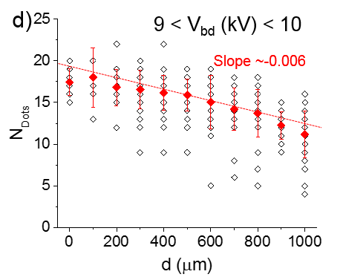
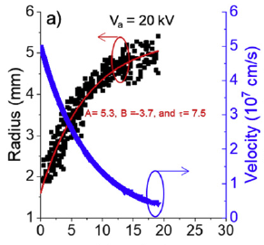
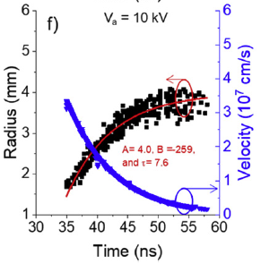
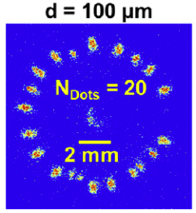
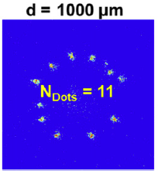


Propagation velocity of the plasma dots and quantification of their number
Increase of the velocity with an increase of the applied voltage
$d_{gap}$ increased of 200$μm$: 1 plasma dot lost
Figure 8: Variation of N_{dots} as a function of d for selected values of V_{bd} (6 < V_{bd} < 7 kV).
A. Herrmann et al (2022)
Figure 7: Evolution of the radial position and the propagation velocity of the plasma dots.
A. Herrmann et al (2022)

Slide 7
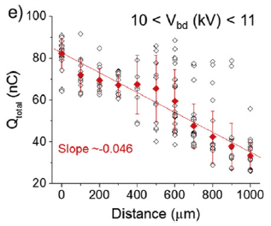
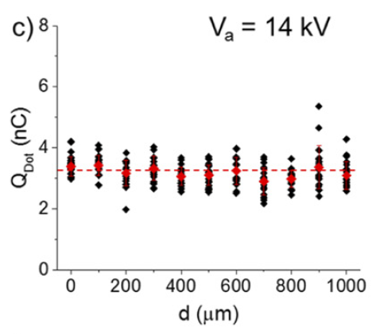
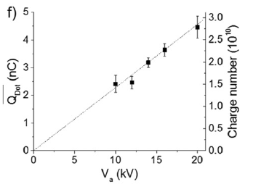
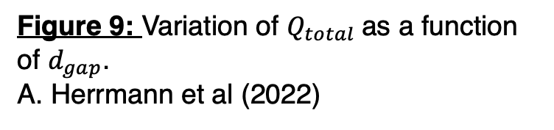
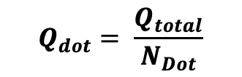

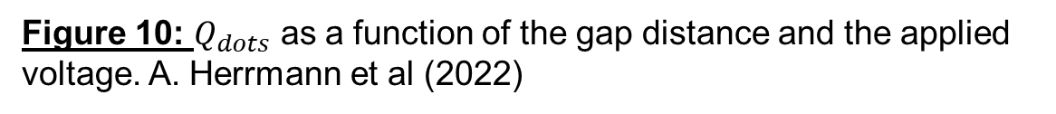
Influence of $d_{gap}$ on the charge measurement
$$Q_{total }$$
$$Q_{dot}= \frac{Q_{total}}{N_{Dot}}$$
Figure 9: Variation of $Q_{total}$as a function of $d_{gap}$.
A. Herrmann et al (2022)
Figure 10: $Q_{dots}$ as a function of the gap distance and the applied voltage. A. Herrmann et al (2022)

Slide 8
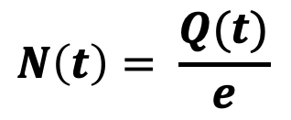



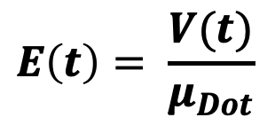

Estimation of the temporal evolution of the plasma dots properties on the water surface based on the experimental data
Measurement of $Q_{dot}$ and $R_{dot}$
Space charge field: $E_{Dot}= \frac{Q_{Dot}}{4πR_{Dot}^{2}}$
$$E_{tot} = E_{external }+ E_{Dot}$$
Estimation of the plasma dot mobility: $μ_{Dot }=V_{Dot}/E_{tot}$
Knowing the temporal evolution of the plasma dot velocity V(t)
$$E\left(t\right)= \frac{V(t)}{μ_{Dot}}$$
$$N\left(t\right)= \frac{Q(t)}{e}$$
$$Q\left(t\right) \sim 4πR_{Dot}^{2} E(t)$$

Slide 9
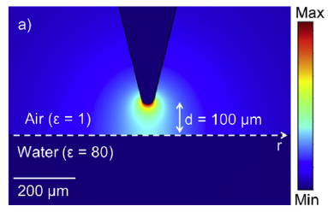
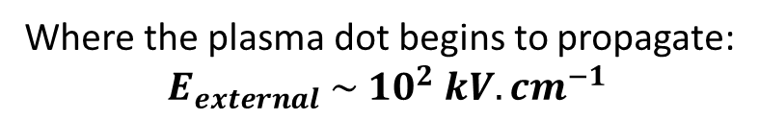

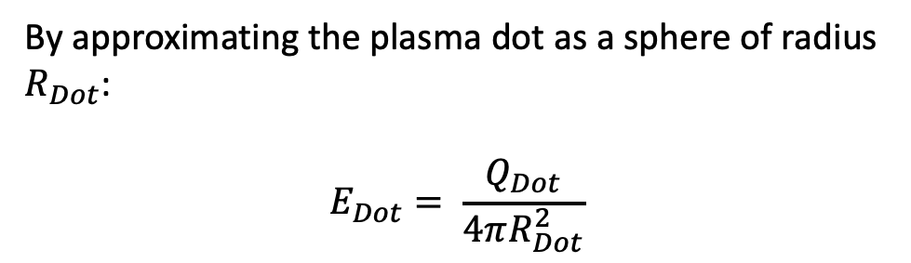
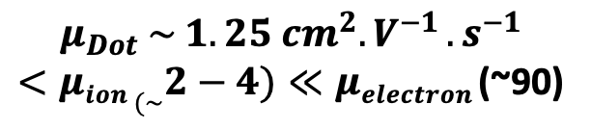
Estimation of the mobility of the plasma dots
Where the plasma dot begins to propagate:
$$E_{external} \sim {10}^{2} kV.{cm}^{−1}$$
By approximating the plasma dot as a sphere of radius $R_{Dot}$:
$$E_{Dot}= \frac{Q_{Dot}}{4πR_{Dot}^{2}}$$
$$Q_{Dot} \sim 4.5 nC ⟹ E_{Dot} \sim 4∗{10}^{4} kV.{cm}^{−1}$$
Figure 11: External field created by the anode.
A. Herrmann et al (2022)
Hence, as $V_{Dot}\sim μ_{Dot}E_{tot}:$
$$μ_{Dot} \sim 1.25 {cm}^{2}{.V}^{−1}{.s}^{−1}$$
$<μion (\sim 2−4)≪μelectron$ (~90)

Slide 10
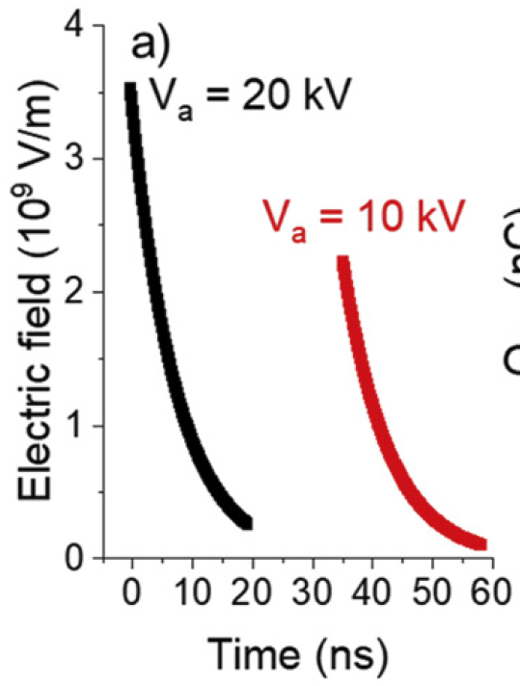
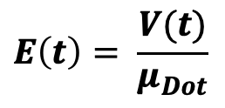
Estimation of the temporal evolution of the space charge field of the plasma dot
$$E\left(t\right)= \frac{V(t)}{μ_{Dot}}$$
E-field produced by a single plasma dot
Figure 12: Evolution of the radial position and the propagation velocity of the plasma dots.
A. Herrmann et al (2022)
Figure 13: Time evolution of the electric field at 100 μm from the center of the plasma dot. A. Herrmann et al (2022)

Slide 11
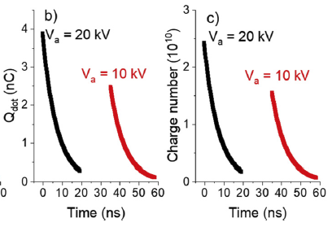


Estimation of the temporal evolution of the charge number of a plasma dot
$$Q\left(t\right) \sim 4πR_{Dot}^{2} E(t)$$
$$N\left(t\right)= \frac{Q(t)}{e}$$
Radial propagation of the plasma dot stops when the number of charged species created during its propagation isn’t sufficient to create a space charge field of the order of the breakdown field.
Figure 14: Time evolution of Qdot and of charge number in a plasma dot for two Va conditions of 20 and 10 kV.

Slide 12
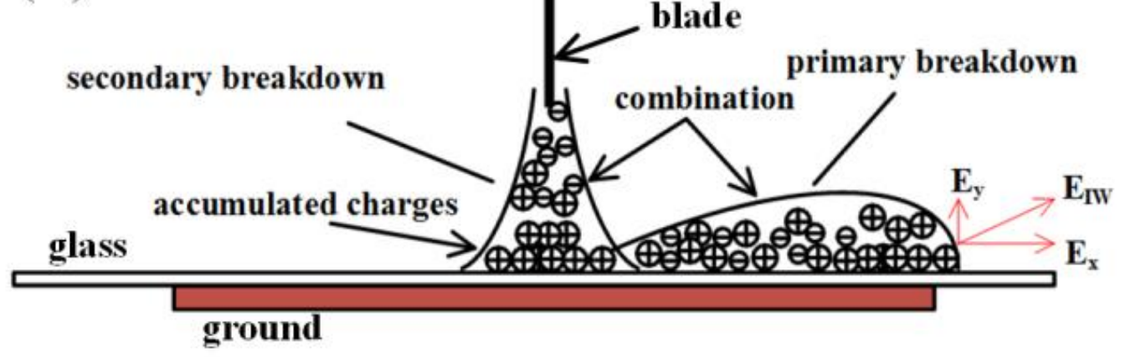
Conclusion
- Increasing the gap distance reduces the number of plasma dots at water surface
- Determination of the plasma dots propagation velocity under different conditions
- Estimation of the mobility of the plasma dot
- Estimation of the evolution of i) plasma dot E-field and ii) charge number of the dot
Perspectives:
Modeling the formation and propagation of plasma dots at water surface
Figure 15: Propagation of a streamer in the air gap and then on the water surface. J. Qiu et al (2017)
Water

