Slide 1


Case Studies for Small-Group Student Collaboration in Large-Enrollment Introductory Physics Classes
Tetyana Antimirova
Department of Physics
Faculty of Science
Toronto Metropolitan University
2022 Canadian Association of Physicists Congress
June 5-10, 2022

Slide 2
Goals
Improve students conceptual learning in large-enrollment introductory physics courses for science and engineering programs using Case Studies format for small-group collaborative activities
Develop Case Studies that explore the fundamental physics principles through realistic physics scenarios
Increase students’ engagement

Slide 3
Motivation
The benefits of peer collaborations in large courses are well-documented [1,2], but typical Peer Instruction often rely on using oversimplified questions presented in a multiple-choice format.
The main disadvantages of multiple choice format are not giving the students an opportunity to formulate their own ideas and the questions not being open-ended.
We aimed at creating more open-ended study materials that would also present more realistic physics scenarios thus reducing the reliance on multiple choice questions.

Slide 4
Fostering Students Collaborations
This project was envisioned before the COVID-19 pandemic and was intended for use during regular on-campus courses.
However, the switch to remote teaching during the pandemic, and the resulting students’ isolation created even more pressing need for student collaboration and community-building.

Slide 5
Background
This proposal is based on some earlier work [3, 4].
It involved introducing stand-alone collaborative group activities based on cognitive conflict that replaced the Peer Instruction activities for a limited number of topics [3].
The analysis of Fall 2007 class intervention demonstrated the high effectiveness of small-group discussions, but at that time, the ability to collect responses to non-multiple choice inquires was limited, as well as the ability to collaborate was also restricted to the nearest neighbors in the classroom.

Slide 6
Case Studies Development
The instructional materials in the form of Case Studies were prepared with the assistance of an upper year student and a recent graduate from Medical Physics program.
Case Studies assignments (worksheets), discussion items, plausible solutions and answers set, as well as grading rubrics were developed.
Each of the Case Studies targets common student misconceptions.
Each Case Study presents a realistic, plausible scenario, and as such, often introduces more than one concept.

Slide 7
Case Studies for Mechanics Content
Free Fall: Dropping a sandbag from a vertically moving balloon
Projectile motion: Throwing a sandbag from a vertically moving balloon
Air resistance: A record-setting jump from a stratosphere
Conservation of energy, normal force, dynamics of circular motion
Conservation of a linear momentum: an investigation of a collision

Slide 8
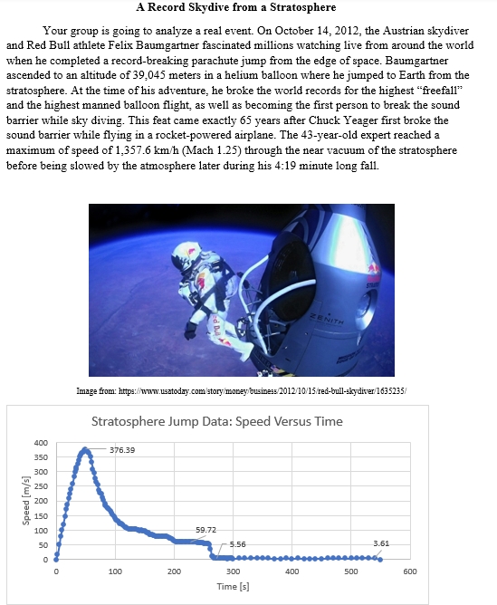
Example of Case Studies
Sky Diving : Record-setting Jump from A Stratosphere
For example, a case study on air resistance and terminal velocity is based on the data log from a record 2011 jump from the stratosphere.

Slide 9
Sample Questions
When and at which altitude did his motion stop being a near unobstructed free fall (evidence of air resistance becomes apparent)?
When and at which altitude did he break the sound barrier? Did this occur after he opened his parachute or before?
When did he reach terminal velocity with his parachute still closed?
For how long and at which altitudes was he in a true free fall?

Slide 10
Sample Questions (Continued)
When he broke the sound barrier, was he still in a free fall or already experiencing the air resistance that cannot be neglected?
What was his vertical speed when he landed?.
Calculate his terminal velocity before he opened his parachute.
Calculate his terminal velocity after he opened his parachute.

Slide 11
Implementation
Two Case Studies were piloted during 2021/2022 academic year as small-group assignments.
Completed outside of the class hours and submitted by the small groups via D2L.
The full set of materials will be used during the 2022/2023 academic year.

Slide 12
Research Questions
Does providing the students with opportunities to collaborate on analyzing realistic physics scenarios and formulating their own ideas increase students’ engagement and fosters active learning?
Will using these open-ended scenarios/activities as a basis for students’ discussions/collaboration further improve students’ conceptual understanding beyond what is achievable while relying only on multiple choice questions and standard end-of-chapter problems?
This is a work in progress. The full impact of students collaborations on Case Studies will be analyzed after a complete implementation during the next academic year.

Slide 13
Acknowledgments
The project on developing Case Studies was funded by the Learning and Teaching Grant (TMU)
The presentation was made possible by the Faculty of Science Dean’s Travel Award

Slide 14
References
E. Mazur, Peer Instruction: A User's Manual. Prentice Hall, 1997
. Crouch, E. Mazur, “Peer Instruction: Ten Years of Experience and Results”, American Journal of Physics, vol.69, no.9, pp.970-977, 2001
Kalman, C. Milner-Bolotin, M., & Antimirova, T. (2010). Comparison of the Effectiveness of Collaborative Groups and Peer Instruction in a Large Introductory Physics Course for Science Majors. Canadian Journal of Physics, 88(5), 325-332.
T. Antimirova, A. Kulesza, A. Noack, M. Stewart, “Evaluating the Effectiveness of Modified Peer Instruction in Large Introductory Physics Classes”. HEQCO,2015.retrieved from http://www.heqco.ca/en-ca/Research/ResPub/Pages/Evaluating-the-Effectiveness-of-Modified-Peer-Instruction-in-Large-Introductory-Physics-Classes-.aspx

Slide 15
Thank you!
Email: antimiro@ryerson.ca

