Slide 1


C14 - Physics Education Commission of the International Union of Pure and Applied Physics
Tetyana Antimirova
Department of Physics
Faculty of Science
Toronto Metropolitan University
C14 - Physics Education Commission Chair
IUPAP
2022 Canadian Association of Physicists Congress
June 5-10, 2022

Slide 2
What is the IUPAP and why we talk about it today?
The International Union of Pure and Applied Physics
(IUPAP) is a unique international physics organization, the only one that is founded and run solely by the physics community.
The IUPAP connects physicists from all fields and all continents.
Its members are nominated by physics communities in member countries representing different regions around the world.
It depends on volunteers.
Canada is one of the founding members of IUPAP.
IUPAP celebrates its centennial anniversary in 2022-2023.
The Commissions of IUPAP (including C14-Physics Education) will promote the educational and scientific activities of IUPAP around the world.

Slide 3

The aims of the Union are:
to stimulate and promote international cooperation in physics;
to sponsor suitable international meetings and to assist organizing committees;
to foster the preparation and the publication of abstracts of papers and tables of physical constants;
to promote international agreements on other use of symbols, units, nomenclature and standards;
to foster free circulation of scientists;
to encourage research and education

Slide 4
Further IUPAP principles:
Foster openness and inclusiveness in physics;
Ensure integrity and credibility;
Promote physics as a building block of innovation and multidisciplinary research;
Promote physics as an essential tool for development and for sustainability;

Slide 5
Strategic Plan
Fulfilling the commitments that were made upon its creation and expanding on them, the new strategic plan of IUPAP and its proposed actions aspire to achieve the following goals:
Assist in the worldwide development of physics and promote physics as an essential tool for development and sustainability;
Engage in the strengthening and improvement of physics education, particularly in developing countries;
Increase diversity and inclusion in physics, enhancing the participation and recognition of women and of people from underrepresented groups;

Slide 6
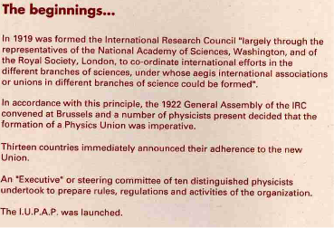
1922
For the history of IUPAP’s first 70 years,
see the IUPAP website
http://iupap.org/about-us/the-history-of-iupap-1922-1992/

Slide 7
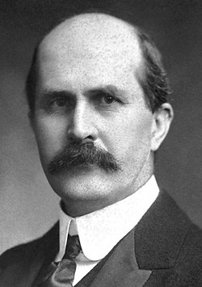
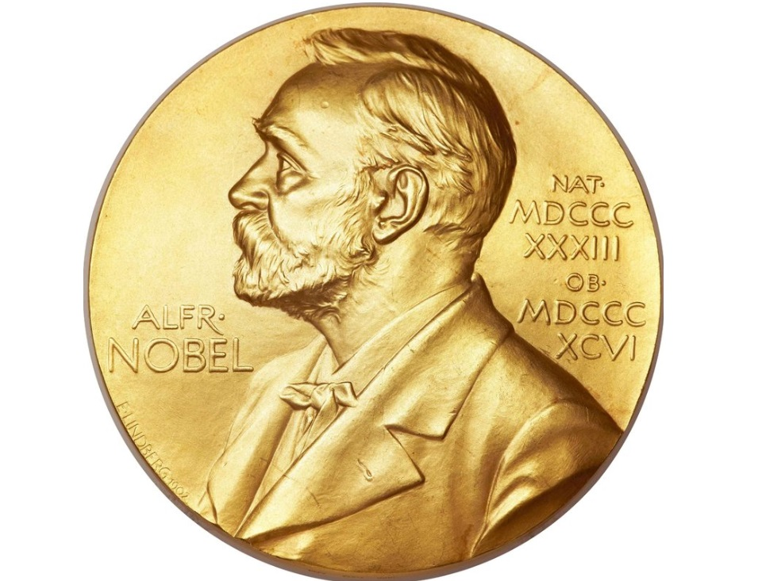
IUPAP was established in 1922
First President:
Sir William Bragg
(1922-1931)

Slide 8
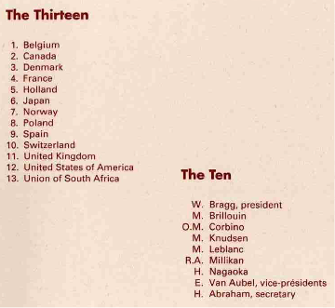






1922
William Bragg
First IUPAP President

Slide 9
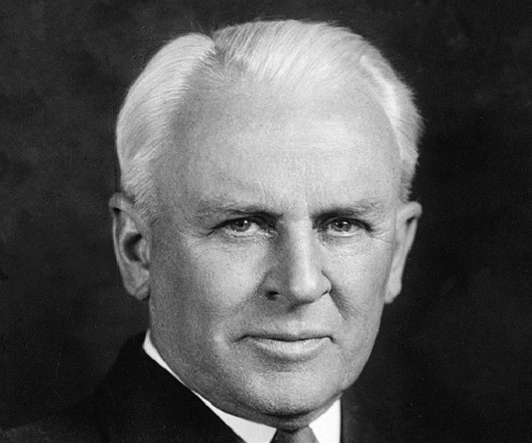
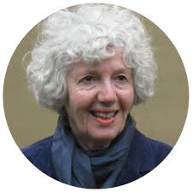
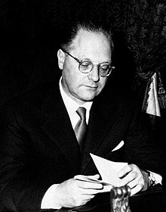
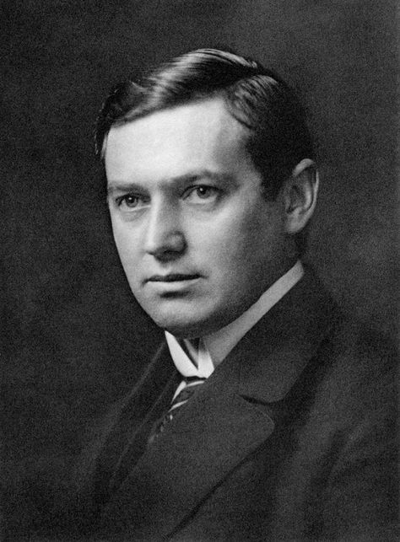
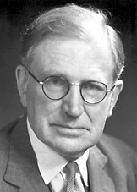
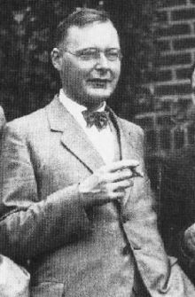
Past Leadership
Robert Millikan (1931-1934)
Cecilia Jarlskpg
(2011-2014)
Edoardo Amaldi
(1957-1960)
Kennedy Reed
(2017-2019)
Manne Siegbahn
(1934-1947)
Neville Francis Mott
(1951-1957))
Hans Kramers
(1947-1951)

Slide 10
Current Members (61)
Algeria
Argentina
Australia
Austria
Belgium
Brazil
Bulgaria
Canada
Chile
China: Beijing
China: Taipei
Colombia
Costa Rica
Croatia
Cuba
Cyprus
Czech Republic
Denmark
Egypt
Estonia
Ethiopia
Finland
France
Germany
Ghana
Greece
Hungary
India
Iran
Ireland
Israel
Italy
Japan
Jordan
Korea
Latvia
Lithuania
Mexico
Netherlands
New Zealand
Norway
Pakistan
Peru
Philippines
Poland
Portugal
Romania
Russia
Saudi Arabia
Senegal
Singapore
Slovak Republic
Slovenia
South Africa
Spain
Sweden
Switzerland
Tunisia
UK
Uruguay
USA
Four regional Physics Societies are observers: African, American, Asian Pacific and European
Corporate Associate Members are being considered
IUPAP is looking into attracting new members (countries)
Ukraine just joined!

Slide 11
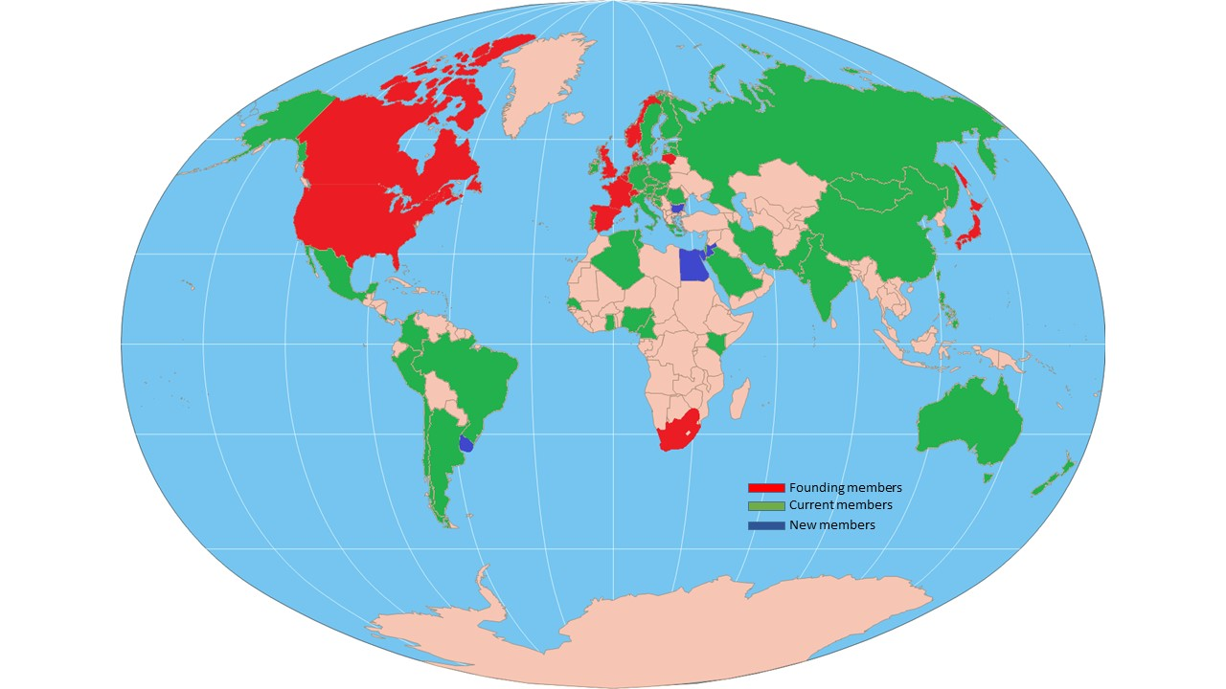
IUPAP Members’ Map

Slide 12
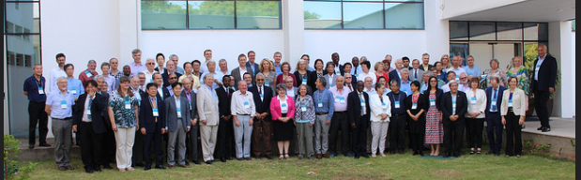
Governance
Governed according to the New Statutes and Bylaws of the International Union of Pure and Applied Physics (adopted by the General Assembly, 2021)
The IUPAP will get the legal status as an Association under Swiss Law, located in Geneva with the Administrative Office in Trieste
Bylaws: https://iupap.org/documents/statutes-bylaws/
Vision, mission, strategic plan are also posted on the website

Slide 13
Governance:
The General Assembly
The General Assembly (GA) of all membres is the highest governing body of the Union.
The GA
Creates and amends the statutes (requires a two-thirds majority of those present).
Sets and amends the procedural bylaws (requires a three-fifths majority of those present).
Elects the Executive Council that oversees Union activities between General Assemblies.
Elects members of its Commissions.
General Assemblies are every 3 years in person, every year virtually in between

Slide 14
The Structure
Commissions
Affiliated Commissions
Working Groups

Slide 15
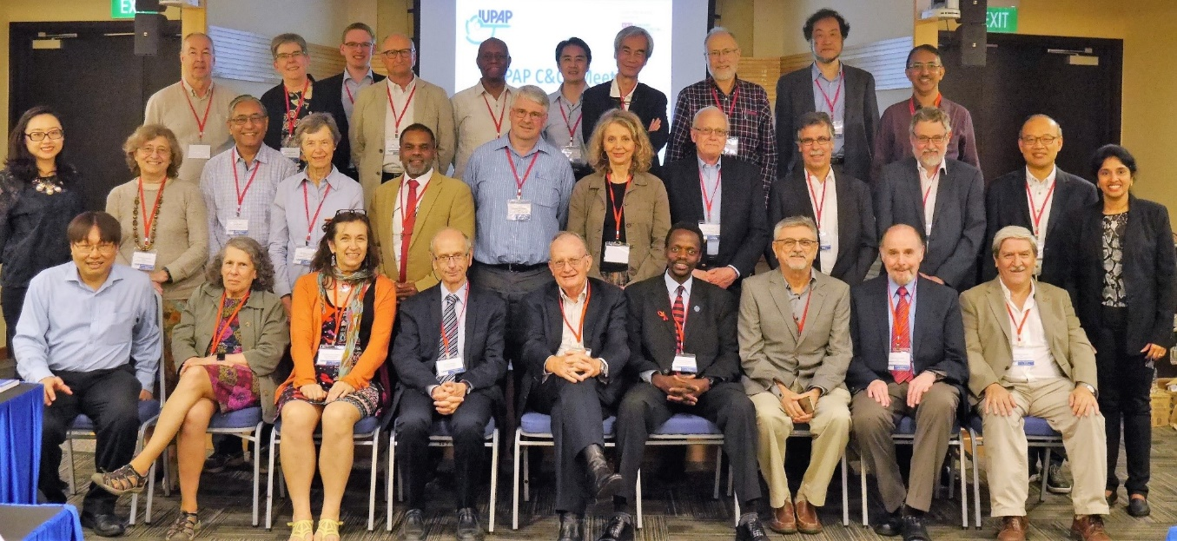
Commissions
• Symbols and Units (C2)
• Statistical Mechanics (C3)
• Astroparticle Physics (C4)
• Low Temperature Physics (C5)
• Biological Physics (C6)
• Semiconductors (C8)
• Magnetism (C9)
• Condensed Matter (C10)
• Particles and Fields (C11)
• Nuclear Physics (C12)
• Physics for Development (C13)
• Physics Education (C14)
• Atomic Molecular and Optical Physics (C15)
• Plasma Physics (C16)
• Laser Physics and Photonics (C17)
• Mathematical Physics (C18)
• Astrophysics (C19)
• Computational Physics (C20)
(There are no commissions 2 and 7)
The first scientific commission, on Units, was established in 1931 at the third General Assembly.
Currently there are 18 Commissions.
The commissions organize the major International conferences in their field; and award Young Scientist Prizes

Slide 16
Affiliated Commissions
International committees or organizations of physicists, with their own administrative structure, who wish to join IUPAP commissions
Currently there are 4 +2 affiliated commissions
Participate in IUPAP
activities, endorse
IUPAP principles
• International Commission for Optics (AC1)
• International Commission on General
Relativity and Gravitation (AC2)
• International Commission on Acoustics
(AC3)
• International Commission on Medical
Physics (AC4)
• International Association of Physics
Students (AC5 New)
• Affiliated Commission on the History
and Philosophy of Physics (AC6 New)

Slide 17
Working Groups
WG1: International Committee for Future Accelerators (ICFA)
WG2: Communication in Physics
WG5: Women in Physics
WG7: International Committee on Ultrahigh Intensity Lasers (ICUIL)
WG9: International Cooperation in Nuclear Physics (ICNP)
WG10: Astroparticle Physics International Committee (ApPIC)
WG11: Gravitational Wave International Committee (GWIC)
WG12: Energy
WG13: Newtonian Constant on Gravitation
WG14: Accelerator Science
WG15: Soft Matter
WG16: Physics and Industry
WG17: Centenary – temporary, time-sensitive
WG18: EthicsWG19: Quantum Science and Technology
Some working groups have had close links with working groups of the OECD Global Science Forum
The Working Group on Women in Physics

Slide 18
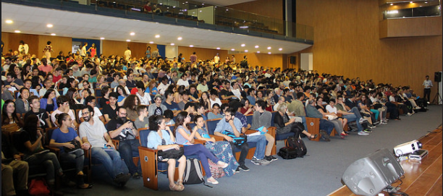
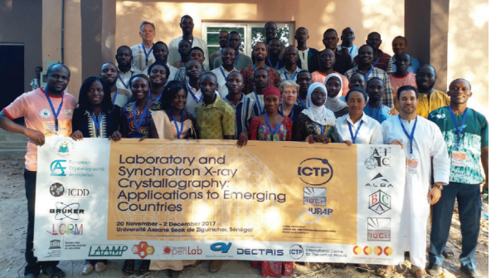
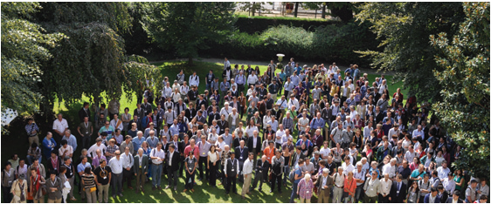
Conferences
IUPAP sponsors and endorses ~50 conferences per year:
Very large, medium size, specialized
everywhere with a special attention to developing countries
Requirements are:
scientific interest
worldwide attendance with no a priori restriction or difficulty to attend
inclusiveness and diversity

Slide 19
Early Career Scientific Prize Awards
The Early Career Scientist Prize is granted by IUPAP on the recommendation of a Commission or an Affiliated Commission.
The award consists of a certificate, medal and a monetary award.
A presentation also takes place at an international conference sponsored through the commission.
192 prizes awarded between 2006 and 2018!

Slide 20
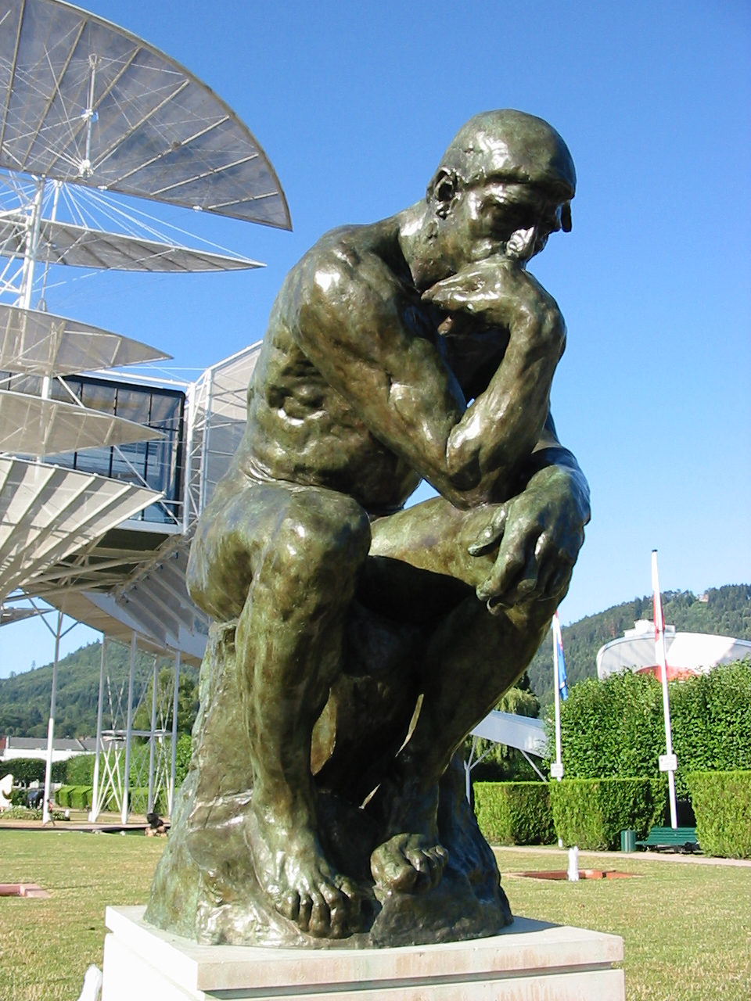
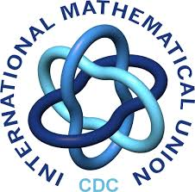










2022/ 2023
Centenary of IUPAP
IYBSSD
June 2022/June 2023
International Year of Basic Sciences for Sustainable Development
Basic Sciences under the spotlight
Basic Sciences are a key tool to provide a multi-cultural dialogue, with “scientific diplomacy” a known and demonstrated means to contribute to a more peaceful world
Leading Union
https://www.iybssd2022.org/

Slide 21
Celebrations For The IUPAP Centennial
IUPAP will celebrate its Centennial in 2022/2023. Several initiatives are being planned.
They include a Centennial Symposium, a photo contest and satellite events around the world.
Many of these activities will be combined with those of the Year of Basics Science for Sustainable Development ( YBSSD ), given that the IUPAP’s work on promoting physics and science for development will be a major part of its centenary celebrations.

Slide 22
Celebrations For The IUPAP Centennial (continued)
IUPAP is arranging for dedicated talks in large IUPAP-sponsored physics conferences to publicize all these activities.
We encourage the various commissions and national physics communities to organize satellite events worldwide.
We suggest to make the Conferences in 2022 and 2023 part of the Celebration of the IUPAP Centenary and IYBSSD
Participants are welcome to use slides from IUPAP presentations, centenary, IYBSSD to show them in events and conferences all along 2022 and 2023

Slide 23
Celebrations For The IUPAP Centennial (Continued)
An important effort has also started to digitize IUPAP’s institutional archival documents of the Union, which are currently spread in various archives.
The digitized documents will be made available for public dissemination and historical research.
They will constitute the primary source of information for a scholarly process, which will be concluded by a two-day academic workshop on the history of IUPAP in the last hundred years and the publication of a volume.

Slide 24
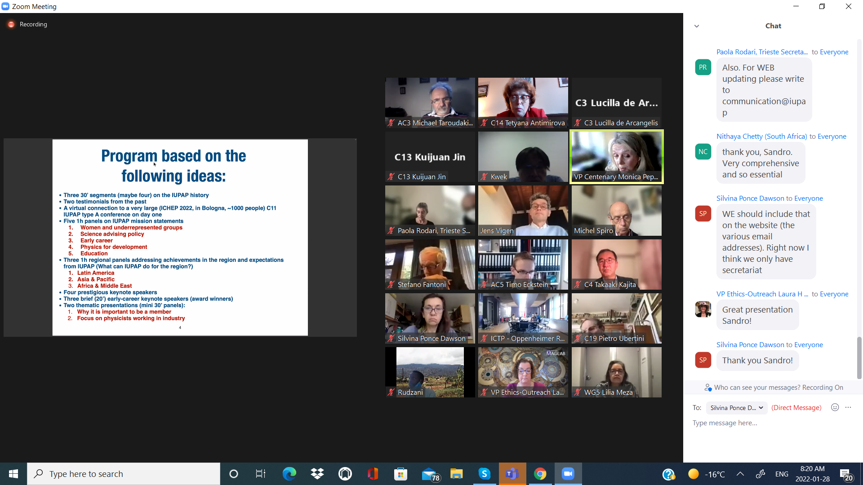



Centennial Symposium Plans

Slide 25
C14-Physics Education Commission of IUPAP
The International Commission on Physics Education (ICPE) mission:
To promote the exchange of information and views among the members of the international scientific community in the general field of Physics Education including:
The collection, evaluation, coordination and distribution of information concerning education in the physical sciences at all levels;
Information relation to the assessment of standards of physics teaching and learning;
Suggesting ways in which the facilities for the study of physics at all levels) might be improved, stimulating experiments at all levels, and giving help to physics teachers in all countries in incorporating current knowledge of physics, physics pedagogy, and the results of research in physics education into their courses and curricula.
Article
2

Slide 26
C14-Physics Education Commission of IUPAP Activities
The complete mission statement can be found at https://iupap.org/who-we-are/internal-organization/commissions/c14-physics-education/#mission-mandate.
One of the core activities of the Commission is the organization of the International Conference on Physics Education (ICPE), often in partnerships with other international or regional physics/science education societies.
The Commission awards Physics Education Medal every year
The Commission produces the ICPE Newsletter.
As IUPAP celebrates its centennial anniversary in 2022-2023 with Canada being one of the founding members of IUPAP, the Commissions of IUPAP (including C14) will promote the educational and scientific activities of IUPAP around the world.

Slide 27
C14 Commission
Recommends for Union sponsorship of the
international conferences which qualify for support under Union
regulations.
Initiates such conferences as their need arises from the evolution of the Commission field.
Assists in the organization of such conferences when practical.
Ensures the compatibility of international conferences in its field and to discourage clashes and incompatibility of dates.
Article
Promotes the free circulation of scientists; assists conference organizers in ensuring such free circulation and in resolving potential infringements.

Slide 28
C14 Mission (continued)
organizes where feasible the award of medals or other testimonials of excellence in its field.
Article
5
publishes where feasible newsletters, circulars, occasional
books, journals or handbooks in its area.
Article
6
maintains liaison with other IUPAP Commissions, with the
Commissions or Committees of other Unions or of
the International Council of Scientific Unions (ICSU) or other
scientific organizations, with a view to collaborating and
cooperating in sponsoring joint conferences and to
participating in joint projects when need arises.Article
7
Prepares to each General Assembly of the Union a summary
of activities and progress in its field since the previous
Assembly.

Slide 29
Collaborations with other Commissions within IUPAP
Physics for Development (C13)
International Association of Physics Students (AC5 New) (I will meet with them tomorrow)
WG2: Communication in Physics
WG5: Women in Physics
WG16: Physics and Industry

Slide 30
Cooperation With Other Organizations and Learning Societies
International Research Group on Physics Teaching (GIREP)
UK Institute of Physics (IoP)
European Physical Society – Physics Education Division (EPS-PED)
Abdus Salam International Centre for Theoretical Physics (ICTP)

Slide 31
C14 Conferences
3rd WCPE Vietnam, 13-17 December 2021
2019
GIREP-ICPE-EPEC 2019 1-5 July 2019, Budapest, Hungary
2018
International Conference on Physics Education 2018: ICPE-SAIP-WITS 1-5 October 2018, Johannesburg, South Africa
2017
GIREP-ICPE-EPEC 2017: Bridging Research and Practice in Physics Teaching and Learning 3-7 July 2017, Dublin, Ireland
2016
The Second World Conference on Physics Education 2- 2016: Contemporary Science Education and Challenges in the Present Society: perspectives in Physics Teaching and Learning 10-15 July 2016, Sao Paulo, Brazil
2015
International Conference on Physics Education 2015: Engaging Students in Physics – Research and Practice 9-14 August 2015, Beijing, China
2014
GIREP-MPTL International Conference 2014 7-12 July 2014, Palermo, Italy
International Conference on Physics Education 2014 18-22 August 2014, Córdoba, Argentina
2013
11th Interamerican Conferences on Physics Education Canadian-American-Mexican Graduate Student Physics Conference 15-18 August 2013, Ontario, Canada

Slide 32
C14 Conferences (Continued)
International Conference on Physics Education 5-9 August 2013, Prague, Czech Republic
2012
World Conference on Physics Education 1–6 July 2012, Istanbul, Turkey
2011
International Conference on Physics Education ICPE 2011: Training Physics Teachers and Educational Networks 15–19 August 2011, Mexico City, Mexico
2010
Teaching and Learning Physics Today: Challenges? Benefits? 22–27 August 2010, Reims, France
2009
10th Inter-American Conference on Physics Education 6-10 July 2009, Medellin, Colombia
International Conference on Physics Education 18-24 October 2009, Bangkok, Thailand
2007
International Conference on Physics Education: Building Careers with Physics 11-16 November 2007, Palais des Congres, Marrakech
GIREP-EPEC 2007 Frontiers of Physics Education August 26-31 2007, Opatija, Croatia
2006
International Conference on Physics Education 2006 15-20 August 2006, Tokyo, Japan
9th Inter-American Conference on Physics Education 3-7 March 2006, San Jose, Costa Rica
2005
World View on Physics Education in 2005: Focusing on Change 21-26 August 2005, New Delhi, India
2004
What Physics Should We Teach? SAIP-ICPE International Conference 5-8 July 2004, Durban, South Africa
2003

Slide 33
C14 Conferences (continued)
2003
8th Inter-American Conference on Physics Education 7-11 July 2003, Havana, Cuba
Summer Course on Research in Physics Education 15-25 July 2003, Rome, Italy
2002
Physics in New Fields and Modern Applications 5 August 2002, Lund, Sweden
2001
Computer and Information Technology in Physics Education 4-6 December 2001, Quezon City, Metro Manila, Philippines
International Conference on Physics Education in Cultural Context 13-17 August 2001, Cheongwon, South Korea
2000
Physics Teachers Education Beyond 2000 27 August-1 September 2000, Barcelona, Spain
1999
International Conference of Physics Teachers and Educators 19-23 August 1999, Guilin, China
1998
Hands-on Experiments in Physics Education 23-28 August 1998, Duisburg, Germany
International Conference on New Technologies in Physics Education 19-22 October 1998, Hefei, China
1997
6th Inter-American Conference on Physics Education 28 June-5 July 1997, Cordoba, Argentina
Creativity in Physics Education 15-22 August 1997, Sopron, Hungary
Taller Iberoamericano de Enseñ de la Fisica Universitaria Havana, Cuba
1996
New Ways of Teaching Physics 21-27 August 1996, Ljubljana, Slovenia
1995
International Conference on Physics Education – New Movement of Reform on Physics Teaching
5-9 August 1995, Nanjing, P.R. China
1994
Teaching Modern Physics for Students Not-majoring in Physics 24-28 July 1994, Sinai, Egypt

Slide 34
History Of ICPE
The following articles describe the first years of existence of ICPE:
Leonard Jossem: PREFACE
French: THE INTERNATIONAL COMMISSION ON PHYSICS EDUCATION
William C. Kelly: WITNESS AT CREATION: I.C.P.E.’s FOUNDING AND EARLY YEARS

Slide 35
Future Development In Strategic Areas: Physics Education
IUPAP/C14 will continue to support the organization of physics schools, workshops, and conferences on physics education, particularly in developing countries.
The Commission on Physics Education (C14) is creating a repository of open (non-commercial) virtual/remote laboratory resources used around the world.
This information will be made available on the remodeled IUPAP website.
The site will also be used to point to other teaching resources, particularly those of strong, long-established national associations that promote teaching/research in less developed countries.

Slide 36
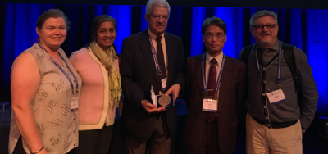
ICPE Medal
The ICPE medal was instituted to recognize “outstanding contributions to physics teaching of a kind that transcends national boundaries”.
The ICPE medal recipient must fulfill two criteria: (1) the contributions to physics education should have extended over a significant number of years; and (2) the contributions should be international in their scope and influence.
Prof. Marco Antonio Moreira (Brazil) – ICPE Medal 2017 among members of the ICPE Commission: left: Eilish Mcloughlin (Ireland), Manjula Sharma (Australia); right: Hideo Nitta – ICPE Chair (2016-2018) – (Japan) and Roberto Nardi (Brazil) – current ICPE Chair (2019-2020).

Slide 37
Status of the initiatives arising from previous (2018-2021) C14 Commission Mandate:
Assembling and publishing resources for virtual labs
Ensuring active learning workshops at all IUPAP sponsored meetings initiative,
Completing physics education panorama (being completed by our former Chair Dr. Roberto Nardi (Brasil))
The third volume of the Handbook "Connecting Research in Physics with Teacher Education“ – just published

Slide 38
Education Panel at the
Centennial Celebration Symposium
The symposium July 11-13, 2022 in Trieste, Italy

Slide 39
Education Panel at the IUPAP Centennial Symposium:
The trajectory of physics curriculum and its impact on society
What are the features of a purposeful and meaningful "physics curriculum for 21st century and its delivery”? How to optimize the continuum ranging from face-to-face to remote approaches prompted by the pandemic which is still ongoing in many parts of the world?
How do we engage today’s students? How to make physics more attractive to the modern students? Would teaching modern physics early on instead of introducing it later in the curriculum help better to engage students?
What is the place of the experimentation and ‘generic skills‘? What other skills are important for work in the industry and for society?
What careers are expected for future students outside of academia, including multidisciplinary, and non-traditional areas of employment?
To summarize, the panelists will provide their insights on how physics teaching and learning has changed since they started their careers and how they envision the future of physics education. They will offer their views on “how physics education can move forward and still maintain its disciplinary authenticity”.

Slide 40
Acknowledgments
This presentation includes information from Commissions’ Chairs and Executive Council (CC&EC) meetings that took place January 25-28, 2022
The presentation contains the slides from the presentations of :
Dr. Michel Spiro (IUPAP President)
D. Silvina Ponce Dawson (Acting President Designate)
Monica Pepe Altareli (Centennial Symposium organizing committee)
My presentation is supported by the Faculty of Science Dean’s Travel Fund, Toronto Metropolitan University (Formerly Ryerson University).

Slide 41
Get involved with IUPAP!
Thank you! antimiro@ryerson.ca

