Slide 1
Monte Carlo Simulation of FFF Photon Beam in Radiotherapy
James Chow PhD PPhys
Princess Margaret Cancer Centre, University Health Network, Canada
TECHNA Institute, University Health Network, Canada
Department of Radiation Oncology, University of Toronto, Canada

Slide 2
Content
Background
  Radiotherapy (3DCRT) using flattening filter
  IMRT using MLC
  Flattening filter free (FFF) photon beams
  Radiation Protection Consideration
  Monte Carlo simulation (Patient Dosimetric Consideration)
Monte Carlo simulations on FFF photon beams
  Bone dose
  Skin dose
  Photon energy spectrum
  Skin dose with cream

Slide 3
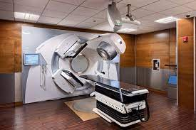
Radiotherapy using Medical Linear Accelerator (Linac)

Slide 4
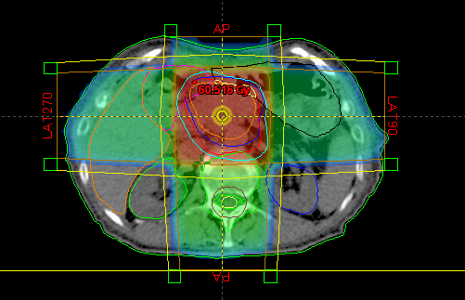
Radiotherapy using 3DCRT
https://www.researchgate.net/profile/Andrei-Fodor/publication/303605048/figure/fig1/AS:366740300156928@1464449109123

Slide 5
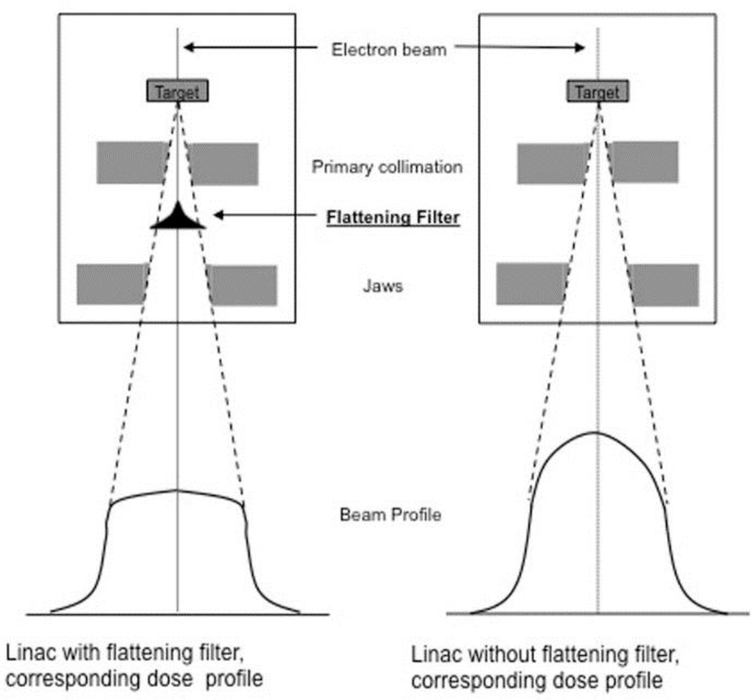
Beam Profile with Flattening Filter
https://d3i71xaburhd42.cloudfront.net/3ad871ac39d98da0a3c4d1c7cbb2fa52f73c7708/22-Figure2-1.png

Slide 6
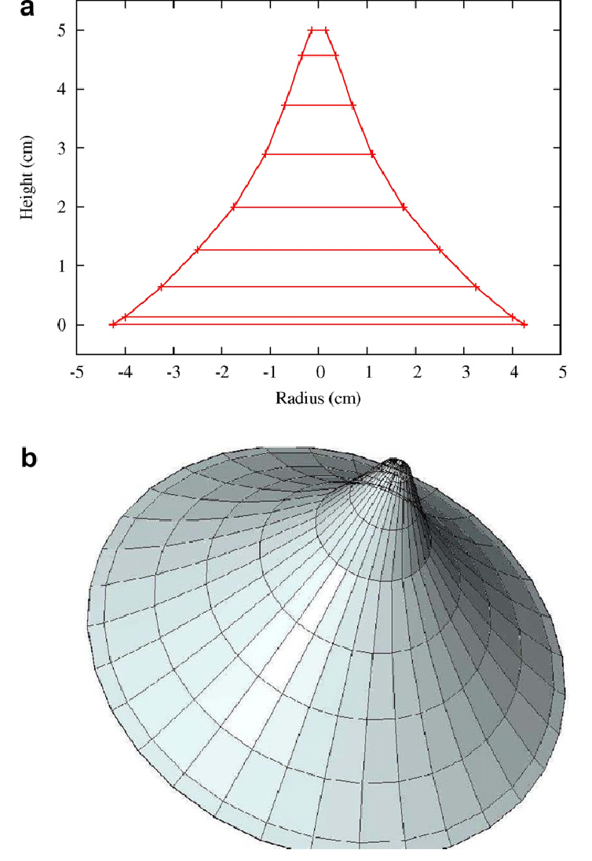
Flattening Filter - Design
Patil et al Nuclear Instruments and Methods in Physics Research Section B: Beam Interactions with Materials and Atoms. 269. 3261-3265. 10.1016/j.nimb.2011.04.013.

Slide 7
Flattening Filter – 6 MV
Lind M. MSc Thesis 2008 Lund Univ.

Slide 8
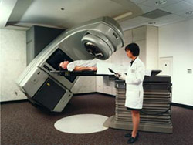

Linac equipped with Multi-leaf Collimation (MLC)
For photon beams

Slide 9
Intensity Modulated Radiotherapy (IMRT)
Conventional beam intensity is either uniform, modified with a wedge or modulated by a compensating filter.
IMRT is a more recent modality in which incident beams are modulated to improve total dose distribution by many fields.
  Can be implemented using MLCs.
  Each beam treats only a portion of the target
  Can be planned by either standard “forward” or inverse iterative methods
  Gives more degrees of freedom and potentially more conformal dose distributions than 3DCRT

Slide 10
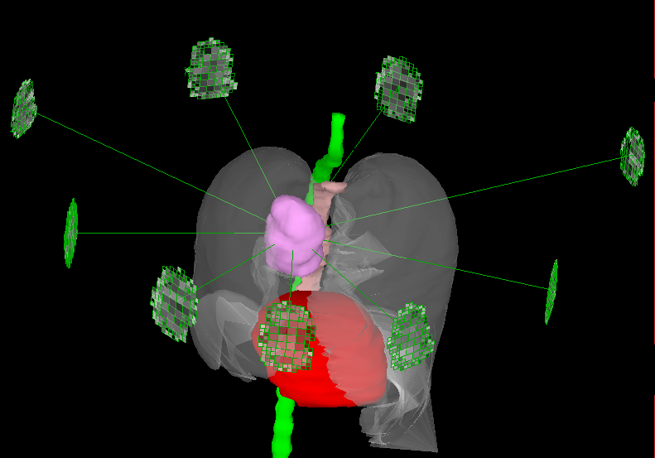
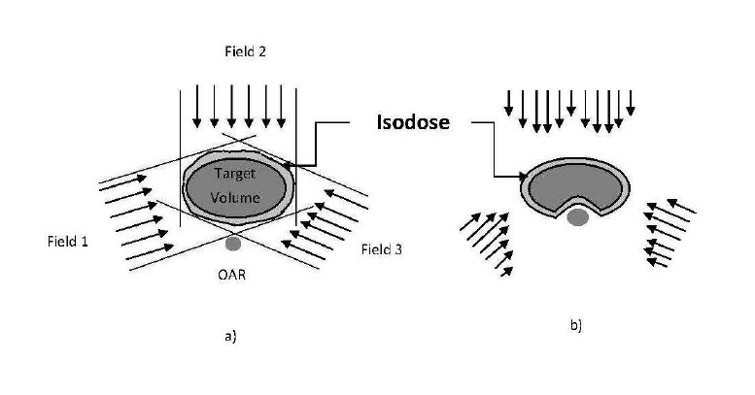
IMRT – Beam Segments
https://www.researchgate.net/publication/253376946_On_the_Optimization_of_Radiation_Therapy_Planning
Notes:
Goal was to escalate the PTV to a higher dose while still meeting all normal tissue constraints as defined by our dose escalation protocol
The plan is slightly different from the 66 Gy plan to spare more of the cord, and 95 % is still met in the PTV
The esophagus and cord were limiting structures
The heart was uninvolved, and bilateral lung constraints were easily met
We were able to escalate the dose to 92 Gy to the PTV
An IMRT case was set up with 9 axial beams
1 by 1 cm “beamlets” were shaped around the PTV, and subdivided to 0.5 by 0.5 cm around the outside of the PTV to allow for sharper dose gradients at the edges
The cost function was defined using clinical parameters based on the constraints for our dose escalation protocol
The PTV goal was 66 Gy +/- 5 %
A dose escalation plan was also optimized for a PTV dose of 100 Gy +/- 5%
Each beam was given 1 cm by 1 cm beamlets, and subdivided at the periphery of the PTV to be 0.5 by 0.5 cm
Investigation of subdividing beamlets around normal structures as well may be interesting
Note the intensity sculpting to spare dose to the esophagus

Slide 11
Radiotherapy with IMRT
For IMRT/VMAT delivery, flattening filter is not necessary.
We can remove the flattening filter from the Linac.

Slide 12
Flattening Filter Free Photon Beams
Xiao et al JACMP 2015;16:12.

Slide 13
When producing a flat beam, the filter causes a series of negative effects, such as:
  • Decreased primary beam intensity, leading to reduced dose rate;
  • Differential absorption across the field (changes in beam spectrum) causing problems for dose calculation and beam modelling;
  • The need for the introduction of ‘horns’ in the particle fluence to compensate for this angular variation of the spectrum;
  • The creation of a significant source of extra-focal scattered radiation;
  • Electron contamination in the primary beam;
  • Increased leakage radiation from the treatment head, increasing head shielding requirements;
  • Amplification of beam steering errors, necessitating the use of active beam monitoring and servo control.
Budgell et al Phys Med Biol 2016;61:8360

Slide 14
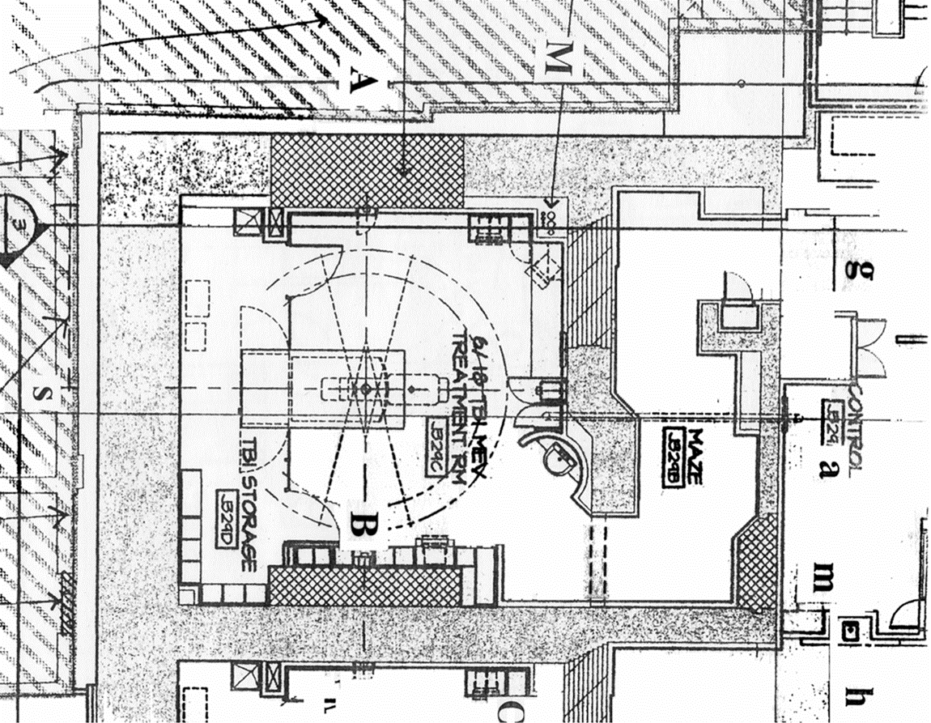
Radiation Protection Consideration – Bunker Design
Primary shielding
  Radiation workload
  Beam energies
  Dose rates
Secondary shielding
  Head leakage and scatter
  Patient scatter
Maze
  Wall and patient scatter
Occupancy of adjacent areas

Slide 15
Radiation Protection Consideration
If the only expected change from an FFF beam is an increase in instantaneous dose rate, not an increase in patient dose or throughput, and if the shielding is sufficient for the energy of the machine being installed, then no further increase in primary shielding is likely to be needed for FFF. Due to the reduction in required current per MU, the secondary shielding present is also likely to be sufficient provided there is no large change in the IMRT factor.
However use of FFF for high dose per fraction treatments may lead to a higher annual dose rate.
Budgell et al Phys Med Biol 2016;61:8360

Slide 16
Patient Dosimetric Concern of FFF Beam
The presence of the flattening filter removes a large number of low-energy photons and results in beam hardening. For the unflattened photon beam, however, these low-energy photons are part of the beam and contribute to the dose deposition in the photon beam build-up region close to the patient surface. Compared to the flattened photon beam, though unflattened beam has less head scatter and leakage, measurements and Monte Carlo simulations have found that irradiation of the unflattened photon beam results in a higher surface dose than the flattened beam.
Chow and Owrangi Rep Pract Oncolo Radiother 2016;21:63

Slide 17
Monte Carlo Simulation – based on a Linac with FF
BEAMnrc
Lind M. MSc Thesis 2008 Lund Univ.

Slide 18
Monte Carlo Simulation – TrueBeam Linac
Constantin et al. Med Phys 2011;38:4018.
Geant4

Slide 19
Some Monte Carlo Results regarding FFF Photon Beams using Phantoms
Bone heterogeneity and beam angle
Photon energy spectrum at the surface
Skin dose enhancement with skin care cream

Slide 20
Phantom Geometry
Beam Angles: 0, 15, 30, 45, 60, 75 and 90 degrees
Photon Beams: 6 MV FFF and 6 MV FF
Phantoms: Heterogeneous (bone and water) and homogeneous (water)
Chow and Owrangi. Rad Phys Chem 2014;101:46

Slide 21
Relative Surface Dose vs. Beam Angle
Chow and Owrangi. Rad Phys Chem 2014;101:46

Slide 22
Photon Energy Distribution
Photon energy distribution at the phantom surface
Beam Angle: 0 – 45 degree
Bone and Water phantom
6 MV and 6 MV FFF
Chow and Owrangi. Rep Pract Oncol Radiother 2016;21:63

Slide 23
Water Phantom Surface
Chow and Owrangi. Rep Pract Oncol Radiother 2016;21:63

Slide 24
Photon Mean Energy at Surface vs. Beam Angle
Chow and Owrangi. Rep Pract Oncol Radiother 2016;21:63

Slide 25
Skin Dose Enhancement with Skin Care Cream
The water-based cream contains H, O, C and P, and the density is equal to 0.92 g/cm³. The silicon-based cream contains C, H, N, O, Si, Ca and Na and the density is equal to 1.14 g/cm³.
Sharma and Chow AIMS Bioeng 2020;7:82

Slide 26
Dose Enhancements vs. Thickness of Cream
Water-based cream
Sharma and Chow AIMS Bioeng 2020;7:82

Slide 27
Dose Enhancements vs. Thickness of Cream
Silicone-based cream
Sharma and Chow AIMS Bioeng 2020;7:82

Slide 28
Dose Enhancements vs. Beam Angle – Water Based Cream
Water-based cream and 6 MV FF beam
Silicone-based cream and 6 MV FF beam
Sharma and Chow AIMS Bioeng 2020;7:82

Slide 29
Dose Enhancements vs. Beam Angle – Silicone Based Cream
Water-based cream and 6 MV FFF beam
Silicone-based cream and 6 MV FFF beam
Figure 3. Dose enhancement factor at each thickness for the (a) water-based cream and 6 MV FF beam, (b) silicone-based cream and 6 MV FF beam, (c) water-based cream and 6 MV FFF beam, and (d) silicone-based cream and 6 MV FFF beam. The sample compares various beam angles in the range of 20–80 deg.
Sharma and Chow AIMS Bioeng 2020;7:82

Slide 30
Conclusion
With removal of Flattening Filter, there are concerns in the radiation protection (bunker design) and patient dosimetry for FFF photon beams.
Presence of Flattening Filter in the MV photon beam affects the surface and bone dose as per phantom study.
Dose and photon energy spectral variations depend on the beam energy, beam angle, presence of FF and the heterogeneities.
Dose enhancements are found in FF and FFF beams when water- and silicone-based cream is applied on the phantom surface.

Slide 31
End

