Slide 1

Characterization of VUV sensitive silicon photomultipliers (SiPMs)
Bindiya Chana
Supervisor: Dr. Simon Viel
CAP Congress, 8th June 2022

Slide 2
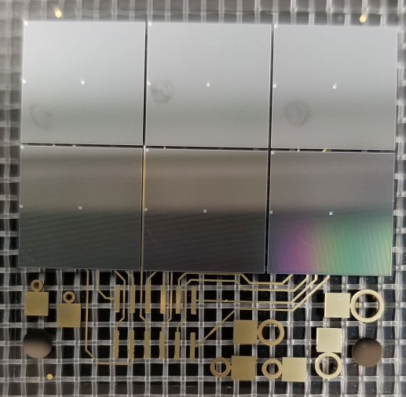
Motivation
Silicon photomultipliers (SiPMs) are emerging technology in photon detection in particle physics.
Large future experiments like nEXO, ARGO etc. will use SiPM based light detection system
SiPM tile
Challenges
Quality control and testing of these large number of SiPMs will be a challenge.
A quick and reliable SiPM testing technique is required at all stages (from single SiPM to fully installed system).

Slide 3
Goals of this project
Current-voltage (IV) characterization of SiPM
Develop the IV fit model to understand the IV curves
Use fit model to extract the empirical parameters of SiPMs
Compare and verify the results from IV analysis with pulse analysis
Extend the study to different SiPM devices at a range of temperatures in different light conditions

Slide 4
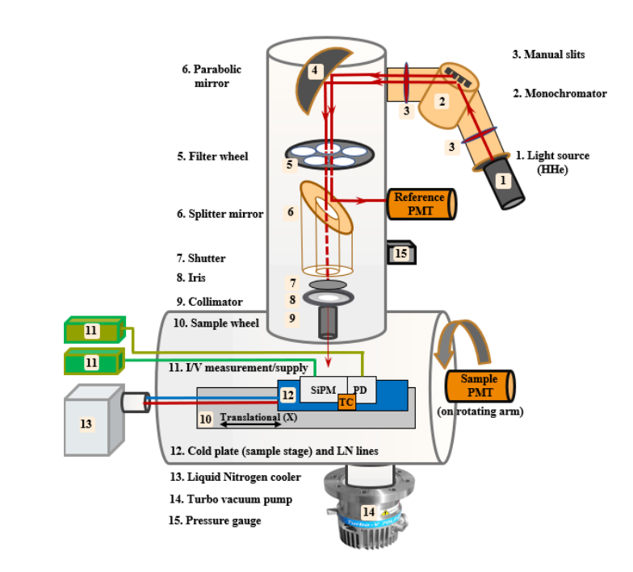
VERA* setup at TRIUMF
SiPM devices
Temperature range
Light conditions
-110º C to +20º C
FBK** VUV HD3
Hamamatsu VUV4
Dark
Light source – 175nm & 385nm
Thanks to Dr. Fabrice Retiere and Dr. Mahsa Mahtab (TRIUMF) for their support in this project
VERA setup at TRIUMF used to take measurements for SiPMs
*VERA – Vacuum Emission, Reflectance and Absorbance
** FBK - Fondazione Bruno Kessler

Slide 5
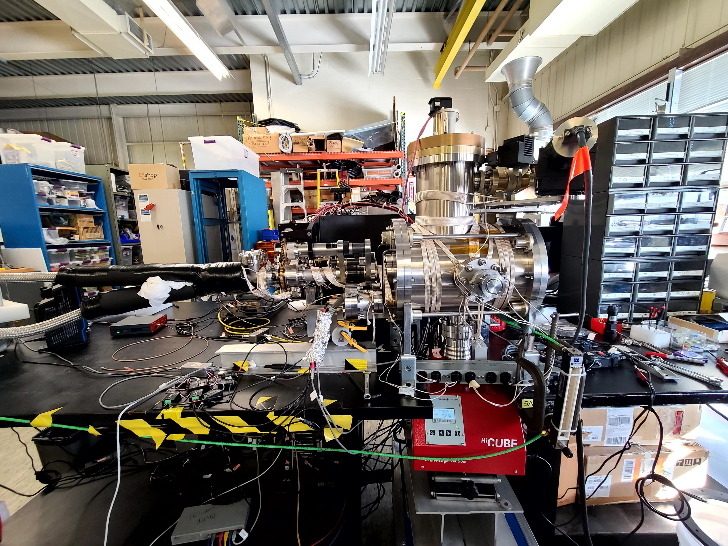
VERA* setup at TRIUMF
SiPM devices
Temperature range
Light conditions
-110º C to +20º C
FBK** VUV HD3
Hamamatsu VUV4
Dark
Light source – 175nm & 385nm
Thanks to Dr. Fabrice Retiere and Dr. Mahsa Mahtab (TRIUMF) for their support in this project
VERA setup at TRIUMF used to take measurements for SiPMs
*VERA – Vacuum Emission, Reflectance and absorbance
** FBK - Fondazione Bruno Kessler

Slide 6
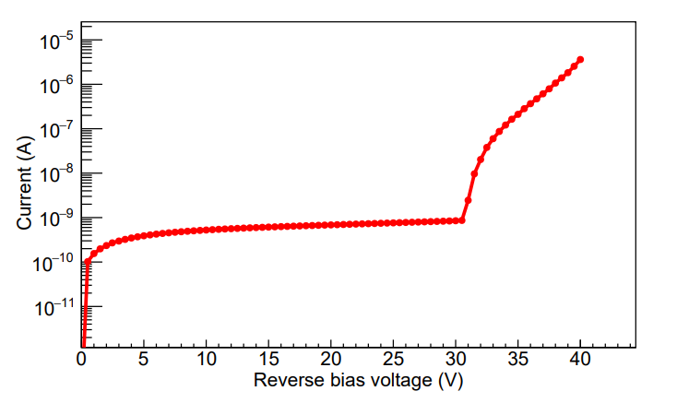
SiPM IV curve
Post-breakdown region
Post-breakdown region
SiPMs are usually operated in post breakdown region
Geiger mode – a single charge carrier is able to trigger an avalanche
High gain
Correlated avalanche noise
Pre-breakdown region
Breakdown voltage

Slide 7
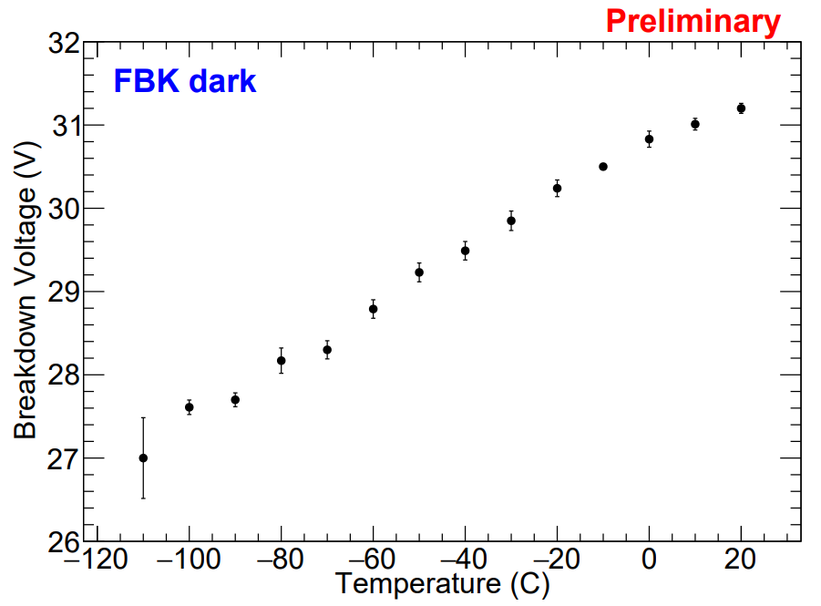
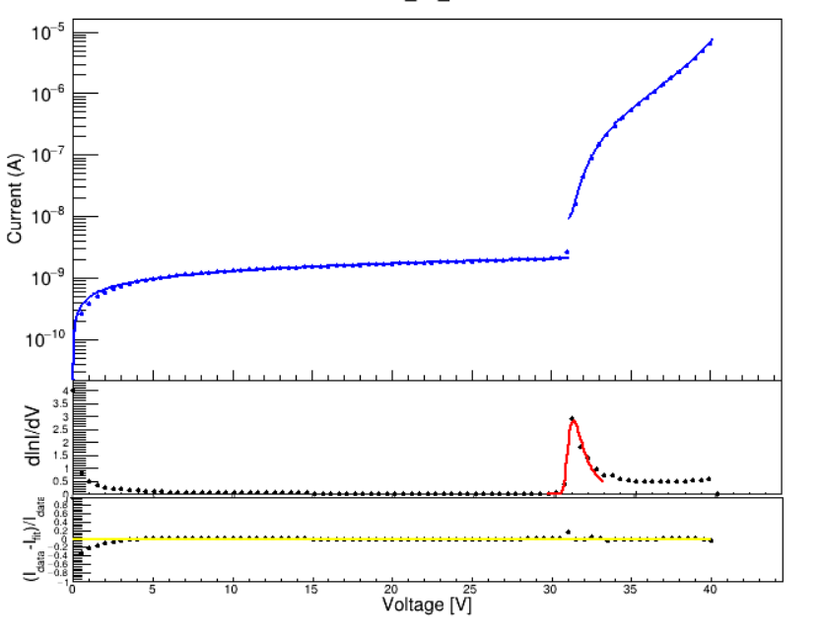
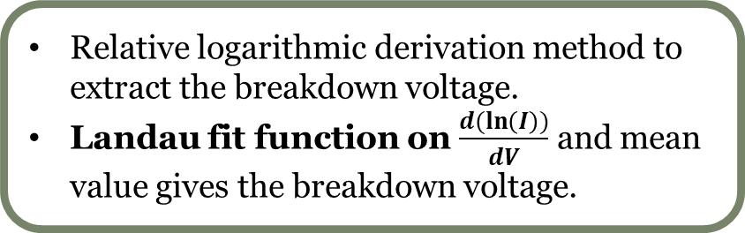
Breakdown voltage
Breakdown voltage increases linearly with temperature.
FBK dark at 20º C
Relative logarithmic derivation method to extract the breakdown voltage.
Landau fit function on $\frac{d(\ln\left(I\right))}{dV}$ and mean value gives the breakdown voltage.

Slide 8
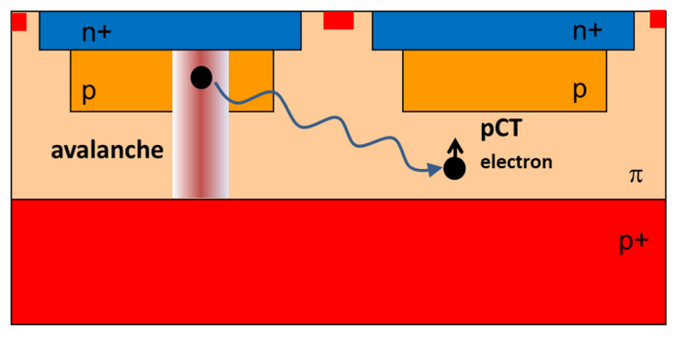
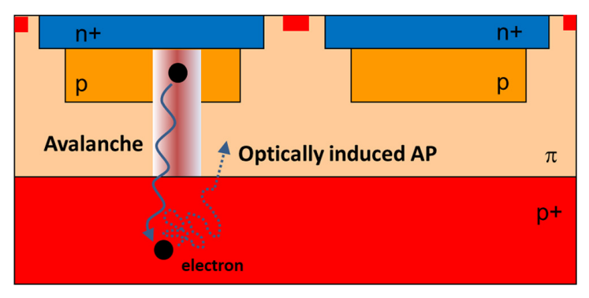
Correlated noise parameters
Cross-talk
Afterpulsing
During avalanche, accelerated carriers in the high field region could emit photons
That photon can initiate a secondary avalanche in a neighbouring microcell.
Carriers get trapped in defects in the silicon.
Released after a delay which initiate an avalanche in the same microcell.
Figures from Piemonte C and Gola A (2019)

Slide 9
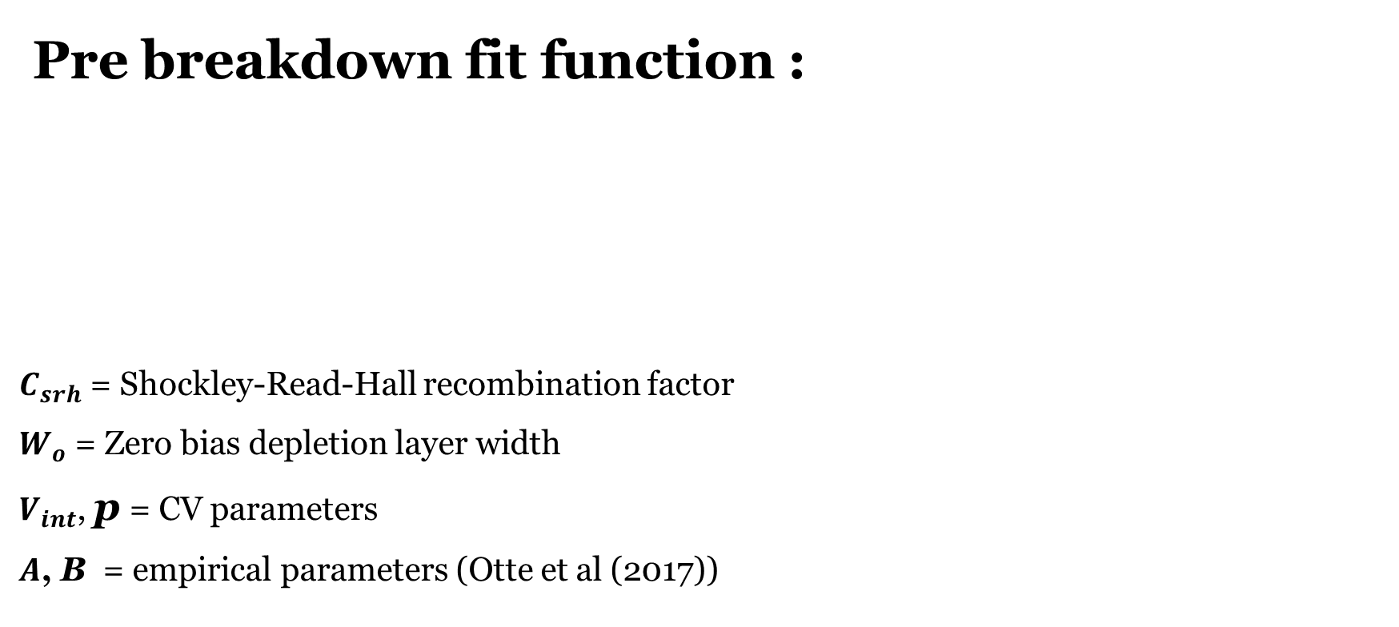

Reverse bias fit model
Pre breakdown fit function :
$C_{srh}$ = Shockley-Read-Hall recombination factor
$W_{o}$ = Zero bias depletion layer width
$V_{int}$, p = CV parameters
$A$, B = empirical parameters (Otte et al (2017))
$$I=q∗C_{srh}∗W_{o}∗\left\{\left({\left(1−\frac{V}{V_{int}}\right)}^{p}−1\right)+A\left(exp\left(\frac{V}{B}\right)−1\right)\right\}$$

Slide 10

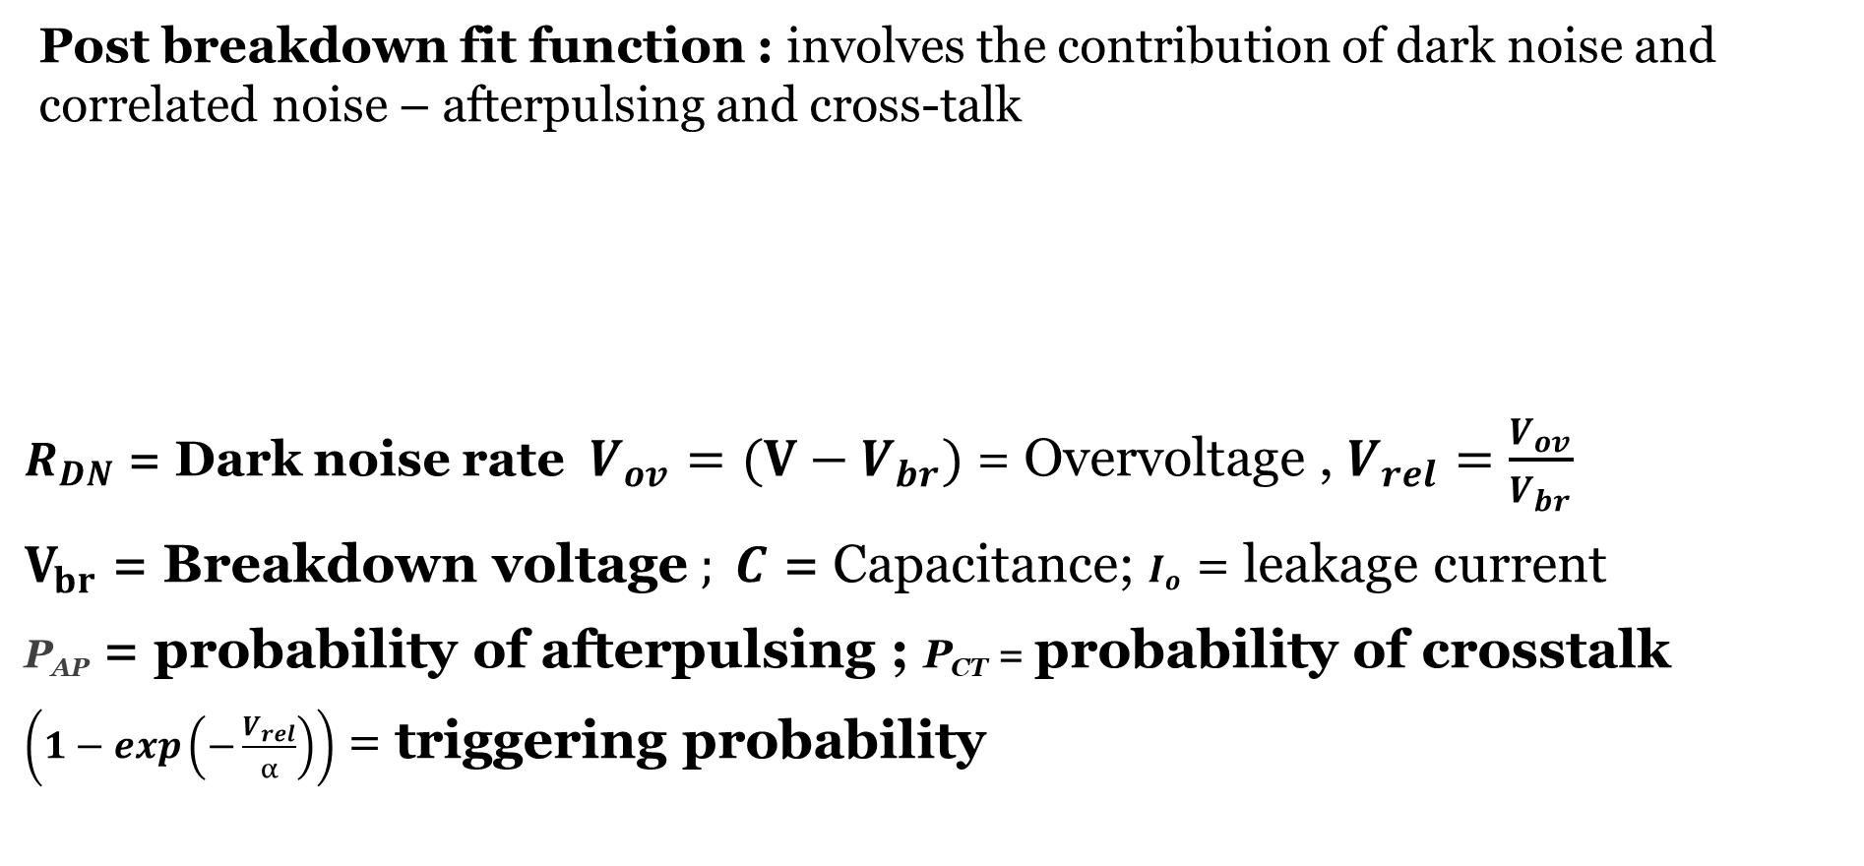
Reverse bias fit model (contd.)
Post breakdown fit function : involves the contribution of dark noise and correlated noise – afterpulsing and cross-talk
$R_{DN}$ = Dark noise rate$V_{ov}=(V−V_{br})$ = Overvoltage , $V_{rel}=\frac{V_{ov}}{V_{br}}$
$V_{br}$ = Breakdown voltage$; C$ = Capacitance; $I_{o}$ = leakage current
P_{AP} = probability of afterpulsing ; P_{CT} = probability of crosstalk
$\left(1−exp\left(−\frac{V_{rel}}{α}\right)\right)$ = triggering probability
$$I_{post}=C∗R_{DN}∗V_{ov}∗\left(1−exp\left(−\frac{V_{rel}}{α}\right)\right)∗\left\{\left(\frac{1}{1−P_{AP}\left(V_{ov}\right)}\right)\left(\frac{1}{1−P_{CT}\left(V_{ov}^{2}\right)}\right)\right\}+I_{o}$$

Slide 11
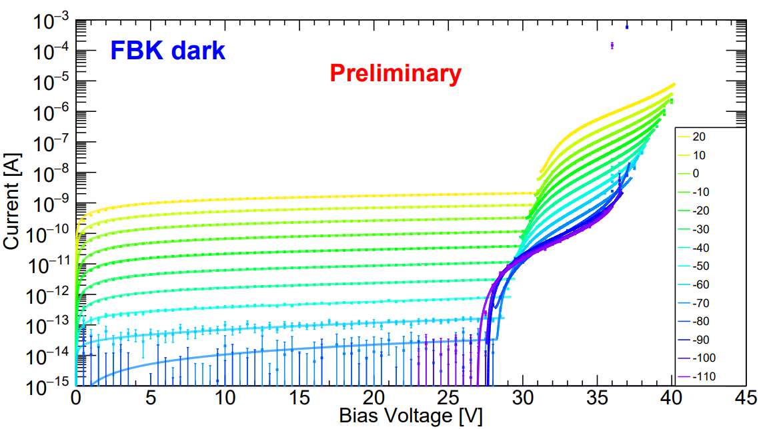
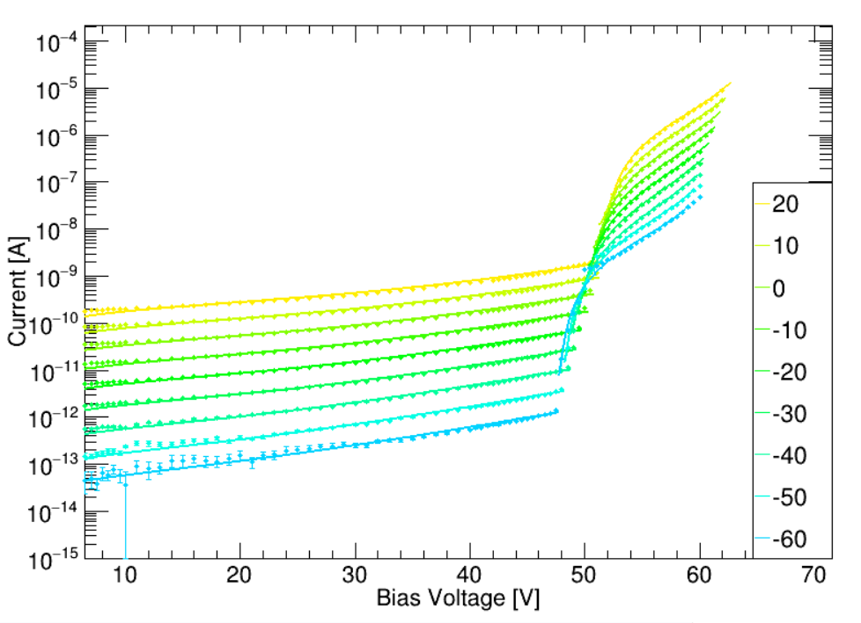
IV fits for 2 devices
HPK dark
Preliminary

Slide 12
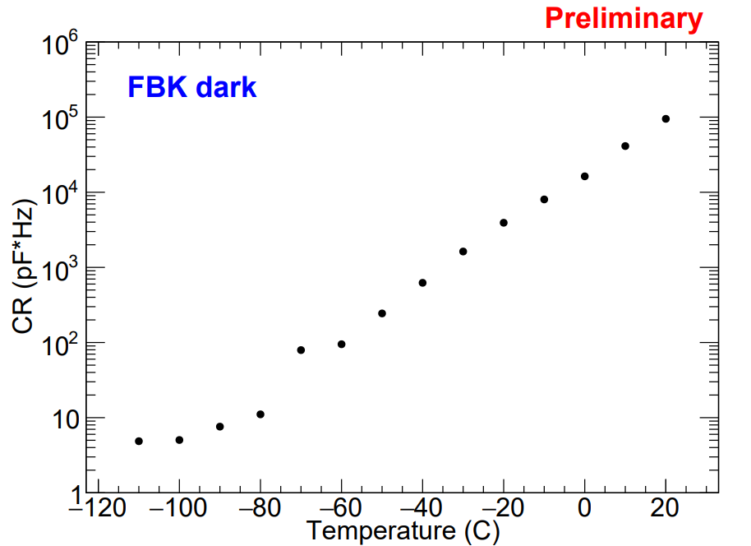
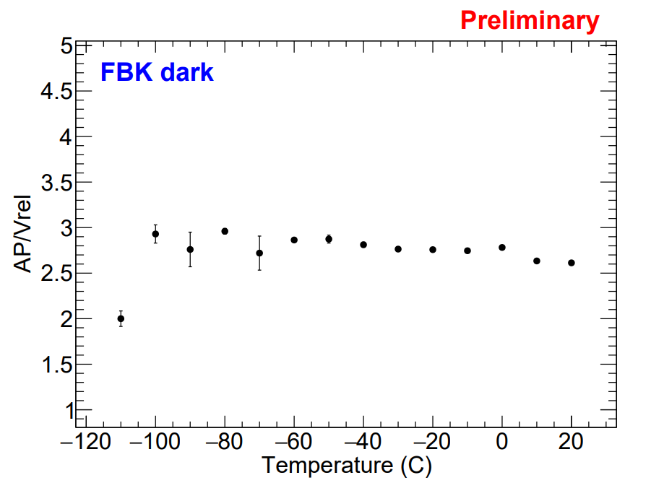
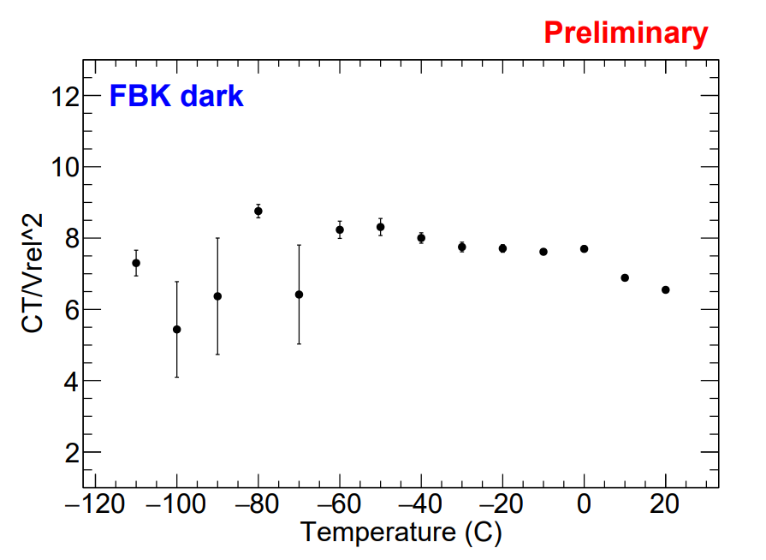
IV parameters
Considering C to be constant over different temperatures, R increases exponentially with temperature
Parameter AP(V) tends to stay constant with temperature, similar results are indicated in literature
Parameter CT(V²) tends to stay constant with temperature
* Only statistical error bars are shown

Slide 13
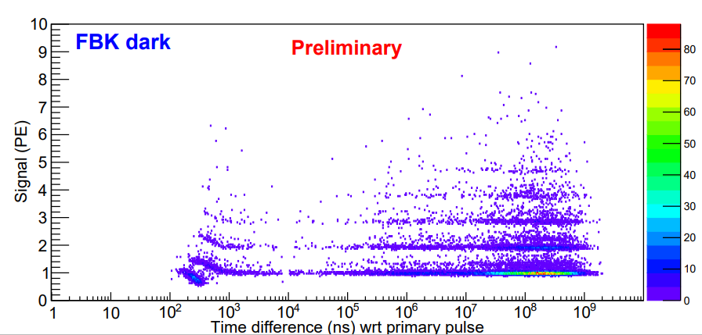
Pulse analysis
SiPM pulse data was taken at two overvoltages (4 & 7V) at 0.5PE threshold.
Primary pulse selection :
  It should be single PE (0.5 - 1.5PE)
  It should happen atleast 500μs later than previous pulse.
4V overvoltage

Slide 14
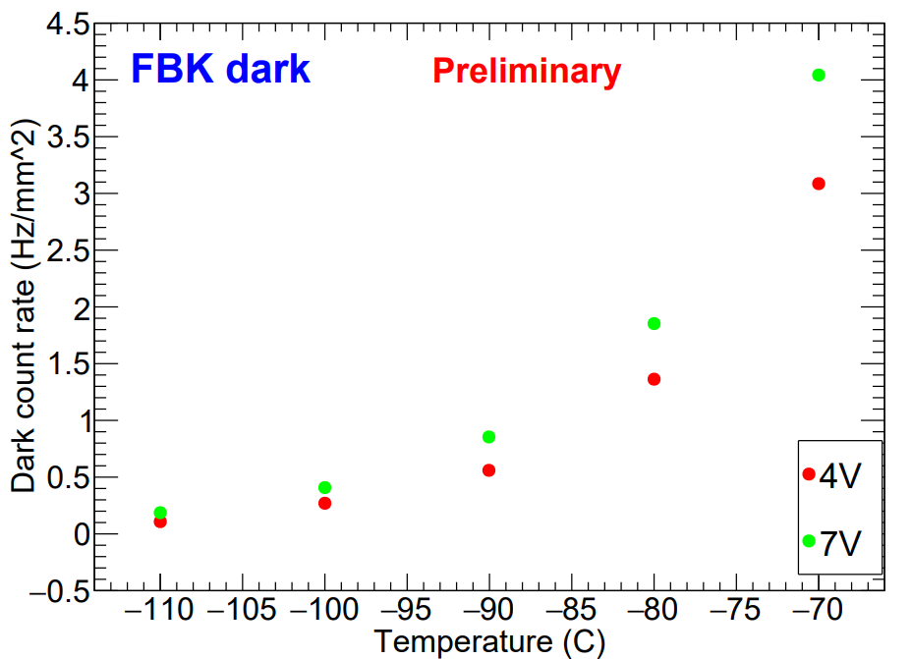
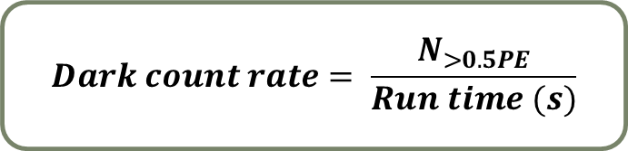
Dark noise rate
$$Dark count rate= \frac{N_{>0.5PE}}{Run time (s)}$$
Dark count rate (DCR) showed exponential rise with temperature
It also increases with increase in overvoltage

Slide 15
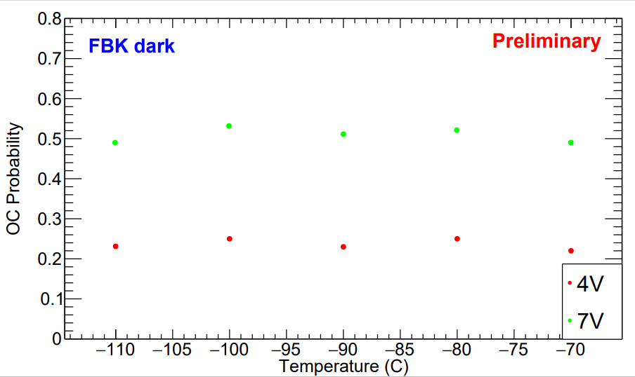
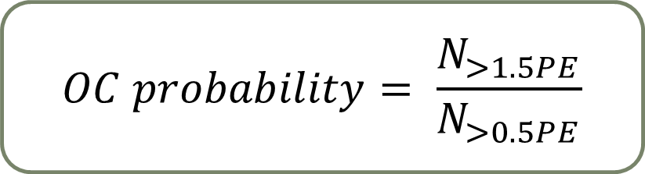
Optical crosstalk
$$OC probability= \frac{N_{>1.5PE}}{N_{>0.5PE}}$$
OC probability increases with overvoltage
Crosstalk seems to be independent of temperature, similar results are indicated by IV analysis as well.

Slide 16
Summary and future plans
  IV characterization and fit model looks promising over a range of temperatures for both FBK and Hamamatsu SiPM devices
  Improve the IV model for dark data
  Extend the fit functions with some additional terms for light data
  Improve pulse analysis for HPK device data
  Light data has already been taken and analysis for both IV and pulse data are ongoing
  At TRIUMF, Cryo probe facility will use IV characterization to test thousands of SiPMs for nEXO.

