Slide 1


Measuring Light Distribution of LED Sources for HyperK
NICHOLAS BOOTH CAP Congress 2022
TRIUMF: Mark Hartz, Michael Sekatchev University of Victoria: Dean Karlen

Slide 2
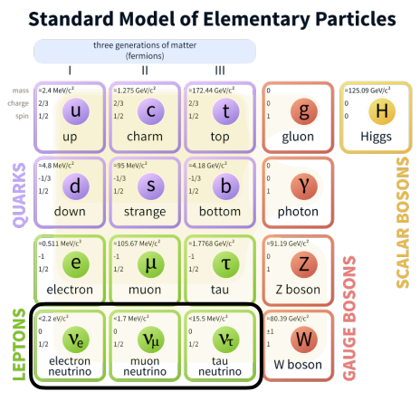
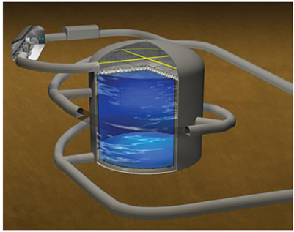
Neutrinos and Hyper-Kamiokande
Neutrinos only interact through the weak force
There are multiple potential flavour and mass states, and a neutrino particle can oscillate between the various states.
The Hyper-Kamiokande (HyperK) experiment employs water-Cherenkov detectors to study this phenomenon.

Slide 3
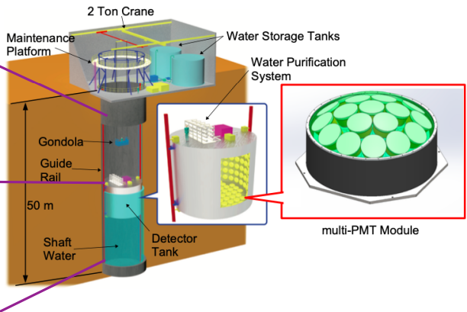
HyperK’s Intermediate Detector
The Intermediate Water-Cherenkov Detector (IWCD) is a close-to-source detector of much smaller volume than the main HyperK tank.
Will be lined with mPMTs that will reconstruct the interaction vertex and other properties of events
Due to small size, high timing precision and photogrammetry are necessary for vertex reconstruction
Notes:
IWCD much smaller detector (10m vs 70m radius); smaller detector needs high timing precision for vertex reconstruction (the point where the incident happens) to confirm vertex is within fiducial area; also need high spatial precision (photogrammetry) to reconstruct vertex.

Slide 4
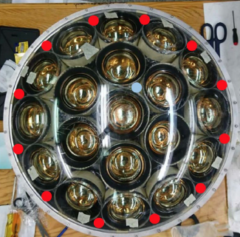
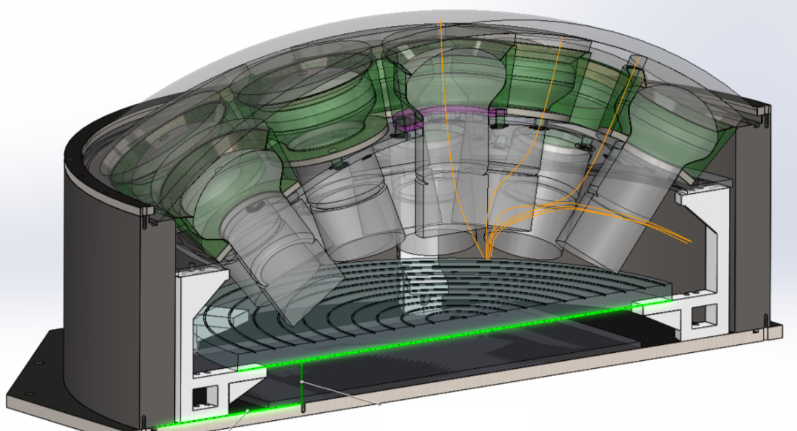
Purpose - LEDs for Calibration
M. Pavin, R. Gaur
13 calibration LEDs beneath sealed dome; powered and controlled by interior electronics
12 directional LEDs for photogrammetry
1 pulsed LED for timing calibration
Notes:
Pulsed led for the time delay to synchronize clocks

Slide 5
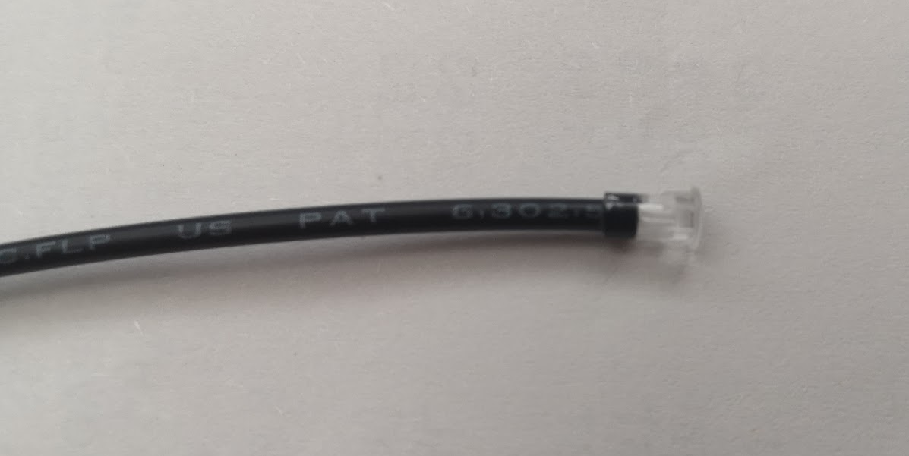
Purpose - LEDs for Calibration
Light transported from LEDs below PMTs to surface of dome by light guides and emitted through attached lens
Must fully quantify the affect of lens and light guide on calibration light
Bivar Inc. SMFLP36.0 Light Guide
Lens Attachment
M. Sekatchev

Slide 6
Theory – Brightness from 2D image
Camera, source, and origin of target plane are all on-axis
d = the distance from the source to the origin of the target plane
Camera
P = (x, y, d)
ϕ
y
x
Relate pixel brightness to incoming polar angle θ
  Each pixel has corresponding (x, y) coordinates
  Convert from Cartesian to Spherical to determine θ
Plot brightness vs polar angle to determine distribution
r
d
θ
y
z
x
Source
O

Slide 7
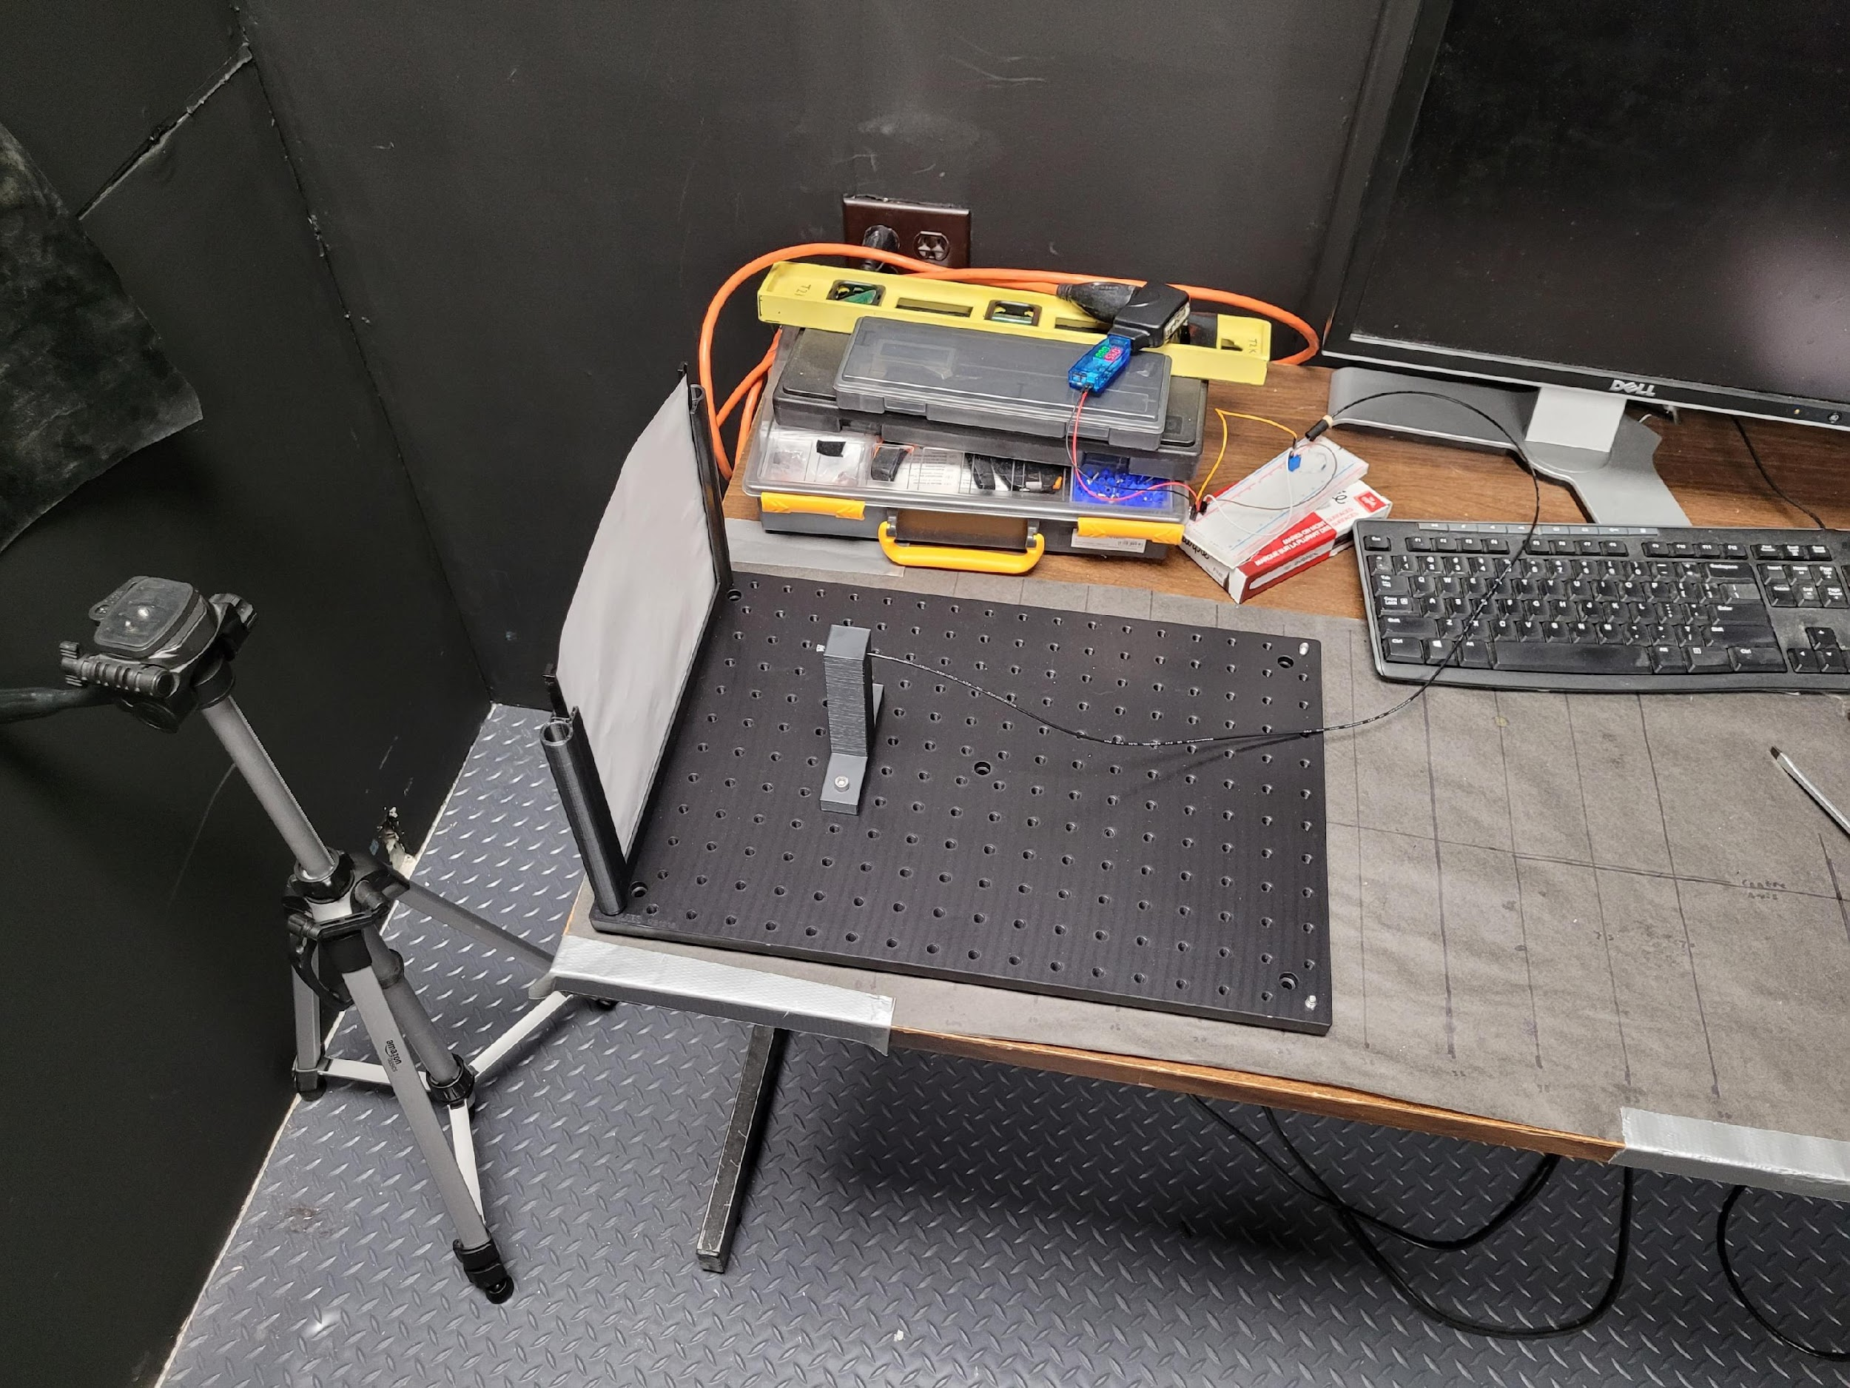
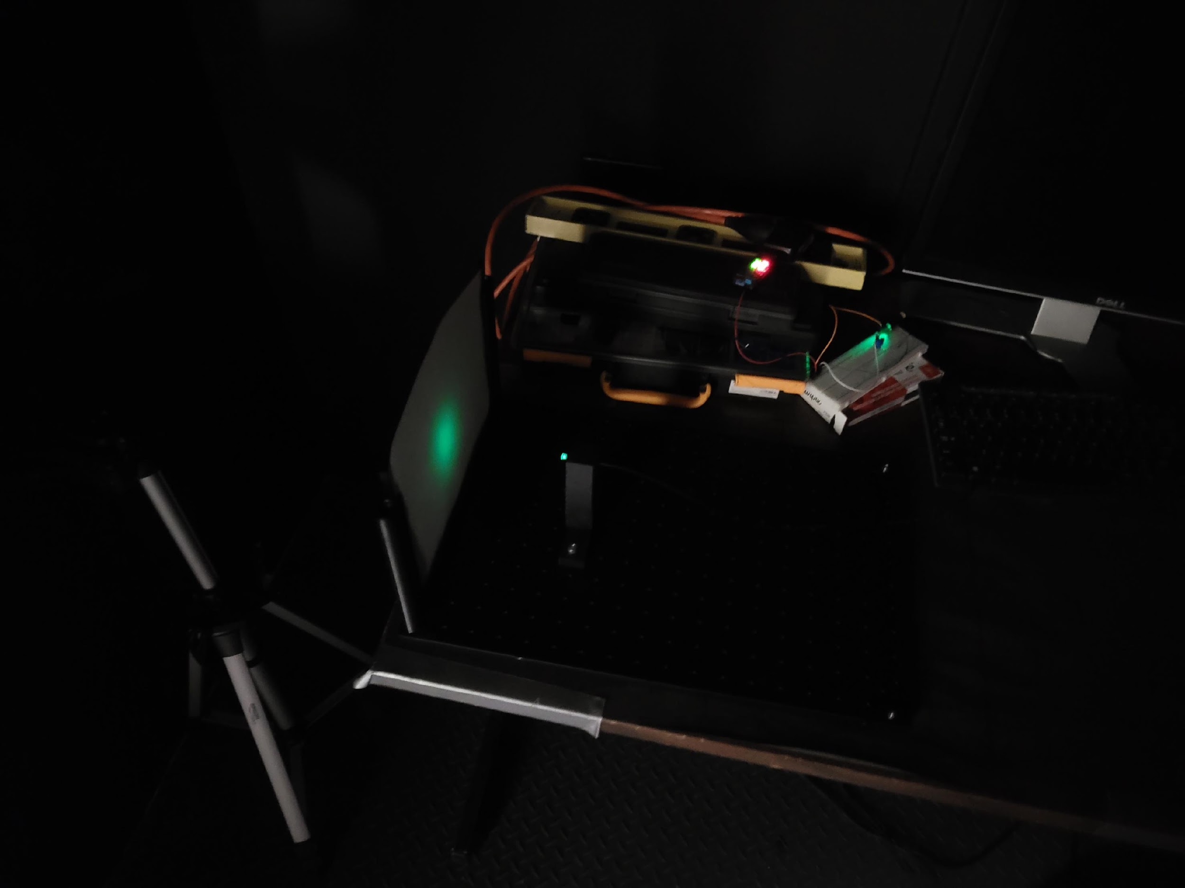
Experimental Set-up
Power & LED
Camera
Light Guide
Lens
Light Distribution
Target Plane

Slide 8
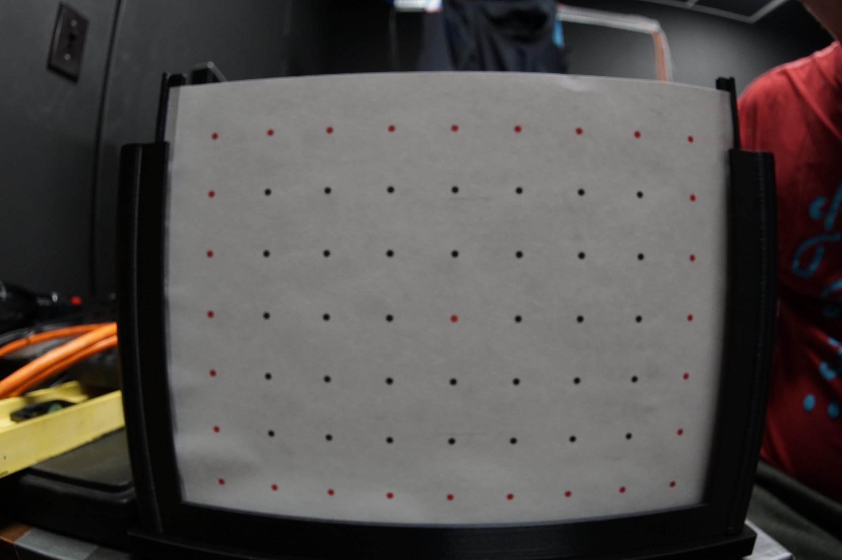
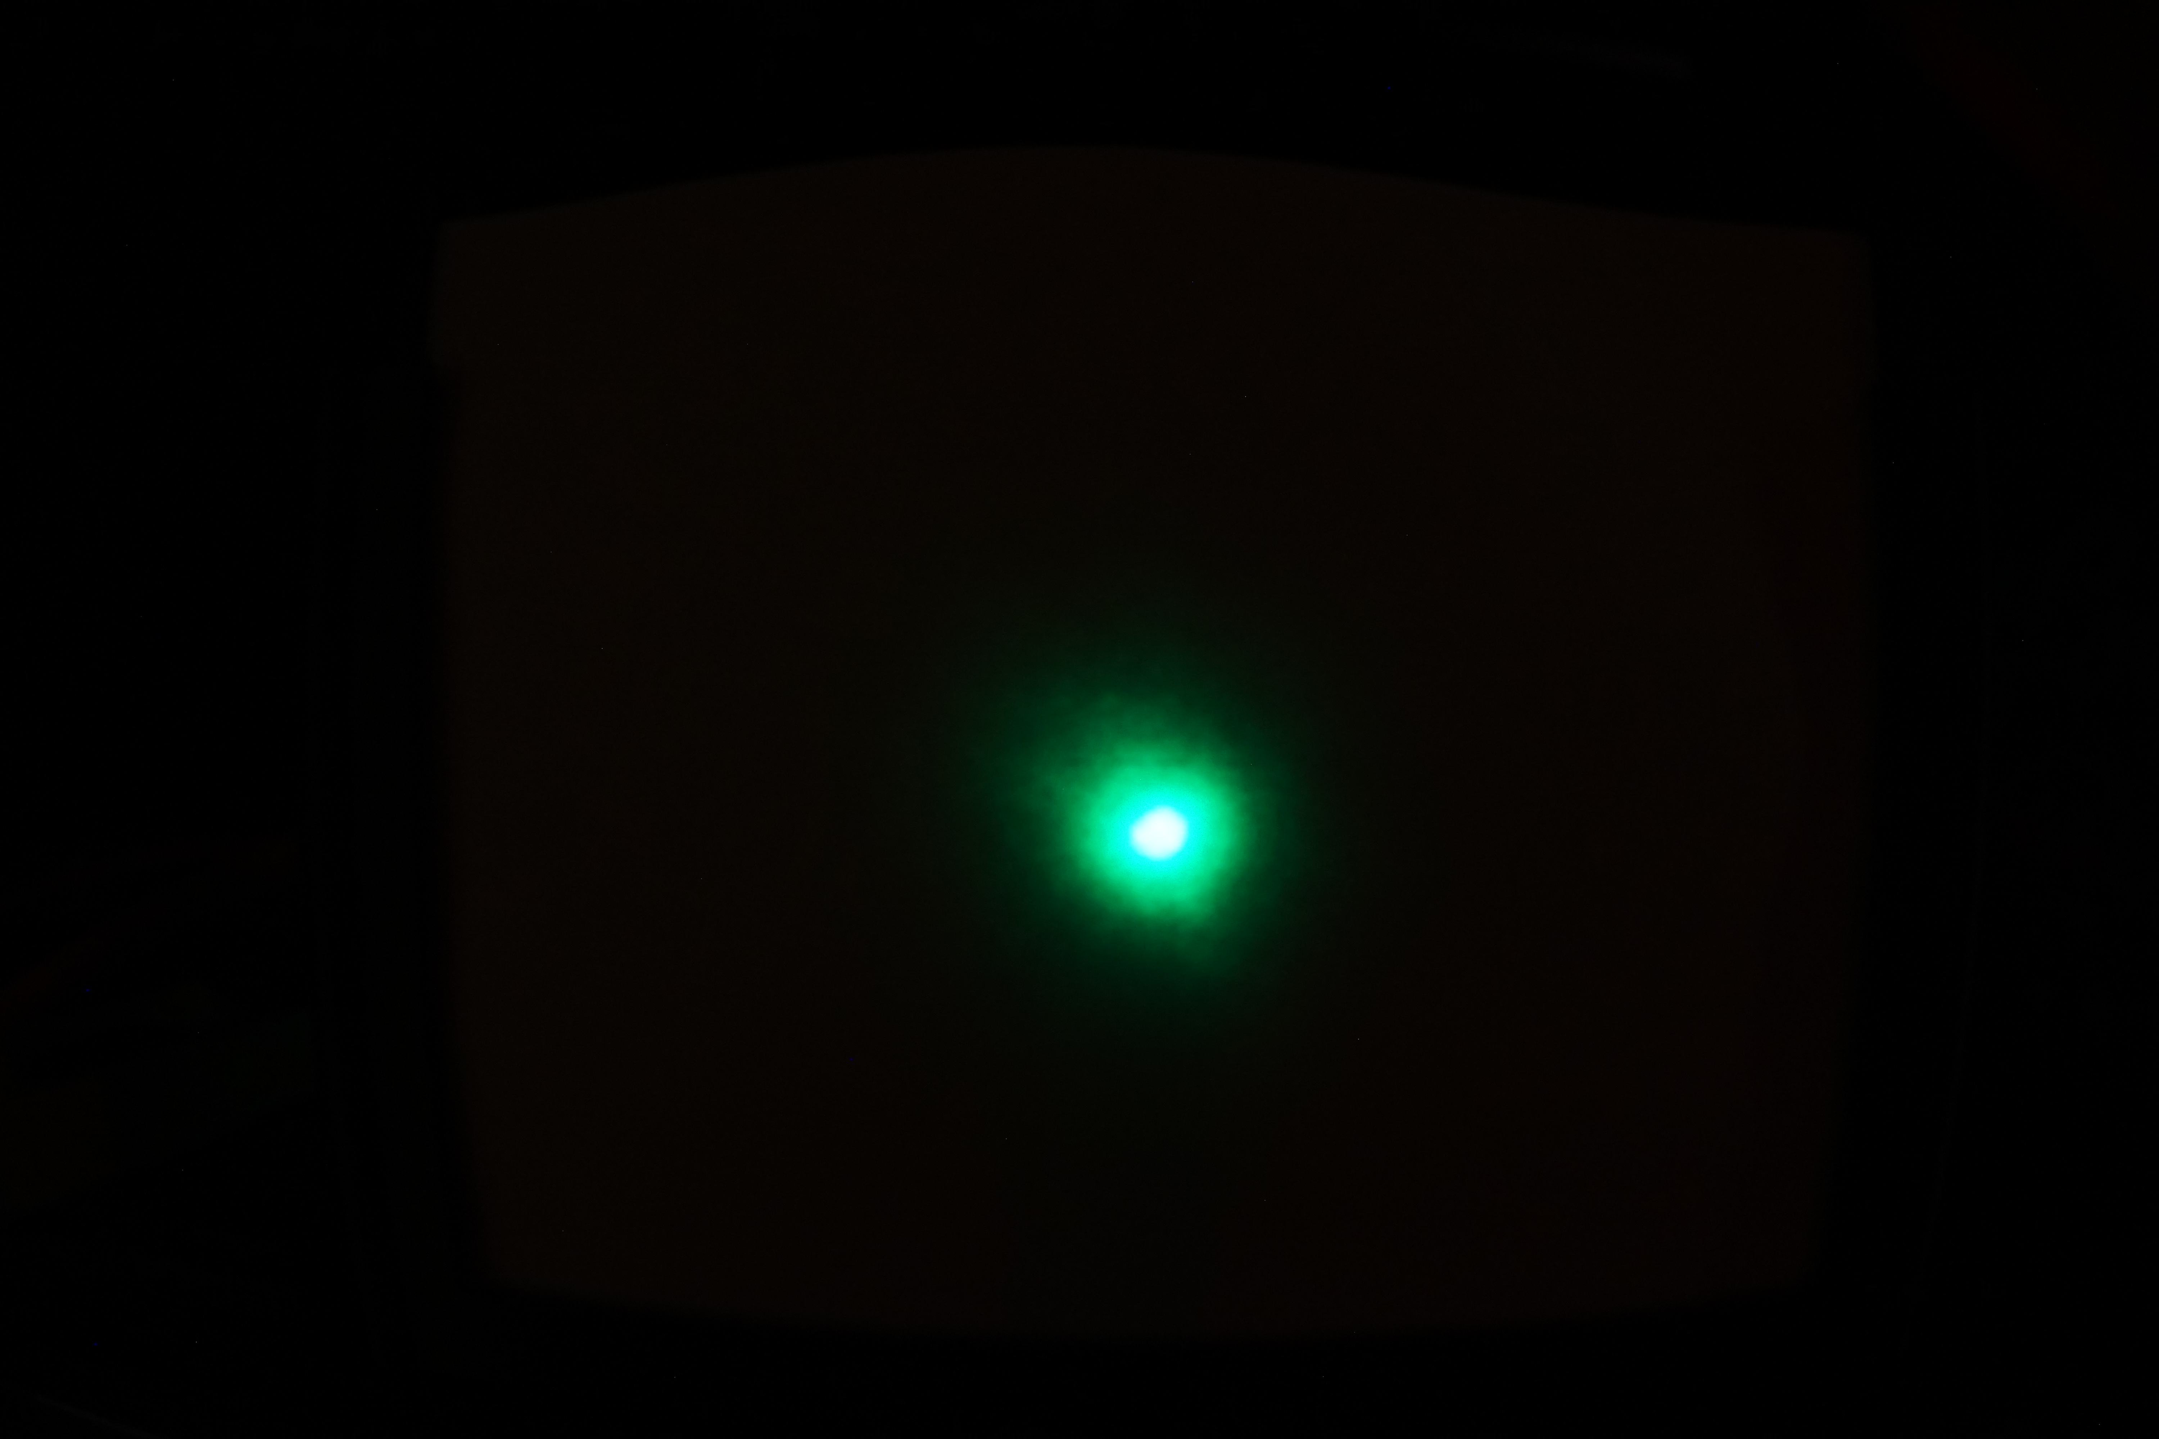
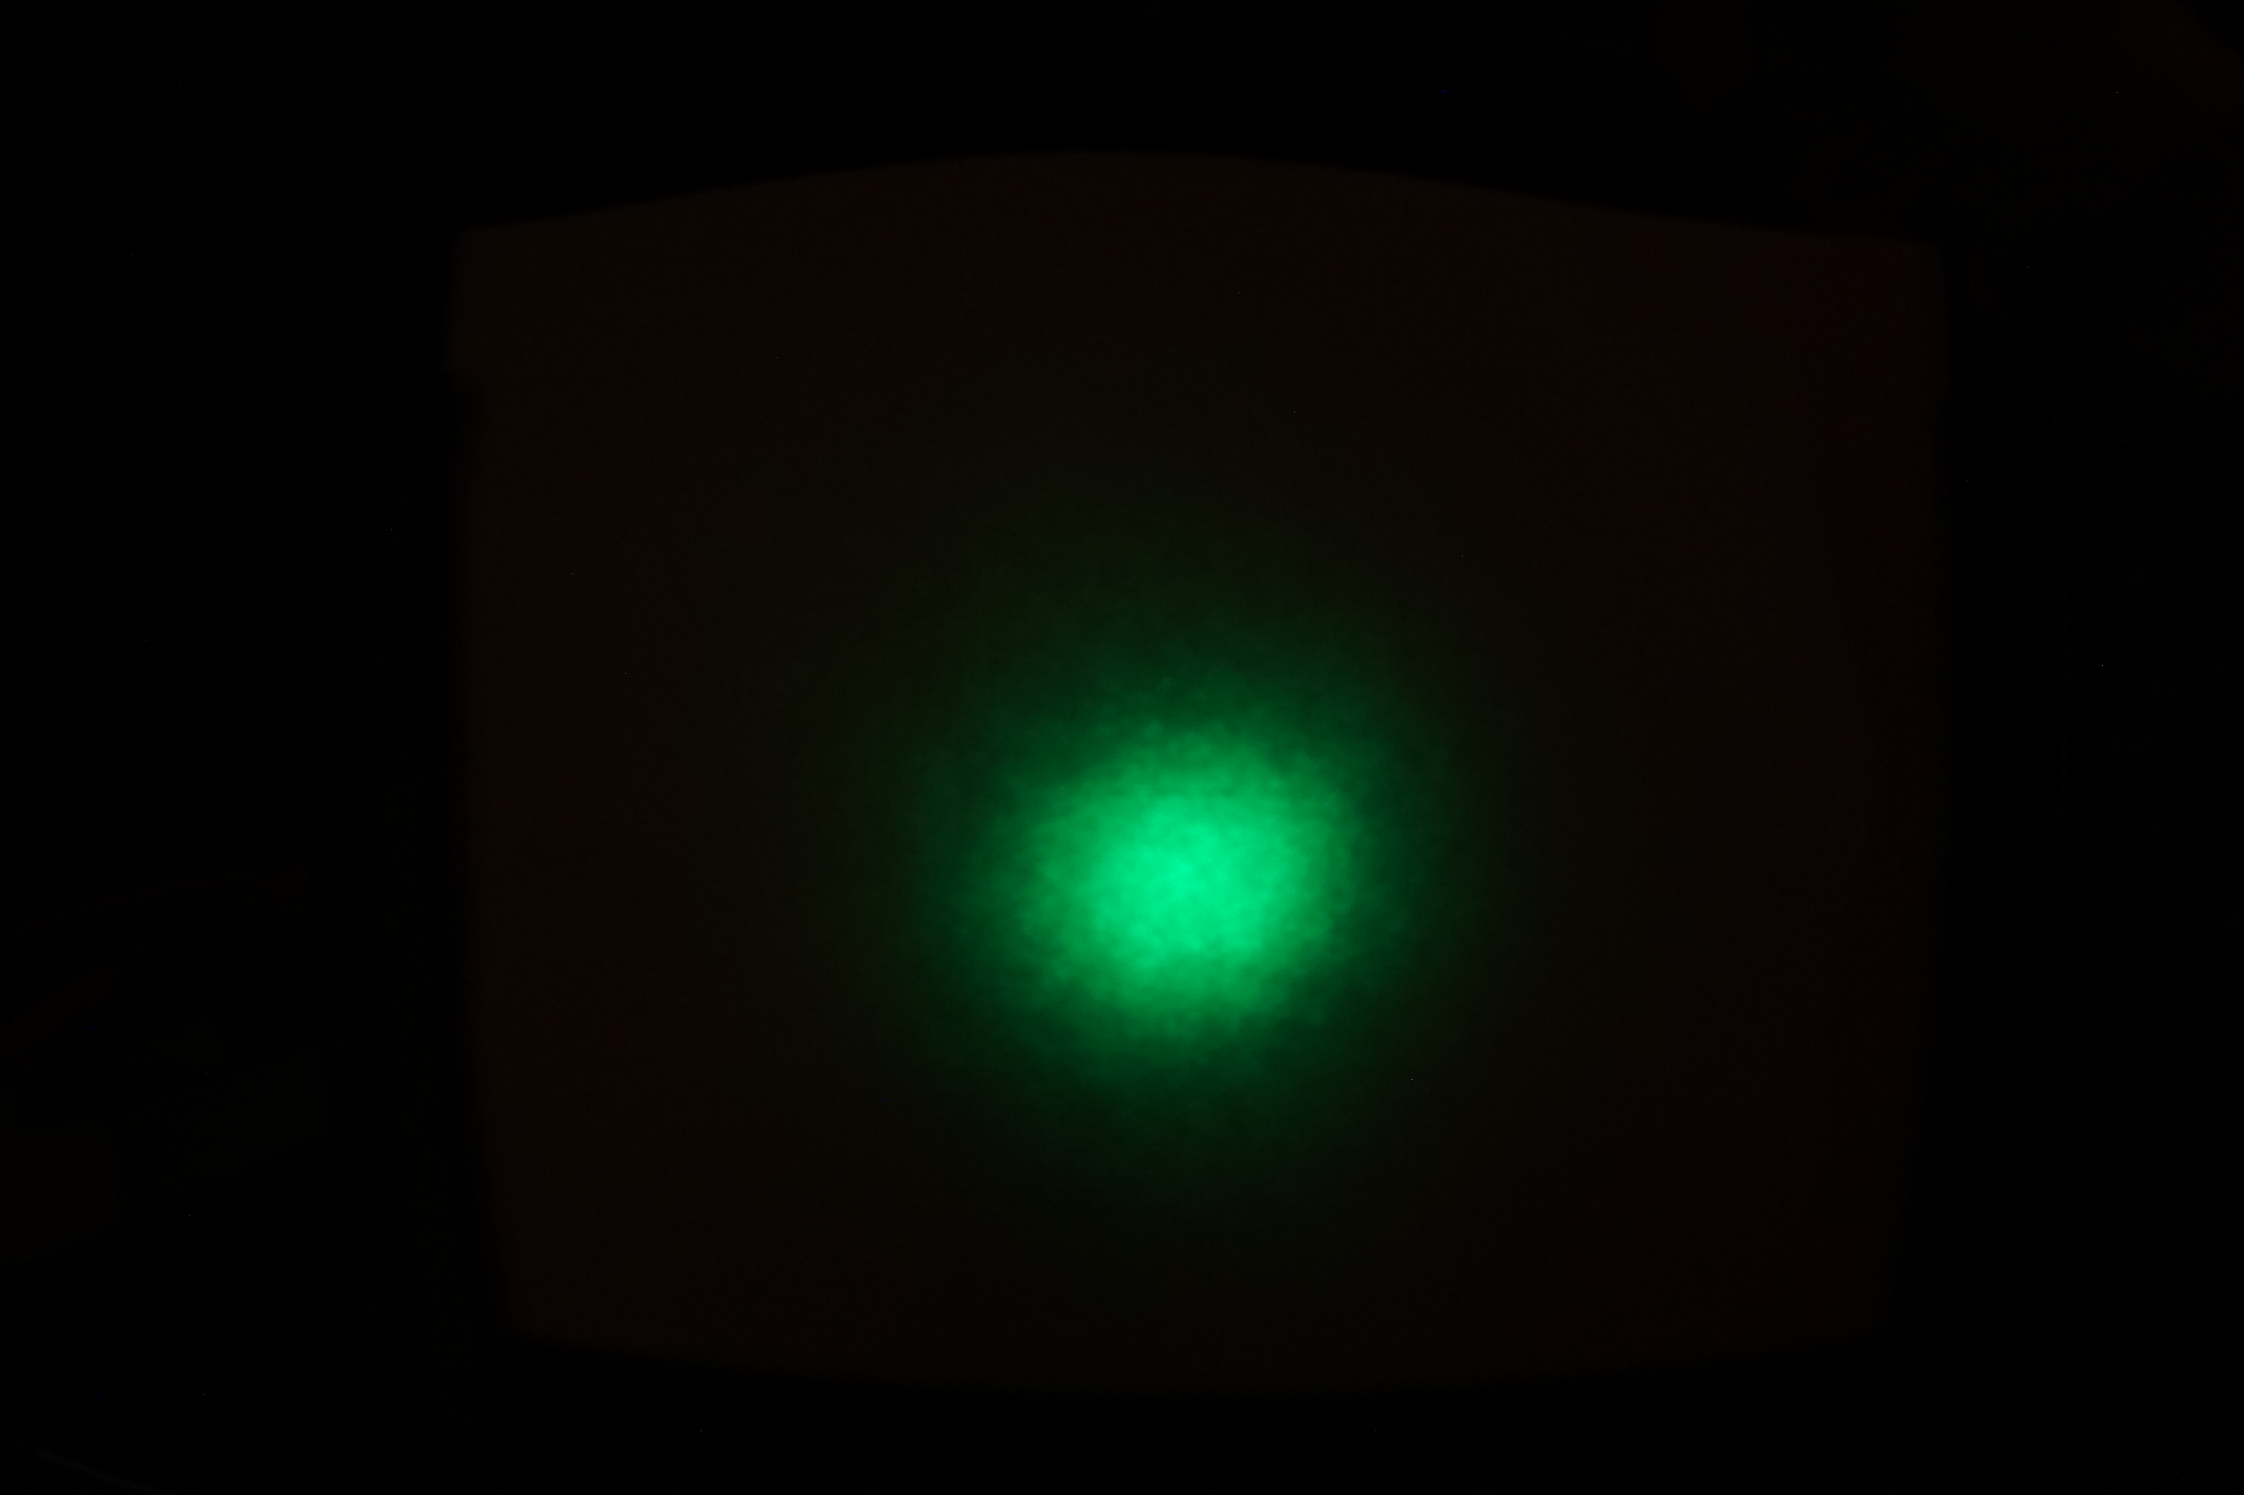
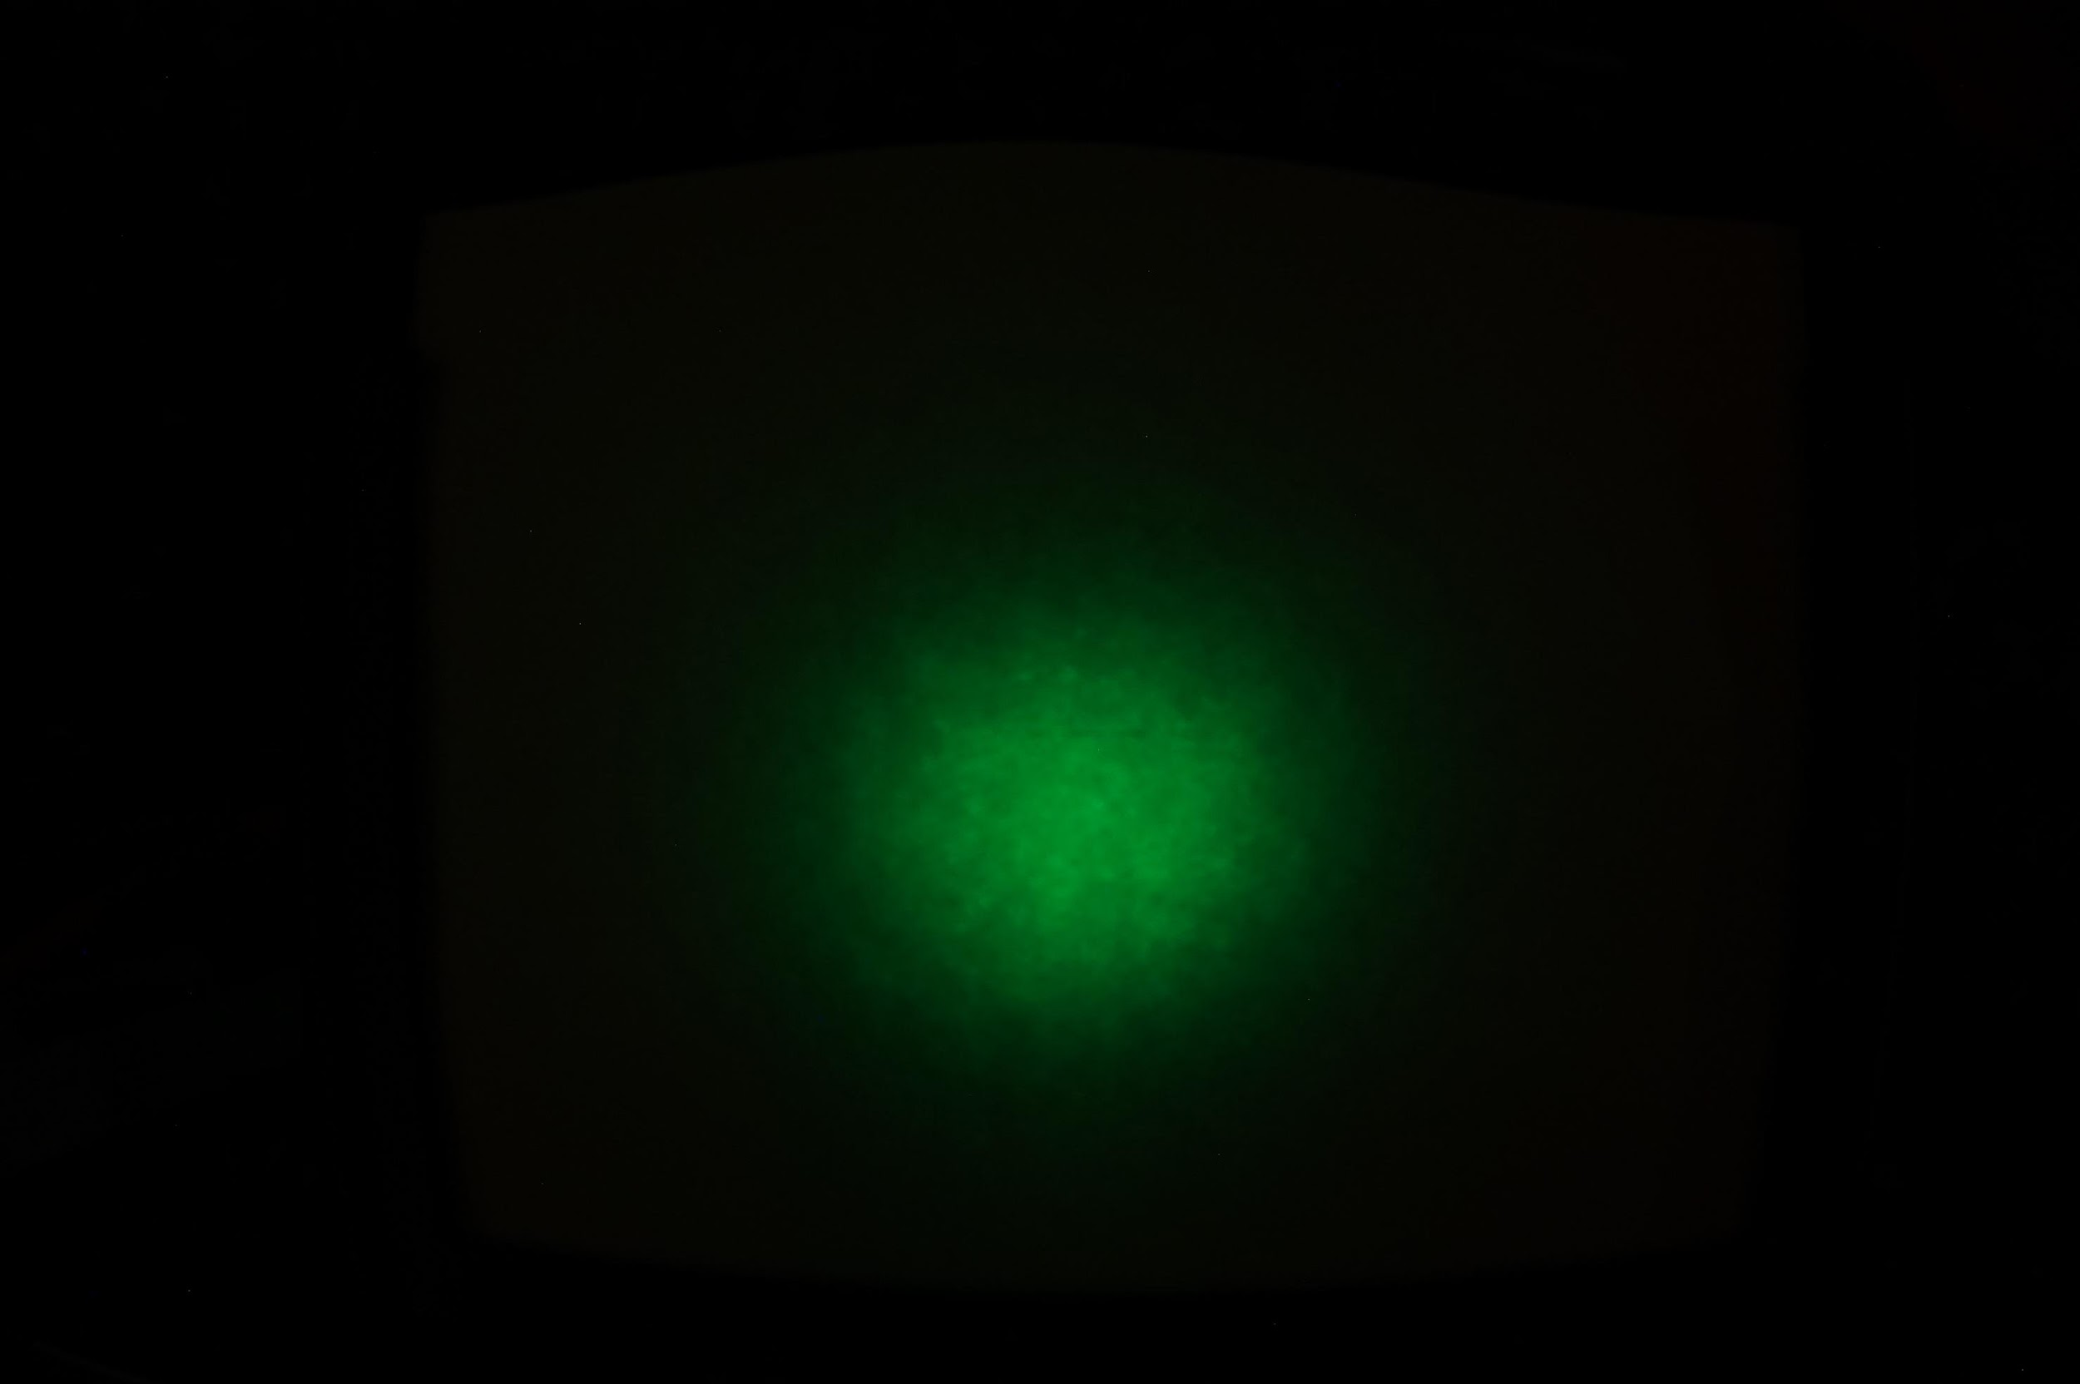
Data Collection
Calibration Screen
d = 1 in
d = 3 in
The LED source is moved further away from target plane for each trial. Angular distribution should be constant as the physical source is not changing.
Each set of trials requires a calibration photograph with known cartesian coordinates to convert to and from pixel coordinates.
d = 5 in

Slide 9

Calibration Technique
Step 1 – Locate all circles
  Uses Hough Circles
Step 2 – Define Corners
  Rough pixel location found via Paint
Step 3 – Define Known Circles
Step 4 – Interpolate between Knowns
  Uses LinearNDInterpolater
Step 5 – Convert Pixel to True Coordinates

Slide 10
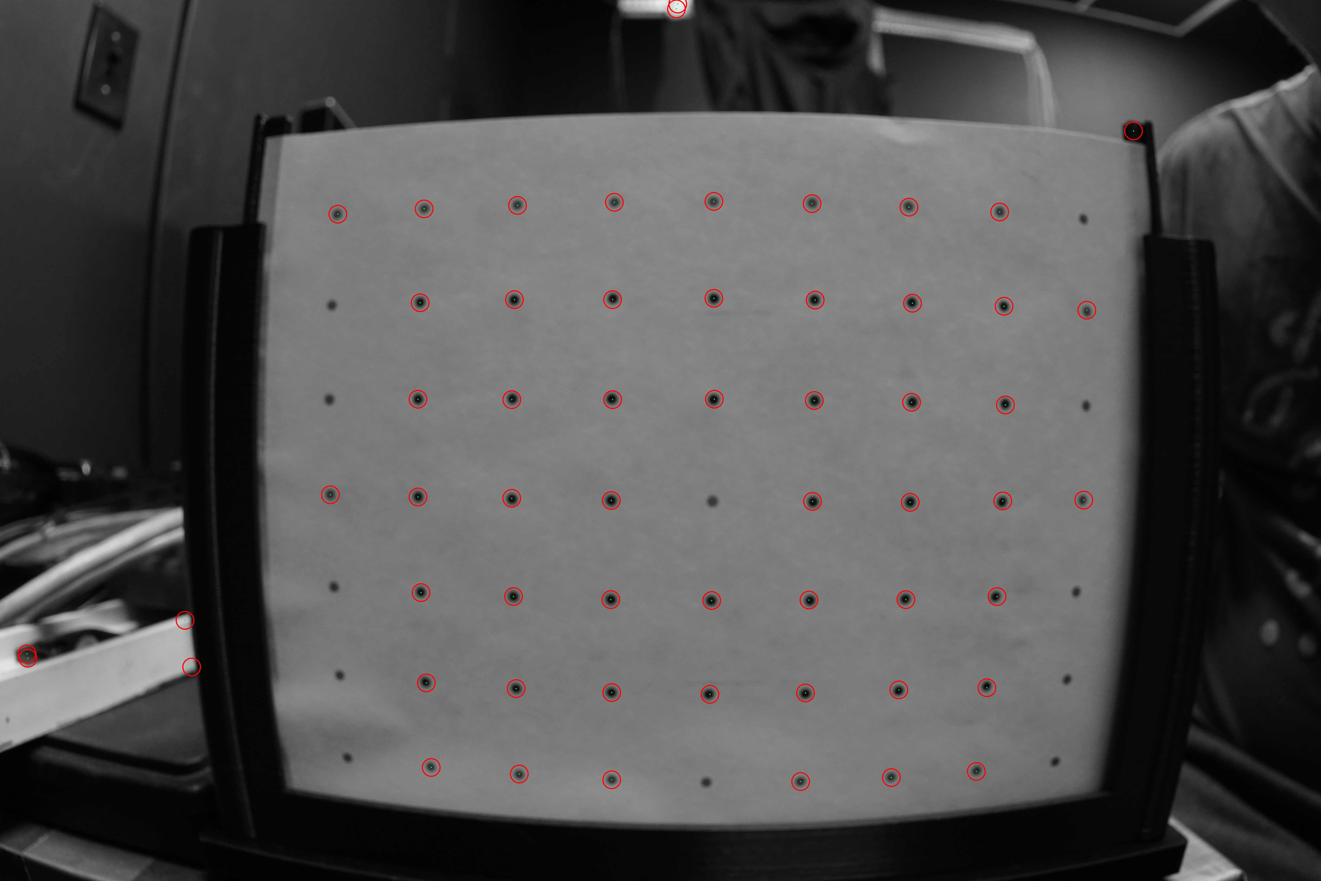
Calibration Technique
Step 1 – Locate all circles
  Uses Hough Circles
Step 2 – Define Corners
  Rough pixel location found via Paint
Step 3 – Define Known Circles
Step 4 – Interpolate between Knowns
  Uses LinearNDInterpolater
Step 5 – Convert Pixel to True Coordinates

Slide 11
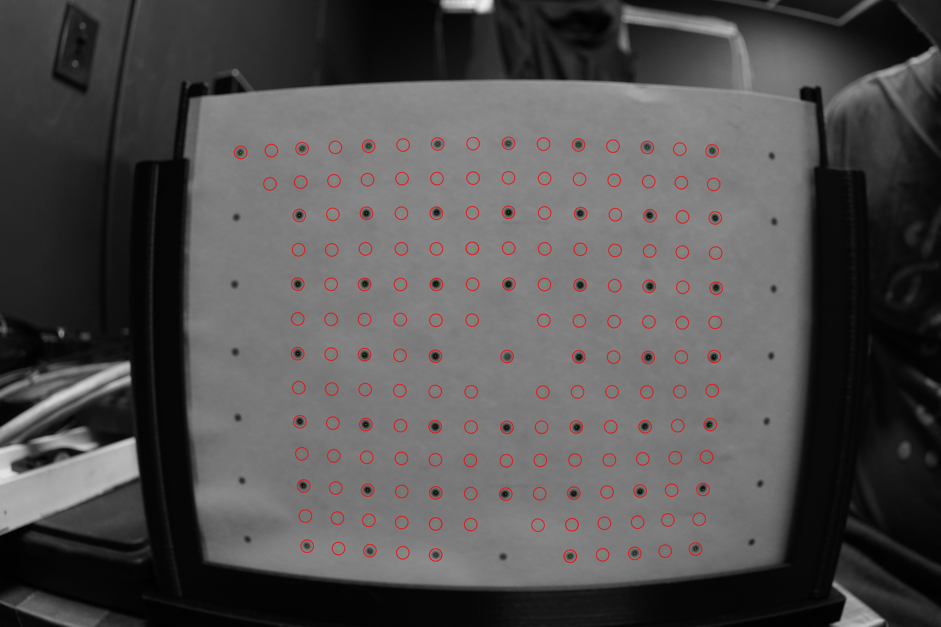
Calibration Technique
Step 1 – Locate all circles
  Uses Hough Circles
Step 2 – Define Corners
  Rough pixel location found via Paint
Step 3 – Define Known Circles
Step 4 – Interpolate between Knowns
  Uses LinearNDInterpolater
Step 5 – Convert Pixel to True Coordinates

Slide 12
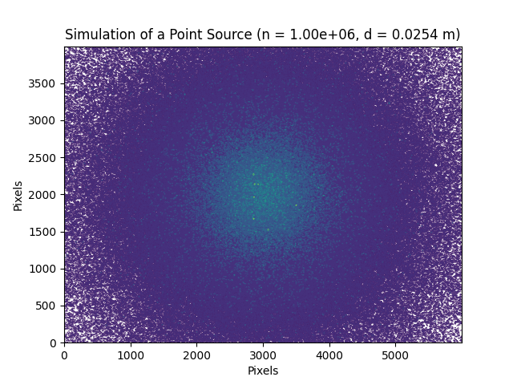
Analysis Technique
Point Source –
Uniform distribution in both cos(theta) and phi
Determine centre of maximum possible circle
cos(theta) limit
Notes:
Draw maximum circle on simulation

Slide 13
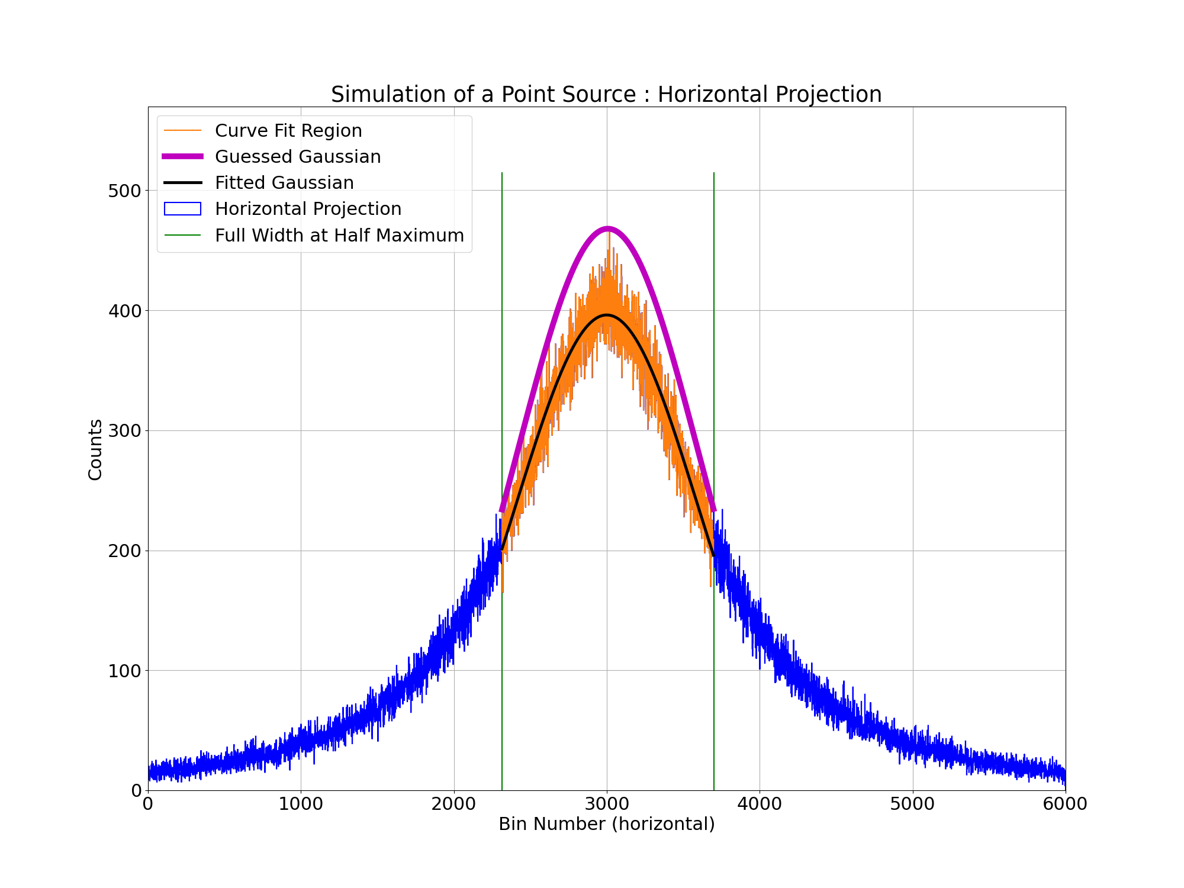
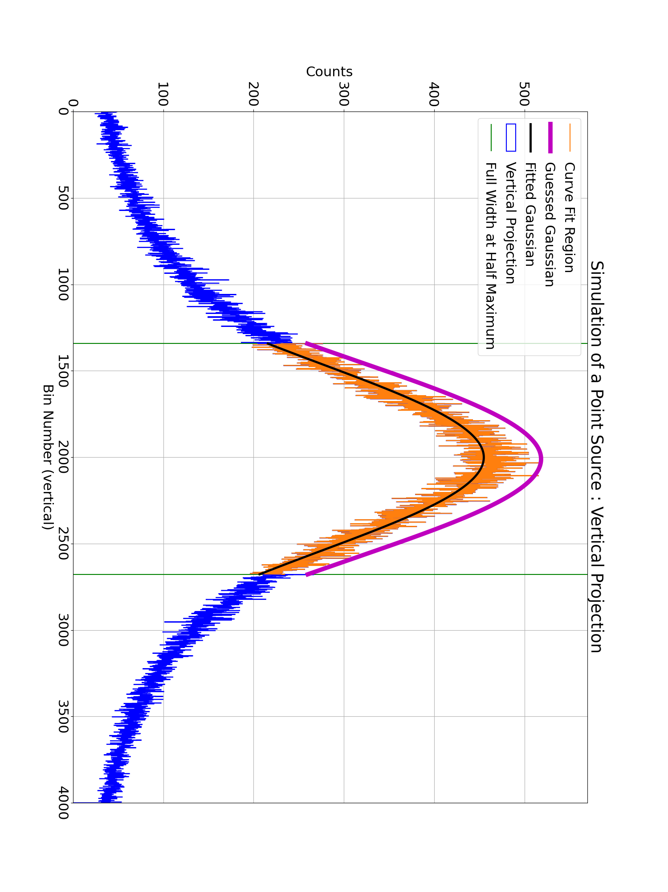
Isolate Full Width at Half Maximum
Approximate isolated data as Gaussian
Fit Gaussians to each data set
Extract centres of Gaussian as the pixel coordinates of the centre of the light distribution

Slide 14
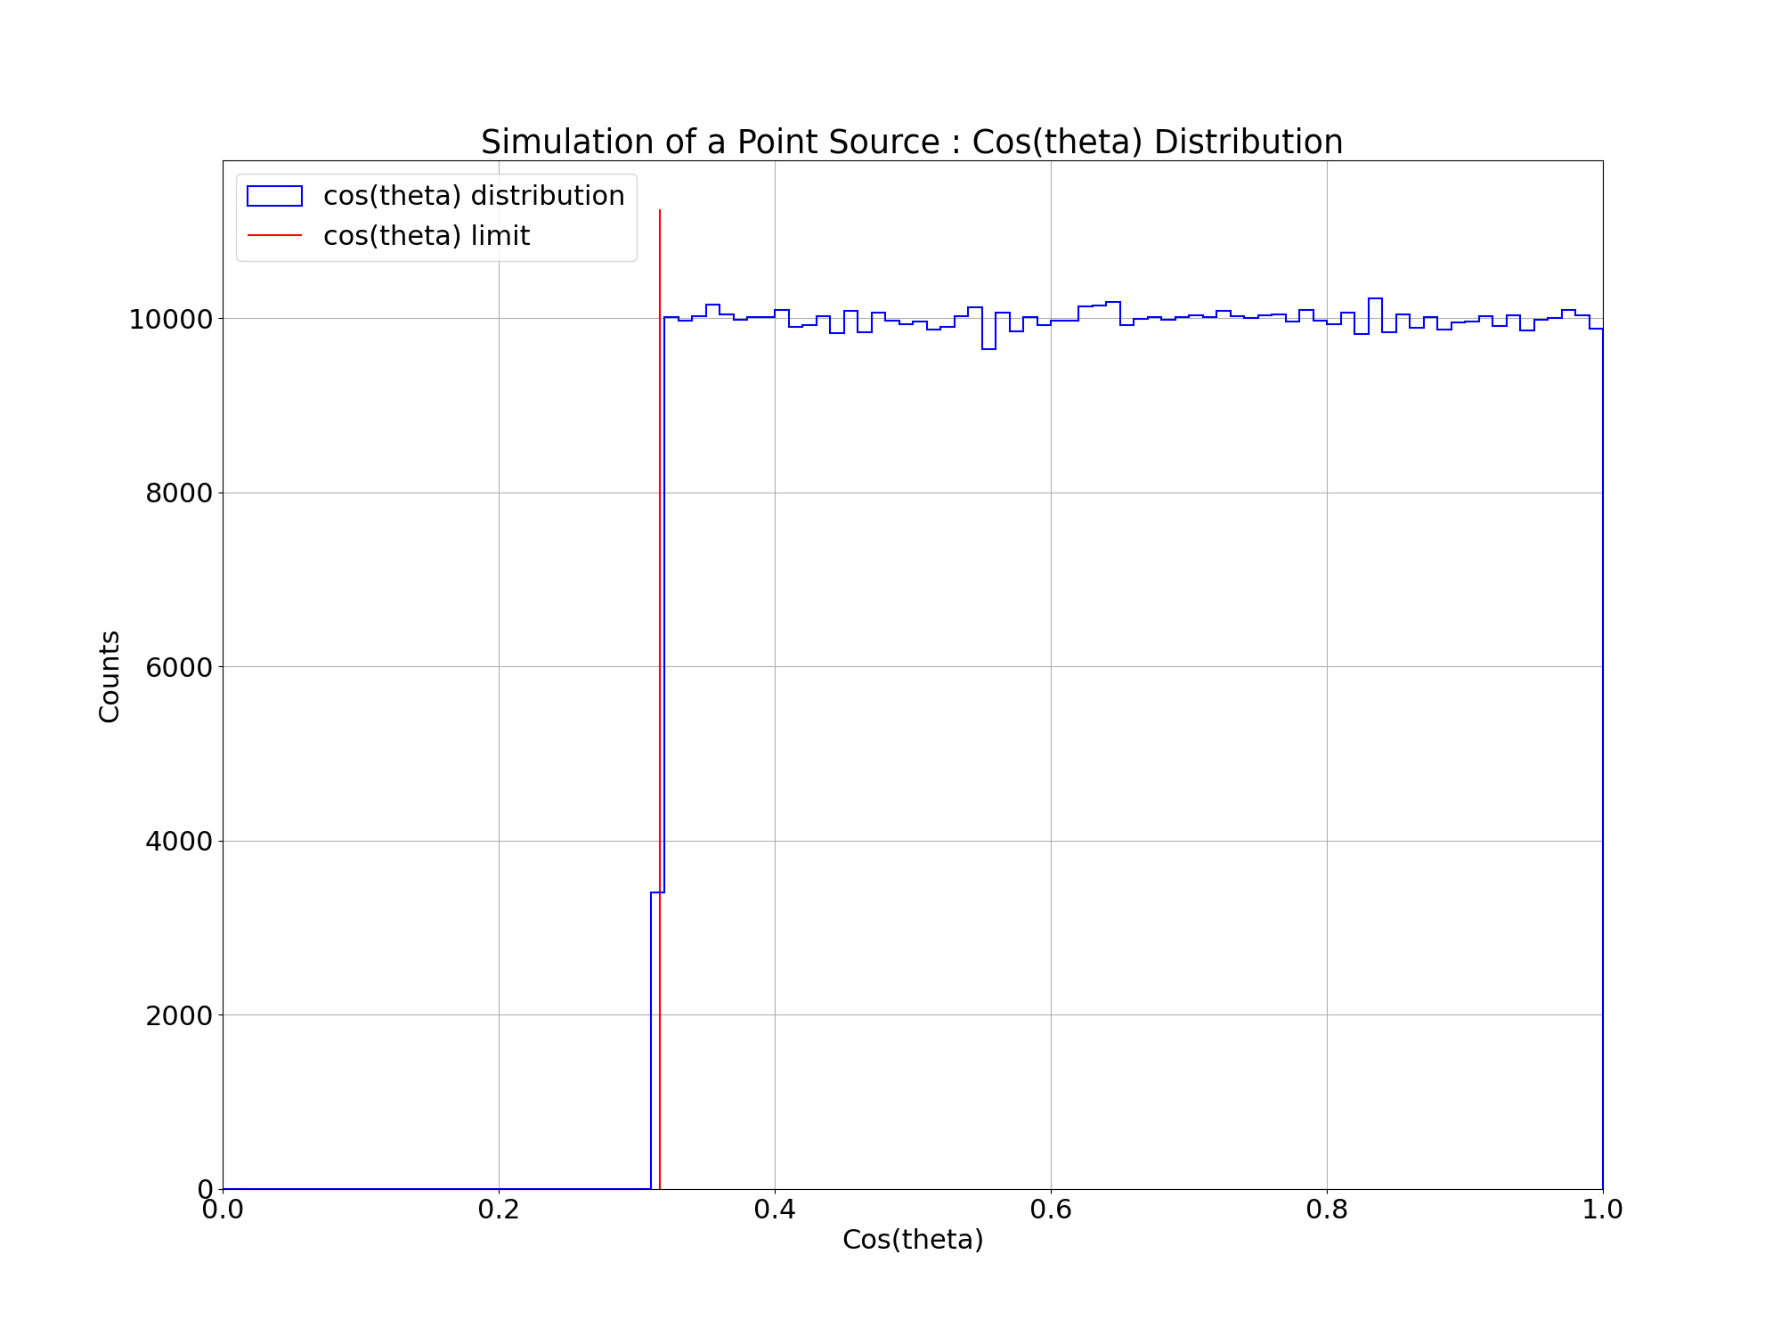
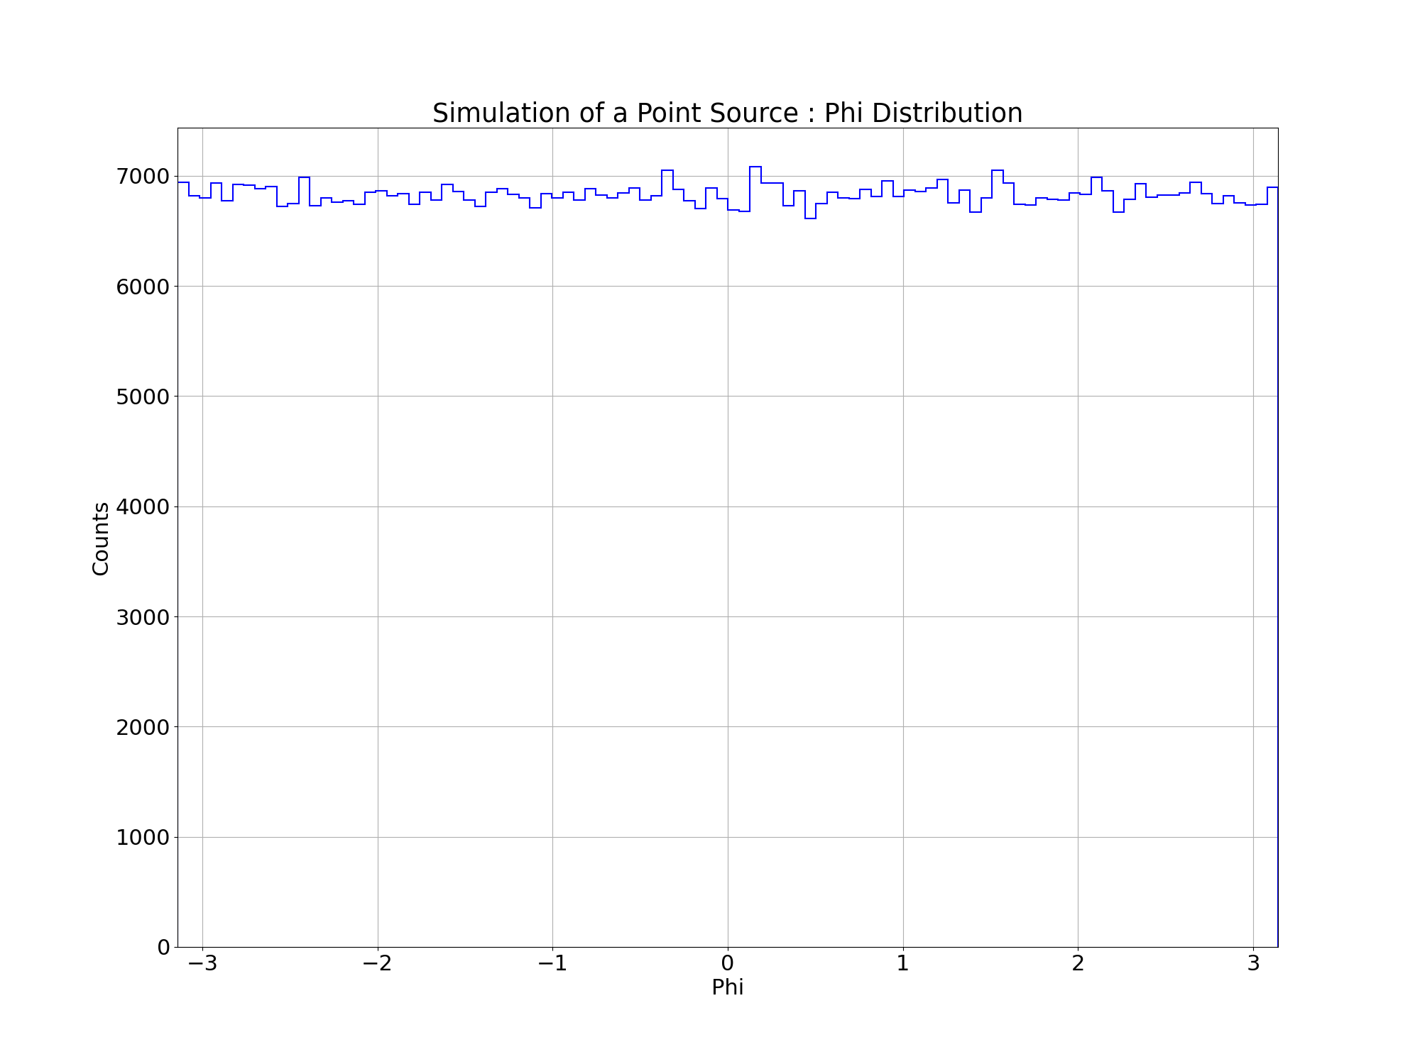
Simulation Results
Uniform distributions in both cos(theta) and phi
Notes:
Vertical offset due to potential background light contribution

Slide 15
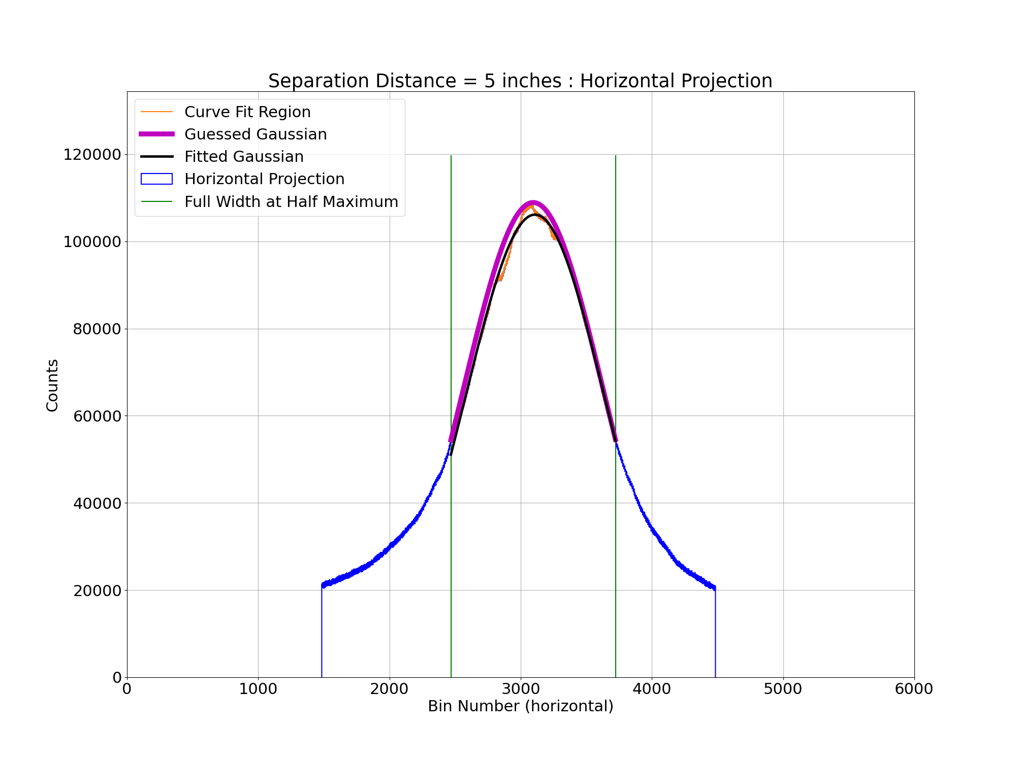
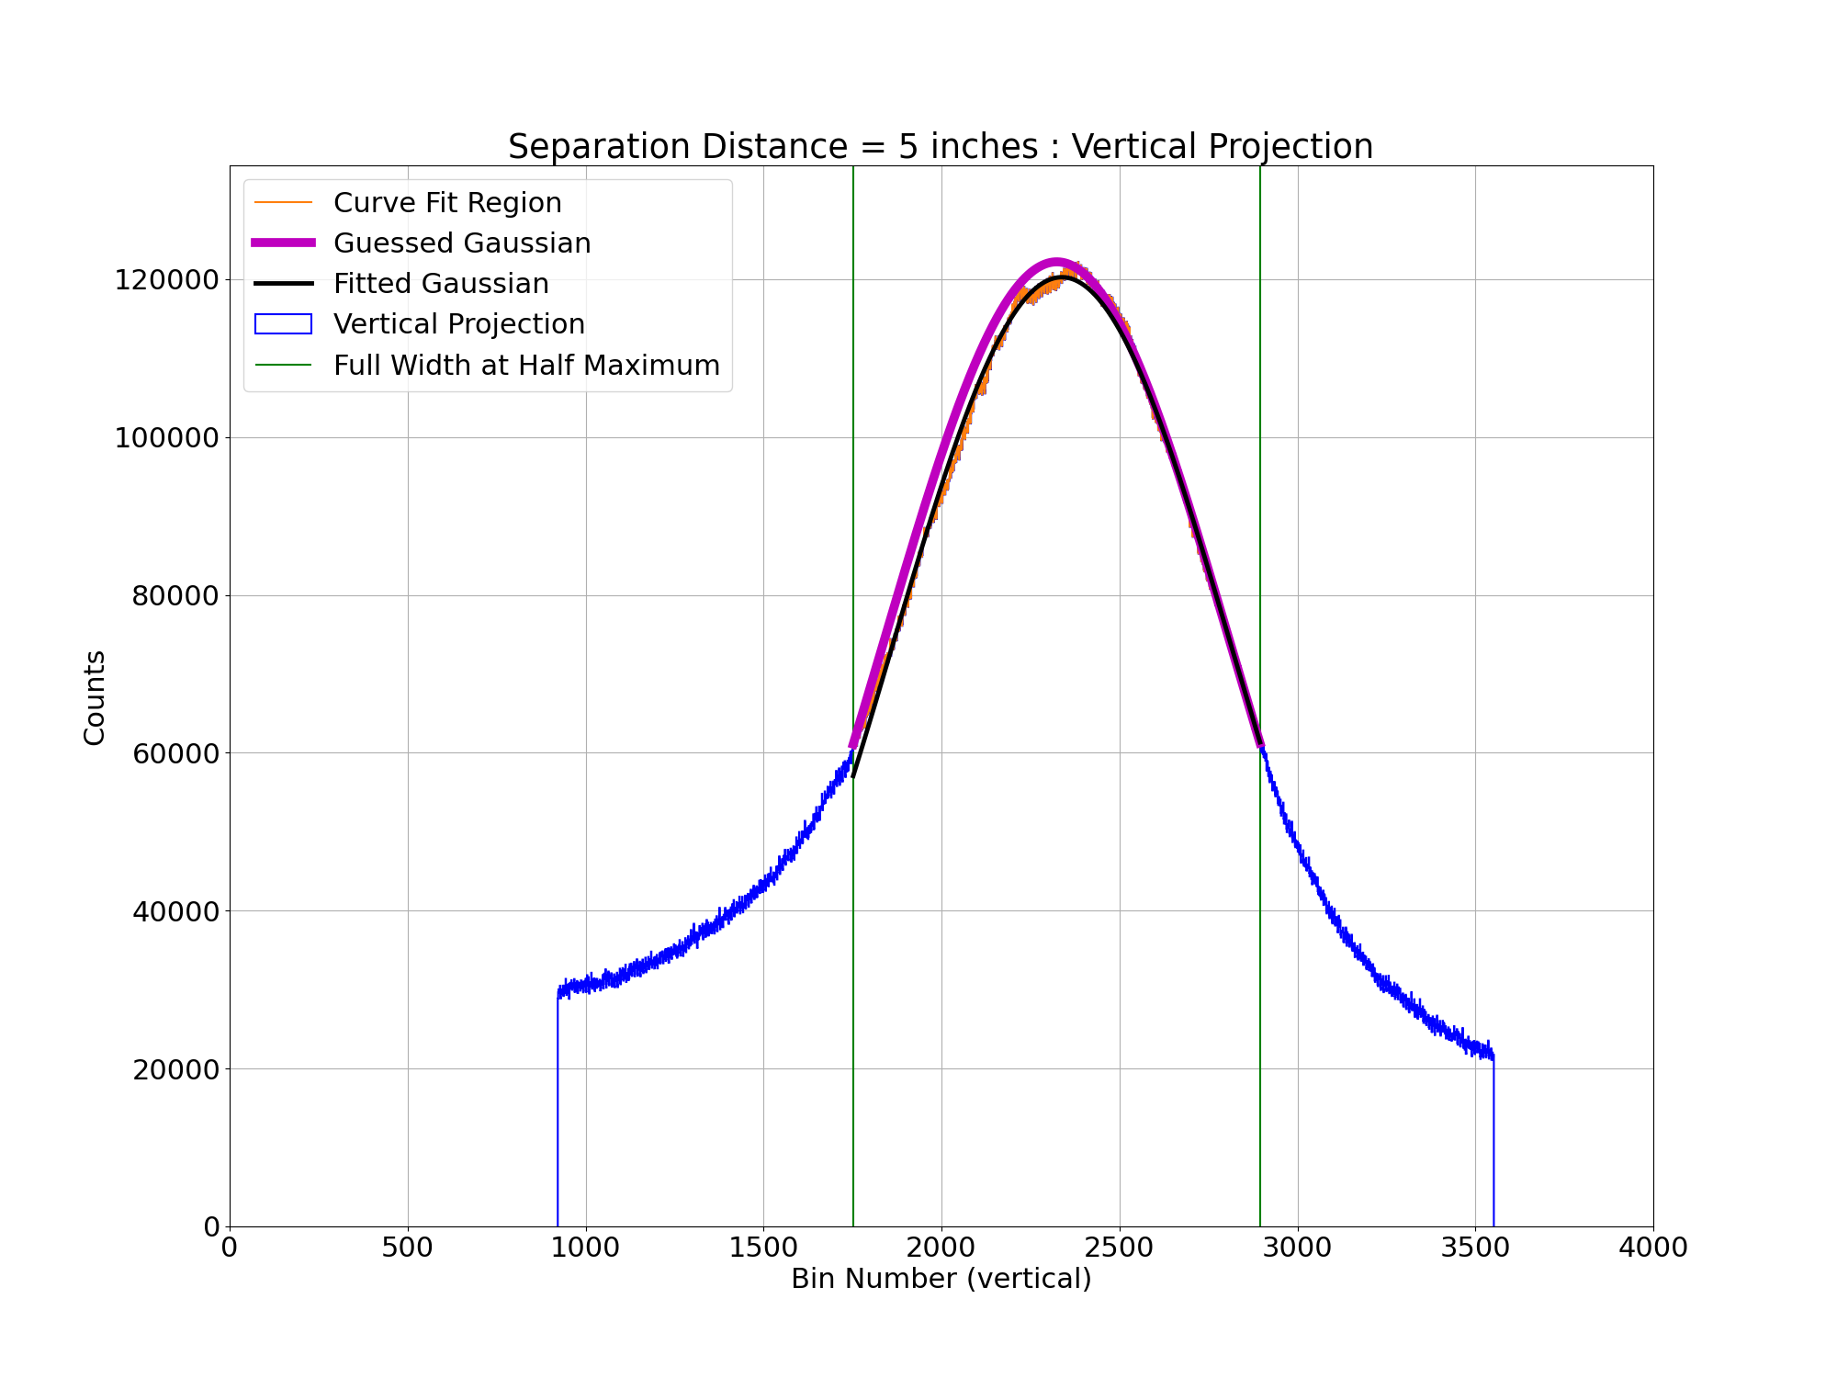
Example Test Results : d = 5 in
d = 5 in
Notes:
Vertical offset due to potential background light contribution

Slide 16
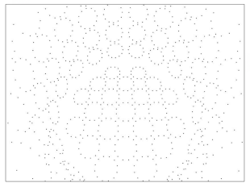
Looking Forward
Create more stable lens stand
Remove background light contribution
Model angular distribution in both cos(theta) and phi
Pass information to full simulation of IWCD tank

Slide 17
Questions?
Thank you!
Merci!

