Slide 1
Machine learning for noise removal in NEWS-G
CAP 2022
Noah Rowe
June 8th 2022

Slide 2
Presentation Outline
NEWS-G Background
Problem Definition
Signal Denoising Model
Single Output Model

Slide 3
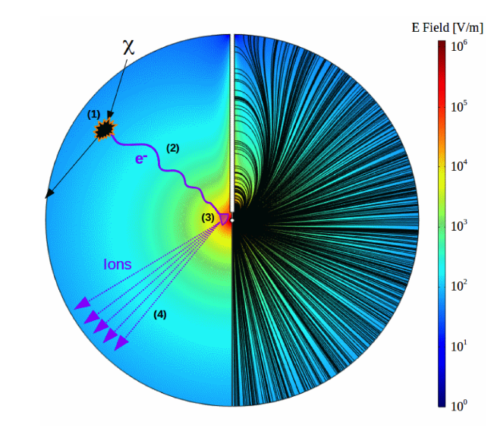
NEWS-G
NEWS-G – Spherical Proportional Counter
Signal Generation:
Primary ionization
Electron drift
Townsend avalanche
Positive ion drift
Analysis data taken from SEDINE at LSM in France

Slide 4
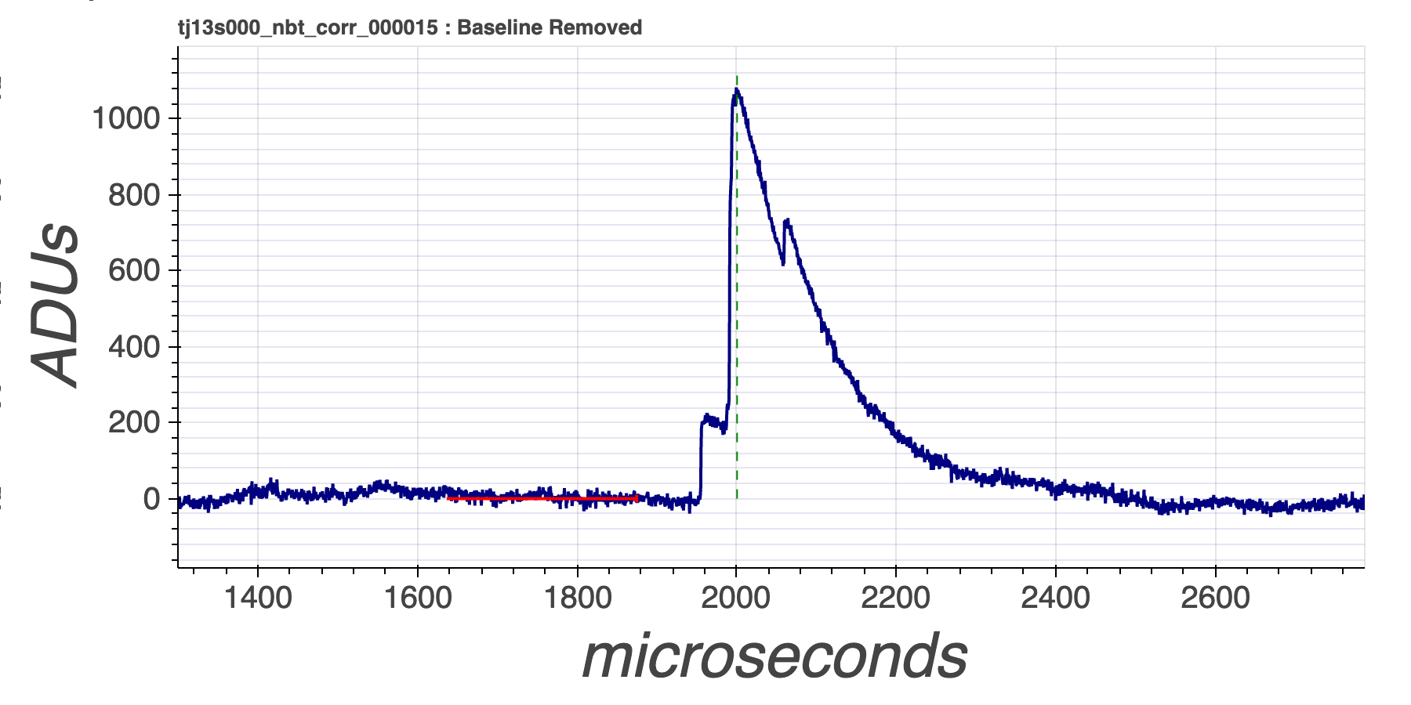
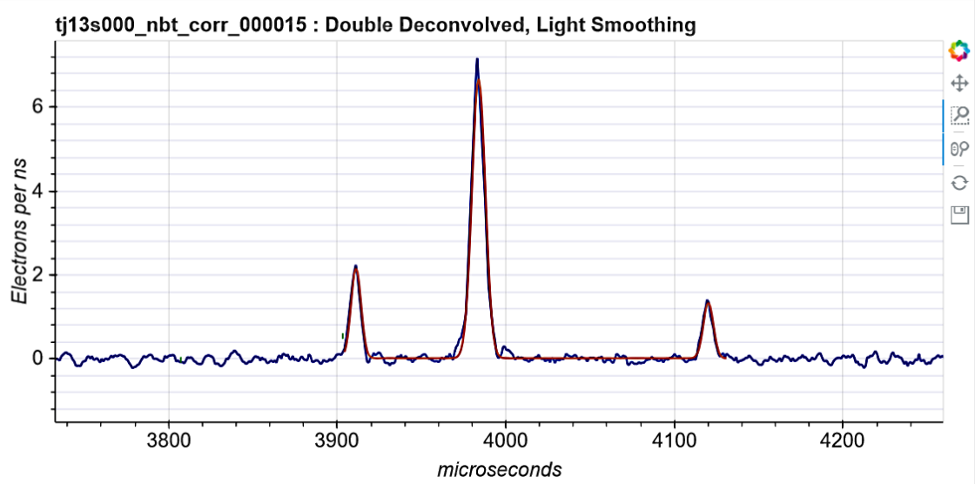
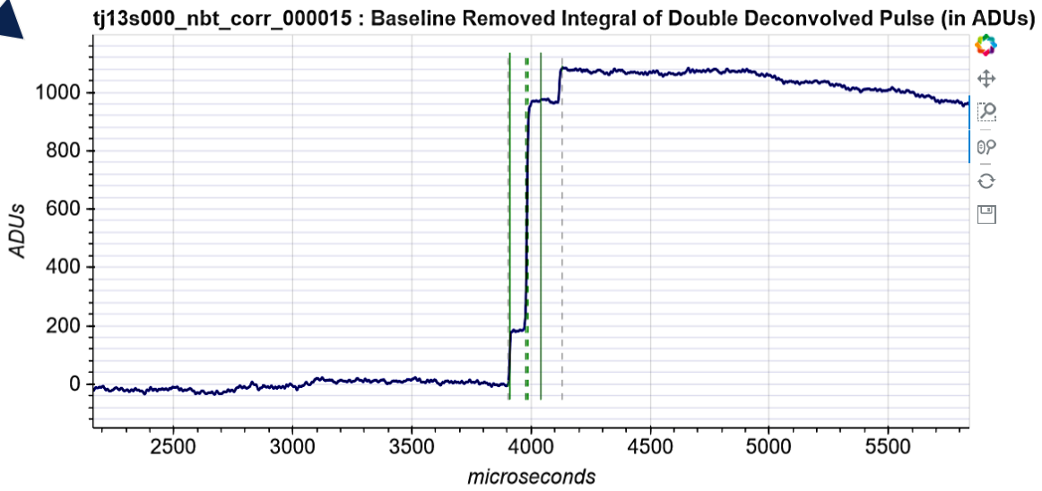
NEWS-G Signal Generation
Integrated Double Deconvolved Pulse
Raw Pulse
Double Deconvolved Pulse
Double Deconvolution Algorithm
Integration
Detector Response

Slide 5
Problem Definition
Goals:
Utilize machine learning methods to remove noise from recorded detector signals
Model implementation should aid in measuring important signal characteristics, such as amplitude and rise-features
Extend existing work on Germanium detector signals to NEWS-G
Our group has designed and trained such a model for a Germanium P-Type Point Contact Detector
(arXiv:2204.06655)
4

Slide 6
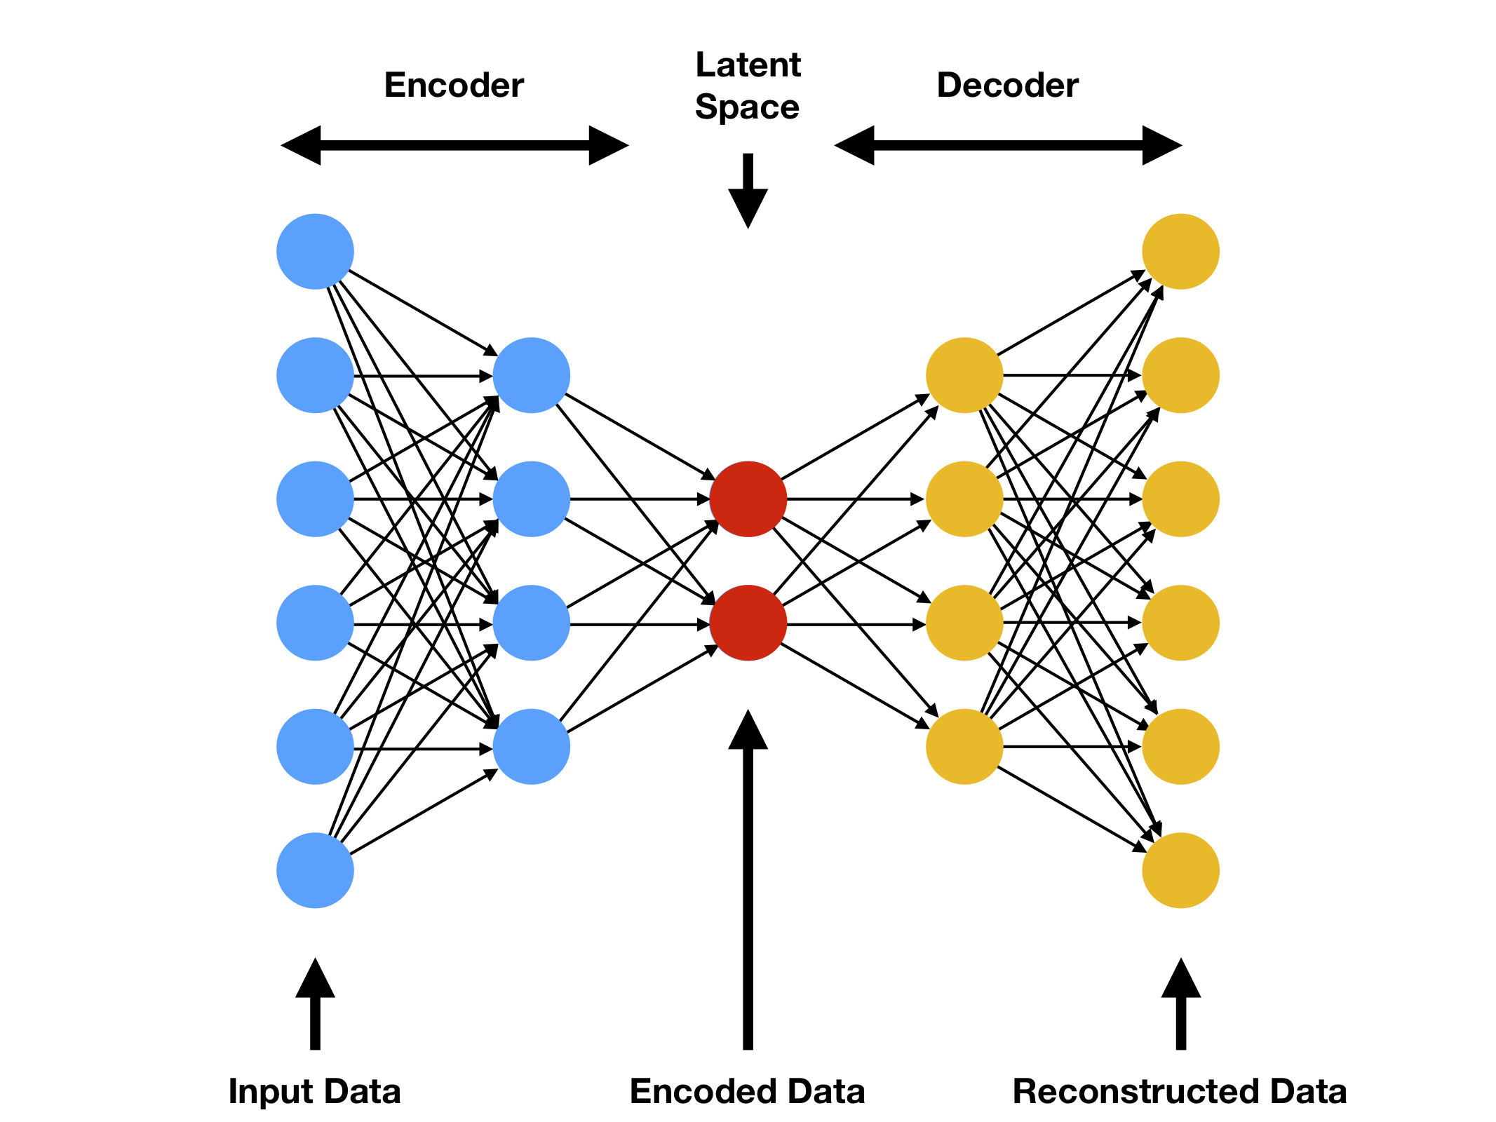
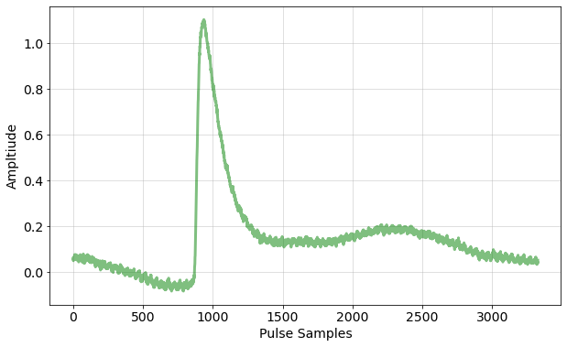
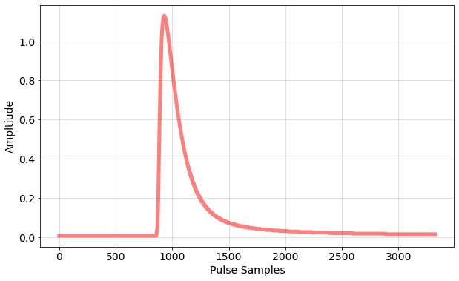
Methods – Model Architecture

Slide 7
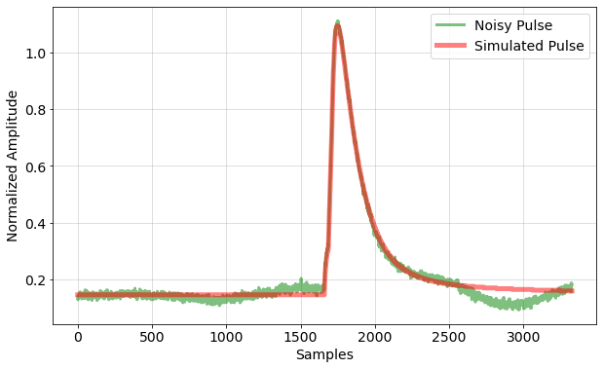
Methods – Model Training
Simulated pulses + real noise
Trained on a simulation-based dataset modeled after our real detector
Simulated pulses
X
Y

Slide 8
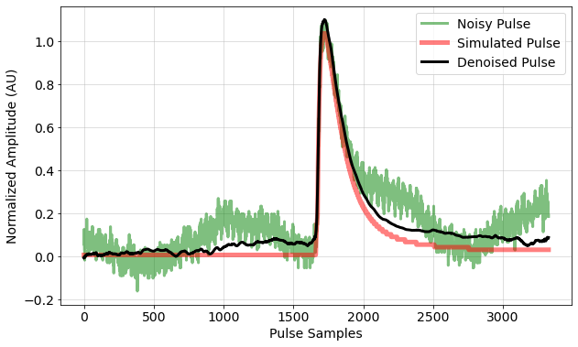
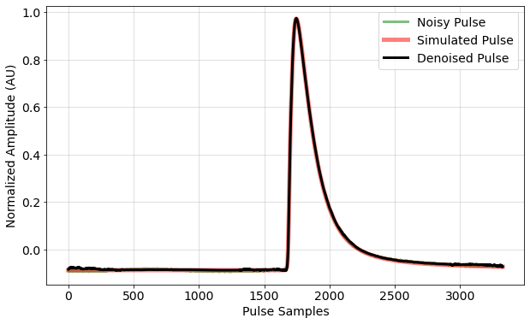
Example Pulses
Energy: ~170eV
Energy: ~1370eV

Slide 9
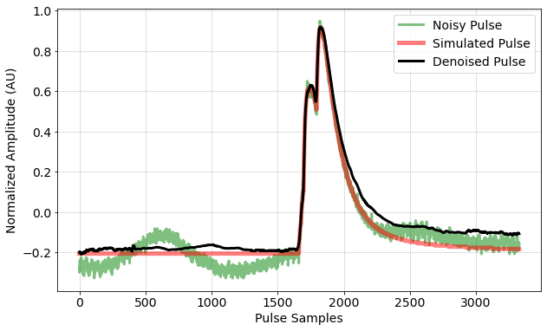
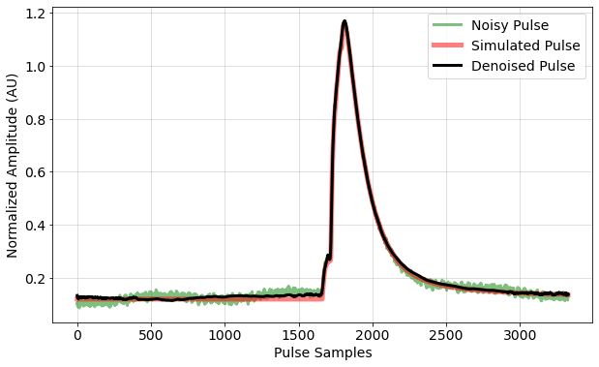
Example Pulses
Energy: ~380eV
Energy: ~540eV

Slide 10
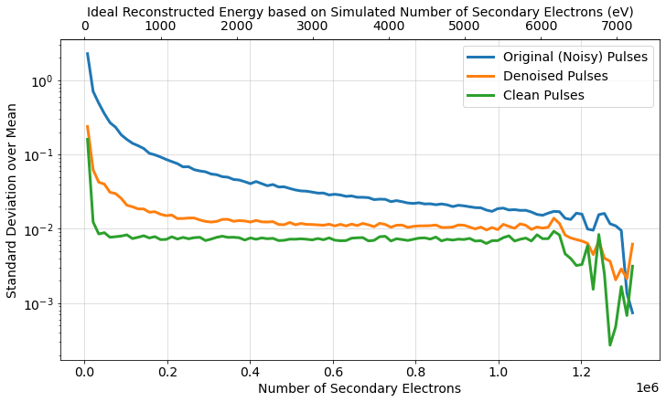
Energy Resolution Results

Slide 11
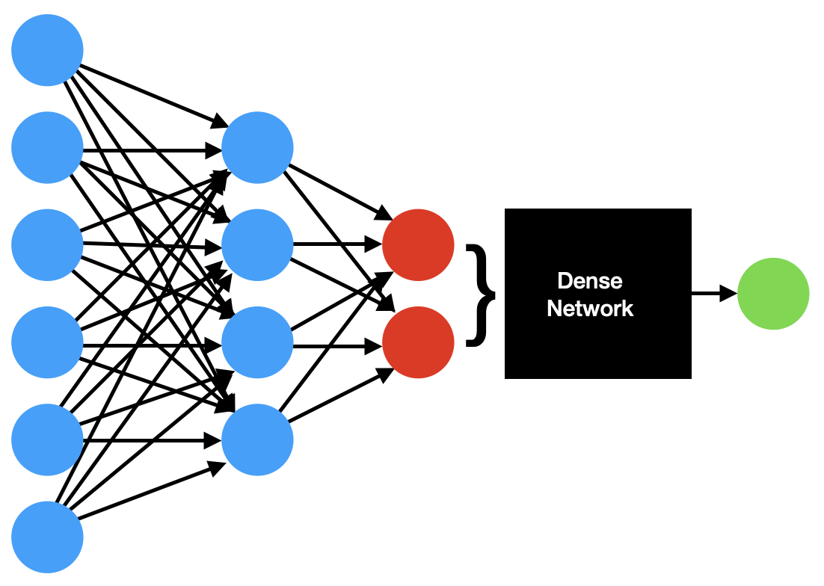

Single Output Model

Slide 12
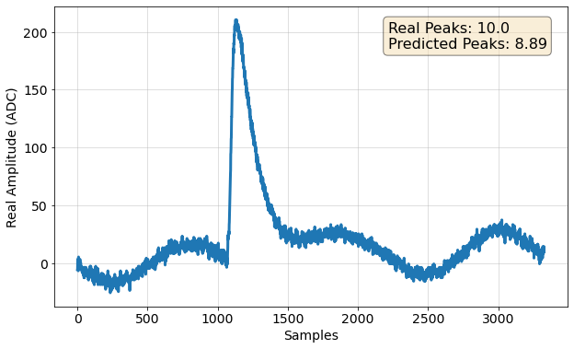
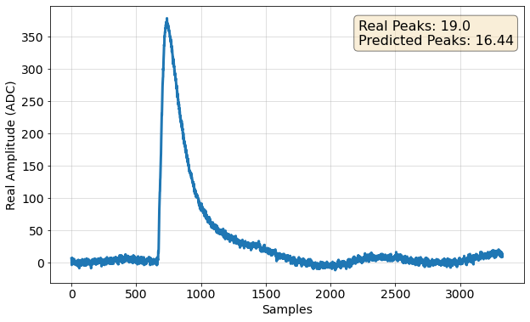
Primary Electron Prediction Examples

Slide 13
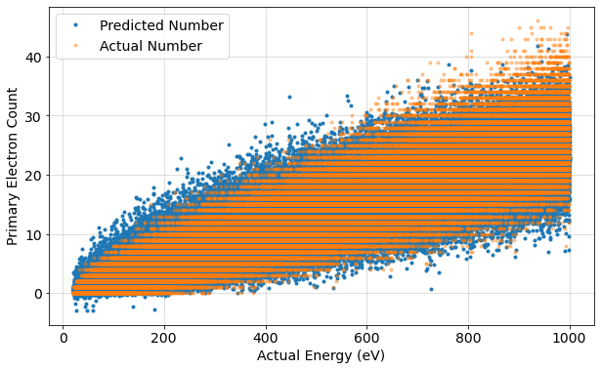
Primary Electron Prediction

Slide 14
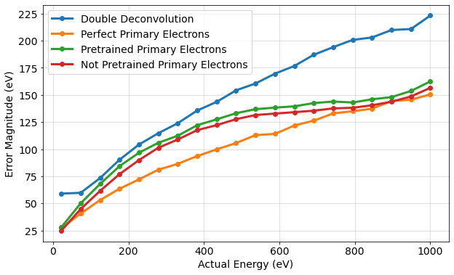
Primary Electron Prediction

Slide 15
Conclusion
Developed an effective machine learning noise removal model resulting in more accurate energy measurements
Developed a single output model to predict the number of primary electrons for a given event
  Offers improvements in energy measurements
Single output model can be extended to different targets
  Direct energy prediction
  Event drift time

Slide 16
Thank you!

Slide 17
Additional Slides

Slide 18
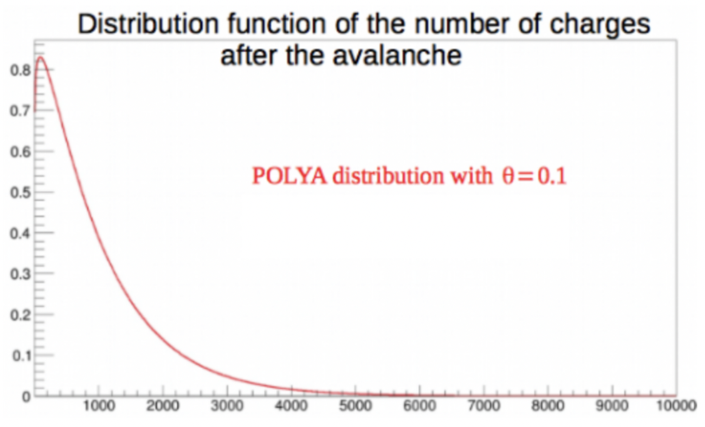
POLYA Distribution

Slide 19
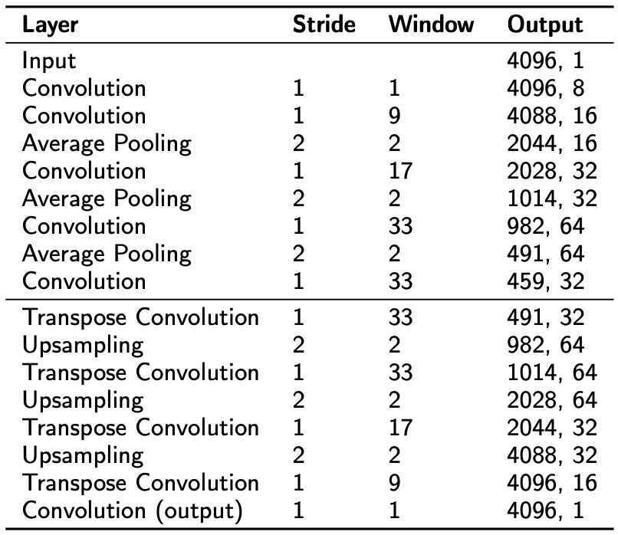
Model Architecture

Slide 20
Dark Matter Search from Electron Counting
NEWS-G searches for dark matter terms of 2, 3, and 4 peak event dispersion times
  Highlighting the need for accurate primary electron counting techniques
Dan Durnford presented on this: “The NEWS-G light Dark Matter search experiment: Current status and preparation for experiment at SNOLAB”

