Slide 1



Improving the Super-Kamiokande PMT modelling using the the photosensor test facility (PTF)
Vincent Gousy-Leblanc, Elena Cornick,Skylar Wingfelder, Matej Pavin, Xiaoyue Li, Ryosuke Akutsu, Thomas Lindner, Patrick de Perio, Akira Konaka
June 8th

Slide 2
Outline
Context
Why ?
  Motivations for measurements
How ?
  Overview of the set up
What ?
  Overview of the measurements
Results
  Integration of measurements into simulation

Slide 3
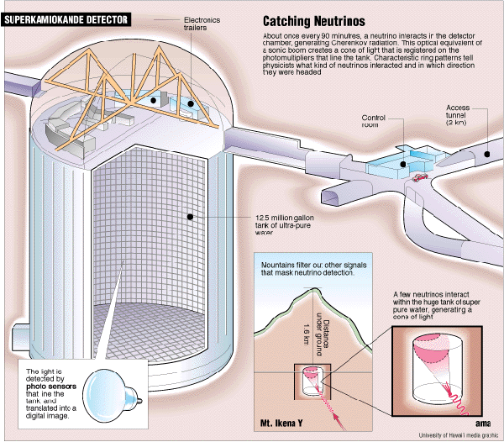
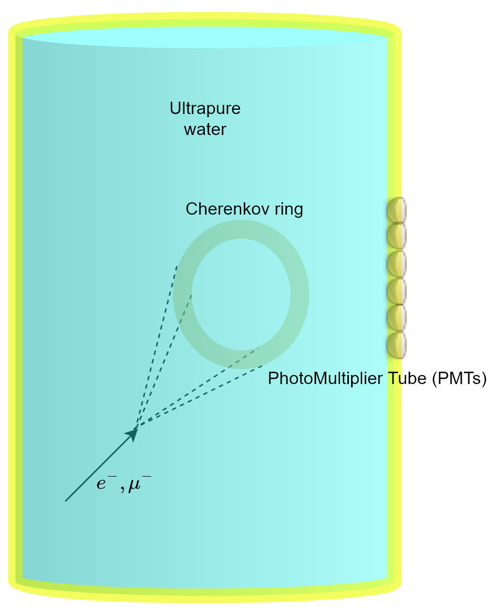
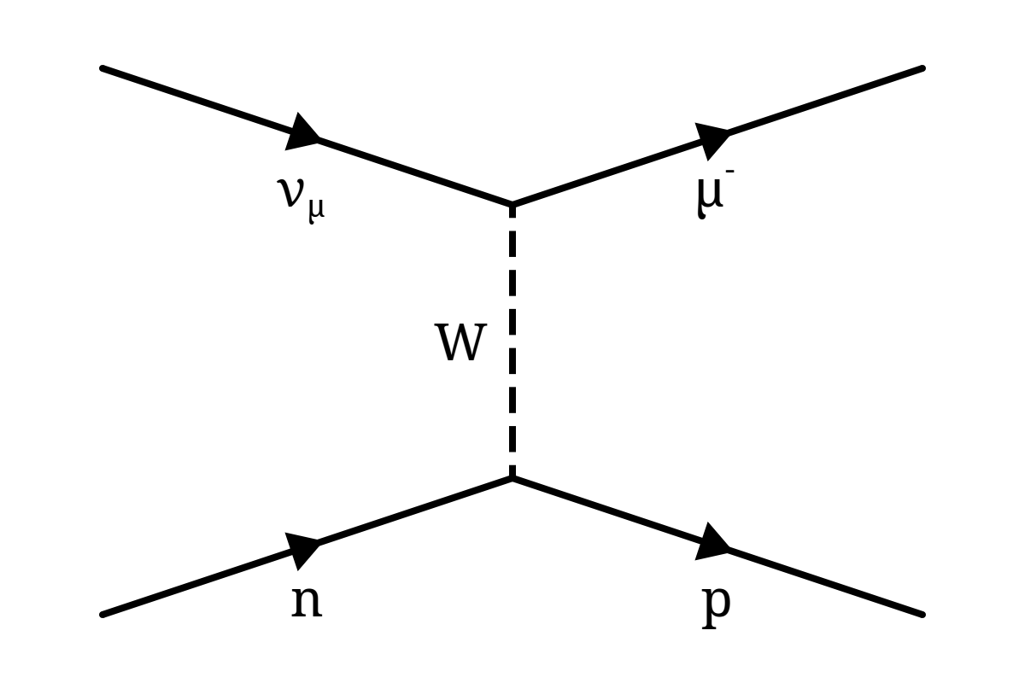
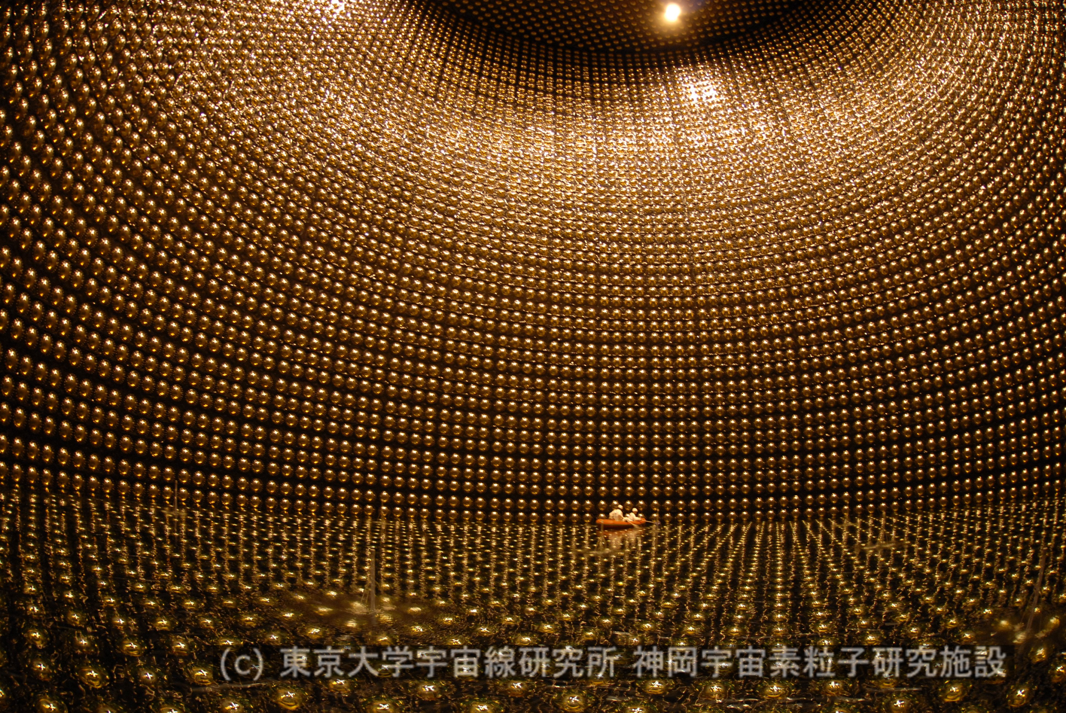
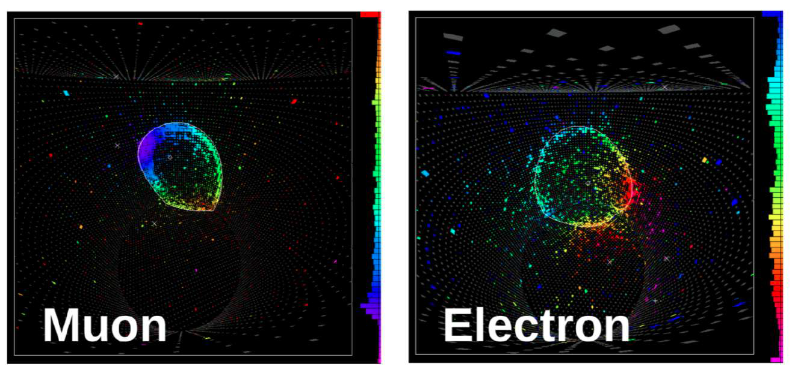
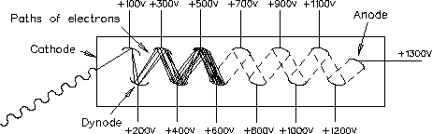
Super-Kamiokande experiment
Super-Kamiokande
Goals: Detect neutrino mixing parameters, proton decay, search for dark matter
Neutrino events creating cherenkov radiation
x
Neutrino interaction
~11,000 photo-multiplier tube (PMT)
Neutrino events

Slide 4
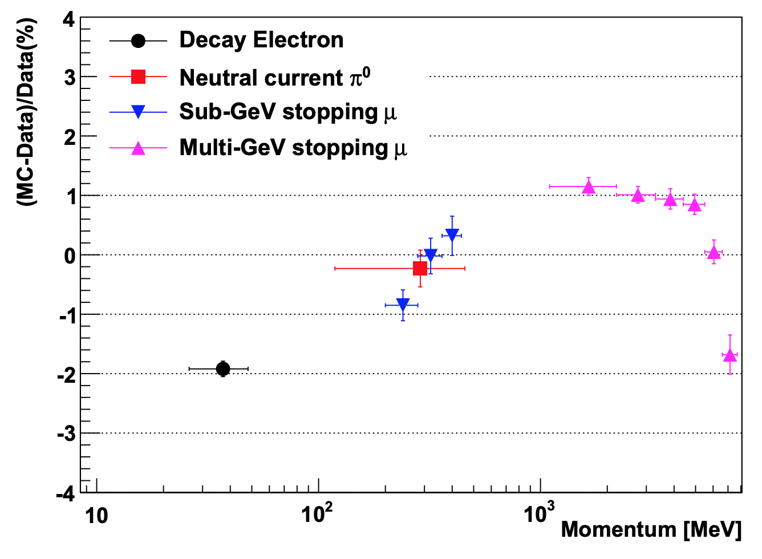
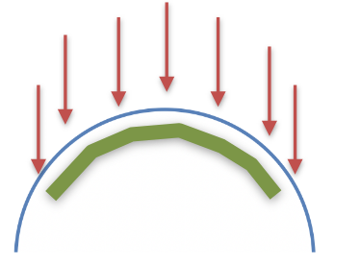
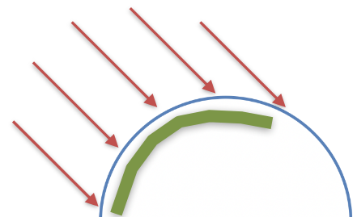
Motivations for PTF measurements
Control samples
Stop-μ (multi-GeV)
Stop-μ (sub-GeV)
±1.9%
Systematic error for
Super-K high energy analysis (~2%)
Can these be partially explained by PMT response mismodelling (eg. angular/magnetic field/polarization/wavelength effects)
  Qualitative example
Will become even more important for next generation neutrino experiment (no longer limited by statistical uncertainties)
  1% required for Hyper-k
    See M.Hartz talk
(MC-Data)/Data (%)
π⁰
Decay-e
PTEP 2019,053F01
Photocathode hit region
Notes:
. Previously discussed on bottom up calibration, let’s see what it is in terms of numbersHigh and low energy are corrected on average, geometrical dependance of the PMT light is left. The average calibration (cosmic muon and linac electrons) goes from top to bottom, only downward going light which opens a potential bias. MENTION Energy scale

Slide 5
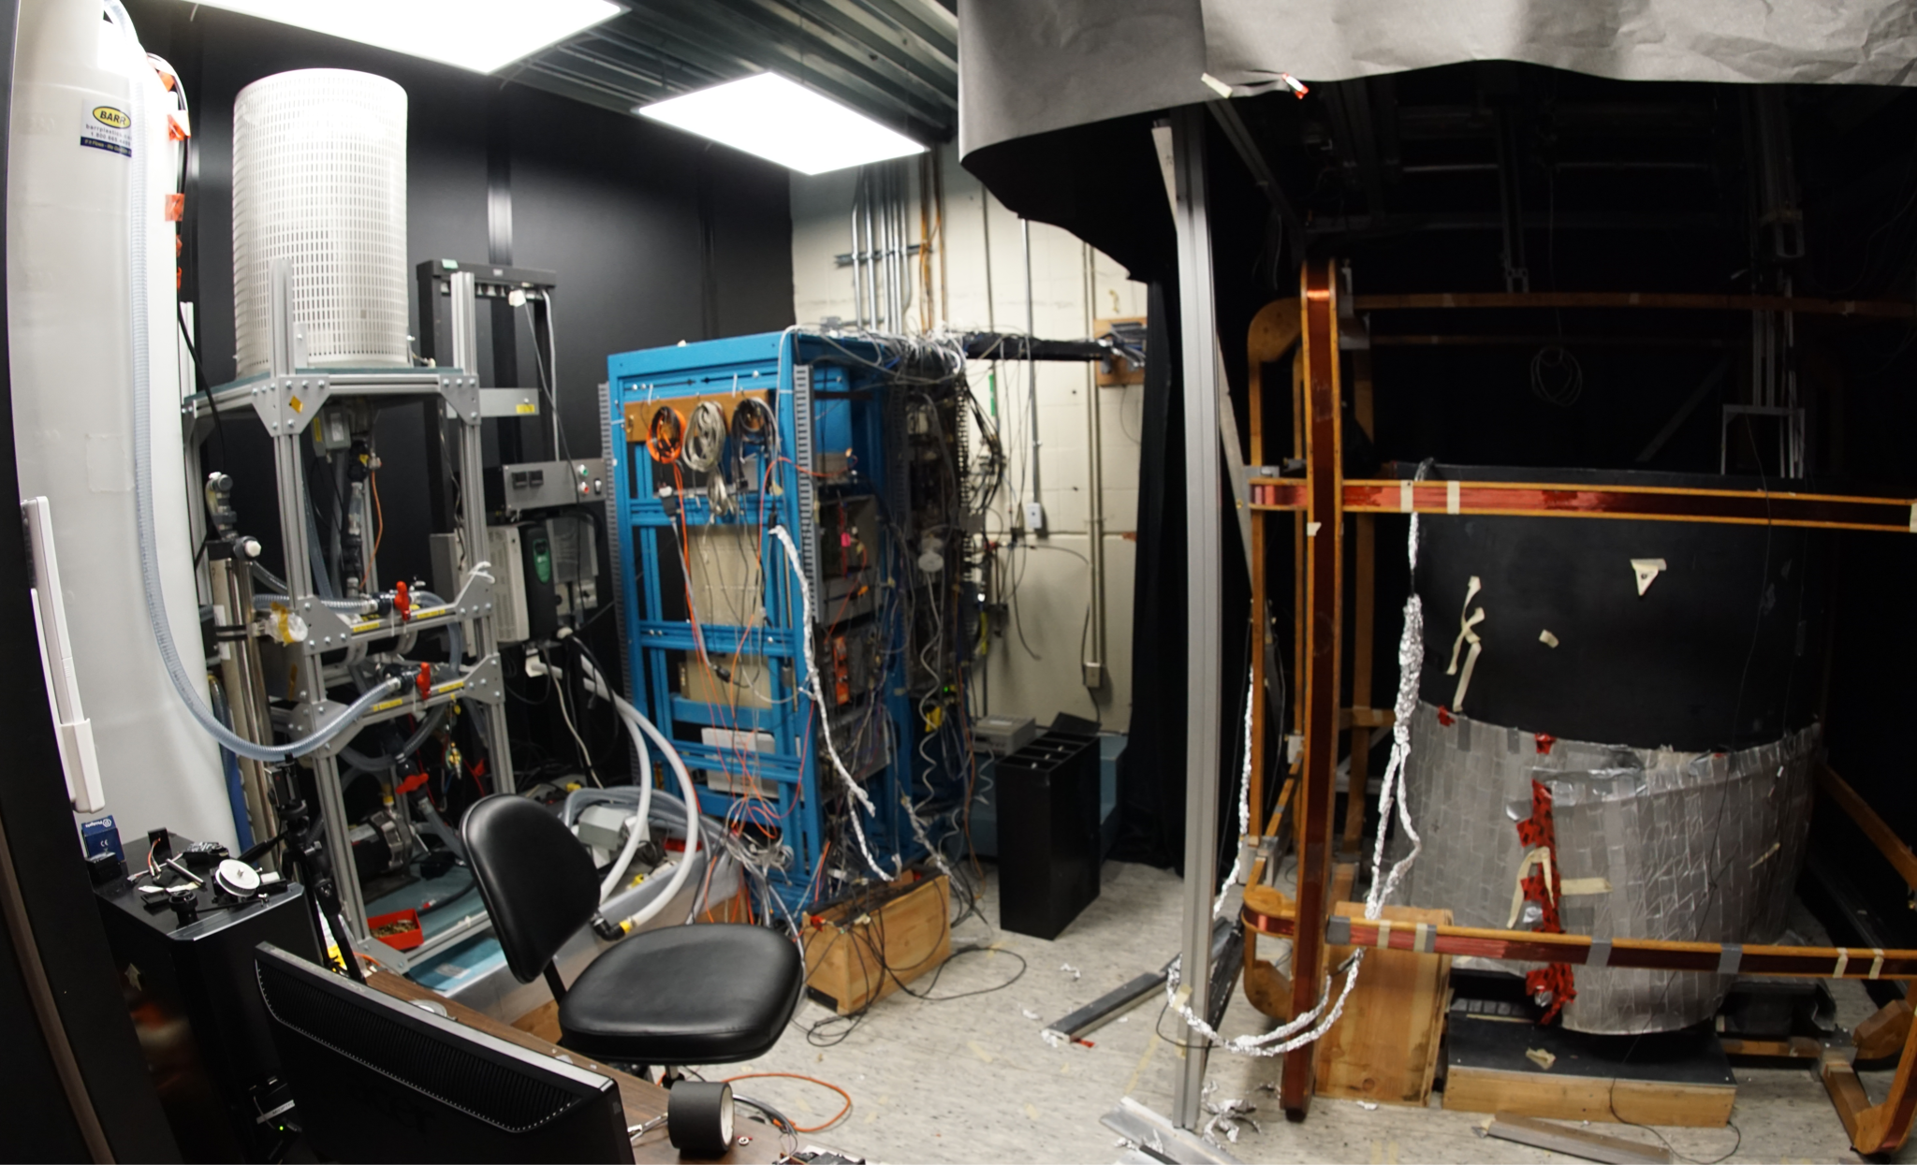
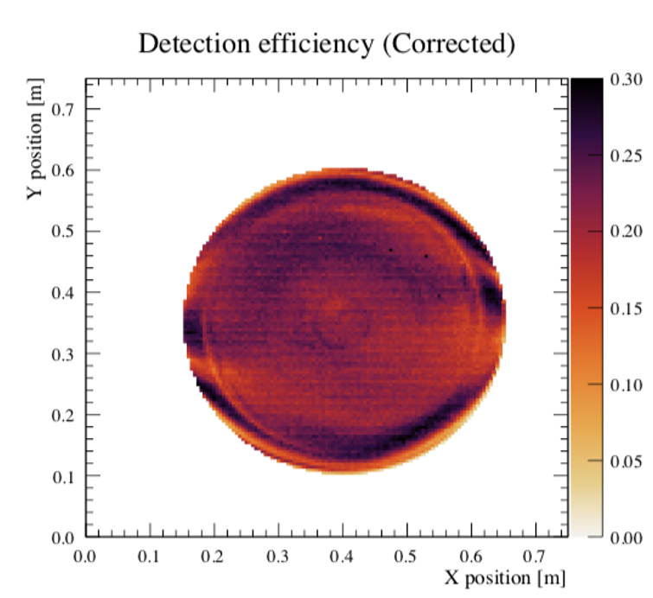
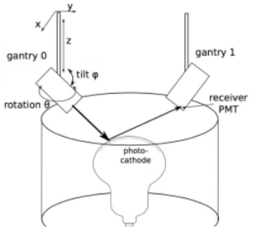
The Photosensor Test facility (PTF) at TRIUMF
PTF room
3 pairs of Helmholtz coils (one in each direction)
  Can control magnetic field
2 optical boxs (laser, sensors to measure tilt, rotation angle and magnetic field)
DAQ to perform 2D scans of PMT
Angular response and reflection measurements
Electronic rack
PTF frame
Water system
PTF measurements
PTF Geometry
Tilt :θ
Rotation:φ

Slide 6
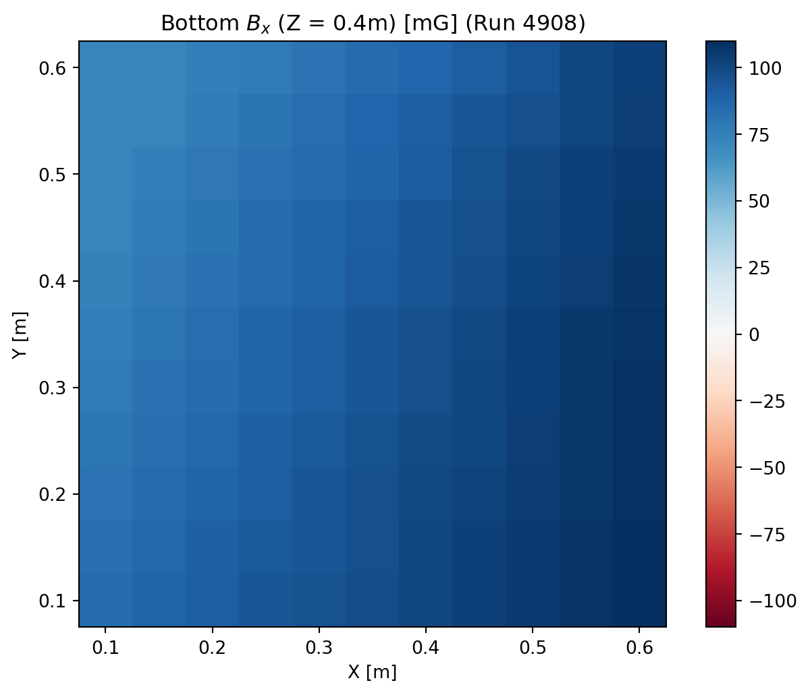
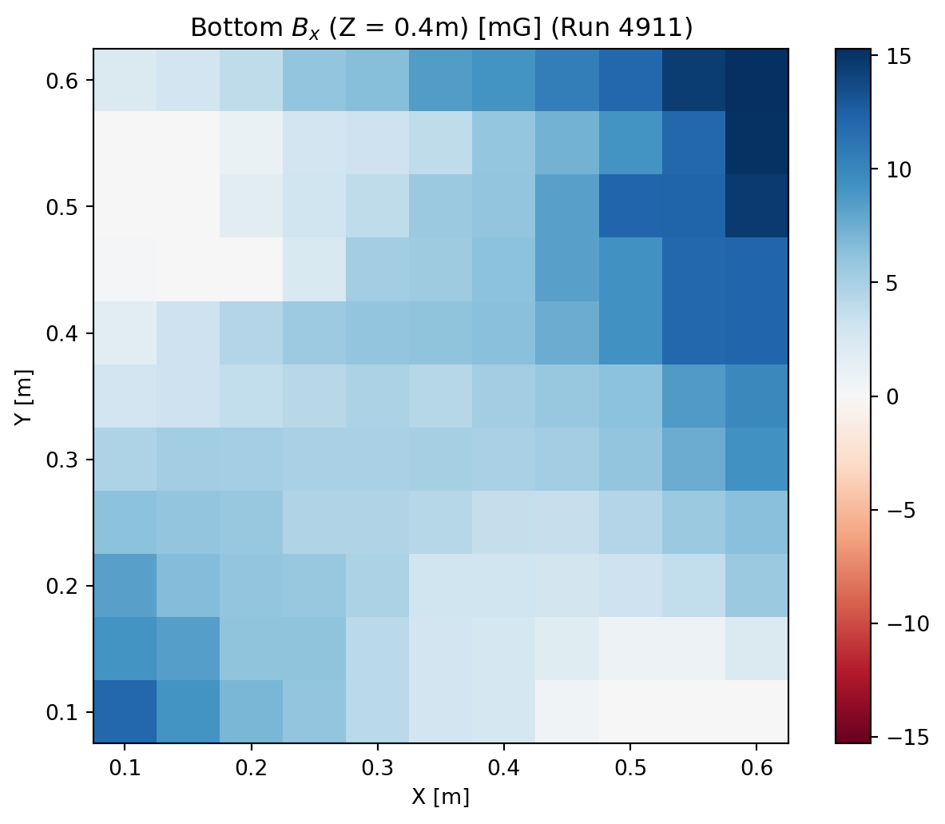
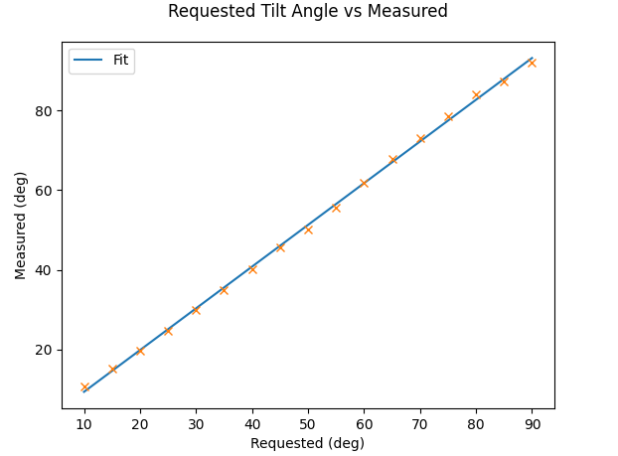

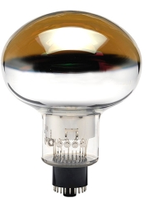
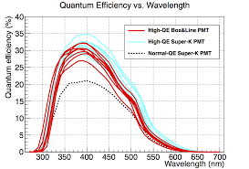
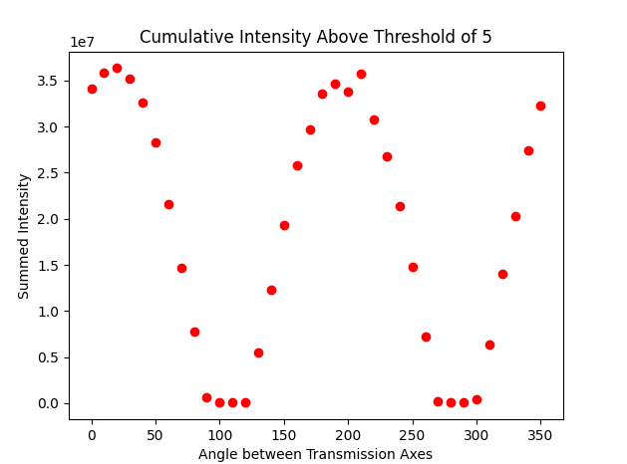
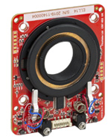
Potential measurements of PTF
Magnetic field compensation
B_{x} [mG]
B_{x} [mG]
PTF will be able to measure and separate external variables
  Magnetic field
  Angular dependance
  Polarization dependance
  Wavelenght dependance
Y[m]
Y[m]
X[m]
X[m]
Angular scan
Calibration of the tilt
G1
Measured [deg]
QE vs wavelenght
Calibration of the polarizer
Requested [deg|
Quantum efficiency [%]
Cumulative intensity
Rotator mount
Wavelength [nm]
Angle between 2 polarizer

Slide 7
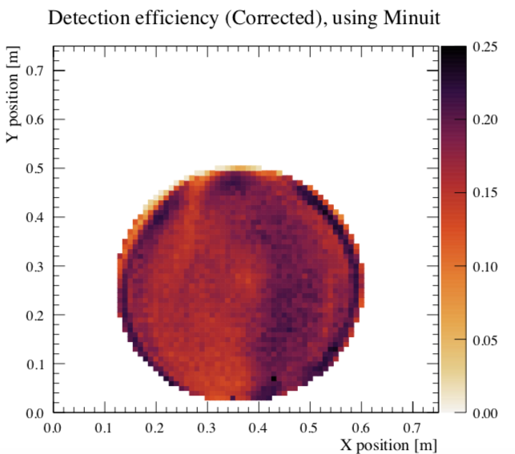
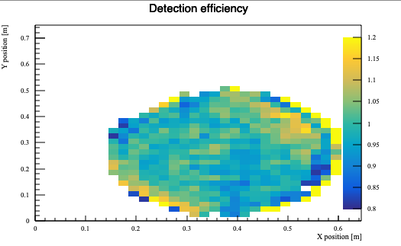

Polarization measurements
DE
nb of photoelectron pulse
nb of pulse
Effect of polarization seems to be diagonal
  Expectations: edges have more reflections so should be more affected
Further investigation is required
0˚ polarization
90˚ polarization
Ratio
=

Slide 8
Integration of measurements into simulations

Slide 9
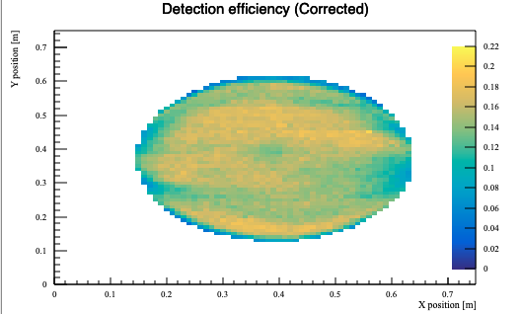
Simulation pipeline
Uniform DE implemented
Super-K Geant4 simulation
Y position
Simplest implementation :
  Replace Uniform DE by position dependant DE
X position
SKG4
Analysis (energy reconstruction, vertex position etc)
Uniform DE
Digitize hits
True hits

Slide 10
Simulation pipeline
PMT measurements done in 2020 (in water, 0mG, no acrylic)
Super-K Geant4 simulation
Y position
Simplest implementation :
  Replace Uniform DE by position dependant DE
X position
SKG4
Analysis (energy reconstruction, vertex position etc)
PTF position dependant DE
Digitize hits
True hits

Slide 11
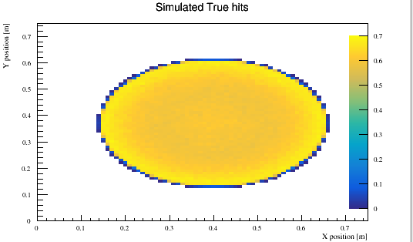
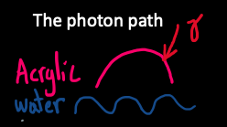

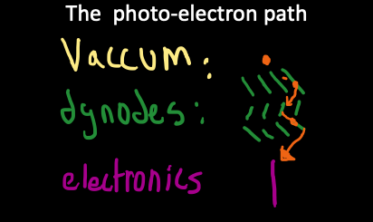
In detail: PMT Modelling
Step 1: Optical simulation assuming uniform DE in SKG4
}
Simulation
Step 2: Input PTF measurements
}
PTF data

Slide 12
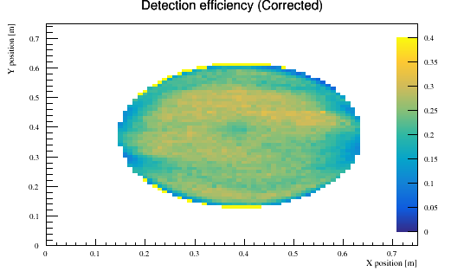
Modelling the experiment
Step 3: Build empirical model
Empirical model of DE (corrected for known effects) for input to sim
Simulation output, assuming uniform PMT response
DE measurements
÷
=
PTF implementation in (SKG4)
Analysis (energy reconstruction, vertex position etc)
PTF position dependant DE
Digitize hits
True hits
Notes:
WCSIm, SKG4, SKDETSIM

Slide 13
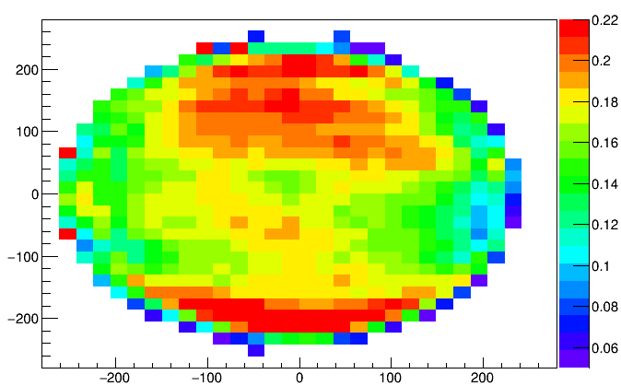
Integration of data into simulation
Step 4: Test empirical model ( first cross check seems to be good)
DE measurements
Implemented DE
PTF implementation in (SKG4)
Analysis (energy reconstruction, vertex position etc)
PTF position dependant DE
Digitize hits
True hits
Notes:
WCSIm, SKG4, SKDETSIM

Slide 14
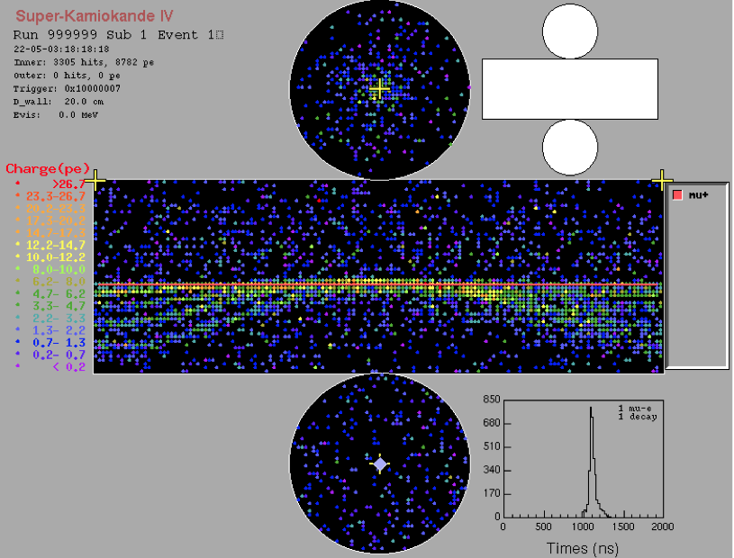
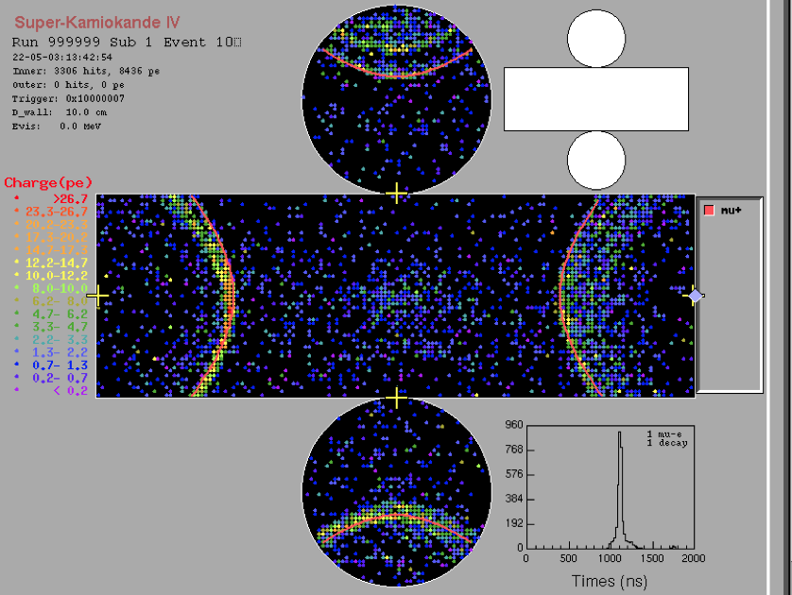
Integration of data into simulations (2)
Step 5: Apply empirical model on simple study : particle gun μ⁺ ,E=1 GeV, dir= (0,0,-1;-1,0,0) vertical and horizontal, 1500 events
Horizontal
Vertical
Super-K tank
MC-MC comparison
Uniform QE
-Total charge
-True hits
Get PTF position dependant DE
Notes:
WCSIm, SKG4, SKDETSIM

Slide 15
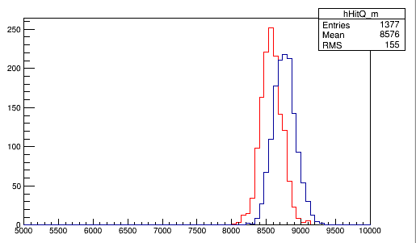
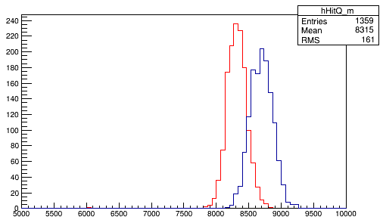
Total charge horizontal vs vertical case
Mean ratio
Muon (Nominal case)
Muon
  Nominal
    Mean ratio : 0.98
  PTF
    Mean ratio: 0.96
Mean Vertical
Vertical : Mean:8576
RMS:155
Mean Horizontal
Horizontal:
Mean: 8762
RMS:162.3
Muon (PTF case)
Ratio_nominal
Vertical :
Mean:8315
RMS:161
Second ratio
Ratio_PTF
Horizontal:
Mean:8694
RMS:171.5
Difference
2.34%

Slide 16
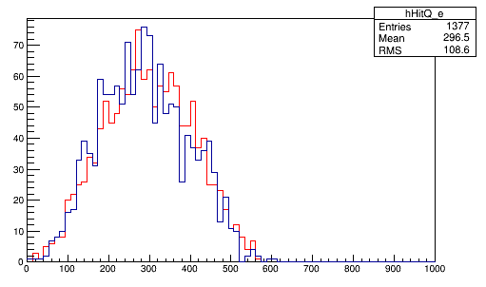
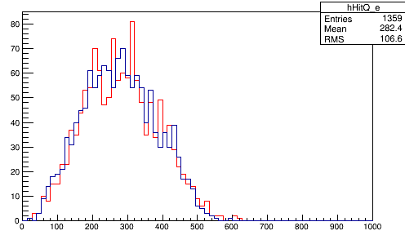
Total charge horizontal vs vertical case (2)
Decay electron
  Nominal
    Mean ratio :1.03
  PTF
    Mean ratio: 1.02
Angular distribution
Electron (Nominal case)
Mean:296.5
RMS:108.6
Difference
1.09%
Mean:288.1
RMS:106.8
Electron (PTF case)
Electron angular distribution
Mean:282.4
RMS:106.6
Mean:277.4
RMS:104.6
ɸ

Slide 17
Conclusion
The PTF facility was rebuild and improve to measure the PMT response
  A better understanding of PMT response could decrease/characterize the systematic uncertainties associated to the detector
  More measurements to come soon !
Integration of measurements into simulation was started
  Only MC-MC comparison and for simple case
  An effect of ~2% was seen but more measurements are required

Slide 18
Thank you

Slide 19
Back up

Slide 20
Total charge horizontal vs vertical case
Control samples
Muon (Nominal case)
Stop-μ (multi-GeV)
Mean: 8762
RMS:162.3
Stop-μ (sub-GeV)
±1.9%
π⁰
Mean:8676
RMS:155
(MC-Data)/Data (%)
Muon
  Nominal
    Mean ratio : 0.98
  PTF :
    Mean ratio: 0.96
  Difference: 2.34%
Decay-e
Muon (PTF case)
Mean:8694
RMS:171.5
Mean:8315
RMS:161

Slide 21
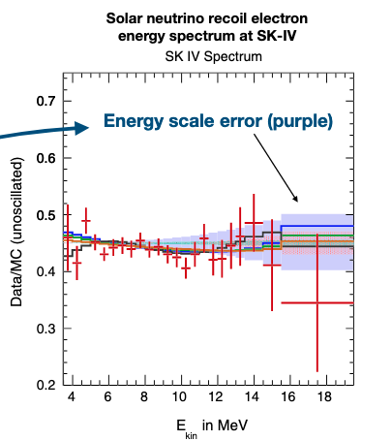
Motivations for PTF measurements
Control samples
Stop-μ (multi-GeV)
Stop-μ (sub-GeV)
±1.9%
(MC-Data)/Data (%)
π⁰
Significant systematic error for
Super-K high energy analysis (~2%)
Also for low energy solar neutrino (~0.5%)
Can these be partially explained by PMT response mismodelling (eg. angular/magnetic field/polarization/wavelength effects)
  Part of bottom-up calibration
  Qualitative example
Will become even more important for next generation neutrino experiment (no longer limited by statisticals uncertainties)
Decay-e
PTEP 2019,053F01
Phys.Rev.D94,052010
Photocathode hit region
Notes:
. Previously discussed on bottom up calibration, let’s see what it is in terms of numbersHigh and low energy are corrected on average, geometrical dependance of the PMT light is left. The average calibration (cosmic muon and linac electrons) goes from top to bottom, only downward going light which opens a potential bias. MENTION Energy scale

Slide 22
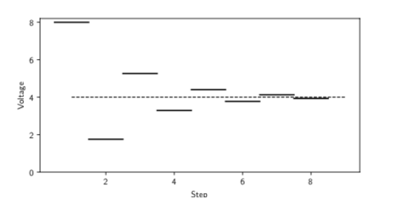
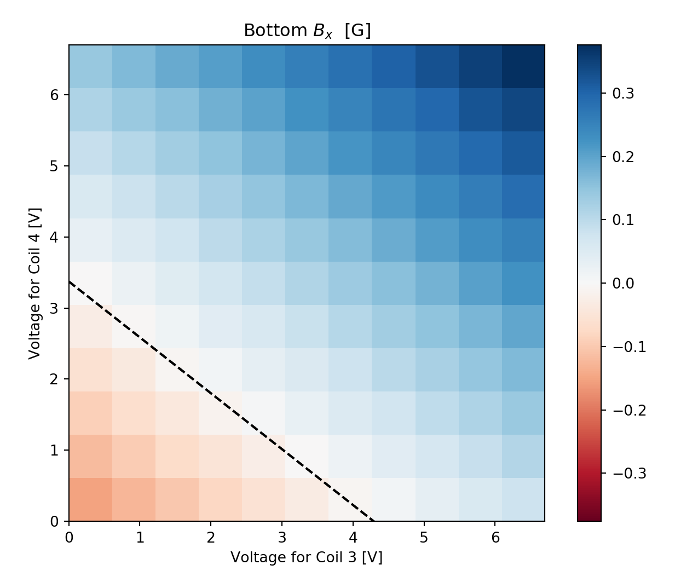
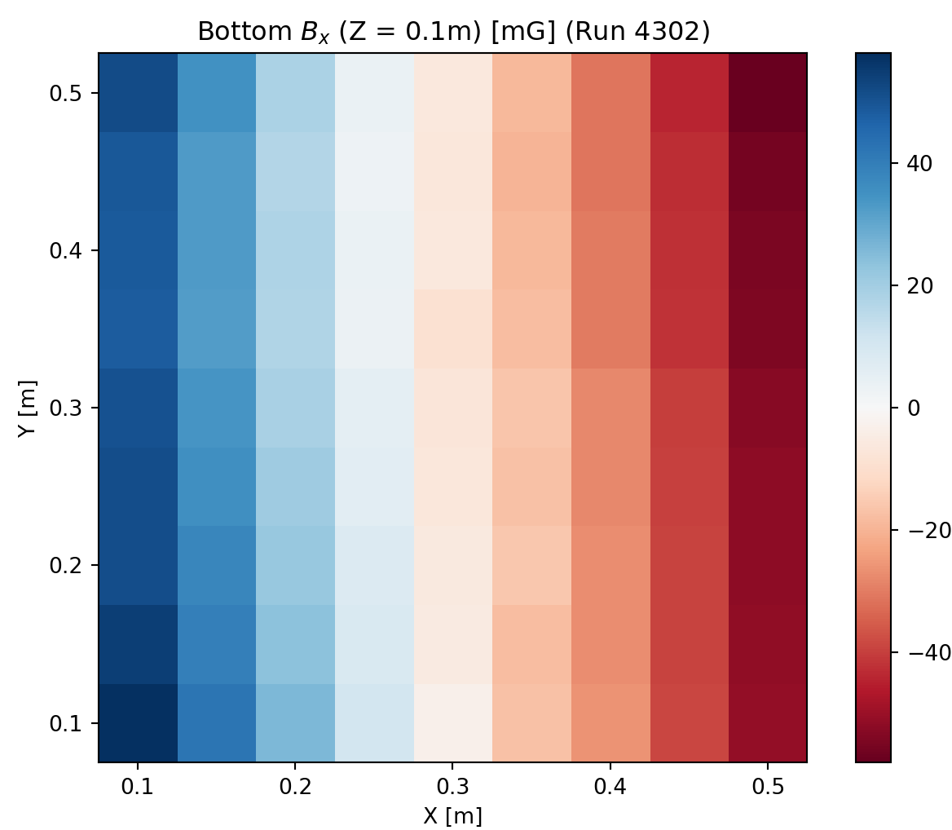
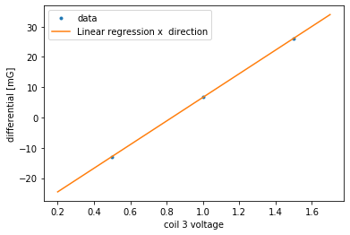
Compensating the magnetic field
Example of a degauss procedure
Try to make the magnetic field as uniform as possible
  Using G-IRON passive shielding
Degauss procedure is needed
  Metals structure surrounding PTF creates their own magnetic field
  Needs to be simultaneously for all directions
Voltage[V]
1-Voltage scan
2-Spatial scan :
Step
3-Differential plot
B_{x} [mG]
B_{x} [mG]
Y[m]
Coil 4 voltage [V]
Differential [mG]
Coil 3 voltage [V]
X[m]
Coil 3 voltage [V]
Notes:
-Fitting function we had the famous +- 100mG
-Planar function

Slide 23
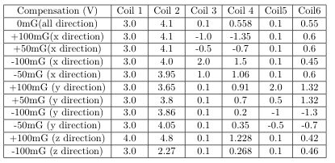
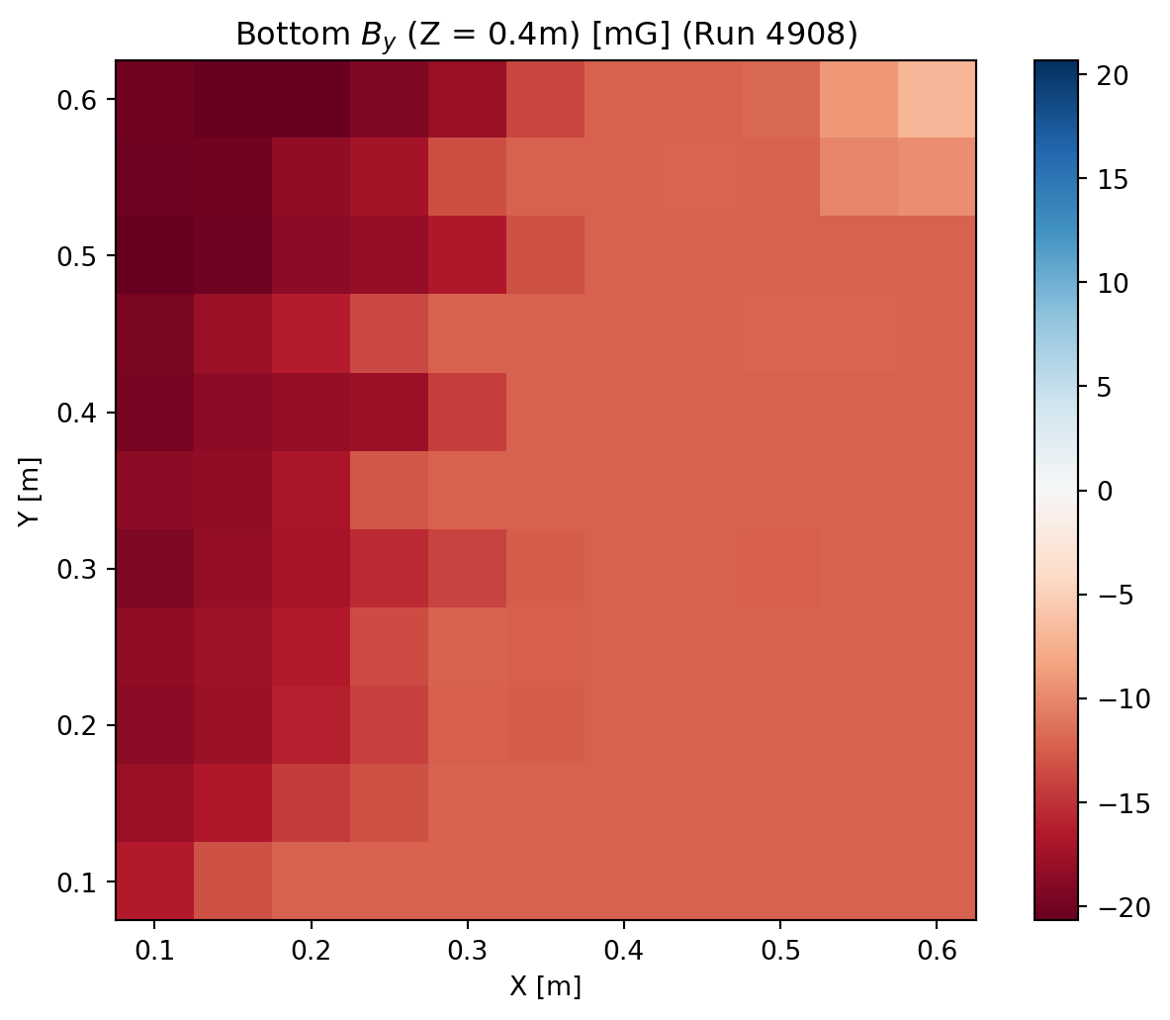
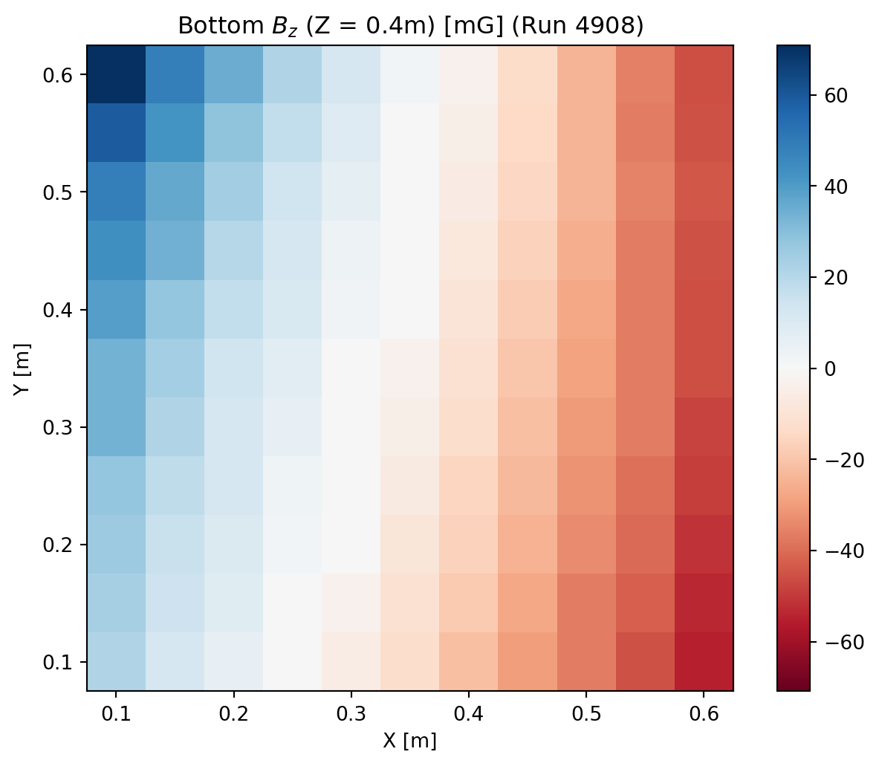
Compensation of the magnetic field
Compensation table
Compensated to 0 but also different offset
  Input from Super-K magnetic field measurements
  Seems to work within 20mG or so
    Z direction has a larger gradient
Example setting X=100mG, y=0mG, Z=0mG
B_{x} [mG]
B_{y} [mG]
B_{z} [mG]
Y[m]
Y[m]
Y[m]
X[m]
X[m]
X[m]

Slide 24
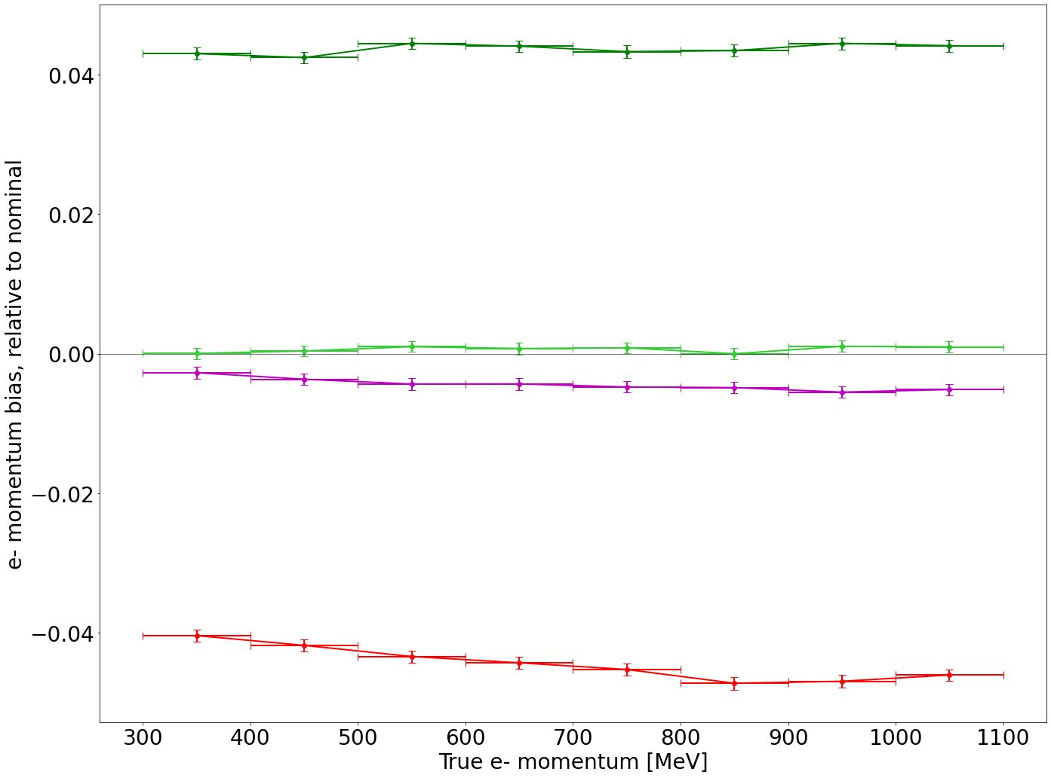
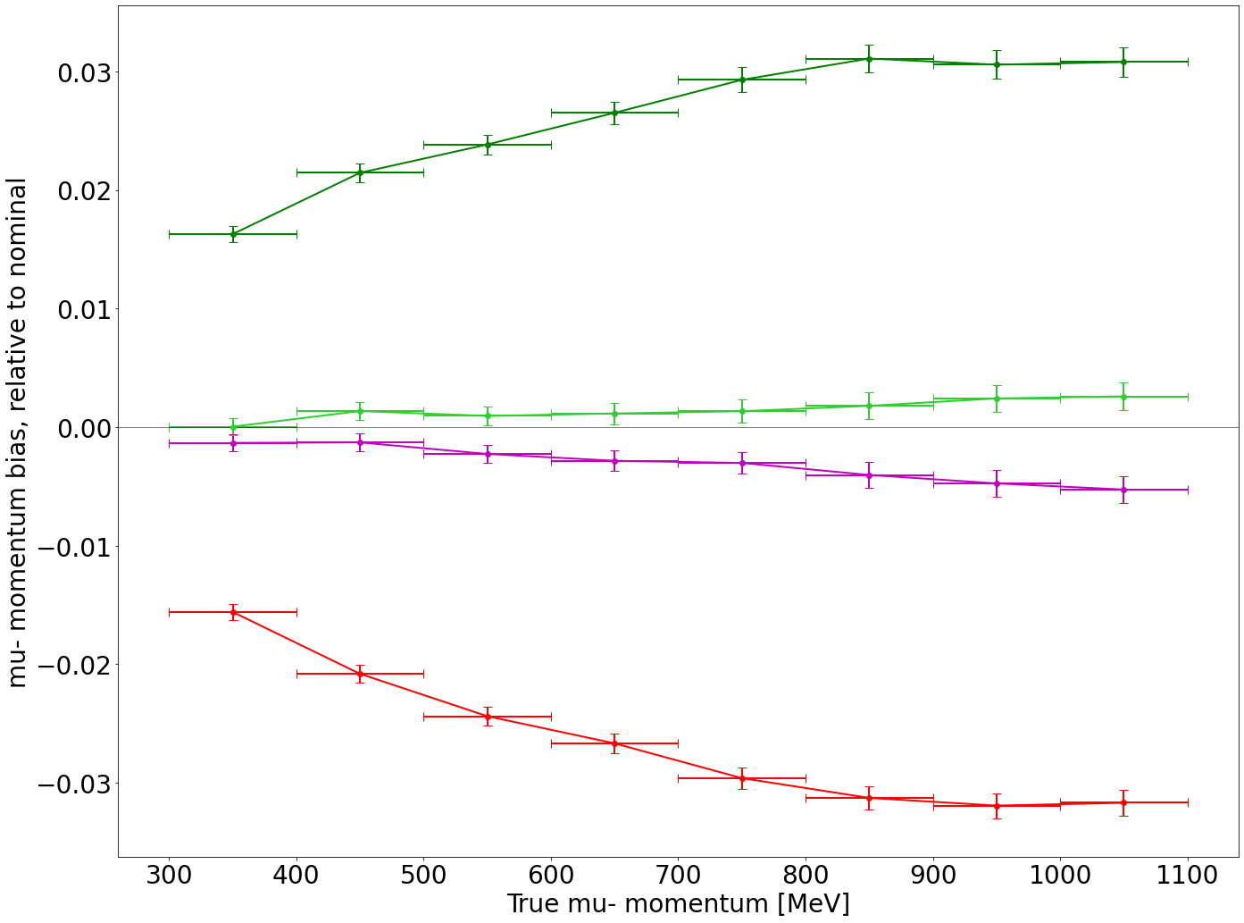
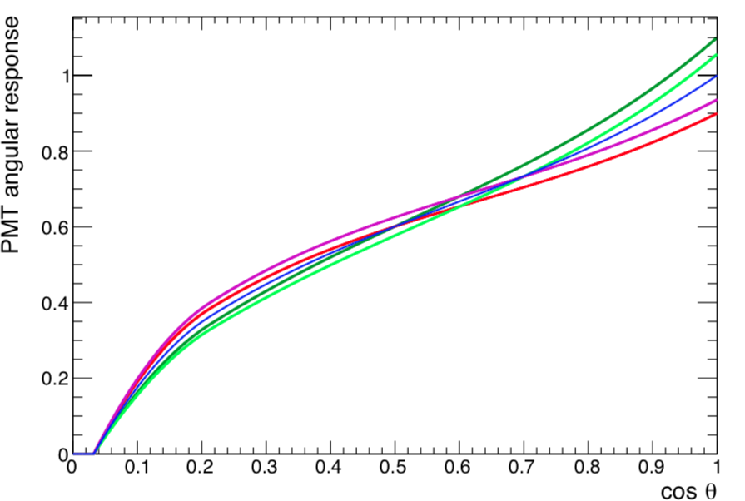
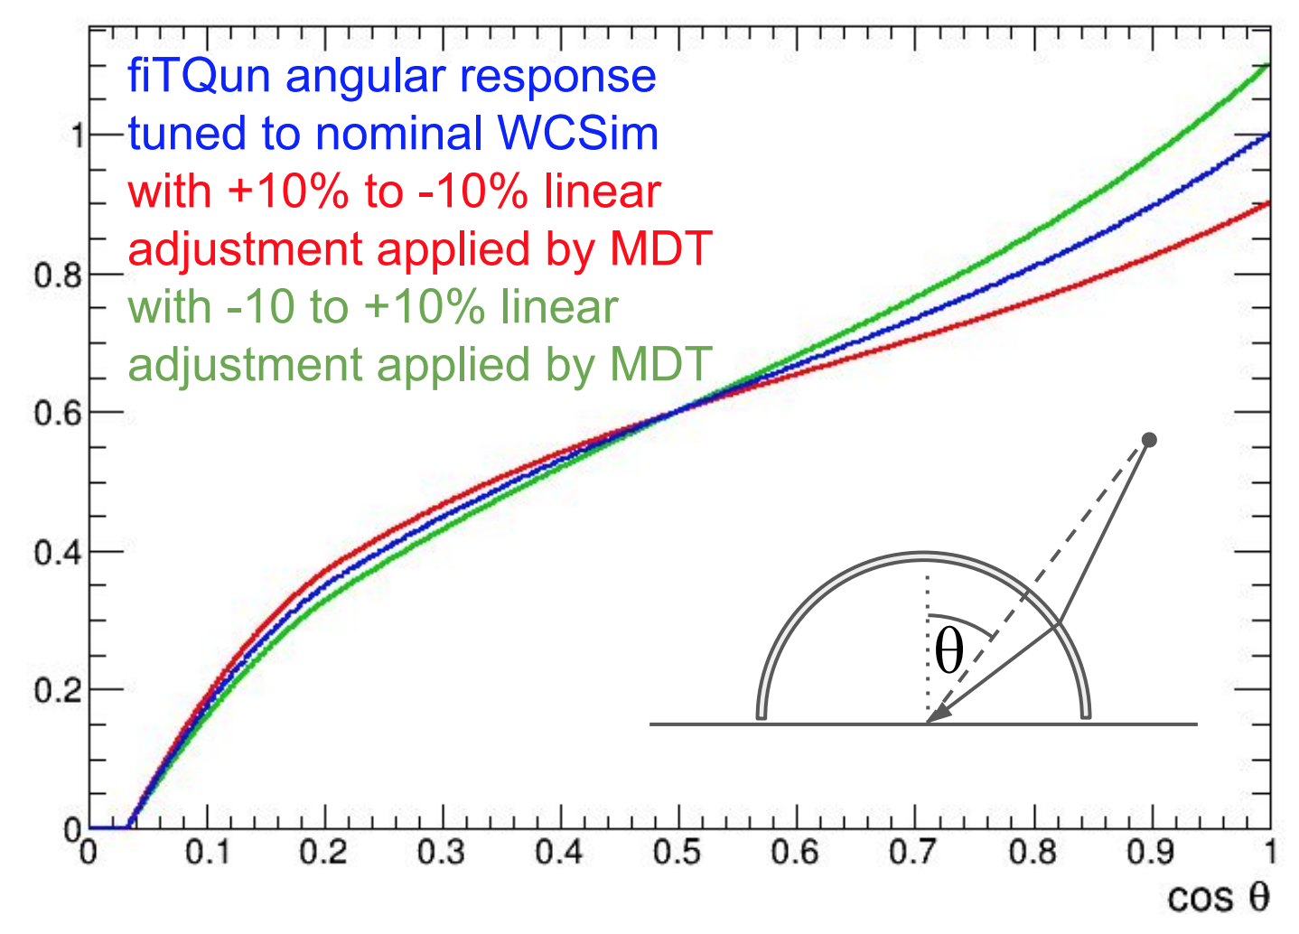
Effect of PMT Angular Response on Reconstruction
Variations at MC level
Reconstructed Momentum Bias in HK (N. Prouse, HK calibration)
-10%→+10%
Different trend
-10%→+10%
-10% → +10% linear scaling
-10% → +10% linear scaling, fixed Q
Nominal (from WCSim)
+10% → -10% linear scaling, fixed Q
+10% → -10% linear scaling
-10% → +10% linear scaling
Nominal (from WCSim)
+10% → -10% linear scaling
Electrons
Muons
-10%→+10%, fixed Q
PMT angular response (efficiency)
-10%→+10%, fixed Q
+10%→-10%, fixed Q
+10%→-10%, fixed Q
+10% →-10%
+10% →-10%
Input to fitqun
Varying angular response can change the total charge
“fixed Q”: scaled overall efficiency averaged over all events to study case of no change in total charge
  Assumes degeneracies with other detector (e.g. water) parameters are fully constrained
  Can still have ~0.5% bias in reconstructed momentum
Different trends indicate not fully correlated between e/μ

Slide 25
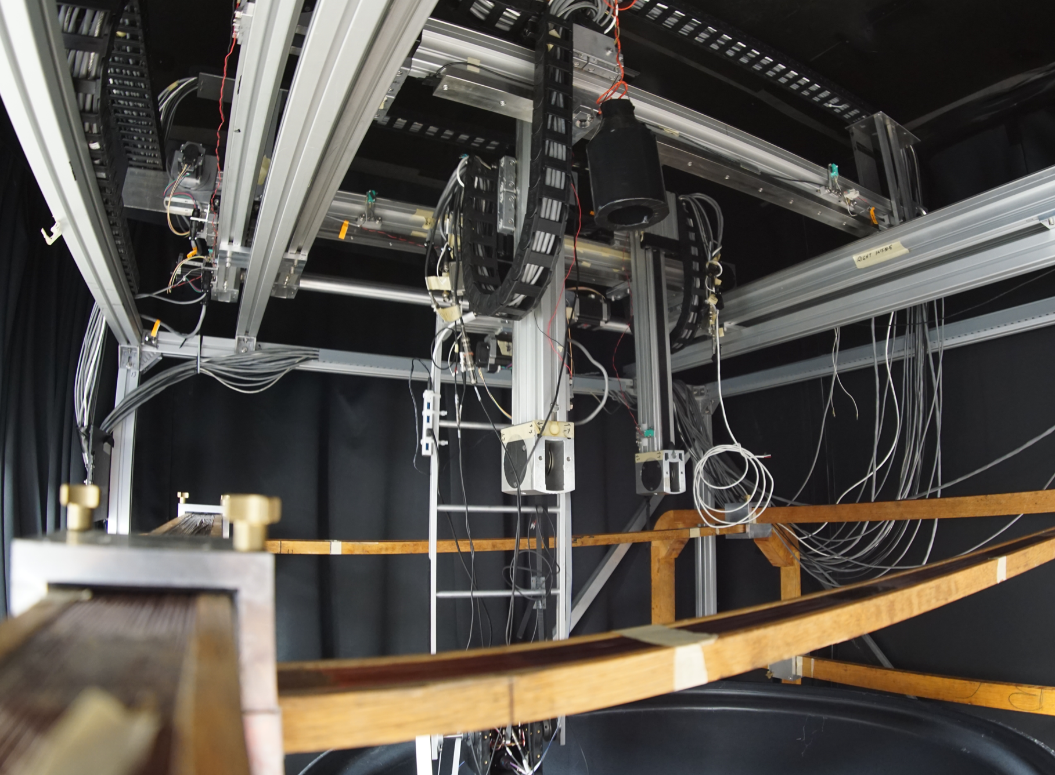
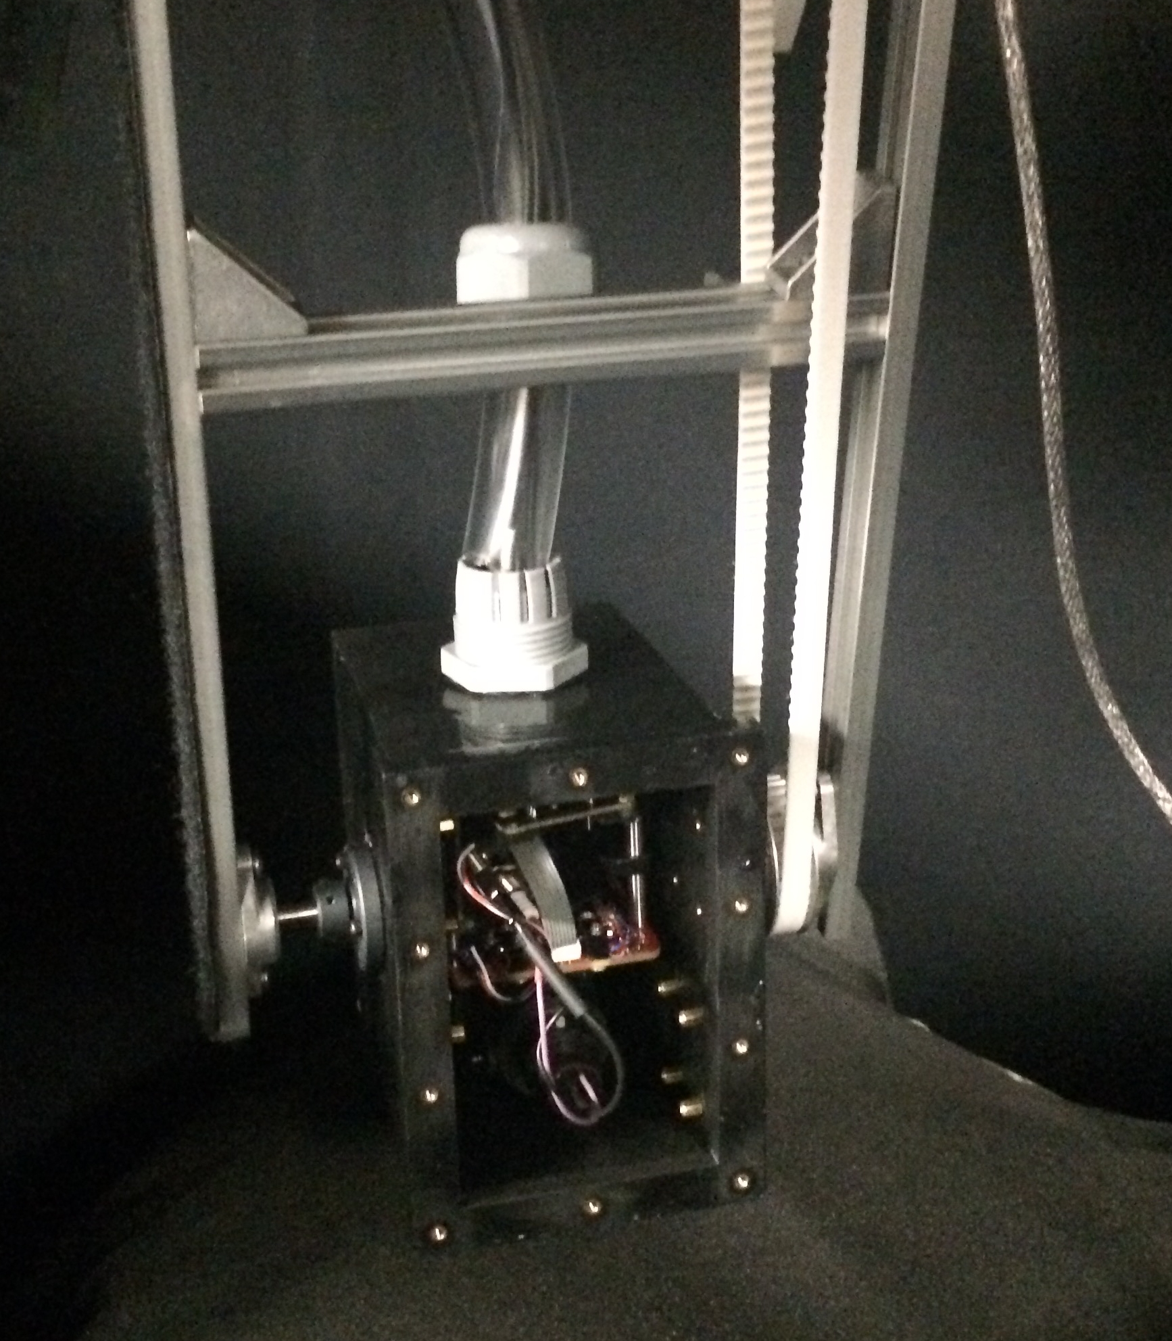
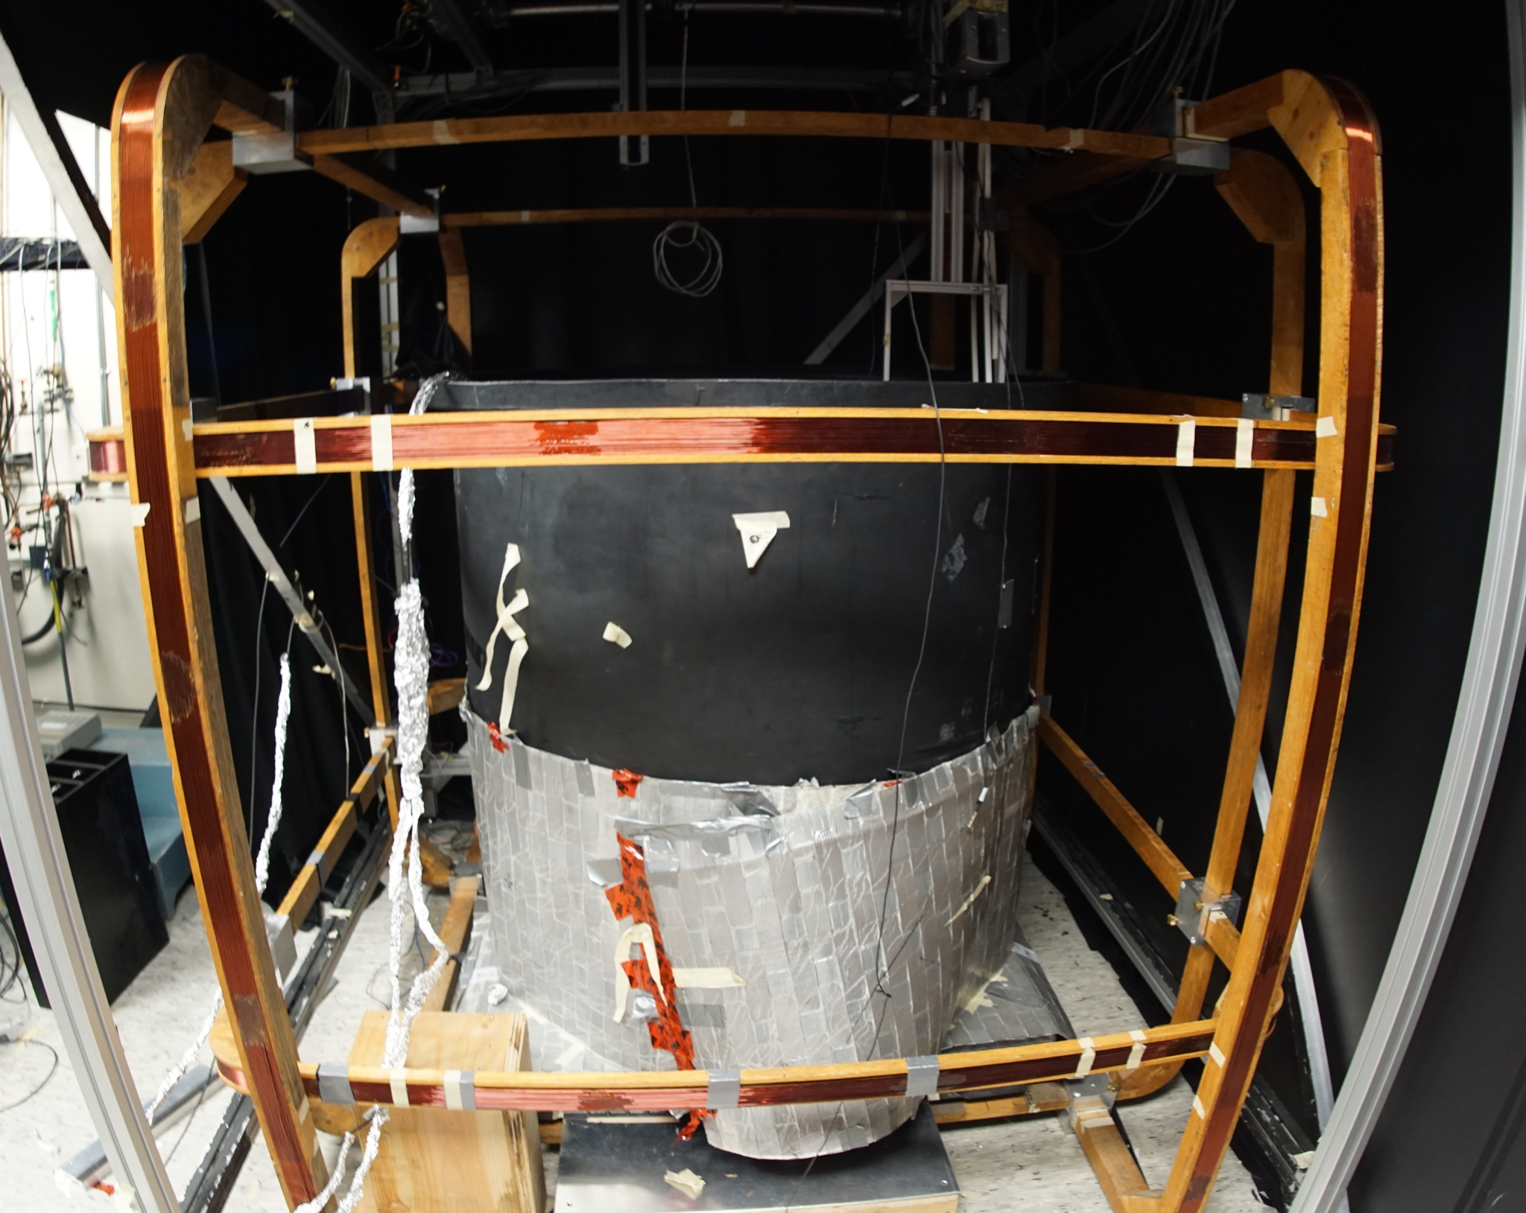
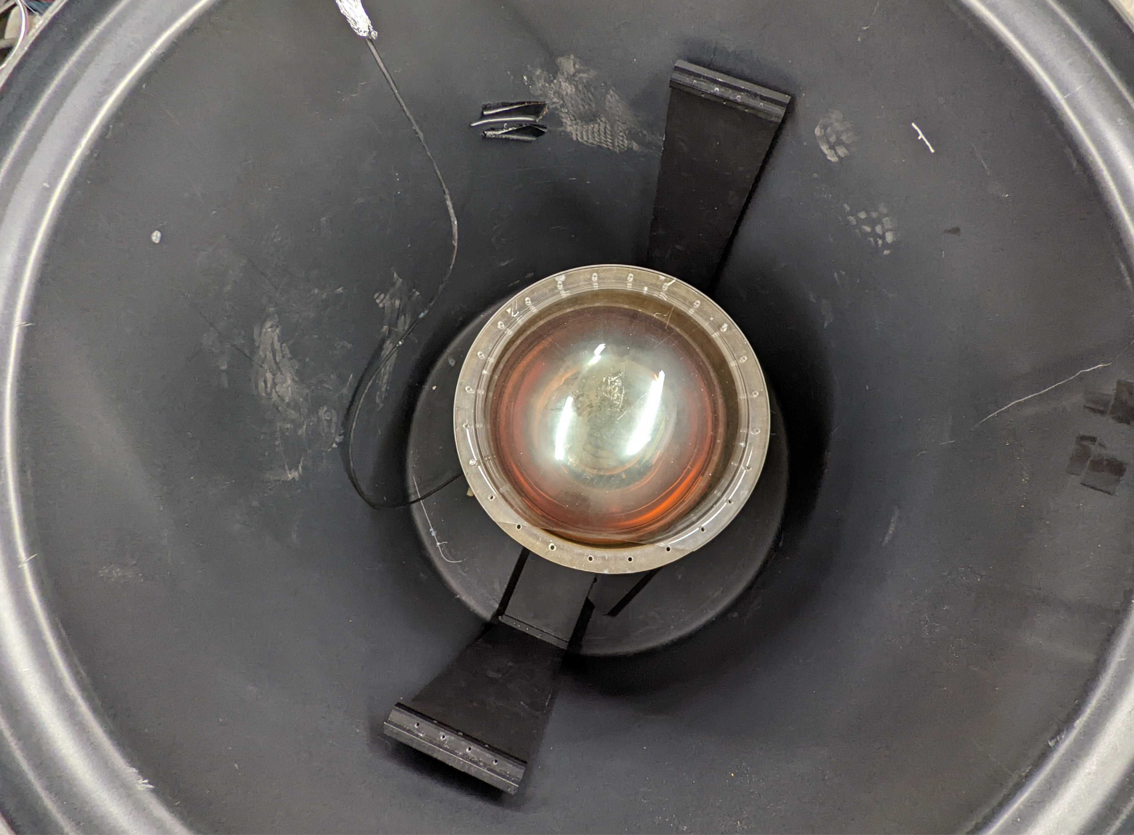
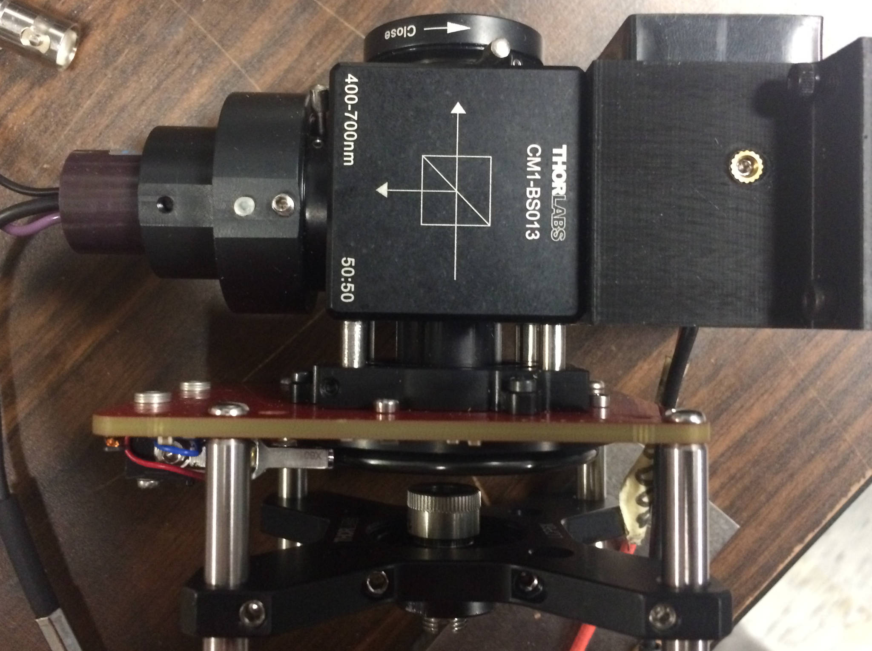
PTF in pictures
Gantry system
Optical box
PTF frame
Stepper motors
20 inch PMT
Monitor PMT
Polarizer
Water tank

Slide 26



Pipeline is ready !
Cosmic muon text file
Superscan
SKG4 (SK4 geometry)
Some text file are empty, partially finished
  Takes ~50hours for 9 text files on local cluster
Move to something quicker for first comparaison with PTF measurements
root2zbs
MC-MC comparaison
fiTQun (SKDETSIM tuning)
Distance from nearest wall
Muon reconstructed energy
zbs2root
Cosmic muon analysis

Slide 27


SKG4 local coordinates system
S and P designation are in terms of the plane of incidence of the photon (parallel vs perpendicular)
Done for incoming photons
Calculate incidence plane angle and randomize s or p polarization
At the center no s or p polarization

Slide 28




Absorption coefficient
Initial conditions
  X polarization
See effect of p vs s polarization
See the maximum predicted
S polarization
P polarization

Slide 29




Potential study
+100mG in Y direction
+100mG in Y direction
Angular scan (60˚) + magnetic field
Angular response move region of high efficiency
  Same position but deformed ?
Highest possible resolution (0.5cm)
  Clearly see the effect of the temperature variations
In terms of gantry position
  Off center scan
+100mG in X direction
+100mG in X direction
N
Z axis
𝞍
Gantry X position

Slide 30
Compensation of the magnetic field
Compensation table
Compensated to 0 but also different offset
  Input from Super-K magnetic field measurements
  Seems to work within 20mG or so
    Z direction has a larger gradient
Example setting X=100mG, y=0mG, Z=0mG
B_{x} [mG]
B_{y} [mG]
B_{z} [mG]
Y[m]
Y[m]
Y[m]
X[m]
X[m]
X[m]

Slide 31



No compensation effect
Detection efficiency
Uncompensated magnetic field
DE plot were generated
  Results looks good
  Analysis pipeline is replicating previous results
  All PMT are working as expected
Detection efficiency (corrected)
Monitor PMT

Slide 32


The magnetic field in Kamioka
Earth field is compensated in Super-K
Older measurements (2013)
  Showed ± 80 mG in Z, ± 100 mG in Y and ± 80 mG in X
Newer measurements
  Showed ± 100 mG in 3 directions
Does it as an impact ?
YES!

Slide 33

Data taking plan
Relocation happened in 2020
  Delays due to COVID and unexpected problems
Finally ready for data taking
  First water scan was done !
  Running angular scan !
DE
Count of photoelectron pulse
The number of pulse
First water measurements!

Slide 34
Decay electron
  Nominal
  Mean ratio :1.03
PTF
  Mean ratio: 1.02
Difference: ~1.09%
Angular distribution

Slide 35
Decay electron
                Nominal
Mean ratio :1.03
PTF
  Mean ratio: 1.02
Difference: ~1.09%
Angular distribution

