Slide 1

Cryogenic Distillation for Xenon Isotopic Enrichment
Abo-Bakr Emara
Supervisor: Dr.Caio Licciardi
2022 CAP Congress
08/06/2022

Slide 2
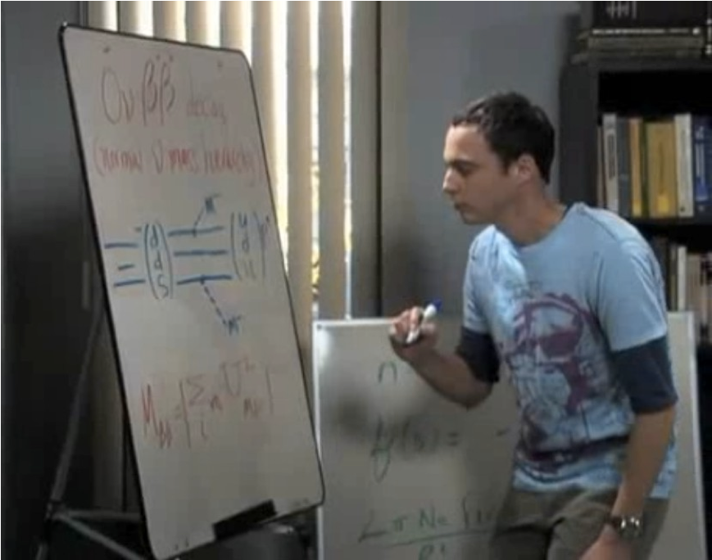
Motivation
Double beta decay process has been observed in several isotopes.
The search for neutrinoless double beta (0νββ ) decay (which is hypothetical process) is one of the most pressing problems in particle physics today. If observed, it could help explain the dominance of matter over antimatter in the Universe.
136Xe is an attractive nuclide to search for 0νββ
136Xe only around 9% of natural composition of Xenon.
Future experiments will need a detector at the ~50 tonnes scale to probe the so called normal ordering of neutrino masses.
"Look, I found my missing neutrino." The Big Bang Theory quote S02E04 Sheldon Cooper
Abo-Bakr Emara 08/06/2022

Slide 3
Introduction
There are several known methods for isotopic enrichment (Centrifugal, Diffusion, Electromagnetic).
The only method used for xenon enrichment is centrifugal.
One of the promising process for isotopic separation is distillation.
Distillation separation relies on the small difference in vapour pressure of different isotopes.
These vapour pressures are known for the lighter noble gases (Kr, Ar) but no credible experimental data existed for xenon.
Small still (2m high) was installed at Carleton university and data has been obtained and first credible measurement for xenon vapour pressure published.
A theoretical calculation of 1000m height column is needed to reach the required enrichment, but data from Carleton’s still has 15% precision so a higher column is required for more accurate measurements.
A higher column 16m high is at SNOLAB and data is being obtained and analysis is ongoing (this work).
Abo-Bakr Emara 08/06/2022

Slide 4
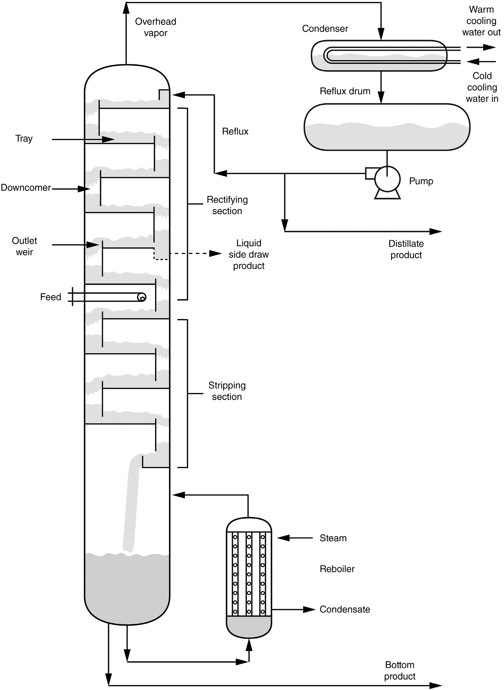
Distillation Process
Distillation separates products from a liquid mixture based on their boiling point differences.
The overall separation achieved between the components primarily arises from the dissimilar effective vapor pressures, or volatilities.
Cryogenic distillation is process of cooling a gas mixture to induce a phase change for effective separation.
J. R. Fair, Distillation, Kirk-Othmer Encyclopedia of Chemical Technology, 2018.
Abo-Bakr Emara 08/06/2022

Slide 5
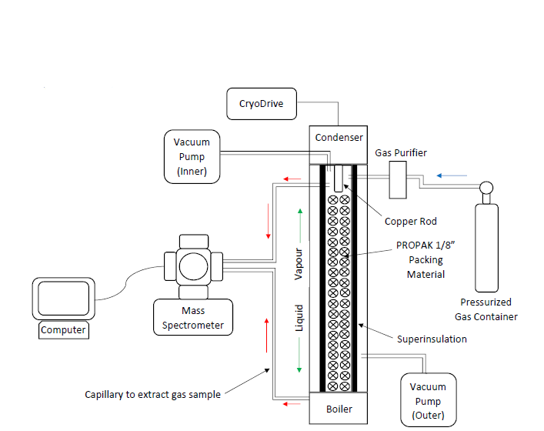
Experiment Setup
Instead of plates we have packing.
Every few centimeters (2-3 cm) consider as theoretical plate.
Random packing filling the whole still.
A mass spectrometer is connected to the still with capillary tubes to get the spectrum of different isotopes.
Abo-Bakr Emara 08/06/2022

Slide 6
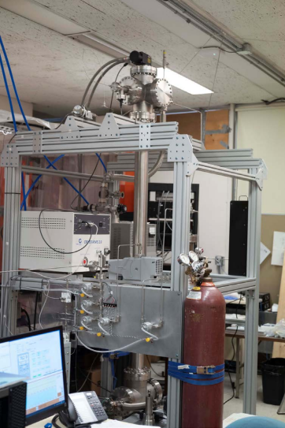
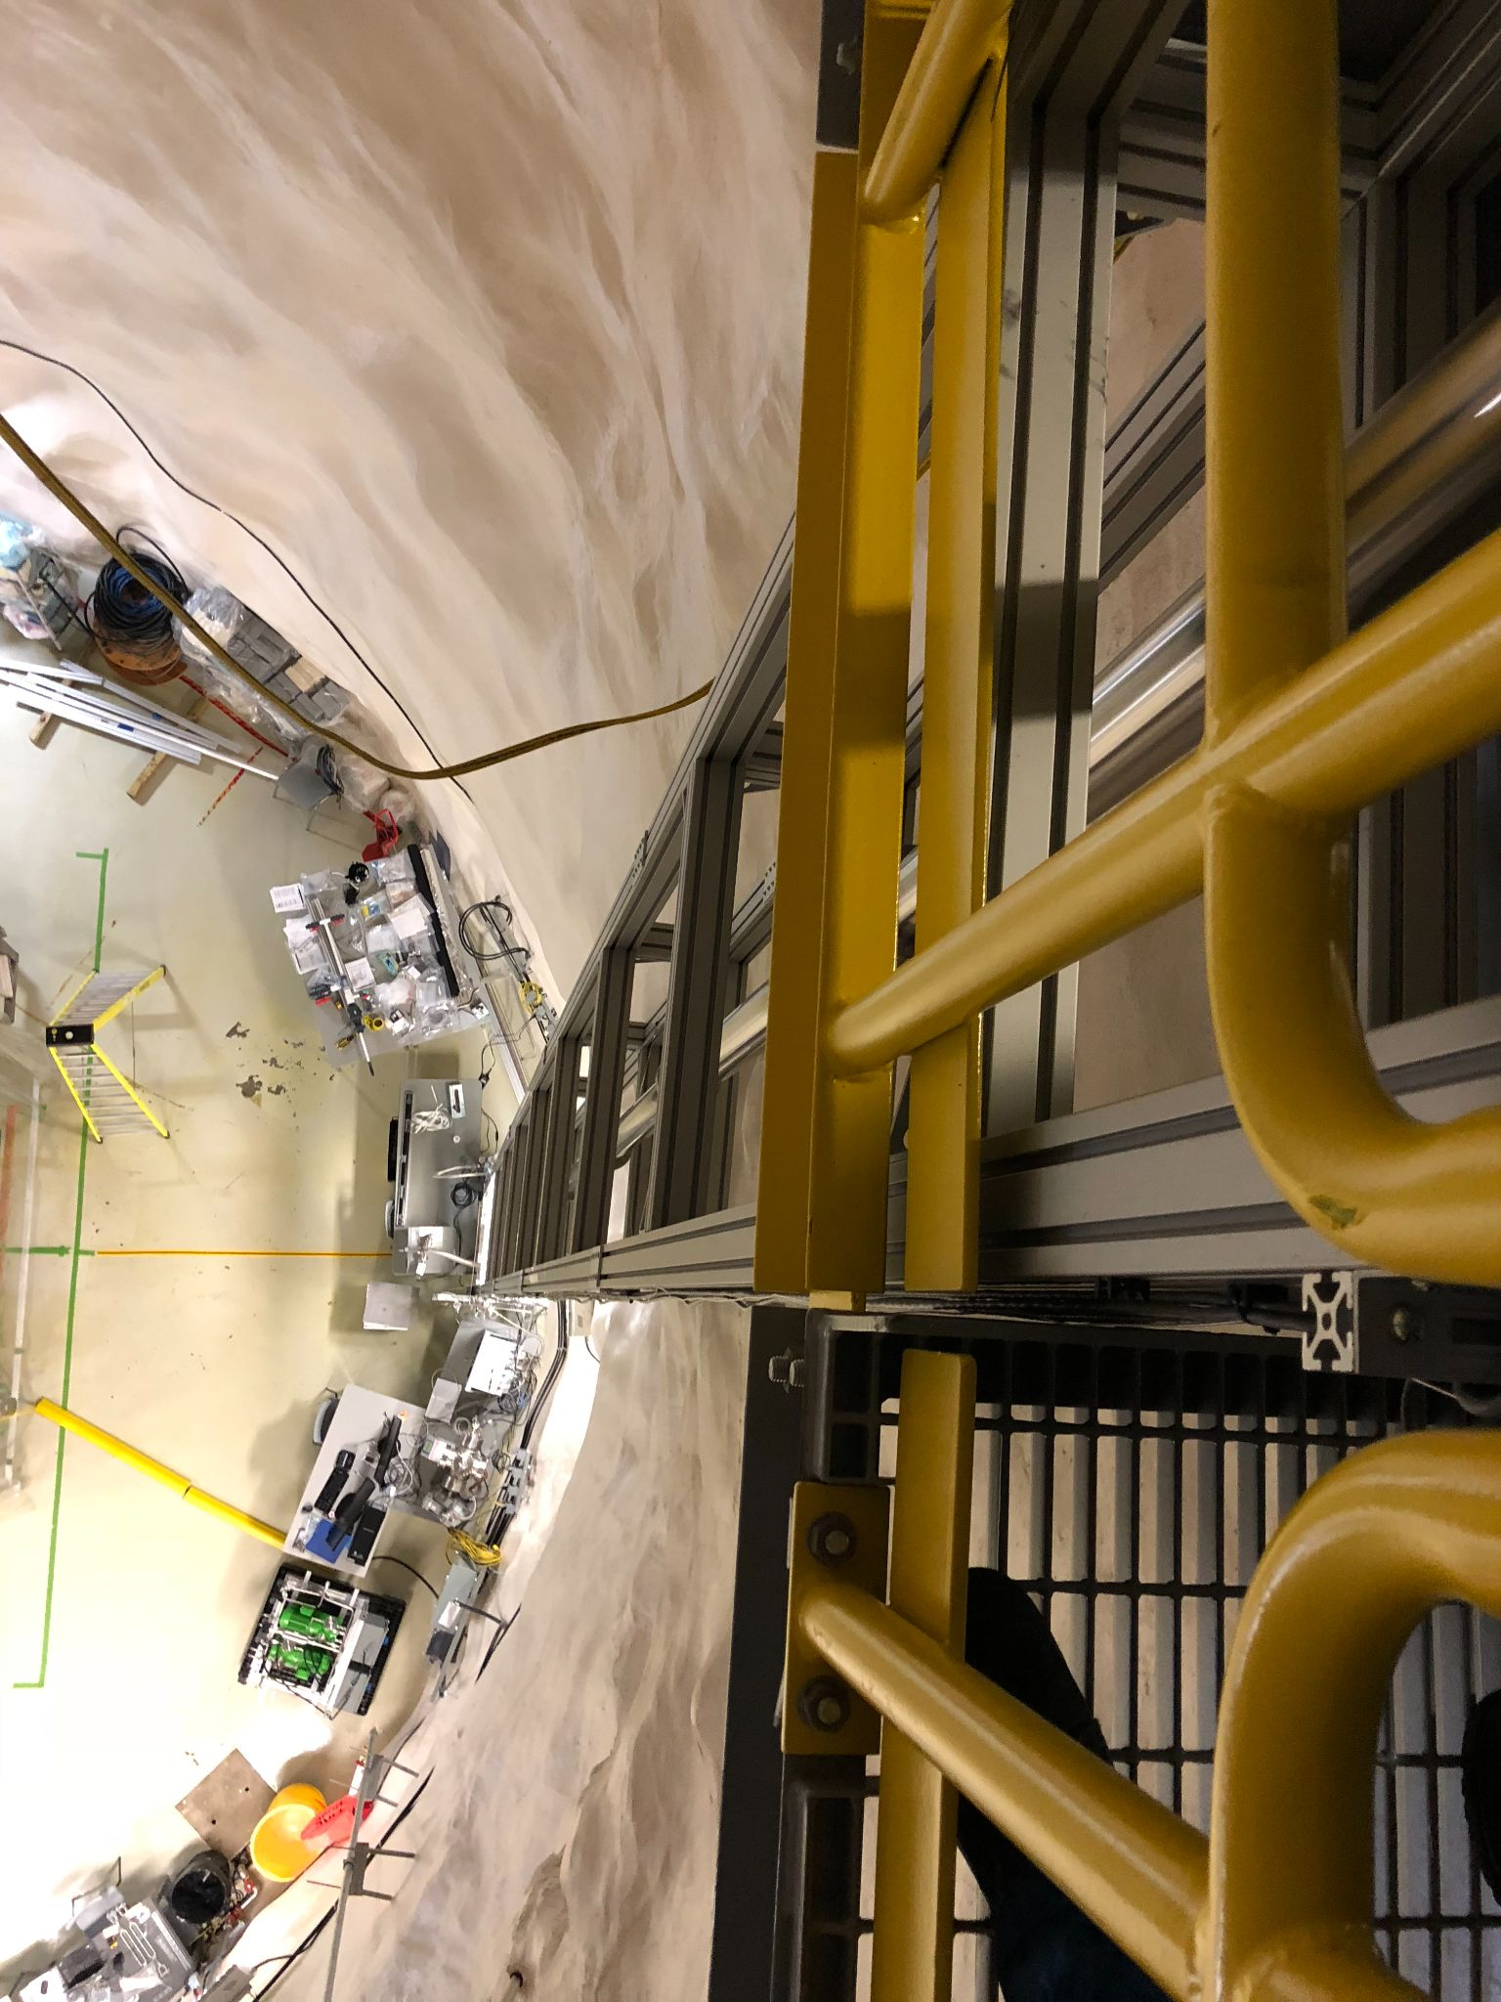
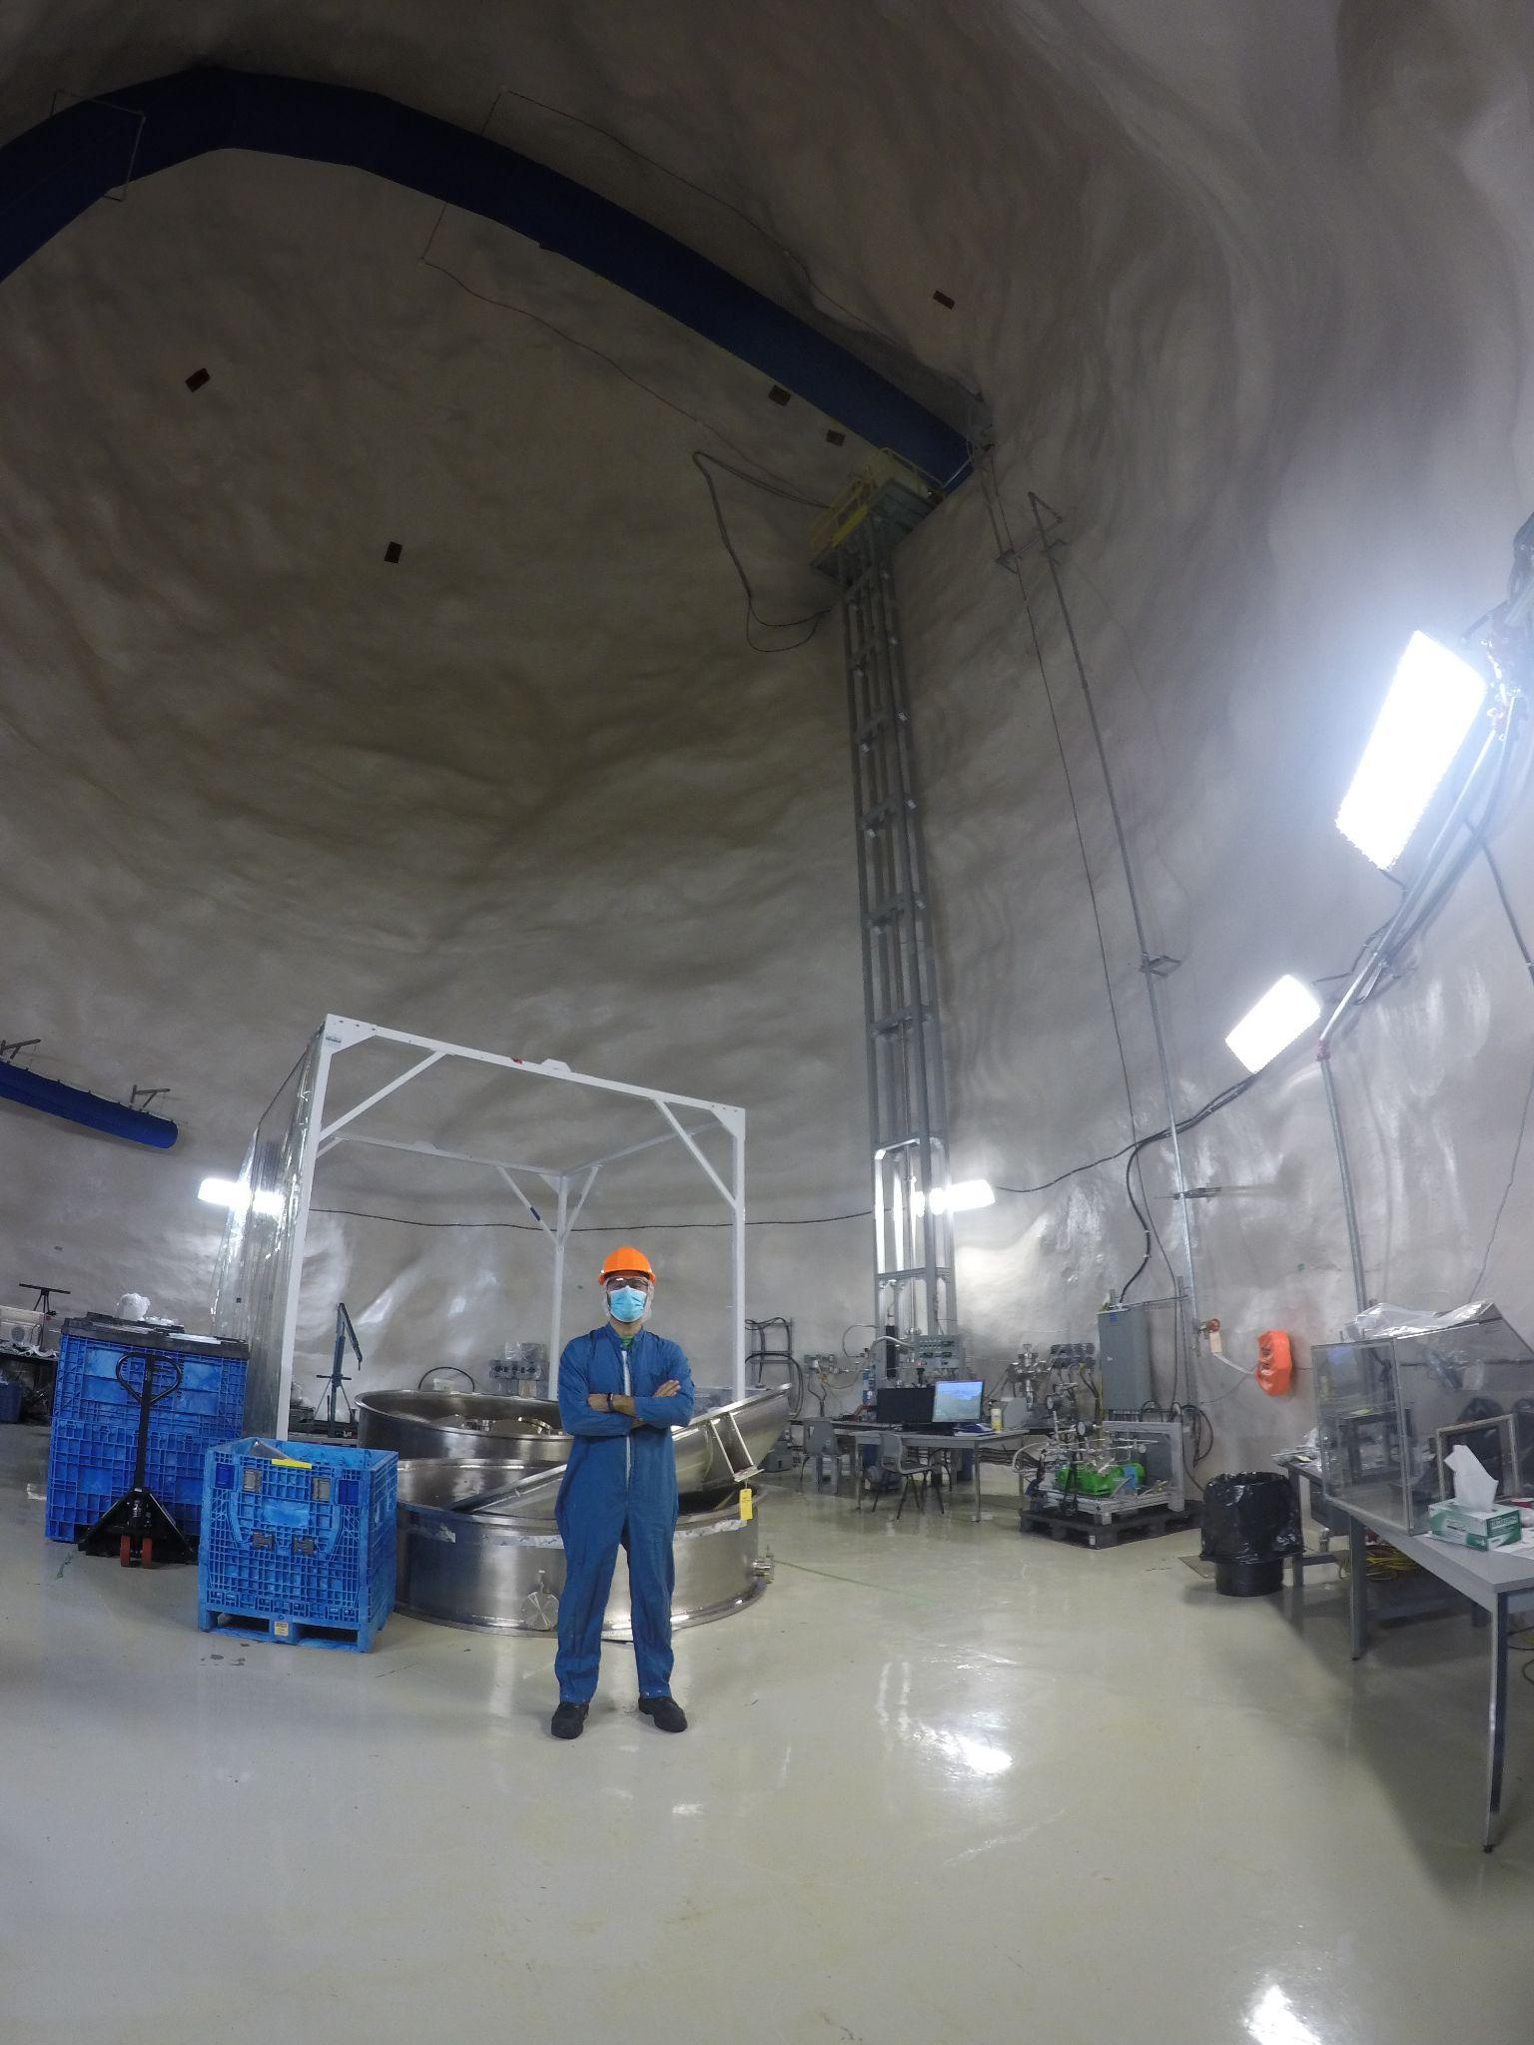
Height Comparison
Carleton’s still
SNOLAB still
SNOLAB still
Abo-Bakr Emara 08/06/2022

Slide 7
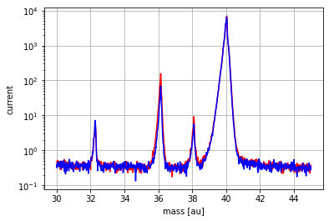
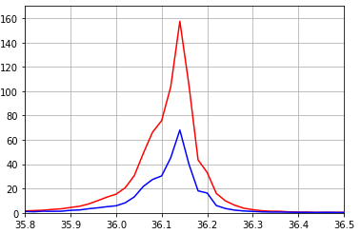
Data Analysis
Spectrum at beginning of the run(Blue)
Spectrum at end of the run (Red)
Spectrum from quadrupole mass spectrometer.
Samples are taken from top and bottom through capillary tubes.
Quantitatively compare the spectrum from the top and the bottom of the still and measure the change of enrichment for each isotope over time.
Oxygen
Spectrum of Argon gas
Abo-Bakr Emara 08/06/2022

Slide 8
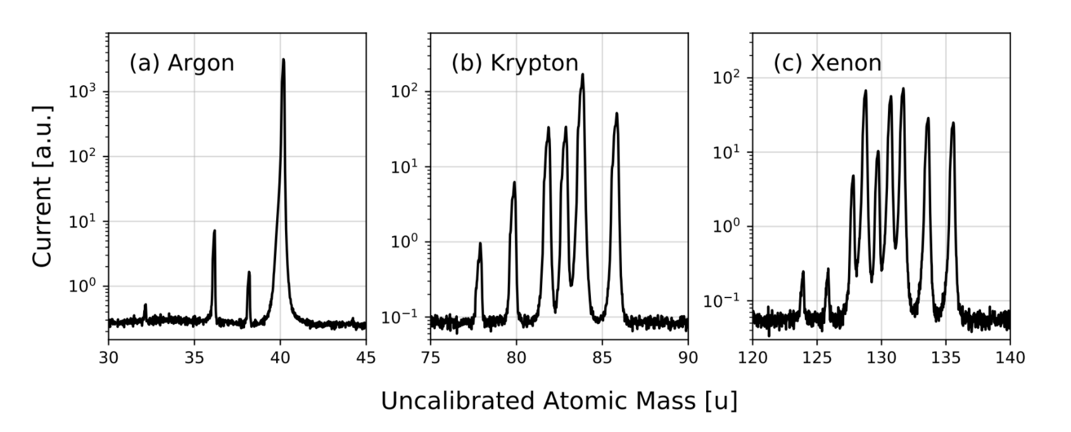
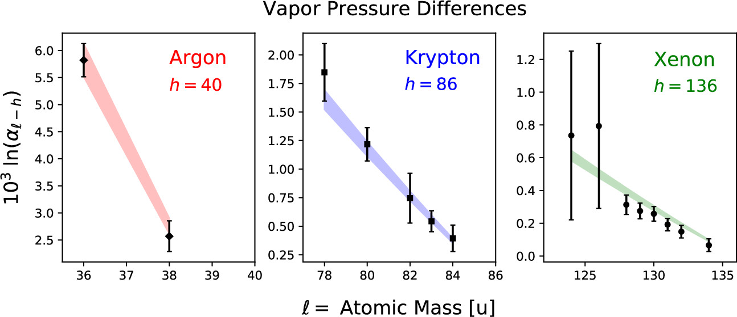
Procedure to get the vapour pressure of Xenon
We start with Argon gas to calibrate our still, vapour pressure for Ar-40 and Ar-36 well known from the literature.
After Argon gas we run with Krypton gas to validate our calibration, the vapour pressure difference between Kr-80 and Kr-84 is compared to the published data.
Same procedure is applied to Xenon gas to get the vapour pressure of xenon.
The experimental results from the literature is only between two isotopes, our data (from Carleton’s still) compare all the isotopes and it matched the theoretical expectation (color bands)
Isotopic Dependence of Vapor Pressure in Xenon
Amal Alamre, Ibtesam Badhrees, Brandon Death, Caio Licciardi, and David Sinclair, ACS Omega 2020 5 (45), 28977-28983
Abo-Bakr Emara 08/06/2022

Slide 9
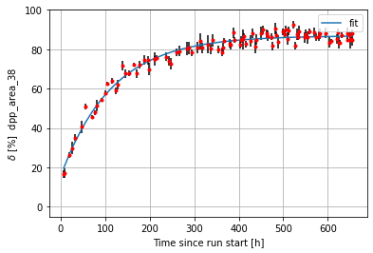
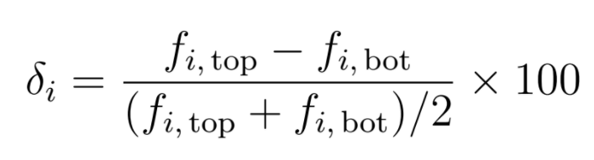
Stabilization Time Of The Still
It take some time for the still to be stable and get to the maximum enrichment.
Kown the stabilization time we allow us to have more data in the stable period and be able to extrapolate this to a higher still.
Comparing enrichment of A-38 and stabilization time from Carleton’s with SNOLAB, enrichment increase from 10.8% to 86.8% , and time increased from 4.6 h to 115 h
In order to calculate the vapor pressure for different isotopes we need to get the maximum enrichment.
Initial enrichment 15.6 %
final enrichment 86.8 %
Stabilization time 115 h
Abo-Bakr Emara 08/06/2022

Slide 10
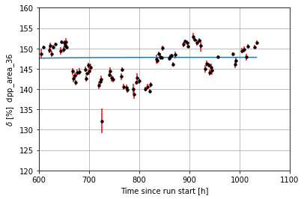
Different operation conditions at SNOLAB
Stable
Separation happen best around the triple point of the gas.
We tried different operation conditions with different pressures and different spectrometer tuning.
The aim is to do more comprehensive study from the still at SNOLAB.
Changed Mass-spec config.
Inc. press.
1000 Torr
Dec.
press.
760 Torr
Abo-Bakr Emara 08/06/2022

Slide 11
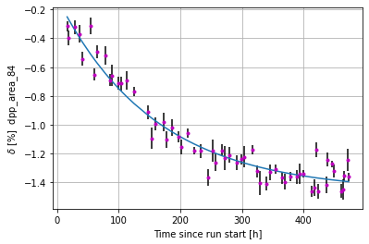
On-Going Data taking And Analysis
Run with argon is done and data is being analyzed.
Krypton run is also done, still evolved and reached stability, under going analysis.
Xenon run expected to start in June, recovery system for xenon should be connected first.
Abo-Bakr Emara 08/06/2022

Slide 12
Summary and Conclusion
Studying the cryogenic distillation process as a reliable way to separate Xe isotopes by studying the Xe isotopes vapour pressure.
To create material for next generation (0 νββ) experiments.
Results from Carleton’s still show that in fact xenon isotopes have different vapour pressure and separation by cryogenic distillation is doable, but have around 15% error in measurement.
Still at SNOLAB will produce more accurate results and help us understand more the physics process of separation. Give us insight about the effect of the height.
May help in future solving one of the unknown questions in physics today.

Slide 13
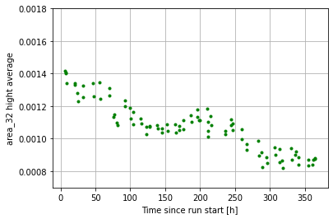
Extra Slide
Source of contamination
Outside the still
Decreasing from both top and bottom
Not evolving with time
Abo-Bakr Emara 22/5/2022

Slide 14
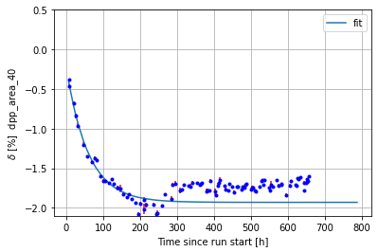
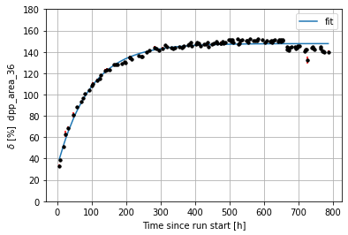

Extra Slide
Abo-Bakr Emara 22/5/2022

