Slide 1
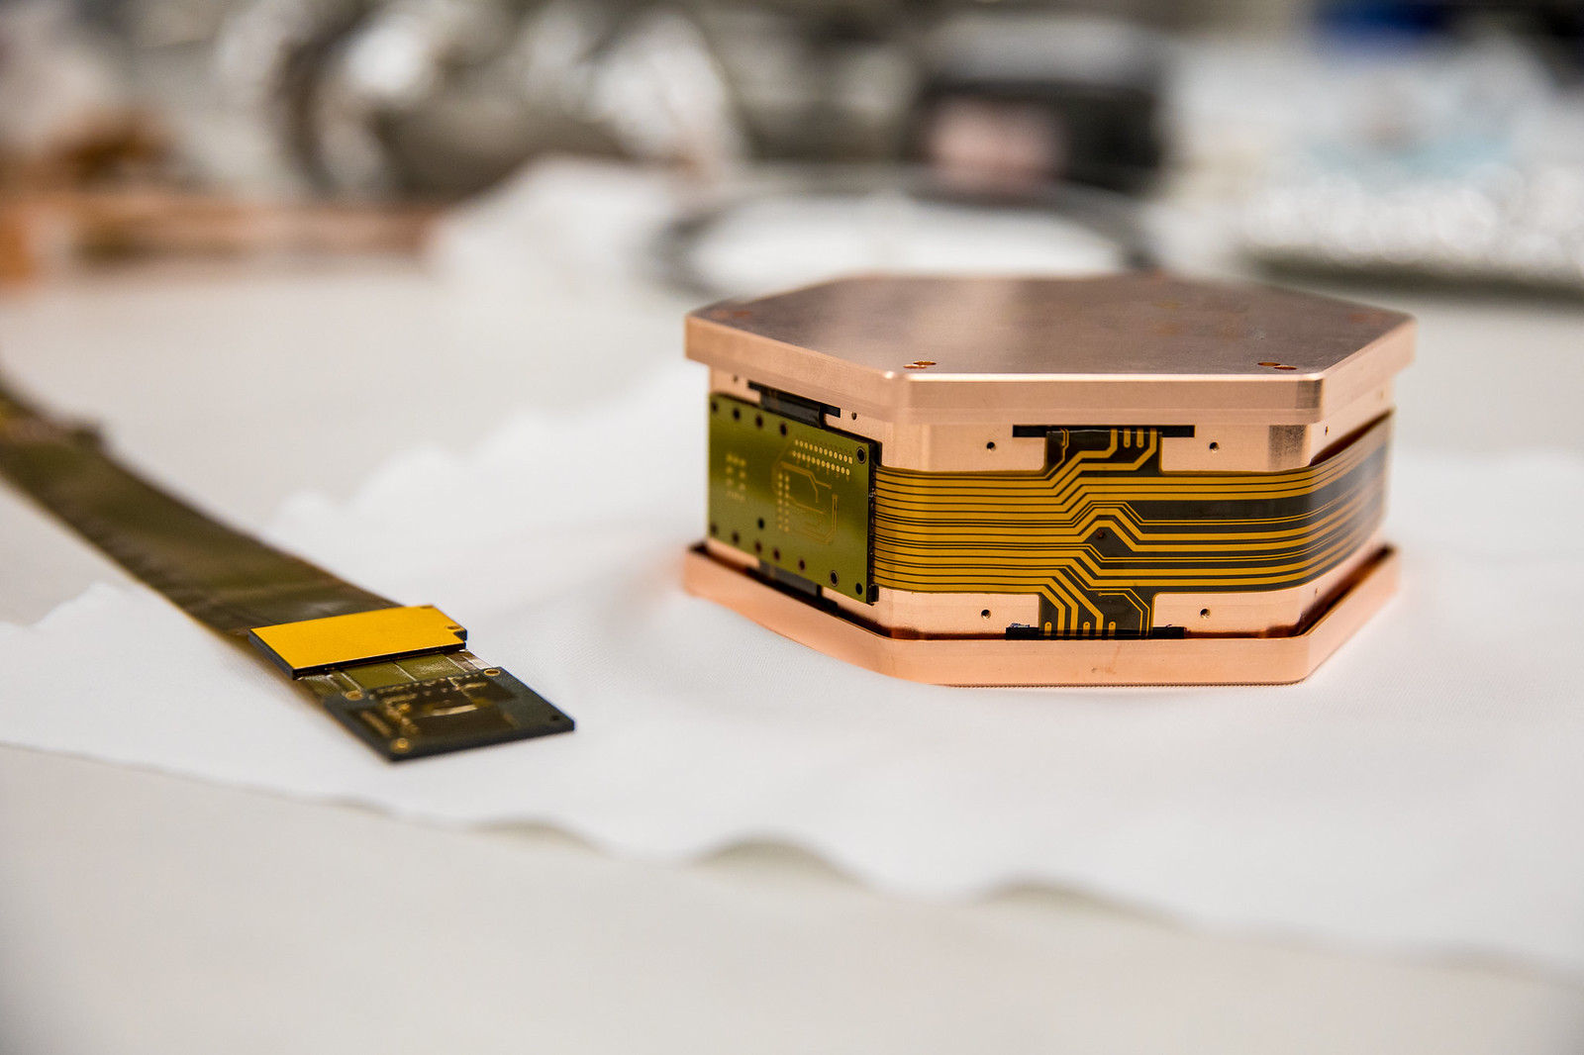




CUTE: An Overview and Applications to SuperCDMS
Aditi Pradeep
CAP Congress
June 6, 2022

Slide 2
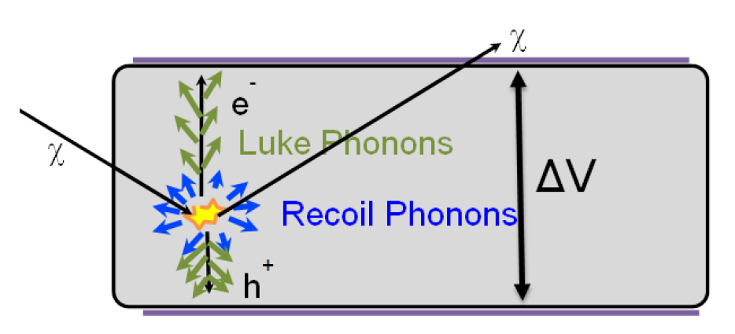
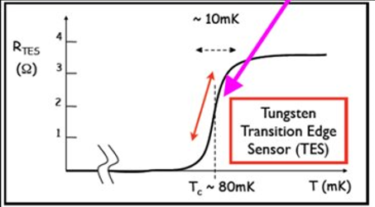
Cold, colder.... dark matter
SuperCDMS looks for DM interactions in cryogenic, semiconductor crystals producing phonons and e⁻h pairs.
Phonon energy is collected using Transition Edge Sensors
Charges drifted with a bias voltage:
  Maximum background discrimination: Small voltage (< 10 V); measure both phonons and charges
  Lowest threshold: Large voltage (10 – 100 V); electric potential energy converted to phonons (NTL effect) giving signal amplification

Slide 3
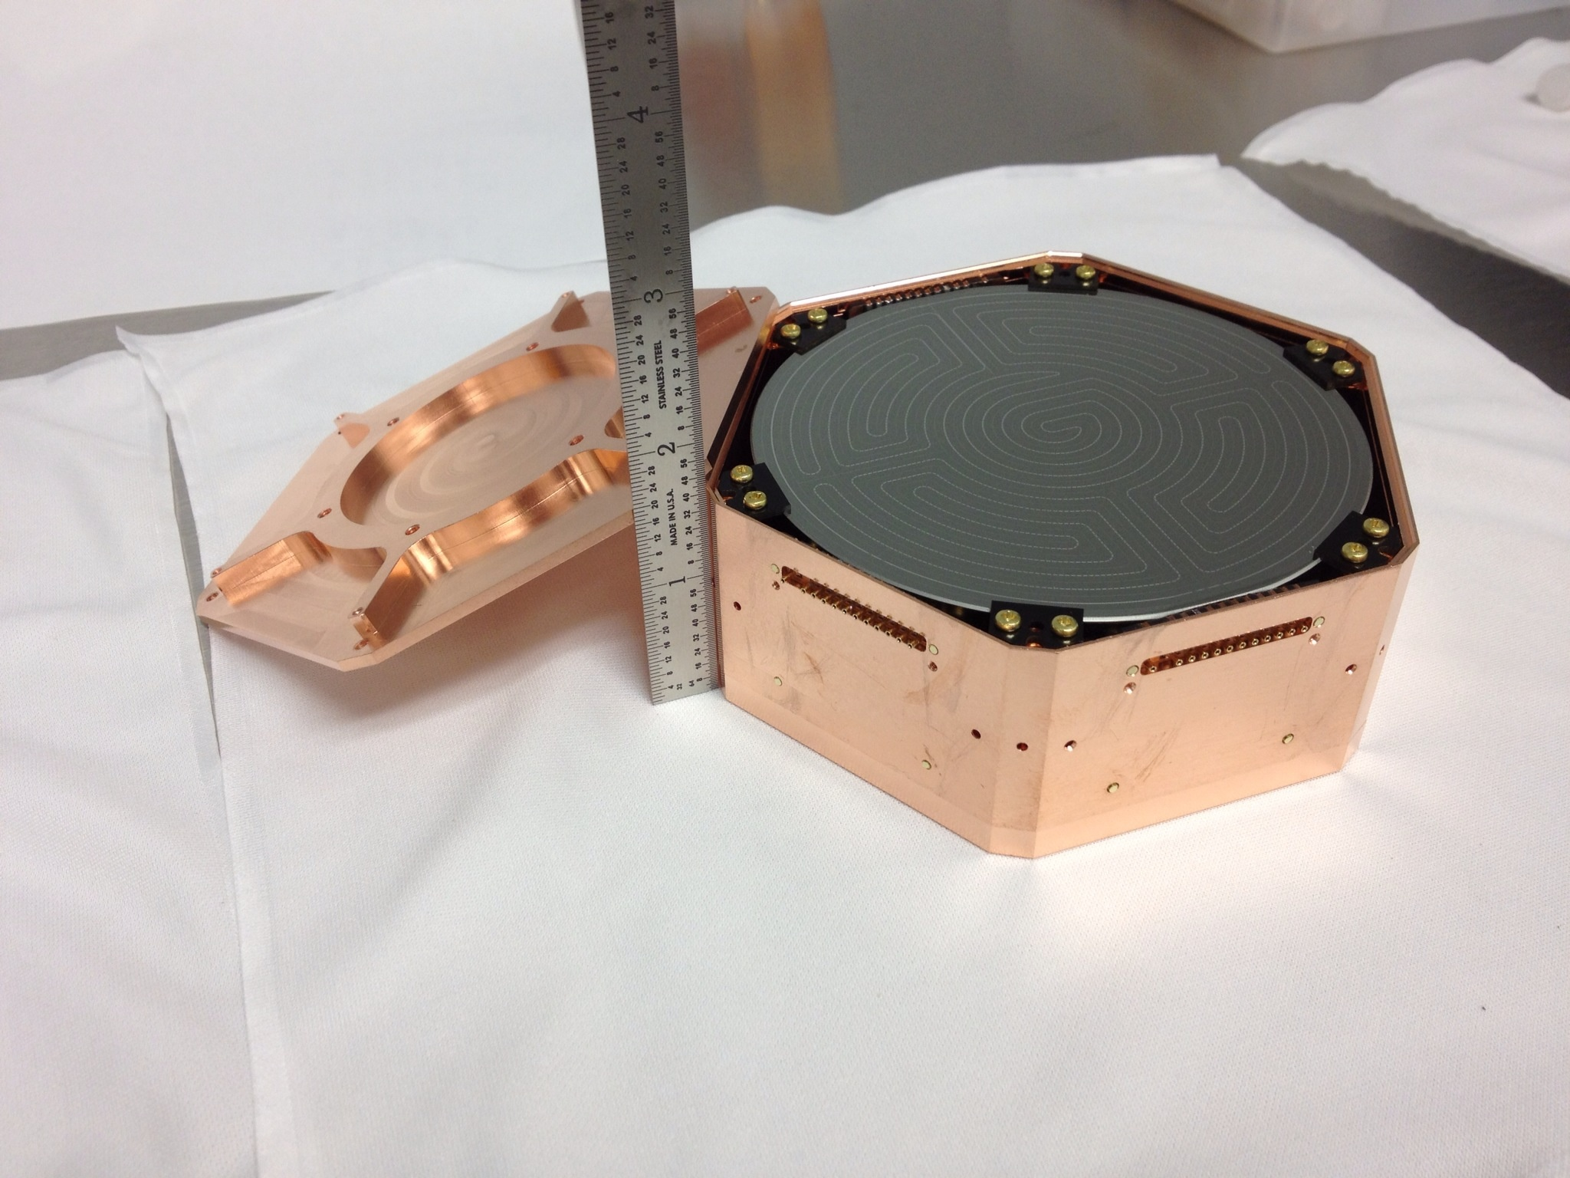
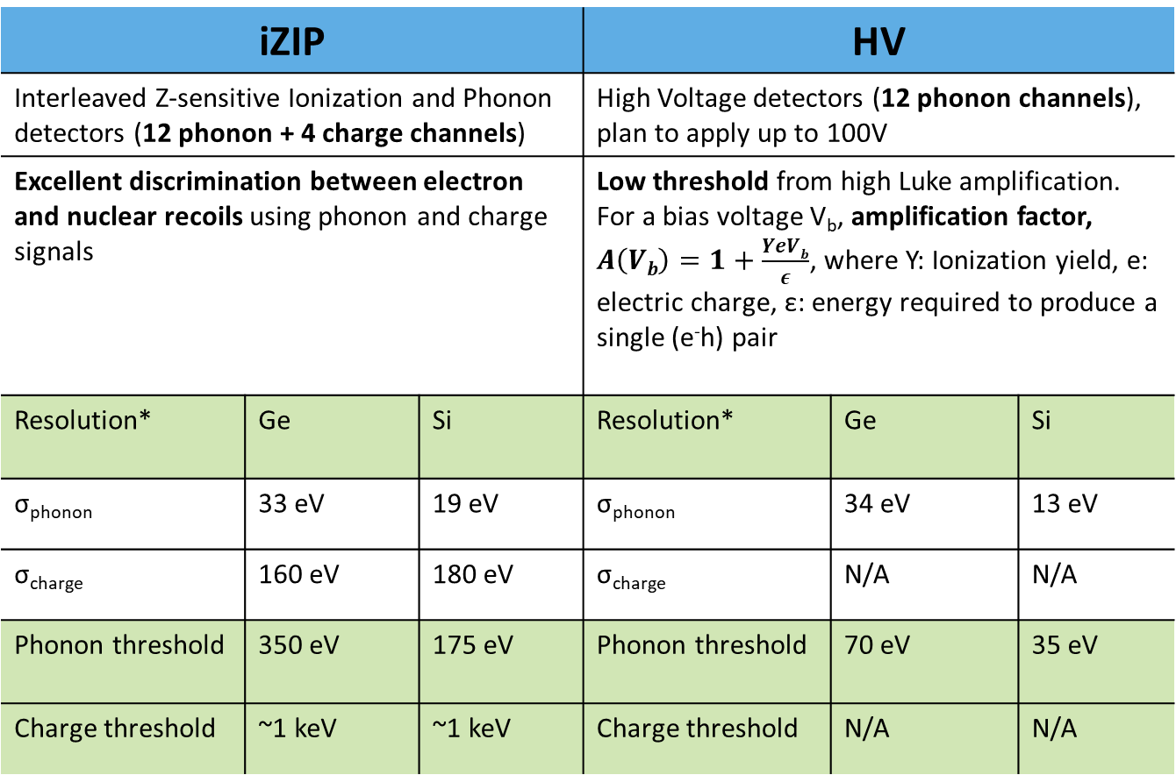
SuperCDMS detectors
iZIP |  |  | HV
Interleaved Z-sensitive Ionization and Phonon detectors (12 phonon + 4 charge channels) |  |  | High Voltage detectors (12 phonon channels), plan to apply up to 100V
Excellent discrimination between electron and nuclear recoils using phonon and charge signals |  |  | Low threshold from high Luke amplification. For a bias voltage V_{b}, amplification factor, $A\left(Vb\right)=1+\frac{YeVb}{ε}$, where Y: Ionization yield, e: electric charge, ε: energy required to produce a single (e⁻h) pair
Resolution* | Ge | Si | Resolution* | Ge | Si
σ_{phonon} | 33 eV | 19 eV | σ_{phonon} | 34 eV | 13 eV
σ_{charge} | 160 eV | 180 eV | σ_{charge} | N/A | N/A
Phonon threshold | 350 eV | 175 eV | Phonon threshold | 70 eV | 35 eV
Charge threshold | ~1 keV | ~1 keV | Charge threshold | N/A | N/A
iZIP prototype
* https://arxiv.org/pdf/2203.08463.pdf

Slide 4
CUTE facility

Slide 5
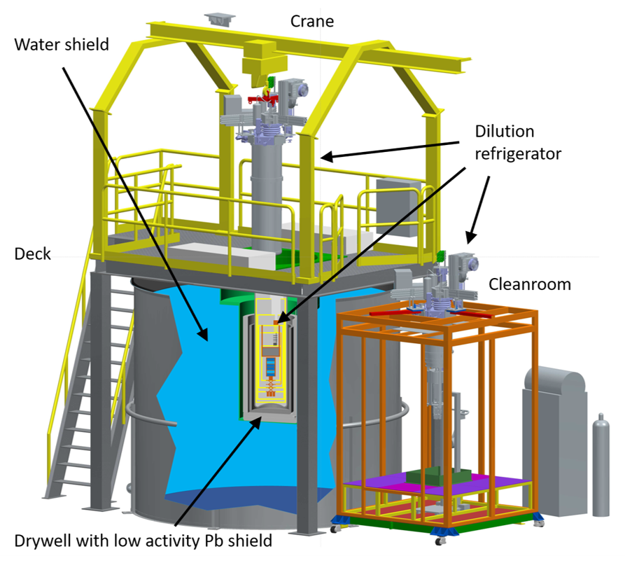
Motivation
Cosmogenic activation, high background rate at ground level: need a low background test site
CUTE : 2 km underground at SNOLAB in Sudbury, ON. Background: ~7 events/ keV/ kg/ day (10-100 keV range)
Located next to SuperCDMS in SNOLAB. Ongoing SuperCDMS detector characterization, hardware/software testing and optimization of readout configuration.
Possibility of early science results from CUTE before the main experiment is commissioned.
CUTE is open to new players post SuperCDMS!

Slide 6
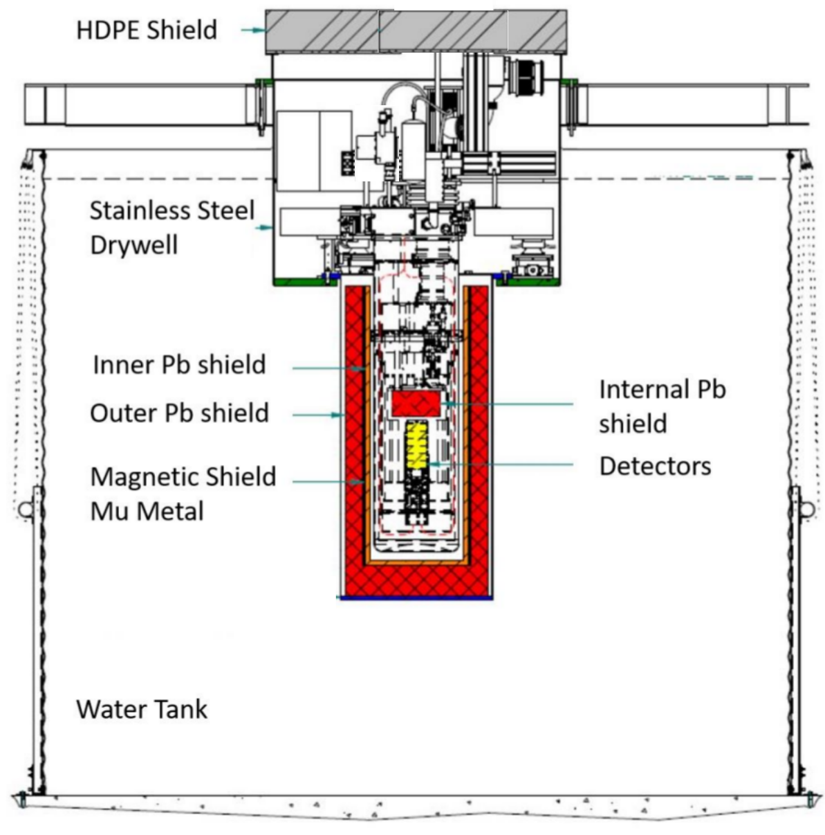
Shield design
1.5 m water shield: neutron & gamma shield
10.7 cm inner and outer Pb cylinders: gamma shield
Mu metal: magnetic shield
20 cm HDPE top cover: shields neutrons from the top
15 cm Internal Pb: shields gamma from the top

Slide 7
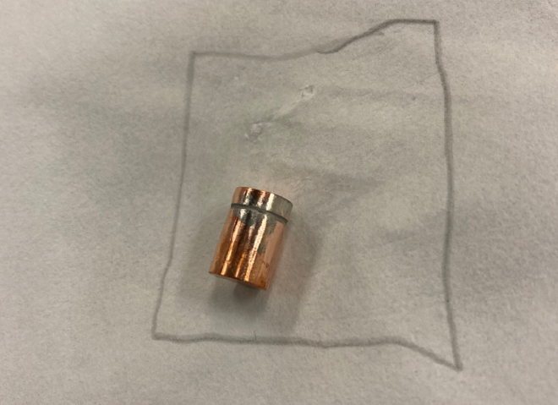
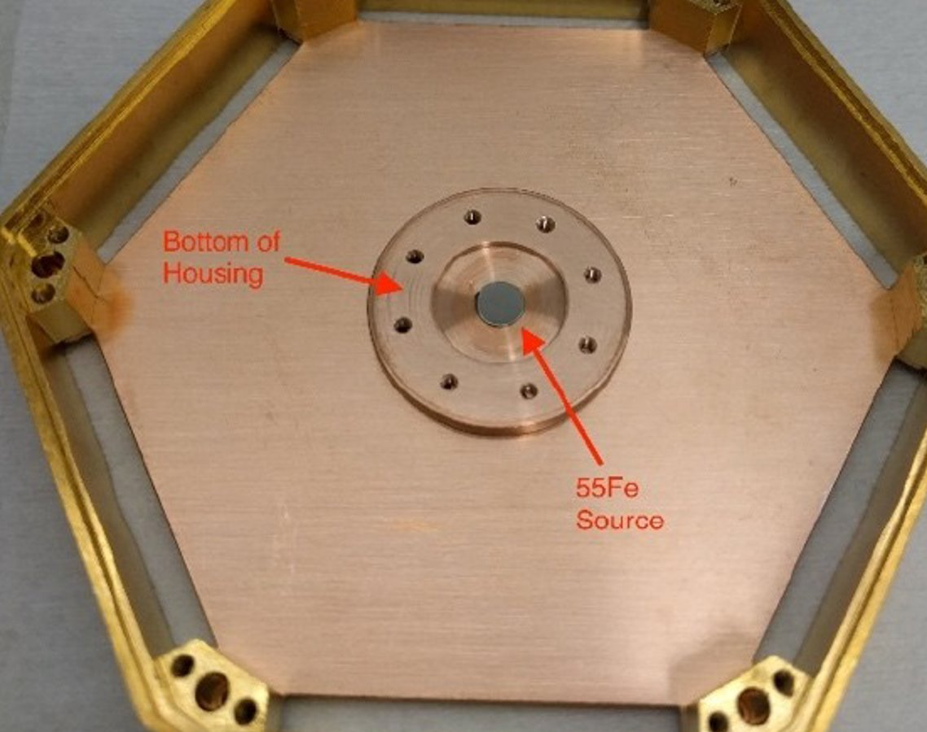
Calibration
Cf source inside first layer of Cu encapsulation
  ¹³³Ba gamma source deployable into the shielding with a stepper motor
  ²⁵²Cf neutron source is being installed: Ge activation for low energy calibration, iZIP neutron/gamma discrimination
  ⁵⁵Fe source (K_{α} 5.9 keV, K_{β} 6.5 keV) with Al foil (~μm thick, 1.5 keV fluorescence) for low energy calibration.
⁵⁵Fe source

Slide 8
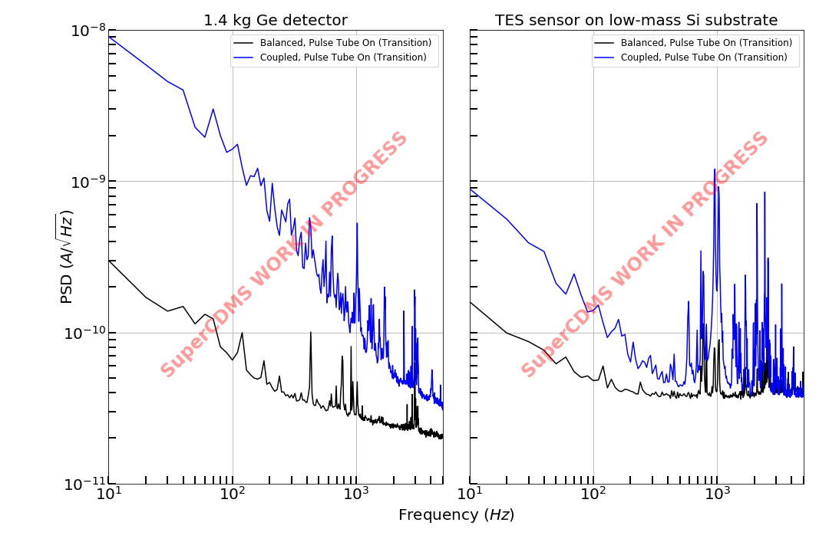
Vibration mitigation
Average noise in our detector as a function of frequency when the cryostat is coupled to vs decoupled from the pulse tube
Pulse Tube is a major source of vibrations in our setup
Vibrational noise is decoupled by mounting the cryostat on a suspension system
CUTE slow control system automatically adjusts the suspension system in response to lab pressure changes
Coupled to PulseTube
Vibrationally decoupled
Frequency (Hz)
CUTE: an underground test facility for cryogenic detectors R. Germond| CAP Congress 2021

Slide 9
SuperCDMS @CUTE

Slide 10
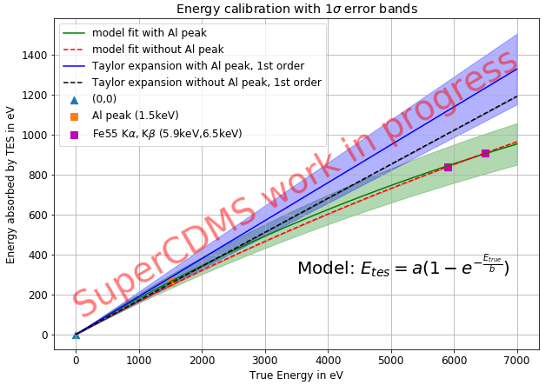
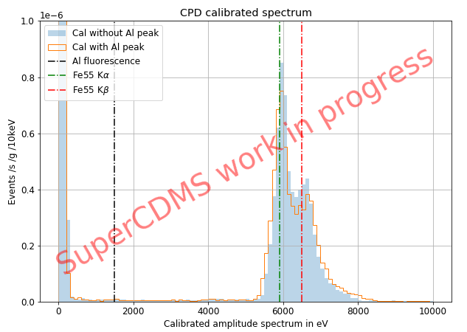
Detector testing :
Cryogenic Photon Detector
CPD: 10.6 g, 3.8 cm radius, 1 phonon channel
Originally designed to detect light from cryogenic scintillators; low threshold
Assessed noise performance
Calibrated with ⁵⁵Fe K_{α}, K_{β} lines and Al fluorescence peak accounting for local saturation effects
Resolution from least noisy series: ~12 eV
Empirical calibration model with local saturation correction
Calibrated energy spectrum for CPD

Slide 11
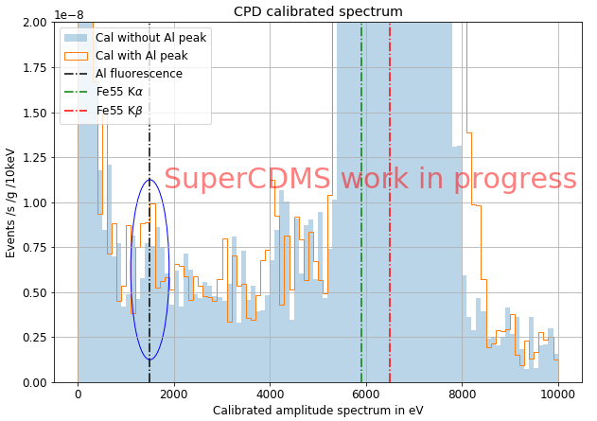
Detector testing :
Cryogenic Photon Detector
CPD: 10.6 g, 3.8 cm radius, 1 phonon channel
Originally designed to detect light from cryogenic scintillators; low threshold
Assessed noise performance
Calibrated with ⁵⁵Fe K_{α}, K_{β} lines and Al fluorescence peak accounting for local saturation effects
Resolution from least noisy series: ~12 eV
Empirical calibration model with local saturation correction
Calibrated energy spectrum for CPD

Slide 12
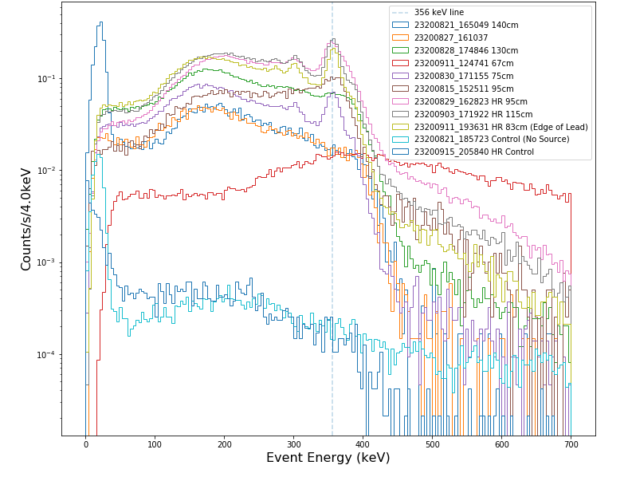
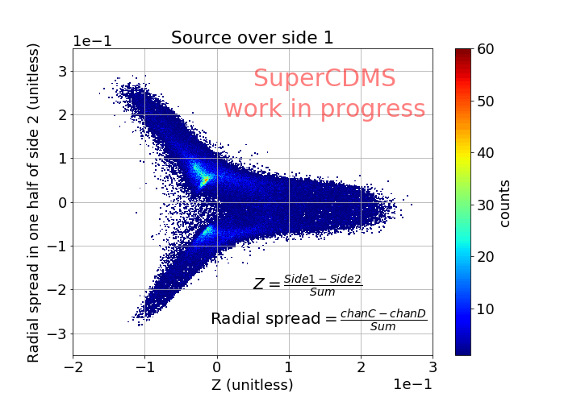
Detector testing: iZIPs
Soudan iZip (8 phonon + 4 charge channels) – Ge, 0.6 kg
Currently, only reading out phonon channels at CUTE
Calibrated with 356 keV Ba gamma peak
Performed background simulations with GEANT4 - M. Baiocchi| CAP Congress 2021
Performed directionality studies to understand position sensitivity
--- 356 keV line
Jonathan Corbett| MASc thesis
Calibrated ¹³³Ba spectrum at various source positions
Event distribution as a function of Z estimator at various source positions

Slide 13
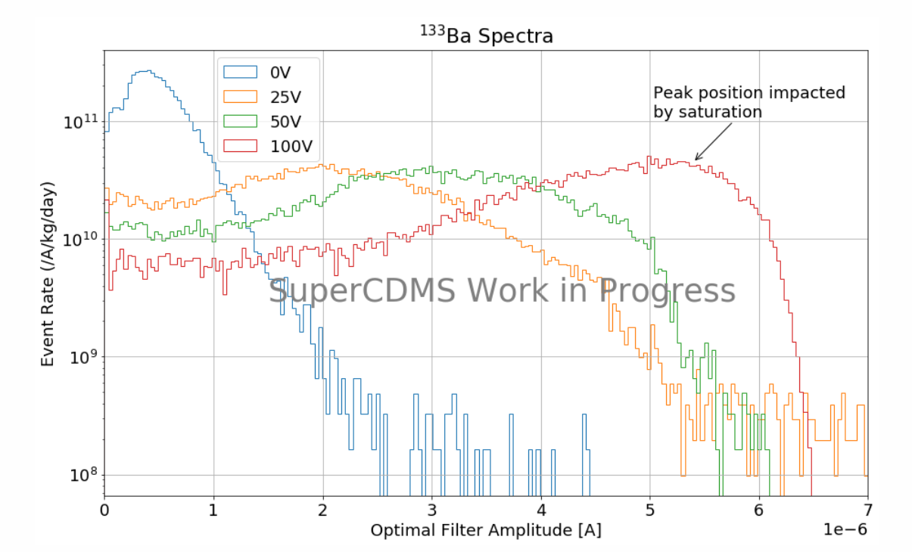
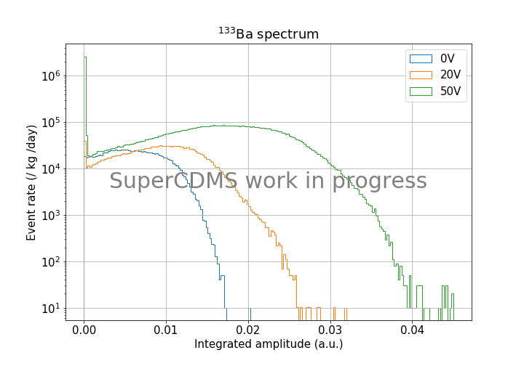
Detector testing: HV
SNOLAB HVs (partial readout): G124 (Ge,1.4 kg), S101 (Si,0.6 kg)
Assessed noise performance and pulse shapes
Studied NTL amplification
Currently focusing on calibrating S101 with Compton steps- Gamma’s can be used to strip e⁻s from Si atomic shells producing steps for each shell
E. Fascione | TRIUMF Science week 2021
G124 spectrum at different bias voltages
S101 spectrum at different bias voltages

Slide 14
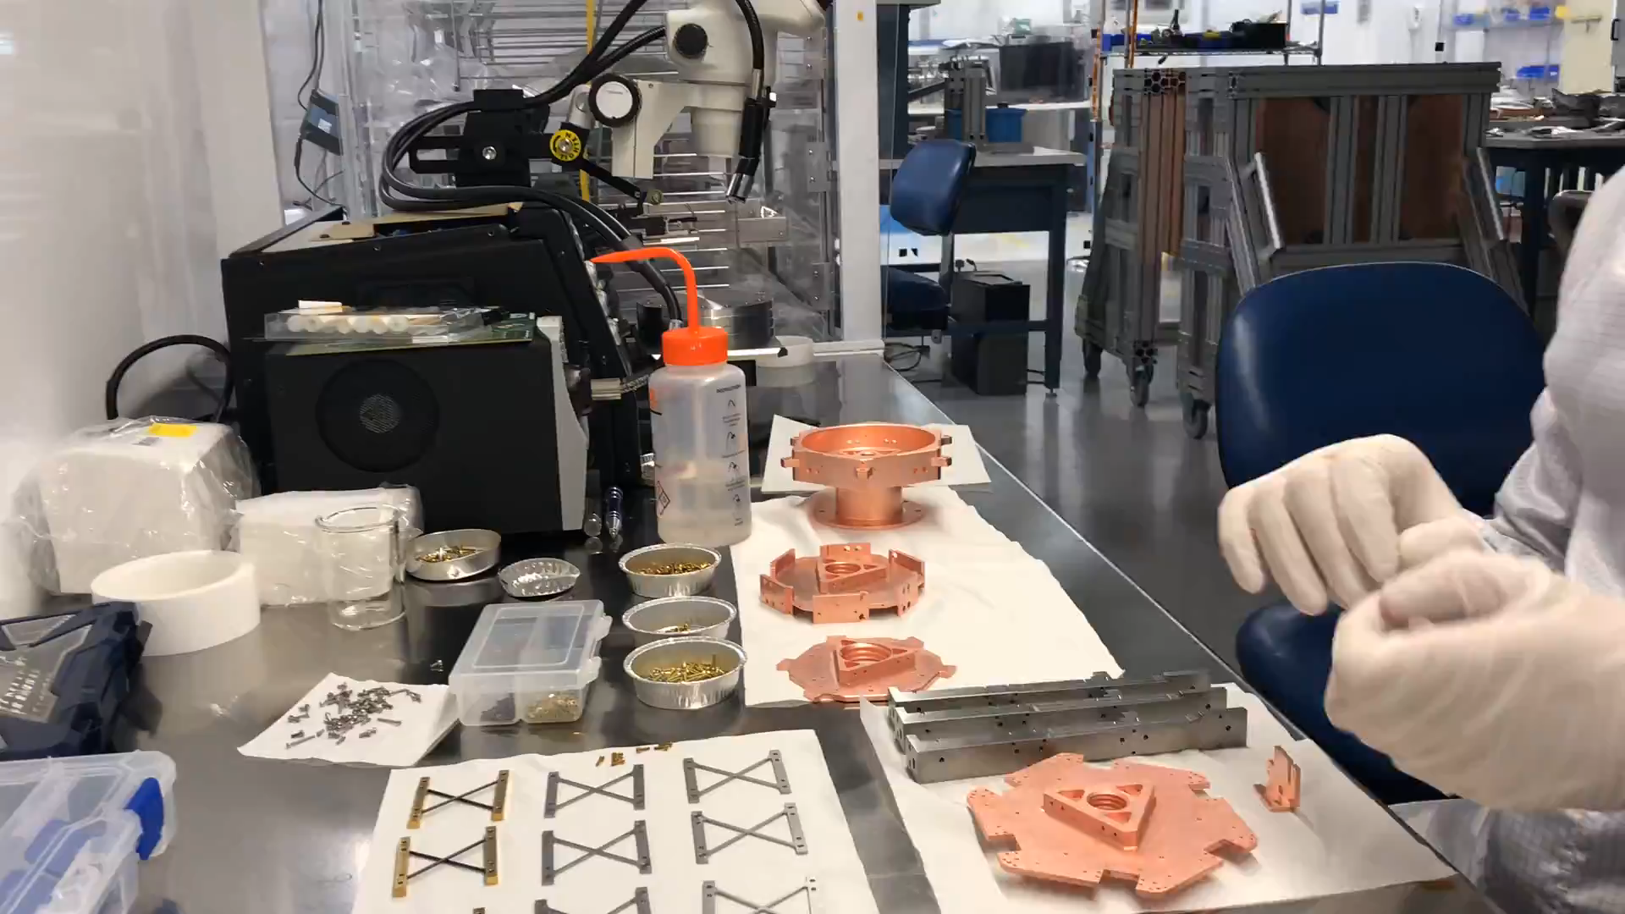
Outlook
First SCDMS tower assembly at SLAC
SuperCDMS SNOLAB is expected to begin operation in 2024
CUTE can house 1 SuperCDMS tower (6 detectors) at a time
The first detector tower (6 Ge iZIPs) has been tested successfully at SLAC
This tower will be shipped to CUTE this summer for testing, and towers 2,3 and 4 will follow.id

Slide 15
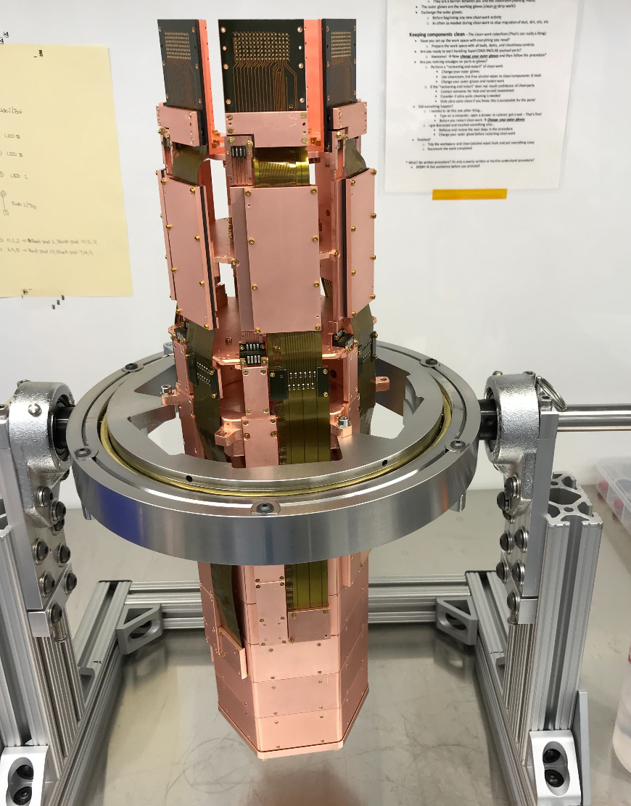
Outlook
SuperCDMS SNOLAB is expected to begin operation in 2024
CUTE can house 1 SuperCDMS tower (6 detectors) at a time
The first detector tower (6 Ge iZIPs) has been tested successfully at SLAC
This tower will be shipped to CUTE this summer for testing, and towers 2,3 and 4 will follow.id
First SCDMS tower assembled at SLAC

Slide 16
Summary
CUTE is an underground test facility for low background experiments.
Various types of SuperCDMS detectors and other operation hardware & software have been successfully tested at CUTE.
The first SuperCDMS tower consisting of 6 Ge iZIP detectors will arrive for testing at CUTE this summer.
Keep an eye out for dark matter results from CUTE in the near future!

Slide 17
Backup slides

Slide 18
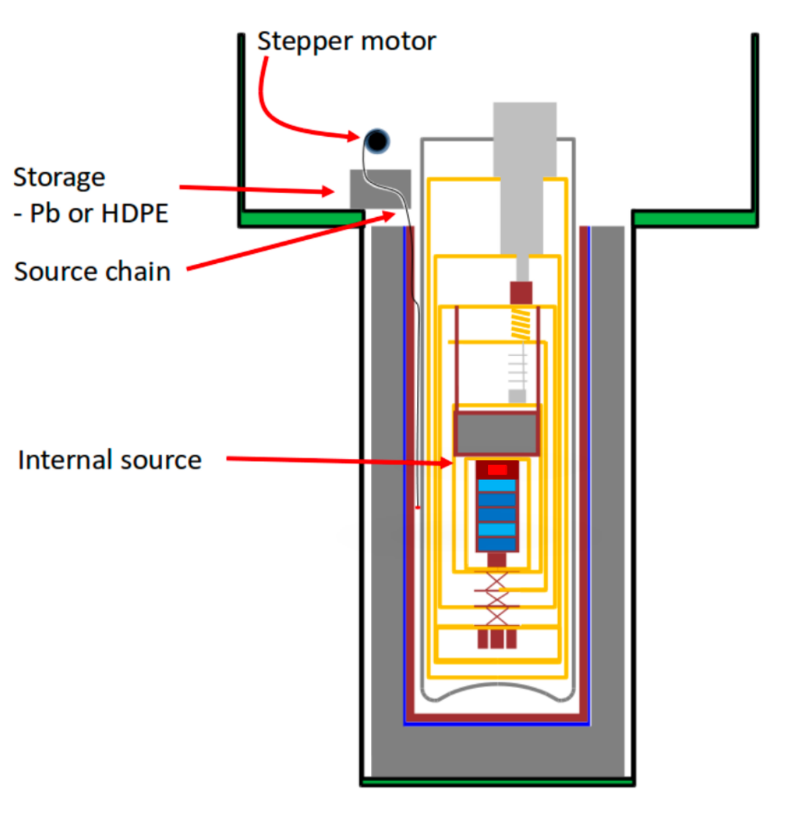
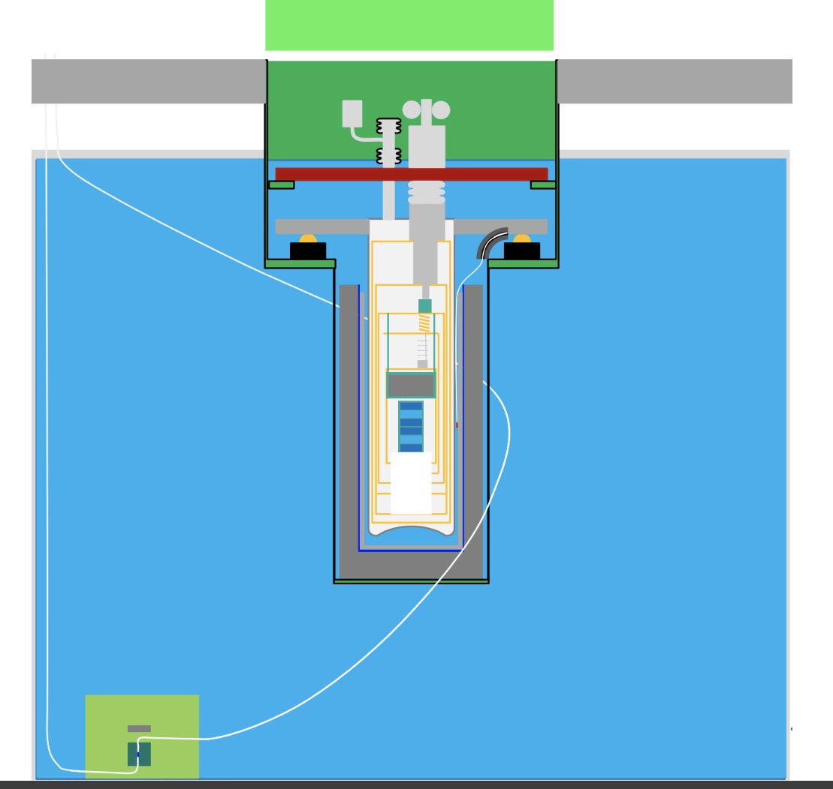
CUTE Calibration
Cf source enclosed in PE box, placed in the water tank

Slide 19
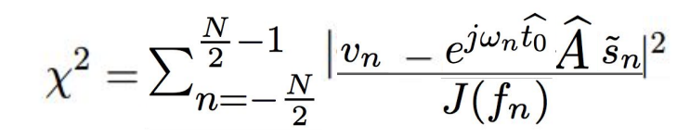
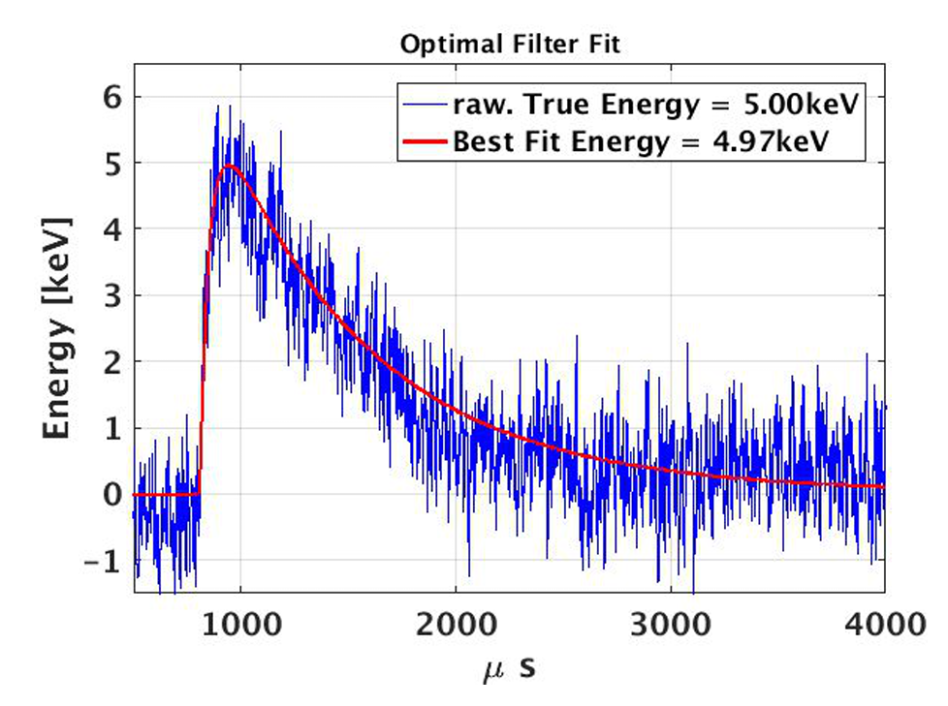
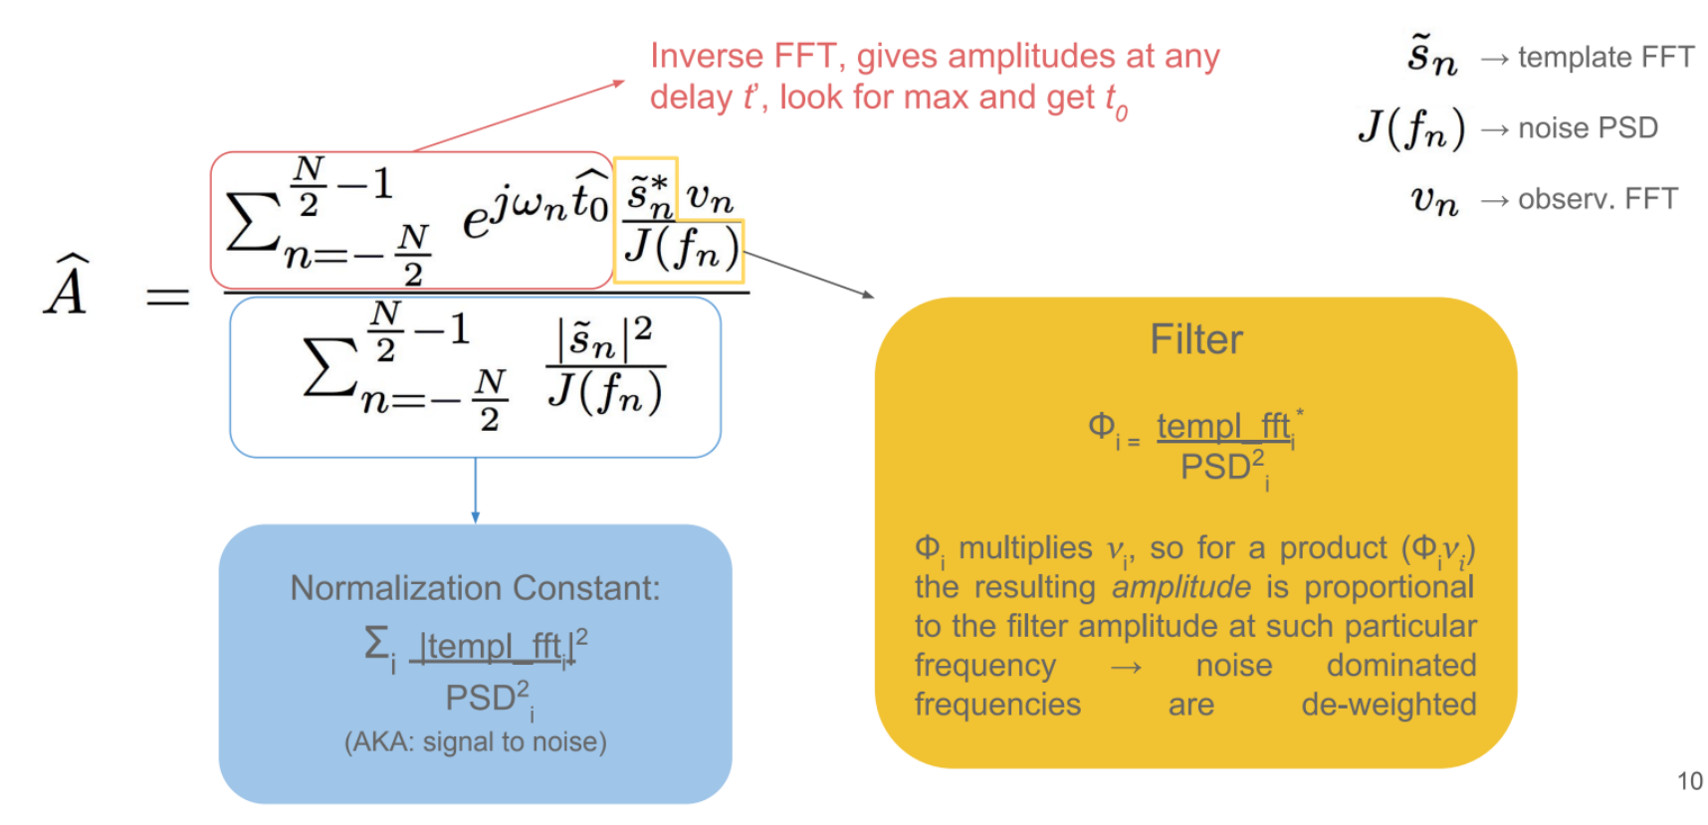
Energy estimator: Optimal Filter
Credit: Jorge Morales| Texas A&M

Slide 20
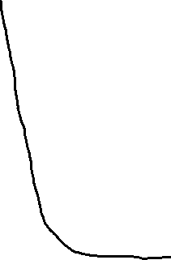
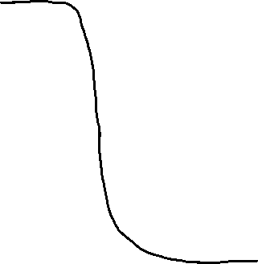
Saturated pulse
Unsaturated pulse
Current
Current
Time
Time

Slide 21
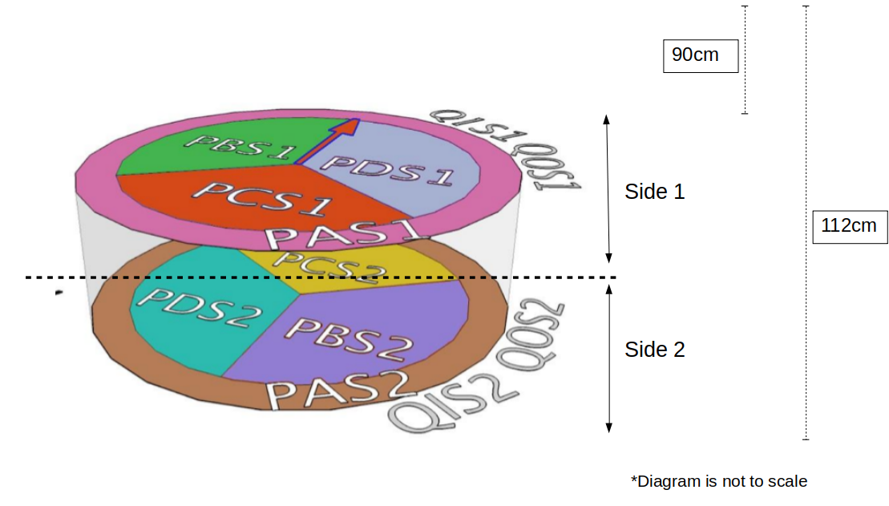
Soudan iZIP channel map and source position (measured from top) for directionality study

