Slide 1
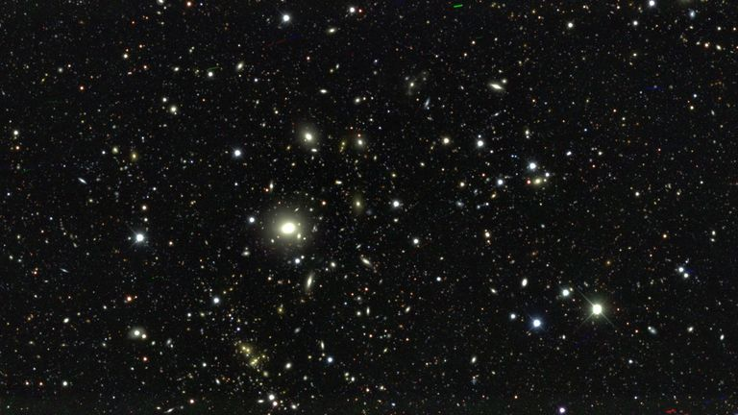


g-2 Dark Sector Portal:
${U(1)}_{L_{μ}−L_{τ}}$ Solution to Dark Matter
Timothy Hapitas
Theoretical Particle Physics Group
Carleton University
Supervisor: Dr. Yue Zhang
Collaborators: Dr. Douglas Tuckler

Slide 2
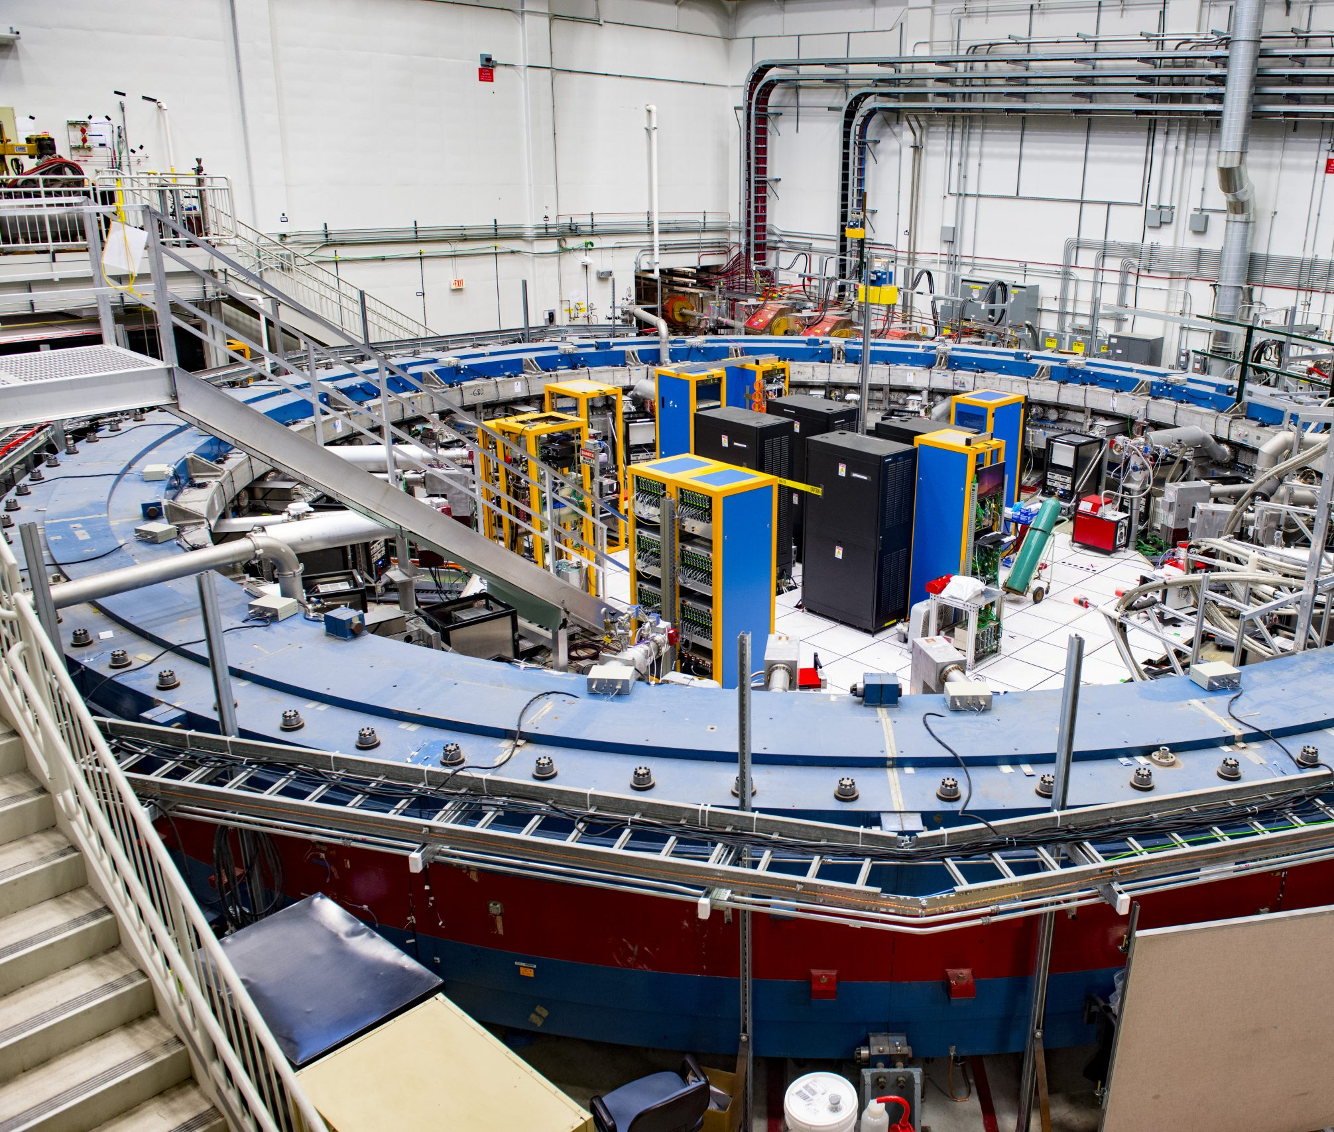

Motivation
Can we construct a model that explains the g-2 excess and provides a viable DM candidate?
We consider a gauged ${U(1)}_{L_{μ}−L_{τ}}$extension to the SM
Introduce a new vector boson Z’
Postulate fermionic dark matter

Slide 3
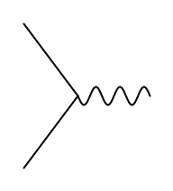



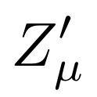

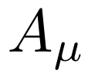
Model Details
Z’ couples directly to DM
Also couples to muon + tau sector
Kinetic mixing with SM photon

Slide 4
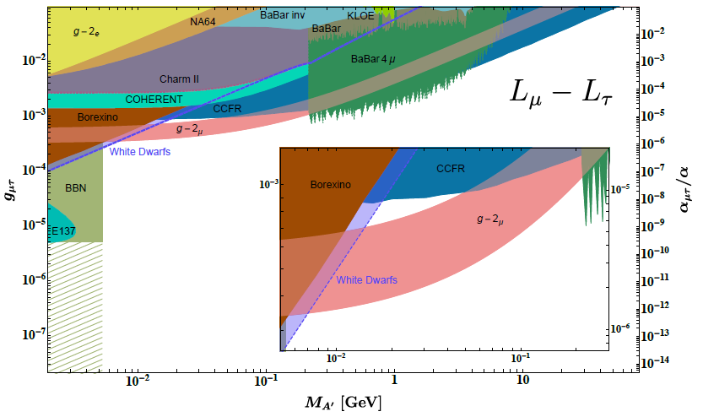
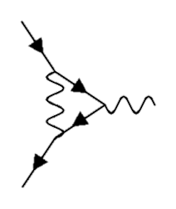


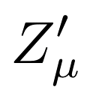
Established constraints on the Z’ parameter space
g-2 favored region shown in salmon-pink
Key takeaway: mass of Z’ is restricted to lie in the range 10 MeV – 200 MeV
g’ central value is fixed as a function of mZ’
Experimental constraints on the ${U(1)}_{L_{μ}−L_{τ} }$gauge boson [arXiv:1803.05466v2]

Slide 5
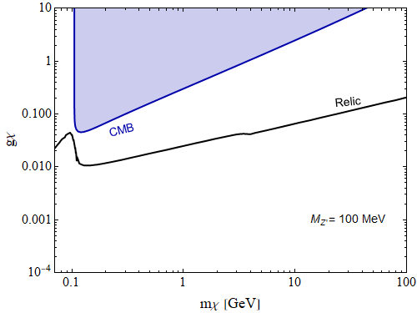
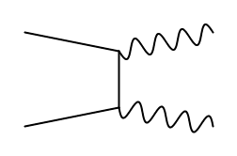
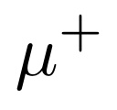
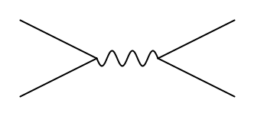


DM Parameter Space – Cosmological Constraints
Relevant Processes:
Both contribute to relic abundance. Only process relevant for CMB constraint is muon/anti-muon pair production
Annihilation to a pair of only possible if DM is the heavier of the two.
preliminary
Cosmological bounds on the dark matter coupling strength

Slide 6
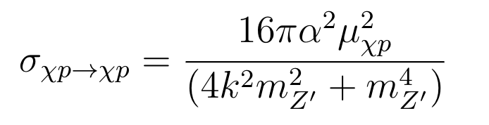

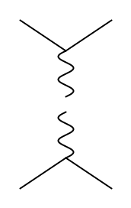



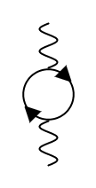







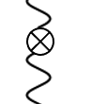
Constraints Imposed by Direct Detection
Consider several experiments: XENON1T, DarkSide-50, CDMSlite, CRESST-III, DarkSide-LM, SuperCDMS
Typically consider low Q limit of loop level kinetic mixing (mixing at tree level taken to be 0)
We consider mixing at both tree and loop level with full Q dependence of along with BC as :
tree level
+
loop level
,

Slide 7
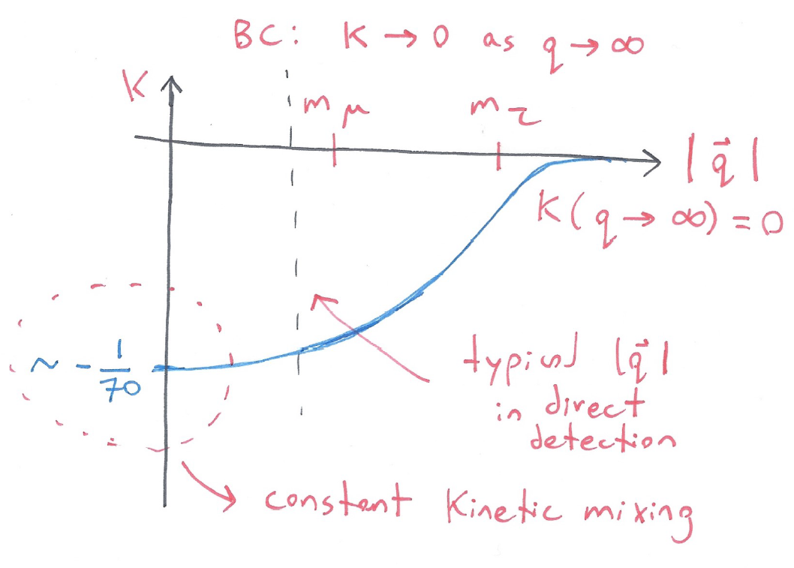
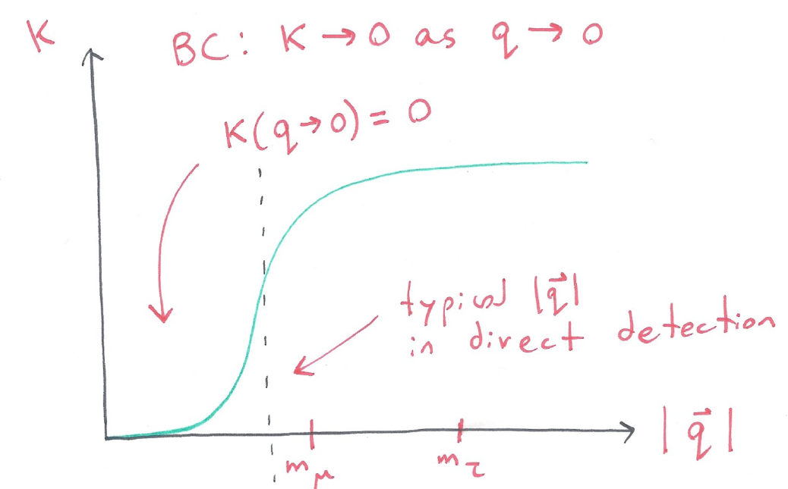
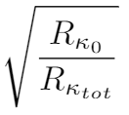
Scaling Direct Detection Upper Bounds
Running kinetic mixing is very supressed in low Q region
Leads to a different event rate for direct detection, suggesting we may modify the constraints found for constant kinetic mixing
We scale the constant mixing bounds by
Constant kinetic mixing
Running kinetic mixing

Slide 8

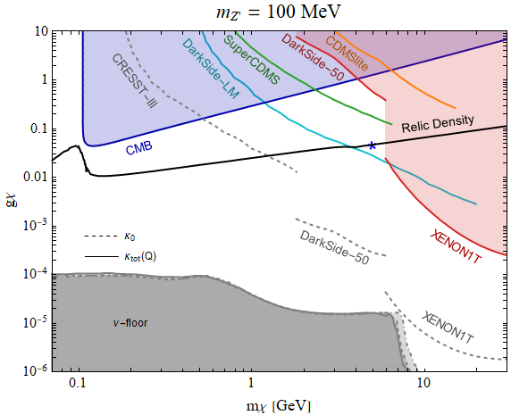
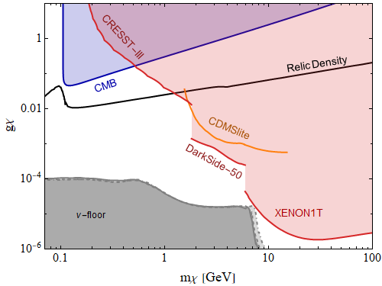

Resulting DM Parameter Space
Constant kinetic mixing limits DM mass range to < 2(1) GeV for mZ’ = 100(20) MeV
Considering running kinetic mixing loosens up the parameter space (upper bound on DM mass increased to 6 GeV)
Parameter space of DM candidate considering constant and total kinetic mixing

Slide 9

Summary + Future Work
An extension to the SM with the gauge group ${U(1)}_{L_{μ}−L_{τ}}$ can explain the observed g-2 excess.
Considering full momentum dependence of kinetic mixing in this model leads to a viable DM parameter space
Work in Progress: We expect a stronger annual modulation effect due to increased rate contribution from higher recoil energies (higher DM velocity)
Hapitas, Tuckler, Zhang, 2107.xxxxx

Slide 10
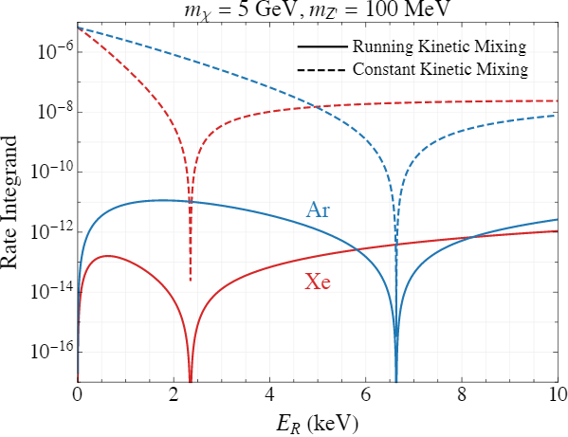

Slide 11
