Slide 1



Precision measurement of the Z-boson transverse momentum with the ATLAS detector
Ben Davis-Purcell
Supervised by Dr. Manuella Vincter
2021 CAP Congress
June 7, 2021

Slide 2

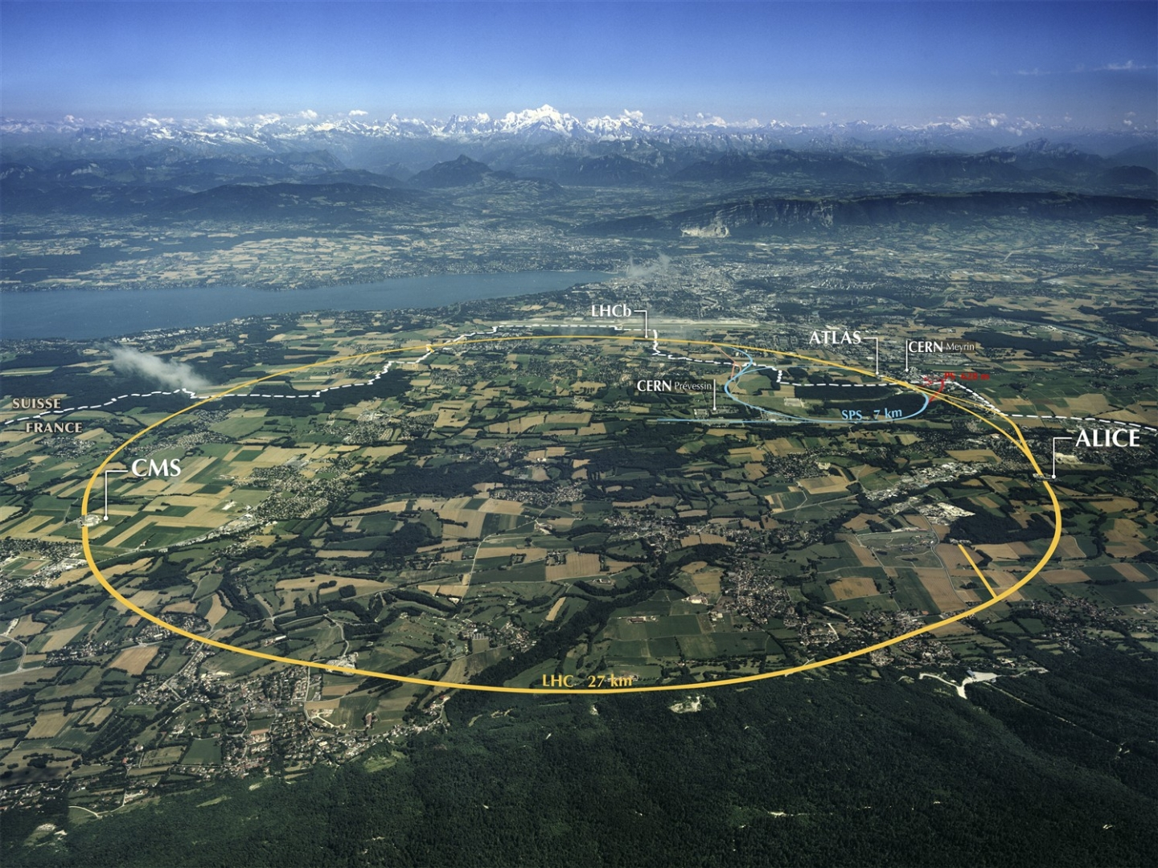



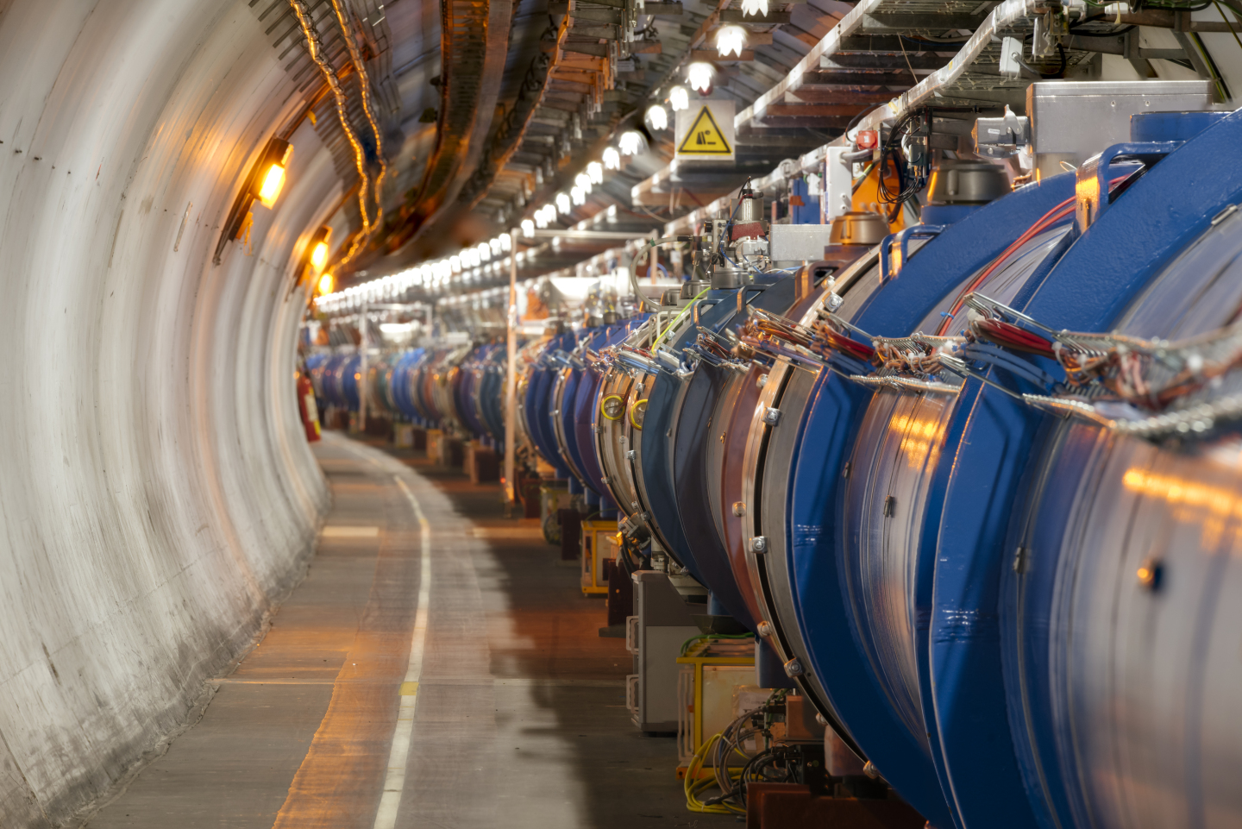
The ATLAS Experiment with the Large Hadron Collider (LHC) at CERN
LHC
C = 27 km
CERN: Huge particle physics laboratory best known for housing the LHC, the most powerful particle accelerator ever built
ATLAS: General-purpose detector that measures the properties of particles created from LHC proton-proton collisions
Collisions involve “bunches” of protons: ~100 billion protons/bunch, 1 bunch/25 ns, ~0-100 pp collisions/bunch (pileup)
2021 CAP Congress
Ben Davis-Purcell
2

Slide 3
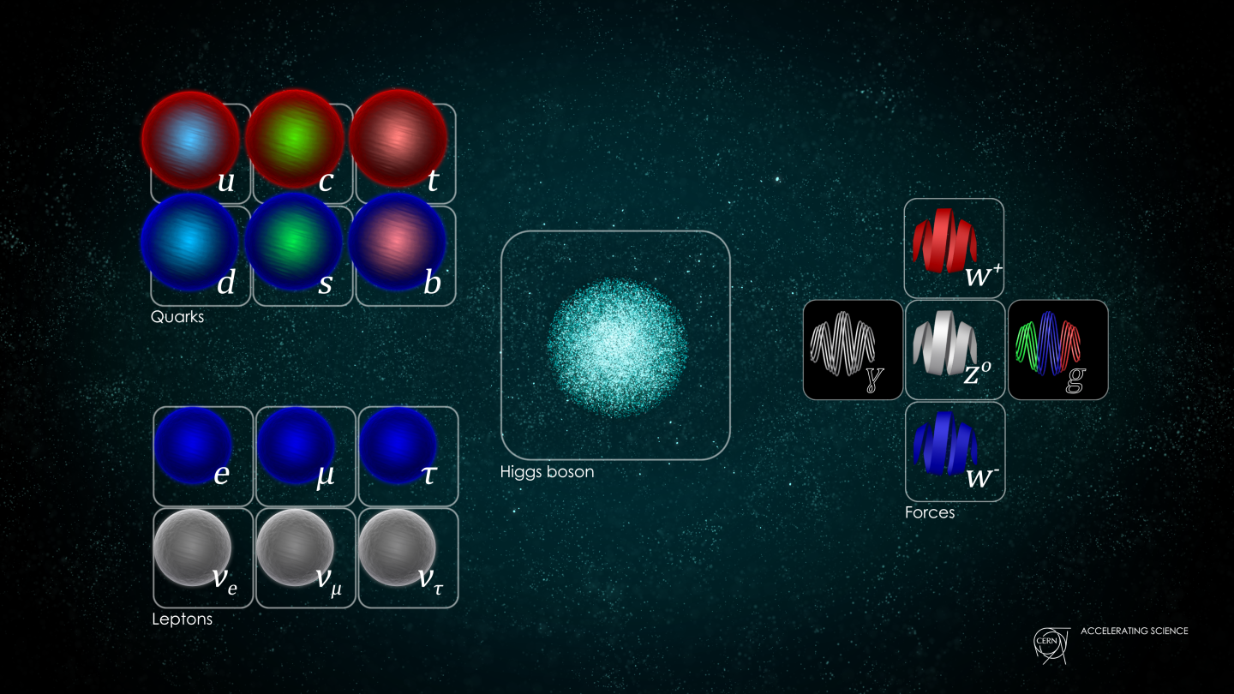
Standard Model of Particle Physics
Fermions
Bosons
Weak nuclear force
2021 CAP Congress
Ben Davis-Purcell
3

Slide 4
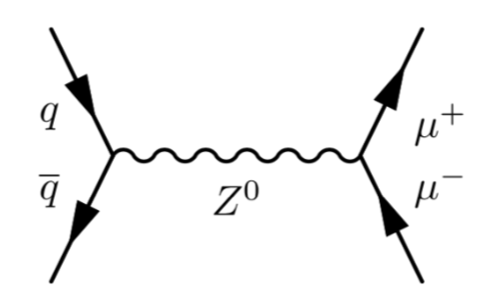
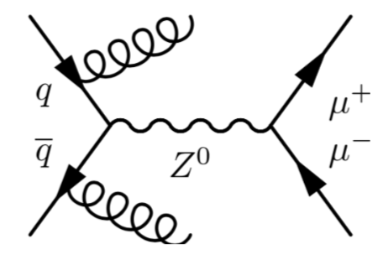


Z-boson Transverse Momentum ($p_{T}^{Z}$)
time
Beyond LO
LO
(LO schematic)
$p_{T}^{Z}$is an excellent probe of Quantum Chromodynamics (QCD) beyond Leading Order (LO)
Use this info. to better understand interactions within the proton
2021 CAP Congress
Ben Davis-Purcell
4

Slide 5
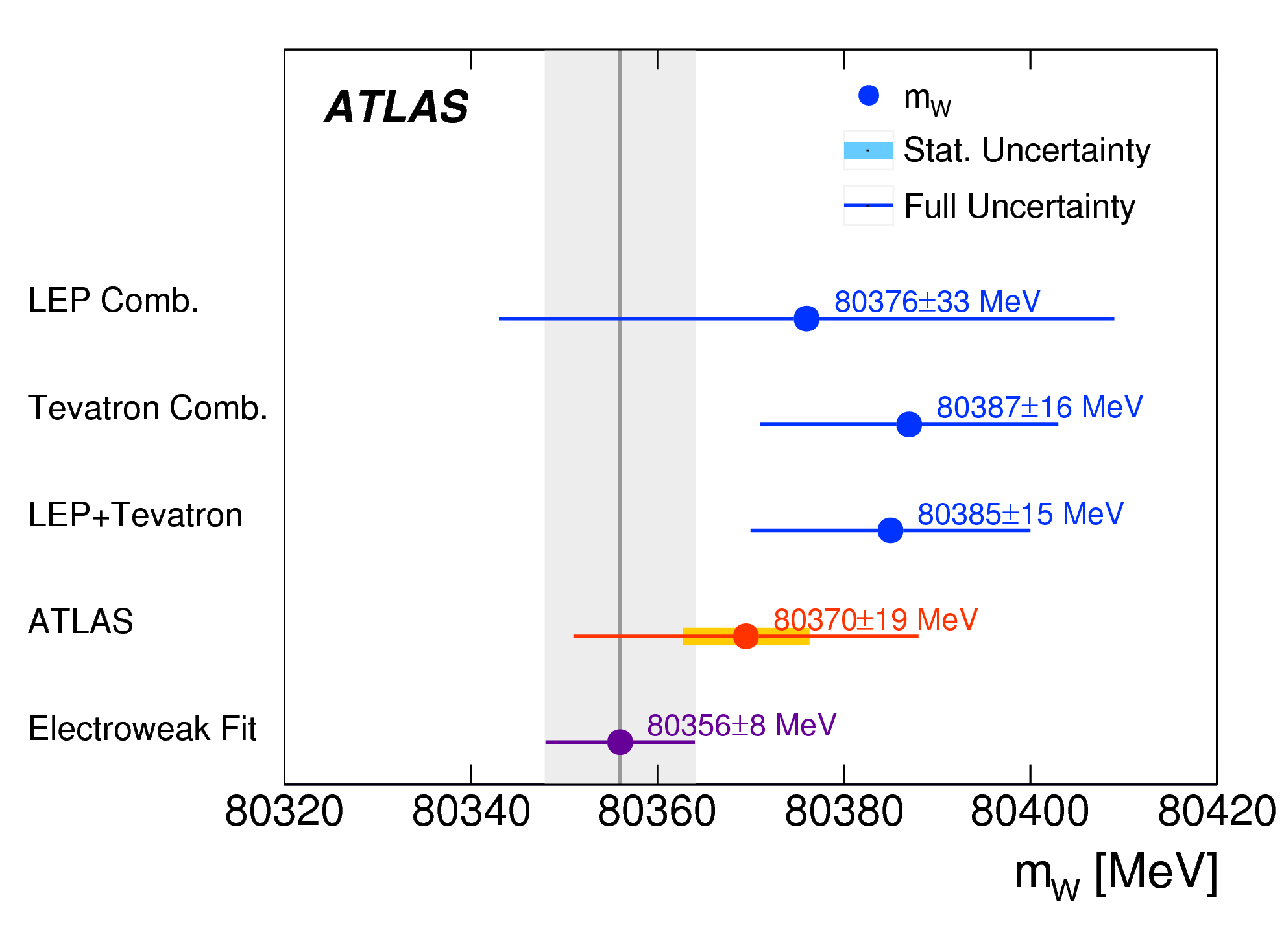


W-boson Mass Measurement (m_{W})
https://arxiv.org/abs/1701.07240
$m_{W}$ measured by fitting templates to $p_{T}^{l}$ and $m_{T}$
Measurements
Systematic uncertainties on $p_{T}^{l}$ and $m_{T}$ account for ∼50% of the measurement error on $m_{W}$
Prediction
Experiment uncertainty > theory uncertainty!
To improve m_{W} measurement, need $p_{T}^{Z}$ (and $p_{T}^{W}$) systematic uncertainties to be < 1%
2021 CAP Congress
Ben Davis-Purcell
5

Slide 6


Motivation for $p_{T}^{Z}$
LO
time
Beyond LO
Z and W have a similar decay schematically; however, we can measure electrons and muons (e±/μ±) but not neutrinos (𝜈)
Important for reducing uncertainties on the W-boson mass; $p_{T}^{W}$is required for measuring $m_{W}$, use Z-boson as a proxy to calibrate $p_{T}^{W}$
2021 CAP Congress
Ben Davis-Purcell
6
Notes:
…but why do we care about mW?

Slide 7
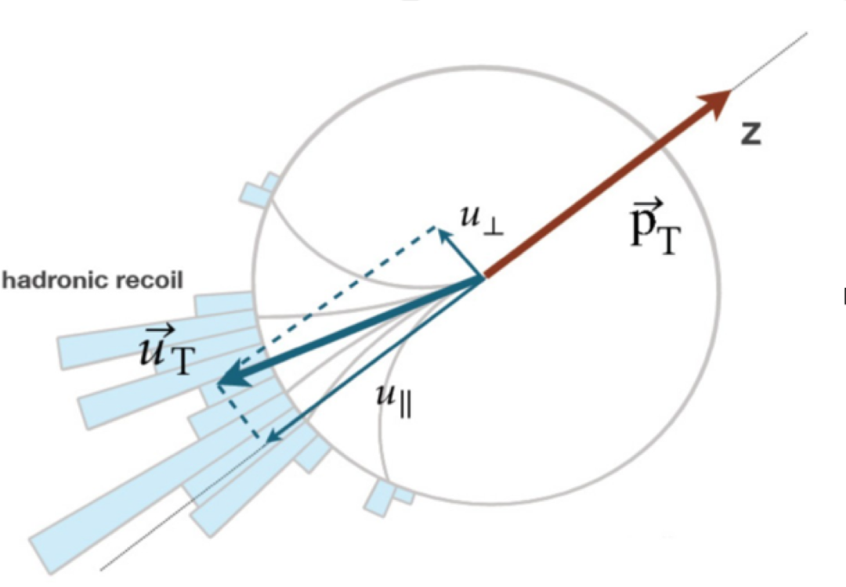
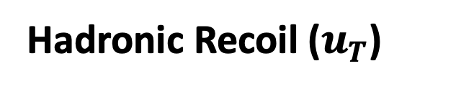




How Z Supports W
Z decay:
W decay:
Only Z ($p_{T}^{ll}$)
W & Z ($u_{T}$)
Hadronic Recoil ($u_{T}$)
Hadronic Recoil ($u_{T}$)
W/Z
$p_{T}^{ll}$ and $u_{T}$ are theoretically equal but hadronic recoil is inherently more difficult to measure
Low pileup (μ) environment improves $u_{T}$ resolution
2021 CAP Congress
Ben Davis-Purcell
7

Slide 8
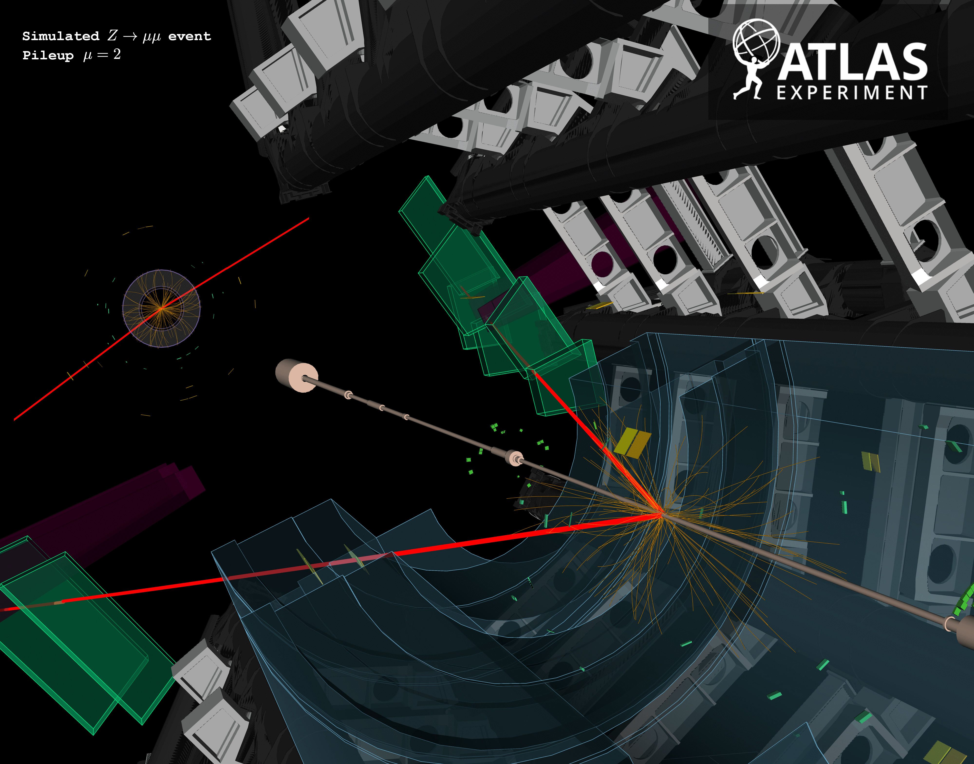
Low Pileup Environment
https://atlas.web.cern.ch/Atlas/GROUPS/DATAPREPARATION/PublicPlots/2018/DataSummary/figs/mu_2015_2018.pdf
https://twiki.cern.ch/twiki/bin/view/AtlasPublic/LuminosityPublicResultsRun2
Fewer proton-proton collisions = cleaner environment = improved $u_{T}$ measurement!
Downside: reduced statistics
2021 CAP Congress
Ben Davis-Purcell
8
Notes:
…and so how does this improve our uncertainties?

Slide 9



$p_{T}^{Z}$Measurement Uncertainties
$$p_{T}^{ll}$$
$$u_{T}$$
work-in-progress
work-in-progress
All Sys. Unc. < 1%
All Sys. Unc. < 1%
Only limited by statistics (pink) and luminosity (orange)! Systematic errors total < 1%
2021 CAP Congress
Ben Davis-Purcell
9

Slide 10



Observable Cross-Section Comparison
$$p_{T}^{ll}$$
work-in-progress
$$u_{T}$$
Example non-zero process
$p_{T}^{ll}/u_{T}$ ratio
Cross-section should be independent of observable: both $p_{T}^{ll}$ and $u_{T}$ are measures of $p_{T}^{Z}$
Excellent agreement seen, confirming the efficacy of the $u_{T}$ measurement
2021 CAP Congress
Ben Davis-Purcell
10

Slide 11




Summary
$p_{T}^{Z}$ differential cross-section measurement made at E_{CM} = 5, 13 TeV
Clean low pileup environment allows for precise measurement of hadronic recoil ($u_{T}$)
$p_{T}^{ll}$ and $u_{T}$ are compatible and both have systematic error below 1%
Finalizing precision $p_{T}^{Z}$ and $p_{T}^{W}$ measurements with low pileup data
$$p_{T}^{ll}$$
work-in-progress
$$u_{T}$$
2021 CAP Congress
Ben Davis-Purcell
11

Slide 12
Backup
Slides

Slide 13
Large Hadron Collider (LHC) at CERN
CERN: Huge particle physics laboratory near Geneva, Switzerland
Best known for housing the LHC, the most powerful particle accelerator ever built
LHC: 27 km circumference ring that accelerates and collides protons to 0.99999999 x (the speed of light), recreating the energy density of less than one billionth of a second after the Big Bang!
r = 4.3 km
2021 CAP Congress
Ben Davis-Purcell
13

Slide 14
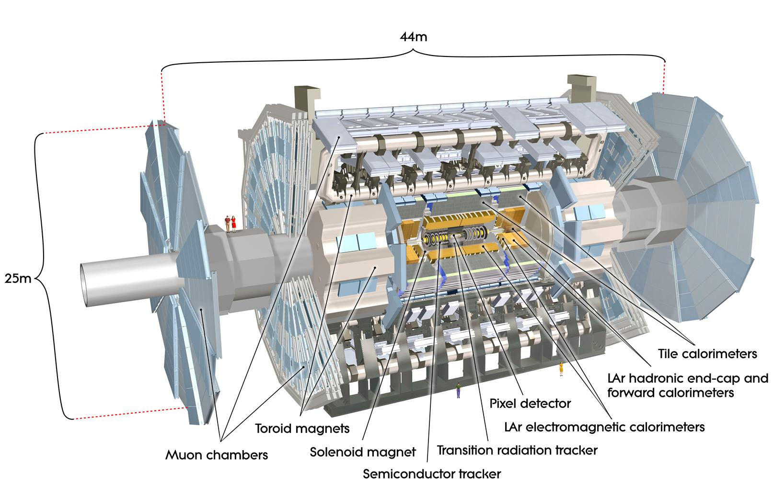
The ATLAS Experiment
General-purpose detector designed to measure the properties of the particles created from the LHC proton-proton collisions
LHC collides “bunches” of protons: about 100 billion protons per bunch; 1 bunch every 25 ns; multiple collisions per bunch: **pileup**
More than 1 billion particle interactions in the detector every second!
Proton bunch interaction point
LHC proton beam direction
z-axis
2021 CAP Congress
Ben Davis-Purcell
14

Slide 15
Performance
Measurements
Measurements
Does this algorithm work well?
Example: new machine learning technique accurately reproduces a previous result
“Known” Processes
Can we measure this for the first time?
Example: first measurement of light-by-light scattering
Searches
Analyses
Precision Measurements
Does this new process/particle exist?
Example: looking for dark matter particles within the ATLAS dataset
Can we reduce the error bars for this well-known property/process?
Example: more data improves the precision of the W-boson mass by reducing the stat. uncertainty, constraining the Standard Model
2021 CAP Congress
Ben Davis-Purcell
15

Slide 16
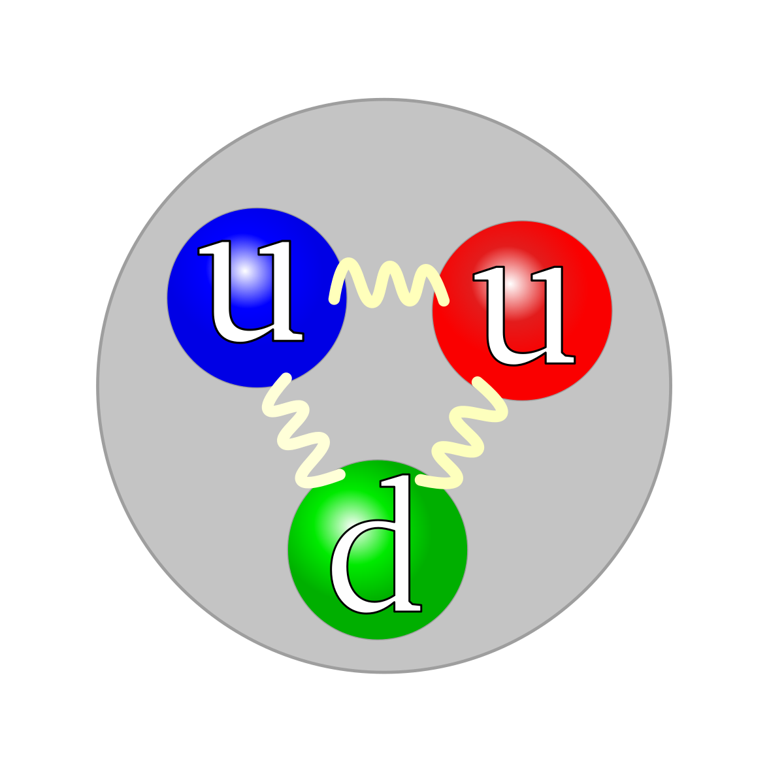
Measurement of the Z-boson Transverse Momentum (p_{T}^{Z})
2021 CAP Congress
Ben Davis-Purcell
16

Slide 17
Measurement of the Z-boson Transverse Momentum (p_{T}^{Z})
2021 CAP Congress
Ben Davis-Purcell
16

Slide 18
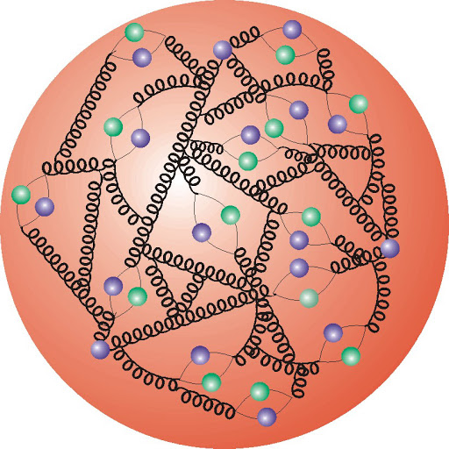
Measurement of the Z-boson Transverse Momentum (p_{T}^{Z})
2021 CAP Congress
Ben Davis-Purcell
16

Slide 19
Measurement of the Z-boson Transverse Momentum (p_{T}^{Z})
At first glance, by momentum conservation we would expect p_{T}^{Z} = 0!
2021 CAP Congress
Ben Davis-Purcell
16

Slide 20
Normalized Differential Cross-Section
work-in-progress
2021 CAP Congress
Ben Davis-Purcell
17

Slide 21
Lepton channel cross-section comparison
work-in-progress
Cross-section should be independent of lepton channel due to lepton universality
Good agreement seen between channels
2021 CAP Congress
Ben Davis-Purcell
18

Slide 22


Measurement Uncertainties @ 5 TeV
$$p_{T}^{ll}$$
$$u_{T}$$
work-in-progress
work-in-progress
2021 CAP Congress
Ben Davis-Purcell
19

Slide 23
Lepton channel cross-section comparison
Observable cross-section comparison
work-in-progress
work-in-progress
E_{CM} = 5 TeV
2021 CAP Congress
Ben Davis-Purcell
20

Slide 24
Normalized Differential Cross-Section
work-in-progress
2021 CAP Congress
Ben Davis-Purcell
21

