Slide 1
TUCAN EDM
TRIUMF Ultra-Cold Advanced Neutron project
Jeff Martin
TUCAN Collaboration
IPP Townhall, July 16, 2020

Slide 2
Physics of Neutron Electric Dipole Moment
Search for new sources of CP violation beyond the standard model.
Motivated by:
  SUSY CP problem / new TeV-scale physics
  Baryogenesis scenarios, e.g. electroweak
  baryogenesis
  Strong CP problem / Peccei-Quinn, axions
Ancillary measurements:
  Precision clock comparison (axionlike particles, Lorentz violation,
  background cosmic field, …)
  Time-dependent EDM’s (axionlike dark matter)
Frequency measurement requiring lots of neutrons and stable magnetic field

Slide 3
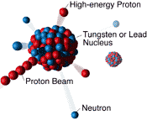
Neutron EDM – experimental status and TUCAN goal
New result for free neutrons:
d_{n} < 1.8 x 10⁻²⁶ e-cm (90% c.l.)
  PSI nEDM experiment, C. Abel et al., Phys. Rev. Lett. 124, 081803 (2020).
Many groups pursuing δd_{n} ~ 10⁻²⁷ e-cm measurement as next step (TUCAN goal). (See backup slides for list of EDM experiments and UCN sources.)
Main unique features of TUCAN:
  Spallation driven, superfluid helium source – unique combination
  Room-temperature EDM apparatus using dual measurement cell in MSR, unique ideas in magnetometry, coils, possible Xe comagnetometer, …

Slide 4

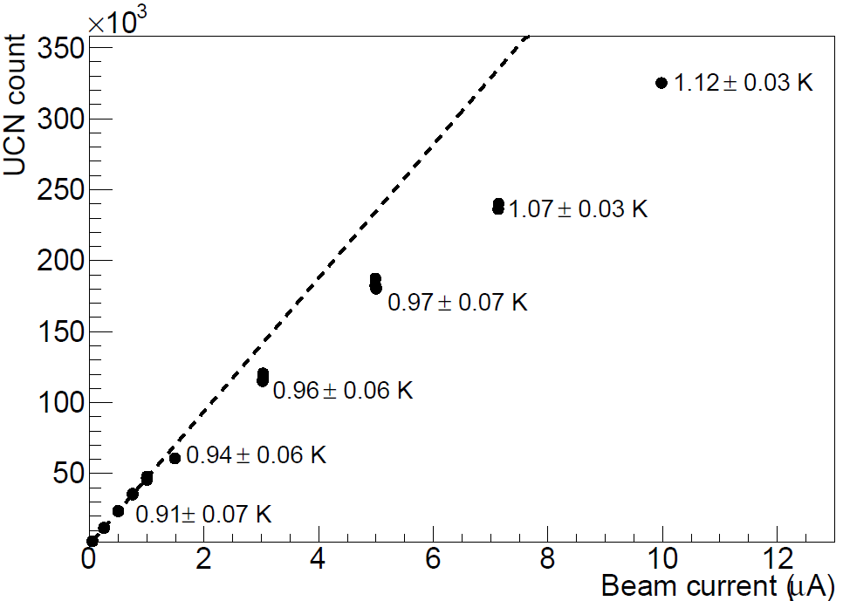
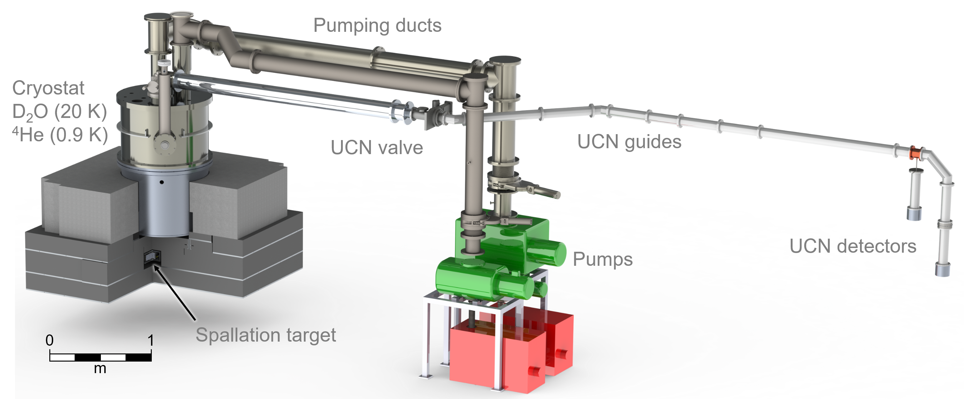
Recent highlights
protons
UCN source prototype operated at TRIUMF
  TUCAN Collab., PRC 99, 025503 (2019).
Proton beamline in operation
  TUCAN Collab., NIM A 927, 101 (2019).
  TUCAN Collab., PRAB 22, 102401 (2019).
Technical papers on neutron moderation, magnetic fields, sensors, comagnetometry, UCN detectors.

Slide 5
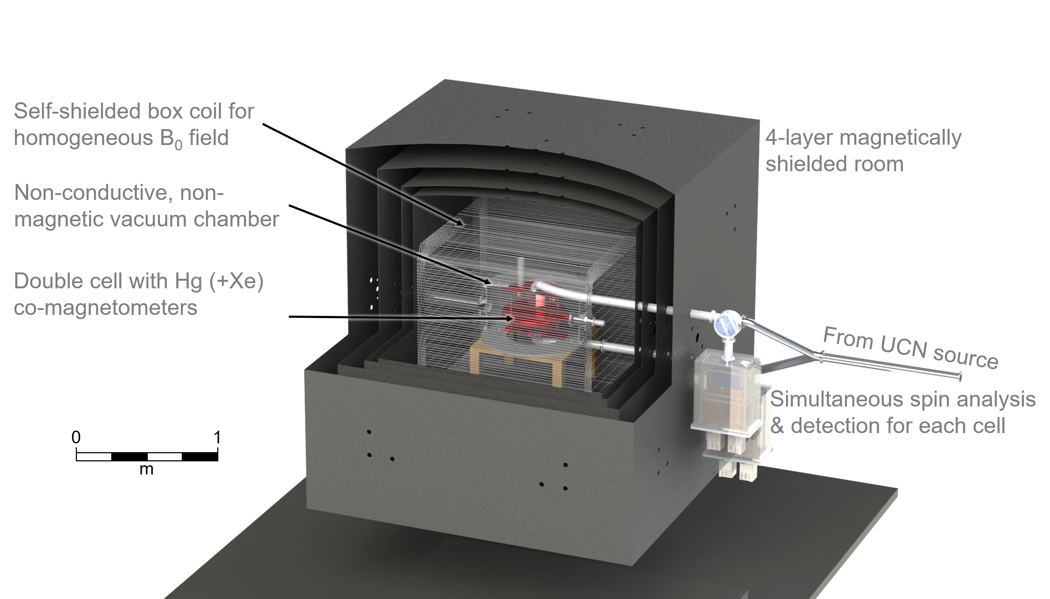
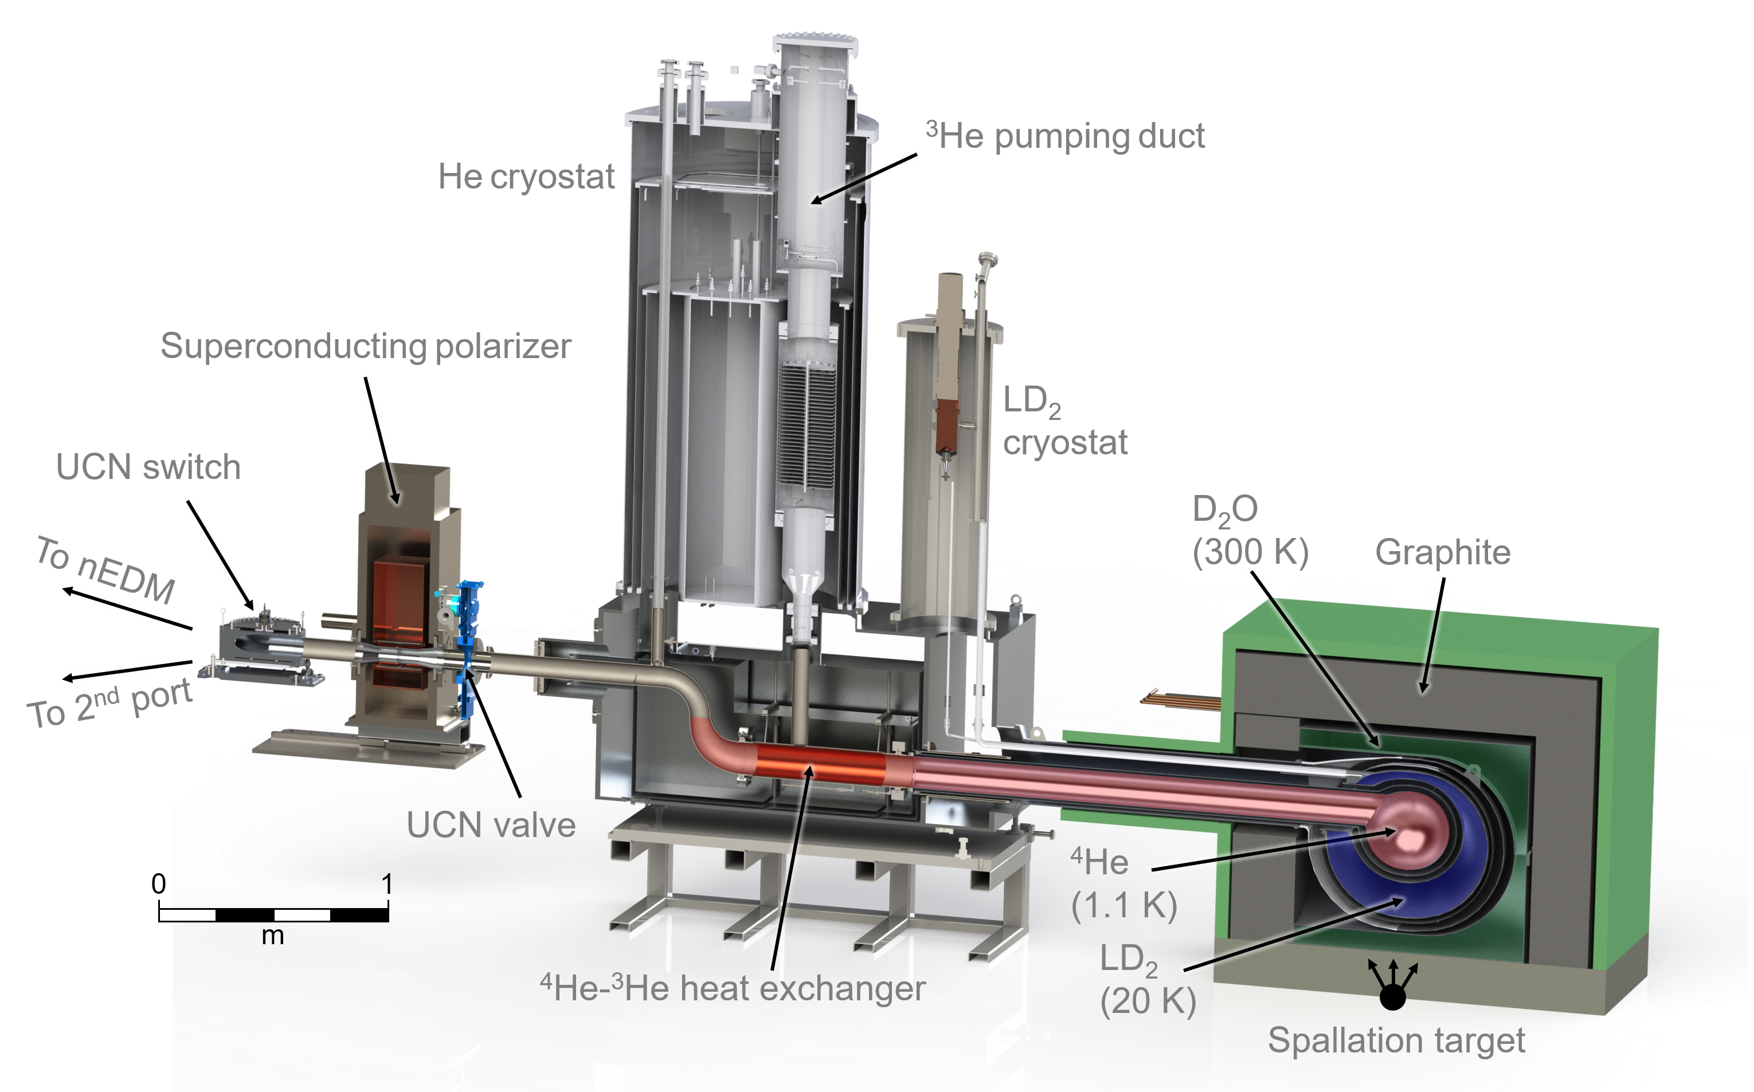
Plans for next five years
2021-22: UCN source installation and commissioning
2022: MSR installation, begin precision magnetometry in situ
2023: nEDM commissioning, thereafter data-taking
Helium liquefaction upgrade in Meson Hall needed to reach full sensitivity

Slide 6
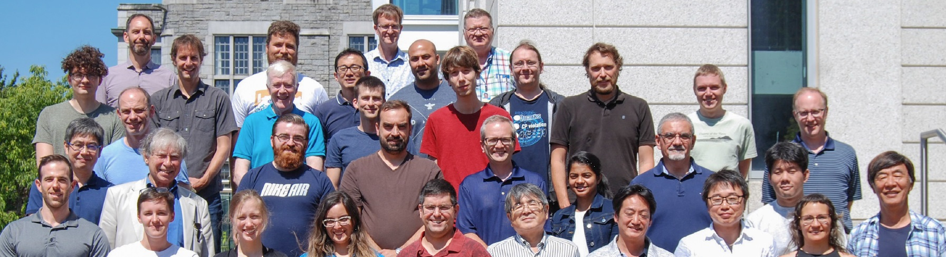
Collaboration, budgetary, and HQP
Japan-Canada collaboration
Source upgrades and EDM experiment funded by CFI IF 2017 award and JSPS (and TRIUMF, provinces, industry in-kind)
14 NSERC cosignatories, 5.95 FTE
  $550k/yr from NSERC SAPES
  $101k/yr from CRC Tier 1 award (till 2025)
  Supports 4 PDF and 8 grad students, constrained travel.
Ideal support would allow 5 PDF and 14 grad students, and travel.
Supportive environment for women, Indigenous students
Examples:
  B. Franke supervision/support of women students, TRIUMF role in promoting diversity and hiring women scientists.
  Winnipeg supervision of Indigenous students, development of new Indigenous programs, university-wide priority of “Indigenization”

Slide 7
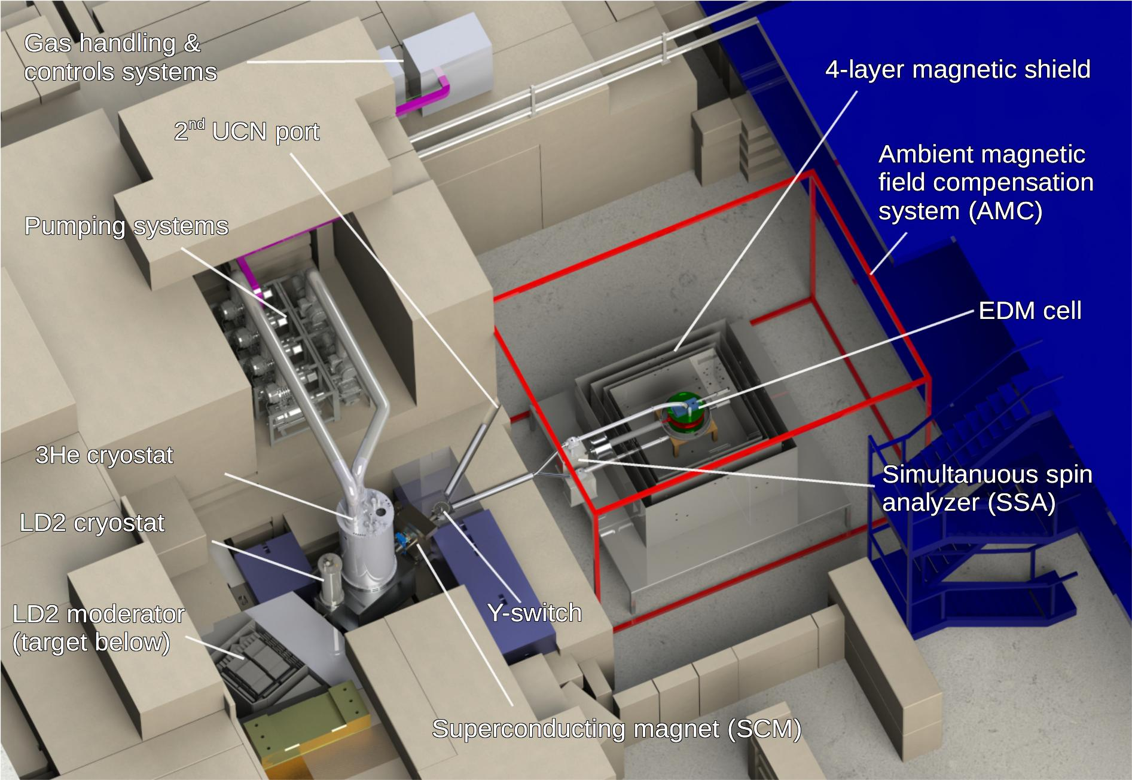
Plans for 2027-36
EDM data analysis and possible additional data taking
Upgrades to UCN source or EDM experiment
  E.g. Xe comagnetometer
User space
UCN source designed as user facility with second port available for other experiments:
  Neutron lifetime puzzle
  Neutron gravity levels experiment
  Exotic interactions
  Bring your ideas!

Slide 8
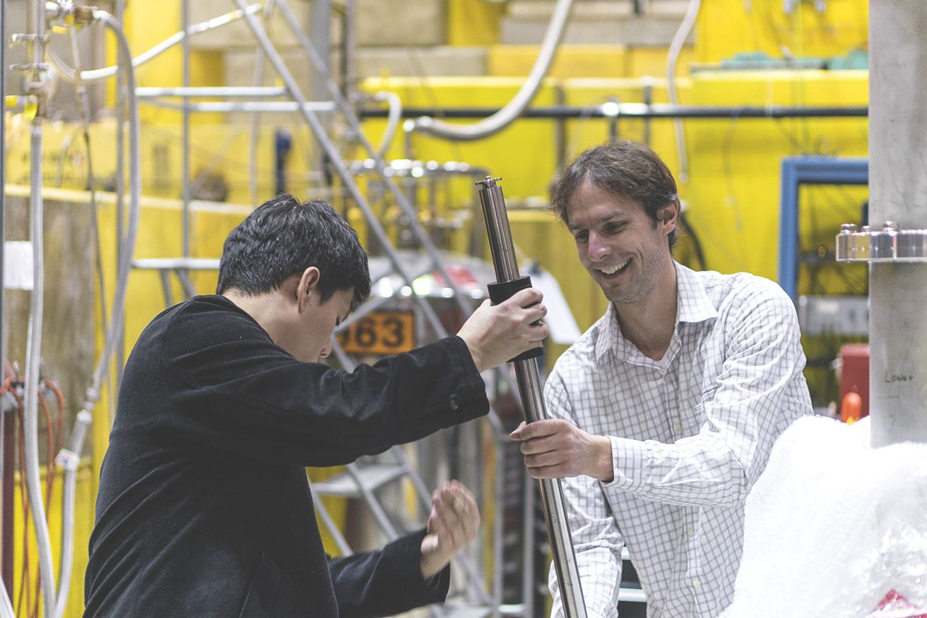
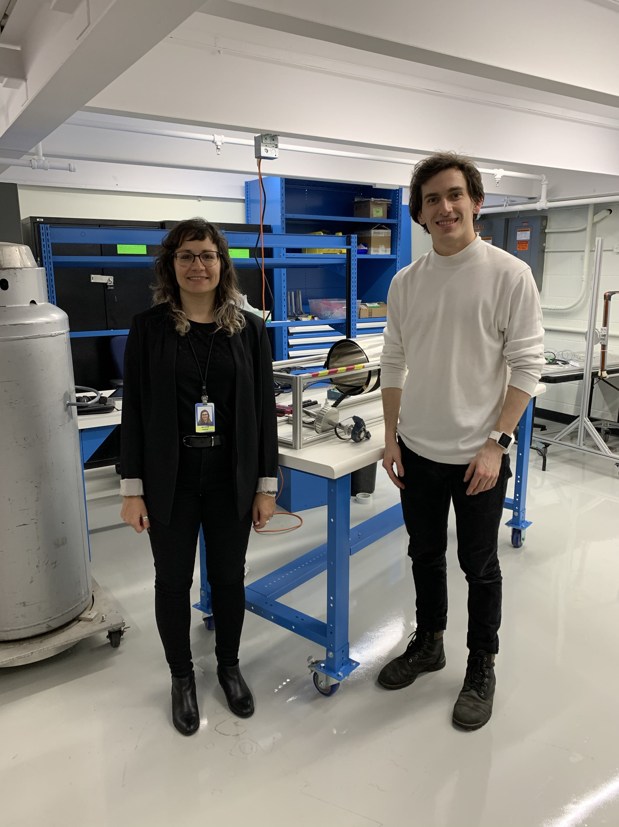
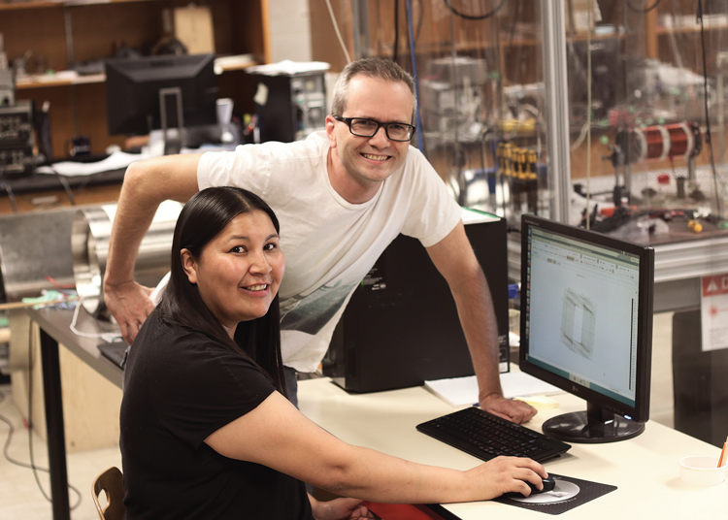
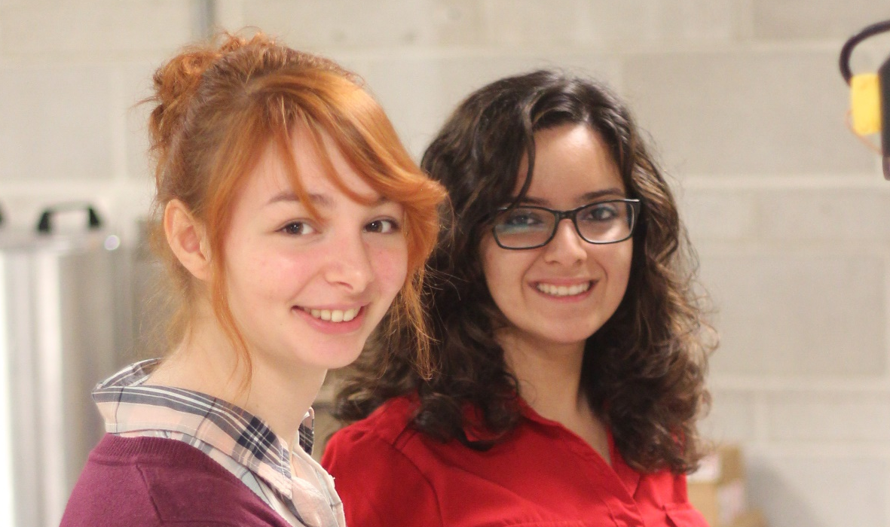
Broader societal impacts
Technology development and training in:
  Beamline design, target design
  neutron physics, neutron and radiation detectors, cryogenics
  magnetometry, low-field NMR, laser physics
  high-voltage design
  data-acquisition systems, and computer simulation.

Slide 9
Opportunities for collaboration, and physical distancing
Based on examples from R&D, there are many opportunities for university involvement:
  UCN detector development and testing (Winnipeg, Manitoba)
  UCN source cryogenics (Winnipeg, Manitoba)
  UCN guide coating facility (Winnipeg)
  CN experiment analysis (Winnipeg, KEK)
  Hg comagnetometer development (UBC)
  Cs magnetometer development and testing (Winnipeg, Manitoba)
  Internal coil design (Winnipeg, Manitoba)
  External coil design (RCNP Osaka)
  Beam physics and magnetic mapping (UBC students)
Each has students and/or university-based PDF/RA involved.
Running at TRIUMF:
  Ran the prototype UCN source one month per year 2017-2019.
  Cryogenic testing of the UCN source upgrade at TRIUMF over the next two years. Expect two PhD’s (UBC, Manitoba) focused on cryogenic aspects.
  UCN production from upgraded source 2022.
  Magnetically shielded room installed 2022 will serve as focal point for magnetic and sensor testing.
  EDM commissioning/running 2023 and beyond.
  Future projects.
Good opportunity to get involved now in local particle physics project at TRIUMF.

Slide 10
Conclusions
Strong physics interest with tight constraint placed on CP violation.
Highly competitive field with many new ideas, technologies.
Next generation of experiment aims at 10⁻²⁷ e-cm uncertainty, order of magnitude improvement on recent new limit from PSI.
TUCAN has made good progress making first UCN at TRIUMF using unique superfluid helium UCN source
TUCAN source upgrade and EDM experiment installation ongoing, commissioning, running, and analyzing data into the future.
User facility for other projects (neutron lifetime, gravity levels, exotic interactions…), collaborators welcome!

Slide 11
Backups

Slide 12
TUCAN Collaboration
B. Bell^{1,2}, C. Bidinosti³, C. Davis², B. Franke^{2,4}, M. Gericke⁵, P. Giampa²,
S. Hansen-Romu⁵, K. Hatanaka⁶, T. Hayamizu⁷, T. Higuchi⁶, G. Ichikawa⁸,
S. Imajo⁶, B. Jamieson³, S. Kawasaki⁸, M. Kitaguchi⁹, W. Klassen⁵, A. Konaka²,
E. Korkmaz¹⁰, F. Kuchler², M. Lang⁵, M. Lavvaf⁵, T. Lindner^{2,3}, K. Madison⁴,
Y. Makida⁸, R. Mammei³, J. Mammei⁵, J. Martin³, R. Matsumiya², M. McCrea³,
E. Miller⁴, K. Mishima⁸, T. Momose⁴, T. Okamura⁸, H. J. Ong⁶, R. Picker^{2,11},
W. D. Ramsay², W. Schreyer², H. Shimizu⁹, S. Sidhu^{11,2}, S. Stargardter⁵,
I. Tanihata⁶, S. Vanbergen^{4,2}, W. van Oers^{2,5}, Y. Watanabe⁸, N. Yamamoto⁹
1. McGill, 2. TRIUMF, 3. Winnipeg, 4. UBC, 5. Manitoba, 6. RCNP Osaka,
7. RIKEN, 8. KEK, 9. Nagoya, 10. UNBC, 11. SFU
Spokespeople: K. Hatanaka (Japan), J. Martin (Canada)

Slide 13
Heritage of EDM’s – how New Physics enters
d_{n} < 1.8 x 10⁻²⁶ e-cm (PSI nEDM collab.)
d_{n} < 1.6 x 10⁻²⁶ e-cm (U. Wash Hg-199)
d_{e} < 1.1 x 10⁻²⁹ e-cm (ACME ThO)
Figure: M. Pospelov & A. Ritz, Ann. Phys. 318, 119 (2005).
See also: J. Engel, M. Ramsey-Musolf, U. van Kolck, Prog. in Part. and Nucl. Phys. 71, 21 (2013).
T. Chupp, P. Fierlinger, M. Ramsey-Musolf, and J. Singh, Rev. Mod. Phys. 91, 015001 (2019).

Slide 14
Planned Neutron EDM Experiments around the World
PSI spallation so-D₂, magnetic fields analysis/upgrading
PanEDM (ILL/Munich) reactor He-II, 1st MSR commissioning
ILL/PNPI/Gatchina dual cell, 2nd best nEDM meas’t upgrading
LANL spallation so-D₂ UCN source 2021-
TUCAN (Japan/Canada) spallation He-II, MSR upgrading, 2022-
SNS fully cryogenic source/experiment 2023-
ILL/ESS n-beam intense pulsed neutron beam R&D, 2025-
J-PARC crystal high E in crystal R&D

Slide 15
Survey of UCN Sources Worldwide
Place | Neutrons | UCN converter | Status
ILL | Reactor, CN | Turbine | Running
J-PARC | Spallation | Doppler shifter | Running
ILL SUN-2 | Reactor, CN | Superfluid He | Running
ILL SuperSUN | Reactor, CN | Superfluid He | Future
RCNP/KEK/TRIUMF | Spallation | Superfluid He | Running/Upgrading
Gatchina WWR-M | Reactor | Superfluid He | Future
LANL | Spallation | Solid D2 | Running/Upgrading
Mainz | Reactor | Solid D2 | Running
PSI | Spallation | Solid D2 | Running/Upgrading
NCSU Pulstar | Reactor | Solid D2 | Installing
FRM-II | Reactor | Solid D2 | Future
KEK-TRIUMF combination of spallation target and superfluid helium is unique.
Upgrade schedule is competitive with other leading sources of UCN.

