Slide 1
SAP technical support
F. Retière [TRIUMF] representing (a fraction of) the technical support community

Slide 2
Overall technical SAP support sources
Cutting edge technical expertise is an absolute necessity to the success of SAP project requiring advanced instrumentation
Recruiting on a per-project basis is highly inefficient:
  Risky – Finding the “right” person is challenging
  Training required
  Limited team dynamic
Alberta MRS
Carleton Uvic Winnipeg MRS
Université de Montreal MRS
McDonald Institute
  Phasing out by 2023
TRIUMF
  Science Technology department
  P&S in Physical Science Division
  Engineering division
SNOLAB

Slide 3
U. Alberta – Toronto CPP+ MRS team
Richard Soluk (detector technologist)
Paul Davis (electronics engineer)
Mircea Cadbaschi (engineer)
Chris Ng (engineer)
And wide ranging capabilities at UofA
  http://cpp-plus.physics.ualberta.ca/

Slide 4
U. Alberta – Toronto CPP+ recent projects
ATLAS LUCID
ATLAS Forward proton
ATLAS-LUCID
MOEDAL-MAPP (complete detector)
DEAP-3600 and
DarkSide-20k
PICO-40, PICO-500 and Scintillating bubble chambers
SNO+
P-ONE
ATLAS Forward proton

Slide 5

Carleton Technical Team (MRS Supported)
Personnel
  James Botte and Olay Chen:
  Electronics Specialist and Electronics Technician
    analog and digital readout systems, power supplies, equipment certification
    soldering, circuit design, cabling, system modeling and control
  Philippe Gravelle
  Machinist/Technician - precision small parts fabrication, welding, vacuum/gas system cleaning and assembly, leak-checking
  Rodney Schnarr
  Designer - 3-D modeling, concept development, detailed design drawings for fabrication (e.g. CNC), as-built drawings, FEA calculations
  a working closely with McDonald Institute and SNOLAB engineers based at Carleton
Facilities and Equipment
  machine shop, electronics lab, clean rooms, vacuum and gas handling equipment (Swagelok, VCR, Conflat, KF, custom), electronics and DAQ
  (NIM, VME, LabView), silicon pixel telescope
Carleton Science and Technology Centre (STC) https://carleton.ca/stc/

Slide 6
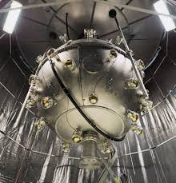
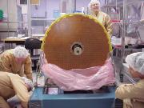
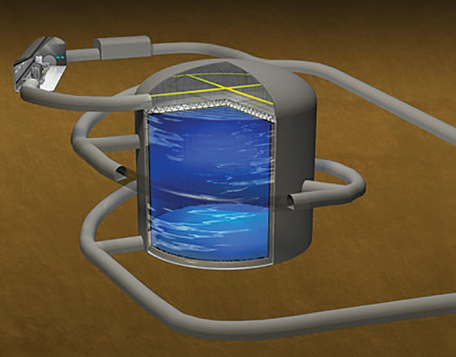
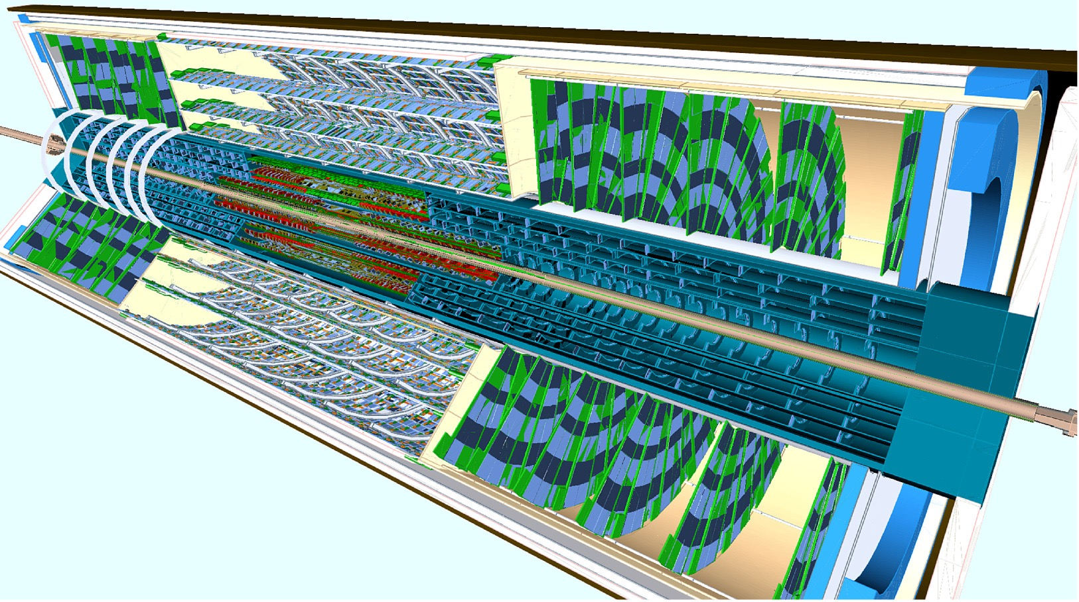

Carleton Technical Team
For more than 20 years, the Carleton Technical Team has been contributing to subatomic physics via R&D, Testing, Large-Scale Assembly and Delivery, and Maintenance of particle detector systems for a variety of projects in Canada and around the world.
Select projects that have been supported:
EXO
DEAP
ATLAS
FCAL
sTGC
ARIEL
Hyper-Kamiokande
ITK

Slide 7
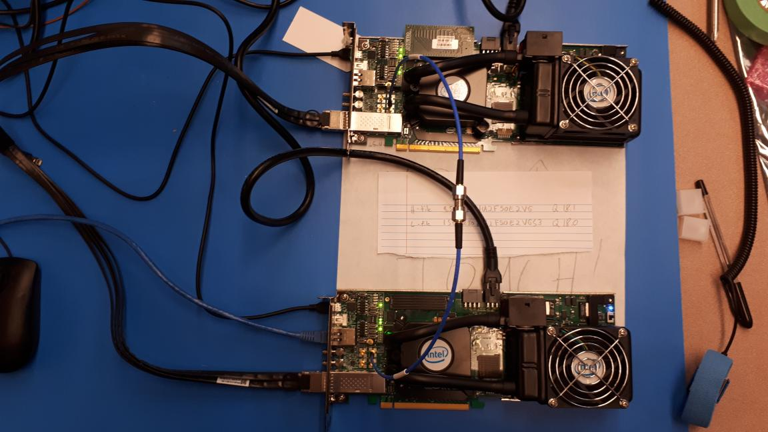
University of Victoria Instrumentation Laboratory May 2020
Randall Sobie
Detector physicist: Sam de Jong (2017-present)
PhD research: designed, assembled, and commissioned thermal neutron detector system using tubes of helium-3 for the Belle II experiment
Current work: FPGA program development for ATLAS LAr Calorimeter and Belle II
Expertise: GEANT4 detector simulation, DAQ software, digital electronics
Resources at the University of Victoria:
Clean room, vacuum test equipment, local machine shop, electronics shop and general laboratory space
https://www.uvic.ca/science/physics/vispa/research/resources/index.php

Slide 8

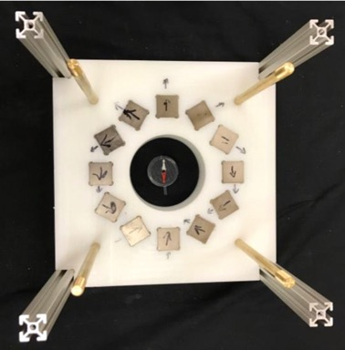

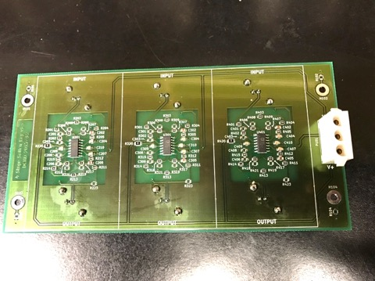
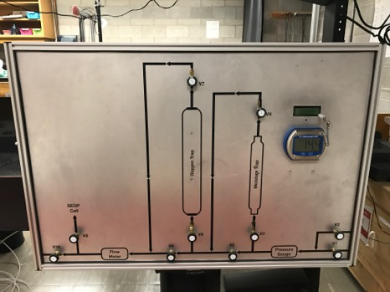
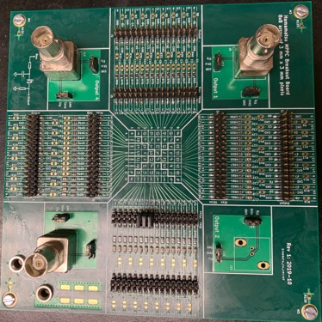
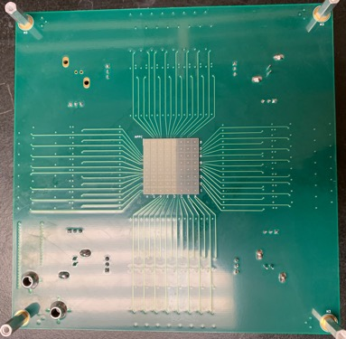
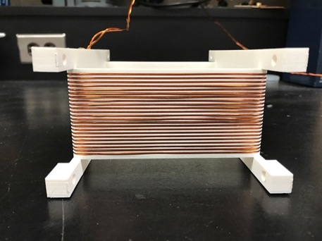
Winnipeg NSERC SAP MRS Resource
For examples of past projects supported by David Ostapchuk see:
www.uwinnipeg.ca/physics/research/nserc-funded-sap-mrs-technician.html
Technician: David Ostapchuk (MSc Physics)
General detector fabrication support
  Electronics PCB, simple machine work, 3D printing, laser cutting
  Access to North Forge Fabrication Lab (www.northforge.ca)
  Larger machined parts contracted out to local machine shops
Resource allocated by UVic/Carleton/UWinnipeg allocation board
Halbach array for polarized Xe
(TUCAN comagnetomter)
Butterworth filters for TUCAN
Gas panel for Xe project
MPPC Breakout board for EMPHATIC
Spin-flipper coil for TUCAN

Slide 9
Université de Montreal
MRS personel
  Jean Soucy - Head of machine shop
  Chen-Chao Wen- Software and system expert
  Hongfei Cao - Electronics technician
  Nikolai Starinsky (50% MRS) – Engineering physics
  Tomy Arial (50% MRS) – Mechanical workshop
  Louis Godbout (20% MRS) – Ion beam facility
Facilities
  Machine shop
  Instrumentation design and prototyping
  Ion beams for testing, calibration and radiation damage

Slide 10
TRIUMF Science Technology department
Physics Instrumentation group
  L. Kurchaninov (front end elec.)
  A. Sher (MC and FEA simulations)
  A. Sorokin (Elec. R&D tech)
Detector facility
  J. Blanco (Mech. tech.)
  P. Lu (Det. Phys./eng.)
  R. Henderson (Det. Phys./eng. - head)
  R. Maharaj (Mech. Tech.)
  N. Massacret (Det. Phys./eng.)
  I. Nikonov (Mech. Eng.)
Detector facility shop
  C. Chan (fabrication tech.)
  C. Lim ()
  Y. Zielinski (machinist)
Electronics Development
  D. Bishop (Elec. hardware – head)
  M. Constables (Elec./Mech. integration)
  Y. Lin (FPGA)
  P. Margetak (Elec. Hardware – MI)
  C. Pearson (FPGA)
  B. Shaw (FPGA)
Data Acquisition
  P-A. Amaudruz (System eng. - head)
  T. Lindner (DAQ system)
  K. Olchanski (computing infrastructure)
  B. Smith (User interface)
And research scientists, B. Franke,
N. Hessey (Phys. Inst. Group head and deputy),
F. Retiere (department head)

Slide 11
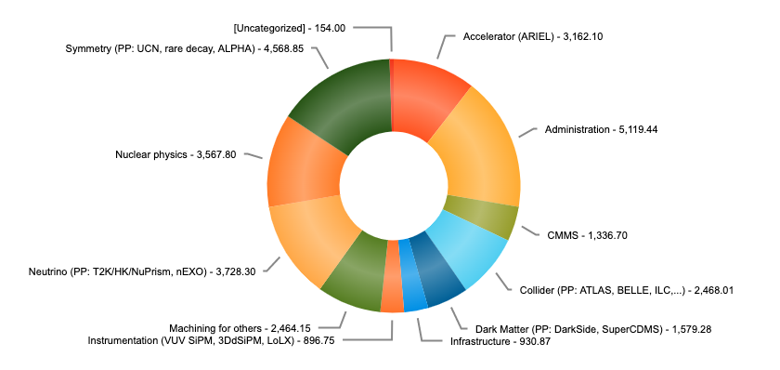
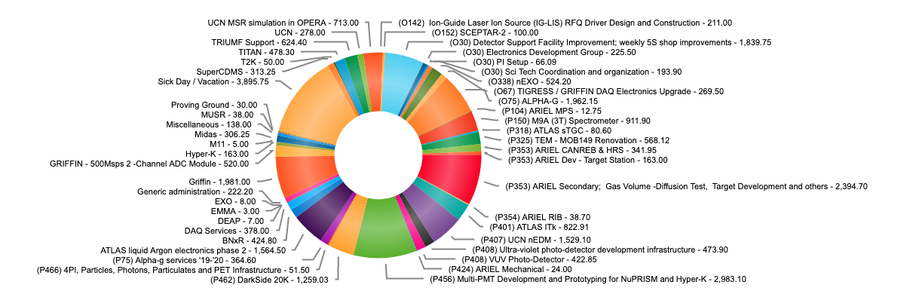
TRIUMF Sci Tech recent projects
Project list since early 2020
Sorted by type
Project list since early 2020
Sci Tech primary mandate is to support the SAP community
Focus on development and not operation

Slide 12
Management structures
Carleton-UVic-Winnipeg a prioritization board
  Reorganized early 2020 to make it more manageable (fewer members)
  Kevin Graham (Carleton manager), Randie Sobie (Uvic manager), Blair Jamieson (Winnipeg manager), Garth Huber (CINP), Mike Roney (IPP), Miriam Diamond (Toronto) and Fabrice Retiere (TRIUMD, chair)
CPP+ (Alberta, Toronto) operating committee
  Alberta [Hallin, Krauss, Pinfold (Chair)], Carleton [Boulay], Queen’s [Chen, Noble], Regina [Huber], Toronto [Orr, Trischuk]
TRIUMF Science Technology department
  Project selection/prioritization by TRIUMF management
  Sci Tech management responsibility on implementation of selected projects
    In practice fair bit of flexibility for small projects

Slide 13
Moving towards pan-Canadian coordination
Pros:
  Cross-institution is a requirement for NSERC MRS
  Maximize utilization of the resources
    the right person for the right job – i.e. foster specialization
Cons:
  less institutional control
Steps forward for 2020
  Cross membership of boards and management structures
  Setting up technical level communication channel
    Share expertise
    Share knowledge of who can do what
    Group setup at TRIUMF to support this effort – virtual meeting soon
Eventually… Single board?

Slide 14
New user/request always welcome
Alberta CPP+, contact Jim Pinfold, pinfoldster@gmail.com
Université de Montreal, contact Jean-Pierre Martin jpmartin@lps.umontreal.ca
Carleton Uvic Winnipeg, submit https://particlephysics.ca/wp/wp-content/uploads/Major-Resources-Support-request-form.pdf to Kevin Graham dr.kevin.graham@gmail.com
TRIUMF Science Technology dept https://www.triumf.ca/science-technology/support-request

