Slide 1



Spatial and time-resolved characterization of HiPIMS spokes
Alex Chang, Lénïac Couêdel, Michael Bradley
Department of Physics and Engineering Physics
2020 CAP Congress DPP
June 2020

Slide 2
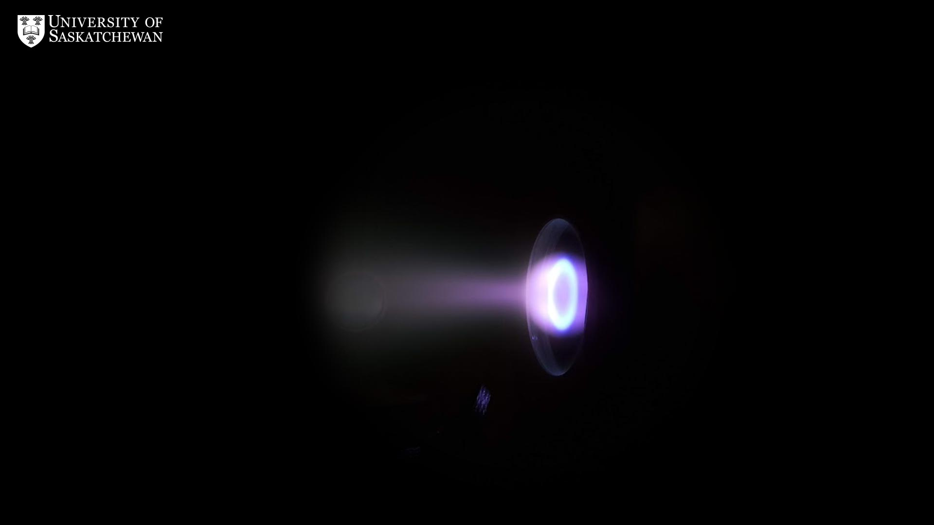

Slide 3


Slide 4
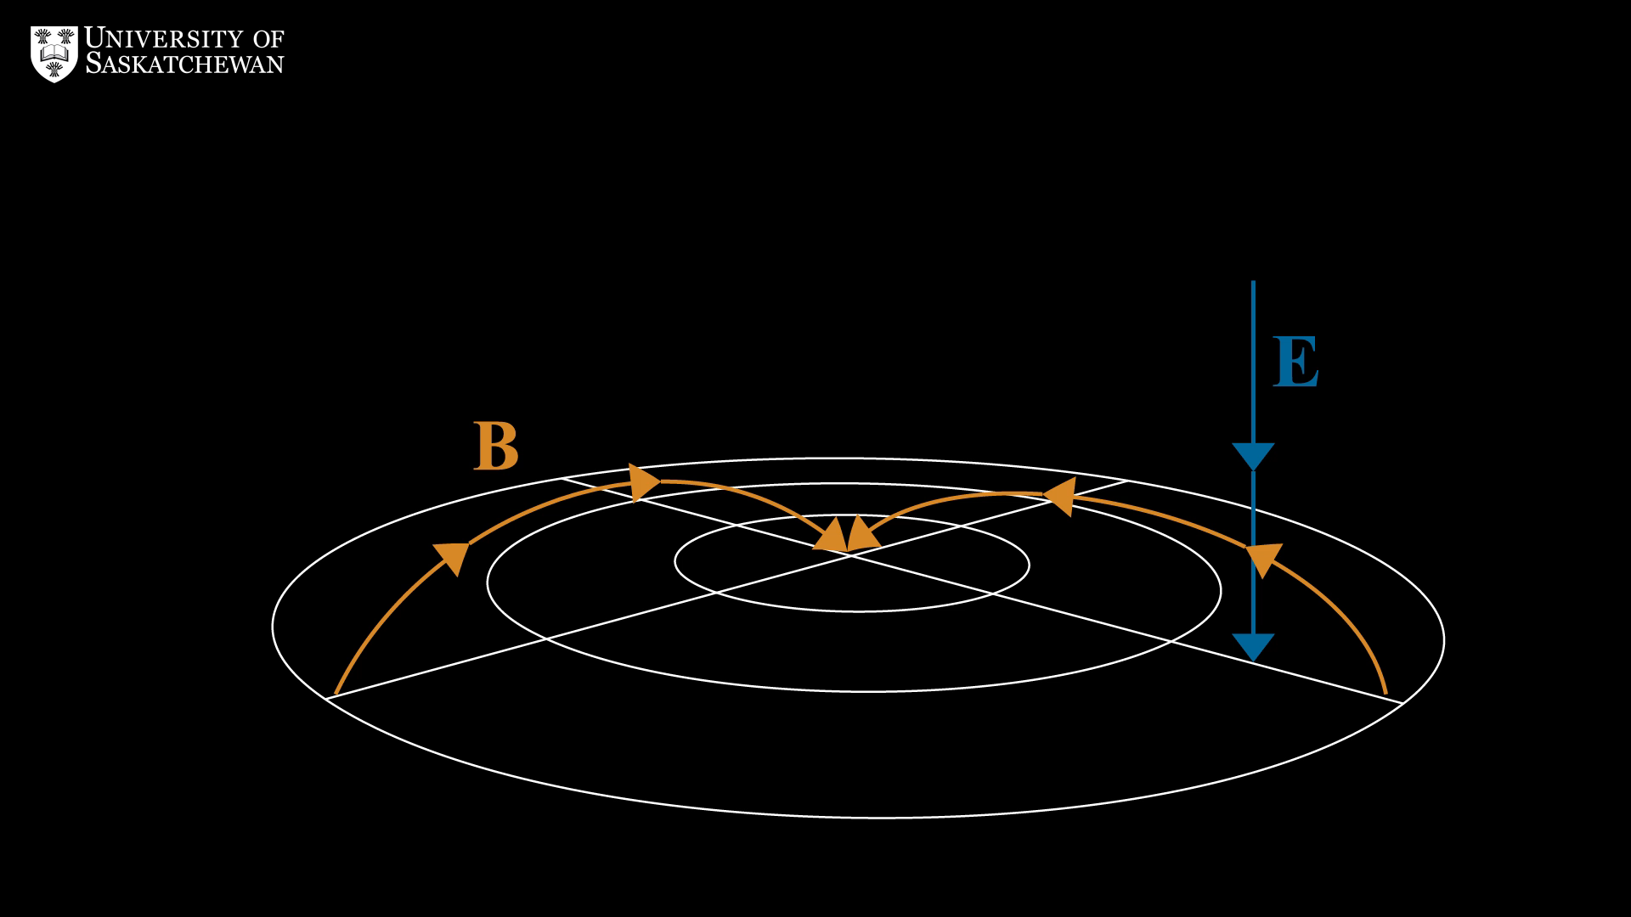

Slide 5
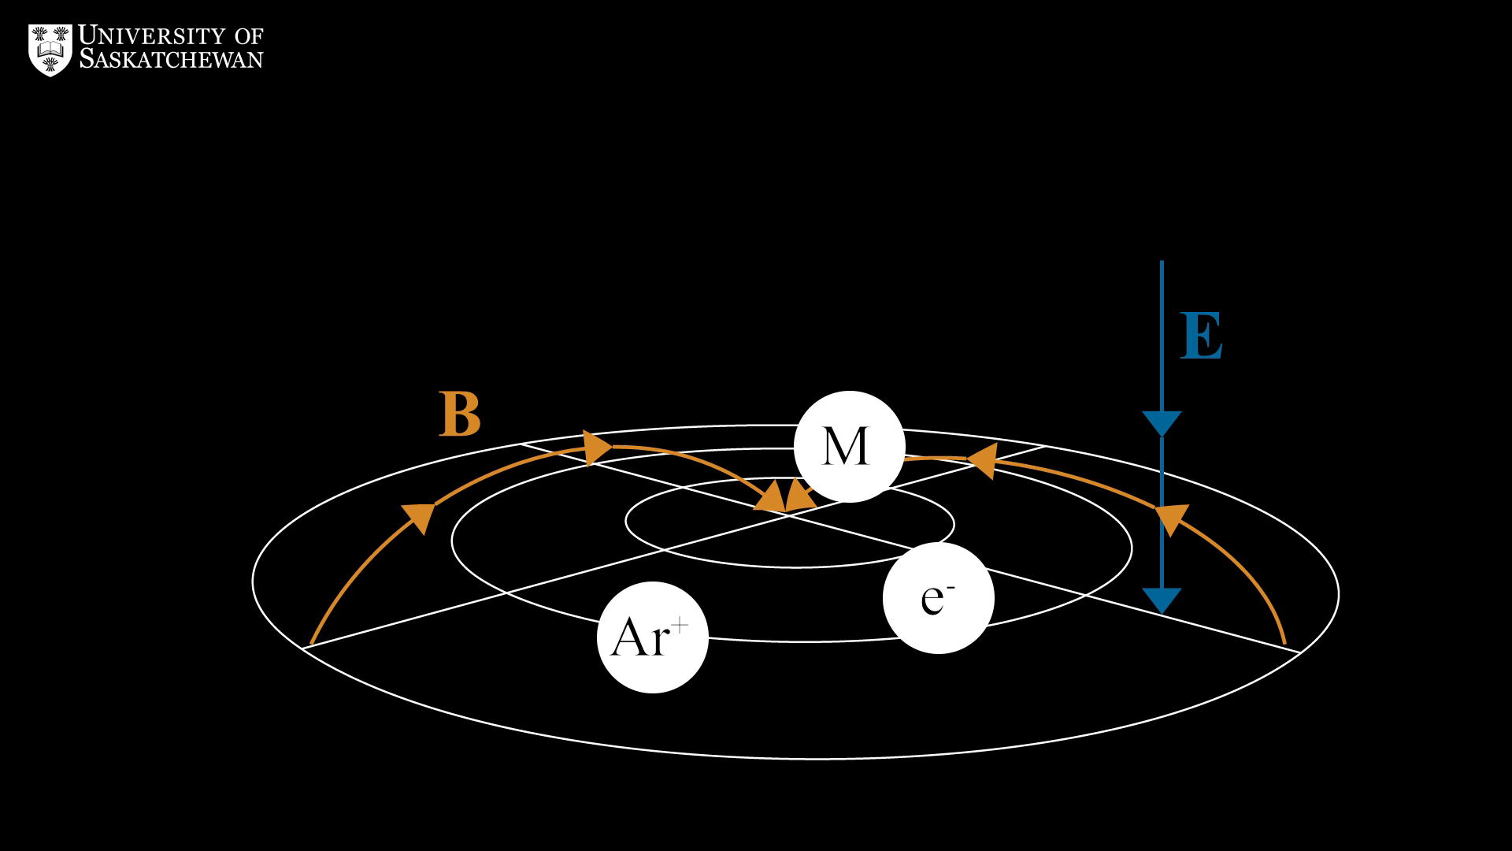

Slide 6
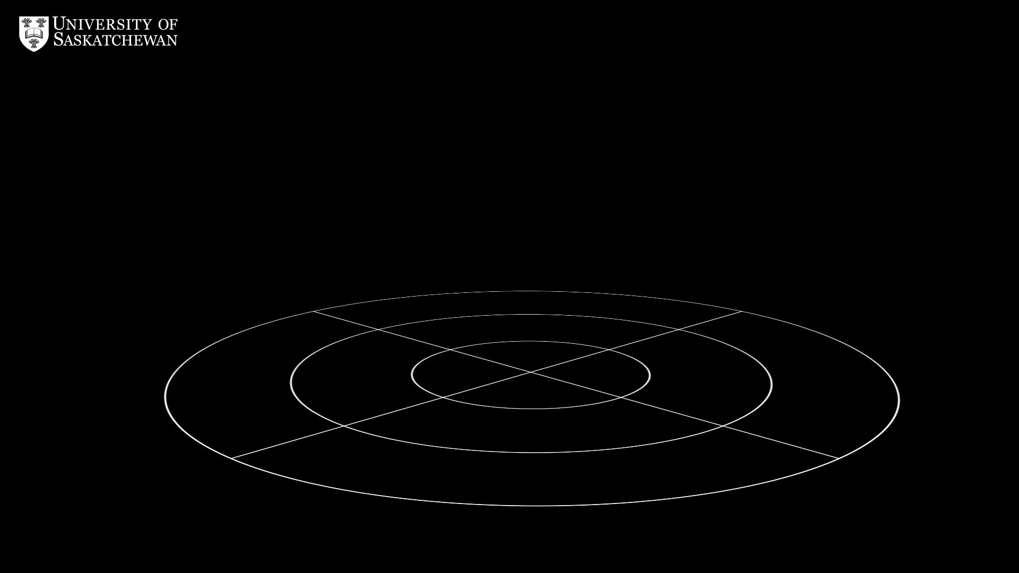

~10 km/s
± $E×B$ direction
5 times Bohm diffusion

Slide 7
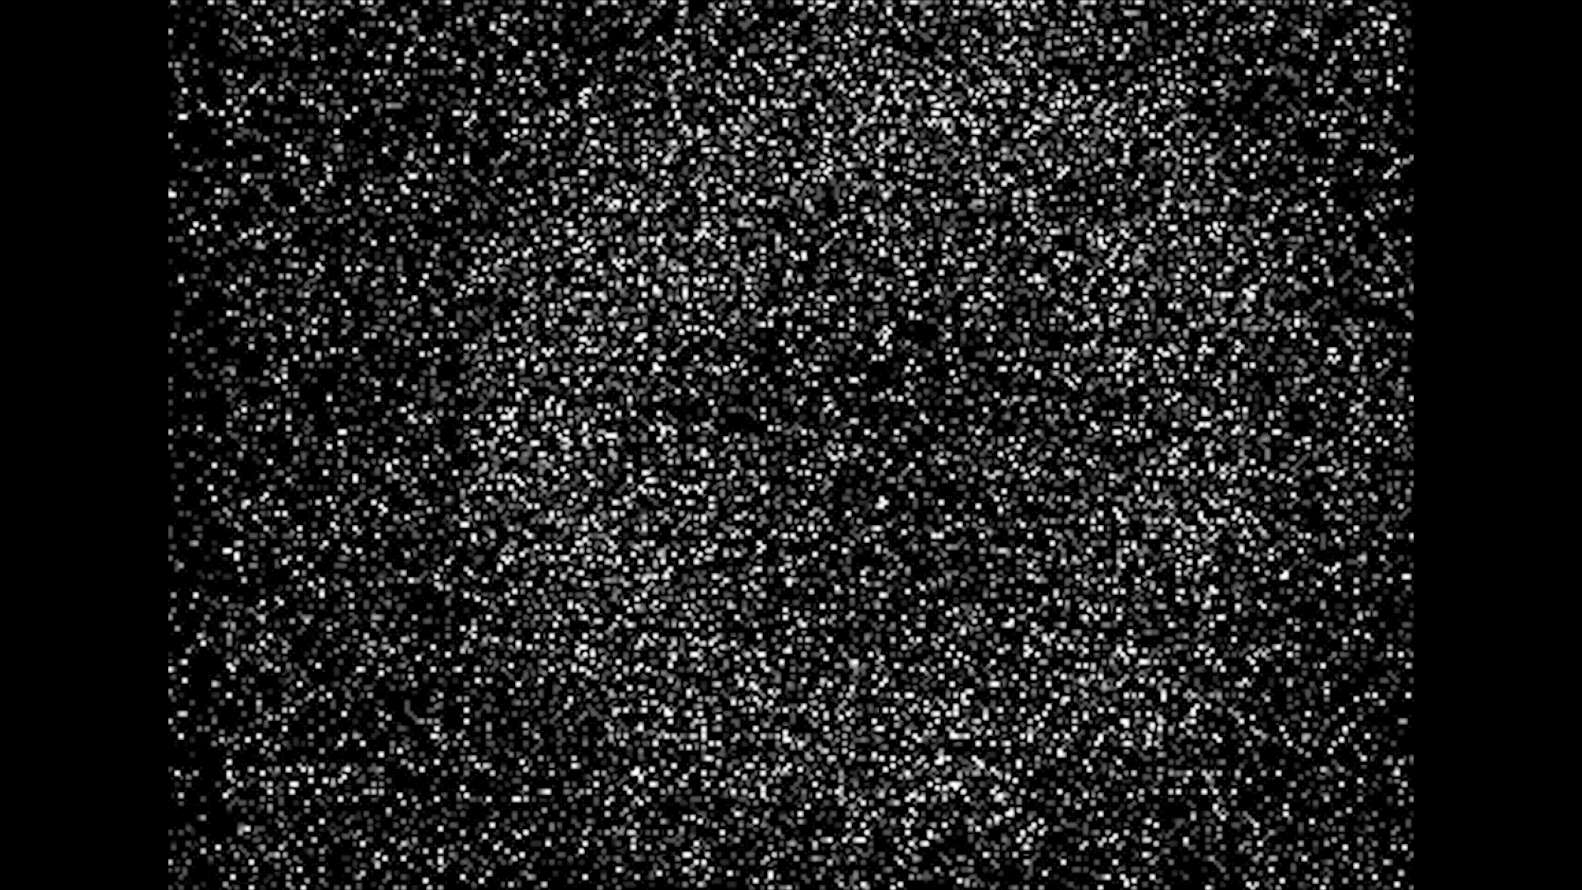

Slide 8
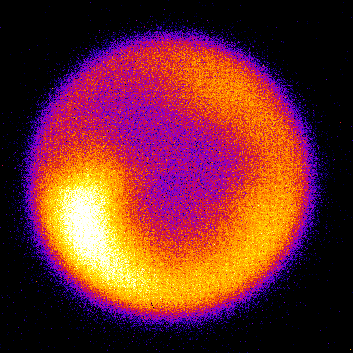

High speed camera characterization
Record 1 frame per pulse over many pulses.
Construct statistical picture of spokes.
Identify spoke mode number, size and intensity.
Less diffuse spokes were observed at higher power discharges due to gas rarefication.
Gas rarefication causes more variation in the size distribution of mode two spokes.
Average spoke mode number follows the discharge power up to a certain threshold, past which it becomes stable around 1.5.

Slide 9
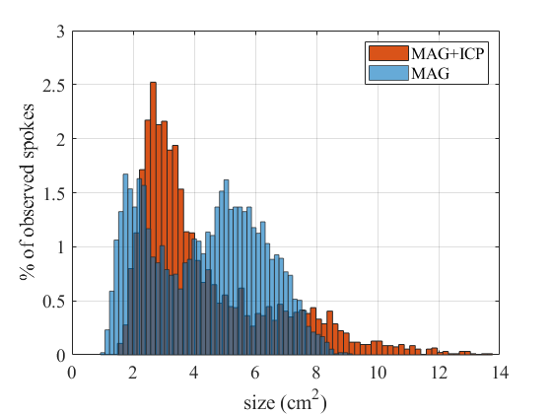
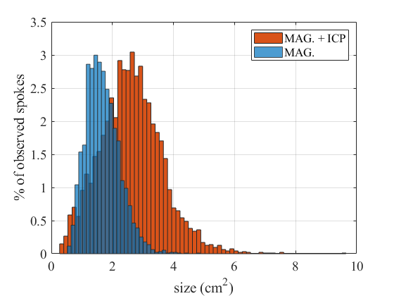
High speed camera characterization
Size distribution

Slide 10
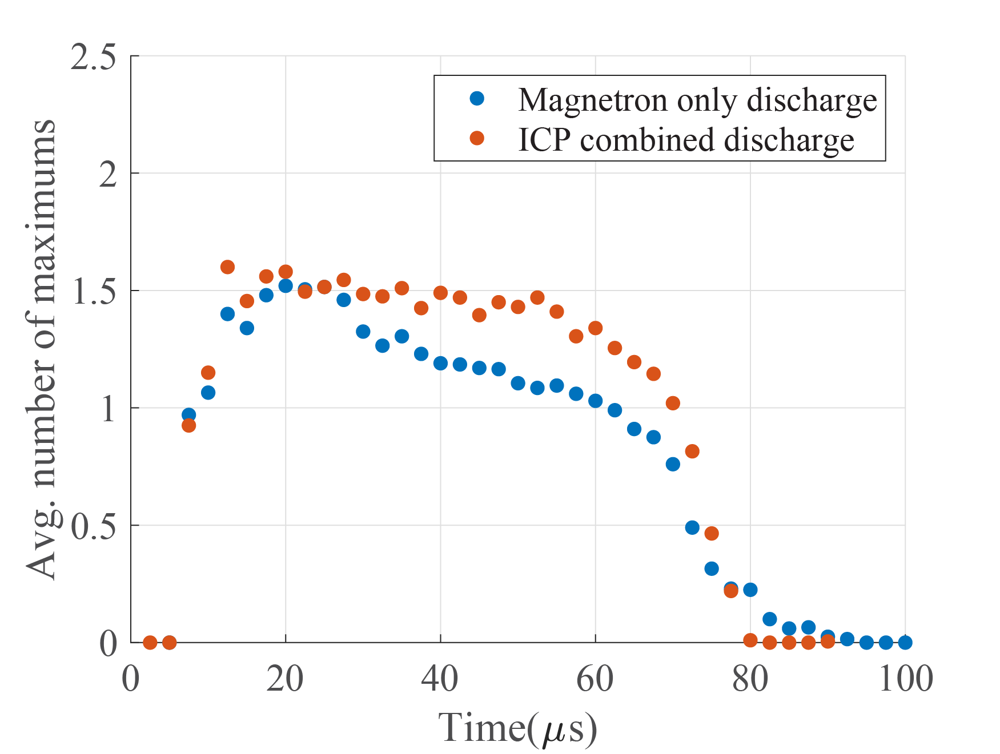
High speed camera characterization
Average mode number

Slide 11
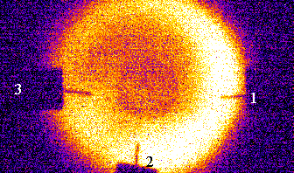
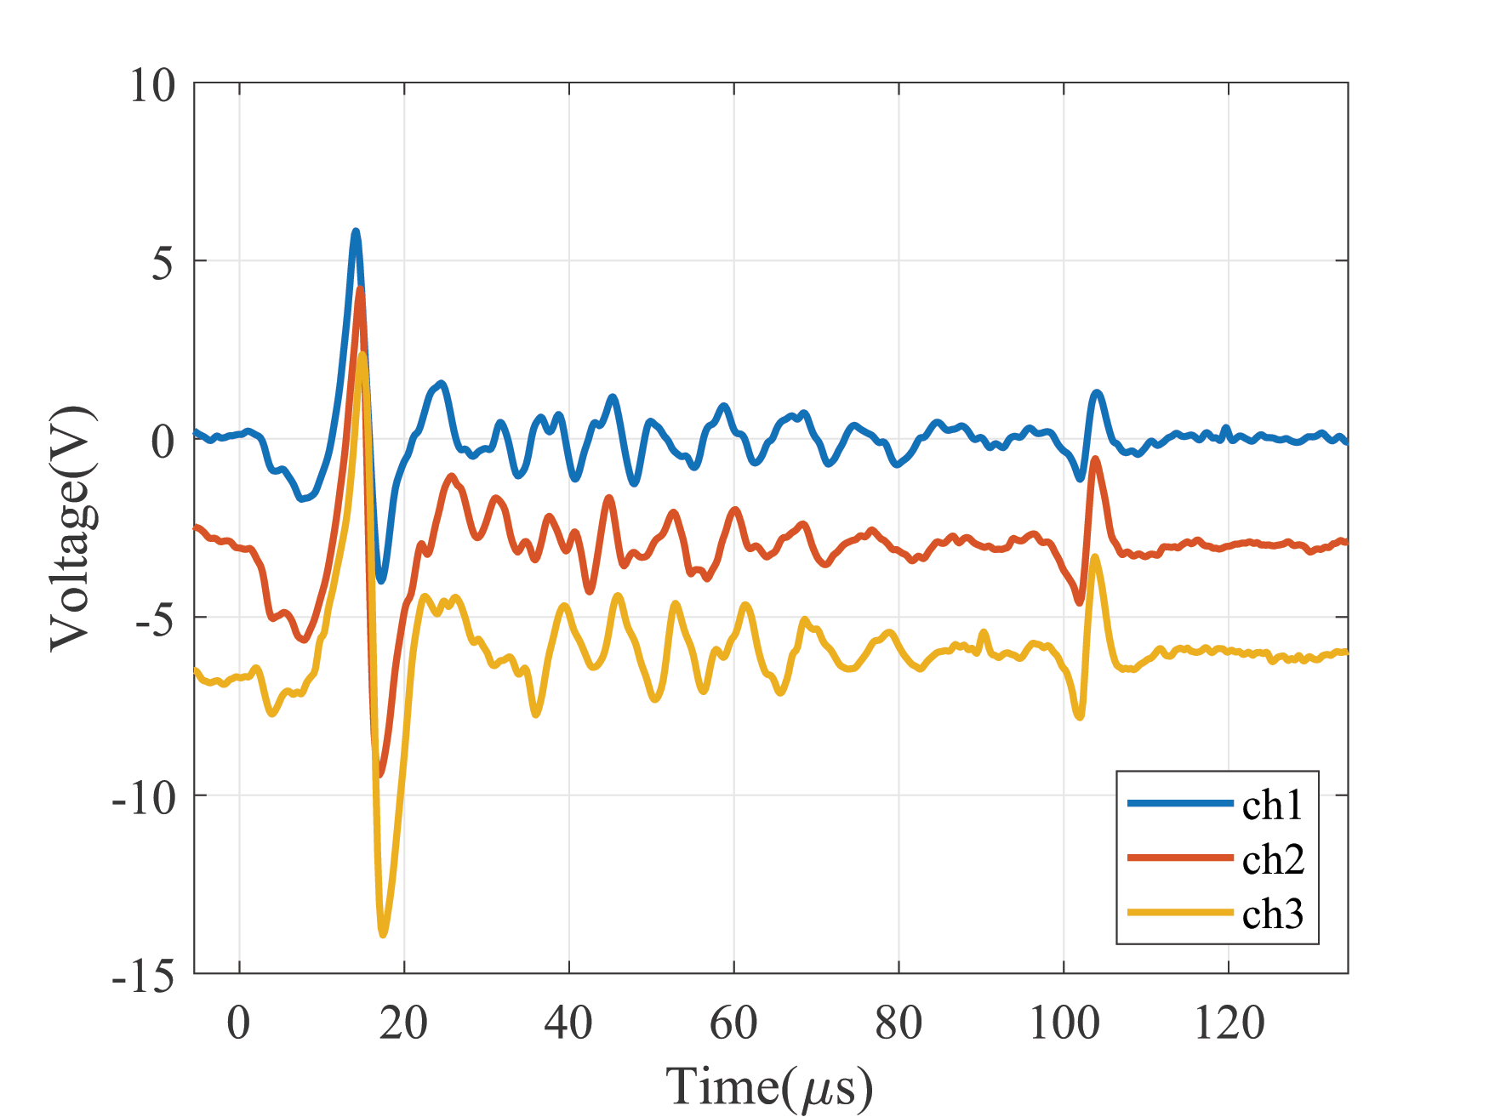
Floating robe measurements
Records floating potential caused by spokes.
Synchronized with camera.
We observed a rotation speed of ~13km/s.
Decreasing plasma potential caused by increased secondary electron production at the leading edge of the spoke.

