Slide 1


Pulsed nanosecond air discharge in contact with water
Influence of voltage polarity, amplitude, pulse width, and gap distance
James Diamond and Ahmad Hamdan
Groupe de physique des plasmas, departement de Physique, Universite de Montreal, Qc, Canada

Slide 2
Outline
Introduction
Experimental Setup
Results and discussion
Conclusion

Slide 3
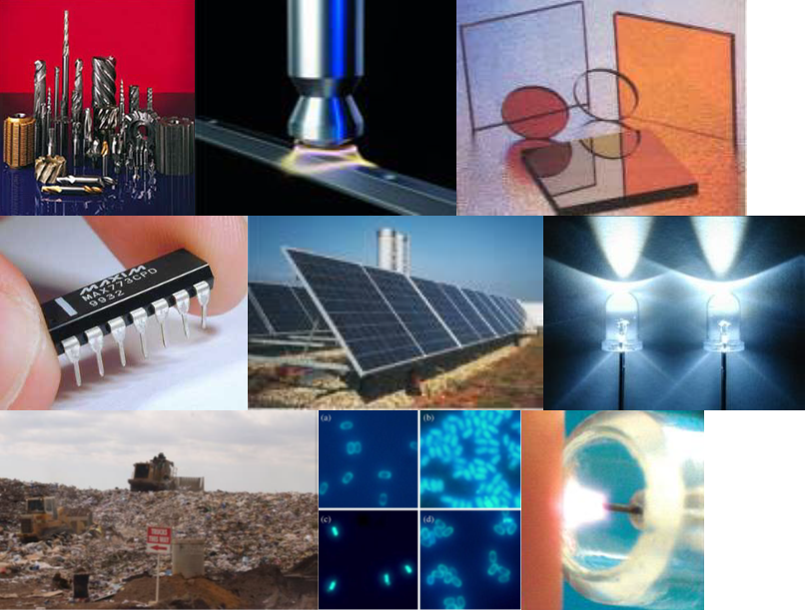
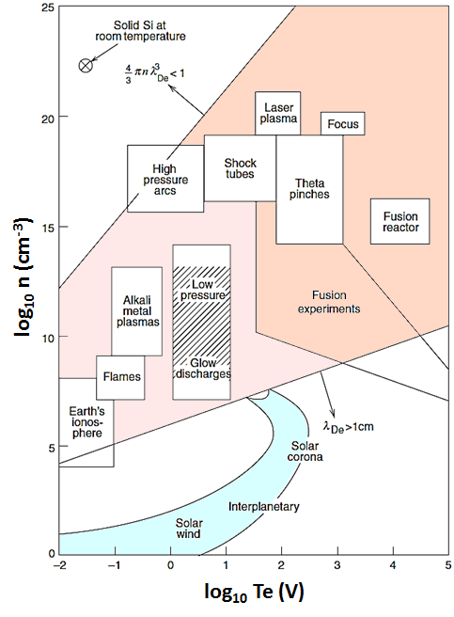
Introduction
non-equilibrium plasma at atmospheric pressure
→ For liquid processing, including water treatment

Slide 4
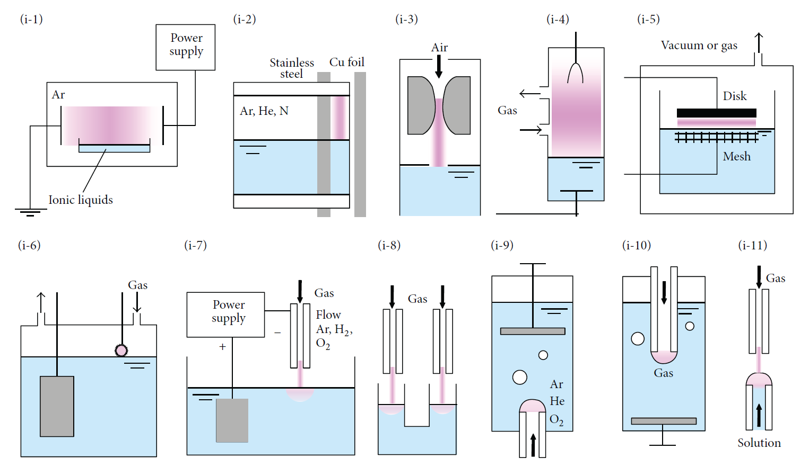
Plasma in-contact with liquids
Countless configurations to produce a plasma in-contact with liquids
Journal of Nanomaterials 123696 (2015)

Slide 5
Plasma in-contact with liquids
A complex and dynamic interaction on a really small scale
≈ nm !
Plasma Sources Sci. Technol. 25 (2016) 053002

Slide 6
Obejectives
What are the differences between the positive and negative air discharge in contact with water?
What is the influence of discharge parameters (polarity, gap distance, pulse width….) on the degradation of an organic pollutant (methylene blue)?

Slide 7
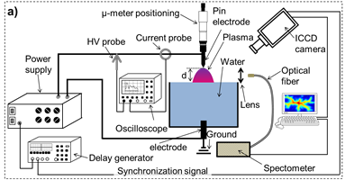
Experimental setup
Parameters:
Voltage polarity (+, -)
Voltage amplitude (kV)
Pulse width (ns)
Gap Distance (d, in mm)

Slide 8
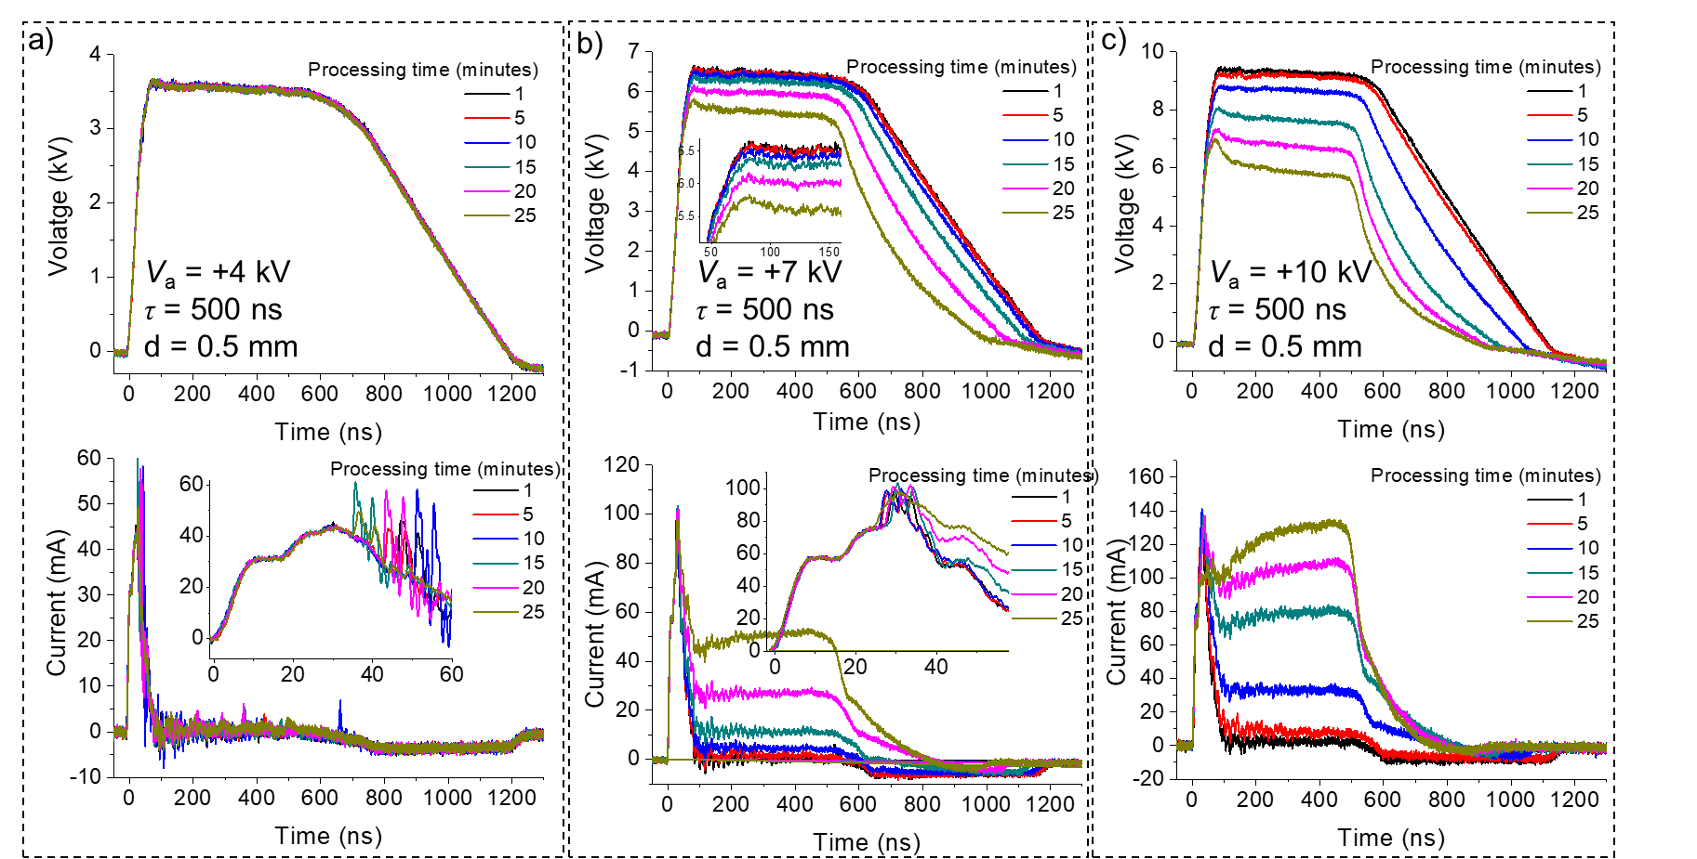
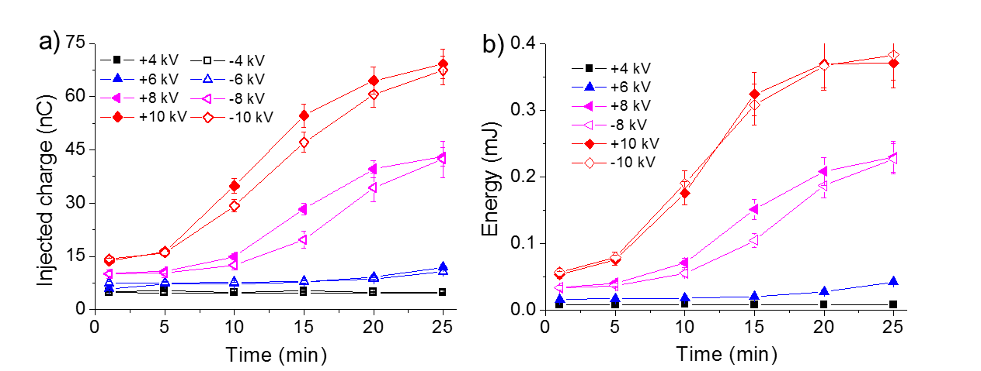


Results : Electrical Characteristics
V_{a} positive
$$Q= \int{I\left(t\right)dt}$$
$$E= \int{I\left(t\right)∗V(t)dt}$$

Slide 9
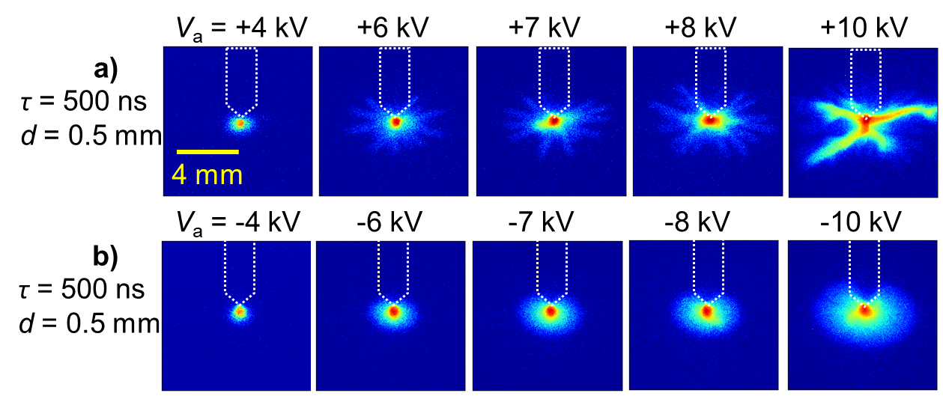
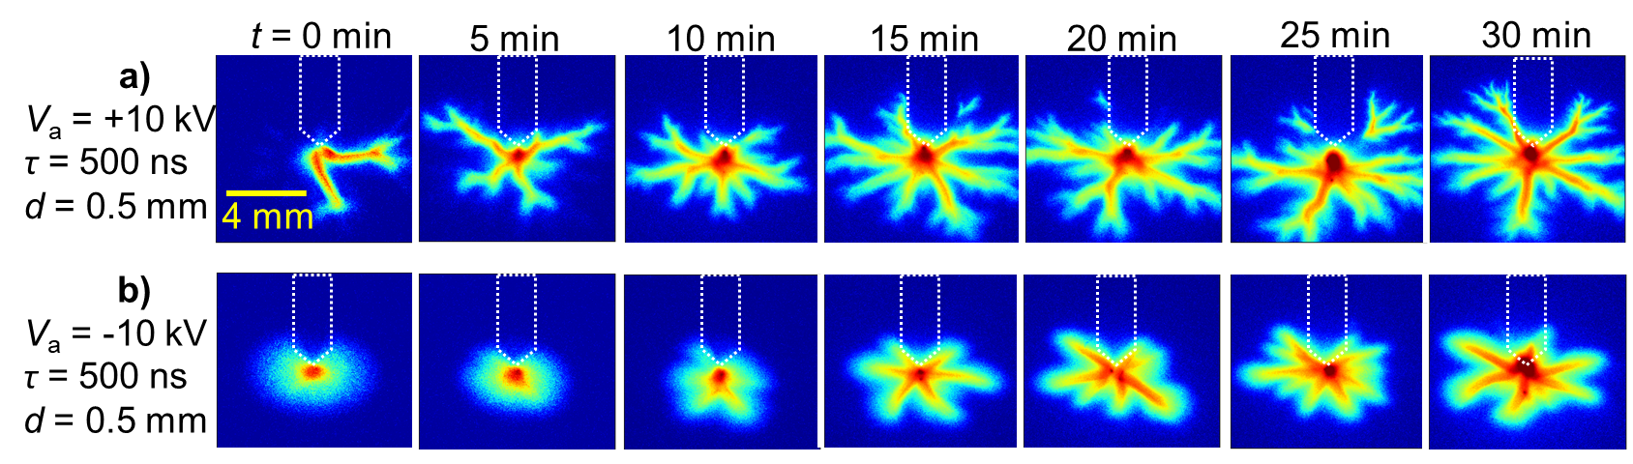
Results : Imaging the surface
Voltage amplitude:
Positive polarity:
4 kV: Small spot at the tip
6kV – 8kV: plasma spot + organised filaments
10 kV: High intensity filaments with less organisation
Negative polarity:
Disc-like shape with no filaments
Diameter increases with higher voltage
Processing time evolution:
Positive polarity:
Number and length of filaments increases
Negative polarity:
Disc-like evolve into a filament structure
Number is smaller and Filaments are shorter and wider than positive polarity

Slide 10
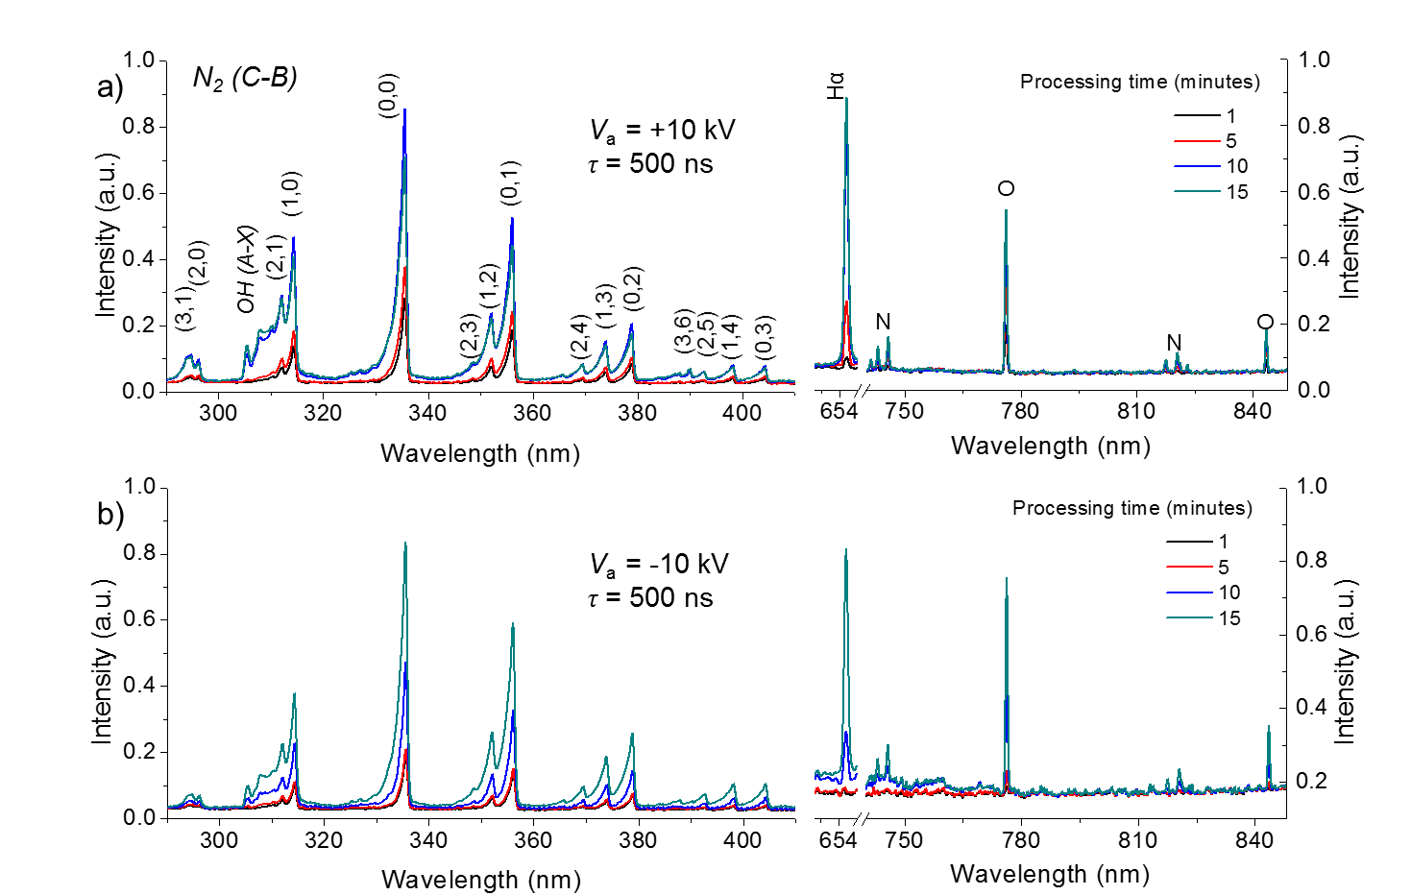
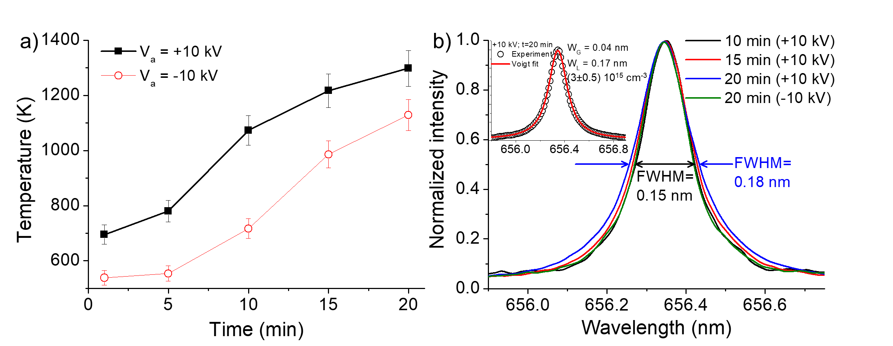
Results : Spectroscopy
  Calculated from N₂ (C-B) 336 nm without NH
Stark Broadening (3.0±0.5) x 10¹⁵ cm⁻³

Slide 11
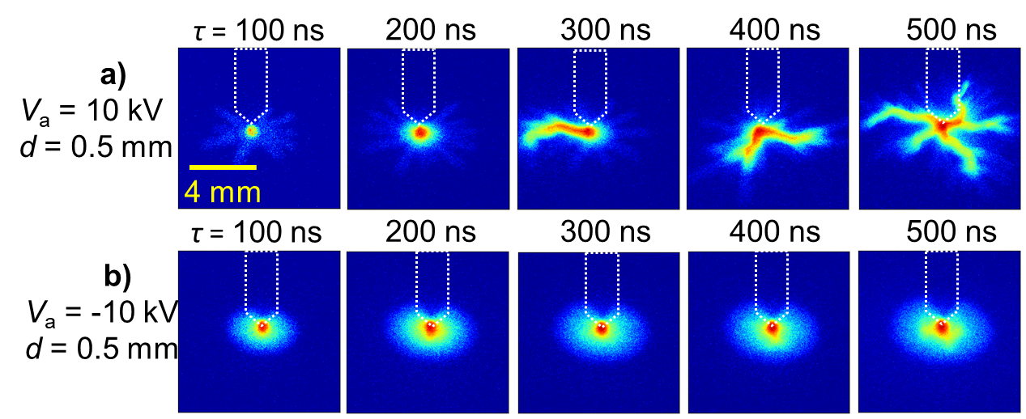
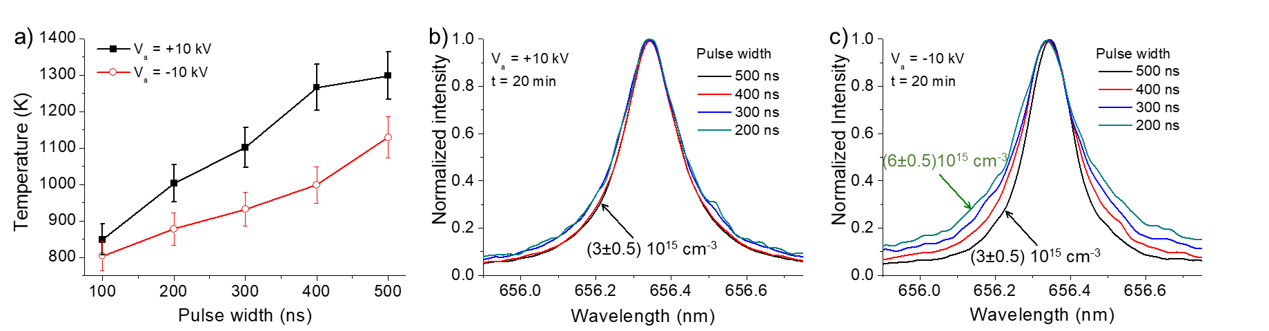
Results : Pulse Width

Slide 12
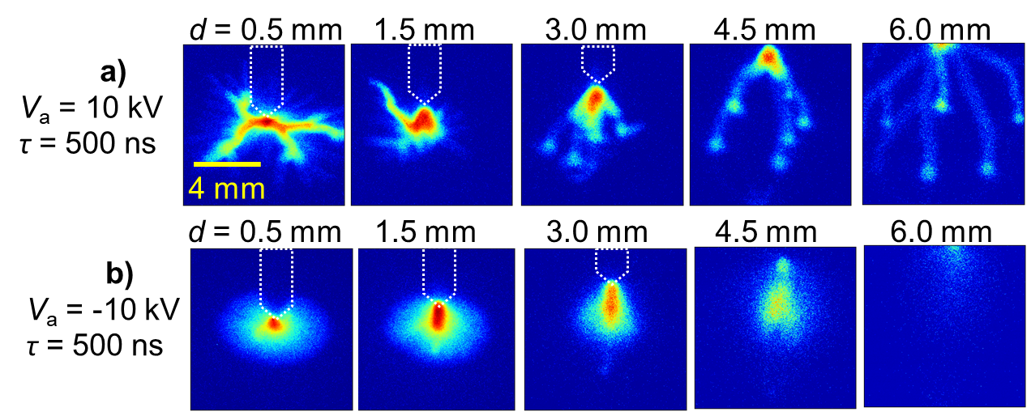
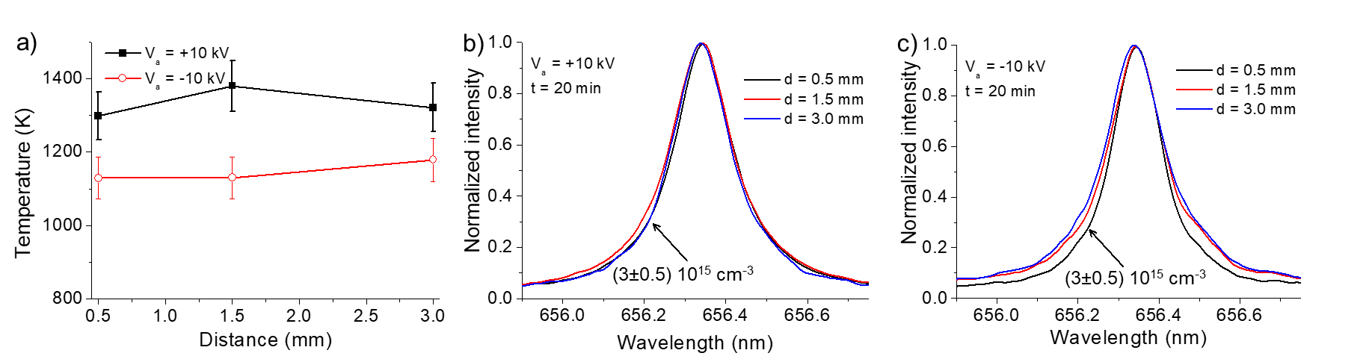
Results : Electrical Characteristics

Slide 13
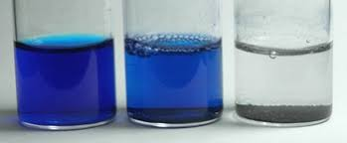
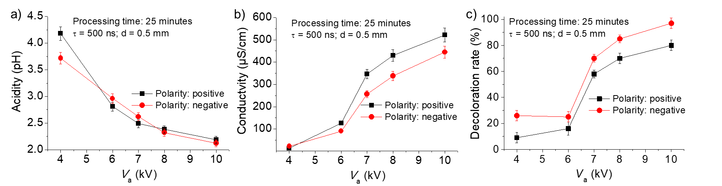

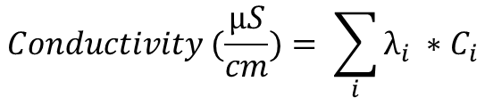
Results : Liquid properties
0% 100%
$$Acidity (pH)=−\log_{10}{[H^{+}]}$$
$$Conductivity (\frac{µS}{cm})= \sum_{i}{λ_{i} ∗C_{i}}$$
Ions: OH⁻, H⁺, NO₂⁺, NO₃⁻, ONO₂⁻, NO⁻, NO₂⁻, …

Slide 14
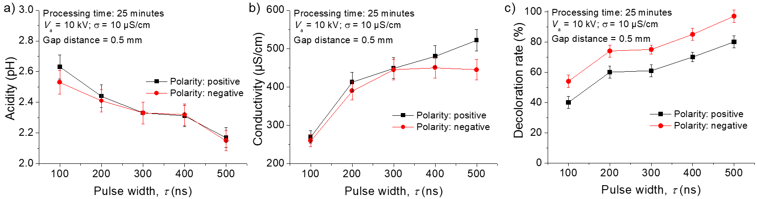
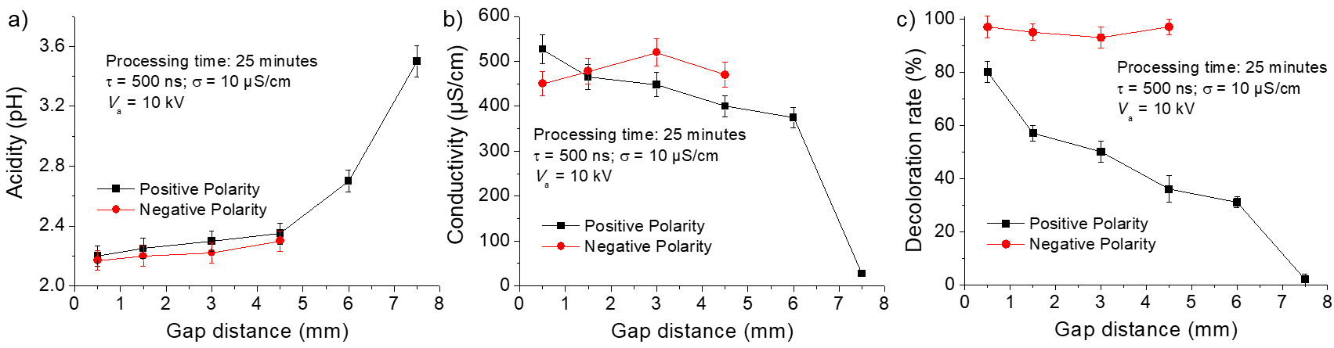
Results : Liquid properties

Slide 15
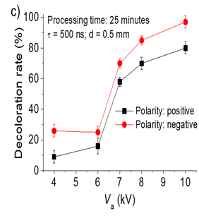
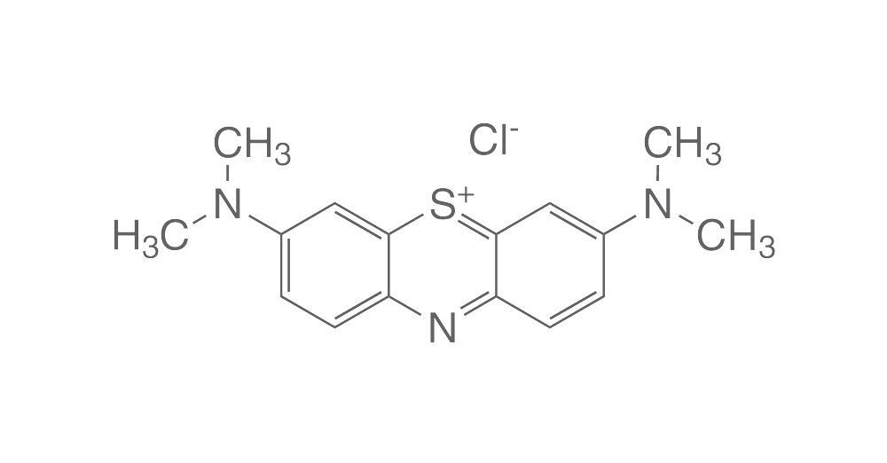
Results : Electrical Characteristics
Electically positive molecule

Slide 16
Conclusion
Our results show:
  The parameters for an optimal methylene blue decoloration are:
    Negative polarity
    Higher voltage amplitude
    longer pulse width
    Shorter gap distance
  The reason behind higher efficiency for negative polarity is:
    Methylene blue is a electrically positive molecule
    The higher flow of the untreated solution
    N2 Vibrational temperature !
    (Matthew J Pavlovich et al 2013 J. Phys. D: Appl. Phys. 46 145202)

Slide 17
Thank you
More details can be found here:
Hamdan A, Ridani DA, Diamond J and Dagrir R, “ Pulsed nanosecond air discharge in contact with water: influence of voltage polarity, amplitude, pulse width, and gap distance”, J. Phys. D. Appl. Phys. , 2020, doi: 10.1088/1361-6463/ab8fde

