Slide 1
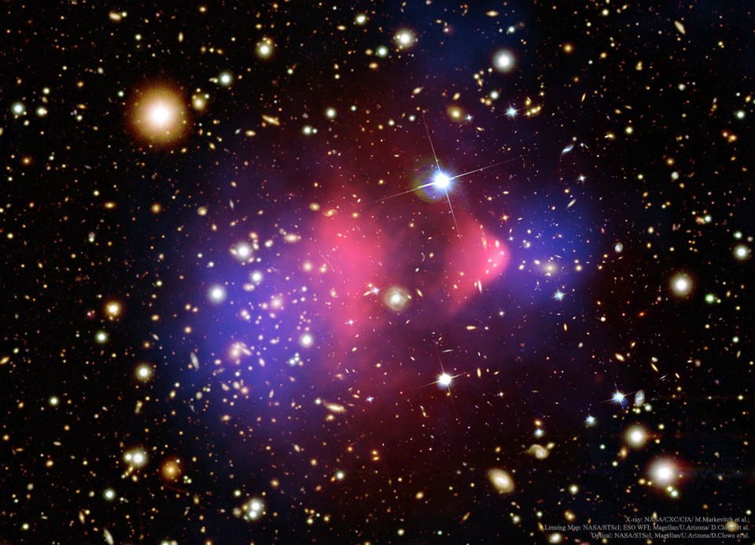

How was Dark Matter Produced in the Early Universe?
A Study of Fermionic Dark Matter with a $Z′$ Portal
Taylor Gray
Supervisor: Prof. Stephen Godfrey
In Collaboration with: Maíra Dutra and Catarina Cosme
CAP 2020

Slide 2
Outline
Dark Matter Evidence and Overview
Thermodynamics Review
Dark Matter Relic Abundance
Model
Results
Conclusions and Future Directions
Goal: Study different ways of producing Dark Matter and how the different mechanisms effect the relic abundance.

Slide 3
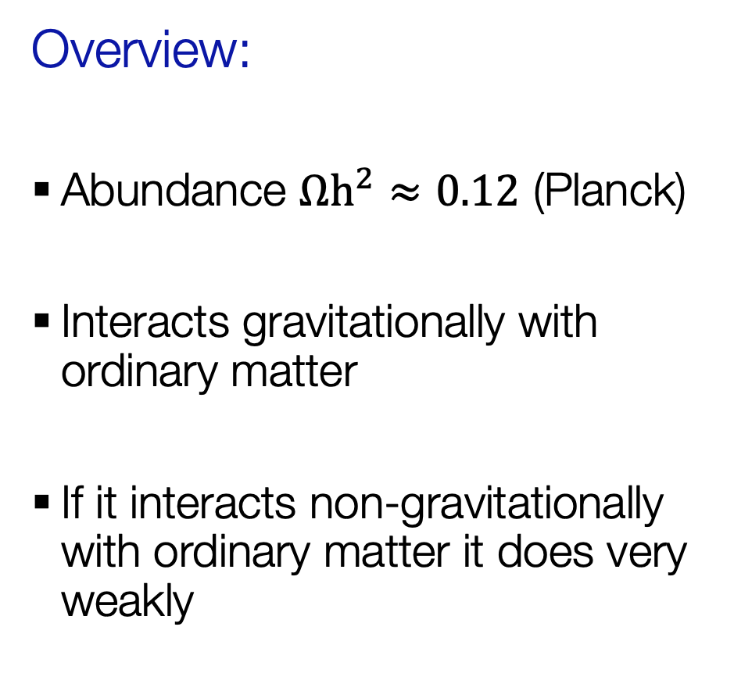
Dark Matter Evidence and Overview
Evidence:
Galaxy clusters
Rotation curves of galaxies
Large scale structure
Cosmic Microwave Background (CMB)
Overview:
Abundance $Ωh^{2}≈0.12$ (Planck)
Interacts gravitationally with ordinary matter
If it interacts non-gravitationally with ordinary matter it does very weakly
NASA, ESA, J. Mack (STScI) and J. Madrid (Australian Telescope National Facility)

Slide 4
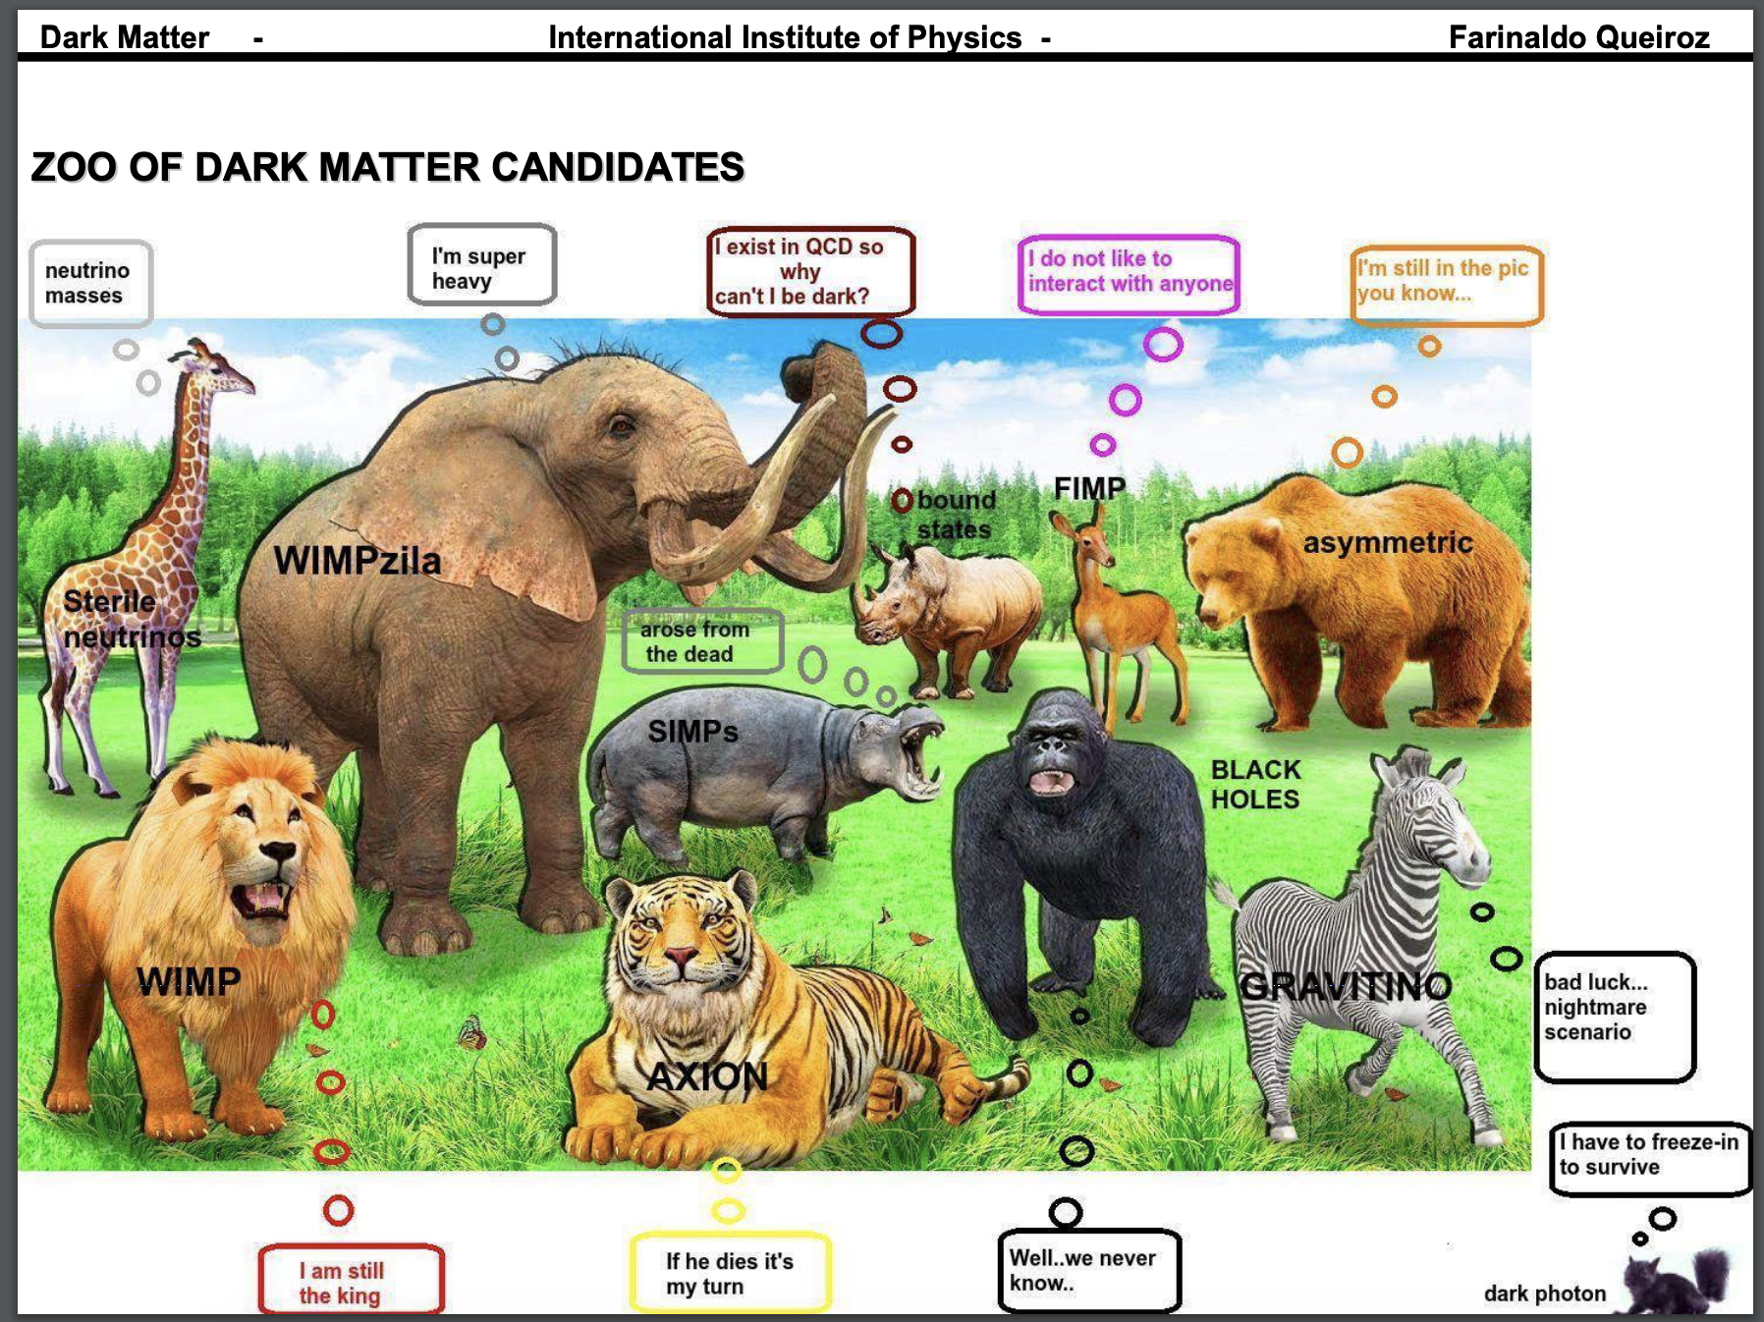
FIMP:
Feebly Interacting Massive Particle
WIMP:
Weakly Interacting Massive Particle

Slide 5
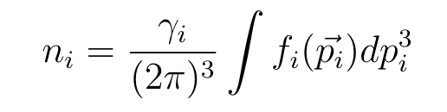
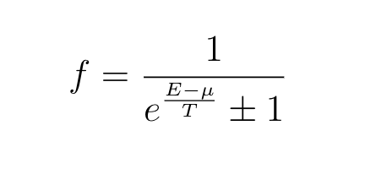
Equilibrium Thermodynamics Review
Number density:
Energy distribution (if in kinetic equilibrium):
Kinetic equilibrium: when particles exchange energy and momentum efficiently
Chemical equilibrium: when the production rate is equal to the annihilation rate
Thermal equilibrium: Kinetic + Chemical equilibrium

Slide 6
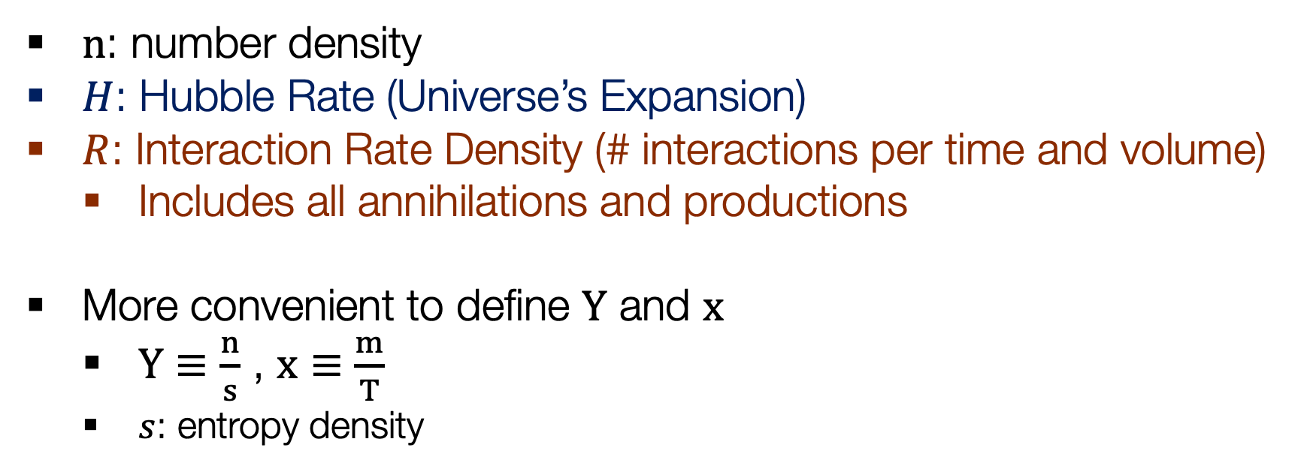
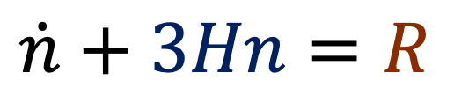
Calculating Dark Matter Abundance:
The Boltzmann Equation
$$\dot{n}+3Hn=R$$
Universe’s Expansion
Particle Physics
$n$: number density
$H$: Hubble Rate (Universe’s Expansion)
$R$: Interaction Rate Density (# interactions per time and volume)
  Includes all annihilations and productions
More convenient to define $Y$ and $x$
  $Y≡\frac{n}{s}$ , $x≡\frac{m}{T}$
  $s$: entropy density

Slide 7
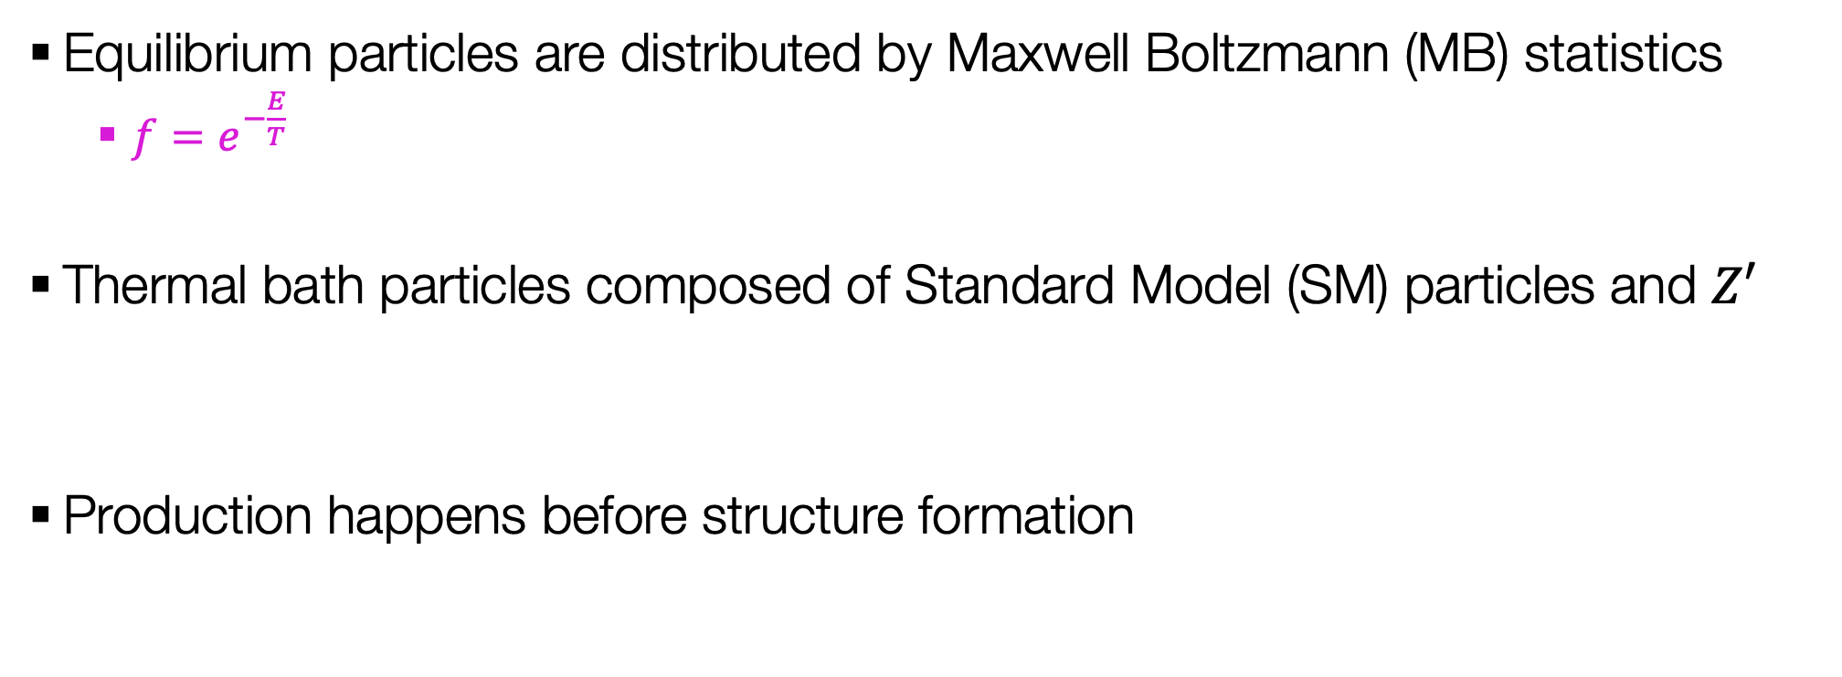
Assumptions
Equilibrium particles are distributed by Maxwell Boltzmann (MB) statistics
  $f=e^{−\frac{E}{T}}$
Thermal bath particles composed of Standard Model (SM) particles and $Z′$
Production happens before structure formation

Slide 8
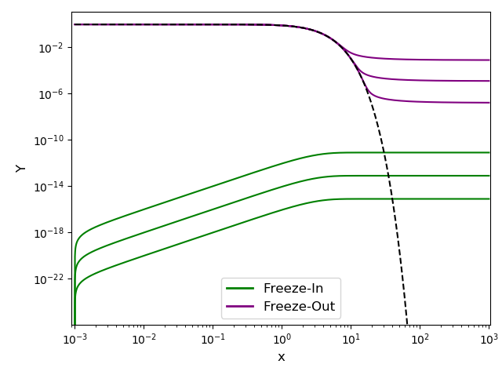
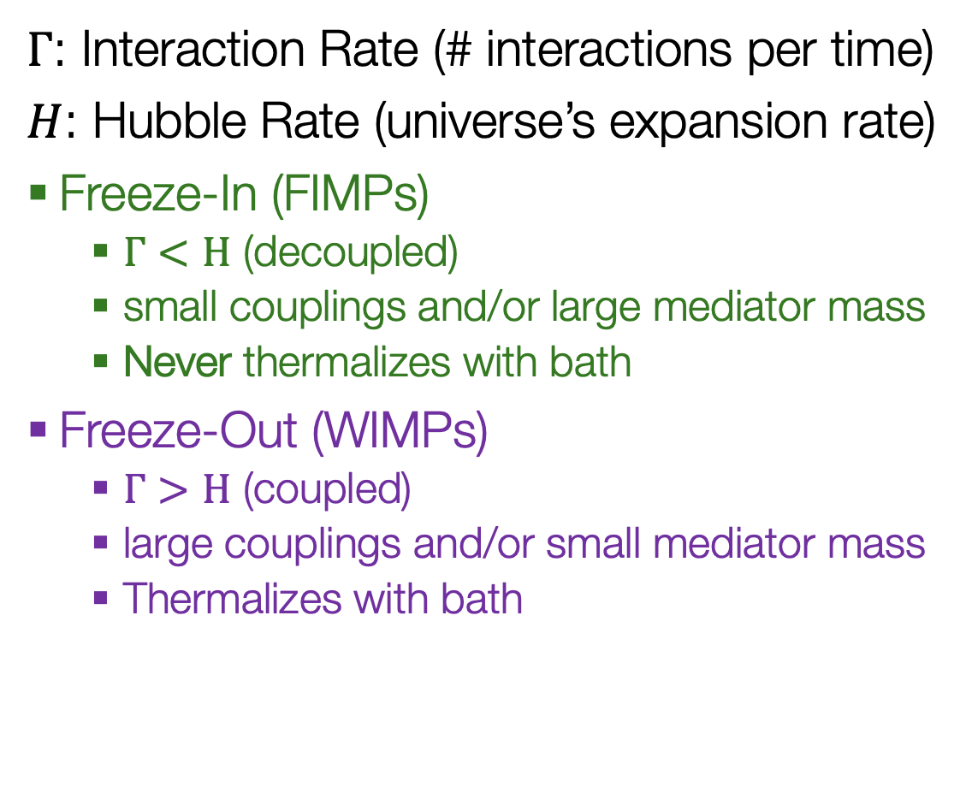

Ways of Producing Dark Matter
$Γ$: Interaction Rate (# interactions per time)
$H$: Hubble Rate (universe’s expansion rate)
Freeze-In (FIMPs)
  $Γ<H$ (decoupled)
  small couplings and/or large mediator mass
  Never thermalizes with bath
Freeze-Out (WIMPs)
  $Γ>H$ (coupled)
  large couplings and/or small mediator mass
  Thermalizes with bath
$→$Increasing Coupling

Slide 9
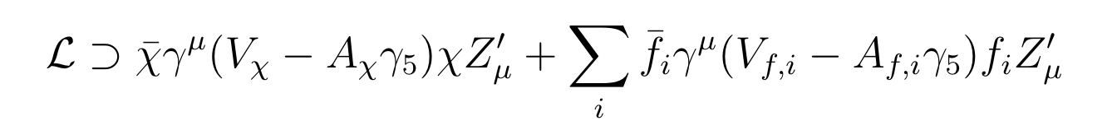
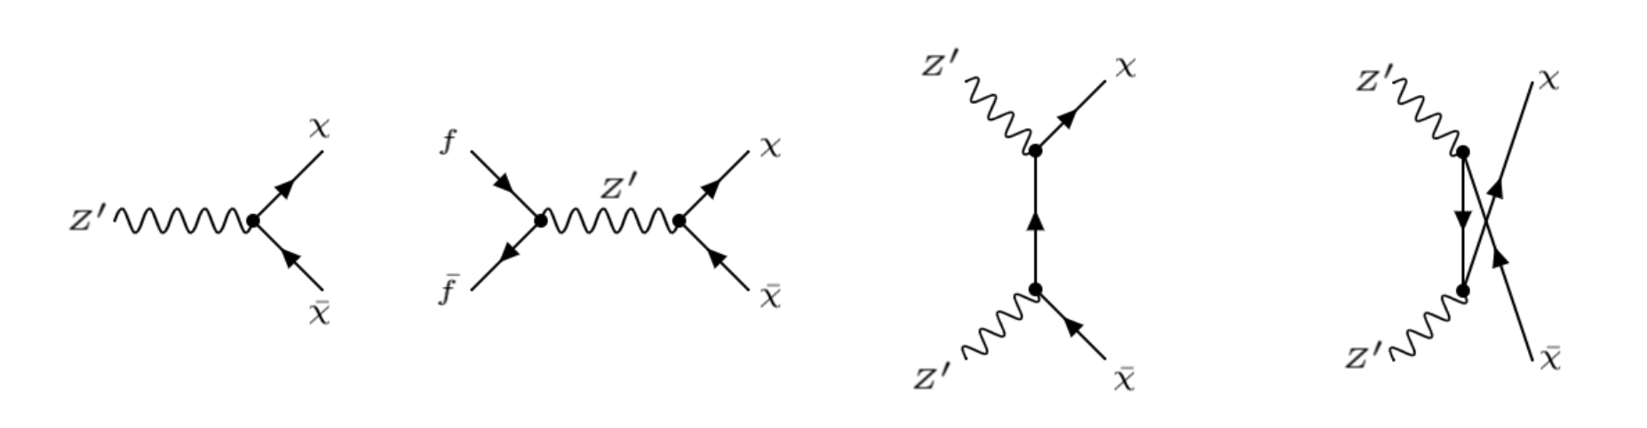
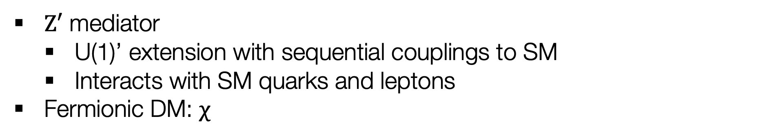
Our Model
$Z′$ mediator
  U(1)’ extension with sequential couplings to SM
  Interacts with SM quarks and leptons
Fermionic DM: $χ$

Slide 10
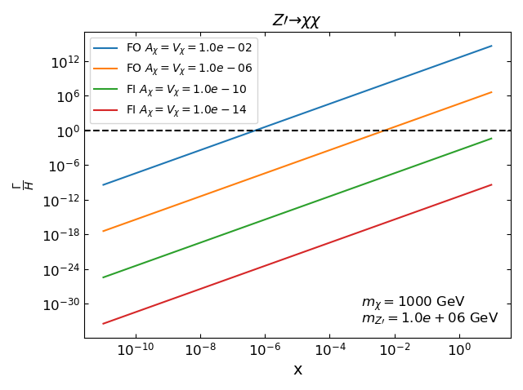
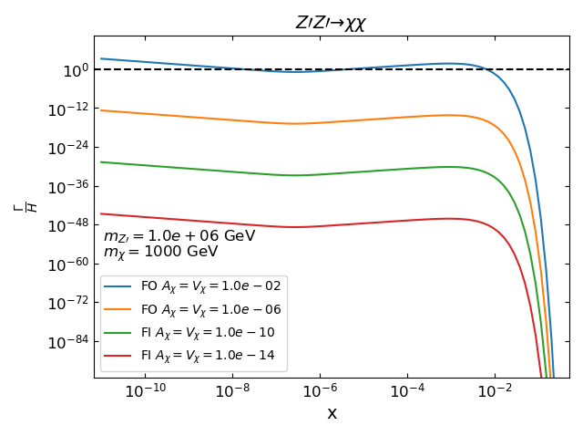
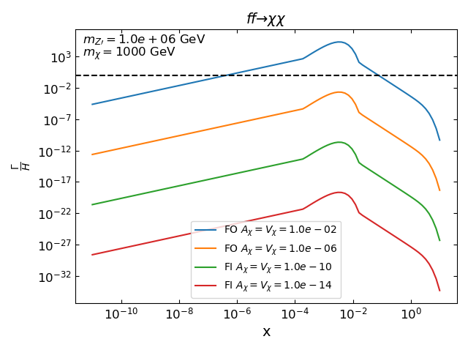


Determining the Production Regime
Does DM thermalize with the bath?
If $\frac{Γ(T)}{H(T)}<1:$
Freeze-In
If $\frac{Γ(T)}{H(T)}>1:$
Freeze-Out

Slide 11
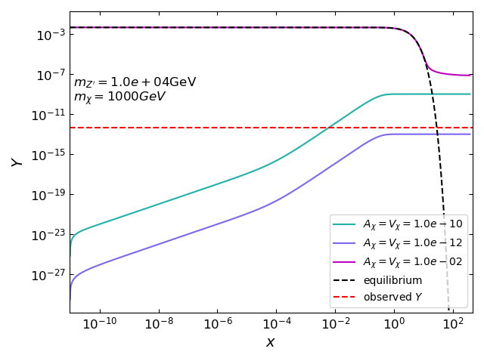
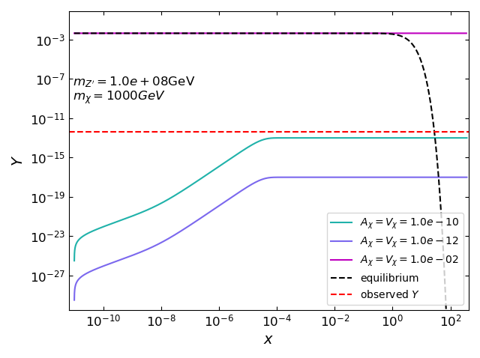
Dark Matter Evolution

Slide 12
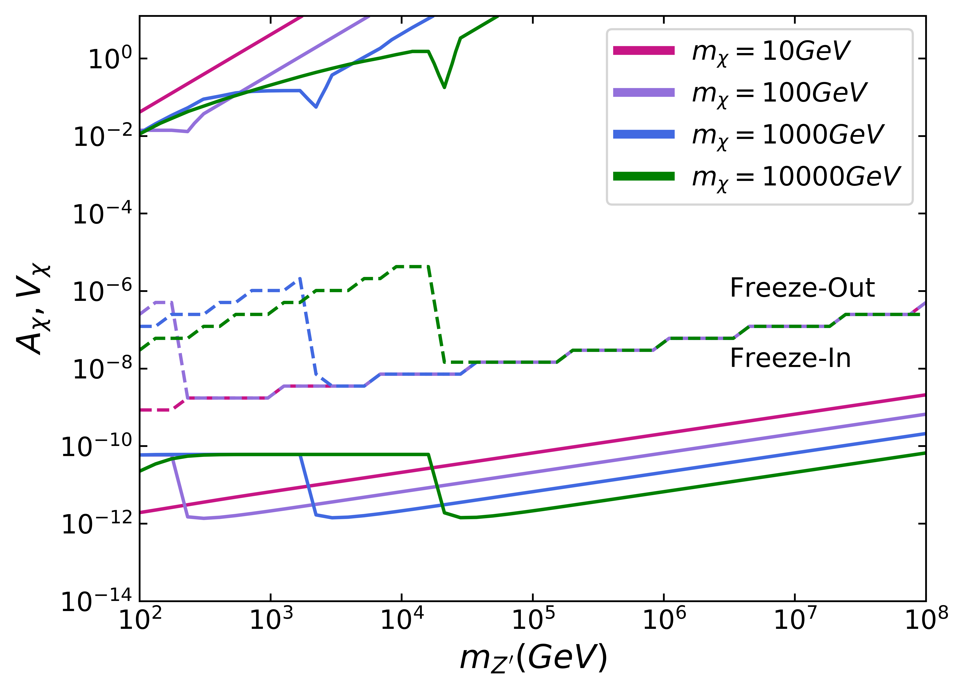
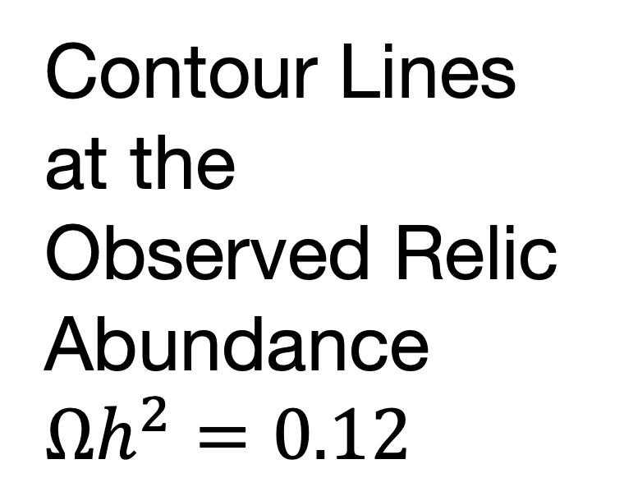

Contour Lines at the Observed Relic Abundance
$$Ωh^{2}=0.12$$
Resonance from s-channel
Decay becomes allowed when $m_{Z′}>2m_{χ}$

Slide 13
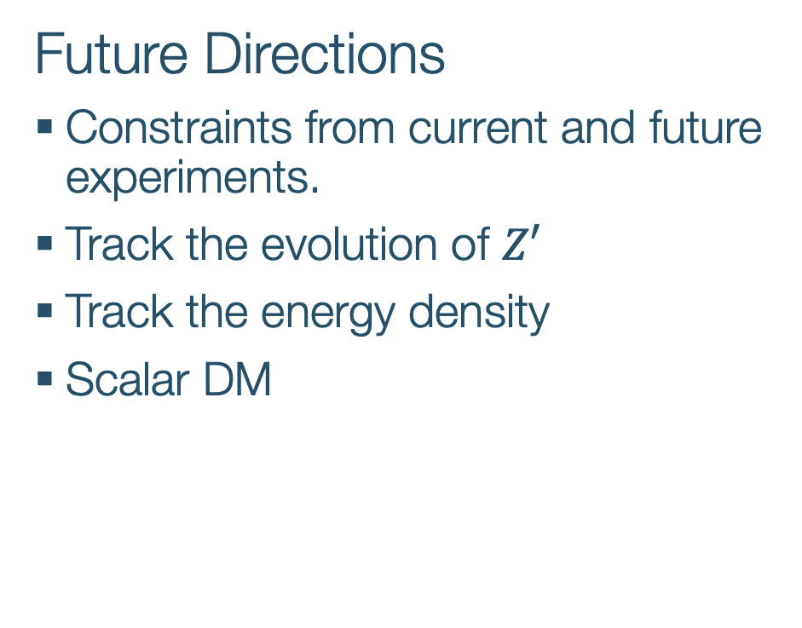
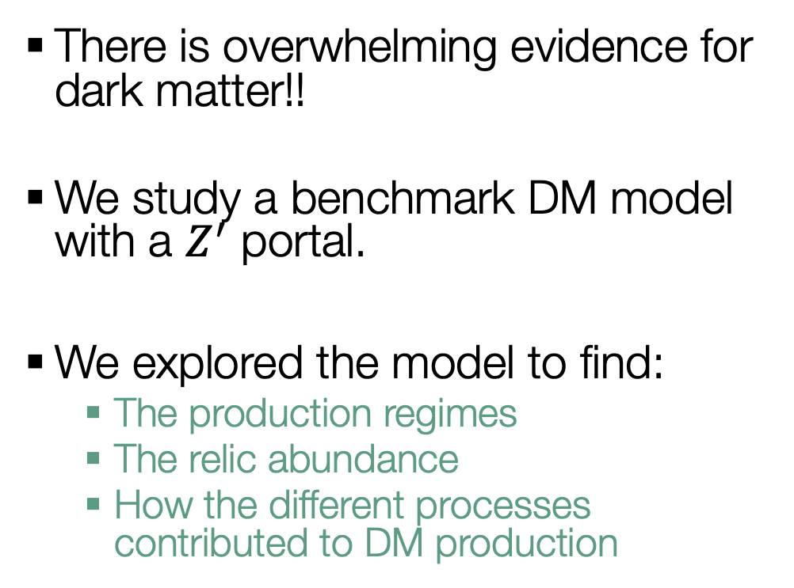
Summary
There is overwhelming evidence for dark matter!!
We study a benchmark DM model with a $Z^{′}$ portal.
We explored the model to find:
  The production regimes
  The relic abundance
  How the different processes contributed to DM production
Future Directions
Constraints from current and future experiments.
Track the evolution of $Z′$
Track the energy density
Scalar DM
Thank You, Merci

Slide 14
Backup Slides

Slide 15
How do we know dark matter exists?
1. Galaxy Clusters
Bullet Cluster
Coma Cluster
NASA, ESA, J. Mack (STScI) and J. Madrid (Australian Telescope National Facility)

Slide 16
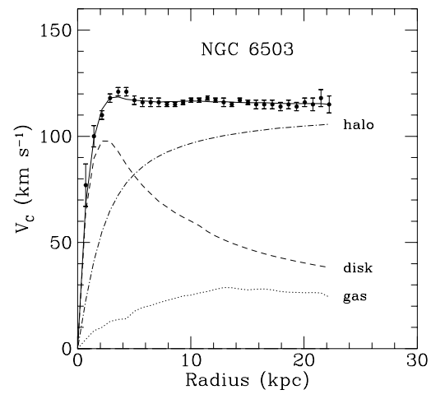
How do we know dark matter exists?
2. Rotation curves of galaxies
  Modified Newtonian dynamics???
3. Large-scale structure
K. G. Begeman, A. H. Broeils and R. H. Sanders, 1991, MNRAS, 249, 523.
Julien Devriendt and the Horizon simulation team.

Slide 17
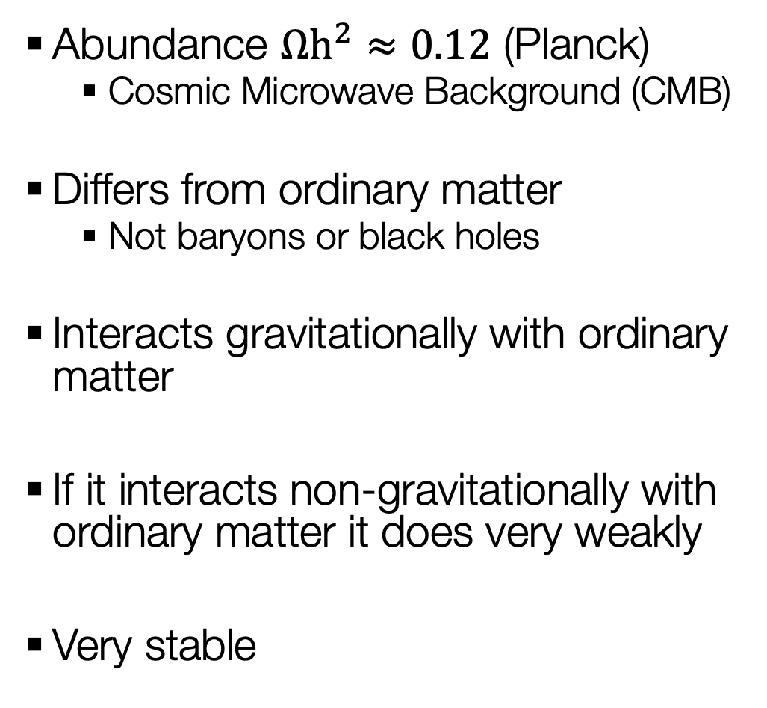
What do we know about dark matter?
Abundance $Ωh^{2}≈0.12$ (Planck)
  Cosmic Microwave Background (CMB)
Differs from ordinary matter
  Not baryons or black holes
Interacts gravitationally with ordinary matter
If it interacts non-gravitationally with ordinary matter it does very weakly
Very stable

Slide 18
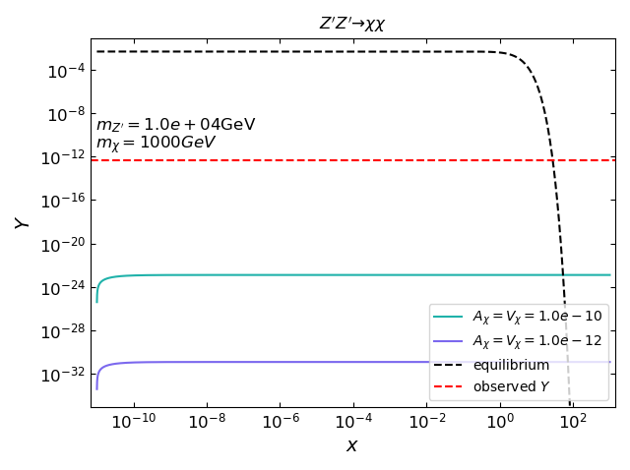
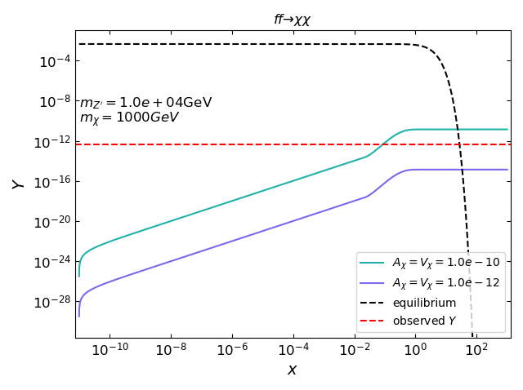
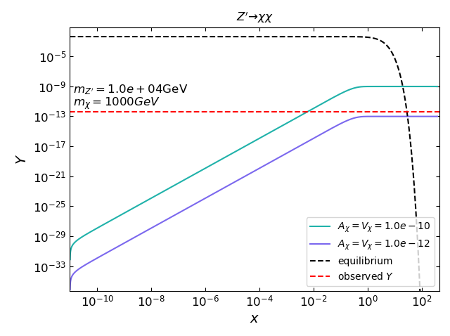
Backup: Evolution mz=1e4GeV

Slide 19
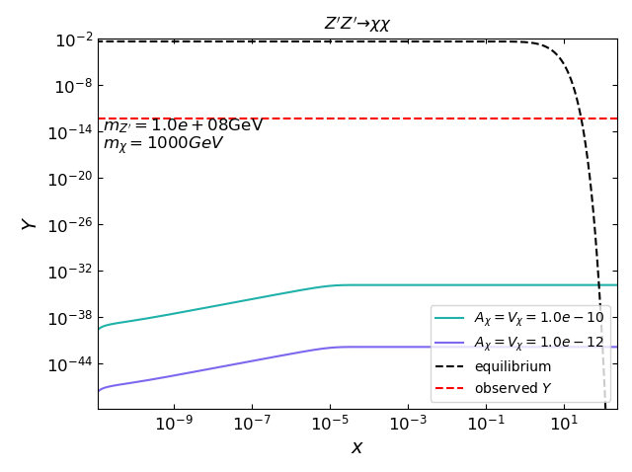
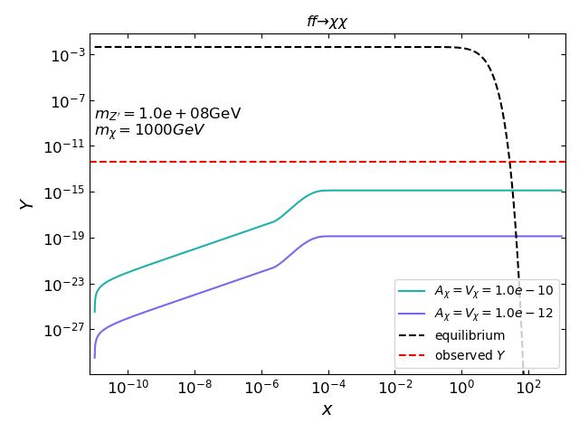
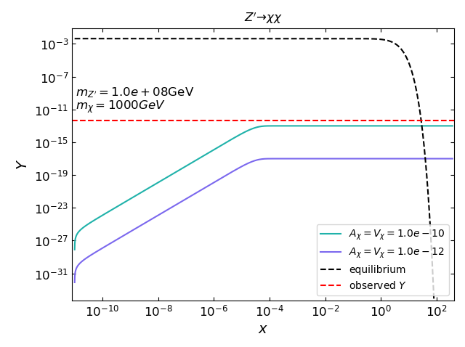
Backup: Evolution mz=1e8GeV

Slide 20
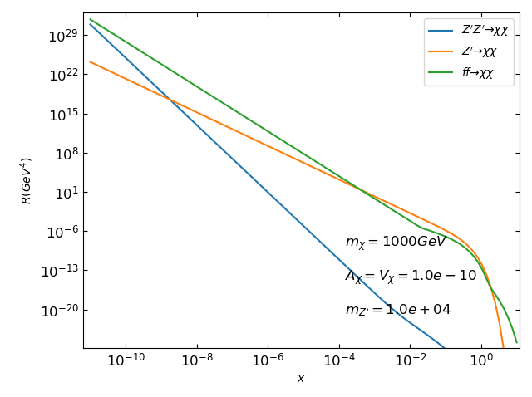
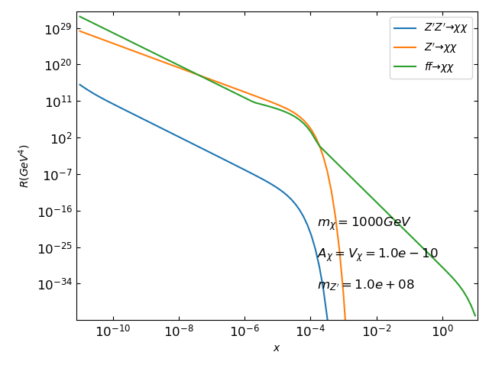
Backup: Rates

Slide 21
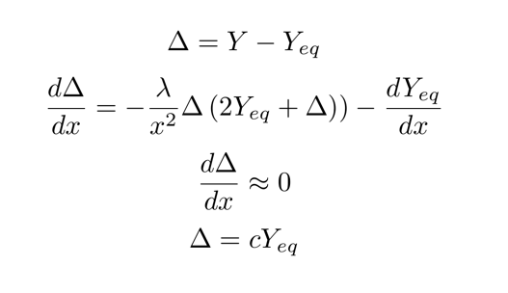
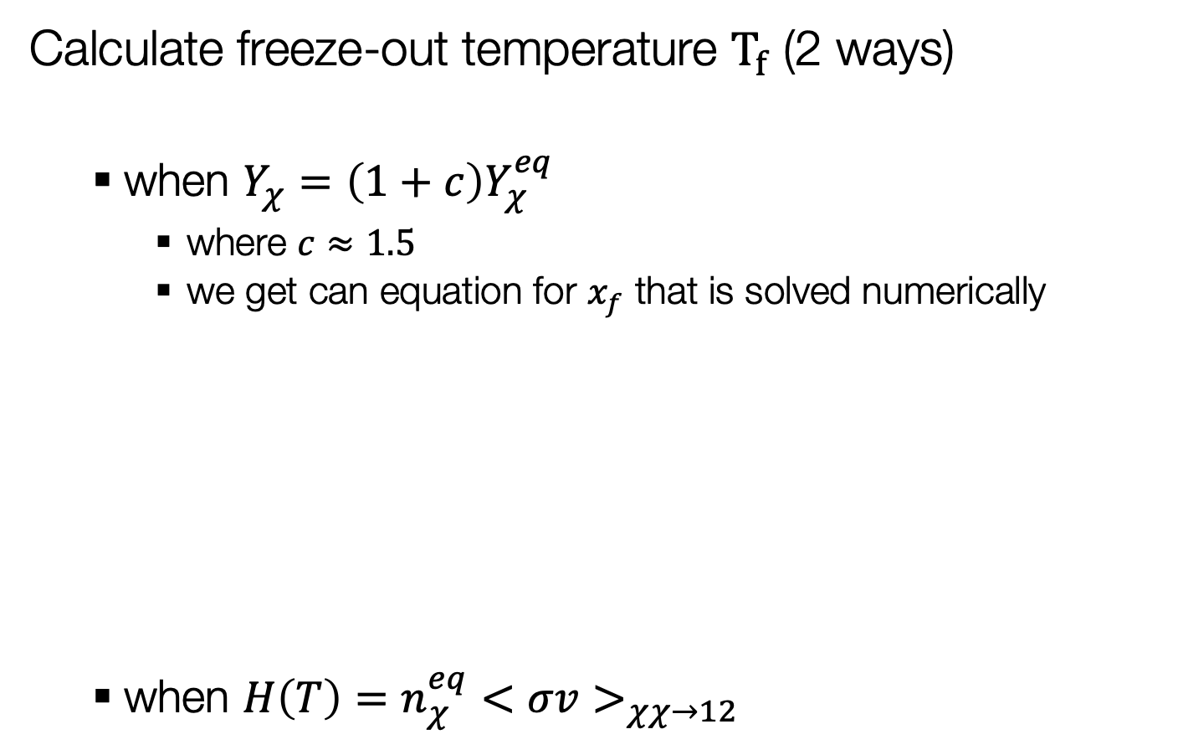
Backup: Freeze-out Temperature
Calculate freeze-out temperature $T_{f}$ (2 ways)
  when $Y_{χ}=\left(1+c\right)Y_{χ}^{eq}$
    where $c≈1.5$
    we get can equation for $x_{f}$ that is solved numerically
  when $H\left(T\right)=n_{χ}^{eq}<σv>_{χχ→12}$

Slide 22

Backup: Unitarity Bound
$$m_{χ}<\sqrt{\frac{πm_{Z′}}{2A_{χ}^{2}}}$$
From arXive 1708.00890 and 1510.02110

Slide 23

Backup: relic abundance
$Ωh^{2}≡\frac{ρ_{χ}}{ρ_{crit}}h^{2}$
  Where $ρ_{crit}$ is the critical density, the density required for a spatially flat universe

Slide 24
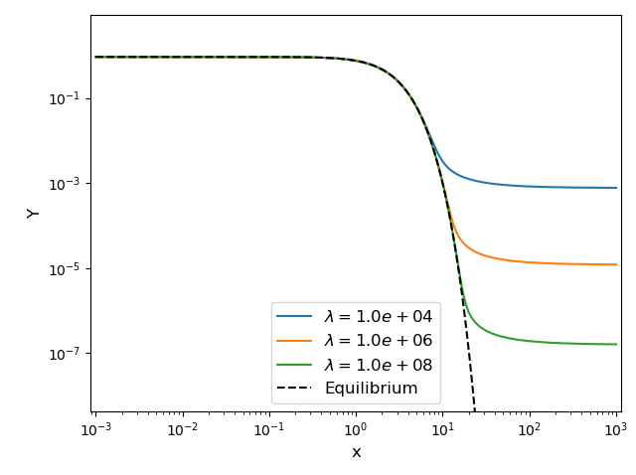
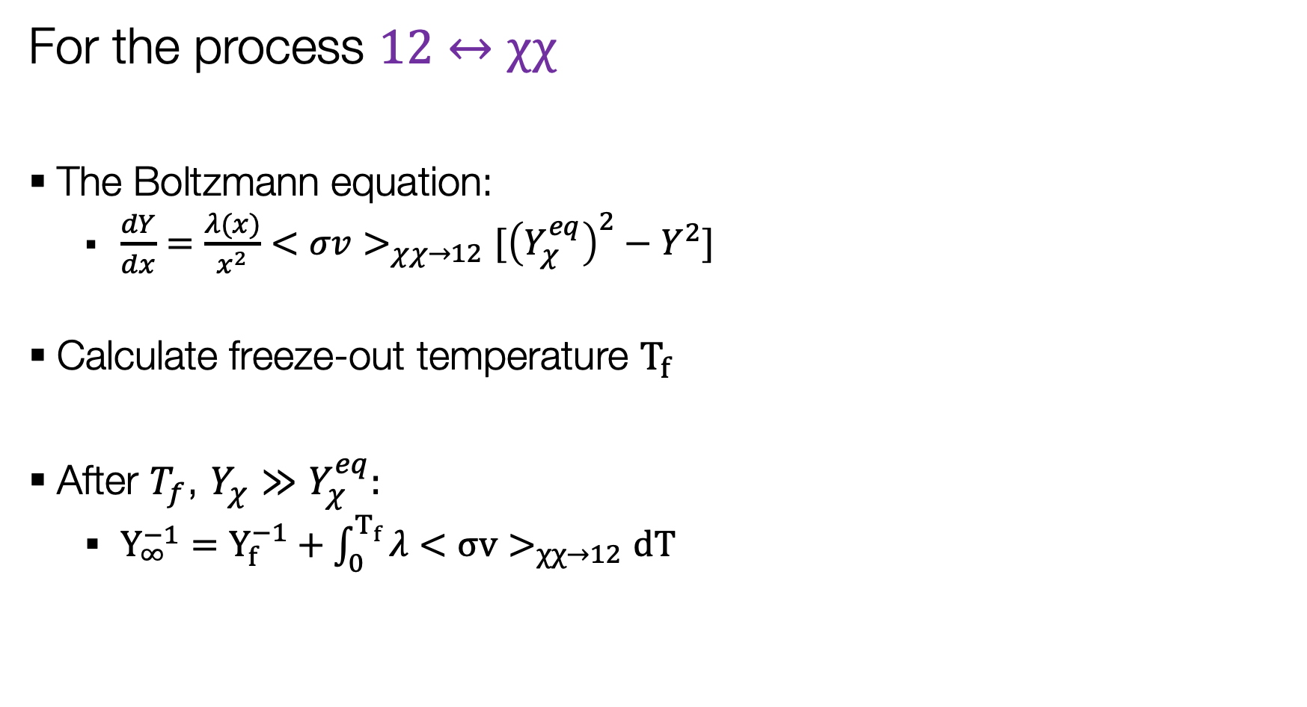
Freeze-Out Calculation
For the process $12↔χχ$
The Boltzmann equation:
  $\frac{dY}{dx}=\frac{λ(x)}{x^{2}}<σv>_{χχ→12}[{\left(Y_{χ}^{eq}\right)}^{2}−Y^{2}]$
Calculate freeze-out temperature $T_{f}$
After $T_{f}$, $Y_{χ}≫Y_{χ}^{eq}:$
  $Y_{∞}^{−1}=Y_{f}^{−1}+\int_{0}^{T_{f}}{λ<σv>_{χχ→12}dT}$

Slide 25
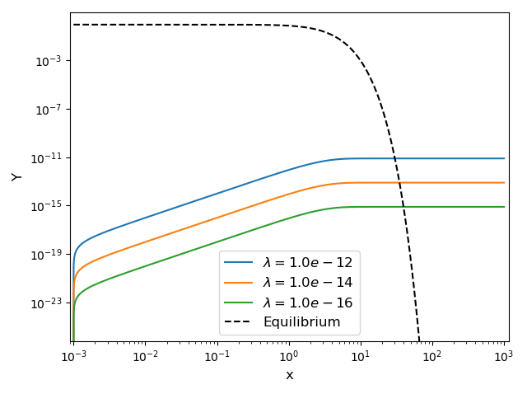
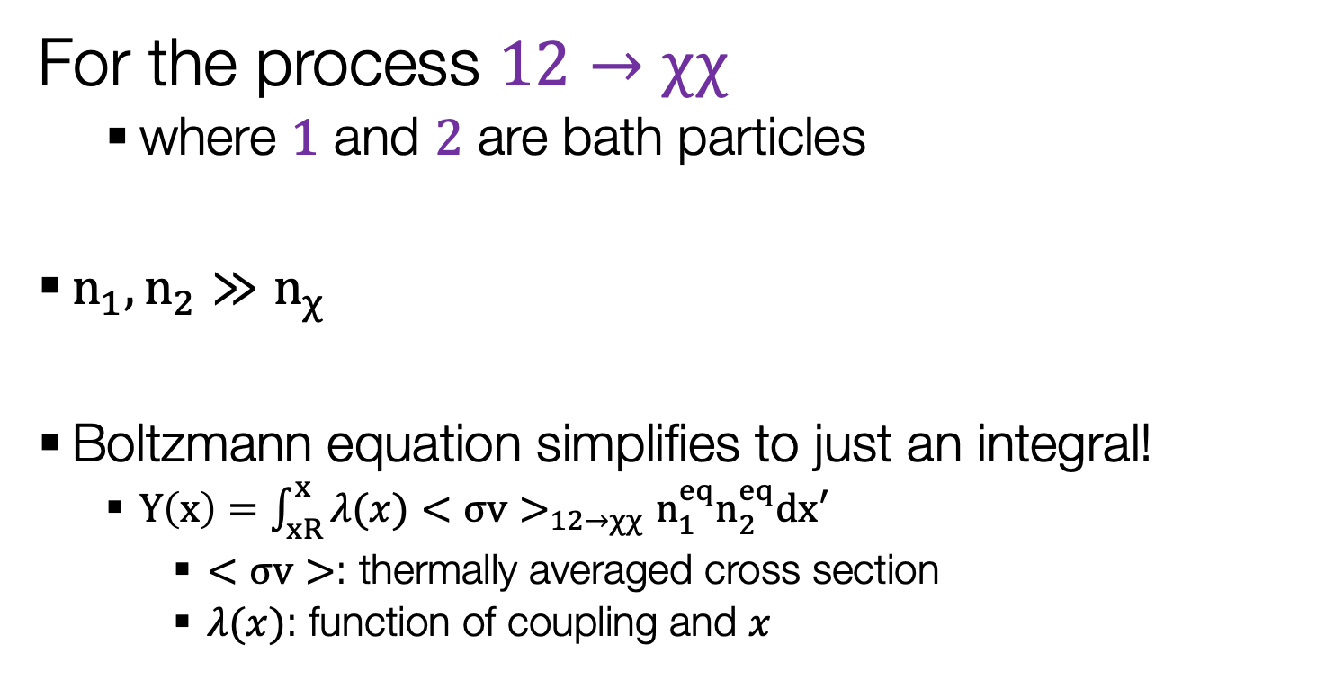
Freeze-In Calculation
For the process $12→χχ$
  where $1$ and $2$ are bath particles
$n_{1},n_{2}≫n_{χ}$
Boltzmann equation simplifies to just an integral!
  $Y\left(x\right)=\int_{xR}^{x}{λ(x)<σv>_{12→χχ}n_{1}^{eq}n_{2}^{eq}dx′ }$
    $<σv>$: thermally averaged cross section
    $λ(x)$: function of coupling and $x$

Slide 26
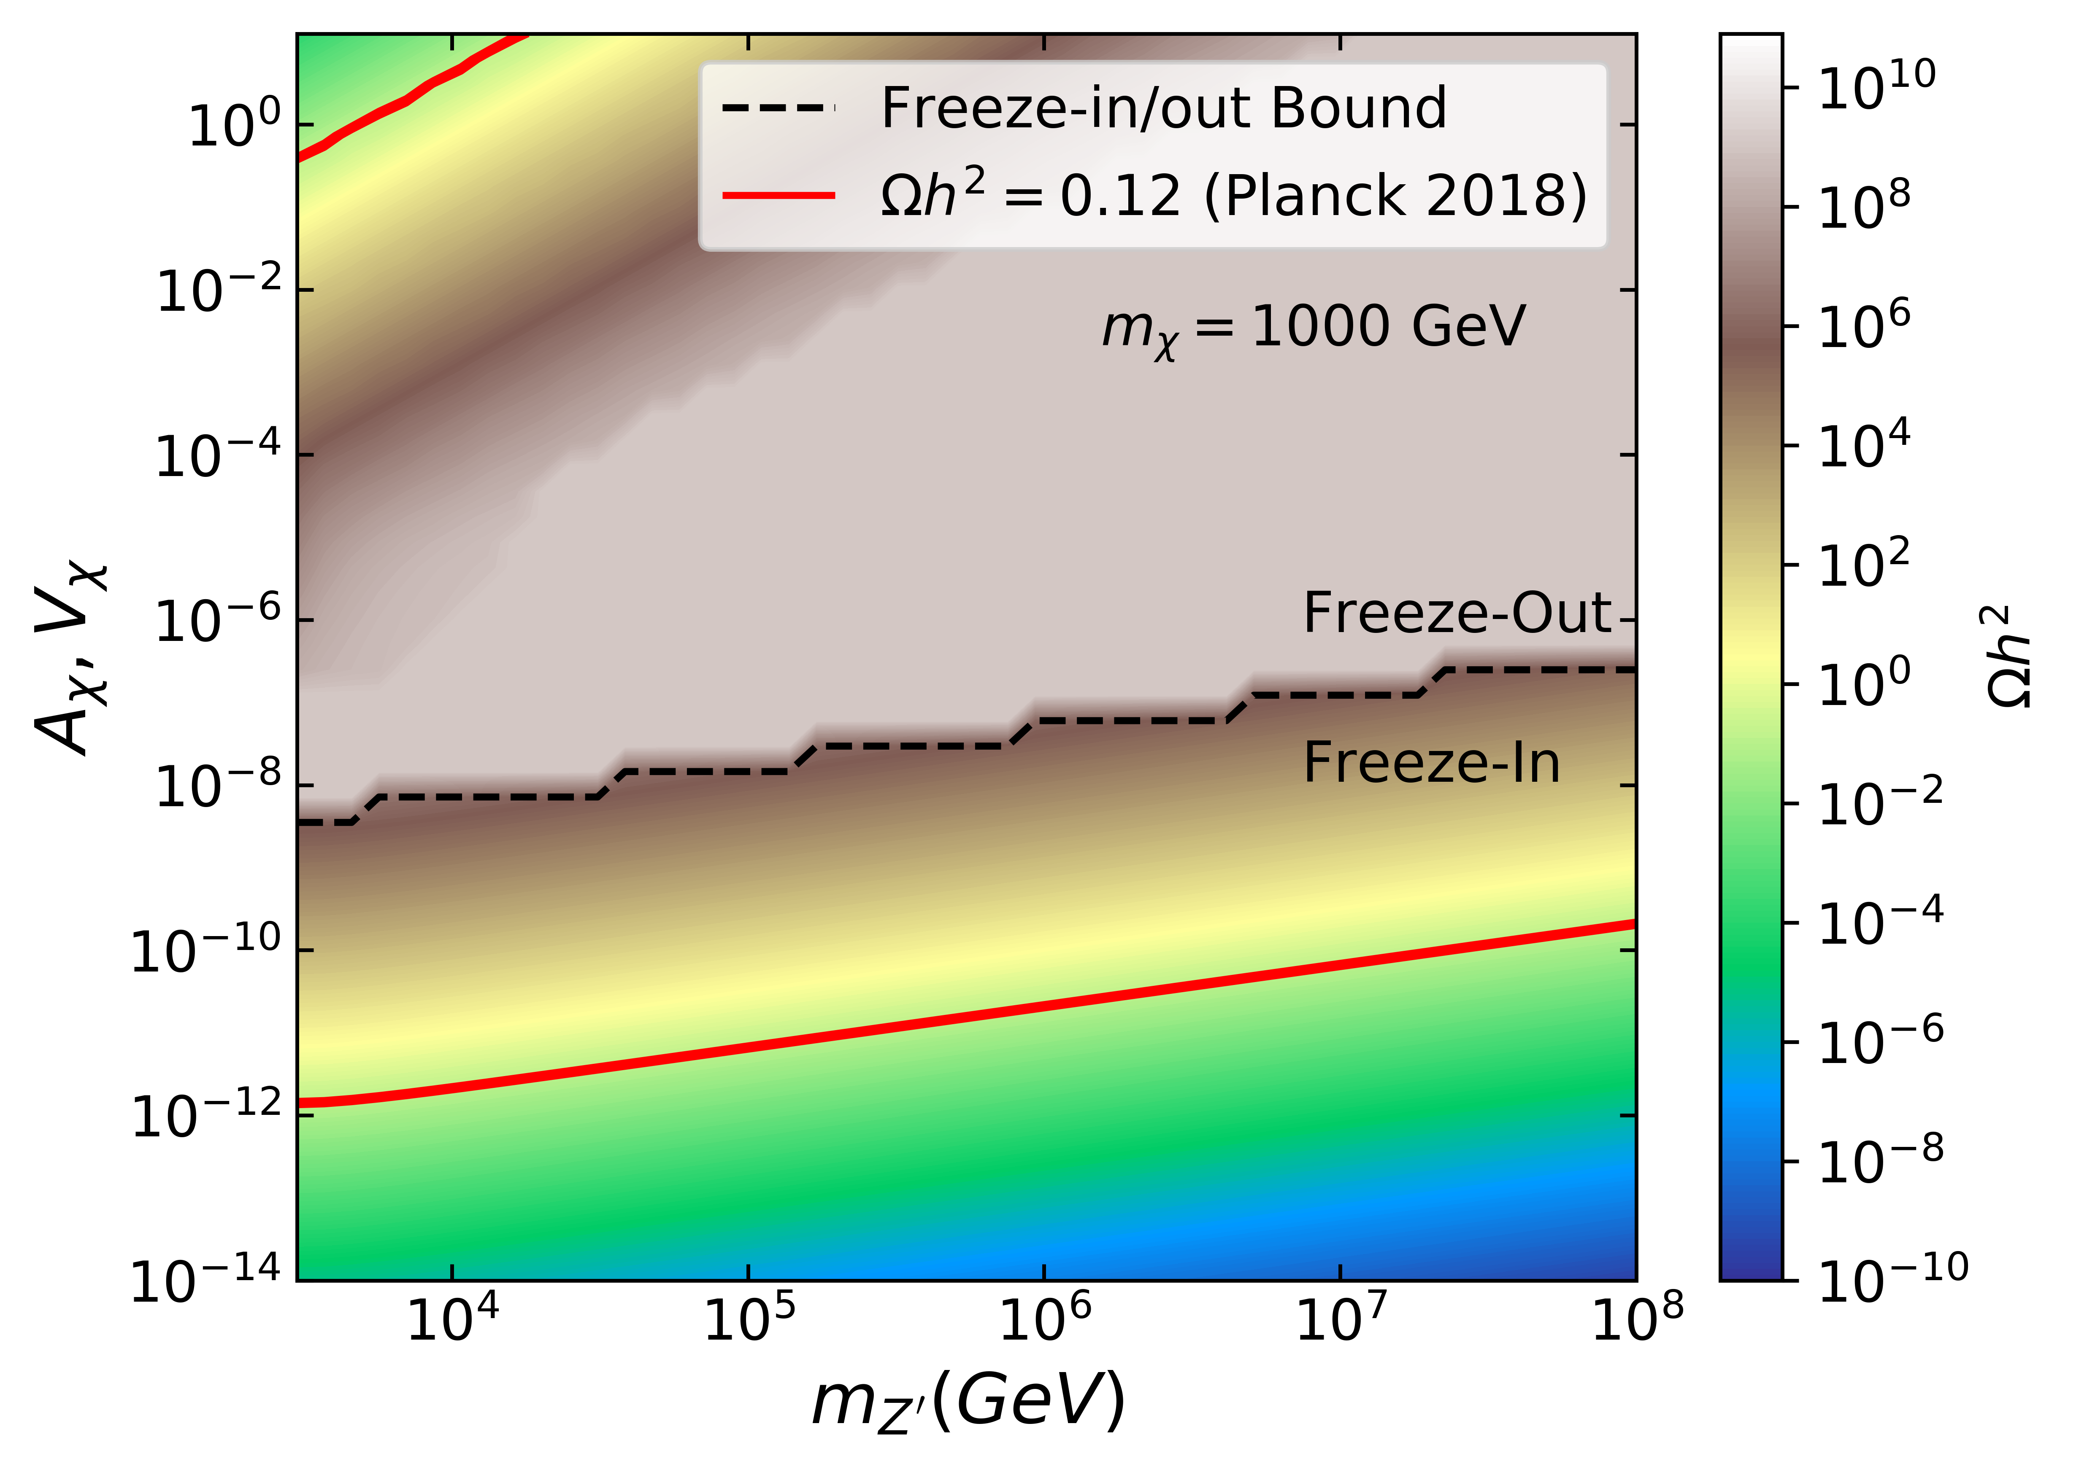
Relic Density Phase Diagram

Slide 27
Backup: Links
Rotation curves paper: http://articles.adsabs.harvard.edu/pdf/1991MNRAS.249..523B
DM Zoo:
https://www.ictp-saifr.org/wp-content/uploads/2018/07/ICTP_workshop1.pdf
Zwicky paper: arXiv:1711.01693

